Slide 1
Ku fiirinta unugyada (cells) mikroskoob iftiin (light microscope)
Unugyo (Cells)

Slide 2
sida loo isticmaalo darasyada Oak

Slide 3
Waxaan isticmaali karaa mikroskoob iftiin (light microscope) si aan u fiiriyo unugyada (cells).

Slide 4
unug (cell)
muraayad (lens)
mikroskoob iftiin (light microscope)
fiiro (focus)
weyneynta (magnification)

Slide 5
Unuggu (cell) waa qaybta ugu yar ee nool ee ka dhisan noole (organism).
Muraayaddu (lens) waa qayb muraayad qaloocan oo fiira iftiinka si ay u beddesho cabbirka sawirka.
Mikroskoob iftiin (light microscope) waa qalab isticmaala muraayado (lenses) si uu u fiiro iftiinka oo u weyneeyo sawirka shayga.
Hagaajinta fiirada (focus) muraayadda (lens) waxay ka dhigaysaa sawirka mid cad.
Kordhinta weyneynta (magnification) shay waxay ka dhigaysaa mid ka weyn.

Slide 6

Ku fiirinta unugyada (cells) mikroskoob iftiin (light microscope)
Noolayaasha (organisms) waxay ka kooban yihiin unugyo (cells)
Mikroskoobyada waxaa loo isticmaalaa in lagu fiiriyo unugyada (cells)
Isticmaalka mikroskoobka

Slide 7
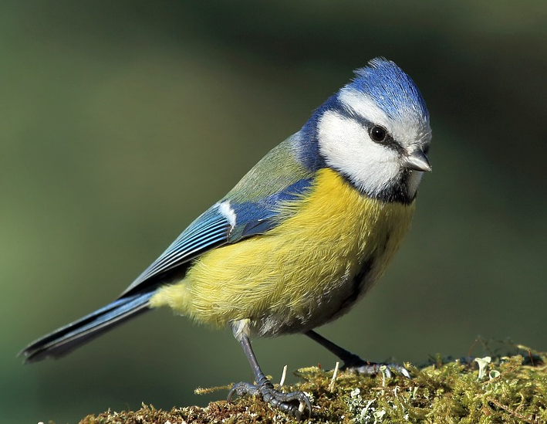
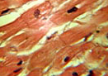
Noolayaasha (organisms) waxay ka kooban yihiin unugyo (cells)
Dhammaan noolayaasha (organisms) waxay ka kooban yihiin qaybo nool oo dhisme ah.
Dhismayaasha nool ee dhismaha ayaa loo yaqaan unugyo (cells).
Unugyadu (cells) inta badan aad bay u yar yihiin inaan indhaha ku arki karno. Waa inaan weyneyno (magnify) si aan u aragno.
xayawaan
aragti weyneyn (magnified) unugyada (cells) ee ka sameysan wadnaha xayawaanka

Slide 8
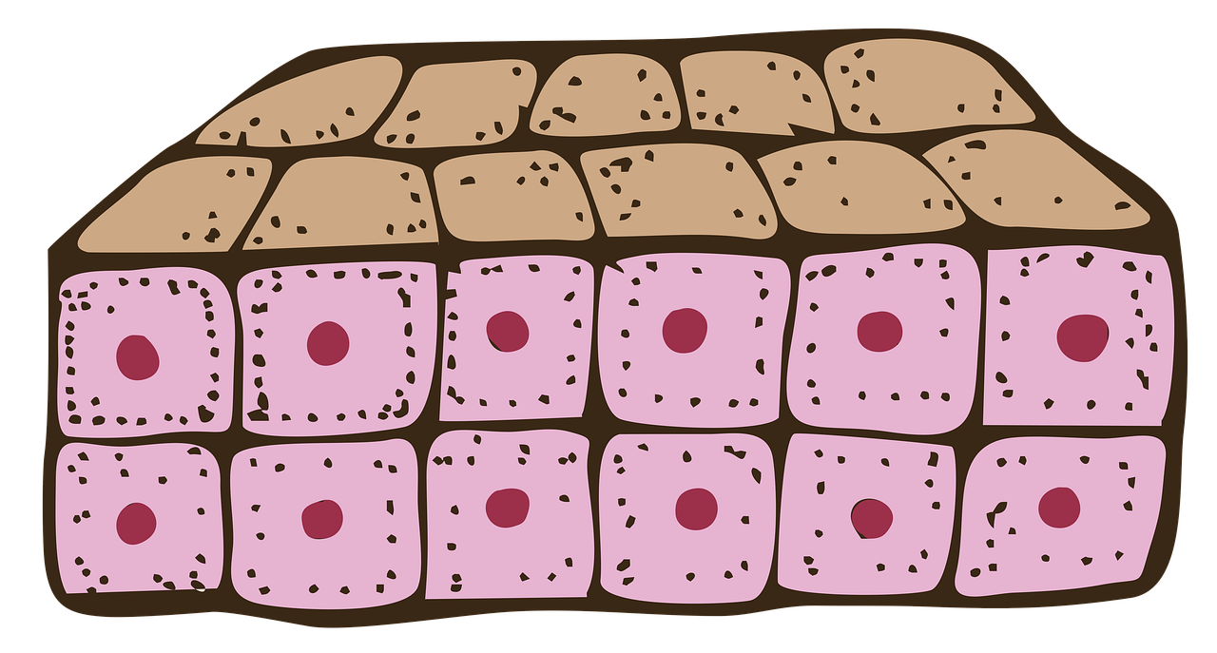
Noolaha (organisms) wuxuu ka kooban yahay unugyo (cells)
Dadka, xayawaanka kale, iyo dhirta, kooxaha unugyada (cells) isku midka ah waxay si wada jir ah u shaqeeyaan unugyada (tissues). Kooxaha unugyada (tissues) si wada jir ah u shaqeeya si ay u gutaan hawl gaar ah waxaa loo yaqaan xubno (organs).
unug (tissue)
unugyo (cells)
Dhammaan unugyadayada (tissues), tusaale ahaan murqaha iyo lafaha; iyo dhammaan xubnaheena (organs) sida wadnaha iyo maqaarka, waxay ka samaysan yihiin unugyo (cells).

Slide 9
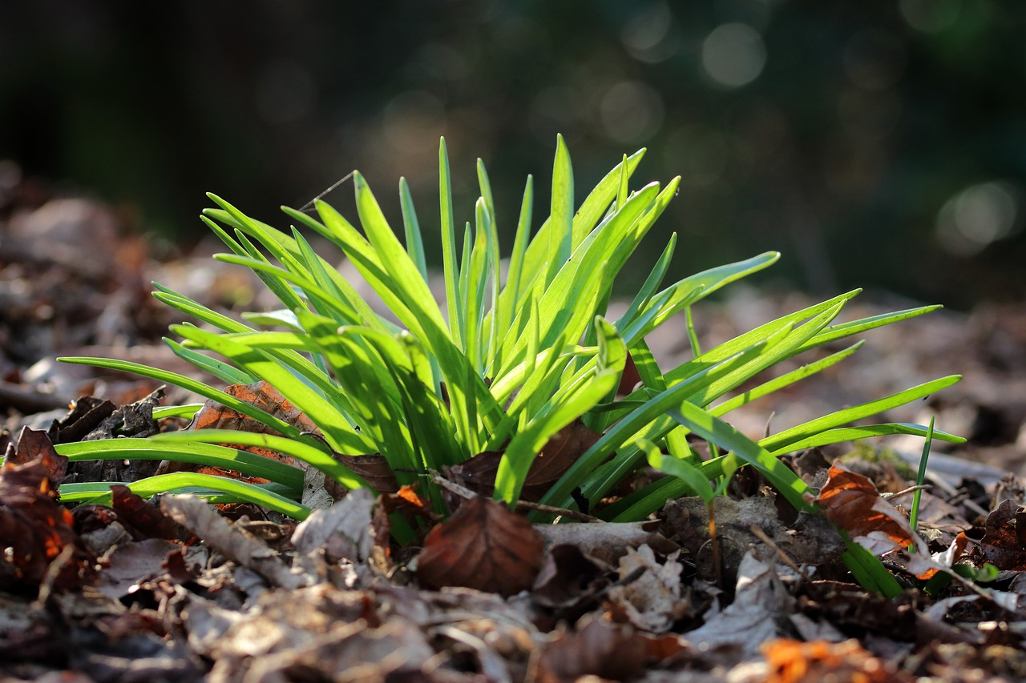
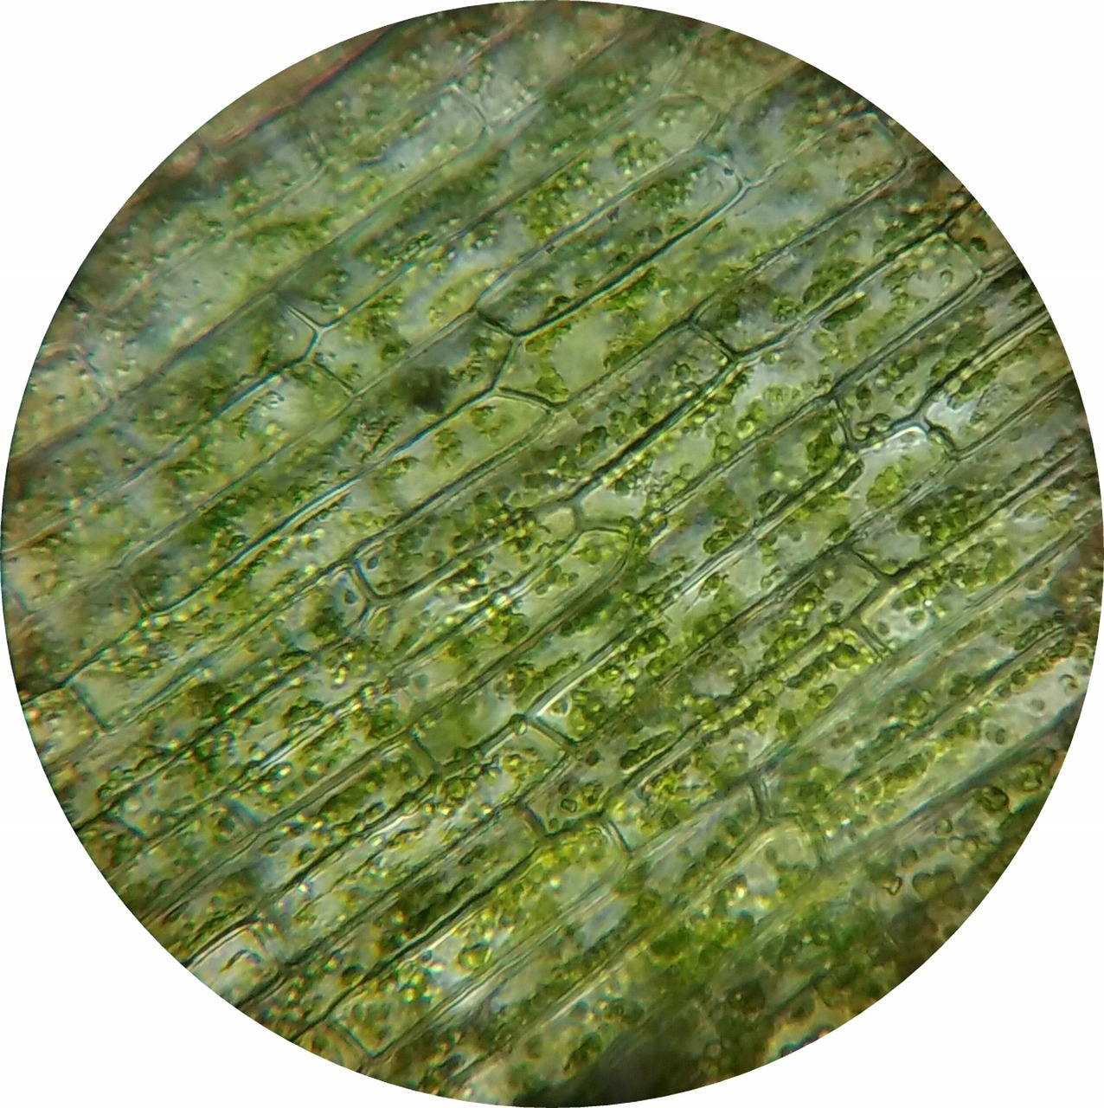
Noolaha (organisms) wuxuu ka kooban yahay unugyo (cells)
dhir
unugyada (cells) sameeya caleemaha dhirta
hal unug (cell) oo dhir ah
Unugyadu (cells) waa nool sababtoo ah waxay fuliyaan dhammaan hababka guud ee noolaha (organisms).
Kee ka mid ah hababkan guud ayaad xusuusan kartaa?

Slide 10

Noolaha (organisms) wuxuu ka kooban yahay unugyo (cells)
Bayaanka (statement) kee ee ku saabsan noolaha (organisms) waa run?
noolaha (organism) nool wuxuu ka kooban yahay unugyo (cells)
noolaha (organism) nool wuxuu ka kooban yahay unugyo (cells)
ma jiraan unugyo (cells) gudaha noolaha (organism) nool

Slide 11

Noolaha (organisms) wuxuu ka kooban yahay unugyo (cells)
Bayaannada (statements) kee ayaad u malaynaysaa inay sax yihiin, kuwaasna khaldan yihiin?
Waxaan ahay
hubaa inay sax tahay
I
qiyaasaa inay sax tahay
I
qiyaasaa inay khalad tahay
Waxaan ahay
hubaa inay khalad tahay
a
Xayawaanku waxay ka kooban yihiin unugyo (cells).
b
Dhammaan noolaha (organisms) nool waxay ka kooban yihiin unugyo (cells).
Unugyadu (cells) caadi ahaan way ku filan yihiin inaan aragno iyagoon weyneyn (magnifying).
c
Unugyadu (cells) waxay la mid yihiin Lego® - waa dhismo (building blocks) oo aan noolayn.
d

Slide 12

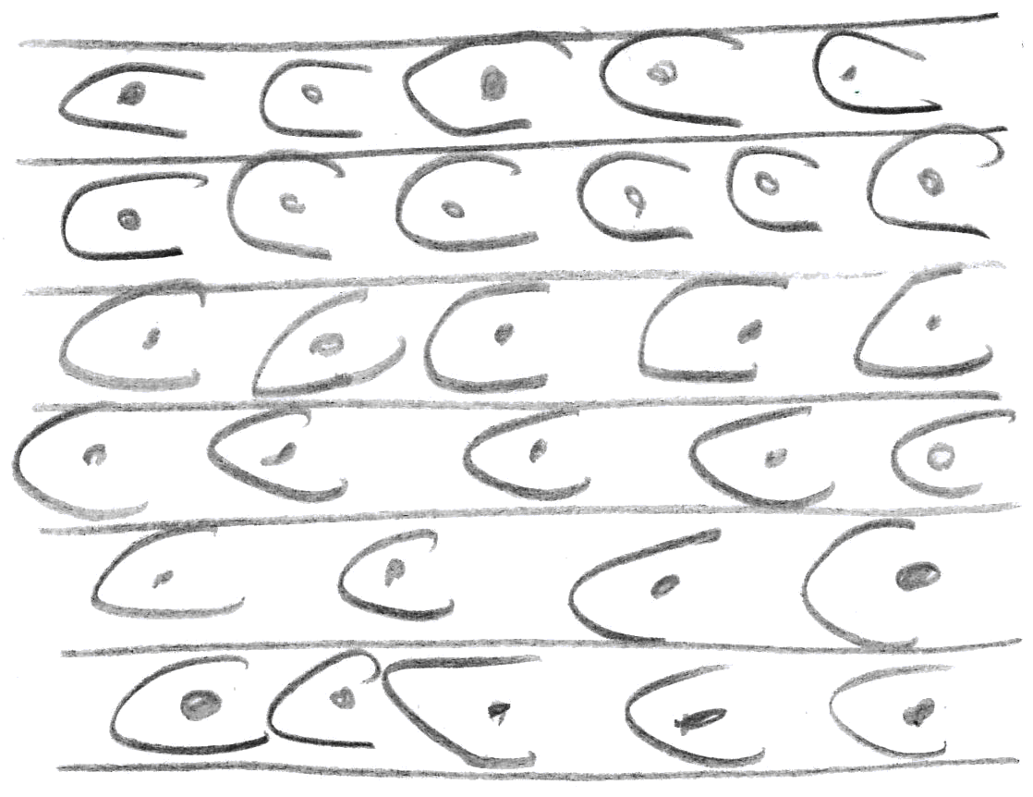
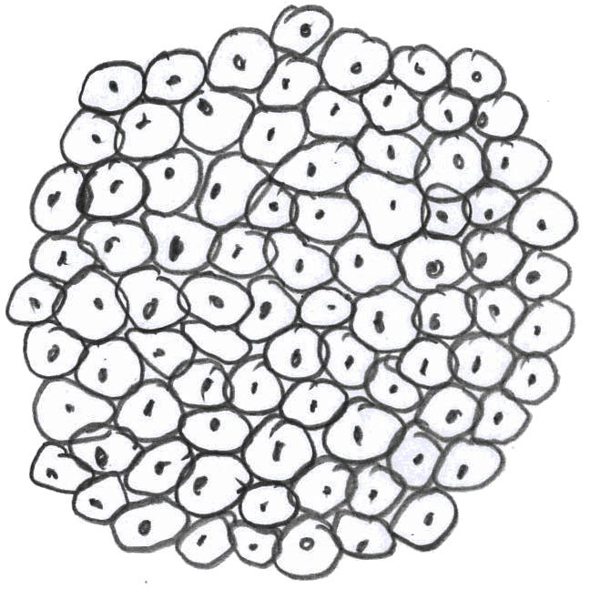

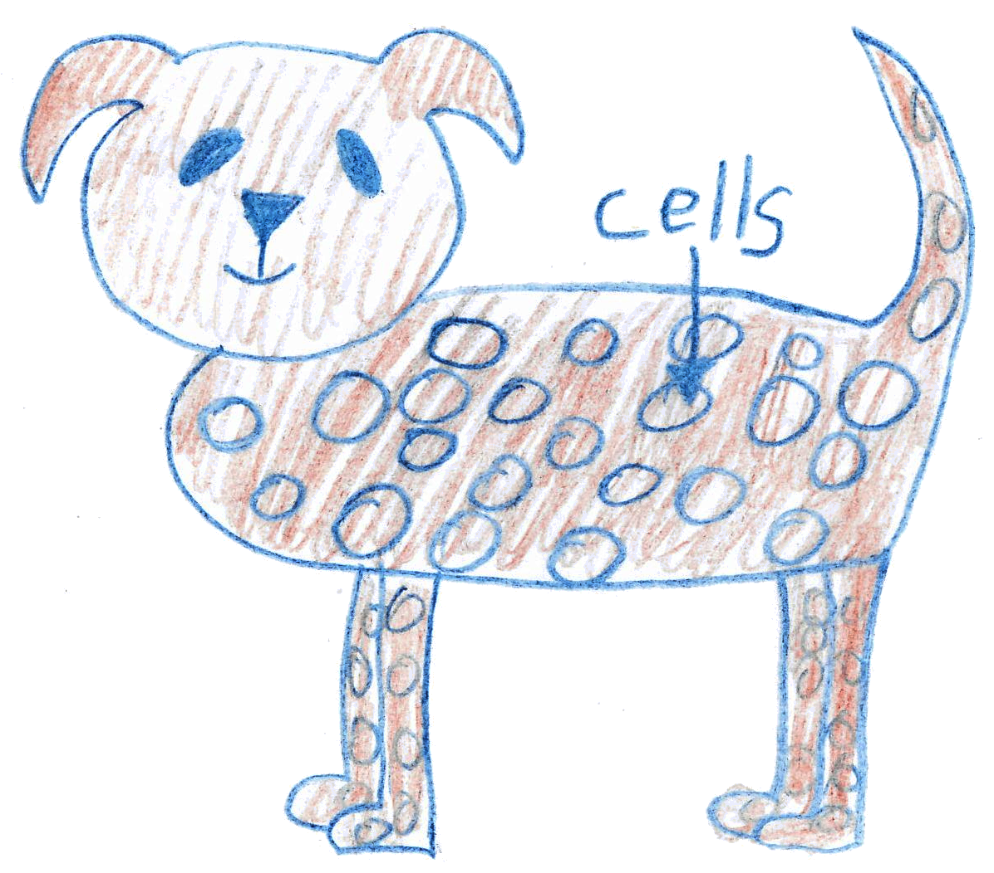
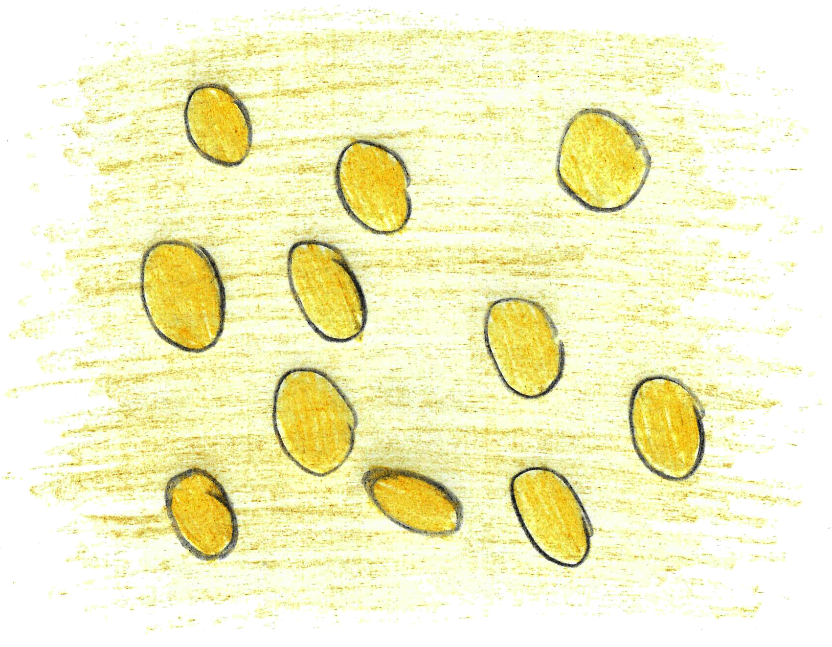



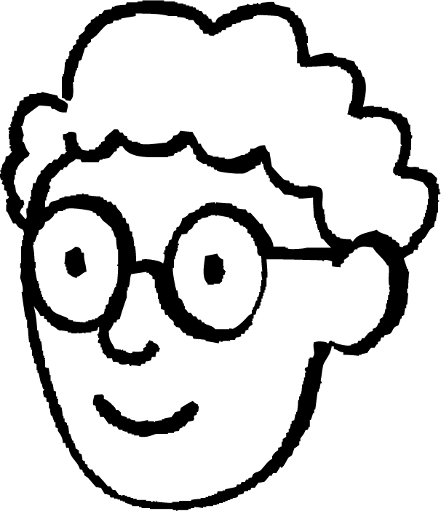






Noolaha (organism) waxay ka kooban yihiin unugyo (cells)
Qaar ka mid ah ardayda ayaa la weydiiyay inay sawiraan unugyo xayawaan (animal cells) oo ku jira unug (tissue).
Caasha
Yacquub
Layla
Axmed
Kee yahay sawirka ugu fiican ee unugyada xayawaanka (animal cells) ee unugga (tissue), iyo sababta?

Slide 13
Noole (organism) waxay ka kooban yihiin unugyo (cells)
Yacquub
Caasha
Axmed
Layla
Kee yahay sawirka ugu fiican ee unugyada xayawaanka (animal cells) ee unugga (tissue), iyo sababta?
Sawirka Yacquub ayaa ugu fiican.
Unugyadu (cells) waxay isku urursan yihiin sida dhismo (building blocks) si ay u sameeyaan unug (tissue).
Unug kasta (cell) waa qaab dhismeed (structure) ama cutub (unit) dhammaystiran.
Unugyada Caasha waa qaab dhismeedyo (structures) aan dhammaystirnayn.
Unugyada Axmed waa kala firdhiyeen oo isku urursan sida dhismo (building blocks).
Unugyada Layla aad bay u weyn yihiin oo waxay noqon lahaayeen kuwo aan arki karno iyagoon weyneyn (magnifying).

Slide 14
Ku fiirsashada unugyada (cells) iyadoo la isticmaalayo mikroskoob iftiin (light microscope)
Noole (organism) waxay ka kooban yihiin unugyo (cells)
Mikroskoobyada (Microscopes) waxaa loo isticmaalaa in lagu eego unugyada (cells)
Isticmaalka mikroskoob (microscope)

Slide 15
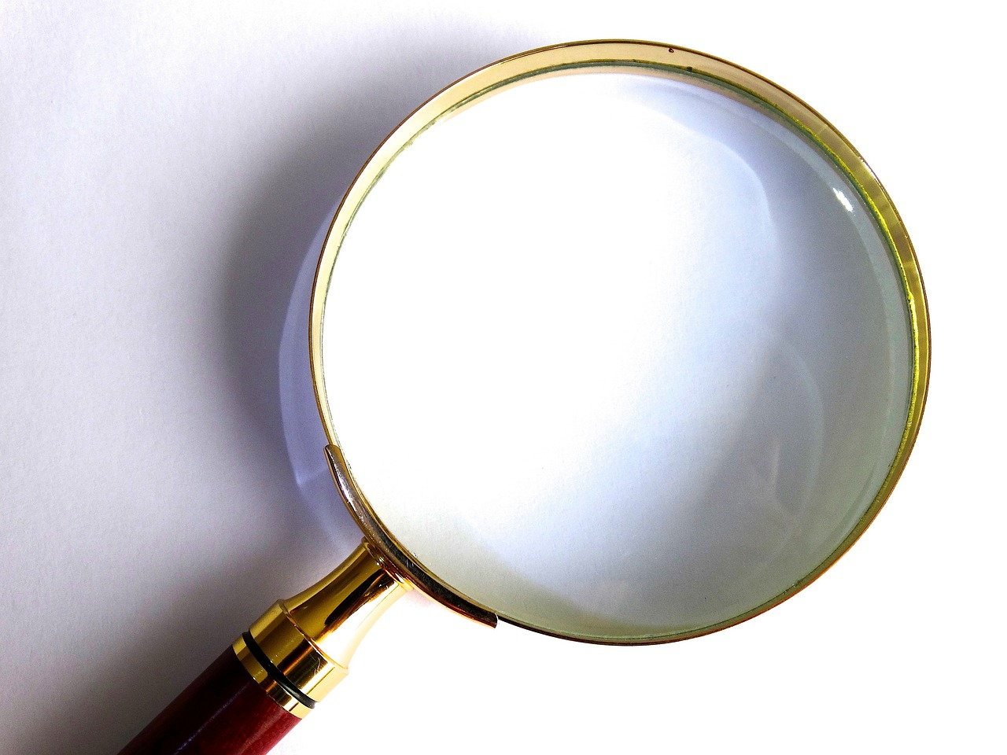
Mikroskoobyada (Microscopes) waxaa loo isticmaalaa in lagu eego unugyada (cells)
Inta badan unugyada (cells) aad bay u yar yihiin in aan ku arki karno indhaha (unaided eyes).
muraayad (lens)
Unugyada (cells) waa la weynayn karaa (magnified) iyadoo la isticmaalayo muraayad (lens).
Muraayad weyneyn (magnifying glass) waxay leedahay muraayad (lens), laakiin xataa tani kama dhigi karto unugyada (cells) kuwa ku filan oo aan arki karno.

Slide 16
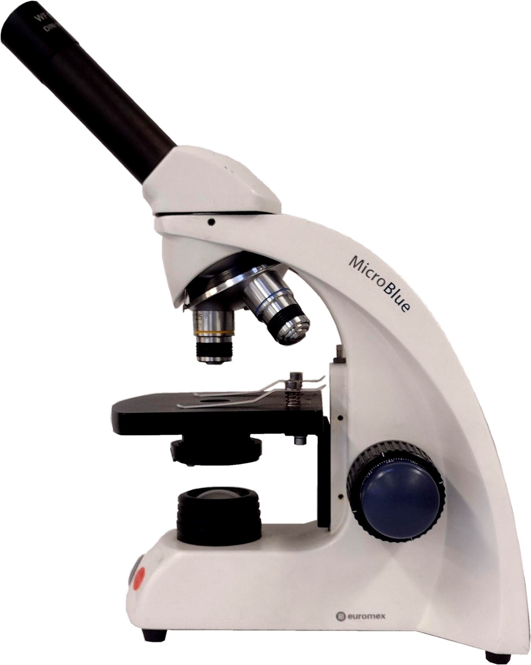
Mikroskoobyada (Microscopes) waxaa loo isticmaalaa in lagu eego unugyada (cells)
Mikroskoob iftiin (light microscope) wuxuu leeyahay laba muraayadood oo weyneyn (magnifying lenses) si unugyada (cells) ugu weynaadaan oo aan ku arki karno indhaha (eyes).
muraayad indhaha (eyepiece lens)
muraayad ujeeddo (objective lens)
Muunad (sample) unug (tissue) waa la weynayn karaa (magnified) si unugyada (cells) gaarka ah loo arko.

Slide 17
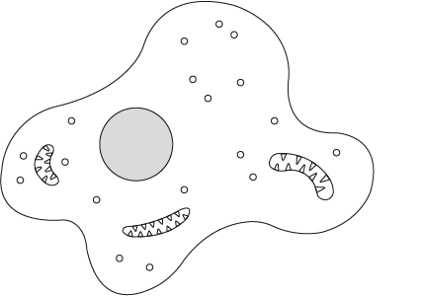
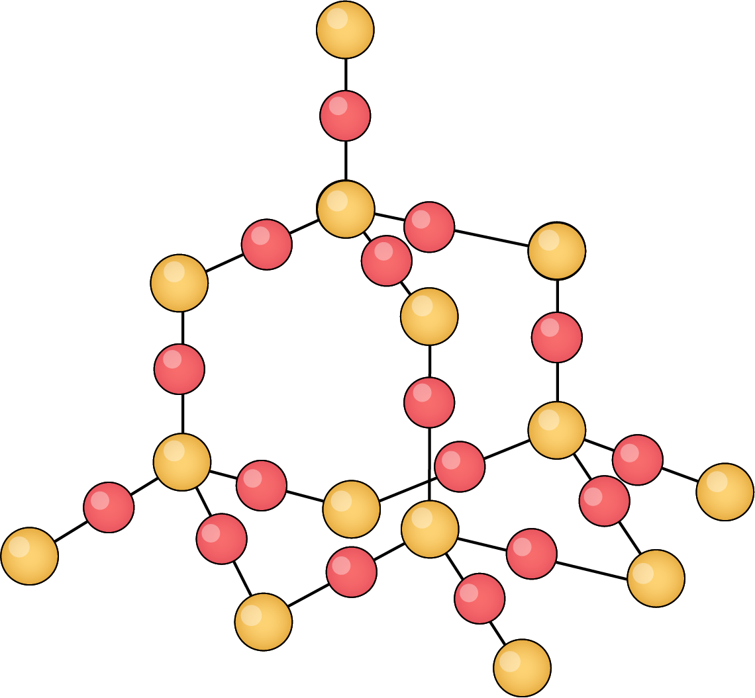
Mikroskoobyada (Microscopes) waxaa loo isticmaalaa in lagu eego unugyada (cells)
Mikroskoob iftiin (light microscope) waxaan ku arki karnaa qaar ka mid ah qaababka unugyada (cell structures), laakiin kuma weynayn karno (magnify) si aan u aragno atamka (atoms) iyo molikyuulada (molecules).
unugyada xayawaanka ee lagu arko mikroskoob iftiin (light microscope)
jaantus unug oo ay ku jiraan qaab dhismeedkiisa gudaha
molikyuul (molecule)
Sawirrada ma aha cabbir sax ah (not to scale)

Slide 18
Mikroskoobyada (Microscopes) waxaa loo isticmaalaa in lagu eego unugyada (cells)
Kuwee ka mid ah kuwan aad kaliya ku arki kartaa adigoo isticmaalaya mikroskoob iftiin (light microscope)?
unug (cell)
moleekul (molecule)
unugyo (tissue)
biyo (water)

Slide 19
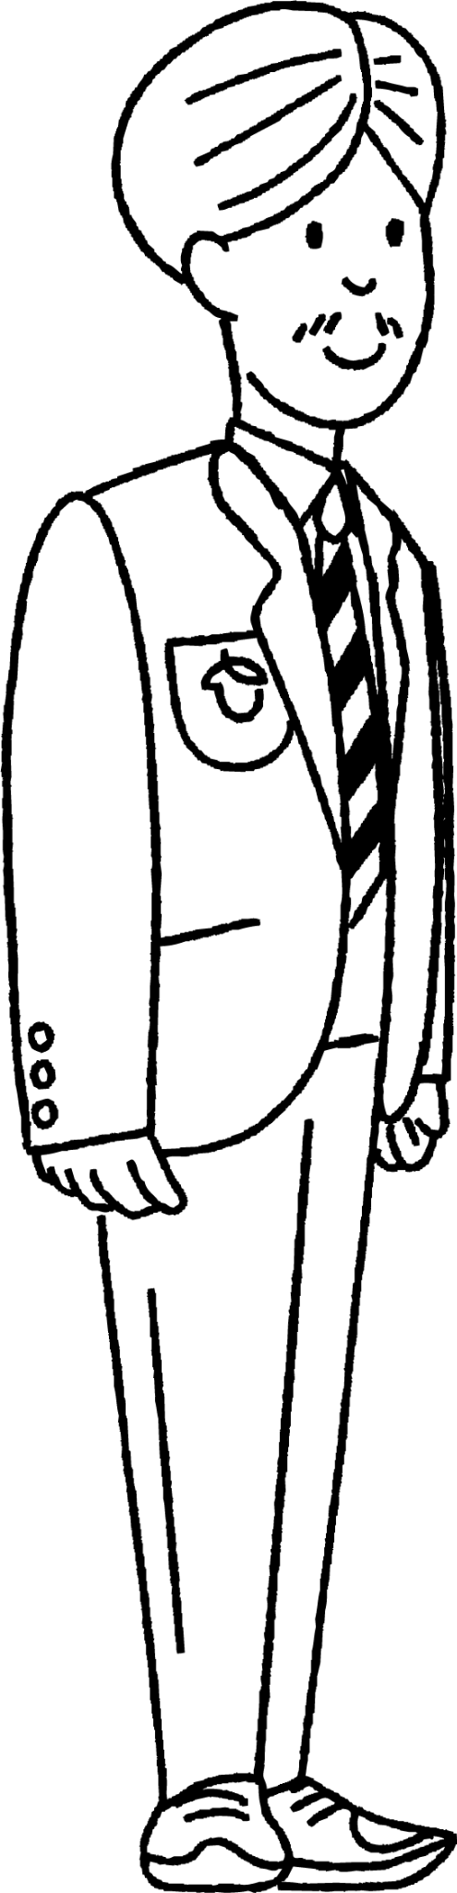

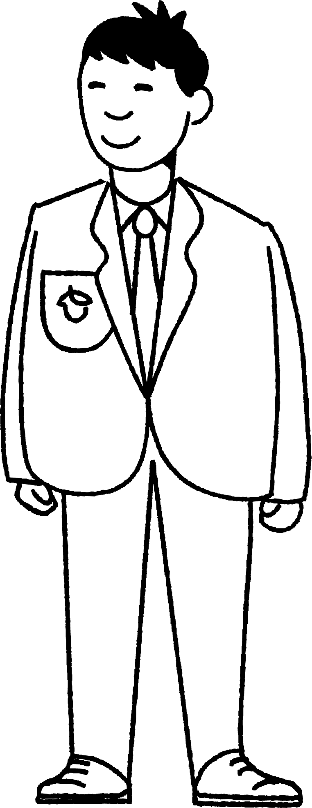
Mikroskoobyada (Microscopes) waxaa loo isticmaalaa in lagu eego unugyada (cells)
Cali iyo Nuur waxay ka wada hadlayaan ujeedooyinkooda isticmaalka mikroskoob iftiin (light microscope).
Waxaan isticmaali doonaa mikroskoob iftiin (light microscope) si aan u raadiyo moleekul biyo (water molecule) gudaha unug (cell).
Waxaan isticmaali doonaa mikroskoob iftiin (light microscope) si aan u eego hal unug (cell).
Cali
Nuur
U sharax Cali iyo Nuur inay awoodi doonaan inay gaadhaan ujeedooyinkooda iyagoo isticmaalaya mikroskoob iftiin (light microscope), iyo sababta.

Slide 20

Mikroskoobyada (Microscopes) waxaa loo isticmaalaa in lagu eego unugyada (cells)
Cali: Waxaan isticmaali doonaa microscope iftiin (light microscope) si aan u raadiyo molecule biyo (water molecule) unug (cell) gudahiisa.
Nuur: Waxaan isticmaali doonaa microscope iftiin (light microscope) si aan u eego hal unug (single cell).
U sharax Cali iyo Nuur inay awoodi doonaan inay gaadhaan ujeedooyinkooda iyagoo isticmaalaya mikroskoob iftiin (light microscope), iyo sababta.
Cali ma arki doono wax moleekul biyo (water molecules) ah.
Moleekulada (molecules) aad bay u yar yihiin.
Muraayadaha (lenses) mikroskoobka (microscope) ma weynayn karaan moleekulada (molecules) si loo arko.
Nuur wuu arki karaa qaab dhismeedka unugga (cell).
Muraayadaha microscope-ku waxay weynayn karaan (magnify) unugyada (cells) si loo arko.
Isagu ma arki karo dhammaan qaab-dhismeedka (structures) unugga (cell) gudahiisa.

Slide 21
Ku fiirsashada unugyada (cells) iyadoo la isticmaalayo microscope iftiin (light microscope)
Nooleyaasha (living organisms) waxay ka kooban yihiin unugyo (cells)
Microscope-yada waxaa loo isticmaalaa in lagu arko unugyada (cells)
Isticmaalka microscope-ka

Slide 22
Isticmaalka microscope-ka
Tani waa jaantus (diagram) calaamadeysan oo microscope iftiin (light microscope) ah.
muraayadda indhaha (eyepiece lens)
muraayadda ujeedada (objective lens)
taayirada diiradda qallafsan (coarse focus wheel)
masraxa (stage)
il iftiin (light source)
taayirada diiradda fiican (fine focus wheel)

Slide 23
Isticmaalka microscope-ka
Ku dar calaamadaha (labels) maqan qaybaha microscope-ka
muraayadda indhaha (eyepiece lens)
muraayadda ujeedada (objective lens)
taayirada diiradda qallafsan (coarse focus wheel)
goob (stage)
isha iftiinka (light source)
taayirada diiradda fiican (fine focus wheel)

Slide 24
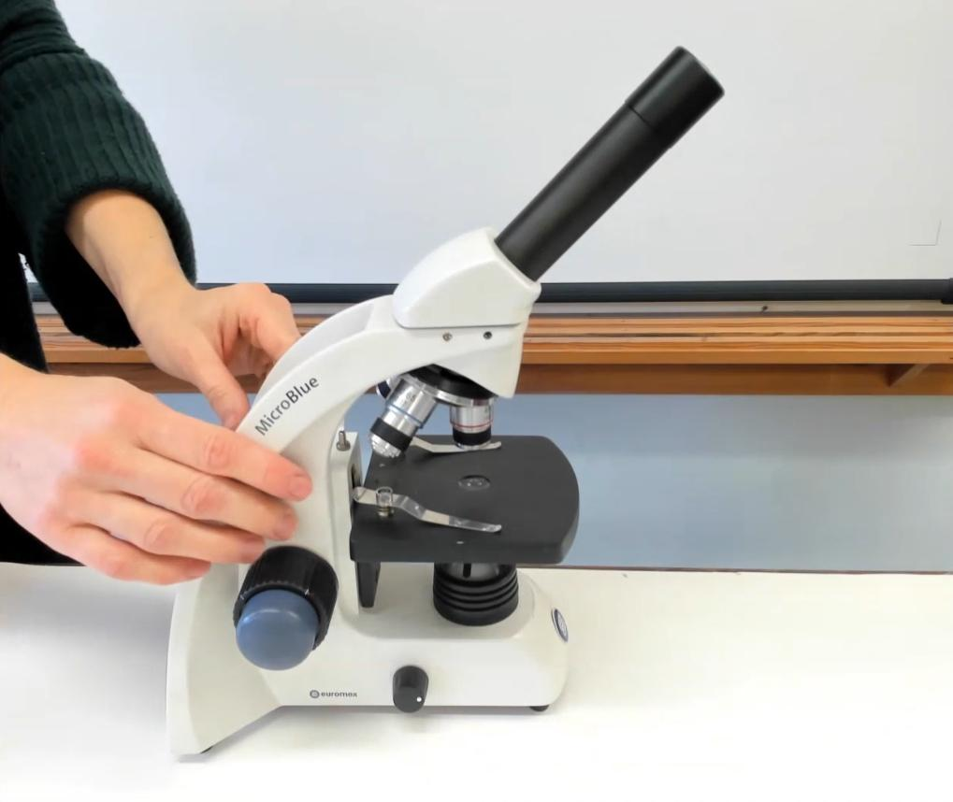

Isticmaalka microscope-ka
Daawo muuqaalka si aad u aragto sida loo isticmaalo microscope-ka si aad u fiiriso unugyada (cells) ku jira muunadda (specimen).

Slide 25

Isticmaalka microscope-ka
Habka isticmaalka microscope-ka waa:
U wareeji lens-ka (objective lens) ee hooseeya (lowest magnification).
Dhig slide-ga goobta (stage) oo hoos yimaada qabsadaha (clips).
Daar isha iftiinka (light source).
Adigoo ka eegaya dhinaca, u wareeji giraangirta (coarse focus wheel) si aad goobta (stage) kor ugu qaaddo oo u dhowaato lens-ka (objective lens).
Adigoo eegaya eyepiece-ka, u wareeji giraangirta (coarse focus wheel) si aad muunaddaada (specimen) u soo saarto.
U wareeji giraangirta (fine focus wheel) si aad sawirka u caddeyso.
Weyneyn (magnification) waa la kordhin karaa isagoo beddelaya lens-ka (objective lens) ee awoodda sare leh.

Slide 26
Isticmaalka microscope-ka
Dhig weedhahan si habboon oo loo isticmaalo microscope-ka si aad u fiiriso slide:
4
Isticmaal giraangirta (fine focus wheel) si aad sawirka u caddeyso.
Dhig slide-ga goobta (stage).
2
1
U wareeji lens-ka (objective lens) ee awoodda hoose (lowest power).
3
Isticmaal giraangirta (coarse focus wheel) si aad u fiiriso muunadda (specimen).

Slide 27
Isticmaalka microscope-ka
Raac habka isticmaalka microscope-ka iftiinka (light microscope) si aad:
Weyneey (magnify) oo fiiri unugyada (cells) ku jira muunadda (specimen) ee unugyada (tissue) ee dhirta ama xayawaanka.
Aqoonso hal unug (cell).

Slide 28
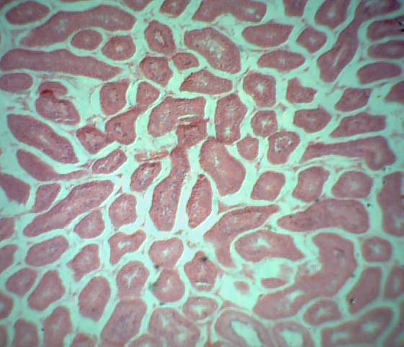
Isticmaalka microscope-ka
Halkan waxaa ah tusaale sawir la mid ah waxa aad ku aragtay microscope-ka iftiinka (light microscope).
unug muruq (muscle tissue)

Slide 29
Ku fiirsashada unugyada (cells) iyadoo la isticmaalayo microscope-ka iftiinka (light microscope)
Noolaha (organism) waxay ka kooban yihiin dhismooyin nool oo la yiraahdo unugyo (cells).
Muunad unugyo ah (sample of cells) waxaa lagu weynayn karaa (magnified) iyadoo la isticmaalayo microscope-ka iftiinka (light microscope), si unugyada gaarka ah (individual cells) uga soo baxaan kuwa ku filan in la arko.
Unugyadu (cells) waxay ka kooban yihiin unugyo (tissues), muunad unug (specimen of tissue) ayaa loo diyaarin karaa in lagu eego iyadoo la isticmaalayo microscope.
Si loo isticmaalo microscope-ka:
  Muunadda (specimen), oo ku taal slide-ga, waxaa la dhigaa masraxa (stage).
  Microscope-ka waxaa loo rogaa muraayadda ugu hooseysa ee weynaynta (lowest power objective lens).
  Muraayaddu (lens) waxay weynayn doontaa (magnify) sawirka; tani waxay ka dhigaysaa unugyada (cells) iyo qaar ka mid ah qaab-dhismeedka gudahooda kuwa ku filan in la arko.
  Iyadoo la eegayo muraayadda indhaha (eyepiece lens), taayirada weyn iyo kuwa yaryar ee diiradda (coarse and fine focus wheels) ayaa loo isticmaalaa in lagu diirado (focus) sawirka, si qaab-dhismeedka unugyada (cell structures) u noqdo kuwa cad.

