Slide 1
Cilmi-baaris hawleed (Operational research)
Xisaab goobta shaqada

Slide 2
Sida agabkeena waxbarista loogu talagalay fasalka

Slide 3
Waxaan fahmi karaa sida xisaabta loogu isticmaalo cilmi-baarista hawleed (operational research).

Slide 4
Saadka (Logistics) waa habayn taxaddar leh oo mashruuc adag (hawlo) ah si uu ugu dhaco si guul leh oo wax ku ool ah.

Slide 5

Cilmi-baaris hawleed (Operational research)
Baakadayn (Packing)
Qorshaynta mashruuc

Slide 6
Baakadayn (Packing)
Si ganacsi uu u noolaado, dakhligiisu waa inuu ka weyn yahay ama la mid yahay kharashkiisa.
Laakiin kaliya daboolida kharashka kuma ogolaan doonto ganacsiga inuu maalgeliyo ama horumariyo kheyraadka jira.
Sidaa darteed, haddii ganacsi uu yahay mid hufan (efficient), waxay u badan tahay inuu faa'iido (profit) sameeyo.

Slide 7
Baakadayn (Packing)
Aynu diiradda saarno diyaarinta alaabta gaadiidka. Si loo fududeeyo, waxaan diiradda saari doonnaa tiro yar oo alaab ah.
Xaqiiqda, shirkaduhu waxay la tacaalaan boqolaal ama kumanaan alaab.

Slide 8
Baakadayn (Packing)
Shirkad waxay u baahan tahay inay u dirto sagaal shay dukaan. Shayyada waa in lagu raraa sariir (pallet). Sariir (pallet) kuma qaadi karto wax ka badan 200 kg.
Waa kuwan cufnaanta (masses) (kg) ee shayyada:
30 70 80 80 100 110 110 120 150
Waa imisa tirada ugu yar ee sariiraha (pallets) loo baahan yahay?

Slide 9
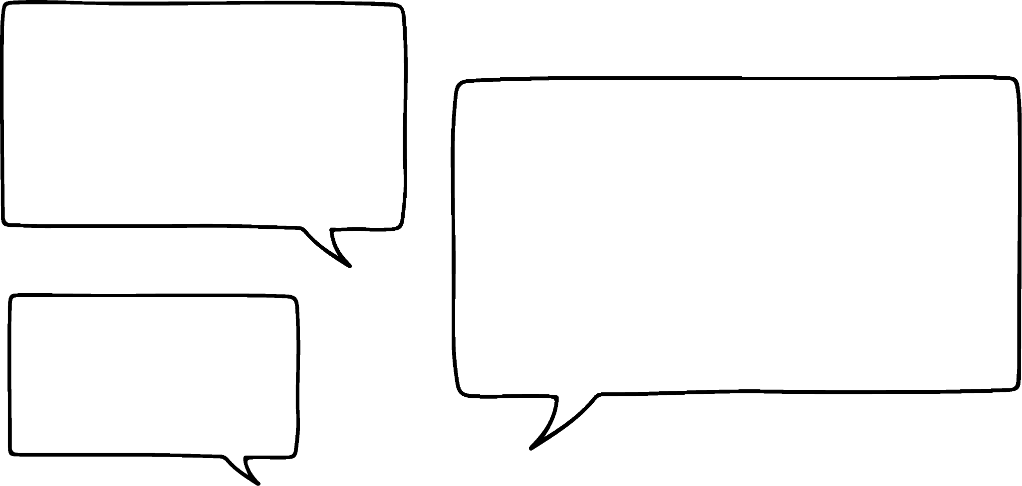


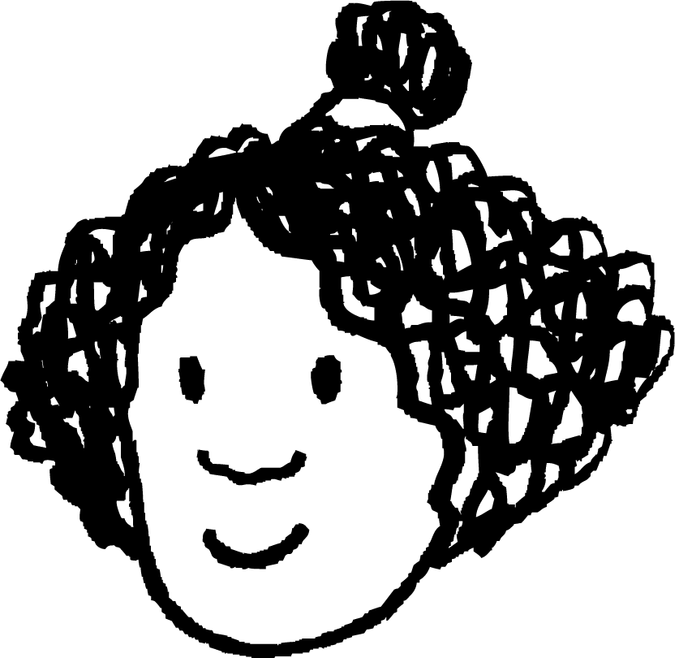



Baakadayn (Packing)
Sariir (pallet) kuma qaadi karto wax ka badan 200 kg.
Waa kuwan cufnaanta (masses) (kg) ee shayyada:
30 70 80 80 100 110 110 120 150
Waxaan u baahan nahay afar pallet oo keliya si aan u qaadno alaabta.
Waxaan u malaynayaa inaan u baahan nahay shan pallet.
Yaa sax ah? Sidee ku ogaanaysaa?
Cabdi
Isra

Slide 10
Baakadeyn (Packing)
Wadarta culeyska (mass) waa: 30 + 70 + 80 + 80 + 100 + 110 + 110 + 120 + 150 = 850
850 loo qaybiyay 200 waa 4.25
4.25 waa la soo koobay (rounds down) ilaa 4, marka waa afar pallet.
Waxaan u baahanahay in ka badan afar pallet, marka tirada ugu yar ee aan u baahanahay waa shan.
Cabdi
Isra

Slide 11
Baakadeyn (Packing)
Pallet kuma qaadi karo wax ka badan 200 kg.
Waa kuwan culeysyada (masses) (kg) ee alaabta:
30 70 80 80 100 110 110 120 150
Go'aanso alaabta kee loo dhigo pallet-ka kee. Ma ku habboon kartaa alaabta shan pallet?
1 2 3 4 5

Slide 12

Baakadeyn (Packing)
Pallet kuma qaadi karo wax ka badan 200 kg.
Waa kuwan culeysyada (masses) (kg) ee alaabta:
30 70 80 80 100 110 110 120 150
Cabdi wuxuu go'aansaday inuu alaab kasta dhigo pallet-kii ugu horreeyay ee qaadi kara.
80
70
100
30
80
110
110
120
1 2 3 4 5

Slide 13

Baakadeyn (Packing)
Pallet kuma qaadi karo wax ka badan 200 kg.
Waa kuwan cufka (masses) (kg) ee alaabta:
30 70 80 80 100 110 110 120 150
Cabdi ayaa markale isku dayay, laakiin markan wuxuu ku bilaabay cufka ugu weyn.
30
80
80
70
150
120
110
110
100
1 2 3 4 5

Slide 14
Baakadayn (Packing)
Pallet kuma qaadi karo wax ka badan 200 kg.
Waa kuwan cufka (masses) (kg) ee alaabta:
30 70 80 80 100 110 110 120 150
Isra ayaa isku soo ururisay cufka (masses) si ay u abuurto pallets 'buuxa'.
30
80
70
80
120
100
110
110
150
1 2 3 4 5

Slide 15
Baakadayn (Packing)
Saddexda hab (methods) midkee ayaad door bidaysaa?
80
70
100
30
80
110
110
120
Cabdi 1
1 2 3 4 5
30
80
80
70
150
120
110
110
100
Cabdi 2
1 2 3 4 5
30
80
70
80
120
100
110
110
150
Isra
1 2 3 4 5

Slide 16
Baakadayn (Packing)
Saddexda hab (methods) midkee ayaad door bidaysaa?
80
70
100
30
80
110
110
120
Cabdi 1
1 2 3 4 5
Habka 1 aad buu u dhakhsaha badnaa laakiin kuma shaqayn qiimahan.

Slide 17
Baakadayn (Packing)
Saddexda hab (methods) midkee ayaad door bidaysaa?
30
80
80
70
150
120
110
110
100
Cabdi 2
1 2 3 4 5
Habka 2 wuu dhakhsaha badnaa wuxuuna keenay tiro la mid ah alaabta pallet kasta.

Slide 18
Baakadayn (Packing)
Saddexda hab (methods) midkee ayaad door bidaysaa?
Habka 3 wuxuu keenay pallets (pallets) oo aan ognahay in aan wax kale lagu saari karin.
30
80
70
80
120
100
110
110
150
Isra
1 2 3 4 5

Slide 19
Baakadayn (Packing)
Waxaa jira hal hab oo hufan oo lagu baakadeeyo alaabta lagu qaado.
Waxay ku xiran tahay xannibaadaha (constraints) jira, sida cabbirka alaabta ama cabbirka sanduuqyada baakadaynta.

Slide 20
Baakadayn (Packing)
1) Doon ayaa gaadiidka u qaada wabiga. Doonku wuxuu leeyahay saddex waddo oo gaadiidku isticmaali karo. Waddo kastaa waa 30 m dherer.
Subax ka mid ah, gaadiidkani waxay yimaadaan sidan:
a) Adigoo raraya gaadiid kasta, marka uu yimaado, waddada ugu horreysa ee furan, ma awoodi doonaan dhammaan gaadiidku inay gudbaan? Caddee jawaabtaada.
Nidaamka imaatinka | Gaadiid | Dhererka (m)
1 | gaari | 4
2 | gaari + xamaar | 7
3 | baabuur weyn | 13
4 | baabuur yar | 6
5 | baabuur weyn | 13
Nidaamka imaatinka | Gaadiid | Dhererka (m)
6 | gaari | 4
7 | baabuur weyn | 12
8 | baabuur weyn | 14
9 | baabuur (van) | 6
10 | gaari (lorry) | 11

Slide 21
Rarista (Packing)
1) Doonye ayaa gaadiidka ku qaada webiga. Doonyuhu wuxuu leeyahay saddex waddo oo gaadiidku isticmaali karo. Waddo kastaa waa 30 m dherer.
Subax ka mid ah, gaadiidkani waxay yimaadaan sidan:
b) Adigoo tixgelinaya dhammaan gaadiidka (iyadoon loo eegin markay yimaadeen), ma lagu rari karaa dhammaan gaadiidka doonyaha? Caddee jawaabtaada.
c) Maxay tahay sababta jawaabtaada qayb b aysan macquul ahayn?
Nidaamka imaatinka | Gaadiidka | Dhererka (m)
1 | gaari (car) | 4
2 | gaari + xamaar (car + trailer) | 7
3 | gaari (lorry) | 13
4 | baabuur (van) | 6
5 | gaari (lorry) | 13
Nidaamka imaatinka | Gaadiidka | Dhererka (m)
6 | gaari (car) | 4
7 | gaari (lorry) | 12
8 | gaari (lorry) | 14
9 | baabuur (van) | 6
10 | baabuur weyn (lorry) | 11

Slide 22
Baakadayn (Packing)
2) Yacquub wuxuu kaydinayaa kombiyuutarkiisa. Wuxuu koobiyaynayaa ciyaaraha (games) oo la gelinayo USB sticks 32 GB ah. Cabbirka (size) ciyaar kasta waxaa lagu qoray jaantuska (table).
a) Yacquub wuxuu u malaynayaa inay suurtagal tahay in dhammaan ciyaaraha (games) lagu kaydiyo shan USB stick. Sharax sababta Yacquub u malayn karo tan iyo sababta uu u qaldan yahay.
b) Sheeg tirada ugu yar ee USB sticks ee loo baahan yahay oo bixi milan (solution) suurtagal ah oo ah ciyaaraha (games) lagu kaydin doono USB stick kasta.
Ciyaar (Game) | A | B | C | D | E | F | G | H
Cabbir (Size) (GB) | 8 | 13 | 17 | 21 | 22 | 24 | 25 | 25

Slide 23
Baakadayn (Packing)
1) Doon (ferry) ayaa qaadda gaadiidka (vehicles) webiga dushiisa. Doonta waxay leedahay saddex waddo (lane) oo gaadiidku isticmaali karo. Waddo kasta waxay dherer tahay 30 m.
Subax ka mid ah, gaadiidkan ayaa yimid sidan u kala horreeya:
Nambarka imaatinka (Arrival order) | Gaadiid (Vehicle) | Dherer (Length) (m)
1 | baabuur (car) | 4
2 | baabuur + xamuul (car + trailer) | 7
3 | baabuur weyn (lorry) | 13
4 | gaari yar (van) | 6
5 | baabuur weyn (lorry) | 13
Nambarka imaatinka (Arrival order) | Gaadiid (Vehicle) | Dherer (Length) (m)
6 | baabuur (car) | 4
7 | baabuur weyn (lorry) | 12
8 | baabuur weyn (lorry) | 14
9 | gaari (van) | 6
10 | baabuur weyn (lorry) | 11

Slide 24
Baakadays (Packing)
a) Marka la raro gaari kasta, sida uu u yimaado, ee marinka ugu horreeya ee la heli karo, ma awoodi doonaan dhammaan gaadiidka inay gudbaan? Caddee jawaabtaada.
Nidaamka imaatinka (Arrival order) | Gaari (Vehicle) | Dhererka (m) (Length (m))
1 | gaari (car) | 4
2 | gaari + xamaar (car + trailer) | 7
3 | baabuur weyn (lorry) | 13
4 | gaari (van) | 6
5 | baabuur weyn (lorry) | 13
Nidaamka imaatinka (Arrival order) | Gaari (Vehicle) | Dhererka (m) (Length (m))
6 | gaari (car) | 4
7 | baabuur weyn (lorry) | 12
8 | baabuur weyn (lorry) | 14
9 | gaari (van) | 6
10 | baabuur weyn (lorry) | 11
6
13
12
Gaariga ugu dambeeya (lorry) ma gudbi karo marinka.
7
4
6
4
13
14
1 2 3

Slide 25
Rarid (Packing)
b) Adigoo tixgelinaya dhammaan gaadiidka (iyadoon loo eegin goortay yimaadeen), ma laga rari karaa dhammaan gaadiidka doonta? Sharax jawaabtaada.
Nidaamka imaatinka (Arrival order) | Gaadiid (Vehicle) | Dherer (m)
1 | baabuur (car) | 4
2 | baabuur + xamaar (car + trailer) | 7
3 | gaari (lorry) | 13
4 | gaari yar (van) | 6
5 | gaari (lorry) | 13
Nidaamka imaatinka (Arrival order) | Gaadiid (Vehicle) | Dherer (m)
6 | baabuur (car) | 4
7 | gaari (lorry) | 12
8 | gaari (lorry) | 14
9 | gaari yar (van) | 6
10 | gaari (lorry) | 11
6
13
11
14
Milan (solution) suurtagal ah
7
6
12
4
13
4
1 2 3

Slide 26
Rarid (Packing)
c) Maxay jawaabtaada qaybta b u ah mid aan macquul ahayn?
Nidaamka imaatinka | Gaari (Vehicle) | Dhererka (m)
1 | gaari | 4
2 | gaari + trailer | 7
3 | tareen (lorry) | 13
4 | baabuur yar (van) | 6
5 | tareen (lorry) | 13
Nidaamka imaatinka | Gaari (Vehicle) | Dhererka (m)
6 | gaari | 4
7 | tareen (lorry) | 12
8 | tareen (lorry) | 14
9 | baabuur yar (van) | 6
10 | tareen (lorry) | 11
Tusaale: Gaadiidka laga yaabaa inaysan isku waqti imaanin.
Waxaa laga yaabaa inaysan suurtagal ahayn in gaadiidku is dhaafo safka.

Slide 27
Baakadayn (Packing)
2) Yacquub wuxuu kaydinayaa kombuyutarkiisa. Wuxuu koobiyeynayaa ciyaaraha (games) USB sticks oo 32GB ah. Cabbirka ciyaar kasta waxaa ku qoran jaantuska.
a) Yacquub wuxuu u malaynayaa inay suurtagal tahay in dhammaan ciyaaraha lagu kaydiyo shan USB sticks. Sharax sababta Yacquub u malayn karo taas iyo sababta uu u qaldan yahay.
8 + 13 + 17 + 21 + 22 + 24 + 25 + 25 = 155
155 ÷ 32 = 4.84375 Sidaa darteed shan USB sticks.
Hase yeeshee waxaa jira lix ciyaarood oo cabbirkoodu ka weyn yahay badhka USB stick-ka. Ciyaarahan laguma kaydin karo wada, marka ugu yaraan lix USB stick ayaa loo baahan yahay.
Game | A | B | C | D | E | F | G | H
Size (GB) | 8 | 13 | 17 | 21 | 22 | 24 | 25 | 25

Slide 28
Packing
2) Jacob is backing up his computer. He is copying games onto 32GB USB sticks. The size of each game is listed in the table.
b) Sheeg tirada ugu yar ee USB sticks ee loo baahan doono oo bixi xal suurtagal ah oo ku saabsan cayaaraha lagu kaydin doono USB kasta.
Laba iyo afar USB ayaa loo baahan doonaa.
E.g.
Game | A | B | C | D | E | F | G | H
Size (GB) | 8 | 13 | 17 | 21 | 22 | 24 | 25 | 25
8
13
25
25
24
22
21
17
1 2 3
4 5 6

Slide 29
Operational research
Packing
Planning a project

Slide 30
Planning a project
Marka la maareynayo mashruuc leh hawlo badan, waxaa faa'iido leh in lagu soo bandhigo jaantus (chart).
Tani waxay si gaar ah faa'iido u leedahay marka qaar ka mid ah hawlahu aysan bilaabi karin ilaa hawlo kale la dhammeeyo.

Slide 31
Planning a project
Tani waa tusaale jaantus noocaas ah:
Tirooyinka kor ku qoran waxay muujinayaan waqtiga. Tani waxay noqon kartaa daqiiqado/saacado/malmo iwm.
0 1 2 3 4 5 6 7 8 9 10 11 12 13 14 15 16

Slide 32
Planning a project
Tani waa tusaale jaantus noocaas ah:
Hawlaha waxaa lagu muujiyaa sanduuqyo (boxes).
Dhererka sanduuqa wuxuu muujinayaa inta ay qaadanayso in la dhammeeyo hawsha.
0 1 2 3 4 5 6 7 8 9 10 11 12 13 14 15 16
A
B
C
D
E

Slide 33
Qorsheynta mashruuc
Tani waa tusaale shaxdaas oo kale:
Waxay qaadataa 4 daqiiqo in la dhammeeyo hawsha A.
Intee ayay qaadataa in la dhammeeyo hawsha D?
Waa kuwee labada hawshood ee qaata waqti isku mid ah?
0 1 2 3 4 5 6 7 8 9 10 11 12 13 14 15 16 daqiiqo
A
B
C
D
Jawaabaha:
E
7 daqiiqo
C iyo E

Slide 34
Qorsheynta mashruuc
Mararka qaarkood waxaa jiri doona meelo bannaan oo u dhexeeya sanduuqyada:
Tani waa sababta oo ah, in kastoo hal hawshood la dhammeeyay, kan xiga weli ma bilaabi karo.
0 1 2 3 4 5 6 7 8 9 10 11 12 13 14 15 16
A
B
C
Jawaabaha:
C
D
E

Slide 35
Qorsheynta mashruuc
Mararka qaarkood waxaa jiri doona safarro badan:
Saf kastaa wuxuu ka dhigan yahay hawshaha uu qofku dhammeeyo iyo waqtiga uu ku qaban doono.
Sidaa darteed shaxdani waxay muujinaysaa hawshaha ay qaban doonaan laba qof oo kala duwan.
0 1 2 3 4 5 6 7 8 9 10 11 12 13 14 15 16
A
C
CB
CB
B
D
Jawaabaha:
E
F
E
CB
G
CB

Slide 36
Qorsheynta mashruuc
Halkan waxaa ah mashruuc ay ka shaqaynayaan Caasha iyo Suad:
Maalinta 4aad, Caasha waxay ka shaqaynaysaa hawsha .
0 1 2 3 4 5 6 7 8 9 10 11 12 13 14 15 16 maalmo (days)
A
A
C
CB
S
CB
B
D
Jawaabaha:
E
F
E
CB
G
CB
A

Slide 37
Qorshaynta mashruuc (Planning a project)
Waa kan mashruuc ay Caasha iyo Suad ka shaqeynayaan:
Maalinta 6-aad, Suad waxay ka shaqeynaysaa:
0 1 2 3 4 5 6 7 8 9 10 11 12 13 14 15 16 maalmo (days)
A
A
C
CB
E
F
E
S
CB
B
D
CB
G
CB
Hawl C (Activity C)
Hawl D (Activity D)
Wax hawlo ah (No activity)

Slide 38
Qorshaynta mashruuc (Planning a project)
Waa kan mashruuc ay Caasha iyo Suad ka shaqeynayaan:
Sharax waxa arday kasta uu sameynayo maalinta 12-aad.
0 1 2 3 4 5 6 7 8 9 10 11 12 13 14 15 16 maalmo (days)
A
A
C
CB
E
F
S
CB
B
D
CB
G
Maalintii 12-aad, Caasha waxay qabanaysaa hawsha E, Suadna ma qabanayso hawshii mashruuca.
Jawaabaha:
E
CB

Slide 39
Qorshaynta mashruuc
1) Isra iyo Layla waxay ka shaqaynayaan mashruuc dugsi. Waxay u kala qaybiyeen mashruuca hawlo taxane ah. Waxay sameeyeen jaantus (table) oo ku qoran hawlahooda, inta ay qaadanayso hawsho kasta, iyo hawlo ay tahay in la dhameeyo ka hor inta aan hawsha kale la bilabn.
Waxay haystaan 2.5 saacadood oo ay ku shaqeeyaan mashruucooda.
Samee jaantus (chart) oo muujinaya cidda ka shaqaynaysa hawlo iyo goorta.
Ma Isra iyo Layla waxay dhammayn karaan mashruucooda waqtiga ku habboon?
(Jaantus (template) ayaa la bixiyay.)

Slide 40
Qorshaynta mashruuc
1)
Hawsha | Muddada | Hawlaha ay tahay in marka hore la dhameeyo
A (cilmi-baaris) | 60 daqiiqo | Waxba
B (soo ururin qalabka) | 20 daqiiqo | Waxba
C (samee templates) | 25 daqiiqo | B
D (samee artwork) | 60 daqiiqo | A, C
E (qoris) | 50 daqiiqo | A, C
F (hubin) | 30 daqiiqo | D, E
G (ururin) | 15 daqiiqo | D, E

Slide 41
Qorshaynta mashruuc
1) Qaabka jaantuska
0 10 20 30 40 50 60 70 80 90 100 110 120 130 140 150 160 170 180

Slide 42
Qorshaynta mashruuc
1) Tusaalahani wuxuu muujinayaa Isra iyo Layla oo dhameystiraya mashruuca waqtigii.
0 10 20 30 40 50 60 70 80 90 100 110 120 130 140 150 160 170 180
A
B
Hawl | Muddada | Hawlaha ay tahay in marka hore la dhameeyo
A (cilmi-baaris) | 60 daqiiqo | Midna
B (soo ururin qalabka) | 20 daqiiqo | Midna

Slide 43
Qorshaynta mashruuc
1) Tusaalahani wuxuu muujinayaa Isra iyo Layla oo dhameystiraya mashruuca waqtigii.
0 10 20 30 40 50 60 70 80 90 100 110 120 130 140 150 160 170 180
A
B
C
Hawl (Activity) | Muddada (Duration) | Hawlaha ay tahay in marka hore la dhameeyo
C (samee templates) | 25 daqiiqo | B

Slide 44
Qorsheynta mashruuc
1) Tusaalahan wuxuu muujinayaa Isra iyo Layla oo dhameystiraya mashruuca waqtigii.
0 10 20 30 40 50 60 70 80 90 100 110 120 130 140 150 160 170 180
A
D
B
C
E
Hawl (Activity) | Muddada (Duration) | Hawlaha ay tahay in marka hore la dhameeyo
D (samee artwork) | 60 daqiiqo | A, C
E (qoraal) | 50 daqiiqo | A, C

Slide 45
Qorsheynta mashruuc
1) Tusaalahan wuxuu muujinayaa Isra iyo Layla oo dhameystiraya mashruuca waqtigii.
0 10 20 30 40 50 60 70 80 90 100 110 120 130 140 150 160 170 180
A
D
F
B
C
E
G
Hawl (Activity) | Muddada (Duration) | Hawlaha ay tahay in marka hore la dhameeyo
F (hubinta) | 30 daqiiqo | D, E
G (ururinta) | 15 daqiiqo | D, E

Slide 46
Cilmi-baadhista hawlgalka (Operational research)
Logistics-ku waa abaabulka taxaddar leh ee mashruuc adag (hawlo kala duwan) si uu ugu dhaco qaab guul leh oo waxtar leh.
Milan (Solution) ayaa laga yaabaa inay u ekaato mid ku habboon (optimal), laakiin dhab ahaantii, aanay ahayn mid la taaban karo (practical).

