Slide 1
Kaaliye shaqsiyeed
Xisaabta goobta shaqada

Slide 2
Sida agabkeena waxbarista loogu talagalay fasalka

Slide 3
Waxaan fahmi karaa sida xisaabta loogu isticmaalo kaaliyeyaasha shaqsiyeed.

Slide 4
Boqolkiiba (percentage) waa qayb ka mid ah guud.

Slide 5

Kaaliye shaqsiyeed
Waqti
Maaliyad (Finance)

Slide 6
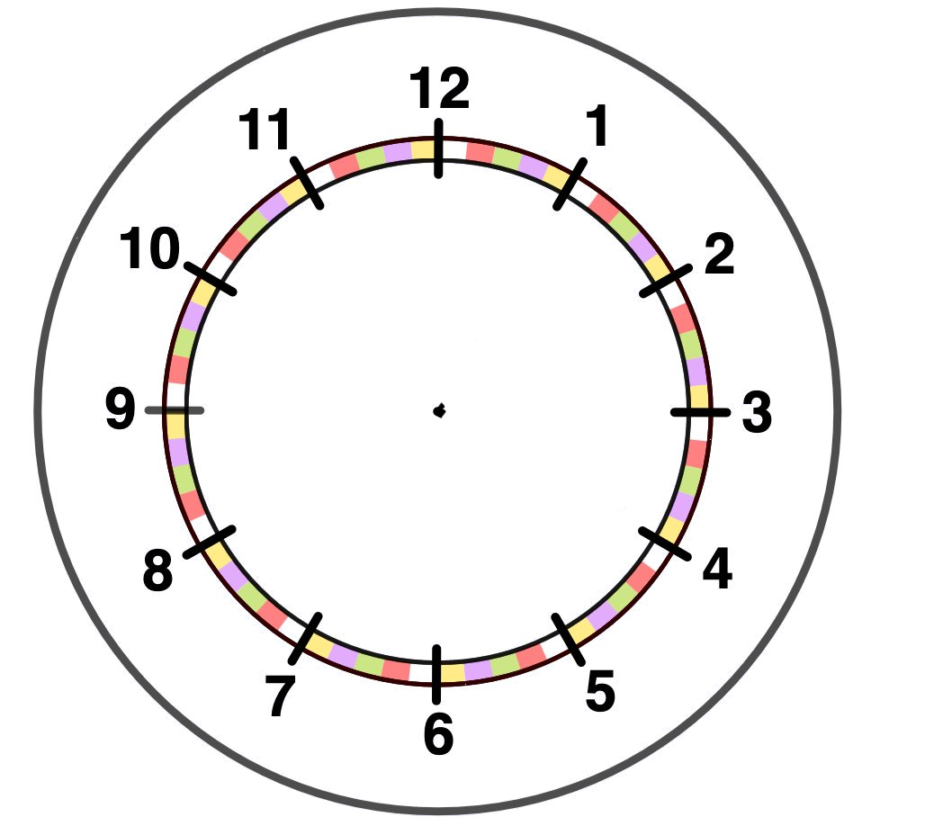


Waqti
Waa maxay qaybaha xisaabta ee aad u malaynaysaa in kaaliye shaqsiyeed uu isticmaalo?
Waqti
  Qabanqaabinta shirarka
  Ballansashada safarka
  Isku-xirka qorshooyinka
Xaashiyaha (Spreadsheets)
Maaliyad (Finance)
  Ballansashada hoyga
  Isticmaalka qiimo-dhimista (boqolkiiba)
  Miisaaniyadaha (Budgets)
Inta lagu guda jiro darsigan waxaan eegi doonaa qaar ka mid ah kuwan.

Slide 7
Waqti
Kaaliye shaqsiyeed (PA) ayaa qabanqaabinaya ka qaybgalka shir.
Shirku wuxuu bilaabmayaa 9 subaxnimo.
Haddii ay u baahan yihiin inay ka baxaan guriga ka hor 6:30 subaxnimo, waxay ku hoyan karaan habeenkii hore hudel u dhow goobta shirka.
Adigoo isticmaalaya macluumaadka ku xiga slide-ka xiga, go'aami inay u baahan yihiin qol hudel habeenkii hore.

Slide 8
Waqti
Waqtiga loo qaato in la wado ilaa saldhigga tareenka A waa 35 daqiiqo.
Shirku wuxuu ku dhow yahay saldhigga H.
Waqtiga loo qaato in laga socdo saldhigga H ilaa goobta waa 6 daqiiqo.
Ma u baahan yahay PA inuu buuxiyo hudel habeenkii hore ee shirka?
A | 0658 | 0743 | 0838
B | 0715 | 0800 | 0855
C | 0733 | 0818 | 0913
D | 0747 | 0832 | 0927
E | 0800 | 0845 | 0940
F | 0814 | - | 0954
G | 0830 | - | 1010
H | 0846 | - | 1026
Haa, way u baahan yihiin. Si ay u gaaraan goobta 9 subaxnimo, waxay u baahan yihiin inay qabtaan tareenka 0658 ee ka baxa saldhigga A. Sidaas darteed, waxay u baahan yihiin inay ka baxaan guriga 0623, taas oo ka hor 0630.

Slide 9
Waqti
PA wuxuu u baahan yahay inuu u sheego macmiilka waqtiga ugu horeeya ee shirku bilaaban karo.
Waxay u baahan yihiin inay ka safraan saldhigga B ilaa saldhigga E.
Waxay qaadan doontaa 20 daqiiqo in laga gaaro saldhigga E ilaa goobta shirka.
Waa maxay waqtiga ugu horeeya ee shirku bilaaban karo?
A | 0658 | 0743 | 0838
B | 0715 | - | 0855
C | 0733 | 0818 | 0913
D | 0747 | 0832 | -
E | - | 0845 | 0940
F | - | - | 0954
G | 0830 | - | 1010
H | 0846 | - | 1026
Tareenka koowaad kuma joogsado saldhigga E.
Tareenka labaad kuma joogsado saldhigga B.
Waxay u baahan yihiin inay qabtaan tareenka 0855 ee ka baxa saldhigga B, kaas oo gaaraya saldhigga E 0940.
Sidaas darteed, waqtiga ugu horeeya ee shirku bilaaban karo waa 10 subaxnimo.

Slide 10
Waqti
PA-ga agaasimaha ayaa qabanqaabinaya subax wareysi ah oo loogu talagalay jagada cusub ee shirkadda.
Mid kasta oo ka mid ah musharraxiinta wuxuu u baahan yahay inuu sameeyo kuwan soo socda:
Salaan 15 daqiiqo.
Dawlad shirkadda, waxaa lagu samayn karaa koox ama si madax-bannaan, waxayna qaadataa 45 daqiiqo.
Wareysi, si gaar ah agaasimaha, waxay qaadataa 60 daqiiqo.
Hawl waqti lagu xaddiday, oo loo qaybin karo laba qaybood waxayna qaadataa 1 saac 30 daqiiqo.
Nasasho 15 daqiiqo ah.
Waxaa jira 3 musharaxiin.

Slide 11
Waqti
PA waxay go'aansatay inay isticmaasho xaashi (spreadsheet) si ay u fududeeyso dib-u-habaynta dhacdooyinka.
Waxay isticmaalaan xannibaado midab leh si ay u fududeeyaan inay arkaan haddii dhacdooyinka is-dul-saraan.
WAQTI | A | B | C
09:00 | SOO DHAWOOW
09:15
09:30
09:45
10:00
10:15
10:30
10:45
11:00
WAQTI | A | B | C
11:15
11:30
11:45
12:00
12:15
12:30
12:45
13:00
HAWL
WAREYSI
DAAWO
B

Slide 12
Waqti
Waa inay ku bilaabaan wareysiga sababtoo ah kuwaasi waa inay ahaadaan kuwo gaar ah waxaana fuliya qof isku mid ah, sidaas darteed ma is-dul-saari karaan.
WAQTI | A | B | C
09:00 | SOO DHAWOOW
09:15
09:30
09:45
10:00
10:15
10:30
10:45
11:00
WAQTI | A | B | C
11:15
11:30
11:45
12:00
12:15
12:30
12:45
13:00
WAREYSI
Ma dhacaan wareysiyada waqtiyadan?
WAREYSI
Maya, halkan waxaa jira is-dul-saar.
WAREYSI
HAWL (TASK)
WAREYSI (INTERVIEW)
DAAWO (TOUR)
B

Slide 13
Waqti
Waxay u qorsheeyaan wareysiyada sidan.
Ma fiican tahay?
WAQTI | A | B | C
09:00 | SOO DHAWAYN (WELCOME)
09:15
09:30
09:45
10:00
10:15
10:30
10:45
11:00
WAQTI | A | B | C
11:15
11:30
11:45
12:00
12:15
12:30
12:45
13:00
WAREYSI (INTERVIEW)
Haa, hadda ma is-dul-saaraan.
WAREYSI (INTERVIEW)
PA-ga wuxuu ka helaa qoraalkan miiska. Waa maxay isbeddelka loo baahan yahay in lagu sameeyo jadwalka?
Fadlan hubi in aan helo nasasho 30 daqiiqo ah inta u dhaxaysa wareysiyada, laakiin aan ka horayn 10:30.
WAREYSI (INTERVIEW)

Slide 14
Waqti
Ma hadda fiican tahay jadwalka wareysiga?
WAQTI | A | B | C
09:00 | SOO DHAWAYN (WELCOME)
09:15
09:30
09:45
10:00
10:15
10:30
10:45
11:00
WAQTI | A | B | C
11:15
11:30
11:45
12:00
12:15
12:30
12:45
13:00
Haa, wareysiyadu isma dhaafaan, wareystuhuna wuxuu leeyahay nasasho 11:15 ilaa 11:45
WAREYSI
Fadlan hubi in aan helo nasasho 30 daqiiqo oo u dhaxaysa wareysiyada, laakiin aan ka horayn 10:30
WAREYSI
WAREYSI

Slide 15
Waqti
Dawladdu waxay ku xigtaa, sababtoo ah hawsha waxaa loo kala qaybin karaa laba qaybood.
WAQTI | A | B | C
09:00 | SOO DHAWAYN
09:15
09:30
09:45
10:00
10:15
10:30
10:45
11:00
WAQTI | A | B | C
11:15
11:30
11:45
12:00
12:15
12:30
12:45
13:00
Hadda nasashooyinka 15 daqiiqo oo midkiiba.
DAWLAAD
DAWLAAD
WAREYSI
WAREYSI
B
B
B
WAREYSI
DAWLAAD
DAWLAAD
B

Slide 16
Waqti
Ugu dambeyntii, hawsha.
WAQTI | A | B | C
09:00 | SOO DHAWAYN
09:15
09:30
09:45
10:00
10:15
10:30
10:45
11:00
WAKHTIGA | A | B | C
11:15
11:30
11:45
12:00
12:15
12:30
12:45
13:00
Maamuluhu wuxuu rabaa 15 daqiiqo oo isu imaatin ah dhammaan musharrixiinta dhamaadka subaxda.
Wakhtigee ayay subaxda wareysiga dhammaanaysaa?
DAAWO
DAAWO
WAREYSI
HAWSHA
HAWSHA
WAREYSI
B
B
B
Subaxdu waxay dhammaataa 1:00 galabnimo
HAWSHA
MACSALAAMAYN
WAREYSI
HAWSHA
DAAWO

Slide 17
Wakhti
WAKHTIGA | A | B | C
09:00 | SOO DHAWAYN
09:15
09:30
09:45
10:00
10:15
10:30
10:45
11:00
WAKHTIGA | A | B | C
11:15
11:30
11:45
12:00
12:15
12:30
12:45
13:00
Maamuluhu wuxuu go'aansaday inuu rabo in musharrix kasta uu daawashada keligiis qaado, halkii uu la qaadi lahaa musharrix kale, oo dhammaan musharrixiintu waxay u baahan yihiin nasasho ka hor 10:30.
Dib u qor jadwalka si aad tani u tixgeliso.
Xusuusnow hawsha waxaa loo qaybin karaa laba qaybood.
DAWACAD
DAWACAD
WAREYSI
HAWL
HAWL
WAREYSI
B
B
B
NABADAAD
WAREYSI
HAWL
DAWACAD

Slide 18
Wakhti
WAKHTI | A | B | C
09:00 | SOO DHAWOW
09:15
09:30
09:45
10:00
10:15
10:30
10:45
11:00
WAKHTI | A | B | C
11:15
11:30
11:45
12:00
12:15
12:30
12:45
13:00
Maamuluhu wuxuu go'aansaday inuu doonayo in musharax kasta uu dawacadda keligii qaato, halkii uu la qaadi lahaa musharax kale, oo dhammaan musharaxiintu waxay u baahan yihiin nasasho ka hor 10:30.
Dib u qor jadwalka si aad tani u tixgeliso.
Xusuusnow hawsha waxaa loo qaybin karaa laba qaybood.
DAAWO
DAAWO
HAWL
WAREYSI
HAWL
WAREYSI
B
B
HAWL
B
NABADAAD
WAREYSI
HAWL
DAWACAD

Slide 19
Waqti
1) PA wuxuu u baahan yahay inuu u sheego macmiilka waqtiga ugu horeeya ee shirku bilaaban karo.
Waxay u baahan yihiin inay ka safraan saldhigga C ilaa saldhigga G.
Waxay qaadanaysaa 20 daqiiqo in laga gaaro saldhigga G goobta shirka.
Waa imisa waqtiga ugu horeeya ee shirku bilaaban karo?
A | 0658 | 0743 | 0838
B | 0715 | - | 0855
C | - | 0818 | 0913
D | 0747 | 0832 | -
E | - | 0845 | 0940
F | - | - | 0954
G | 0830 | - | 1010
H | 0846 | - | 1026

Slide 20
Waqti
2) Waxaad tahay PA oo waxaad qabanaysaa subax wareysiyo ah. Waxaad isticmaali kartaa xaashida (slide-ka xiga) si ay kuu caawiso.
Mid kasta oo musharax ah wuxuu u baahan yahay inuu sameeyo kuwan soo socda:
15 daqiiqo soo dhaweyn.
Daawo shirkadda, laba-laba, oo qaadata 30 daqiiqo.
Wareysi, si gaar ah agaasimaha, oo qaadata 45 daqiiqo.
Hawl waqti lagu xadiday, oo loo kala qaybin karo qaybo badan oo qaadata 60 daqiiqo.
Hawl laba-laba ah, oo qaadata 45 daqiiqo.
Nasasho 15 daqiiqo ah oo lala yeesho musharax kale, ka dib 10:30.
Agaasimuhu wuxuu rabaa nasasho 15 daqiiqo ah ka dib 2 wareysi.
Waxaa jira 4 musharax.

Slide 21
Waqti
WAQTI | A | B | C | D
09:00
09:15
09:30
09:45
10:00
10:15
10:30
10:45
11:00
WAQTI | A | B | C | D
11:15
11:30
11:45
12:00
12:15
12:30
12:45
13:00

Slide 22
Waqti
1) PA (kaaliyaha shaqsiyadeed) wuxuu u baahan yahay inuu u sheego macmiilka waqtiga ugu horeeya ee shirku bilaabmi karo.
Waxay u baahan yihiin inay ka safraan saldhigga C ilaa saldhigga G.
Waxay qaadanaysaa 20 daqiiqo in laga gaaro saldhigga G goobta shirka.
Waa maxay waqtiga ugu horeeya ee shirku bilaabmi karo?
A | 0658 | 0743 | 0838
B | 0715 | - | 0855
C | - | 0818 | 0913
D | 0747 | 0832 | -
E | - | 0845 | 0940
F | - | - | 0954
G | 0830 | - | 1010
H | 0846 | - | 1026
Tareenka koowaad kuma joogsado saldhigga C.
Tareenka labaad kuma joogsado saldhigga G.
Waxay u baahan doonaan inay qabtaan tareenka 0913 ee ka baxa saldhigga C oo gaaraya saldhigga G 1010.
Sidaas darteed, waqtiga ugu horeeya ee shirku bilaabmi karo waa 10:30 subaxnimo.

Slide 23
Waqti
2) Waxaad tahay PA (kaaliye shaqsiyadeed) waxaadna qabanqaabinaysaa subax wareysiyo ah. Waxaad isticmaali kartaa xaashida (slaydhka xiga) si ay kuu caawiso.
Mushtari kasta wuxuu u baahan yahay inuu sameeyo waxyaabaha soo socda:
15 daqiiqo soo dhaweyn.
Dawlad (tour) shirkadda, laba-laba, oo qaadata 30 daqiiqo.
Wareysi, shaqsi ahaan la taliyaha, oo qaadata 45 daqiiqo.
Hawl wakhti go'an, oo loo qaybin karo qaybo badan oo qaadata 60 daqiiqo.
Hawl labo qof ah, oo qaadata 45 daqiiqo.
Nasasho 15 daqiiqo ah oo ay la yeeshaan mushtari kale, ka hor 10:30 ma aha.
La taliyuhu wuxuu rabaa nasasho 15 daqiiqo ah ka dib 2 wareysi.
Waxaa jira 4 musharax.

Slide 24
Waqti
WAQTI | A | B | C | D
09:00 | SOO DHAWOOW
09:15 | I | T | TT | T
09:30
09:45 |  | TT |  | TT
10:00 | T | I | T
10:15
10:30 | B |  | B
10:45 | TT | B | TT | B
11:00 |  | PT | I | PT
WAQTI | A | B | C | D
11:15 | TT | PT | I | PT
11:30
11:45 | PT | TT | PT | I
12:00
12:15
12:30 | Nabadgelyo
12:45
13:00
Waa kuwan tusaale:
Fure
I = wareysi
T = dalxiis
TT = hawsha waqtiga
PT = hawsha lammaane
B = nasasho

Slide 25
Kaaliyaha shakhsiga
Waqti
Maaliyad

Slide 26

Maaliyad
Kaaliyaha shakhsiga wuxuu u baahan yahay inuu buuxiyo hoy 2 habeen.
Hoteelkee ayay dooranayaan?
HALKAN SEEXO
£87 habeenkii
MADAXA HOOS U DHIG
£98 habeenkii
10% qiimo dhimis haddii aad joogto in ka badan hal habeen
KA FOGOW
£91 habeenkii
10% qiimo dhimis habeenka labaad
HALKAN SEEXo
Wadarta qiimaha
= £87 × 2
= £174
MADAXA HOOS U DHIG
Wadarta qiimaha
= 0.9 × (£98 × 2)
= £176.40
A STAY AWAY
Wadarta qiimaha
= £91 + 0.9 × £91
= £172.90

Slide 27
Maaliyad (Finance)
Kaaliye shaqsiyeed wuxuu u baahan yahay inuu buuxiyo hoy 3 habeen oo joog ah.
Hoteelkee ayay tahay inay doortaan?
KIP HERE
£90 pn
GET YOUR HEAD DOWN
£98 pn
10% qiimo dhimis haddii aad joogto in ka badan laba habeen
A STAY AWAY
£99 pn
10% qiimo dhimis habeenka labaad
15% qiimo dhimis habeenka saddexaad
KIP HERE
Wadarta qiimaha
= £90 × 3
= £270
GET YOUR HEAD DOWN
Wadarta qiimaha
= 0.9 × (£98 × 3)
= £264.60
A STAY AWAY
Wadarta qiimaha
= £99 + 0.9 × £99 + 0.85 × £99
= £272.25

Slide 28
Maaliyad (Finance)
Shaqaale wuxuu u baahan yahay inuu ka safro London si uu uga qaybgalo shir ku yaalla Manchester.
Waxay jeclaan lahaayeen inay wataan gaari laakiin waxay awoodi doonaan oo kaliya haddii ay ka jaban tahay tareenka.
Isbarbardhig qiimaha 2 hab ee safarka kala duwan.
Haddii ay wataan, waxaa lagu celin doonaa qiimo dhan 45 p halkii mayl.
Haddii ay qabtaan tareenka, waxay u baahan doonaan inay isticmaalaan taksi si ay u tageen uguna soo noqdaan saldhig kasta.
Taksigu waxay ku kici doonaan £2.70 halkii mayl.

Slide 29
Maaliyad (Finance)
Masaafada London ilaa Manchester waa 210 mayl.
Aan bilowno xisaabinta qiimaha isticmaalka gaariga.
Wadarta masaafada la safray = 2 × 210 = 420 mayl
Qiimaha isticmaalka gaariga = 420 × 0.45 = £189
Hadda isticmaalka tareenka.
Qiimaha tigidhka laabto ee London ilaa Manchester = £115
Masaafada lagu safray taksiga = 28 mayl
Qiimaha taksiga = 28 × £2.70 = £75.60
Wadarta qiimaha isticmaalka tareenka = £115 + £75.60 = £190.60
Waxay ku kaxayn karaan gaariga shirka.

Slide 30
Maaliyad (Finance)
Xisaabi farqiga qiimaha safarka gaariga iyo tareenka/taksiga.
Mileage gaariga = 45 p halkii mayl
Qiimaha mileage taksiga = £2.70
Masaafada u dhaxaysa Liverpool iyo Bristol waa 180 mayl.
Tigidhka tareenka ee laabto £71.80
Maylada lagu safray tagaasiga = 36 mayl
Isticmaalka gaariga = 360 × 0.45 = £162
Tareenka iyo tagaasiga = 71.80 + 36 × 2.70 = £169
Isticmaalka gaariga waa ka jaban yahay £7

Slide 31
Maaliyad (Finance)
1) Kaaliye shaqsiyeed wuxuu u baahan yahay inuu buuxiyo hoy 3 habeen oo joog ah.
Hoteelkee ayay tahay inay doortaan?
HALKAN SEEXO
£105 habeenkii
MADAXA HOOS DHIIG
£118 habeenkii
10% qiimo dhimis haddii aad joogto in ka badan laba habeen
KA FOGOW
£115 habeenkii
10% qiimo dhimis habeenka labaad
15% qiimo dhimis habeenka saddexaad

Slide 32
Maaliyad (Finance)
2) Xisaabi farqiga u dhexeeya kharashka safarka gaariga iyo tareenka/tagaasiga.
Maylka gaariga = 45 p maylkii
Kharashka maylka tagaasiga = £2.70
Fogaanta Exeter ilaa Birmingham waa 169 mayl.
Tigidhka tareenka ee laabashada £108
Miles lagu safray tagaasida = 16 miles

Slide 33
Maaliyadda (Finance)
1) Kaaliye shaqsiyeed wuxuu u baahan yahay inuu buuxiyo hoy 3 habeen ah.
Hoteelkee ayay dooran lahaayeen?
HALKAN SEEXO
£105 pn
MADAXA HOOS DHIIG
£118 pn
10% qiimo dhimis haddii aad joogto in ka badan laba habeen
KA FOGOW
£115 pn
10% qiimo dhimis habeenka labaad
15% qiimo dhimis habeenka saddexaad
HALKAN SEEXO
Wadarta qiimaha
= £105 × 3
= £315
MADAXA HOOS DHIIG
Wadarta qiimaha
= 0.9 × (£118 × 3)
= £318.60
KA FOGOW
Wadarta qiimaha
= £115 + 0.9 × £115 + 0.85 × £115
= £316.25

Slide 34
Maaliyadda (Finance)
2) Xisaabi farqiga qiimaha safarka gaariga iyo tareenka/tagaasida.
Mileage gaariga = 45 p per mile
Qiimaha maylka tagaasigu waa £2.70
Fogaanta u dhaxaysa Exeter iyo Birmingham waa 169 mayl.
Tigidhka tareenka ee laabashada waa £108
Maylalka lagu safray tagaasi waa 16 mayl
Isticmaalka gaariga = 338 × 0.45 = £152.10
Tareenka iyo tagaasi = 108 + 16 × 2.70 = £151.20
Isticmaalka tareenka/tagaasigu wuu ka jaban yahay 90 pence.

Slide 35
Kaaliyaha shaqsiga
Meelaha ugu muhiimsan ee xisaabta ee kaaliyaha shaqsiga uu isticmaalo waa waqtiga iyo lacagta.
Waqti
  Habaynta shirarka
  Ballansashada safarka
  Isku xirka qorshooyinka
Xaashiyaha xisaabta (Spreadsheets)
Maaliyadda
  Ballansashada hoyga
  Isticmaalka qiimo-dhimista (boqolleyda)
  Miyaaniyadda

