Slide 1
Miisaanka pH iyo milan (solution) tilmaame guud
Aashito (acids) iyo saldhigyo (bases)

Slide 2
Sida agabkeena waxbarista loogu talagalay fasalka

Slide 3

Waxaan ku qiyaasi karaa pH-ga aashitada (acid) ama alkaliyada (alkali) adigoo isticmaalaya miisaanka pH.

Slide 4
Miisaanka pH
aashito (acidic)
alkali (alkaline)
milan dhexdhexaad (neutral solution)
uruurinta (concentration)

Slide 5
Miisaanka pH waa miisaan ka bilaabma 1 ilaa 14 oo loo isticmaalo in lagu qiyaaso aashitada (acidity) ama alkaliga (alkalinity) ee milannada (solutions). pH7 waxay u taagan tahay milannada dhexdhexaadka (neutral).
Milan (solution) leh pH ka yar 7 waa aashito (acidic).
Milan (solution) leh pH ka badan 7 waa alkali (alkaline).
Milan (solution) leh pH 7 waa dhexdhexaad (neutral).
Uruurinta (concentration) waa xadiga kiimikada ku milan mugga milan (solution).

Slide 6

Miisaanka pH iyo milan (solution) tilmaame guud
Miisaanka pH
Tilmaame guud (Universal indicator)

Slide 7
Miisaanka pH
pH waxay u taagan tahay 'awoodda hydrogen' (potential of hydrogen).
Miisaanka pH waa miisaan tirooyin ah oo u dhexeeya pH 1 ilaa pH 14.
Aashitada (Acids) waxay ka kooban tahay hydrogen.
Marka hydrogen-ka uu sareeyo, pH-ga ayaa hooseeya.
Marka hydrogen-ka uu hooseeyo, pH-ga ayaa sareeya.
1
7
14
hydrogen badan
pH-ga saxda ah 7 waa dhexdhexaad (neutral)
hydrogen yar
pH-ga ka yar 7 waa aashito (acidic)
pH-ga ka badan 7 waa alkali (alkaline)

Slide 8

miisaanka pH-ga (pH scale)
Miisaanka pH-ga (pH scale) wuxuu ka bilaabmaa:
1-10
1-100
1-7
1-14

Slide 9
miisaanka pH-ga (pH scale)
Milan (Solution) leh pH sax ah 7 waa …
aashito (acidic).
dhexdhexaad (neutral).
alkali (alkaline).

Slide 10
miisaanka pH-ga (pH scale)
Marka hydrogen-ka uu sareeyo …
pH-ga ayaa hooseeya.
pH-ga ayaa sareeya.
hydrogen-ka isku xadka kuma beddelo pH-ga.

Slide 11
miisaanka pH-ga (pH scale)
Miisaanka pH-ga (pH scale) wuxuu kor iyo hoos u socdaa qaybo toban ah, sidaas darteed aashito (acid) pH 2 ah waxay tahay toban jeer oo aashito (acidic) badan marka loo eego pH 3.
Alkali (alkali) pH 9 ah waxay tahay toban jeer oo alkali (alkaline) badan marka loo eego pH 8.
1
2
3
4
5
6
7
8
9
10
11
12
13
14
pH 4 waa 10 jeer oo aashito (acidic) badan marka loo eego pH 5.
pH 13 waa 100 jeer ka alkaline (alkaline) badan pH 11.

Slide 12
Miisaanka pH (pH scale)
Miisaanka pH wuxuu kor iyo hoos u socdaa qodobo 14 ah.
Milan (solution) pH 5 waa 10 jeer ka acidic (acidic) badan milan (solution) pH 6.
Milan (solution) pH 5 waa 10 jeer ka yar acidic (acidic) marka loo eego milan (solution) pH 6.

Slide 13
Miisaanka pH (pH scale)
Dooro dhammaan weedhaha saxda ah. Marka alkaline (alkaline) badan yahay milan (solution), pH-ga sareeyo, sidaas darteed …
pH 9 waa 10 jeer ka alkaline (alkaline) badan pH 8.
pH 9 waa 14 jeer ka alkaline (alkaline) badan pH 8.
pH 9 waa 10 jeer ka yar alkaline (alkaline) marka loo eego pH 8.
pH 11 waa 100 jeer ka alkaline (alkaline) badan pH 9.

Slide 14
Miisaanka pH (pH scale)
Sheeg haddii milan (solution) yahay acidic (acidic), neutral (neutral) ama alkaline (alkaline).
Milan (solution) wuxuu leeyahay pH 5.
Milan (solution) nadiifin ah wuxuu leeyahay pH 8.
Biyo (water) waxay leeyihiin pH 7 sax ah.
Caano waxay leeyihiin pH 6.5.
Khal wuxuu leeyahay pH 3.
Milan (solution) furitaanka biyo-mareenka wuxuu leeyahay pH 10.
Weji-nadiifiye wuxuu leeyahay pH 7.5.

Slide 15
Miisaanka pH (pH scale)
Sheeg haddii milan (solution) yahay acidic (acidic), neutral (neutral) ama alkaline (alkaline).
Milan (solution) wuxuu leeyahay pH 5.
Milan (solution) nadiifin (cleaning) waxay leedahay pH 8.
Biyo (water) waxay leeyihiin pH 7 sax ah.
Caano (milk) waxay leeyihiin pH 6.5.
Khal (vinegar) wuxuu leeyahay pH 3.
Milan (solution) furitaan biyo-mareen (drain unblocker) wuxuu leeyahay pH 10.
Nadiifiye weji (facial cleanser) wuxuu leeyahay pH 7.5.
Jawaabaha:
Aashito (acidic)
Alkali (alkaline)
Dhexdhexaad (neutral)
Aashito (acidic)
Aashito (acidic)
Alkali (alkaline)
Alkali (alkaline)

Slide 16






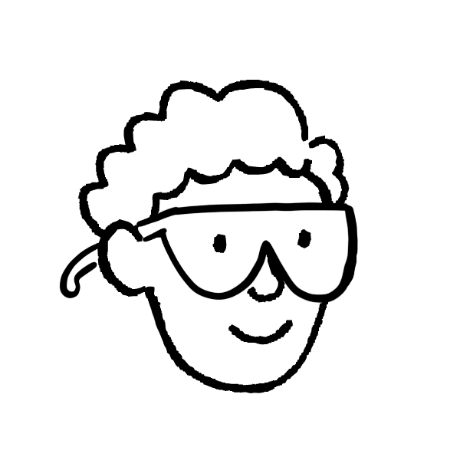
Miisaanka pH (pH scale)
2) Hadallada Yacquub iyo Axmed ma run baa mise been?
Milan (solution) leh pH 2 wuu ka aashito badan yahay (more acidic) milan (solution) leh pH 7.
Milan (solution) A wuxuu leeyahay pH 3, milan (solution) B waa 100 jeer ka aashito badan (acidic). Sidaas darteed, milan (solution) B wuxuu leeyahay pH 2.
Miisaanka pH (pH scale) wuxuu u dhexeeyaa 1-20.
Axmed
pH waxay u taagan tahay ‘awooda helium’ (potential of helium).
Yacquub

Slide 17
Miisaanka pH
2) Ma run ama been bay yihiin hadalada Yacquub iyo Axmed?
Milan (solution) leh pH 2 wuxuu ka aashito badan yahay milan (solution) leh pH 7.
Milan (solution) A wuxuu leeyahay pH 3, milan (solution) B wuxuu 100 jeer ka badan yahay aashito. Sidaas darteed, milan (solution) B wuxuu leeyahay pH 2.
run
been
Miisaanka pH wuxuu u dhexeeyaa 1-20.
Axmed
been
pH waxay u taagan tahay 'awooda helium'.
been
Yacquub

Slide 18
Miisaanka pH
Six hadalada beenta ah si ay u noqdaan kuwo cilmi ahaan sax ah.
Milan (solution) leh pH 2 wuxuu ka aashito badan yahay milan (solution) leh pH 7.
Milan (solution) A wuxuu leeyahay pH 3, milan (solution) B wuxuu 100 jeer ka badan yahay aashito. Sidaas darteed, milan (solution) B wuxuu leeyahay pH 2.
run
been
Miisaanka pH wuxuu u dhexeeyaa 1-20.
Axmed
been (false)
pH waxay u taagan tahay 'awooda helium'.
been (false)
Yacquub

Slide 19

miisaanka pH (pH scale)
Sax (Correct) odhaahyada been (false) ah si ay u noqdaan kuwa cilmi ahaan sax ah (scientifically correct).
Milan (Solution) A waxay leedahay pH 3, milan (solution) B waa 100 jeer aashito badan (more acidic). Sidaas darteed, milan (solution) B waxay leedahay pH 1.
ama
Milan (Solution) A waxay leedahay pH 3, milan (solution) B waa 10 jeer aashito badan (more acidic). Sidaas darteed, milan (solution) B waxay leedahay pH 2.
Axmed
Miisaanka pH (pH scale) wuxuu u dhexeeyaa 1-14.
pH waxay u taagan tahay 'awoodda hydrogen' (potential of hydrogen).
Yacquub

Slide 20
miisaanka pH (pH scale)
Qor pH-ga milanada (solutions).
Milan (Solution) A waxay leedahay pH 3, milan (solution) B waa 10 jeer aashito badan (more acidic). Waa maxay pH-ga milan (solution) B?
Milan (Solution) C waa dhexdhexaad (neutral). Waa maxay pH-ga milan (solution) C?
Milan (Solution) D waxay leedahay pH 8, milan (solution) E waa 1000 jeer alkalin badan (more alkaline). Waa maxay pH-ga milan (solution) E?
Milan (Solution) F waxay leedahay pH 7, milan (solution) G waa 100 jeer aashito badan (more acidic). Waa maxay pH-ga milan (solution) G?

Slide 21
miisaanka pH (pH scale)
Qor pH-ga milanada (solutions).
Milan (Solution) A waxay leedahay pH 3, milan (solution) B waa 10 jeer aashito badan (more acidic). Waa maxay pH-ga milan (solution) B?
Milan (Solution) C waa dhexdhexaad (neutral). Waa maxay pH-ga milan (solution) C?
Milan (Solution) D waxay leedahay pH 8, milan (solution) E waa 1000 jeer alkalin badan (more alkaline). Waa maxay pH-ga milan (solution) E?
Milan (Solution) F waxay leedahay pH 7, milan (solution) G waa 100 jeer aashito badan (more acidic). Waa maxay pH-ga milan (solution) G?
Jawaabaha:
pH 2
pH 7
pH 11
pH 5

Slide 22
miisaanka pH (pH scale) iyo milanka indicator-ka guud (universal indicator solution)
miisaanka pH (pH scale)
indicator-ka guud (Universal indicator)

Slide 23
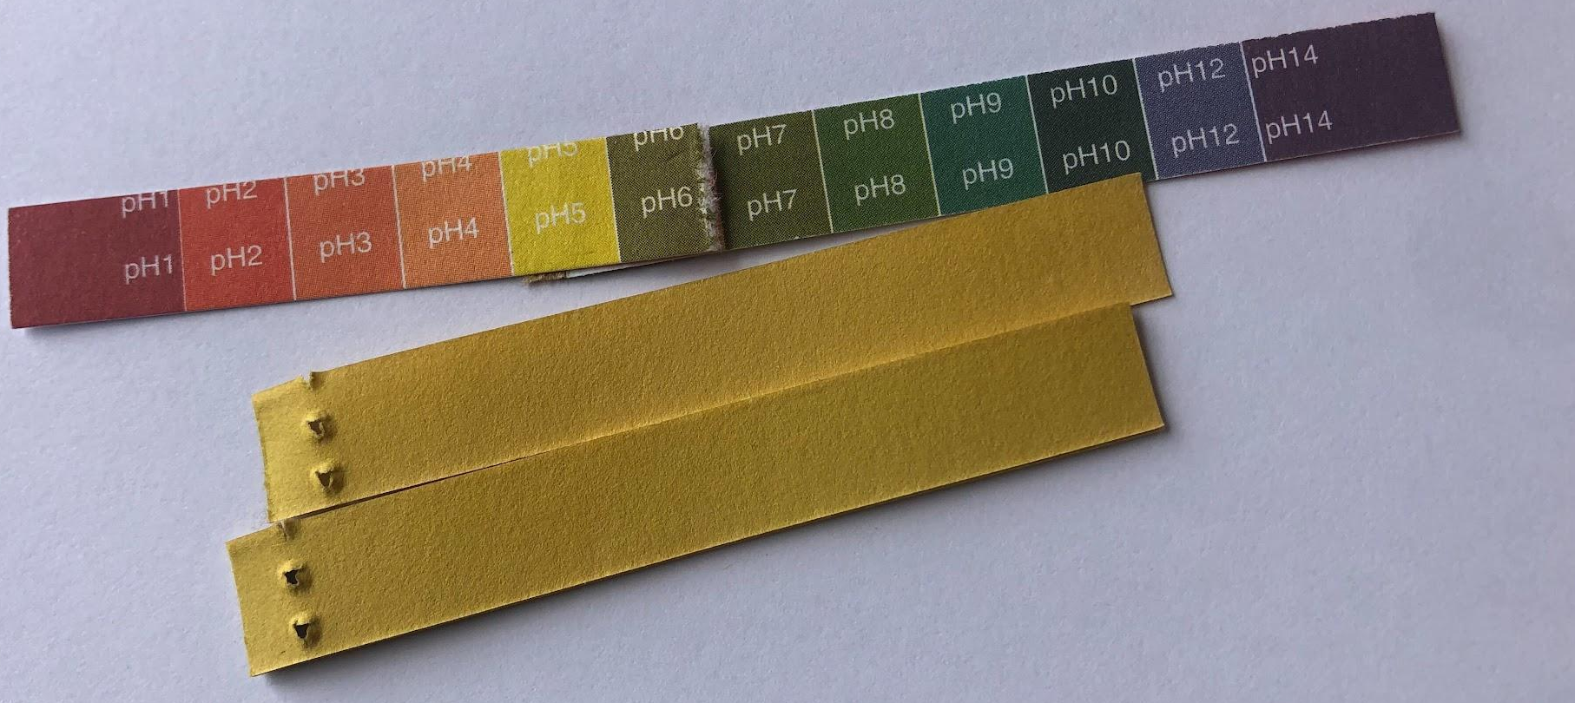
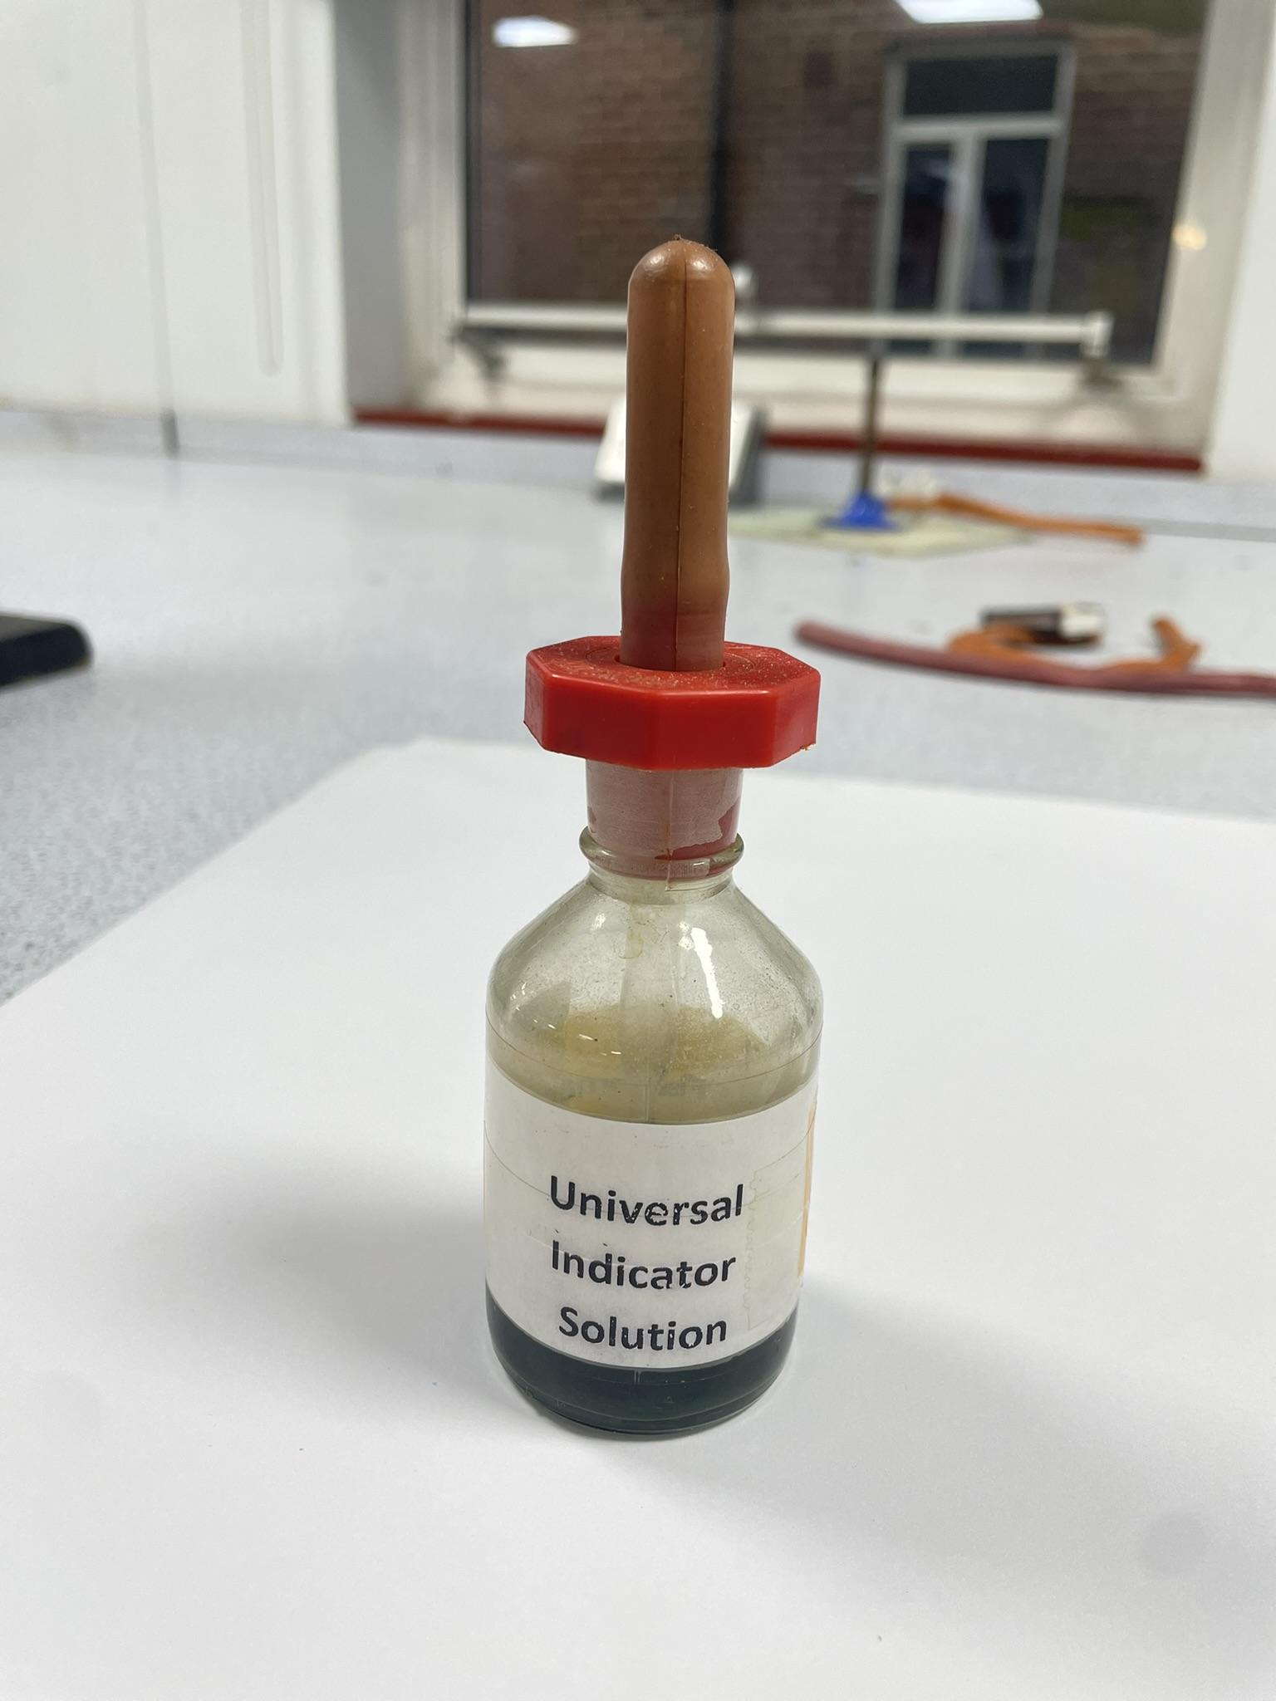
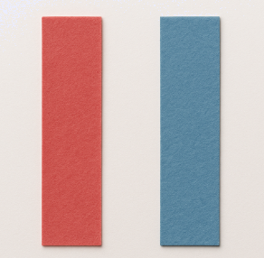
indicator-ka guud (Universal indicator)
Inta badan asiidhyada (acids) iyo alkaliyada (alkalis) waa milano (solutions) aan midab lahayn, sidaas darteed indicator-ka ayaa loo isticmaali karaa in lagu garto.
waraaqda indicator-ka guud (universal indicator paper)
milanka indicator-ka guud (universal indicator solution)
waraaqaha litmus-ka (litmus paper) ee cas iyo buluug

Slide 24
indicator-ka guud (Universal indicator)
indicator-ka guud (Universal indicator):
Wuxuu ku helmi karaa qaab milan (solution) ama waraaq (paper).
Waxay ka samaysan tahay isku darka midabyo (dyes) oo isu beddeli doona midab kale iyadoo ku xiran pH-ga milanka (solution).
The paper can be dipped in the solution being tested or drops of the solution form can be added to the solution being tested.
Si looga hortago wasakhaynta, dhibic ka mid ah milanka la tijaabinayo ayaa lagu dari karaa warqadda.
cas (red)
oranji (orange)
jaalle (yellow)
cagaar (green)
buluug (blue)
guduudan (purple)
acidic
neutral
alkaline
1
2
3
4
5
6
7
8
9
10
11
12
13
14

Slide 25
Universal indicator
Universal indicator solution in an acidic solution will be …
red / orange / yellow
green
blue / purple

Slide 26
Universal indicator
Universal indicator has a wide range of colours in different pH solutions.
Midabka milanka ama warqadda tilmaanta (indicator) ayaa kuu sheegi doona pH-ga milanka aad tijaabinayso.
Ma kala saari kartid milannada leh pH kala duwan.

Slide 27



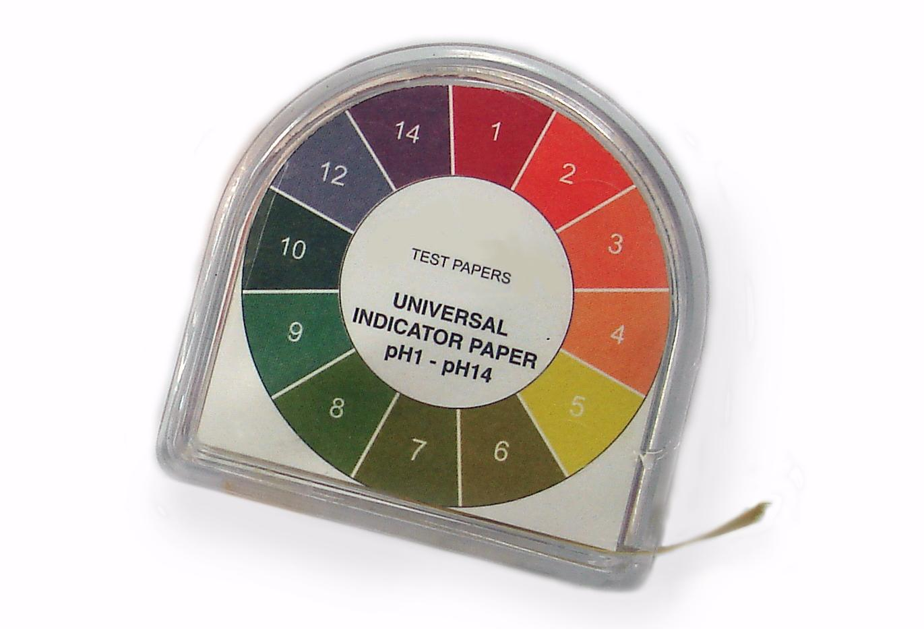

Universal indicator
Which is the indicator paper that has been dipped in an alkaline solution? Use the universal indicator pH chart to help you.
green
red
dark blue
universal indicator pH chart
a
b
c

Slide 28
Muuqashada guud (Universal indicator)
Samee shax natiijooyin (results table) tijaabada hoos ku qoran.
Tijaabi taxane ah milano (solutions) si aad u go'aamiso pH-ga iyadoo la isticmaalayo milan (solution) muuqashada guud (universal indicator) ama warqad.
Habka (Method):
Adigoo isticmaalaya pipette, ku rid 3-4 dhibco oo milan (solution) tijaabo ah gudaha ceelka saxanka spotting.
Ama ku dar 1-2 dhibco oo milan (solution) muuqashada guud (universal indicator) ah ama dhig dhamaadka warqadda muuqashada guud (universal indicator paper) gudaha ceel kasta oo saxanka spotting ah.
Adigoo isticmaalaya jaantuska miisaanka pH, fiiri oo qor midabka iyo pH-ga milanka (solution) gudaha shaxda natiijooyinkaaga.

Slide 29
Muuqashada guud (Universal indicator)
1) iyo 2) Shaxda natiijooyinkaadu waxay u ekaan kartaa tan.
magaca milanka (solution) | midabka muuqashada guud (universal indicator) | pH-ga muuqashada (indicator)
liin dhanaan
guduud
2
khal
oranji
3
nadiifiye
buluug madow
11
buuris ilkaha
cagaar madow
9
biyo (water) saafi ah
cagaar khafiif ah
7
cabitaan fizz (fizzy drink)
jaalle
2

Slide 30
Indheecade guud (Universal indicator)
Qor gunaanad (conclusion) tijaabadaada (experiment) adoo buuxinaya bilowgan weedha:
Milanka (solution) aashinka (acidic) ugu xoogga badnaa ee aan tijaabiyey waa __________, waxaan tan uga ogahay sababtoo ah …
Milanka (solution) alkaline-ga (alkaline) ugu xoogga badnaa ee aan tijaabiyey waa __________, waxaan tan uga ogahay sababtoo ah …
Waxaan (tijaabiyey / ma tijaabin) milan (solution) dhexdhexaad (neutral), waxaan tan uga ogahay sababtoo ah …

Slide 31
Indheecade guud (Universal indicator)
Gunaanadkaaga (conclusion) waxaa laga yaabaa inuu la mid yahay kan hoose.
magaca milan (solution)
Milanka (solution) aashinka (acidic) ugu xoogga badnaa ee aan tijaabiyey waa __ ________, waxaan tan uga ogahay sababtoo ah …
milan (solution) wuxuu noqday midab cas / wuxuu lahaa pH hoose oo ah 1.
magaca milan (solution)
Milanka (solution) alkaline-ga (alkaline) ugu xoogga badnaa ee aan tijaabiyey waa ___ _______, waxaan tan uga ogahay sababtoo ah …
milan (solution) wuxuu ahaa midab guduud / wuxuu lahaa pH sare oo ah 12.
Waxaan tijaabiyey milan (solution) dhexdhexaad (neutral), waxaan tan uga ogahay sababtoo ah …
milan (solution) wuxuu noqday midab cagaar / wuxuu lahaa pH ah 7.
ama
Ma tijaabin milan (solution) dhexdhexaad (neutral), waxaan tan uga ogahay sababtoo ah …
milan (solution) kuma noqon midab cagaar / kuma lahayn pH ah 7.

Slide 32
Miisaanka pH iyo milan (solution) tilmaame universal
Inta badan aashinka (acids) iyo alkaline-ga (alkalis) waa milan (solutions) aan midab lahayn, marka indheecadaha (indicators) ayaa loo isticmaali karaa in lagu garto.
pH waxay u taagan tahay 'awoodda hydrogen' (potential of hydrogen) iyo aashinka (acids) waxay ka kooban yihiin hydrogen.
Marka uu sareeyo uruurinta (concentration) hydrogen, hooseeyaa pH.
Miisaanka pH wuxuu kor u kacaa oo hoos u dhacaa qodobo toban ah, sidaas darteed aashito pH 2 waa toban jeer aashito badan marka loo eego pH 3.
pH hoose waxaa loola jeedaa aashito, pH sare waxaa loola jeedaa alkaline, iyo milan (solution) leh pH 7 waa dhexdhexaad.

