Slide 1
Sawirka cuntada (Photosynthesis)
Nafaqada dhirta iyo sawirka cuntada (Photosynthesis)

Slide 2
Sida loo isticmaalo darasyada Oak

Slide 3
Waxaan aqoonsan karaa fal-celiyeyaasha (reactants) iyo waxsoosaarka (products) ee sawirka cuntada (Photosynthesis) waxaana qori karaa soo koob erayo ah oo ku saabsan habka.

Slide 4
Jawaabaha:
soosaare (producer)
falgal kiimiko (chemical reaction)
sawirka cuntada (Photosynthesis)
kaarboon labo ogsaydh (carbon dioxide)
glucose

Slide 5
Soosaare (producer) waa noole (organism) sameysta cuntadiisa.
Falgal kiimiko (chemical reaction) dhexdiisa, walxaha waa la kala jajabiyaa waxayna falgalaan si ay u sameeyaan walxo cusub.
Sawirka cuntada (Photosynthesis) waa taxane falgal kiimiko (chemical reaction) ah oo ay soosaarayaashu (producers) ku sameystaan cuntadooda.
Kaarboon labo ogsaydh (carbon dioxide) waa iskudhis ka kooban kaarboon iyo ogsaydh, waa gaas heerkulka qolka, waana fal-celiye (reactant) sawirka cuntada (Photosynthesis).
Glucose waa sonkor (karbohaydrayt) oo uu soo saaro sawirka cuntada (Photosynthesis).

Slide 6

Sawirka cuntada (Photosynthesis)
Sida soosaarayaashu (producers) u sameystaan cuntadooda
Fal-celiyeyaasha (reactants) iyo waxsoosaarka (products) ee sawirka cuntada (Photosynthesis)

Slide 7
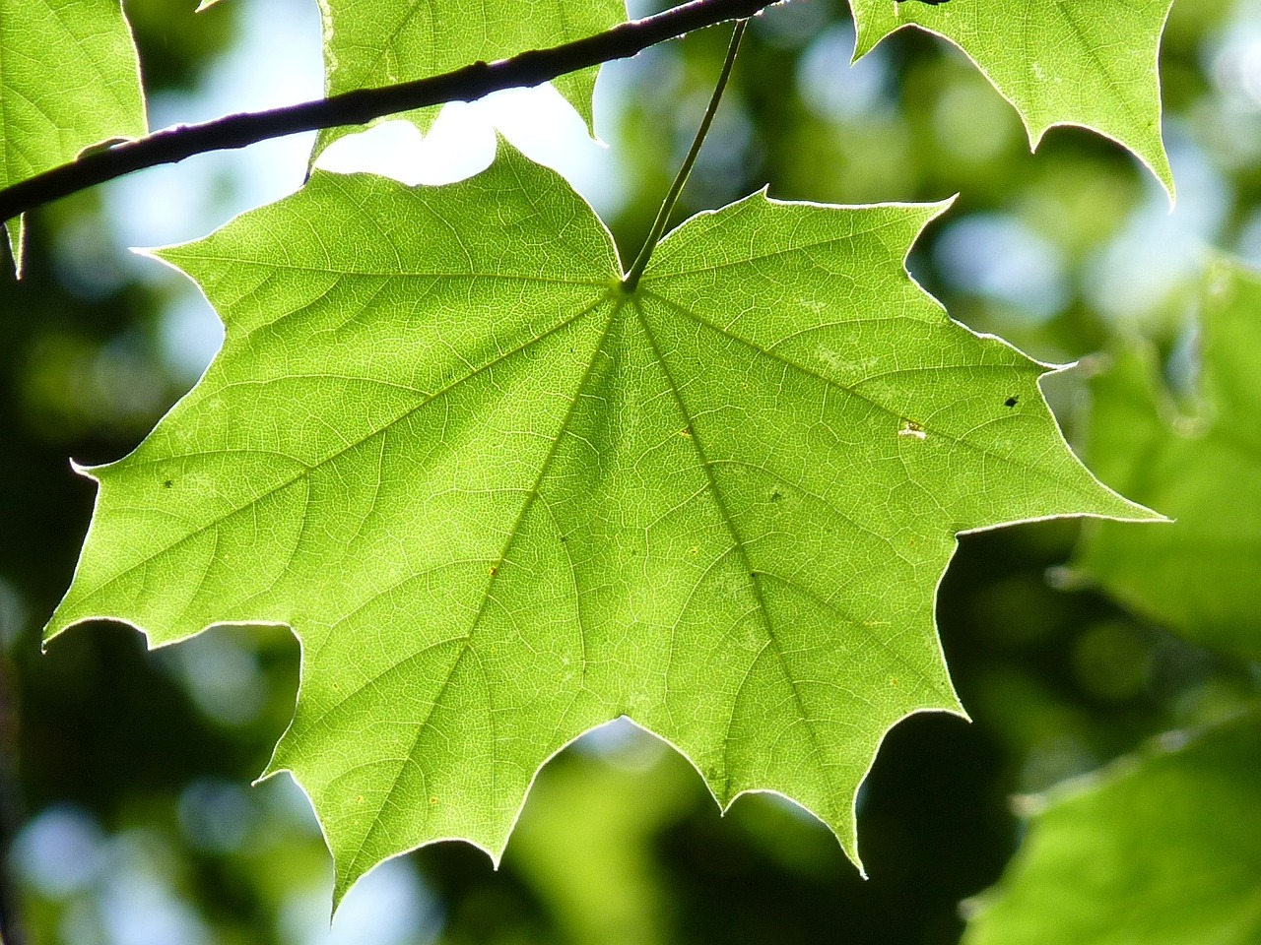
Sida soosaarayaashu (producers) u sameystaan cuntadooda
Dhirta iyo soosaarayaasha kale (producers) waxay sameystaan cuntadooda.
Cuntada waxaa lagu sameeyaa hab loo yaqaan sawirka cuntada (Photosynthesis).
Habkani wuxuu ku dhacaa caleemaha iyo qaybaha kale ee dhirta ee ka sarreeya dhulka.
caleen geed maple ah

Slide 8
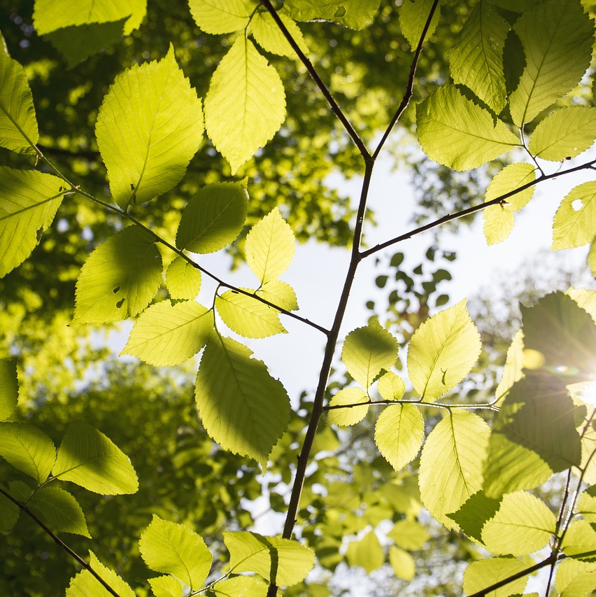
Sida soosaarayaasha (producers) u sameeyaan cuntadooda
Photosynthesis wuxuu dhici karaa oo kaliya marka uu jiro iftiin (light).
photosynthesis
iftiin (light)
in la sameeyo (to make)
Waa maxay ereyada kale ee aad taqaanid oo ay ku jirto 'photo'?

Slide 9

Sida soosaarayaasha (producers) u sameeyaan cuntadooda
Photosynthesis wuxuu ku dhacaa xididdada dhirta.
Photosynthesis wuxuu ku dhacaa caleemaha dhirta marka uu jiro iftiin (light).
Photosynthesis wuxuu ku dhacaa qaybaha dhirta oo dhan.

Slide 10
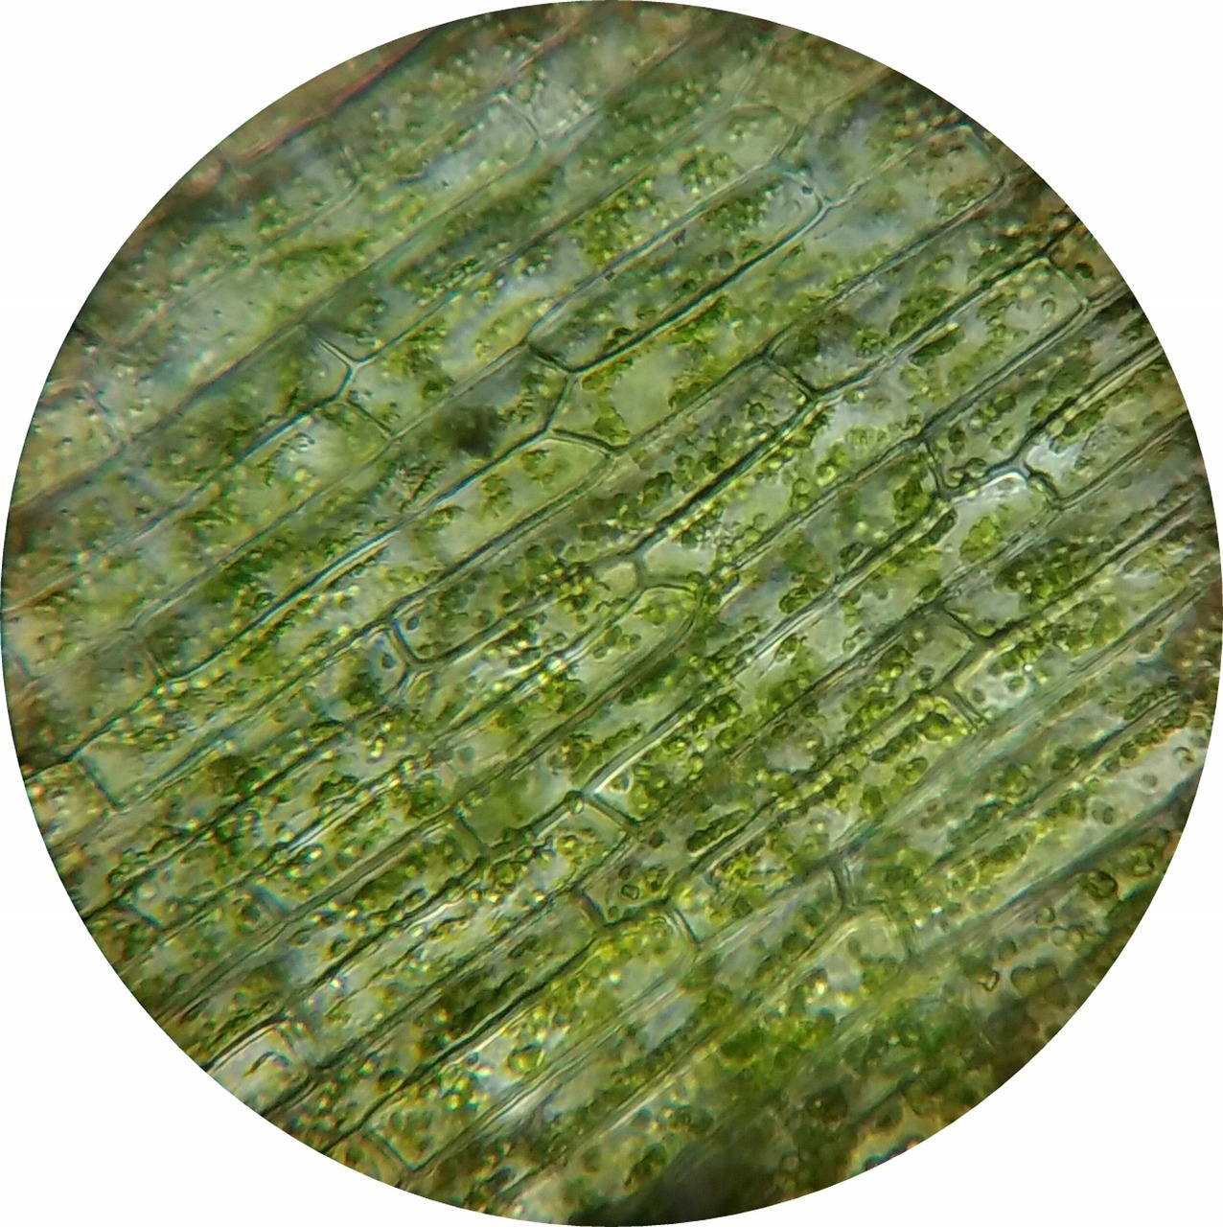
Sida soosaarayaasha (producers) u sameeyaan cuntadooda
Caleemaha waxay ka kooban yihiin unugyo (cells).
Photosynthesis wuxuu ka dhacaa gudaha unugyada (cells).
caleen geed maple ah (leaf of a maple tree)
unugyada caleenta (leaf cells) oo lagu arkay microscope

Slide 11
Sida soosaarayaasha (producers) u sameeyaan cuntadooda
Isku xidh bilowga saxda ah ee jumladda… …iyo dhamaadka saxda ah ee jumladda si aad u samaysato hal jumlad.
Cuntada dhirta waxaa laga sameeyaa inta u dhaxaysa unugyada dhirta (plant cells)…
…iyadoo la adeegsanayo habka neefsiga unugyada (cellular respiration).
Cuntada dhirta waxaa laga sameeyaa unugyada dhirta (plant cells)…
...iyada oo loo marayo habka photosynthesis.
Cuntada dhirta waxaa laga sameeyaa gudaha unugyada dhirta (plant cells)…
…iyadoo la adeegsanayo habka dheefshiidka (digestion).

Slide 12
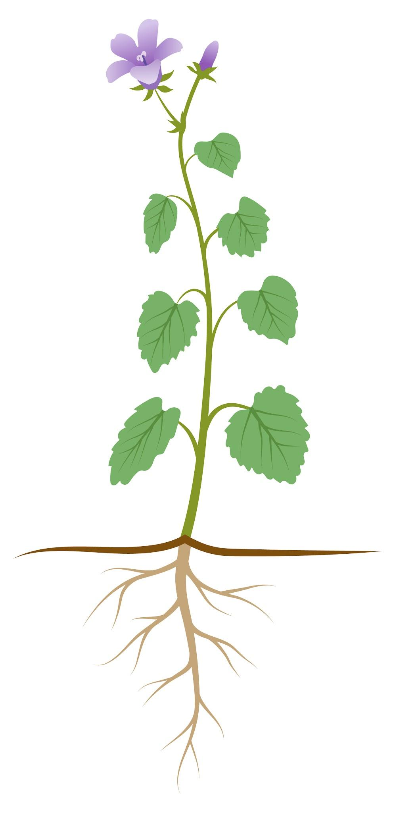
Sida soosaarayaashu (producers) u sameeyaan cuntadooda
Photosynthesis wuxuu u baahan yahay iftiin (light).
Iftiin (light)
Iftiin (light) wuxuu ka wareejiyaa tamarta (energy) isha iftiinka una gudbiyaa unugyada caleenta.
Iftiin (light) waxaa nuugaya caleemaha
Tani waxay siisaa tamarta (energy) loo baahan yahay si photosynthesis uu u dhaco.

Slide 13
Sida soosaarayaashu (producers) u sameeyaan cuntadooda
Yaa run ah oo ku saabsan iftiinka (light) iyo photosynthesis?
Iftiinku (light) wuxuu abuuraa unugyo loogu talagalay photosynthesis.
Iftiinka (light) waxaa sameeya photosynthesis.
Iftiinku (light) wuxuu bixiyaa tamarta (energy) loo baahan yahay photosynthesis.

Slide 14
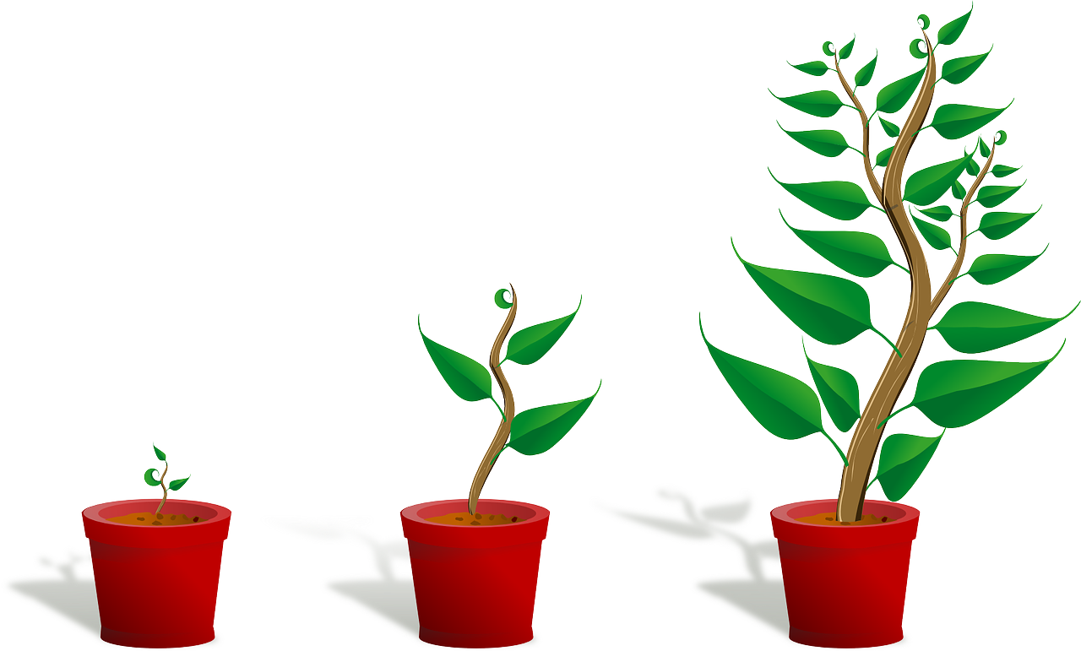
1
Sida soosaarayaashu (producers) u sameeyaan cuntadooda
Isra waxay haysatay geed guri ah (houseplant) muddo dheer.
Weli waa mid aad u yar.
Waxay ku haystaa gees mugdi ah oo qolka ah, oo ka fog daaqadda.
Geedka guriga ee Isra
Isra waxay go'aansatay inay geedka u dhaqaaqdo si uu ugu xirnaado daaqadda.
Sharax sababta tani uga caawin doonto geedka inuu weynaado.

Slide 15

1
Sida soosaarayaashu (producers) u sameeyaan cuntadooda
In geedka guriga la dhigo daaqadda agteeda waxay ka caawin doontaa geedka inuu weynaado sababtoo ah:
Wuxuu heli doonaa iftiin (light) badan oo ka yimaada qorraxda (Sun).
Ifku wuxuu u kala wareejiyaa tamarta (energy) Qorraxda unugyada caleenta (leaf cells) ee noolaha (organism).
Tani waxay siisaa tamar (energy) falgalka (reaction) sawir-iftiin (photosynthesis).
Sawir-iftiinku (photosynthesis) wuxuu sameeyaa cuntada (food) noolaha (organism).
Cuntadan (food) waxaa loo isticmaalaa sida:
  il (source) walxaha (materials) koritaanka (growth)
  il (source) tamarta (energy) hab-nololeedyada kale (other life processes).

Slide 16
Sawir-iftiin (Photosynthesis)
Sida soosaarayaasha (producers) u sameeyaan cuntadooda (food)
Fal-celiyeyaasha (reactants) iyo wax-soo-saarka (products) sawir-iftiinka (photosynthesis)

Slide 17
Fal-celiyeyaasha (reactants) iyo wax-soo-saarka (products) sawir-iftiinka (photosynthesis)
Sawir-iftiinku (photosynthesis) waa taxane (series) falgal (reaction) kiimikada (chemical) oo ka dhaca gudaha unugyada caleenta (leaf cells).
unugyada caleenta (leaf cells) oo lagu arkay mikroskoob (microscope)
Inta lagu jiro falgalka kiimikada (chemical reactions):
hal ama in ka badan oo walxo (substances) ayaa la kala jebiyaa - kuwani waa fal-celiyeyaasha (reactants)
hal ama in ka badan oo walxo (substances) cusub ayaa la sameeyaa - kuwani waa wax-soo-saarka (products).

Slide 18
Fal-celiyeyaasha (reactants) iyo wax-soo-saarka (products) sawir-iftiinka (photosynthesis)
Sida hawlgalka kiimikada oo kale, photosynthesis wuxuu leeyahay fal-celiye (reactants) iyo wax-soo-saarka (products).
gaasta kaarboon laba-ogsaydh (carbon dioxide gas)
Jawaabaha:
iftiin (light)
glucose (glucose)
wax-soo-saarka (products)
gaasta oksijiin (oxygen gas)
fal-celiye (reactants)
biyo (water)

Slide 19
Fal-celiyeyaasha (reactants) iyo wax-soo-saarka (products) ee photosynthesis
Photosynthesis ma aha hal falgal (reaction) oo keliya.
Waa taxane falgal (reaction) oo ka dhaca gudaha unugyada dhirta.
Laakiin waa faa'iido in la xasuusto soo koobida ereyada ee fal-celiyeyaasha (reactants) iyo wax-soo-saarka (products):
biyo (water) + carbon dioxide glucose + oxygen
Jawaabaha:
fal-celiye (reactants)
wax-soo-saar (products)

Slide 20
Fal-celiyeyaasha (reactants) iyo wax-soo-saarka (products) ee photosynthesis
Dhammeystir soo koobida ereyada ee photosynthesis.
+
+
Jawaabaha:
carbon dioxide
biyo (water)
glucose
oxygen

Slide 21
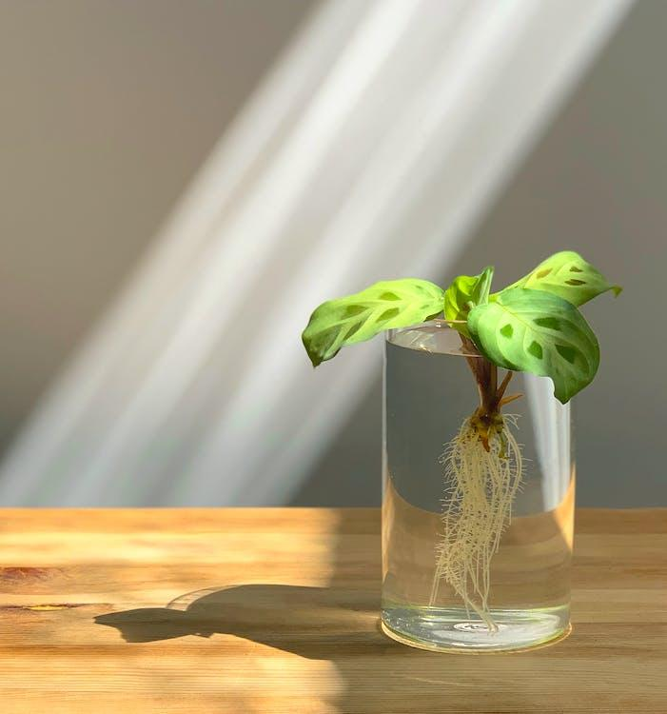
Fal-celiyeyaasha (reactants) iyo wax-soo-saarka (products) ee photosynthesis
biyo (water) + carbon dioxide glucose + oxygen
Mid ka mid ah fal-celiyeyaasha (reactants) ee photosynthesis waa biyo (water).
Dhirta waxay u qaataan biyo (water) photosynthesis iyagoo sii mara
xididdada.
Biyaha (water) waxaa loo qaadaa caleemaha si loogu isticmaalo photosynthesis.
biyo (water)

Slide 22
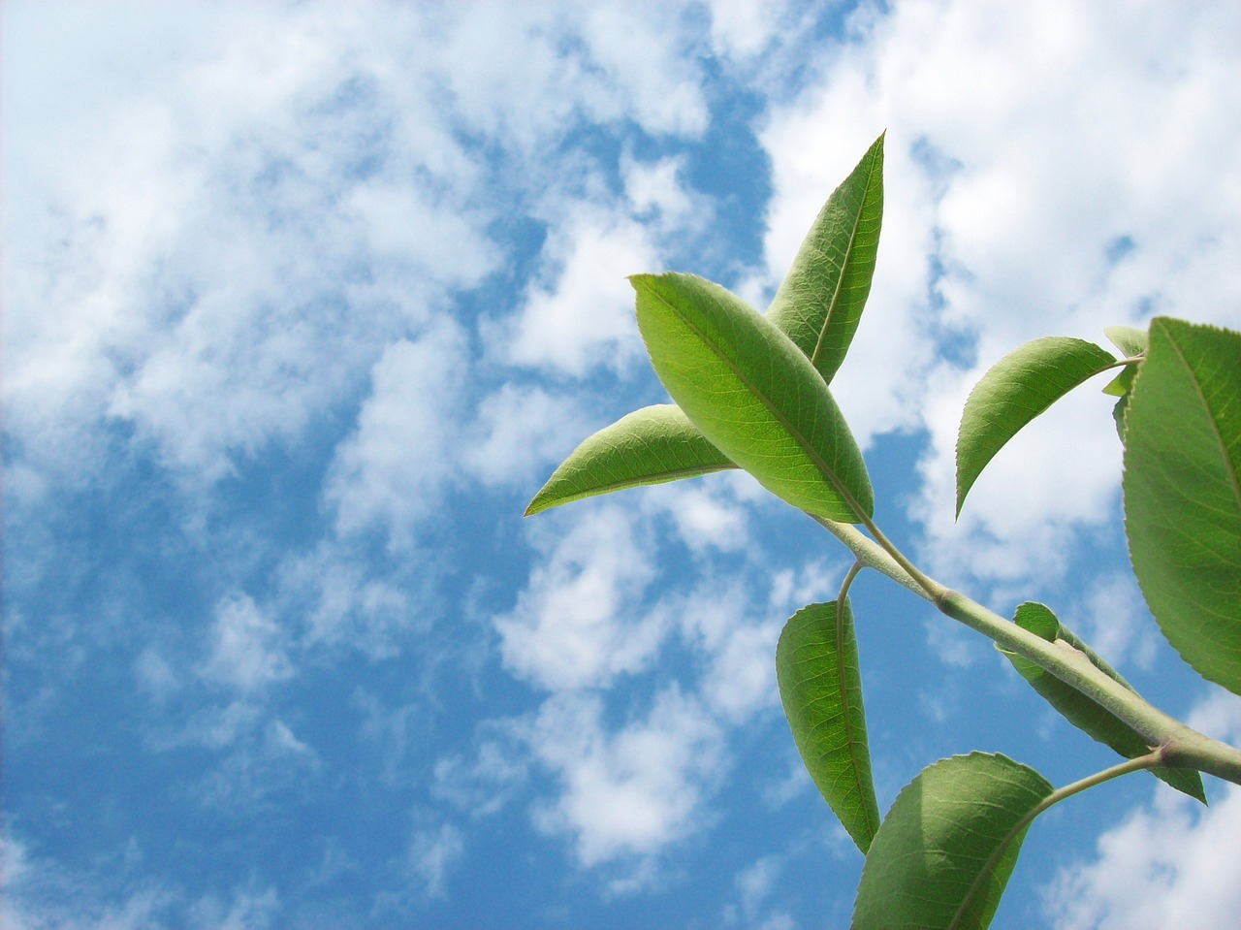
Falgal-celiyeyaasha (reactants) iyo wax-soo-saarka (products) ee sawir-qaadista (photosynthesis)
biyo (water) + neef-karboon-laba-ogsaydh (carbon dioxide) glucose + oksijiin (oxygen)
Mid ka mid ah falgal-celiyeyaasha (reactants) ee sawir-qaadista (photosynthesis) waa neef-karboon-laba-ogsaydh (carbon dioxide).
Dhirtu waxay ka soo qaaddaa neef-karboon-laba-ogsaydh (carbon dioxide gas) hawada, caleemaheeda dhexdooda, si loo sameeyo sawir-qaadista (photosynthesis).
neef-karboon-laba-ogsaydh (carbon dioxide gas)

Slide 23
Falgal-celiyeyaasha (reactants) iyo wax-soo-saarka (products) ee sawir-qaadista (photosynthesis)
biyo (water) + neef-karboon-laba-ogsaydh (carbon dioxide) glucose + oksijiin (oxygen)
Mid ka mid ah wax-soo-saarka (products) ee sawir-qaadista (photosynthesis) waa glucose.
glucose waxaa laga sameeyaa gudaha unugyada caleenta (leaf cells)
Glucose waa nooc sonkor ah, oo ah karbohaydrayt (carbohydrate). Waa cuntada dhirta.
Glucose-ga waxaa la geeyaa qaybaha dhirta oo dhan halkaas oo loo isticmaalo:
il tamar (energy) ahaan
il qalab (materials) ahaan si loo sameeyo unugyo (cells) cusub iyo nud (tissues) cusub oo koritaan (growth) ah.
glucose waxaa loo qaybiyaa qaybaha dhirta oo dhan

Slide 24
Falgal-celiyeyaasha (reactants) iyo wax-soo-saarka (products) ee sawir-qaadista (photosynthesis)
biyo (water) + neef-karboon-laba-ogsaydh (carbon dioxide) glucose + oksijiin (oxygen)
Mid ka mid ah wax-soo-saarka (products) ee sawir-qaadista (photosynthesis) waa oksijiin (oxygen).
Dhirtu waxay sii daysaa oksijiinkan (oxygen) hawada caleemaheeda.
neef-oksijiin (oxygen gas)

Slide 25
Falgal-celiyeyaasha (reactants) iyo wax-soo-saarka (products) ee sawir-qaadista (photosynthesis)
U dhigma walax kasta (substance) doorkeeda (role) sawir-qaadista (photosynthesis).
carbon dioxide (carbon dioxide)
glucose (glucose)
oxygen (oxygen)
biyo (water)
walax (substance)
waxaa sameeya photosynthesis (made by photosynthesis)
loo isticmaalaa photosynthesis (used for photosynthesis)
waxaa sameeya photosynthesis (made by photosynthesis)
loo isticmaalaa photosynthesis (used for photosynthesis)
doorka (role)

Slide 26
Reactants iyo products ee photosynthesis
Ku xidh walax kasta sharaxaadda saxda ah.
carbon dioxide (carbon dioxide)
glucose (glucose)
oxygen (oxygen)
biyo (water)
walax (substance)
reactant (reactant)
product (product)
reactant (reactant)
product (product)
sharaxaad (description)

Slide 27
Reactants iyo products ee photosynthesis
biyo (water) + carbon dioxide glucose + oxygen
Photosynthesis-ku wuxuu u baahan yahay iftiin.
iftiin
Si kastaba ha ahaatee:
Iftiinku ma aha walax (substance).
Iftiinku ma aha fal-celin kiimiko (chemical reactant) ee photosynthesis-ka.
Iftiinku iskuma beddelo wax soo saar (product) inta lagu jiro photosynthesis-ka.
Iftiinka waxaa nuugaya caleemaha
Iftiinku wuxuu bixiyaa tamarta (energy) loo baahan yahay fal-gallada (chemical reactions) kiimikada ee photosynthesis-ka si ay u dhacaan.

Slide 28
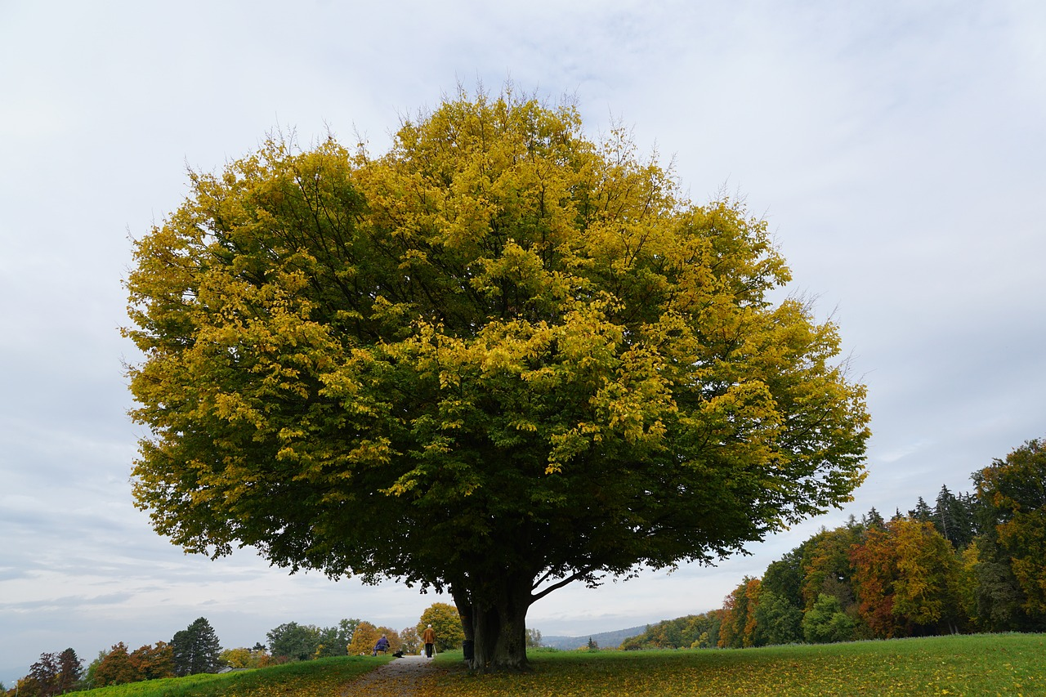
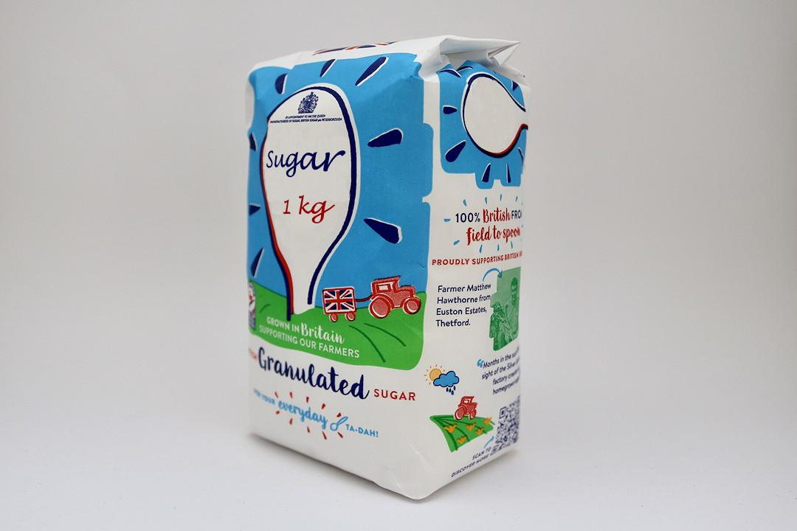
Fal-celiyeyaasha (reactants) iyo wax soo saarka (products) ee photosynthesis-ka
biyo (water) + carbon dioxide glucose + oxygen
Glucose waa nooc sonkor (sugar) ah.
Sonkor shay (bag) ah oo laga iibsaday dukaanku wuxuu leeyahay cuf (mass) dhan 1 kiilogaraam (1 kg).
Imisa sonkor shay (kiilogaraam) ayaad u malaynaysaa in geed weyn uu samayn karo hal maalin oo qorrax leh?

Slide 29
Fal-celiyeyaasha (reactants) iyo wax soo saarka (products) ee photosynthesis-ka
biyo (water) + carbon dioxide glucose + oxygen
Geed weyn wuxuu soo saari karaa ilaa 90 kg oo glucose ah maalin karta photosynthesis-ka.
Inta badan cufka (mass) glucose-gaas wuxuu ka kooban yahay atamka (atoms) kaarboon (carbon).
Dhammaan atamkaas kaarboon (carbon atoms) waxay ka yimaadeen gaasta carbon dioxide ee hawada!

Slide 30
Falgalyada (reactants) iyo waxsoosaarka (products) ee photosynthesis
Dhammeystir weedhaha ku saabsan photosynthesis-ka.
Fal-celiyeyaasha (reactants) ee photosynthesis-ku waa ________________ oo ka yimid hawada iyo __________ oo ka yimid ciidda.
Photosynthesis-ku wuxuu sameeyaa nooc kaarbohaydrayt (carbohydrate) ah oo la yiraahdo __________ oo uu geedku u isticmaalo inuu ka weynaado (grow bigger).
Inta badan cufka (mass) ee karbohaydraytkan (carbohydrate) wuxuu ka kooban yahay atamka __________, kuwaas oo laga soo qaaday hawada.
Jawaabaha:
carbon dioxide
biyo (water)
glucose
carbon

Slide 31
2
Falgalyada (reactants) iyo waxsoosaarka (products) ee photosynthesis
Cabdi wuxuu iibsaday geed yar oo dheri ku jira.
Wuxuu geedka ku hayaa meel qorrax leh.
Wuxuu geedka waraabiyaa marka ciiddu engegto.
4 bilood ka dib geedku aad buu u weyn yahay.
4 bilood ka dib
Waxyaabaha la sameeyo:
Qor waxa geedku soo qaatay si uu u koro.
4 bilood ka dib cufka (mass) geedku wuu kordhay, laakiin cufka ciidda wuxuu ahaa sidii bilowgii. Sharax sababta.

Slide 32
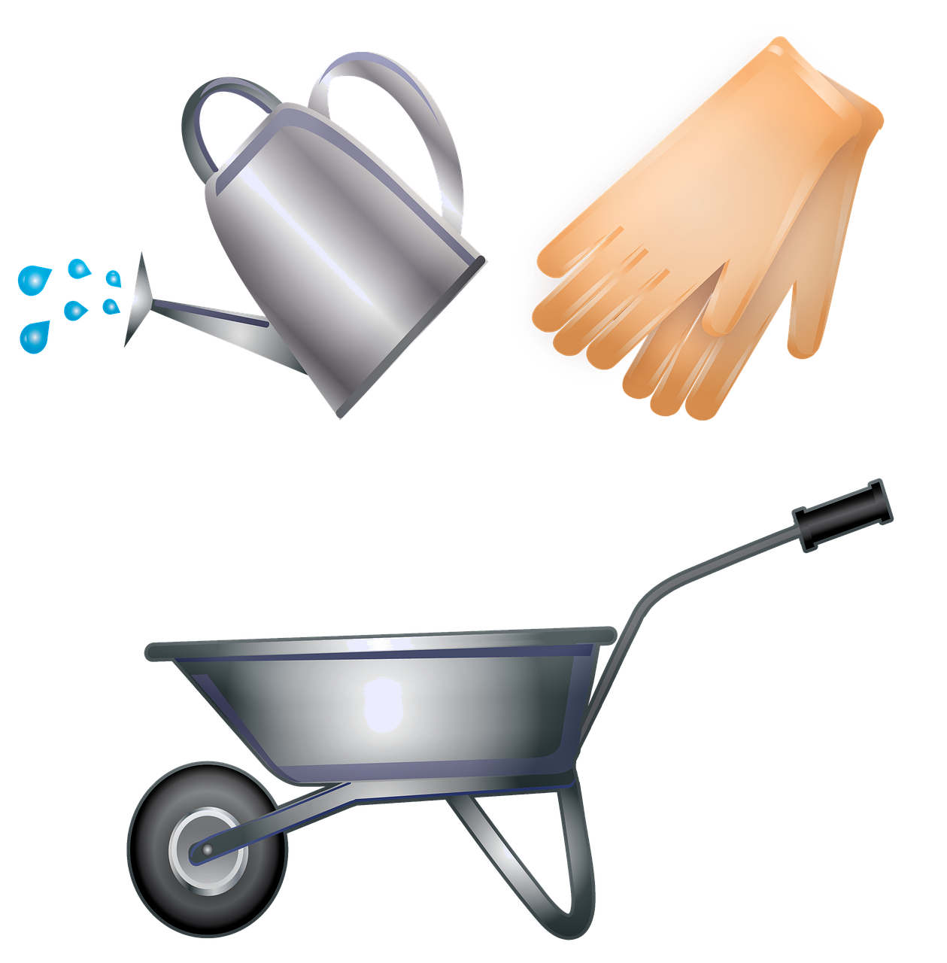

2
Falgalyada (reactants) iyo waxsoosaarka (products) ee photosynthesis
Qor waxa geedku soo qaatay si uu u koro.
Geedku wuxuu soo qaatay biyo (water) (ciidda) iyo carbon dioxide (hawada) si uu u sameeyo photosynthesis. Geedku wuxuu kaloo soo qaatay iftiin si uu u helo tamar (energy) photosynthesis.
2. 4 bilood ka dib cufka (mass) geedku wuu kordhay, laakiin cufka ciidda wuxuu ahaa sidii bilowgii. Sharax sababta.
Cufka (mass) geedku wuu kordhay sababtoo ah wuxuu isticmaalay karbohaydrayt (carbohydrate) ka yimid photosynthesis si uu u sameeyo unugyo (cells) iyo unugyo cusub. Inta badan cufka karbohaydraytkan wuxuu ka yimid carbon dioxide hawada. Geedku wuxuu soo qaatay biyo (water) ciidda, laakiin biyahan waa la beddelay marka cufka ciidda ma dhiman.

Slide 33
Photosynthesis
Soosaarayaashu (Producers) waxay sameeyaan cuntadooda iyagoo isticmaalaya hab loo yaqaan photosynthesis.
Sawir-qaadasho (Photosynthesis) waxay dhacdaa oo kaliya marka iftiin (light) jiro.
Sawir-qaadasho (Photosynthesis) waa taxane falgal (reactions) kiimiko ah oo ka dhaca unugyada dhirta (plant cells) gudahood.
Waxyaabaha falgala (reactants) ee sawir-qaadashada (photosynthesis) waa biyo (water) iyo carbon dioxide.
Waxyaabaha soo baxa (products) waa oksijiin (oxygen) iyo gulukoos (glucose) (karbohaydrayt (carbohydrate)).
Soo koobid erey ah oo ku saabsan waxyaabaha falgala (reactants) iyo waxyaabaha soo baxa (products) ee sawir-qaadashada (photosynthesis) waa:
biyo (water) + carbon dioxide gulukoos (glucose) + oksijiin (oxygen)

