Slide 1
Tijaabo (experiment): milan (solution) indhaha cas (red cabbage indicator)
Aashito iyo sal (Acids and bases)

Slide 2
Sida agabkeena waxbarasho loogu talagalay fasalka

Slide 3
Waxaan samayn karaa milan (solution) indhaha cas (red cabbage indicator) oo waxaan u isticmaali karaa inaan ku tijaabiyo milannada (solutions) si aan u ogaado inay yihiin aashito ama alkali.

Slide 4
moos iyo haan (pestle and mortar)
tilmaame kiimiko (chemical indicator)
miisaanka pH (pH scale)
tilmaame guud (universal indicator)
milan (solution)

Slide 5
Moos iyo haan (pestle and mortar) waa qalab loo isticmaalo in lagu burburiyo oo lagu shiido walxaha. Moosku waa ul lagu shiido, haankuna waa weel culus.
Tilmaame kiimiko (chemical indicator) waa kiimiko beddela midabkiisa si uu u muujiyo joogitaanka walax, tusaale ahaan haddii milanku yahay aashito ama alkali.
Miisaanka pH (pH scale) waa miisaan u dhexeeya 1 ilaa 14 oo loo isticmaalo in lagu cabbiro aashitada ama alkalinta milannada (solutions); pH7 waa milannada dhexdhexaadka ah.
Tilmaame guud (universal indicator) waa milan (solution) ama warqad u beddesha midabyo kala duwan iyadoo ku xiran pH-ga milanka.
Milan (solution) waxaa la sameeyaa marka walax ku milato dareere.

Slide 6

Tijaabo (experiment): milan (solution) indhaha cas (red cabbage indicator)
Samaynta tilmaame (indicator)
Tijaabinta tilmaamayaasha (indicators)

Slide 7
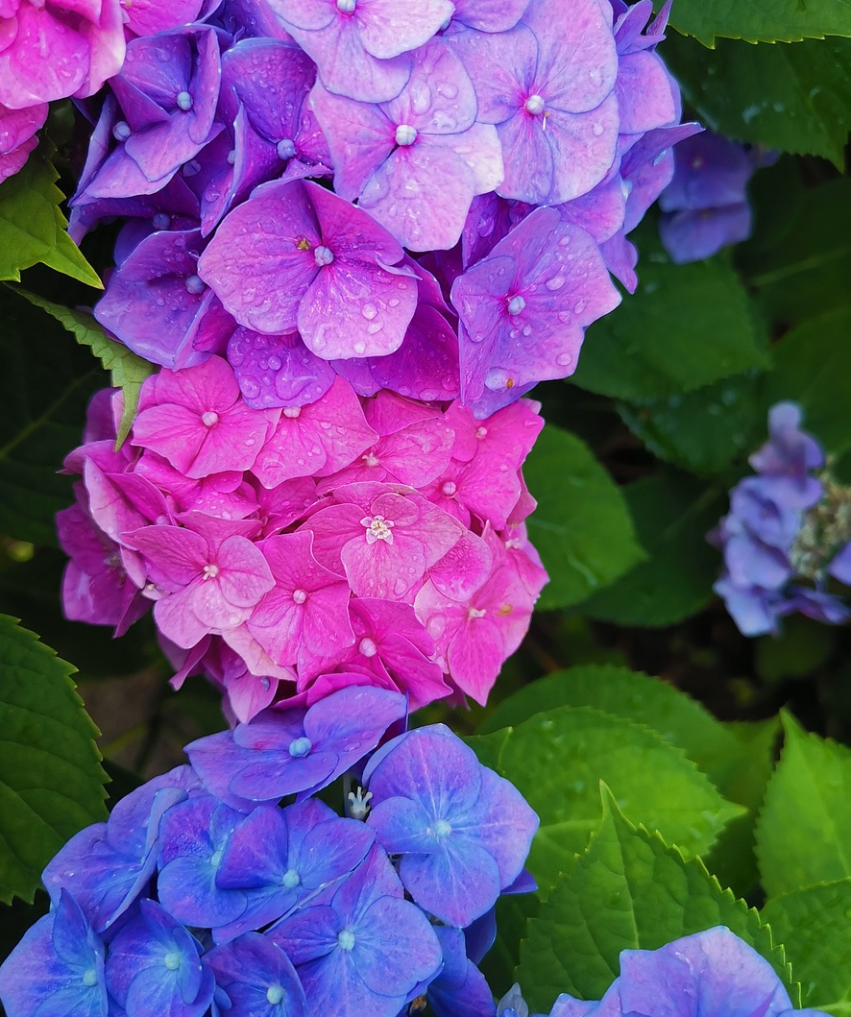
Samaynta tilmaame (indicator)
Ubaxyo, khudaar iyo faakiha badan oo midabyo dhalaalaya leh waxay ka kooban yihiin kiimikooyin loo yaqaan midabaynta (colourants) kuwaas oo beddeli kara midabkooda marka ay ku jiraan milannada (solutions) pH kala duwan.
Ubaxa Hydrangea wuxuu leeyahay midabyo kala duwan iyadoo ku xiran pH-ga ciidda uu ku korayo.
Qaar ka mid ah ubaxyada, khudaarta iyo faakihaha ayaa midabayntooda (colourants) la soo saari karaa oo loo isticmaali karaa tilmaame (indicator) si loo tijaabiyo milannada (solutions) aashitada ama alkalinta.
Ubaxa Hydrangea

Slide 8

Samaynta tilmaame (indicator)
Milan (solution) tilmaame (indicator) waxaa laga samayn karaa ubaxa.
Midabada dhammaan ubaxa waxaa laga samayn karaa milan (solution) is beddela haddii lagu daro aashito (acids) ama basaas (alkalis).
Midabada qaar ka mid ah ubaxa waxaa laga samayn karaa milan (solution) is beddela haddii lagu daro aashito (acids) ama basaas (alkalis).

Slide 9
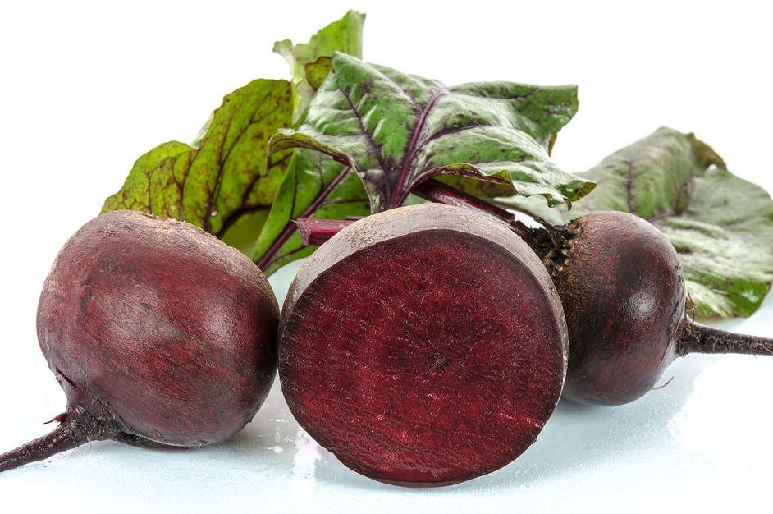
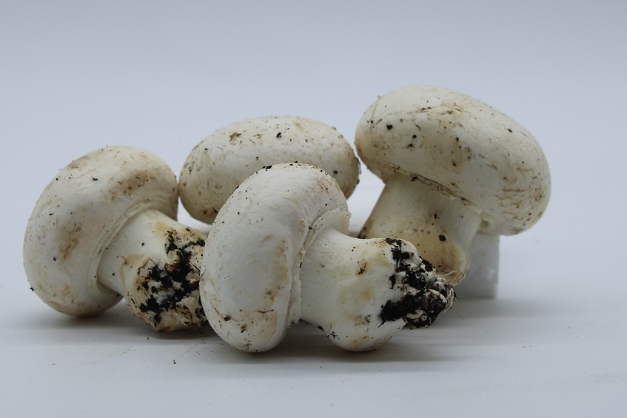
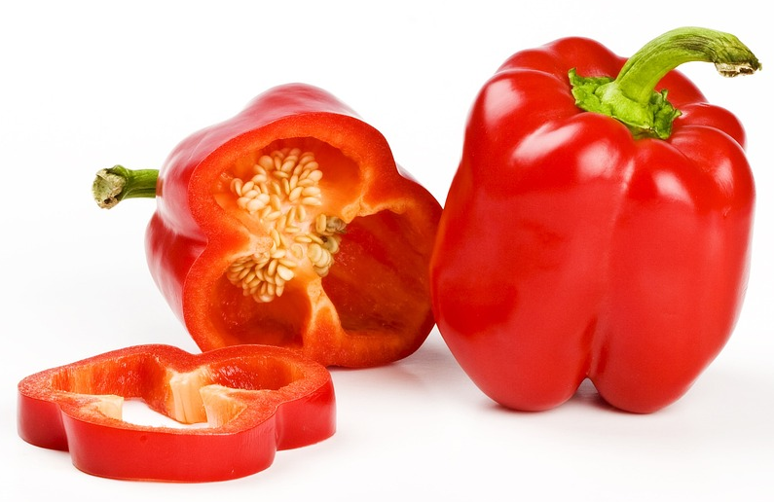
Samaynta tilmaame (indicator)
Khudaarta(s) kee / kuwee u badan yihiin tilmaame (indicator) wanaagsan?
beetroot
mushroom
pepper

Slide 10
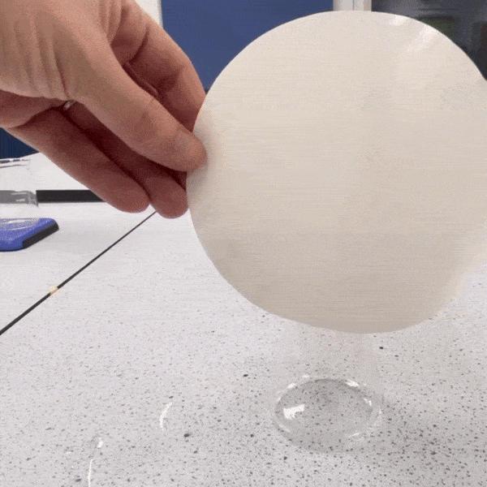
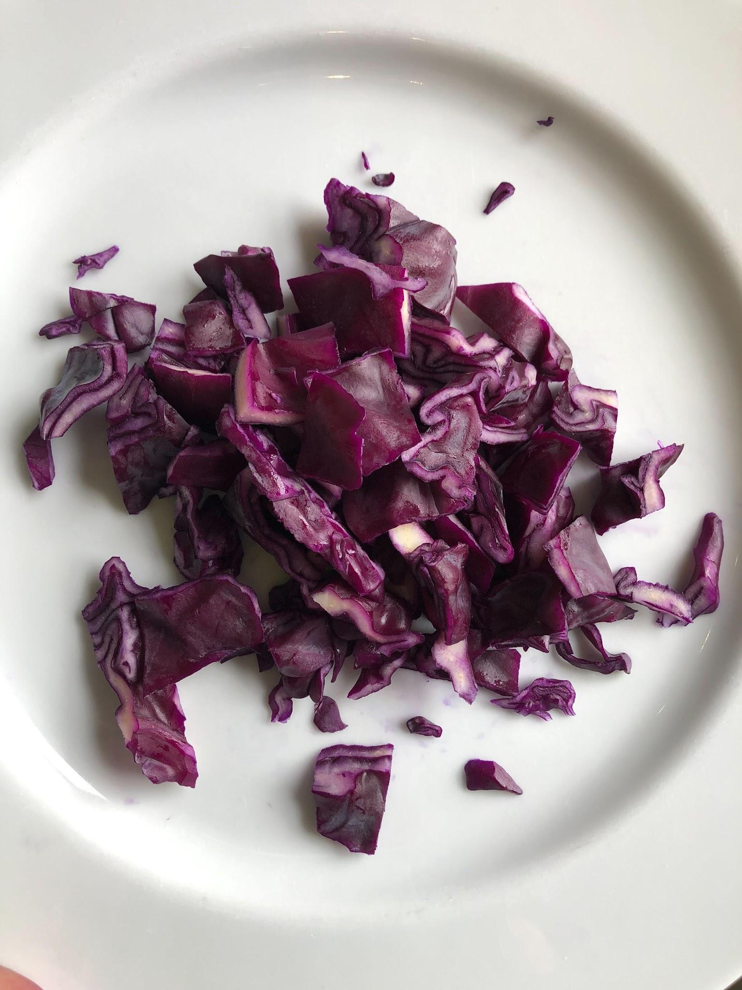
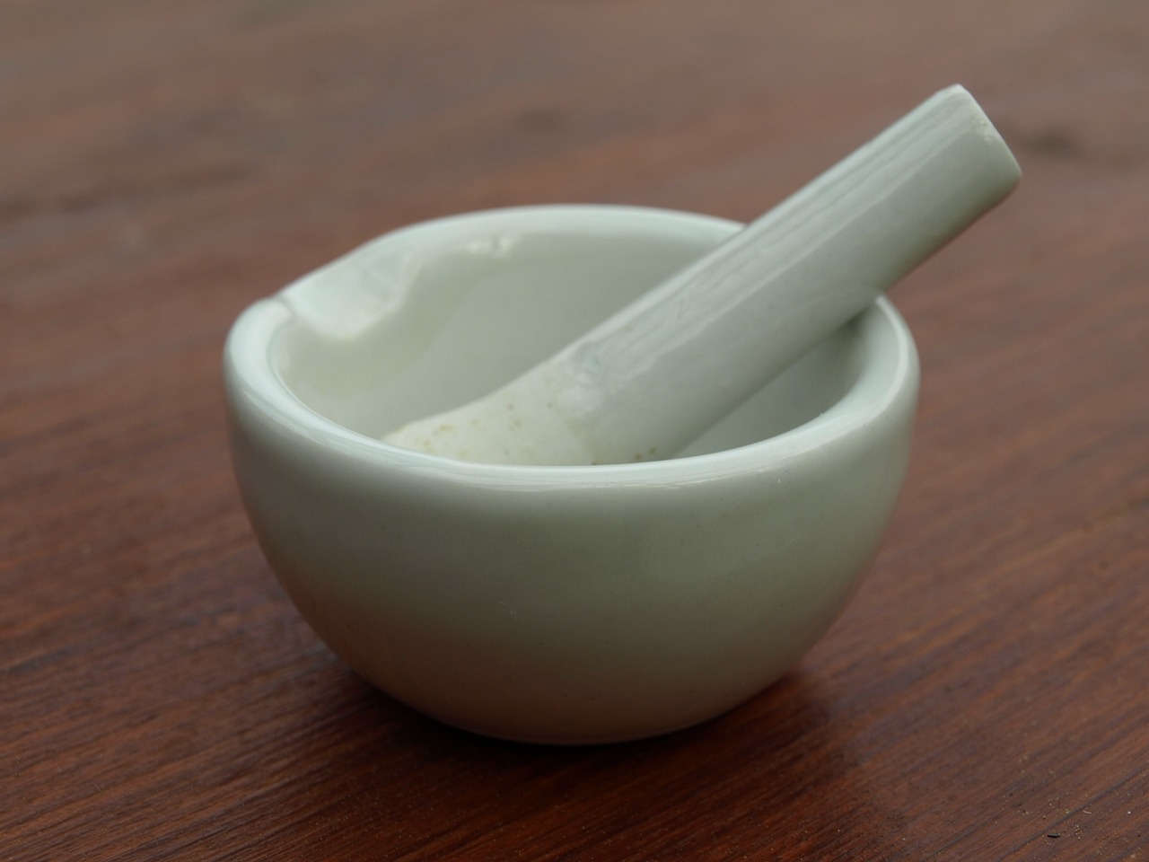
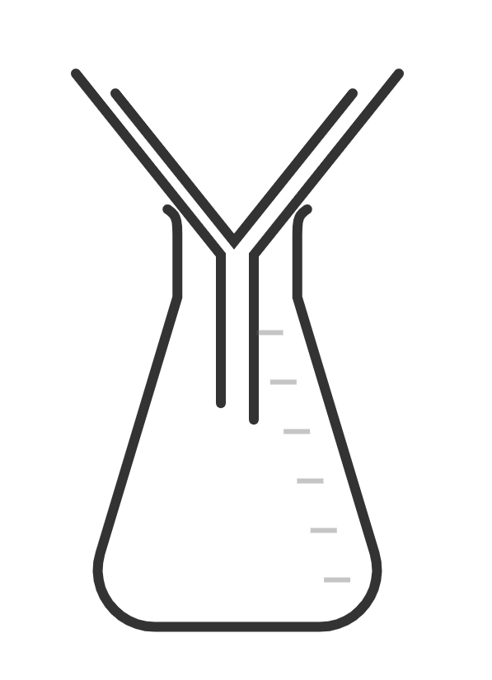
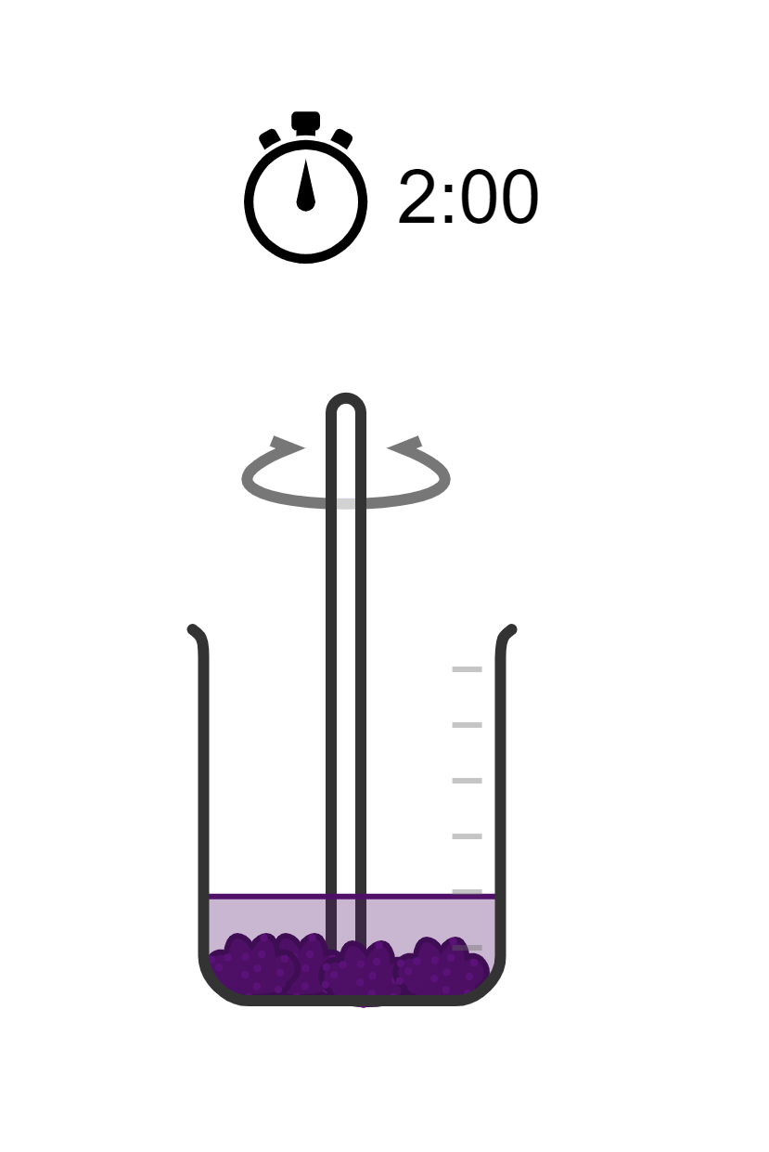
Samaynta tilmaame (indicator)
Si loo sameeyo tilmaame (indicator) ka sameysan kaabaj cas waxaad u baahan doontaa:
kaabaj cas oo jarjar ah (chopped red cabbage)
hoormo iyo sibiriir (mortar and pestle)
biyo (water) kulul oo ka yimid kettel (kettle)
beaker
laabista warqadda shaandhaynta (folding filter paper)
warqad shaandhayn (filter paper)
funnel
conical flask
stirring rod

Slide 11
Samaynta tilmaame (indicator)
Habka loo sameeyo tilmaame (indicator) kaabaj cas waa sida soo socota:
Jajabka kaabajka ee la jarjaray ku burburi 2-3 daqiiqo adoo isticmaalaya moos iyo sibidh (mortar and pestle).
Kaabajka la burburiyay ku wareeji beaker (beaker).
Ku shub biyo (water) kulul oo ka yimid kettled ilaa uu qariyo kaabajka la burburiyay. Ha ku darin biyo (water) badan ama waxaad samayn doontaa indicator midabkiisu aad u fudud yahay.
Walaaq kaabajka iyo biyaha (water) isku darka ah adoo isticmaalaya ul walaaqid (stirring rod) 2 daqiiqo ilaa biyuhu (water) isku beddelaan midab guduudan (purple).
Shaandhee (filter) isku darka kaabajka iyo biyaha (water). Hay biyaha (water) midabka leh, kani waa indicator-kaaga kaabajka guduudan.

Slide 12
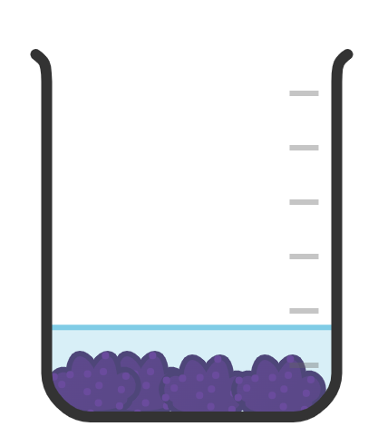
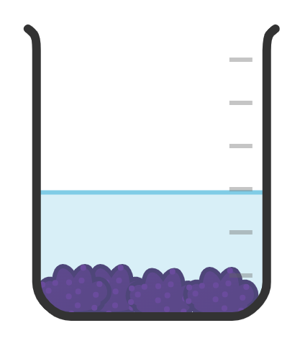
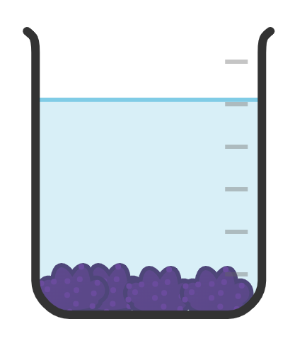
Samaynta indicator (indicator)
Waa maxay mugga (volume) ugu fiican ee biyaha (water) lagu daro kaabajka guduudan si loo sameeyo indicator?

Slide 13
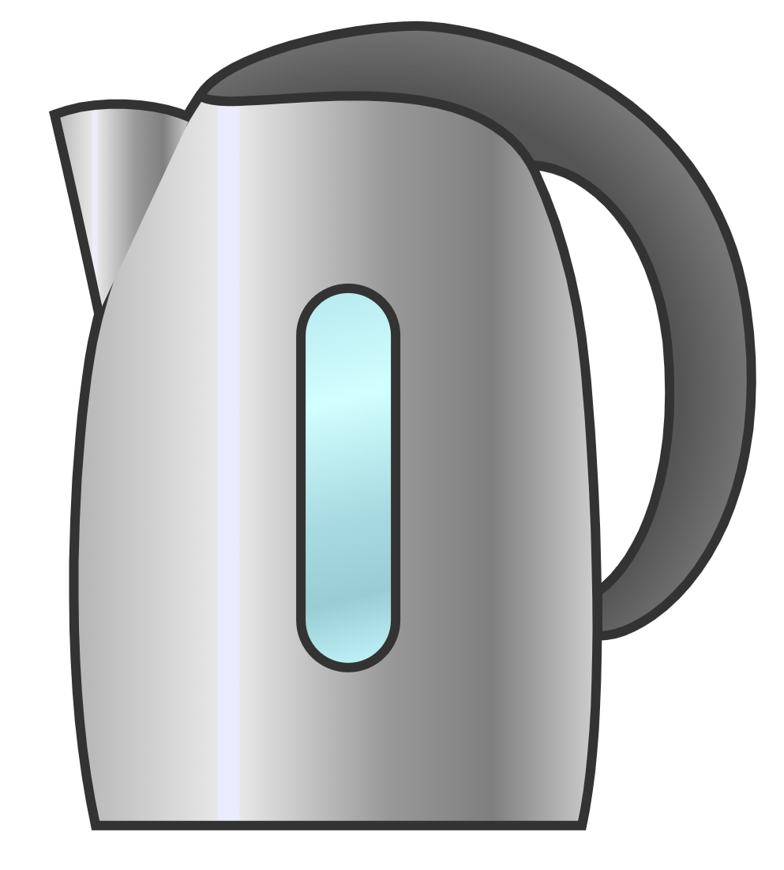

Samaynta indicator (indicator)
Qalabkee ayaa loo isticmaalaa in lagu kala saaro qaybaha kaabajka guduudan iyo milanka (solution) indicator-ka?

Slide 14
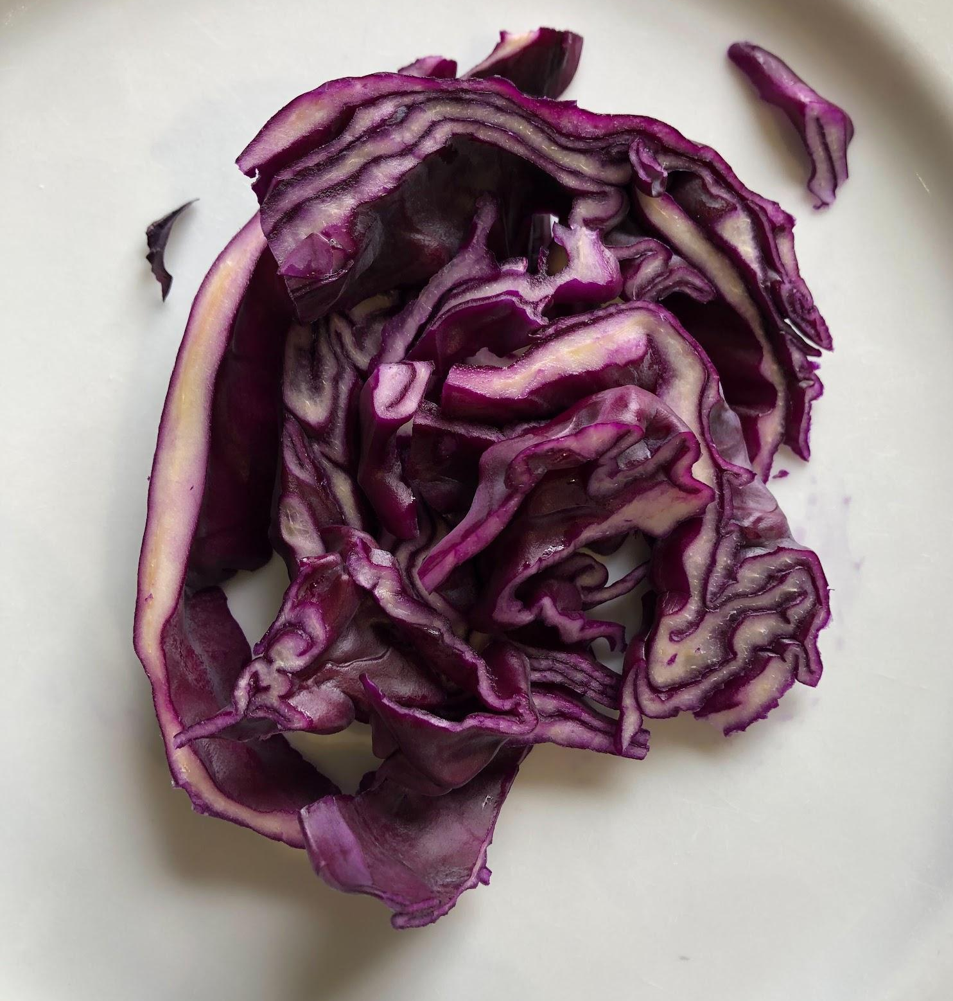
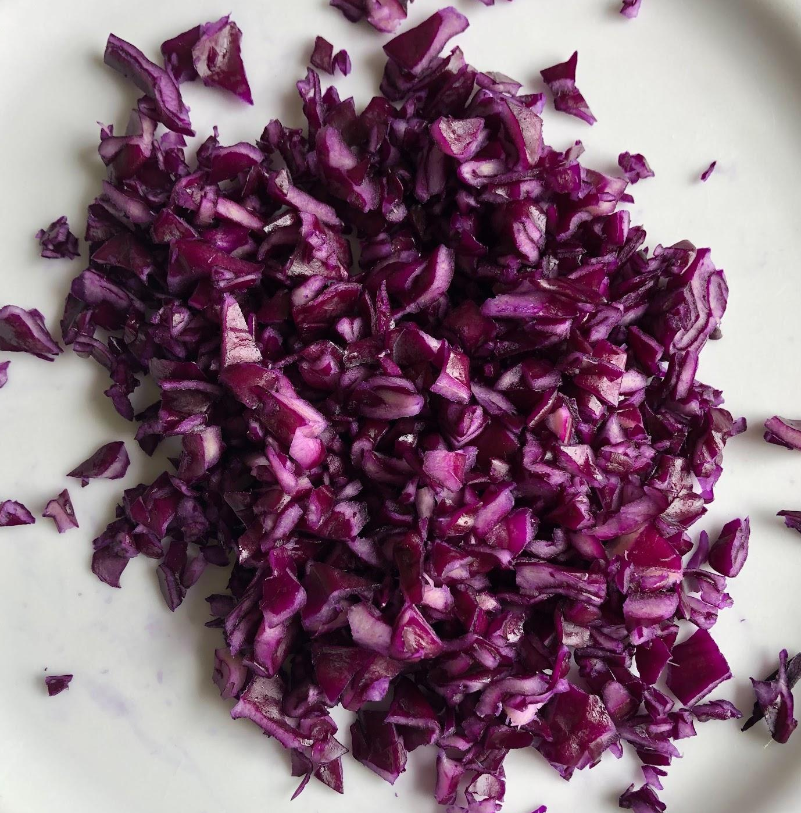
Samaynta indicator (indicator)
Waa maxay cabbirka (size) ugu fiican ee qaybaha kaabajka guduudan si loo sameeyo indicator?

Slide 15
Samaynta indicator (indicator)
Maxaad uga taxaddari kartaa inaadan ku darin biyo (water) badan kaabajka la burburiyay?
Milan (solution) indicator-ku wuxuu noqon doonaa mid midabkiisu aad u madow yahay.
Milan (solution) indicator-ku wuxuu noqon doonaa mid midabkiisu aad u fudud yahay.
Milan (solution) indicator-ku wuxuu noqon doonaa mid aad u falgala (reactive).

Slide 16
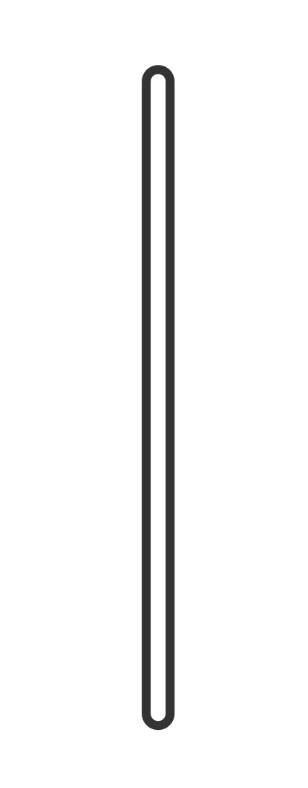
Samaynta indicator (indicator)
Isku xidh qalabka iyo sawirka iyo sharaxaadda.
qayb (funnel)
halka warqadda shaandhaynta (filter paper) la dhigo si loo shaandheeyo (filtration)
tus (pestle)
weelka 'bowl' ah oo lagu shiido kaabajka cas si loo sameeyo qaybo yaryar
galaas koonti (conical flask)
loo isticmaalo in lagu walaaqo isku darka kaabajka guduudan iyo biyaha (water)
hooy shiid (mortar)
loo isticmaalo in lagu burburiyo kaabajka guduudan si loo soo saaro midabka (colourant)
ul walaaq (stirring rod)
loo isticmaalo in lagu kala saaro kaabajka la burburiyay iyo milanka (solution) midabka leh
warqad shaandho (filter paper)
halkan waxaa lagu ururiyaa milan (solution) midabka leh

Slide 17
Samaynta tilmaame (indicator)
Isku dhig qalabka sawirka iyo sharaxaadda.
qayb (funnel)
halka warqadda shaandhada (filter paper) la dhigayo shaandhaynta (filtration)
tus (pestle)
weelka 'bowl' ah oo lagu shiido kaabajka cas si loo sameeyo qaybo yaryar
galaas koonti (conical flask)
loo isticmaalo in lagu walaaqo isku darka kaabajka cas iyo biyaha (water)
hooy shiid (mortar)
loo isticmaalo in lagu shiido kaabajka cas si loo soo saaro midabaynta (colourant)
ul walaaq (stirring rod)
loo isticmaalo in lagu kala saaro kaabajka la shiiday iyo milanka (solution) midabka leh
warqad shaandho (filter paper)
halkan waxaa lagu ururiyaa milanka (solution) midabka leh

Slide 18
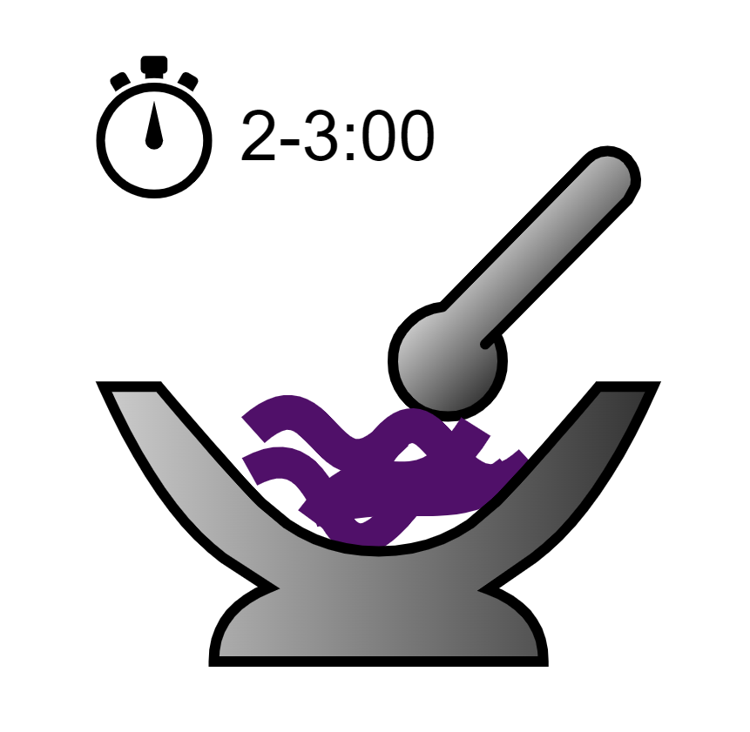
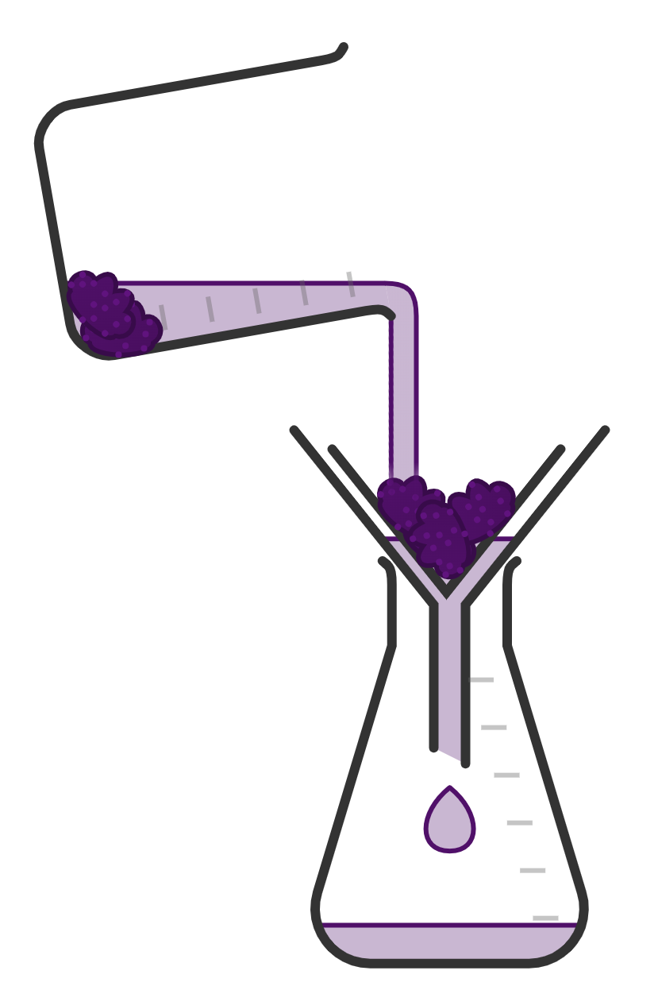
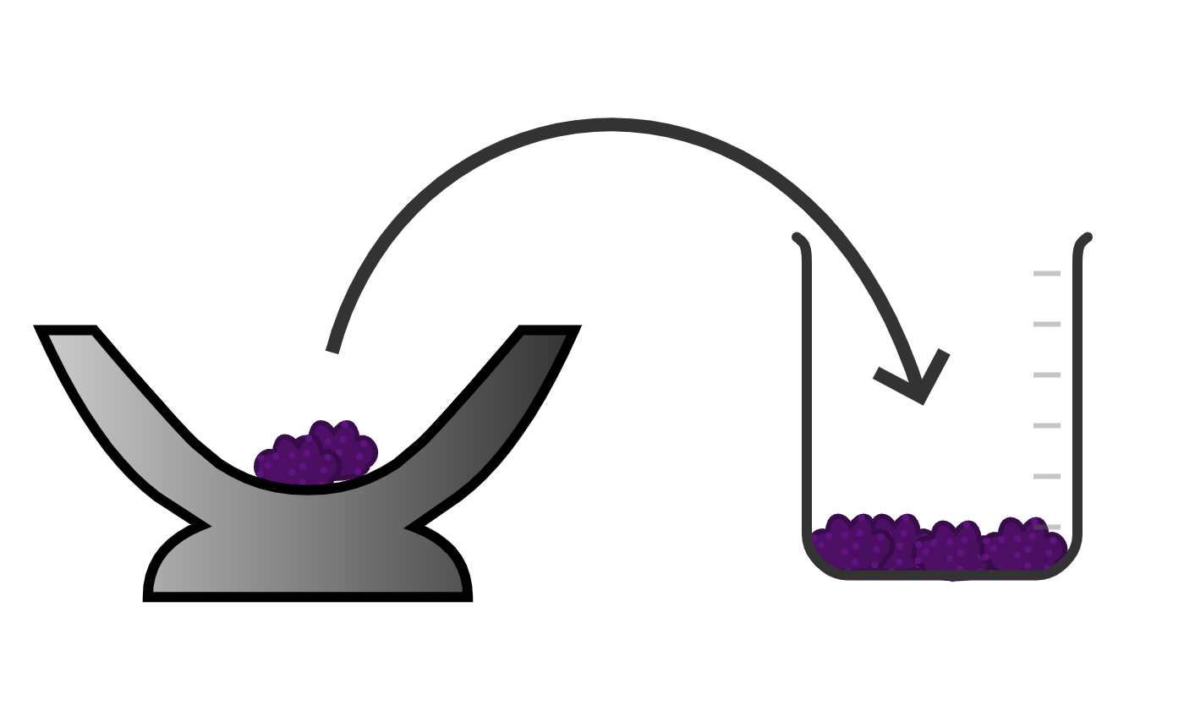
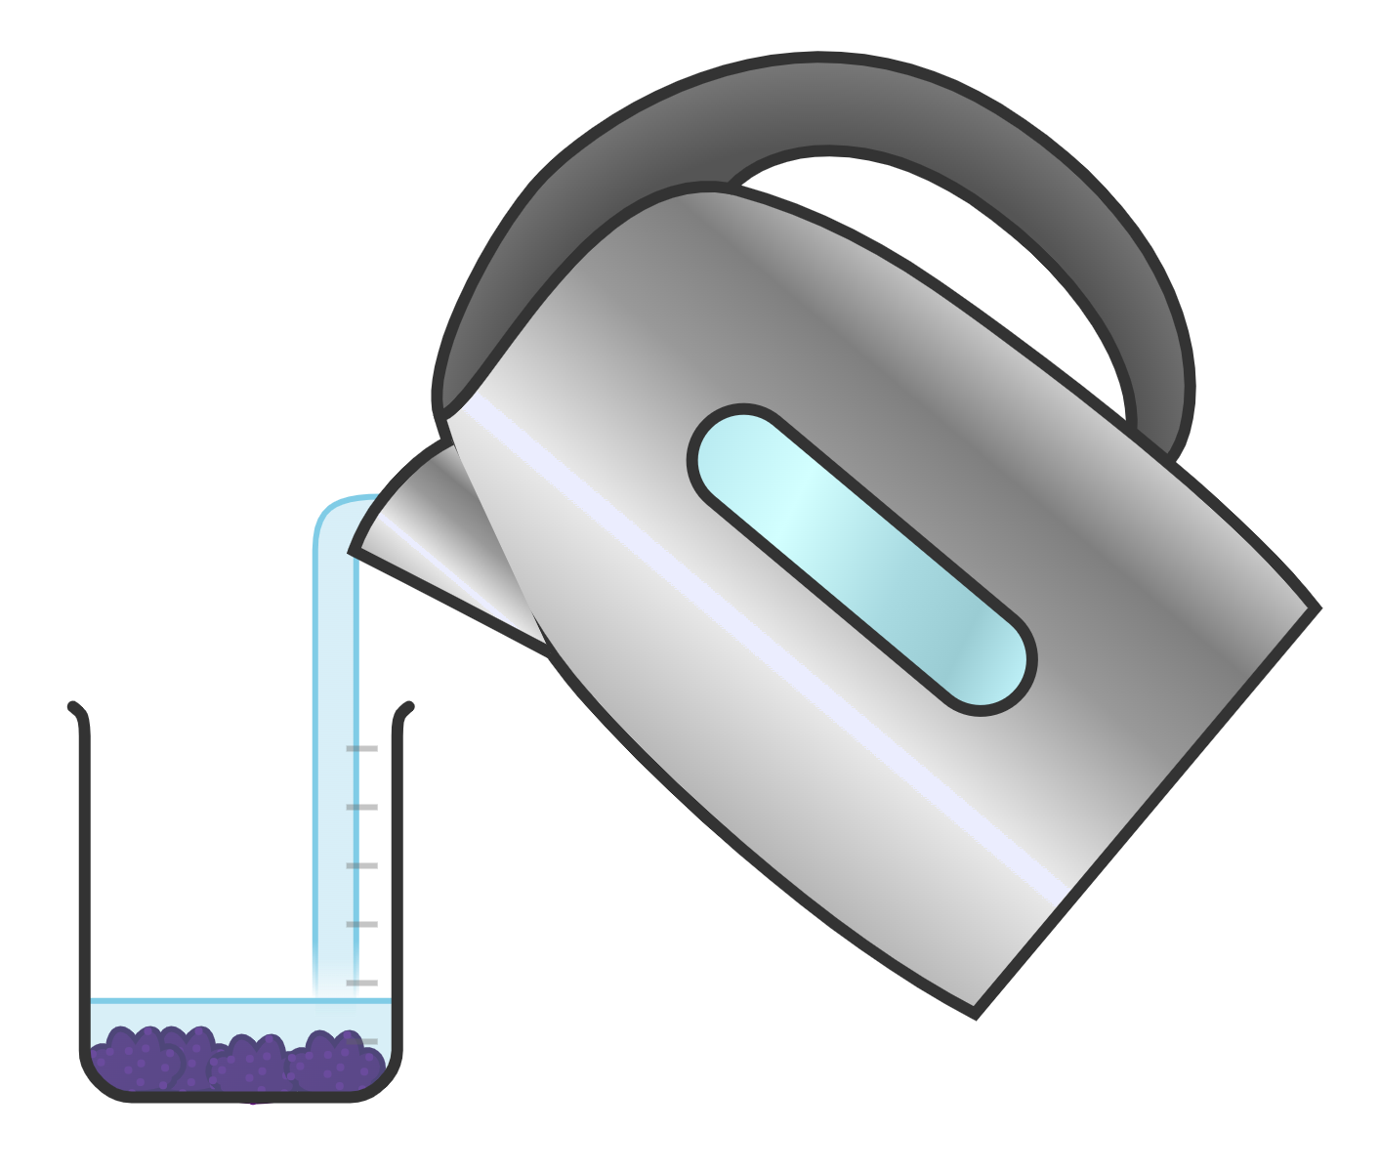
Samaynta indicator (indicator)
2) Qor hab 5-tallaabo ah oo lagu sameeyo indicator (indicator). Isticmaal sawirada si ay kuu caawiyaan.
a.
b.
e.
c.
d.
hay

Slide 19
Samaynta indicator (indicator)
2) Qor hab 5-tallaabo ah oo lagu sameeyo indicator (indicator). Isticmaal sawirada si ay kuu caawiyaan.
Isticmaal pestle iyo mortar (pestle and mortar) si aad u jajabiso kaabajka cas 2-3 daqiiqo.
Geli kaabajka la jajabiyay gudaha beaker (beaker).
Ku dabool kaabajka la jajabiyay biyo kulul (hot water).
Walaaq kaabajka la jajabiyay iyo biyaha (water) isku darka 2 daqiiqo.
Shaandheey isku darka kaabajka oo hay milanka (solution) midabka leh.

Slide 20
Samaynta indicator (indicator)
Samee tijaabada (experiment) si aad u diyaariso milanka (solution) indicator (indicator) ee adiga kuu gaar ah.
Isticmaal mortar iyo pestle (mortar and pestle) si aad u jajabiso kaabajka cas 2-3 daqiiqo.
Geli kaabajka la jajabiyay gudaha beaker (beaker).
Ku dabool kaabajka la jajabiyay biyo kulul (hot water).
Walaaq kaabajka la jajabiyay iyo biyaha (water) isku darka 2 daqiiqo.
Shaandheey isku darka kaabajka oo hay milanka (solution) midabka leh.

Slide 21
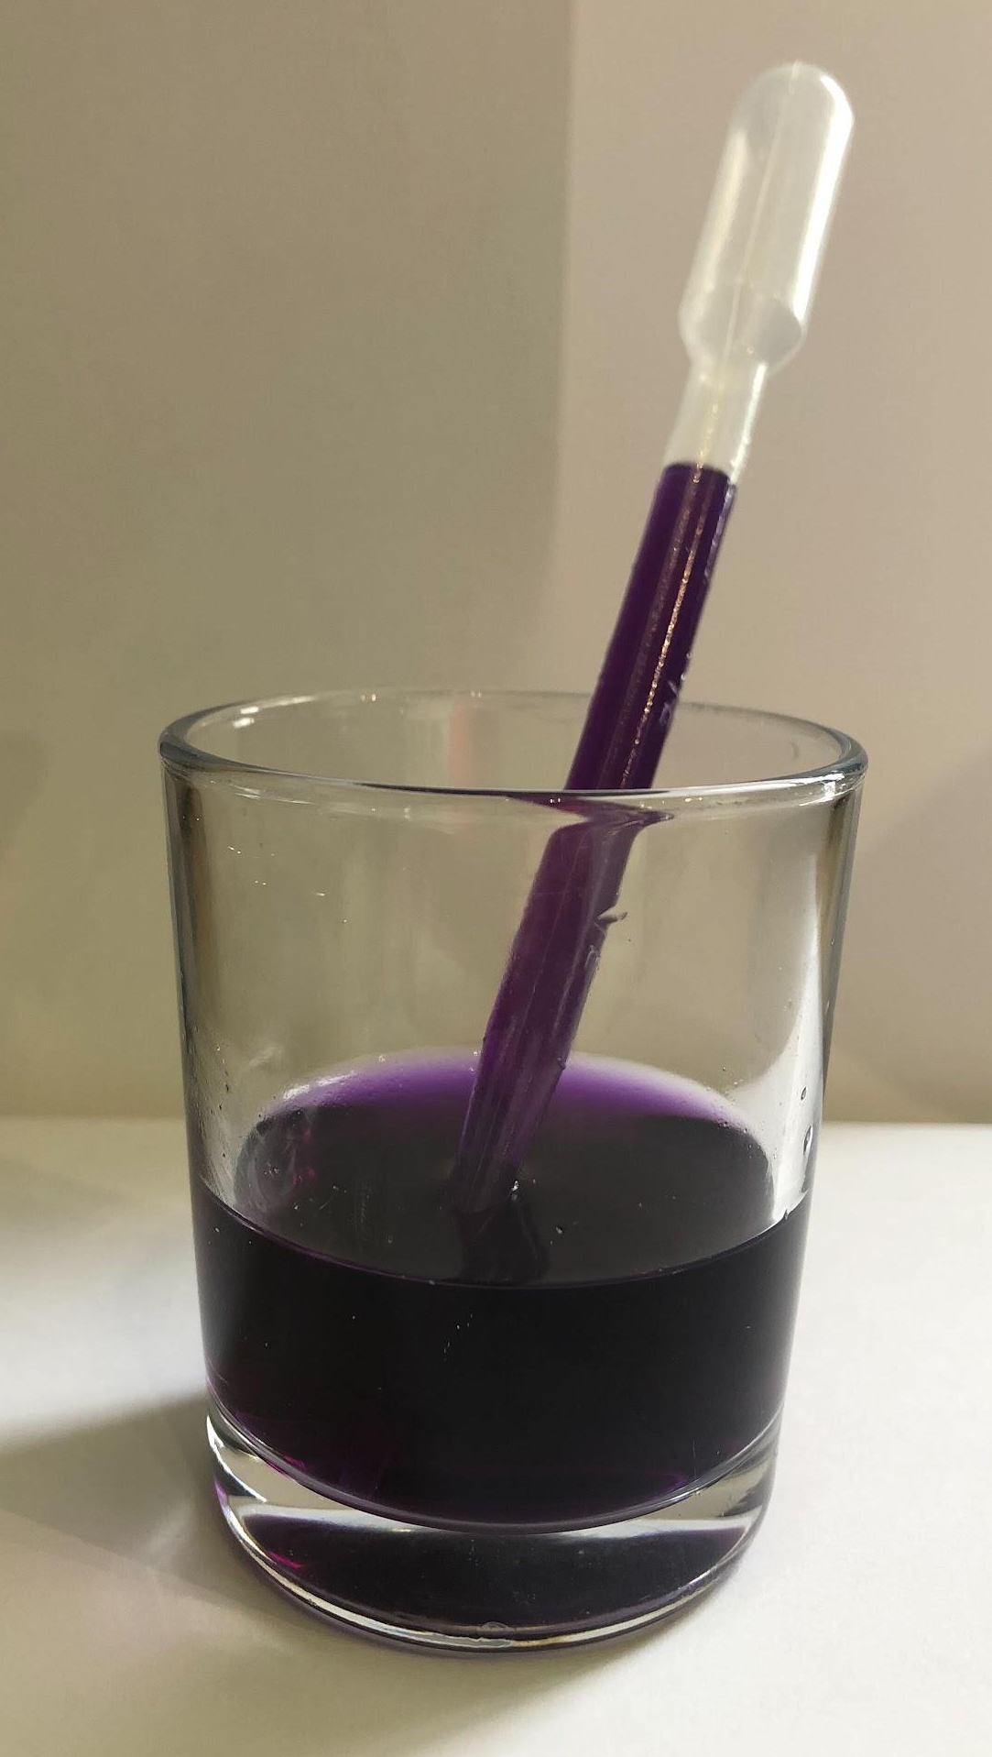
Samaynta indicator (indicator)
Waa inaad haysataa milan (solution) indicator (indicator) kaabaj cas oo u eg sidan:
Midabka guduudan ee qoto dheer, waa ka fiican yahay milanka (solution) indicator (indicator) kaabajka cas.

Slide 22
Tijaabo (experiment): milan (solution) kaabajka guduudka ah
Samaynta indicator (indicator)
Tijaabinta indicators (indicators)

Slide 23
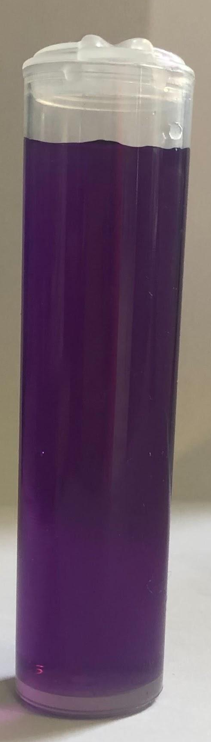

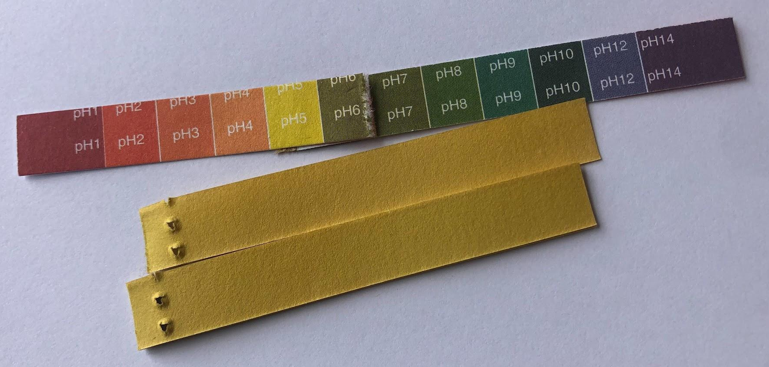
Tijaabinta (testing) indicators-ka
Indicators-ka waxaa laga tijaabin (experiment) karaa iyadoo lagu daro milan (solution) kala duwan oo kale loo fiirsado isbeddelka midabada.
Si loo tijaabiyo (test) indicators-ka, waxaad u baahan doontaa:
milan (solution) kala duwan oo leh heerar pH kala duwan
indicators:
warqadda litmus guduudan iyo buluug
milan (solution) kaabajka guduudka ah
milan (solution) ama warqad universal indicator
pipette
saxan (spotting tile)

Slide 24
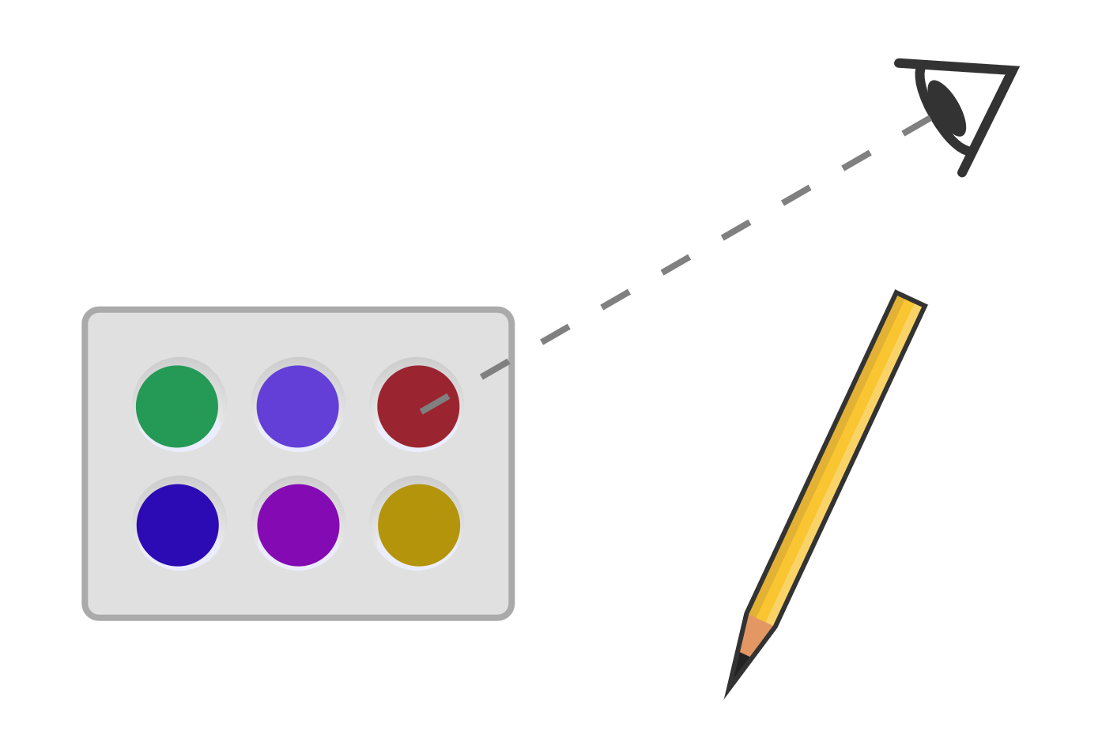
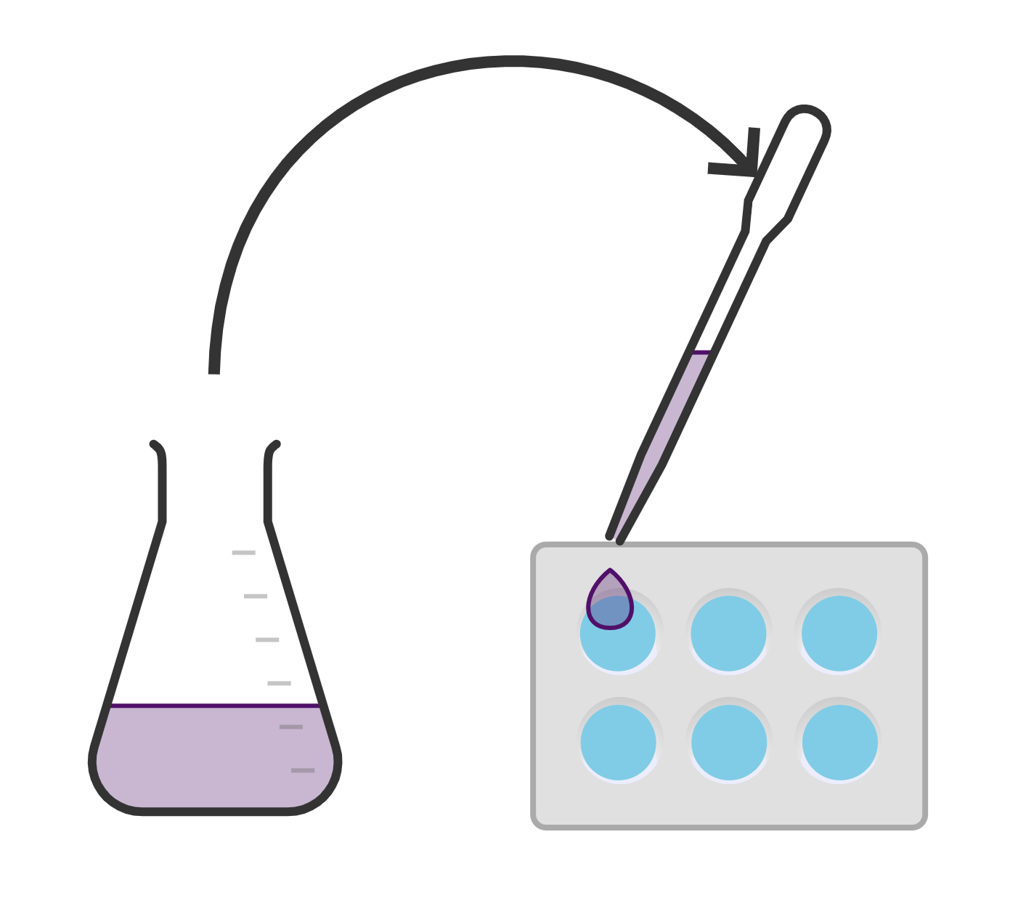
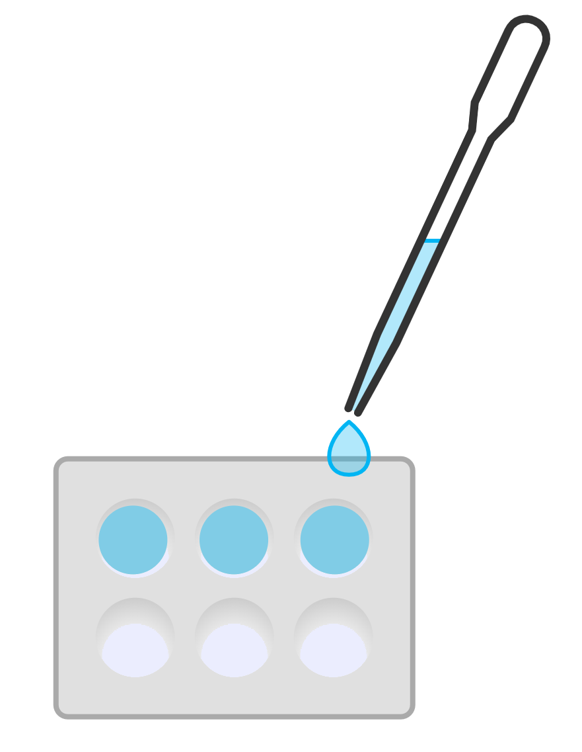
Tijaabinta (testing) indicators-ka
Habka (Method):
Geli 3-4 dhibic oo pH solution kasta ah godadka (wells) saxanka (spotting tile).
Qor midabka milan (solution)-ka.
Ku dar milan (solution) indicator (2-3 dhibic) ama warqad indicator godka (well).
Ku celi pH solution-yada kale iyo indicators-ka kale.

Slide 25
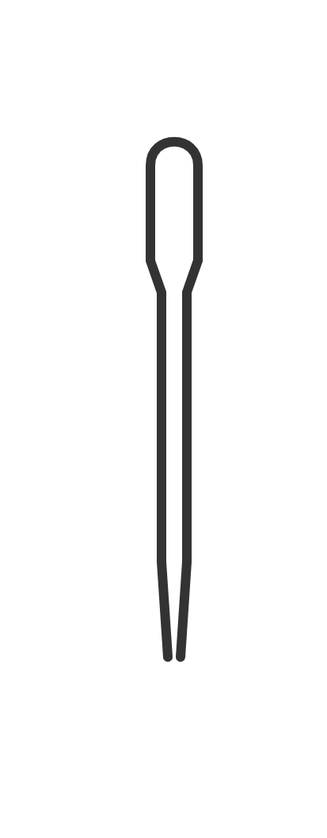

Tijaabinta (testing) indicators-ka
Qalabkee ayaa loo isticmaalaa in lagu shubo solutions-ka iyo indicators-ka godadka (wells) saxanka (spotting tile)?

Slide 26
Tijaabinta (testing) indicators-ka
Maxaa tahay inaad ku qorto shaxda natiijooyinka (results table)?
Tirada dhibcaha pH solution-ka la tijaabinayo (testing) ee lagu shubay godka (well) saxanka (spotting tile).
Tirada dhibcood ee milan (solution) indicator-ka lagu shubo ceelka saxanka tijaabada (spotting tile).
Kaliya midabka milanka (solution) ka hor inta aan lagu darin milanka indicator-ka / warqadda indicator-ka.
Kaliya midabka milanka (solution) / warqadda indicator-ka ka dib marka lagu daro milanka indicator-ka / warqadda indicator-ka.

Slide 27
Tijaabinta indicators-ka
Samee tijaabada (experiment) adigoo raacaya tilmaamaha macallinkaaga si aad u barbardhigto indicators kala duwan.
indicator | midabka indicator-ka marka lagu daro milanka (solution)
 | pH2 | pH4 | pH7 | pH9 | pH11
litmus guduud (red litmus)
litmus buluug (blue litmus)
indicator guud (universal indicator)
kaabashka guduud (red cabbage)

Slide 28
Tijaabinta indicators-ka
Natiijooyinkaagu waxay u ekaan karaan kuwan:
indicator | midabka indicator-ka marka lagu daro milanka (solution)
 | pH2 | pH4 | pH7 | pH9 | pH11
litmus cas (red litmus)
litmus buluug (blue litmus)
indicator guud (universal indicator)
kaabaj cas (red cabbage)
Jawaabaha:
buluug khafiif (light blue)
buluug madow (dark blue)
jaalle
oranji
cagaar
cagaar
guduudan
biriin
biriin
cagaar
cas
cas
cas
buluug
buluug
cas
cas
buluug
buluug
buluug

Slide 29
Tijaabinta indicator-yada
2) Qor gabagabo (conclusion) tijaabada (experiment) indicator-ka. Keeb/kuwee indicator-yada aad u malaynaysaa inay bixiyeen natiijooyinka ugu fiican tijaabadan (experiment) iyo kuwee ayaa ahaa kuwa ugu waxtarka yar?
Indicator-ka/kuwa ugu fiican wuxuu/ay ahaayeen __________. Faa'iidooyinka isticmaalkiisa/ooda waa ...
Indicator-ka/kuwa ugu waxtarka yar wuxuu/ay ahaayeen __________. Khasaarooyinka isticmaalkiisa/ooda waa ...

Slide 30
Tijaabinta indicator-yada
Gabagabadaada (conclusion) waxay la mid noqon kartaa tan:
Indicator-ka ugu fiican wuxuu ahaa universal indicator. Faa'iidada isticmaalkiisa waxay ahayd inay fududayd in la arko dhammaan milan-yada (solutions) pH ee kala duwan, sababtoo ah mid kastaa wuxuu lahaa midab kala duwan.
Indicator-yada ugu waxtarka yar waxay ahaayeen litmus guduudan iyo buluug. Khasaaraha isticmaalkooda waxay ahayd in litmus guduudan aadan ku garan karin farqiga u dhexeeya pH7 (dhexdhexaad), pH2 iyo 4 (ashito) milan-yada (solutions) iyo litmus buluug ee u dhexeeya pH7, pH9 iyo pH11 (alkaline) milan-yada (solutions).
Indicator-ka ugu waxtarka yar wuxuu ahaa kaabashka guduudan (red cabbage). Khasaaraha isticmaalkiisa waxay ahayd inaadan ku garan karin farqiga u dhexeeya pH2 iyo pH4 (ashito) milan-yada (solutions) iyo sidoo kale pH9 iyo 11 (alkaline) milan-yada (solutions).

Slide 31
Fasal (Practical): milan-ka (solution) indicator-ka kaabashka guduudan (red cabbage)
Milan-ka (solution) kaabashka guduudan (red cabbage) wuxuu noqdaa biriin ama guduudan marka uu yahay acid, purple marka uu yahay milan (solution) dhexdhexaad, iyo cagaar marka uu yahay alkali.
Universal indicator wuxuu u rogi doonaa midabyo badan oo kala duwan iyadoo ku xiran pH.
Indicator-yada kiimikada ee kala duwan waxay leeyihiin faa'iidooyin iyo khasaarooyin.

