Slide 1
Xallinta dhibaatooyinka iyadoo la adeegsanayo tibaaxaha (expressions) iyo qaaciidooyinka (formulae)
Tibaaxaha (expressions) iyo qaaciidooyinka (formulae)

Slide 2
Sida agabkeena waxbarista loogu talagalay fasalka

Slide 3
Waxaan u isticmaali karaa aqoontayda tibaaxaha (expressions) iyo qaaciidooyinka (formulae) si aan u xalliyo dhibaatooyin.

Slide 4
Binomial waa tibaax aljabreed (algebraic expression) oo ka dhigan wadarta laba eray oo aan isku mid ahayn.
Tusaalooyin
x + 2
5 − 6x
x²− x
a + 2y
Qaab isku dhafan (compound shape) waa qaab laga sameeyay laba qaab oo aasaasi ah ama in ka badan.

Slide 5

Xallinta dhibaatooyinka iyadoo la adeegsanayo tibaaxaha (expressions) iyo qaaciidooyinka (formulae)
Sameynta tibaaxaha (expressions) ee bedka (area)
Bedka (area) qaababka isku dhafan (compound shapes)

Slide 6
Sameynta tibaaxaha (expressions) ee bedka (area)
Waxaan u isticmaali karnaa taranta (product) laba binomial si aan u qorno tibaaxaha (expressions) bedka (area) qaababka ay dhererka dhinacyadoodu yihiin tibaaxo binomial.
x + 7
Sideen u qori karnaa tibaax (expression) bedka (area) qaabkan?
x − 1
bedka (area) = ballaca (width) × dhererka (length)
= (x + 7)(x − 1)
Waxaan heli karnaa tibaax u dhigma (equivalent expression) adoo balaadhinaya (expanding).
(x + 7)(x − 1) ≡ x² − x + 7x − 7
≡ x² + 6x − 7

Slide 7
Sameynta tibaaxaha (expressions) ee bedka (area)
Sideen u qori karnaa tibaax (expression) bedka (area) qaabkan?
Kani waa laba jibaaran (square) marka bedka (area) waxaa loo qori karaa (3x + 2)2
3x + 2
≡ (3x + 2)(3x + 2)
≡ 9x² + 6x + 6x + 4
≡ 9x² + 12x + 4
Dhammaan kuwani waa tibaaxo (expressions) bedka (area) qaabkan, laakiin qaabab kala duwan.

Slide 8
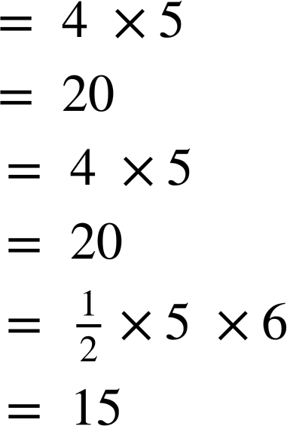
Sameynta tibaaxaha (expressions) ee bedka (area)
Waxaan sidaas oo kale u samayn karnaa qaab kasta, haddii aan haysanno tibaax (expression) dhammaan cabbirada loo baahan yahay si loo xisaabiyo bedka (area).
Bedka (area) saddexagalka waxaa lagu xisaabin karaa isku dhufashada salka (base) dhererka toosan (perpendicular height), ka dibna u qaybinta 2.
Isticmaalka qaacidada (formula):
bed = × sal × joog (area = × base × height)
2x + 2
(x + 5)(2x + 2)
Sidee kale ayaan u qori karnaa tan?
x + 5

Slide 9
Samaynta tibaaxaha (expressions) bedka (area)
(x + 5)(2x + 2)
Sidee kale ayaan u qori karnaa tan?
Waxaan ku dhufan karnaa binomials-ka (binomials) ka dibna hel karnaa badh (half) sheygaas (product).
≡ (2x² + 2x + 10x + 10)
≡ (2x² + 12x + 10)
2x + 2
Si loo badh (half) qaybta (expression) oo dhan, waxaan ku dhufan karnaa eray kasta (term)
x + 5
≡ x² + 6x + 5

Slide 10
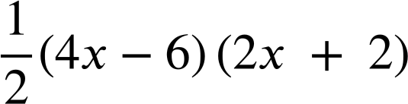
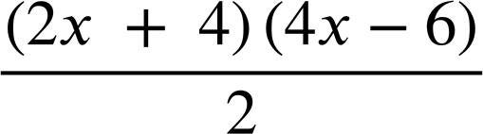
Samaynta tibaaxaha (expressions) bedka (area)
Kuwee ka mid ah kuwani waxay noqon karaan tibaaxaha (expressions) bedka (area) saddex-xagalkan (triangle)?
(x + 2)(2x − 3)
(2x + 4)(2x − 6)
4x − 6
(x + 2)(4x − 6)
(2x + 4)(4x − 6)
Qiimahan (value) waa inuu ahaadaa 4
2x + 4
(x + 4)(2x − 6)
(2x + 4)(2x − 3)

Slide 11
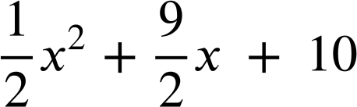
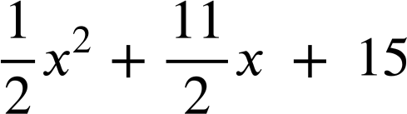
Samaynta tibaaxaha (expressions) bedka (area)
Waa kan trapezium (trapezium).
Si loo xisaabiyo tibaax (expression) fudud (simplified) bedka (area) waxaan u kala qaybin karnaa laba saddex-xagal (triangle).
Bedka A (Area of A): (x + 4)(x + 5)
x + 4
(x² + 9x + 20)
A
x + 5
B
Bedka B (Area of B): (x + 6)(x + 5)
(x² + 11x + 30)
x + 6

Slide 12
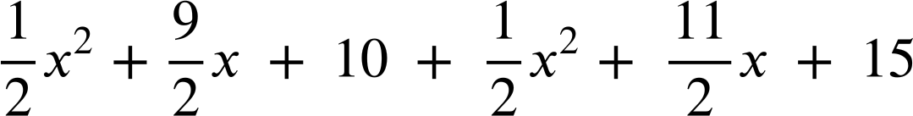

Samaynta tibaaxaha (expressions) bedka (area)
x + 4
Bedka A (Area of A): (x + 4)(x + 5)
(x² + 9x + 20)
A
x + 5
B
Bedka B (Area of B): (x + 6)(x + 5)
(x² + 11x + 30)
x + 6
Wadarta (Total):

Slide 13
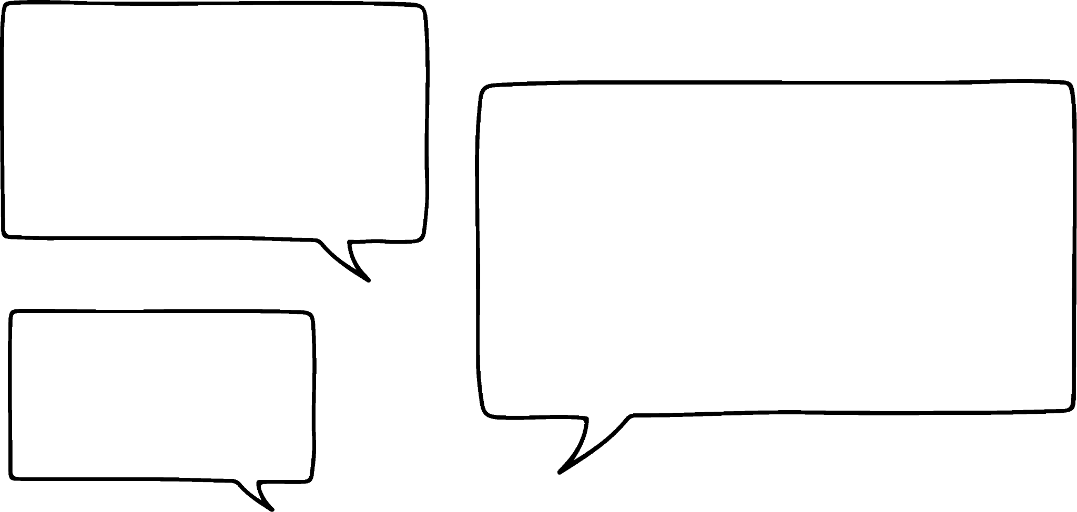

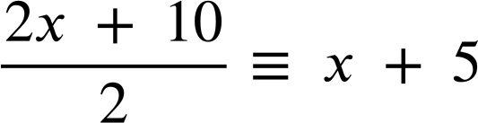
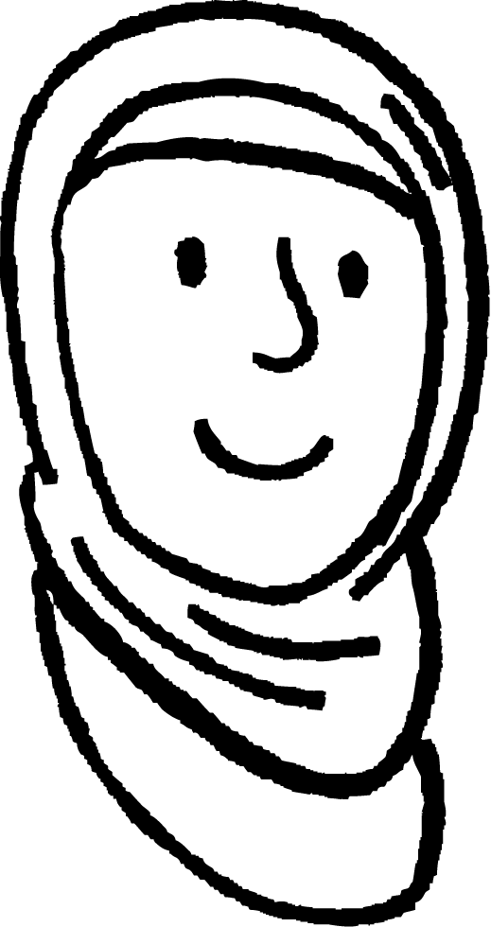

Samaynta tibaaxaha (expressions) bedka (area)
x + 4
Waxaan u malaynayaa inaan ogahay hab ka fudud oo aan ku helo bedka (area) trapezium-ka (trapezium)
x + 5
Caasha
x + 5
Waxaan ku bilaabi karnaa inaan isku darka dhinacyada isbarbar socda (parallel sides) kuna qaybino 2
Tani waxay helaysaa dhexda labada dherer (lengths).
x + 6
x + 4 + x + 6 ≡ 2x + 10

Slide 14
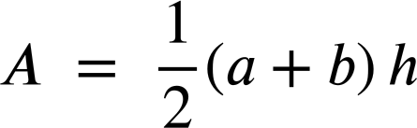
Sameynta tibaaxaha (expressions) ee bedka (area)
Waxaan u malaynayaa inaan ogahay hab fudud oo lagu helo bedka (area) trapezium-ka
x + 5
Caasha
x + 5
Kadibna waxaan ku dhufan karnaa dhererka (height).
≡ (x + 5)(x + 5)
≡ x² + 10x + 25
Caasha waxay isticmaashay qaacidada (formula) bedka (area) trapezium-ka:
Halka a iyo b ay yihiin dhinacyada isbarbar socda (parallel sides).

Slide 15



Sameynta tibaaxaha (expressions) ee bedka (area)
Layla waxay rabtaa tibaax (expression) fudud oo loogu talagalay bedka (area) trapezium-kan.
Waxay isticmaashaa qaacidada (formula) (halka a iyo b ay yihiin dhinacyada isbarbar socda (parallel sides).)
x + 5
Halkee ayay ku khalday?
x + 3
(x + 5 + x + 3)(3x + 7)
(2x + 8)(3x + 7)
3x + 7
Layla
Waxay isticmaashay cabbiro (dimensions) khaldan. Waa inay ku dartaa dhinacyada isbarbar socda (parallel sides) oo ku dhufataa dhererka toosan (perpendicular height).
(x + 4)(3x + 7)
3x² + 7x + 12x + 28
3x² + 19x + 28

Slide 16
Sameynta tibaaxaha (expressions) ee bedka (area)
Layla waxay rabtaa tibaax (expression) fudud oo loogu talagalay bedka (area) trapezium-kan.
Waxay isticmaashaa qaacidada (formula)
x + 5
Mar kale ayaan isku dayi doonaa.
2x + 6
x + 3
(x + 5 + 3x + 7)(x + 3)
3x + 7
Layla
(4x + 12)(x + 3)
Taas ayaan iyana helay.
Caasha
(2x + 6)(x + 3)
2x² + 6x + 6x + 18
2x² + 12x + 18

Slide 17
Sameynta tibaaxaha (expressions) ee bedka (area)
Waa kuwan qaar ka mid ah qaaciidooyinka (formula) bedka (area) qaababka 2D (2D shapes) oo kaa caawin kara hawsha soo socota.
a
l
b
h
w
h
b
bed (area) = ballac (width) × dherer (length)
bed (area) = × sal (base) × joog (height)
bed (area) = × × joog (height)
Halka a iyo b ay yihiin dhinacyada isbarbar socda (parallel sides).

Slide 18
Samaynta tibaaxaha (expressions) bedka (area)
1) Qor jumlad sharraxaysa sababta bedka (area) qaabkan loo qori karo siyaabaha soo socda mid kasta:
a) (x − 4)²
b) (x − 4)(x − 4)
c) x² − 8x + 16
2) Sawir leydi (rectangle) leh bed (area) (6 + y)(2 + y) qor tibaax (expression) ka duwan oo bedka (area) leydigaaga ah.
x − 4

Slide 19
Samaynta tibaaxaha (expressions) bedka (area)
3a) Sharrax sababta bedka (area) qaabkan loo qori karo sida
(4x + 5)(6x + 2)
6x + 2
b) Qor tibaaxda (expression) bedka (area) qaabkan laba siyaabood oo kala duwan.
4x + 5
c) Sawir oo calaamadee saddex-xagal (triangle) leh bed (area) (x + 1)(3x − 2)

Slide 20
Samaynta tibaaxaha (expressions) bedka (area)
4) Isku-dhaf qaababkan iyo tibaaxda (expression) saxda ah ee bedkooda (area).
a
b
2x + 2
c
d
x + 2
x + 1
x + 2
x + 1
4x − 4
4x − 4
4x − 4
2x − 2
e
f
g
h
x² − 1
2x²+ 2x − 4
3x²+ 2x − 1
4x²+ 4x − 8

Slide 21
Samaynta tibaaxaha (expressions) bedka (area)
1) Qor jumlad sharraxaysa sababta bedka (area) qaabkan loo qori karo siyaabaha soo socda mid kasta:
a) (x − 4)²
b) (x − 4)(x − 4)
c) x² − 8x + 16
Qaabku waa laba-jibaarane (square) marka bedka (area) waxaa laga heli karaa isku-dhufashada dhererka hal dhinac (side length).
x − 4
Laba-jibaarista (squaring) tibaax (expression) waxay la mid tahay isku-dhufashada tibaaxdaas nafteeda. (x − 4)2 ≡ (x − 4)(x − 4)
Waxaan isku-dhufan karnaa laba-xubnaha (binomials) iyadoo la adeegsanayo sharciga qaybinta (distributive law): (x − 4)(x − 4) ≡ x(x − 4) − 4(x − 4) ≡ x2 − 4x − 4x + 16 ≡ x2 − 8x + 16

Slide 22
Samaynta tibaaxaha (expressions) bedka (area)
2) Sawir leydi (rectangle) leh bed (area) (6 + y)(2 + y) qor tibaax (expression) ka duwan oo bedka (area) leydigaaga ah.
6 + y
(y + 6)(y + 2) ama laba-xubno (binomials) u dhigma (equivalent).
2 + y
y² + 2y + 6y + 12
y² + 8y + 12

Slide 23
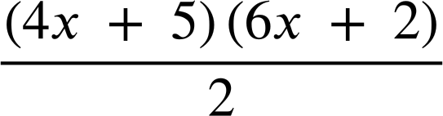
Sameynta tibaaxaha (expressions) ee bedka (area)
3a) Sharax sababta bedka (area) qaabkan loo qori karo
(4x + 5)(6x + 2)
Bedka (area) saddexagalka waxaa lagu xisaabin karaa isku dhufashada salka (base) dhererka (height) iyo isku dhufashada nus.
6x + 2
b) Qor tibaaxa (expression) bedka (area) qaabkan laba siyaabood oo kala duwan.
4x + 5
E.g.
(4x + 5)(3x + 1)
(2x + 2.5)(6x + 2)
12x² + 4x + 15x + 5
12x² + 19x + 5

Slide 24
Sameynta tibaaxaha (expressions) ee bedka (area)
c) Sawir oo calaamadee saddexagal leh bed (area) (x + 1)(3x − 2)
6x − 4
ama
2x + 2
x + 1
3x − 2
Binomials-ka (binomials) waxay ku yaalliin cabbir kasta.

Slide 25
Sameynta tibaaxaha (expressions) ee bedka (area)
4) Isku xir qaababkan tibaaxa (expression) saxda ah ee bedkooda (area).
a
b
2x + 2
c
d
x + 2
x + 1
x + 2
x + 1
4x − 4
4x − 4
4x − 4
2x − 2
(4x − 4)(x + 2)
(6x − 2)(x + 1)
(4x − 4)(x + 2)
(2x − 2)(x + 1)
(2x − 2)(x + 2)
(3x − 1)(x + 1)
4x²+ 8x − 4x − 8
(x − 1)(x + 1)
2x²+ 4x − 2x − 4
3x²+ 3x − x − 1
x²+ x − x − 1
e
f
g
h
x² − 1
2x²+ 2x − 4
3x²+ 2x − 1
4x²+ 4x − 8

Slide 26
Xallinta mashaakilaadka (problem solving) iyadoo la adeegsanayo tibaaxaha (expressions) iyo qaaciidooyinka (formulae)
Sameynta tibaaxaha (expressions) ee bedka (area)
Bedka (area) qaababka isku dhafan (compound shapes)

Slide 27
Bedka (area) qaababka isku dhafan (compound shapes)
Bedka (area) qaababka isku dhafan (compound shapes) waxaa lagu heli karaa iyadoo loo kala qaybiyo qaababka bedkooda (area) la heli karo.
x + 2
x + 2
Waxaan u baahanahay inaan helno dhererka (length) maqan ee leydi yar marka hore.
3x + 5
2x + 1
2x + 1
2x + 3
2x + 3

Slide 28
Bedka (area) qaababka isku dhafan (compound shapes)
Bedka (area) qaababka isku dhafan (compound shapes) waxaa lagu heli karaa iyadoo loo kala qaybiyo qaababka bedkooda (area) la heli karo.
x + 2
x + 2
3x + 5 − (2x + 1)
?
x + 4
3x + 5 − 2x − 1
x + 4
3x + 5
2x + 1
Hadda waxaan u xisaabin karnaa tibaaxaha (expressions) labada bed (area).
2x + 3

Slide 29

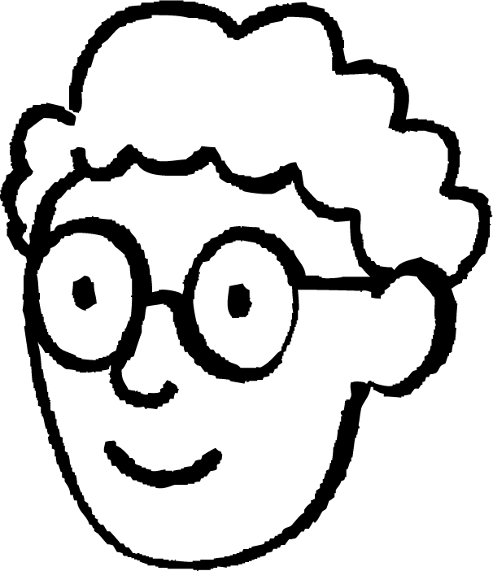

Bedka (area) qaababka isku dhafan (compound shapes)
x + 2
Waan ogahay hab kale oo aan ku sameeyo!
Axmed
2x + 1
x + 4
2x + 3
(x + 2) (x + 4)
x² + 4x + 2x + 8
x² + 6x + 8
(2x + 3) (2x + 1)
4x² + 2x + 6x + 3
4x² + 8x + 3
Wadarta bedka (area):
x² + 6x + 8 + 4x² + 8x + 3
5x² + 14x + 11
Xisaabinta aan samaynay waa:
(x + 2)(x + 4) + (2x + 3)(2x + 1) ≡ 5x² + 14x + 11

Slide 30
Bedka qaababka isku dhafan (Area of compound shapes)
Waxaan sidoo kale u arki karnaa sidii hal leydi oo weyn oo laga jaray leydi yar.
x + 2
Axmed
3x + 5
2x + 1
2x + 3
Waa maxay cabbirrada leydiyadan?

Slide 31
Bedka qaababka isku dhafan (Area of compound shapes)
x + 2
?
x + 4
3x + 5
?
3x + 5
x + 1
2x + 1
2x + 3 − (x + 2)
2x + 3 − x − 2
2x + 3
2x + 3
x + 1
3x + 5 − (2x + 1)
x + 4

Slide 32
Bedka qaababka isku dhafan (Area of compound shapes)
Hadda waan fududayn karnaa (expand simplify):
(3x + 5)(2x + 3) − (x + 1)(x + 4)
x + 4
3x + 5
6x² + 9x + 10x + 15 − (x² + x + 4x + 4)
x + 1
6x² + 19x + 15 − (x² + 5x + 4)
5x² + 14x + 11
2x + 3
Habeenkee ayaad door biday?

Slide 33
Bedka qaababka isku dhafan (Area of compound shapes)
Soo hel cabbirrada maqan ee qaabkan isku dhafan.
5x + 7
5x + 7 − (2x + 3)
3x + 2
3x + 4
3x + 4
6x + 1
3x + 2 + (3x − 1)
3x − 1
6x + 1
2x + 3

Slide 34
Bedka qaababka isku dhafan (Area of compound shapes)
Sideen u xisaabin karnaa bedka qaabka hadhka leh?
Ka jar bedka leydiga yar bedka leydiga weyn.
(2x + 1)(x + 9) − (x + 2)(x − 1)
x − 1
2x² + 18x + x + 9 − (x² − 1x + 2x − 2)
x + 9
x + 2
2x² + 19x + 9 − (x² + x − 2)
x² + 18x + 11
2x + 1
9 − (−2) = 11

Slide 35


Bedka qaababka isku dhafan (Area of compound shapes)
Bedka qaabka hadhka leh waa 250 halbeeg oo laba jibaaran (square units).
Kee mid ka mid ah kuwani waa isla'eg (equation) bedka qaabka hadhka leh?
x + 1
x + 8
x + 5
a
(x + 10)(x + 1) − (x + 5)(x + 8) = 250
x + 10
b
(x + 10)(x + 8) + (x + 1)(x + 5) = 250
c
(x + 10)(x + 8) − (x + 5)(x + 1) = 250
d
(x + 10) − (x + 5) × (x + 8) − (x + 1) = 250

Slide 36
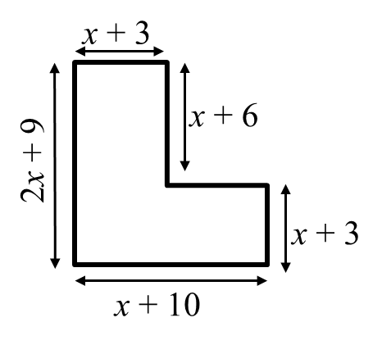
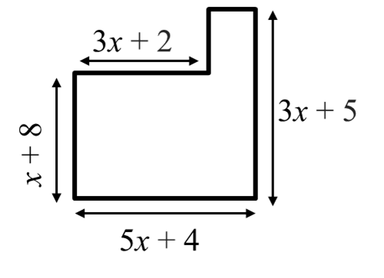
Bedka qaababka isku dhafan (Area of compound shapes)
1) Qor tibaax fududaysan (simplified expression) oo loogu talagalay bedka qaabkan.
2) Qor tibaax fududaysan (simplified expression) oo loogu talagalay bedka qaabkan.

Slide 37
Bedka qaababka isku dhafan (Area of compound shapes)
3a) Xisaabi tibaax fudud oo ah bedka qaabka hadhka leh.
x + 7
x − 2
x − 2
x + 12
b) Bedka qaabka hadhka leh waa 149 halbeeg oo laba jibaaran (square units). Isticmaal tan si aad u hesho qiimaha (value) x.

Slide 38
Bedka qaababka isku dhafan (Area of compound shapes)
4a) Xisaabi tibaax fudud oo ah bedka qaabka hadhka leh.
Lama sawirin qiyaas sax ah (Not drawn to scale)
3x
2x + 7
4x − 1
6x − 9
b) Bedka qaabka hadhka leh waa 99 halbeeg oo laba jibaaran. Isticmaal tan si aad u hesho qiimaha x

Slide 39
Bedka qaababka isku dhafan (Area of compound shapes)
5) Afar leydi oo isku mid ah ayaa ku wareegsan dibadda laba jibaaranka hadhka leh.
2x + 3
a) Raadi tibaax fudud oo ah bedka hal leydi.
b) Raadi tibaax fudud oo ah bedka qaabka oo dhan.
c) Raadi tibaax fudud oo ah bedka laba jibaaranka hadhka leh.
x + 2

Slide 40
Bedka qaababka isku dhafan (Area of compound shapes)
1) Xisaabi tibaax fudud oo ah bedka qaabkan.
2) Xisaabi tibaax fudud oo ah bedka qaabkan.
5x + 4 − (3x + 2)
2x + 2
(3x + 2)(x + 8) + (2x + 2)(3x + 5)
(x + 10)(x + 3) + (x + 6)(x + 3)
(3x² + 24x + 2x + 16) + (6x² + 10x + 6x + 10)
(x² + 13x + 30) + (x² + 9x + 18)
(3x² + 26x + 16) + (6x² + 16x + 10)
2x² + 22x + 48
9x² + 42x + 26

Slide 41
Bedka qaababka isku dhafan (Area of compound shapes)
3a) Xisaabi tibaax fudud oo ah bedka qaabka hadhka leh.
(x + 12)(x + 7) − (x − 2)(x − 2)
(x² + 7x +12x + 84) − (x² − 2x − 2x + 4)
x + 7
x − 2
(x² + 19x + 84) − (x² − 4x + 4)
x − 2
23x + 80
x + 12
b) Bedka qaabka hadhka leh waa 149 halbeeg oo laba jibaaran. Isticmaal tan si aad u hesho qiimaha x
23x + 80 | = | 149
23x + 80 − 80 | = | 149 − 80
23x | = | 69
x | = | 3

Slide 42
Bedka qaababka isku dhafan (Area of compound shapes)
4a) Xisaabi tibaax fudud oo ah bedka qaabka hadhka leh.
(6x − 9)(2x + 7) − 3x(4x − 1)
(12x² + 42x − 18x − 63) − (12x² − 3x)
3x
(12x² + 24x − 63) − (12x² − 3x)
2x + 7
4x − 1
27x − 63
6x − 9
27x − 63 | = | 99
(27x − 63) ÷ 9 | = | 99 ÷ 9
3x − 7 | = | 11
3x − 7 + 7 | = | 11 + 7
3x | = | 18
x | = | 6
b) Bedka qaabka hadhka leh waa 99 halbeeg oo laba jibaaran. Isticmaal tan si aad u hesho qiimaha x

Slide 43
Bedka (Area) qaababka (shapes) isku dhafan (compound)
5) Afar leydi (rectangle) oo isku mid ah ayaa ku wareegsan bannaanka labajibbaaran (square) hadhsan.
2x + 3
a) Raadi tibaax fudud oo ah bedka hal leydi.
b) Raadi tibaax fudud oo ah bedka qaabka oo dhan.
c) Raadi tibaax (expression) fudud oo ah bedka (area) labajibbaaran (square) hadhsan.
(2x + 3)(x + 2) ≡ 2x² + 4x + 3x + 6
≡ 2x² + 7x + 6
2x + 3 + x + 2 ≡ 3x + 5
x + 2
(3x + 5)² ≡ 9x² + 30x + 25
4(2x² + 7x + 6) ≡ 8x² + 28x + 24
2x + 3 − (x + 2) ≡ x + 1
ama
9x² + 30x + 25 − (8x² + 28x + 24) ≡ x² + 2x + 1
(x + 1)² ≡ x² + 2x + 1

Slide 44
Xallinta (Solving) mashaakilka (problems) iyadoo la isticmaalayo tibaax (expressions) iyo qaaciidooyin (formulae)
Marka dhererka (lengths) qaab (shape) loo bixiyo tibaax (expressions), sharciga qaybinta (distributive law) ayaa loo isticmaali karaa in lagu qoro tibaax (expression) bedka (area) oo qaab ballaaran (expanded form) ah.
Bedka (Area) qaababka (shapes) isku dhafan (compound) ama gobollada (regions) hadhsan waxaa laga heli karaa iyadoo lagu darayo ama laga jarayo bedka (areas) qaababka (shapes) la yaqaan.

