Slide 1
Xallinta dhibaatooyinka xiriirrada aan tooska ahayn (non-linear relationships)
Xiriirro aan toos ahayn (non-linear relationships)

Slide 2
sida loo isticmaalo darasyada Oak

Slide 3
Waxaan u isticmaali karaa aqoontayda xiriirrada aan tooska ahayn (non-linear relationships) si aan u xalliyo dhibaatooyin.

Slide 4
Taxane joomatari (geometric sequence) waa taxane leh xiriir isku dhufasho joogto ah oo u dhexeeya xubnaha isku xiga.
Tiro saddexagal (triangular number) waa tiro lagu matali karo qaab dhibco loo habeeyay saddexagal siman (equilateral triangle). Tirada xubnaha waa tirada dhibcood ee dhinaca saddexagalka.
1
3
6
10
15

Slide 5

Xallinta dhibaatooyinka xiriirrada aan tooska ahayn (non-linear relationships)
Xallinta dhibaatooyinka xiriirrada joomatari (geometric relationships)
Ku darista taxanayaasha (sequences)

Slide 6
Xallinta dhibaatooyinka taxanayaasha joomatari (geometric sequences)
Ciyaarta Chess waxaa la ikhtiraacay sanado badan oo hore.
Sheeko ayaa sheegaysa in ciyaarta la soo gudbiyay Boqor xun oo diiday inuu la wadaago dadka kaydkiisa bariiska ee weyn inkastoo ay jirtay abaar.
Boqorku wuu jeclaa ciyaarta.
“Waa maxay abaalmarinta aad rabto ee ciyaartan quruxda badan? Waxaad heli kartaa abaalmarin kasta oo aad rabto” ayuu yidhi Boqorku.

Slide 7
Xallinta dhibaatooyinka taxanayaasha joomatari (geometric sequences)
“Waxaan rabaa hal xabbad oo bariis ah oo ku taal square-ka koowaad ee sabuulka, laba xabbadood oo ku taal square-ka labaad, afar xabbadood oo ku taal square-ka saddexaad, oo labanlaabma mar kasta” ayuu yidhi ikhtiraacihii.
Boqorkii wuu la yaabay qiimaha yar ee ciyaartan quruxda badan. Wuxuu bilaabay inuu tiriya bariiska.
1 | 2 | 4
Immisa xabbadood ayaa ku jiri doona square-ka 64aad?

Slide 8
Xallinta dhibaatooyinka taxanayaasha joomatari (geometric sequences)
1, 2, 4, 8, 16, 32, 64, 128,
1 | 2 | 4
256, 512, 1024, 2048, 4096, 8192, 16 384, 32 768,
1 | 2 | 4 | 8 | 16 | 32 | 64 | 128
65 536, 131 072, 262 144, …….. 8 388 608,
In ka badan 8 milyan oo xabbadood marka la gaaro square-ka 24aad!
Immisa xabbadood oo ku yaal square-ka 64aad?

Slide 9
Xallinta dhibaatooyinka iyadoo la adeegsanayo isku-xigxiga joomatari (geometric sequences)
Square | Xabbo (Grains) | Xeer (Rule)
1 | 1 | 2⁰
2 | 2 | 2¹
3 | 4 | 2²
4 | 8 | 2³
5 | 16 | 2⁴
6 | 32 | 2⁵
Labajibbaaran (Square) | Xabbo (Grains) | Xeer (Rule)
1 | 1
2 | 2
3 | 4
4 | 8
5 | 16
6 | 32
Labajibbaaran (Square) | Xabbo (Grains) | Xeer (Rule)
1 | 1 | 2⁰
2 | 2 | 2¹
3 | 4 | 2²
4 | 8 | 2³
5 | 16 | 2⁴
6 | 32 | 2⁵
64
1 | 2 | 4 | 8 | 16 | 32 | 64 | 128
2⁶³
Imisa xabbo oo ku yaal labajibbaaran (square) 64-aad?

Slide 10
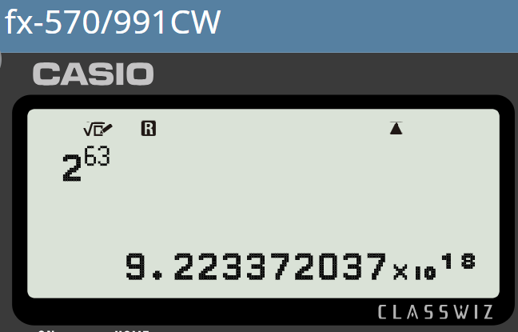
Xallinta dhibaatooyinka iyadoo la adeegsanayo isku-xigxiga joomatari (geometric sequences)
Waxaa jira 263 xabbo oo ku yaal labajibbaaran (square) 64-aad.
1 | 2 | 4 | 8 | 16 | 32 | 64 | 128
Marka la eego 1 s.f. (1 s.f.), taasi waa 9 × 10^18
Ama… 9 000 000 000 000 000 000
Taasi waa lambarka sagaal quintillion!
Boqorku wuu awoodi waayey inuu bixiyo deyntiisa.
Xataa Boqorku ma lahayn bariiskan badan.
Sheekadani waa tusaale wanaagsan oo ku saabsan awoodda isku-xigxiga joomatari (geometric sequences) iyo sidoo kale xaddidnaanta isticmaalka curiyahan (element) xisaabta ee qaabaynta (modelling).

Slide 11


Xallinta dhibaatooyinka iyadoo la adeegsanayo isku-xigxiga joomatari (geometric sequences)
Waxaa laga yaabaa inaan aragno tirooyinka iyo qaabka isku mid ah xaalad aad u kala duwan.
Waxaa jira 2 kun oo penguin ah oo ku nool jasiirad. Tobankii sano ee kasta, tiradoodu waa labanlaabtaa.
Toban sano (Decade) | Pop (000’s)
1 | 2
2
3
4
5
6

Slide 12
Xallinta dhibaatooyinka isku xigxiga joomatari (geometric sequences)
Waxaa laga yaabaa inaan aragno tirooyin iyo qaab isku mid ah oo ku jira macno aad u kala duwan.
Waxaa ku nool 2 kun oo penguin ah jasiirad. Tobankii sano ee kasta tiradoodu waa labanlaabtaa.
Toban sano (Decade) | Pop (000’s)
1 | 2
2
3
4
5
6
Toban sano (Decade) | Pop (000’s)
1 | 2
2 | 4
3
4
5
6
Toban sano (Decade) | Pop (000’s)
1 | 2
2 | 4
3 | 8
4
5
6
Toban sano (Decade) | Pop (000’s)
1 | 2
2 | 4
3 | 8
4 | 16
5
6

Slide 13
Xallinta dhibaatooyinka isku xigxiga joomatari (geometric sequences)
Waxaa laga yaabaa inaan aragno tirooyin iyo qaab isku mid ah oo ku jira macno aad u kala duwan.
Waxaa ku nool 2 kun oo penguin ah jasiirad. Tobankii sano ee kasta tiradoodu waa labanlaabtaa.
Toban sano (Decade) | Pop (000’s)
1 | 2
2 | 4
3 | 8
4 | 16
5 | 32
6

Slide 14
Xallinta dhibaatooyinka isku xigxiga joomatari (geometric sequences)
Waxaa laga yaabaa inaan aragno tirooyin iyo qaab isku mid ah oo ku jira macno aad u kala duwan.
Waxaa ku nool 2 kun oo penguin ah jasiirad. Tobankii sano ee kasta tiradoodu waa labanlaabtaa.
Toban sano (Decade) | Pop (000’s)
1 | 2
2 | 4
3 | 8
4 | 16
5 | 32
6 | 64

Slide 15
Xallinta dhibaatooyinka (Problem solving) iyo isku xigxiga joomatari (geometric sequences)
Waxaa laga yaabaa inaan aragno tirooyin iyo qaab isku mid ah, laakiin meel ka duwan.
Waxaa jira 2 kun oo penguin ah oo ku nool jasiirad. Tobankii sano ee kasta, tiradoodu waa labanlaabtaa.
Ma arki kartaa dhibaato?
Jasiiraddu waxay ka baxaysaa meel. Biyaha (water) agagaarkooda cuntadu way dhammaan doontaa. Markay penguin-ku u dabaashaan meel fog si ay cunto u helaan, waxay waqti badan ku qaataan biyaha (water) iyagoo la jira ugaadhsadayaasha. Tani waxay si dabiici ah u xaddidi doontaa tirada penguin-ka ee jasiiradda.

Slide 16
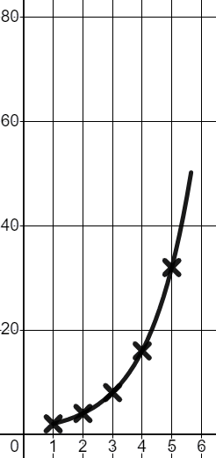
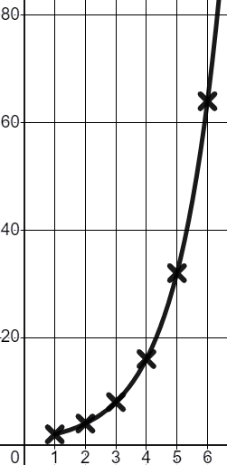
Xallinta dhibaatooyinka (Problem solving) iyo isku xigxiga joomatari (geometric sequences)
Isku xigxiga joomatari (geometric sequence) waa la garaafi karaa, qaabkan korriinkuna wuxuu noqon karaa mid sax ilaa heer…
Laakiin, waxaa jiri doona xad dabiici ah.
Toban sano (Decade) | Tirada (Pop) (000’s)
1 | 2
2 | 4
3 | 8
4 | 16
5 | 32
6 | 64
Korriinku ma noqon karo mid aan dhammaad lahayn; xariiqdu waxay ku siman doontaa meel.
Tirada (Pop) (000’s)
Toban sano (Decade)

Slide 17

Xallinta dhibaatooyinka (Problem solving) iyo isku xigxiga joomatari (geometric sequences)
Marka qorraxdu soo baxdo guga, ubaxu si degdeg ah ayuu u koraa.
Dhererka ubaxan wuxuu raacayaa qaab joomatari (geometric pattern).
Toddobaad (Week) | Dhererka (Height) (cm)
1 | 1
2 | 3
3 | 9
4
Maxaan u qaadan karnaa in dhererka ubaxu noqon doono toddobaadka soo socda?
Maxay yihiin dhibaatooyinka aad ku arki karto qaabkan korriinka?

Slide 18
Xallinta dhibaatooyinka (Problem solving) iyo isku xigxiga joomatari (geometric sequences)
Marka qorraxdu soo baxdo guga, ubaxu si degdeg ah ayuu u koraa.
Dhererka ubaxan wuxuu raacayaa qaab joomatari (geometric pattern).
Toddobaad | Dhererka (cm)
1 | 1
2 | 3
3 | 9
4
Toddobaad | Dhererka (cm)
1 | 1
2 | 3
3 | 9
4 | 27
×3
Maxaan u qaadan karnaa dhererka ubaxa toddobaadka soo socda?
Maxay yihiin dhibaatooyinka aad ku arki karto qaabkan koritaanka?
×3
×3

Slide 19
Xallinta mashaakilaadka (problem solving) ee taxanaha joomatari (geometric sequences)
Marka qorraxdu soo baxdo guga, ubaxu si degdeg ah ayuu u koraa.
Dhererka ubaxan wuxuu raacayaa qaab joomatari (geometric pattern).
Toddobaad | Dhererka (cm)
1 | 1
2 | 3
3 | 9
4 | 27
5 | 81
6 | 243
7 | 729
8 | 2187
Toddobaad | Dhererka (cm)
1 | 1
2 | 3
3 | 9
4 | 27
×3
Maxaan u qaadan karnaa dhererka ubaxa toddobaadka soo socda?
Maxay yihiin dhibaatooyinka aad ku arki karto qaabkan koritaanka?
×3
×3
Koritaanku caadi ahaan ma aha mid aan dhammaad lahayn. Qaabkani wuxuu yeelan doonaa xad dabiici ah (natural limit).
Inta badan ubaxu ma koraan ilaa 20 m dherer!

Slide 20
Xallinta mashaakilaadka (problem solving) ee taxanaha joomatari (geometric sequences)
1) Gudbinta macluumaadka (passing information) ayaa sidoo kale samayn karta taxane joomatari (geometric sequence). Basku wuu dib uga soo laaban doonaa safarka iskuulka. Hal arday ayaa wacaya waalidkiis. Waalidku wuxuu wacaa 5 waalid oo kale. Mid kasta oo ka mid ah waalidkaas wuxuu wacaa 5 waalid oo kale. U qaad inay qaadato 10 daqiiqo in la sameeyo 5 wicitaan.
a) Immisa qof ayaa ogaan lahaa 40 daqiiqo (mins) kadib?
b) Sababta tan macquul uga noqon karto?
c) Immisa qof ayaa ogaan lahaa 2 saac (hours) kadib?
d) Sababta tan macquul uga noqon karto?
Waqti | Dadka
10 daqiiqo (mins) | 5
20 daqiiqo (mins) | 25
(oo ay ku jirto waalidkii marka hore ogaa)

Slide 21
Xallinta mashaakilaadka iyadoo la adeegsanayo taxanayaasha joomatari (geometric sequences)
1) Gudbinta macluumaadka waa shay kale oo sameyn kara taxane joomatari (geometric sequence). Basku wuu soo daahayaa safarka dugsiga. Hal arday ayaa wacayaa waalidkiis. Waalidku wuxuu wacayaa 5 waalid oo kale. Mid kasta oo ka mid ah waalidkaas wuxuu wacayaa 5 waalid oo kale. U qaad inay 5 daqiiqo (mins) qaadato in taleefan lagu waco.
a) Immisa qof ayaa ogaan lahaa 40 daqiiqo (mins) kadib?
Waqti (Time) | Dad (People)
10 daqiiqo (mins) | 5
20 daqiiqo (mins) | 25
30 daqiiqo (mins) | 125
626 qof ayaa ogaan lahaa haddii koritaanku sii socdo heerka kore.
Waqti (Time) | Dad (People)
10 daqiiqo (mins) | 5
20 daqiiqo (mins) | 25
30 daqiiqo | 125
40 daqiiqo | 625 + 1
×5
b) Sababta tan macquul uga noqon karto?
×5
×5
Qaar ka mid ah waalidka ayaa laga yaabaa inay wacaan dad isku mid ah. Qaar ka mid ah waalidka ayaa laga yaabaa inaysan qofna wacin.
Waxaa laga yaabaa in qaar ka mid ah waalidku ay qaataan in ka badan 10 daqiiqo si ay u wacaan 5 waalid.

Slide 22
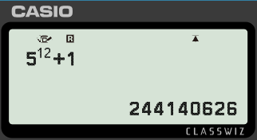
Xallinta mashaakilaadka isku xigxiga joomatari (geometric sequences)
1) Gudbinta macluumaadka waa shay kale oo samayn kara isku xigxig joomatari (geometric sequence). Basku wuxuu ku soo daahayaa safar dugsi. Hal arday ayaa waca waalidkiisa. Waalidku wuxuu wacaa 5 waalid oo kale. Mid kasta oo ka mid ah waalidkaas wuxuu wacaa 5 waalid oo kale. U qaad inay qaadato 5 daqiiqo inuu sameeyo wicitaan taleefan.
c) Immisa qof ayaa ogaan lahaa 2 saacadood ka dib?
Waqti | Dad
10 daqiiqo
20 daqiiqo
30 daqiiqo
40 daqiiqo
50 daqiiqo
60 daqiiqo
120 daqiiqo
Waqti | Dad
10 daqiiqo | 5
20 daqiiqo | 25
30 daqiiqo | 125
40 daqiiqo | 625
50 daqiiqo | 3125
60 daqiiqo | 15 625
70 daqiiqo | 78 125
5
5²
≈ 200 000 000 qof
5³
5⁴
d) Maxay tahay sababta aan tani u noqon karin mid dhab ah?
5⁵
5⁶
Ma jiri doonaan waalidin badan oo la waco.
5¹²

Slide 23
Xallinta dhibaatooyinka xiriirrada aan tooska ahayn (non-linear relationships)
Xallinta dhibaatooyinka xiriirrada joomatari (geometric relationships)
Isugeynta taxanaha (sequences)

Slide 24
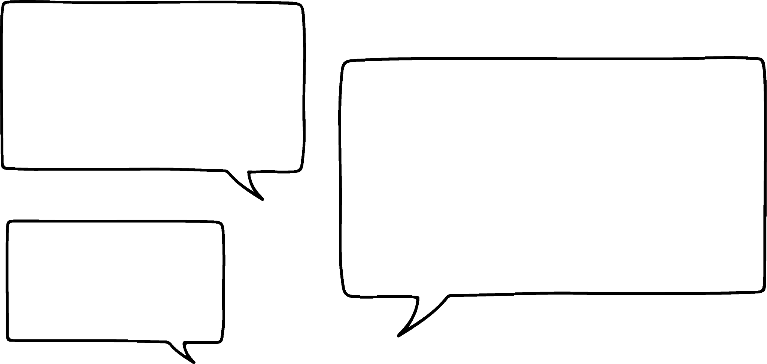

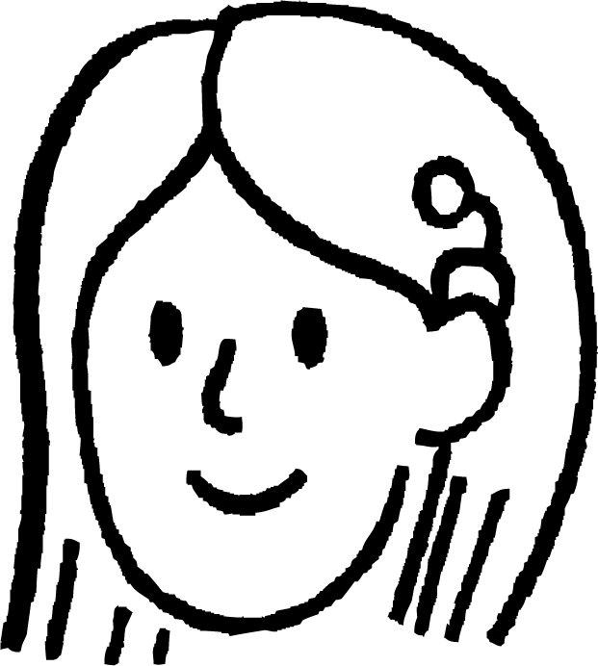

Isugeynta taxanaha (sequences)
Mararka qaarkood isugeynta laba taxane oo kala duwan waxay keeni kartaa natiijooyin xiiso leh.
Waxaan baari doonnaa fikraddan qaybtan darsiga (lesson).
Waxaan u malaynayaa in isugeynta laba taxane oo xisaabeed (arithmetic sequences) ay bixin doonto taxane xisaabeed (arithmetic sequence) oo kala duwan.
Maxaad u malaynaysaa?
Suad
Tusaale 3, 5, 7, 9, 11, …. oo lagu daray 4, 7, 10, 13, 16, ….
7, 12, 17, 22, 27, …. Kani waa taxane xisaabeed (arithmetic sequence) oo leh kala duwanaansho guud (common difference) +7
Iska day tusaale kuu gaar ah.

Slide 25

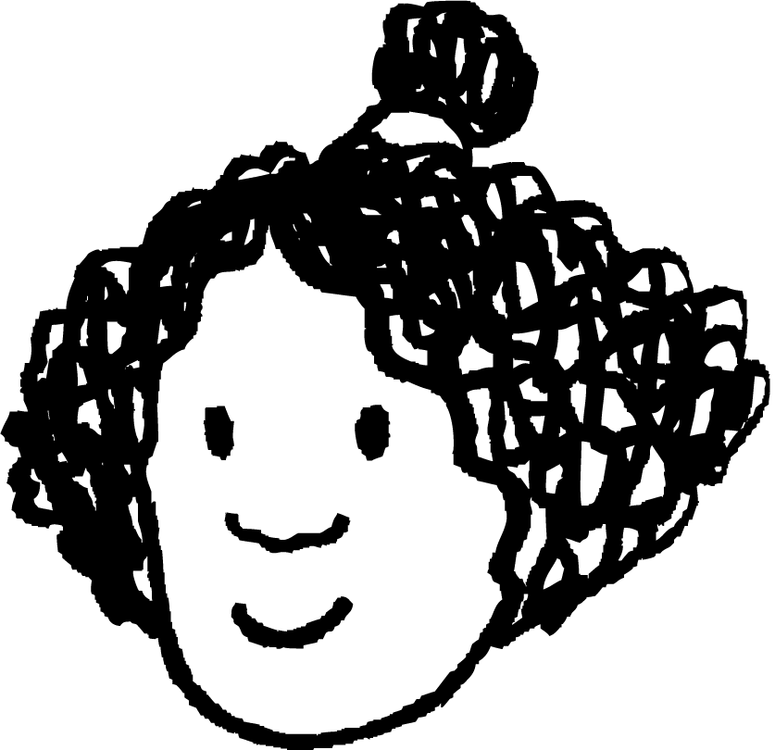

Isugeynta taxanaha (sequences)
Suad waa sax tusaalahan, miyay tani had iyo jeer shaqaynaysaa?
Aynu isku dayno taxane koraya (increasing) iyo taxane hoos u dhacaya (decreasing).
Tusaale 5, 8, 11, 14, … ku dar 10, 8, 6, 4, …
15, 16, 17, 18, … Waxaan haynaa taxane xisaabeed (arithmetic sequence) oo leh kala duwanaansho guud (common difference) 1.
Isra
Waxaan isku daynay kaliya laba tusaale, marka ma aanan dhihi karin in tani had iyo jeer shaqeyso. Xataa haddii aan isku dayno 100 tusaale, tani ma noqon doonto caddayn in tani had iyo jeer shaqeyso.
Taa beddelkeeda, waxaan sahamin karnaa qaabka waxa dhacaya marka aan ku darno ereyada laba taxane (sequences).

Slide 26

Ku darista taxanayaasha (sequences)
Waa maxay xeerarka nth term ee taxanayaasha toosan (linear sequences)?
3, 5, 7, 9, 11, …. iyo 4, 7, 10, 13, 16, ….
2n + 1 iyo 3n + 1
Si aad u hesho tiro kasta oo ka mid ah taxanayaasha la isku daray, waxaad adeegsataa xeerka 2n + 1 ka dibna ku dar qiimaha (value) 3n + 1
2n + 1 + 3n + 1 waa la fududeyn karaa isagoo la ururinaya ereyada la midka ah.
5n + 2
Taxanaha cusub 7, 12, 17, 22, …. waa inuu leeyahay xeerka nth term 5n + 2 kaas oo ka dhigi doona taxane toosan (linear sequence). Hubi in tani run tahay.

Slide 27
Ku darista taxanayaasha (sequences)
Marka, ku darista laba taxane (sequences) waxay ka dhigan tahay inaan ku dari karno xeerarkooda nth term si aan u helno xeerka taxanaha cusub.
Ku darista laba tibaax toosan (linear expressions) waxay siin doontaa tibaax kale oo toosan. Waxaad tani ku caddayn kartaa algebra haddii aad rabto.
Ka warran haddii aan ku darno laba taxane (sequences) laba jibaaran (quadratic)?
Taxane laba jibaaran (quadratic sequence) wuxuu leeyahay xiriir toosan (linear relationship) oo ku saabsan kala duwanaanshaha (differences) ee u dhexeeya ereyada.
Tusaale: ku dar 2, ku dar 4, ku dar 6, ku dar 8, …
Waxaan dhihi karnaa waxay leeyihiin kala duwanaansho labaad oo wadaag ah (common second difference).
Suad
Maxaad u malaynaysaa inay dhacdo?
Isku day tusaale.

Slide 28
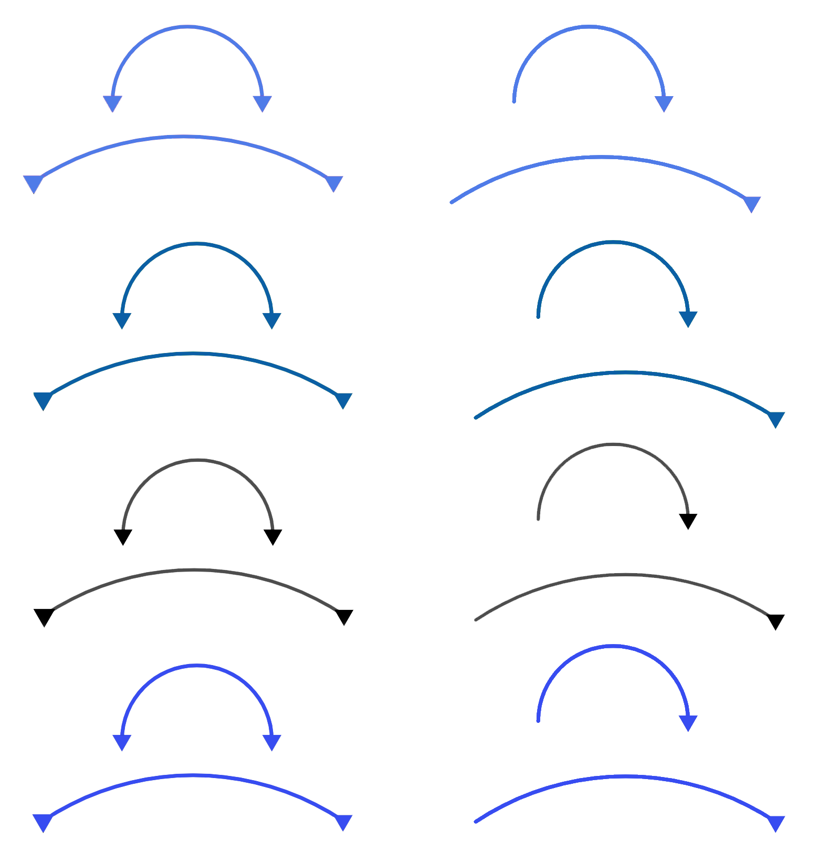
Ku darista taxanayaasha (sequences)
2, 6, 12, 20, 30, … waa taxane laba jibaaran (quadratic sequence) oo leh kala duwanaansho labaad oo wadaag ah +2
+4
+6
+8
+10
5, 6, 8, 11, 15, … waa taxane laba-jibbaaran (quadratic sequence) oo leh kala-duwanaansho labaad oo guud +1
+1
+2
+3
+4
Markaan isku darno waxaan helaynaa: 7, 12, 20, 31, 45, …
+5
+8
+11
+14
+3
+3
+3
Waxaan haynaa taxane laba-jibbaaran (quadratic sequence) oo kale oo leh kala-duwanaansho labaad oo guud +3
Ma awoodno inaan aljabra ahaan ku baarno iyada oo aan aqoonin xeerarka nth term, laakiin waxaan isku dayi karnaa tusaalooyin dheeri ah.

Slide 29
Isku darka taxanayaasha (Adding sequences)
Tirooyinka laba-jibbaaran (square numbers) waxay sameeyaan taxane laba-jibbaaran (quadratic sequence) marka loo qoro si tiro ahaan u kaca.
Tirooyinka saddex-xagalka (triangle numbers) sidoo kale way sameeyaan!
Suad
Isra
1) Qor shanta xubnood ee ugu horreeya ee taxanaha tirooyinka laba-jibbaaran (square numbers) si kor u kaca.
2) Qor shanta xubnood ee ugu horreeya ee taxanaha tirooyinka saddex-xagalka (triangle numbers) si kor u kaca.
3) Isku dar taxanayaashaada (wadarta xubnaha ugu horreeya ee mid kasta ayaa sameeya xubinta ugu horreeya ee taxanaha cusub iwm.), maxaad uga dareentaa taxanahan cusub?

Slide 30
Isku darka taxanayaasha (Adding sequences)
Tirooyinka laba-jibbaaran (square numbers) waxay sameeyaan taxane laba-jibbaaran (quadratic sequence) marka loo qoro si tiro ahaan u kaca.
Tirooyinka saddex-xagalka (triangle numbers) sidoo kale way sameeyaan!
Suad
Isra
1) Qor shanta xubnood ee ugu horreeya ee taxanaha tirooyinka laba-jibbaaran (square numbers) si kor u kaca 1, 4, 9, 16, 25, …
2) Qor shanta xubnood ee ugu horreeya ee taxanaha tirooyinka saddex-xagalka (triangle numbers) si kor u kaca 1, 3, 6, 10, 15, …
3) Isku dar taxanayaashaada, maxaad uga dareentaa taxanahan cusub? 2, 7, 15, 26, 40, …

Slide 31
Isku darka taxanayaasha (Adding sequences)
Tirooyinka laba jibaaran waxay sameeyaan isku xigxig (sequence) quadratic marka loo qoro sida nambarada isku xigxiga.
Tirooyinka saddexagalka sidoo kale!
Suad
Isra
3) Isku dar taxanayaashaada, maxaad uga dareentaa taxanahan cusub? 2, 7, 15, 26, 40, …
+5
+8
+11
+14
+3
+3
+3
Waxay sidoo kale tahay isku xigxig (sequence) quadratic. Waxay kordhisaa 5, ka dib 8, ka dib 11, ka dib 14…
Waxay leedahay farqi labaad (second difference) guud oo ah 3

Slide 32
Ku darista isku xigxigyada (sequences)
1) Su'aal kasta, isku xigxigyada waxaa lagu abuuray iyadoo lagu daro xubnaha laba ka mid ah isku xigxigyada hoos ku qoran. Soo hel labada isku xigxig ee lagu daray su'aal kasta.
A
1, 2, 4, 8, 16 …
B
4, 12, 36, 108, …
C
4, 9, 14, 19, …
D
1, 3, 5, 7, 9 …
E
4, 7, 12, 19, …
F
1, 6, 16, 31, 51, …
G
4, 6, 6, 4, 0 …
H
1, 8, 27, 64, …
a) 5, 12, 19, 26, 33, …
b) 5, 11, 18, 27, 40, …
c) 5, 13, 28, 50, 79, …
d) 2, 9, 21, 38, 60, …
e) 2, 5, 9, 15, 25, …
f) 2, 11, 32, 71, 134, …
g) 5, 14, 40, 127, 356, …
h) 8, 15, 20, 23, 24, …
i) 8, 13, 18, 23, 28, …
2) Waa maxay qaanuunka nth term ee isku xigxiga a)? Sidee ayay ula xiriirtaa labada isku xigxig ee aad u dooratay jawaabta a)?

Slide 33
Ku darista isku xigxigyada (sequences)
3) Adigoo isticmaalaya tusaalooyinka hore iyo tusaalooyinkaaga gaarka ah, baar su'aalahan soo socda oo qor jumlad ku saabsan qaababka aad ogaatay.
a) Maxaa dhacaya markaad ku darto laba isku xigxig oo geometric?
b) Maxaa dhacaya markaad ku darto laba isku xigxig oo quadratic?
(tirooyinka laba jibaaran iyo saddexagalka waa tusaalooyin isku xigxig quadratic)
c) Maxaa dhacaya markaad ku darto isku xigxig toosan (linear) iyo isku xigxig geometric?
d) Maxaa dhacaya markaad ku darto isku xigxig toosan (linear) iyo isku xigxig quadratic?

Slide 34
Ku darista isku xigxigyada (sequences)
1) Su'aal kasta, isku xigxigyada waxaa lagu abuuray iyadoo lagu daro xubnaha laba ka mid ah isku xigxigyada hoos ku qoran. Soo hel labada isku xigxig ee lagu daray su'aal kasta.
A
1, 2, 4, 8, 16 …
B
4, 12, 36, 108, …
C
4, 9, 14, 19, …
D
1, 3, 5, 7, 9 …
E
4, 7, 12, 19, …
F
1, 6, 16, 31, 51, …
G
4, 6, 6, 4, 0 …
H
1, 8, 27, 64, …
a) 5, 12, 19, 26, 33, … C + D
b) 5, 11, 18, 27, 40, … A + C
c) 5, 13, 28, 50, 79, … E + F
d) 2, 9, 21, 38, 60, … D + F
e) 2, 5, 9, 15, 25, … A + D
f) 2, 11, 32, 71, 134, … D + H

Slide 35
Ku darista isku xigxigyada (sequences)
1) Su'aal kasta, isku xigxigyada waxaa lagu abuuray iyadoo lagu daro xubnaha laba ka mid ah isku xigxigyada hoos ku qoran. Soo hel labada isku xigxig ee lagu daray su'aal kasta.
A
1, 2, 4, 8, 16 …
B
4, 12, 36, 108, …
C
4, 9, 14, 19, …
D
1, 3, 5, 7, 9 …
E
4, 7, 12, 19, …
F
1, 6, 16, 31, 51, …
G
4, 6, 6, 4, 0 …
H
1, 8, 27, 64, …
g) 5, 14, 40, 127, 356, … A + B
h) 8, 15, 20, 23, 24, … C + G
i) 8, 13, 18, 23, 28, … E + G
2) Waa maxay qaanuunka nth term ee isku xigxiga a)? Sidee ayay ula xiriirtaa labada isku xigxig ee aad u dooratay jawaabta a)?
7n − 2. Qaanuunyada nth term ee C iyo D waa 5n − 1 iyo 2n − 1. Ku darista nth terms: 5n−1 + 2n − 1 = 7n − 2.

Slide 36
Ku darista isku xigxigyada (sequences)
3) Adigoo isticmaalaya tusaalooyinkii hore iyo tusaalooyinkaaga gaarka ah, baar su'aalahan soo socda oo qor jumlad ku saabsan qaababka aad aragtay.
a) Maxaa dhacaya markaad ku darto laba isku xigxig oo joomatari (geometric sequences)?
b) Maxaa dhacaya markaad ku darto laba isku xigxig oo laba jibaaran (quadratic sequences)?
Tusaale: Ma helaysid isku xigxig joomatari kale. Ma jiro qaab cad oo tiro (arithmetic) ama joomatari (geometric) oo ku saabsan kala duwanaanshaha ama saamiyada (ratios) ee xubnaha.
Tusaale: Inta badan waxaad helaysaa isku xigxig laba jibaaran (quadratic sequence) oo kale, iyadoo kala duwanaanshaha labaad ee guud (common second difference) ee isku xigxiga cusub uu la mid yahay wadarta kala duwanaanshooyinka labaad ee isku xigxigyada asalka ah. Haddii kala duwanaanshaha labaad ee labada isku xigxig ay yihiin isku xigxig isku celin (additive inverses) oo isku mid ah, waxaa suurtogal ah inaad ku darto laba isku xigxig oo laba jibaaran si aad u hesho isku xigxig toosan (linear sequence) - Su'aasha 1i) waa tusaale tan.

Slide 37
Ku darista isku xigxigyada (sequences)
3) Adigoo isticmaalaya tusaalooyinkii hore iyo tusaalooyinkaaga gaarka ah, baar su'aalahan soo socda oo qor jumlad ku saabsan qaababka aad aragtay.
c) Maxaa dhacaya markaad ku darto isku xigxig toosan (linear sequence) iyo isku xigxig joomatari (geometric sequence)?
d) Maxaa dhacaya markaad ku darto isku xigxig toosan (linear sequence) iyo isku xigxig laba jibaaran (quadratic sequence)?
Tusaale: Isku xigxigyada ka soo baxa ma aha kuwa tiro (arithmetic) ama joomatari (geometric). Waxaa muuqda xiriirro joomatari (geometric relationships) oo ku saabsan kala duwanaanshooyinka labaad ee xubnaha.
Tusaale: Waxaad heli doontaa isku xigxig laba jibaaran (quadratic sequence). Haddii aad taqaanid xeerarka nth term, ku daristoodu waxay ku siin doontaa xeerka nth term ee cusub.

Slide 38
Xallinta mashaakilaadka iyadoo la isticmaalayo xiriirro aan toosnayn (non-linear relationships)
Haddii aad aragto isku xigxig, waxaa suurtogal ah inaad saadaaliso hab-dhaqanka.
Ku dabaqista qaabaynta xisaabeed (mathematical modelling) xaaladaha nolosha dhabta ah waxay leedahay xaddidaadyo.
Isku xigxigyada waxaa lagu dhisi karaa iyadoo lagu daro isku xigxigyada kale. Xeerarka nth term waa la isku dari karaa si loo helo xeerka isku xigxiga cusub.
Isku xigxigyadu waxay naga caawin karaan xallinta mashaakilaadka xisaabta.
Waxaa jira mashaakilaad xisaabeed oo socda oo ay xisaabiyayaashu ka shaqaynayaan si ay u xalliyaan.

