Slide 1
Xallinta dhibaatooyinka isku ekaanshaha (similarity) iyo aragtida Pythagoras (Pythagoras’ theorem)
Sifooyinka joomatari: isku ekaanshaha (similarity) iyo aragtida Pythagoras (Pythagoras’ theorem)

Slide 2
Sida agabkeena waxbarista loogu talagalay fasalka

Slide 3
Waxaan isticmaali karaa aqoontayda isku ekaanshaha (similarity) iyo aragtida Pythagoras (Pythagoras’ theorem) si aan u xalliyo dhibaatooyin.

Slide 4
Aragtida Pythagoras (Pythagoras’ theorem) waxay sheegaysaa in wadarta labajibbaaranaha labada dhinac ee gaagaaban ee saddexagalka qumman (right-angled triangle) ay la mid tahay labajibbaaranaha hypotenuse-ka.

Slide 5

Xallinta dhibaatooyinka isku ekaanshaha (similarity) iyo aragtida Pythagoras (Pythagoras’ theorem)
Aragtida Pythagoras (Pythagoras’ theorem) iyo isku-duwayaasha (coordinates)
Aragtida Pythagoras (Pythagoras’ theorem) iyo saamiyada (ratios)

Slide 6
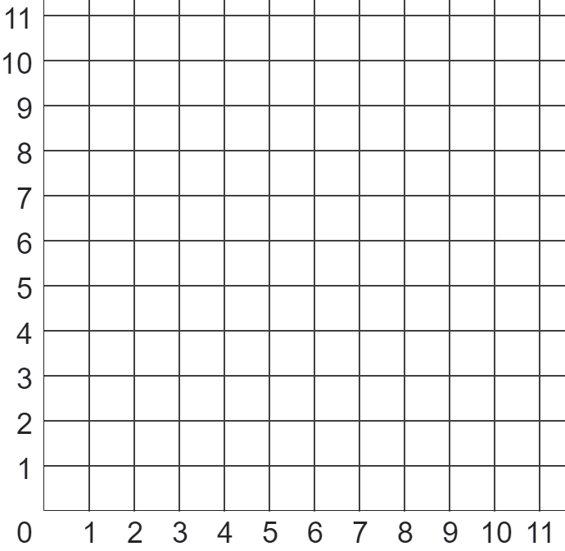
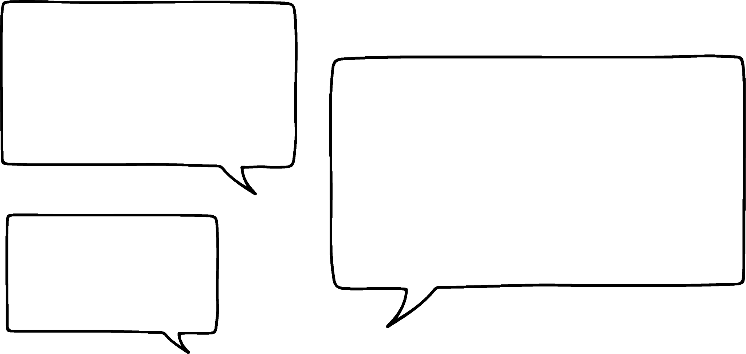

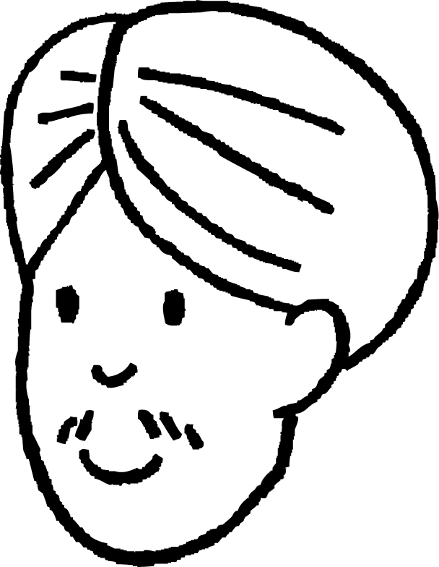

Aragtida Pythagoras (Pythagoras’ theorem) iyo isku-duwayaasha (coordinates)
Aragtida Pythagoras (Pythagoras’ theorem) waxaa loo isticmaali karaa in lagu xisaabiyo masaafada ugu gaaban ee u dhaxaysa laba dhibcood oo ku yaal shabag isku-duwayaasha (coordinate grid).
??? halbeeg (units)
Laakiin sidee?
Waxaan u malaynayay in aragtida Pythagoras (Pythagoras’ theorem) ay tahay saddexagalka qumman (right-angled triangle).
Sidee baad uga samayn kartaa saddexagal qumman (right-angled triangle) hal xariiq toosan (straight line segment) oo keliya?
Cali

Slide 7
Aragtida Pythagoras (Pythagoras’ theorem) iyo isku-duwayaasha (coordinates)
Aragtida Pythagoras (Pythagoras’ theorem) waxaa loo isticmaali karaa in lagu xisaabiyo masaafada ugu gaaban ee u dhaxaysa laba dhibcood oo ku yaal shabag isku-duwayaasha (coordinate grid).
Xariiq toosan oo jiifa (horizontal ray) ayaa laga soo bixin karaa mid ka mid ah dhibcaha,
iyo xariiq toosan oo taagan (vertical ray) ayaa laga soo bixin karaa dhibcaha kale.
Dhibcaha ay labada xariiq toosan (rays) isku gooyaan ayaa ah dhibcaha saddexaad ee saddexagalka qumman (right-angled triangle).

Slide 8
Aragtida Pythagoras (Pythagoras’ theorem) iyo isku-duwayaasha (coordinates)
Dhab ahaantii, dhibcaha ay labada xariiq toosan (rays) isku gooyaan had iyo jeer waa cidhifka xagasha qumman (right angle), laftiisa.
Oh, taas waa fududahay marka.
Waan ogahay dhinaca had iyo jeer ah hypotenuse-ka (hypotenuse) saddex-xagashaas!
Cali

Slide 9
Aragtida Pythagoras (Pythagoras’ theorem) iyo isku-duwayaasha (coordinates)
Xaqiiqdii, barta ay labada shucaac (rays) isku gooyaan had iyo jeer waa cidhifka (vertex) xagasha qumman (right angle), lafteeda.
??? cutub (units)
Fogaanta (distance) u dhaxaysa labada bari ee asalka ah sidoo kale had iyo jeer waa dhererka hypotenuse-ka (hypotenuse), sababtoo ah waxay ka soo horjeedaa xagasha qumman (right angle) ee laga sameeyay labada shucaac (rays)!
Cali

Slide 10
Aragtida Pythagoras (Pythagoras’ theorem) iyo isku-duwayaasha (coordinates)
Xaqiiqdii, barta ay labada shucaac (rays) isku gooyaan had iyo jeer waa cidhifka (vertex) xagasha qumman (right angle), lafteeda.
??? cutub (units)
Laakiin weli ma aqaano dhererka (lengths) dhinacyada saddex-xagasha (triangle) midkoodna!
Ma isticmaali karo aragtida Pythagoras (Pythagoras’ theorem) laba ka mid ah la'aan.
Cali

Slide 11
Aragtida Pythagoras (Pythagoras’ theorem) iyo isku-duwayaasha (coordinates)
Waxaan heli karnaa dhererka (lengths) labada dhinac ee gaaban (shorter sides) anagoo tirinayna tirada labajibbaaranayaasha (squares) kor iyo guud.
5.385 cutub (units)
h cutub (units)
Hadda waxaan isticmaali karnaa aragtida Pythagoras (Pythagoras’ theorem) si aan u helno fogaanta (distance) ugu gaaban (shortest) ee u dhaxaysa labada bari ee asalka ah:
2 cutub (units)
h² = 2² + 5²
5 cutub (units)
h² = 29
h² = 5.385
Fogaanta (distance) ugu gaaban (shortest) ee u dhaxaysa labadan bari waa 5.385 cutub (units) dherer.

Slide 12

Aragtida Pythagoras (Pythagoras’ theorem) iyo isku-duwayaasha (coordinates)
Saddex xagal qumman (right-angled triangle) ayaa la sameeyay iyadoo hypotenuse (hypotenuse) uu yahay AB.
Waa maxay dhererka (halbeeg) saldhigga tooska ah iyo joogga toosan ee saddexagalkan?
B
A
5
saldhig: ________ halbeeg
a
3
joog: ________ halbeeg
b

Slide 13
Aragtida Pythagoras (Pythagoras’ theorem) iyo isku-duwayaasha (coordinates)
Waa maxay masaafada ugu gaaban (shortest distance) ee u dhaxaysa dhibcaha A iyo B?
5.83 halbeeg
B
A

Slide 14
Aragtida Pythagoras (Pythagoras’ theorem) iyo isku-duwayaasha (coordinates)
Su'aal: xisaabi wareega (perimeter) saddexagalkan.
Si aad u xisaabiso wareega (perimeter), waxaad u baahan doontaa inaad xisaabiso dhererka dhinac kasta.
Dherer kasta oo aan la garanayn, waxaan u baahanahay inaan dhisno saddex xagal qumman (right-angled triangle) oo dhinaciisa uu yahay hypotenuse (hypotenuse).
x halbeeg
y halbeeg
10 halbeeg

Slide 15
Aragtida Pythagoras (Pythagoras’ theorem) iyo isku-duwayaasha (coordinates)
Su'aal: xisaabi wareega (perimeter) saddexagalkan.
Hypotenuse (hypotenuse) saddexagalka A waa:
saddex xagal
B
x² = 5² + 7²
x² = 74
saddex xagal A
8.60 halbeeg
x² = 8.60
5.83 cutub (units)
Jibbaarta (hypotenuse) ee saddex-xagalka B waa:
y² = 5² + 3²
y² = 34
10 halbeeg
y² = 5.83

Slide 16
Aragtida (theorem) ee Pythagoras iyo isku-duwayaasha (coordinates)
Su'aal: xisaabi wareega (perimeter) saddex-xagalkan.
8.60 + 5.83 + 10
Sidaa darteed, wareega (perimeter) saddex-xagalkan waa:
24.43 cutub (units)
8.60 cutub (units)
5.83 cutub (units)
10 cutub (units)

Slide 17

Aragtida (theorem) ee Pythagoras iyo isku-duwayaasha (coordinates)
Mid ka mid ah kuwani waa isla'eg (equation) ku habboon xisaabinta jibbaarta (hypotenuse) saddex-xagalka A?
saddex-xagalka A
a
a² = 7² + 9²
b
b² = 1² + 9²
c
c² = 6² + 7²
d
d² = 1² + 2²

Slide 18
Aragtida (theorem) ee Pythagoras iyo isku-duwayaasha (coordinates)
Xisaabi dhererka (length) dhinaca lagu calaamadeeyay e, ilaa 2 d.p.
7.07 cutub (units)
saddex-xagalka A
e cutub (units)

Slide 19
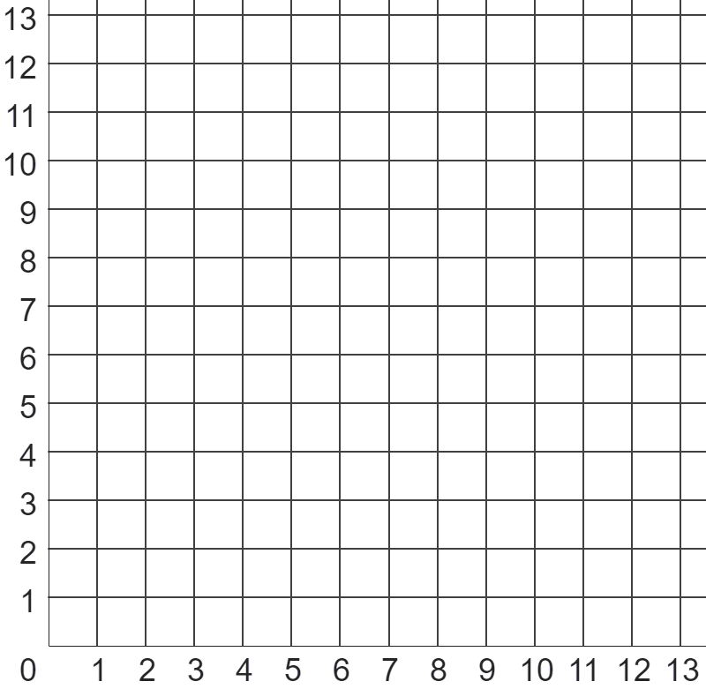
Aragtida (theorem) ee Pythagoras iyo isku-duwayaasha (coordinates)
B
1) Isticmaal aragtida (theorem) ee Pythagoras si aad u hesho masaafada (distance) ugu gaaban (ilaa 1 d.p) inta u dhaxaysa dhibcaha (points):
A
a) A iyo B
b) A iyo C
c) B iyo D
d) C iyo D
e) B iyo E
C
D
E

Slide 20
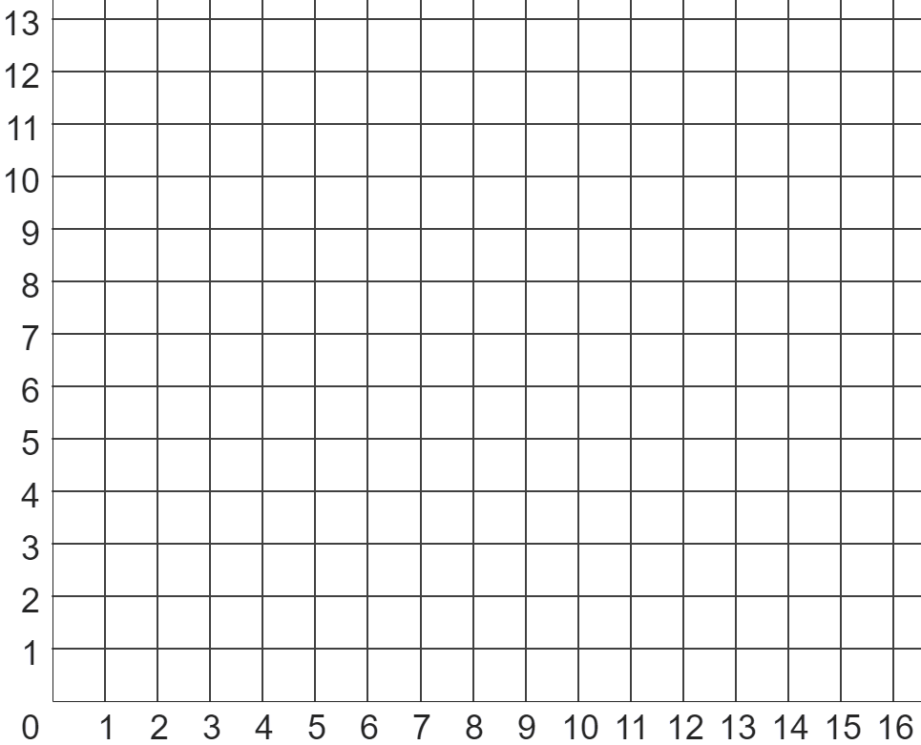
Aragtida Pythagoras (Pythagoras’ theorem) oo leh isku-duway (coordinates)
scalene (scalene)
saddexagal (triangle)
2) Xisaab wareegga (perimeter) qaab kasta (ilaa 2 d.p.).
labajibbaaran (square)
3) Qor saddex isku-duway (coordinates) oo geesahoodu sameeyaan saddexagal (triangle) leh wareeg (perimeter) u dhexeeya 20 iyo 22 halbeeg (units) dherer.
Muuji tani waa sax iyadoo la adeegsanayo aragtida Pythagoras (Pythagoras’ theorem).
isosceles (isosceles)
saddexagal (triangle)

Slide 21
Aragtida Pythagoras (Pythagoras’ theorem) oo leh isku-duway (coordinates)
B
1) Adeegso aragtida Pythagoras (Pythagoras’ theorem) si aad u hesho masaafada ugu gaaban (ilaa 1 d.p) ee u dhaxaysa dhibcaha:
A
a) A iyo B
b) A iyo C
c) B iyo D
d) C iyo D
e) B iyo E
6.7 units
4.5 units
8.1 units
8 units
12.2 cutub (units)
C
D
E

Slide 22
Aragtida Pythagoras (Pythagoras’ theorem) oo leh isku-duwayaal (coordinates)
scalene (scalene)
saddex-xagal (triangle)
2) Xisaabi wareegga (perimeter) qaab kasta (ilaa 2 d.p.).
labajibbaaran (square)
4 × 3.60555
14.42 cutub (units)
labajibbaaran (square)
saddex-xagal isosceles (isosceles triangle)
2 × 7.071 + 10
24.14 cutub (units)
isosceles (isosceles)
saddex-xagal (triangle)
saddex-xagal scalene (scalene triangle)
5.83095 + 5 + 6.08276
16.91 cutub (units)

Slide 23
Aragtida Pythagoras (Pythagoras’ theorem) oo leh isku-duwayaal (coordinates)
scalene (scalene)
saddex-xagal (triangle)
3) Qor saddex isku-duwayaal (coordinates) oo geesahoodu (vertices) sameeyaan saddex-xagal leh wareeg (perimeter) u dhexeeya 20 iyo 22 cutub (units) dherer.
Muuji tani waa sax iyadoo la adeegsanayo aragtida Pythagoras (Pythagoras’ theorem).
labajibbaaran (square)
Waxaa jira xalal badan oo suurtagal ah, sida saddex-xagal leh geeso (vertices) (4, 6), (3, 12) iyo (10, 8)
isosceles (isosceles)
saddex-xagal (triangle)

Slide 24
Xallinta dhibaatooyinka isku ekaanshaha (similarity) iyo aragtida Pythagoras (Pythagoras’ theorem)
Aragtida Pythagoras (Pythagoras’ theorem) iyo isku-duwayaasha (coordinates)
Aragtida Pythagoras (Pythagoras’ theorem) iyo saamiyada (ratios)

Slide 25
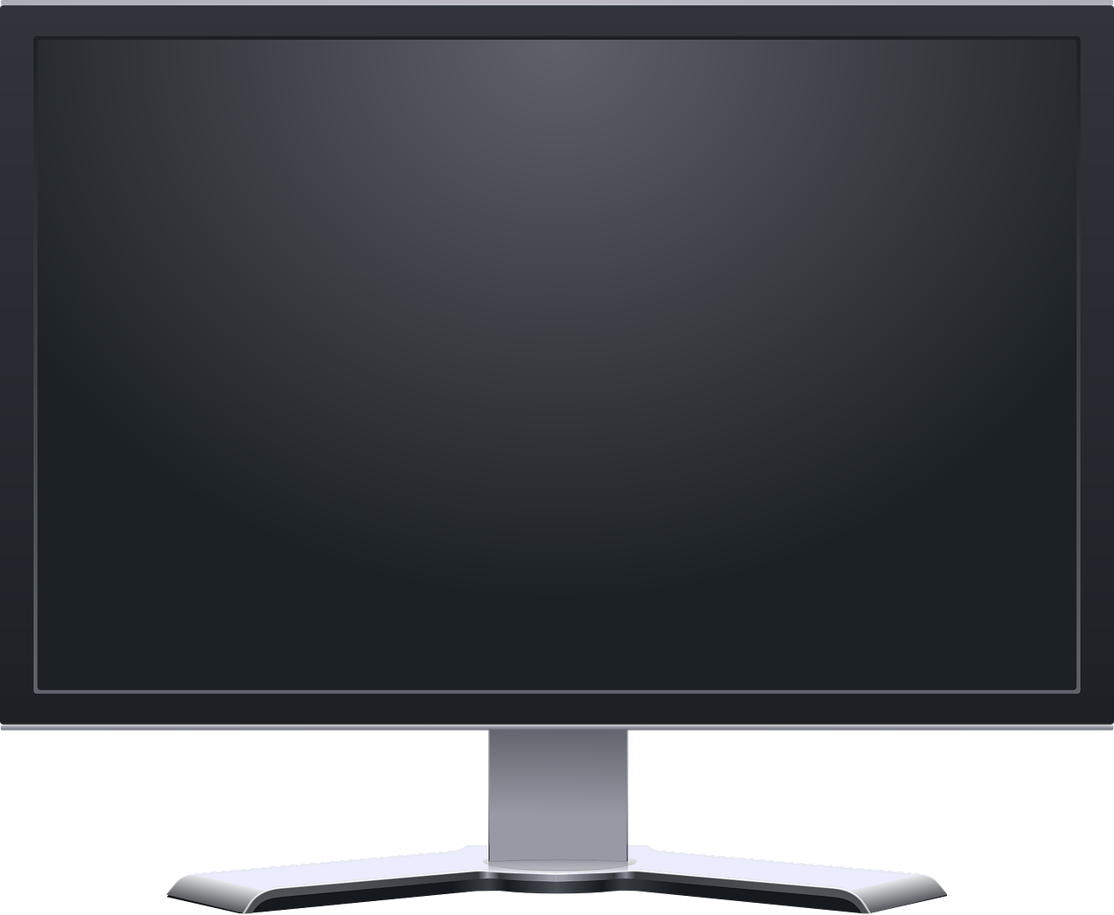





Aragtida Pythagoras (Pythagoras’ theorem) iyo saamiyada (ratios)
Waxaa laga yaabaa inaad maalin kasta aragto qaabab isku eg (similar shapes) oo ay ku jiraan saddexagallo qumman (right-angled triangles) iyada oo aanad xitaa garanayn!
Inta badan shaashadaha TV-ga,
shaashadaha kombiyuutarka,
iyo shaashadaha taleefannada gacanta
waxay isku eg yihiin qaab ahaan.
Tani waxay u tahay si filim loo ciyaari karo si caadi ah hal shaashad iyada oo aan u ekaan...
qalloocan ama la fidsan shaashad kale oo ka ballaadhan marka loo eego dhererkeeda.

Slide 26
Aragtida Pythagoras (Pythagoras’ theorem) iyo saamiyada (ratios)
Waxaan dhahnaa mid kasta oo ka mid ah shaashadahan ballaadhan (widescreen) wuxuu ku jiraa saamiga (aspect ratio) 16 : 9.
16 halbeeg (units)
Macneheedu waa 16 halbeeg (units) oo xagga dhinaca ah,
waxaa jira 9 halbeeg (units) oo kor ah.
9 halbeeg (units)

Slide 27

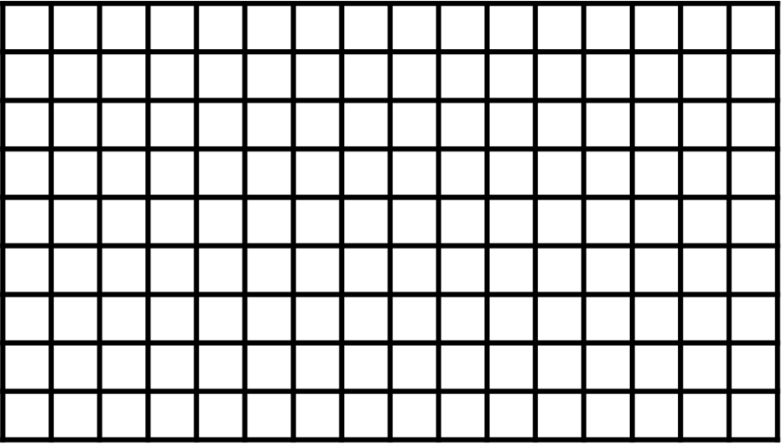


Aragtida Pythagoras (Pythagoras’ theorem) iyo saamiyada (ratios)
Dhererka hal “halbeeg” (unit) ayaa ah waxa isbeddelaya inta u dhaxaysa shaashad kasta.
16 halbeeg (units)
9 halbeeg (units)
That’s really cool…
Laakiin maxay tani xiriir la leedahay aragtida Pythagoras?
16 units
9 units
Andeep

Slide 28
Pythagoras’ theorem with ratios
Marka cabbirka shaashadda TV-ga, kormeeraha, ama taleefanka la qeexo, kaliya hal dherer ayaa la bixiyaa.
For example:
“Shaashaddan taleefanku waa 7 inji”
16 units
7 inches
9 units
Dhererkani wuxuu qeexayaa jaantuska shaashadda.
And so we can find the width and length of a screen by using Pythagoras’ theorem and ratios, since we know the screen will be in proportion to 16 units and 9 units.

Slide 29
Pythagoras’ theorem with ratios
To find the diagonal of a screen in units, we can use Pythagoras’ theorem:
16 units
x² = 16² + 9²
18.36 units
Shaashaddu waa 18.36 halbeeg oo ku xagasha jaantuskeeda.
x units
x² = 337
9 units
x² = 18.36
We can then represent this information in a ratio table.
16 | 9 | 18.36
halbeegyo ahaan (in units)
width of screen
joogga shaashadda (height of screen)
jaantuska shaashadda (diagonal of screen)

Slide 30
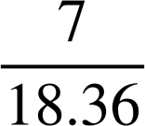
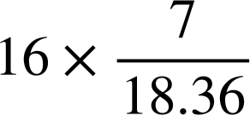
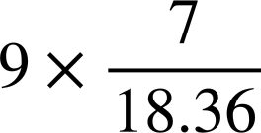
Aragtida Pythagoras (Pythagoras’ theorem) iyo saamiyada (ratios)
Haddii aan ognahay in shaashadda talefoonku tahay 7 inji oo ku xagasha jaantuskeeda, waxaan heli karnaa ballaca iyo jooggeeda inji ahaan.
16 halbeeg (units)
6.1 inji
18.36 halbeeg (units)
7 inji
3.4 inji
9 halbeeg (units)
Waxaan markaa ku matali karnaa macluumaadkan jaantus saami (ratio table).
16 | 9 | 18.36
halbeegyo ahaan (in units)
×
÷
6.1
3.4
7
inji ahaan (in inches)
Shaashadda talefoonku waa 6.1 inji ballac iyo 3.4 inji joog.

Slide 31

Aragtida Pythagoras (Pythagoras’ theorem) iyo saamiyada (ratios)
Shaashadaha retro waxay lahaayeen ballac iyo joog oo saami ahaan 4 : 3
Adigoo isticmaalaya aragtida Pythagoras (Pythagoras’ theorem), soo hel inta halbeeg ee jaantuska shaashaddani dhererkiisu yahay.
5 units
Jaantusku waa 5 halbeeg dherer.
Jawaabaha:
4 halbeeg (units)
3 halbeeg (units)

Slide 32
Qiyaasta (theorem) ee Pythagoras oo leh saamiyada (ratios)
Sanduuqa shaashadda retro waxaa ku qoran
“18 inch screen”.
Xaggee shaxdan saamiyada (ratio table) ayuu tiro 18 ku dhacayaa?
4 units
5 units
3 units
ballac (width) | joog (height) | xagal (diagonal)
4 | 3 | 5
units
inches
a
b
c

Slide 33
Qiyaasta (theorem) ee Pythagoras oo leh saamiyada (ratios)
Sanduuqa shaashadda retro waxaa ku qoran
“18 inch screen”.
Waa maxay isku-dhufashadan (multiplier), k?
4 units
5 units
3 units
ballac (width) | joog (height) | xagal (diagonal)
4 | 3 | 5
 |  | 18
× k
÷
k = 3.6

Slide 34
Aragtida Pythagoras (Pythagoras’ theorem) iyo saamiyada (ratios)
Sanduuqa shaashadda retro waxaa ku qoran
“18 inch screen”.
Waa maxay ballaca (width) iyo jooga (height) shaashaddan, oo ku qoran inches?
4 units
14.4 inches
5 units
18 inches
3 units
10.8 inches
ballac (width) | joog (height) | jaantus (diagonal)
4 | 3 | 5
 |  | 18
× 3.6
÷
14.4 inches
10.8 inches
a
b

Slide 35
Aragtida Pythagoras (Pythagoras’ theorem) iyo saamiyada (ratios)
1) Mid kasta oo ka mid ah saddexdan TV-ga ballaaran (widescreen) wuxuu leeyahay ballac (width) iyo joog (height) oo saami (ratio) 16 : 9 ah.
8 inches
12 inches
a) Dhammaystir jumlada kasta adoo dooranaya erayga ku habboon hoose.
shaashadda A (screen A)
Mid kasta oo ka mid ah TV-yada waa ___________ midka kale.
shaashadda B
Tani waa sababta oo ah ___________ iyo ___________ waxay ku jiraan ___________ midba midka kale.
30 inches
___________ shaashadda A ilaa B waa 1.5.
saami (proportion)
qiyaasta weyneyn (scale factor)
ballaca (width)
isku qaab (congruent)
joogga (height)
isku mid (similar)
shaashadda C

Slide 36
Aragtida Pythagoras (Pythagoras’ theorem) iyo saamiyada (ratios)
1) Mid kasta oo ka mid ah saddexdan TV oo ballaadhan ayaa leh ballaca (width) iyo joogga (height) saami (ratio) 16 : 9.
8 inches
12 inches
b) Adoo adeegsanaya aragtida Pythagoras (Pythagoras’ theorem), dhammaystir shaxda saamiyada (ratio table) ee shaashadda B (3 d.p.)
shaashadda A
ballaci (width) | joogga (height) | jaantus (diagonal)
16 | 9
 |  | 12
shaashadda B
30 inches
c) Sidaas awgeed, xisaabi ballaca (width) shaashadaha A iyo C (2 d.p.)
shaashadda C

Slide 37

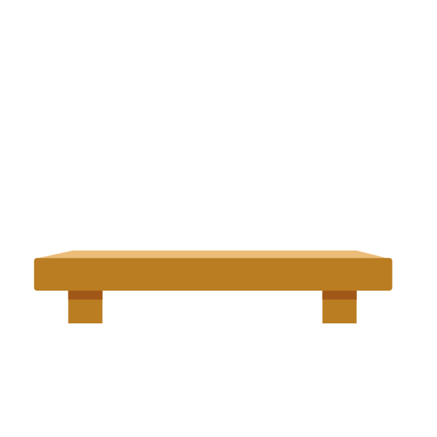
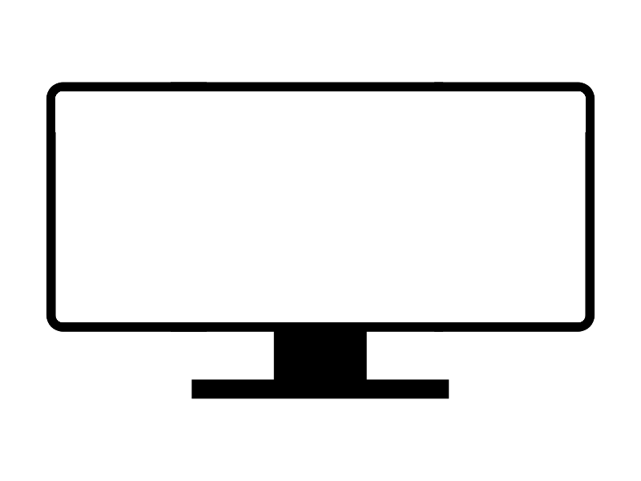
Aragtida Pythagoras (Pythagoras’ theorem) iyo saamiyada (ratios)
2) Isra waxay rabtaa inay iibsato TV-ga ultra widescreen, kaas oo ballaciisa iyo jooggiisu yihiin saami 22 : 9.
TV-gu wuxuu leeyahay shaashad 35 inch, iyo saldhig dhererkiisu yahay 2 inch.
Ma ku habboonaa TV-ga gudaha armaajo TV-ga?
armaajo TV (TV cabinet)
15 inches
36 inches
ballaci (width) | joogga (height) | jaantus (diagonal)
ultra widescreen
22 : 9
saamiga dhinacyada (aspect ratio)

Slide 38
Aragtida Pythagoras (Pythagoras’ theorem) iyo saamiyada (ratios)
3) Yacquub wuxuu arkayaa saddex TV oo iib ah, mid kastaa wuxuu leeyahay shaashad 28 inch.
Yacquub wuxuu rabaa inuu iibsado TV-ga shaashadiisu leedahay bedka ugu weyn.
Kee ayuu iibsanayaa?
TV retro (saami 4 : 3)
TV widescreen (saami 16 : 9)
TV ultra widescreen (saami 22 : 9)

Slide 39
Qiyaasta (theorem) ee Pythagoras oo leh saamiyada (ratios)
1) Mid kasta oo ka mid ah saddexdan TV-ga ballaadhan (widescreen) wuxuu leeyahay ballac (width) iyo joog (height) oo ku jira saamiga (ratio) 16 : 9.
8 inches
12 inches
a) Dhammaystir jumlad kasta adoo dooranaya erayga ku habboon ee hoos ku qoran.
shaashadda A (screen A)
Mid kasta oo ka mid ah TV-yada (TVs) wuxuu ___________ yahay kuwa kale.
shaashadda B (screen B)
isku mid (similar)
Tani waa sababta oo ah _________ iyo _________ waxay ku jiraan ___________ midba midka kale.
ballac (width)
joog (height)
saami (proportion)
30 inches
___________-ka laga bilaabo shaashadda A (screen A) ilaa B (screen B) waa 1.5.
qiyaasta isweyneyn (scale factor)
shaashadda C (screen C)

Slide 40
Qiyaasta (theorem) ee Pythagoras oo leh saamiyada (ratios)
1) Mid kasta oo ka mid ah saddexdan TV-ga ballaadhan (widescreen) wuxuu leeyahay ballac (width) iyo joog (height) oo ku jira saamiga (ratio) 16 : 9.
8 inches
12 inches
b) Adigoo isticmaalaya aragtida Pythagoras, buuxi jaantuska saamiga ee shaashadda B (3 d.p.)
shaashadda A
ballaca (width) | joogga (height) | jaantuska (diagonal)
16 | 9 | 18.358
10.459 | 5.883 | 12
shaashadda B
30 inji
c) Sidaa awgeed, xisaabi ballaca (width) shaashadaha A (screen A) iyo C (screen C) (2 d.p.)
shaashadda A: 10.459 ÷ 1.5 = 6.97 inji
shaashadda C: 10.459 × 2.5 = 26.15 inji
shaashadda C

Slide 41
Aragtida Pythagoras oo leh saamiyo
2) Isra waxay rabta inay iibsato TV-ga ultra widescreen, kaas oo ballaca iyo jooggiisu yihiin saami 22 : 9.
TV-ga wuxuu leeyahay shaashad 35 inji, iyo saldhig 2 inji oo dheer.
Ma ku habboona TV-ga gudaha armaajooyinkeeda TV-ga?
armaajo TV-ga
15 inji
36 inji
Maya, TV-ga kuma habboona armaajada.
In kasta oo shaashadu ka yar tahay ballaca iyo joogga armaajada, saldhigga 2 inji ee TV-ga ayaa ka dhigaya TV-ga mid aad u dheer.
ballaca (width) | joogga (height) | jaantuska (diagonal)
22 | 9 | 23.77
32.39 | 13.25 | 35

Slide 42
Aragtida Pythagoras (Pythagoras’ theorem) oo leh saamiyada (ratios)
3) Yacquub wuxuu arkayaa saddex TV oo la iibinayo, mid walbana leh shaashad 28 inch.
jadwalka soo koobida xalalka (summary table of solutions)
TV retro (4 : 3 saamiga (aspect ratio))
TV ballaadhan (widescreen) (16 : 9 saamiga (aspect ratio))
TV aad u ballaadhan (ultra widescreen) (22 : 9 saamiga (aspect ratio))
TV | ballaca (width) | joogga (height) | bedka (area)
retro | 22.4 | 16.8 | 376 inches²
ballaadhan (widescreen) | 24.4 | 13.7 | 335 inches²
aad u ballaadhan (ultra widescreen) | 25.9 | 10.6 | 275 inches²
Inkasta oo saddexda TV ay dhererka geeska (diagonal) yihiin 28 inches, TV-ga retro ayaa leh shaashadda bedka (area) ugu weyn.

Slide 43
Xallinta mashaakilaadka (problem solving) iyadoo la isticmaalayo isku midnimada (similarity) iyo aragtida Pythagoras (Pythagoras’ theorem)
Inkasta oo aragtida Pythagoras (Pythagoras’ theorem) ay caawin karto helista dhererka dhinaca saddex-xagalka qumman (right-angled triangle) marka la bixiyo dhererka labada dhinac ee kale, waxaa laga yaabaa inaysan lagama maarmaan ahayn in la isticmaalo, iyadoo ku xiran haddii qiimaha (value) aan raadinayno uu yahay xagal (angle), bed (area), ama wareeg (perimeter).
Aragtida Pythagoras (Pythagoras’ theorem) waxaa loo isticmaali karaa in lagu helo dhererka dhinaca marka la isbarbardhigayo laba saddex-xagal oo qumman (right-angled) oo isku mid ah (similar).
Waxaad isticmaali kartaa aragtida Pythagoras (Pythagoras’ theorem) si aad u hesho masaafada ugu gaaban (shortest distance) ee u dhaxaysa laba isku-duwayaal (coordinates), ama wareegga (perimeter) qaababka (shapes) geesahoodu ku yaalliin shabkada isku-duwayaasha (coordinate grid).
Aragtida Pythagoras (Pythagoras’ theorem) waxaa loo isticmaali karaa iyadoo lala shaqeynayo saamiga (aspect ratio) ee TV-yada si loo xisaabiyo ballaca (width) iyo joogga (height) shaashadda TV-ga, marka la bixiyo dhererka geeska (diagonal).

