Slide 1
Sifooyinka curiyeyaasha (Properties of elements)
Atamka, curiyeyaasha iyo xeryahooda (Atoms, elements and compounds)

Slide 2
sida loo isticmaalo darasyada Oak

Slide 3
Waxaan qiyaasi karaa sifooyinka kiimikada iyo jireed ee curiyeyaasha kiimikada kala duwan.

Slide 4
walax saafi ah (pure substance)
sifo (property)
sifo jireed (physical property)
sifo kiimiko (chemical property)

Slide 5
Walax saafi ah waxay ka kooban tahay hal nooc oo kiimiko ah.
Sifada walaxdu waa astaan ama qaab lagu kala saari karo ama lagu qiyaasi karo sida ay u dhaqanto.
Sifada jireed ee walaxdu waxay qiyaasaysaa sida walaxdu u muuqato oo u dhaqanto, tusaale: barta karkarinta (boiling point).
Sifada kiimikadu waxay qiyaasaysaa isbeddelada kiimikada ee ku dhaca walaxda falcelinta kiimikada si ay u sameeyaan walxo cusub.

Slide 6

Sifooyinka curiyeyaasha (Properties of elements)
Sifooyinka jireed ee curiyeyaasha (Physical properties of elements)
Sifooyinka kiimikada iyo isbeddellada curiyeyaasha (Chemical properties and trends of elements)

Slide 7
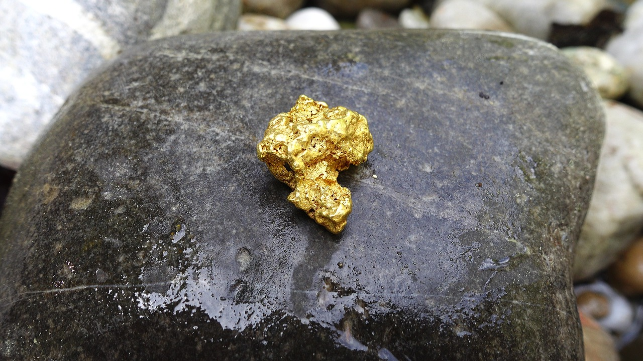

Sifooyinka jireed ee curiyeyaasha (Physical properties of elements)
Curiye (element):
waa walax saafi ah
wuxuu ka kooban yahay hal nooc oo atam ah
gooldhagax saafi ah (pure gold nugget)
atamka dahabka oo kaliya

Slide 8
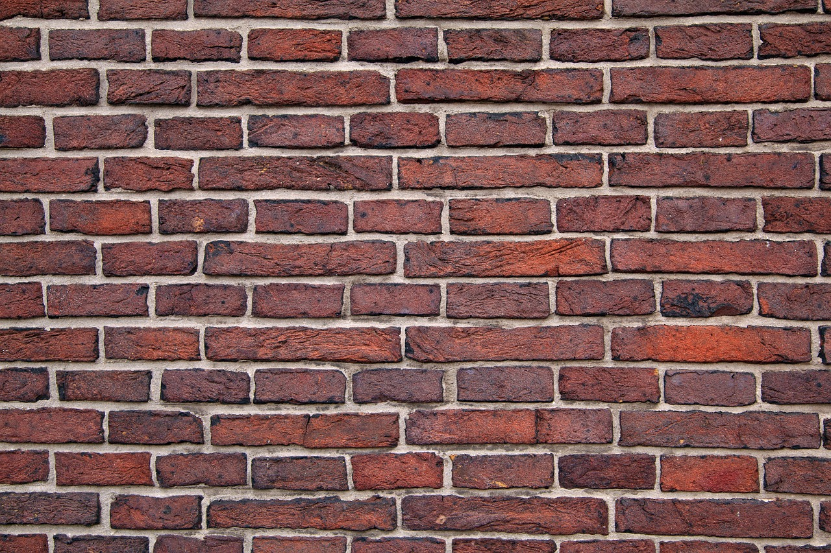
Sifooyinka jireed ee curiyeyaasha (Physical properties of elements)
Marka atam badan oo isku nooc ah ay isku yimaadaan, waxay abuuraan sifooyinka guud ee curiyaha.
Atamku (Atoms) waa dhismaha aasaasiga ah ee curiyeyaasha (elements), mana laha sifooyin la mid ah kuwa curiyaha (element) oo dhan.
Faham qaldan oo caadi ah ayaa ah in atamku (atoms) midab leeyihiin (tusaale, atamka dahabku waa dahab). Dhammaan atamka (atoms) shaqsigu waa kuwo aan midab lahayn.

Slide 9

Sifooyinka jireed ee curiyeyaasha (Physical properties of elements)
Atamka qalinka (Silver atoms) shaqsigu waa kuwo midab qalin leh.
Atamka qalinka (Silver atoms) ma laha sifooyin la mid ah kuwa curiyaha qalinka (element silver). Atamka (atoms) shaqsigu ma laha midab.
Atamka qalinka (Silver atoms) shaqsigu waxay midab qalin leh yihiin oo keliya marka ay ku jiraan xaalad adag (solid state).

Slide 10
Sifooyinka jireed ee curiyeyaasha (Physical properties of elements)
Dooro dhammaan jawaabaha qeexaya curiyeyaasha (elements).
Aluminium-ku (Aluminium) wuxuu ka samaysan yahay hal nooc oo atam (atom) ah.
Koloriinta (Chlorine) waxay ka samaysan tahay hal nooc oo atam (atom) ah.
Aluminium-ku (Aluminium) wuxuu ka samaysan yahay laba atam (atom) oo kala duwan.
Koloriinta (Chlorine) waxay ka samaysan tahay saddex nooc oo atam (atom) ah.

Slide 11
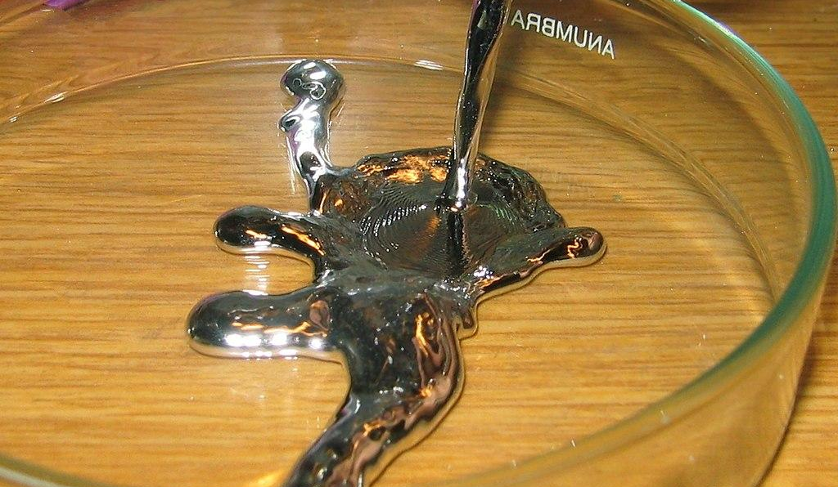
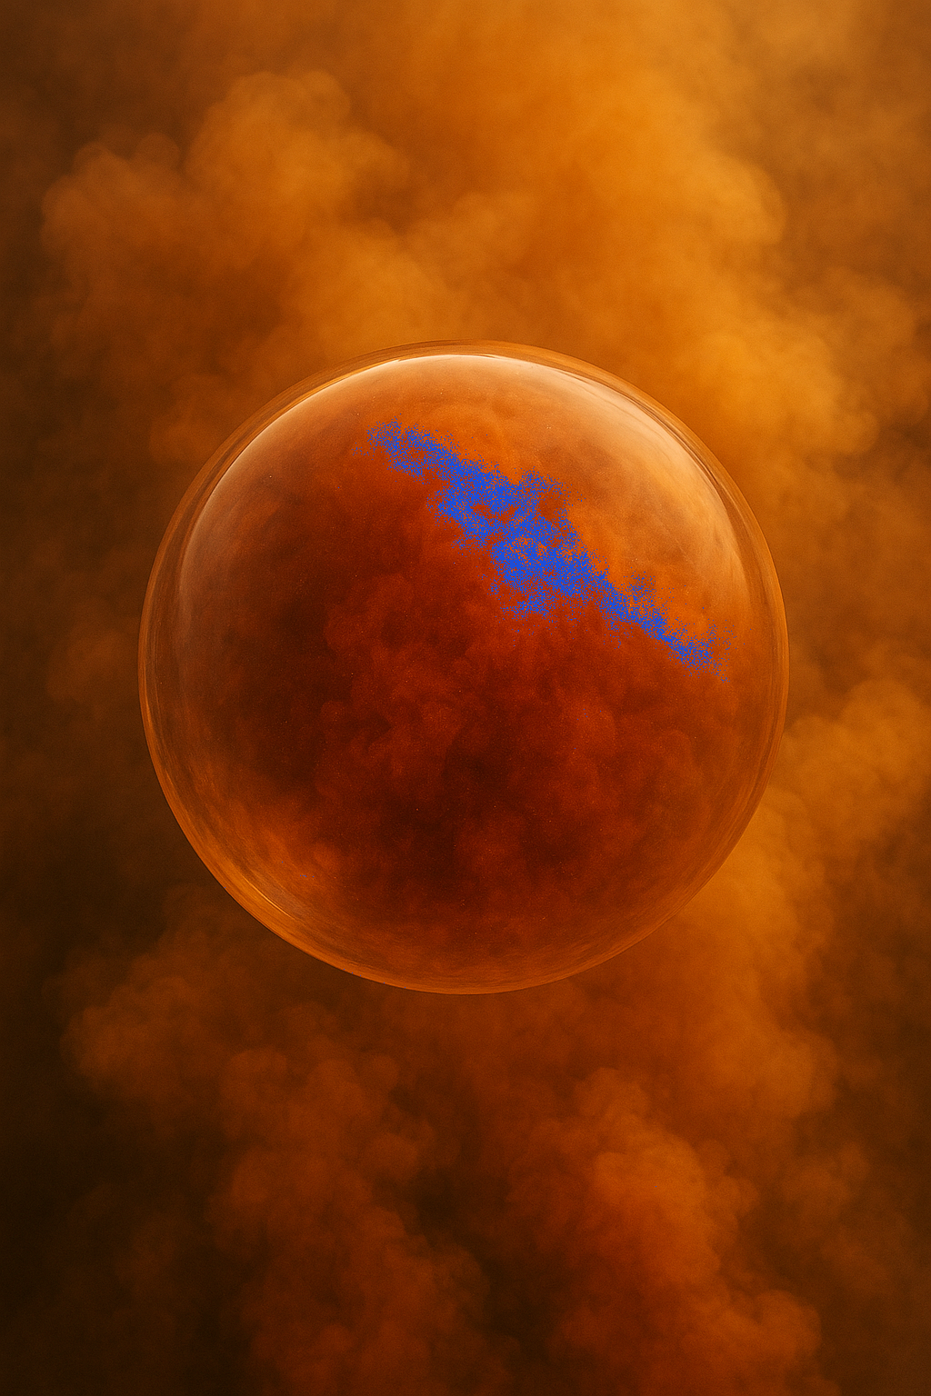
Sifooyinka jireed ee curiyeyaasha (Physical properties of elements)
Dhammaan curiyeyaasha (elements) waxay leeyihiin barta dhalaalidda (melting point) iyo barta karkarinta (boiling point) oo go'an.
Barta dhalaalidda (Melting point) iyo barta karkarinta (boiling point) waa sifooyin jireed (physical properties).
dahab (gold)
heerkulka dhalaalka = 1,064°C
heerkulka karkarinta = 2,836°C
mercury
barta dhalaalidda (melting point) = -39°C
barta karkarinta (boiling point) = 357°C
bromine
barta dhalaalidda (melting point) = -7°C
barta karkarinta (boiling point) = 59°C
Sawirka dhexe: Bionerd, CC BY 3.0, via Wikimedia Commons

Slide 12
Sifooyinka jirka ee curiyeyaasha (elements)
Walaxdu waxay leedahay heerkul dhalaal 75-80°C. Tani waxay ka dhigan tahay inay tahay curiye (element).
Dhammaan curiyeyaasha (elements) waxay leeyihiin heerkul dhalaal go'an iyo heerkul karkarin go'an.
Dhammaan walxaha curiyeyaasha (elements) ah waxay leeyihiin kala duwanaansho heerkulka dhalaalka iyo karkarinta.

Slide 13
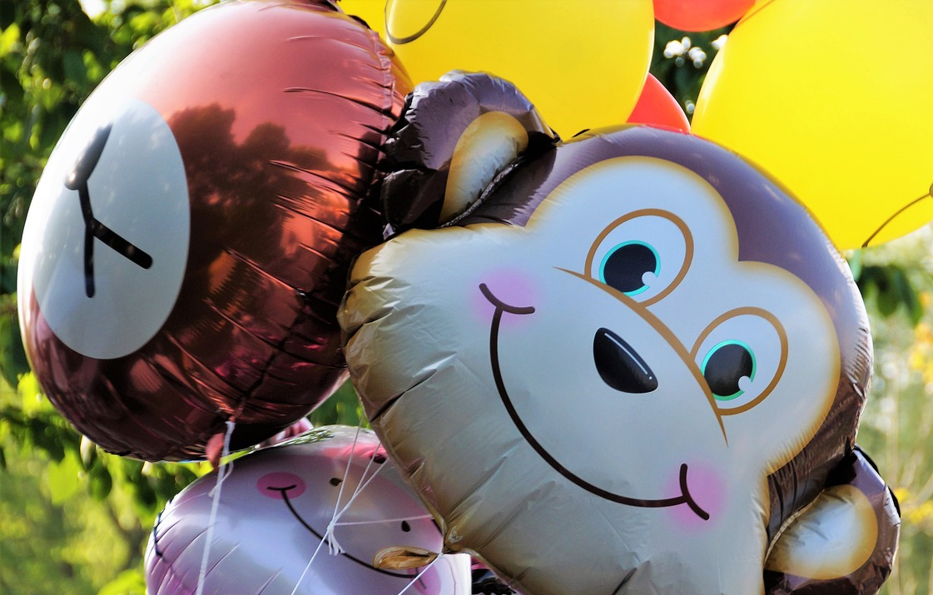
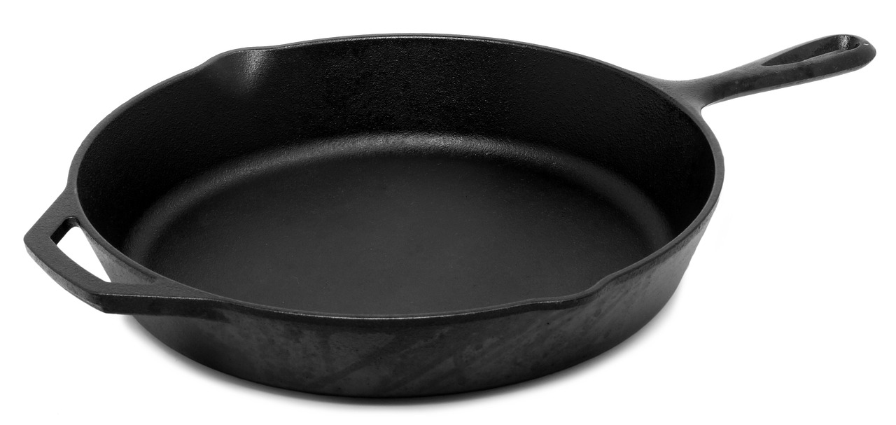
Sifooyinka jirka ee curiyeyaasha (elements)
Sifooyinka jirku waxay qeexaan sida curiyaha (element) u muuqdo oo u dhaqmo.
Kulayl-qabashada (thermal conductivity): awoodda lagu qaado ama lagu qaadin karin kulaylka.
Xaaladda walaxda: gaas, dareere, adag.
Muuqaalka: sida walaxdu u egtahay. tusaale: dhalaalaysa, caajis ah.
Xoogga: xoog leh ama daciif ah.

Slide 14
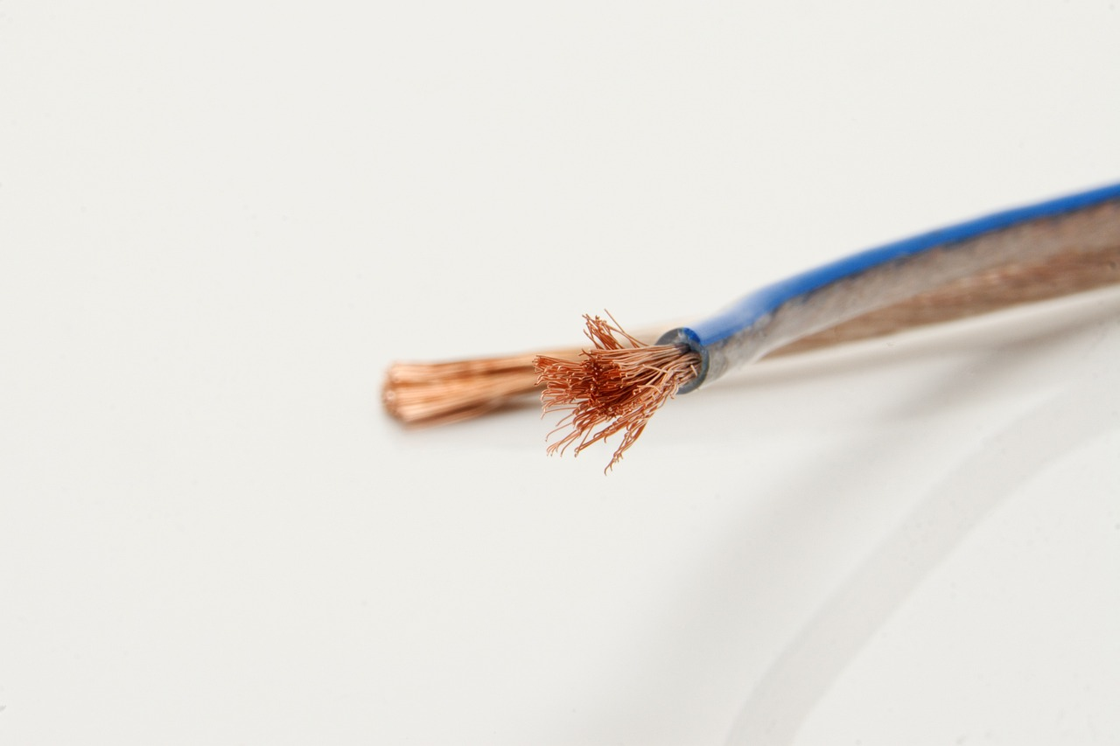
Sifooyinka jirka ee curiyeyaasha (elements)
Sifooyinka jirku waxay qeexaan sida curiyaha (element) u muuqdo oo u dhaqmo.
Ductile: waxaa la jiidi karaa silig.
Malleable: waxaa la qaloocin karaa qaab iyada oo aan jabbin marka xoog (force) la saaro.
Koronto-qabashada (electrical conductivity): awoodda lagu qaado ama lagu qaadin karin korontada.

Slide 15
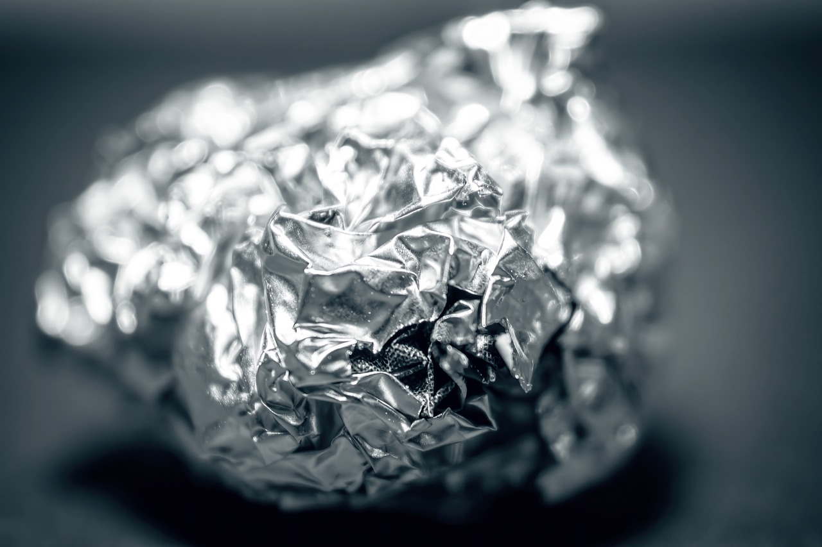
Sifooyinka jirka ee curiyeyaasha (elements)
Tusaalooyinka sifooyinka jirka ee curiyeyaasha (elements) kala duwan.
Aluminium:
barta dhalaalidda (melting point) = 660°C
wax-qaadid fiican oo kulayl (thermal) iyo koronto (electrical) ah
jilicsan marka loo barbardhigo curiyeyaasha (elements) kale ee birta ah
la jajabin karo (malleable)
la soo dhuuqi karo (ductile)
dhalaalaya (shiny)
aluminium

Slide 16
Sifooyinka jireed (physical properties) ee curiyeyaasha (elements)
Tusaalooyinka sifooyinka jireed (physical properties) ee curiyeyaasha (elements) kala duwan.
Bromine:
barta karkarinta (boiling point) = 59°C
midab cagaar-casaan (dull orange)
dareere (liquid) heerkulka qolka (room temperature)
ur xun (unpleasant smell)
bromine

Slide 17
Sifooyinka jireed (physical properties) ee curiyeyaasha (elements)
Sifooyinka jireed (physical properties) ee aluminium waa inay tahay dhalaalaya (shiny), la jajabin karo (malleable) iyo dareere (liquid) heerkulka qolka (room temperature).
Qaar ka mid ah sifooyinka jireed (physical properties) ee aluminium waa inay tahay dhalaalaya (shiny), la soo dhuuqi karo (ductile) iyo dareere (liquid) heerkulka qolka (room temperature).
Qaar ka mid ah sifooyinka jireed (physical properties) ee aluminium waa inay tahay dhalaalaya (shiny), la jajabin karo (malleable) iyo adag (solid) heerkulka qolka (room temperature).

Slide 18
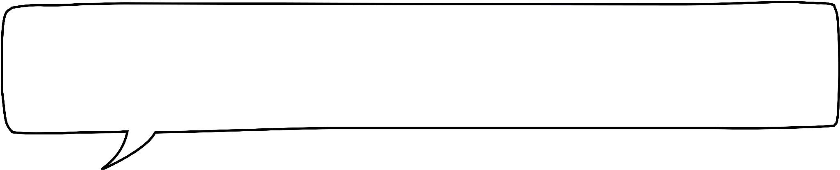


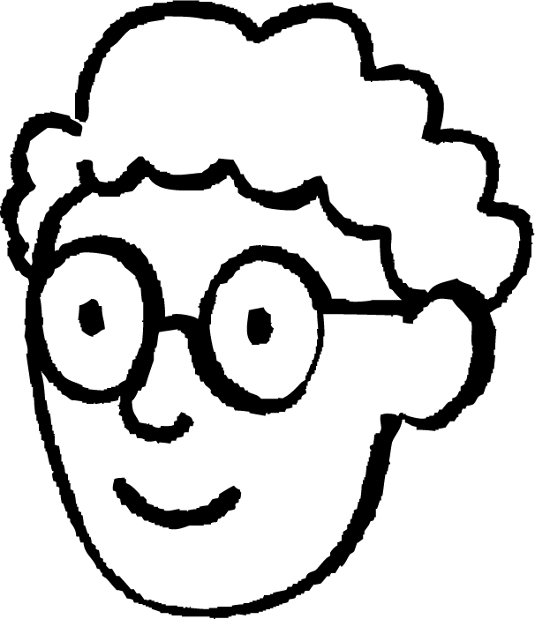
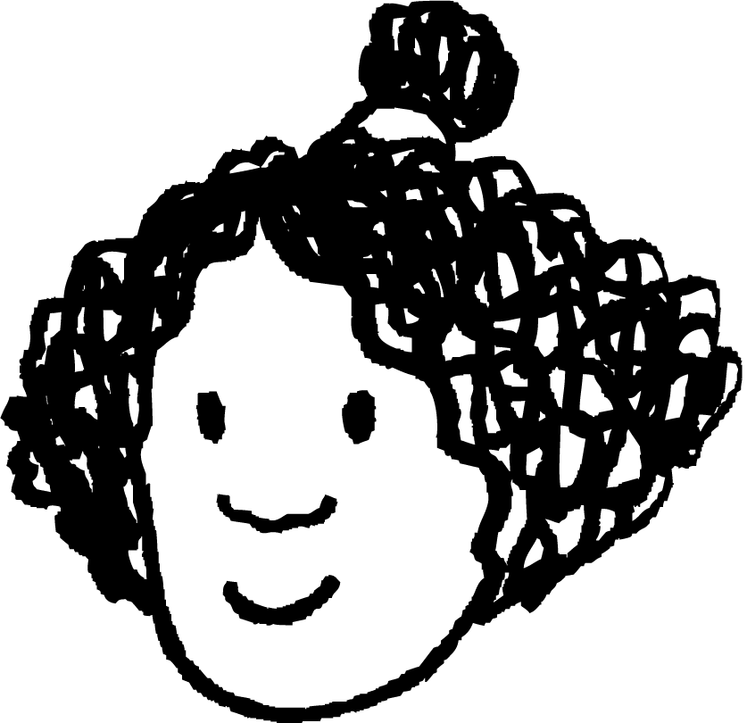


Sifooyinka jireed (physical properties) ee curiyeyaasha (elements)
1a) Sixi hadalada Isra iyo Axmed adoo dooranaya ikhtiyaarka saxda ah ee qawska (brackets) ku jira.
Curiye (element) wuxuu leeyahay (go'an/go'aan kala duwan/midna) dhibic dhalaal ah. Curiye (element) wuxuu leeyahay (go'an/go'aan kala duwan/midna) dhibic karkar ah.
Isra
Curiye (element) waa (had iyo jeer/mararka qaar/marna) ka samaysan yahay hal nooc oo atom (atom) ah.
Axmed

Slide 19
Sifooyinka jireed ee curiyeyaasha (elements)
1a) Sax Isra iyo Axmed hadalkooda adoo dooranaya ikhtiyaarka saxda ah ee qawska ku jira.
Isra
Curiye (element) wuxuu leeyahay dhibic dhalaal go'an.
Curiye (element) wuxuu leeyahay dhibic karkar go'an.
Curiye (element) had iyo jeer wuxuu ka kooban yahay hal nooc oo atom ah.
Axmed

Slide 20
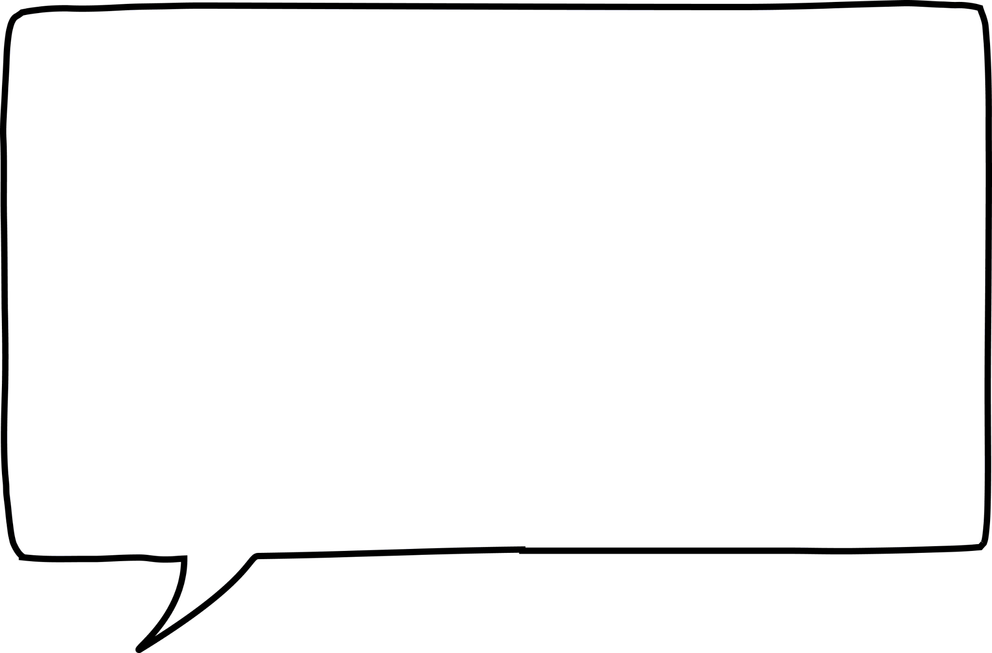
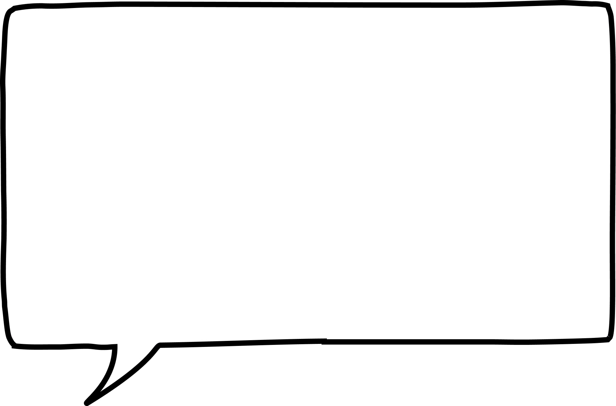
Sifooyinka jireed ee curiyeyaasha (elements)
1b) Sax Isra iyo Axmed hadalkooda adoo dooranaya ikhtiyaarka saxda ah ee qawska ku jira.
Atomyada curiye (element) (waa isku midab/kala midab ah/midab ma laha). Tusaale, atomyada naxaasta (copper) waa (midab naxaas ah/midab la'aan/midab bir qalin ah).
Atom kaliya oo curiye (element) ah wuxuu leeyahay sifooyin (isku mid ah/kala duwan) marka loo eego tiro badan oo curiyaha ah.
Isra
Axmed

Slide 21
Sifooyinka jireed ee curiyeyaasha (elements)
1b) Sax Isra iyo Axmed hadalkooda adoo dooranaya ikhtiyaarka saxda ah ee qawska ku jira.
Atomyada curiye (element) midab ma laha. Tusaale, atomyada naxaasta (copper) waa kuwo midab la'aan ah.
Atom kaliya oo curiye (element) ah wuxuu leeyahay sifooyin kala duwan marka loo eego tiro badan oo curiyaha ah.
Isra
Axmed

Slide 22
Sifooyinka jireed ee curiyeyaasha (elements)
Aqoonsi maadooyinka kuwa curiye (element) ah iyo kuwa aan curiye (element) ahayn.
maadada (substance) | barta dhalaalka (°C) (melting point (°C)) | barta karkarinta (°C) (boiling point (°C)) | noocyada atom-ka ee maadada ku jira (types of atom in substance) | curiye (element) mise ma aha curiye (element)?
A | 98 | 150 | 1
B | 0 | 100 | 2
C | 15-17 | 80-85 | 6
D | 32 | 65 | 2
E | -290 | -185 | 1
F | 1265-1280 | 1300-1392 | 5

Slide 23
Sifooyinka jireed ee curiyeyaasha (elements)
2)
maadada (substance) | barta dhalaalka (°C) (melting point (°C)) | barta karkarinta (°C) (boiling point (°C)) | noocyada atom-ka ee maadada ku jira (types of atom in substance) | curiye (element) mise ma aha curiye (element)?
A | 98 | 150 | 1
B | 0 | 100 | 2
C | 15-17 | 80-85 | 6
D | 32 | 65 | 2
E | -290 | -185 | 1
F | 1265-1280 | 1300-1392 | 5
curiye (element)
ma aha curiye (element)
ma aha curiye (element)
ma aha curiye (element)
curiye (element)
ma aha curiye (element)

Slide 24
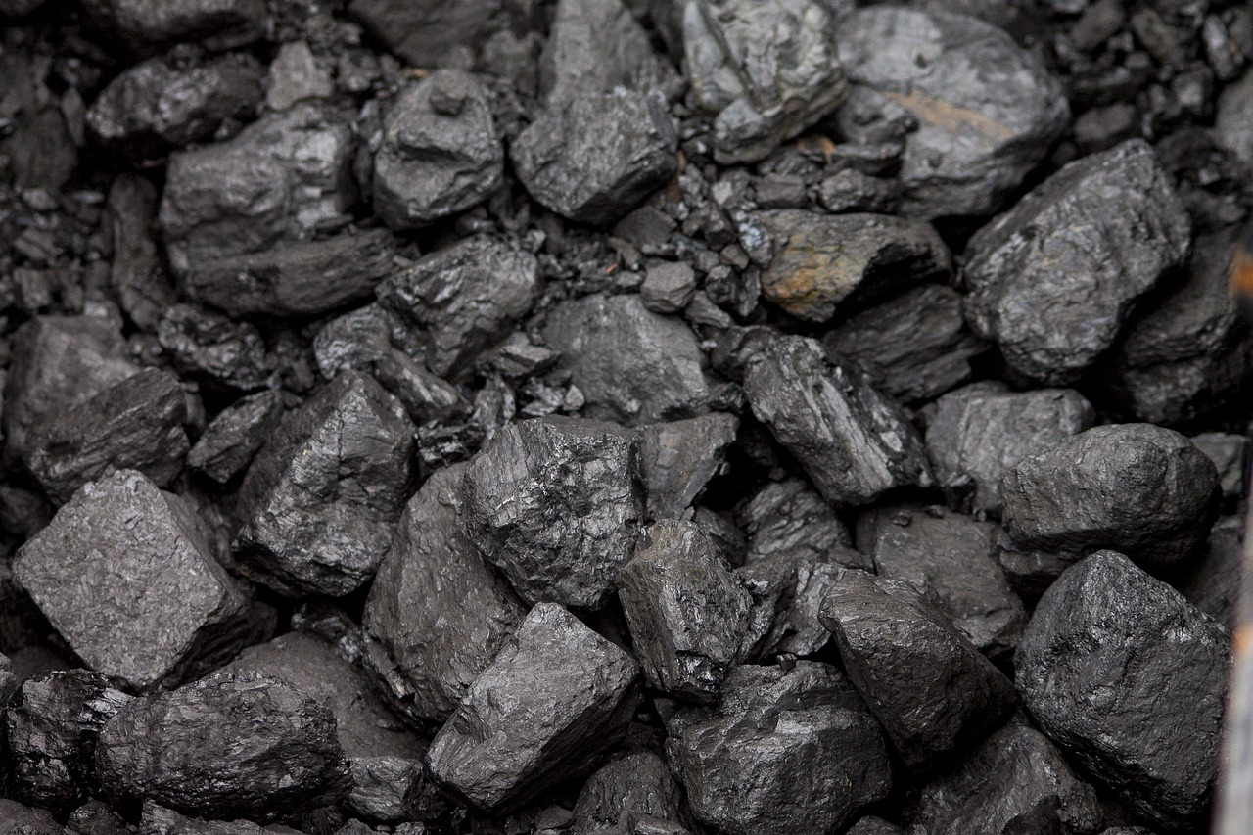
Sifooyinka jireed ee curiyeyaasha (elements)
Kani waa dhuxul (coal), waxa uu ka samaysan yahay kaarboon (carbon).
Dooro sifooyinka curiye (element) kaarboon (carbon) liiska.
Liiska sifooyinka:
la kala bixi karo (ductile)
aan la kala bixin karin (not ductile)
dhalaalaya (shiny)
caajis ah (dull)
jajaban (brittle)
la qaabayn karo (malleable)
xaaladda maadada heerkulka qolka

Slide 25
Sifooyinka jireed ee curiye (element)
Kani waa dhuxul (coal), wuxuu ka samaysan yahay kaarboon (carbon). Dooro sifooyinka kaarboon (carbon) liiska.
aan la kala bixin karin (not ductile)
caajis ah (dull)
jajaban (brittle)
xaaladda maadada - adag heerkulka qolka

Slide 26
Sifooyinka jireed ee curiye (element)
Fiiladani waxay ka samaysan yihiin naxaas (copper).
Liis garo sifooyinka naxaasta (copper).
Sharax sida aad u ogaatay in naxaastu (copper) leedahay sifadan.
Liiska sifooyinka:
la kala bixi karo (ductile)
ma aha mid la jiidi karo (not ductile)
dhalaalaya (shiny)
ma aha koronto qaade (not an electrical conductor)
caajis ah (dull)
xoog badan (strong)
koronto qaade (electrical conductor)
daciif (weak)
xaaladda walaxda ee heerkulka qolka (state of matter at room temperature)
la qaabayn karo (malleable)
jajab badan (brittle)

Slide 27
Sifooyinka jireed ee curiyeyaasha (Physical properties of elements)
Fiiladani waxay ka samaysan yihiin naxaas (copper).
Tax sifooyinka naxaasta (copper).
b) Sharax sida aad u ogaatay in naxaastu (copper) leedahay sifadan.
la jiidi karo (ductile)
dhalaalaya (shiny)
koronto qaade (electrical conductor)
la qaabayn karo (malleable)
adag (solid)
xoog badan (strong)
la jiidi karo (ductile) - sawirku wuxuu muujinayaa fiilooyin
dhalaalaya (shiny) - sawirku wuxuu muujinayaa inay dhalaalayso
koronto-socod (electrical conductor) - loo isticmaalo fiilooyinka korontada
la qaabayn karo (malleable) - fiilooyinka naxaasta (copper) waa la qaabayn karaa iyaga oo aan jabin
xoog badan (strong) - way adag tahay in la jebiyo
adag (solid) - heerkulka qolka

Slide 28
Sifooyinka curiyeyaasha (elements)
Sifooyinka jireed ee curiyeyaasha (elements)
Sifooyinka kiimikada iyo isbeddellada curiyeyaasha (elements)

Slide 29
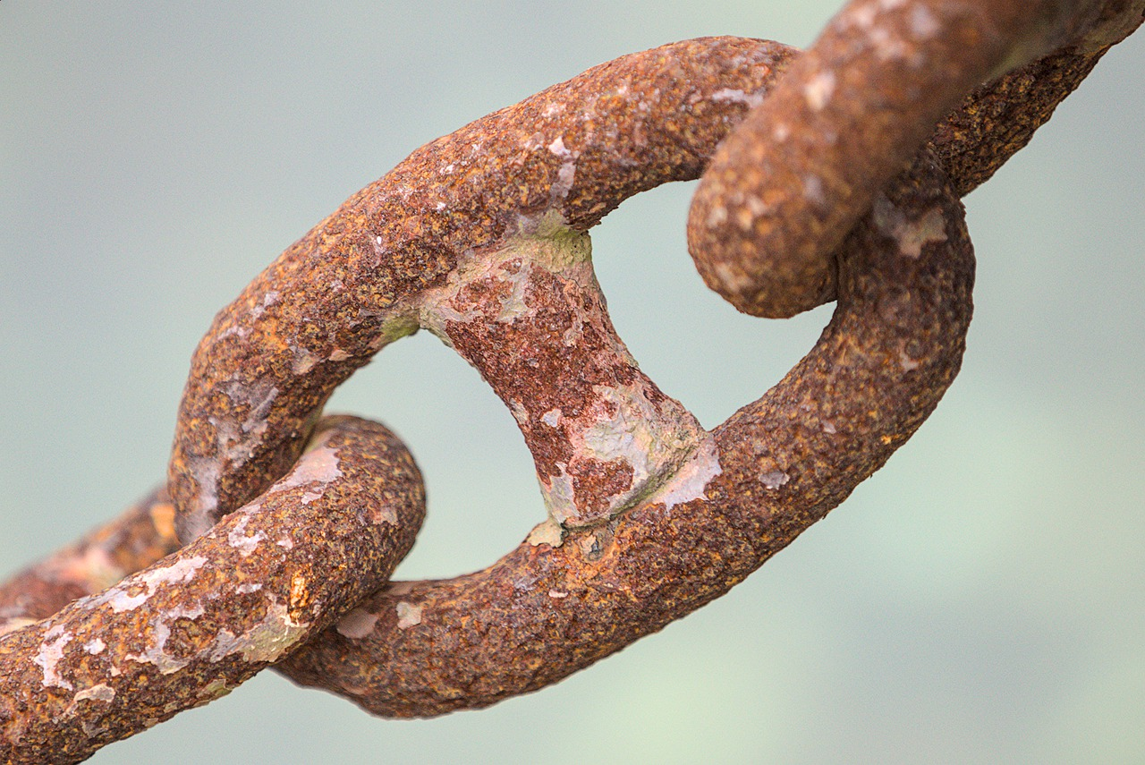
Sifooyinka kiimikada iyo isbeddellada curiyeyaasha (elements)
Curiye kastaa (element) wuxuu leeyahay sifooyin kiimikada oo gaar ah.
Mid ka mid ah sifooyinka kiimikada ee birta (iron) waa inay si tartiib ah ula falceliso oksijiinta (oxygen) si ay u samayso walax cusub oo la yiraahdo bir-oksaydh (iron oxide) (miridh).
Sifo kiimikada waa sida walax ugu falceliso kiimikooyin gaar ah, tusaale:
biyo (water)
aashito (acids)
oksijiin (oxygen)
Walxo cusub had iyo jeer waa la sameeyaa.

Slide 30
Sifooyinka kiimikada iyo isbeddellada curiyeyaasha (elements)
Tusaale sifo kiimikada: curiyaha (element) hydrogen wuxuu si qarax ah ula falceliyaa oksijiinta (oxygen), waxaa la sameeyaa badeecad cusub.
Hydrogen si qarax ah ula falcelinta oksijiinta (oxygen) waa sifo kiimikada ee hydrogen.
Hydrogen falcelinta si uu u sameeyo badeecad cusub waa tusaale sifo jireed.

Slide 31
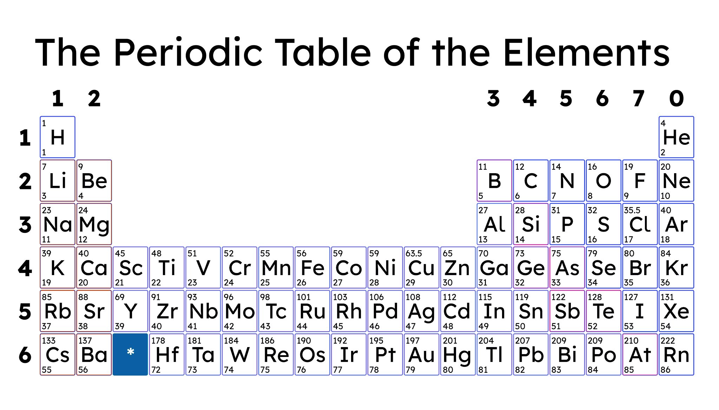
Sifooyinka kiimikada iyo isbeddellada curiyeyaasha (elements)
Curiyeyaasha (elements) leh sifooyin isku mid ah ayaa si wada jir ah loogu habeeyaa shaxda xilliyeedka (periodic table).
shaxda xilliyeedka (periodic table)

Slide 32
Sifooyinka kiimikada iyo isbeddellada curiyeyaasha (elements)
Tusaale sifo kiimikada: curiyeyaashan (elements) dhamaantood waxay si firfircoon ula falceliyaan biyaha (water).
Tusaale sifo jireed (physical property): curiyayaashan (elements) dhammaantood waa jilicsan yihiin.

Slide 33
Sifooyinka kiimikada (chemical properties) iyo isbeddellada (trends) curiyayaasha (elements)
Tusaale sifo kiimikada (chemical property): curiyayaashan (elements) ma aha kuwo falcelin (reactive) badan.
Tusaale sifo jireed (physical property): curiyayaashan (elements) waxay leeyihiin barta dhalaalida (melting point) iyo barta karkarinta (boiling point) oo aad u hooseeya.

Slide 34
Sifooyinka kiimikada (chemical properties) iyo isbeddellada (trends) curiyayaasha (elements)
Curiyayaasha (elements) isla qaybta (part) miiska xilliyeedka (periodic table) waxay u dhaqmaan si isku mid ah midba midka kale.
Curiyayaasha (elements) leh sifooyin kiimiko (chemical) iyo jireed (physical) oo isku mid ah waxay ku dhow yihiin midba midka kale miiska xilliyeedka (periodic table).
Curiyayaasha (elements) waxaa loo habeeyey taariikhda (date) laga helay miiska xilliyeedka (periodic table).

Slide 35
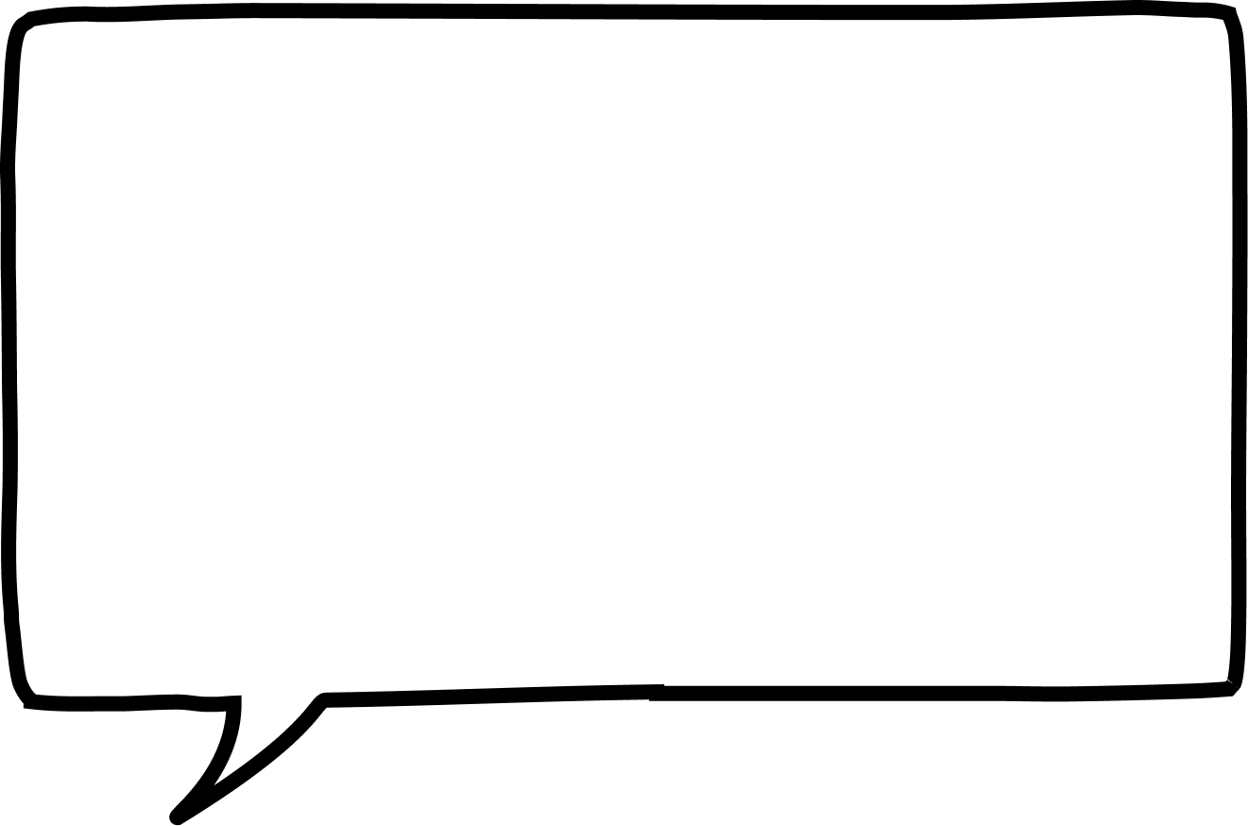


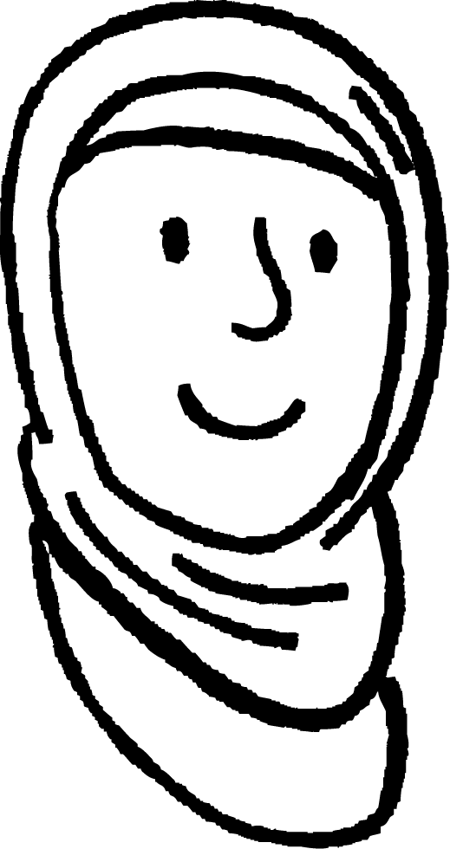
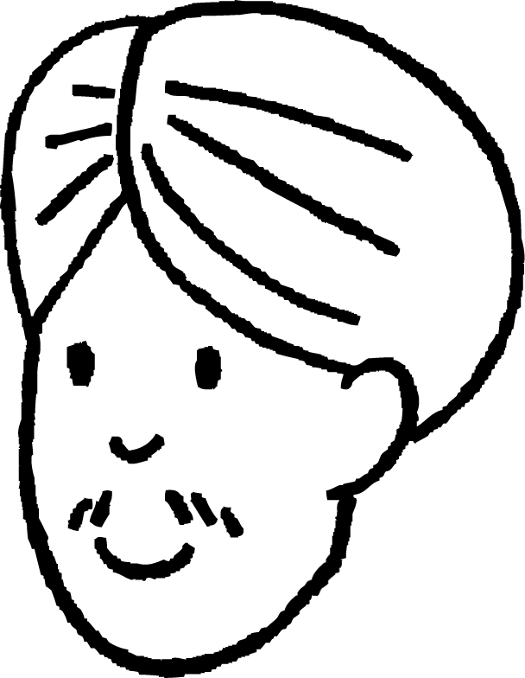

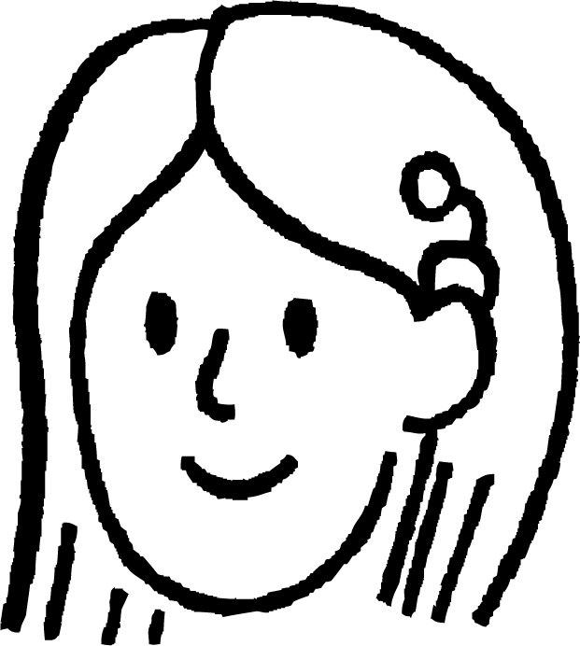
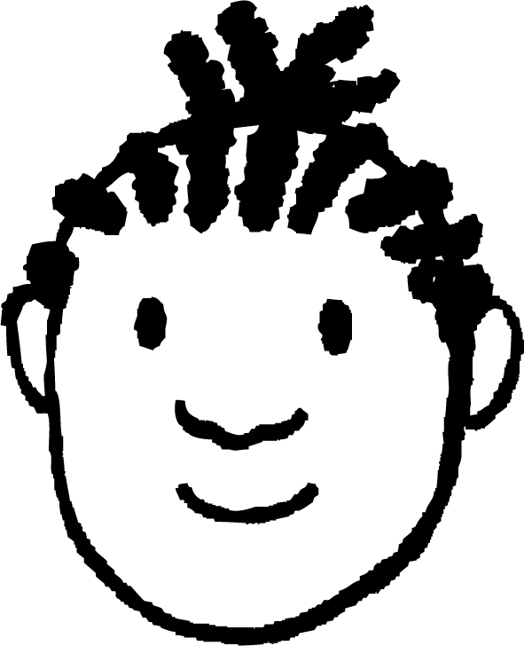


Sifooyinka kiimikada (chemical properties) iyo isbeddellada (trends) curiyayaasha (elements)
Ardayda (students) kee/kutub qeexaya sifooyinka kiimikada (chemical properties) curiye (element)?
Sida curiye (element) ula falcelin doono (react) kiimikooyin (chemicals) kale.
Sida uu u dhalaalayo (shiny) curiye (element).
Caasha
Walxo (substances) cusub ayaa la sameeyaa marka uu falceliyo (reacts).
Cali
Marka curiye (element) xoog (strong) yahay.
Barta karkarinta (boiling point) curiye (element).
Suad
Cabdi
Yacquub

Slide 36
Sifooyinka kiimikada (chemical properties) iyo isbeddellada (trends) curiyayaasha (elements)
Ardaydee (ama ardayda) ku tilmaamaya sifooyinka kiimikaad ee curiye (element)?
Sida curiye (element) uu ula falgalo kiimikooyinka kale.
Sida uu u dhalaalayo (shiny) curiye (element).
Caasha
Walxo cusub ayaa la sameeyaa marka uu falgalo.
Cali
Marka curiye (element) uu xooggan yahay.
Heerkulka karkarinta ee curiye (element).
Suad
Cabdi
Yacquub

Slide 37
Sifooyinka kiimikaad iyo isbeddellada curiyeyaasha (elements)
Ardaydee (ama ardayda) ku tilmaamaya sifooyinka jireed ee curiye (element)?
Cali
Haddii curiye (element) uu la falgalo koloriin.
Heerkulka dhalaalka ee curiye (element).
Caasha
Heerkulka uu qalajku (silver) ku dhalaalo.
Haddii curiye (element) uusan falgalin.
Haddii curiye (element) uu adag yahay.
Yacquub
Suad
Cabdi

Slide 38
Sifooyinka kiimikada iyo isbeddellada curiyeyaasha (elements)
Ardaydee (ama ardayda) ayaa qeexaya sifooyinka jireed ee curiye (element)?
Cali
Haddii curiye (element) uu falceliyo koloriin (chlorine).
Heerka dhalaalka ee curiye (element).
Caasha
Heerkulka qalinka (silver) ku dhalaalo.
Haddii curiye (element) uu yahay mid aan falcelin (unreactive).
Haddii curiye (element) uu adag yahay.
Yacquub
Suad
Cabdi

Slide 39
Sifooyinka kiimikada iyo isbeddellada curiyeyaasha (elements)
Qalinku (silver) waa curiye (element). Halkan waxaa ah liis sifooyinka qalinka (silver).
U kala saar sifooyinka kiimikada (chemical) iyo kuwa jireed (physical).
heerka dhalaalka = 962°C
adag
wuxuu la falceliyaa koloriin (chlorine)
wuxuu sameeyaa walxo cusub markuu taabto oksijiin (oxygen)
wuxuu qaadi doonaa koronto (electricity)
wuxuu la falceliyaa aashitada hydrochloric (hydrochloric acid)
waa la qaloocin karaa qaabab kala duwan
dhalaalaya marka la nadiifiyo

Slide 40
Sifooyinka kiimikada iyo isbeddellada curiyeyaasha (elements)
sifooyinka jireed ee qalinka (silver) | sifooyinka kiimikada ee qalinka (silver)
barta dhalaalka = 962°C
wuxuu la falgalaa koloriin (chlorine)
adag
wuxuu qaadi doonaa koronto (electricity)
wuxuu sameeyaa walxo cusub markuu la xiriiro oksijiin (oxygen)
waa la qaloocin karaa qaabab kala duwan
wuxuu la falgalaa aashitada hydrochloric (hydrochloric acid)
dhalaalaya marka la nadiifiyo

Slide 41
Sifooyinka curiyeyaasha (elements)
Curiyeyaasha (elements) waa nadiif kiimiko ah laakiin way isla falgali karaan.
Curiye kastaa wuxuu leeyahay barta dhalaalka iyo karkarinta go'an.
Curiye kastaa wuxuu leeyahay sifooyin jireed iyo kiimiko oo gaar ah.
Sifooyinka curiyeyaasha (elements) way ka duwan yihiin kuwa atom (atom) keliya.
Curiyeyaasha (elements) leh sifooyin isku mid ah ayaa si wada jir ah loogu habeeyay shaxda xilliyeedka (periodic table).

