Slide 1
Sifooyinka prism-yada
Wareeg, bed, iyo mug

Slide 2
sida loo isticmaalo darasyada Oak

Slide 3
Waxaan qirayaa in dhammaan prism-yadu leeyihiin laba weji polygonal oo isku mid ah oo isbarbar socda (saldhigyo) oo leh wejiyo isbarbar yaal oo ku xira geesaha u dhigma ee saldhigyada.

Slide 4
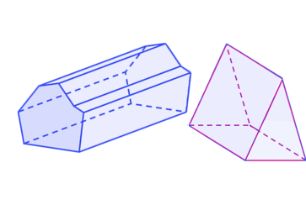
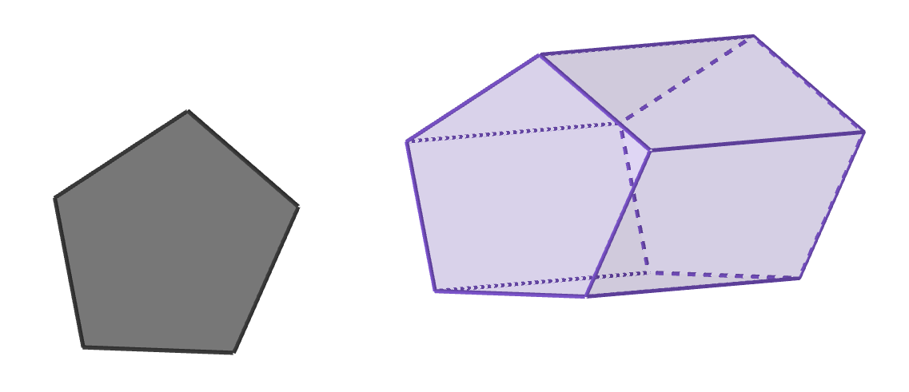
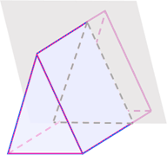
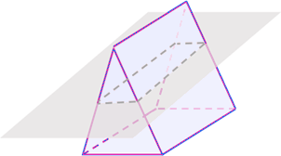
Prism waa polyhedron leh saldhig polygon ah iyo weji ka soo horjeeda oo isbarbar socda oo isku mid ah. Geesaha u dhigma ee labada polygon waxaa ku xira isbarbar yaal.
prism-yada
Goosashada isdhaafka waa weji 2D oo laga sameeyay gooyn toos ah oo dhex mara diyaarad kasta oo shay 3D ah.
goosashada isdhaafka (cross sections)
Goosashada isdhaafka ee prism oo laga sameeyay isbarbar socda saldhiga waxay noqon doontaa mid isku mid ah saldhiga.

Slide 5
Wejiyadu waa dusha 2D ee fidsan ee qaab 3D ah.
Laba xariiq ayaa isbarbar socda haddii ay yihiin xariiqyo toosan oo had iyo jeer isku masaafo (aan eber ahayn) u kala fog.
Haddii hal qaab uu si sax ah ugu habboonaado dusha mid kale iyadoo la isticmaalayo wareeg, milicsi, ama turjumaad, markaas qaababku waa isku mid (congruent).
Uniform macneheedu waa aan isbeddelin. Prism-yadu waxay leeyihiin goosasho isdhaaf oo uniform, taas oo macneheedu yahay in goosashada isdhaafka (oo laga gooyay isbarbar socda saldhiga) ay si joogto ah ugu sii ahaato cabbir iyo qaab isku mid ah.

Slide 6

Sifooyinka prism-yada
Qeexida prism
Kala saarista prism-yada

Slide 7
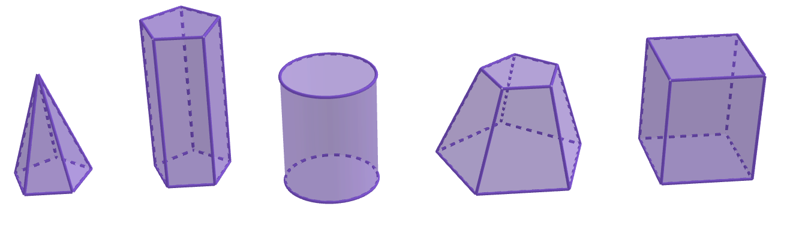



Qeexida prism
Kee ka mid ah qaababkan 3D ayaad u malaynaysaa inuu yahay prism?
a
b
d
e
c
Waa maxay sifooyinka ka dhigaya b iyo e inay yihiin prism-yo, halka kuwa kalena aysan ahayn?

Slide 8
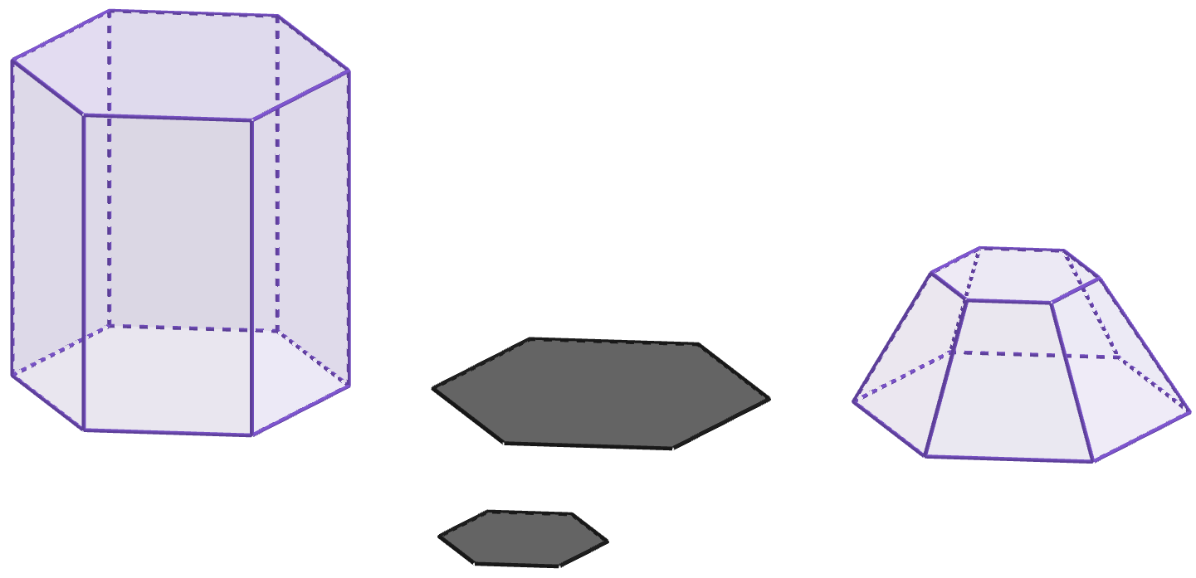
Qeexida prism
Si qaab 3D uu u noqdo prism, goosasho isdhaaf oo kasta oo laga qaado isbarbar socda saldhiga waa inay noqotaa: isku mid, qaab 2D uniform ah oo la mid ah goosasho isdhaaf kasta oo kale oo laga qaaday isbarbar socda kan hore.
Geeso badan (polygon) ee ku yaal dusha sare ee qaabkan 3D ayaa aad uga yar
Maadaama qaababkan iskutallaabta ah ee barbar socda aysan is-ekeynin, ma aha prism.
Jawaabaha:
geeso badan (polygon) xagga hoose.
tusaale-darro ah oo prism ah
tusaale prism

Slide 9
Qeexista prism-ka
Waa inay is-ekeysiiyaan oo kaliya qaybaha iskutallaabta ee barbar socda salka.
Laba qaybood oo iskutallaab ah oo aan barbar socon uma baahna inay is-ekeysiiyaan.
Qaybaha iskutallaabta ee barbar socda salka waa is-ekeysi.
Laba-geesoodkan (hexagons) ma aha kuwo is-ekeysi ah sababtoo ah ma aha kuwo barbar socda.

Slide 10
Qeexista prism-ka
Ogsoonow in kaliya qaybaha iskutallaabta ee barbar socda salka ee hal jiho laga qaaday ay tahay inay is-ekeysiiyaan.
Qaybaha iskutallaabta ee barbar socda salka waa is-ekeysi.
Qaybaha iskutallaabta ee jihooyinka kale uma baahna inay is-ekeysiiyaan si ay u noqdaan prism.

Slide 11
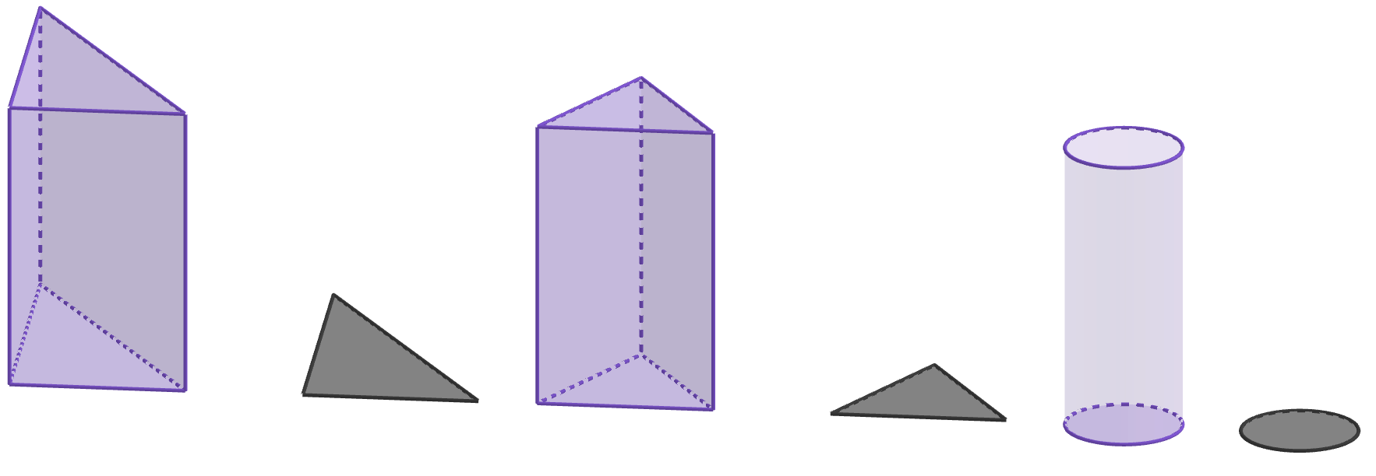
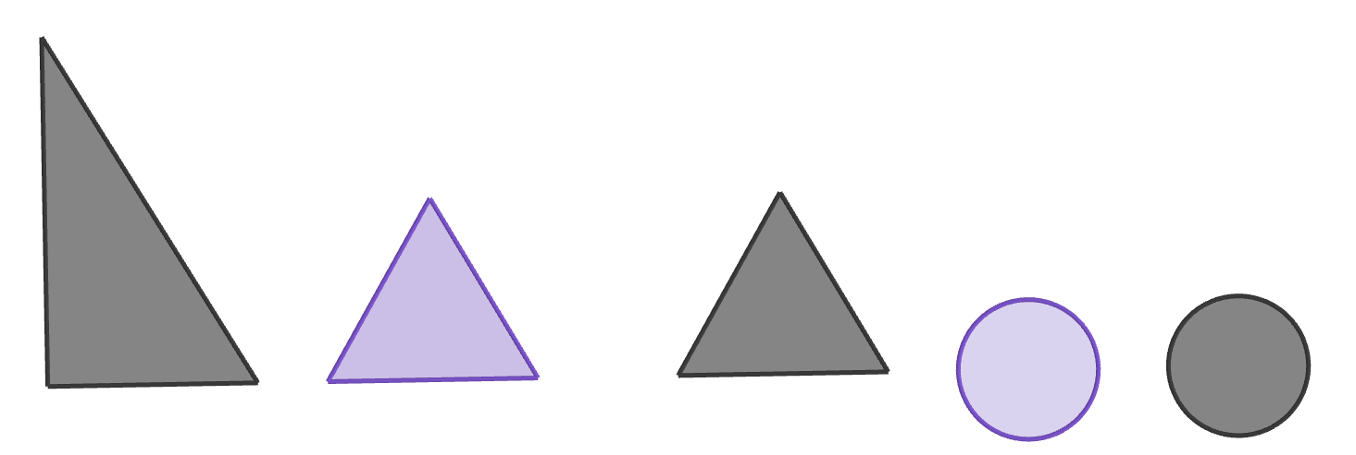
Qeexista prism-ka
Qaababka iskutallaabta ee 2D waa inay ahaadaan geeso badan (polygon).
Prism-kani wuxuu leeyahay saddex-xaglo siman (equilateral triangles) oo ah geeso badan (polygon) iskutallaabtiisa.
Dhululubadani waxay leedahay goobo is-ekeysi ah oo ah qaabkeeda iskutallaabta.
goobo (circles) ma aha geeso badan (polygons)
Jawaabaha:
tusaale prism ah
tusaale-darro ah oo prism ah

Slide 12
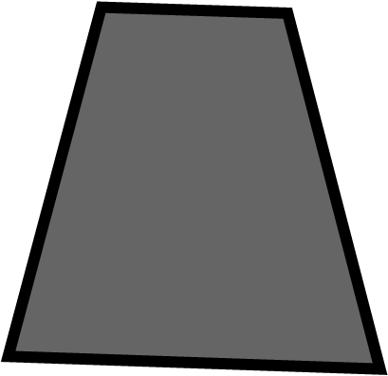
Qeexista prism-ka
Dhammaan wejiyada kale ee aan iskutallaabta ahayn ee prism-ka waa inay ahaadaan barbarroole (parallelograms).
Prismyada toosan, wejigaan oo dhami waa leydi (rectangles).
Wejigaan waa trapezia, ma aha parallelograms.
Wejigaan oo dhami waa leydi (rectangles).
Sidaas darteed, shaygan ma aha prism.

Slide 13
Qeexida prism-ka
Mararka qaarkood prism-ku wuxuu yeelan karaa polygons joogto ah, sida saddexagalka siman (equilateral triangle).
Mararka qaarkoodna, prism-ku wuxuu yeelan karaa polygons aan joogto ahayn, sida saddexagalka scalene.

Slide 14
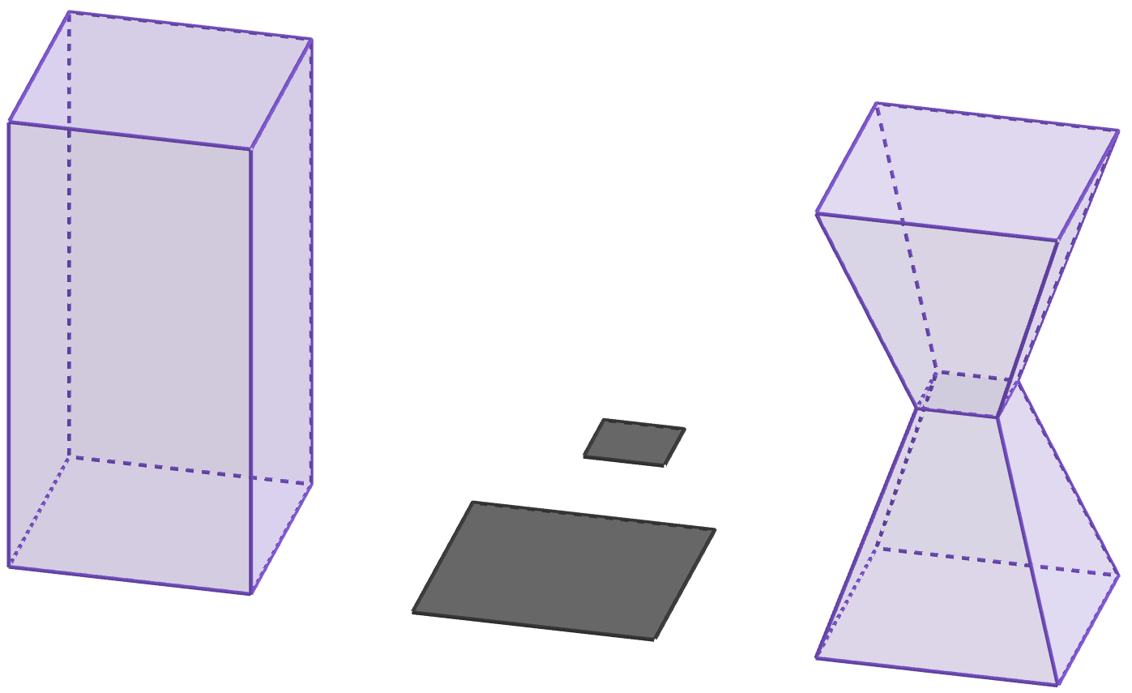
Qeexida prism-ka
Si loo ahaado prism, qaybta iskutallaabtu waa inay isku mid tahay dhammaan dhererka qaabka. Kuma filna in la barbar dhigo labada weji ee darafyada ka soo horjeeda.
Prism-kan wuxuu leeyahay qayb iskutallaab ah oo isku mid ah. Leydiyada (rectangles) waa isku mid (congruent) dhammaan.
Shaygan wuxuu leeyahay leydi (rectangles) isku mid ah (congruent) oo ku yaal xagga sare iyo xagga hoose ee qaabka.
Hase yeeshee, leydiga (rectangle) qaybta iskutallaabta ee xarunta ayaa aad uga yar.
Sidaas darteed, kani ma aha prism.

Slide 15
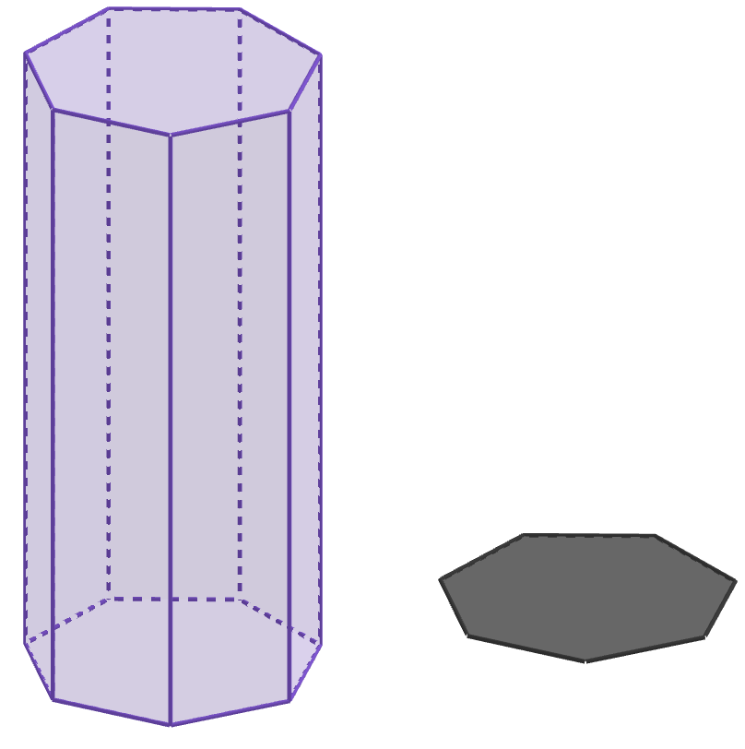
Qeexida prism-ka
Qaabkan 3D waa prism.
Afartan qaab ee 2D ayaa loo adeegsaday in lagu garto in qaabku yahay prism.
Ereyadaan iyo weedhahan kee baa run u ah in lagu qeexo afartan qaab ee 2D?
a
d
b
e
c
f
Jawaabaha:
goobo (circles)
isbarbar yaal (parallel)
isku mid (congruent)
masaafo isku mid ah kala fog
cabbirro kala duwan
geesoolayaal (polygons)

Slide 16
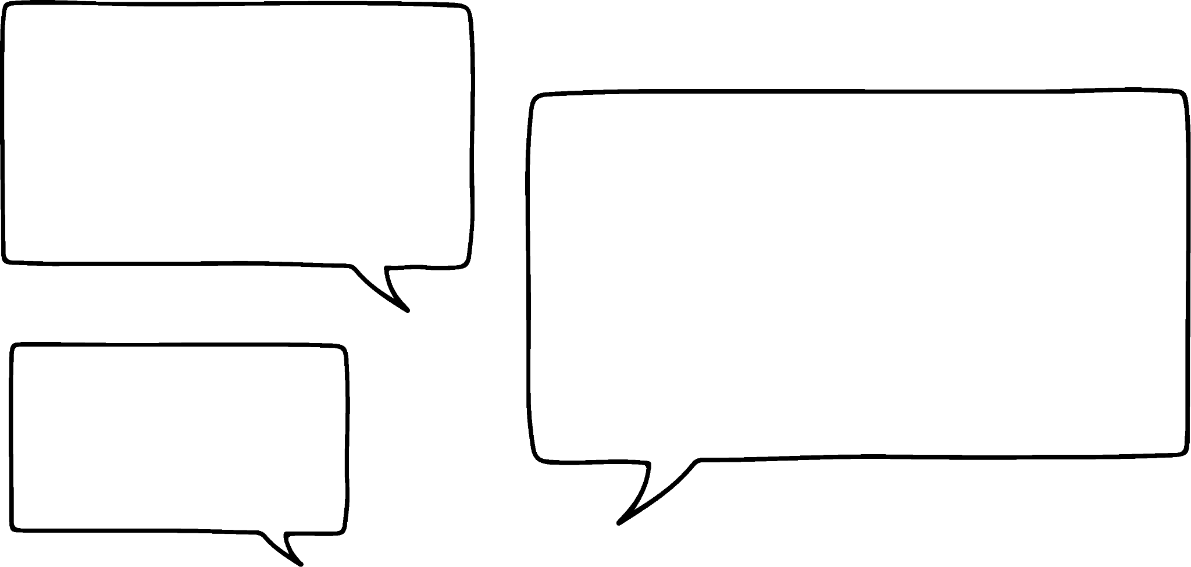
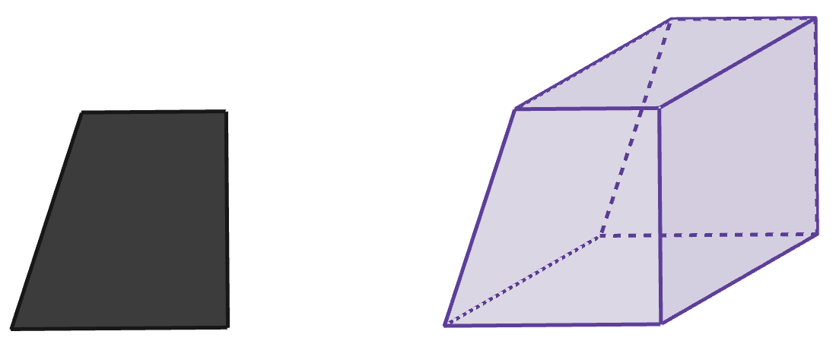

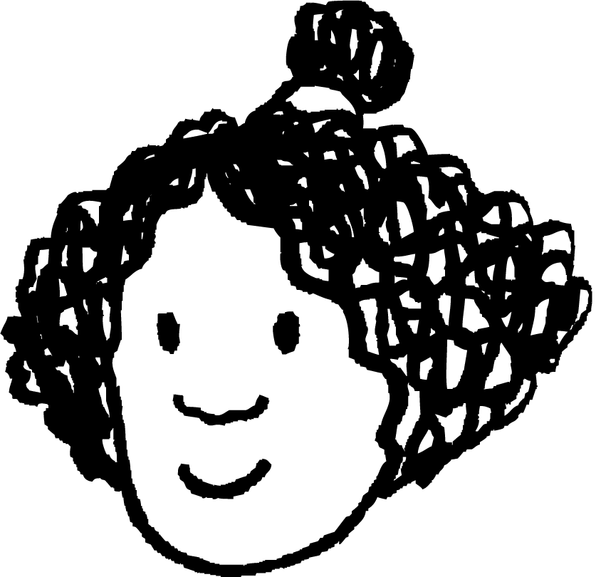

Qeexida murabba' (prism)
Isra
Qaabkan 3D ma aha murabba' (prism), sababtoo ah qaybaha iskutallaabta (cross sections) dhammaantood isku mid (congruent) ma aha!
Sheegashooyinkan kee baa si fiican u qeexaya sababta Isra u khaldan tahay?
a
Qaybaha iskutallaabta (cross sections) is barbar socda (parallel) ma aha.
b
Qaybaha iskutallaabta (cross sections) looma qaadin jihada saxda ah.
c
Qaybaha iskutallaabta (cross sections) waa inay ku yaalliin wejiyada (faces) qaabka 3D.

Slide 17
Qeexida murabba' (prism)
Isra
Qaabkan 3D ma aha murabba' (prism), sababtoo ah qaybaha iskutallaabta (cross sections) dhammaantood isku mid (congruent) ma aha!
b
Qaybaha iskutallaabta (cross sections) looma qaadin jihada saxda ah.
Qaybaha iskutallaabta (cross sections) ee is barbar socda (parallel) ee murabba' (prism) waa inay isku mid (congruent) yihiin, laakiin kaliya hal jihada qaabka.
Haddii laba qaybood oo iskutallaab ah oo is barbar socda (parallel) aysan isku mid (congruent) ahayn, qaabku wali wuxuu noqon doonaa murabba' (prism) haddii dhammaan qaybaha iskutallaabta ee geesoolayaasha (polygonal) ay isku mid (congruent) yihiin jihada kale.
Qaybaha iskutallaabta (cross sections) waxay ku yaalliin meel kasta oo qaabka 3D ah, ma aha oo kaliya wejiyada (faces).

Slide 18
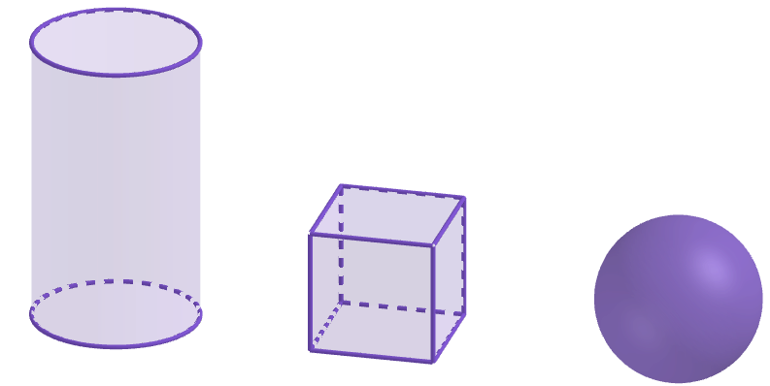
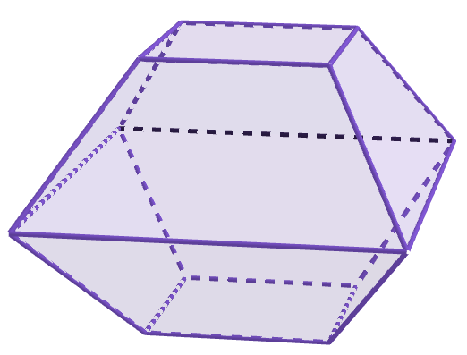
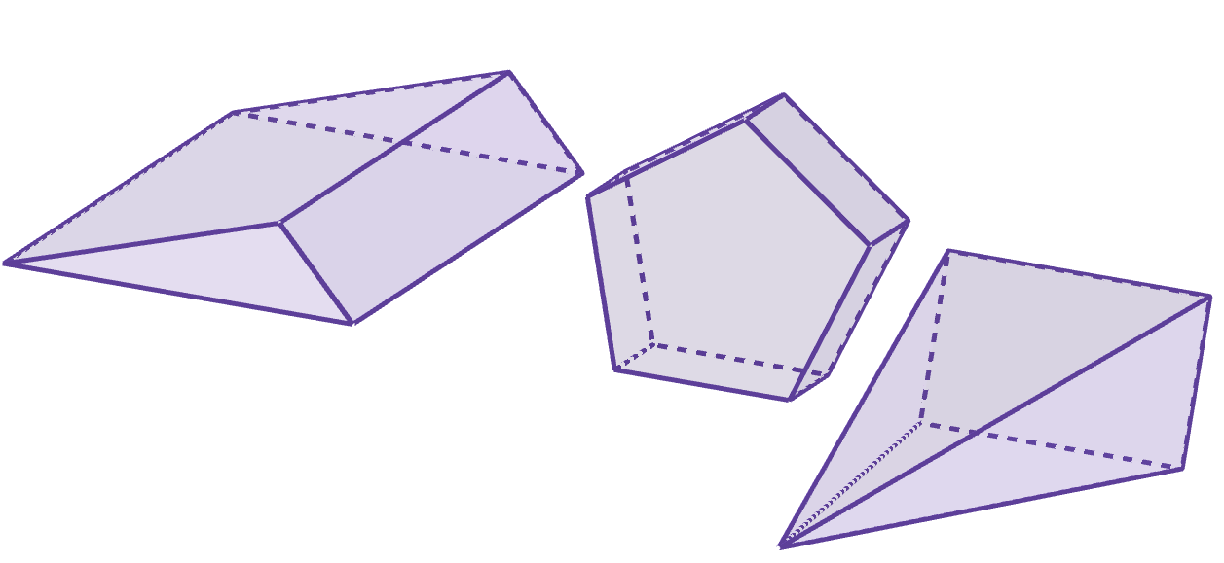
Qeexida murabba' (prism)
1) Kuwaas kee baa u dhigma astaamaha (properties) murabba' (prism)?
b
c
d
a
e
g
f

Slide 19
Qeexida prism-ka
2) Ku buuxi jumladaha erayada maqan si aad u sharaxdo waxa murabba' (prism) yahay.
Murabba' (prism) waa shay ah.
Dhammaan qaybihiisa iskutallaabta (cross sections) ee 2D waa inay ahaadaan .
Ugu yaraan hal jihada, dhammaan qaybaha iskutallaabta (cross sections) waa inay
is barbar socdaan (parallel) midba midka kale.
2D
wareeg (circular)
isbar-barocod (parallel)
isku mid ah (congruent)
3D
geeso badan (polygons)
isku qumman (perpendicular)
isku masaafo (equidistant)

Slide 20
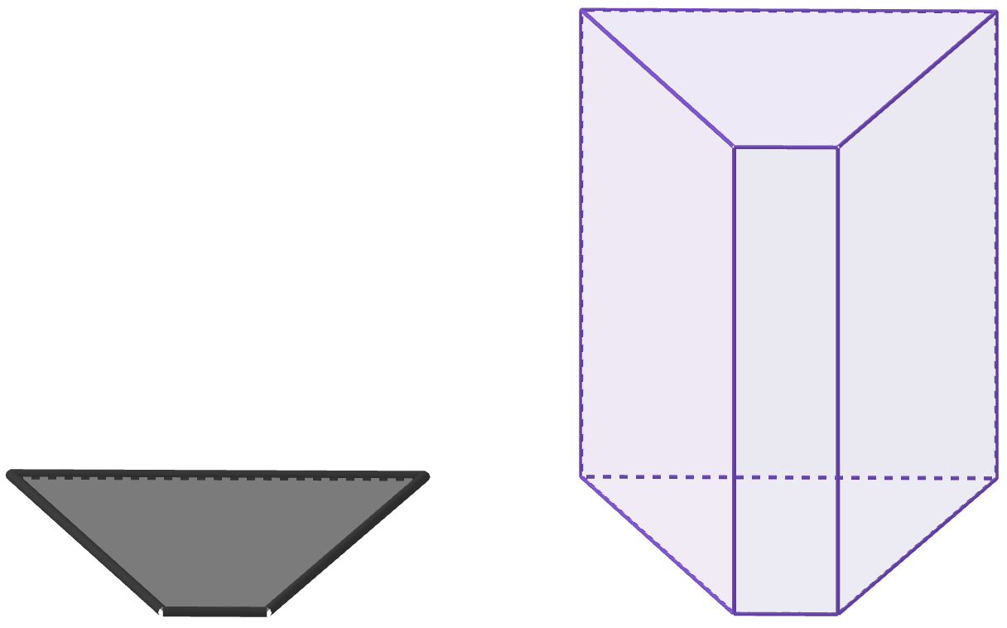
Qeexida prism-ka
3) Jaantusyadani dhamaantood waxay muujinayaan isla prism-ka.
Kee jaantusyada ayaa muujinaya qaybaha isgoysyada saxda ah ee ka caawiya in la muujiyo inuu yahay prism? Sharax sida aad u ogaatay.
a
b
c

Slide 21
Qeexida prism-ka
1) Kee ka mid ah kuwani waxay u dhigmaan sifooyinka prism-ka?
b
c
d
a
e
g
f

Slide 22
Qeexida prism-ka
2) Dhammeystir jumladaha erayada la bixiyay si aad u sharaxdo waxa prism-ku yahay.
3D
Prism-ku waa shay .
Dhammaan qaybihiisa isgoysyada 2D waa inay ahaadaan .
Ugu yaraan hal jiho, dhammaan isgoysyada waa inay
isku ahaadaan.
geeso badan (polygons)
isbar-barocod (parallel)
isku mid ah (congruent)
2D
wareeg (circular)
toosan (perpendicular)
isle'eg (equidistant)

Slide 23
Qeexida prism-ka
3) Jaantusyadani waxay dhammaan muujinayaan isla prism-ka.
Jaantusyadee ayaa muujinaya qaybaha iskutallaabta (cross sections) ee saxda ah ee kaa caawinaya inay muujiso inuu yahay prism? Sharax sida aad u ogaatay.
a
b
c

Slide 24
Qeexida prism-ka
3) Jaantusyadani waxay dhammaan muujinayaan isla prism-ka.
Jaantusyadee ayaa muujinaya qaybaha iskutallaabta (cross sections) ee saxda ah ee kaa caawinaya inay muujiso inuu yahay prism? Sharax sida aad u ogaatay.
a
Qaybahan iskutallaabta (cross sections):
waa geeso badan (polygons)
is barbar socdaan (parallel)
isku mid ma aha (not congruent)
Sidaa darteed, qaybahan iskutallaabtu kuma caawiyaan muujinta inuu kani yahay prism.

Slide 25
Qeexida prism-ka
3) Jaantusyadani waxay dhammaan muujinayaan isla prism-ka.
Jaantusyadee ayaa muujinaya qaybaha iskutallaabta (cross sections) ee saxda ah ee kaa caawinaya inay muujiso inuu yahay prism? Sharax sida aad u ogaatay.
b
Qaybahan iskutallaabta (cross sections):
waa geeso badan (polygons)
is barbar socdaan (parallel)
isku mid yihiin (congruent)
Sidaa darteed, qaybahan iskutallaabtu waxay caawiyaan muujinta inuu kani yahay prism.

Slide 26
Qeexida prism-ka
3) Jaantusyadani waxay dhammaan muujinayaan isla prism-ka.
Kee ka mid ah jaantusyada ayaa muujinaya goosashada saxda ah ee ka caawinaysa in la muujiyo in ay tahay prism? Sharax sida aad u ogaatay.
c
Goosashadan (cross sections):
waa geesoolayaal (polygons)
isku barbar ma aha
waa isku mid (congruent)
Sidaas darteed, goosashadani kama caawinayaan in la muujiyo in tani tahay prism.

Slide 27
Sifooyinka prism-yada
Qeexida prism-ka
Kala saarista prism-yada

Slide 28
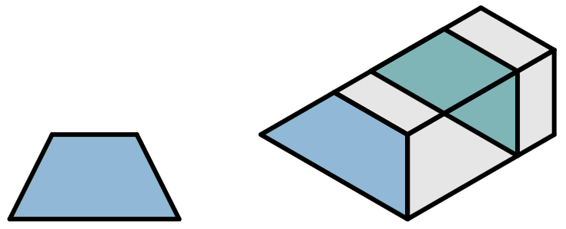
Kala saarista prism-yada
Sidee u magacaabnaa noocyada kala duwan ee prism-ka?
Waxaan qaadanaa wejiga ama goosashada (cross section) ee isku mid ah dhammaan qaabka,
oo waxaan eegnaa qaabkiisa iyo sifooyinkiisa.
Tani waa afar geesle (quadrilateral).
Gaar ahaan, waa trapezium.
Sidaas darteed, waxaan ugu yeeri karnaa tani:
prism afar geesle (quadrilateral) ama
prism ku salaysan trapezium

Slide 29
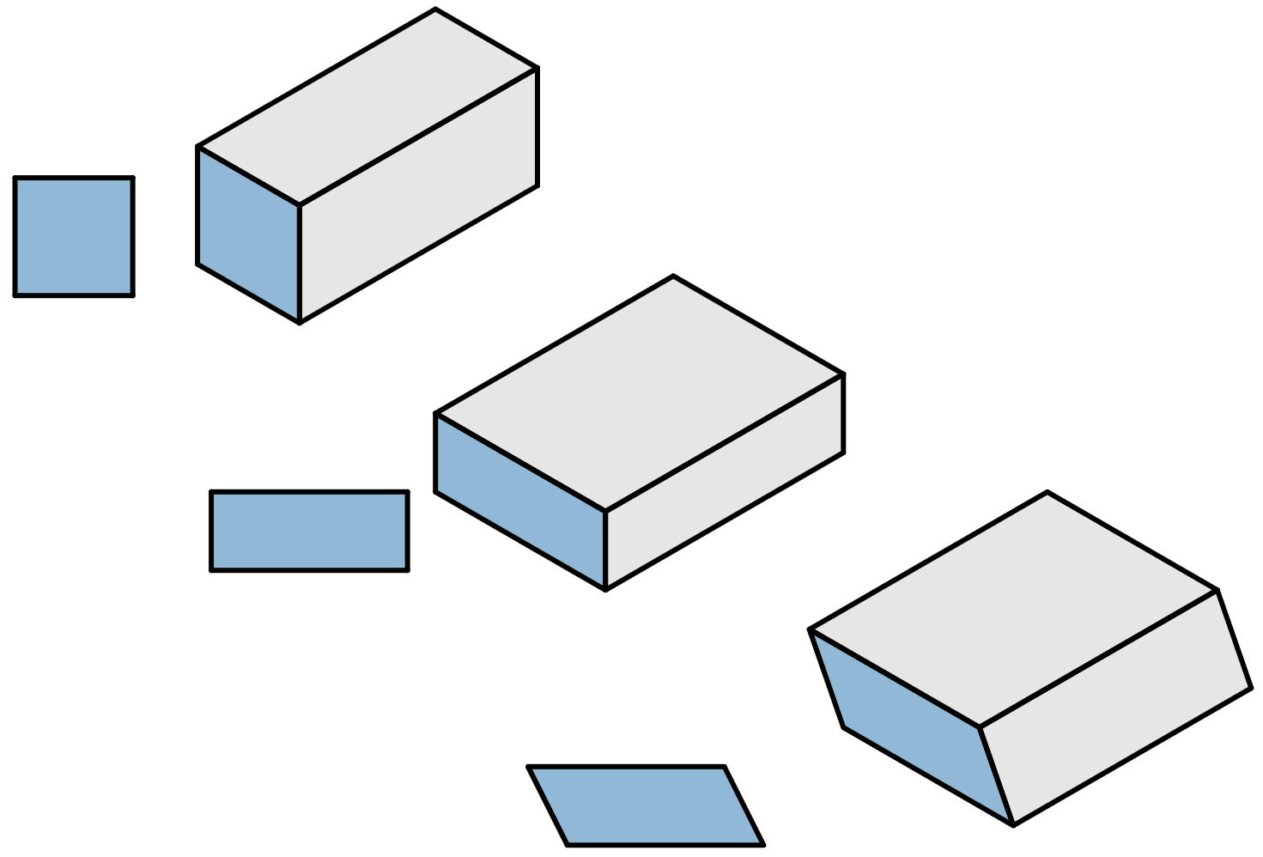
Kala saarista prism-yada
Magaca prism-ka sidoo kale badanaa wuxuu qeexaa in geesoolaha goosashada uu yahay mid joogto ah iyo in kale.
Marka laga hadlayo afar geeslayaasha, waxaan leenahay:
sal-labo-geesle (square-based)
murabba (prism)
leydi (rectangular)
murabba (prism)
murabba sal-bar-bar (parallelogram-based prism)

Slide 30
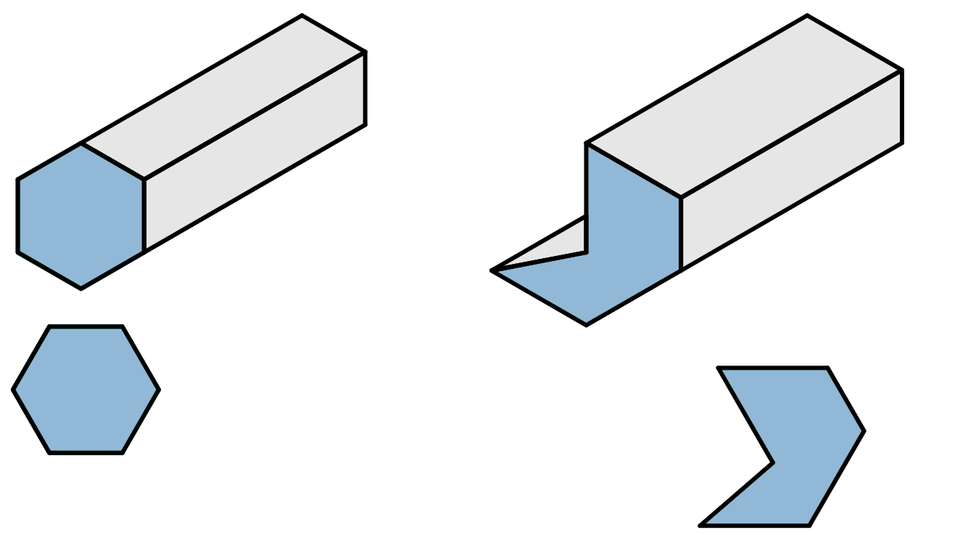
Kala-saarista murabbada (Categorising prisms)
Magaca murabbada wuxuu inta badan caddeeyaa in geeso-goynta (cross sectional polygon) ay tahay mid joogto ah (regular) iyo in kale.
Geeso-goyn kale (polygons), waxaan leenahay tusaalooyin, sida:
lix-geesle joogto ah (regular hexagonal)
murabba (prism)
lix-geesle (hexagonal)
murabba (prism)

Slide 31
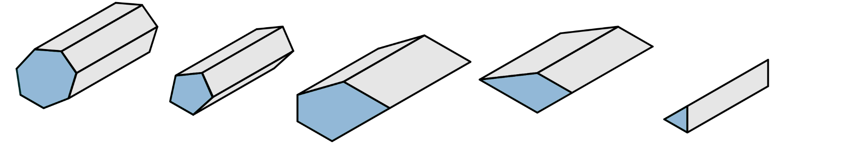
Kala-saarista murabbada (Categorising prisms)
Isku-dhig murabbada (prism) magaceeda.
1
murabba toddoba-geesle joogto ah (regular heptagonal prism)
2
murabba shan-geesle (pentagonal prism)
a
b
3
murabba trapezium (trapezium prism)
c
4
murabba shan-geesle joogto ah (regular pentagonal prism)
5
murabba saddex-geesle siman (equilateral triangle prism)
e
d

Slide 32
Kala-saarista murabbada (Categorising prisms)
Isku-dhig murabbada (prism) magaceeda.
1
murabba toddoba-geesle joogto ah (regular heptagonal prism)
d
2
Prism shan-gees (pentagonal prism)
b
a
b
3
Prism trapezium (trapezium prism)
c
e
4
Prism shan-gees joogto ah (regular pentagonal prism)
a
5
Prism saddex-gees siman (equilateral triangle prism)
e
d
c

Slide 33
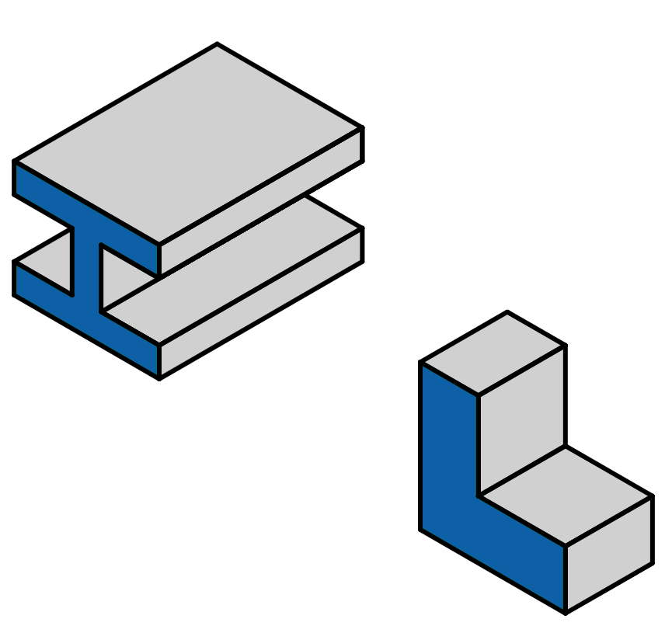
Kala-saarista prism-yada
Prism-yada waxaa loo isticmaalaa meelo kala duwan, oo ay ku jiraan dhismaha.
Waa kuwan tusaalayaal caadi ah.
Jawaabaha:
Marka la eego dhismaha, I-beam iyo L-frame waa magacyada ay doorbidaan.
L-frame
I-beam

Slide 34
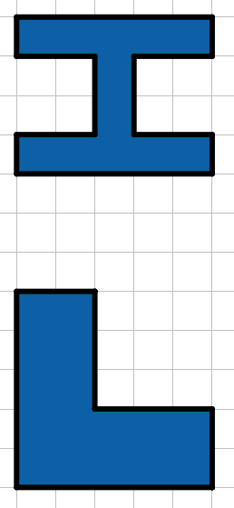
Kala-saarista prism-yada
Hase yeeshe, waxaa sidoo kale lagu tilmaami karaa iyadoo la adeegsanayo geesoolayaasha isgoysyada (cross sectional polygon).
Haddii tirada dhinacyada prism-ka ay adag tahay in la arko aragtida 3D, waxaad had iyo jeer qori kartaa geesoolaha isgoysyada 2D marka hore oo tiri tirada dhinacyada.
Jawaabaha:
Dodecagon (dodecagon)
Hexagon (hexagon)
Prism hexagonal (hexagonal prism)
L-frame
I-beam
Prism dodecagonal (dodecagonal prism)

Slide 35
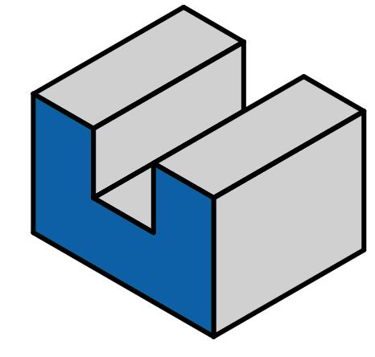
Kala-saarista prism-yada
Adigoo qoraya geesoolaha isgoysyada ee prism-kan, tiri inta dhinac ee uu leeyahay geesoolaha isgoysyada.
8 dhinac

Slide 36
Kala-saarista priism-yada
Waa maxay magaca priism-kaan?
a
Priismka U-beam
b
priismka lix-geesoodka (hexagonal prism)
c
priismka lix-geesoodka joogtada ah (regular hexagonal prism)
d
priismka siddeed-geesoodka (octagonal prism)
e
priismka siddeed-geesoodka joogtada ah (regular octagonal prism)

Slide 37
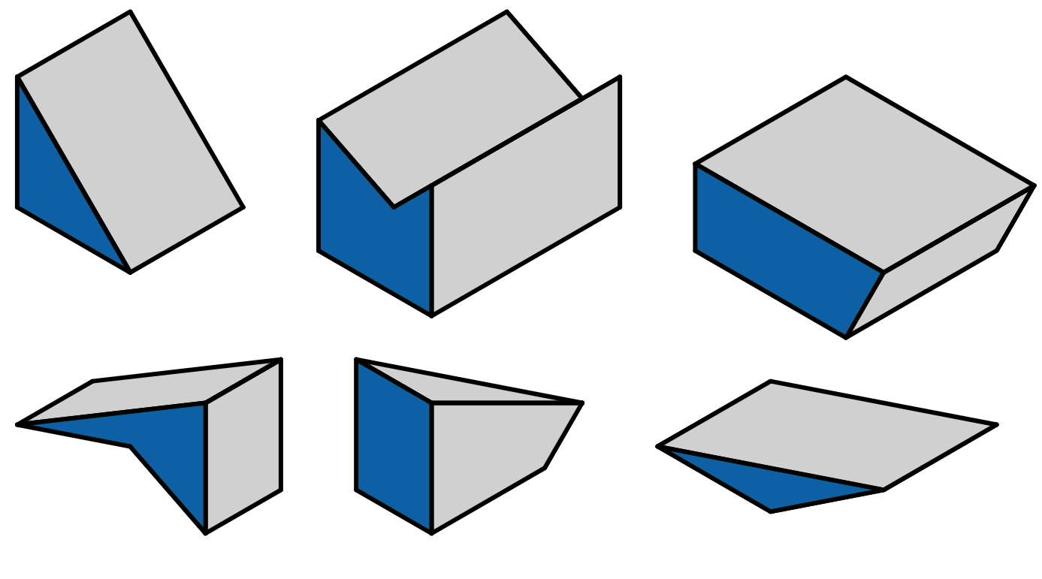
Kala-saarista priism-yada
1) Dhig qaababkan 3D-ga ah safka saxda ah ee shaxda.
priismka saddex-geesoodka (triangular prism)
priismka afar-geesoodka (quadrilateral prism)
priismka shan-geesoodka (pentagonal prism)
ma aha priism
a
b
c
d
e
f

Slide 38
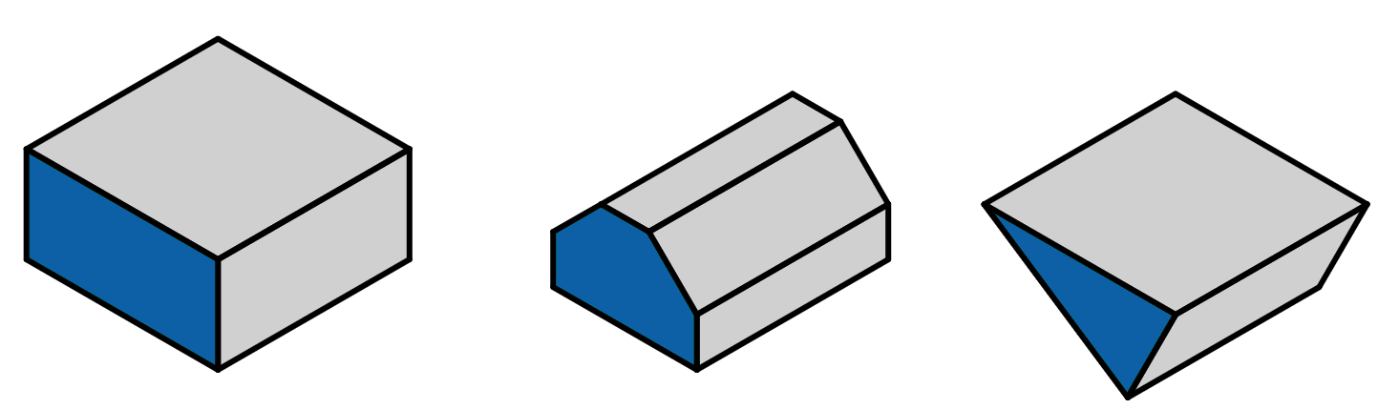
Kala-saarista priism-yada
2) Waraaqaha shaxanka (squared paper), sawir qaabka isgoysyada (cross sectional polygon) ee priism kasta.

Slide 39
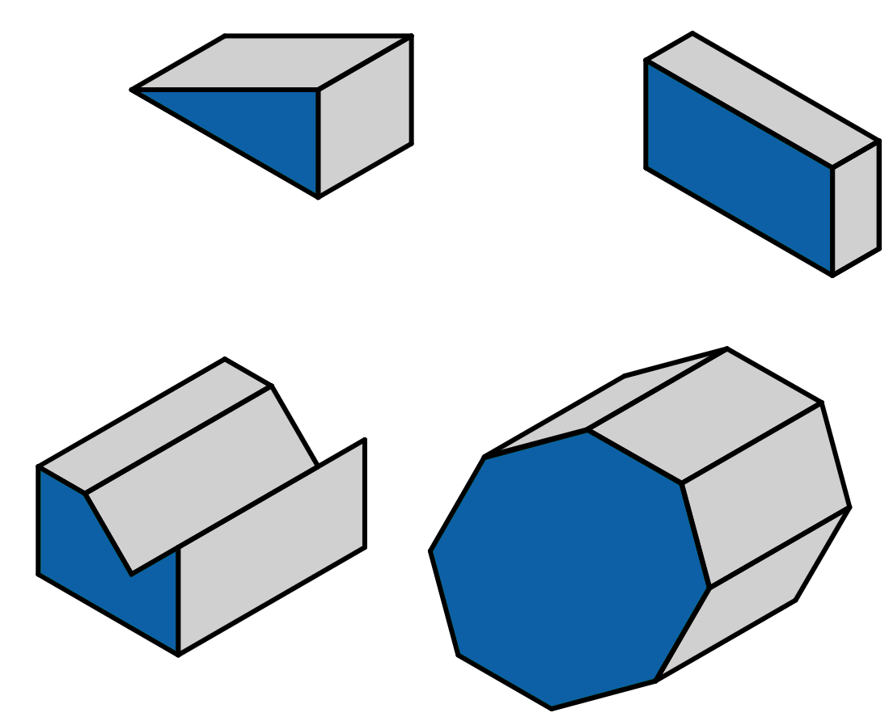

Kala-saarista priism-yada
3) Qor magac ku habboon priism kasta.
a
b
e
d
c

Slide 40
Kala-saarista priism-yada
1) Dhig qaababkan 3D ee safka saxda ah ee shaxda.
priismka saddex-geesoodka (triangular prism)
priismka afar-geesoodka (quadrilateral prism)
priismka shan-geesoodka (pentagonal prism)
ma aha priism
a
b
a
f
c
c
d
b
d
e
f
e

Slide 41
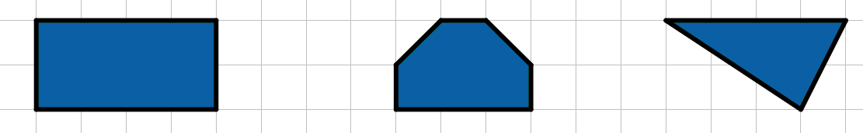
Kala saarista prism-yada
2) Waraaqo laba jibaaran, sawir qaabka isgoyska (cross section) ee mid kasta oo ka mid ah prism-yadan.
Kuwani waa qaabab qiyaas ah - haddii sawirkaagu wax yar ka duwan yahay, waa ok.

Slide 42
Kala saarista prism-yada
3) Qor magac ku habboon prism kasta.
a
a
prism saddexagal
prism saddexagal xagal-qumman
b
b
prism afar-geesood
prism leydi
d
c
prism hexagonal
prism hexagonal aan joogto ahayn
c
d
prism sideed-gees
prism sideed-gees joogto ah
Haddii aad la timid jawaab ka duwan, ma caddeyn kartaa?

Slide 43
Kala saarista prism-yada
3) Qor magac ku habboon prism kasta.
e
prism sideed-gees
prism sideed-gees aan joogto ahayn
e
Haddii aad la timid magac ka duwan prism kasta, ma caddeyn kartaa?

Slide 44
Sifooyinka prisms (prisms)
Fahanka sifooyinka prism-ka wuxuu fududeeyaa in la garto prism-yada iyo kuwa aan ahayn.
Ogaanshaha in prism-yada badanaa lagu garto qaabka iyo sifooyinka geesoolaha isgoyska (cross-sectional polygon) wuxuu u oggolaanayaa magacaabista iyo kala saarista prism-yada.
Fahamka in ay jiraan laba nooc oo prism (prism) ah: mid toosan (right) iyo mid qalloocan (oblique), wuxuu ballaariyaa fahamka waxa loo aqoonsan karo prism (prism).

