Slide 1
Aragtida Pythagoras (Pythagoras’ theorem) ee macnaha guud
Sifooyinka joomatari (Geometrical properties): isku ekaansho (similarity) iyo aragtida Pythagoras (Pythagoras’ theorem)

Slide 2
Sida agabkeena waxbarista loogu talagalay fasalka

Slide 3
Waxaan awoodi karaa inaan isticmaalo oo aan dabaqo aragtida Pythagoras (Pythagoras’ theorem) si aan u xalliyo mashaakil xaalado kala duwan.

Slide 4
Dhererka toosan (perpendicular height) waa masaafada toosan (perpendicular distance) ee u dhaxaysa saldhiga (base) iyo cidhifka (vertex) ka soo horjeeda.
Aragtida Pythagoras (Pythagoras’ theorem) waxay muujinaysaa in wadarta labajibbaaranayaasha (squares) labada dhinac ee gaagaaban ee saddexagalka qumman (right-angled triangle) ay la mid tahay labajibbaaranaha (square) dhinaca ugu dheer (hypotenuse).
Hypotenuse (hypotenuse) waa dhinaca saddexagalka qumman (right-angle triangle) ee ka soo horjeeda xagasha qumman (right-angle).

Slide 5

Aragtida Pythagoras (Pythagoras’ theorem) ee macnaha guud
Xaalado lagu qaabeeyey saddexagallo qumman (right-angled triangles)
Falanqaynta iyo qiimeynta xaaladaha la qaabeeyey (modelled contexts)

Slide 6
Xaalado lagu qaabeeyey saddexagallo qumman (right-angled triangles)
Waxaa jira xaalado badan oo dunida dhabta ah oo ku lug leh:
dherer ama masaafo isku toosan (perpendicular) midba midka kale
dherer saddexaad oo xira saddexagal qumman (right-angled triangle) oo mala awaal ah
Mararka qaarkood waxaa faa'iido leh in xaaladahan loo qaabeeyo saddexagallo qumman (right-angled triangles) si loo xisaabiyo dhererka ama masaafada muhiimka ah.

Slide 7
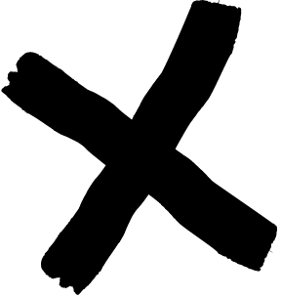

Xaalado lagu qaabeeyey saddexagallo qumman (right-angled triangles)
Tusaale ahaan, si xariiqdan baastada (spaghetti) si siman u karsato, waa inay si buuxda ugu dhex milanto weelka (saucepan), iyada oo aan qayb ka soo bixin.
Waa maxay macluumaadka ku saabsan baastada (spaghetti) iyo weelka (saucepan) ee laga yaabo inaan u baahanno si aan u ogaanno in baastadu si buuxda ugu habboonaan doonto?
xariiq baasto (spaghetti)
weel (saucepan)

Slide 8
Xaalado lagu qaabeeyey saddexagallo qumman (right-angled triangles)
joogga weelka (saucepan),
Haddii aan ognahay
iyo dhererkeeda ugu weyn (diameter-ka saldhiggeeda wareegsan),
waxaan xisaabin karnaa masaafada ugu weyn ee u dhaxaysa dhammaadka weelka iyo dhammaadka kale ee iska soo horjeeda.
Oo haddii xariijinta baastadu (strand of spaghetti) ka gaaban tahay masaafadan, waxay ku habboonaan doontaa weelka.
28 cm
12 cm
xariijin baasto (strand of spaghetti)
22 cm

Slide 9
Macnaha (Contexts) ay qaabeeyaan saddex-xagallada quman (right-angled triangles)
Waxaan u qaabayn karnaa weelka (saucepan) sida saddex-xagal quman (right-angled triangle), iyadoo joogga iyo saldhigga ugu weyn ee weelka ay matalaan labada dhinac ee gaaban ee saddex-xagalkan.
Masaafada ugu weyn ee weelka (saucepan) waa hypotenuse-ka saddex-xagalkan quman (right-angled triangle).
12² + 22² = x²
628 = x²
x² = 628
hypotenuse (x cm)
12 cm
x² = 25.1
12 cm
joog (height)
Masaafada ugu weyn ee u dhaxaysa dhammaadka weelka iyo kan kale waa 25.1 cm.
22 cm
saldhig ugu weyn (maximum base)

Slide 10
Macnaha (Contexts) ay qaabeeyaan saddex-xagallada quman (right-angled triangles)
Oo maxaa yeelay dhererka xariijinta spaghetti waa 28 cm, waxay ka dheer tahay jibaaran (hypotenuse) saddexagalka qumman (25.1 cm).
Tani waxay ka dhigan tahay inaysan si buuxda ugu habboonayn weelka - waxaa jiri doona qayb yar oo spaghetti ah oo aan ku dhex jiri doonin biyo (water), sidaas darteedna aan si siman u karin doonin.
2.9 cm oo aan ku dhex jirin weelka (saucepan)
jibaaran (hypotenuse) (25.1 cm)
28 cm
12 cm
joog (height)
xariijin spaghetti ah (strand of spaghetti)
22 cm
saldhig ugu weyn (maximum base)

Slide 11

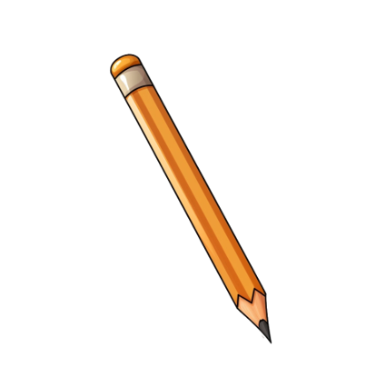

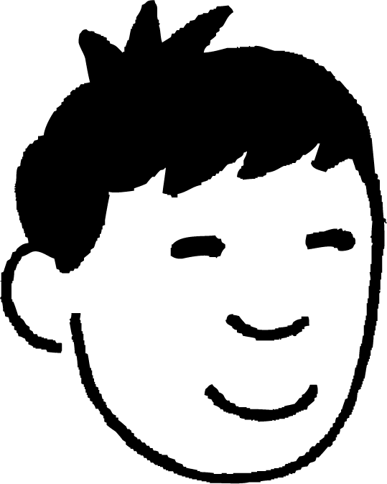
Xaalado lagu qiyaaso saddexagal qumman (right-angled triangles)
Nuur wuxuu doonayaa inuu isticmaalo qalimo dhaadheer oo ka soo baxa weelka qalimada, si uusan u raadin qalimo gaagaaban.
In kastoo qalinkani uu ka dheer yahay weelka qalimada, wuxuu ka walwalsan yahay in qalinku ku dhaco weelka oo ku xirmo gudaha.
Nuur wuxuu u qaabeeyaa weelka qalimada sidii saddexagal qumman (right-angled triangle). Waa maxay dhererka labada dhinac ee gaagaaban ee saddexagalkan?
11 cm
a
14 cm
11 cm
6 cm
b
6 cm

Slide 12
Xaalado lagu qiyaaso saddexagal qumman (right-angled triangles)
Nuur wuxuu doonayaa inuu isticmaalo qalimo dhaadheer oo ka soo baxa weelka qalimada, si uusan u raadin qalimo gaagaaban.
In kasta oo qalin-kan uu ka dheer yahay weelka qalinka (pencil pot), wuxuu ka walaacsan yahay in qalinku ku dhaco weelka qalinka (pencil pot) oo ku xirmo gudaha.
Waa maxay dhererka hypotenuse-ka (hypotenuse) saddex-xagalkan (triangle), oo loo soo koobay 2 meelood oo jajab tobanle (decimal places)?
12.53 cm
11 cm
14 cm
11 cm
6 cm
6 cm

Slide 13
Macnaha (Contexts) ay qaabeeyaan saddex-xagal quman (right-angled triangles)
Nuur wuxuu doonayaa inuu isticmaalo qalimo dhaadheer oo ka soo baxa weelka qalinka (pencil pot), si uusan u baahan inuu gacanta ku raadiyo qalimo gaagaaban.
Hypotenuse-ka (hypotenuse) saddex-xagalkan (triangle) waa 12.53 cm.
Maxaa gunaanad (conclusion) ah oo aan ka soo qaadan karnaa qalinka (pencil) iyo weelka qalinka (pencil pot)?
a
b
Qalinku waa dheer yahay oo wuu ka soo bixi karaa weelka qalinka (pencil pot).
Qalinku kuma filna inuu ka soo baxo weelka qalinka (pencil pot), wuxuuna ku xirmi doonaa gudaha.
14 cm

Slide 14
Macnaha (Contexts) ay qaabeeyaan saddex-xagal quman (right-angled triangles)
Nuur wuxuu doonayaa inuu isticmaalo qalimo dhaadheer oo ka soo baxa weelka qalinka (pencil pot), si uusan u baahan inuu gacanta ku raadiyo qalimo gaagaaban.
Hypotenuse-ka (hypotenuse) saddex-xagalkan (triangle) waa 12.53 cm.
Maxaa gunaanad (conclusion) ah oo aan ka soo qaadan karnaa qalinka (pencil) iyo weelka qalinka (pencil pot)?
Qalinku waa dheer yahay oo wuu ka soo bixi karaa weelka qalinka (pencil pot), sababtoo ah qalinku waa ka dheer yahay (14 cm) hypotenuse-ka (hypotenuse) saddex-xagalka quman (right-angled triangle) (12.53 cm), taasoo la micno ah inuu ka dheer yahay masaafada ugu weyn ee gudaha weelka qalinka (pencil pot).
a
Qalinku waa dheer yahay oo wuu ka soo bixi karaa weelka qalinka (pencil pot).
14 cm

Slide 15
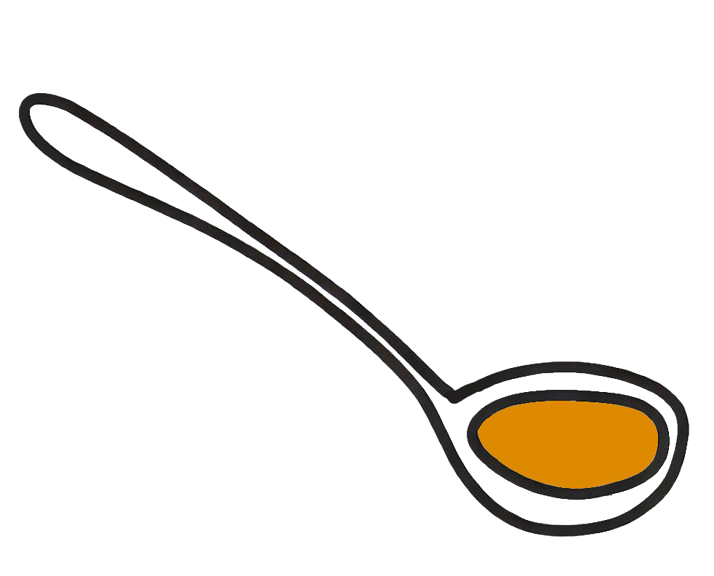
Macnaha (Contexts) ay qaabeeyaan saddex-xagal quman (right-angled triangles)
1) Si qaaddadan loo isticmaali karo weelka (saucepan), waa inay dheer tahay si aysan ugu dhex liqin weelka.
Weelku wuxuu dheer yahay 20 cm, saldhiggiisuna wuxuu ugu badnaan yahay 30 cm.
a) Saddexagalka qumman (right-angled triangle) wuxuu u eg yahay weelka. Ku calaamadee weelka iyo saddexagalka dhererka ku habboon.
b) Adigoo isticmaalaya aragtida Pythagoras (Pythagoras’ theorem), sharax haddii qaadadu dheer tahay oo loo isticmaali karo weelkan.
dheri (saucepan)
qabato (ladle)
35 cm

Slide 16

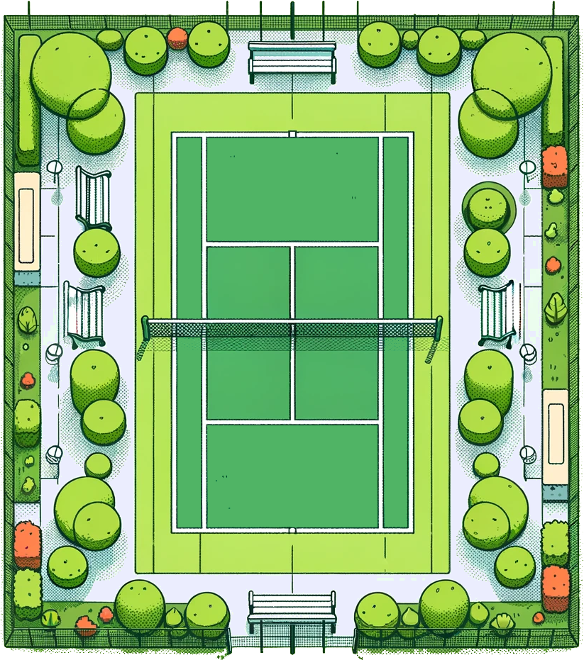
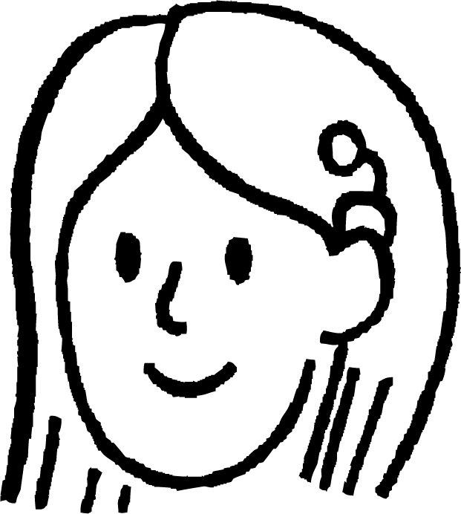

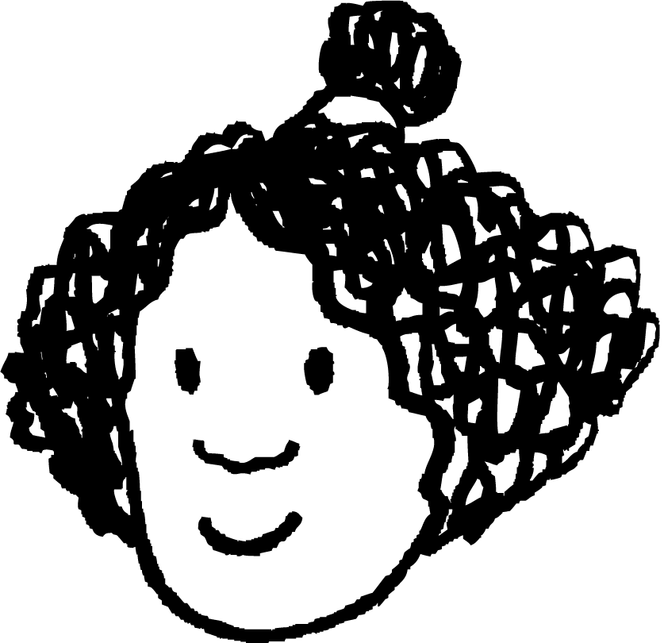


Xaalado lagu qiyaaso saddexagal qumman (right-angled triangles)
Isra
2) Isra waxay ku tababaranaysaa garaacyada gadaasha (backhand). Waxay ku garaaci kartaa 28 mitir.
Suad iyo Layla waxay taagan yihiin geeso kala duwan oo garoonka.
a) Ku qiyaas xaaladdan saddexagalka qumman, adigoo calaamadinaya masaafooyinka ku habboon ee xaaladda lagu sheegay.
24 m
b) Sharax haddii garaaca Isra uu gaari karo Suad.
11 m
c) Adigoo isticmaalaya aragtida Pythagoras (Pythagoras’ theorem), sharax haddii garaaca Isra uu gaari karo Layla.
Suad
Layla

Slide 17

Xaalado lagu qiyaaso saddexagal qumman (right-angled triangles)
3) Tareenka (train) wuxuu isticmaalaa ramp (access ramp) dhererkiisu yahay 256 cm si uu u caawiyo rakaabka inay fuulaan tareenka maglev.
Tallaabada lagu fuulo tareenka waxay ka sarraysaa 43 cm meesha rakaabku ku suganyihiin.
Intee ayay ramp-ku gaari doonaa meesha lagu sugayo (ilaa 1 d.p.)?
tareen (train)
ramp (access ramp)
meel lagu sugayo (platform)
tareen (train)

Slide 18
Contexts modelled by right-angled triangles
1 a) Saddexagalka qumman (right-angled triangle) wuxuu u eg yahay weelka. Ku calaamadee weelka iyo saddexagalka dhererka ku habboon.
b) Adigoo isticmaalaya aragtida Pythagoras, sharax haddii qaaddada dheer tahay in lagu isticmaalo digsigan.
Qaaddadu waa gaaban tahay, 35 cm.
Sababta waa masaafada ugu badan ee gudaha digsigu waa dhererka jaantuska 36 cm, sidaas darteed qaaddadu waxay ku dhex dhici kartaa digsiga oo dhan.
saucepan
ladle
36 cm
20 cm
20 cm
35 cm
30 cm
30 cm

Slide 19
Contexts modelled by right-angled triangles
Izzy
I
2 a) Model this context onto this right-angled triangle, labelling any relevant distances given in the context.
26.4 m
24 m
24 m
S
L
b) Explain whether Izzy’s backhand shot can reach Sofia.
11 m
Waa karaa, maadaama tallaabada Izzy ee 28 m ay ka dheer tahay 24 m ee u dhaxaysa iyada iyo Sofia.
11 m
c) Using Pythagoras’ theorem, explain whether Izzy’s backhand shot can reach Laura.
Sofia
Laura
Adigoo isticmaalaya aragtida Pythagoras, masaafada u dhaxaysa Izzy iyo Laura waa 26.4 m. Sidaas darteed, tallaabada Izzy ee 28 m waxay gaari kartaa Laura.

Slide 20
Xaalado lagu qaabeeyey saddexagal qumman (right-angled triangle)
3) A train conductor uses a 256 cm long access ramp to help passengers board a maglev train.
Tallaabada lagu fuulo tareenka waa 43 cm ka sareysaa platform-ka (platform) ee rakaabku ku sugnaan.
tareen (train)
256 cm
43 cm
waddo gelitaan (access ramp)
252.4 cm
platform (platform)
Fogaanta ugu yar ee tooska ah (horizontal) ee ka fog tareenka waa 252.4 cm.
tareen (train)
252.4 cm

Slide 21
Aragtida Pythagoras (Pythagoras’ theorem) ee xaaladaha
Xaalado lagu qaabeeyey saddexagal qumman (right-angled triangle)
Falanqaynta iyo qiimaynta xaaladaha la qaabeeyey

Slide 22
Falanqaynta iyo qiimaynta xaaladaha la qaabeeyey
Mararka qaarkood, waxaan la tacaalaynaa sharaxaad xaalado ah oo aan lahayn jaantusyo, waxaan u qaabeynaa saddexagal qumman (right-angled triangle).
Tusaale ahaan:
Shimbir yar waxay fadhidaa 3 mitir oo toos ah (horizontal) u jirta geed dheer.
Shimbirdu waxay duushaa 9 mitir si ay u gaadho dusha geedka.
Immisa ayuu dhererkiisu yahay geedku, oo lagu soo koobay 1 meel jajab tobanle?
Sidee loo qaabeyn karaa dhibaatadan saddexagal qumman (right-angled triangle), oo loo xallin karaa iyadoo la adeegsanayo aragtida Pythagoras (Pythagoras’ theorem)?

Slide 23
Falanqaynta (analysing) iyo qiimeynta (evaluating) jawiga la qaabeeyey (modelled contexts)
Shimbir yar waxay fadhidaa 3 mitir oo toos ah (horizontal) u jirta geed dheer.
Shimbirku (bird) wuxuu duulaa 9 mitir (metres) ilaa dusha geedka (tree).
Imisa buu dhererkiisu yahay geedka (tree), oo lagu soo koobay 1 meel jajab tobanle (decimal place)?
waddada duulista shimbirka (flight path of bird)
Shimbirka (bird), geedka (tree), iyo masaafada (distances) u dhaxaysa ayaa hadda loo qaabeeyey (modelled) saddex-xagal qumman (right-angled triangle), halkaas oo aan rabno inaan helno dhererka geedka (height of the tree): dhererka (length) mid ka mid ah dhinacyada gaagaaban (shorter sides) ee saddex-xagalka (triangle).
9 m
geed (tree)
x mitir (metres) dherer (tall)
shimbir (bird)
3 m

Slide 24
Falanqaynta (analysing) iyo qiimeynta (evaluating) jawiga la qaabeeyey (modelled contexts)
Shimbir (bird) yar ayaa fadhiya 3 mitir (metres) si toosan (horizontally) uga fog geed (tree) dheer.
Shimbirku (bird) wuxuu duulaa 9 mitir (metres) ilaa dusha geedka (tree).
Imisa buu dhererkiisu yahay geedka (tree), oo lagu soo koobay 1 meel jajab tobanle (decimal place)?
x² + 3² = 9²
waddada duulista shimbirka (flight path of bird)
x² + 3² = 9² – 3²
9 m
x² + 3² = 72
geed (tree)
x² + 3² = 72 = 8.5 (1 d.p.)
x mitir (metres) dherer (tall)
Geedka (tree) wuxuu dhererkiisu yahay 8.5 mitir (metres).
shimbir (bird)
3 m

Slide 25
Falanqaynta (analysing) iyo qiimeynta (evaluating) jawiga la qaabeeyey (modelled contexts)
Tiir calan (flagpole) 10 mitir (metres) dherer ah ayaa lagu taageeray silig (wire) bir ah oo dheer oo ku xidhan dusha tiirka calanka (flagpole) iyo qabatow (hook) dhulka ah, 4 mitir (metres) u jira saldhigga tiirka calanka (base of the flagpole).
Tiirka calanka (flagpole) iyo qabatowga (hook) waxaa loo qaabeeyn karaa (modelled) saddex-xagal qumman (right-angled triangle) ah.
Saddex-xagalka (triangle), maxay dhererkan toosan (vertical height) u taagan tahay?
a
tiirka calanka (flagpole)
Waa imisa dhererka dhinacan saddexagalka?
10 mitir

Slide 26
Falanqaynta iyo qiimaynta macnaha (contexts) la qaabeeyey
Tiir calan (flagpole) oo dhererkiisu yahay 10 mitir ayaa lagu taageeray silig bir ah oo dheer oo ku xidhan dusheeda iyo jillaab (hook) dhulka ku yaal, 4 mitir u jira saldhigga tiirka.
Tiirka iyo jillaabka waxaa lagu qaabayn karaa saddexagal qumman (right-angled triangle).
Laba dhinac ee kale ee saddexagalka, kee baan u garanaynaa dhererkiisa, iyo waa imisa?
c
10 m
b
4 mitir
jillaab (hook) dhulka ku yaal
tiir calan (flagpole)

Slide 27
Falanqaynta iyo qiimaynta macnaha (contexts) la qaabeeyey
Tiir calan (flagpole) oo dhererkiisu yahay 10 mitir ayaa lagu taageeray silig bir ah oo dheer oo ku xidhan dusheeda iyo jillaab (hook) dhulka ku yaal, 4 mitir u jira saldhigga tiirka.
Tiirka iyo jillaabka waxaa lagu qaabayn karaa saddexagal qumman (right-angled triangle).
Sidaas awgeed, xisaabi dhererka siligga birta, oo ku soo wareeji 2 jajab tobanle (decimal places).
c
10 m
4 m
10.77 mitir

Slide 28
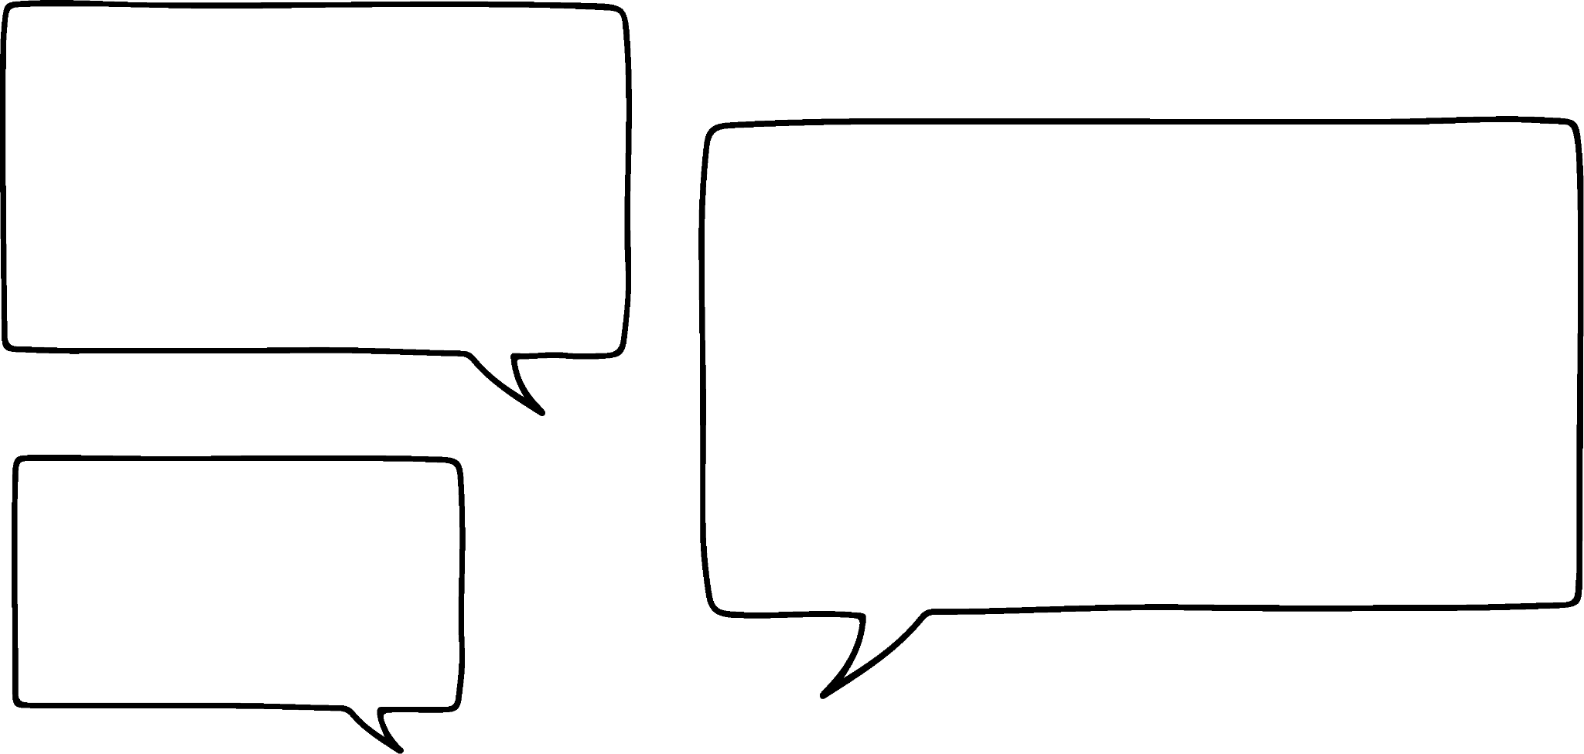

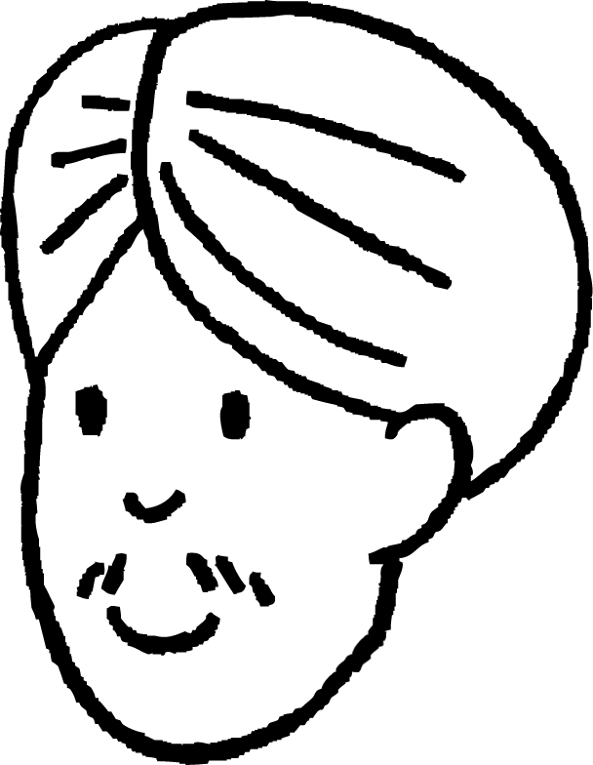

Falanqaynta iyo qiimaynta macnaha (contexts) la qaabeeyey
Wow, waxaa jira xaglo qumman (right-angles) iyo saddexagallo badan oo qarsoon oo adduunka aanan moodin!
Haa, laakiin dhamaantood xaaladahan miyay dhab ahaan leeyihiin xaglo qumman (right angles)?
Cali
Layla
waddada duulimaadka shimbirta (flight path of bird)
9 m
geed
Sida, miyaanay ahayn inaan samaynay mala-awaal (assumptions) badan oo ku saabsan shimbirta iyo geedka?
shimbir
3 m

Slide 29
Falanqaynta iyo qiimeynta duruufaha la qaabeeyey (Analysing and evaluating modelled contexts)
Marka la qaabeeyeyno (modelling) waxaa inta badan loo baahan yahay in la sameeyo qiyaaso macquul ah si loo xalliyo dhibaatada. Qaar ka mid ah qiyaasaha waxaa ka mid ah:
qiyaasashada in dhammaan dhererka iyo masaafada ay yihiin waddooyin toosan (linear paths), oo aan ahayn qalooc (curves)
qiyaasashada in laba dherer ama masaafo ay isku qumman yihiin (perpendicular), oo aan ahayn xagal kale
qiyaasashada in labada dherer ee isku qumman (perpendicular) ay taabtaan ama isgooyaan si uun

Slide 30
Falanqaynta iyo qiimeynta duruufaha la qaabeeyey (Analysing and evaluating modelled contexts)
Dheriga (saucepan) this, waxay ahayd mid macquul ah in la qiyaaso in saldhigga ugu weyn iyo joogga (height) ay isku qumman yihiin (perpendicular) oo ay taabtaan wareegga (circumference) goobada (circle) saldhigga dheriga.
12 cm
22 cm
Dherigan (saucepan), waa maxay qiyaasta (assumption) aan runta ahayn taas oo ka dhigan in aannu u qaabeyn karin (model) sida saddex-xagal quman (right-angled triangle)?
12 cm
Midna ka mid ah saddexda dherer (lengths) iskuma qummana (perpendicular) midba midka kale.
18 cm

Slide 31
Falanqaynta iyo qiimeynta duruufaha la qaabeeyey (Analysing and evaluating modelled contexts)
1) Taawerada raadiyaha (Radio towers) waa in ay ugu badnaan 3000 m kala fog yihiin si calaamadda raadiyaha (radio signal) loogu baahiyo (broadcast) aagga deegaanka.
Taawerada raadiyaha B waxay 1900 m waqooyi (north) u jirtaa taawerada raadiyaha A.
Taawerada raadiyaha C waxay 2400 m galbeed (west) u jirtaa taawerada raadiyaha A.
a) Qaabee (Model) masaafada (distances) u dhaxaysa saddexda taawero raadiyaha (radio towers) saddex-xagalkan quman (right-angled triangle), oo ku calaamadee (label) gees kasta (vertex) A, B, ama C si ay u matalaan (represent) saddexda taawero.
b) Taawerada raadiyaha A way jabtay (breaks down). Taawerada raadiyaha B iyo C ma ku dhow yihiin (close enough) midba midka kale si calaamadda raadiyaha (radio signal) weli loo baahiyo (broadcast)? Sharax sida aad u ogaatay.

Slide 32
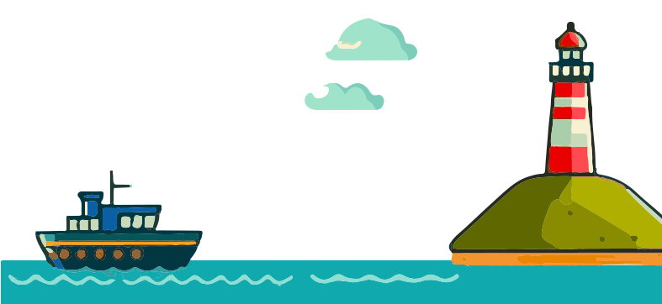
Falanqaynta iyo qiimeynta macnaha (contexts) la qaabeeyey
2) Iftiin-guri (lighthouse) dhererkiisu waa 50 mitir (metres), oo iftiinka (light) ka soo baxa wuxuu u safraa (travels) 130 mitir (metres) si uu u gaaro doonta (boat).
Kabiidka (captain) doonta (boat) wuxuu si kalsooni leh (confidently) ku dhawaaqayaa (declares):
“Waxaan ka fog nahay xeebta 120 mitir (metres).”
Sharax sababta kabiitanka (captain) laga yaabo inuu khaldan yahay.
Waxaad tixraaci kartaa mala-awaal (assumptions) uu sameeyay kabiitanka (captain) oo khaldan.
130 m
50 m

Slide 33
Falanqaynta iyo qiimeynta macnaha (contexts) la qaabeeyey
3) Nadiifiyaha daaqadaha (window cleaner) wuxuu u baahan yahay inuu gaaro daaqad 412 cm ka sarraysa dhulka. Tani waa ammaan in la sameeyo haddii masaafada toosan (horizontal distance) ee darbiga ilaa cagta sallalka (ladder) ay tahay rubuc (quarter) dhererka uu sallalku (ladder) u baahan yahay inuu gaaro.
a) Qaabeey xaaladdan saddexagalka qumman (right-angled triangle), oo ku calaamadee dhererka la yaqaan iyo dhinaca saddexagalka ee matalaya sallalka (ladder).
b) Intee buu Nadiifiyaha daaqadaha (window cleaner) u dhigayaa sallalkiisa (ladder)?
c) Waa maxay mala-awaal (assumptions) aad ka samaynaysid xaaladdan?

Slide 34
Falanqaynta iyo qiimeynta macnaha (contexts) la qaabeeyey
4) Tiir taleefan (phone mast) oo dhererkiisu yahay 15 m waxaa taageeraya fiil (cable) dhererkiisu yahay 24 m oo dhulka ku xidhan jillaab (hook).
Laba nal (lights) ayaa lagu xidhay: mid kororka tiirka taleefanka (phone mast), iyo midka jillaabka (hook), si loo yareeyo khatarta dadka ku socda habeenkii.
Si nalku (lights) u shaqeeyo, koronto-dhaliye (battery generator) ayaa lagu xidhay saldhigga tiirka taleefanka (phone mast), wuxuuna u baahan yahay in lagu xiro labada nal (lights) fiil koronto (electrical wire).
a) Ma ku filan tahay fiil koronto (electrical wire) oo dhererkeedu yahay 35 mitir (metres) in lagu xiro koronto-dhaliyaha (battery) labada nal (lights)?
b) Waa maxay mala-awaal (assumptions) aad ka samaysay xaaladdan qaybta a)?

Slide 35
Falanqaynta iyo qiimeynta macnaha (contexts) la qaabeeyey
1) Taawarada raadiyaha (radio towers) waa inay ugu badnaan 3000 m kala fogaan si calaamadda raadiyaha (radio signal) loogu baahiyo aagga deegaanka.
Taawarka raadiyaha (radio tower) B wuxuu ka xigaa 1900 m woqooyi taawarka raadiyaha (radio tower) A.
Taawarka raadiyaha (radio tower) C wuxuu ka xigaa 2400 m galbeed taawarka raadiyaha (radio tower) A.
a) Qaabeey masaafada (distances) u dhaxaysa saddexda taawarka raadiyaha (radio towers) saddexagalkan qumman (right-angled triangle), oo ku calaamadee gees kasta A, B, ama C si ay u matalaan saddexda taawarka (towers).
b) Taawarka raadiyaha (radio tower) A wuu jajabay. Ma ku dhow yihiin taawarada raadiyaha (radio towers) B iyo C si calaamadda raadiyaha (radio signal) weli loo baahiyo? Sharax sida aad u ogaatay.
B
3061 m
1900 m
C
A
2400 m
Calaamadda raadiyaha (radio signal) waa lumi doonaa, sababtoo ah masaafada ugu gaaban (shortest distance) ee taawarka raadiyaha (radio tower) B ilaa taawarka raadiyaha (radio tower) C waa in ka badan 3000 m, oo ah 3061 m.

Slide 36
Falanqaynta (Analysing) iyo qiimeynta (evaluating) qaababka la qaabeeyey (modelled contexts)
2) Taam (Lighthouse) dhererkiisu waa 50 mitir (metres), iftiinka (light) ka soo baxa wuxuu u safraa 130 mitir (metres) si uu u gaaro doonta (boat).
Kabiirka (captain) doonta wuxuu si kalsooni leh u cadeeyaa:
“waxaan ka fog nahay xeebta (shore) 120 mitir (metres)”.
Sharax sababta kabiirka (captain) uu khalad u noqon karo.
Waxaad tixraaci kartaa malooyinka (assumptions) uu sameeyay kabiirka (captain) ee khaldan.
130 m
50 m
Qaabka (model) saddex-xagalka qumman (right-angle triangle) ee taamka (lighthouse) iyo doonta, 120 m waa sax. Haddaba maxaa u khaldan?
120 m

Slide 37
Falanqaynta (Analysing) iyo qiimeynta (evaluating) qaababka la qaabeeyey (modelled contexts)
Jawaabaha suurtagalka ah waxaa ka mid noqon kara:
Xeebta (shore) ayaa u dhow doonta (boat) si toosan (horizontally) marka loo eego taamka (lighthouse).
50 m
Dhererka taamka (lighthouse) ma aha masaafada (distance) toosan (vertical) ee heerka badda (sea level). Sidaa darteed, kabiirka (captain) kuma xisaabtamin masaafada (distance) toosan (vertical) ee dheeriga ah.
???
masaafada (distance) taamka (lighthouse)
masaafada (distance) xeebta (shore)

Slide 38
Falanqaynta (Analysing) iyo qiimeynta (evaluating) qaababka la qaabeeyey (modelled contexts)
3) Nadiifiyaha daaqadaha (window cleaner) wuxuu u baahan yahay inuu gaaro daaqad (window) dhererkeedu yahay 412 cm oo ka sarreysa dhulka (ground). Tani waa badbaado (safe) haddii masaafada (distance) toosan (horizontal) u dhaxaysa gidaarka (wall) iyo cagta (foot) sallanka (ladder) ay tahay rubuc (quarter) dhererka uu sallanku (ladder) u baahan yahay inuu gaaro.
a) Qaabeey (Model) xaaladdan (situation) saddex-xagalkan qumman (right-angled triangle), ku calaamadee dherer kasta oo la yaqaan iyo dhinaca (side) saddex-xagalka (triangle) ee qaabeynaya sallanka (ladder).
424.68 cm
masaafada (distance) sallanku (ladder) u baahan yahay inuu gaaro
412 cm
dhererka (height) daaqadda (window)
103 cm

Slide 39
Falanqaynta iyo qiimaynta macnaha la qaabeeyey (modelled contexts)
3) Nadiifiyaha daaqadaha (window cleaner) wuxuu u baahan yahay inuu gaaro daaqad (window) dhererkeedu yahay 412 cm oo ka sarreysa dhulka (ground). Tani waa badbaado (safe) haddii masaafada (distance) toosan (horizontal) u dhaxaysa gidaarka (wall) iyo cagta (foot) sallanka (ladder) ay tahay rubuc (quarter) dhererka uu sallanku (ladder) u baahan yahay inuu gaaro.
b) Intee buu dherer ugu habboon yahay in nadiifiyaha daaqadaha uu dejiyo sallalka (ladder)?
Masaafada uu sallalku (ladder) u baahan yahay inuu gaadho waa 424.68 cm.
Sidaas darteed, nadiifiyaha daaqadaha wuxuu u baahan yahay inuu dejiyo sallalka (ladder) ilaa 425 cm.
412 cm
joogga daaqadda
103 cm

Slide 40
Falanqaynta iyo qiimaynta macnaha la qaabeeyey (modelled contexts)
3) Nadiifiyaha daaqadaha wuxuu u baahan yahay inuu gaadho daaqad 412 cm ka sarraysa dhulka. Tani waa ammaan haddii masaafada tooska ah (horizontal) ee gidaarka ilaa cagta sallalka (ladder) ay tahay rubuc (quarter) joogga uu sallalku (ladder) u baahan yahay inuu gaadho.
c) Maxaad u qaadanaysaa (assumptions) oo ku saabsan macnahan?
Tusaalooyinka waxaa ka mid ah:
Gidaarku wuxuu qumman yahay (perpendicular) dhulka
Dhulku ma aha mid janjeedha
Sallalku (ladder) ma foorarsado marka nadiifiyaha daaqadaha uu saaran yahay
425 cm
sallal (ladder)
412 cm
joogga daaqadda
103 cm

Slide 41
Falanqaynta iyo qiimaynta macnaha la qaabeeyey (modelled contexts)
a) Ma waxaa ku filan gariiradda (reel) korontada ee dhererkeedu yahay 35 mitir in lagu xiro batteriga (battery) labada nal (lights)?
dusheeda tiirka iyo iftiinka (top of mast and light)
35 m oo dherer ah oo ah duub koronto (electrical wire) ayaa ku filan.
Sababtoo ah waxaad u baahan tahay 15 m oo silig (wire) ah si aad ugu xidho iftiinka (light) dusheeda tiirka, iyo 18.7 m si aad ugu xidho iftiinka (light) qabatada (hook).
15 m + 18.7 m = 33.7 m, taas oo ka yar 35 m.
24 m
15 m
qabatada iyo iftiinka (hook and light)
18.7 m
batteri (battery)

Slide 42
Falanqaynta iyo qiimeynta macnaha (contexts) la qaabeeyey (modelled)
b) Maxaa malo ah (assumptions) oo aad ka qaadatay macnahan (context) qaybta a)?
dusheeda tiirka iyo iftiinka (top of mast and light)
Jawaabaha suurtagalka ah waxaa ka mid noqon kara:
24 m
Tiirka taleefoonka (phone mast) waa si toos ah (vertical), sidaas darteed waa u qumman yahay (perpendicular) dhulka.
15 m
Siliga (cable) uu qaabeeyey (modelled) hypotenuse-ka saddexagalka (triangle) waa si toos ah (straight), oo ma foorarsado ama ma hoobto.
qabatada iyo iftiinka (hook and light)
18.7 m
batariga (battery)
Dhulku waa si siman (horizontal), oo ma beddelo jiiradiisa (gradient) meel kasta oo u dhaxaysa qabatada (hook) iyo tiirka.

Slide 43
Qiyaasta (theorem) ee Pythagoras ee macnaha (context)
Waxaa jira macnayaal badan oo dhabta ah (real-world contexts) oo ku lug leh dherer ama masaafo u qumman (perpendicular) oo loo qaabeyn karo (modelled) sida saddexagallo qumman (right-angled triangles).
Qiyaasta (theorem) ee Pythagoras ayaa markaa loo isticmaali karaa xisaabinta dhererka maqan (missing lengths) si loo xalliyo dhibaatooyinka macnaha (context).
Si kastaba ha ahaatee, macnayaashan (contexts), haddii qaar ka mid ah malooyinka (assumptions) la qaaday ay run kama aha, tani waxay burin kartaa in macnaha (context) loo qaabeyn karo (modelled) sida saddexagal qumman (right-angled triangle), sidaas darteedna in qiyaasta (theorem) ee Pythagoras la isticmaali karo.
Qaar ka mid ah malooyinkan (assumptions) waxaa ka mid ah: dhererka iyo masaafada (lengths and distances) oo ah waddooyin toosan (linear paths), dhererka oo isu qumman (perpendicular), iyo masaafada (distances) oo isgoysa (intersect).

