Slide 1
Aqoonsiga isku xigxiga joomatari (geometric sequences)
Xiriirrada aan tooska ahayn (non-linear relationships)

Slide 2
sida loo isticmaalo darasyada Oak

Slide 3
Waxaan aqoonsan karaa isku xigxig joomatari (geometric sequence).

Slide 4
Isku xigxig joomatari (geometric sequence) waa isku xigxig leh xiriir isku dhufasho (multiplicative relationship) joogto ah oo u dhexeeya xubnaha isku xiga.
Saami guud (common ratio) waa sifo muhiim u ah isku xigxiga joomatari. Isku dhufashada joogtada ah ee u dhexeeya xubnaha isku xiga waxaa loo yaqaan saamiga guud (common ratio).

Slide 5

Aqoonsiga isku xigxiga joomatari (geometric sequences)
Helista saamiga guud (common ratio)
Isticmaalka saamiga guud (common ratio)

Slide 6
Helista saamiga guud (common ratio)
Isku xigxig joomatari (geometric sequence) dhexdiisa, waxaa jira xiriir isku dhufasho (multiplicative relationship) oo joogto ah oo u dhexeeya xubnaha.
162 ÷ 54 = 3
2, | 6, | 18, | 54, | 162, | …
54 ÷ 18 = 3
×3
×3
×3
×3
×3
×3
×3
×3
18 ÷ 6 = 3
6 ÷ 2 = 3
Si loo hubiyo in isku xigxigu yahay joomatari (geometric), waxaan qaadan karnaa xuban kasta oo u qaybin karnaa xubantii hore si aan u hubinno inuu jiro isku dhufasho (multiplier) guud.

Slide 7
Helista saamiga guud (common ratio)
Isku dhufashadan guud waxaa loo yaqaan saamiga guud (common ratio).
2, | 6, | 18, | 54, | 162, | …
2 | : | 6
6 | : | 18
18 | : | 54
54 | : | 162
2 | : | 6
1 | : | 3
6 | : | 18
18 | : | 54
54 | : | 162
2 | : | 6
1 | : | 3
6 | : | 18
1 | : | 3
18 | : | 54
1 | : | 3
54 | : | 162
1 | : | 3
2 | : | 6
1 | : | 3
6 | : | 18
1 | : | 3
18 | : | 54
54 | : | 162
2 | : | 6
1 | : | 3
6 | : | 18
1 | : | 3
18 | : | 54
1 | : | 3
54 | : | 162
÷3
÷3
×3
×3
×3
×3
×3
×3
×3
×3
Waxaad arki kartaa sababta loogu yeedho saami guud (common ratio), sababtoo ah lammaane kasta oo xubno ah waa isku saami.
÷6
÷6
Ka jar saami kasta (ratio) qaabkiisa ugu fudud.
÷18
÷18
÷54
÷54

Slide 8


Helista saamiga guud (common ratio)
Si loo helo saamiga guud (common ratio) ee isku xigxiga joomatari (geometric sequence), waa inaad …
isku dhufo xubnaha isku xiga.
ka jartaa xubintii hore xuban kasta.
u qaybiso xuban kasta xubintii hore.

Slide 9
Helista saamiga guud (common ratio)
Raadi saamiga guud (common ratio) ee taxanahan joometeriga (geometric sequence).
22, | 242, | 2662, | 29 282, | 322 102, | …
×11
×11
×11
×11
322 102 ÷ 29 282 = 11
29 282 ÷ 2662 = 11
2662 ÷ 242 = 11
242 ÷ 22 = 11
Adigoo u qaybinaya eray kasta eraygii hore waxaan helnaa saami guud (common ratio) oo ah 11.

Slide 10
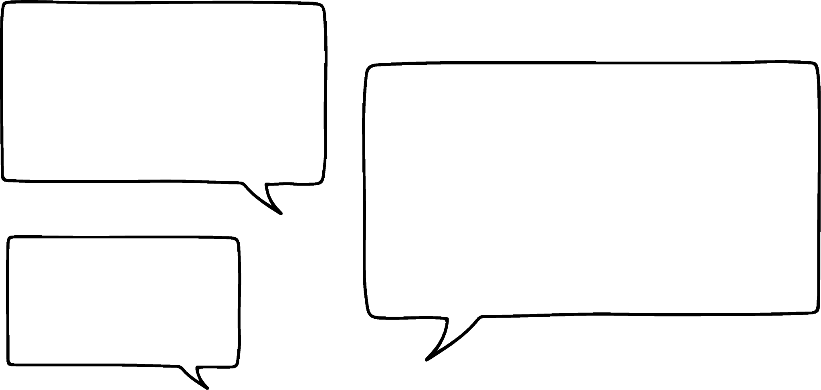
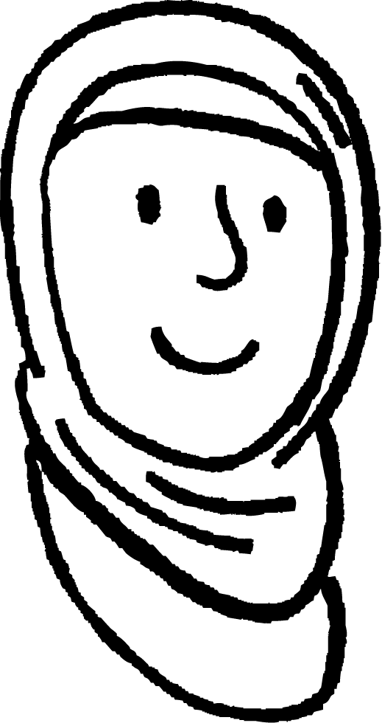
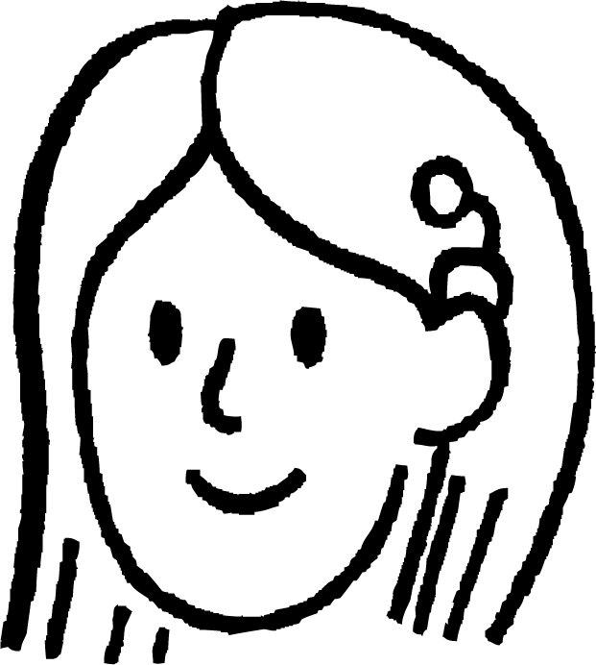
Helista saamiga guud (common ratio)
Suad iyo Caasha waxay eegayaan taxane kale.
80, | 200, | 500, | 1250, | 3125, | …
Tijaabi. Qaado eray kasta oo u qaybi eraygii hore. Haddii aad hesho xiriir isku dhufasho oo guud (common multiplicative relationship) oo u dhexeeya eray kasta, taxanuhu waa joometeri (geometric).
Taxanahan ma noqon karo joometeri (geometric) sababtoo ah 80 ma aha qaybiyaha (factor) 200, 200-na ma aha qaybiyaha 500.

Slide 11
Helista saamiga guud (common ratio)
Suad iyo Caasha waxay eegayaan taxane kale.
80, | 200, | 500, | 1250, | 3125, | …
Tijaabi. Qaado eray kasta oo u qaybi eraygii hore. Haddii aad hesho xiriir isku dhufasho oo guud (common multiplicative relationship) oo u dhexeeya eray kasta, taxanuhu waa joometeri (geometric).
×2.5
×2.5
×2.5
×2.5
200 ÷ 80 = 2.5
500 ÷ 200 = 2.5
1250 ÷ 500 = 2.5
3125 ÷ 1250 = 2.5
Taxanahan waa joometeri (geometric)! Wuxuu leeyahay saami guud (common ratio) oo jajab tobanle (decimal).

Slide 12


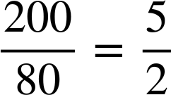
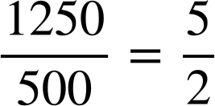
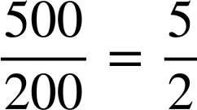
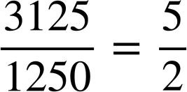
Helista saamiga guud (common ratio)
Suad iyo Caasha waxay eegayaan taxane kale.
80, | 200, | 500, | 1250, | 3125, | …
Waxaa fiican in loo fikiro sidii tiro isku dhufasho jajab leh (fractional multiplier). 2.5 =
200 ÷ 80 = 2.5
500 ÷ 200 = 2.5
1250 ÷ 500 = 2.5
3125 ÷ 1250 = 2.5
Taxanahan waa joometeri (geometric)! Wuxuu leeyahay saami guud (common ratio) oo jajab tobanle (decimal).

Slide 13


Helista saamiga guud (common ratio)
Cabdi wuxuu isku dayayaa inuu helo erayga 5aad (5th term) ee taxanahan joometeriga (geometric sequence).
162, | 216, | 288, | 384, | ? , | …
Maxay tahay talada aad u malaynaysid in Caasha siin doonto Cabdi iyo sababta?
216 ÷ 162 = 1.33 (ilaa 2 d.p.)
288 ÷ 216 = 1.33 (ilaa 2 d.p.)
384 ÷ 288 = 1.33 (ilaa 2 d.p.)
Saamiga guud (common ratio) waa 1.33, marka erayga xiga waa 384 × 1.33 = 510.72

Slide 14

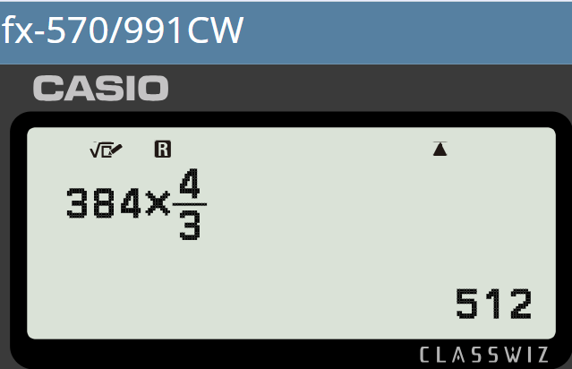
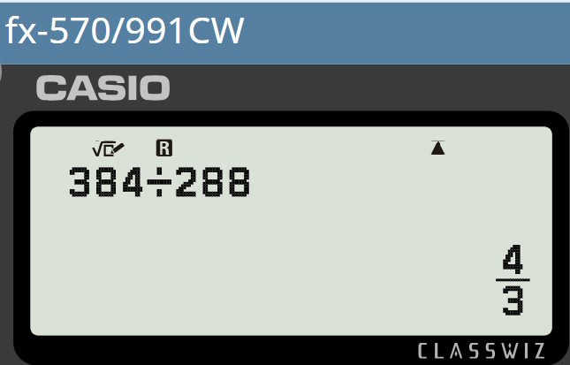
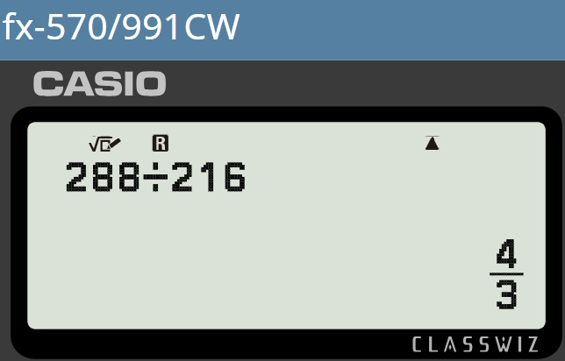
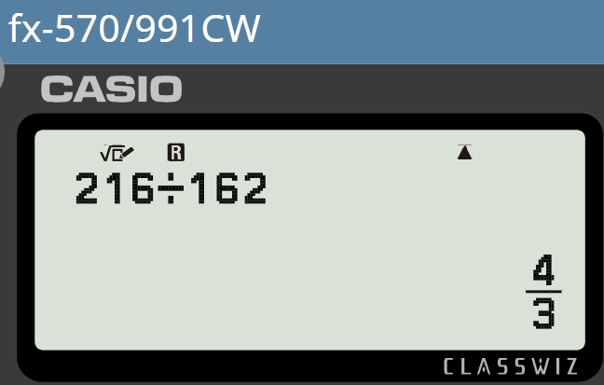
Helista saamiga guud (common ratio)
Cabdi wuxuu isku dayayaa inuu helo 5-aad (5th term) ee taxanahan joomatari (geometric sequence).
162, | 216, | 288, | 384, | ? , | …
162, | 216, | 288, | 384, | 512, | …
Uga tag saamiga guud (common ratio) qaab jajab (fraction) si sax ah oo hufan. Xisaabiyahaagu wuxuu ku caawin doonaa.
216 ÷ 162 = 1.33 (ilaa 2 tiro jajab tobanle)
288 ÷ 216 = 1.33 (ilaa 2 tiro jajab tobanle)
384 ÷ 288 = 1.33 (ilaa 2 tiro jajab tobanle)
Saamiga guud (common ratio) waa 1.33, markaa xiga waa 384 × 1.33 = 510.72

Slide 15


Helista saamiga guud (common ratio)
Cabdi wuxuu isku dayayaa inuu helo 5-aad (5th term) ee taxanahan joomatari (geometric sequence).
162, | 216, | 288, | 384, | 512, | …
Uga tag saamiga guud (common ratio) qaab jajab (fraction) si sax ah oo hufan. Xisaabiyahaagu wuxuu ku caawin doonaa.
Mahadsanid Caasha!

Slide 16
Helista saamiga guud (common ratio)
Cabdi iyo Caasha waxay heleen taxanahan.
5, | 10, | 30, | 120, | 600, | …
Xusuusnow, waa inuu ahaadaa xiriir isku dhufasho (multiplicative) guud oo u dhexeeya xubin kasta si taxanuhu u noqdo joomatari (geometric).
Isku dhufashadaadu (multiplier) way isbeddeshaa taxanahaaga, markaa ma aha joomatari (geometric).
×2
×3
×4
×5
Waxaan ku raaxaysanayaa taxanaha joomatari (geometric sequences). Kan wuxuu leeyahay qaab aad u yaab leh!
Taxane joomatari (geometric sequence) waa inuu yeesho xiriir isku dhufasho (multiplicative) joogto ah oo u dhexeeya xubnaha.

Slide 17
Helista saamiga guud (common ratio)
Kee ka mid ah kuwan waa taxane joomatari (geometric sequences)?
71, | 213, | 639, | 1917, | 5751, | …
Xiriir isku dhufasho (multiplicative) joogto ah - Joomatari (Geometric)
×3
×3
×3
×3
71, | 142, | 426, | 852, | 2556, | …
Ma aha isku dhufasho (multiplier) joogto ah - Ma aha joomatari (Geometric)
×2
×3
×2
×3
71, | 142, | 568, | 4544, | 72 704, | …
Ma aha isku dhufasho (multiplier) joogto ah - Ma aha joomatari (Geometric)
×2
×4
×8
×16
71, | 355, | 1775, | 8875, | 44 375, | …
Xiriir isku dhufasho (multiplicative) joogto ah - Joomatari (Geometric)
×5
×5
×5
×5

Slide 18
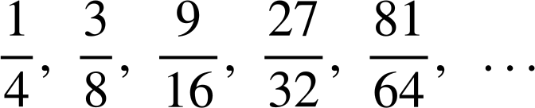
Helista saamiga guud (common ratio)
1) U qaybi eray kasta eraygii hore si aad u hesho saamiga guud (common ratio) ee mid kasta oo ka mid ah taxanahan joometeriga (geometric sequences).
a) | 15, | 105, | 735, | 5145, | 36 015, | …
b) | 0.08, | 0.72, | 6.48, | 58.32, | 524.88, | …
c) | 567, | 189, | 63, | 21, | 7, | …
d)

Slide 19
Helista saamiga guud (common ratio)
2) a) Taxanahan waa joometeri (geometric). Muuji inuu yahay oo qor jumlad ku caddaynaysa sababta.
768, 576, 432, 324, 243, …
b) Taxanahan ma aha joometeri. Muuji inuusan ahayn oo qor jumlad ku caddaynaysa sababta.
756, 252, 126, 42, 21, …

Slide 20
Helista saamiga guud (common ratio)
1) U qaybi eray kasta eraygii hore si aad u hesho saamiga guud (common ratio) ee mid kasta oo ka mid ah taxanahan joometeriga (geometric sequences).
a) | 15, | 105, | 735, | 5145, | 36 015, | …
36 015 ÷ 5145 = 7
×7
×7
×7
×7
5145 ÷ 735 = 7
735 ÷ 105 = 7
105 ÷ 15 = 7
b) | 0.08, | 0.72, | 6.48, | 58.32, | 524.88, | …
524.88 ÷ 58.32 = 9
×9
×9
×9
×9
58.32 ÷ 6.48 = 9
6.48 ÷ 0.72 = 9
0.72 ÷ 0.08 = 9

Slide 21

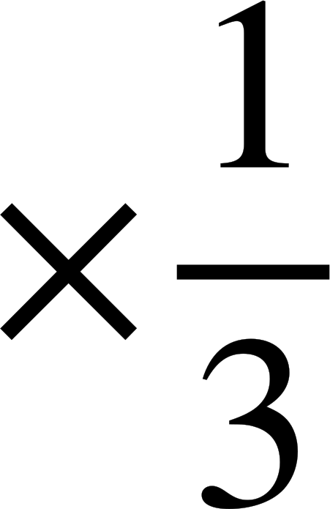
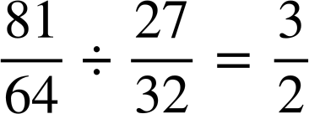
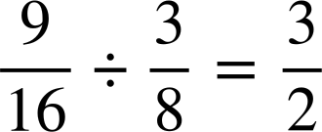

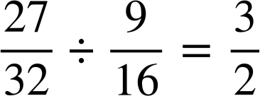
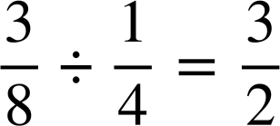
Helista saamiga guud (common ratio)
1) U qaybi eray kasta eraygii hore si aad u hesho saamiga guud (common ratio) ee mid kasta oo ka mid ah taxanahan joometeriga (geometric sequences).
c) | 567, | 189, | 63, | 21, | 7, | …
7 ÷ 21 =
21 ÷ 63 =
63 ÷ 189 =
189 ÷ 567 =
d)

Slide 22


Helista saamiga guud (common ratio)
2) a) Taxanahan waa joometeri (geometric). Muuji inuu yahay oo qor jumlad ku caddaynaysa sababta.
768, 576, 432, 324, 243, …
243 ÷ 324 =
324 ÷ 432 =
432 ÷ 576 =
Taxanahu wuxuu leeyahay saami guud (common ratio) oo u dhexeeya erayaasha is xiga, sidaa darteed waa joometeri (geometric).
576 ÷ 768 =

Slide 23
Helista saamiga guud (common ratio)
2) a) Taxanahan waa joometeri (geometric). Muuji inuu yahay oo qor jumlad ku caddaynaysa sababta.
768, 576, 432, 324, 243, …
768 | : | 576
4 | : | 3
576 | : | 432
4 | : | 3
432 | : | 324
4 | : | 3
324 | : | 243
4 | : | 3
768 | : | 576
576 | : | 432
432 | : | 324
324 | : | 243
÷192
÷192
Waxaa laga yaabaa inaad sidoo kale tidhi…
Taxanahu wuxuu leeyahay saami joogto ah (constant ratio) 4 : 3 oo u dhexeeya erayaasha is xiga, sidaa darteed waa joometeri (geometric).
Xusuusnow in saamiga guud (common ratio) la bixiyo sida hal qiime (single value).
÷144
÷144
÷108
÷108
÷81
÷81

Slide 24



Helista saamiga guud (common ratio)
2) b) Taxanahan ma aha joometeri. Muuji inuusan ahayn oo qor jumlad ku caddaynaysa sababta.
756, 252, 126, 42, 21, …
21 ÷ 42 =
42 ÷ 126 =
Taxanahu wuxuu leeyahay xiriir isku dhufasho (multiplicative relationship) oo u dhexeeya qaar ka mid ah erayaasha iyo oo u dhexeeya kuwa kale, sidaa darteed ma aha joometeri (not geometric).
126 ÷ 252 =
252 ÷ 756 =

Slide 25
Helista saamiga guud (common ratio)
2) b) Taxanahan ma aha joometeri. Muuji inuusan ahayn oo qor jumlad ku caddaynaysa sababta.
756, 252, 126, 42, 21, …
756 | : | 252
3 | : | 1
252 | : | 126
2 | : | 1
126 | : | 42
3 | : | 1
42 | : | 21
2 | : | 1
756 | : | 252
252 | : | 126
126 | : | 42
42 | : | 21
÷252
÷252
Waxa laga yaabaa inaad sidoo kale tidhi…
÷126
÷126
Taxanuhu wuxuu leeyahay saami (ratio) 3 : 1 inta u dhaxaysa qaar ka mid ah xubnaha iyo 2 : 1 inta u dhaxaysa kuwa kale, sidaas darteed ma aha geometric.
÷42
÷42
÷21
÷21

Slide 26
Aqoonsiga taxanaha geometric (geometric sequences)
Helista saamiga guud (common ratio)
Isticmaalka saamiga guud (common ratio)

Slide 27


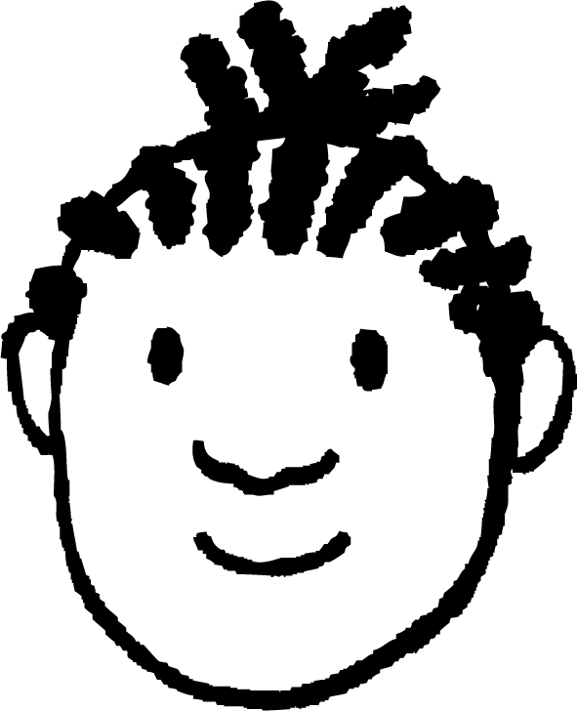
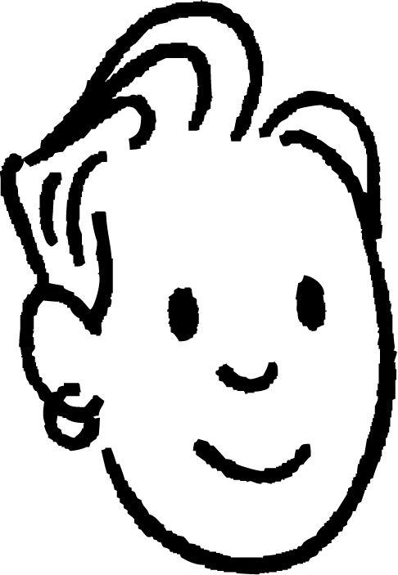
Isticmaalka saamiga guud (common ratio)
Saciid iyo Yacquub waxay eegayaan xubnaha maqan.
, | 3, | 15, | 75, | 375, | …
75 × 5 = 375
15 ÷ 5 = 3
÷5
÷5
×5
×5
3 ÷ 5 =
Kani waa taxane geometric (geometric sequence) oo leh saami guud (common ratio) 5
Ma heli kartaa xubnaha maqan ee kan?
Haa! Waxaan ku dhufanayaa 5 si aan u helo xubinta 5aad, ka dibna waxaan sameeyaa rogaalka (inverse) ee ÷5 si aan u helo xubnaha hore.

Slide 28
Isticmaalka saamiga guud (common ratio)
Saciid iyo Yacquub waxay eegayaan xubnaha maqan.
, | 3, | 15, | 75, | 375, | …
×5
×5
×5
×5
Haa! Waxaan ku dhufanayaa 5 si aan u helo xubinta 5aad, ka dibna waxaan sameeyaa rogaalka (inverse) ee ÷5 si aan u helo xubnaha hore.
Waan hubiyay.
Waxaad sax tahay Yacquub!

Slide 29

Isticmaalka saamiga guud (common ratio)
Waa maxay xubinta 5aad ee taxanahan geometric (geometric sequence)?
, | 8, | 88, | 968, | 10 648, | …
×11
×11
968 ÷ 88 = 11
Saamiga guud (common ratio) ee u dhexeeya xubnaha isku xigxiga waa 11
968 × 11 = 10 648

Slide 30
Isticmaalka saamiga guud (common ratio)
Waa maxay xubinta 2aad ee taxanahan geometric (geometric sequence)?
, | 8, | 88, | 968, | 10 648, | …
÷11
×11
×11
Rogaalka (inverse) ee ×11 waa ÷11
88 ÷ 11 = 8

Slide 31
Isticmaalka saamiga guud (common ratio)
Waa maxay ereyga 1aad ee taxanahan joomatari (geometric sequence)?
, | 8, | 88, | 968, | 10 648, | …
Si aan u helno erey hore waxaan u baahanahay inaan samayno rogaal celinta (inverse) ee ×11
88
×11
×11
×11
×11
0.727
8 ÷ 11 = 0.727272… laakiin markaad soo wareejiso waxaad lumisaa saxnaanta (accuracy).
8 ÷ 11 waxaa si sax ah oo kooban loogu gudbiyaa jajab (fraction).

Slide 32

Isticmaalka saamiga guud (common ratio)
Waxa sidoo kale suurtogal ah in la helo ereyada maqan ee taxanaha joomatari (geometric sequences) marka aan lagu siin ereyada isku xiga.
1aad | 2aad | 3aad | 4aad | 5aad
1 | 2 | 4 | 8 | 16
8 ÷ 2 = 4 marka saamiga guud (common ratio) waa inuu ahaadaa 4
Nuur ma saxna. Sidee ku ogaatay?
Ereyga 3aad: 2 × 4 = 8
Ereyga 4aad: 8 × 4 = 32

Slide 33
Isticmaalka saamiga guud (common ratio)
Waxa sidoo kale suurtogal ah in la helo ereyada maqan ee taxanaha joomatari (geometric sequences) marka aan lagu siin ereyada isku xiga.
1aad | 2aad | 3aad | 4aad | 5aad
1 | 2 | 4 | 8 | 16
2 × r × r = 8
×r
×r
Waan hubiyay. Saamiga guud (common ratio) ma noqon karo 4. Waa inay tahay wax isku dhufanaya laba jeer si loo helo 4
2 × r² = 8
r² = 4

Slide 34
Isticmaalka saamiga guud (common ratio)
Waxa sidoo kale suurtogal ah in la helo xubno maqan oo ku jira taxanaha joomatari (geometric sequences) marka aan lagu siin xubno isku xiga.
1aad | 2aad | 3aad | 4aad | 5aad
1 | 2 | 4 | 8 | 16
2 × r × r = 8
×2
×2
×2
×2
2 × r² = 8
Waa 2
Markaad laba jibaaranto (square) 2 waxaad heleysaa 4
r² = 4
r = 2

Slide 35

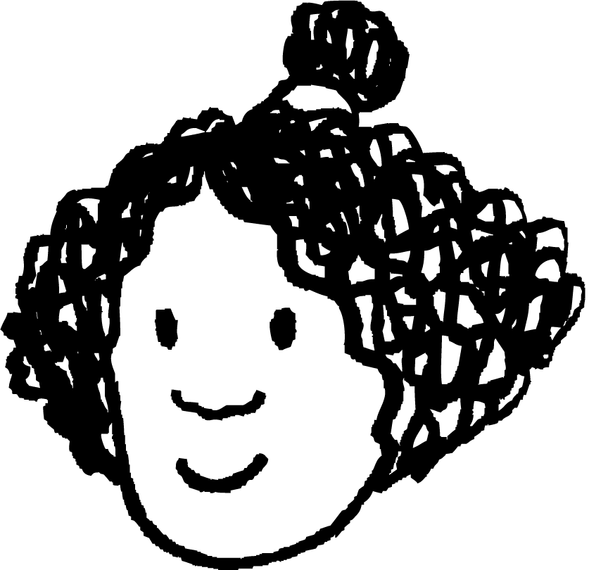
Isticmaalka saamiga guud (common ratio)
Waxa sidoo kale suurtogal ah in la helo xubno maqan oo ku jira taxanaha joomatari (geometric sequences) marka aan lagu siin xubno isku xiga.
1aad | 2aad | 3aad | 4aad | 5aad
1 | 2 | 4 | 8 | 16
1aad | 2aad | 3aad | 4-aad | 5-aad
1 | 2 | 4 | 8 | 16
×2
×2
×2
×2
×r
×r
Aad ayaan ugu faanaa nafteyda!
Ha u dabaaldegina goor hore. Dhab ahaantii waxaa jira laba xal oo dhibaatadan.

Slide 36
Isticmaalka saamiga guud (common ratio)
Waxaa sidoo kale suurtogal ah in la helo ereyada (terms) maqan ee taxanaha joomatari (geometric sequences) marka aan la siinin ereyo isku xiga.
r² = 4
1-aad | 2-aad | 3-aad | 4-aad | 5-aad
1 | 2 | 4 | 8 | 16
r = 2 ama −2
Wax kale oo labajibbaaran (squared) siinaya 4?
×r
×r
Ha u dabaalgelin goor hore. Waxaa jira laba xal (solutions) oo dhibaatadan ah.
Waan helay! Tabane 2 (Negative 2)

Slide 37
Isticmaalka saamiga guud (common ratio)
Waxaa sidoo kale suurtogal ah in la helo ereyada (terms) maqan ee taxanaha joomatari (geometric sequences) marka aan la siinin ereyo isku xiga.
r² = 4
1-aad | 2-aad | 3-aad | 4-aad | 5-aad
−1 | 2 | −4 | 8 | −16
r = 2 ama −2
×−2
×−2
×−2
×−2
Waa ku mahadsan tahay Nuur. Waxaad heshay labada taxane (sequences) ee suurtogalka ah.

Slide 38
Isticmaal saami guud (common ratio)
Waa maxay saami guud (common ratio) ee taxanahan joomatari (geometric sequence)?
1aad | 2aad | 3aad | 4aad | 5aad
2 | 6 | 18 | 54 | 162
3
×3
×3
×3
×3
−3
1aad | 2aad | 3aad | 4aad | 5aad
−2 | 6 | −18 | 54 | −162
9
×−3
×−3
×−3
×−3

Slide 39


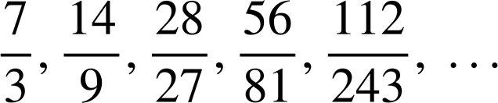
Isticmaal saami guud (common ratio)
1) Raadi xubnaha (terms) ka maqan ee taxanahan joomatari (geometric sequences).
a)
, | 17, | 51, | 153, | 459, | …
1125, | 225, | 45, | 9, | , | …
b)
c)
0.07, | 0.14, | 2.8, | 56, | 1120, | …
d)

Slide 40
Isticmaal saami guud (common ratio)
2) Raadi labada taxane joomatari (geometric sequences) ee suurtogalka ah, marka la eego xubnahan (terms) ka maqan, ee aan isku xigxin.
1aad | 2aad | 3aad | 4aad | 5aad
4 | 20 | 100 | 500 | 2500

Slide 41


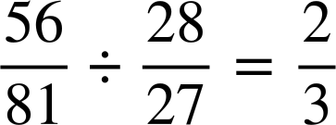

Isticmaalka saamiga guud (common ratio)
1) Raadi xubnaha (terms) ka maqan ee taxanahan joomatari (geometric sequences).
a)
, | 17, | 51, | 153, | 459, | …
1125, | 225, | 45, | 9, | , | …
b)
×3
×3
×3
×3
153 ÷ 51 = 3
45 ÷ 225 =
c)
0.007, | 0.14, | 2.8, | 56, | 1120, | …
d)
×20
×20
×20
×20
2.8 ÷ 0.14 = 20

Slide 42
Isticmaalka saamiga guud (common ratio)
2) Soo hel labada isku xigxig (geometric sequences) ee suurtogalka ah marka la eego erayadan maqan, ee aan isku xigxignayn.
1aad | 2aad | 3aad | 4aad | 5aad
4 | 20 | 100 | 500 | 2500
4 × r × r = 100
4 × r² = 100
r² = 25
×5
×5
×5
×5
r = 5 ama −5
1aad | 2aad | 3aad | 4aad | 5aad
4 | −20 | 100 | −500 | 2500
×−5
×−5
×−5
×−5

Slide 43
Aqoonsiga isku xigxiga joomatari (geometric sequences)
Waxaan aqoonsan karaa isku xigxiga joomatari (geometric sequences) anigoo helaya saami guud (common ratio) oo u dhexeeya erayada isku xigxiga.
Tusaale ahaan, 7, 14, 28, 56, … waa joomatari (geometric) sababtoo ah waxay leedahay saami guud (common ratio) oo ah 2 oo u dhexeeya erayada isku xigxiga.

