Slide 1
Aqoonsiga taxanaha tirooyinka gaarka ah
Xiriirrada aan tooska ahayn (Non-linear relationships)

Slide 2
Sida loo isticmaalo darasyada Oak

Slide 3
Waxaan aqoonsan karaa taxane tirooyin gaar ah.

Slide 4
Taxane xisaabeed (ama toosan) waa taxane halkaasoo farqiga u dhexeeya xubnaha isku xigta uu yahay mid joogto ah.
Taxane joomatari waa taxane leh xiriir isku dhufasho joogto ah oo u dhexeeya xubnaha isku xigta.
Tiro saddexagal (ama tiro saddexagal) waa tiro lagu matali karo qaab dhibco lagu habeeyay saddexagal siman. Tirada xubnaha waa tirada dhibcood ee dhinaca saddexagalka.
1
3
6
10
15

Slide 5

Aqoonsiga taxanaha tirooyinka gaarka ah
Taxanaha xisaabeed iyo joomatari
Sahminta taxanaha kale

Slide 6
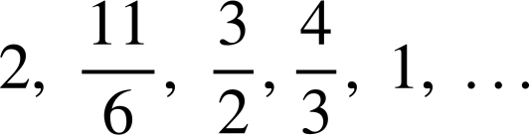
Taxanaha xisaabeed iyo joomatari
Taxanaha xisaabeed (toosan) waxay leeyihiin farqi guud oo u dhexeeya xubnaha isku xigta.
Sideen u arki karnaa kuwaas oo ah shanta xubnood ee ugu horreeya ee taxane xisaabeed?
a) 81, 138, 195, 252, 309, …
b) −24, −13, −2, 13, 24, …
c) 21.7, 19.4, 17.1, 14.8, 12.5, …
d)
Soo saar farqiga u dhexeeya xubnaha isku xigta oo hubi inuu isku mid yahay inta u dhexeysa lammaane kasta oo xubnaha ah.

Slide 7
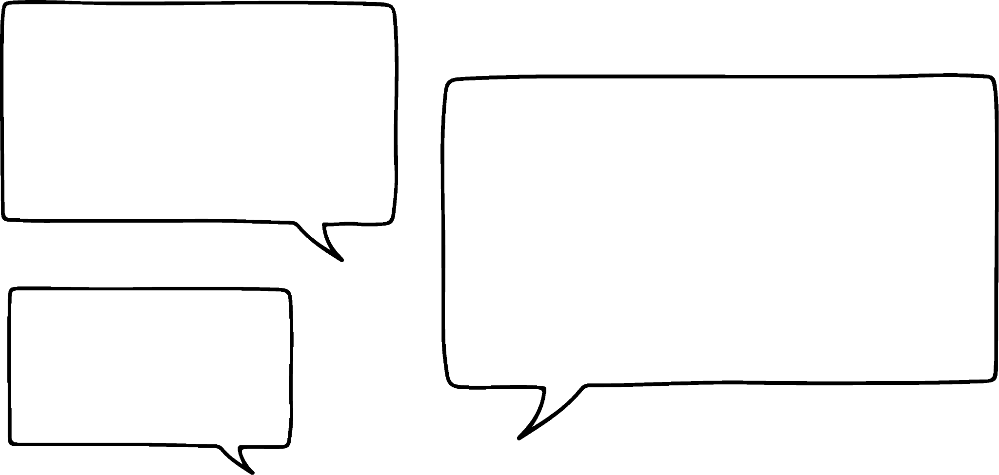
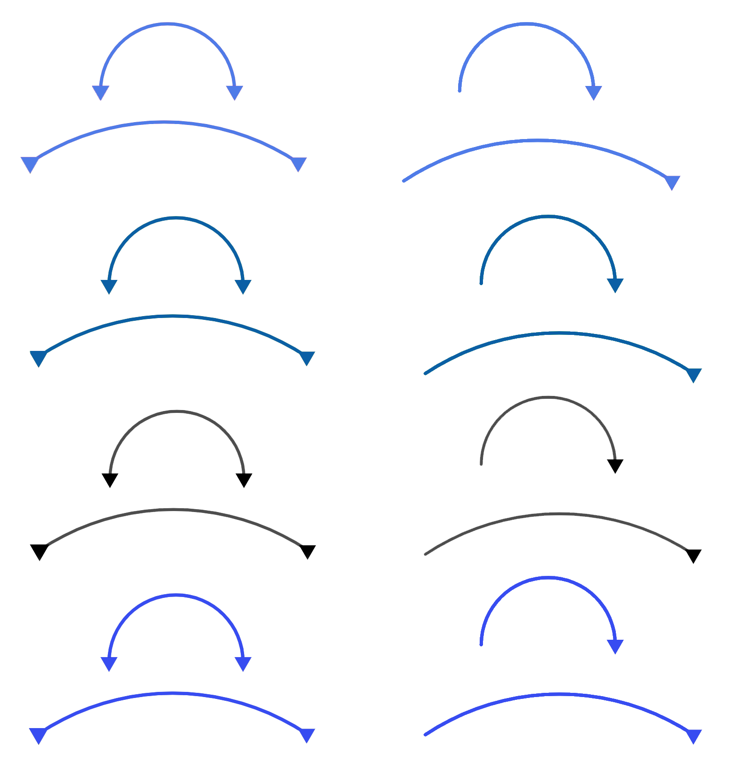







Taxanaha xisaabeed iyo joomatari
Kuwee oo ka mid ah kuwan yihiin shanta xubnood ee ugu horreeya ee taxane xisaabeed?
a) 81, 138, 195, 252, 309, …
b) −24, −13, −2, 13, 24, …
c) 21.7, 19.4, 17.1, 14.8, 12.5, …
d)
138 − 81 = 57
Waa inay tahay xisaabeed markaa
+ 57
+ 57
+ 57
+ 57
195 − 138 = 57
252 − 195 = 57
Caasha
309 − 252 = 57
Dhab ahaantii, waxaan u baahanahay inaan hubinno xubnaha kale.
Layla
Marka kani waa taxane toosan laakiin wali waxaa muhiim ah inaan hubinnay xubin kasta.

Slide 8

Taxanaha xisaabeed iyo joomatari
Kuwani waa shanta erey ee ugu horreeya ee taxane xisaabeed (arithmetic sequence)?
a) 81, 138, 195, 252, 309, …
b) −24, −13, −2, 13, 24, …
c) 21.7, 19.4, 17.1, 14.8, 12.5, …
d)
−13 − (−24) = 11
+ 57
+ 57
+ 57
+ 57
−2 − (−13) = 11
Ma aha xisaabeed (arithmetic)
13 − (−2) = 15
24 − 13 = 11
+ 11
+ 11
+ 15
+ 11
Waa fiicantahay inaan sii hubiyay dhammaan ereyada markan!
Caasha

Slide 9
Taxanayaasha xisaabeed iyo joomatari (arithmetic and geometric sequences)
Kuwani waa shanta erey ee ugu horreeya ee taxane xisaabeed (arithmetic sequence)?
a) 81, 138, 195, 252, 309, …
b) −24, −13, −2, 13, 24, …
c) 21.7, 19.4, 17.1, 14.8, 12.5, …
d)
+ 57
+ 57
+ 57
+ 57
Layla
Waxaa ii fudud in aan sii kala googooyo 2.3 oo aan eego haddii aan helo ereyga xiga
+ 11
+ 11
+ 15
+ 11
19.4 − 21.7 = − 2.3
− 2.3
− 2.3
− 2.3
− 2.3
19.4 − 2.3 = 17.1
17.1 − 2.3 = 14.8
14.8 − 2.3 = 12.5

Slide 10
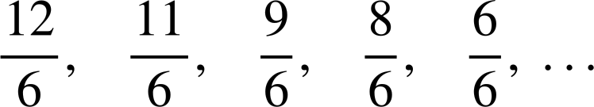


Taxanayaasha xisaabeed iyo joomatari (arithmetic and geometric sequences)
Kuwani waa shanta erey ee ugu horreeya ee taxane xisaabeed (arithmetic sequence)?
a) 81, 138, 195, 252, 309, …
b) −24, −13, −2, 13, 24, …
c) 21.7, 19.4, 17.1, 14.8, 12.5, …
d)
Midka ugu dambeeya, isticmaalka hooseeye wadaag ah (common denominator) ayaa laga yaabaa inuu caawiyo.
+ 57
+ 57
+ 57
+ 57
+ 11
+ 11
+ 15
+ 11
− 2.3
− 2.3
− 2.3
− 2.3
Kala duwanaanshuhu (differences) isku mid ma aha, marka kani ma aha taxane xisaabeed (arithmetic sequence).

Slide 11



Taxanayaasha xisaabeed iyo joomatari (arithmetic and geometric sequences)
Waxaan bilaabay taxane 8, 12, 18, 27, …
Taxanaha Cabdi ma xisaabeed (arithmetic) baa?
Maya, kala duwanaanshaha (difference) u dhexeeya labada erey ee ugu horreeya waa 4 laakiin kani ma sii joogto (constant).
Cabdi
Waa noocee kale oo taxane ah oo uu noqon karaa?
Waxaa laga yaabaa inuu yahay joomatari (geometric)?
Sideen u hubin karnaa haddii Caasha sax tahay?
U qaybi ereyada isku xiga oo fiiri haddii ay jirto saami wadaag ah (common ratio).
Caasha

Slide 12
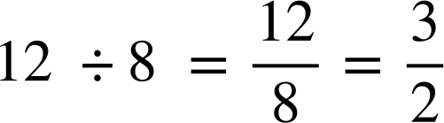

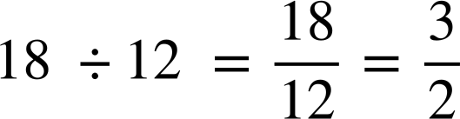
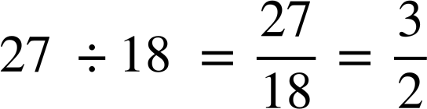

Tixraacyada xisaabeed iyo joomatari (Arithmetic and geometric sequences)
8, 12, 18, 27, …
Marka Caasha waa sax, kuwani waxay noqon karaan afarta xubnood ee ugu horreeya ee tix joomatari ah oo leh saami guud (common ratio) ah

Slide 13


Tixraacyada xisaabeed iyo joomatari (Arithmetic and geometric sequences)
Kee ka mid ah kuwani waxay noqon karaan afarta xubnood ee ugu horreeya ee tix joomatari ah?
3, 12, 48, 194, …
48 × 4 = 192
× 4
× 4
2, 10, 50, 250, …
Saami guud (common ratio) oo ah 5
× 5
× 5
× 5
16, 40, 100, 250, …
Saami guud (common ratio) oo ah
−5, 10, 20, 40, …
Wuxuu ku bilaabmaa isku dhufashada −2 ka dibna wuxuu u wareegaa isku dhufashada 2
× −2
× 2

Slide 14
Tixraacyada xisaabeed iyo joomatari (Arithmetic and geometric sequences)
Tixraacyadu waxay yeelan karaan tibaaxyo aljabra ah (algebraic expressions) sida xubnaha.
Tixda ku bilaabata
a + 3, a + 7, a + 11, a + 15, …
Waxay noqon kartaa tix xisaabeed (arithmetic sequence) oo leh xubinta koowaad a + 3 iyo farqiga guud (common difference) (+ 4)
+ 4
+ 4
+ 4
Waa maxay xubinta xigta haddii tani tahay tix xisaabeed?
a + b, a + 3b, a + 5b, …
a + 7b
+ 2b
+ 2b
+ 2b

Slide 15
Tixraacyada xisaabeed iyo joomatari (Arithmetic and geometric sequences)
Waxaan u malaynayaa in a, 2a, 3a, 4a, … ay tahay tix joomatari (geometric sequence) sababtoo ah waxay isticmaashaa isku dhufasho si loo helo xubinta xigta.
Layla
Ma sax baa Layla?
Maya a × 2 = 2a laakiin 2a × 2 ≠ 3a
a, 2a, 3a, 4a, …
Tani waxay noqon kartaa tix toosan (linear sequence) oo leh farqi guud (+a)
+ a
+ a
+ a

Slide 16
Tixraacyada xisaabeed iyo joomatari (Arithmetic and geometric sequences)
Haddii tix joomatari (geometric sequence) ay ku bilaabato a, 2a, …
waa maxay saddexda xubnood ee xiga?
× 2
2a × 2 = 4a
4a × 2 = 8a
8a × 2 = 16a
a, 2a, 4a, 8a, 16a, ….
Waa tix joomatari (geometric sequence) oo leh saami guud (common ratio) oo ah 2

Slide 17
Tixraacyada (sequences) Xisaabeed (Arithmetic) iyo Joometri (Geometric)
Tixraacyadan (sequences) kee baa noqon kara mid Joometri (Geometric)?
a , 5a, 10a, 50a, …
× 5
× 2
× 5
a , a², a³, a⁴, …
Saamiga guud (Common ratio) ee a
× a
× a
× a
a , ab, 2ab, 4ab, …
× b
× 2
× 2

Slide 18
Tixraacyada (sequences) Xisaabeed (Arithmetic) iyo Joometri (Geometric)
Kala saar tixraacyadan (sequences) tiirka saxda ah ee jaantuska.
Xisaabeed (arithmetic) | Joometri (geometric) | kale (other)
1, 2, 3, 4, 5, …
3, 9, 27, 81, ….
0.5, 1, 2, 4, …
1, 1, 2, 4, 7, …
1, 2, 4, 7, 11, …
−2, 4, −8, 16, …
−1, 5, 11, 17, 23, …
18, 35, 52, 69, 88, …
36, 12, −12, −36 …
13.5, 9, 6, 4, …
24, 12, 6 , 3 , 0, …

Slide 19
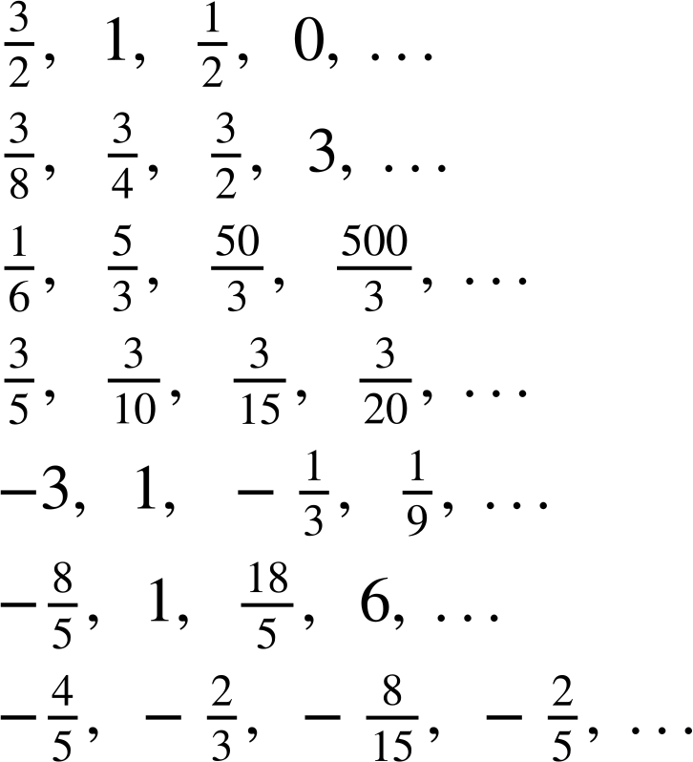
Tixraacyada (sequences) Xisaabeed (Arithmetic) iyo Joometri (Geometric)
2) Kala saar tixraacyadan (sequences) tiirka saxda ah ee jaantuska.
Xisaabeed (arithmetic) | Joometri (geometric) | kale (other)
a)
b)
c)
d)
e)
f)
g)

Slide 20
Tixraacyada (sequences) Xisaabeed (Arithmetic) iyo Joometri (Geometric)
3) Tixraac (sequence) ayaa ka bilaabanta 2a, 6a, …
Haddii tixraacu (sequence) yahay Xisaabeed (arithmetic), waa maxay seddexda xubnood ee xiga?
Haddii tixraacu (sequence) yahay Joometri (geometric), waa maxay seddexda xubnood ee xiga?
Ku sii wad tixraacan (sequence) qaab kale, sharax qaanuunka (rule) aad isticmaashay.

Slide 21
Tixraacyada (sequences) Xisaabeed (Arithmetic) iyo Joometri (Geometric)
Kala saar tixraacyadan (sequences) tiirka saxda ah ee jaantuska.
Xisaabeed (arithmetic) | joomatari (geometric) | midna (neither)
a) 1, 2, 3, 4, 5,… g) −1, 5, 11, 17, 23,... i) 36, 12, −12, −36,... | b) 3, 9, 27, 81,… c) 0.5, 1, 2, 4,... f) −2, 4, −8, 16,.. j) 13.5, 9, 6, 4, … | d) 1, 1, 2, 4, 7,... e) 1, 2, 4, 7, 11,... h) 18, 35, 52, 68,... k) 12, 6 , 3 , 0, …
1, 2, 3, 4, 5, …
3, 9, 27, 81, ….
0.5, 1, 2, 4, …
1, 1, 2, 4, 7, …
1, 2, 4, 7, 11, …
−2, 4, −8, 16, …
−1, 5, 11, 17, 23, …
18, 35, 52, 68, …
36, 12, −12, −36 …
13.5, 9, 6, 4, …
12, 6 , 3 , 0, …

Slide 22
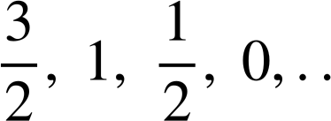
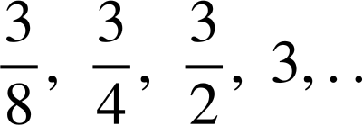
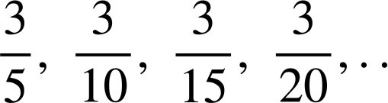
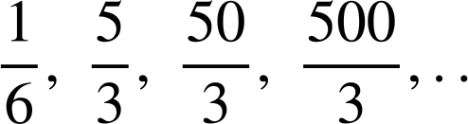
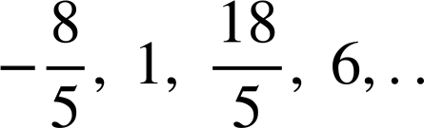
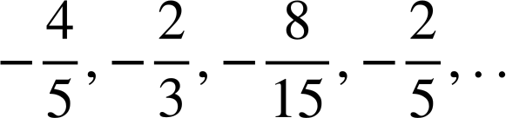
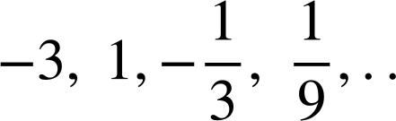
Tixraacyada xisaabeed iyo joomatari (Arithmetic and geometric sequences)
2) Kala saar tixraacyadan shaxda ee tiirka saxda ah.
xisaabeed (arithmetic) | joomatari (geometric) | midna (neither)
a) g) | b) c) e) | d) f)
a)
b)
c)
d)
e)
f)
g)

Slide 23
Tixraacyada xisaabeed iyo joomatari (Arithmetic and geometric sequences)
3) Tixraac wuxuu ku bilaabmaa 2a, 6a, …
Haddii tixraacu yahay xisaabeed (arithmetic), waa maxay saddexda xubnood ee xiga?
10a, 14a, 18a,….
Haddii tixraacu yahay joomatari (geometric), waa maxay saddexda xubnood ee xiga?
18a, 54a, 162a, …
Sii wad tixraacan qaab kale, sharax qaanuunka aad isticmaashay.
Jawaabo badan ayaa suurtagal ah.

Slide 24
Aqoonsiga tixraacyada tirooyinka gaarka ah
Tixraacyada xisaabeed iyo joomatari (Arithmetic and geometric sequences)
Sahminta tixraacyada kale

Slide 25
Sahminta tixraacyada kale
Waxaa jira noocyo kale oo tixraacyo ah oo aan ku aqoonsan karno astaamahooda muhiimka ah.
3, 6, 11, 18, 27, …
× 2
+ 3
+ 5
+ 7
+ 9
Tixraacani ma aha joomatari (geometric) maxaa yeelay ma jiro saami guud (common ratio).
3 × 2 = 6 laakiin 6 × 2 ≠ 11 iyo 11 × 2 ≠ 18
Tixraacani ma aha xisaabeed (arithmetic) maxaa yeelay ma jiro farqi guud (common difference).
Ma sharxi kartaa qaanuun xubnaha isku xira oo shaqeeya shanta xubnood?

Slide 26
Sahaminta taxanaha kale
3, 6, 11, 18, 27, …
+ 3
+ 5
+ 7
+ 9
Ma qeexi kartaa qaanuun eray-ku-eray (term-to-term rule) oo u shaqeeya shantaan eray?
Waxaa laga yaabaa inaad tidhi:
Taxanuhu wuxuu ku darayaa 3, ka dib 5, ka dib 7, ka dib 9, ….
Taxanuhu wuxuu ku darayaa tirooyinka khayaaliga ah (odd numbers).
Waxaa jira qaab toosan (linear pattern) oo ku jira kala-duwanaanshaha (differences).
Kala-duwanaanshuhu (differences) wuxuu kordhayaa 2 mar kasta.

Slide 27
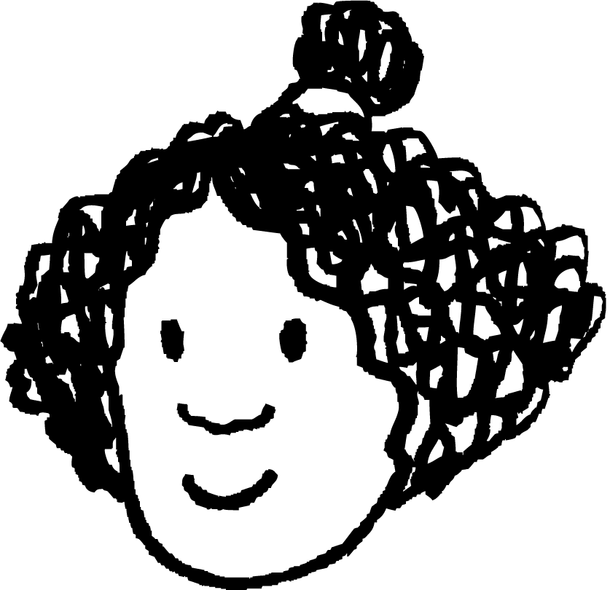
Sahaminta taxanaha kale
3, 6, 11, 18, 27, …
Waxaan tan hore u arkay. Tirooyinka laba jibaaran (square numbers) waxay sameeyaan wax la mid ah.
+ 3
+ 5
+ 7
+ 9
kala-duwanaanshaha koowaad (first difference)
+2
+2
+2
kala-duwanaanshaha labaad (second difference)
Isra
Taxanuhu ma aha xisaabeed (arithmetic) sababtoo ah kala-duwanaanshaha (differences) ee erayada isku xigxiga ma aha mid joogto ah. Laakiin kala-duwanaanshaha u dhexeeya kala-duwanaanshaha ayaa joogto ah.
Waxaan dhihi karnaa waxaa jira kala-duwanaansho labaad oo guud (common second difference) oo ah 2
1, 4, 9, 16, 25, …
+ 3
+ 5
+ 7
+ 9
+2
+2
+2

Slide 28
Sahaminta taxanaha kale
Taxanaha dhammaan tirooyinka laba jibaaran (square numbers) ee kor u kaca wuxuu leeyahay qaanuun erayga nth (nth term rule) oo ah n2 sababtoo ah laba jibaarista (squaring) lambarka erayga (term number) waxay bixisaa erayga (term).
1² = 1
2² = 4
3² = 9
4² = 16
5² = 25
Lambarka erayga (n) | 1 | 2 | 3 | 4 | 5
Erayga (T) | 1 | 4 | 9 | 16 | 25
… | n
 | n²
+2
+2
+2
+2
+2
Lambarka erayga (n) | 1 | 2 | 3 | 4 | 5
Erayga (T) | 3 | 6 | 11 | 18 | 27
… | n
 | n²+ 2
Taxanahayagu wuxuu leeyahay qaanuun erayga nth (nth term rule) oo ah n2 + 2 sababtoo ah eray kasta wuxuu ka badan yahay 2 tirooyinka laba jibaaran (square numbers).

Slide 29
Sahaminta taxanaha kale
Maxaa dhacaya haddii aan ka jarnay 2 tirooyinka laba jibaaran (square numbers)?
Nambarka term-ka | 1 | 2 | 3 | 4 | 5 | n
Term | 1 | 4 | 9 | 16 | 25 | n²
−2
−2
−2
−2
Cabdi
Sidaan (sequence) weli leedahay farqi labaad oo guud oo ah 2?
Nambarka term-ka | 1 | 2 | 3 | 4 | 5 | n
Term | −1 | 2 | 7 | 14 | 23 | n²− 2
Haa
+ 3
+ 5
+ 7
+ 9
+2
+2
+2

Slide 30
Sahminta sidaano kale
Ka warran haddii aan laba jibaarno tirooyinka laba jibaaran?
Nambarka term-ka | 1 | 2 | 3 | 4 | 5 | n
Term | 1 | 4 | 9 | 16 | 25 | n²
× 2
× 2
× 2
× 2
Cabdi
Nambarka term-ka | 1 | 2 | 3 | 4 | 5 | n
Term | 2 | 8 | 18 | 32 | 50 | 2n²
Sidaan waxay leedahay farqi labaad oo guud oo ah 4
+ 6
+ 10
+ 14
+ 18
+4
+4
+4

Slide 31
Sahminta sidaano kale
Qor shanta tiro ee saddexagalka ee ugu horreeya si aad u aragto in Isra sax tahay.
Waxaan u malaynayaa in tirooyinka saddexagalka (triangular numbers) ay leeyihiin farqi labaad oo guud sidoo kale.
Isra
1, 3, 6, 10, 15, …
Isra sax, tirooyinka saddexagalka waxay leeyihiin farqi labaad oo guud oo ah 1
+ 2
+ 3
+ 4
+ 5
+1
+1
+1
Sidaan kasta oo leh farqi labaad oo guud waxaa loo yaqaan sidaan quadratic (quadratic sequence) (uma baahnid inaad xusuusato magaca noocan sidaan hadda).

Slide 32

Sahaminta taxanaha kale
Kuwee oo ka mid ah kuwani leh kala duwanaansho labaad oo guud?
(waxaa loo yaqaan taxanayaal quadratic).
a
7, 8, 10, 13, 17, …
+ 1
+ 2
+ 3
+ 4
+1
+1
+1
b
5, 7, 11, 17, 25, …
+ 2
+ 4
+ 6
+ 8
+2
+2
+2
c
6, 8, 12, 20, 36, …
+ 2
+ 4
+ 8
+ 16
+2
+4
+8

Slide 33
Sahaminta taxanaha kale
Layla iyo Caasha waxay eegayaan taxanaha ka bilaabma
2, 3, 5, 8, 13, …
Kani ma noqon karo taxane xisaabeed (arithmetic) ama joomatari (geometric)
Waxaa laga yaabaa inuu yahay quadratic?
Layla
Caasha
Maxaad u malaynaysaa?
2, 3, 5, 8, 13, …
Layla waa sax, si kastaba ha ahaatee taxanahani sidoo kale ma aha quadratic.
+ 1
+ 2
+ 3
+ 5
+1
+1
+2

Slide 34
Sahaminta taxanaha kale
Ereyga xiga ee taxanaha waa 21
2, 3, 5, 8, 13, 21, …
Ma arki kartaa qaanuun kuu sheegaya sida taxanahan loo soo saaray?
Waxaa laga yaabaa inaad aragtay:
2 + 3 = 5
3 + 5 = 8
5 + 8 = 13
8 + 13 = 21
Waa maxay erayga xiga?
13 + 21 = 34

Slide 35
Sahaminta taxanaha kale
Taxanahaygu wuxuu ka bilaabmaa 10, erey kastana wuxuu ka yimaadaa isku darka labada erey ee hore
Maxay tahay sababta aan u awoodi karin inaan qorno taxanaha Layla?
Ma naqaano ereyga labaad.
Qor shanta erey ee ugu horreeya ee taxanaha Layla.
Layla
Ereyga labaad waa 4
10, 4, 14, 18, 32, …
Ma beddeli kartaa ereyga labaad si ereyga saddexaad uu uga yaraado kii ugu horreeyay?
Haddii ereyga labaad uu yahay taban (negative)
Tusaale: 10, −2, 8, 6, 14, … ama 10, −12, −2, −14, −16, …

Slide 36
Sahminta taxanayaasha kale
Taxanahan, erey kasta waxaa lagu sameeyaa isku darka labada erey ee hore. Soo hel saddexda erey ee xiga ee taxane kasta.
1, 1, 2, …
7, 1, 8, …
8, 5, …
5, −3, …

Slide 37
Sahminta taxanayaasha kale
Taxanahan, erey kasta waxaa lagu sameeyaa isku darka labada erey ee hore. Soo hel saddexda erey ee xiga ee taxane kasta.
1, 1, 2, 3, 5, 8 …
7, 1, 8, 9, 17, 26, …
8, 5, 13, 18, 31, …
5, −3, 2, −1, 1 …

Slide 38
Sahminta taxanayaasha kale
1) Adigoo ogaanaya qaabka (pattern), soo hel labada erey ee xiga ee taxane kasta.
2, 8, 32, 128, …
2, 8, 14, 20, …
2, 8, 15, 23, …
2, 8, 16, 26, …
2, 8, 10, 18, …
2, 8, 17, 29, …
8, 2, 10, 12, …
8, 2, −4, −10, …
3, 5, 11, 21, …
4, 6, 12, 22, …
6, 10, 22, 42, …
−3, −5, −8, −13, …
−3, −5, −7, −9, …
2, −6, 18, −54, …
1, −7, −10, −8, …

Slide 39
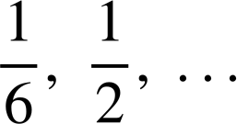
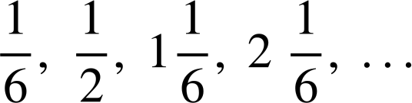
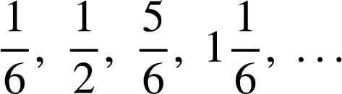
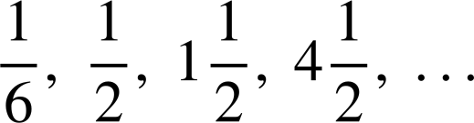
Sahminta taxanayaasha kale
2) Caasha, Isra iyo Cabdi waxay abuureen taxane oo ka bilaabmaya ereyada
Su'aal kasta, sharax jawaabtaada.
Yaa abuuray taxane xisaabeed (arithmetic sequence)?
Yaa abuuray taxane joomatari (geometric sequence)?
Yaa abuuray taxane laba jibaaran (quadratic sequence)?
(taxane leh kala duwanaansho labaad oo wada mid ah)
Caasha
Isra
Cabdi

Slide 40
Sahminta taxanayaasha kale
1) By working out the pattern, find the next two terms in each sequence.
2, 8, 32, 128, … 512, 2048 Taxane joomatari oo leh saami guud (common ratio) ×2
2, 8, 14, 20, … 26, 32, Arithmetic sequence with common difference +6
2, 8, 15, 23, … 32, 42 Quadratic sequence with second difference +1
2, 8, 16, 26, … 38, 52 Quadratic sequence with second difference +2
2, 8, 10, 18, … 28, 46 Ku dar labada xilli ee hore si aad u hesho xiga
2, 8, 17, 29, … 44, 62 Quadratic sequence with second difference +3
8, 2, 10, 12, … 22, 34 Ku dar labada xilli ee hore si aad u hesho xiga
8, 2, −4, −10, … −16, −22 Linear sequence with common difference −6

Slide 41
Exploring other sequences
1) By working out the pattern, find the next two terms in each sequence.
3, 5, 11, 21, … 35, 53 Quadratic sequence with second difference +4
4, 6, 12, 22, … 36, 54 Quadratic sequence with second difference +4
6, 10, 22, 42, … 70, 106 Quadratic sequence with second difference +8
−3, −5, −8, −13, … −21, −34 Ku dar labada xilli ee hore si aad u hesho xiga
−3, −5, −7, −9, … −11, −13 Arithmetic sequence with common difference −2
2, −6, 18, −54, … 162, −486 Geometric sequence with common ratio ×(−3)
1, −7, −10, −8, … −1 11 Quadratic sequence with second difference + 5
−8
−3
+2
+7
+12
+5
+5
+5
+5

Slide 42



Exploring other sequences
2) Aisha, Izzy iyo Lucas dhamaantood waxay abuureen taxane oo ka bilaabmaya xilliyada
Su'aal kasta, sharax jawaabtaada.
Who has created an arithmetic sequence?
Izzy, common difference
Yaa abuuray taxane joomatari (geometric sequence)?
Cabdi, saamiga guud (common ratio) × 3
Yaa abuuray taxane laba jibaaran (quadratic sequence)?
Caasha, taxanaha ka dib ka dib
farqiga labaad ee guud (common second difference) waa
Caasha
Isra
Cabdi

Slide 43
Aqoonsiga taxanayaasha gaarka ah
Taxanaha xisaabeed (arithmetic sequences) waxaa lagu gartaa hubinta farqiga guud (common difference) ee xubnaha.
Taxanaha joomatari (geometric sequences) waxaa lagu gartaa hubinta saamiga guud (common ratio) ee xubnaha.
Qaar ka mid ah taxanayaasha waxay leeyihiin farqi labaad oo guud, tirooyinka laba jibaaran iyo saddexagalka waa tusaale.
(Waxaa loo yaqaan taxanayaasha laba jibaaran (quadratic sequences).)
Xeerar kale ayaa loo isticmaali karaa in lagu abuuro noocyo badan oo taxane ah.

