Slide 1
Midabka milicsiga (Reflecting colour)
Samaynta sawirada (Making images)

Slide 2
Sida agabkeena waxbarista loogu talagalay fasalka

Slide 3
Waxaan sharxi karaa midabka shayga iftiinka cad iyo iftiinka midabka leh.

Slide 4
milicsi (reflect)
in lagu dhaco dusha kana 'boodo'
ku dhaca (incident)
erey lagu qeexo iftiinka imanaya ee ku dhaca dusha
kala firdhi (scatter)
in iftiinka lagu milicsado jihooyin badan isku mar
unugyada koorta (cone cell)
unugyada gadaasha isha ee ogaada midabka
nuugid (absorb)
shay nuuga iftiinka / hela tamar iftiinka dhex mara, oo xaddiga iftiinka hoos u dhaca

Slide 5

Midabka milicsiga (Reflecting colour)
Aragtida shayga iftiinka cad
Aragtida shayga iftiinka midabka leh

Slide 6
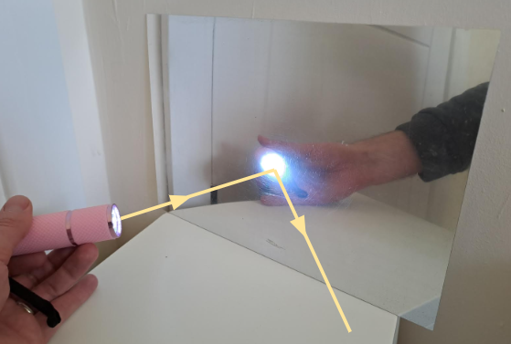
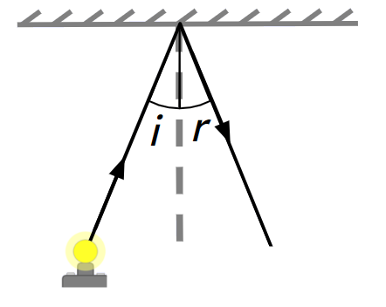
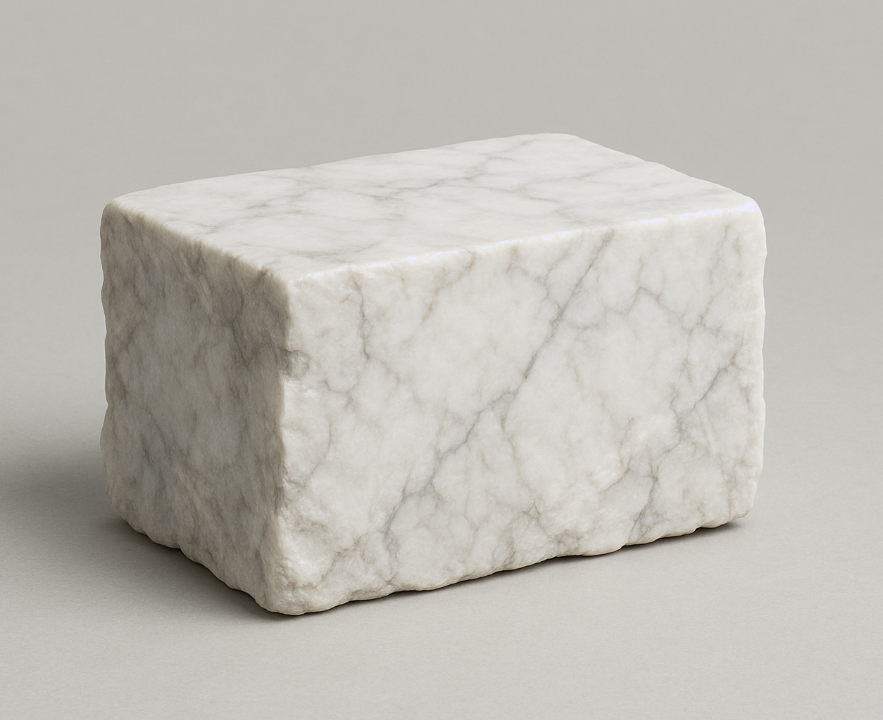
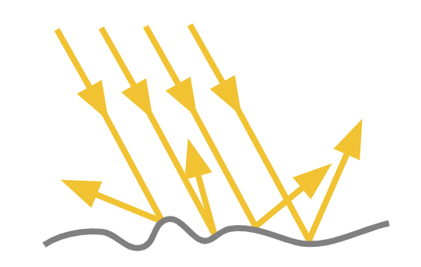
Aragtida shayga iftiinka cad
Dhammaan dusha sare waxay milicsadaan iftiinka.
muraayad (mirror)
Muraayadaha (Mirrors) waxay ka milicsadaan shucaac kasta oo iftiin ah hal jiho, iyagoo u hogaansamaya sharciyada milicsiga (laws of reflection).
fallaadhaha ku dhaca (incident ray)
shucaaca la milicshay (reflected ray)
i = xagasha ku dhaca (angle of incidence)
r = xagasha milicsiga (angle of reflection)
Dusha kale waxay kala firdhiyaan iftiinka, iyagoo milicsada jihooyin badan.

Slide 7



Aragtida walxaha iftiinka cad (white light)
Waa maxay walxaha qolkan ku yaal ee iftiinka ka milicsada (reflect light)?
a
muraayad (mirror)
e
barkimaha fadhiga (sofa cushions)
b
dhulka (floor)
f
lugaha fadhiga (sofa legs)
c
roogga (rug)
g
gidaarada iyo saqafka (walls and ceiling)
d
miiska (table)
h
dhirta (plant)
Dhammaan sagxadaha (surfaces) waxay ka milicsadaan iftiinka.

Slide 8
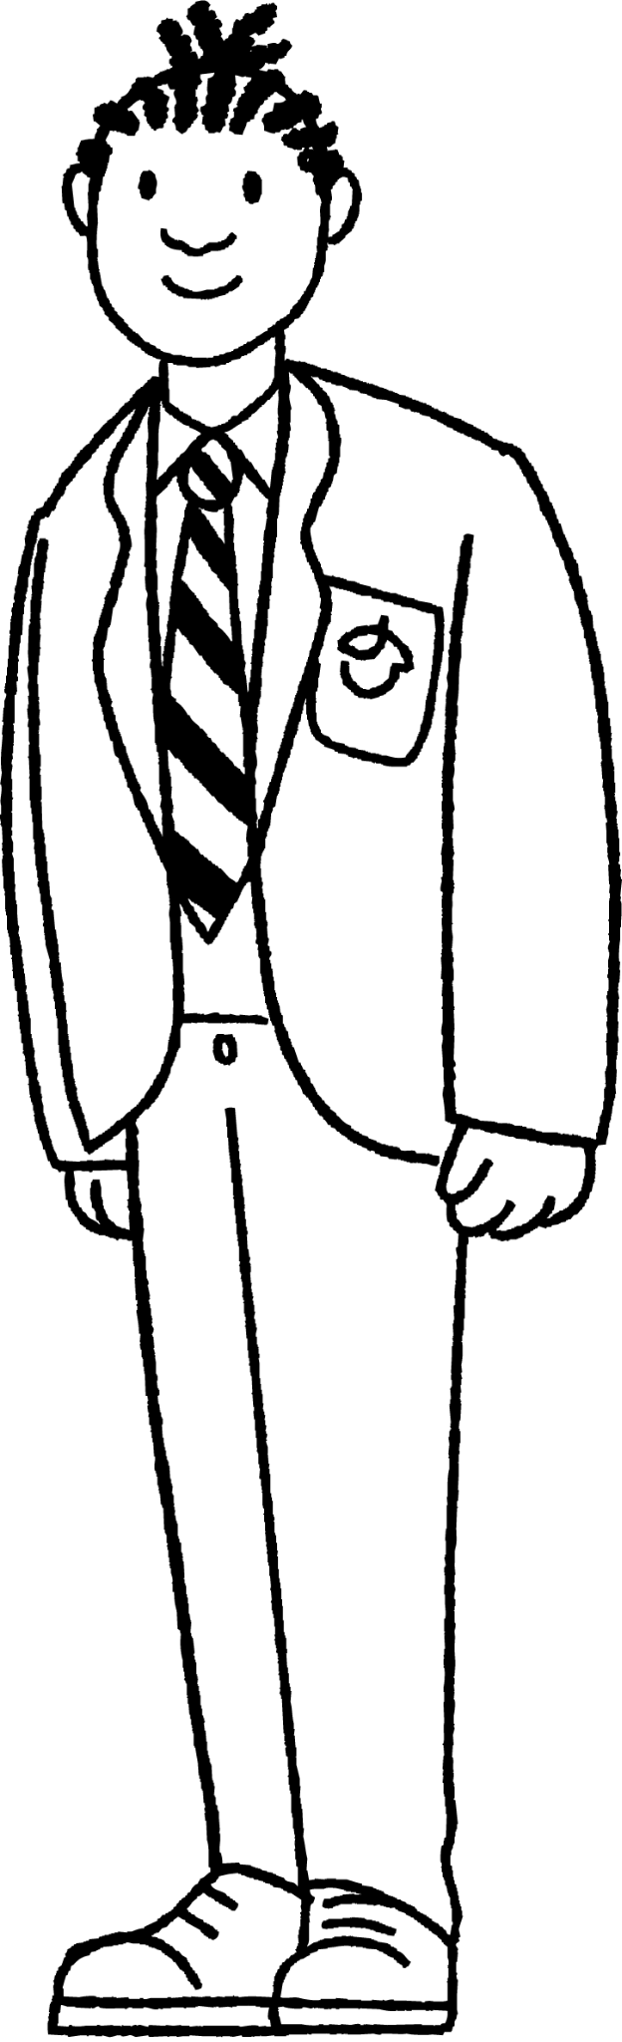

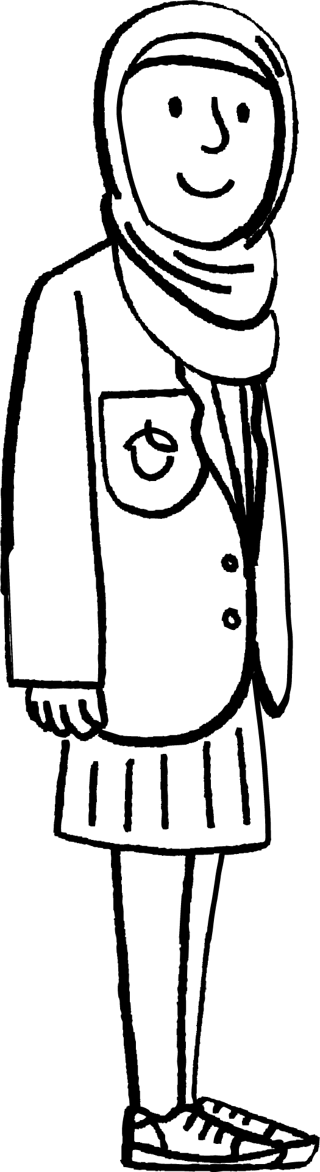

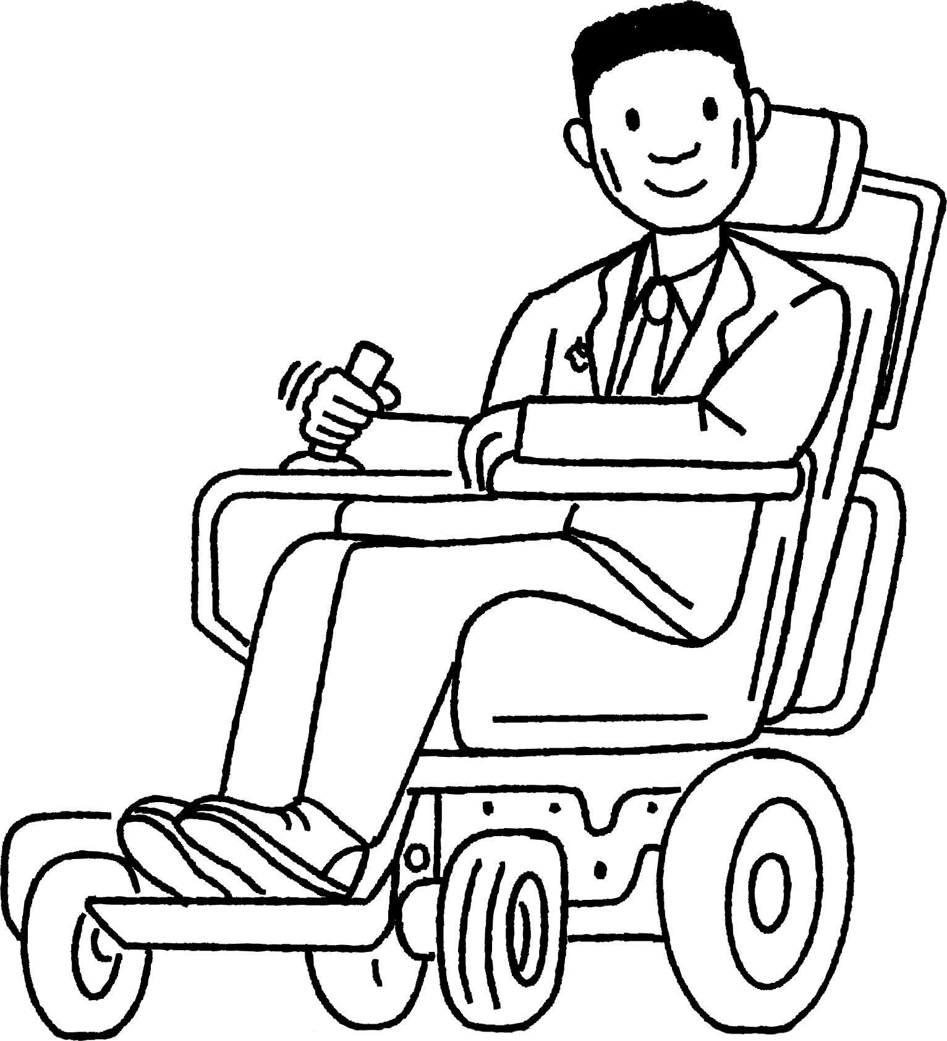
Aragtida walxaha iftiinka cad (white light)
Waxaan aragnaa walxaha aan iftiin lahayn (non–luminous objects) marka qaar ka mid ah iftiinka ay ka milicsadaan uu galo indhahayaga.
Yacquub
Walxaha cawlan (Dull objects) waxay kala firdhiyaan (scatter) iftiinka, sidaas darteed waxaa laga arki karaa dhammaan jihooyinka.
Caasha
Cabdi

Slide 9
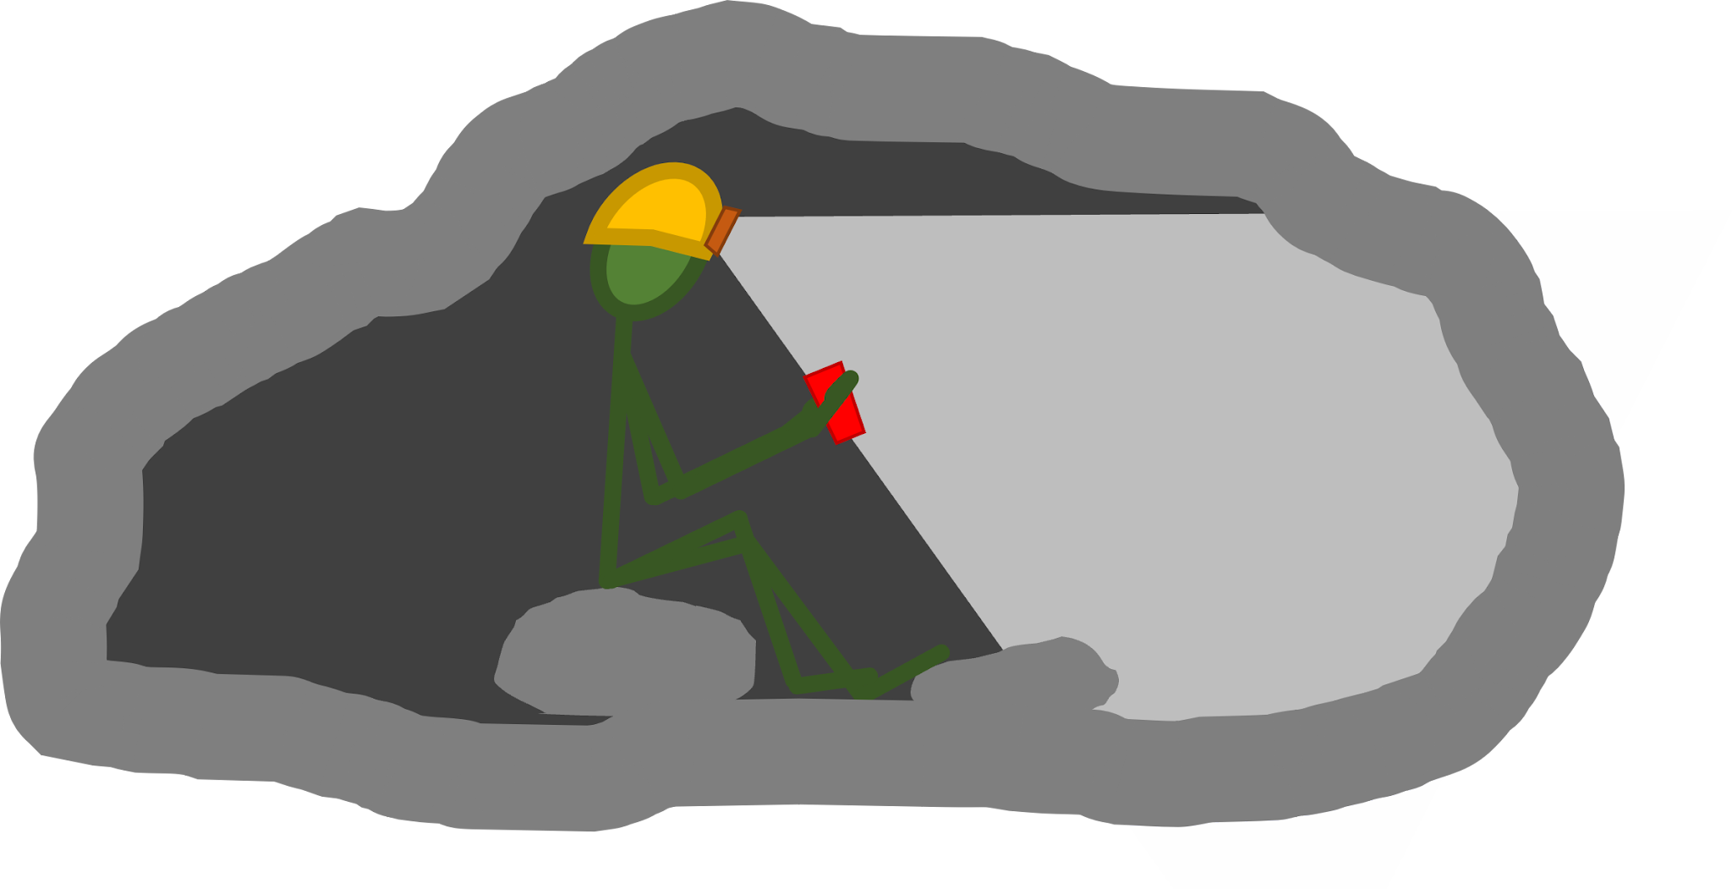
Aragtida walxaha iftiinka cad (white light)
Qiyaas inaad sahaminaysid god hoose oo dhulka hoostiisa ah.
Iftiinka kaliya waa kan ka imanaya tooshka madaxaaga.
Haddii aad damiso, waxaad ku sugnaan doontaa mugdi buuxa. Ma awoodi doontid inaad waxba aragto. Indhahaagu weligood ma 'habboonaan doonaan'.
Taasi waa sababta oo aanay jirin iftiin haba yaraatee. Si aad u aragto, waa in iftiin ka soo milicsado dusha walxaha oo ku soo gaadho indhahaaga.

Slide 10
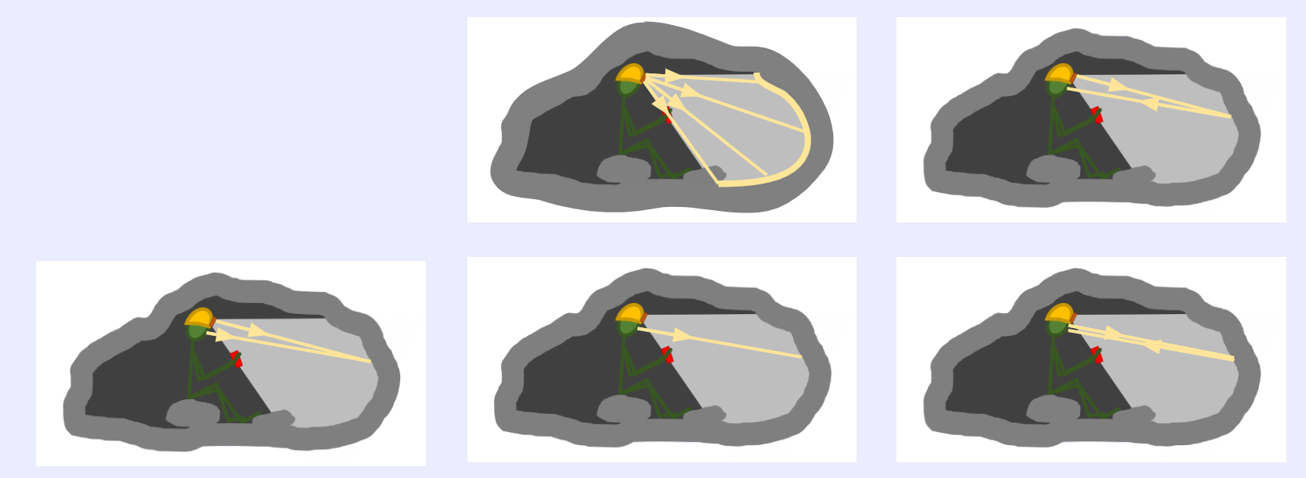
Aragtida walxaha iftiinka cad (white light)
Qof ku jira god hoose oo dhulka hoostiisa ah oo mugdi buuxa ku jira, ayaa dib u shida tooshka madaxa.
Jaantuskeebaa muujinaya sababta ay hadda u arki karaan gidaarka godka?
a
b
c
d
e

Slide 11
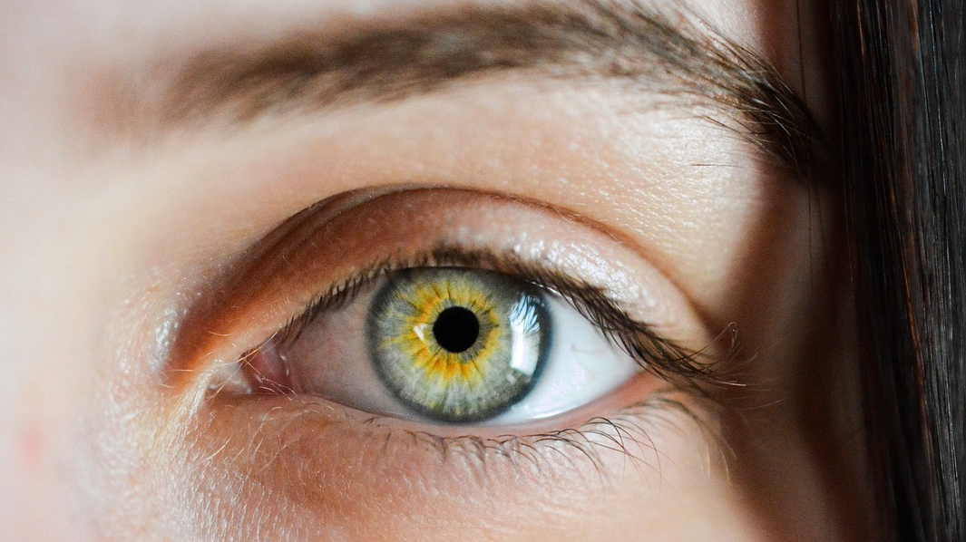
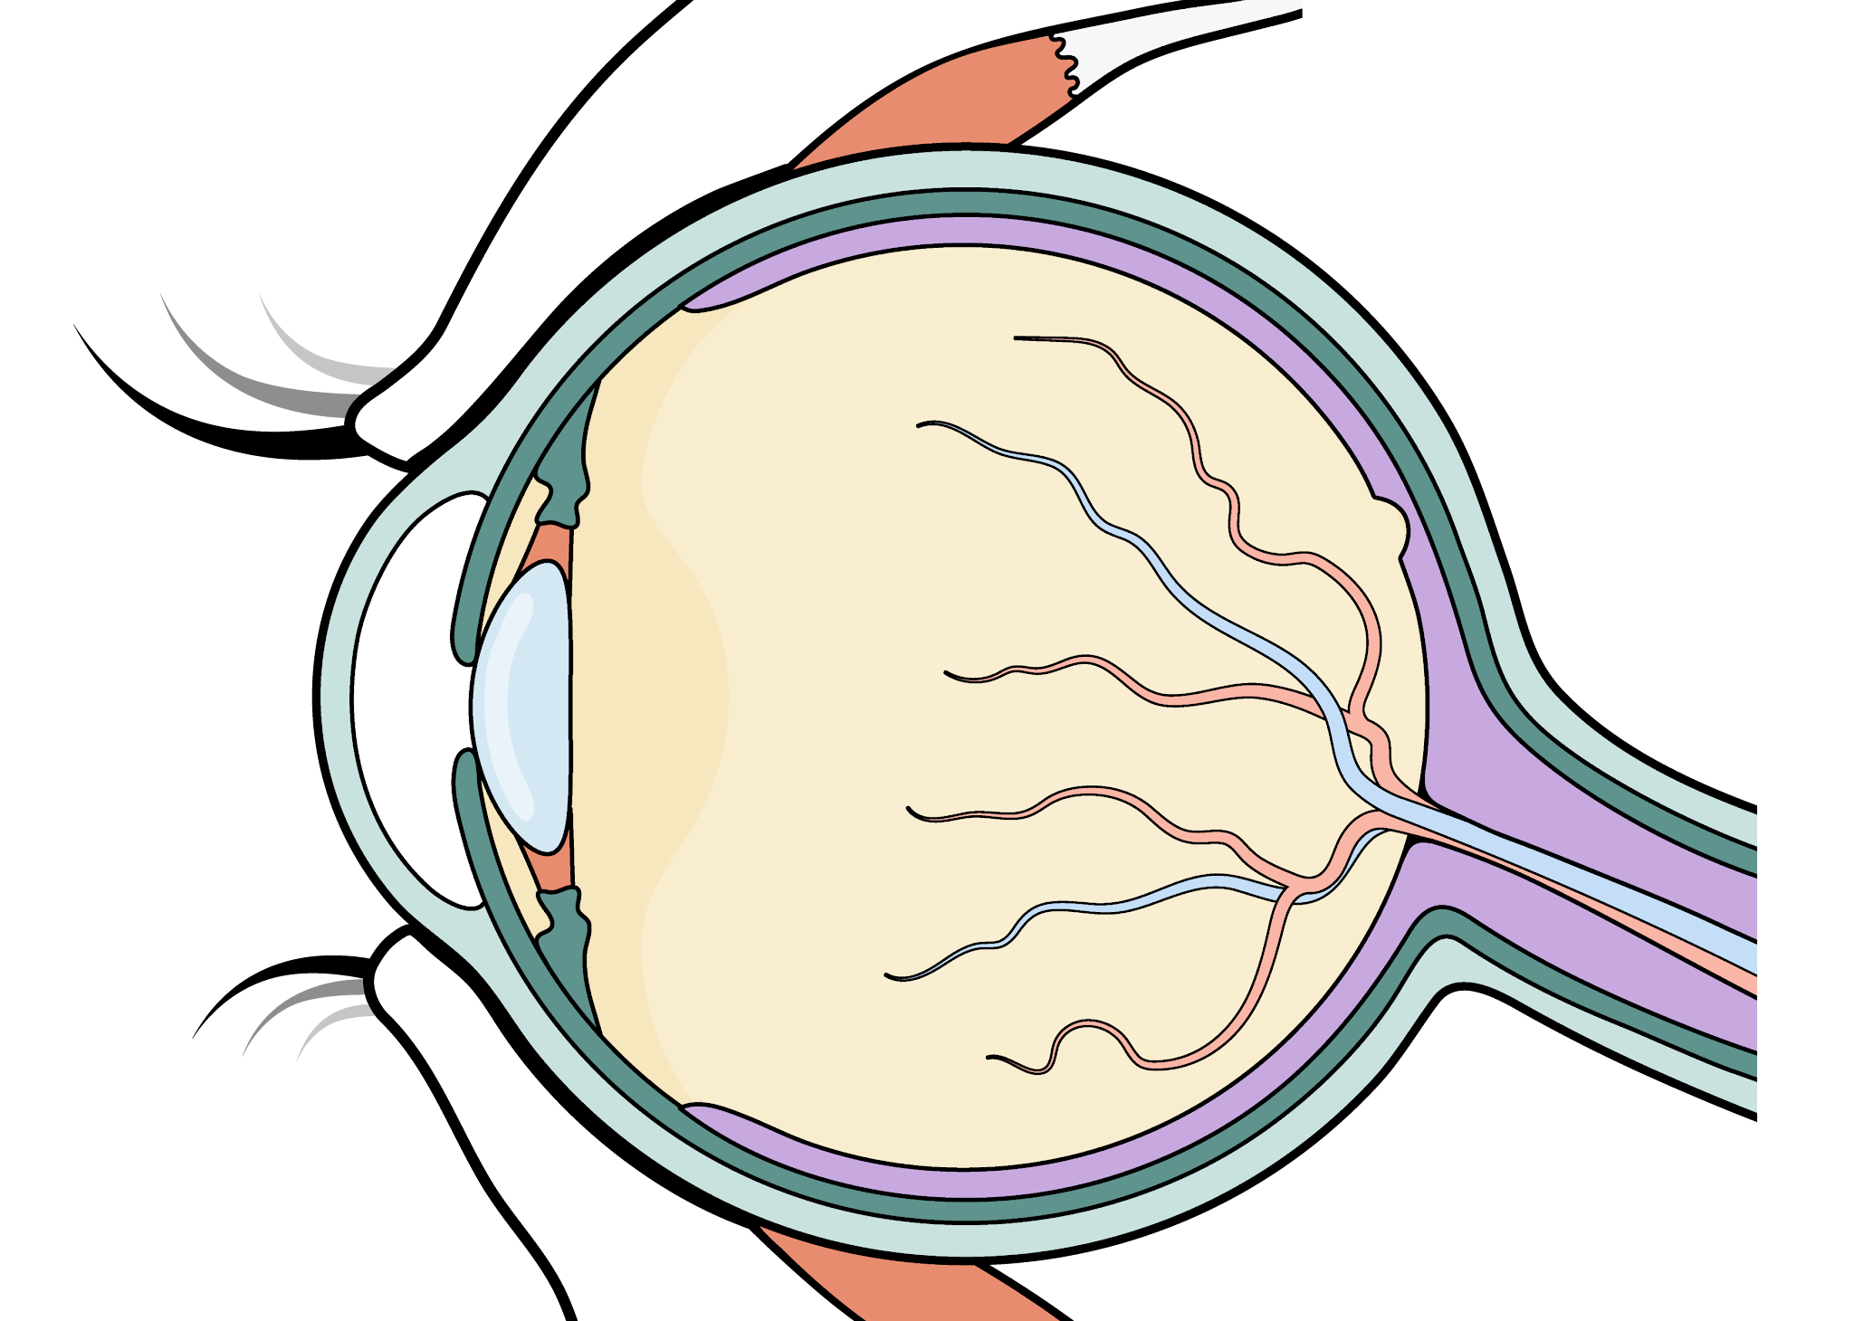

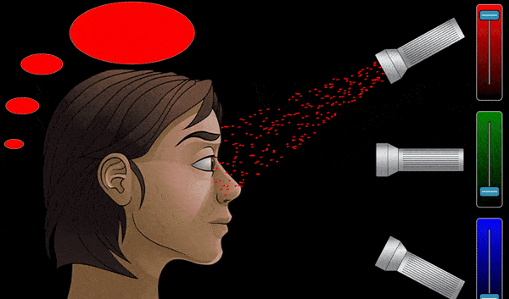
Aragtida walxaha iftiinka cad (white light)
Waxaan u aragnaa midab marka iftiinka indhaha soo gala uu nuugo unugyada qaabka koofiyadda (cone cells) ee ku yaal retina.
jaantuska isha (aragti-dhinac)
retina
Waxaa jira 3 nooc oo unug qaab koofiyad ah (cone cell). Nooc kastaa wuxuu nuugaa oo ogaadaa midab ka duwan: casaan (R), cagaar (G) ama buluug (B).
pupil
Marka midabka saxda ah uu ku dhaco unugga qaabka koofiyadda (cone cell), waxaa la diraa calaamad neerf oo koronto ah maskaxda.
Midabka aan aragno wuxuu ku xiran yahay heerarka calaamadaha R, G iyo B ee maskaxdu hesho.
Hoos-midig: Simulation by PhET Interactive Simulations, University of Colorado Boulder, licensed under CC–BY–4.0 (https://phet.colorado.edu).

Slide 12
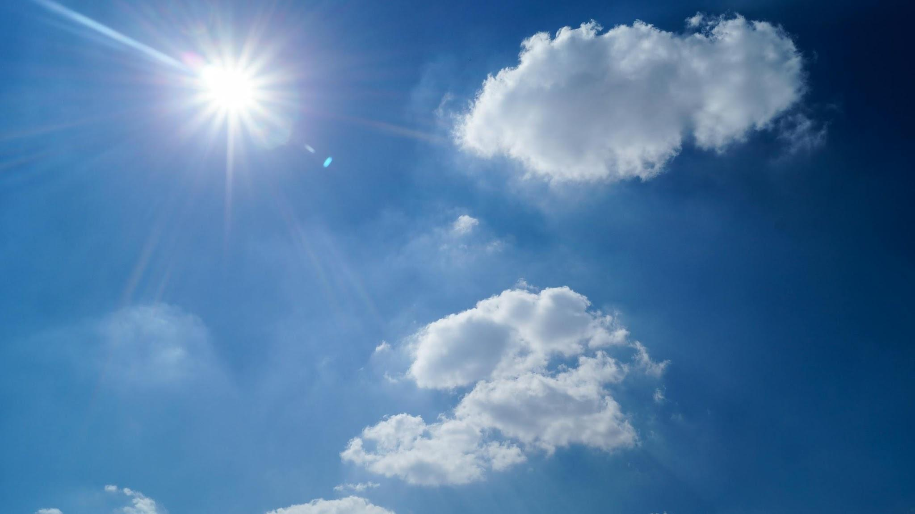
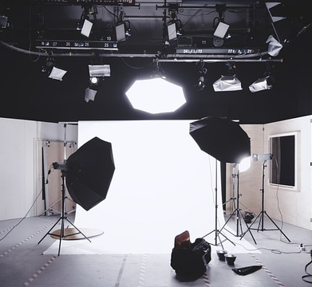
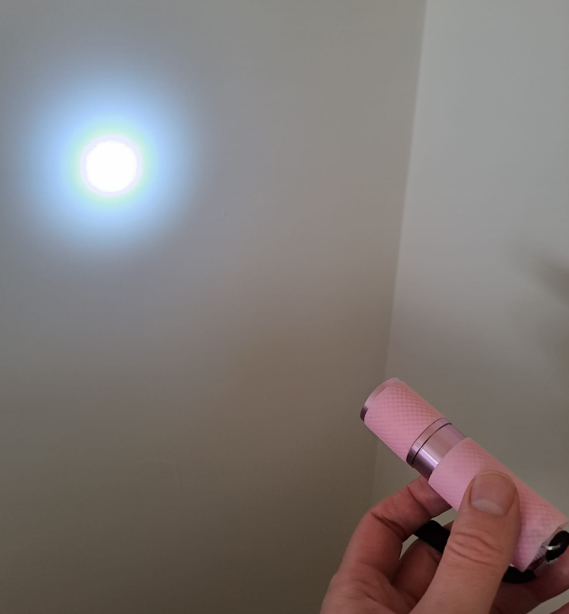
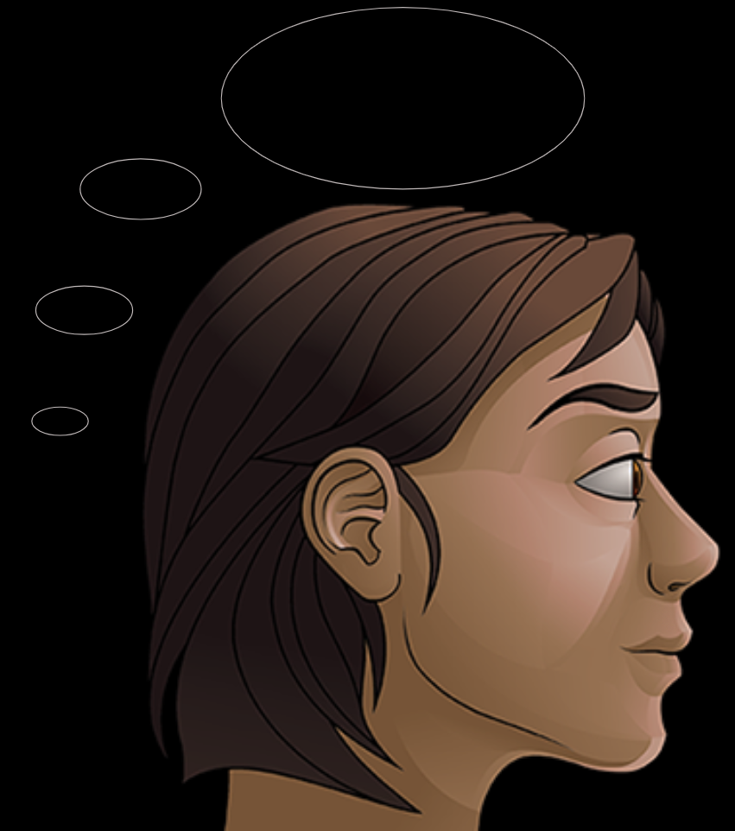
Aragtida walxaha iftiinka cad (white light)
Qorraxda iyo laambadaha badankoodu waxay soo saaraan iftiin cad (white light).
Iftiinkan cad (white light) wuxuu ka kooban yahay iftiin dhammaan midabada jeegaan (spectrum) ee la arki karo.
iftiinka qorraxda
Marka uu indhaha soo galo, unugyada qaabka koofiyadda (cone cells) ee casaan, cagaar iyo buluug ah ayaa dhammaantood 'shida' isla waqti. Marka maskaxdu hesho saddexda calaamad oo wada jira, tani waxay keentaa inaan u aragno cad.
Sawirka madaxa by PhET Interactive Simulations, University of Colorado Boulder, licensed under CC–BY–4.0 (https://phet.colorado.edu).

Slide 13
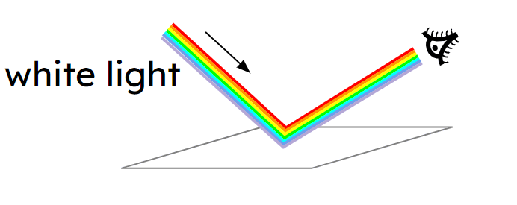
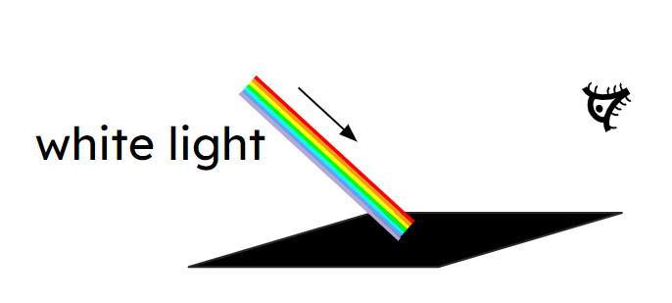
Aragtida shayga iftiinka cad (white light)
Dusha cad (white surfaces) waxay si siman u milicsadaan dhammaan midabada iftiinka.
Iftiinka cad (white light), dhammaan midabada iftiinka ayaa indhahaaga ka soo gala dusha sare.
dusha cad (white surface)
Dusha madow oo dhammaystiran (perfectly black surface) ma milicsan doonto iftiin gabi ahaanba.
Iftiin kasta oo ku dhaca waa la nuugi doonaa (absorbed) oo iftiin kuma soo milicsan doono indhahaaga.
dusha madow (black surface)

Slide 14
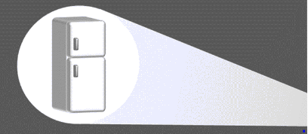
Aragtida shayga iftiinka cad (white light)
Maxay shayga cad (white objects) u ekaadaan cad (white) iftiinka cad (white light)?
a
Shayga cad (white objects) had iyo jeer waxay u ekaadaan cad (white).
b
Waxay kaliya milicsadaan hal midab oo iftiin ah (cad).
c
Waxay milicsadaan dhammaan midabada jeegaan (spectrum).
d
Ma milicsadaan midabada iftiinka midna.

Slide 15
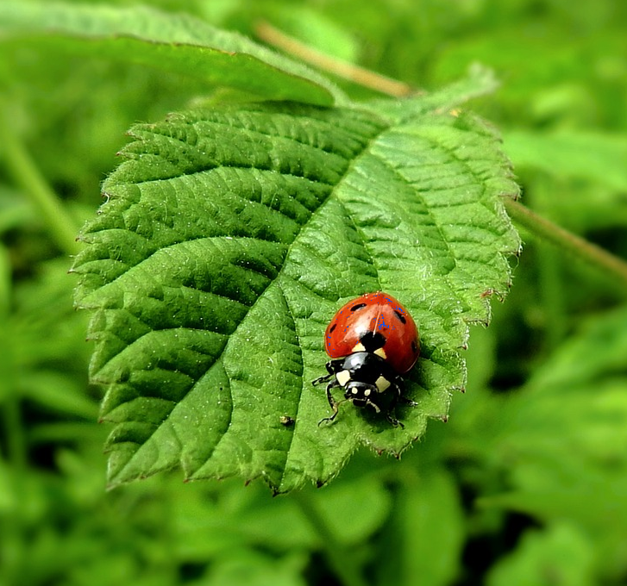
Aragtida shayga iftiinka cad (white light)
Midabka shaygu wuxuu ku xiran yahay midabada iftiinka uu milicsado.
Midabada iftiinka ee aan dusha milicsan waa la nuugaa (absorbed).
iftiin cad (white light)
aragti (viewpoint)
Shayga cagaaran (green objects) waxay kaliya milicsadaan iftiinka cagaaran (green light).
Waxay u ekaadaan cagaar (green) sababtoo ah iftiinka cagaaran (green light) oo keliya ayaa indhahaaga ka soo gala.

Slide 16
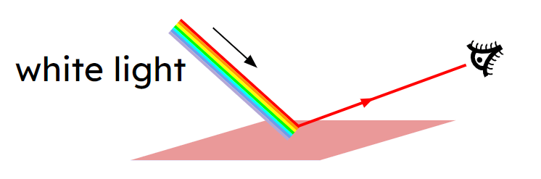
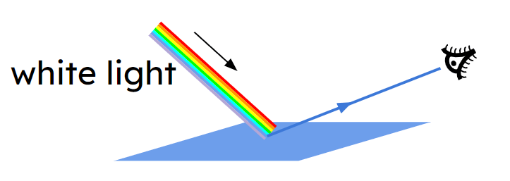
Aragtida shayga iftiinka cad (white light)
Dusha cas waxay kaliya ka tarjumaysaa iftiinka cas. Dhammaan midabada kale ee iftiinka waa la nuugaa.
Dusha buluugga ah (blue surfaces) waxay kaliya milicsadaan iftiinka buluugga ah (blue light). Dhammaan midabada kale waa la nuugaa (absorbed).

Slide 17

Aragtida walxaha iftiinka cad
Run ama been?
Walxaha cagaaran waxay u eg yihiin cagaar sababtoo ah waxay kaliya nuugaan iftiinka cagaaran.
T
Run
F
Been
Sabab?
Walxaha cagaaran waxay u eg yihiin cagaar sababtoo ah waxay kaliya ka tarjumaan iftiinka cagaaran. Haddii shay uu nuugo iftiinka cagaaran, markaas iftiin cagaaran oo ka tarjumaya isaga indhahaaga ma gaari karo.

Slide 18
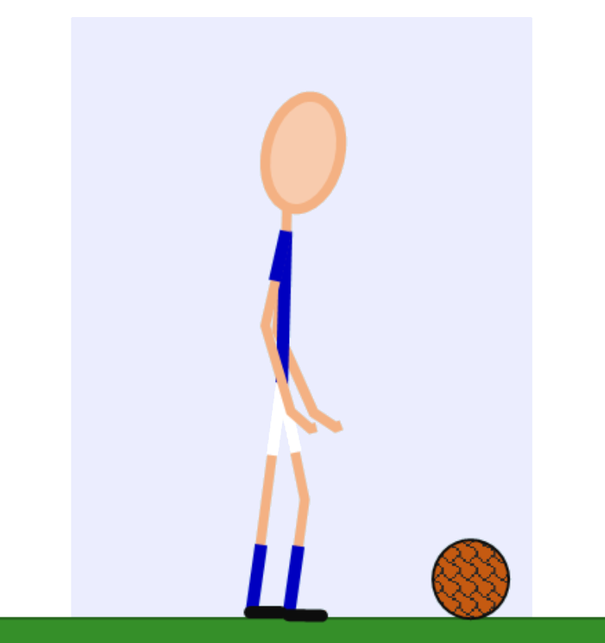
Aragtida walxaha iftiinka cad
Qalabka kubbadda cagta ee kooxdu wuxuu leeyahay shaati buluug ah iyo surwaal cad.
Kee ka mid ah weedhahan soo socda ayaa sax ah?
a
Shaatigu wuxuu ku darayaa midab buluug ah iftiinka qorraxda.
b
Shaatigu wuxuu ka tarjumayaa iftiinka buluuga ah ee qorraxda.
c
Shaatigu wuxuu beddelaa midabka iftiinka qorraxda oo u rogaa buluug.
d
Shaatigu wuxuu sii daayaa iftiin buluug ah.
e
Surwaalku wuxuu ka tarjumayaa iftiinka buluuga ah ee qorraxda.

Slide 19
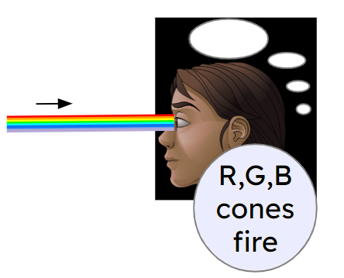
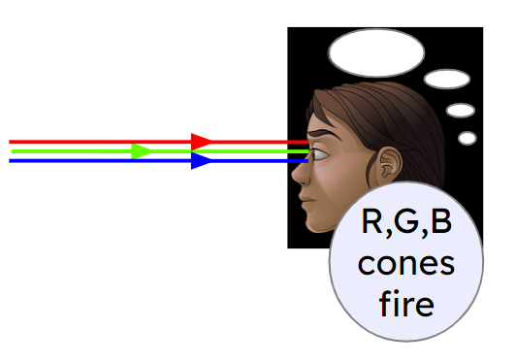
Aragtida walxaha iftiinka cad
Iftiinka cad ee qorraxda iyo nalka waxaa loo matali karaa sidan oo kale maadaama uu ka kooban yahay dhammaan midabada jeegaan (spectrum).
Si kastaba ha ahaatee, midab kasta oo aan aragno wuxuu ku xiran yahay heerarka calaamadaha R, G, iyo B ee maskaxdu hesho (oo ka imanaya unugyada koorta).
Sidaa darteed, iftiinka cad waxaa sidoo kale loo matali karaa iyadoo la isticmaalayo kaliya fallaadhaha cas, cagaar, iyo buluug.
Saddexda fallaadhood waxay u taagan yihiin saddexda qaybood ee midabada iftiinka ee kiciya saddexda nooc ee unugyada koorta.
Sawirka Madaxa waxaa sameeyay PhET Interactive Simulations, Jaamacadda Colorado Boulder, oo shatiyeysan CC–BY–4.0 (https://phet.colorado.edu).

Slide 20
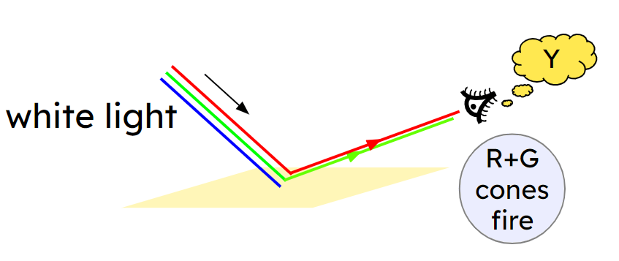
Arinta shayyada iftiinka cad (white light)
Isticmaalka qaabka 'RGB' ee iftiinka cad (white light), waxaynu niraahnaa dhammaan sagxadaha jaalle (yellow) ah waxay ka tarjumaan iftiinka guduudan (red) iyo iftiinka cagaaran (green), laakiin waxay nuugaan iftiinka buluugga ah (blue).
Tani runtii waxay ka dhigan tahay in sagxadaha jaalle (yellow) ah ay ka tarjumaan kaliya midabada iftiinka (colours of light) ee kiciya unugyada isha ee R iyo G, waxayna nuugaan midabada iftiinka ee kiciya unugyada isha ee B.

Slide 21
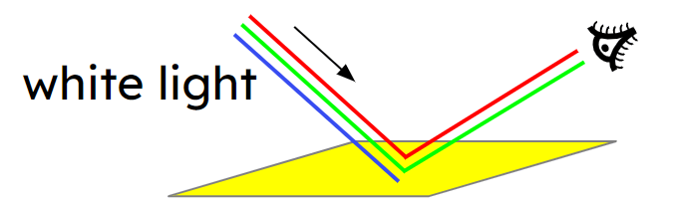
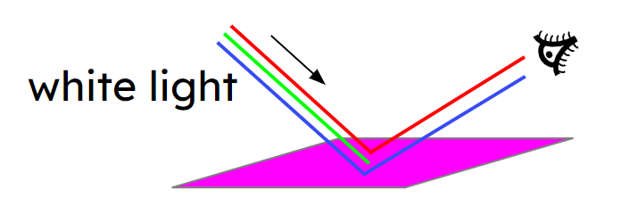
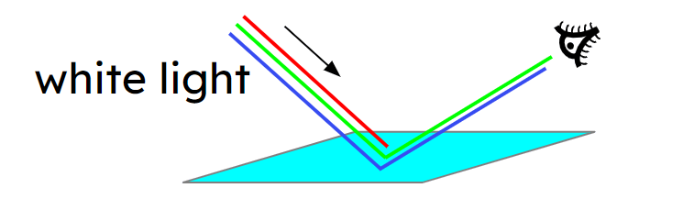
Arinta shayyada iftiinka cad (white light)
Sagxadaha jaalle (yellow) ah waxay si isku mid ah u tarjumaan iftiinka guduudan (red) iyo cagaaran (green) laakiin waxay nuugaan buluugga (blue).
Sagxadaha magentada (magenta) ah waxay si isku mid ah u tarjumaan iftiinka guduudan (red) iyo buluugga (blue) laakiin waxay nuugaan cagaarka (green).
Sagxadaha cyan (cyan) ah waxay si isku mid ah u tarjumaan iftiinka cagaaran (green) iyo buluugga (blue) laakiin waxay nuugaan guduudka (red).

Slide 22
Arinta shayyada iftiinka cad (white light)
Maxay shay u ekaadaa magenta (magenta) marka uu iftiin cad (white light) ku jiro?
a
Wuxuu nuugaa iftiinka guduudan (red) iyo buluugga (blue) ee iftiinka cad (white light).
b
Wuxuu nuugaa iftiinka oo waxaa dhaca falgal (reaction).
c
Wuxuu ku daraa guduud (red) iyo buluug (blue) iftiinka cad (white light) ee ka tarjuma shayga.
d
Wuxuu ka tarjumaa kaliya iftiinka guduudan (red) iyo buluugga (blue) ee iftiinka cad (white light).
e
Iftiinka indhahaaga ayaa isu beddela guduud (red) iyo buluug (blue) marka uu taabto shayga.

Slide 23
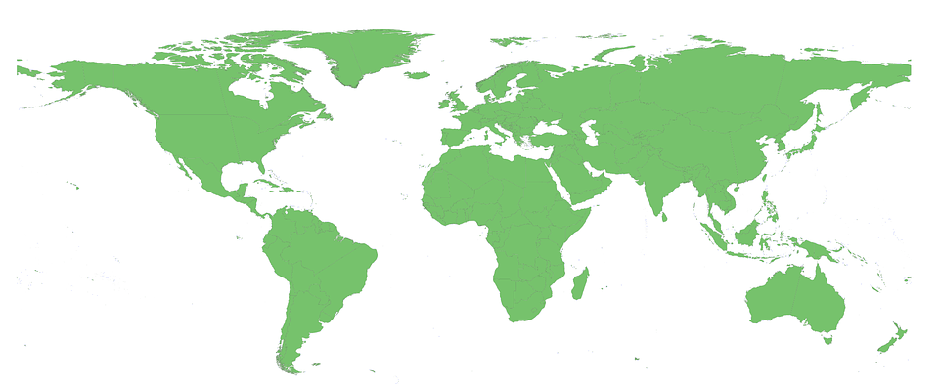

Arinta shayyada iftiinka cad (white light)
Guyana waa waddan ku yaal Koonfurta Ameerika.
Kani waa calanka Guyana.
Calanku wuxuu duulayaa bannaanka maalin qorrax leh.
Sharax sababta qayb kasta oo calanka ugu ekaato midabka ay u ekaato (iftiinka qorraxda).
saddex-xagalka guduudan (red triangle)
xadka madow (black border)
jeegaan (chevron) huruudka ah
xadka cad (white border)
asalka cagaaran (green background)
Ku bilow sharaxaadaada adigoo dhammaystiraya jumladahan:
Iftiinka qorraxdu waa …
Saddexagalka cas wuxuu u eg yahay cas sababtoo ah …

Slide 24

Aragtida walxaha iftiinka cad (white light)
Sharax sababta qayb kasta oo calanka ugu egtahay midabkeeda (iftiinka qorraxda).
Fikradaha aad ku dari kartay:
Iftiinka qorraxdu waa isku darka dhammaan midabada iftiinka ee jeegaan (spectrum) la arki karo.
Saddexagalka cas wuxuu u eg yahay cas sababtoo ah wuxuu kaliya ka tarjumaa iftiin cas indhahaaga.
Xadka madow wuxuu u eg yahay madow sababtoo ah ma tarjumayo iftiin indhahaaga.
Jeegaanka (chevron) huruudka ah wuxuu u eg yahay huruud sababtoo ah wuxuu kaliya ka tarjumaa iftiin cas iyo cagaar indhahaaga (wuxuuna nuugaa buluug).
Xadka cad wuxuu u eg yahay cad sababtoo ah wuxuu ka tarjumaa dhammaan midabada iftiinka indhahaaga.
Asalka cagaaran wuxuu kaliya ka tarjumaa iftiin cagaar indhahaaga.

Slide 25
Tarjumaadda midabka (Reflecting colour)
Aragtida walxaha iftiinka cad (white light)
Aragtida walxaha iftiinka midabka leh (coloured light)

Slide 26
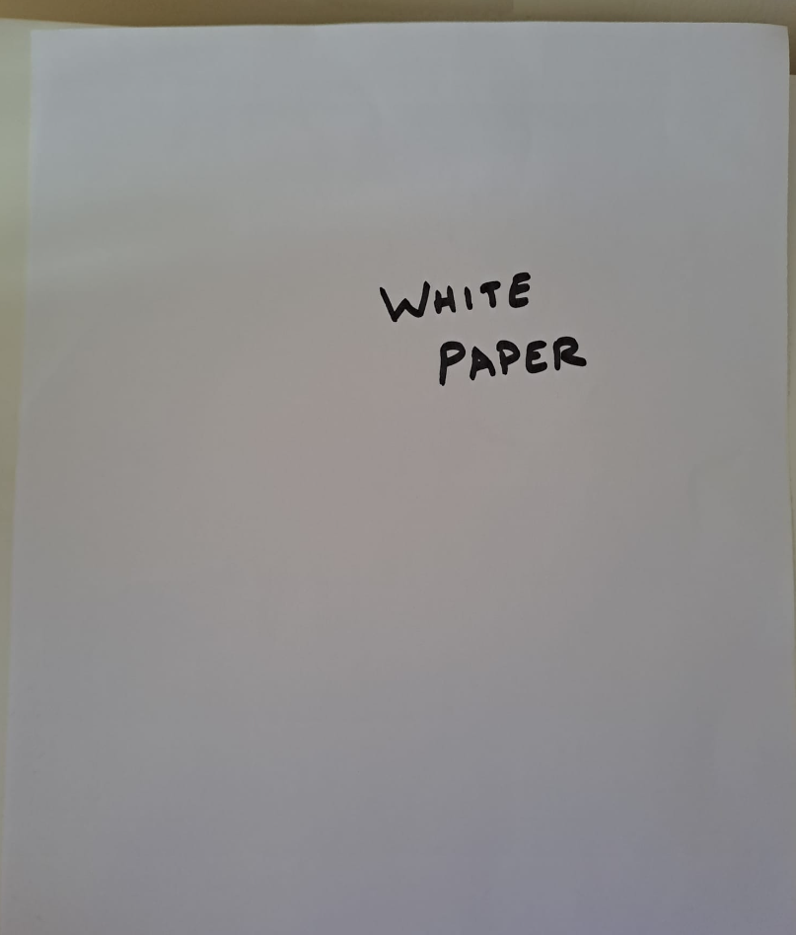
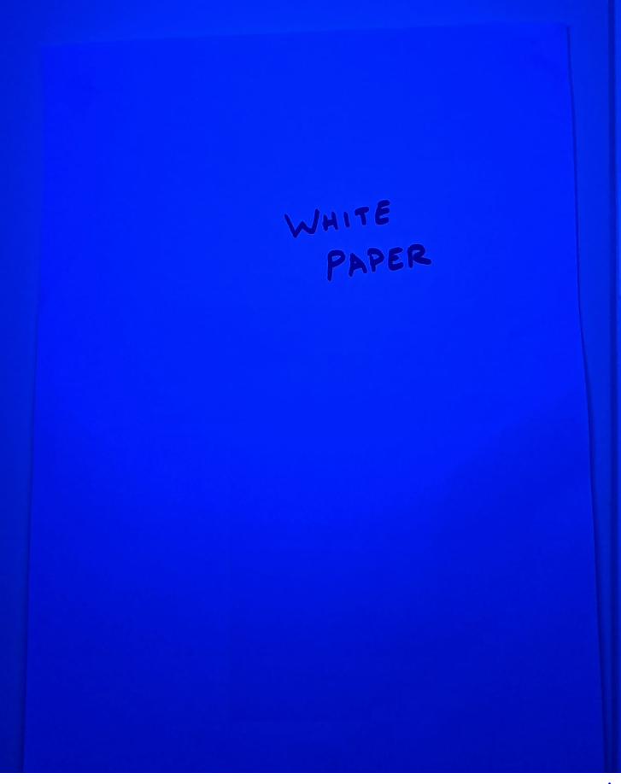
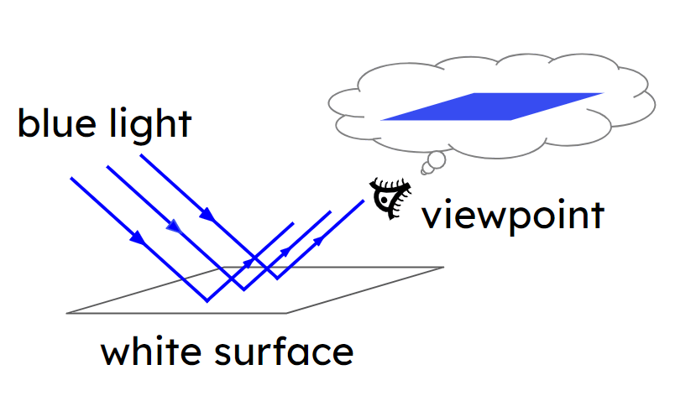
Aragtida walxaha iftiinka midabka leh (coloured light)
Iftiinka buluuga ah, dusha cad waxay u egtahay buluug.
Taas waxaa ugu wacan in dusha cad ay ka tarjumi karto dhammaan midabada iftiinka, laakiin waxaa jira iftiin buluug ah oo ku dhaca. Marka waxay kaliya ka tarjumaysaa iftiin buluug indhahaaga.
Qaybaha madow ee dusha waxay nuugaan dhammaan midabada iftiinka.
Marka waxay weli u eg yihiin madow iftiinka midabka leh.

Slide 27
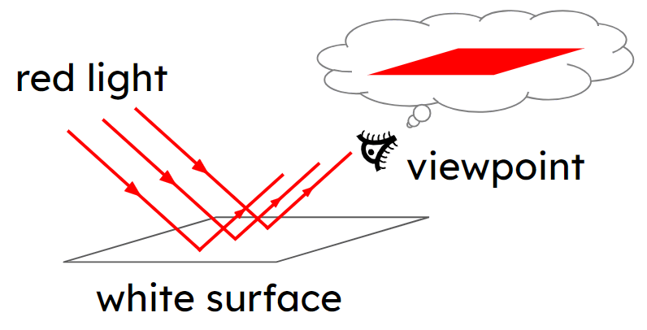
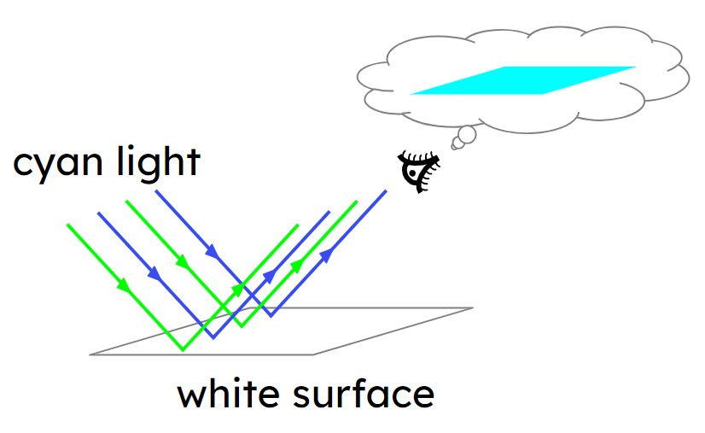
Aragtida shay ee iftiinka midabka leh
Midabkee ayay u ekaan doontaa dusha cad xaalad kasta?
1) Iftiin cas (red light) ah?
2) Iftiin cyan (cyan light) ah?
cas (red)
cyan

Slide 28
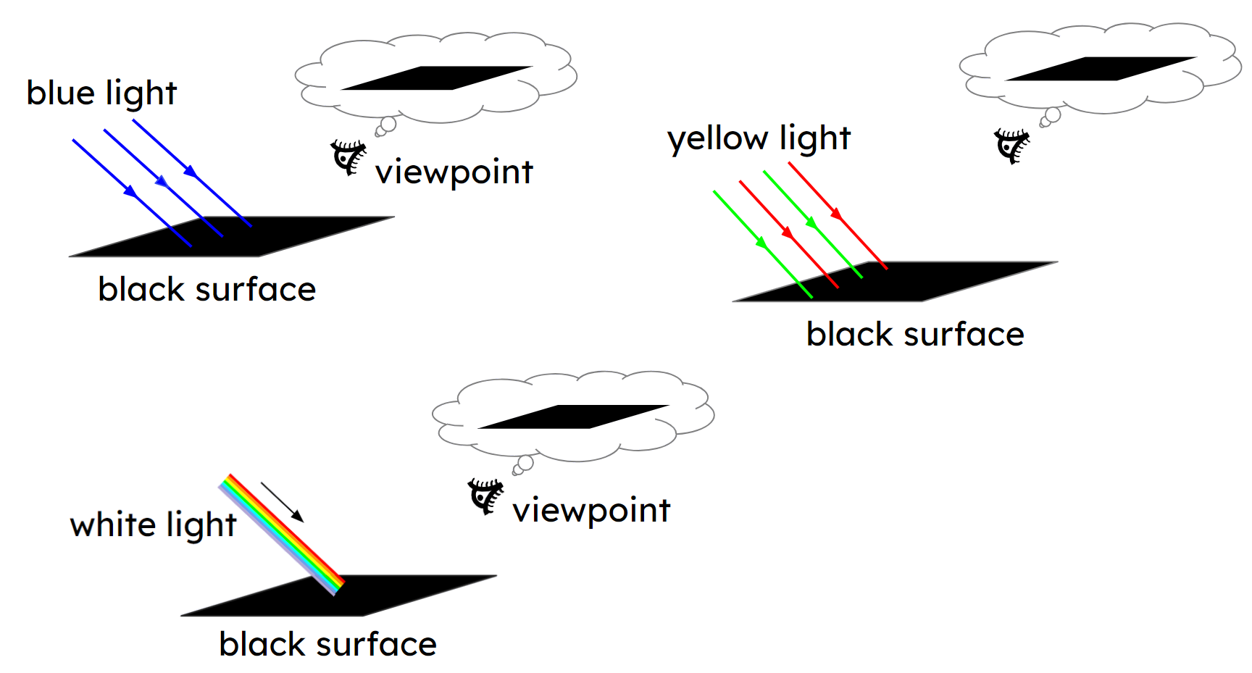
Aragtida shay ee iftiinka midabka leh
Dusha madow oo dhammaystiran waxay si buuxda u nuugtaa dhammaan midabada iftiinka ku dhaca.
Waxay u ekaan doontaa madow midab kasta oo iftiin ah.

Slide 29
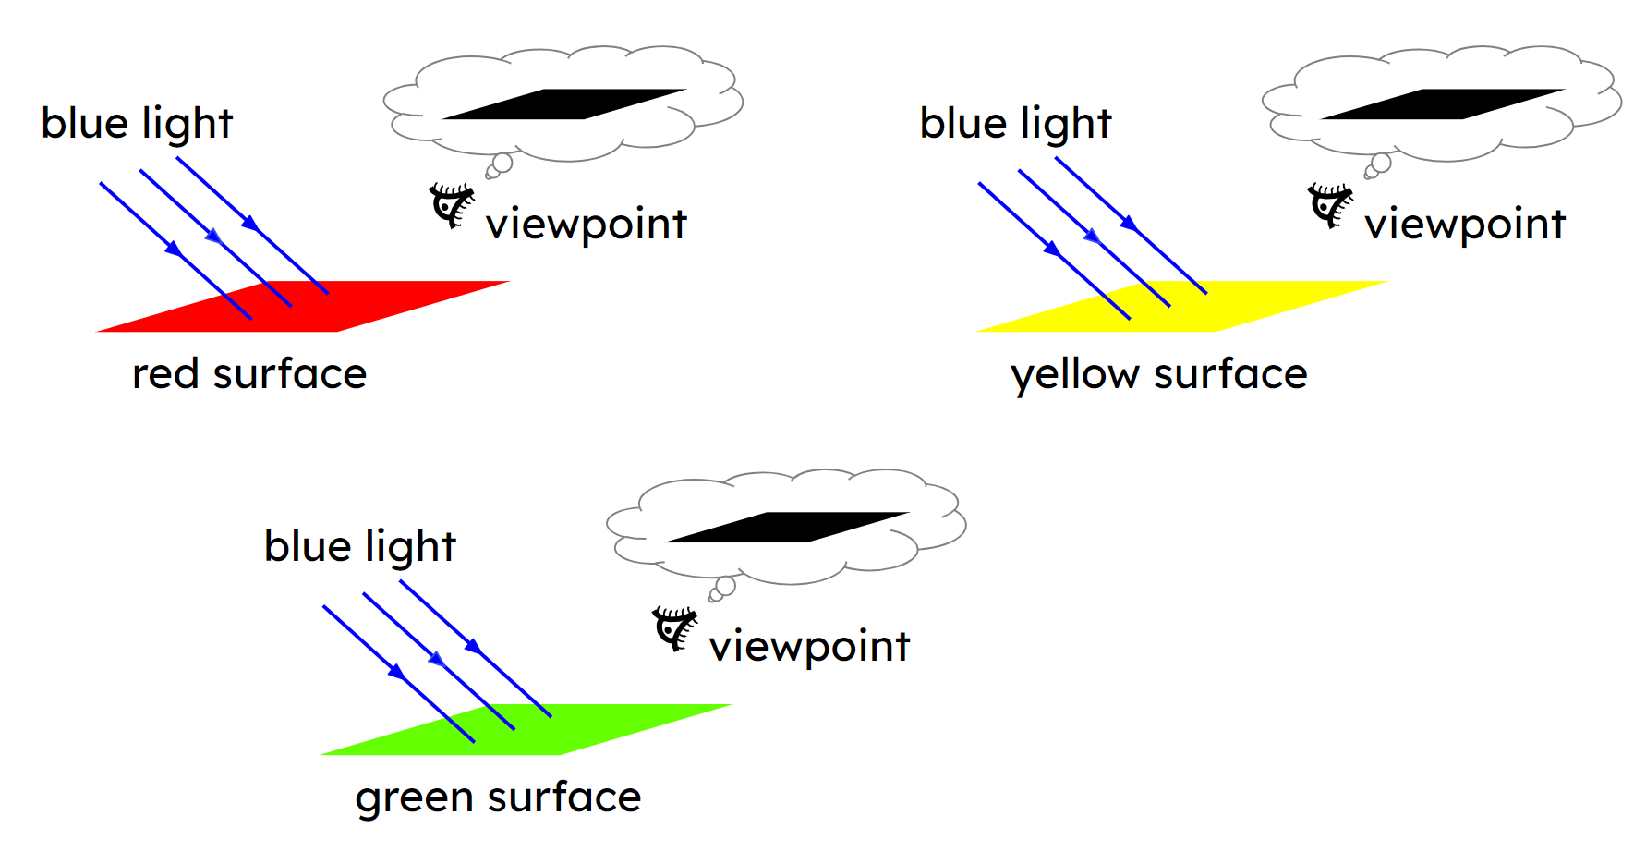
Aragtida shay ee iftiinka midabka leh
Iftiin buluug (blue light) ah, shayda cas (red), cagaar (green) iyo jaalle (yellow) dhamaantood waxay u ekaan doonaan madow.
Sababtoo ah dhamaantood waxay nuugaan iftiinka buluugga ah (blue light).
Waxay kaliya ka tarxi karaan iftiin cas (red), cagaar (green), ama iftiin cas iyo cagaar (red and green light).

Slide 30
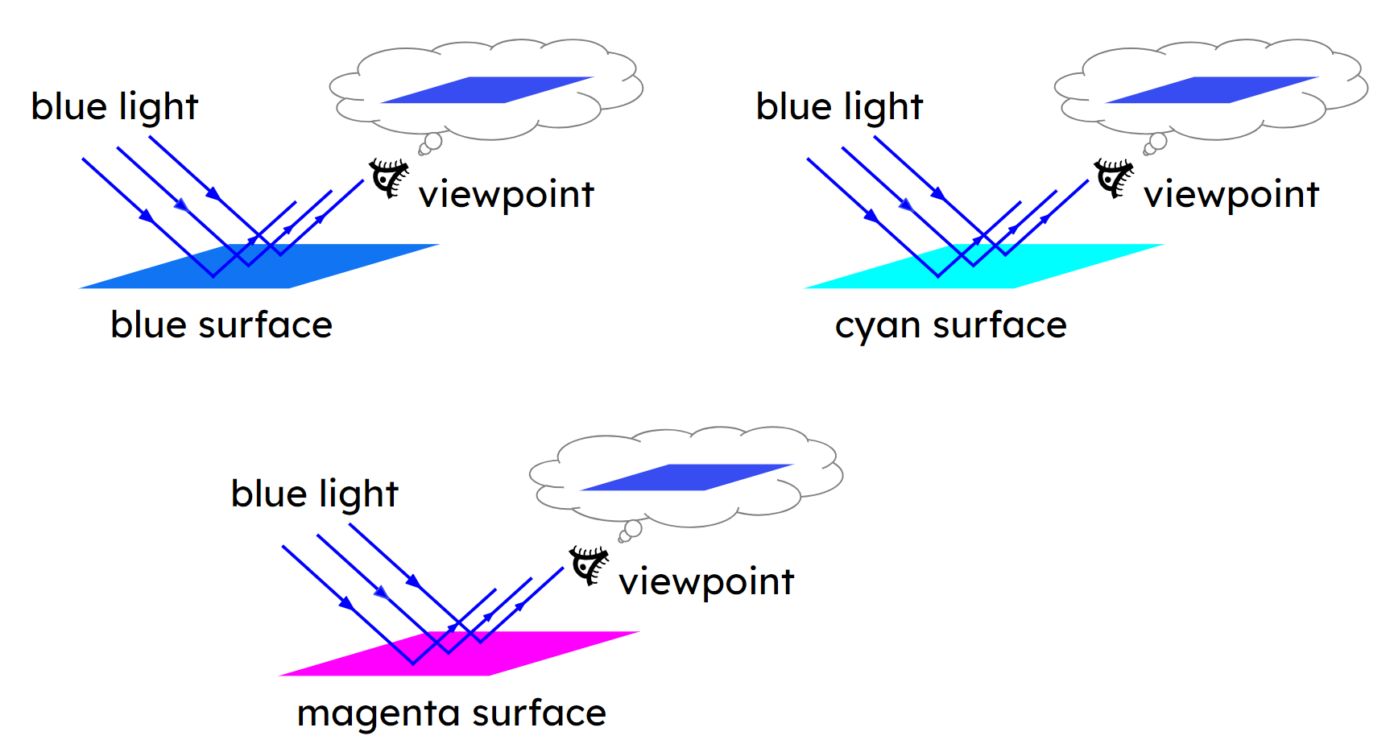
Aragtida shay ee iftiinka midabka leh
Iftiin buluug (blue light) ah, shayda buluug (blue), cyan ama magenta dhamaantood waxay u ekaan doonaan buluug (blue).
Sababtoo ah dhamaantood waxay ka tarxiyaan iftiinka buluugga ah (blue light), oo ma jiro midab kale oo iftiin ah oo ay ka tarxi karaan.

Slide 31
Aragtida shay ee iftiinka midabka leh
1) Cube-yada (cubes) kee ayaa u ekaan doona cas (red) haddii iftiin cas (red light) kaliya ku dhaco?
a
cas (red)
b
jaalle (yellow)
c
cagaar (green)
d
cyan
e
buluug (blue)
f
magenta (magenta)
g
cad (white)
h
madow (black)
2) Waa maxay midabka ay kuwa kale ee dhamaan cubes-ku u ekaan doonaan iftiinka cas (red light)?
madow (black)

Slide 32
Aragtida walxaha iftiinka midabka leh
Iftiinka cyan (cyan light) wuxuu ka kooban yahay iftiinka cagaaran iyo iftiinka buluugga ah. Iftiinka cyan (cyan light) dhexdiisa …
cas (red)
jaalle (yellow)
cagaar (green)
cyan (cyan)
buluug (blue)
magenta (magenta)
cad (white)
madow (black)
… cubes-ka kuwa ka tarjumaya iftiinka cagaaran iyo iftiinka buluugga ah labadaba waxay u ekaan doonaan cyan (cyan).
… cubes-ka kuwa ka tarjumaya buluug laakiin aan cagaar ahayn waxay u ekaan doonaan buluug (blue).
… cubes-ka kuwa ka tarjumaya cagaar laakiin aan buluug ahayn waxay u ekaan doonaan cagaar (green).
… cubes-ka kuwa aan ka tarjumin buluug ama cagaar midna waxay u ekaan doonaan madow (black).

Slide 33
Aragtida walxaha iftiinka midabka leh
Iftiinka jaalle (yellow light) wuxuu ka kooban yahay iftiinka cas iyo iftiinka cagaaran.
Sheeg midabka ay u muuqato cube kasta iftiin jaalle (yellow light) ah.
a
b
c
d
guduud (red)
jaalle (yellow)
cagaar (green)
cyan
buluug (blue)
magenta
e
f
g
h
caddaan (white)
madow (black)
Jawaabaha:
guduud (red)
jaalle (yellow)
cagaar (green)
cagaar (green)
madow (black)
guduud (red)
jaalle (yellow)
madow (black)

Slide 34
Aragtida walxaha iftiin midab leh (coloured light)
Saadaali midabka uu u muuqan doono qayb kasta oo ka mid ah calanka Guyana marka la eego iftiin cagaar (green light) ah.
Sharax sababta aad u malaynayso inaad arki doonto tan.
qayb ka mid ah calanka | saadaal | sharaxaad
saddexagal cas
xuduud madow
chevron jaalle
xuduud cad
asal cagaar
Daawo tusaale (demonstration).
Saadaalintii iyo sharaxaadii ma sax ahayd?
Qor sharaxaado (explanations) la hagaajiyay oo ku saabsan waxa aad aragtay inay dhaceen.

Slide 35

Aragtida walxaha iftiin midab leh
Saadaasha iyo sharaxaadda moodeelka.
qayb ka mid ah calanka | saadaal | sharaxaad
saddexagal cas | madow | Wuxuu ka tarjumaa kaliya iftiinka cas wuxuuna nuugaa midabada kale. Iftiinka cagaaran waa la nuugay sidaas darteed wuxuu u ekaanayaa madow.
xuduud madow | madow | Madow ma tarjumayo midab kasta oo iftiin ah.
chevron jaalle | cagaar | Jaalle (Yellow) wuxuu ka tarjumaa iftiinka guduudan (red) iyo cagaaran (green), laakiin ma jiro iftiin guduudan (red) oo la tarjumo.
xuduud cad (white border) | cagaar (green) | Wuxuu ka tarjumaa dhammaan midabada (colours) iftiinka, sidaas darteed wuxuu ka tarjumaa iftiinka cagaaran (green) oo wuxuu u muuqdaa cagaar (green).
asalka cagaaran (green background) | cagaar (green) | Wuxuu ka tarjumaa iftiinka cagaaran (green) ee soo gaaray (incident).

Slide 36
Ka tarjunta midabka (Reflecting colour)
Waxaan aragnaa midab (colour) marka iftiinka (light) soo galaya indhahayaga uu nuugo (absorbed) unugyada (cells) qaabaysan (cone) ee guduudan (red), cagaaran (green) iyo buluug (blue) oo ku yaal gadaasha indhahayaga.
Midabka (colour) uu shay (object) noogu muuqdo wuxuu ku xiran yahay xaddiga (amounts) iftiinka guduudan (red), cagaaran (green) iyo buluug (blue) ee ka soo tarjumaya (reflect) isaga oo soo galaya indhahayaga.
Walxaha cad (White objects) waxay ka tarjumaan dhammaan midabada (colours) iftiinka, sidaas darteed waxay u muuqdaan isku midab (same colour) sida iftiinka (light) ee soo gaaray (incident).
Walxaha guduudan (red), cagaaran (green) iyo buluug (blue) waxay ka tarjumaan (reflect) kaliya hal midab (primary colour) oo iftiin (light) ah. Walxaha Cyan, Magenta iyo Jaalle (yellow) waxay ka tarjumaan (reflect) laba midab (primary colours) oo iftiin (light) ah.
Midabada (colours) iftiinka (light) ee uu shay (object) aanu ka tarjumin (reflect) waa la nuugaa (absorbed).
Walxaha madow (Black objects) waxay nuugaan (absorb) dhammaan midabada (colours) iftiinka (light).

