Slide 1
Milicsiga muraayadaha (Reflections in mirrors)
Dhawaaqa, iftiinka iyo aragga (Sound, light and vision)

Slide 2
Sida agabyadayada waxbarista loogu talagalay fasalka
Darsigani wuxuu ku jiraan agabyo dheeri ah oo laga soo dejin karo bogga darsiga.

Slide 3
Waxaan sharxi karaa sababta milicsiga (reflections) (sawirada) looga arko muraayadaha iyo sifooyinka sawirada muraayadaha.

Slide 4
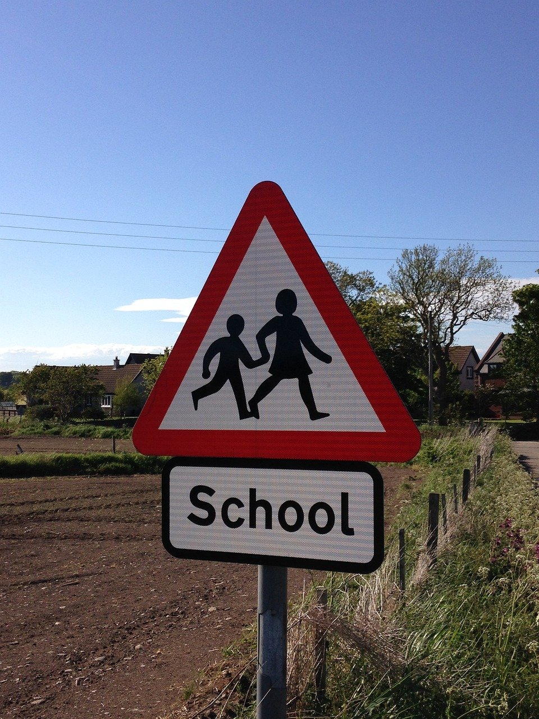
milicsi (reflection)
ereygani wuxuu leeyahay labo macne:
habka iftiinka uu 'ka boodo' dusha
sawir lagu arko muraayad
sawir (image)
matalaad shay
dhinac rogan (laterally inverted)
qeexaysa sawir 'la rogay' si toosan
sawir (image):
sawir dhinac rogan (laterally inverted image):

Slide 5

Milicsiga muraayadaha (Reflections in mirrors)
Baaritaanka sawirada muraayadaha
Gunaanad

Slide 6
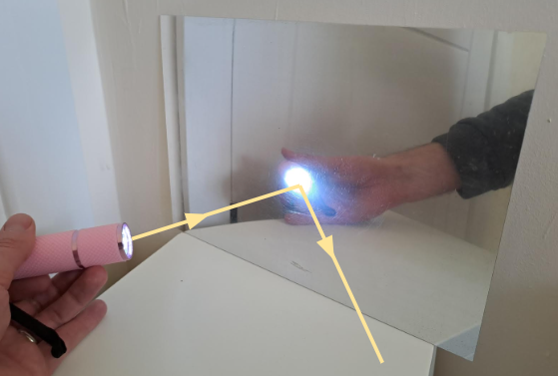
Baaritaanka sawirada muraayadaha
Iftiinka waxaa ka soo baxa shay ifaya dhammaan jihooyinka. Iftiinku wuxuu ku socdaa xariiq toosan, xawaare aad u sareeya.
Haddii iftiinku ku dhaco muraayad, wuu milicsadaa ('ka boodaa'). Iftiinka ku socda hal jiho (hal iftiin ray) kaliya wuxuu ka milicsadaa hal jiho.
Raygani wuxuu muujinayaa jihooyinka qaar ka mid ah iftiinka ka baxaya tooshka.
Fallaadhkani wuxuu muujinayaa jihada iftiinka ka dib marka uu ka milicsaday muraayadda (mirror).

Slide 7
Baaritaanka sawirada muraayadda (mirror)
Iftiinka ku dhaca muraayadda (mirror) had iyo jeer wuu milicsadaa isagoo raacaya sharciyada milicsiga (laws of reflection).
‘Xariiqda toosan (normal)’ waa xariiq mala-awaal ah oo laga soo dhigay 90° ilaa barta milicsiga (point of reflection).
xariiq toosan (normal)
fallaadh soo-gaadhaysi (incident ray)
fallaadh milicsan (reflected ray)
i
r
i = xagasha soo-gaadhista (angle of incidence)
r = xagasha milicsiga (angle of reflection)
muraayad (mirror)
(loo qiyaasay xariiqda toosan (normal))
Xagasha milicsiga (angle of reflection) had iyo jeer waxay la mid tahay xagasha soo-gaadhista (angle of incidence), dhinaca kale ee xariiqda toosan (normal), iyo isla diyaaradda (same plane).

Slide 8
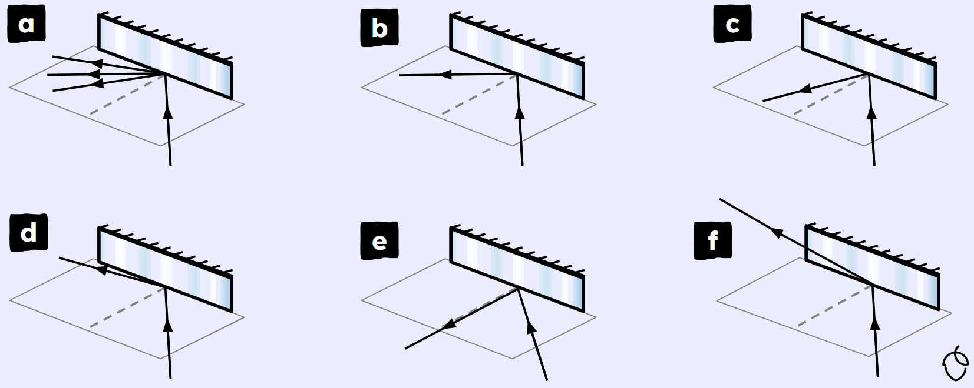

Baaritaanka sawirada muraayadda (mirror)
Jaantuskee ayaa si sax ah u muujinaya fallaadh ka milicsanaysa muraayadda (mirror)?

Slide 9
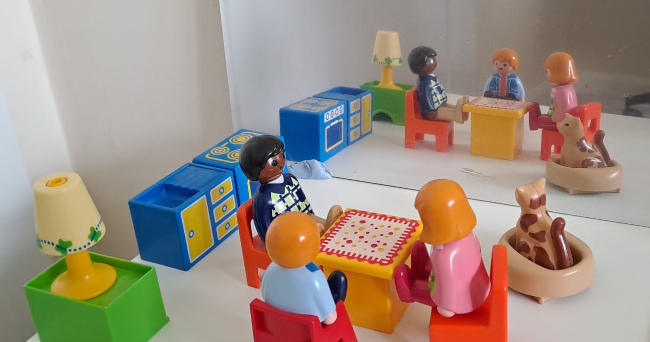
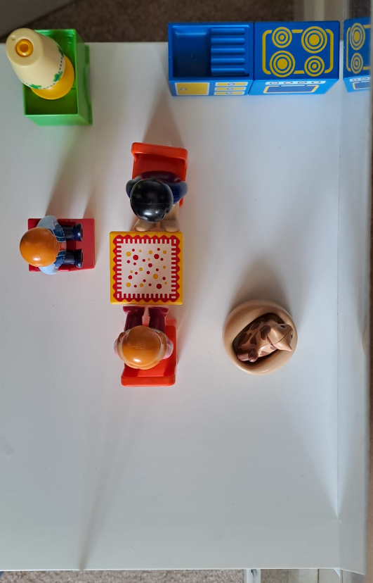
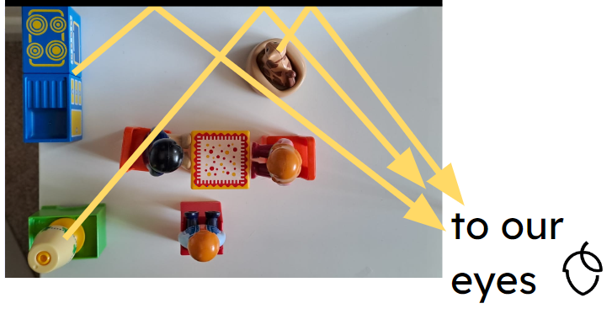
Baaritaanka sawirada muraayadda (mirror)
Sawirka lagu arko muraayadda (mirror) sidoo kale waxaa loo yaqaan milicsi (reflection).
Walxaha qolka ku jira waxay iftiin ka milicsadaan dusha muraayadda (mirror). Kadibna muraayaddu (mirror) waxay qaar ka mid ah fallaadhahan u milicsataa indhahayaga.
Indhahayagu waxay ‘dib u raacaan’ halka ay fallaadhaha ka soo baxeen dusha muraayadda (mirror surface). Tani waa waxa abuura milicsiga (reflection).

Slide 10

Baaritaanka sawirada muraayadda (mirror)
Midkee ka mid ah kuwan soo socda ayaa sababa sawirada lagu arko muraayadda (mirror)?
a
Iftiinka qolka ayaa ka milicsada muraayadda (mirror).
b
Iftiinku wuxuu galaa muraayadda (mirror).
c
Muraayaduhu waxay sameeyaan nuqul (copy) wax kasta oo hortooda ku yaal.
d
Muraayaduhu waxay abuuraan iftiin (light) si ay u sameeyaan sawirka (image).

Slide 11
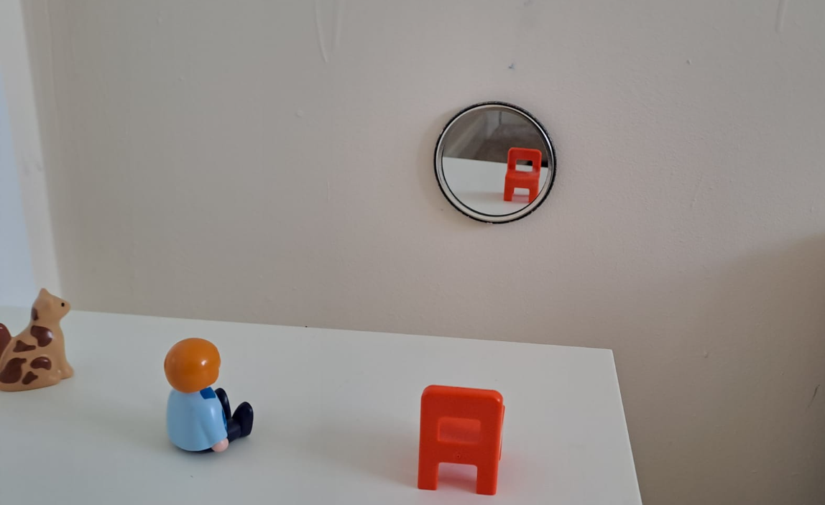
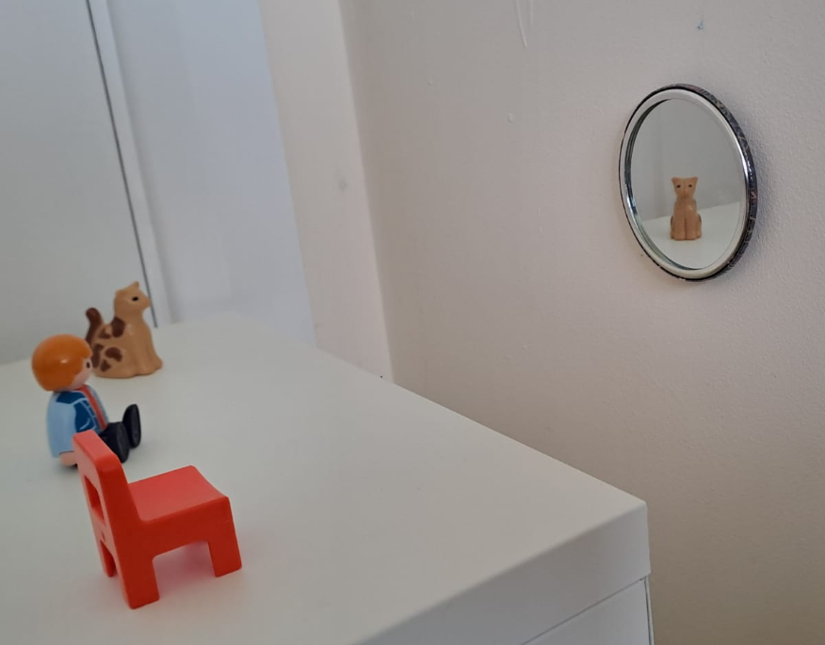
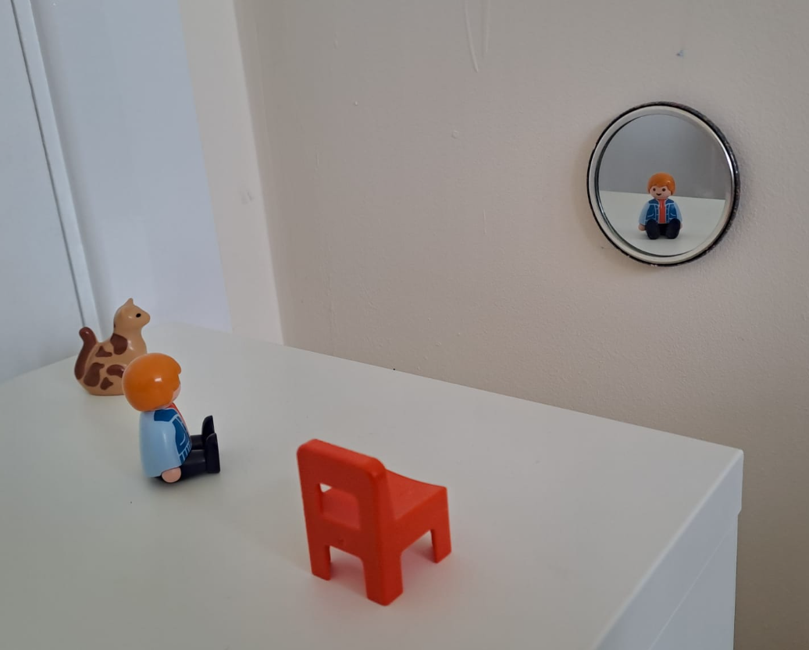
Baaritaanka sawirada muraayadda (mirror images)
Waxa aad ku aragto muraayad waxay ku xiran tahay booskaaga.
Si aan u aragno milicsiga (reflection) bisadda waa inaan halkan joognaa.
Si aan u aragno milicsiga (reflection) ilmaha waa inaan halkan joognaa.
Booskan waxaan ku arki karnaa milicsiga (reflection) kursiga.
Dadka boosaska kala duwan ku jira waxay arki doonaan sawiro (images) kala duwan isla muraayadda isla waqtigaas.

Slide 12
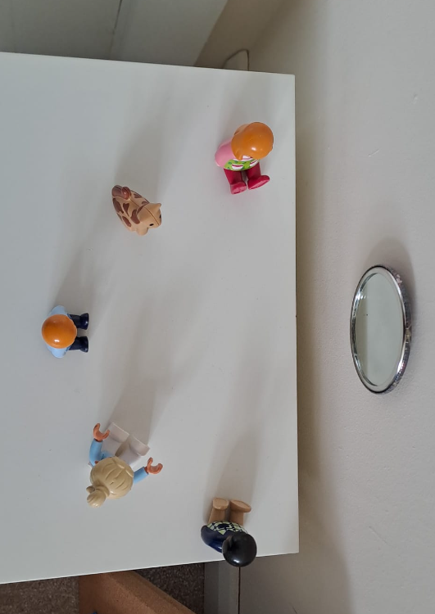
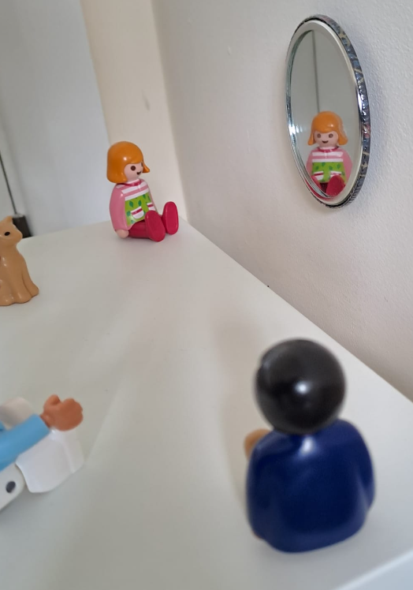
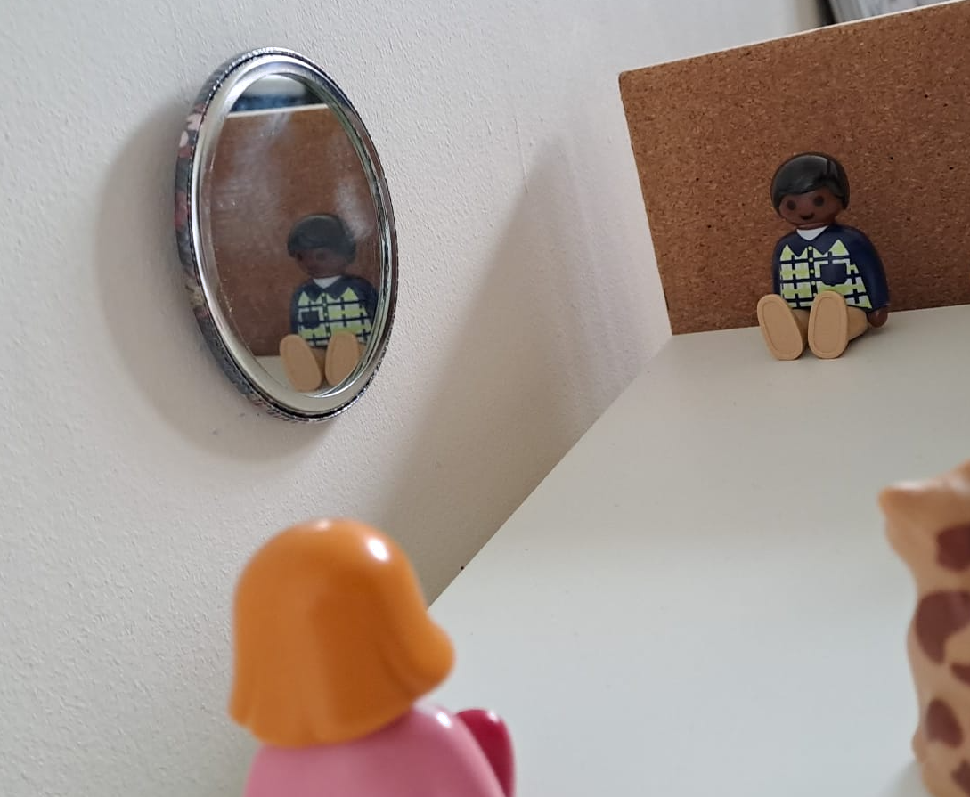
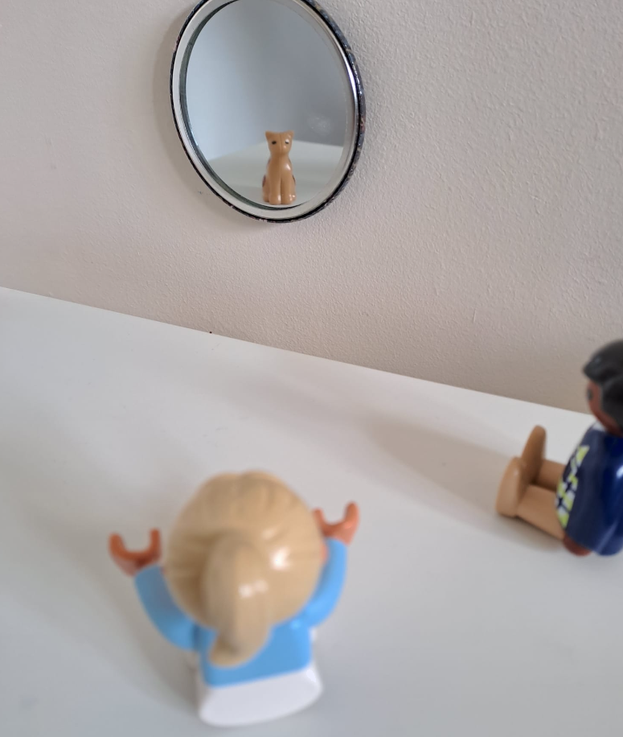

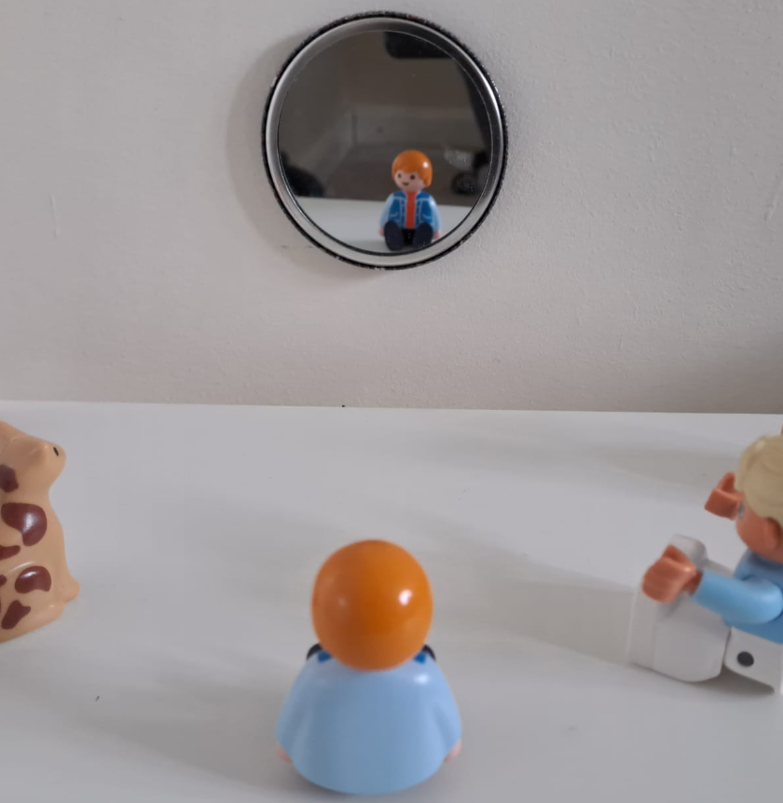

Baaritaanka sawirada muraayadda (mirror images)
Yaa arki kara milicsiga (reflection) bisadda ee muraayadda?
Cali
Suad
bisad
Layla
Axmed

Slide 13
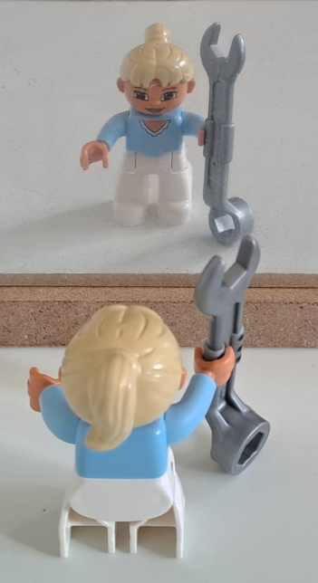
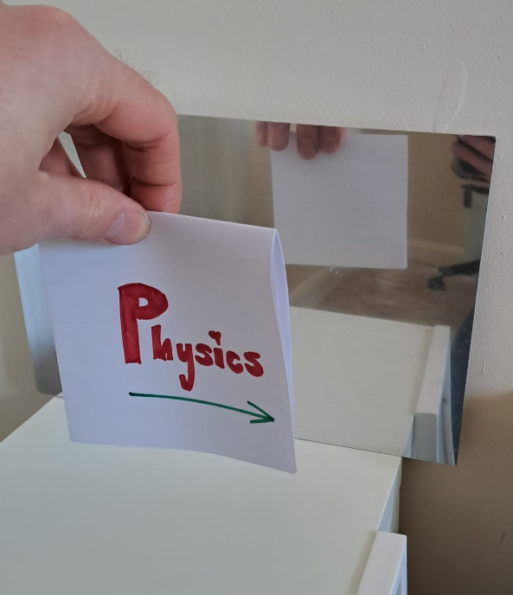
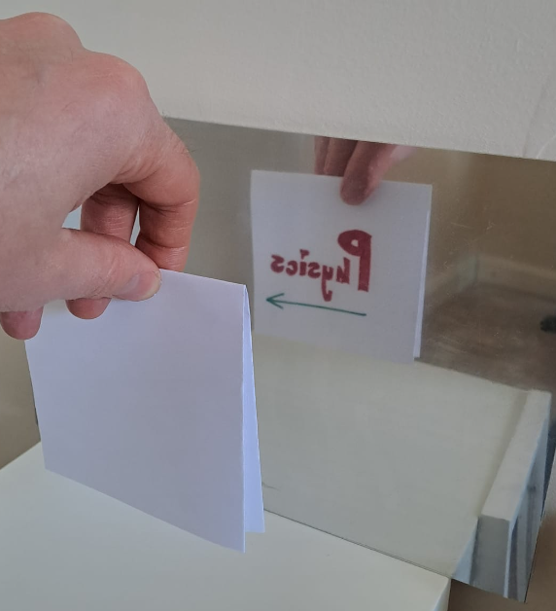
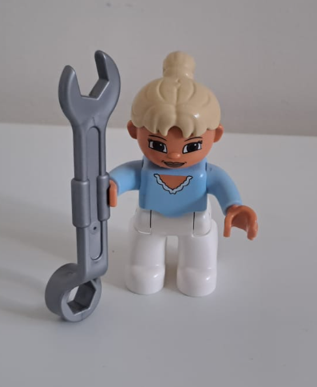
Baaritaanka sawirada muraayadda (mirror images)
Sawirka (image) muraayadda waa mid rogan (laterally inverted) marka loo barbardhigo shayga marka uu soo jeedo.
Furaha (spanner) wuxuu ku jiraa gacanta midig ee Layla. Sawirkiisa muraayadda wuxuu u eg yahay gacanta bidix.
Layla oo soo jeedda
sawirka (image) muraayadda
Saamaynta ayaa aad u muuqata marka la eego qoraalka.

Slide 14
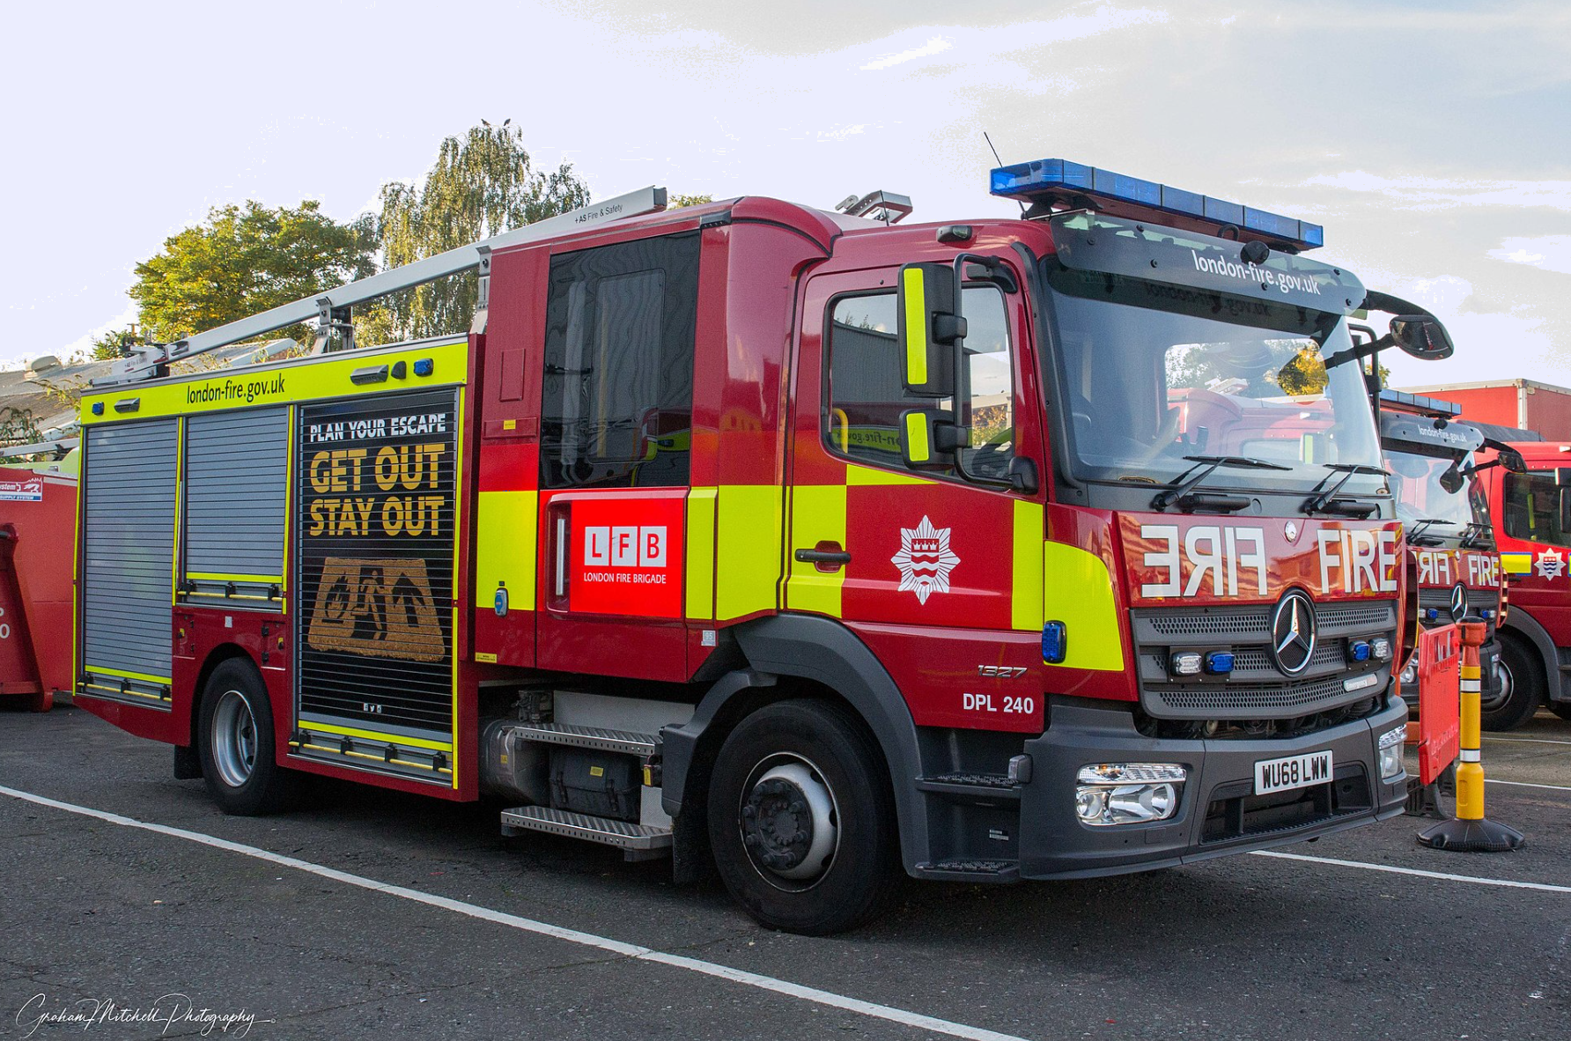
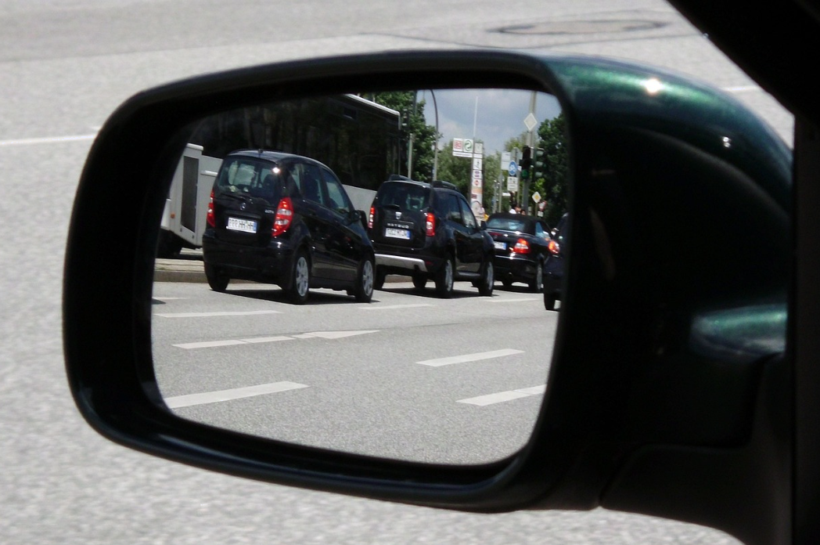
Baaritaanka sawirada muraayadda (mirror images)
Qaar ka mid ah qoraalka ku yaal baabuurta degdegga ah waa rogan yihiin dhinac (laterally inverted).
Tani waa si qoraalku u muuqdo qaab sax ah marka lagu arko muraayadda baabuurta kale.
Sawirka bidix: London Fire Brigade, Graham Mitchell, 2021, shatiyaysan CC-BY-2.0.

Slide 15
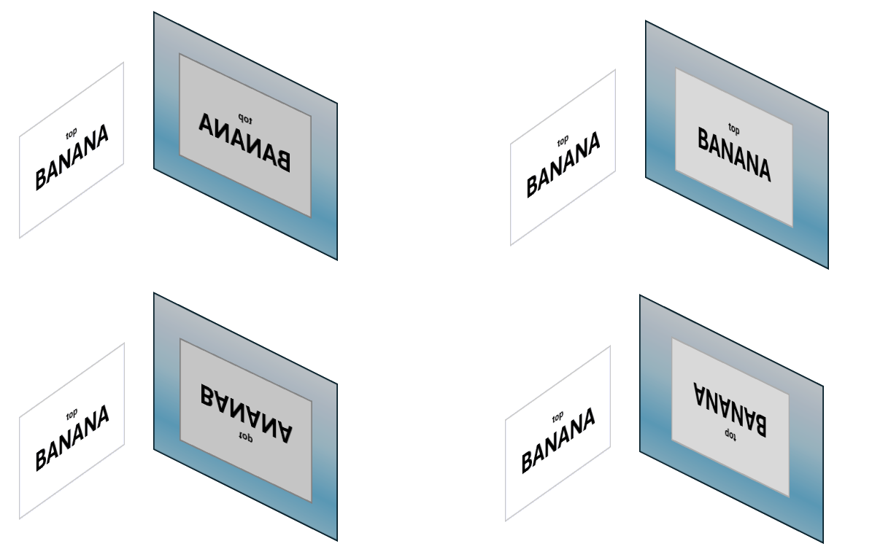

Baaritaanka sawirada muraayadda (mirror images)
Waa kee milicsiga saxda ah ee qoraalka kaarka cad?
a
b
c
d

Slide 16

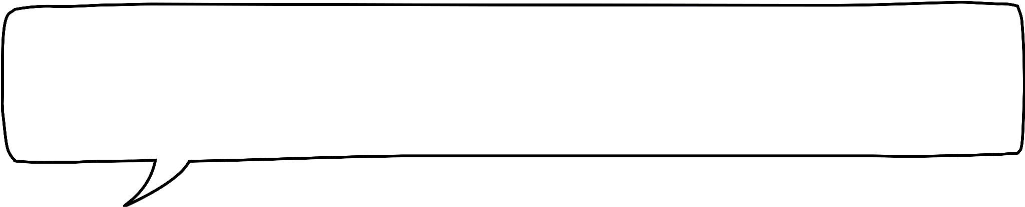
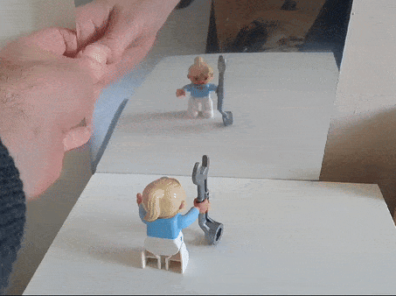
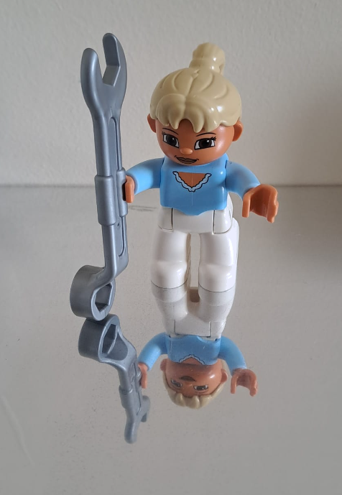
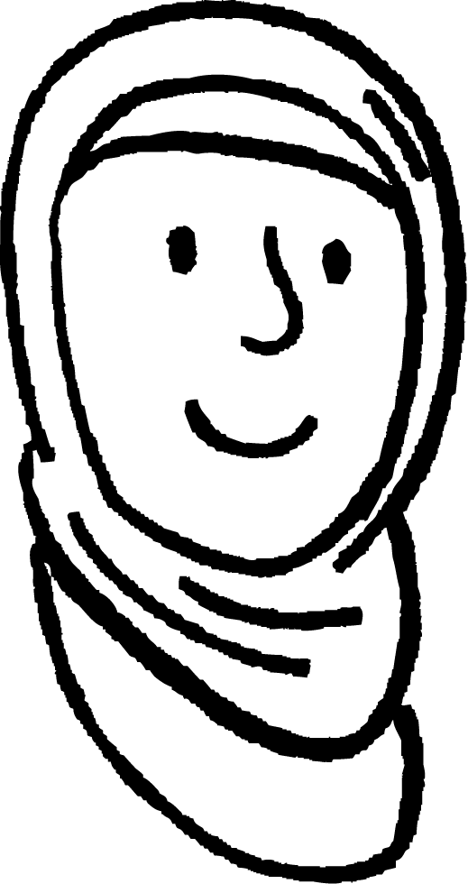

Baaritaanka sawirada muraayadda (mirror images)
Haddii sawirada muraayadda ay yihiin rogan dhinac (laterally inverted), maxay u rogmayn kor-hoos (vertically inverted)? Miyay muraayaduhu garanayaan jihada kor?
Caasha
Fikradda Caasha waa khalad: muraayaduhu ma dareemi karaan jihada kor.
Wareejinta muraayadda gidaarka taagan saamayn kuma leh milicsiga.
Waa had iyo jeer rogan dhinac (laterally inverted).
Sawirka muraayadda dhulka ku taal wuxuu u muuqdaa rogan kor-hoos iyo dhinac (vertically and laterally inverted).

Slide 17
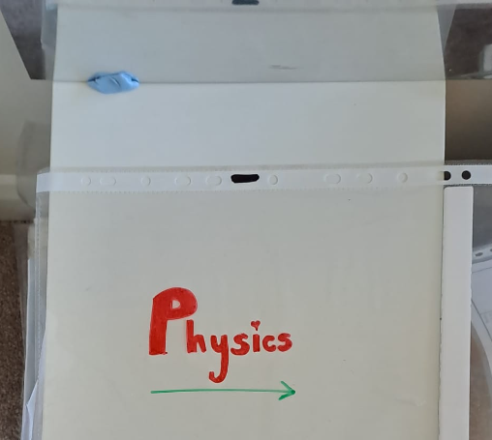
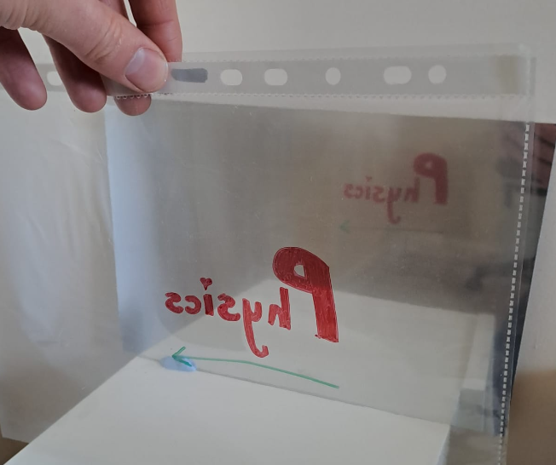
Baaritaanka sawirada muraayadda (mirror images)
Muraayaduhu waxay si fudud u milicsadaan waxa hortooda ku yaal.
Waxa ku yaal midigta horteeda muraayadda wuxuu ku yaali doonaa midigta milicsiga.
Waxa ku yaal xagga sare horteeda muraayadda wuxuu ku yaali doonaa xagga sare milicsiga.
Waxa ugu fog muraayadda wuxuu noqon doonaa kan ugu fog milicsiga.
Qoraalka waa loo jeediyay muraayadda, muraayadduna waxay milicsataa waxa horteeda ku yaal.

Slide 18
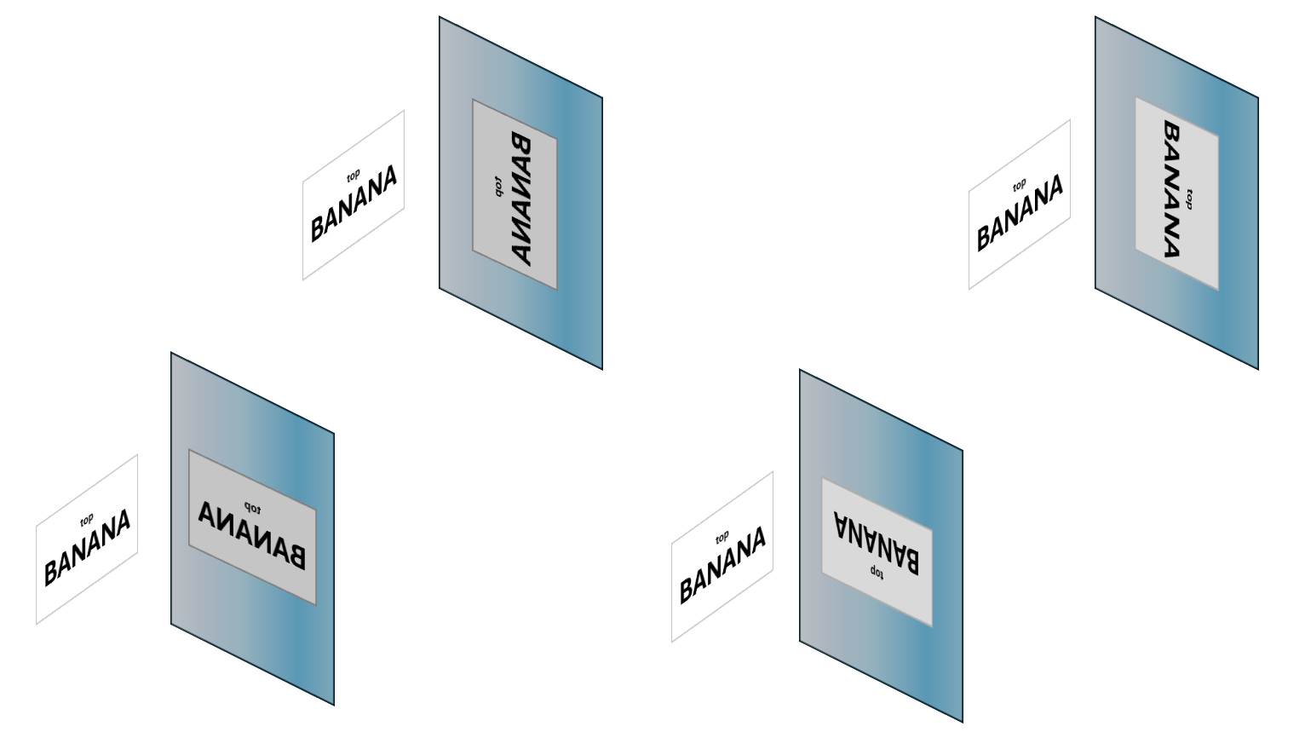
Baaritaanka sawirada muraayadda (mirror images)
Maxaa dhacaya haddii aad muraayadda u rogto 90°?
a
b
?
c
d

Slide 19
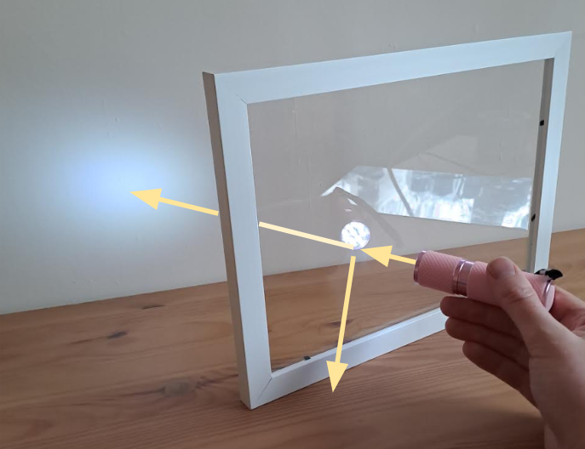
Baaritaanka sawirada muraayadda (mirror images)
Galaasku waa daahsoon (transparent) sababtoo ah wuxuu gudbiyaa (transmits) inta badan iftiinka ku dhaca.
Si kastaba ha ahaatee, qaar ka mid ah iftiinka ayaa sidoo kale ka muuqda (reflected) dusha galaaska.
Tan waxaa loo isticmaali karaa in lagu abuuro khiyaano (illusions).

Slide 20
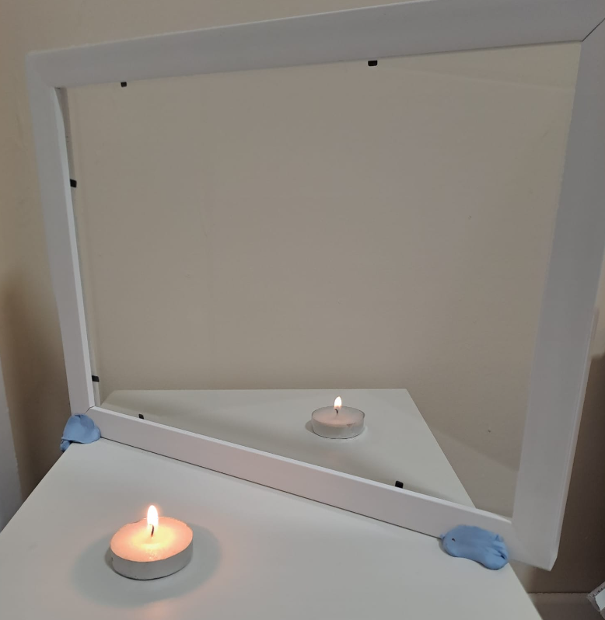
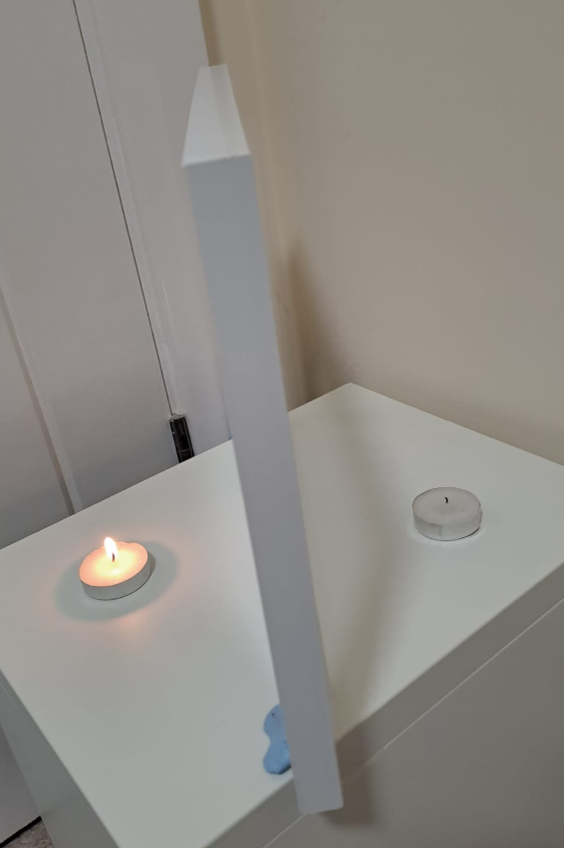

Baaritaanka sawirada muraayadda (mirror images)
Shumashan waxay u muuqataa inay shidan tahay.
Si kastaba ha ahaatee, waxaad ku arki doontaa kaliya milicsiga (reflection) ololka, oo ka yimid shumac kale.
Iftiinka qolka ayaa ka muuqda (reflects) shumaca aan shidanayn oo wuxuu dhex maraa galaaska.
Wuxuu ku socdaa ishaada oo ay weheliso iftiinka ololka (ka muuqda galaaska).
Sidaas darteed waxaan ku aragnaa sawirka ololka oo ka sarreeya shumaca aan shidanayn.
Fiidiyow muujinaya xaglo kala duwan:

Slide 21
Baaritaanka sawirada muraayadda (mirror images)
Shumacyada iyo galaaska ayaa loo habeeyay si milicsiga (reflection) ololka uu ugu dhaco meel sax ah si shumaca aan shidanayn ugu muuqdo mid shidan.
Sawirka (milicsiga) ololka wuxuu u muuqdaa inuu halkan yahay.
Waxaan nidhaahnaa sawirka milicsan (reflected image) wuxuu ka dambeeyaa muraayadda.
Milicsiga waxaa loo yaqaan sawirro aan dhab ahayn (virtual images) sababtoo ah ma jiraan raajo iftiin oo dhab ah oo ka yimaada sawirka oo ku soo gala ishaada.

Slide 22
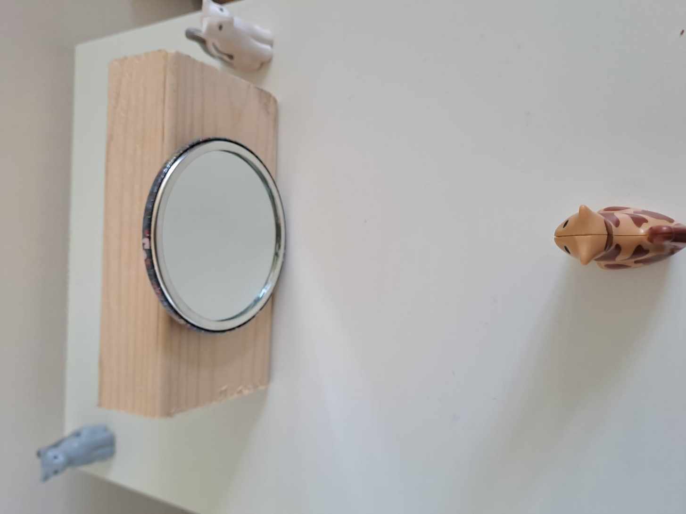
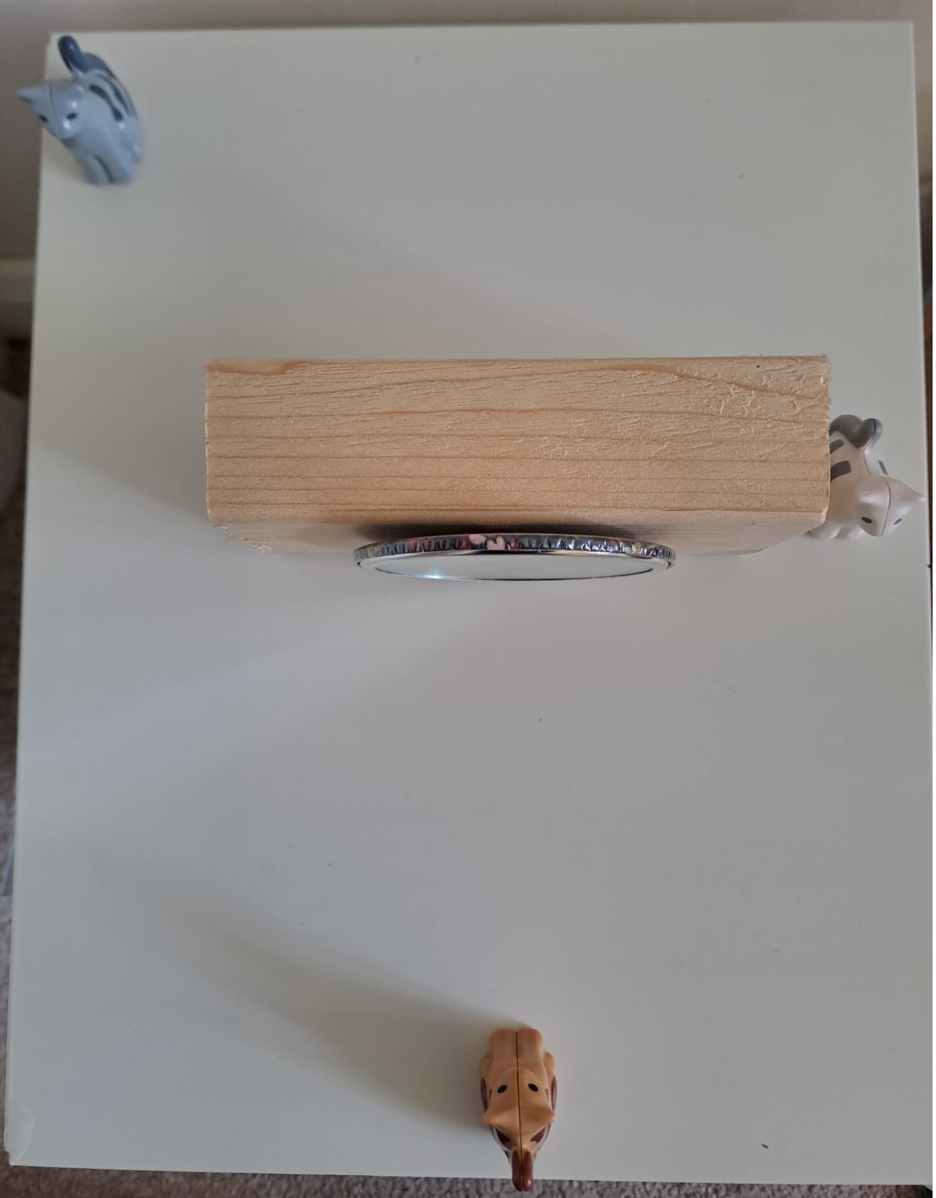
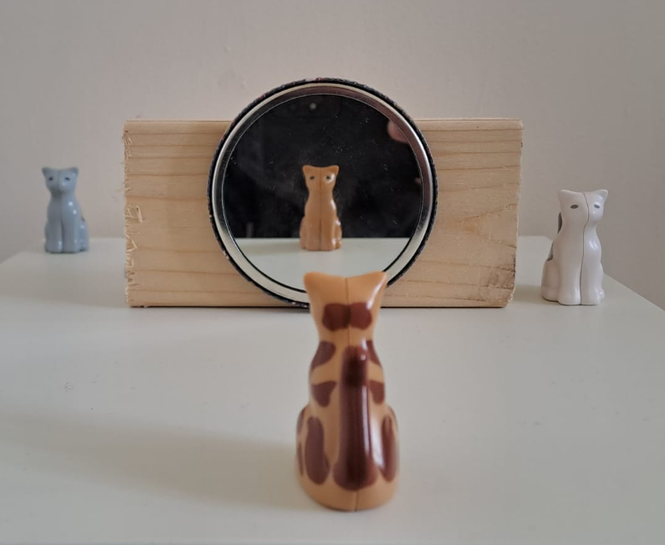
Baaritaanka sawirada muraayadda (mirror images)
Bisad ayaa eegaysa muraayad.
Xaggee ayay ku taal milicsiga bisadda?
a
b
c
Milicsigu wuxuu u muuqdaa inuu ka dambeeyo muraayadda.
d

Slide 23
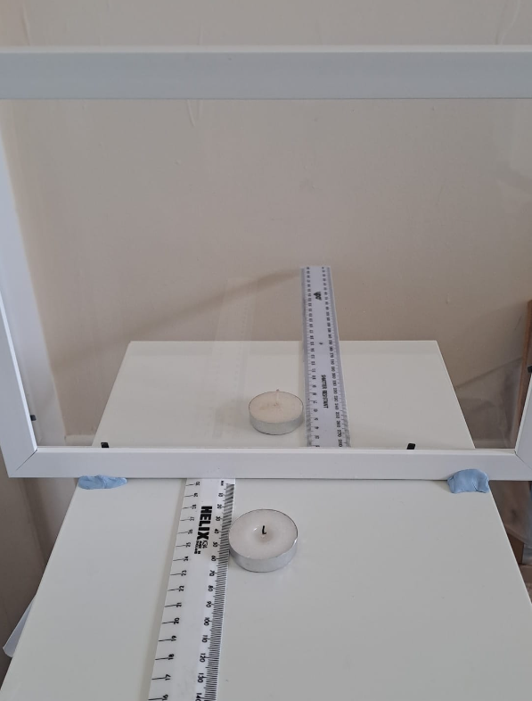
Baaritaanka sawirada muraayadda (mirror images)
Baar sida goobta sawirka muraayadda u isbeddelo markaad shayga ka dhaqaajiso dusha milicsiga.
Samee shaashad hufan (oo leh cago deggan ama qabato), laba shumac iyo laba xisaab (rulers) sida ku cad.
Shid shumaca kuugu dhow oo u dhaqaaji shaashadda.
Qiyaas oo duub masaafada ololkeeda u jirto shaashadda (screen).

Slide 24
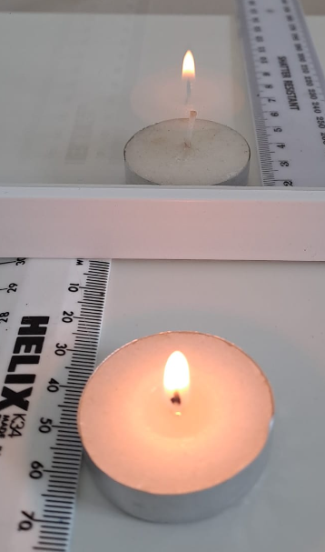
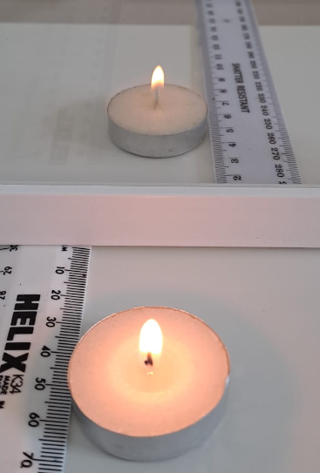
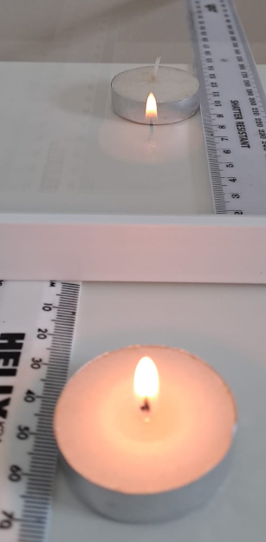
Baaritaanka sawirada muraayadda (mirror images)
Dhaqaaji shumaca (candle) ka dambeeya shaashadda (screen) ilaa uu u ekaado sidii oo shidan yahay.
aad u dhow
aad u fog
Qiyaas oo duub masaafada u jirta shaashadda (screen).
masaafada ololka u jirta shaashadda (cm) | masaafada milicsiga (reflection) ka dambeeya shaashadda (cm)
Qaado qiyaaso dheeri ah oo shumaca shidan leh shan masaafo oo kale oo u jira muraayadda (mirror).

Slide 25
Baaritaanka sawirada muraayadda (mirror images)
Natiijooyin tusaale.
masaafada ololka u jirta shaashadda (cm) | masaafada milicsiga (reflection) ka dambeeya shaashadda (cm)
5 | 5
10 | 10
15 | 16
20 | 20
25 | 24
30 | 31
Kala duwanaanshaha masaafooyinka ayaa ku xidhan qalabka saxda ah ee la isticmaalay.

Slide 26
Milicsiga (Reflections) muraayadaha (mirrors)
Baaritaanka sawirada muraayadda (mirror images)
Gunaanad (Conclusions)

Slide 27
Gunaanad (Conclusions)
Gunaanadku (conclusion) wuxuu sheegaa waxa aad ku ogaatay tijaabada (experiment), iyo sida aad tan u ogaatay.
Gunaanad (Conclusion)
Waxaan ogaaday in …

Slide 28

Gunaanad (Conclusions)
Run ama been? Natiijooyinka jadwalku waxay taageeraan gabagabada ah in milicsigu u muuqdo inuu yahay isla fogaanta gadaasha muraayadda sida shayga hortiisa ugu yaal.
fogaanta ololka iyo shaashadda (cm) | fogaanta milicsiga gadaasha shaashadda (cm)
5 | 5
10 | 10
15 | 16
20 | 20
25 | 24
30 | 31
T
Run
F
Been
Caddee jawaabtaada.
a
Way adag tahay in la qiyaaso fogaanta saxda ah, marka waxaad filan kartaa qaladaad yaryar.
b
Natiijooyinka, milicsigu mar walba isku fogaanta kama dambeeyo shaashadda sida shayga (ololka) hortiisa ugu yaal.

Slide 29
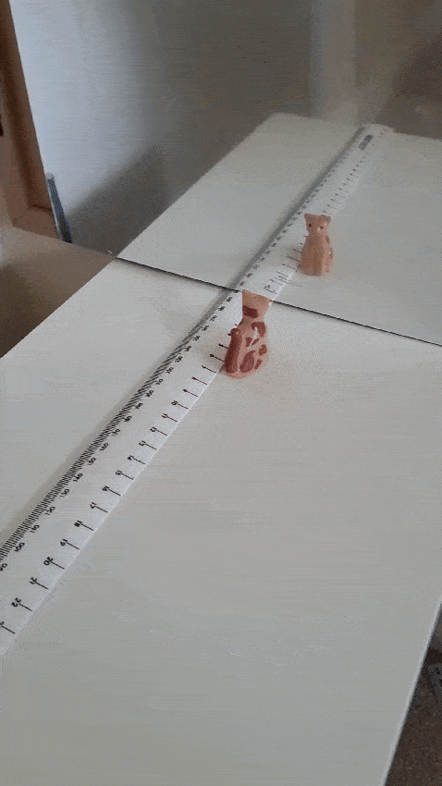
Gabagabo
Milicsigu wuxuu u muuqdaa inuu yahay isla fogaanta gadaasha muraayadda sida shayga hortiisa ugu yaal.
Milicsigu runti kama dambeeyo muraayadda, sababtoo ah ma aha shay dhab ah.
Waa sawirro (images).
Meelaha milicsigu u muuqdo inuu ka dambeeyo inta badan ma jiraan dhab ahaan.

Slide 30
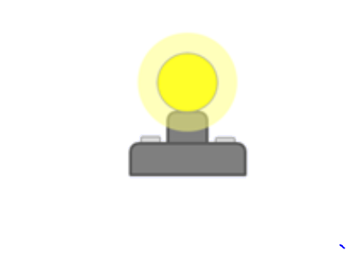

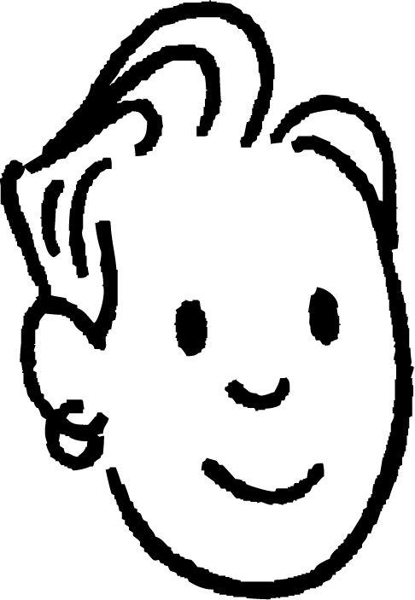
Gabagabo
Milicsigan, iftiinku wuxuu safraa 3 m ilaa muraayadda, ka dibna 2 m muraayadda ilaa indhaha Saciid.
Indhaha Saciid waxay ogaadaan iftiin ku yimaada xagal gaar ah oo 5 m u jira.
3 m
5 m
2 m
Indhaha Saciid, xaaladdu waxay lamid tahay haddii runti lahaa laambad 5 m u jirta jihadaas.
3 m
iftiinkani wuxuu ka yimid 5 m
iftiinkani wuxuu ka yimid 5 m
Marka waa waxa ay aragto: laambad (milicsiga) oo u muuqata inay 5 m u jirto.

Slide 31
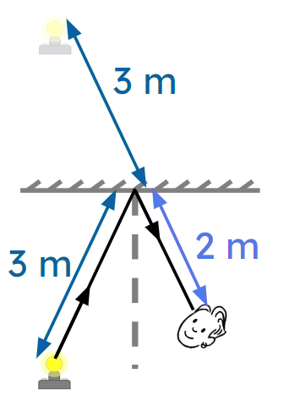
Gabagabo
Taasi waa sababta milicsigu mar walba ugu muuqdo isla fogaanta gadaasha muraayadda sida shayga hortiisa ugu yaal.
Inta uu iftiinka (light) u socdo ka hor inta uusan ku dhicin muraayad (3 m kiiskan), waa masaafada uu milicsiga (reflection) uga muuqdo gadaasha muraayadda.
d
d
Masaafada tooska ah (d) ee muraayadda sidoo kale waa siman yihiin.

Slide 32
Gunaanad (Conclusions)
Bisad (cat) ayaa eegaysa muraayad.
Intee ayuu uga fog yahay bisadda milicsiga (reflection) bisadda u muuqdo?
a
10 cm
20 cm
b
20 cm
c
In yar ka badan 20 cm
d
30 cm
e
40 cm
f
80 cm
Jawaabaha:
20 cm
20 cm

Slide 33
Gunaanad (Conclusions)
Sharax sababta milicsiga (reflections) looga arko muraayadaha.
Qeex oo sharax sifooyinka milicsiga (reflections) (sawirada muraayadda).

Slide 34
Gunaanad (Conclusions)
Jawaabaha tusaalaha ah (Example answers).
Sharax sababta milicsiga (reflections) looga arko muraayadaha.
Muraayaduhu aad bay u dhalaalaan, sidaas darteed waxay milicsadaan (reflect) iftiinka (light) ku dhaca. Qaar ka mid ah iftiinka (light) ayaa nagu soo milicsada indhaha, taasoo keenta inaan ku aragno sawir (image) muraayadda. Sawirka (image) wuxuu ku yaal meesha iftiinka (light) uu uga soo muuqdo inuu ka yimid, taasoo ah gadaasha muraayadda.
Sharax oo faahfaahi sifooyinka milicsiga (reflections) (sawirrada muraayadda).
Milicsiga (reflections) (sawirada muraayadda) waxay u muuqdaan masaafo isku mid ah gadaasha muraayadda sida shayga (object) uga horreeyo muraayadda, iyagoo toosan. Waxa ku jira midigta horteeda muraayadda wuxuu ku jiri doonaa midigta milicsiga (reflection) (markaad eegayso). Tani waxay keentaa in qoraalka u jeeda muraayadda uu rogmado dhinac (laterally inverted). Shayga (Objects) ku jira midigtaada wuxuu ku jiraa bidixda milicsigaaga (reflection) (haddii ay qof kaa soo horjeedaan).

Slide 35
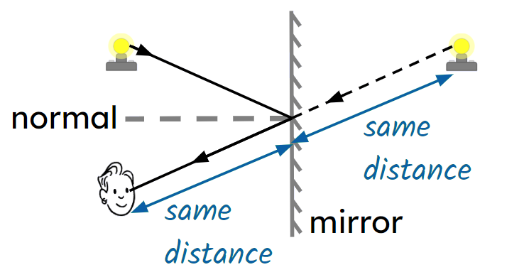
Milicsiga (reflections) ee muraayadaha
Iftiinka (light) ayaa ka milicsanaya muraayadaha (iyo dusha kale ee dhalaalaya) isagoo raacaya sharciyada milicsiga (laws of reflection).
Qaar ka mid ah iftiinka (light) ayaa lagu milicsadaa indhahayaga taasoo keenta inaan aragno sawir (image) muraayadda dhexdeeda.
Sawirku (image) wuxuu u muuqdaa inuu ka yimid meesha iftiinku (light) ka yimid, taasoo ah masaafo (distance) la mid ah gadaasha muraayadda sida shayga (object) uga hor jeedo muraayadda.
Sawirka (image) muraayadda waa mid toosan (right way up). Wax kasta oo ku yaal midigta muraayadda horteeda waxay ku jiri doonaan midigta milicsiga (reflection). Tani waxay keentaa in qoraalka muraayadda horteeda uu noqdo mid rogan (laterally inverted), iyo walxaha ku yaal midigtaada waxay ku yaalliin bidixda milicsigaaga (haddii ay qof kaa soo hor jeedo).

