Slide 1
Ilo wareejin (Refracting light)
Samaynta sawirada (Making images)

Slide 2
Sida agabkeena waxbarista loogu talagalay fasalka
Darsigani wuxuu ku darayaa agab dheeri ah oo laga soo dejin karo bogga darsiga.

Slide 3
Waxaan awoodi karaa inaan sharaxo oo sawiro sida iftiin (ray of light) uu u leexdo (refracts) marka uu ka dhaqaaqo hal dhexdhexaad (medium) una guuro mid kale, iyo inaan sharaxo sida leexashada (refraction) ay u keento sawirro aan dhab ahayn (virtual images).

Slide 4
gudbinta (transmitted)
marka iftiinku uu dhaqaaqo oo uu dhex maro dhexdhexaad cusub
dhexdhexaad (medium)
maaddada iftiinku dhex marayo
leexashada (refraction)
marka iftiinku uu beddelo jihadiisa marka uu galo dhexdhexaad cusub
caadi (normal)
xariiq lagu sawiray 90° ilaa dusha maaddada
sawir aan dhab ahayn (virtual image)
matalaad shay lagu arko meesha iftiinku u muuqdo inuu ka imanayo, ma aha meesha uu dhab ahaan ka imanayo

Slide 5

Ilo wareejin (Refracting light)
Baaritaanka leexashada (Investigating refraction)
Gunaanad (Conclusions)
Khayaaliyada leexashada (Refraction illusions)

Slide 6
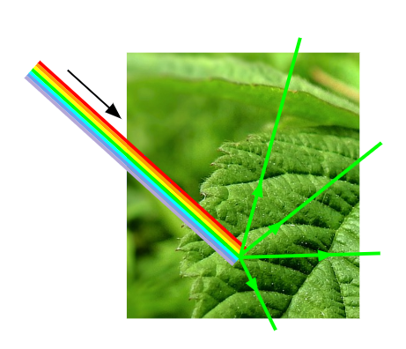

Baaritaanka leexashada (Investigating refraction)
Marka iftiinku ku dhaco dusha maaddada, qaar baa laga yaabaa inay ka muuqdaan (reflected), qaar la nuugo (absorbed), qaarna laga gudbiyo (transmitted) iyada oo loo marayo maaddada.
Maaddooyinka hufan (transparent) sida galaaska iyo biyaha (water) waxay gudbiyaan (transmit) inta badan iftiinka ku dhaca. Waxaad arki kartaa iyaga dhexdooda.
Walxaha aan iftiinka karin (opaque) waxay milicsadaan ama nuugaan inta badan iftiinka (light) ku dhaca.

Slide 7
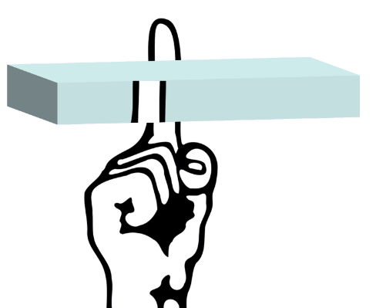
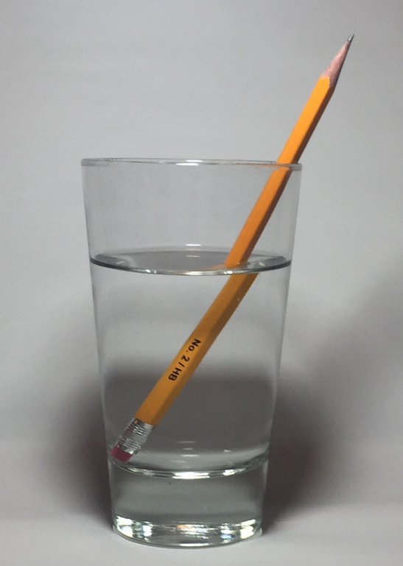
Baaritaanka leexinta iftiinka (refraction)
Marka iftiinka (light) la gudbiyo (transmitted) iyada oo loo marayo walxaha cad (transparent), tani waxay mararka qaarkood sababi kartaa khiyaano (illusions).
Balac (block) cad (transparent) ayaa ka dhigi kara dhexda faraha qofka inay u muuqato dhinac kale.
Qaybta hoose ee qalin (pencil) oo ku jirta biyo (water) waxay u muuqan kartaa mid ka go'an qaybta sare (hawada (air) ku taal).

Slide 8
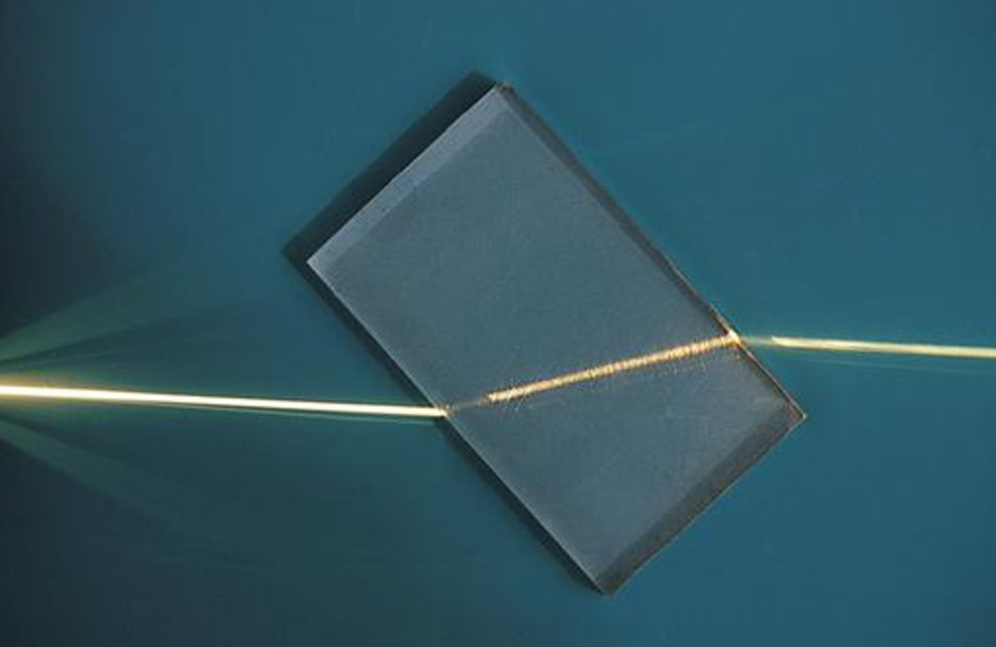
Baaritaanka leexinta iftiinka (refraction)
Khiyaanadahan (illusions) waxay dhacaan sababtoo ah iftiinka (light) wuxuu bedeli karaa jihada (direction) marka loo gudbiyo (transmitted) dhexdhexaad (medium) cusub (walax (material)).
galaas (glass)
hawada (air)
hawada (air)
Tan waxaa loo yaqaan leexinta iftiinka (refraction).
Iftiinka (light) wuxuu bedeli jihada (direction) (leexdo (refracts)) oo kaliya xudduudda (boundary) u dhaxaysa labada dhexdhexaad (media).
Marka dhexdhexaadka (medium) aanu isbeddelin, iftiinka (light) wuxuu ku safraa xariiq toosan (straight lines).

Slide 9


Baaritaanka leexinta iftiinka (refraction)
Jaantus (diagram) kee baa si sax ah u muujinaya sida iftiin (beam of light) uga gudbo hawada (air), galo oo ka soo baxo balac (block) galaas (glass) ah?
a
b
c
d
e
f

Slide 10
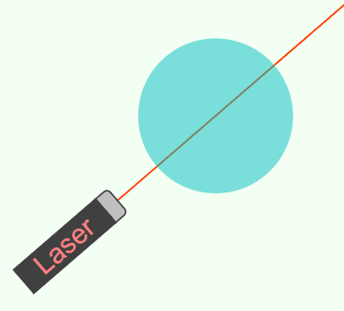
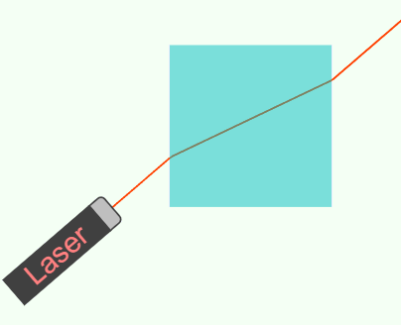
Baaritaanka leexinta iftiinka (refraction)
Waxaa jiri kara gudbin (transmission) aan leexin (refraction) lahayn.
Leexinta iftiinka (refraction) waa isbeddelka jihada (direction).
Gudbin (transmission) aan leexin (refraction) lahayn.
Gudbin (transmission) leh leexin (refraction).
Jilaha Tijaabada Indhaha (Optical Experiment Simulator), https://javalab.org/en/optics_en/

Slide 11
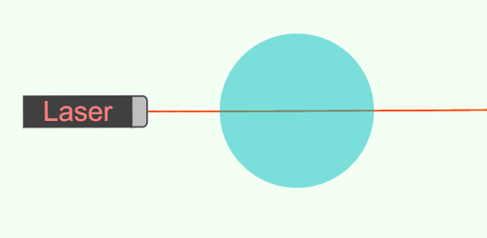
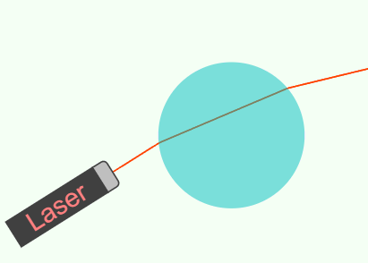
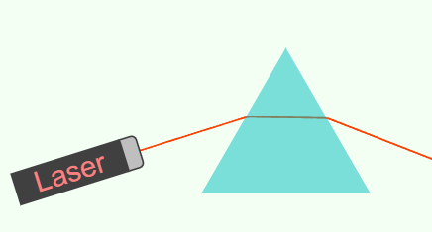
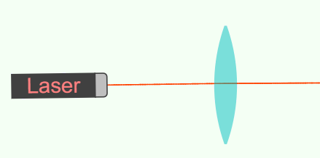
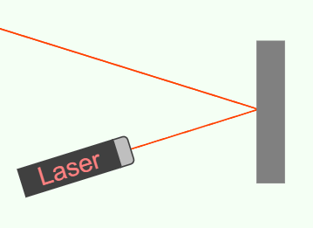
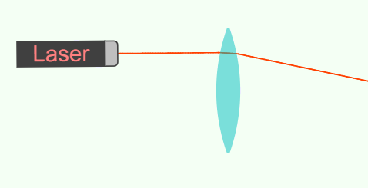
Baaritaanka leexinta iftiinka (refraction)
Kee ka mid ah jaantusyada soo socda ayaa muujinaya refraction (refraction)?
a
b
c
d
e
f
Simulator-ka Tijaabada (Experiment) Indhaha, https://javalab.org/en/optics_en/

Slide 12
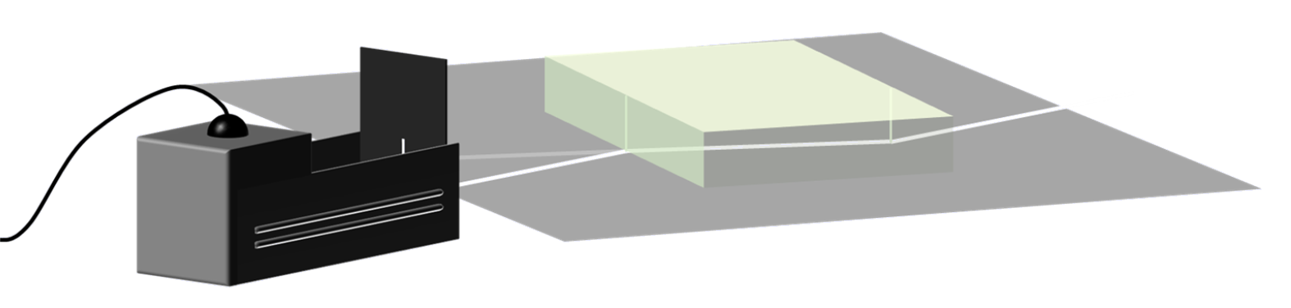
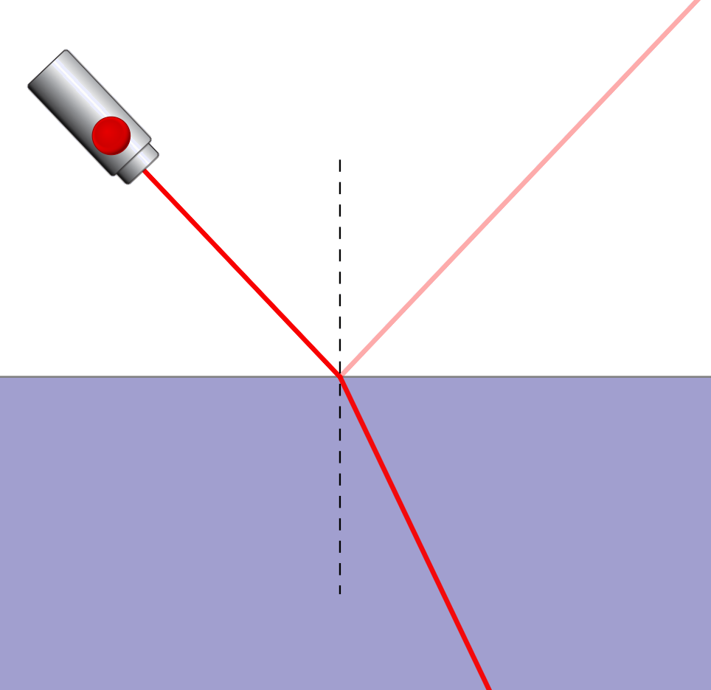
Baarista refraction (refraction)
Waxaad baari doontaa refraction (refraction) gudaha block (block) leydi ah oo hufan.
Waxaad samayn doontaa iftiin (light) cidhiidhi ah iyadoo la isticmaalayo sanduuqa raajo (ray box) oo leh dalool (slit) kaliya.
Digniin: kuwani waxay noqon karaan kuwo kulul!
Qaar ka mid ah iftiinka (light) ku dhaca block-ga (block) ayaa laga yaabaa inuu ka soo boodo (reflected).
Tan waa la iska indhatiri karaa daras (darsiga) kan oo aan diirada saareyno refraction (refraction).
Jilitaanka (Simulation) waxaa sameeyay PhET Interactive Simulations, Jaamacadda Colorado Boulder, oo shatiyeysan CC–BY–4.0 (https://phet.colorado.edu).

Slide 13
Baarista refraction (refraction)
Waxaad 'raadraaci' doontaa dariiqyada ay qaadaan 4 iftiin (light) oo kala duwan iyagoo dhex maraya block (block) hufan.
Bilow adoo sawiraya 'xariiqda saldhiga' (baseline) dhexda warqad iyadoo la isticmaalayo xisaab (ruler).
caadiga (normal)
xariiqda saldhiga (baseline)
Kadib sawir xariiq dhex mara xariiqda saldhiga (baseline), 90°. Tan waxaa loo yaqaan xariiqda caadiga ah (normal line). (Isticmaal geeska block-ga (block) si aad u hesho 90°.)
Kadib sawir saddex xariiq oo xaglo kala duwan ku leh xariiqda caadiga ah (normal) oo ku dhaca xariiqda saldhiga (baseline) meel isku mid ah. (Waxaad la safi doontaa iftiinka (light) mid kasta oo ka mid ah kuwan iyo xariiqda caadiga ah (normal)).

Slide 14
Baarista refraction (refraction)
Dhig block-ga (block) leydiga ah ee hufan iyadoo cidhifkiisa sare uu ku beegan yahay xariiqda saldhiga (baseline).
Ku sawir hareerihiisa oo iska jir inaad dhaqaajiso ama garaacdo laga bilaabo hadda.
?
Markaa, iftiin (light) kasta waxaa lala safin karaa xariiqda caadiga ah (normal) iyo saddexda xariiq ee kale.
Waxaad raadraaci doontaa dariiqda uu qaado iftiin (light) kasta iyadoo uu dhex marayo block-ga (block).

Slide 15
Baarista refraction (refraction)
Ku calaamee xarunta (centre) kasta oo ka mid ah fallaadhaha (rays) ka baxaya block-ka laba meelood, adigoo isticmaalaya qalin fiiqan.
Marka dhammaan 4-ka fallaadho (rays) la calaameeyay:
qaad block-ka iyo sanduuqa fallaadhaha (ray box)
Sida loo sameeyo tan mid ka mid ah laythyada (beams):
isticmaal xisaabiyaha (ruler) si aad ugu xidho lammaane kasta oo iskutallaab ah (crosses) cidhifka block-ka
isticmaal xisaabiyaha (ruler) si aad u raad raacdo waddada fallaadhaha (ray) markii uu block-ka ku jiray.
Muujinta fallaadho (ray) kasta oo dhammaystiran midab kala duwan ayaa ka dhigi kara mid cad.

Slide 16
Baaritaanka jajabinta (refraction)
Dhig tillaabooyinka baaritaanka (investigation) sida saxda ah.
b
a
d
c
Ifi laydh (beam of light) ah oo dhex mara xariiqda caadiga ah (normal) oo calaamee fallaadhaha (ray) ka baxaya block-ka 2 meelood.
a
Sawir xariiqda saldhiga (baseline), xariiqda caadiga ah (normal) iyo 3-ka xariiq ee kale ee laydhka (incident beam). Dhig block-ka meeshiisa oo sawir hareerihiisa.
b
c
Ku xidh lammaane kasta oo iskutallaab ah (crosses) block-ka oo dhammaystir fallaadho (ray) kasta.
d
Ku celi tillaabada hore laakiin laydhka (beam) la jaanqaadiyo mid kasta oo ka mid ah 3-ka xariiq ee kale ee laydhka (incident beam), si isku xigta.

Slide 17
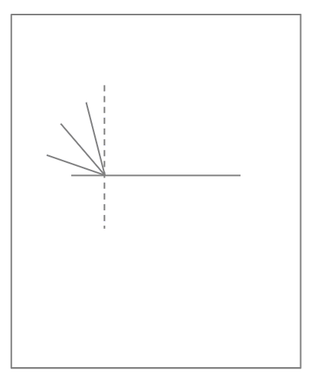
Baaritaanka jajabinta (refraction)
Soo qaad block-ka leydi ah oo hufan (rectangular transparent block) iyo sanduuqa fallaadhaha (ray box) oo leh dalool (slit) (iyo koronto bixiye (power supply) haddii loo baahdo).
Warqad ku sawir adigoo isticmaalaya xisaabiyaha (ruler) xariiqda saldhiga (baseline), xariiqda caadiga ah (normal) iyo 3-ka xariiq ee kale ee laydhka (incident beam). (Isticmaal geeska block-ka si aad u hesho 90°.)
Dhig block-ka warqadda sida ku cad sawirka, iyadoo cidhifka dheer ee sare uu taabbanayo xariiqda saldhiga (baseline). Sawir hareerihiisa.

Slide 18
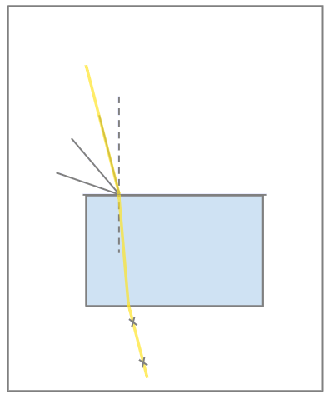
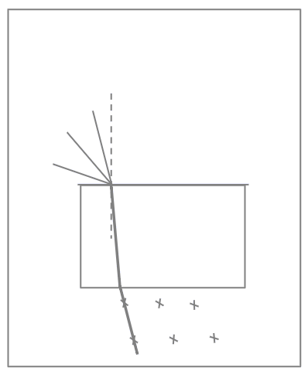
Baaritaanka jajabinta (refraction)
Ifi laydh cidhiidhi ah (narrow beam of light) oo dhex mara xariiqda caadiga ah (normal) ka dibna mid kasta oo ka mid ah xariiqyada laydhka (incident beam), si isku xigta. Mid kasta, calaamee fallaadhaha (ray) ka baxaya block-ka 2 meelood.
Qaad block-ka iyo sanduuqa fallaadhaha (ray box).
Isticmaal xisaabiyaha (ruler) si aad ugu xidho lammaane kasta oo iskutallaab ah (crosses) cidhifka block-ka.
Kadib isticmaal xisaabiyaha (ruler) si aad u raad raacdo waddada fallaadho (ray) kasta markii uu block-ka ku jiray.
Midab kala duwan ku calaamadee ray kasta oo dhammaystiran.

Slide 19
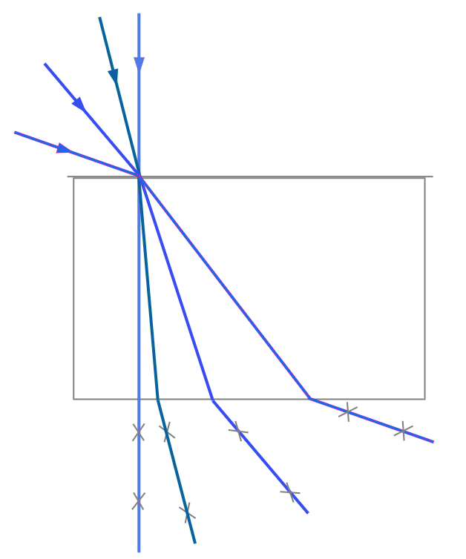
Baaritaanka jajabinta (refraction)
Jaantus dhammaystiran oo tusaale ah:
(iyadoo la raad-raacay beam kasta midab kala duwan, si caddayn loogu helo)

Slide 20
Jajabinta iftiinka (Refracting light)
Baaritaanka jajabinta (refraction)
Gunaanad (Conclusions)
Wahyaal khiyaameeya (Refraction illusions)

Slide 21
Gunaanad (Conclusions)
Gunaanad (Conclusion) wuxuu sheegayaa waxa aad ku ogaatay tijaabo (experiment), iyo sida aad u ogaatay.
Gunaanad (Conclusion)
Waxaan ogaaday in …

Slide 22
Gunaanad (Conclusions)
Beam kee baa aan la jajabin (refracted)?
c
d
b
d
a
Beam kee baa ugu jajabinta badan (refracted)?
a

Slide 23
Gunaanad (Conclusions)
Iftiinka ku dhaca dusha shay cad (transparent) ee ku beegan xariiqda toosan (normal) (‘si toos ah’) lama jajabiyo (refracted).
Marka xagasha beam uu la leeyahay xariiqda toosan (normal) ay weyn tahay, waxaa uu aad u jajabmaa (refracted) (isbeddelka xagasha ayaa weyn).

Slide 24
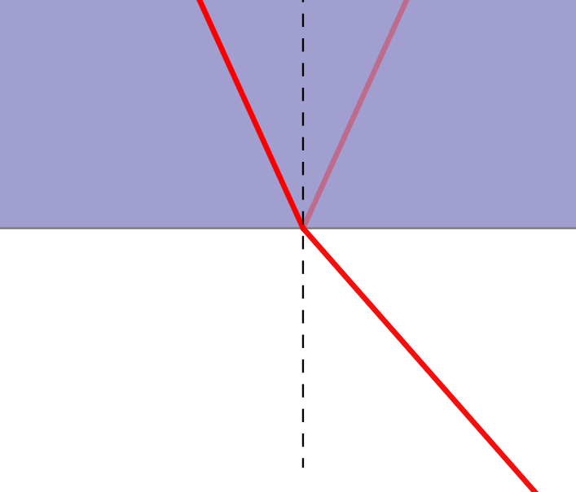
Gunaanad (Conclusions)
Gelista shay cad (transparent) oo ka imanaya hawada:
Ka bixista shayga cad (transparent) ee dib ugu noqoshada hawada:
Ray (ray) waa la qalloociyaa ‘gudaha’ xagga xariiqda toosan (normal).
Raajo (Ray) ayaa loo qalloociyay 'banaanka' (away) ka soo horjeeda caadiga (normal), qaddar isku mid ah.
Jilitaan (Simulation) by PhET Interactive Simulations, University of Colorado Boulder, shatiga CC–BY–4.0 (https://phet.colorado.edu).

Slide 25
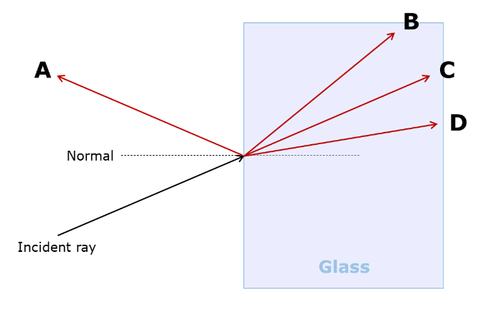
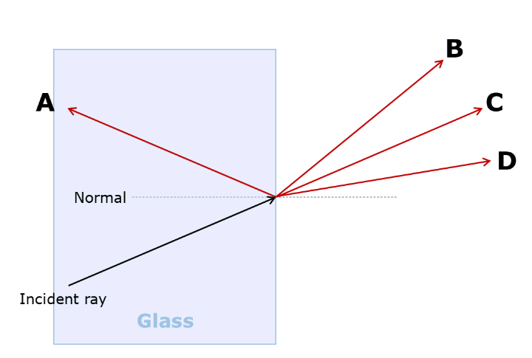
Gunaanad (Conclusions)
Xulasho (option) kee baa muujinaya dariiqa saxda ah ee raajada (refracted ray) ee jaantus (diagram) kasta?
1)
2)
caadi (normal)
caadi (normal)
raajo soo gasha (incident ray)
raajo soo gasha (incident ray)

Slide 26
Gunaanad (Conclusions)
Raajo (Ray) soo gasha oo ka baxda baloog (block) dhinacyo isbarbar socda (parallel sides) leh, waxay ku dhamaataa inay ku soo noqoto jihadeedii hore, laakiin waxay u wareegaysaa dhinaca.
Labadan raajo (ray) waa isbarbar socdaan (parallel).
Raajada (ray) waxaa loo qalloociyay 'gudaha' (in) (xagga caadiga (normal)) markay soo gasho balooga (block). Markay ka baxdo balooga, waxaa loo qalloociyay 'banaanka' (out) (ka fog caadiga) qaddar isku mid ah.
dhinacyo isbarbar socda (parallel sides)
Jilitaan Tijaabo Indhaha (Optical Experiment Simulator), https://javalab.org/en/optics_en/

Slide 27
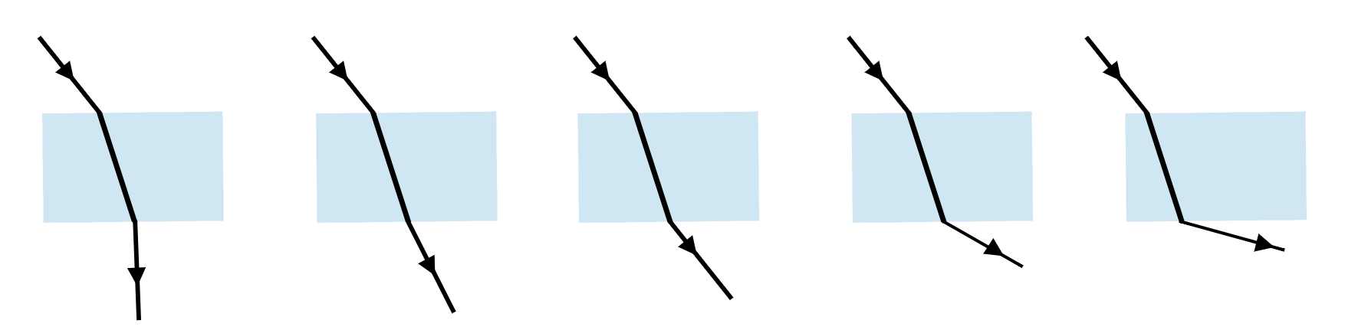
Gunaanad (Conclusions)
Jaantus (diagram) kee baa muujinaya raajada (ray) si sax ah u qalloocaysa (refracting) iyada oo dhex maraysa baloog (block) daahsoon (transparent)?
a
b
c
d
e

Slide 28
Gunaanad (Conclusions)
Sawir (Draw) dariiqa (path) ee raajo (ray) kasta oo iftiin (light) ah uu u maro gudaha iyo dibadda baloog (block) kasta oo dhalo (glass) ah oo leydi (rectangular) ah.
Ku dar caadi (normal) mar kasta oo raajadu (ray) qalloocdo (refracts).
(Qaddarka qallooca (refraction) uma baahna inuu sax ahaado, laakiin waa inuu ahaadaa jihada saxda ah.)

Slide 29
Gunaanad (Conclusions)
Sawir dariiqa ay qaaddo iftiin kasta (ray) markay gasho oo ay ka baxdo baloog kasta oo muraayad ah oo leydi ah.
Ku dar xariiq toosan (normal) mar kasta oo iftiinku (ray) leexdo (refract).
(Qaddarka qallooca (refraction) uma baahna inuu sax ahaado, laakiin waa inuu ahaadaa jihada saxda ah.)

Slide 30
Leexinta iftiinka (Refracting light)
Baaritaanka leexinta iftiinka (refraction)
Gunaanad (Conclusions)
Wahyaal khiyaano ah oo leexinta iftiinka (refraction) keento

Slide 31
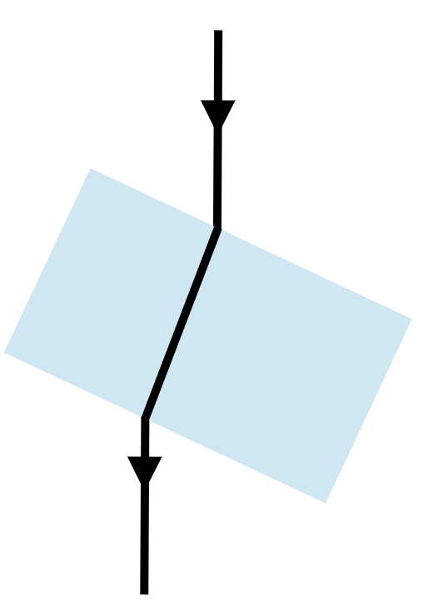
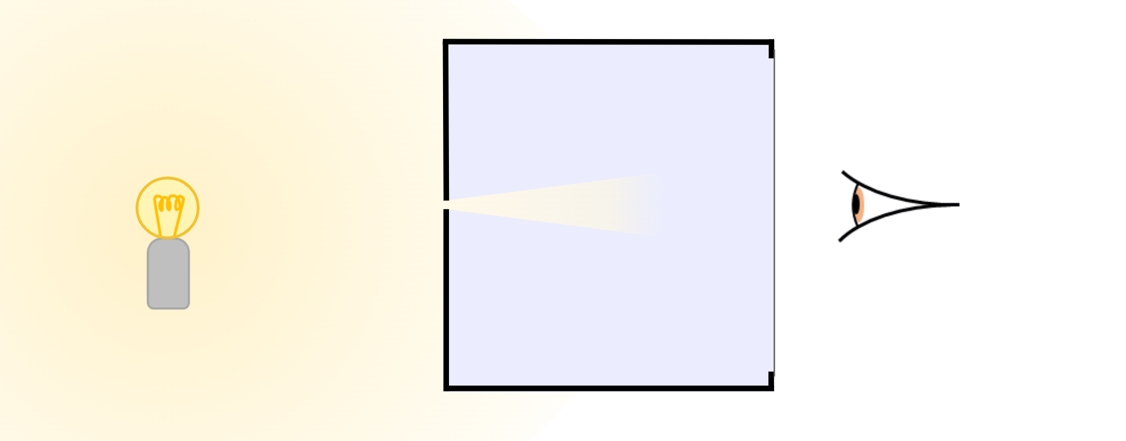
Wahyaal khiyaano ah oo leexinta iftiinka (refraction) keento
Khiyaamadan waxay dhacdaa sababtoo ah iftiin (ray) gala oo ka baxa baloog dhinacyo isbarbar yaal ah, wuxuu ku dhammaadaa isagoo ku noqonaya jihadiisii asalka ahayd, laakiin wuxuu u wareegaa dhinac.
Ishaadu markaa 'dib u raadshaa' halka iftiinku u muuqdo inuu ka yimid. Halkaas waxaad ku aragtaa sawirka farta la wareejiyay.
sawir (image)
far (finger)
fallaadh khiyaano ah (virtual ray)
Jaantusyada, 'fallaadho khiyaano ah' (virtual rays) oo dhibic ah ayaa loo sawiraa si loo muujiyo halka iftiinku u muuqdo (laakiin aan dhab ahaan ka iman).

Slide 32
Wahyaal khiyaano ah oo leexinta iftiinka (refraction) keento
Maxay khiyaamadani u dhacdaa?
Iftiinku (light) wuxuu beddelaa jihadiisa markuu dhex maro muraayadda (glass).
a
b
Iftiinku (light) wuxuu beddelaa jihadiisa markuu gala oo ka baxo muraayadda (glass).
c
Muraayaddu (glass) waxay qayb ka mid ah sawirka u wareejisaa dhinac.
d
Muraayaddu (glass) waxay qalloocisaa sawirka.

Slide 33
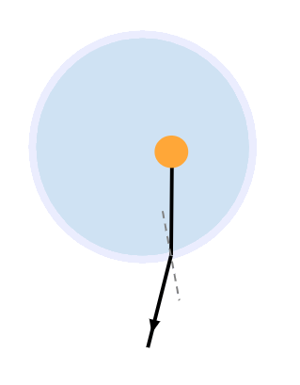
Wahyaal khiyaano ah oo leexinta iftiinka (refraction) keento
Khiyaamadu waa sawir khiyaano ah (virtual image) sababtoo ah waxay u muuqataa meel ay iftiin (rays) u muuqdaan inay ka yimaadeen, ma aha meesha ay dhab ahaan ka yimaadeen.
qalin (pencil) (biyo (water) gudihiisa)
Qalin–biyo (water)–ku-jir waa khiyaamo (illusion) oo shaqeysa si la mid ah.
sawir (image) dhammaystir (virtual) (waxa aad aragto)
raajo (ray) dhammaystir (virtual)

Slide 34
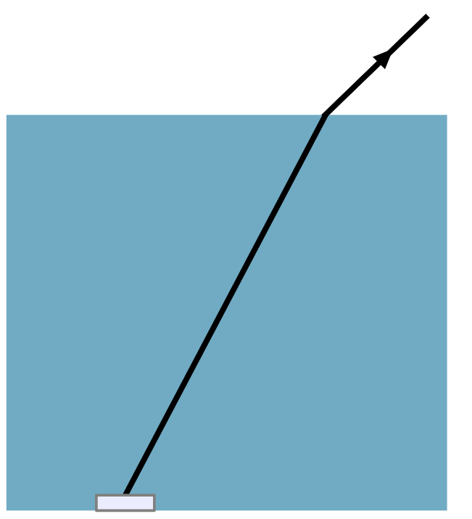
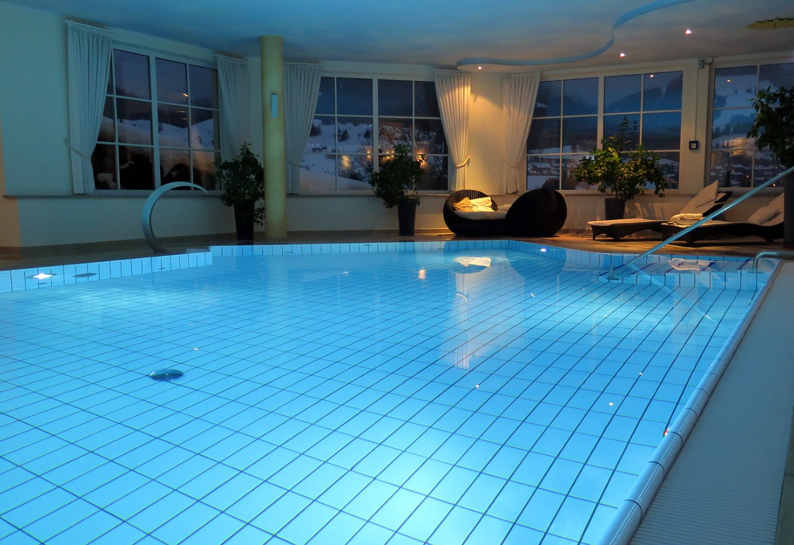
Khiyaamooyin (illusions) leexin (refraction)
Biyaha (water) iyo walxaha biyaha (water) hoostooda waxay inta badan u muuqdaan kuwo gacmo-gashan (shallower) marka loo eego sida dhabta ah.
Taas waa sababta iftiinka (light) ka muuqda walxaha biyaha (water) hoostooda uu u leexdo (refract) marka uu ka gudbo biyaha (water) hawada.
Sawir (image) dhammaystir (virtual) oo shayga (object) ah ayaa la arkaa halka iftiinka (light) uu uga yimid.
Sawirka (image) wuxuu had iyo jeer u muuqdaa qoto-dheer (depth) gacmo-gashan (shallower) halka uu shayga (object) dhab ahaan ku yaallo.

Slide 35

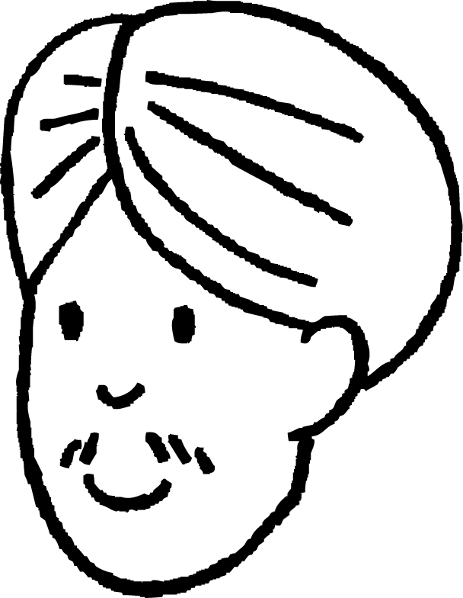

Khiyaamooyin (illusions) leexin (refraction)
Cali wuxuu taagan yahay balli (pond) agtiisa. Waxaa jira kalluun (fish) biyaha (water) hoostooda oo u dhow Cali.
Xaggee buu kalluunku (fish) u muuqdaa?
Cali
a
b
c
d

Slide 36
Khiyaamooyin (illusions) leexin (refraction)
Marka raajooyinka (rays) iftiinka (light) ay ka baxaan biyaha (water) oo ay galaan hawada, waxay u leexdaan (refract) __________ ka fog (away from) caadiga (normal).
Cali wuxuu arkaa sawir (image) _________ oo kalluunka (fish) ah halka raajooyinka (rays) iftiinka (light) ay uga yimaadeen.
Cali
sawir (image)
kalluun (fish)
Jawaabaha:
ka fog (away from)
dhammaystir (virtual)

Slide 37
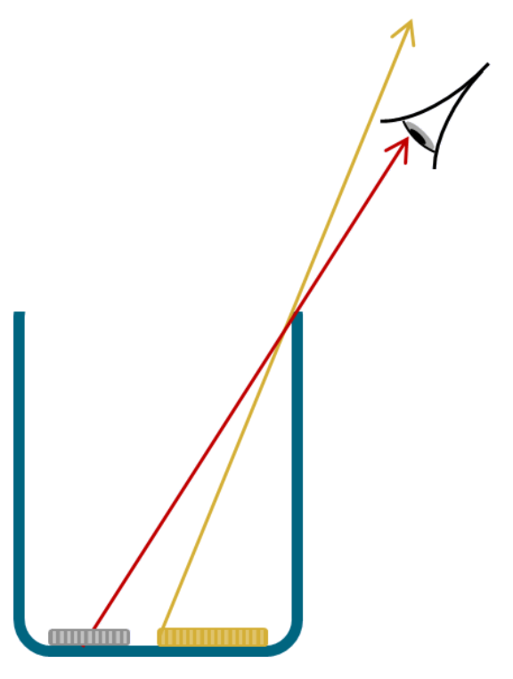
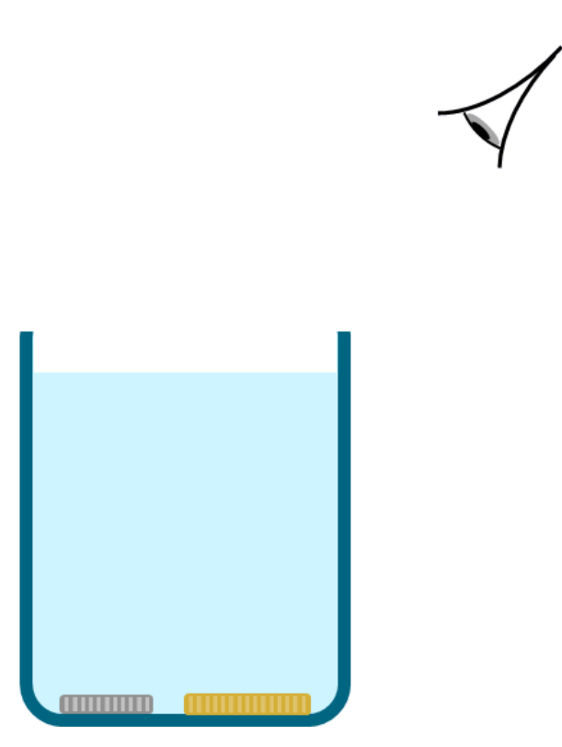
Khiyaamooyin (illusions) leexin (refraction)
Dhig laba qadaadiic (coins) gunte (bottom) koob (mug) ah.
Hagaaji aragtidaada si aad u aragto hal qadaadiic oo keliya. Ha ka dhaqaaqin aragtidan.
aragti (viewpoint)
Qof kale ayaa si taxadir leh u buuxin doona koobka biyo (water), isagoo hubinaya in qadaadiicdu aysan dhaqaaqin inta lagu jiro.
Saadaali waxa aad u malaynaysid inaad arki doonto marka koobka laga buuxiyo biyo (water).
?
aragti (viewpoint)
Sharax sababta aad u malaynaysid inaad arki doonto tan.
Ka daawado aragtida marka koobka la buuxinayo.
Ma sax ahayd saadaalintaada iyo sharaxaadkaaga? Qor sharaxaad ka fiican oo ku saabsan waxa aad aragtay.

Slide 38
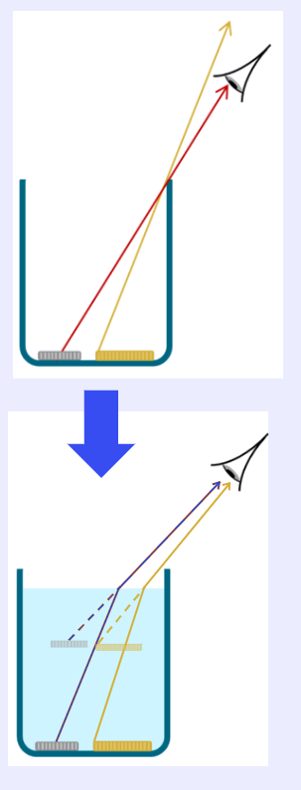
Waxyaabaha khiyaanada ah ee jajabinta (Refraction illusions)
Jawaabo tusaale.
Saadaalin:
Markii biyaha la shubayay, cidhifka qadaadiicda labaad ayaa si tartiib ah u muuqday. Qadaadiicda koowaad ayaa sii muuqatay. Waxay u muuqatay inay si yar u dhaqaaqday meesha aan ka eegay.
Sharaxaad:
Marka koobku uu ka buuxo biyo (water), iftiinka ka soo baxa qadaadiicda ayaa jajabay (ka fogaanaya caadiga) marka ay ka soo baxaan biyaha oo ay galaan hawada. Iftiinka qadaadiicda labaad ayaa hadda geli kara indhahayaga, sidaa darteed waan arki karaa. Waxa aan dhab ahaan arkayay waa sawir dhammaystiran (virtual image) oo qadaadiicda labaad, oo ku yaal meesha ay iftiinka qadaadiicdaas uga soo baxayaan.

Slide 39
Iftiinka jajabinta (Refracting light)
Iftiinku wuxuu beddelaa jihada marka loo gudbiyo dhexdhexaad (medium) cusub (maaddo) xagal ka ah caadiga. Tan waxaa loo yaqaan jajabinta (refraction).
Marka iftiinku uu ka soo galo hawada oo uu galo maaddo hufan, wuxuu u leexdaa xagga caadiga.
Marka iftiinku uu ka baxo maaddo hufan oo uu dib ugu soo laabto hawada, wuxuu ka leexdaa caadiga.
Ray ka soo galaya oo ka baxaya baloog hufan oo dhinacyo isbarbar yaal ah, wuxuu ku dhamaadaa isagoo ku soconaya jihada asalka ah laakiin u wareegay dhinaca.
Jajabintu waxay sababi kartaa in sawirada dhammaystiran (virtual images) ee walxaha ay u muuqdaan inay ka yimaadaan meel ay iftiinku uga soo baxayo, tusaale ahaan biyaha oo u muuqda kuwo ka gacanyar (shallower) inta ay dhab ahaan yihiin.

