Slide 1
Matixita taxanaha joomatari (geometric sequences) garaaf ahaan
Xiriirrada aan tooska ahayn (non-linear relationships)

Slide 2
Sida loo isticmaalo darasyada Oak

Slide 3
Waxaan matixi karaa taxanaha joomatari (geometric sequences) garaaf ahaan waxaanan qiimeeyaa qaab-dhismeedka guud.

Slide 4
Taxane joomatari (geometric sequence) waa taxane leh xiriir isku dhufasho joogto ah oo u dhexeeya xubnaha isku xiga.
Saami guud (common ratio) waa sifo muhiim u ah taxanaha joomatari. Isku-dhufashada joogtada ah ee u dhexeeya xubnaha isku xiga waxaa loo yaqaan saamiga guud (common ratio).

Slide 5

Matixita taxanaha joomatari (geometric sequences) garaaf ahaan
Garaaf u sameynta saami guud (common ratio) ka weyn 1
Garaaf u sameynta saami guud (common ratio) ka yar 1

Slide 6
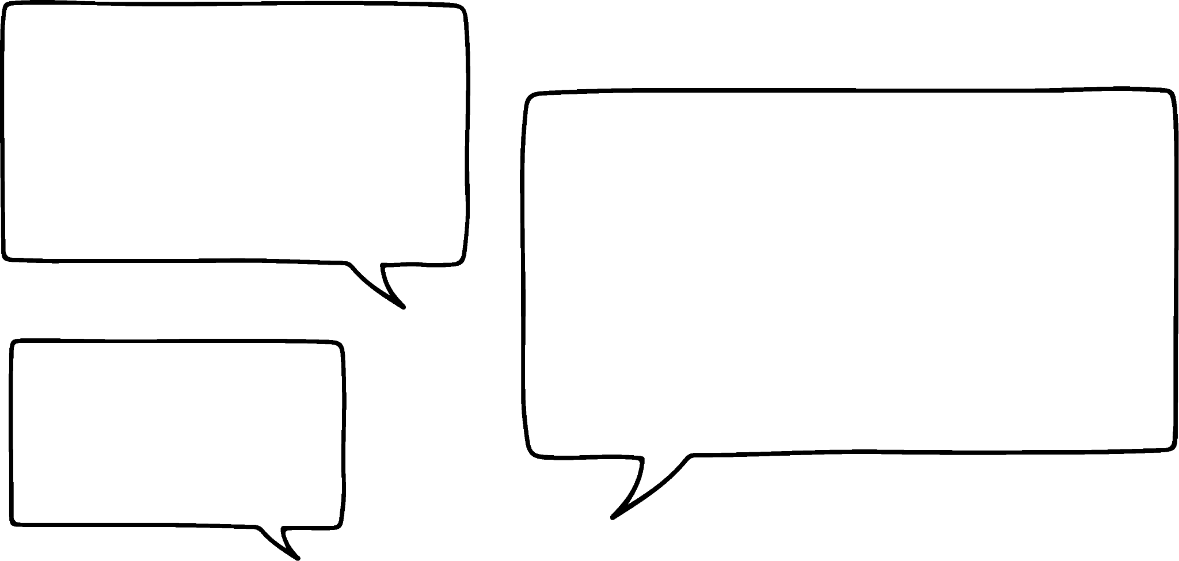

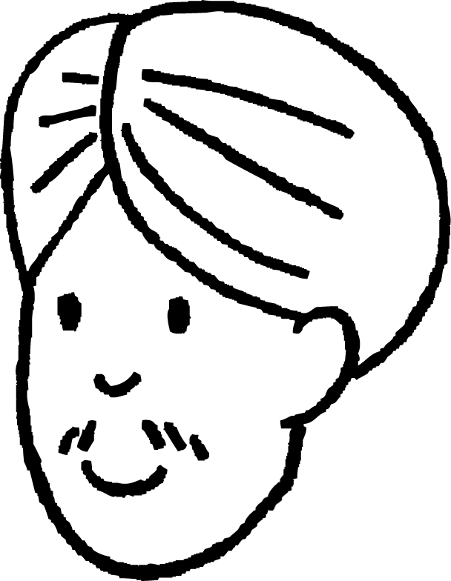
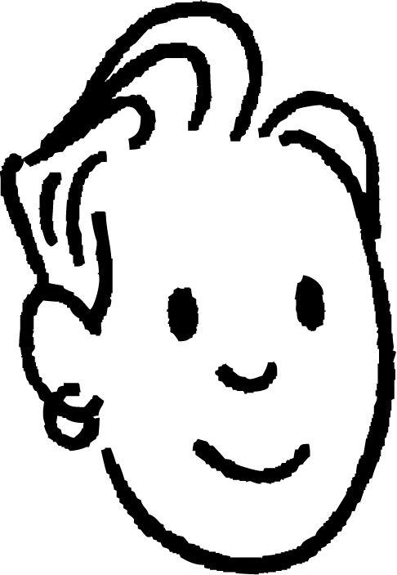
Garaaf u sameynta saami guud (common ratio) ka weyn 1
Cali iyo Saciid waxay samaynayaan moodello taxane ah.
Taxanahaygu waa xisaabeed (arithmetic). Wuxuu ka bilaabmaa 1 wuxuuna leeyahay xeer xubnaha isku xiga oo ah +2
Taxanahaygu waa joomatari (geometric). Wuxuu ka bilaabmaa 1 wuxuuna leeyahay xeer xubnaha isku xiga oo ah ×2

Slide 7
Garaaf u sameynta saami guud (common ratio) ka weyn 1
Cali iyo Saciid waxay samaynayaan moodello taxane ah.
Taxanahaygu waa xisaabeed (arithmetic). Wuxuu ka bilaabmaa 1 wuxuuna leeyahay xeer xubnaha isku xiga oo ah +2
Waxaan arki karaa sababta loogu yeero taxanayaal toosan (linear sequences). Wuxuu ku kordhayaa xariiq toosan.

Slide 8
Garaaf u sameynta saami guud (common ratio) ka weyn 1
Cali iyo Saciid waxay samaynayaan moodello taxane ah.
Cali iyo Saciid waxay samaynayaan moodello taxane ah.
Taxanahaygu waa xisaabeed (arithmetic). Wuxuu ka bilaabmaa 1 wuxuuna leeyahay xeer xubnaha isku xiga oo ah +2
Waxaan arki karaa sababta loogu yeero taxanayaal toosan (linear sequences). Wuxuu ku kordhayaa xariiq toosan.
Aynu qorsheeyno isku-xiggeyga (sequence) aniga

Slide 9
Garaafyada (Graphing) saamiga guud (common ratio) oo ka weyn 1
Cali iyo Saciid waxay samaynayaan moodello (models) isku-xiggeyada (sequences).
Isku-xiggeygan joomatari (geometric sequence) wuxuu leeyahay kordhin sii kordheysa, sidaas darteed wuxuu sameeyaa qalooc (curve).
Laba jibbaar 8
Ku dar 2
Ku dar 2
Laba jibbaar 4
Kordhin toosan (Linear increase)
Ku dar 2
Laba jibbaar 2
Ku dar 2
Laba jibbaar 1

Slide 10
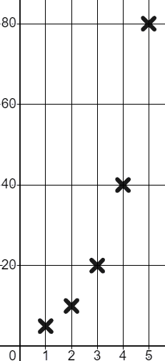
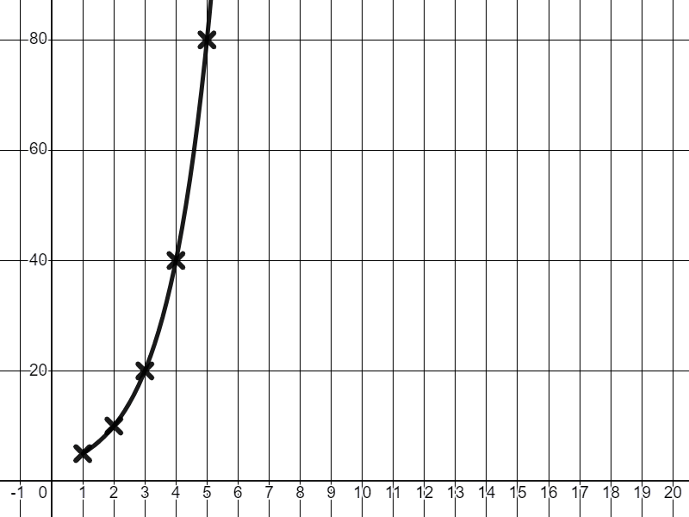
Garaafyada (Graphing) saamiga guud (common ratio) oo ka weyn 1
Waxaanu ku aragnaa qaabka qalooca (curved shape) isku mid ah marka aanu garaafyeyno (graph) isku-xiggeyada (sequences) kale ee joomatari (geometric).
T
Nambarka ereyga (Term number (n)) | 1 | 2 | 3 | 4 | 5
Qiimaha ereyga (Term value (T)) | 5 | 10 | 20 | 40 | 80
Nambarka ereyga (Term number (n)) | 1 | 2 | 3 | 4 | 5
Qiimaha ereyga (Term value (T)) | 5
×2
×2
×2
×2
Xariiq (line) dhex maraya dhibcahan (points) wuxuu naga caawinayaa inaan si cad u aragno qaabkan qalooca (curved shape) ee jiirada (gradient) sii kordheysa. Si kastaba ha ahaatee, sida caadiga ah ma sawirno xariiqda (line) marka aanu qorsheynayno isku-xiggeyada (sequences).
n

Slide 11
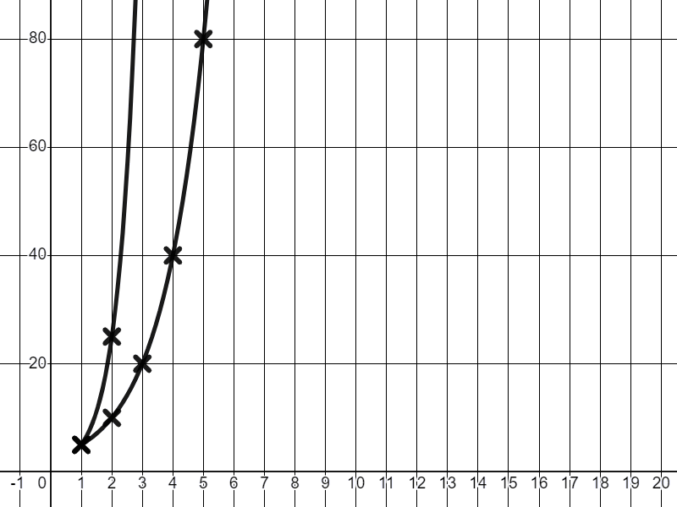
Garaafyada saamiga guud (common ratio) oo ka weyn 1
Kordhinta saamiga guud (common ratio) waxay kordhisaa xawaaraha isbeddelka (rate of change).
T
×5
Nambarka term-ka (n) | 1 | 2 | 3 | 4 | 5
Qiimaha term-ka (T) | 5 | 10 | 20 | 40 | 80
×2
×2
×2
×2
Nambarka ereyga (Term number (n)) | 1 | 2 | 3 | 4 | 5
Qiimaha ereyga (Term value (T)) | 5
×2
Nambarka term-ka (n) | 1 | 2 | 3 | 4 | 5
Qiimaha term-ka (T) | 5 | 25 | 125 | 625 | 3125
×5
×5
×5
×5
n

Slide 12
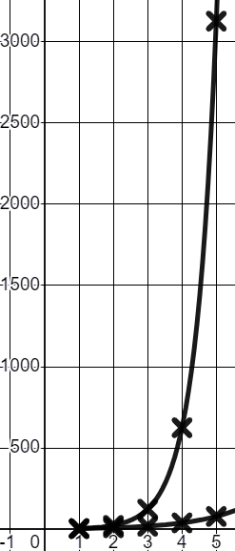
Garaafyada saamiga guud (common ratio) oo ka weyn 1
Sababtoo ah isbeddelka (rate of change) ee ×5 waa mid aad u degdeg badan, waxaan u baahanahay inaan hagaajinno miisaanka dhidibka (axis scale).
T
×5
Nambarka term-ka (n) | 1 | 2 | 3 | 4 | 5
Qiimaha term-ka (T) | 5 | 10 | 20 | 40 | 80
×2
×2
×2
×2
Nambarka term-ka (n) | 1 | 2 | 3 | 4 | 5
Qiimaha term-ka (T) | 5
Nambarka term-ka (n) | 1 | 2 | 3 | 4 | 5
Qiimaha term-ka (T) | 5 | 25 | 125 | 625 | 3125
×2
×5
×5
×5
×5
n

Slide 13
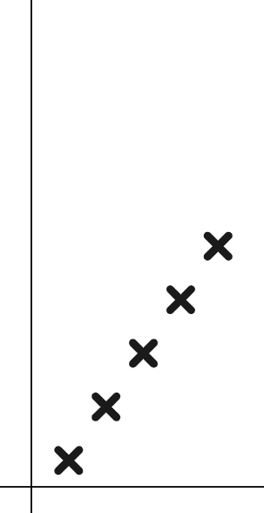
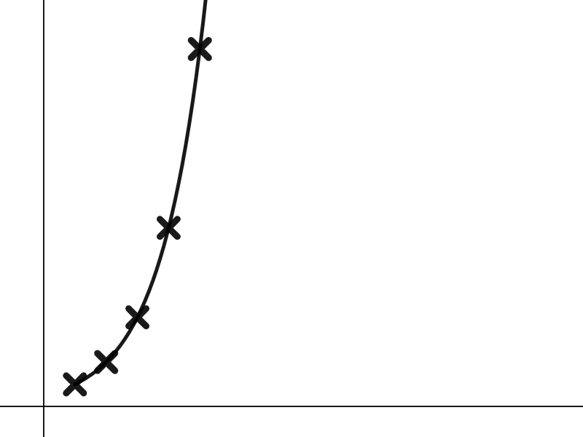
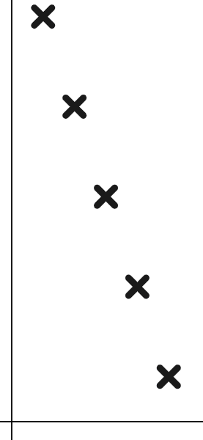
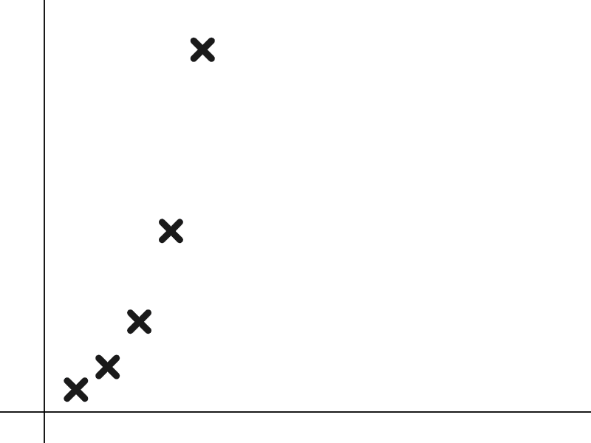


Garaafyada saamiga guud (common ratio) oo ka weyn 1
Kee ka mid ah garaafyadan ayaa muujin kara isku xigxig joomatari (geometric sequence)?
Miisaanka T iyo n waxay kordhaan qaddar isku mid ah.
T
T
T
Isku xigxig xisaabeed (arithmetic/linear sequence)
Isku xigxig xisaabeed (arithmetic/linear sequence)
Isku xigxig joomatari (geometric sequence)
n
n
n

Slide 14
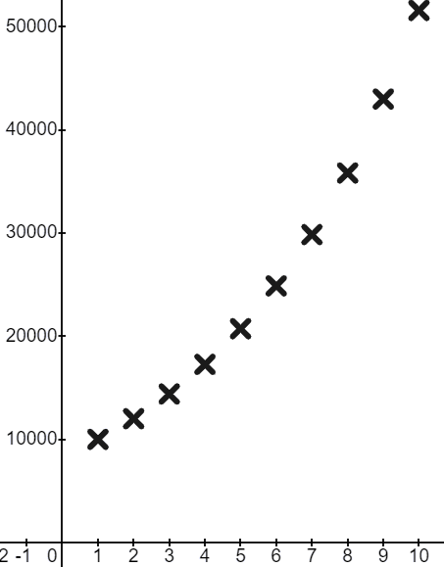
Garaafyada saamiga guud (common ratio) oo ka weyn 1
Garaafkani waa tusaale fiican oo ku saabsan halka aad ku arki doonto xisaabtan adduunka dhabta ah.
£
Ganacsi ayaa maalgeliya £10 000 oo ah saamiyada (shares) shirkad Tamar Cagaaran. Qiimahoodu (value) wuxuu kordhaa 20% sanad walba.
t | 1 | 2 | 3 | 4 | 5 | …
£ | 10 000 | 12 000 | 14 400 | 17 280 | 20 736
t | 1 | 2 | 3 | 4 | 5 | …
£ | 10 000
×1.2
×1.2
×1.2
×1.2
t
Inta ay dheer tahay waqtiga ay maalgashiga (investment) ka tagaan, ayuu si dhakhso ah u koraa.

Slide 15

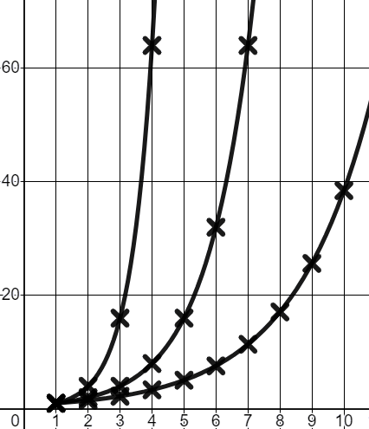
Garaafyada (Graphing) saamiga guud (common ratio) oo ka weyn 1
Halkan waxaa ah garaafyada (graphs) seddex isku-xigxig joomatari (geometric sequences) oo leh xariiqo (lines) la sawiray si loo muujiyo qaloocyadooda kor u kaca.
T
c
a
Isku-dhaf (Match) saamiyadan guud (common ratios) ee xariiqdooda (line) u dhigma.
b
a
Saamiga guud (Common ratio) ee 2
b
Saamiga guud (Common ratio) ee 1.5
c
Saamiga guud (Common ratio) ee 4
n

Slide 16
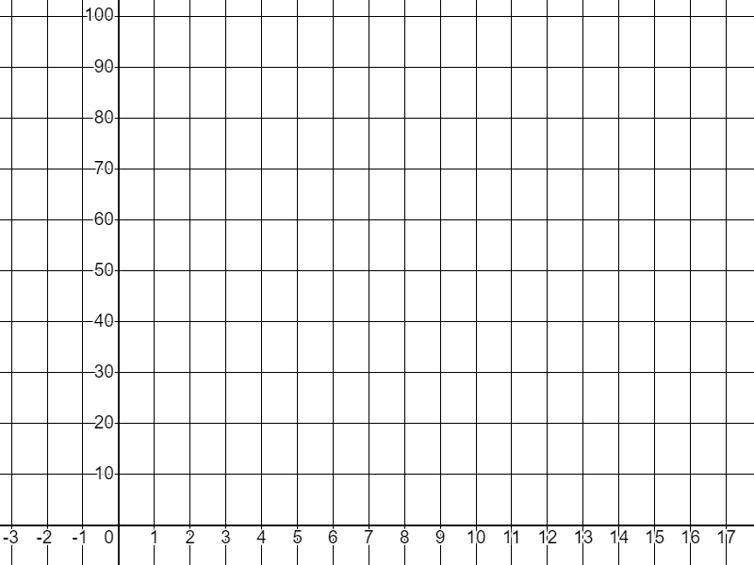
Garaafyada (Graphing) saamiga guud (common ratio) oo ka weyn 1
1) Buuxi shaxda (table) qiimaha (values) oo sawir isku-xigxiga joomatari (geometric sequence) ee ka bilaabma 1 oo leh saami guud (common ratio) ah 3
T
Nambarka xubinta (Term number) (n) | 1 | 2 | 3 | 4 | 5
Qiimaha xubinta (Term value) (T)
n

Slide 17
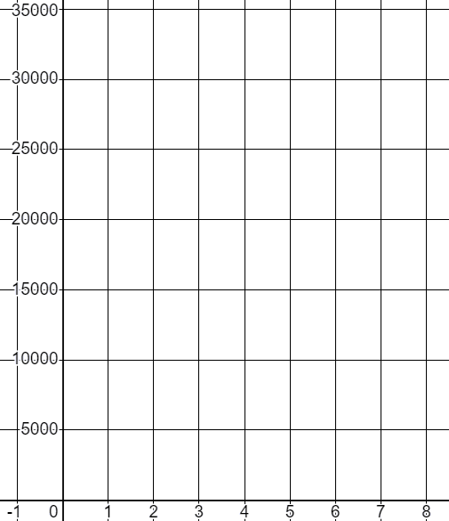
Garaafyada (Graphing) saamiga guud (common ratio) oo ka weyn 1
2) Waxaad maalgashataa £2000 shirkad tignoolajiyad cusub, saamiyadaagu (shares) waxay qiimahooda (value) kordhiyaan 50% sanad walba. Xisaab qiimahooda (value) 8ka sano ee ugu horreeya oo ku sawir garaafka (graph).
£
t | 1 | 2 | 3 | 4 | 5 | 6 | 7 | 8
£ | 2000
×1.5
Talo: Kordhinta 50% waa isku-dhufasho (multiplier) ah 1.5
t
Talo: Ku soo wareeji (Round) qiimahaaga (values) £1-ka ugu dhow oo ku sawir qiyaas ahaan (approximately).

Slide 18
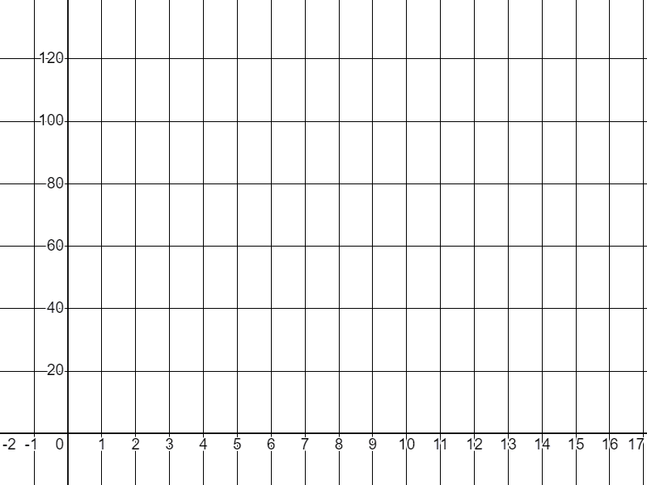
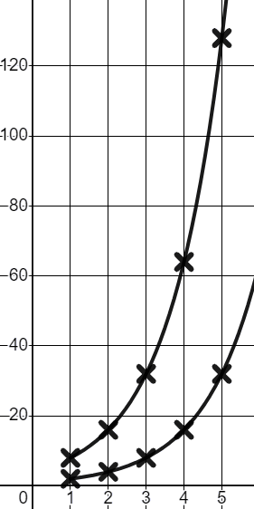
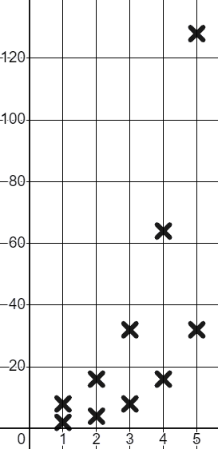
Garaafyada (Graphing) saamiga guud (common ratio) oo ka weyn 1
3) Saciid wuxuu ka fikirayaa qaabka (shape) garaafyada (graphs) isku-xigxiga joomatari (geometric sequences).
T
Ma garanayo in xubinta bilowga (starting term) ay saamayso qaabka (shape). Haddii aan isticmaalo isku saami guud (common ratio) 2 laakiin aan ka bilaabo laba nambar oo kala duwan, miyaan heli doonaa qaab (shape) kala duwan?
n | 1 | 2 | 3 | 4 | 5
T | 2
n | 1 | 2 | 3 | 4 | 5
T | 8
Isticmaalka saamiga guud (common ratio) 2 si loo dhammeeyo shaxda (tables), sawir labada garaaf (graphs), oo u qor gunaanad (conclusion) Saciid.
Ka digtoonow, waxaad kaliya oo qiyaas ahaan (approximately) sawiri kartaa dhibcaha (points).
n

Slide 19
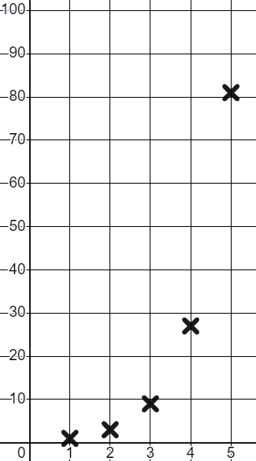
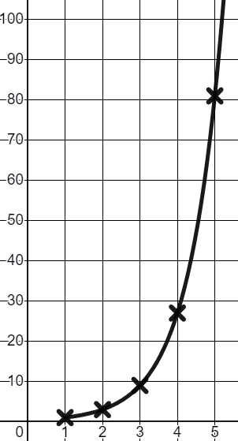
Sawirista saami guud (common ratio) ka weyn 1
1) Buuxi shaxda qiimaha (value) oo sawir taxanaha joomatari (geometric sequence) ee ka bilaabma 1 oo leh saami guud (common ratio) 3
T
Nambarka xubinta (Term number) (n) | 1 | 2 | 3 | 4 | 5
Qiime (value) (T) | 1 | 3 | 9 | 27 | 81
Nambarka term-ka (n) | 1 | 2 | 3 | 4 | 5
Qiime (value) (T)
×3
×3
×3
×3
Xariiq (line) wuxuu naga caawinayaa inaan aragno qalooca taxanaha joomatari (geometric sequence), laakiin ma sawirno.
n

Slide 20
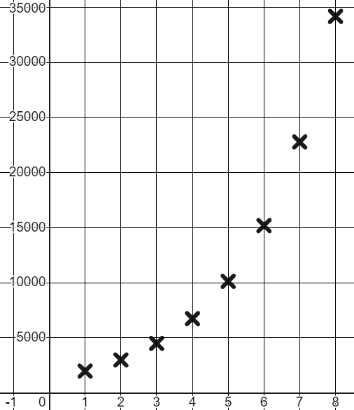
Sawirista saami guud (common ratio) ka weyn 1
2) Waxaad maal gashatay £2000 shirkad tignoolajiyadeed cusub, saamiyadaadu waxay ku kordhaan qiime (value) 50% sannadkii. Xisaabi qiimahooda 8 sano ee ugu horreeya oo ku sawir garaafka.
£
t | 1 | 2 | 3 | 4 | 5 | 6 | 7 | 8
£ | 2000
t | 1 | 2 | 3 | 4 | 5 | 6 | 7 | 8
£ | 2000 | 3000 | 4500 | 6750 | 10 125 | 15 188 | 22 781 | 34 172
×1.5
×1.5
×1.5
×1.5
×1.5
×1.5
×1.5
t
Dhibcuhu waxay sawiraan qaabka qalooca taxanaha joomatari (geometric sequence).

Slide 21
Sawirista saami guud (common ratio) ka weyn 1
3) Saciid wuxuu ka fikirayaa qaabka garaafyada taxanayaasha joomatari (geometric sequences).
T
Ma garanayo in term-ka bilowga uu saameeyo qaabka. Haddii aan isticmaalo saami guud (common ratio) isku mid ah 2 laakiin aan ku bilaabo laba lambar oo kala duwan, ma heli doonaa qaab kala duwan?
n | 1 | 2 | 3 | 4 | 5
T | 2 | 4 | 8 | 16 | 32
n | 1 | 2 | 3 | 4 | 5
T | 2
n | 1 | 2 | 3 | 4 | 5
T | 8 | 16 | 32 | 64 | 128
n | 1 | 2 | 3 | 4 | 5
T
×2
×2
×2
×2
×2
×2
×2
×2
Isticmaal saami guud (common ratio) si aad u buuxiso shaxanka, sawir labada garaaf, oo u qor gabagabo (conclusion) Saciid.
n

Slide 22
Sawirista saami guud (common ratio) ka weyn 1
3) Saciid wuxuu ka fikirayaa qaabka garaafyada taxanayaasha joomatari (geometric sequences).
T
Ma garanayo in term-ka bilowga uu saameeyo qaabka. Haddii aan isticmaalo saami guud (common ratio) isku mid ah 2 laakiin aan ku bilaabo laba lambar oo kala duwan, ma heli doonaa qaab kala duwan?
n | 1 | 2 | 3 | 4 | 5
T | 2 | 4 | 8 | 16 | 32
n | 1 | 2 | 3 | 4 | 5
T | 2
n | 1 | 2 | 3 | 4 | 5
T | 8 | 16 | 32 | 64 | 128
n | 1 | 2 | 3 | 4 | 5
T
×2
×2
×2
×2
×2
×2
×2
×2
Labada garaaf waxay leeyihiin qaab isku mid ah.
Qalooc kor u kacaya oo sii sii kordhaya.
n

Slide 23
Matixista taxanayaasha joomatari (geometric sequences) garaaf ahaan
Sawirista saami guud (common ratio) ka weyn 1
Sawirista saami guud (common ratio) ka yar 1

Slide 24

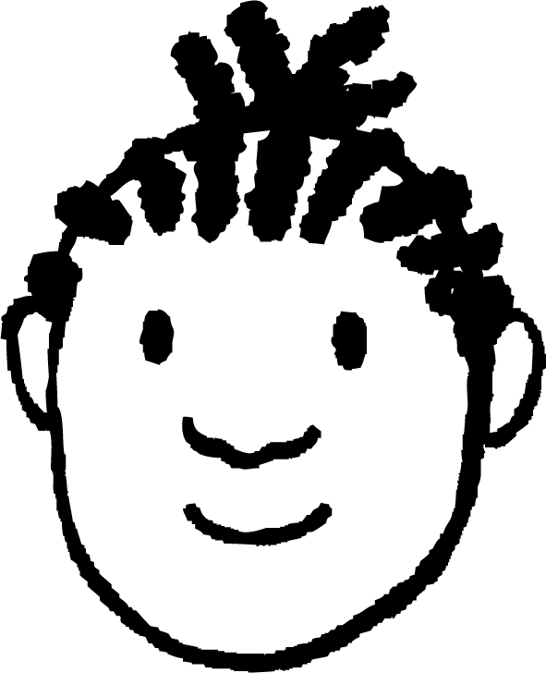
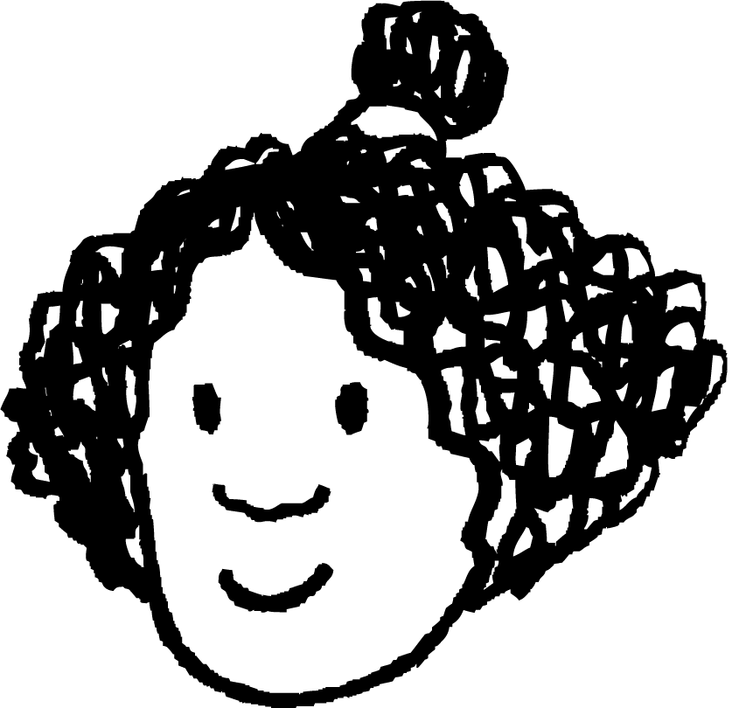
Garaafyada saamiga guud ee ka yar 1 (Graphing a common ratio less than 1)
Isra iyo Yacquub waxay sawirayaan garaafyada joomatari (geometric graphs).
n | 1 | 2 | 3 | 4 | 5 | …
T | 10 000 | 12 000 | 14 400 | 17 280 | 20 736
T
×1.2
×1.2
×1.2
×1.2
Garaafyada joomatari (Geometric graphs) aad bay u qurxoon yihiin!
Waxay had iyo jeer sameeyaan qalooca kor u kaca (upward curve), xataa haddii saamiga guud (common ratio) yar yahay!
Ma hubtaa Yacquub? Miyaad isku dayday saami guud (common ratio) oo ah 1?
n

Slide 25
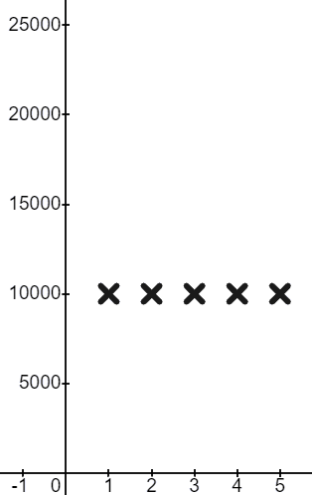
Garaafyada saamiga guud ee ka yar 1 (Graphing a common ratio less than 1)
Isra iyo Yacquub waxay sawiraan garaafyada joomatari (geometric graphs).
n | 1 | 2 | 3 | 4 | 5 | …
T | 10 000 | 10 000 | 10 000 | 10 000 | 10 000
T
n | 1 | 2 | 3 | 4 | 5 | …
T | 10 000
×1
×1
×1
×1
Waa hubaal! Saamigu (ratio) had iyo jeer waa 1 : 1
Qiimuhu (value) weligiis ma beddelmo!
Haa. Waxaad ka heshaa xariiq toosan oo jiif ah (straight horizontal line) laga bilaabo qiimahaaga (value) koowaad.
n

Slide 26

Garaafyada saamiga guud ee ka yar 1 (Graphing a common ratio less than 1)
Saami guud (Common ratio) 2
Saami guud (Common ratio) 1
T
Marka, qaab (shape) intee le'eg ayay saami guud (common ratio) oo ah ina siinaysaa?
T
Ma aqaan. Aynu ogaanno!
n
n

Slide 27
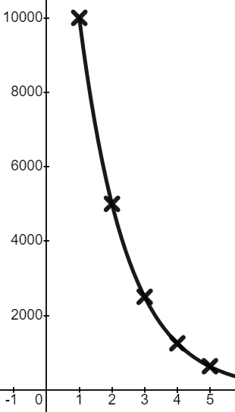
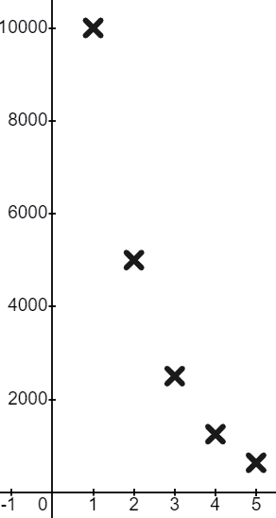

Garaafyada saamiga guud ee ka yar 1 (Graphing a common ratio less than 1)
Saami guud (Common ratio) oo ah
T
n | 1 | 2 | 3 | 4 | 5
T | 10 000 | 5 000 | 2 500 | 1 250 | 625
n | 1 | 2 | 3 | 4 | 5
T | 10 000
Waa hubaal! Qiimayaashu (values) way yaraanayaan!
Wali waxay samaysaa qalooc (curve) laakiin waa qalooc hoos u dhacaya (downward curve).
n

Slide 28
Garaafyada saamiga guud ee ka yar 1 (Graphing a common ratio less than 1)
Saami guud (Common ratio) oo ah
T
n | 1 | 2 | 3 | 4 | 5
T | 10 000 | 5 000 | 2 500 | 1 250 | 625
n | 1 | 2 | 3 | 4 | 5
T | 10 000
Xariiqdu (line) waxay ina tusaysaa dabeecadda qalooca (nature of the curve). Hoos u dhacaya (Decreasing) laakiin heer hoos u dhaca oo gaabiya (slowing).
Sikastaba, ma sawirno xariiqda (line) taxanahan (sequence). Ma jiro 1.5-aad (1.5th term).
n

Slide 29

Garaaf samaynta saami guud (common ratio) ka yar 1
Saami guud (common ratio) ee
T
n | 1 | 2 | 3 | 4 | 5
T | 10 000 | 5 000 | 2 500 | 1 250 | 625
n | 1 | 2 | 3 | 4 | 5
T | 10 000
Marka ma waxaan heli doonnaa qaabkan dhammaan saamiyada ka yar 1?
Ma aqaan. Aan isku dayno
n

Slide 30
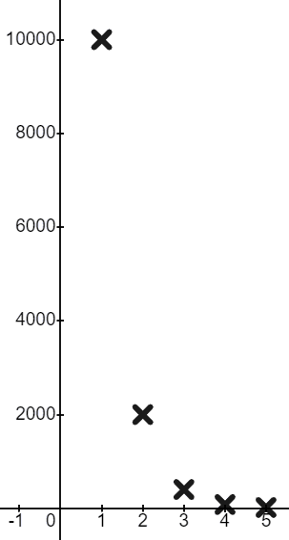
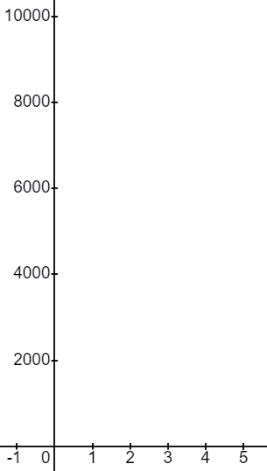
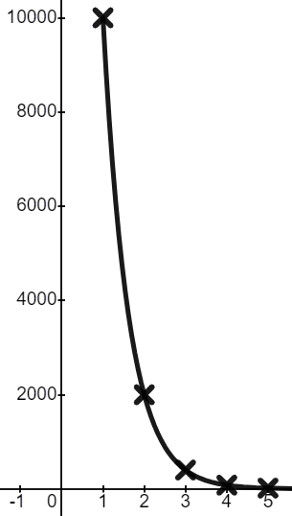

Garaaf samaynta saami guud (common ratio) ka yar 1
Saami guud (common ratio) ee
T
n | 1 | 2 | 3 | 4 | 5
T | 10 000 | 2000 | 400 | 80 | 16
n | 1 | 2 | 3 | 4 | 5
T | 10 000
Waa isku qaab. Kaliya waa qalooc (curve) aad u taag badan!
Waa garaaf (graph) aad u xiiso leh!
n

Slide 31

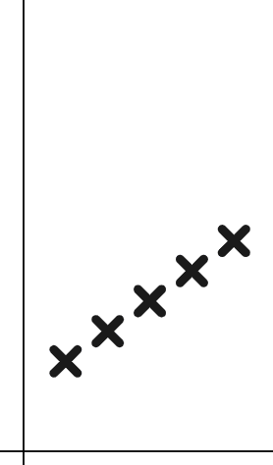
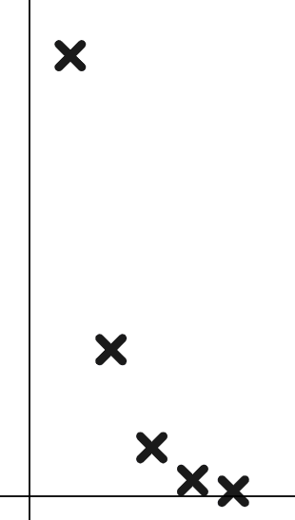
Garaaf samaynta saami guud (common ratio) ka yar 1
Kee ka mid ah garaafyadan (graphs) wuxuu muujinayaa taxane joomatari (geometric sequence) oo leh saami guud (common ratio) ?
(Miyaasaha (scales) T iyo n waxay kordhaan qaddarro isleeg.)
T
T
T
Taxane joomatari (geometric sequence) saami guud (common ratio) >1
Taxane xisaabeed (arithmetic sequence) (toosan)
Taxane joomatari (geometric sequence) saami guud (common ratio)
n
n
n

Slide 32
Garaaf samaynta saami guud (common ratio) ka yar 1
Saami guud (common ratio) ee
T
n | 1 | 2 | 3 | 4 | 5
T | 10 000 | 2000 | 400 | 80 | 16
n | 1 | 2 | 3 | 4 | 5
T | 10 000
Sug! Ma aan tijaabin dhammaan noocyada saamiyada guud (common ratios) ee ka yar 1
Maxaad u malaynaysaa inuu Yacquub ula jeedo?
n

Slide 33
Garaaf samaynta saami guud (common ratio) ka yar 1
Saami guud (common ratio) ee
T
n | 1 | 2 | 3 | 4 | 5
T | 10 000 | 2000 | 400 | 80 | 16
n | 1 | 2 | 3 | 4 | 5
T | 10 000
Sug! Ma aan tijaabin dhammaan noocyada saamiyada guud (common ratios) ee ka yar 1
Ma waxaad u jeeddaa kuwa taban (negatives)?
n

Slide 34
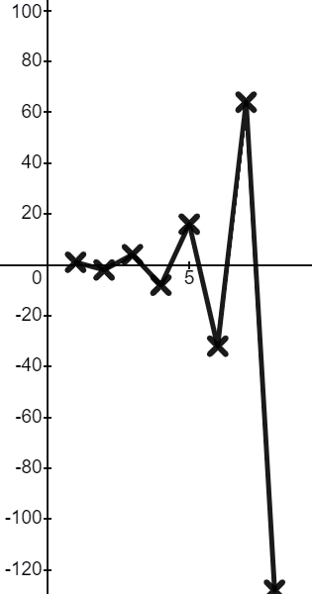
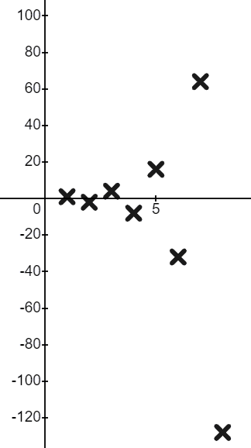
Jaantusyada (graphing) saamiga guud (common ratio) oo ka yar 1
Saamiga guud (common ratio) waa −2
T
n | 1 | 2 | 3 | 4 | 5 | 6 | 7 | 8
T | 1
n | 1 | 2 | 3 | 4 | 5 | 6 | 7 | 8
T | 1 | −2 | 4 | −8 | 16 | −32 | 64 | −128
×−2
×−2
×−2
×−2
×−2
×−2
×−2
n
Waa jaantus (graph) cajiib ah!
Waxay u kala boodboodaysaa (oscillating) inta u dhaxaysa ereyada togan (positive) iyo kuwa taban (negative).

Slide 35
Jaantusyada (graphing) saamiga guud (common ratio) oo ka yar 1
Saamiga guud (common ratio) waa −2
T
n | 1 | 2 | 3 | 4 | 5 | 6 | 7 | 8
T | 1
n | 1 | 2 | 3 | 4 | 5 | 6 | 7 | 8
T | 1 | −2 | 4 | −8 | 16 | −32 | 64 | −128
×−2
×−2
×−2
×−2
×−2
×−2
×−2
n
Marka saamiga guud (common ratio) ee taxanaha joomatari (geometric sequence) uu yahay mid taban (negative), ereyadu waxay u kala boodboodaan (oscillate) togan (positive) ilaa taban (negative).

Slide 36
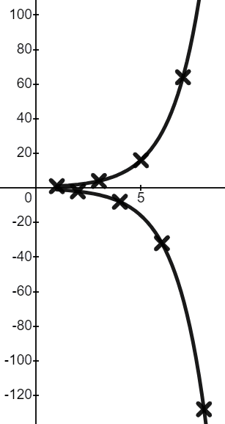
Jaantusyada (graphing) saamiga guud (common ratio) oo ka yar 1
Saamiga guud (common ratio) waa −2
T
n | 1 | 2 | 3 | 4 | 5 | 6 | 7 | 8
T | 1
n | 1 | 2 | 3 | 4 | 5 | 6 | 7 | 8
T | 1 | −2 | 4 | −8 | 16 | −32 | 64 | −128
×−2
×−2
×−2
×−2
×−2
×−2
×−2
n
Waxaa laga yaabaa inaad ogaato in ereyada togan (positive) ay wali sameeyaan qalooc (curve), ereyada taban (negative)na ay sameeyaan qalooc (curve) iyaga u gaar ah.

Slide 37
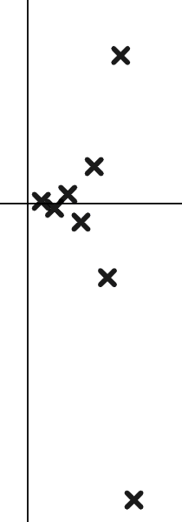
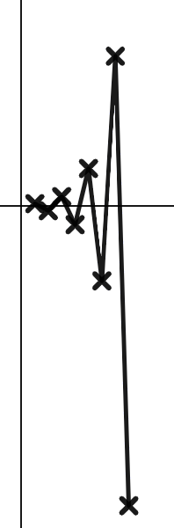
Jaantusyada (graphing) saamiga guud (common ratio) oo ka yar 1
Kani waa jaantuska (graph) taxanaha joomatari (geometric sequence). Waa maxay saamiga guud (common ratio) uu noqon karo?
T
5
n
Marka ereyadu u kala boodboodaan (oscillate) togan (positive) ilaa taban (negative), saamiga guud (common ratio) waa inuu ahaadaa mid taban (negative).
−5

Slide 38
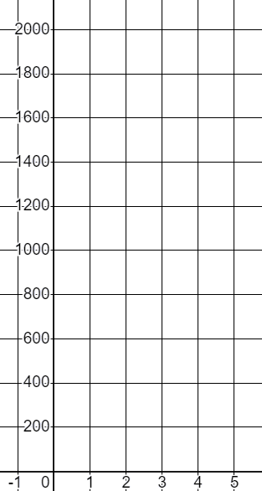

Jaantusyada (graphing) saamiga guud (common ratio) oo ka yar 1
1) a) Buuxi shaxda qiimaha (table of values) oo jaantus (graph) taxanahan joomatari (geometric sequence) oo leh saamiga guud (common ratio)
T
n | 1 | 2 | 3 | 4 | 5
T | 2025
Ku sawir isku-duwayaasha (coordinates) sida ugu saxsan ee aad karto.
n

Slide 39


Jaantusyada (graphing) saamiga guud (common ratio) oo ka yar 1
1) b) Buuxi shaxda qiimaha (table of values) oo jaantus (graph) taxanahan joomatari (geometric sequence) oo leh saamiga guud (common ratio)
T
n | 1 | 2 | 3 | 4 | 5
T | 2025
Ku sawir isku-duwayaasha (coordinates) sida ugu saxsan ee aad karto.
n

Slide 40
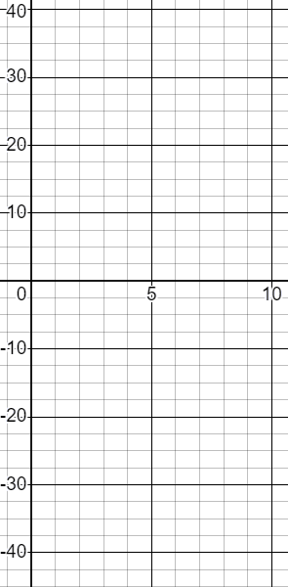
Jaantusyada (graphing) saamiga guud (common ratio) oo ka yar 1
2) Buuxi shaxda qiimaha (table of values) oo jaantus (graph) taxanahan joomatari (geometric sequence) oo leh saamiga guud (common ratio) −1.5
T
n | 1 | 2 | 3 | 4 | 5 | 6 | 7 | 8
T | 2.56
n
×−1.5
Ku sawir isku-duwayaasha (coordinates) sida ugu saxsan ee aad karto.

Slide 41
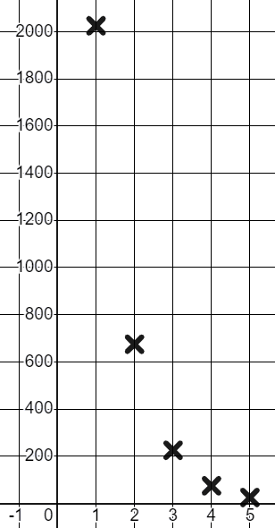
Garaaf samaynta saami guud oo ka yar 1 (Graphing a common ratio less than 1)
1) a) Buuxi shaxda qiimaha oo garaaf tixdan joomatari (geometric sequence) leh saami guud (common ratio)
T
n | 1 | 2 | 3 | 4 | 5
T | 2025 | 675 | 225 | 75 | 25
n | 1 | 2 | 3 | 4 | 5
T | 2025
Common ratio between 0 and 1 giving us a downward curve.
n

Slide 42
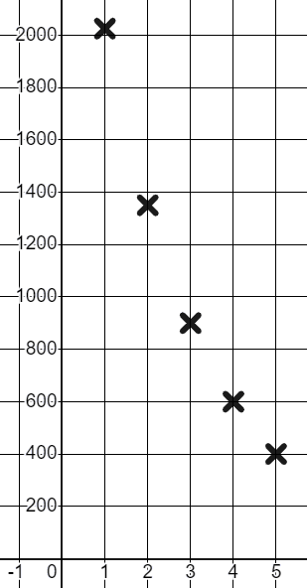
Graphing a common ratio less than 1
1) b) Buuxi shaxda qiimaha oo garaaf tixdan joomatari (geometric sequence) leh saami guud (common ratio)
T
n | 1 | 2 | 3 | 4 | 5
T | 2025 | 1350 | 900 | 600 | 400
n | 1 | 2 | 3 | 4 | 5
T | 2025
Saami guud (common ratio) inta u dhaxaysa 0 iyo 1 oo na siinaya qalooc hoos u dhaca oo ka yar qaloocayaga.
n

Slide 43
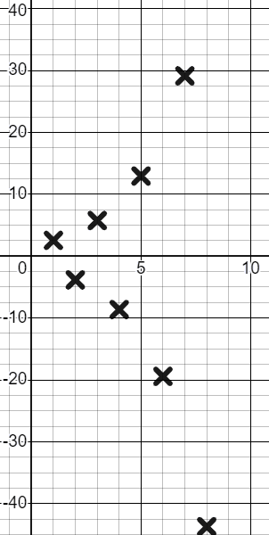
Graphing a common ratio less than 1
2) Buuxi shaxda qiimaha oo garaaf tixdan joomatari (geometric sequence) leh saami guud (common ratio) −1.5
T
n | 1 | 2 | 3 | 4 | 5 | 6 | 7 | 8
T | 2.56 | −3.84 | 5.76 | −8.64 | 12.96 | −19.44 | 29.16 | −43.74
n | 1 | 2 | 3 | 4 | 5 | 6 | 7 | 8
T | 2.56
n
×−1.5
×−1.5
×−1.5
×−1.5
×−1.5
×−1.5
×−1.5
Saami guud (common ratio) taban oo na siinaya ereyo isbeddelaya, kuwa toganna sameeya qalooc, kuwa tabanna sameeya qalooc.

Slide 44
Representing geometric sequences graphically
Waxaan u matali karnaa tixaha joomatari (geometric sequences) garaaf ahaan oo qaddarin karnaa in qaarkood sameeyaan qalooc kor u kaca, qaarkood qalooc hoos u dhaca, qaarna isbeddelaan togan ilaa taban.

