Slide 1
Taranka iyo kala duwanaanshaha (Reproduction and variation)
Kala duwanaansho (Variation) (farqiga u dhexeeya noocyada (species))

Slide 2
sida loo isticmaalo darasyada Oak

Slide 3
Waxaan sharxi karaa sababta ubadku ugu ekaato waalidkood laakiin aan u ekaansho isku mid ah, iyo midba midka kale.

Slide 4
taranka (reproduction)
habka abuura shakhsiyaad cusub oo noole (organism) ah
dhaxal (inherit)
in lagu gudbiyo sifooyinka waalidka ilaa ubadka
DNA
moleekulka kaydiya macluumaadka hidaha (genetic information)
kala duwanaansho (variation)
farqiga u dhexeeya shakhsiyaadka gudaha noole (species)

Slide 5

Taranka (Reproduction) iyo kala duwanaanshaha (variation)
Noocyada (Species) iyo isku ekaanshaha qoyska
DNA iyo dhaxalka (inheritance)
Kala duwanaansho (Variation)

Slide 6
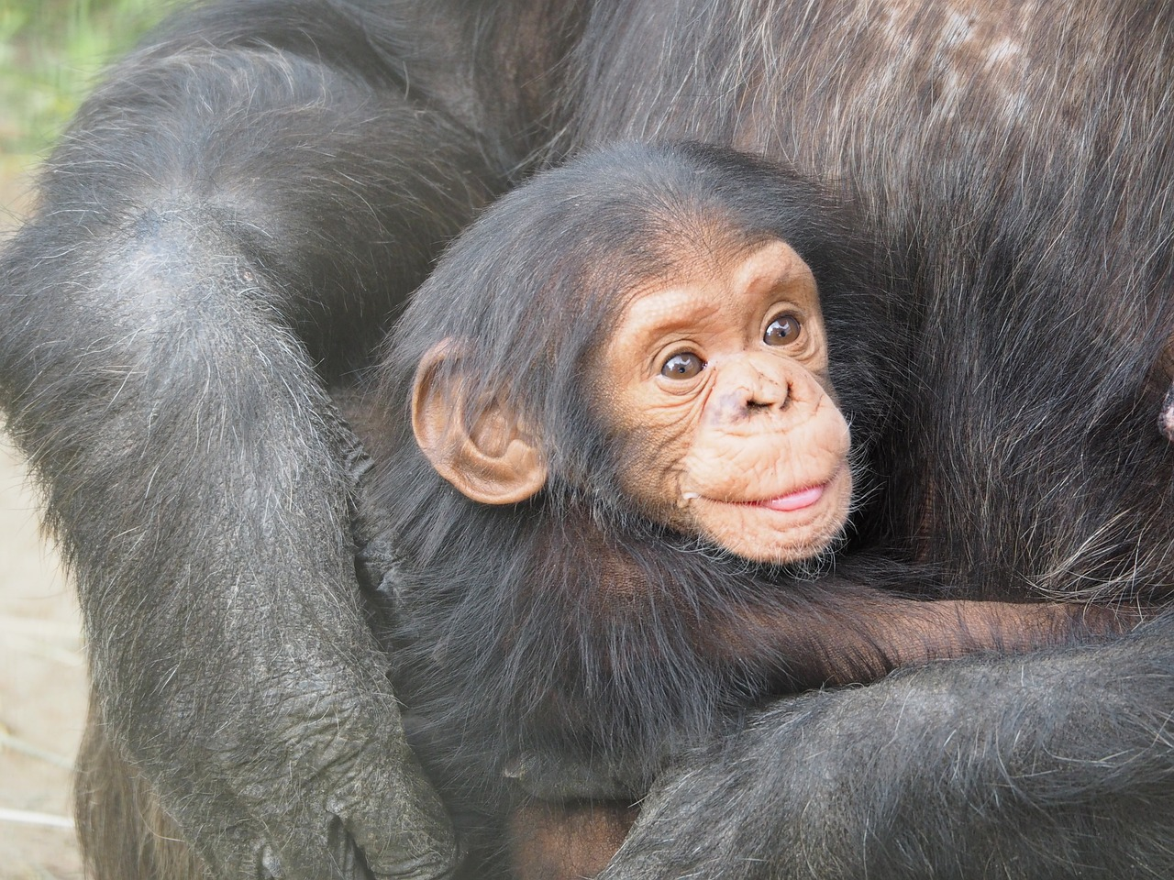
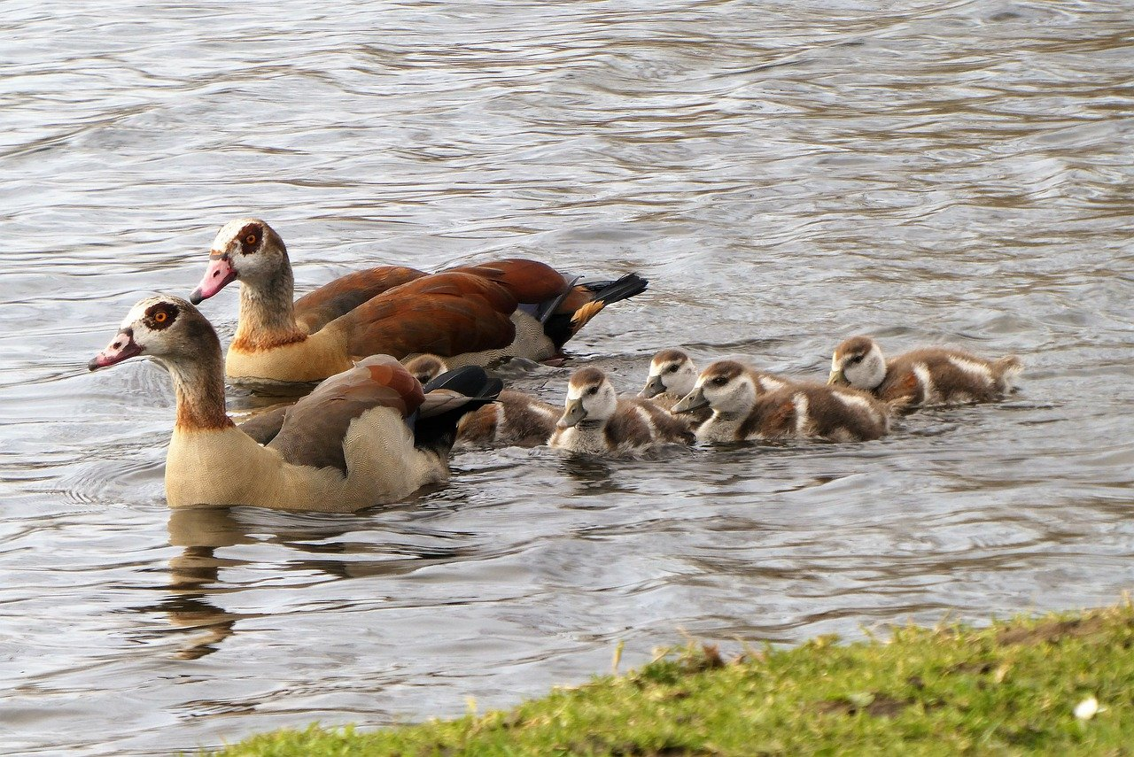
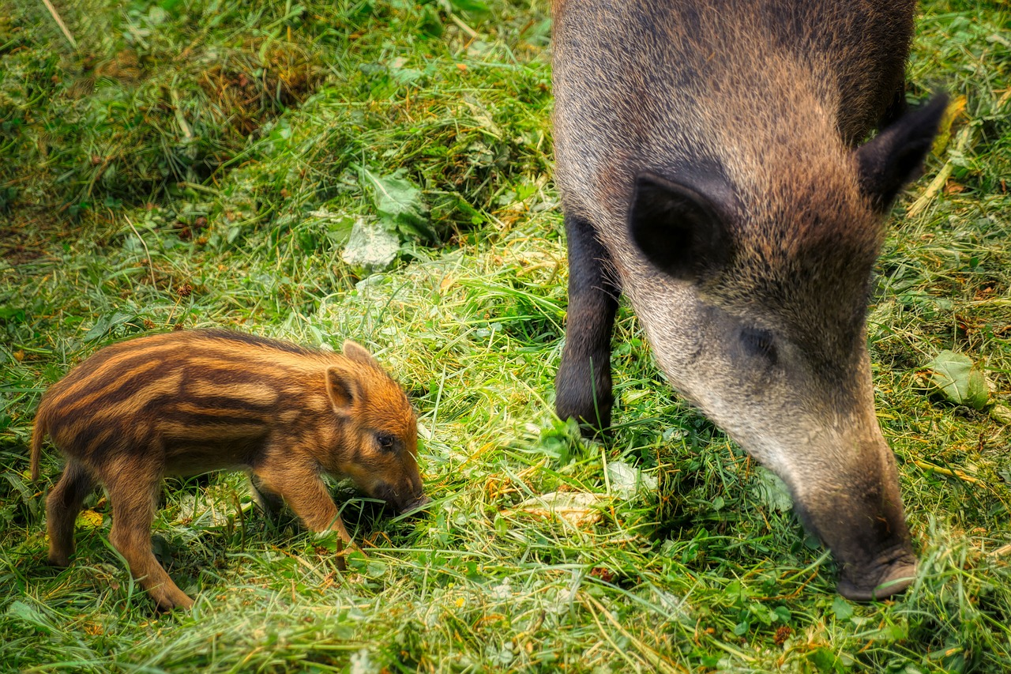
Noocyada (Species) iyo isku ekaanshaha qoyska
Noole (Species) waa koox noole (organism) ah oo, iyada oo loo marayo taranka (reproduction), ay sameeyaan ubad wax soo saari kara (ay taranki karaan).
Ubadku waa isku noole (species).
chimpanzees waxay dhalaan chimpanzees
geese waxay dhalaan geese
wild boar waxay dhalaan wild boar

Slide 7
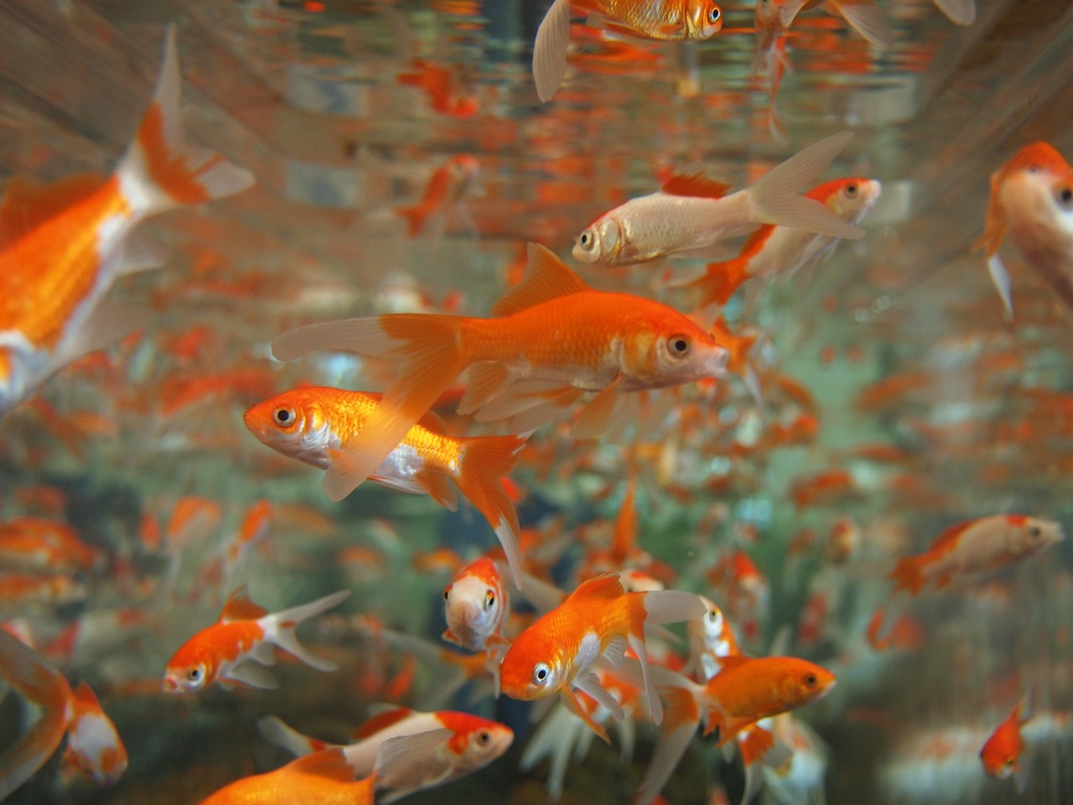
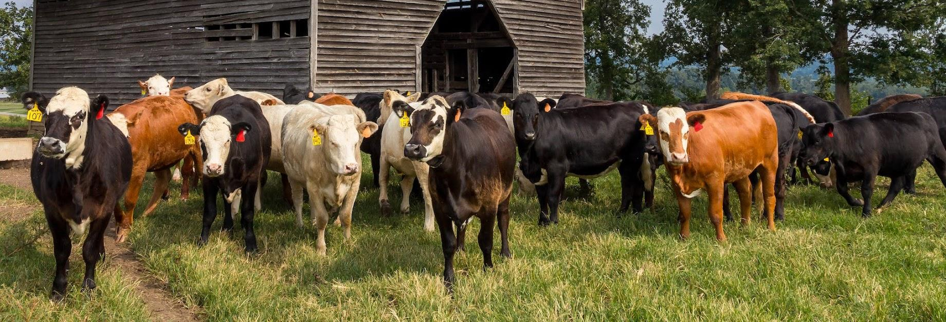
Isku ekaanshaha nooca (species resemblance) iyo qoyska (family resemblance)
Faracyadu waxay la wadaagaan astaamo (characteristics) xubnaha kale ee noocyadooda (species).
Tan waxaa loo yaqaan isku ekaanshaha nooca (species resemblance).
Kalluunka dahabka (goldfish) oo dhami waxay leeyihiin qaab jir isku mid ah waxayna ku nool yihiin biyo macaan (freshwater).
Lo'da oo dhami waxay u baahan yihiin cunto isku mid ah waxayna wadaagaan qaabka wejiga iyo jirka oo isku mid ah.

Slide 8
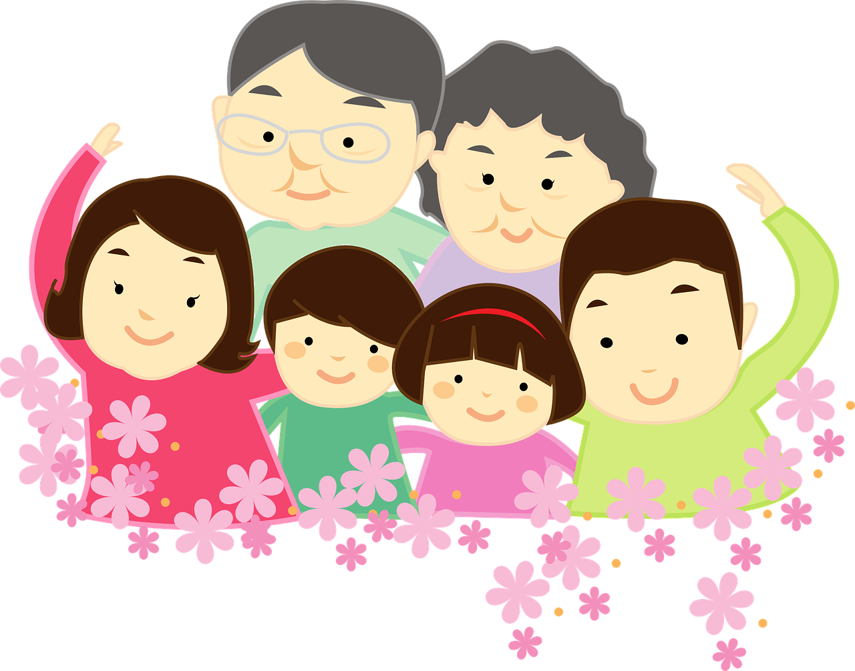
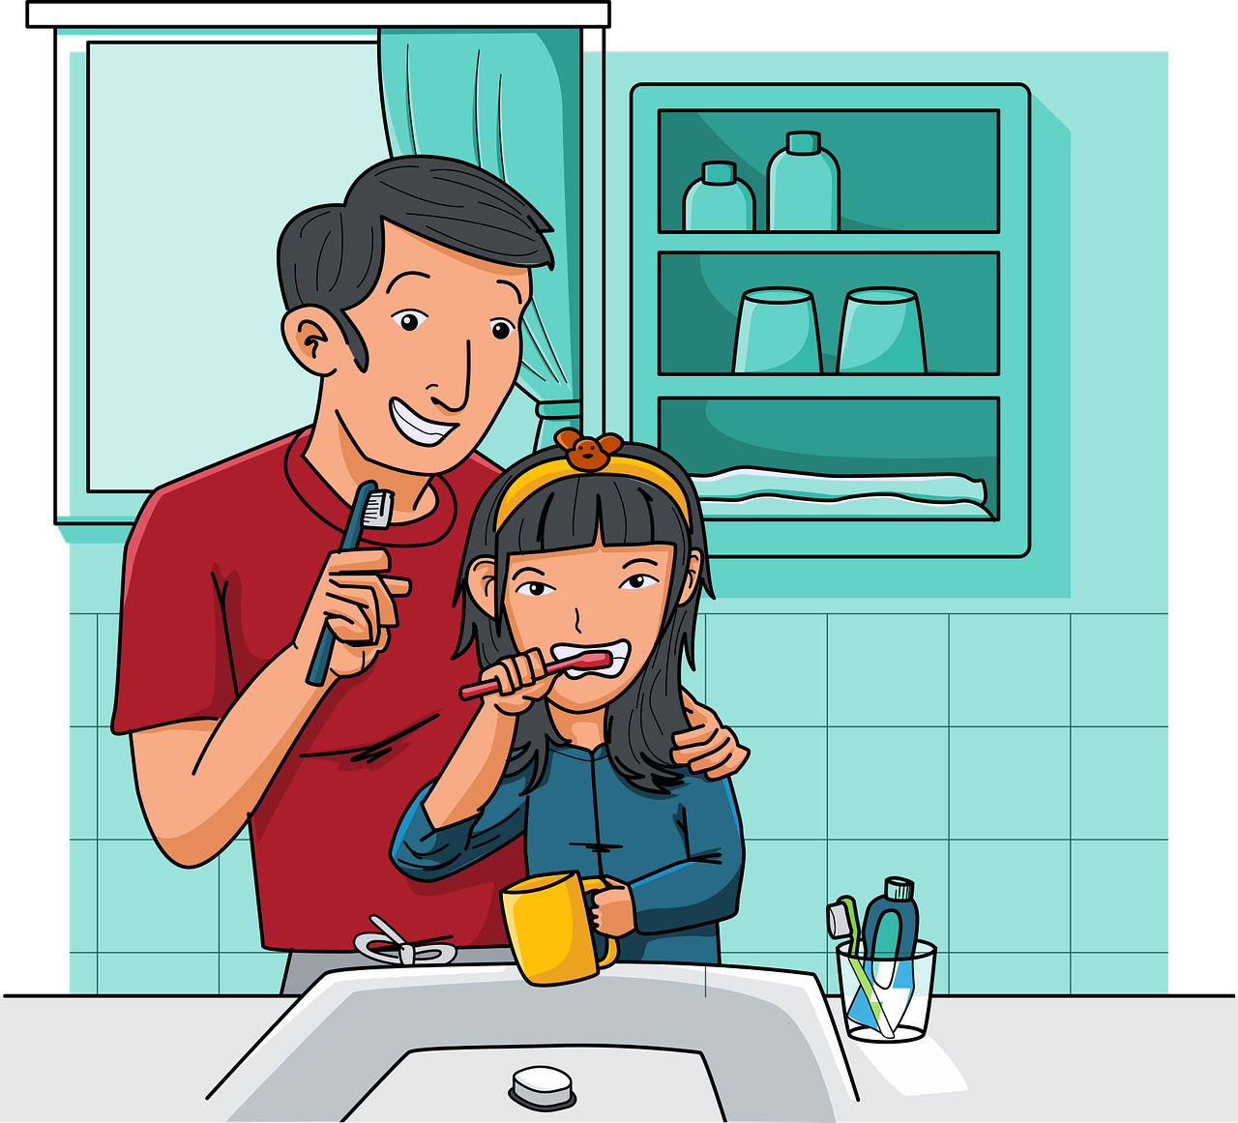
Isku ekaanshaha nooca (species resemblance) iyo qoyska (family resemblance)
Faracyadu waxay la wadaagaan astaamo (characteristics) waalidkood iyo walaalahood.
Tan waxaa loo yaqaan isku ekaanshaha qoyska (family resemblance).
Gabadhu waxay la wadaagtaa astaamo (characteristics) aabbeheed.
Carruurtu waxay u egyihiin waalidkood iyo midba midka kale.

Slide 9
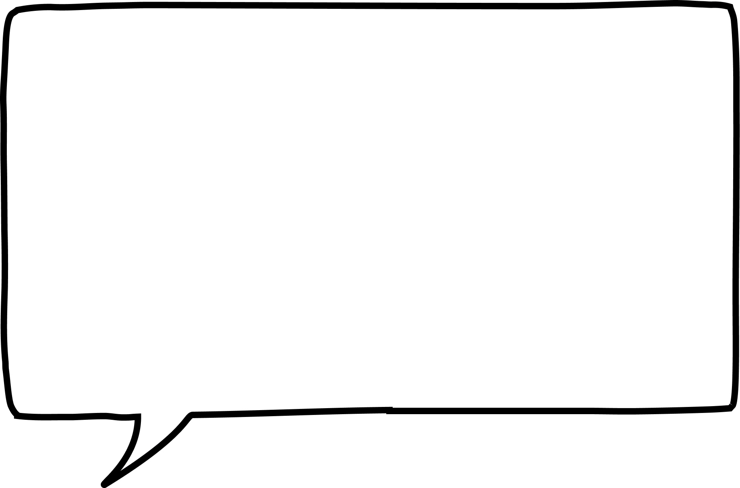



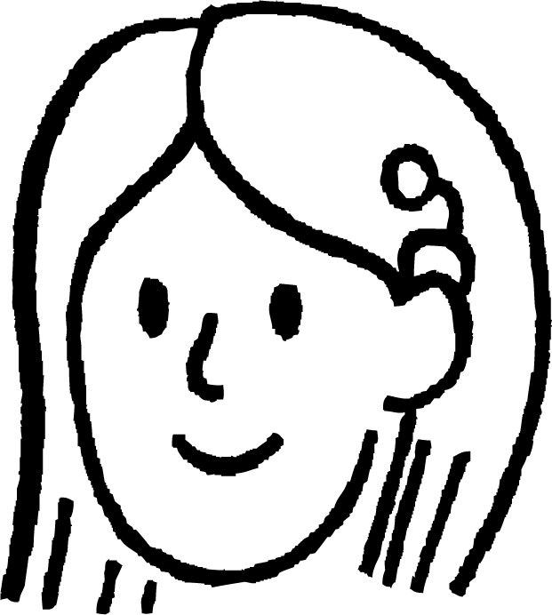


Isku ekaanshaha nooca (species resemblance) iyo qoyska (family resemblance)
Labo gabdhood ayaa ka wada hadlaya isku ekaanshaha qoyska (family resemblance) iyo isku ekaanshaha nooca (species resemblance). Ku habboon (Match) ereyga qeexidiisa.
Carruurtu waxay u egyihiin waalidkood waxayna la mid yihiin awoowayaashood. Waad garan kartaa cidda is qaraabada ah.
Nooleyaashu (Organisms) waxay u egyihiin xubnaha kale ee noocooda (species) sababtoo ah waxay leeyihiin astaamo (characteristics) isku mid ah.
isku ekaanshaha qoyska (family resemblance)
isku ekaanshaha nooca (species resemblance)
Layla
Suad

Slide 10
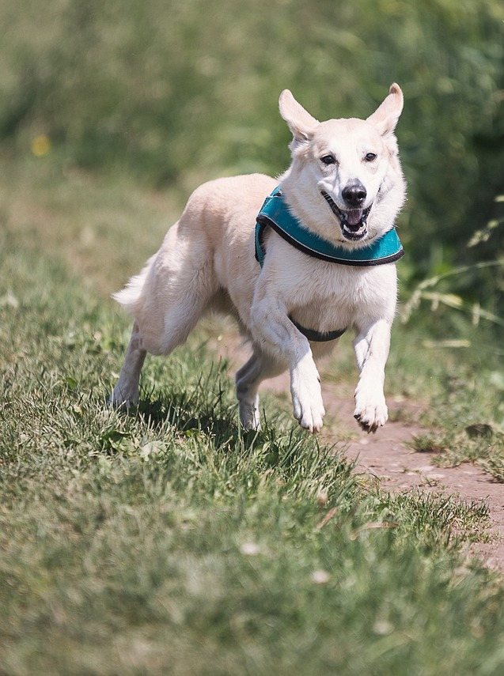
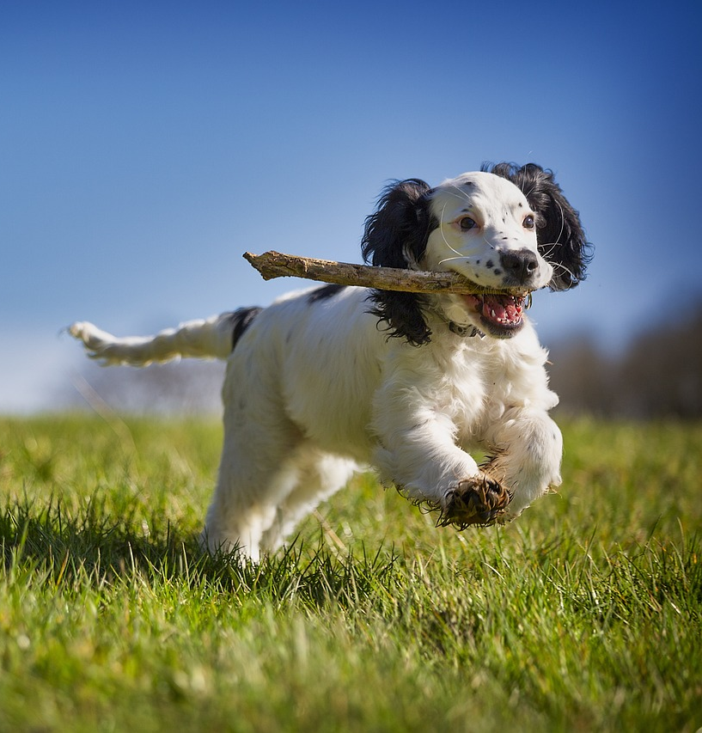
Nooc iyo isku ekaanshaha qoyska (Species and family resemblance)
Samee jaantus Venn (Venn diagram) si aad u barbardhigto (compare) isku ekaanshaha iyo kala duwanaanshaha labadan eey.
isku ekaanshaha (similarities)
Eeydu waxay ka yimaadeen qoysas (families) kala duwan laakiin waa isku nooc (species).
Skippy
kala duwanaanshaha (differences)
Bouncer

Slide 11
Nooc iyo isku ekaanshaha qoyska (Species and family resemblance)
Samee jaantus Venn (Venn diagram) si aad u barbardhigto isku ekaanshaha iyo kala duwanaanshaha labadan eey.
Jawaabtaadu waxay noqon kartaa:
Skippy
Bouncer
Jawaabaha:
dheguhu laalaadaan
dheguhu taaganyihiin
lugo gaagaaban
dhogor cad oo leh qaybo madow
dhogor cad
sanka madow
ilko
dhogortu waa gaaban oo toosan
qaabka jirka
dhogortu waa gaaban oo qalloocan

Slide 12
Tarmida iyo kala duwanaansho (Reproduction and variation)
Nooc iyo isku ekaanshaha qoyska (Species and family resemblance)
DNA iyo dhaxalka (DNA and inheritance)
Kala duwanaansho (Variation)

Slide 13
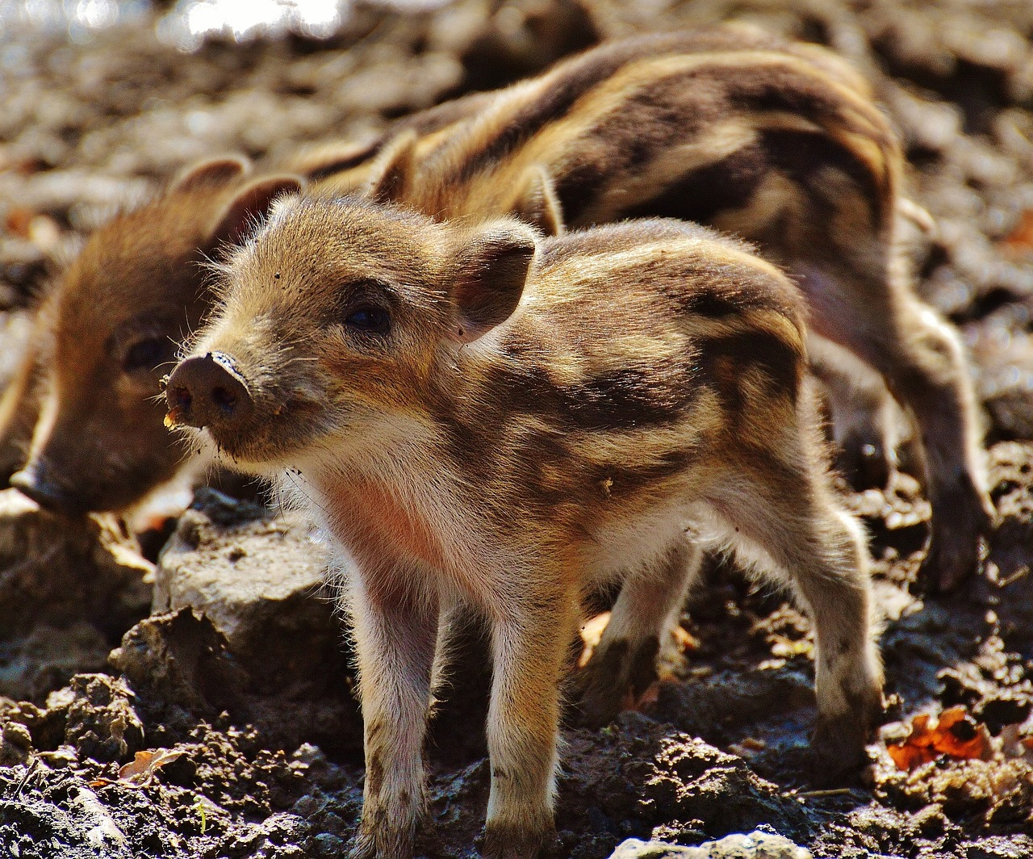
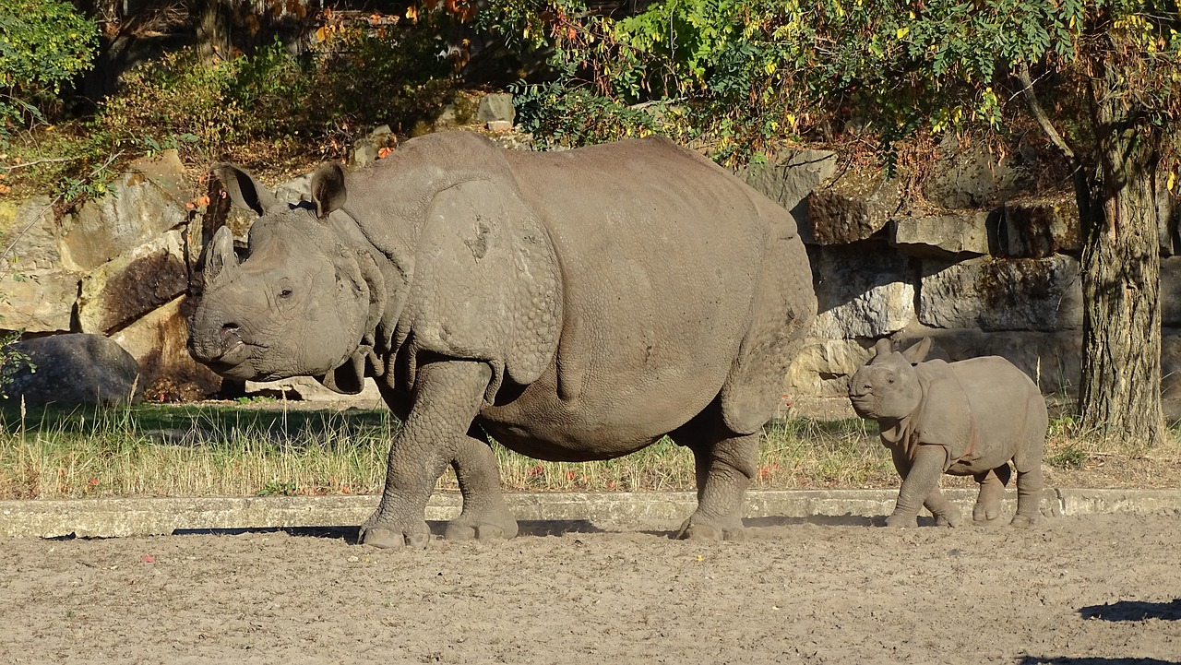
DNA iyo dhaxalka (inheritance)
Waxaa jira kala duwanaansho (variation) udhaxeysa noolaha (organism) isku nooc (species) ah.
Tani waxay ka dhigan tahay inay jiraan kala duwanaansho (differences) muujintooda (features).
waxaa jira kala duwanaansho (variation) udhaxeysa faraca (offspring)
waxaa jira kala duwanaansho (variation) udhaxeysa faraca (offspring) iyo waalidkooda

Slide 14
DNA iyo dhaxalka (inheritance)
Faraca (Offspring) waxay la wadaagaan sifooyin (characteristics) waalidkooda sababtoo ah waxay ka dhaxlaan (inherit) sifooyinka (characteristics) iyaga.
Sifooyinka (Characteristics) waa la dhaxlaa (inherited) sababtoo ah DNA oo ay ku jiraan tilmaamo (instructions) ayaa laga gudbiyaa (passed) waalidka una gudba faraca (offspring).
Kaliya sifooyinka (characteristics) ay sabab u yihiin tilmaamaha (instructions) ku jira DNA ayaa la dhaxli karaa (inherited).

Slide 15
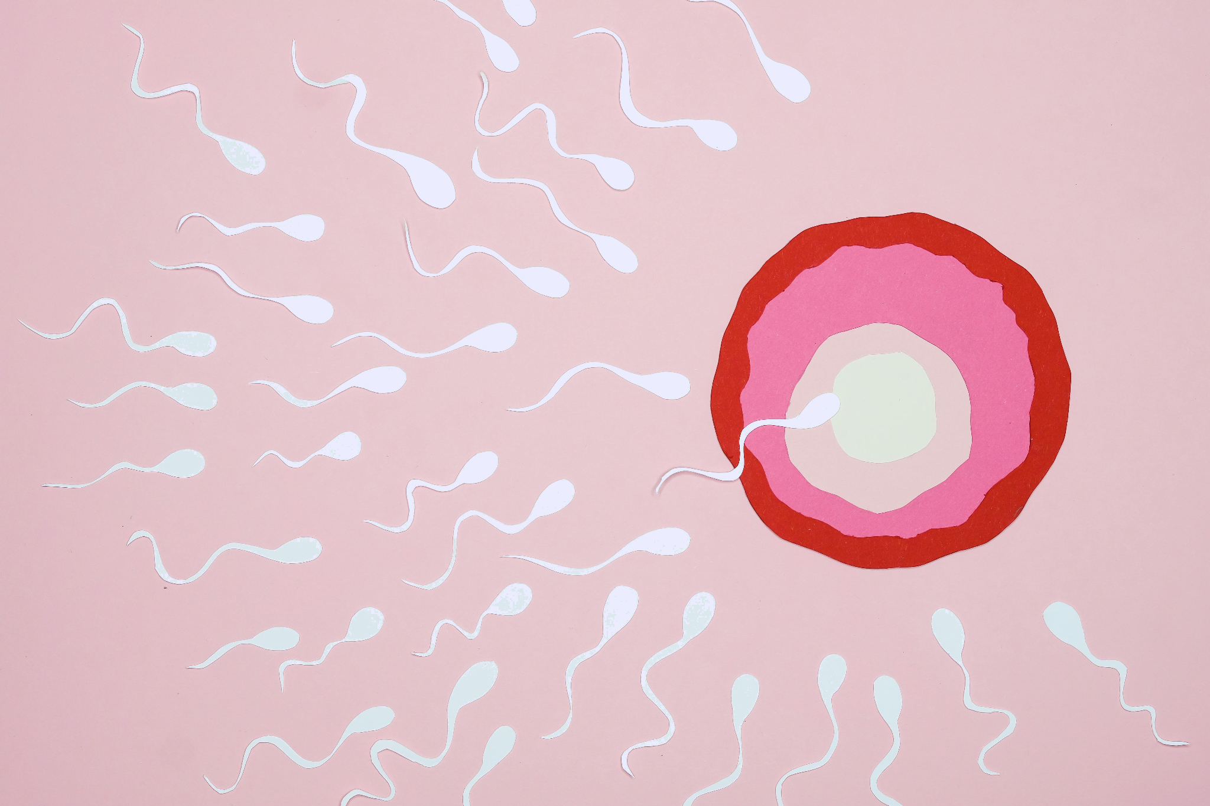
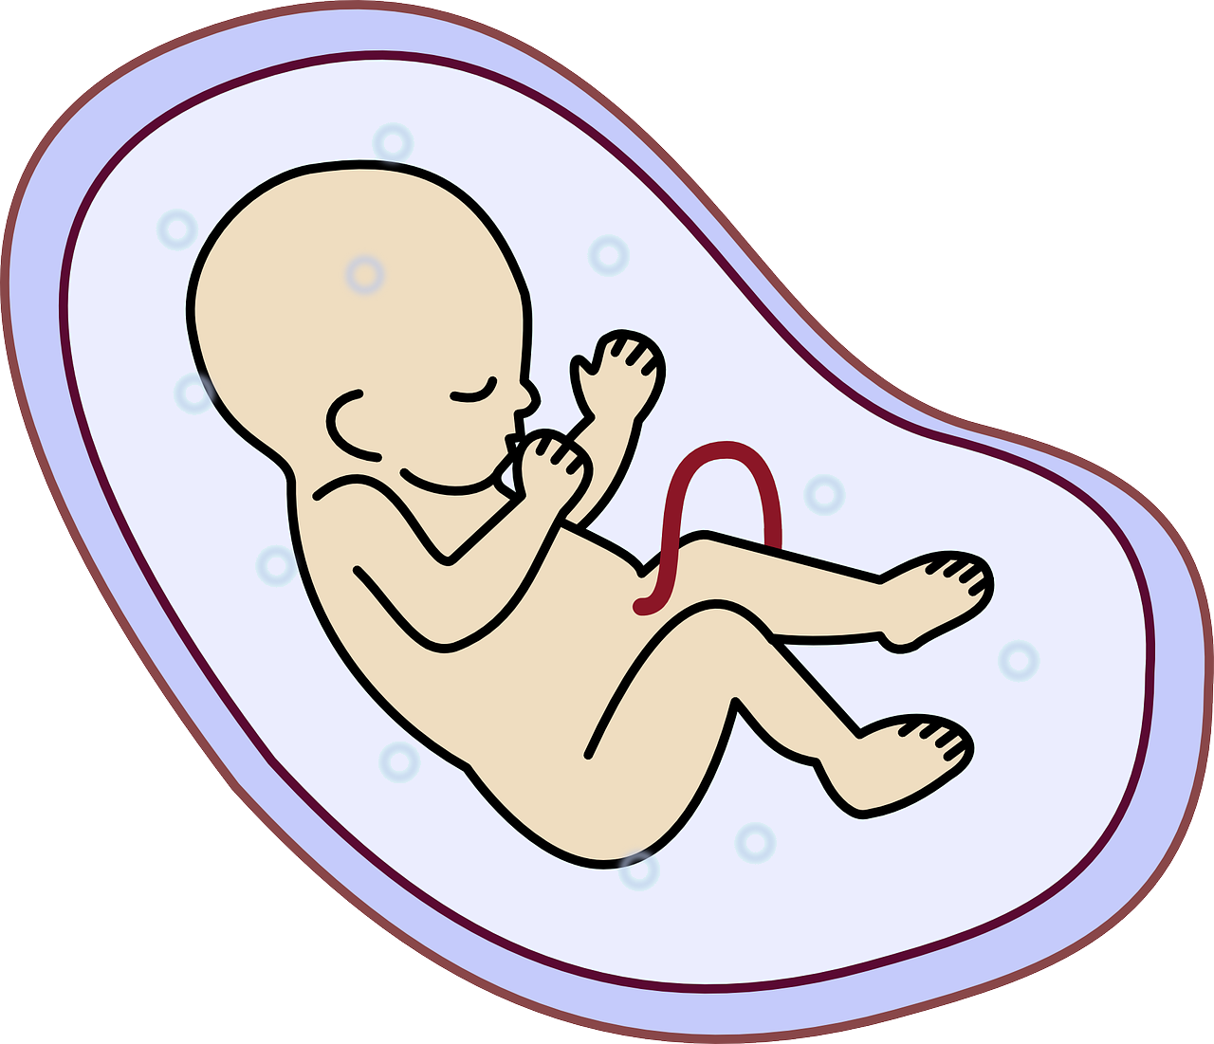
DNA iyo dhaxalka (inheritance)
Tilmaan kasta oo DNA ah waxaa loo yaqaan hiddo-side (gene).
DNA oo ka yimid aabe
Waxaan ka dhaxalnaa (inherit) hal nuqul (copy) oo hiddo-side (gene) kasta ah hooyadeenna dhalay (biological mother).
Waxaan ka dhaxalnaa (inherit) hal nuqul (copy) oo hiddo-side (gene) kasta ah aabbeheen dhalay (biological father).
DNA oo ka yimid hooyo
Marka 50% DNA-gaaga wuxuu ka yimaadaa hooyadaa, 50% wuxuu ka yimaadaa aabahaa.
Waxaan leenahay laba nuqul (copies) oo hiddo-side (gene) kasta ah.

Slide 16
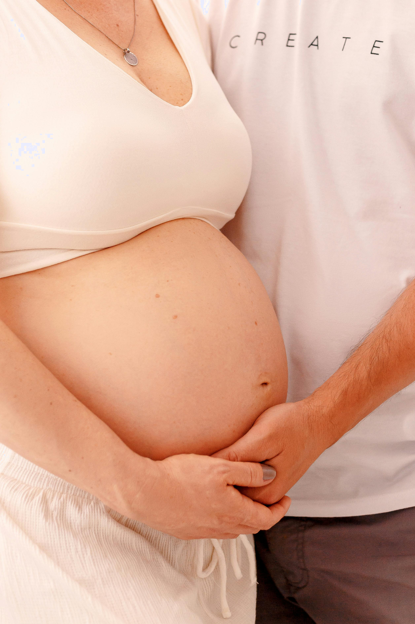

DNA iyo dhaxalka (inheritance)
Haddii lamaanahan ay dhashaan gabadh yar, waxay ka dhaxli doontaa (inherit) kaliya sifooyinka (features) hooyadeed.
Carruurtu waxay la mid yihiin waalidkood.
Carruurtu waxay ka dhaxlaan (inherit) isku dhaf (mix) ah sifooyin (features) labada waalid.

Slide 17
DNA iyo dhaxalka (inheritance)
Mid kasta oo ka mid ah hidde-sidaha (genes) wuxuu ka yimaadaa aabbahayaga dhabta ah.
hidde-sidaha aabbaha (dad’s genes)
hidde-sidaha hooyada (mum’s genes)
Mid kasta oo ka mid ah hidde-sidaha (genes) wuxuu ka yimaadaa hooyadayo dhabta ah.
Nooca hidde-sidaha (genes) ee ilmuhu ka dhaxlo waalidkiis waa random (random).
hidde-sidaha ilmaha (baby’s genes)
Tani waxay abuurtaa kala duwanaansho (variation) ilmaha.

Slide 18
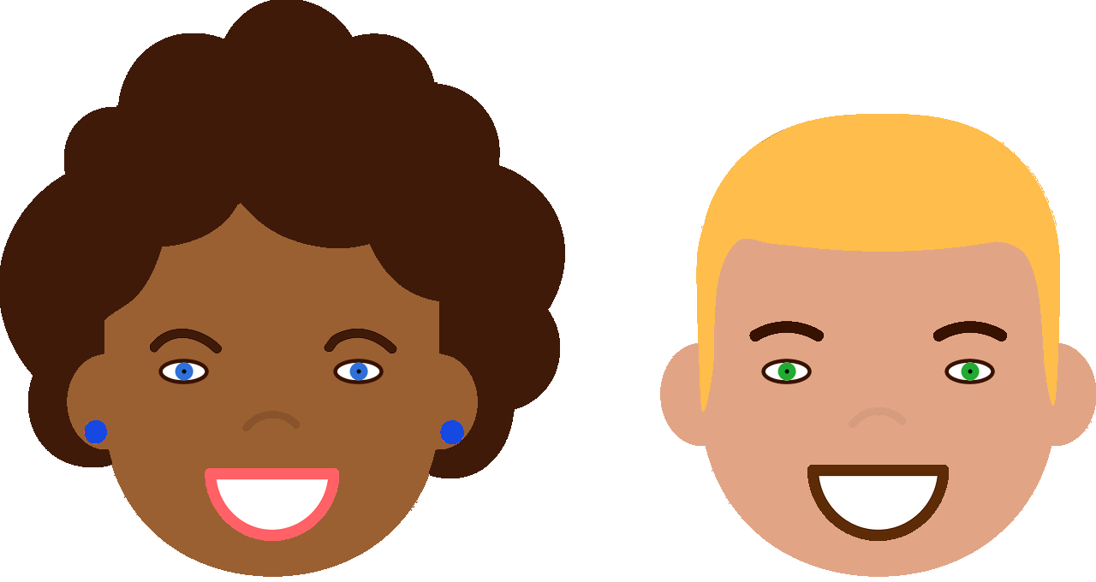

DNA iyo dhaxalka (inheritance)
Flo waxay leedahay indho buluug ah. Ninkeeda Joe wuxuu leeyahay indho cagaar ah. Flo waxay rabtaa in ilmahaagu yeesho indho buluug ah.
Waxaan ahay
hubaa inay tani sax tahay
I
qiyaasaa inay sax tahay
I
qiyaasaa inay khalad tahay
Waxaan ahay
hubaa inay khalad tahay
Kee ayaa sax ah ama khalad?
a
Flo waxay yeelan kartaa ilmo indho buluug ah haddii ay go'aansato.
Midabka indhaha ilmaha wuxuu ku xiran yahay macluumaadka hidde-sidaha (genetic information) ee uu ka helo waalidkiis.
b
c
Ilmuhu wuxuu dhaxli doonaa kala badh hidde-sideyaashiisa (genes) waalid kasta.
d
Indhaha ilmuhu waxay noqon karaan buluug ama cagaar.

Slide 19


DNA iyo dhaxalka (inheritance)
Marka hore, ka wada hadla su'aalaha laba-laba, ka dibna qor sharaxaad gaar ah su'aal kasta.
Siyaabaha ay xayeysiintu u siin karto fikrad khaldan oo ku saabsan sida astaamaha (characteristics) loo dhaxlo?
Sidee u sharxi lahayd dhaxalka noole (biological inheritance) qof ku wareeray xayaysiiska?
“Taleefankani wuxuu ka dhaxlay (inherited) dhammaan sifooyinka ugu fiican ee moodooyinkii hore!”
Sell Phones Magazine

Slide 20
DNA iyo dhaxalka (inheritance)
Sidee buu xayaysiisku u siin karaa fikrad khaldan oo ku saabsan sida sifooyinka loo dhaxlo (inherited)?
Jawaabtaadu waxaa laga yaabaa inay ka kooban tahay:
Taleefannada gacanta ma tarmaan (reproduce) si ay u gudbiyaan sifooyinka; waa in la naqshadeeyaa oo la dhisaa.
Taleefannada gacanta ma laha DNA ama hiddo-sideyaal (genes), marka ma gudbin karaan tan jiilka taleefannada xiga.
Taleefannada gacanta cusub ma dhaxli karaan (inherit) sifooyin jiilalkii hore.

Slide 21
DNA iyo dhaxalka (inheritance)
2) Sidee u sharxi lahayd dhaxalka noole (biological inheritance) qof ku wareeray xayaysiiska?
Jawaabtaadu waxaa laga yaabaa inay ka kooban tahay:
Kaliya sifooyinka noole (biological characteristics) ayaa la dhaxli karaa (inherited).
Kaliya sifooyinka ay saameeyaan hiddo-sideyaasha (genes)/DNA ayaa la dhaxli karaa (inherited).
Faraca (Offspring) waxay helaan kala badh DNA-ga mid ka mid ah waalidka waxayna leeyihiin laba waalid oo noole (biological parents).

Slide 22
Tarmidda (Reproduction) iyo kala duwanaanshaha (variation)
Noocyada (Species) iyo isku ekaanshaha qoyska (family resemblance)
DNA iyo dhaxalka (inheritance)
Kala duwanaanshaha (Variation)

Slide 23
Kala duwanaanshaha (Variation)
Kala duwanaanshaha (Variation) udhaxeeya xubnaha isku nooca (same species) wuxuu dhacaa sababtoo ah xubin kastaa wuxuu leeyahay isku dhaf kala duwan oo ah noocyada hiddo-sideyaasha (genes).
hidde-sidaha aabbaha (dad’s genes)
hidde-sidaha hooyada (mum’s genes)
Astaamaha la arki karo ee ay keliya xakameeyaan hidde-sidaha (genes) waxaa ka mid ah midabka indhaha, ku-xidhnaanta dhegta, awoodda carrabka oo la duubo, iyo nooca dhiigga (blood type).
hidde-sidaha ilmaha 1 (baby 1 genes)
hidde-sidaha ilmaha 2 (baby 2 genes)

Slide 24
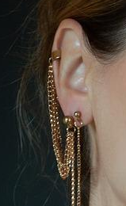
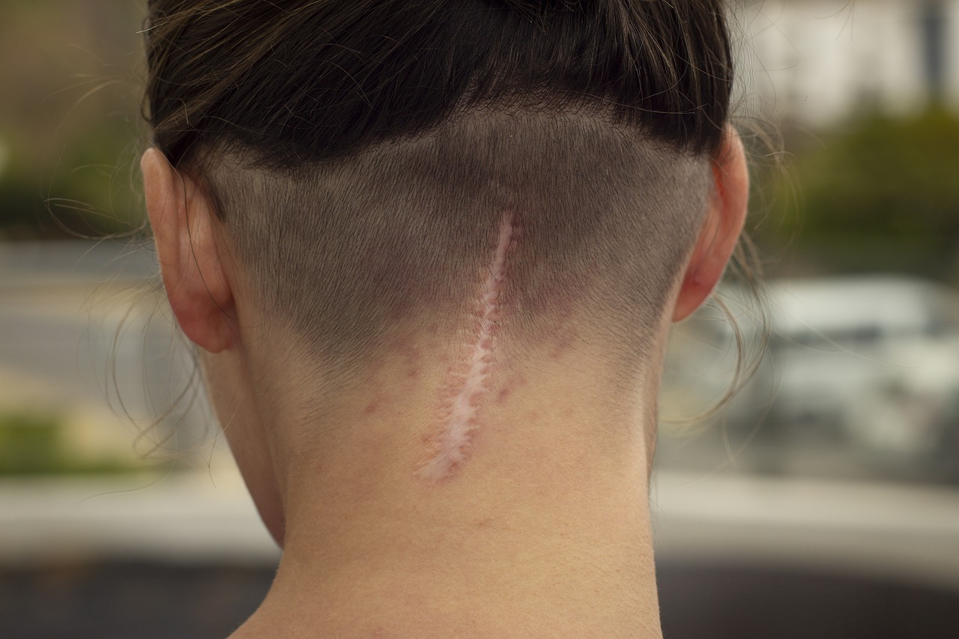
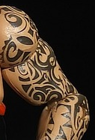
Kala-duwanaansho (Variation)
Qaar ka mid ah kala-duwanaanshaha (variation) waxaa sidoo kale sababa deegaanka (environment).
Dhegaha oo la dalooliyo iyo sawir-qaadista (tattoos) waa isbeddello ku yimaada muuqaalka jidhka oo aan dooranayno. Nabarrada (scars) waxaa sababa deegaanka (environment) sidoo kale.
Kuwan lama dhaxli karo (cannot be inherited).

Slide 25
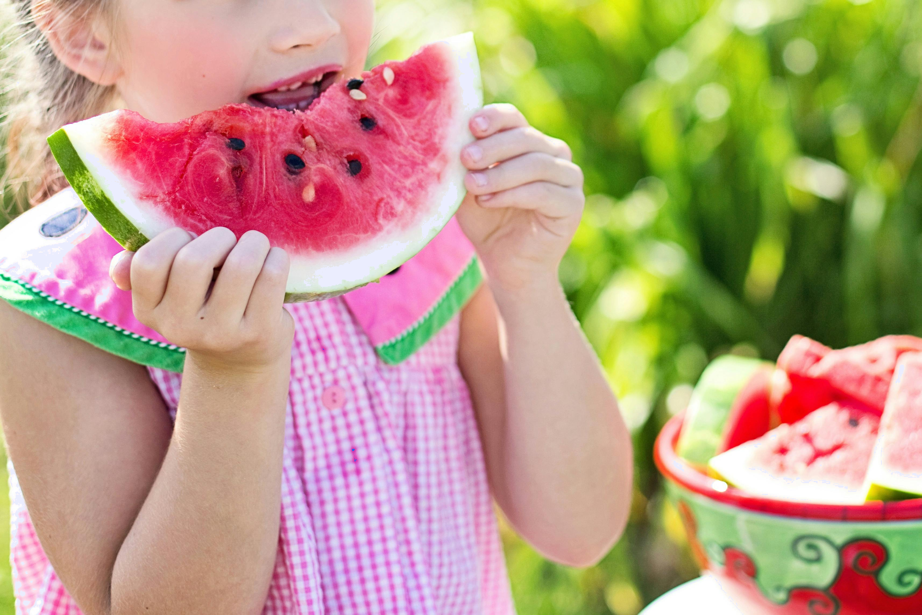
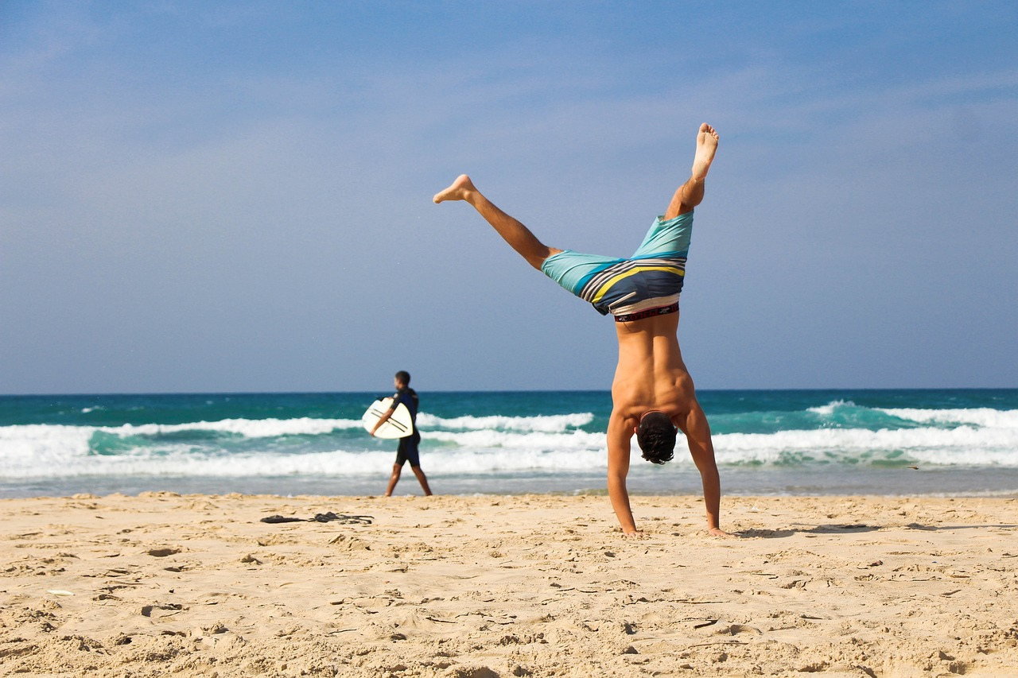
Kala-duwanaansho (Variation)
Cufka jidhkeenna (body mass) qayb ahaan waxaa xakameeya hidde-sidaha (genes).
Waxaa sidoo kale saameeya qaab nololeedkeenna: waxa aan cunno iyo sida aan u firfircoonahay, cufka jidhkeenna (body mass) wuu isbeddelayaa.
Tani waa tusaale astaan (feature) ay saameeyaan labadaba dhaxalka (inheritance) iyo qaab nololeedka (lifestyle).

Slide 26
Kala-duwanaansho (Variation)
Ku habboonaynta bayaanka (statement) astaan kasta.
Waxaa sababa oo keliya hidde-sidaha (genes)
midabka timaha/qaabka timaha (hair colour/style)
midabka indhaha (eye colour)
Waxaa sababa oo keliya deegaanka/qaab nololeedka (environment/lifestyle)
dhererka (height)
gacmo muruq leh (muscular arms)
Waxaa saameeya hidde-sidaha (genes) iyo deegaanka/qaab nololeedka (environment/lifestyle)
miisaanka (weight)
dhegaha daloosha (nose piercing)

Slide 27

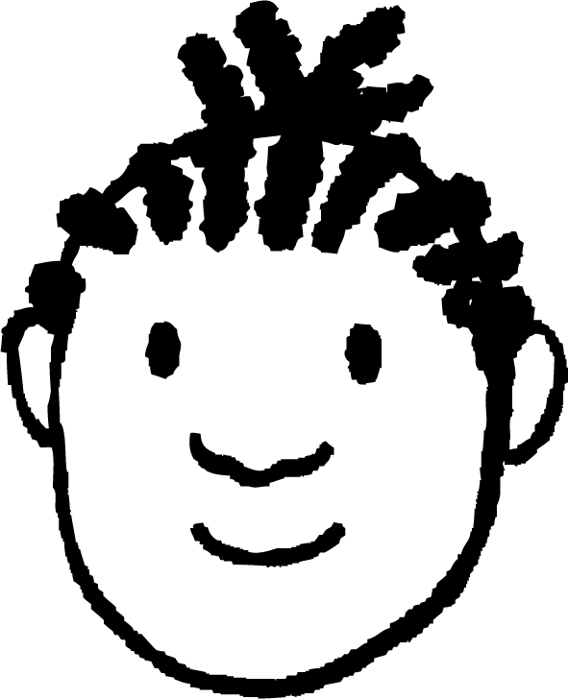

Kala duwanaansho (Variation)
Ku soo noqo jaantuska Venn ee Hawsha A. Isticmaal furaha si aad u aqoonsato sifo kasta mid ka mid ah:
  Waxaa sababa oo kaliya hiddo-sideyaal (G)
  Waxaa sababa oo kaliya deegaanka/qaab nololeed (E)
  Waxaa saameeya labadaba (B)
2) U sharax Yacquub sababta taladiisu khalad u tahay iyo nooca sifooyinka ay tani u shaqayn doonto.
Waxaad u isticmaali kartaa macluumaadka hiddo-sideyaasha ee ilmaha si aad u ogaato sida uu u ekaan doono marka uu weynaado.
Yacquub

Slide 28
Kala duwanaansho (Variation)
Isticmaal furaha si aad u aqoonsato sifo kasta mid ka mid ah: Hiddo-sideyaal oo kaliya (G); Deegaanka/qaab nololeed oo kaliya (E); Hiddo-sideyaal iyo deegaanka/qaab nololeed (B: labadaba).
Waxaa laga yaabaa inaad dhigtay:
dheguhu hoos u dhacaan (ears flop down)
dheguhu taagan yihiin (ears point up)
lugo gaaban (short legs)
dhogor cad oo leh qaybo madow (white fur with black sections)
dhogor cad (white fur)
san madow (black nose)
Skippy
ilko (teeth)
Bouncer
dhogortu waa gaaban tahay oo toosan tahay (fur is short and straight)
qaabka jirka (body shape)
dhogortu waa gaaban tahay oo qalloocan tahay (fur is short and curly)
Jawaabaha:
G
G
B
B
G
B
B
B
G/B
G/B

Slide 29
Kala duwanaansho (Variation)
2) U sharax Yacquub sababta soo jeedintiisu ay khalad tahay iyo noocyada astaamaha ee tani kaliya u shaqayn karto.
Waxaad isticmaali kartaa macluumaadka hidaha (genetic) ee ilmaha si aad si sax ah u ogaato sida uu u ekaan doono marka uu weynaado.
Yacquub
Waxaa laga yaabaa inaad dhigtay:
deegaanka/qaab nololeedku waxay saameyn weyn ku leeyihiin muuqaalka noole (organism)
dhawr astaamood oo muuqda ayaa kaliya go'aamiya hidaha (genetics)
tusaale ahaan, midabka indhaha, ku dhegganaanta dhegta, awoodda carrabka oo la duubo, nooca dhiigga
inta badan astaamaha waxaa saameeya deegaanka ama doorashada qaab nololeedka

Slide 30
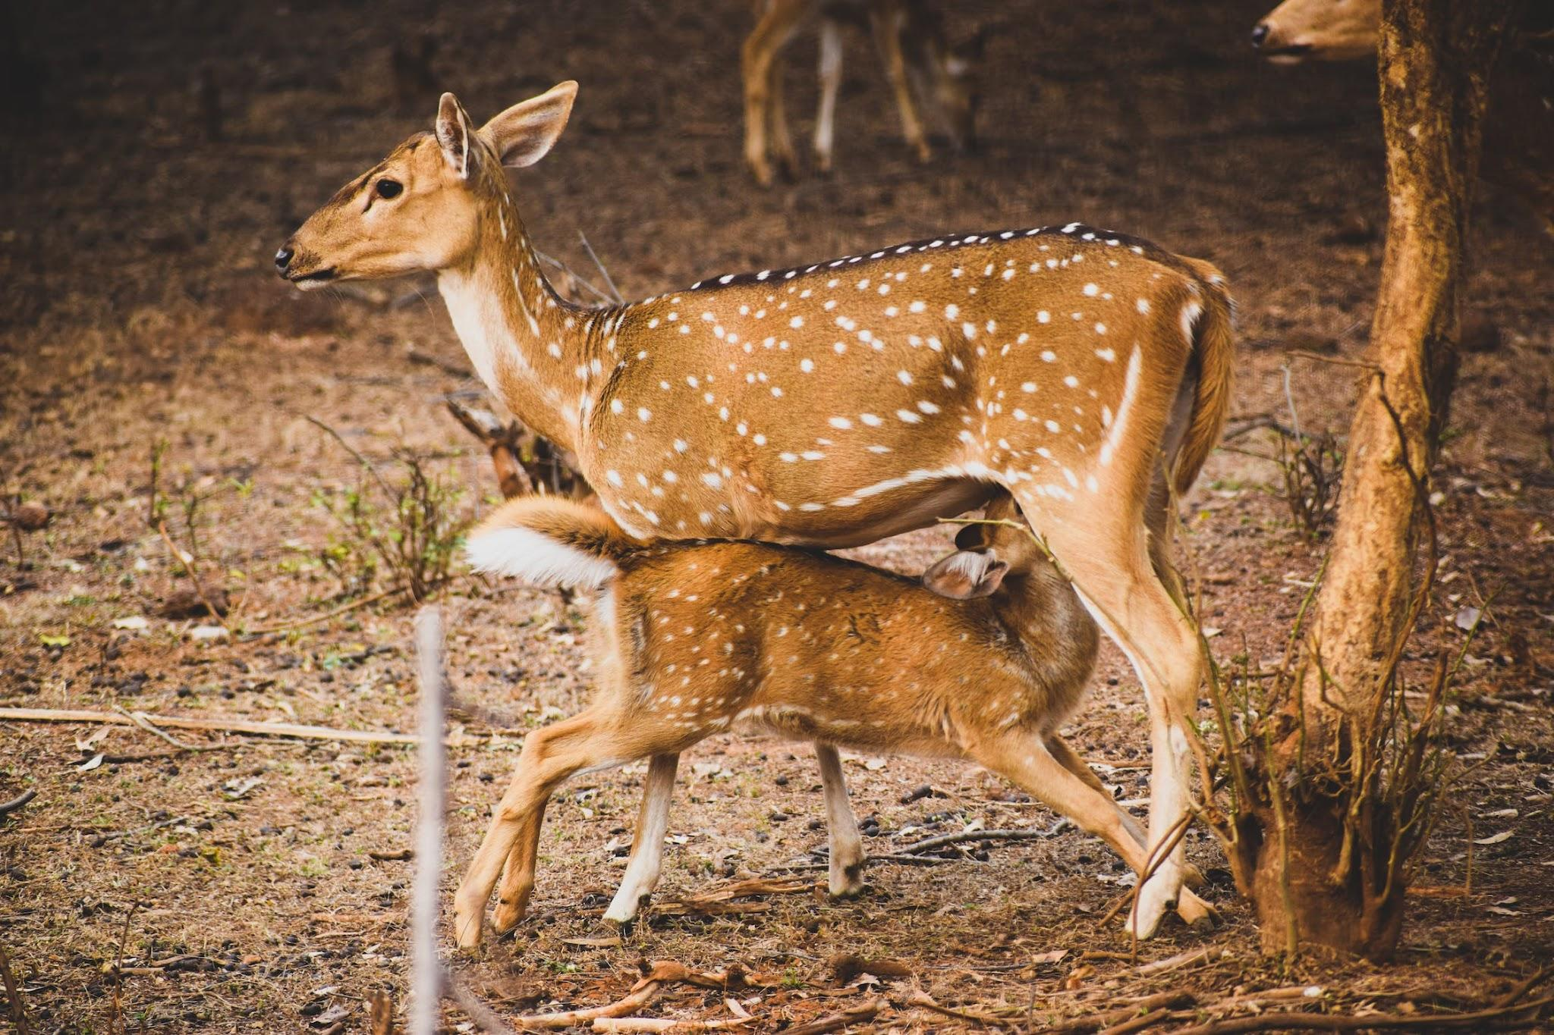
Taranka iyo kala duwanaanshaha (Reproduction and variation)
Xubnaha isku nooca (species) ah waxay isu eg yihiin.
Carruurtu waxay ka dhaxlaan astaamaha labada waalid, sidaas darteed waxay u eg yihiin waalidkood iyo midba midka kale, laakiin ma aha kuwa isku mid ah. Waxaa dhexdooda ah kala duwanaansho (variation).
Astaamaha qaarkood waa la dhaxlaa marka DNA laga gudbiyo waalidka ilaa carruurta inta lagu jiro taranka (reproduction), sida midabka indhaha, nooca dhiigga, iyo awoodda carrabka oo la duubo.
Astaamaha qaarkood waxaa keena ama beddela qaab nololeedka iyo deegaanka noole (organism), sida cufnaanta jirka, dhererka, nabarrada iyo tattoo-yada.

