Slide 1
Maareynta ganacsi yar
Xisaab goobta shaqada

Slide 2
Sida agabkeena waxbarista loogu talagalay fasalka

Slide 3
Waxaan fahmi karaa sida xisaabta loogu isticmaalo ganacsatada madaxa-bannaan.

Slide 4
Faa'iidada boqolkiiba (percentage profit) waa korodhka marka la tixraaco shay lagu iibiyo qiime ka badan qiimaha kharashka, oo loo muujiyo boqolkiiba xaddiga asalka ah.
Celcelis (average) waa hal lambar oo muujiya qiimaha dhexe ama caadiga ah ee xogta; mode, median, iyo mean.

Slide 5

Maareynta ganacsi yar
Faa'iido boqolkiiba (percentage profit)
La socodka waxqabadka

Slide 6
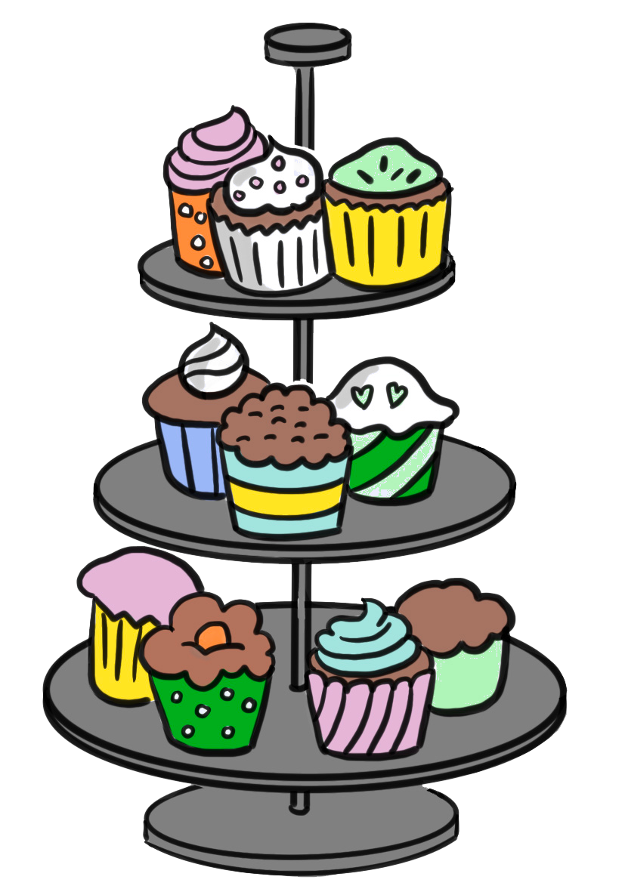




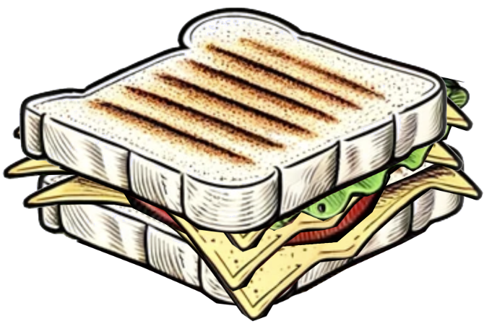


Faa'iido boqolkiiba (percentage profit)
Axmed iyo Isra waxay fureen ganacsigoodii ugu horreeyay, kafateeri. Waa kuwan natiijooyinkoodii saddexda sano ee ugu horreeyay.
 | Faa'iidada guud (gross profit) | Dakhliga (revenue)
Sannadka koowaad | £24 000 | £60 000
Sannadka labaad | £28 000 | £80 000
Sannadka saddexaad | £30 000 | £120 000

Slide 7
Faa'iido boqolkiiba (percentage profit)
Erayo qaar:
 | Faa'iidada guud (gross profit) | Dakhliga (revenue)
Sannadka koowaad | £24 000 | £60 000
Sannadka labaad | £28 000 | £80 000
Sannadka saddexaad | £30 000 | £120 000
Revenue (Dakhliga) waa dakhliga ganacsiga, tusaale ahaan, lacagta soo gasha sanduuqa iibka. Haddii macaamiishu iibsadaan 300 koob oo kafe ah toddobaadkii oo midkiiba £3 yahay, taasi waa £900 oo dakhli (revenue) ah.

Slide 8
Faa'iidada boqolleyda (Profit in percentages)
Ereyo qaar:
 | Faa'iidada guud (Gross profit) | Dakhliga (Revenue)
Sannadka koowaad | £24 000 | £60 000
Sannadka labaad | £28 000 | £80 000
Sannadka saddexaad | £30 000 | £120 000
Faa'iidada guud (Gross profit) waa dakhliga guud (total revenue) laga jaray qiimaha badeecadaha la iibiyay. Tusaale: Haddii caanaha iyo bunka loo isticmaalo koob kafe oo kiciya £1, oo aan koobka ku iibinno £3, taasi waa faa'iido guud (gross profit) oo ah £2 koobkii.

Slide 9
Faa'iidada boqolleyda (Profit in percentages)
Ereyo qaar:
 | Faa'iidada guud (Gross profit) | Dakhliga (Revenue)
Sannadka koowaad | £24 000 | £60 000
Sannadka labaad | £28 000 | £80 000
Sannadka saddexaad | £30 000 | £120 000
Faa'iidada guud (Gross profit) waxay ku kooban tahay qiimaha badeecadaha, kharashyada doorsooma (variable costs). Tusaale: Marka tirada koobabka kafadu isbeddesho, xaddiga bunka iyo caanaha loo baahan yahay wuu isbeddelaa. Faa'iidada guud (Gross profit) kuma jiraan kharashyada go'an (fixed costs) sida dhismayaasha iyo biilasha.

Slide 10
Faa'iidada boqolleyda (Profit in percentages)
Ganacsiga Axmed iyo Isra ma wanaagsan yahay?
 | Faa'iidada guud (Gross profit) | Dakhliga (Revenue)
Sannadka koowaad | £24 000 | £60 000
Sannadka labaad | £28 000 | £80 000
Sannadka saddexaad | £30 000 | £120 000

Slide 11
Faa'iido boqolkiiba (percentages)
Ma ganacsiga Axmed iyo Isra ayaa si fiican u socda?
 | Faa'iidada guud (Gross profit) | Dakhliga (Revenue)
Sannadka koowaad | £24 000 | £60 000
Sannadka labaad | £28 000 | £80 000
Sannadka saddexaad | £30 000 | £120 000
Faa'iidada guud (Gross profit) iyo dakhliga (Revenue) labaduba way kordheen, marka waxay u egtahay in ganacsigu si fiican u socdo.
Hase yeeshee, saamiga (proportion) wuxuu door muhiim ah ka ciyaaraa fahamka haddii ganacsigu si fiican u socdo; haddii uu yahay mid wax ku ool ah.

Slide 12
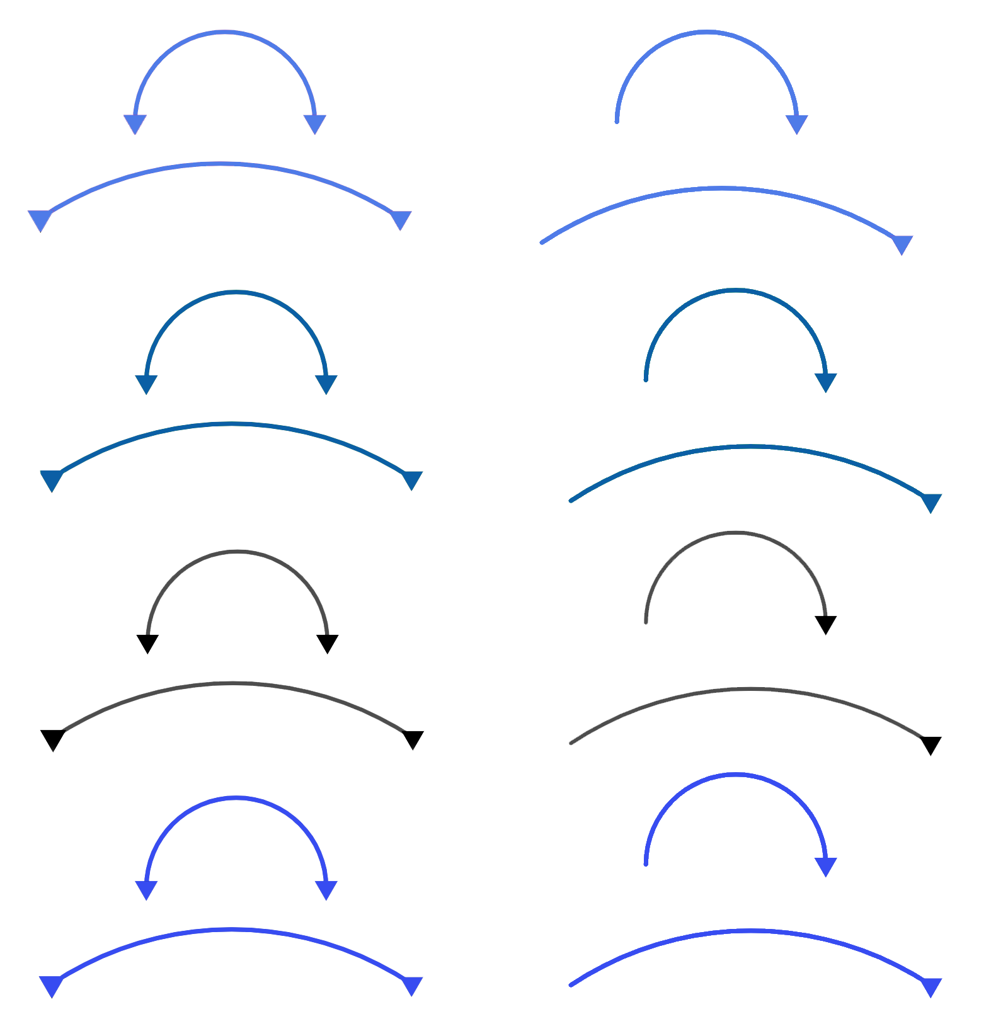
Faa'iido boqolkiiba (percentages)
Ma ganacsiga Axmed iyo Isra ayaa si fiican u socda?
 | Faa'iidada guud (Gross profit) | Dakhliga (Revenue)
Sannadka koowaad | £24 000 | £60 000
Sannadka labaad | £28 000 | £80 000
Sannadka saddexaad | £30 000 | £120 000
×2
Si ay uga helaan £60 000 dakhli (revenue) ilaa £120 000, Axmed iyo Isra waxay ahayd inay laba jeer firfircoonaadaan. Waxay ahayd inay sameeyaan laba jeer ka badan oo bun, keeg, iyo sandwiish ah. Waxaa laga yaabaa inay ahayd inay shaqaaleeyaan dad dheeri ah ama ay maalgashadaan qalab jik oo ka weyn.

Slide 13
Faa'iido boqolkiiba (percentages)
Ma ganacsiga Axmed iyo Isra ayaa si fiican u socda?
Faa'iidada guud (Gross profit) | Dakhliga (Revenue)
£24 000 | £60 000
£28 000 | £80 000
£30 000 | £120 000
×1.25
×2
Kordhinta labanlaabista dadaalka waxay keentay koror 25% ah oo ku yimid faa'iidada (profit).
Haddii aad shaqo qayb-ku-ool ah ku jirtid oo loo-shaqeeyahaagu yidhi, "Waxaan ku siinayaa 25% in ka badan haddii aad labanlaabato dadaalkaaga." Waxaan u malaynayaa inaad si edeb leh u diidi lahayd.

Slide 14
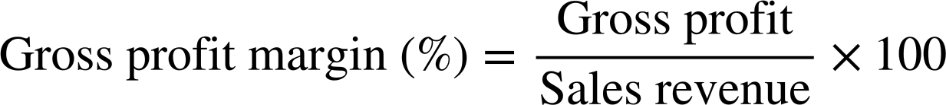
Faa'iidada (Profit) boqolleyda
Si loo fahmo waxtarkooda u dhexeeya dakhliga (Revenue) iyo faa'iidada (profit), ganacsiyadu waxay ku daraan tiir saddexaad natiijooyinkan oo kale.
 | Faa'iidada guud (Gross profit) | Dakhliga (Revenue)
Sannadka koowaad | £24 000 | £60 000
Sannadka labaad | £28 000 | £80 000
Sannadka saddexaad | £30 000 | £120 000
 | Faa'iidada guud (Gross profit) | Dakhliga (Revenue) | Heerka faa'iidada guud (Gross profit margin)
Sannadka koowaad | £24 000 | £60 000
Sannadka labaad | £28 000 | £80 000
Sannadka saddexaad | £30 000 | £120 000
Heerka faa'iidada guud (Gross profit margin) waxaa lagu xisaabiyaa iyadoo la adeegsanayo qaaciddo (formula):

Slide 15
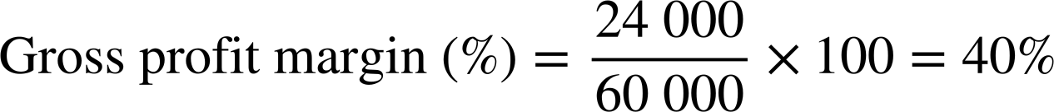
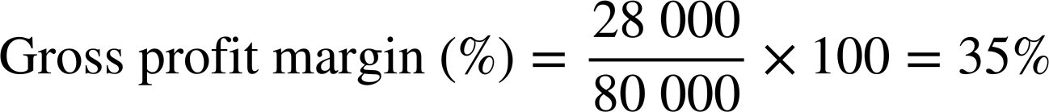
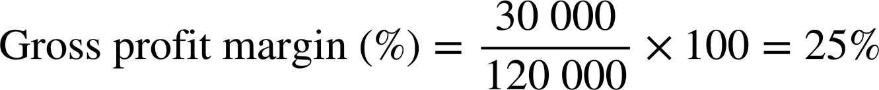
Faa'iidada (Profit) boqolleyda
Si loo fahmo waxtarkooda u dhexeeya dakhliga (Revenue) iyo faa'iidada (profit), ganacsiyadu waxay ku daraan tiir saddexaad natiijooyinkan oo kale.
 | Faa'iidada guud (Gross profit) | Dakhliga (Revenue)
Sannadka koowaad | £24 000 | £60 000
Sannadka labaad | £28 000 | £80 000
Sannadka saddexaad | £30 000 | £120 000
 | Faa'iidada guud (Gross profit) | Dakhliga (Revenue) | Saamiga faa'iidada guud (Gross profit margin)
Sannadka koowaad | £24 000 | £60 000
Sannadka labaad | £28 000 | £80 000
Sannadka saddexaad | £30 000 | £120 000
 | Faa'iidada guud (Gross profit) | Dakhliga (Revenue) | Saamiga faa'iidada guud (Gross profit margin)
Sannadka koowaad | £24 000 | £60 000 | 40%
Sannadka labaad | £28 000 | £80 000
Sannadka saddexaad | £30 000 | £120 000
 | Faa'iidada guud (Gross profit) | Dakhliga (Revenue) | Saamiga faa'iidada guud (Gross profit margin)
Sannadka koowaad | £24 000 | £60 000 | 40%
Sannadka labaad | £28 000 | £80 000 | 35%
Sannadka saddexaad | £30 000 | £120 000
 | Faa'iidada guud (Gross profit) | Dakhliga (Revenue) | Saamiga faa'iidada guud (Gross profit margin)
Sannadka koowaad | £24 000 | £60 000 | 40%
Sannadka labaad | £28 000 | £80 000 | 35%
Sannadka saddexaad | £30 000 | £120 000 | 25%
Sannadka koowaad:
Sannadka labaad:
Sannadka saddexaad:

Slide 16
Faa'iidada boqolleyda (Profit in percentages)
Haddii qaabkani sii socdo, saamiyadu (margins) waxay noqon karaan kuwo aad u cidhiidhi ah oo ganacsigoodu aanu sii shaqeyn karin.
 | Faa'iidada guud (Gross profit) | Dakhliga (Revenue) | Saamiga faa'iidada guud (Gross profit margin)
Sannadka koowaad | £24 000 | £60 000 | 40%
Sannadka labaad | £28 000 | £80 000 | 35%
Sannadka saddexaad | £30 000 | £120 000 | 25%
Sannadkoodii ganacsi ee koowaad, 40% dakhligoodu wuxuu ahaa faa'iidada guud (gross profit).
Sannadkoodii ganacsi ee saddexaad, kaliya 25% dakhligoodu wuxuu ahaa faa'iidada guud (gross profit).

Slide 17
Faa'iidada boqolleyda (Profit in percentages)
Waa kuwan natiijooyinka sannadka afraad iyo shanaad. Xisaabi qiime (value) faa'iidada guud ee labada sannadood.
 | Faa'iidada guud (Gross profit) | Dakhliga (Revenue) | Saamiga faa'iidada guud (Gross profit margin)
Sannadka koowaad | £24 000 | £60 000 | 40%
Sannadka labaad | £28 000 | £80 000 | 35%
Sannadka saddexaad | £30 000 | £120 000 | 25%
Sannadka afraad | £33 000 | £110 000
Sannadka shanaad | £40 000 | £120 000
 | Faa'iidada guud (Gross profit) | Dakhliga (Revenue) | Qiime (value) faa'iidada guud (Gross profit margin)
Sannadka koowaad | £24 000 | £60 000 | 40%
Sannadka labaad | £28 000 | £80 000 | 35%
Sannadka saddexaad | £30 000 | £120 000 | 25%
Sannadka afraad | £33 000 | £110 000 | 30%
Sannadka shanaad | £40 000 | £120 000 | 33.3% (ilaa 1 d.p.)

Slide 18
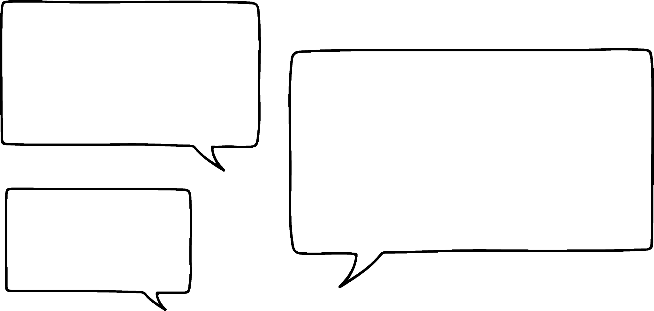
Faa'iidada boqolleyda
Si loo hubiyo in qiime (value) faa'iidada (profit margin) dhammaadka sannadku uu yahay mid caafimaad qaba, ganacsiyadu waxay dejistaan qiimaha (prices) alaabta gaarka ah iyagoo ku talo jira qiime (value) faa'iidada (profit margin) la doonayo.
Isra, ma aanan hagaajin qiimahayaga sannadaha saddexda ah ee ugu horreeya. Waxaan hoos u dhigay qiimahayaga, waxaan iibinnay wax badan, laakiin waxay dhimisay qiime (value) faa'iidada (profit margin).
Taasi ma aha dhibaato Axmed. Hadda waan ognahay. Laga bilaabo hadda, ma iibin doonno alaab kasta oo gaar ah qiimo ka hooseeya 40% qiime (value) faa'iidada (profit margin).

Slide 19
Faa'iidada boqolleyda
Qiime (value) faa'iidada guud (Gross profit margin) alaab kasta waxaa lagu xisaabin karaa qaacidada (formula).
Axmed iyo Isra waxay iibiyaan rooti iyo yaanyo (cheese and tomato sandwich) £4. Qiimaha alaabta (ingredients) waa £2.20
£1.80 waa qiime (value) faa'iidada guud ee lacagta ah ee ay ka helaan sandwij kasta.
£1.80 waa qiime (value) faa'iidada guud ee lacagta ah ee ay ka helaan sandwij kasta, 45% waa saamiga (proportion) qiimaha (value) iibka.

Slide 20
Faa'iidada boqolleyda (Profit in percentages)
Xisaabi farqiga faa'iidada guud (gross profit margin) shay kasta.
Flapjack: Qiimaha (value) iibka £2, qiimaha (value) kharashka £0.90
Kafe: Qiimaha (value) iibka £3, qiimaha (value) kharashka £0.30
Sandwij jiis riyaha: Qiimaha (value) iibka £4.50, qiimaha (value) kharashka £3
Talo sii Axmed iyo Isra shay kasta oo aan gaareyn 40% bartilmaameedka farqiga faa'iidada guud (gross profit margin).

Slide 21
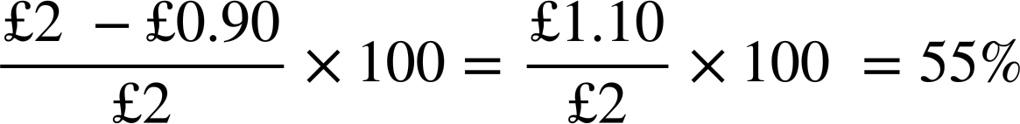
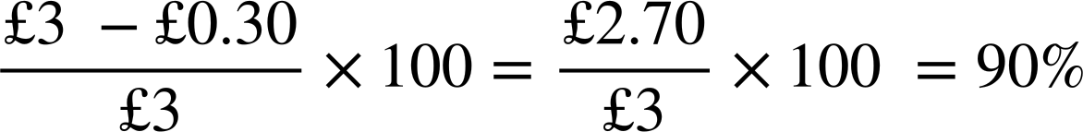
Faa'iidada boqolleyda (Profit in percentages)
Xisaabi farqiga faa'iidada guud (gross profit margin) shay kasta.
Flapjack: Qiimaha (value) iibka £2, qiimaha (value) kharashka £0.90
Kafe wuxuu leeyahay farqi faa'iido (profit margin) aad u sarreeya. Axmed iyo Isra waxay doonayaan inay ka iibiyaan kafe shay kasta oo kale!
Kafe: Qiimaha (value) iibka £3, qiimaha (value) kharashka £0.30

Slide 22
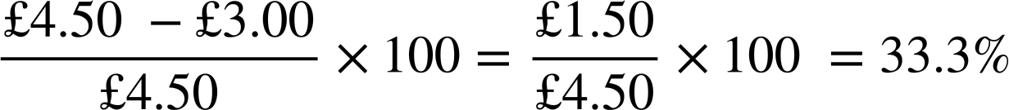
Faa'iidada boqolleyda (Profit in percentages)
Xisaabi farqiga faa'iidada guud (gross profit margin) shay kasta.
Sandwij jiis riyaha: Qiimaha (value) iibka £4.50, qiimaha (value) kharashka £3
(ilaa 1 d.p.)
Sandwijyada jiiska riyaha (Goats’ cheese sandwiches) kama qancayaan 40% bartilmaameedka farqiga faa'iidada (profit margin). Axmed iyo Isra waa inay kordhiyaan qiimaha (value) iibka, helaan hab lagu yareeyo qiimaha (value) kharashka, ama joojiyaan iibinta sandwijyadan.

Slide 23
Faa'iidada boqolleyda (Profit in percentages)
Xisaabaadka boqolleyda (Percentage calculations) waxay u sahlayaan ganacsiyada yaryar inay go'aamiyaan sida loo qiimeeyo (value) alaabtooda.
Sandwij jiis riyaha:
Qiimaha iibka (selling price): £5
Qiimaha iibka (selling price):
Qiime (value) kharash (cost) 60%
Qiime (value) dakhli (profit margin) 40%
Qiimaha (value) kharashka £3
Qiimaha iibka (selling price) × 0.6 = £3
£5 waa qiimaha iibka (selling price) ugu yar ee Axmed iyo Isra ay tahay inay ku iibiyaan sandwich-ka jiiska riyaha (goats’ cheese sandwich).
sidaas darteed…
£3 ÷ 0.6 = Qiimaha iibka (selling price)
£3 ÷ 0.6 = £5

Slide 24
Dakhli (profit) boqolleyda (percentages)
Axmed iyo Isra waa inay sameeyaan ugu yaraan 40% dakhli (profit margin) saafi ah (gross) alaabtan. Xisaabi qiimaha iibka (selling price) ugu yar.
Chicken mayo s’wich:
Qiimaha kharashka (cost price) £2.40
Qiimaha kharashka (cost price) £1.50
Qiimaha kharashka (cost price) £1.15
Jawaabaha:
£2.40 ÷ 0.6 = £4
£1.50 ÷ 0.6 = £2.50
Croissants:
£1.15 ÷ 0.6 = £1.92
Shakes:

Slide 25
Dakhli (profit) boqolleyda (percentages)
Axmed iyo Isra waa inay sameeyaan ugu yaraan 40% dakhli (profit margin) saafi ah (gross) alaabtan. Xisaabi qiimaha iibka (selling price) ugu yar.
Chicken mayo s’wich:
Qiimaha kharashka (cost price) £2.40
£2.40 ÷ 0.6 = £4
Croissants:
Qiimaha kharashka (cost price) £1.50
£1.50 ÷ 0.6 = £2.50
Shakes:
Qiimaha kharashka (Cost price) £1.15
£1.15 ÷ 0.6 = £1.92
Axmed iyo Isra waxay doonayaan inay sameeyaan ugu yaraan 75% faa'iidada saafiga ah (gross profit margin) ee keega. Xisaabi qiimaha iibinta ugu hooseeya (minimum selling price).
Lemon drizzle:
Qiimaha kharashka (Cost price) £0.30
£0.30 ÷ 0.25 = £1.20
Keega karootada (Carrot cake):
Qiimaha kharashka (Cost price) £0.45
£0.45 ÷ 0.25 = £1.80
75% faa'iidada saafiga ah (gross profit) macneheedu waa 25% waa qiimaha kharashka (cost price) sidaas darteed…

Slide 26

Faa'iidada boqolleyda (Profit in percentages)
Chicken mayo s’wich:
Qiimaha kharashka (Cost price) £2.40
Qiimaha kharashka (Cost price) £1.50
Qiimaha kharashka (Cost price) £1.15
Lemon drizzle:
Qiimaha kharashka (Cost price) £0.30
Keega karootada (Carrot cake):
Qiimaha kharashka (Cost price) £0.45
Waan jeclahay xisaabta (maths) laakiin waxaan iibineynaa ku dhawaad boqol alaab. Xisaabinta qiimaha ugu hooseeya (minimum pricing) waxay qaadanaysaa saacado!
Taasi waa sababta ganacsiyada yaryar u isticmaalaan spreadsheets. Annaguna waa inaan isticmaalno!
Jawaabaha:
£2.40 ÷ 0.6 = £4
£1.50 ÷ 0.6 = £2.50
Croissants:
£1.15 ÷ 0.6 = £1.92
Shakes:
£0.30 ÷ 0.25 = £1.20
£0.45 ÷ 0.25 = £1.80

Slide 27
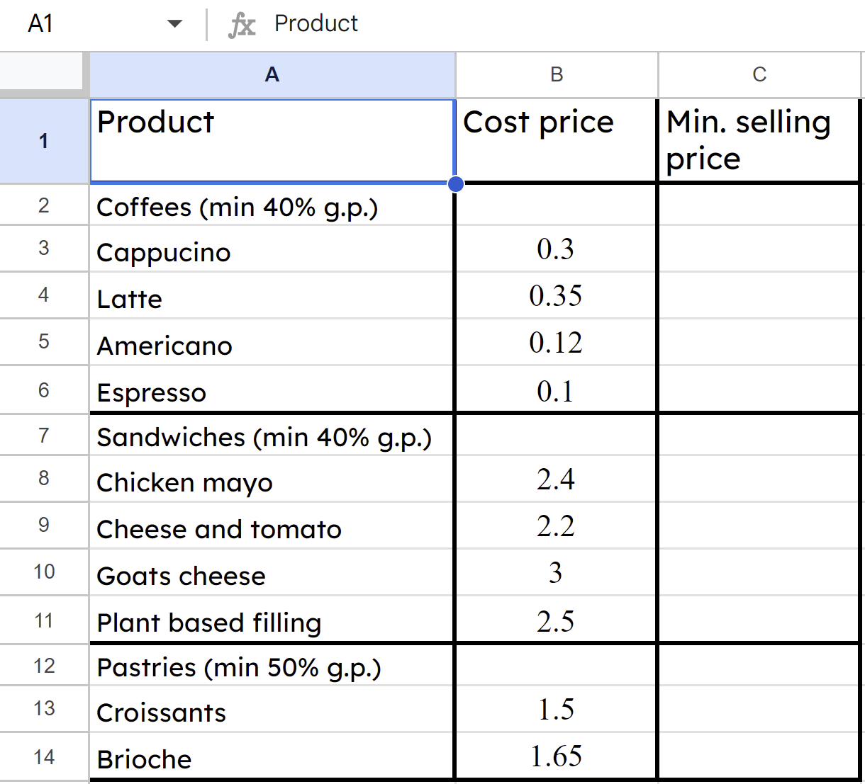
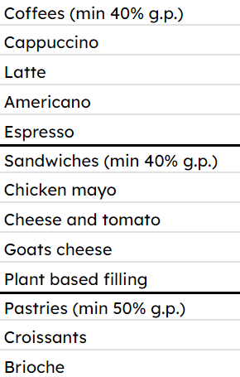
Faa'iidada boqolleyda (Profit in percentages)
Axmed iyo Isra waxay bilaabeen iyagoo sameynaya liis alaabta iyo qiimaha (value) kharashka (cost price) ee ay leeyihiin.

Slide 28
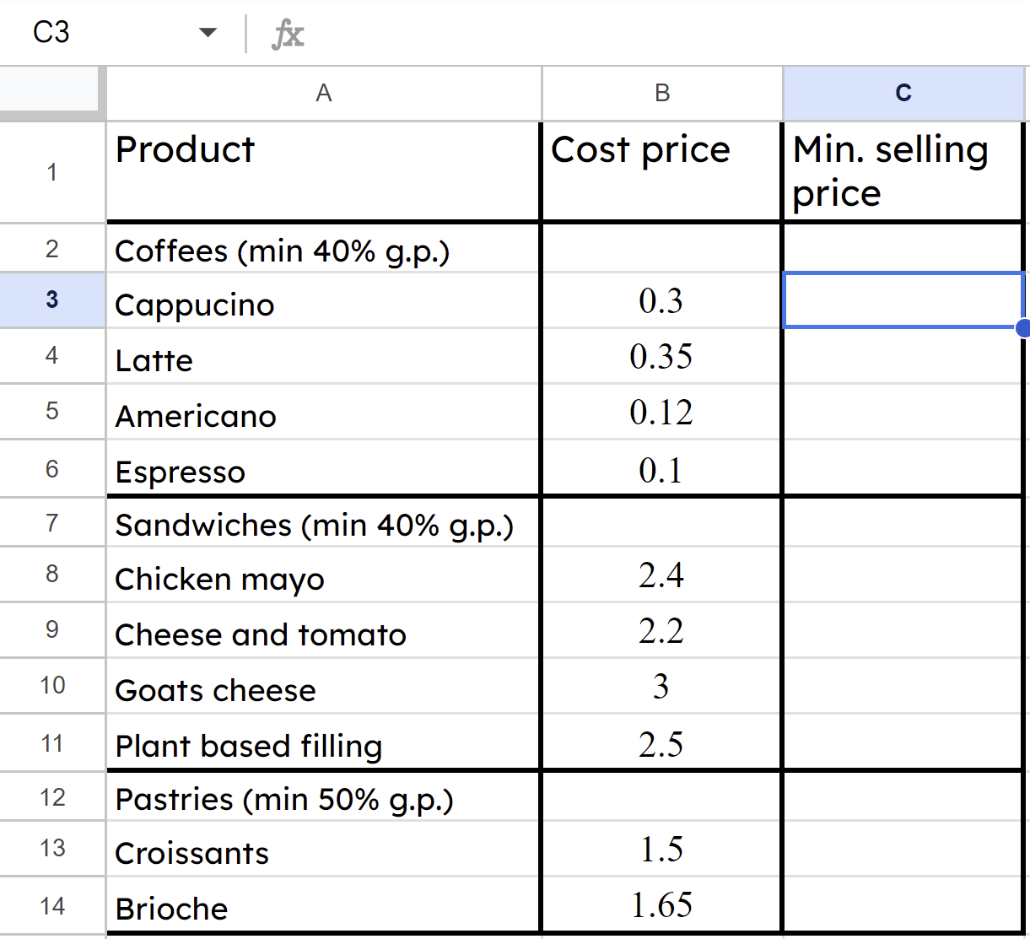
Faa'iido (Profit) boqolleyda (percentages)
Hadda waxay qori karaan qaacidada (formula) si ay u xisaabiyaan dhammaan qiimaha (value) iibka ugu yar si toos ah.
Waxay ku qoraan qaacidada (formula) =B3/0.6 halkan.
B3 waa unugga (cell) ka kooban qiimaha (value) kharashka (cost price) ee alaabtan,
B3 waa unugga (cell) ka kooban qiimaha (value) kharashka (cost price) ee alaabtan, /0.6 macneheedu waa ÷ 0.6

Slide 29
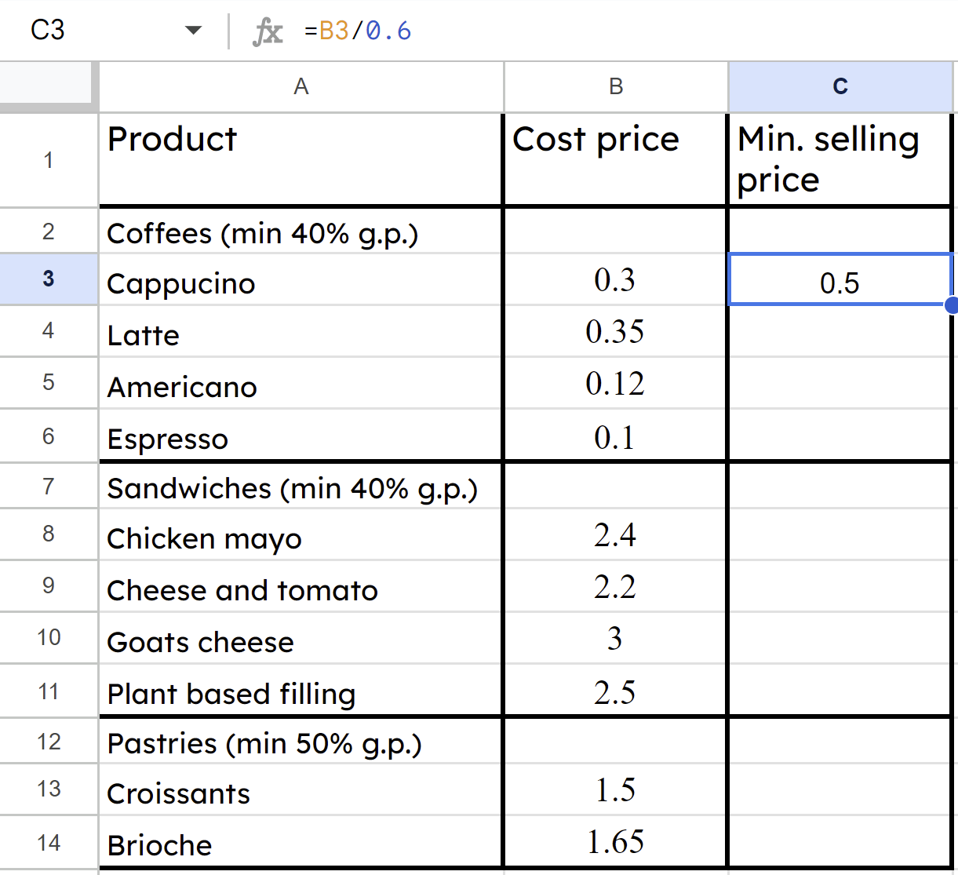
Faa'iido (Profit) boqolleyda (percentages)
Qaacidada (formula) =B3/0.6 ma muuqato, natiijada xisaabinta ayaa muuqata. Xaashida (spreadsheet) waxay xisaabisaa qiimaha (value) iibka ugu yar ee cappuccino inuu yahay £0.50
Waxay qoraan qaacido (formula) =B3/0.6 halkii ay ka qori lahaayeen xisaabta gaarka ah =0.3/0.6 sababtoo ah waxaan rabnaa inaan ku koobiyeyno dhammaan alaabta.

Slide 30
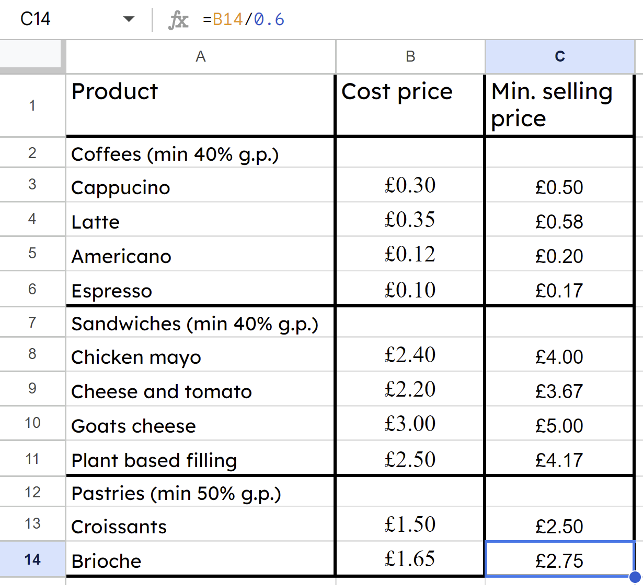
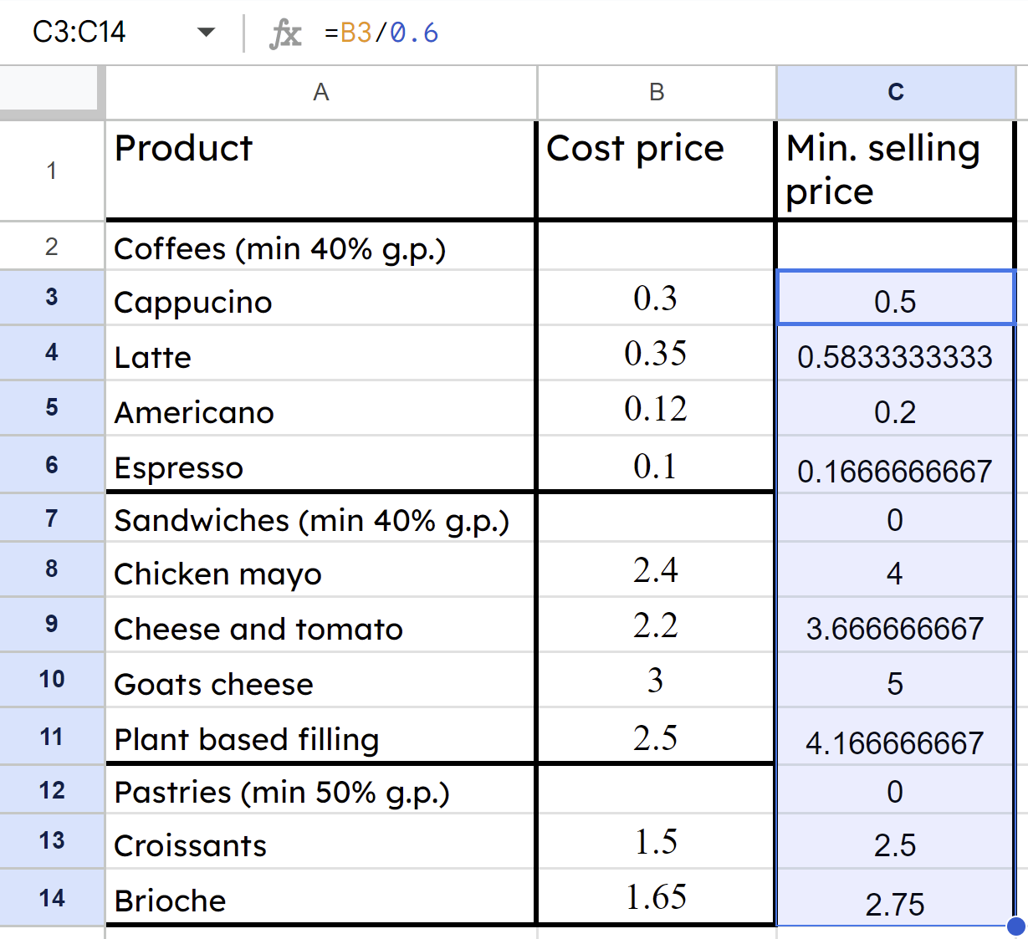
Faa'iido (Profit) boqolleyda (percentages)
Waxay tirtiri karaan safafka (rows) aan loo baahnayn, ka dibna guji Format/Number/Currency iyo natiijooyinka waxay u muuqdaan qaab lacageed (currency).
Jiidista qaacidada (formula) hoos waxay ka dhigan tahay in lagu celiyo saf kasta.

Slide 31
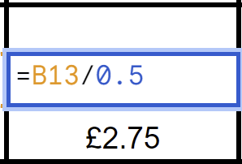
Faa'iido (Profit) boqolleyda (percentages)
Beddel 0.6 ilaa 0.5 si ay u muujiso G.P. (target) kan, oo koobiyee qaacidada (formula) hoos.
Waxay u baahan yihiin inay hagaajiyaan qaacidada (formula) alaab kasta oo G.P. (target) aanu ahayn 40%

Slide 32
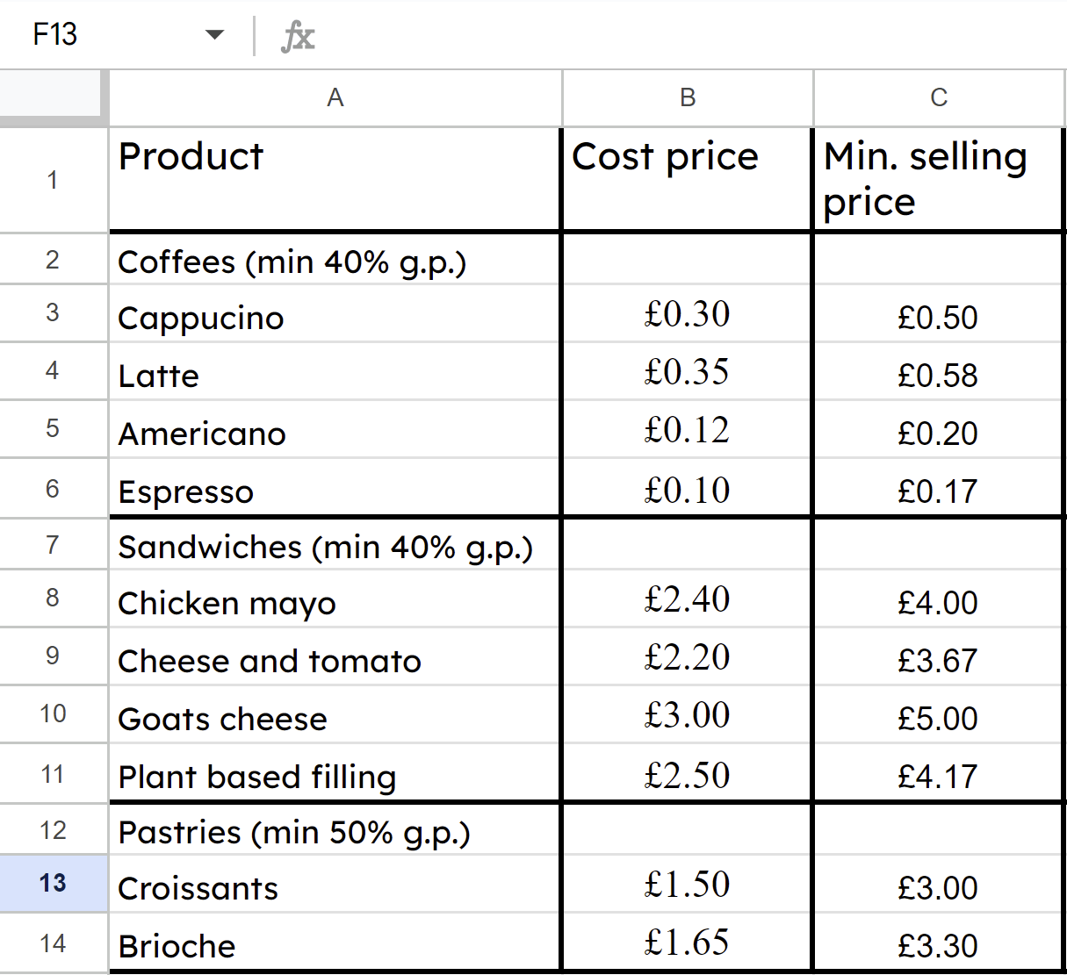
Faa'iido (Profit) boqolleyda (percentages)
Daqiiqado gudahood Axmed iyo Isra waxay xisaabin karaan qiimaha (value) iibka ugu yar noocyo badan oo alaab ah iyagoo isticmaalaya xaashida (spreadsheet) iyo qaacidada (formula).

Slide 33
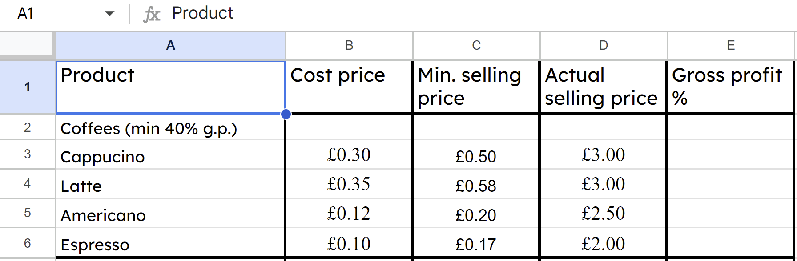
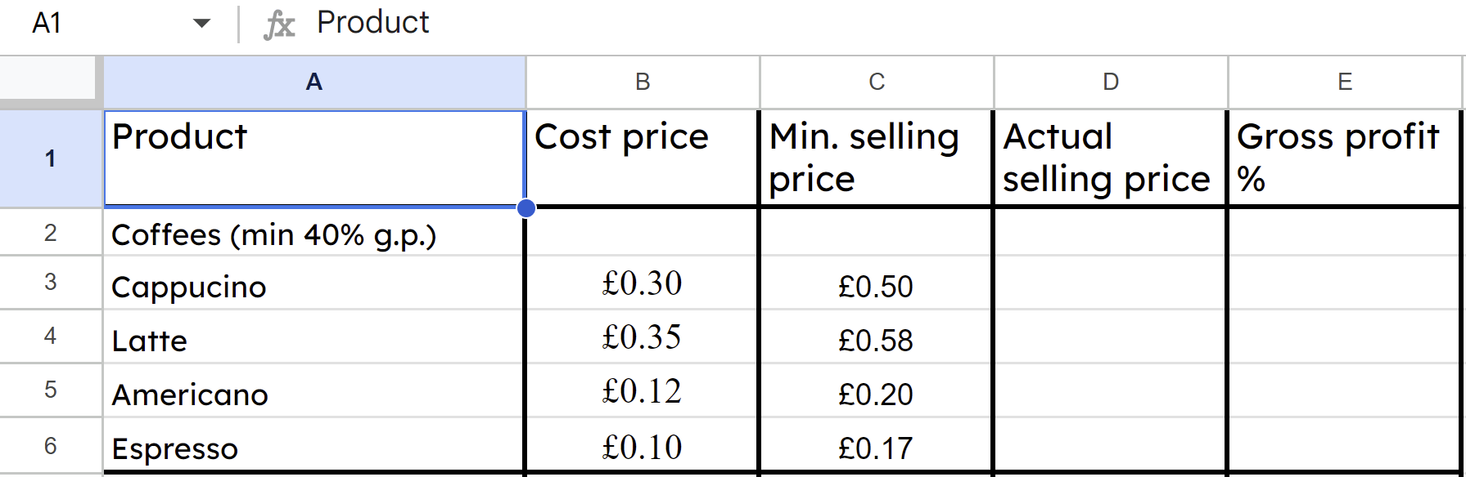
Faa'iido (Profit) boqolleyda (percentages)
Ganacsi yar ma iibin doono dhammaan alaabtiisa qiimaha (value) ugu yar ee la xisaabiyay. Waxay eegi doonaan suuqa (market) si ay u fahmaan waxa ay kuwa la tartamaya (competitors) ku dallaca iyo waxa macaamiishoodu diyaar u yihiin inay bixiyaan ka hor inta aanay go'aamin qiimaha (value) iibka.

Slide 34
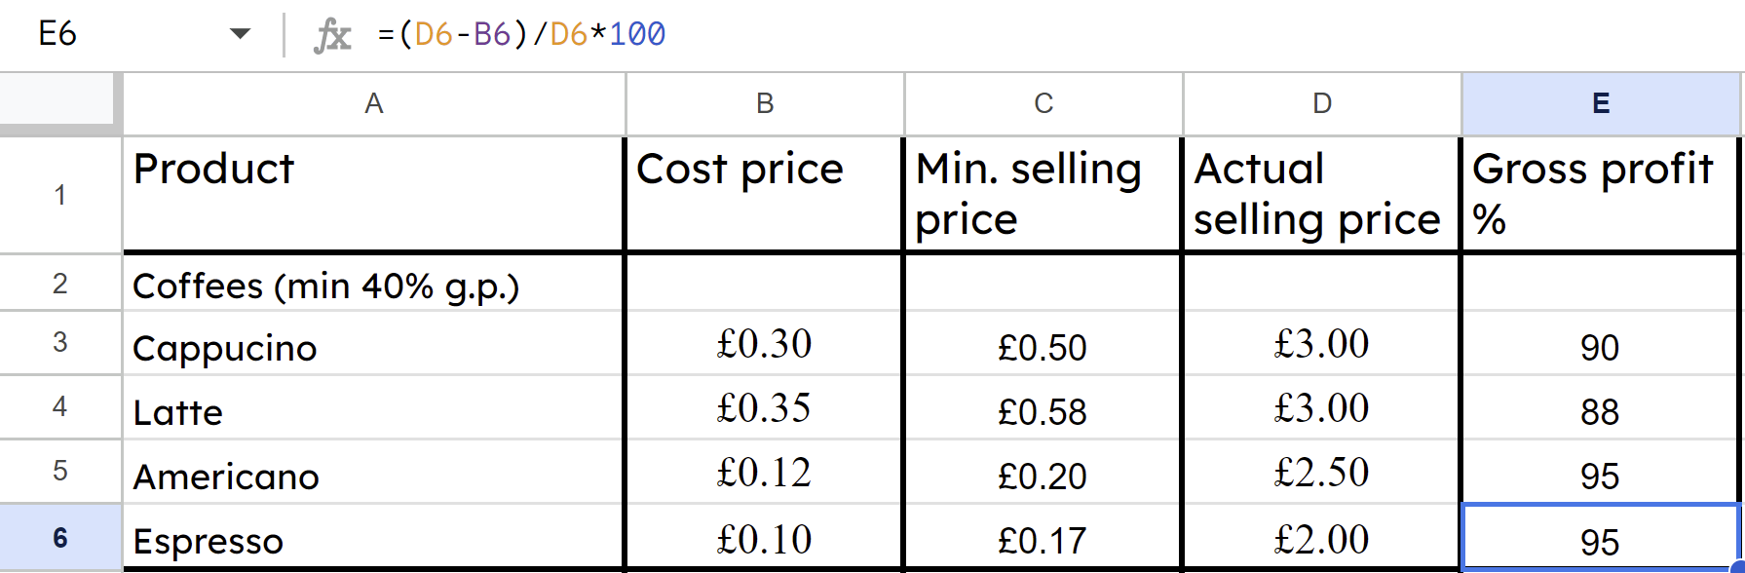

Faa'iido (Profit) boqolleyda (percentages)
Ka dib go'aaminta qiimaha (value) iibka, qaacido (formula) kale ayaa lagu qori karaa tiirka 'Gross profit %' si ay si toos ah ugu xisaabiso taas alaab kasta.

Slide 35
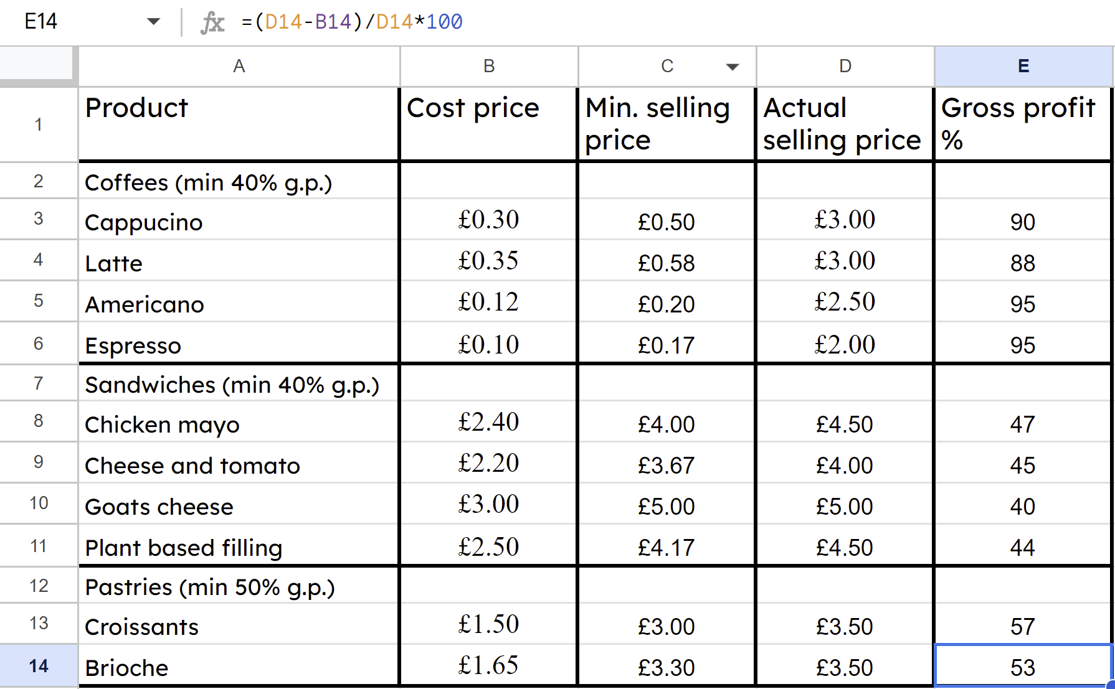
Faa'iido (Profit) boqolleyda (percentages)
Axmed iyo Isra hadda way fahmi karaan waxa alaabtooda ugu faa'iidada badan (most profitable).

Slide 36
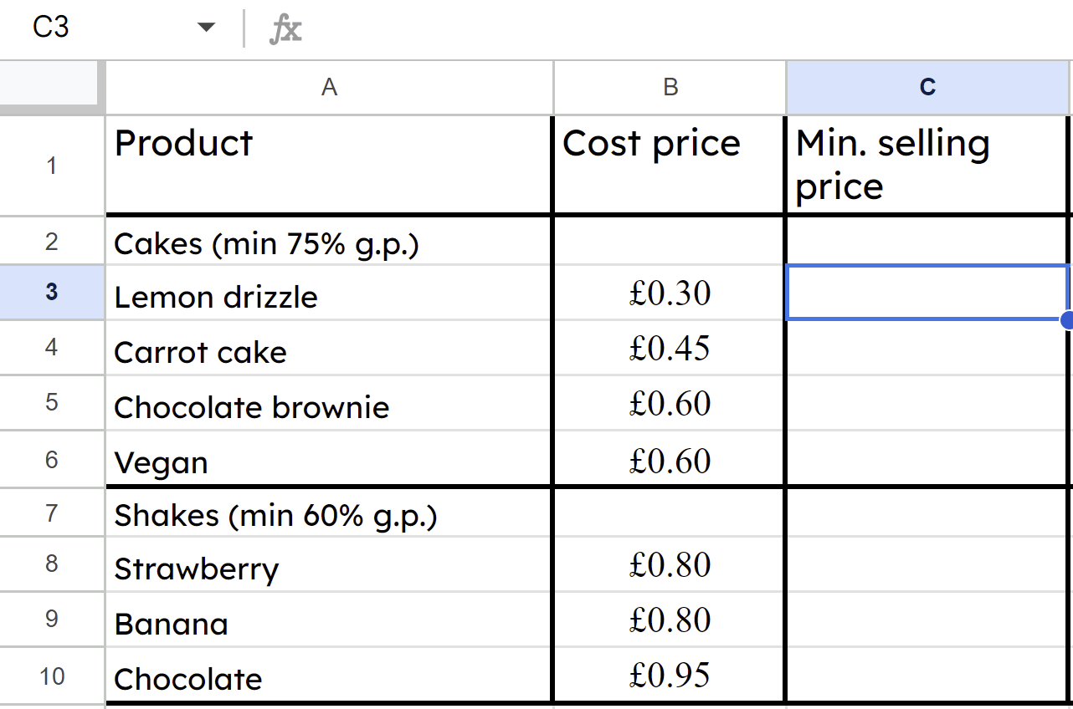


Faa'iidada (Profit) boqolleyda (percentages)
Shaxdan (spreadsheet) qaaciddada (formula) noocee ah ayaa loo qorayaa unugga (cell) C3?
=B3/0.6
Bartilmaameedka (Target) G.P. waa 75%, ma aha 40%
a
b
=B3/0.25
Qaaciddada (Formula) waa inay ku jirtaa calaamadda '='.
c
B3/0.25

Slide 37
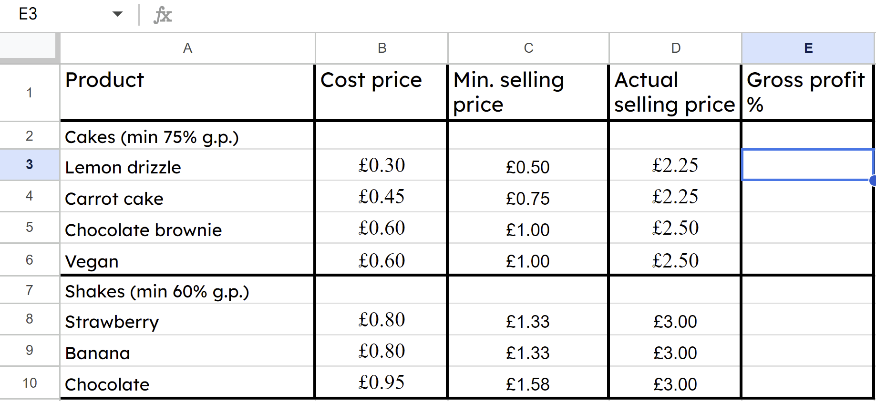
Faa'iidada (Profit) boqolleyda (percentages)
Marka la go'aamiyo qiimaha (value) iibka (selling prices), waa maxay qaaciddada (formula) loo qoray unugga (cell) E3?
a
=(D3−B3)/D3*100
b
=D3−B3/D3*100
c
=B3−D3/B3*100
Waa inay leedahay qawsyo (brackets).
Sida khaldan (Wrong order).

Slide 38
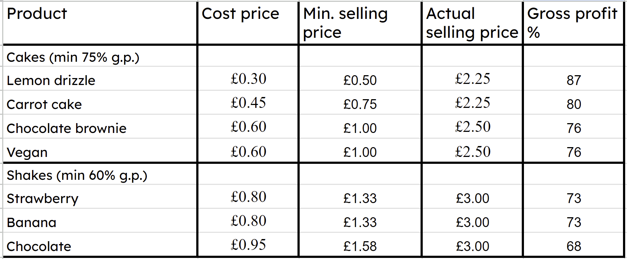
Faa'iidada (Profit) boqolleyda (percentages)
Shaxda (spreadsheet) oo dhamaystiran, maxay alaabta (product) aad u malaynaysaa in Axmed iyo Isra ay dhigi doonaan meesha ugu caansan (most prominent) ee kafaatiga (cafe)?
Keega (cake) liinta (lemon drizzle) sababtoo ah waxay leedahay G.P. % ugu sarreeya (highest).

Slide 39
Faa'iidada (Profit) boqolleyda (percentages)
1) Buuxi meelaha bannaan (blanks) ee natiijooyinka (results) sanadaha ugu horreeya ee ganacsigan yar (small business) oo faallo ka bixi sida faa'iidadooda (profit margin) u isbeddeleysa.
 | Faa'iidada guud (Gross profit) | Dakhliga (Revenue) | Faa'iidada guud ee boqolleyda (Gross profit margin)
Sannadka koowaad (Year one) | £0 | £12 000 | 0%
Sannadka labaad (Year two) | £1000 | £20 000
Sannadka saddexaad (Year three) |  | £48 000 | 12.5%
Sannadka afraad (Year four) | £20 000 |  | 40%
Sannadka shanaad (Year five) | £24 500 | £56 000

Slide 40
Faa'iidada boqolleyda (Profit in percentages)
2) Xisaabi faa'iidada guud ee boqolleyda (gross profit margin) shay kasta oo ka mid ah dukaankan paddleboard-ka cusub.
a) Paddleboard 10 ft: Qiimaha iibka £575, qiimaha kharashka £373.75
b) Paddleboard 12 ft: Qiimaha iibka £650, qiimaha kharashka £390
c) Carbon paddle: Qiimaha iibka £110, qiimaha kharashka £82.50
d) Buoyancy aid: Qiimaha iibka £60, qiimaha kharashka £34.50
e) Ka faallo bixi waxa aan gaareynin 30% faa'iidada guud ee boqolleyda (gross profit margin) oo kula tali waxay tahay inay sameeyaan.

Slide 41
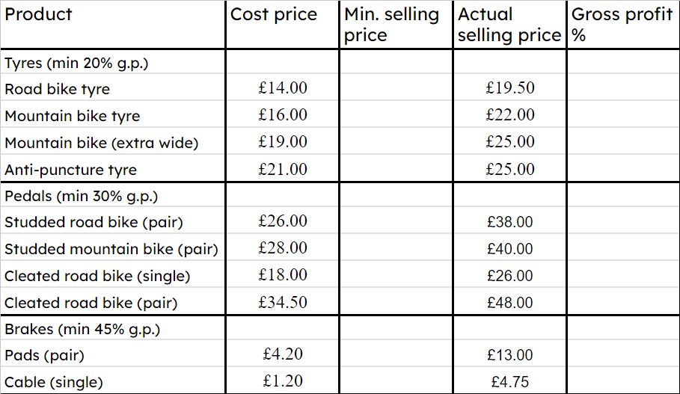
Faa'iidada boqolleyda (Profit in percentages)
3) a) Adigoo buuxinaya spreadsheet (spreadsheet) ama si kale, xisaabi qiimaha ugu yar ee iibka iyo faa'iidada guud ee boqolleyda (gross profit margins) alaabta dukaanka baaskiilkaan.
b) Ka faallo bixi wax alaabo ah oo aan gaareynin faa'iidada guud ee boqolleyda (gross profit margins) ugu yar.
c) Kula tali ganacsiga alaabta ay tahay inay si weyn u soo bandhigaan dukaankooda.

Slide 42
Faa'iidada (Profit) boqolleyda
1) Buuxi meelaha bannaan ee natiijooyinka sannadaha ugu horreeya ee ganacsigan yar, oo faallo ka bixi sida faa'iidada (profit margin) u isweydaarto.
 | Faa'iidada guud (Gross profit) | Dakhliga (Revenue) | Faa'iidada guud ee boqolleyda (Gross profit margin)
Sannadka koowaad | £0 | £12 000 | 0%
Sannadka labaad | £1000 | £20 000
Sannadka saddexaad |  | £48 000 | 12.5%
Sannadka afraad | £20 000 |  | 40%
Sannadka shanaad | £24 500 | £56 000
 | Faa'iidada guud (Gross profit) | Dakhliga (Revenue) | Faa'iidada guud ee boqolleyda (Gross profit margin)
Sannadka koowaad | £0 | £12 000 | 0%
Sannadka labaad | £1000 | £20 000 | 5%
Sannadka saddexaad | £6000 | £48 000 | 12.5%
Sannadka afraad | £20 000 | £50 000 | 40%
Sannadka shanaad | £24 500 | £56 000 | 43.75%
Waxaa laga yaabaa inaad soo sheegtay, "Inkasta oo kororka dakhliga (revenue) uu hoos u dhacayo, faa'iidada guud (gross profit margins) ayaa kor u kacday heer caafimaad leh."

Slide 43
Faa'iidada (Profit) boqolleyda
2) Xisaabi faa'iidada guud (gross profit margin) ee shay kasta oo ka mid ah dukaankan cusub ee looxaasha (paddleboard).
a) Loox 10 ft (paddleboard): Qiimaha iibka (selling price) £575, qiimaha kharashka (cost price) £373.75
35%
b) Loox 12 ft (paddleboard): Qiimaha iibka (selling price) £650, qiimaha kharashka (cost price) £390
40%
c) Carbon paddle: Qiimaha iibka (selling price) £110, qiimaha kharashka (cost price) £82.50
25%
d) Buoyancy aid: Qiimaha iibka (selling price) £60, qiimaha kharashka (cost price) £34.50
42.5%
e) Faallo ka bixi alaabta aan gaareyn bartilmaameedkooda 30% ee faa'iidada guud (gross profit margin), oo ku talo waxay tahay inay sameeyaan.

Slide 44
Faa'iidada (Profit) boqolleyda
2) Xisaabi faa'iidada guud (gross profit margin) ee shay kasta oo ka mid ah dukaankan cusub ee looxaasha (paddleboard).
e) Carbon paddle ma gaareyn 30% G.P. Ganacsigu waa inuu helo alaab jaban (cheaper supplier), kordhiyo qiimaha iibka (selling price), ama joojiyo iibinta alaabtan.
c) Carbon paddle: Qiimaha iibka (selling price) £110, qiimaha kharashka (cost price) £82.50
25%
e) Faallo ka bixi alaabta aan gaareyn bartilmaameedkooda 30% ee faa'iidada guud (gross profit margin), oo ku talo waxay tahay inay sameeyaan.

Slide 45
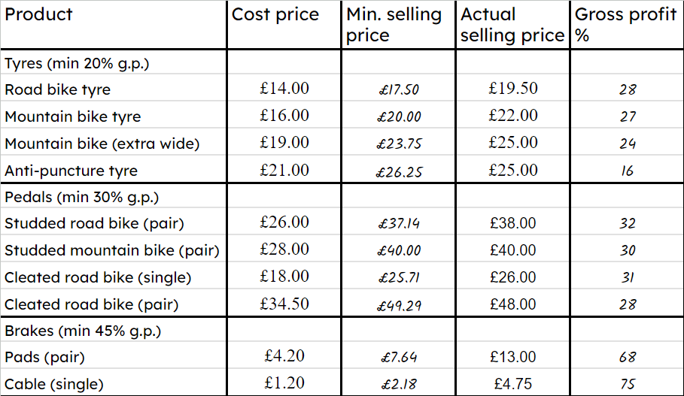
Faa'iido boqolkiiba (Profit in percentages)
3) a) Adigoo buuxinaya xaashi xisaabeed (spreadsheet) ama si kale, xisaabi qiimaha iibka ugu yar (minimum selling price) iyo faa'iidada guud (gross profit margins) ee alaabta dukaankan baaskiilka.
b) Ka faallo bixi waxyaabaha aan gaareyn heerka ugu yar ee faa'iidada (gross profit margins).
c) Ku talo ganacsiga alaabta ay tahay inay si weyn u soo bandhigaan dukaankooda.

Slide 46
Faa'iido boqolkiiba (Profit in percentages)
3) a) Adigoo buuxinaya spreadsheet ama si kale, xisaabi qiimaha ugu yar ee iibka iyo faa'iidada (gross profit margins) ee alaabta dukaankan baaskiilka.
b)
Taayirada ka hortaga daloolinta iyo baedalka (cleated pedals) ma gaareyn heerka ugu yar ee G.P. (gross profit margins).
c)
Waa inay dhigaan fiilooyinka bareegyada (brake cables) meesha ugu muuqata dukaankooda.

Slide 47
Maaraynta ganacsi yar (Running a small business)
Faa'iido boqolkiiba (Profit in percentages)
La socodka waxqabadka (Tracking performance)

Slide 48
La socodka waxqabadka (Tracking performance)
Inta badan ganacsiyada yaryar waxay isticmaalaan spreadsheets si ay ula socdaan waxqabadkooda.
Waa maxay dakhliga ugu weyn ee ganacsigan soo galay bishii sannadkan?
Ogosto, £21 300
Waa maxay dakhligoodii ugu yaraa bishii sannadkan?
Janaayo, £11 000
Waa maxay celceliska bisha ee ganacsigan?
Celceliska (Mean average): £161 000 ÷ 12 = £13 417
Dhexdhexaadka (Median average): £12 350

Slide 49
La socodka waxqabadka (Tracking performance)
Inta badan ganacsiyada yaryar waxay isticmaalaan spreadsheets si ay ula socdaan waxqabadkooda.
Dakhliga bisha ugu sarreeya: £21 300
Kala duwanaansho (Range): £10 300
Dakhliga bisha ugu hooseeya: £11 000
Celcelis dhexe (Mean average): £161 000 ÷ 12 = £13 417
Celcelis dhexe (Median average): £12 350
Fahamka celcelisyada (averages) iyo faafinta (spread) xogta waxqabadkoodu waxay ka caawisaa ganacsigu qorsheynta. Ganacsi kastaa wuxuu u baahan yahay inuu saadaaliyo iibkiisa si uu u hubiyo inuu haysto alaabta diyaarka u ah macaamiishiisa.

Slide 50
Raadraaca waxqabadka (Tracking performance)
Soo hel kala duwanaanshaha (range) iyo celceliska (average) iibka sanadka labaad ee isla ganacsiga.
Dakhliga bisha ugu sarreeya: £23 500
Kala duwanaansho (Range): £11 900
Dakhliga bisha ugu hooseeya: £11 600
Celcelis dhexe (Mean average): £174 300 ÷ 12 = £14 525
Celcelis dhexe (Median average): £13 550

Slide 51
Raadraaca waxqabadka (Tracking performance)
Sanadka koowaad:
Sanadka labaad:
Kala duwanaansho (Range): £10 300
Kala duwanaansho (Range): £11 900
Celcelis dhexe (Mean average): £13 417
Celcelis dhexe (Mean average): £14 525
Isbarbardhigga celcelisyada (averages) iyo faafinta (spread) sanadba sanadka ka dambeeya wuxuu u sheegaa mulkiilaha ganacsiga caafimaadka ganacsigiisa.
Mulkiiluhu wuxuu soo gabagabeyn karaa, “Celceliska dhexe (mean average) wuu ka sarreeyaa sidaas darteed waxaan ka iibinay wax badan sanadka labaad”.
“Kala duwanaanshuhu (range) wuu ka sarreeyaa sidaas darteed iibka bishu waa mid isbeddel badan, oo aan la saadaalin karin”.

Slide 52
Raadraaca waxqabadka (Tracking performance)
Sannadka koowaad:
Sannadka labaad:
Kala-duwanaansho (Range): £36 100
Kala-duwanaansho (Range): £17 500
Celcelis (Mean average): £145 000
Celcelis (Mean average): £139 000
Samee laba isbarbardhig oo ku saabsan waxqabadka sannadka ee ganacsigan.
Waxaa laga yaabaa inaad tidhi, “Celcelisku (Mean average) wuu hooseeyaa sidaas darteed waxay ku iibeen wax ka yar sannadka labaad”.
“Kala-duwanaanshuhu (Range) wuu hooseeyaa sidaas darteed iibka bishii waa joogto, waa la saadaalin karaa.”

Slide 53
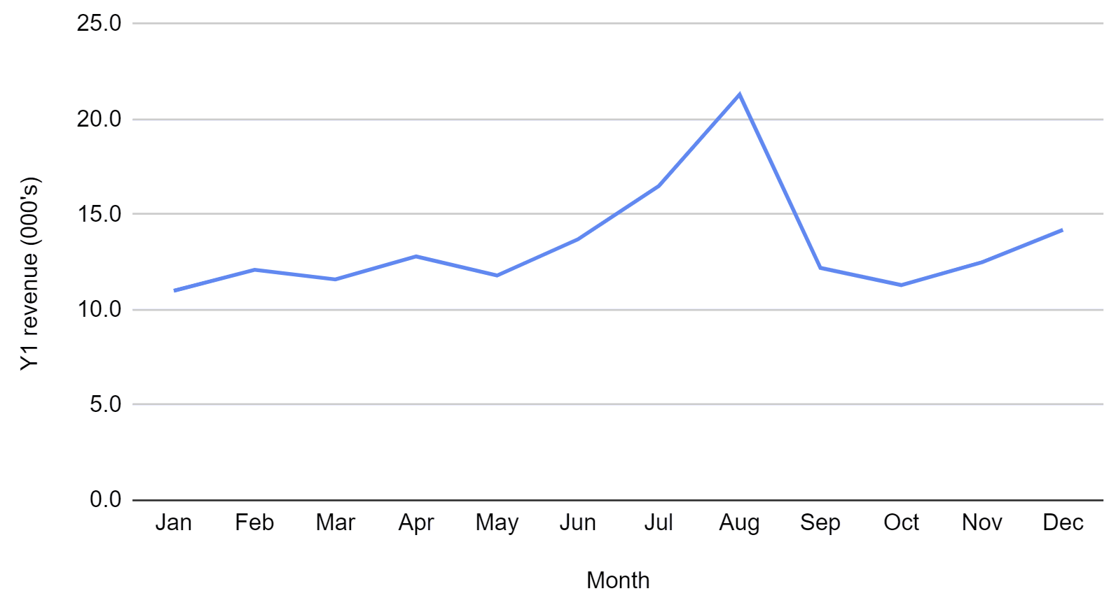
La socodka waxqabadka (Tracking performance)
Faaiidada ugu muhiimsan ee isticmaalka xaashida (spreadsheet) waa in milkiilayaasha ganacsiyada yaryar ay si fudud u soo saari karaan garaafyada si ay u arkaan isbeddellada (trends).
Isticmaalka shaqada insert/chart, milkiiluhu wuxuu arki karaa…
Waa maxay qaabka (pattern) aad hadda si fudud u arki karto?

Slide 54
La socodka waxqabadka (Tracking performance)
Sawirka garaafka (graphical representation) wuxuu inoo tusinayaa in ganacsigan uu la kulmo isbeddel xilliyeed (seasonal trends).
Shirkaddan waxay iibin kartaa badeecad dadku inta badan isticmaalaan xagaaga,
Shirkaddan waxay iibin kartaa badeecad dadku inta badan isticmaalaan xagaaga, oo hadiyad ahaan la bixiyo waqtiga Kirismaska.

Slide 55
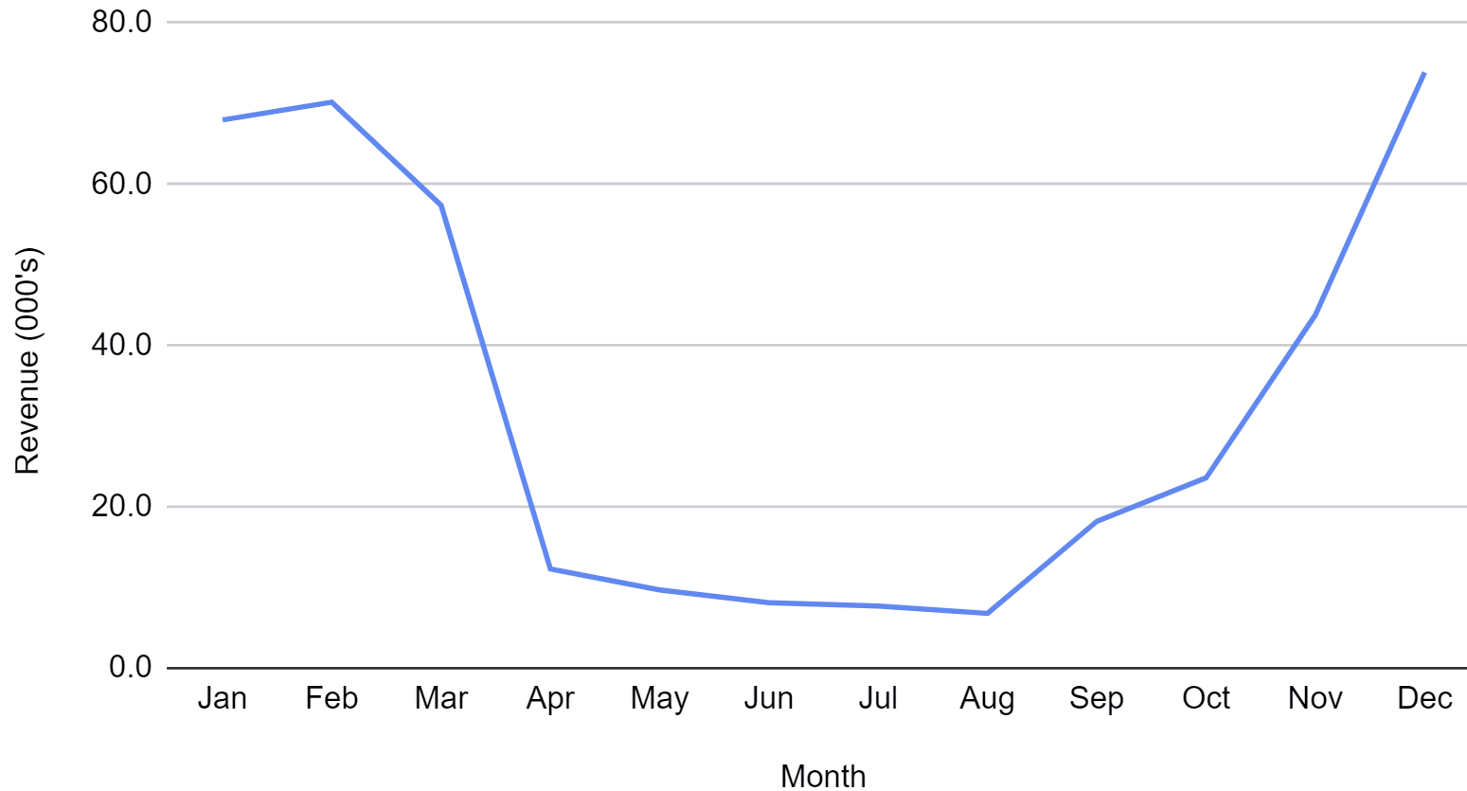
La socodka waxqabadka (Tracking performance)
Waa maxay qaabka (pattern) aad ka arki karto garaafka xogta iibka ganacsigan yar?
Waxaa laga yaabaa inaad tidhi, “Isbeddel xilliyeed (seasonal variation) oo weyn oo leh iib sare bilaha qabow”.

Slide 56
La socodka waxqabadka (Tracking performance)
Ganacsiyo badan oo yaryar ayaa la kulma isbeddel xilliyeed (seasonal variation). Kala-duwanaanshaha garaafka ayaa adkeynaya in la arko haddii iibku soo hagaagayo.
Iibintani miyay kor u socdaan ama hoos? Ma saadaalin kartaa waxa dhici doona?

Slide 57
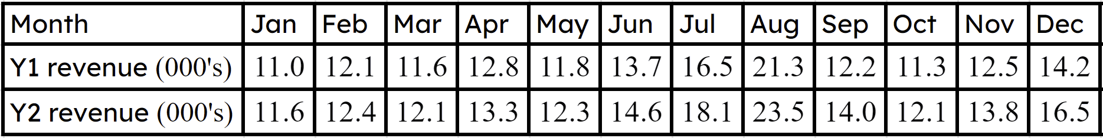
Raadinta waxqabadka (Tracking performance)
Ganacsi yar oo isticmaalaya xaashida (spreadsheet) si uu u raad raaco iibinta sanadba sanadka ku xiga qaabkan oo kale wuxuu ka faa'iideysan karaa noocyada kala duwan ee jaantusyada (charts) uu barnaamijku noo sawiri karo.

Slide 58
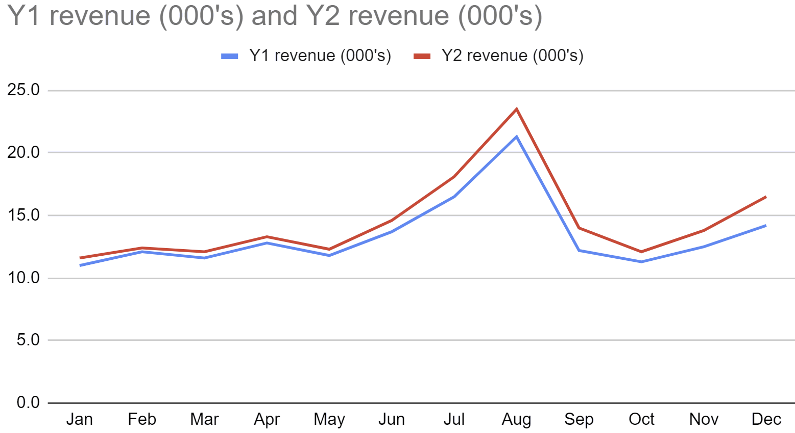
Raadinta waxqabadka (Tracking performance)
Waxaad ugu yeeri kartaa jaantus laba xariiq (dual line graph), ama jaantus xariiq oo la isbarbardhigi karo (comparable line graph).
Waxay si cad u tusaysaa dakhliga S2 (Y2) inuu ka sarreeyo dhammaan dakhliga S1 (Y1). Sanadba sanadka ku xiga ganacsigani wuxuu wanaajinayaa iibintiisa.

Slide 59
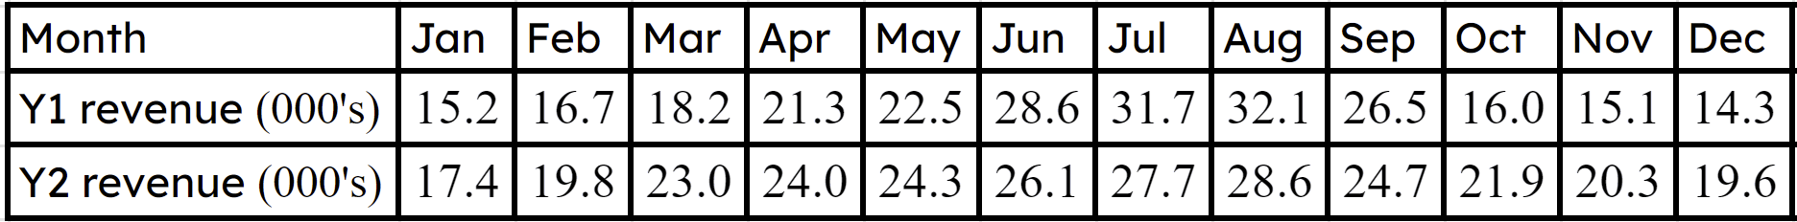
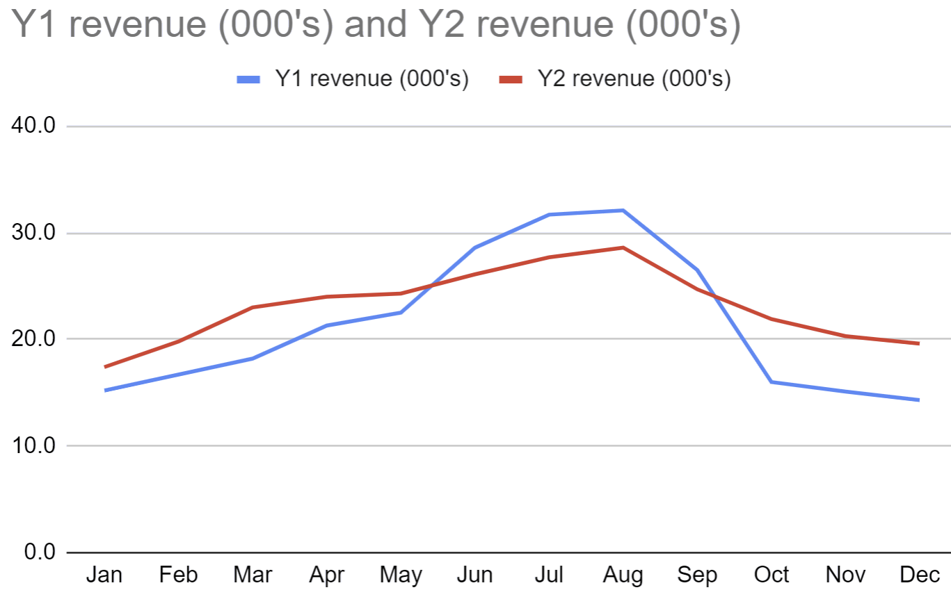
Raadinta waxqabadka (Tracking performance)
Waa maxay qaababka (patterns) aad ku aragtaa sanadba sanadka ku xiga jaantuska iibinta ganacsigan yar?
Waxaa laga yaabaa inaad tidhi, "Kala duwanaanshaha xilliyada (seasonal variation) ayaa ka yar S2 (Y2). Iibinta Jiilaalka/Dayaanta ayaa ka sarreysa S2 (Y2), halka iibinta Xagaaga ay hoos u dhacday".

Slide 60
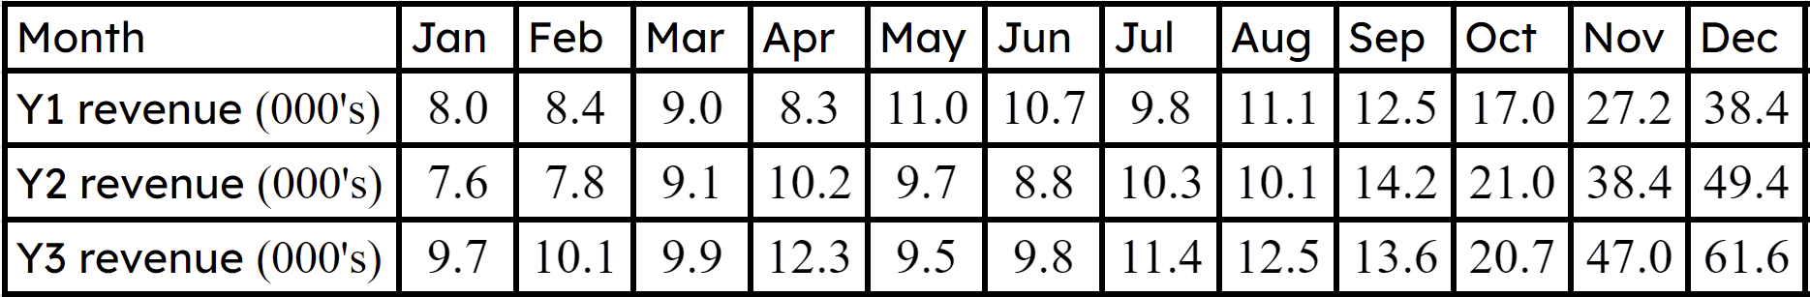
Raadinta waxqabadka (Tracking performance)
1) Halkan waxaa ah saddexda sano ee ugu horreeya ee iibinta ganacsi yar oo cusub.
a) Xisaabi celceliska (mean) iyo kala duwanaanshaha (range) sanad kasta, oo ka hadal isbeddellada sanadba sanadka ku xiga.

Slide 61
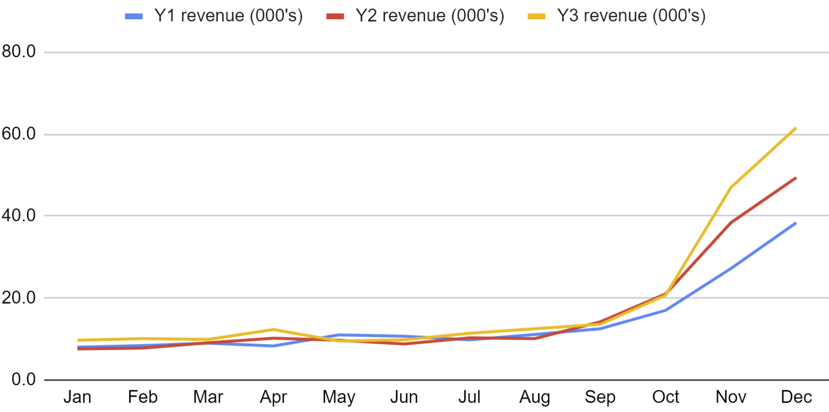
Raadinta waxqabadka (Tracking performance)
b) Ka hadal qaababka (patterns) aad ku aragto xogtan.

Slide 62
Raadinta waxqabadka (Tracking performance)
1) Halkan waxaa ah saddexda sano ee ugu horreeya ee iibinta ganacsi yar oo cusub.
a) Xisaabi celceliska (mean) iyo kala duwanaanshaha (range) sanad kasta, oo ka hadal isbeddellada sanadba sanadka ku xiga.

Slide 63
Raadinta waxqabadka (Tracking performance)
1) Halkan waxaa ah saddexda sano ee ugu horreeya ee iibinta ganacsi yar oo cusub.
a)
Sanka koowaad (Year one):
Sannadka labaad:
Sannadka saddexaad:
Kala duwanaansho (Range): £30 400
Kala-duwanaansho (Range): £41 800
Kala-duwanaansho (Range): £52 100
Celcelis (Mean): £14 283
Celcelis (Mean): £16 383
Celcelis (Mean): £19 008
Waxaa laga yaabaa inaad tidhi, “Celcelisku (Mean) wuu kordhayaa sidaas darteed ganacsigu wuxuu iibinayaa wax badan sannad kasta. Kala-duwanaanshuhu (Range) wuu kordhayaa sidaas darteed iibku wuxuu noqonayaa mid aan joogto ahayn, aan la saadaalin karin bil kasta”.

Slide 64
La socodka waxqabadka (Tracking performance)
1) b)
1) c) Waxaa laga yaabaa inaad tidhi, “Garaafku wuxuu muujinayaa inay jirto heer sare oo xilliyeed oo iibka ganacsigu Nov/Dec. Waxqabadkoodu waa isku heer sannad kasta Jan ilaa Sept laakiin iibka Oct/Nov/Dec wuu hagaagayaa sannad kasta”.

Slide 65
Maamulista ganacsi yar (Running a small business)
Milkiilayaasha ganacsiyada madaxa-bannaan waxay isticmaalaan xisabinta boqolleyda (percentage) si ay ula socdaan faa'iidada muddo ka dib, faa'iidada alaabta gaarka ah, iyo inay dejiyaan qiimaha iibka. Xaashiyaha shaqada (spreadsheets) waxaa loo isticmaalaa inay ka caawiyaan ganacsiyada yaryar inay fahmaan alaabtooda ugu faa'iidada badan.
Ganacsiyada yaryar waxay sidoo kale isticmaalaan celcelis (averages), kala-duwanaansho (spread), xaashiyaha shaqada (spreadsheets), iyo teknoolojiyadda garaafyada si ay ula socdaan waxqabadka muddo ka dib.

