Slide 1
Iibka iyo suuqgeynta (Sales and marketing)
Xisaabta goobta shaqada (Xisaab in the workplace)

Slide 2
Sida agabkeena waxbarista loogu talagalay fasalka

Slide 3
Waxaan fahmi karaa sida xisaabta loogu isticmaalo iibka iyo suuqgeynta.

Slide 4
Faa'iidada (Profit) waa faa'iidada dhaqaale ee ganacsiga; farqiga u dhexeeya dakhliga (revenue) iyo kharashka (cost).
Qaaciddo (formula) fudud oo loogu talagalay faa'iidada sanadlaha ah waa:
dakhliga guud − kharashyada guud = faa'iidada sanadlaha ah

Slide 5

Iibka iyo suuqgeynta (Sales and marketing)
Xisaabta suuqgeynta (Xisaab in marketing)
Xisaabta iibka (Xisaab in sales)

Slide 6
Xisaabta suuqgeynta (Xisaab in marketing)
Haddii aad barato ganacsiga, waxaad heli doontaa qeexitaanno (definitions) kala duwan oo suuqgeynta ah. Hab fudud oo aad u fahamto waa inaad u fiirsato macaamiishaada (customers) inay yihiin suuqaaga (market), iyo habka 'suuqgeynta' (marketing) sida aad ku xiiso macaamiisha si ay u iibsadaan badeecadaada ama adeegaaga.
Habka dadka loogu xiiseeyo badeecada ama adeega waa xayaysiis (advertising). Boqortooyada Ingiriiska, shirkaduhu waxay ku bixiyaan qiyaastii afartan bilyan oo ginni sanadkii xayaysiiska.
Taasi waa £40 000 000 000

Slide 7
Xisaabta suuqgeynta (Xisaab in marketing)
Xayaysiisku (advertising) wuu isbeddelay sanadihii la soo dhaafay.
120 sano ka hor:
Xayaysiisyo daabacan (printed adverts) oo ku yaal wargeysyada, joornaalada iyo boostada (billboards) magaalooyinka.
100 sano ka hor:
Xayaysiiska raadiyaha (radio advertising) ayaa bilaabmay.
80 sano ka hor:
Xayaysiiska TV-ga (TV advertising) ayaa bilaabmay.
Foomamkani waxay ahaayeen kuwa ugu badan ilaa …
20 sano ka hor:
Xayeysiinta dhijitaalka ah (digital) iyo khadka tooska ah (online) ayaa bilaabmay.
Shirkadaha Boqortooyada Midowday (UK) hadda waxay ku kharash gareeyaan xayeysiinta khadka tooska ah (online) in ka badan nooc kasta oo kale.

Slide 8
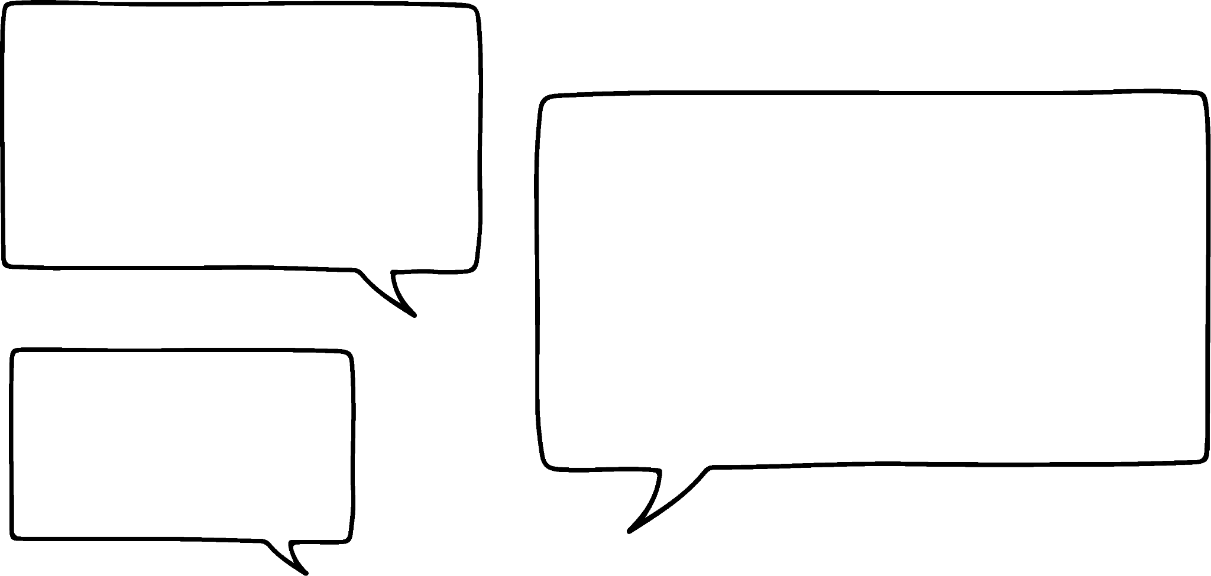


Xisaabta (Xisaab) ee suuqgeynta (marketing)
Saciid wuxuu maamulaa shirkad dharka ah oo la yiraahdo 'Saciid's Sleepwear' oo ku takhasustay dharka hurdada ee aadka u raaxada badan.
Waxay iibiyaan kaliya khadka tooska ah (online), marka soo jiidashada dadka (traffic) ee websaydhkooda ayaa muhiim u ah guusha ganacsigooda.
Waxaan isticmaalaa Google Analytics si aan u fahmo xayeysiinta ugu waxtarka badan. Waxay i siisaa xog (data) badan oo wanaagsan!

Slide 9
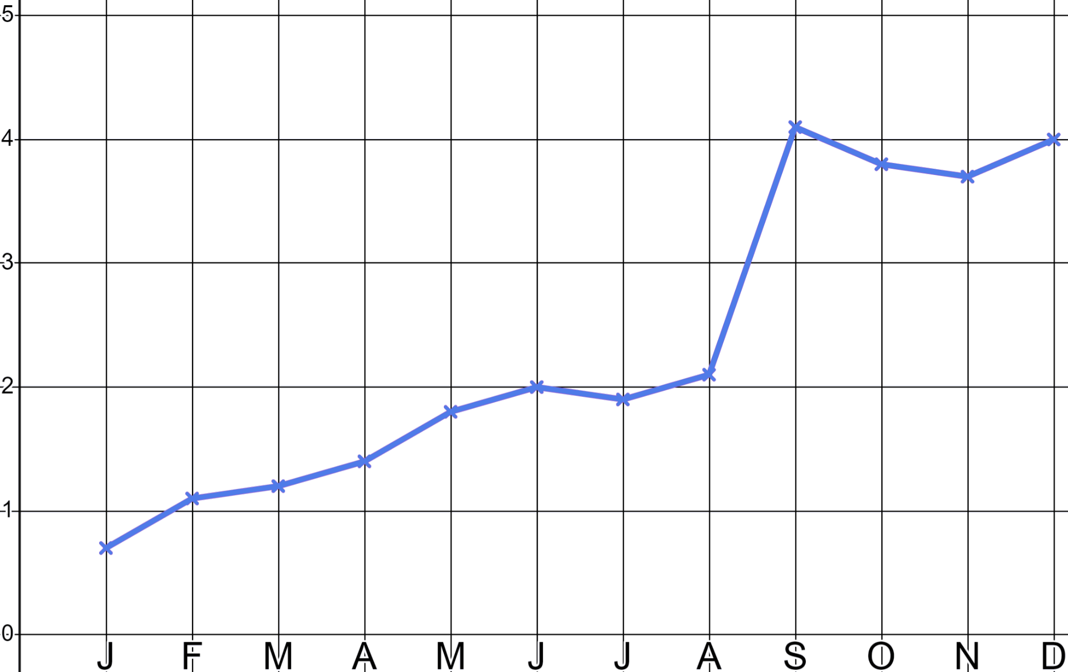
Xisaabta (Xisaab) ee suuqgeynta (marketing)
Kani waa xogta (data) booqashada websaydhka ee Saciid ee sanadkii ganacsi ee koowaad.
Booqashada websaydhka (Site visits) (000's)
Ma qiyaasi kartaa markii aan maalgeliyey (invested) xoogaa lacag ah xayeysiinta khadka tooska ah (online)?
Saciid wuxuu maalgeliyey (invested) xayeysiinta khadka tooska ah (online) bishii Sebtembar, taasoo keentay 2000 booqasho oo dheeri ah.
Bil (Month)

Slide 10
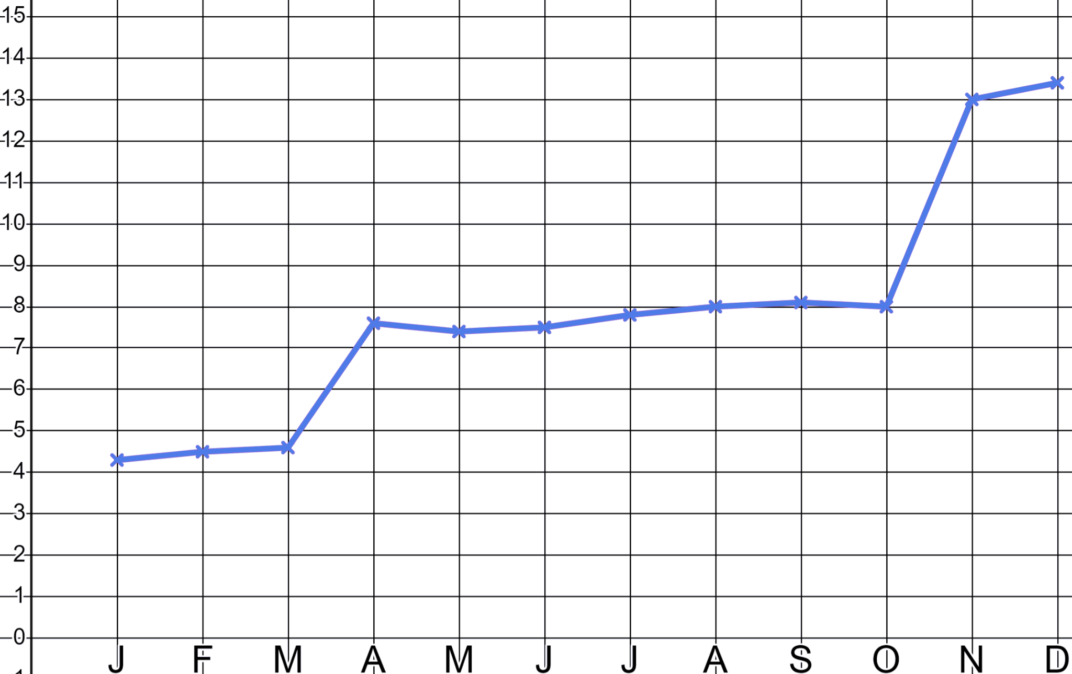
Xisaabta (Xisaab) ee suuqgeynta (marketing)
Kani waa xogta (data) booqashada websaydhka ee Saciid ee sanadkii ganacsi ee labaad.
Maalgashiga (Investment) bishii Abriil wuxuu keenaa qiyaastii 3000 booqasho oo dheeri ah.
Booqashada websaydhka (Site visits) (000's)
Goorma ayuu Saciid lacag ku kharash gareeyey xayeysiinta?
Qiyaastii imisa booqasho oo dheeri ah ayay tani keentay?
Maalgashiga (Investment) bishii Nofeembar wuxuu keenaa qiyaastii 5000 booqasho oo dheeri ah.
Bil (Month)

Slide 11
Xisaab (Xisaab) suuqgeynta
Google analytics waxay ii sheegaysaa halka ay ka yimaadeen 5000 booqdayaasha November ee dheeraadka ah ee boggeyga.
Booqashada bogga (000's)
Maalgashiga November wuxuu keenay qiyaastii 5000 booqasho oo dheeri ah.
Bil (Month)

Slide 12
Xisaab (Xisaab) suuqgeynta
Google analytics waxay ii sheegaysaa halka ay ka yimaadeen 5000 booqdayaasha November ee dheeraadka ah ee boggeyga.
Iimayl toos ah (Direct email)
(20%)
Xayaysiis YouTube (YouTube advert)
(50%)
YouTube:
Xayaysiis Facebook (Facebook advert)
(30%)
0.5 × 5000 = 2500 booqasho (visits)
Facebook:
0.3 × 5000 = 1500 booqasho (visits)
Iimayl toos ah (Direct email):
0.2 × 5000 = 1000 booqasho (visits)

Slide 13
Xisaab (Xisaab) suuqgeynta
Kuwani waa booqdayaashayda 3000 ee April ee dheeraadka ah. Ma shaqeyn kartaa inta ka timid mid kasta oo ka mid ah warbaahinta?
Xayaysiis Insta (Insta advert)
(11%)
Xayaysiis YouTube (YouTube advert)
(61%)
Xayaysiis Facebook (Facebook advert)
(28%)
YouTube:
0.61 × 3000 = 1830 booqashooyin
Facebook:
0.28 × 3000 = 840 booqashooyin
Insta:
0.11 × 3000 = 330 booqashooyin

Slide 14
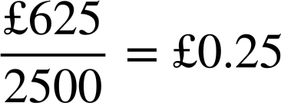
Xisaab (Xisaab) suuqgeynta
Kuwani waa booqashooyinkayga dheeraadka ah ee 5000 ee Nofeembar. Waan ogahay in YouTube shaqeeyo laakiin waa qaali!
Iimayl toos ah
(20%)
Xayaysiis YouTube
(50%)
YouTube: 2500 booqasho
Xayaysiis Facebook
(30%)
Facebook: 1500 booqasho
Iimayl toos ah: 1000 booqasho
YouTube: £625
Facebook: £270
Iimayl toos ah: £140

Slide 15
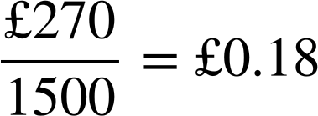
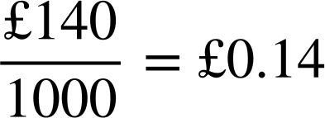
Xisaab (Xisaab) suuqgeynta
Waxay ku kacdaa £0.25 in la soo saaro booqde kasta markaan xayaysiiyo YouTube. Ma shaqayn kartaa in Facebook ama email ay yihiin qiime (value) ka fiican?
Email toos ah
(20%)
Xayaysiis YouTube
(50%)
YouTube: 2500 booqasho
Xayaysiis Facebook
(30%)
Facebook: 1500 booqasho
Email toos ah: 1000 booqasho
YouTube: £625
Facebook: £270
Iimayl toos ah: £140
Facebook iyo email toos ah ayaa ka jaban YouTube xayaysiis.

Slide 16
Xisaab (Xisaab) suuqgeynta
Google analytics waxay i sheegtaa meesha dadku aadaan markay booqdaan websaytkeyga. Waxay i sheegtaa in 1 ka mid ah 50 booqde uu iibsado. Waxaan sameeyaa celcelis ahaan £12 faa'iido (profit) iib kasta.
Waxaan weli haystaa faa'iido (profit) markaan xayaysiiyo iyada oo loo marayo olole email toos ah.
YouTube: £625
Facebook: £270
Email toos ah: £140
£0.25 booqasho kasta
£0.18 booqasho kasta
£0.14 booqasho kasta
£0.14 × 50 = £7
12 − 7 = £5 faa'iido (profit)

Slide 17
Xisaab (Xisaab) suuqgeynta
Google analytics waxay i sheegtaa meesha dadku aadaan markay booqdaan websaytkeyga. Waxay i sheegtaa in 1 ka mid ah 50 booqde uu iibsado. Waxaan sameeyaa celcelis ahaan £12 faa'iido (profit) iib kasta.
Saciid wali ma ilaashanayaa faa'iido (profit) marka uu xayaysiiyo Facebook iyo YouTube?
YouTube: £625
Facebook: £270
Iimayl toos ah: £140
£0.25 booqasho kasta
£0.18 booqasho kasta
£0.14 booqasho kasta
£0.25 × 50 = £12.50
£0.18 × 50 = £9
£0.14 × 50 = £7
12 − 12.50 = £0.50 khasaare (loss)
12 − 9 = £3 faa'iido (profit)
12 − 7 = £5 faa'iido (profit)

Slide 18
Xisaab (Xisaab) suuqgeynta
Google analytics sidoo kale waxay ii sheegtaa halka dadku aadaan markay booqdaan shabakadayda. Waxay ii sheegtaa in 1 ka mid ah 50 booqdayaashu ay iibsadaan. Waxaan helaa celcelis ahaan £12 faa'iido (profit) iib kasta.
Qaababka xayaysiinta qaaliga ah waxay yareeyaan faa'iidada (profit), laakiin waxay kaa caawin karaan horumarinta aqoonsiga astaanta (brand recognition) iyo iibka soo noqnoqda. Ganacsiyadu waxay u baahan yihiin inay isku dheelitiraan khatarta (risk) iyo abaalmarinta (reward) maalgashiga noocan oo kale ah.
YouTube: £625
Facebook: £270
Iimayl toos ah: £140
£0.25 booqasho kasta
£0.18 booqasho kasta
£0.14 booqasho kasta
£0.25 × 50 = £12.50
£0.18 × 50 = £9
£0.14 × 50 = £7
12 − 12.50 = £0.50 khasaare (loss)
12 − 9 = £3 faa'iido (profit)
12 − 7 = £5 faa'iido (profit)

Slide 19
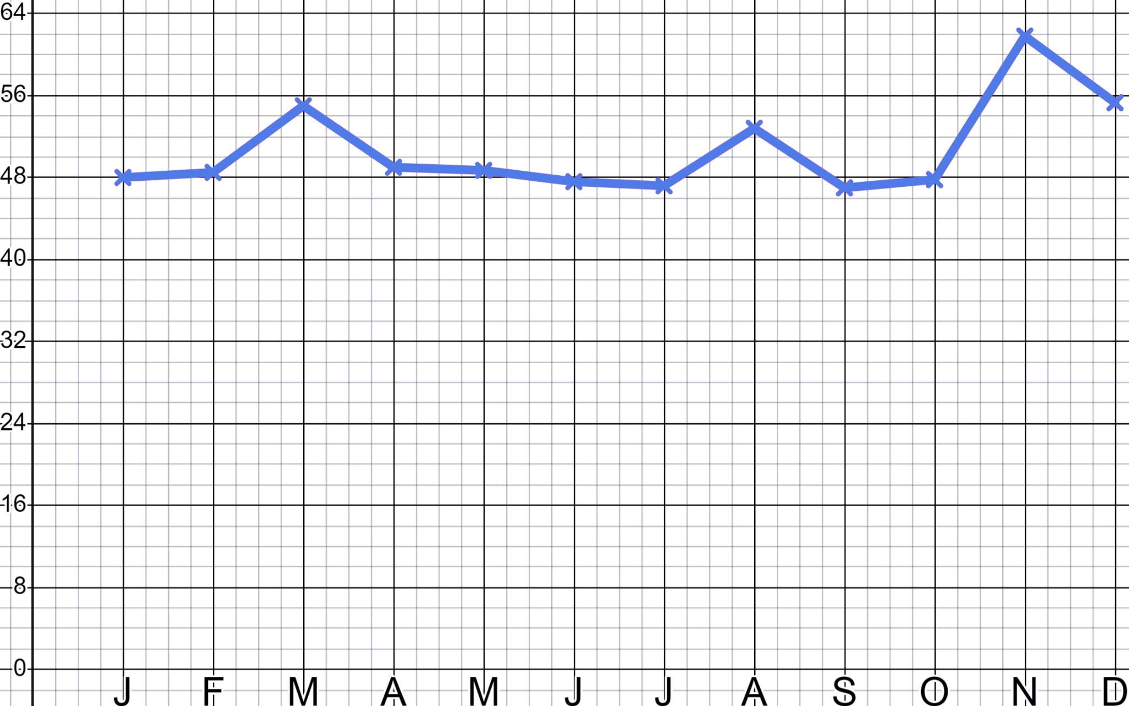
Xisaab (Xisaab) ee suuqgeynta
1) 'Saciid Sleepwear' waa si fiican u aasaasay suuqa dharka hurdada. Saddex jeer sanadkan waxay ku kharash gareeyeen wax ka yar £5000 ololeyaal xayaysiis oo khadka ah.
Goorma ayay ahaayeen ololeyaashan?
Kee baa ahaa kan ugu waxtarka badan?
Sidee ku ogaatay?
Booqashada goobta (000's)
Bil

Slide 20
Xisaab (Xisaab) ee suuqgeynta
2) 'Saciid's Sleepwear' hada si fiican ayuu ugu xoqan yahay suuqa sariiraha. Waxay ku bixiyaan xayaysiisyada hoose waxayna soo jiitaan 14 000 booqdayaal dheeri ah oo websaydhkooda yimaada.
Xayaysiis YouTube
(28%)
Xayaysiis Google
(38%)
YouTube £1100
Iimayl toos ah £350
Facebook £500
Google £2500
Hada waxay iib ka sameeyaan 1 ka mid ah 40
booqdayaal iyo celcelis ahaan £14 iibkiiba.
Xayaysiis Facebook
(16%)
Iimayl toos ah
(18%)
Xisaabi nooca warbaahinta ugu faa'iidada badan una talo Saciid halka uu ku bixiyo miisaaniyadda xayaysiiska ee xiga.

Slide 21
Xisaab (Xisaab) ee suuqgeynta
1) 'Saciid's Sleepwear' hada si fiican ayuu ugu xoqan yahay suuqa sariiraha. Saddex jeer oo sannadkan ah waxay ku bixiyeen wax ka yar £5000 ololeyaal xayaysiis oo khadka tooska ah.
Goorma ayay ahaayeen ololeyaashaa?
Kee baa ahaa kii ugu waxtarka badnaa?
Sidee baad u ogtahay?
Booqashada goobta (000's)
Bil

Slide 22
Xisaab (Xisaab) suuqgeynta
1)
Waxaa laga yaabaa inaad tidhi:
“Ololihii xayaysiiska (advertising campaigns) wuxuu dhacay Maarso, Ogosto iyo Nofeembar.”
“Waxaan ognahay in ololihii Nofeembar uu ahaa kan ugu waxtarka badan sababtoo ah wuxuu keenay koror (spike) ugu weyn ee booqashada goobta (site visits).”
Booqashada goobta (Site visits) (000’s)
Bil (Month)

Slide 23
Xisaab (Xisaab) suuqgeynta
2) ‘Saciid’s Sleepwear’ (Sam’s Sleepwear) hada si fiican ayuu ugu xoqmay suuqa sariiraha (bedwear marketplace). Waxay ku bixiyaan xayaysiiska (advertising) qadarka hoose waxayna soo jiitaan 14 000 booqde oo dheeri ah oo booqda websaydkooda.
Xayaysiis YouTube (YouTube advert)
(28%)
Xayaysiis Google (Google advert)
(38%)
YouTube £1100
Iimayl toos ah (Direct email) £350
Facebook £500
Google £2500
Hada waxay ka sameeyaan iib (sale) 1 ka mid ah 40
booqde, celcelis ahaanna £14 iibkiiba.
Xayaysiis Facebook (Facebook advert)
(16%)
Iimayl toos ah (Direct email)
(18%)
Xisaabi nooca warbaahinta (media) ugu faa'iidada badan uguna talo Saciid halka uu ku bixiyo miisaaniyadda xayaysiiska (advertising budget) ee xiga.

Slide 24
Xisaab (Xisaab) suuqgeynta
2)
YouTube £1100
Facebook £500
0.28 × 14 000 = 3920 booqdayaal (visitors)
0.16 × 14 000 = 2240 booqdayaal (visitors)
£1100 ÷ 3920 = £0.28… booqasho kasta (per visit)
£500 ÷ 2240 = £0.22… booqasho kasta (per visit)
£0.28… × 40 = £11.22… iib kasta (per sale)
£0.22… × 40 = £8.92… iib kasta (per sale)
£14 − £11.22… ≈ £2.78 faa'iido (profit)
£14 − £8.92… ≈ £5.07 faa'iido (profit)
Email toos ah £350
Google £2500
0.18 × 14 000 = 2520 booqdayaal (visitors)
0.38 × 14 000 = 5320 booqdayaal (visitors)
£350 ÷ 2520 = £0.13… booqasho kasta (per visit)
£2500 ÷ 5320 = £0.46… booqasho kasta (per visit)
£0.13… × 40 = £5.55… iib kasta (per sale)
£0.46… × 40 = £18.79… iib kasta (per sale)
£14 − £5.55… ≈ £8.44 faa'iido (profit)
£14 − £18.79… ≈ £4.80 khasaare (loss)

Slide 25
Xisaabta suuqgeynta (Xisaab in marketing)
2)
Waxaa laga yaabaa inaad ku talisay:
“Google waa qaali oo hadda ma faa'iidaynin ganacsi cabbirkaaga ah.”
Google £2500
0.38 × 14 000 = 5320 booqdayaal (visitors)
£2500 ÷ 5320 = £0.46… booqasho kasta (per visit)
£0.46… × 40 = £18.79… iib kasta (per sale)
£14 − £18.79… ≈ £4.80 khasaare (loss)

Slide 26
Xisaab (Xisaab) suuqgeynta (marketing)
2)
Waxaa laga yaabaa inaad ku talisay:
“Wargeysyada iimaylka tooska ah (direct email campaigns) ayaa ah nooca ugu faa'iidada badan ee xayeysiinta (advertising) ganacsigaaga, suuqaaga.”
“Waxaad ku kharash gashay in ka badan toddoba jibaar (times) £350 oo aad ku xayeysiisay Google. Haddaba lacagtaas dib u wareeji oo samee wacyigelin iimayl toos ah (direct email campaigns) oo dheeri ah.”
Iimayl toos ah (Direct email) £350
0.18 × 14 000 = 2520 booqdayaal (visitors)
£350 ÷ 2520 = £0.13… booqasho kasta (per visit)
£0.13… × 40 = £5.55… iib kasta (per sale)
£14 − £5.55… ≈ £8.44 faa'iido (profit)

Slide 27
Xisaab (Xisaab) suuqgeynta (marketing)
2)
Waxaa laga yaabaa inaad ku talisay:
YouTube £1100
Facebook £500
0.28 × 14 000 = 3920 booqdayaal (visitors)
0.16 × 14 000 = 2240 booqdayaal (visitors)
£1100 ÷ 3920 = £0.28… booqasho kasta
£500 ÷ 2240 = £0.22… booqasho kasta (per visit)
£0.28… × 40 = £11.22… iib kasta
£0.22… × 40 = £8.92… iib kasta
£14 − £11.22… ≈ £2.78 faa'iido (profit)
£14 − £8.92… ≈ £5.07 faa'iido (profit)
“YouTube iyo Facebook labaduba way ka qaali yihiin oo ka faa'iido yar yihiin iimaylka tooska ah (direct email), laakiin weli waxay sameeyaan faa'iido (profit) waxayna siiyaan astaantaada/ganacsigaaga soo-gaabasho (exposure) fiican, sidaas darteed sii maal-geli (invest) kuwan.”

Slide 28
Iibka (Sales) iyo suuqgeynta (marketing)
Xisaab (Xisaab) suuqgeynta (marketing)
Xisaab (Xisaab) iibka (sales)

Slide 29



Xisaab (Xisaab) iibka (sales)
Yacquub iyo Isra waxay maamulaan ganacsi iibiya digsi shiilan tayo sare leh oo loogu talagalay warshadaha cuntada. Sannadkii hore ganacsigu wuxuu iibiyay 200 000 cutub (units) qiimo £30 midkiiba.
Yacquub waa agaasimaha iibka (sales director) wuxuuna soo bandhigayaa soo-jeedin (proposal) shir guddiga.
Cilmi-baaris suuqeed (market research) waxay muujinaysaa in haddii aan nuskeexno qiimaha (price) aan labanlaabi karno iibka (sales). Taasi waxay nooga dhigi doontaa hogaamiyaha suuqa (market leader). Waxaan u malaynayaa inaan sidaa yeelno.
Ma waxaad u malaynaysaa inay tahay fikrad wanaagsan?

Slide 30
Xisaab (Xisaab) iibka (sales)
200 000 × £30 = 400 000 × £15
Soo-jeedintu (proposal) waa mid la yaab leh.
Ganacsigu hadda wuxuu iibiyaa 200 000 cutub (units) qiimo £30, isagoo soo saaraya £6 000 000 dakhli (revenue).
Nuskeenta qiimaha (price) ilaa £15 iyo iibinta 400 000 cutub (units) waxay soo saari doonaan isla dakhli (revenue) isku mid ah oo ah £6 000 000
Waxaan noqon doonnaa hogaamiyayaasha suuqa (market leaders)! Waxaan samayn doonnaa iibka (sales) ugu weyn taariikhda shirkaddan!

Slide 31
Xisaab (Xisaab) iibka (sales)
Nasiib wanaag, Isra waa xisaabiye ganacsi (commercial accountant) oo fahmaya farqiga u dhexeeya dakhliga (revenue) iyo faa'iidada (profit).
Dakhliga (Revenue) waa dakhliga soo gala ganacsigeena, tusaale ahaan, wadarta lacagta ku tagta sanduuqa (till) iibka (sales) kaaga. Halka faa'iidada (profit) ay tahay faa'iidada maaliyadeed; farqiga u dhexeeya dakhliga (revenue) iyo qiimaha (cost) soo saarista alaabteenna.

Slide 32
Xisaab (Xisaab) iibka
Nasiib wanaag, Isra waa xisaabiye ganacsi (commercial accountant) oo fahmaya farqiga u dhexeeya dakhliga (revenue) iyo faa'iidada (profit).
Waxaan hadda iibinaynaa 200 000 unug oo qiimihiisu yahay £30 midkiiba. Mid kasta oo ka mid ah unugyadaas waxaa ku kacaya £20 in la soo saaro, la baakadeeyo oo la qaybiyo.
Ma arki kartaa dhibaatada hadda ku jirta soo jeedinta Yacquub ee ah 'Nus qiimaha (price), labanlaab iibka (sales)'?

Slide 33
Xisaab (Xisaab) iibka
Tani waa tusaale caadi ah oo xisaabtu (maths) ka caawiso ganacsiyada go'aan qaadashada muhiimka ah ee noqon kara mid guuleysta ama fashilma.
Xaaladda hadda jirta:
200 000 unug oo la iibiyay sannadkii
Qiimaha iibka (selling price) unugkiiba: £30
Ganacsigu wuxuu 'sameeyay' £2 000 000 oo faa'iido ah.
Qiimaha kharashka (cost price) unugkiiba: £20
Faa'iidada (profit) unugkiiba: £30 − £20 = £10
Faa'iidada sannadlaha ah: 200 000 × £10 = £2 000 000

Slide 34
Xisaab (Xisaab) iibka
Hab kale oo loo eego tirooyinka isku midka ah…
Xaaladda hadda jirta:
Tani waxay noqon kartaa hab fudud oo loo fahmo faa'iidada (profit) iyo dakhliga (revenue). "Waxaan ku khasnay £4 000 000 si aan u soo saarno £6 000 000. Taasi waa faa'iido (profit) ah £2 000 000"
200 000 unug oo la iibiyay sannadkii
Qiimaha iibka (selling price) unugkiiba: £30
Qiimaha kharashka (cost price) unugkiiba: £20
Dakhliga (revenue): 200 000 × £30 = £6 000 000
Kharashyada (costs): 200 000 × £20 = £4 000 000
Faa'iidada (profit) = Dakhliga (revenue) − Kharashyada (costs) = £6 000 000 − £4 000 000 = £2 000 000

Slide 35
Xisaabta iibka (Xisaab in sales)
Sida xisaabiye (accountant) u fasiri lahaa soo jeedinta Yacquub.
Xaalad cusub:
400 000 cutub (units) la iibiyey sannadkii (p.a.)
Qiimaha iibka (selling price) cutubkiiba: £15
Ganacsigu wuxuu 'sameeyay khasaare (loss)' ah £2 000 000
Qiimaha kharashka (cost price) cutubkiiba: £20
Faa'iidada (profit) cutubkiiba: £15 − £20 = −£5
Faa'iidada sannadlaha ah: 400 000 × −£5 = −£2 000 000

Slide 36
Xisaabta iibka (Xisaab in sales)
Haddii kale…
“Waxaan ku bixinnay £8 000 000 si aan u helno £6 000 000. Waxaan luminnay £2 000 000”
Xaalad cusub:
400 000 cutub (units) la iibiyey sannadkii (p.a.)
Tani si cad ma aha wax caqli gal ah. Ganacsiyadu waxay u isticmaalaan xisaabta qaab xisaabinta ganacsi (commercial accounting) si ay u go'aamiyaan qiimaha (pricing).
Qiimaha iibka (selling price) cutubkiiba: £15
Qiimaha kharashka (cost price) cutubkiiba: £20
Dakhliga (revenue): 400 000 × £15 = £6 000 000
Kharashaadka (costs): 400 000 × £20 = £8 000 000
Faa'iidada (profit) = Dakhliga (revenue) − Kharashaadka (costs) = £6 000 000 − £8 000 000 = −£2 000 000

Slide 37


Xisaabta iibka (Xisaab in sales)
Caasha iyo Axmed waxay u shaqeeyaan ganacsi iibiya qalabka qaanso-gan (archery sets).
Ganacsigoodu hadda iibiyaa 12 000 unug sannadkii (p.a.) qiimo £80 ah, kharashka soo saarista, baakadaynta iyo qaybinta unug kastana waa £50. Xisaabi dakhligooda sannadlaha ah iyo faa'iidada.
Dakhliga (Revenue): 12 000 × £80 = £960 000
Kharashaadka (Costs): 12 000 × £50 = £600 000
Faa'iidada (Profit) = Dakhliga (Revenue) − Kharashaadka (Costs)
= £960 000 − £600 000 = £360 000

Slide 38
Xisaabta iibka (Xisaab in sales)
Caasha iyo Axmed waxay u shaqeeyaan ganacsi iibiya qalabka qaanso-xadhigga (archery sets).
Xaaladda hadda (Current situation):
12 000 unug oo la iibiyay sannadkii (p.a.)
Qiimaha iibka (Selling price): £80
Qiimaha kharashka (Cost price): £50
Macmiilku waxay ii sheegeen in haddii aan nuska qiimaha (half our price) yeelno ay iibsan doonaan laba jeer tirada. Waxaan si dhab ah ugu dhufan doonnaa bartamaha (bullseye) tirooyinka iibka!
Noqo xisaabiyaha (accountant) oo muuji sababta ay u tahay go'aan ganacsi oo liita in la nuskeeyo qiimaha.

Slide 39
Xisaabta iibka (Xisaab in sales)
Caasha iyo Axmed waxay u shaqeeyaan ganacsi iibiya qalabka qaanso-xadhigga (archery sets).
Xaaladda hadda (Current situation):
Xaaladda cusub (New situation):
12 000 unug oo la iibiyay sannadkii (p.a.)
24 000 unug oo la iibiyay sannadkii (p.a.)
Qiimaha iibka (Selling price): £80
Qiimaha iibka (Selling price): £40
Qiimaha kharashka (Cost price): £50
Qiimaha iibka (Cost price): £50
Faa'iidada (Profit) = £360 000
Dakhliga (Revenue): 24 000 × £40 = £960 000
Kharashaadka (Costs): 24 000 × £50 = £1 200 000
Faa'iidada (Profit)
= £960 000 − £1 200 000 = −£240 000
Isbeddelku wuxuu keeni lahaa khasaare (loss) ah £240 000

Slide 40
Xisaabta (Xisaab) iibka (sales)
Xisaabiyayaashu waa inay tixgeliyaan go'aan kasta, mararka qaarkoodna natiijooyinku waa kuwo lama filaan ah.
Xaaladda hadda jirta (Current situation):
Cilmi-baaris suuqa (market research) waxay muujinaysaa in haddii aan kordhinno qiimaha (price) 10% iibkayagu (sales) hoos u dhacayo 15%. Waxaan u malaynayaa inaan sidaa yeelno.
200 000 cutub (units) oo la iibiyo sannadkii (p.a.)
Qiimaha iibka (Selling price) cutubkiiba: £30
Qiimaha kharashka (Cost price) cutubkiiba: £20
Ma u malaynaysaa inay tahay fikrad wanaagsan?

Slide 41
Xisaabta (Xisaab) iibka (sales)
Kani waa murug (conundrum) xiiso leh, sababtoo ah dareenkaagu (intuition) waxaa laga yaabaa inuu kuu sheego in khasaaraha (loss) 15% ee faa'iidada (gain) 10% aysan u qalmin.
Xaaladda hadda jirta (Current situation):
Cilmi-baaris suuqa (market research) waxay muujinaysaa in haddii aan kordhinno qiimaha (price) 10% iibkayagu (sales) hoos u dhacayo 15%. Waxaan u malaynayaa inaan sidaa yeelno.
200 000 cutub (units) oo la iibiyo sannadkii (p.a.)
Qiimaha iibka (Selling price) cutubkiiba: £30
Qiimaha kharashka (Cost price) cutubkiiba: £20
Laakin xusuusnow, xisaabiyayaashu waxay joogaan si ay nooga caawiyaan fahamka faa'iidadayada (profitability).

Slide 42
Xisaab (Xisaab) ee iibka (sales)
Aan noqono xisaabiye (accountant) oo aan xisaabino waxa kor u kaca 10% ee qiimaha (price) uu ku sameeyo lumista 15% ee iibka (sales) ganacsigeenna.
Xaaladda hadda jirta:
Xaaladda cusub:
200 000 oo cutub (units) oo la iibiyo sannadkii (p.a.)
170 000 oo cutub (units) oo la iibiyo sannadkii (p.a.)
Qiimaha iibka (selling price) cutubkiiba: £30
Qiimaha iibka (selling price) cutubkiiba: £33
Qiimaha kharashka (cost price) cutubkiiba: £20
Qiimaha kharashka (cost price) cutubkiiba: £20
Dakhliga (Revenue): £6 000 000
Dakhliga (Revenue): 170 000 × £33 = £5 610 000
Kharashyada (Costs): £4 000 000
Kharashyada (Costs): 170 000 × £20 = £3 400 000
Faa'iidada (Profit) = £2 000 000
Faa'iidada (Profit) = £2 210 000
Go'aankan ayaa dhab ahaantii kordhinaya faa'iidadooda (profit)!

Slide 43

Xisaab (Xisaab) ee iibka (sales)
Sannadku waa 2050, Laura's Lunar Launches waxay ku dallacaan £250 000 safar maalin ah oo Dayaxa ah oo ay ku jirto socod dusha sare.
Waxay hadda qaadaan 600 oo rakaab ah sannadkii (p.a.) iyadoo kharashku yahay £225 000 qofkiiba.
Cilmi-baaris suuqa (market research) ayaa noo sheegaysa haddii aan hoos u dhigno qiimaha (price) 5% waxaynu heli doonnaa 30% rakaab oo dheeri ah. Kooxdeyda iibka (sales team) waxay rabaan inay sameeyaan si ay u kordhiyaan saamiga suuqa (market share). Ma sameynaa?

Slide 44
Xisaab (Xisaab) ee iibka (sales)
Xaaladda hadda jirta:
600 duulimaad
Qiimaha iibka: £250 000
Qiimaha kharashka: £225 000
Dakhliga (Revenue): 600 × £250 000 = £150 000 000
Kharashaadka (Costs): 600 × £225 000 = £135 000 000
Faa'iidada (Profit) = £150 000 000 − £135 000 000 = £15 000 000

Slide 45
Xisaabta (Xisaab) ee iibka
Xaaladda hadda jirta:
Xaaladda cusub:
600 duulimaad
780 duulimaad (30% dheeri)
Qiimaha iibka: £250 000
Qiimaha iibka: £237 500 (5% hoos u dhac)
Qiimaha kharashka: £225 000
Qiimaha kharashka: £225 000
Dakhliga (Revenue): £150 000 000
Dakhliga (Revenue): 780 × £237 500 = £185 250 000
Kharashaadka (Costs): £135 000 000
Kharashaadka (Costs): 780 × £225 000 = £175 500 000
Faa'iidada (Profit): £15 000 000
Faa'iidada (Profit): £9 750 000
Waxaa laga yaabaa inaad tidhaahdo, "Ha sameynin isbedelka Layla. Inkastoo ay soo saari doonto dakhli (revenue) badan, waxay shirkadda ku khasbi doontaa in ka badan £5 000 000 oo faa'iido (profit) ah."

Slide 46


Xisaab (Xisaab) ee iibka (sales)
1) Nuur waa CEO (CEO) oo ah soosaaraha macmacaanka (sweets) oo iibiyay 36 000 xirmo oo macmacaan sannadkii hore qiime (value) £1.80 xirmo. Kharashka soosaarku waa £0.60 halbeeg (unit).
a) Xisaabi dakhliga (revenue) iyo faa'iidada (profit) ee Nuur ee hadda.
b) Haddii Nuur uu labanlaabi karo iibkiisa (sales) isagoo nus ka dhiga qiimaha (price), ma sameeyaa?
c) Haddii Nuur uu kordhin karo iibkiisa (sales) saddex meelood meel isagoo dhimi kara qiimaha (price) saddex meelood meel, ma sameeyaa?

Slide 47

Xisaab (Xisaab) ee iibka (sales)
2) Cali waa xisaabiyaha ganacsiga (commercial accountant) ee soosaaraha gitaarka (guitar) oo iibiya 1200 halbeeg (units) sannadkii qiime (value) £600 halbeeg, kharashkuna waa £480 halbeeg.
Kee ka mid ah kuwan hoose waa heshiisyo ganacsi oo wanaagsan?
a) 5% korodhka iibka (sales) oo 10% hoos u dhaca qiimaha (price)?
b) 50% korodhka iibka (sales) oo 15% hoos u dhaca qiimaha (price)?
c) 10% hoos u dhaca iibka (sales) oo 5% korodhka qiimaha (price)?
d) Haddii Cali uu dhimo qiimaha (price) 12%, waa imisa boqolkiiba korodhka iibka (sales) uu u baahan yahay si uu u ilaaliyo faa'iidadiisa (profit) hadda?

Slide 48
Xisaab (Xisaab) ee iibka (sales)
1) Nuur waa CEO (CEO) oo ah soosaaraha macmacaanka (sweets) oo iibiyay 36 000 xirmo oo macmacaan sannadkii hore qiime (value) £1.80 xirmo. Kharashka soosaarku waa £0.60 halbeeg (unit).
a) Xisaabi dakhliga (revenue) iyo faa'iidada (profit) ee Nuur ee hadda.
36 000 xirmo
Qiimaha iibka (selling price): £1.80
Qiimaha kharashka (cost price): £0.60
Dakhliga (revenue): 36 000 × £1.80 = £64 800
Kharashyada (costs): 36 000 × £0.60 = £21 600
Faa'iidada (profit) = £64 800 − £21 600 = £43 200

Slide 49
Xisaab (Xisaab) ee iibka (sales)
1)
b) Haddii Nuur uu labanlaabi karo iibkiisa isagoo nus dhigaya qiimihiisa, ma waa inuu sameeyaa?
72 000 xirmo
Waxaa laga yaabaa inaad tidhaahdid, "Inkastoo tani kordhinayso mugga iyo saamiga suuqa, waxay nus dhigaysaa faa'iidadaada, marka waxaan kugula talinayaa inaadan samayn".
Qiimaha iibka: £0.90
Qiimaha kharashka: £0.60
Dakhliga (Revenue): 72 000 × £0.90 = £64 800
Kharashyada: 72 000 × £0.60 = £43 200
Faa'iidada (Profit) = £64 800 − £43 200 = £21 600

Slide 50
Xisaabta iibka
1)
c) Haddii Nuur uu kordhin karo iibkiisa saddex meelood meel isagoo dhimi karo qiimihiisa saddex meelood meel, ma waa inuu sameeyaa?
Waxaa laga yaabaa inaad tidhaahdid, "Inkastoo tani kordhinayso mugga iyo saamiga suuqa, waxay dhimi doontaa faa'iidada saddex meelood meel, marka waxaan kugula talinayaa inaadan samayn".
48 000 xirmo
Qiimaha iibka: £1.20
Qiimaha kharashka: £0.60
Dakhliga (Revenue): 48 000 × £1.20 = £57 600
Kharashyada: 48 000 × £0.60 = £28 800
Faa'iidada (Profit) = £57 600 − £28 800 = £28 800

Slide 51
Xisaabta iibka
2) Cali waa xisaabiye ganacsi oo ka tirsan soosaaraha gitaarka kaas oo iibiya 1200 cutub sanadkii £600 cutubkiiba, waxaana ku kacaya £480 cutubkiiba in la soo saaro.
Kuwee ka mid ah kuwan hoose kuwaas oo ah heshiisyo ganacsi oo wanaagsan?
a) 5% korodhka iibka ee 10% hoos u dhaca qiimaha?
b) 50% korodhka iibka ee 15% hoos u dhaca qiimaha?
c) 10% hoos u dhac (drop) iibka (sales) 5% korodhka (increase) qiimaha (price)?
d) Haddii Cali uu hoos u dhigo qiimihiisa (price) 12%, intee in ay tahay korodhka (uplift) iibka (sales) uu u baahan yahay si uu u ilaaliyo faa'iidada (profit) hadda jirta?

Slide 52

Xisaabta (Xisaab) iibka (sales)
Hadda (Current):
a) 5% korodhka (uplift) iibka (sales) 10% hoos u dhaca (drop) qiimaha (price)?
1200 guitars
1260 guitars
Qiimaha iibka (Selling price): £600
Qiimaha iibka (Selling price): £540
Qiimaha kharashka (Cost price): £480
Qiimaha kharashka (Cost price): £480
Dakhliga (Revenue): 1200 × £600 = £720 000
Dakhliga (Revenue): 1260 × £540 = £680 400
Kharashyada (Costs): 1200 × £480 = £576 000
Kharashyada (Costs): 1260 × £480 = £604 800
Jawaabaha:
2)
Faa'iidada (Profit): £144 000
Faa'iidada (Profit): £75 600

Slide 53
Xisaabta (Xisaab) iibka (sales)
2)
Hadda (Current):
b) 50% korodhka (uplift) iibka (sales) 15% hoos u dhaca (drop) qiimaha (price)?
1200 guitars
1800 guitars
Qiimaha iibka (Selling price): £600
Qiimaha iibka (Selling price): £510
Qiimaha iibka (Cost price): £480
Qiimaha iibka (Cost price): £480
Dakhliga (Revenue): 1200 × £600 = £720 000
Dakhliga (Revenue): 1800 × £510 = £918 000
Kharashaadka (Costs): 1200 × £480 = £576 000
Kharashaadka (Costs): 1800 × £480 = £864 000
Faa'iidada (Profit): £144 000
Faa'iidada (Profit): £54 000

Slide 54

Xisaabta iibka (Xisaab in sales)
2)
Hadda (Current):
c) 10% hoos u dhaca iibka (drop in sales) 5% kororka qiimaha (increase in price)?
1200 guitars
1080 guitars
Qiimaha iibka (Selling price): £600
Qiimaha iibka (Selling price): £630
Qiimaha iibka (Cost price): £480
Qiimaha iibka (Cost price): £480
Dakhliga (Revenue): 1200 × £600 = £720 000
Dakhliga (Revenue): 1080 × £630 = £680 400
Kharashaadka (Costs): 1200 × £480 = £576 000
Kharashaadka (Costs): 1080 × £480 = £518 400
Faa'iidada (Profit): £144 000
Faa'iidada (Profit): £162 000

Slide 55
Xisaabta (Xisaab) ee iibka (sales)
2)
d) Haddii Cali uu hoos u dhigo qiimihiisa (price) 12%, imisa boqolkiiba (percent) korodhka iibka (sales) ayuu u baahan yahay si uu u ilaaliyo faa'iidada (profit) hadda jirta?
Wadarta faa'iidada (Profit) hadda: £144 000
Qiimaha (Price) cusub: £600 × 0.88 = £528
Faa'iidada (Profit) cusub ee hal cutub: £528 − £480 = £48
£144 000 ÷ £48 = 3000 unug
Waxay u baahan yihiin inay arkaan korodhka 150% ee iibka (sales) si ay u gaadhaan isla faa'iidada (profit).
3000 ÷ 1200 = 2.5 = 250%

Slide 56
Iibka (Sales) iyo suuqgeynta (marketing)
Suuqgeynta (marketing) waxaan u isticmaali karnaa xogta (data) ka imanaysa nidaamyada sida Google Analytics si aan u ogaanno noocyada xayaysiisyada (advertising) ugu faa'iidada badan ganacsigeena.
Iibka (sales) waxaan ognahay in kooxda iibka ay had iyo jeer doonayaan inay hoos u dhimaan qiimaha (price) si ay u kordhiyaan mugga iibka (sales), laakiin xisaabiyeyaashu (accountants) waxay samayn karaan xisaabta (maths) si ay u fahmaan haddii go'aankaasi uu noqon karo mid faa'iido leh.

