Slide 1
Weyneyn (Enlargement) saddexagalka xagal-qumman ee goobada halbeegga ah
Trigonometry

Slide 2
Sida agabkeena waxbarista loogu talagalay fasalka

Slide 3
Waxaan aqoonsan karaa saddexagalka xagal-qumman ee goobada halbeegga ah waxaana u isticmaali karaa saami (proportion) si aan u weyneeyo (enlargement) saddexagallo la mid ah.

Slide 4
Radius waa qayb kasta oo xariiq ah oo isku xirta xarunta goobada iyo meel kasta oo ka mid ah wareegeeda.
Hypotenuse waa dhinaca saddexagalka xagal-qumman ee ka soo horjeeda xagasha qumman.

Slide 5
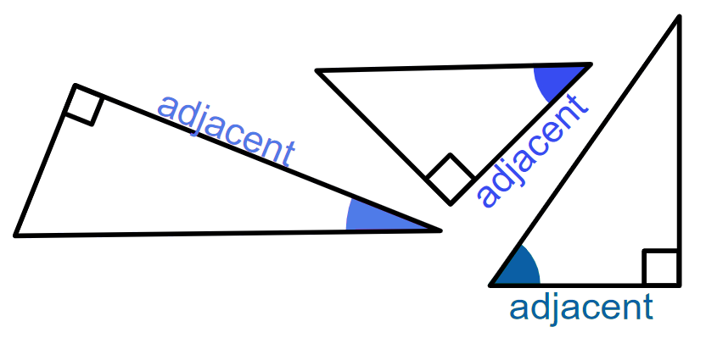
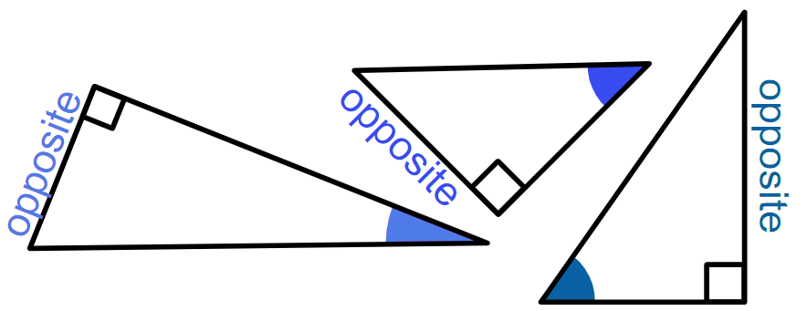
Dhinaca adjacent (ku xiga) ee saddexagalka xagal-qumman waa dhinaca ku xiga xagasha qumman iyo xagasha la calaamadeeyay labadaba.
Dhinaca opposite (ka soo horjeeda) ee saddexagalka xagal-qumman waa dhinaca ka soo horjeeda xagasha la calaamadeeyay.
Saamiyada trigonometric (trigonometric ratios) waa saamiyada u dhexeeya laba dhinac oo ka mid ah saddexagalka xagal-qumman:
sin(θ°) = opposite cos(θ°) = adjacent tan(θ°) = opposite
hypotenuse hypotenuse adjacent

Slide 6

Weyneyn (Enlargement) saddexagalka xagal-qumman ee goobada halbeegga ah
Calaamadaynta dhinacyada saddexagalka xagal-qumman
Isticmaalka sine iyo cosine ee goobada halbeegga ah
Isticmaalka tangent ee goobada halbeegga ah

Slide 7
Calaamadaynta dhinacyada saddexagalka xagal-qumman
Saddexagalka xagal-qumman ee hoose, mid ka mid ah xagasha fiiqan (acute) ayaa la calaamadeeyay.
Hypotenuse had iyo jeer waa dhinaca ugu dheer.
Waxaan u tixraaci karnaa labada dhinac ee kale ee saddexagalka iyadoo lagu salaynayo booskooda marka loo eego xagasha la calaamadeeyay.
Dhinaca ka soo horjeeda xagasha fiiqan ee gudaha ah ee la calaamadeeyay ee saddexagalka waxaa loo yaqaan 'opposite'.
hypotenuse
ka soo horjeeda (opposite)
Dhinaca ku xiga xagasha qumman iyo xagasha kale ee gudaha ah ee la calaamadeeyay waxaa loo yaqaan 'adjacent'.
ku xiga (adjacent)

Slide 8
Magacaabista dhinacyada saddex-xagal qumman (right-angled triangle)
Hypotenuse-ku (hypotenuse) had iyo jeer waa dhinaca ugu dheer.
Dhererka labada dhinac ee kale saamayn kuma laha sida opposite-ka (opposite) iyo adjacent-ka (adjacent) loo magacaabo. Calaamadahan waxay ku xiran yihiin oo keliya booska xagasha fiiqan (acute angle) ee la calaamadeeyay.
hypotenuse (hypotenuse)
hypotenuse (hypotenuse)
ka soo horjeeda (opposite)
ka soo horjeeda (opposite)
ku xiga (adjacent)
ku xiga (adjacent)

Slide 9
Magacaabista dhinacyada saddex-xagal qumman (right-angled triangle)
Jihada (orientation) saddex-xagalku saamayn kuma laha sida opposite-ka (opposite) iyo adjacent-ka (adjacent) loo magacaabo.
Calaamadahan waxay ku xiran yihiin oo keliya booska xagasha fiiqan (acute angle) ee la calaamadeeyay.
hypotenuse (hypotenuse)
hypotenuse (hypotenuse)
ka soo horjeeda (opposite)
ka soo horjeeda (opposite)
ku xiga (adjacent)
ku xiga (adjacent)

Slide 10

Magacaabista dhinacyada saddexagalka xagasha qumman
Opposite-ku (opposite) had iyo jeer waa dhinaca ugu gaaban ee saddex-xagal qumman (right-angled triangle).
Dhinaca loo magacaabay opposite (opposite) had iyo jeer waa ka soo horjeeda xagasha fiiqan (acute angle) ee la calaamadeeyay.
Dhinaca loo yaqaan 'opposite' (ka soo horjeeda) had iyo jeer waa ka soo horjeeda xagasha qumman.

Slide 11
Magacaabista dhinacyada saddexagalka xagasha qumman
Dhinac kee baa ah 'opposite' (ka soo horjeeda) saddexagalkan?
C
A
C
B
opposite (ka soo horjeeda)

Slide 12
Magacaabista dhinacyada saddexagalka xagasha qumman
1) Ku magacaab dhinacyada saddexagal kasta ereyada 'opposite' (ka soo horjeeda), 'adjacent' (ku xiga) iyo 'hypotenuse' (jifaarka). Qaybaha (g) iyo (h), sidoo kale ku calaamadee xagasha ku habboon θ.
Jawaabaha:
a)
b)
c)
d)
θ
θ
θ
θ
e)
f)
g)
h)
θ
θ
adjacent (ku xiga)
opposite (ka soo horjeeda)

Slide 13
Magacaabista dhinacyada saddexagalka xagasha qumman
1) Ku magacaab dhinacyada saddexagal kasta ereyada 'opposite' (ka soo horjeeda), 'adjacent' (ku xiga) iyo 'hypotenuse' (jifaarka). Qaybaha (g) iyo (h), sidoo kale ku calaamadee xagasha ku habboon θ.
Jawaabaha:
a)
b)
c)
d)
ku xiga (adjacent)
opposite (ka soo horjeeda)
θ
θ
hypotenuse (jifaarka)
hypotenuse (jifaarka)
ku xiga (adjacent)
opposite (ka soo horjeeda)
ka soo horjeeda (opposite)
ku xiga (adjacent)
hypotenuse (jifaarka)
hypotenuse (jifaarka)
θ
θ
opposite (ka soo horjeeda)
ku xiga (adjacent)
e)
f)
g)
h)
hypotenuse (jifaarka)
ku xiga (adjacent)
ku xiga (adjacent)
θ
hypotenuse (jifaarka)
θ
ka soo horjeeda (opposite)
θ
θ
hypotenuse (jifaarka)
ku xiga (adjacent)
ku xiga (adjacent)
ka soo horjeeda (opposite)
hypotenuse (jifaarka)
ka soo horjeeda (opposite)
ka soo horjeeda (opposite)

Slide 14
Cabbiridda saddex-xagalka qumman ee goobada halbeegga (Scaling the right-angled triangle from the unit circle)
Calaamadaynta dhinacyada saddex-xagal qumman (Labelling sides of a right-angle triangle)
Isticmaalka sine iyo cosine ee goobada halbeegga (Using sine and cosine from the unit circle)
Isticmaalka tangent ee goobada halbeegga (Using tangent from the unit circle)

Slide 15

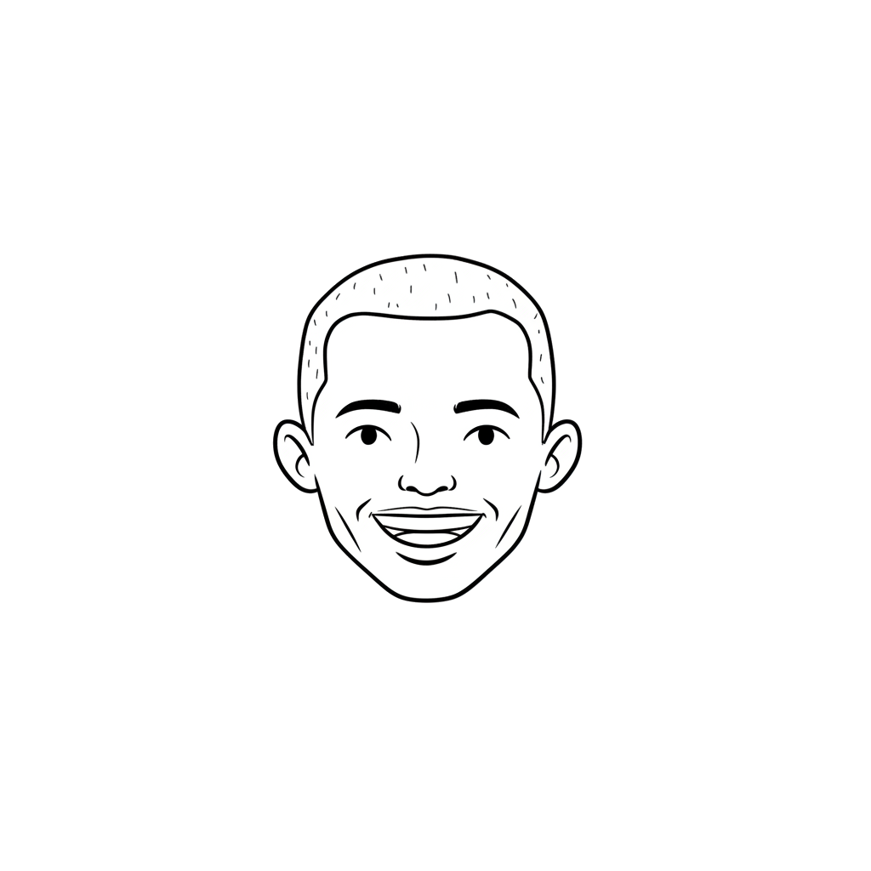
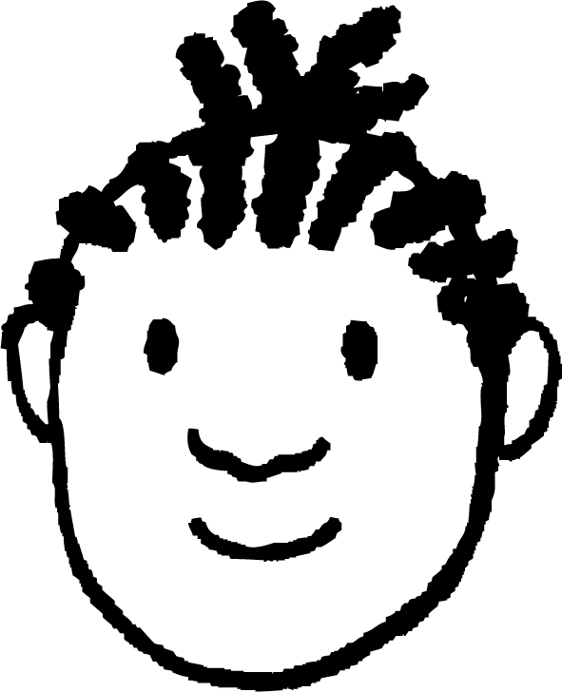

Isticmaalka sine iyo cosine ee goobada halbeegga (Using sine and cosine from a unit circle)
Jaantusku wuxuu muujinayaa saddex-xagal qumman oo ku dhex jira goobada halbeegga.
y
Waxaan sawiray saddex-xagal la mid ah.
1
Waa kuwo isku mid ah (similar) sababtoo ah waxay leeyihiin xaglo (angles) isku mid ah.
(0.8, 0.6)
37°
5 cm
−1
O
1
x
Yacquub
37°
−1
Sidee buu Yacquub u ogyahay inay isku mid yihiin?

Slide 16
Isticmaalka sine iyo cosine ee goobada halbeegga (unit circle)
Saddexagal kasta oo xagal qumman (right-angled triangle) ah, saddexagal isku mid ah (similar triangle) ayaa laga samayn karaa gudaha goobada halbeegga (unit circle).
y
1
θ°
θ°
−1
O
1
x
Rubuca koowaad (first quadrant) waa qaybta kaliya ee goobada halbeegga (unit circle) halkaas oo θ° uu la mid yahay xagasha gudaha (interior angle) ee saddexagalka.
−1

Slide 17
Isticmaalka sine iyo cosine ee goobada halbeegga (unit circle)
Sine-ga xagasha, sin(θ), waa isku-dubbaridka y (y-coordinate) ee barta halka radius-ka loo wareejiyay xagashaas.
y
1
sin(θ)
ka soo horjeeda (opposite)
1
jibaax (hypotenuse)
sin(θ)
θ°
θ°
O
1
x
Saddexagalka gudaha rubuca koowaad (first quadrant) ee goobada halbeegga (unit circle), dhererka dhinaca ka soo horjeeda (opposite) wuxuu la mid yahay sin(θ).

Slide 18
Isticmaalka sine iyo cosine ee goobada halbeegga (unit circle)
Cosine-ga xagasha, cos(θ), waa isku-dubbaridka x (x-coordinate) ee barta halka radius-ka loo wareejiyay xagashaas.
y
1
sin(θ)
ka soo horjeeda (opposite)
1
jibaax (hypotenuse)
sin(θ)
θ°
θ°
O
1
x
cos(θ)
cos(θ)
ku xiga (adjacent)
Saddexagalka gudaha goobada halbeegga (unit circle), dhererka dhinaca ku xiga (adjacent) wuxuu la mid yahay cos(θ).

Slide 19
Isticmaalka sine iyo cosine ee goobada cutubka (unit circle)
Haddii θ iyo mid ka mid ah dhererka geesaha (edge lengths) ee saddex-xagalka la yaqaan, kuwa kale waxaa loo xisaabin karaa iyadoo la isticmaalayo isla saamiyada (ratios) sida saddex-xagalka ee goobada cutubka (unit circle).
dhinac ka soo horjeeda (opposite)
jibaax (hypotenuse)
1
sin(θ)
θ°
θ°
O
cos(θ)
dhinac ku xiga (adjacent)

Slide 20
Isticmaalka sine iyo cosine ee goobada cutubka (unit circle)
Haddii θ iyo mid ka mid ah dhererka geesaha (edge lengths) ee saddex-xagalka la yaqaan, kuwa kale waxaa loo xisaabin karaa iyadoo la isticmaalayo isla saamiyada (ratios) sida saddex-xagalka ee goobada cutubka (unit circle).
Tusaalaha Yacquub:
jibaax (hypotenuse)
× 0.6
dhinac ka soo horjeeda (opposite)
× 0.6
dhinac ka soo horjeeda (opposite)
5 cm
jibaax (hypotenuse)
3 cm
1
× 0.8
0.6
× 0.8
37°
37°
O
0.8
4 cm
dhinac ku xiga (adjacent)
dhinac ku xiga (adjacent)

Slide 21
Isticmaalka sine iyo cosine ee goobada cutubka (unit circle)
Waa maxay qiimaha (value) y?
0.5
y
1
10 cm
0.87
y cm
0.87
5
60°
60°
O
1
x
8.7
0.5

Slide 22
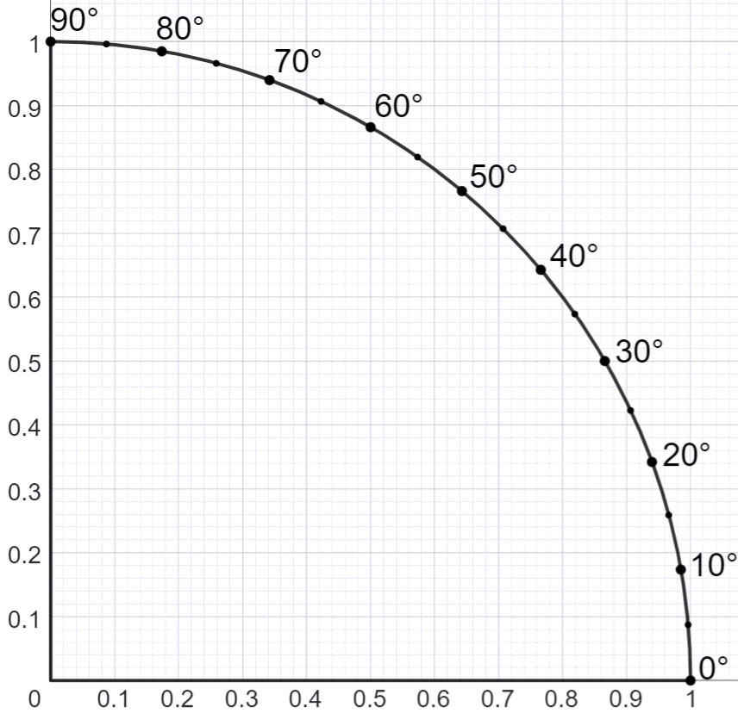
Isticmaalka sine iyo cosine ee goobada halbeegga (unit circle)
sin(θ)
Jaantusku wuxuu muujinayaa qaybta goobada halbeegga (unit circle) ee ku taal rubuca koowaad.
Dhibcaha ku wareegsan wareegga waxay muujinayaan xagasha wareegga (θ) ee ka soo bilaabmaysa dhidibka toosan ilaa radius ee dhibic kasta.
Link si ay u noqoto mid isdhexgala: goobada halbeegga ee rubuca koowaad 🖇
cos(θ)

Slide 23
Isticmaalka sine iyo cosine ee goobada halbeegga (unit circle)
sin(θ)
Tusaale 1: Raadi qiimaha (value) x.
8 cm
x cm
30°
Isticmaal xagasha si aad u abuurto saddexagal la mid ah gudaha goobada halbeegga (unit circle).
30°
cos(θ)

Slide 24
Isticmaalka sine iyo cosine ee goobada halbeegga (unit circle)
sin(θ)
Tusaale 1: Raadi qiimaha (value) x.
hypotenuse
8 cm
x cm
30°
Dhererka 8 cm waa hypotenuse.
1
Jibbaarta (hypotenuse) saddexagalka goobada cutubka waa 1 cutub (unit).
30°
cos(θ)

Slide 25
Isticmaalka sine iyo cosine ee goobada cutubka
sin(θ)
Tusaale 1: Soo hel qiimaha (value) x.
jibbaarta (hypotenuse)
8 cm
x cm
30°
ka soo horjeeda (opposite)
Dhinaca lagu calaamadeeyay x waa dhinaca ka soo horjeeda (opposite).
1
0.5
30°
cos(θ)

Slide 26
Isticmaalka sine iyo cosine ee goobada cutubka
sin(θ)
Tusaale 1: Soo hel qiimaha (value) x.
jibbaarta (hypotenuse)
8 cm
× 0.5
x cm
30°
ka soo horjeeda (opposite)
Isticmaal isla saamiyada (proportions) si aad u hesho qiimaha (value) x.
1
× 0.5
0.5
x = 8 × 0.5
30°
= 4
cos(θ)

Slide 27
Isticmaalka sine iyo cosine ee goobada cutubka
sin(θ)
Waa maxay qiimaha (value) x?
0.87
x cm
8 cm
60°
x = 8 × 0.87
= 6.96
60°
cos(θ)
0.5

Slide 28
Isticmaalka sine iyo cosine ee goobada halbeegga ah
1) Isticmaal qaybtan goobada halbeegga ah si aad u hesho dhererka maqan ee saddexagal kasta.
sin(θ)
a)
b)
10 m
10 m
30°
60°
c)
d)
12 m
45°
15°
8 m
Ku xidh nooc isdhexgal ah: goobo halbeeg ah rubuc kowaad 🖇
cos(θ)

Slide 29
Isticmaalka sine iyo cosine ee goobada halbeegga ah
2) Isticmaal qaybtan goobada halbeegga ah si aad u hesho qiimaha (value) mid kasta oo aan la garanayn.
sin(θ)
a)
b)
a m
b m
6 m
50°
50°
6 m
c)
d)
c m
20 m
10 m
20°
d°
15 m
Ku xidh nooc isdhexgal ah: goobo halbeeg ah rubuc kowaad 🖇
cos(θ)

Slide 30
Isticmaalka sine iyo cosine ee goobada halbeegga ah
1) Isticmaal qaybtan goobada halbeegga ah si aad u hesho dhererka maqan ee saddexagal kasta.
sin(θ)
a)
b)
10 m
8.7 m
10 m
5 m
30°
8.7 m
60°
5 m
c)
5.7 m
d)
12 m
45°
5.7 m
15°
8 m
11.6 m
3.1 m
cos(θ)

Slide 31
Isticmaalka sine iyo cosine ee goobada halbeegga ah
2) Isticmaal qaybtan goobada halbeegga ah si aad u hesho qiimaha (value) mid kasta oo aan la garanayn.
sin(θ)
a)
b)
a m
b m
6 m
50°
50°
6 m
a = 7.8
b = 9.3
c)
d)
c m
20 m
10 m
20°
d°
15 m
c = 14.1
d = 30
cos(θ)

Slide 32
Cabbiridda (scaling) saddex-xagalka qumman (right-angled triangle) ee goobta cutubka (unit circle)
Magacaabista dhinacyada saddexagal qumman (right-angle triangle)
Isticmaalka sine iyo cosine ee goobta cutubka (unit circle)
Isticmaalka tangent ee goobta cutubka (unit circle)

Slide 33
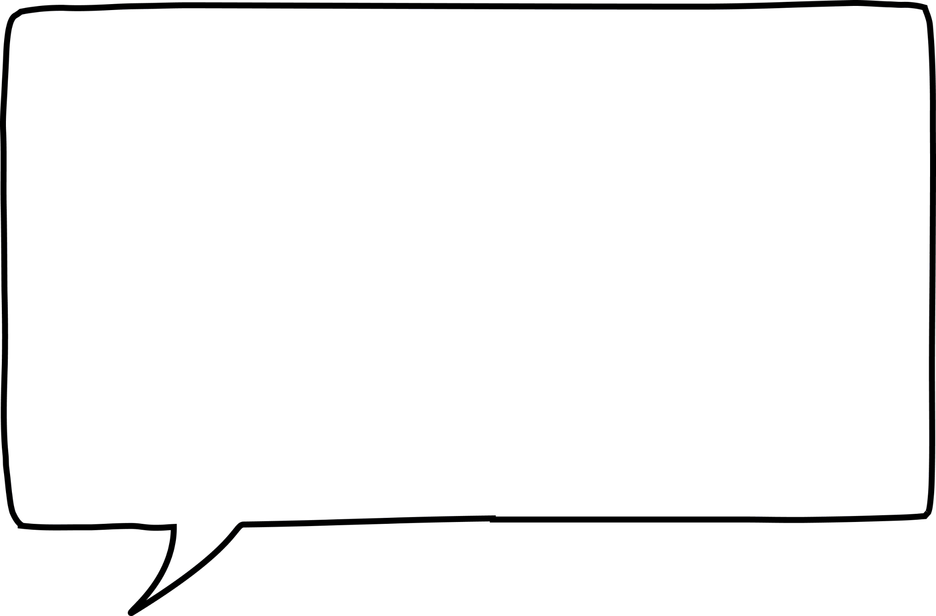
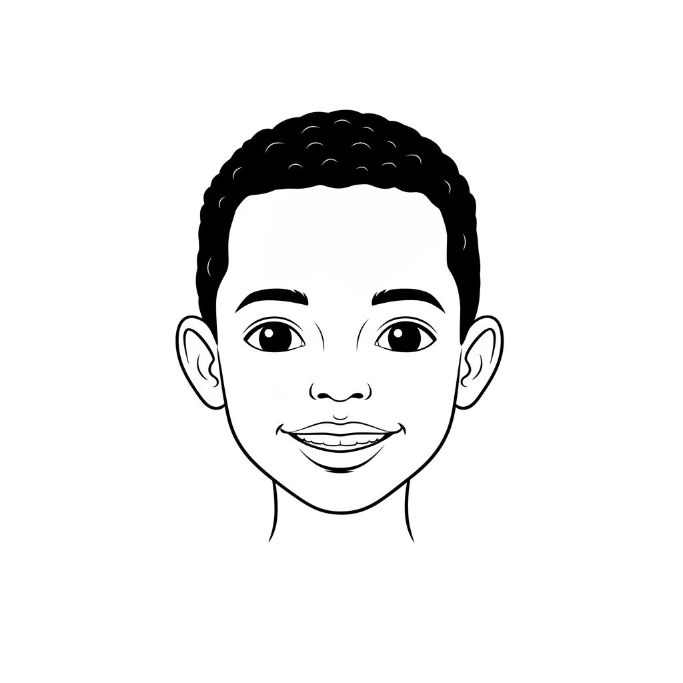
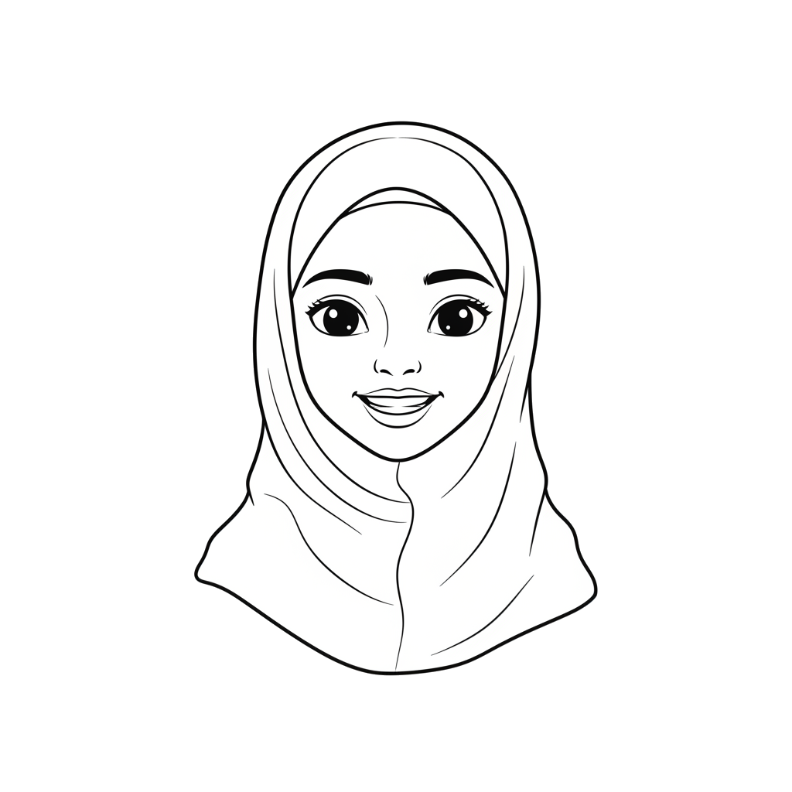
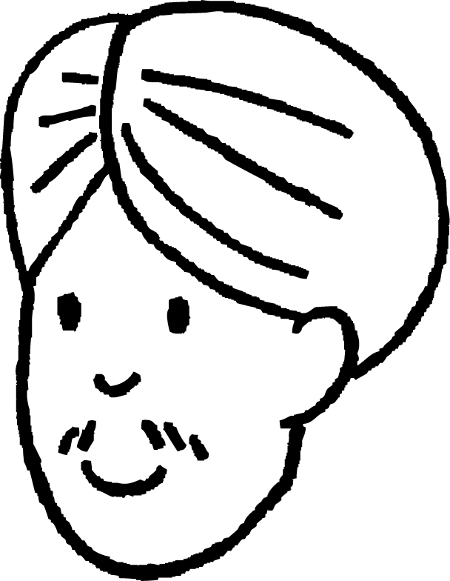
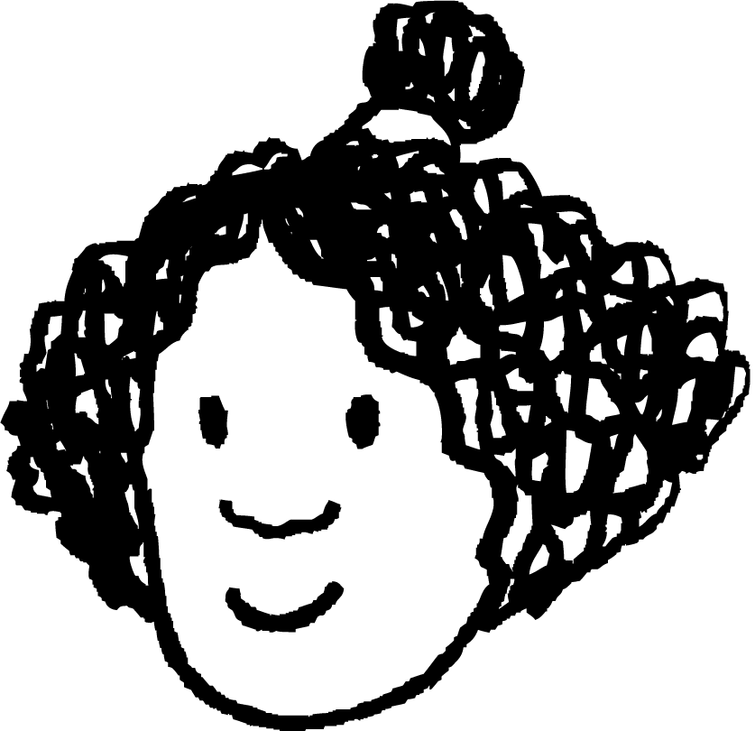
Isticmaalka tangent ee goobta cutubka (unit circle)
Cali iyo Isra waxay raadinayaan qiimaha (value) x ee saddex-xagalka (triangle).
Waxaan isticmaali karnaa goobta cutubka (unit circle) si aan u abuurno saddex-xagal (triangle) halkaas oo adjacent (dhinaca ku xidhan) uu dhererkiisu yahay 1 cutub (unit).
Opposite (dhinaca ka soo horjeeda) ee saddex-xagalkan cusub waa hadda tangent (taabte) goobta cutubka (unit circle).
y
opposite (dhinaca ka soo horjeeda)
1
x cm
40°
40°
1
x
5 cm
O
1
adjacent (dhinaca ku xidhan)

Slide 34
Isticmaalka tangent ee goobta cutubka (unit circle)
Waxaan tan u isticmaali karnaa si aan u helno dhererka opposite (dhinaca ka soo horjeeda) ee saddex-xagalka (triangle) ku jira goobta cutubka (unit circle).
Waxaan markaas u isticmaali karnaa saamiga (proportions) si aan u helno qiimaha (value) x.
y
opposite (dhinaca ka soo horjeeda)
1
0.84
x cm
0.84
40°
40°
× 0.84
1
x
5 cm
O
1
× 0.84
adjacent (dhinaca ku xidhan)

Slide 35
Isticmaalka tangent ee goobta cutubka (unit circle)
Tangent (taabte) xagal (angle) (0 ≤ θ ≤ 90) waa dhererka dhinaca opposite (dhinaca ka soo horjeeda), kaas oo ku yaal tangent (taabte) goobta cutubka (unit circle) ee (1, 0).
y
1
tan(θ)
lidka (opposite)
θ°
θ°
O
1
1
adjacent (dhinaca ku xidhan)
Tangent (taabte) waxaa loo isticmaali karaa in lagu helo mid ka mid ah opposite (dhinaca ka soo horjeeda) ama adjacent (dhinaca ku xidhan) ee saddex-xagal qumman (right-angle triangle), marka dhererka kale iyo xagal (angle) la yaqaan.

Slide 36
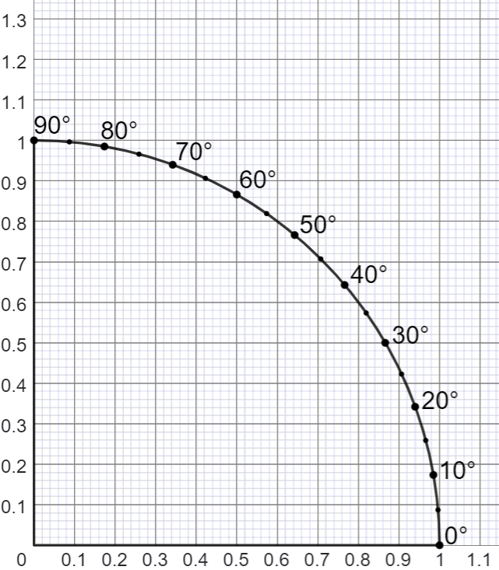
Isticmaalida tangent-ka (tangent) ee goobta halbeegga (unit circle)
y
Tusaale 1: Raadi qiimaha (value) x.
ku xiga (adjacent)
6 cm
lidka (opposite)
40°
x cm
Magacow dhinacyada.
Waxaan isticmaaleynaa lidka (opposite) iyo ku xiga (adjacent), marka sawir tangent (tangent) x = 1.
x

Slide 37
Isticmaalida tangent-ka (tangent) ee goobta halbeegga (unit circle)
y
Tusaale 1: Raadi qiimaha (value) x.
ku xiga (adjacent)
6 cm
lidka (opposite)
40°
x cm
lidka (opposite)
Isticmaal tangent-ka (tangent) si aad u abuurto saddexagal isku mid ah (similar triangle).
40°
x
Hubi cidhifyada (edges) ee u dhigma saddexagallada.
ku xiga (adjacent)

Slide 38
Isticmaalida tangent-ka (tangent) ee goobta halbeegga (unit circle)
y
Tusaale 1: Raadi qiimaha (value) x.
ku xiga (adjacent)
6 cm
soohor (opposite)
40°
x cm
0.84
Ku xiga (adjacent) ee goobta cutubka (unit circle) wuxuu leeyahay dherer 1 cutub (unit).
40°
Dhererka soohorta (opposite) ee saddexagalkaan wuxuu la mid yahay tan(θ).
x
1

Slide 39
Isticmaalka taanjanta (tangent) ee goobta cutubka (unit circle)
y
Tusaale 1: Soo hel qiimaha (value) x.
ku xiga (adjacent)
× 0.84
6 cm
soohor (opposite)
40°
x cm
0.84
Isticmaal isku saamiyada (proportions) si aad u xisaabiso qiimaha (value) x.
40°
× 0.84
x = 6 × 0.84
x
= 5.04
1

Slide 40
Isticmaalka taanjanta (tangent) ee goobta cutubka (unit circle)
y
Waa maxay qiimaha (value) x?
x cm
30°
0.57
10 cm
x = 10 × 0.57
= 5.7
30°
x
1

Slide 41
Isticmaalka taanjanta (tangent) ee goobta cutubka (unit circle)
1) Isticmaal qaybtan (sector) ee goobta cutubka (unit circle) si aad u hesho qiimaha (value) mid kasta oo aan la garanayn.
y
a)
b)
a m
10 m
50°
50°
b m
10 m
c)
d)
4 m
20°
d m
c m
9 m
30°
Ku xidh nooca is-dhexgalka (interactive version): goobta cutubka (unit circle) ee rubaca koowaad (first quadrant)🖇
x

Slide 42
Isticmaalka taanjanta (tangent) ee goobta cutubka (unit circle)
1) Isticmaal qaybtan (sector) ee goobta cutubka (unit circle) si aad u hesho qiimaha (value) mid kasta oo aan la garanayn.
y
a)
b)
a m
10 m
50°
50°
b m
10 m
a = 11.9
b = 8.4
c)
d)
4 m
20°
d m
c m
9 m
30°
x
c = 3.3
d = 6.9

Slide 43
Cabbirka (Scaling) saddexagalka qumman ee ka yimid goobta halbeegga (unit circle)
Waxaa jira saamiyo (ratios) gaar ah oo ku dhex jira labada saddexagal qumman ee muhiimka ah ee lagu qeexay goobta halbeegga (unit circle).
Mid ka mid ah saddexagalka qumman ee muhiimka ah wuxuu leeyahay hypotenuse dhererkiisu yahay 1 unit. Dhinacyada iska soo horjeeda (opposite) iyo kuwa ku xiga (adjacent) ee saddexagalkan waxay leeyihiin dherer sin(θ) iyo cos(θ) siday u kala horreeyaan.
Saddexagalka qumman ee muhiimka ah ee kale wuxuu leeyahay dhinac ku xiga (adjacent) oo dhererkiisu yahay 1 unit. Dhinaca iska soo horjeeda (opposite) ee saddexagalkan wuxuu leeyahay dherer tan(θ).
Waxaad isticmaali kartaa isku ekaansho (similarity) u dhaxaysa saddexagal qumman oo kasta iyo mid ka mid ah saddexagalka qumman ee muhiimka ah si aad u hesho dhererka maqan.

