Slide 1
Hadhyo (Shadows)
Dhawaaq, iftiin iyo aragga (Sound, light and vision)

Slide 2
Sida agabkeena waxbarista loogu talagalay fasalka

Slide 3
Waxaan qeexi karaa waxa dhaca marka iftiinku safro iyo sida hadhyadu u samaysmaan.

Slide 4
hufan (transparent)
qeexaysa walxaha si cad uga arki karto dhexdooda sababtoo ah waxay u oggolaadaan iftiinka inuu dhex maro
gudbin (transmit)
haddii iftiinku dhex maro walax, waxaan dhahnaa walaxdaasi waxay gudbisaa iftiinka (transmits light)
madow (opaque)
qeexaysa walxaha aanad gabi ahaanba ka arki karin dhexdooda, sababtoo ah walxahan uma oggolaadaan iftiin inuu dhex maro
fallaadh iftiin (light ray)
fallaaro lagu daray jaantus si loo muujiyo jihada iftiinka qaar socda
hadh (shadow)
meel aan iftiin lahayn oo qaabka shayga xannibaya iftiinka u eg

Slide 5

Hadhyo (Shadows)
Hufan iyo madow (Transparent and opaque)
Waxa dhaca marka iftiinku safro
Hadhyo (Shadows)

Slide 6

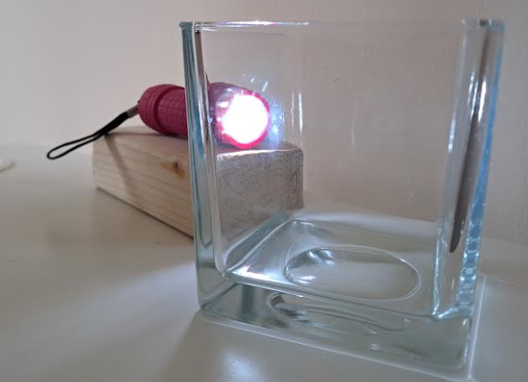
Hufan iyo madow (Transparent and opaque)
Galaasku waa hufan (transparent) – waad ka arki kartaa dhexdiisa.
Biyuhu (water) sidoo kale waa hufan (transparent).
Walxaha iyo agabka hufan (transparent) waxay u oggolaadaan iftiinka inuu dhex maro.
Waxay gudbiyaan iftiin (light).

Slide 7
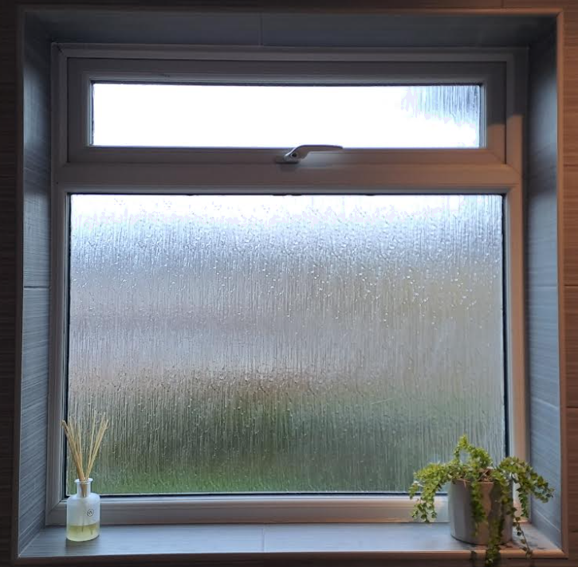
Muuqda (Transparent) iyo madmadow (opaque)
Dariishaddan musqusha waxay u ogolaataa iftiinka (light) inuu soo galo, laakiin si cad uma aragtid dhexdeeda.
Qaar iftiin (light) ah waa la gudbiyaa, laakiin si cad ma aha.
Waa mid qayb-muuqda (translucent) halkii ay ka ahaan lahayd mid muuqda (transparent).

Slide 8
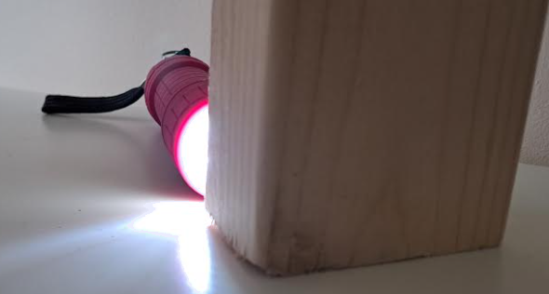
Muuqda (Transparent) iyo madmadow (opaque)
Qoryuhu (wood) ma gudbiyaan iftiin (light) (iftiinku (light) ma dhex maro).
Waxay xannibaysaa iftiinka (light).
Qoryuhu (wood) waa madmadow (opaque).

Slide 9


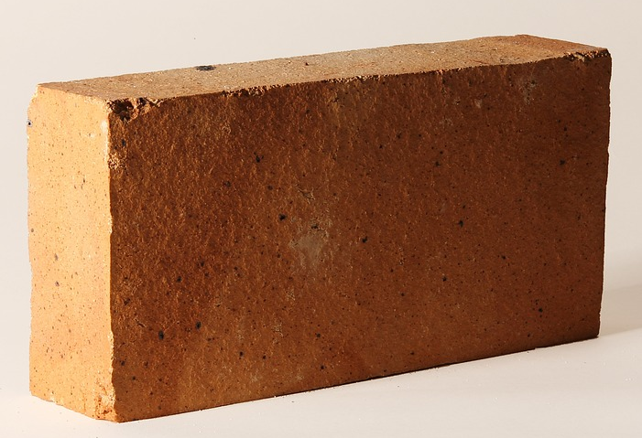
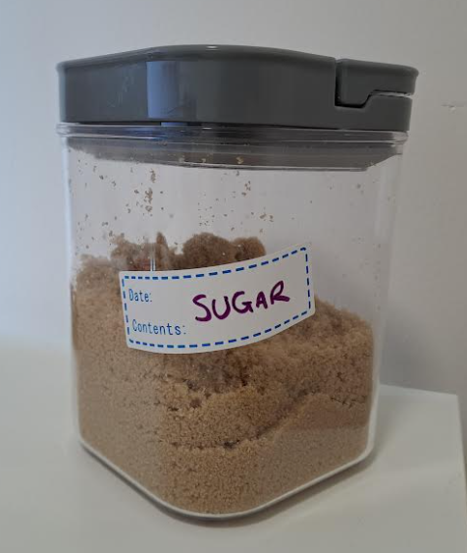
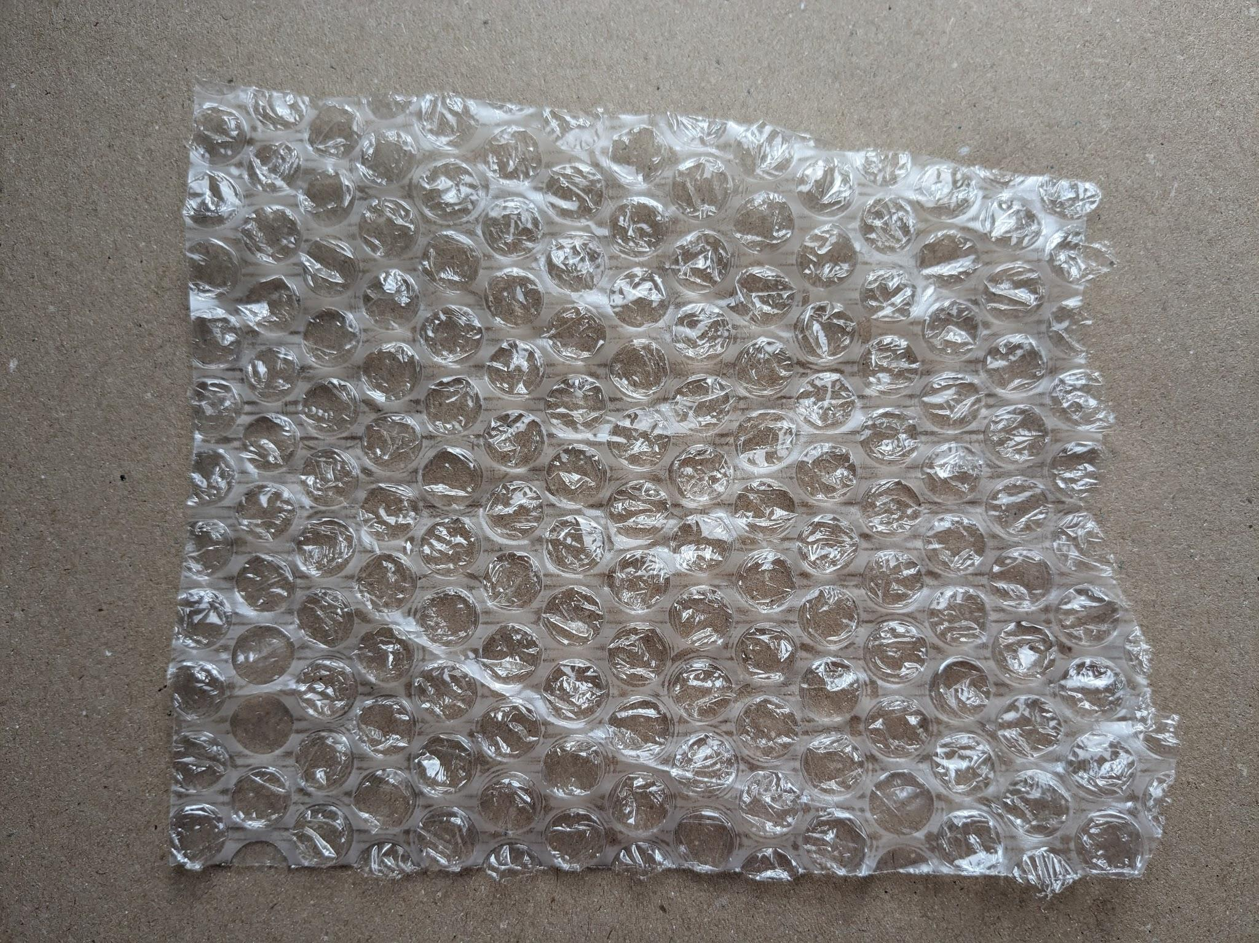
Muuqda (Transparent) iyo madmadow (opaque)
Sheyadaan soo socda kee baa yahay:
1. muuqda (transparent)? 2. qayb-muuqda (translucent)? 3. madmadow (opaque)?
b
c
a
a
leben (brick)
b
weel kaydin (storage container)
c
bubble wrap

Slide 10
Muuqda (Transparent) iyo madmadow (opaque)
Ka jawaab su'aalaha ku saabsan sheyada hoose.
Sharax waxa ka dhigaya weelka kaydinta (storage container) mid muuqda (transparent).
Waa muuqdaa (transparent) sababtoo ah …
Sharax waxa ka dhigaya bubble wrap-ka mid qayb-muuqda (translucent).
Sharax waxa ka dhigaya lebenka (brick) mid madmadow (opaque).

Slide 11
Muuqda (Transparent) iyo madmadow (opaque)
Jawaabo tusaale.
Sharax waxa ka dhigaya weelka kaydinta mid iftiin-gudbiya (transparent).
Waa iftiin-gudbiye (transparent) sababtoo ah iftiinka waa la gudbiyaa / wuxuu dhex mari karaa dhinacyada. Waxa ku jira weelka si cad ayaa loo arki karaa.
Sharax waxa ka dhigaya xumbo-duubka (bubble wrap) mid iftiin-qayb-gudbiya (translucent).
Waa iftiin-qayb-gudbiye (translucent) sababtoo ah iftiinku wuu dhex mari karaa laakiin waxyaabaha gadaasha ka dambeeya si cad looma arki karo. Kaliya qaar ka mid ah iftiinka ayaa la gudbiyaa.
Sharax waxa ka dhigaya lebenka mid iftiin-gudbin (opaque).
Waa iftiin-gudbin (opaque) sababtoo ah ma gudbiyo iftiinka – iftiinku ma dhex mari karo. Wuxuu xannibaa iftiinka.

Slide 12
Hooska (Shadows)
Iftiin-gudbiye (transparent) iyo iftiin-gudbin (opaque)
Waxa dhaca marka iftiinku safro
Hooska (Shadows)

Slide 13
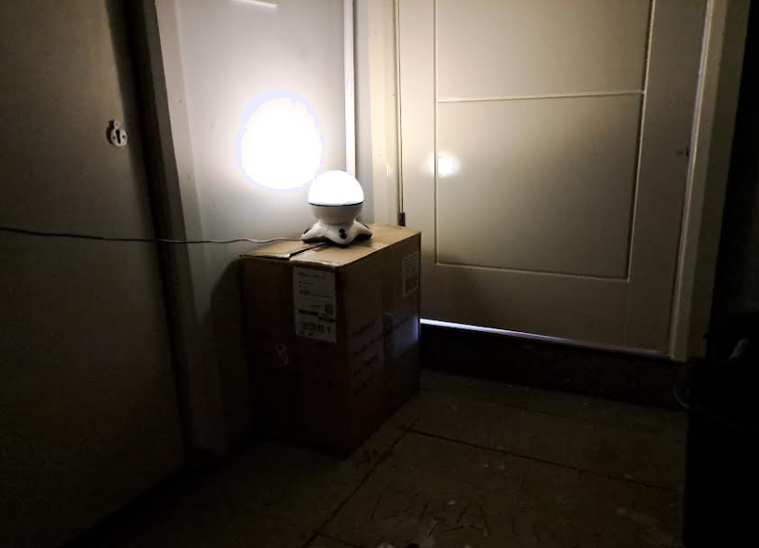
Waxa dhaca marka iftiinku safro
Dhibic kasta oo ka mid ah dusha iftiimaysa waxay si joogto ah u sii daysaa iftiin dhan kasta.
Fallaadhahan waxaa loo yaqaan 'fallaadho iftiin' (light rays).
Waxay muujinayaan qaar ka mid ah jihada iftiinku safro, laga bilaabo dhibco ka mid ah dusha iftiimaysa ee laambadda.

Slide 14
Waxa dhaca marka iftiinku safro
Ma sawiri kartid fallaadho kasta oo iftiin oo ka yimaada dhibic kasta oo dusha iftiimaysa. Kaliya sawir dhowr si aad u muujiso fikradda jihada iftiinku safro.
Iftiinku kama koobna fallaadho iftiin (light rays).
Fallaadhaha iftiinka (light rays) waa uun fallaadho la sawiro si loo muujiyo jihada iftiinku qaato, sida fallaadho khariidad.

Slide 15


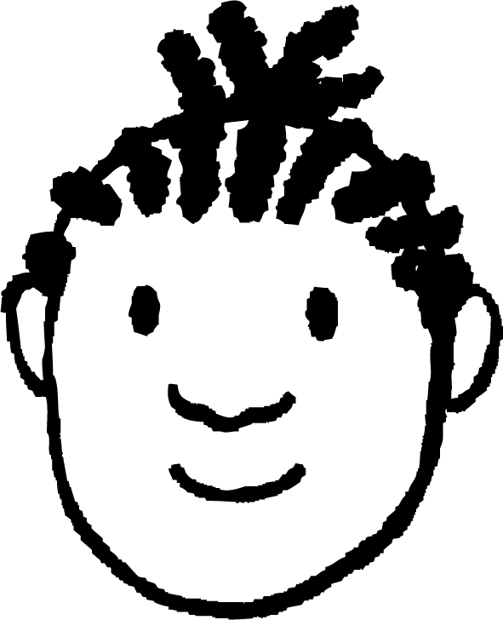
Waxa dhaca marka iftiinku safro
Yacquub wuxuu lumiyay bisaddiisa guriga ee mugdiga.
Wuxuu isticmaalaa toosh (torch) si uu u helo iyaga beerta.
Ku calaamadee xaraf kasta haddii iftiin (light) uu jiro booskaas sawirka.
a
b
a
b
c
c
Rays (rays) lagu daray jaantuska waxay muujinayaan halka iftiinku (light) yahay iyo jihada uu ku socdo.

Slide 16
Maxaa dhacaya marka iftiinku (light) socdo
Mid ka mid ah weedhahan soo socda ee ku saabsan iftiin-rays (light rays) ayaa run ah?
a
Iftiin-ray (light ray) waa qayb dheer oo iftiin (light) ah oo khafiif ah.
b
Iftiinka (light) wuxuu ka samaysan yahay iftiin-rays (light rays) oo la isku daray.
c
Iftiin-rays (light rays) waxay muujinayaan jihada iftiinku (light) socdo.

Slide 17
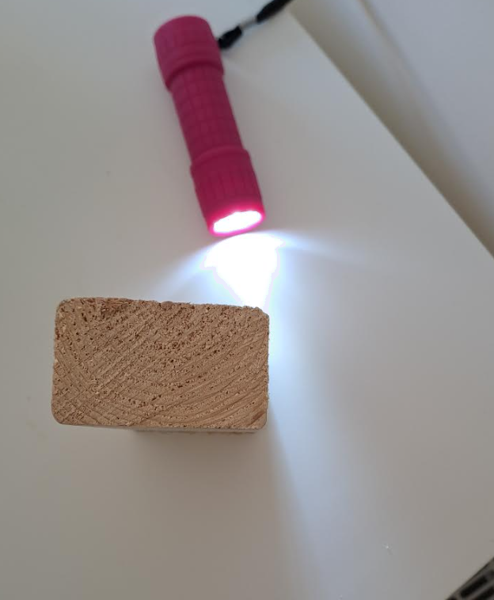
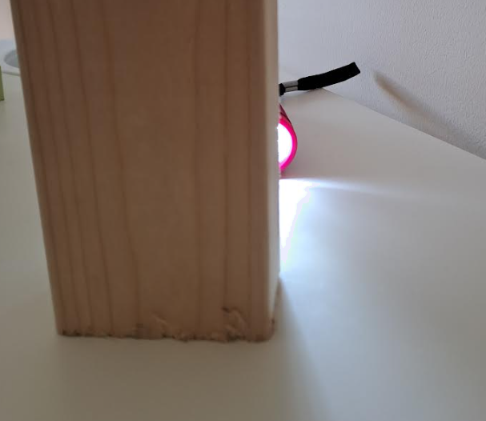
Maxaa dhacaya marka iftiinku (light) socdo
Iftiin-rays (light rays) waa in had iyo jeer loo sawiraa sida xariiqo toosan (straight lines), sababtoo ah sidaas ayuu iftiinku (light) u socdaa.
Tani waa sababta aadan u arki karin geesaha.

Slide 18
Maxaa dhacaya marka iftiinku (light) socdo
Sawirka hoose kee baa muujinaya waddooyin ay qaar ka mid ah iftiinka (light) tooshkan qaadeen?
a
b
c
d

Slide 19
Maxaa dhacaya marka iftiinku (light) socdo
Qolka wuxuu u iftiimaa (lit) si ka xoog badan meelaha laambadda (lamp) u dhow marka loo eego meelaha ka fog. Tani waa sababta oo ah iftiinku (light) wuu fidaa (spreads out) markuu socdo.
Tani sidoo kale waa sababta shay ifaya (glowing objects) uga ekaadaan kuwo daciif ah (dimmer) marka laga eego meel fog.
Iftiinku (light) wuxuu u socdaa si isku mid ah maalintii (daylight) iyo habeenkii (darkness)ba.
Maalintii (daylight) laambaduhu (lamps) uma ekaan karaan kuwo dhalaalaya (bright) sababtoo ah waxaanu isbarbardhigaynaa hareeraha ka iftiim badan (brighter surroundings).

Slide 20
Maxaa dhacaya marka iftiinku (light) socdo
Iftiinku (light) wuxuu had iyo jeer sii wadi doonaa inuu ku socdo xariiqo toosan (straight lines) ilaa uu ku dhaco dusha (surface) shay.
Dusha (surfaces) badankoodu waxay nuugaan (absorb) qaar ka mid ah iftiinka (light) waxayna ka tarjumaan (reflect) (soo celiyaan) inta kale, iyagoo ku kala firdhiya (scattering) jihooyin badan.
Tani waxay dhacdaa si aad u degdeg ah sababtoo ah iftiinku (light) waa aad u dhakhso badan (extremely fast).
Taasi waa sababta iftiinka (light) qolka la sii daayo (given out) si dhakhso leh loo nuugo (absorbed).
Laambaduhu waxay joogteyn karaan heerka iftiinka (light) ee qolka iyagoo si joogto ah iftiin (light) siinaya.

Slide 21
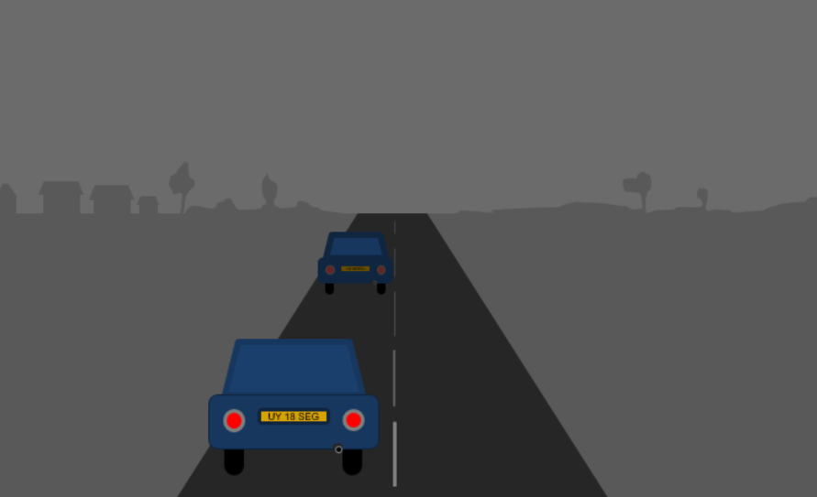
Maxaa dhacaya marka iftiinku (light) socdo
Habeen mugdi ah, gaari ayaa kaa durkaya. Maxay iftiimada (lights) u muuqdaan kuwo daciif ah marka gaarigu ka fog yahay?
a
Iftiinku (light) wuu daciifayaa marka uu sii fogaanayo.
b
Iftiinku (light) wuu ku faafaa marka uu sii fogaanayo.
c
Waxaa jira mugdi (darkness) badan oo iftiinku (light) dhex maro.
d
Waxaa jira mugdi (darkness) badan oo aad dhex aragto marka gaarigu ka fog yahay.

Slide 22
Maxaa dhacaya marka iftiinku (light) socdo
Ka wada hadla weedhaha ku saabsan sida laambad (lamp) u iftiimiso qolka. Kadibna calaamee hal sanduuq oo weedh kasta ah.
I
Waan hubaa inay tani sax tahay
I
Waxaan u malaynayaa inay tani sax tahay
I
Waxaan u malaynayaa inay tani khalad tahay
I
Waan hubaa inay tani khalad tahay
a
Iftiinku (light) wuxuu ka soo baxaa laambadda (lamp) xariiq toosan (straight lines).
Waxaa jira masaafo go'an oo iftiinka (light) laambadda (lamp) uu ku socon karo.
b
Iftiinku (light) wuxuu ka soo baxaa laambadda (lamp) ilaa uu buuxiyo qolka, kadibna wuu istaagaa.
c
Iftiinku (light) wuxuu sii socdaa inuu ka soo baxo laambadda (lamp) isagoo ka boodaya (bouncing) walxaha.
d

Slide 23
Maxaa dhacaya marka iftiinku (light) socdo
Ka wada hadla weedhaha ku saabsan sida laambad (lamp) u iftiimiso qolka. Kadibna calaamee hal sanduuq oo weedh kasta ah.
I
Waan hubaa inay tani sax tahay
I
Waxaan u malaynayaa inay tani sax tahay
I
Waxaan u malaynayaa inay tani khalad tahay
I
Waxaan hubaa in kani khalad yahay
a
Iftiinka (Light) wuxuu ka soo baxaa laambadda (lamp) khadadka toosan (straight lines).
Waxaa jira masaafo (distance) go'an oo iftiinka (light) ka iman kara laambadda (lamp).
b
Iftiinka (Light) wuxuu ka soo baxaa laambadda (lamp) ilaa uu buuxiyo qolka, ka dibna wuu istaagaa.
c
Iftiinka (Light) wuxuu sii wadaa inuu ka soo baxo laambadda (lamp) isagoo ka boodboodaya (bouncing) walxaha.
d

Slide 24
Hooska (Shadows)
Daah-furan (Transparent) iyo daah-xiran (opaque)
Waxa dhaca marka iftiinka (light) socdo
Hooska (Shadows)

Slide 25
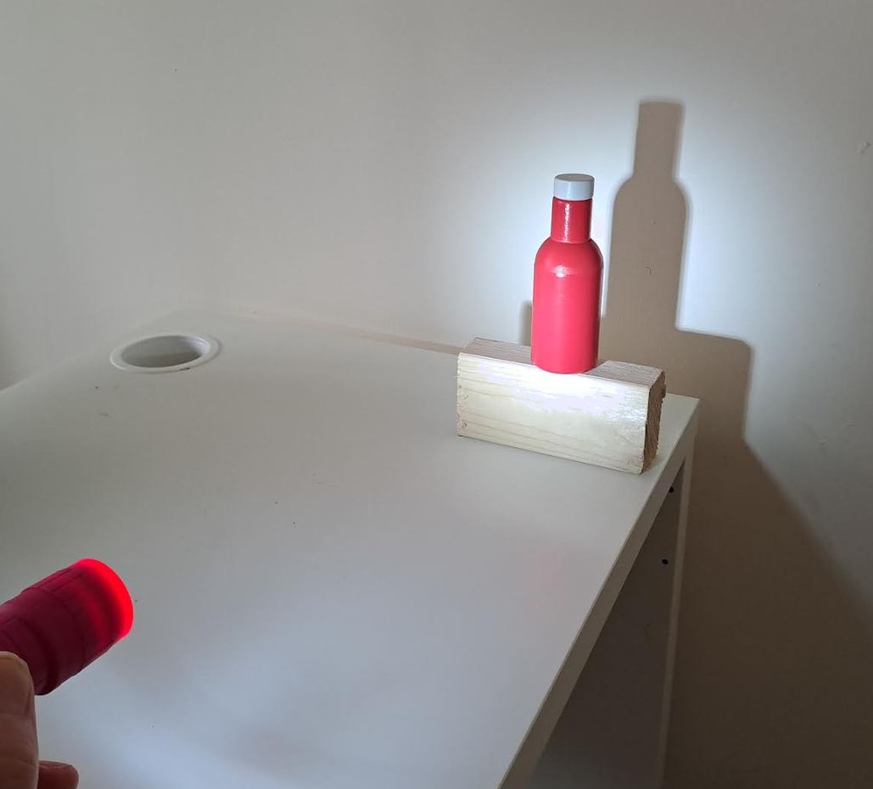
Hooska (Shadows)
Marka iftiin (light) dhalaalaya lagu iftiimiyo shay daah-xiran (opaque object) ayaa hoos (shadow) sameysma.
Hoosku (Shadow) waa meel uu iftiinku (light) gaari kari waayey, sababtoo ah iftiinka (light) wuxuu u socdaa khadadka toosan (straight lines) oo keliya.
Iftiinku (Light) ma qalooci karo (curve) shay si uu u iftiimiyo meesha ka dambeysa.

Slide 26
Hooska (Shadows)
Fallaarradan (Rays) waxay ku dhacaan walxaha daah-xiran (opaque objects) marka waa la xannibay. Gidaarka (wall) si toos ah uga dambeeya lama iftiimin.
Fallaarradan (Rays) waxay dhaafaan dhinaca walxaha, marka waxay iftiimiyaan gidaarka (wall) halka ay ku dhacaan.

Slide 27
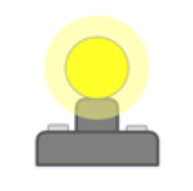
Hooska (Shadows)
Kani waa jaantus (diagram) 2D oo muujinaya sida hoosku (shadow) u sameysmo.
iftiimsan (lit)
aan iftiimsanayn: hoos (not lit: shadow)
iftiimsan (lit)
gidaar (wall)

Slide 28
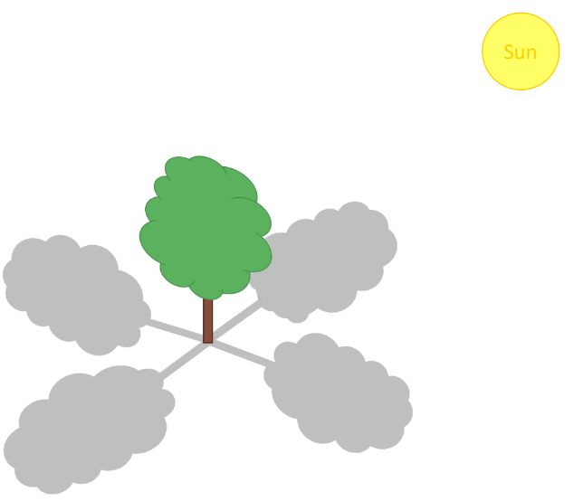
Hooska (Shadows)
Kee ka mid ah doorashooyinka soo socda ayaa muujinaya meesha hooska geedku ku yaalli?
a
b
c
d

Slide 29
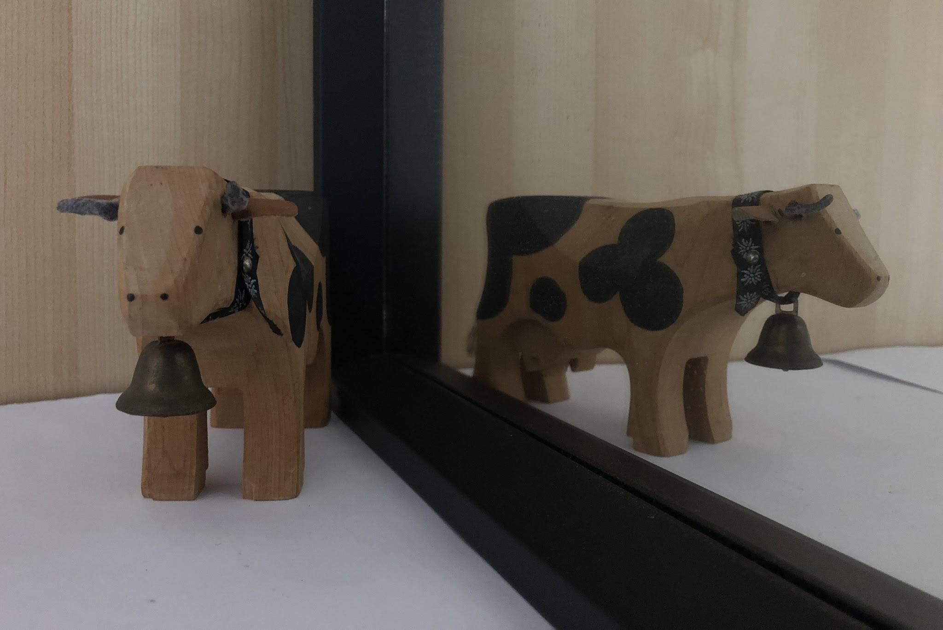
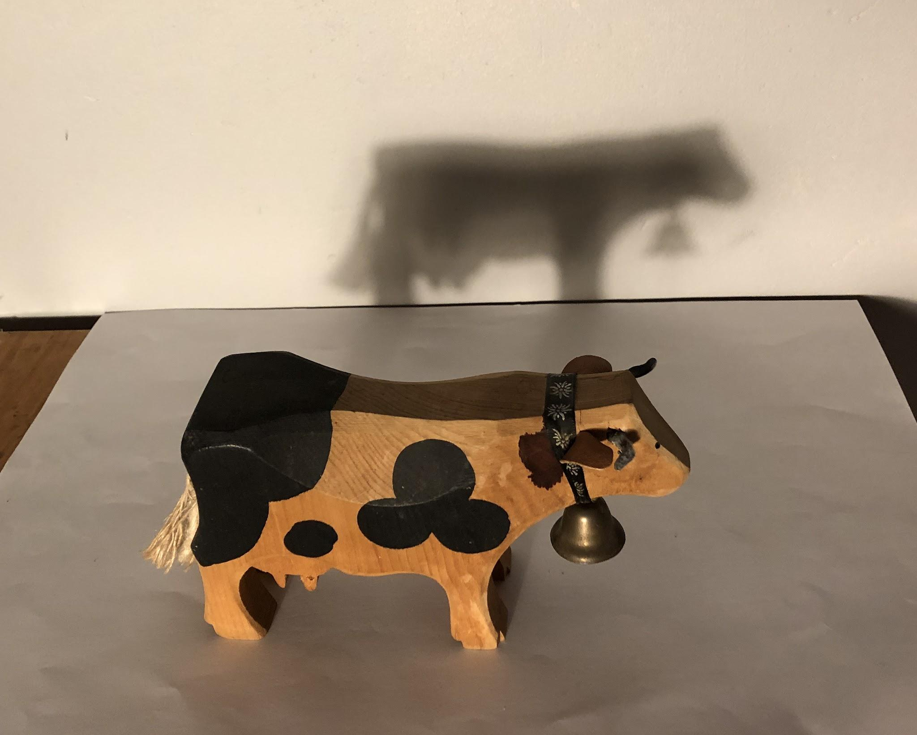
Hooska (Shadows)
Hoosku ma aha milicsi (reflection).
Milicsigu (reflection) wuxuu dhacaa marka iftiinku (light) ka boodo dusha dhalaalaysa.
Hoosku wuxuu dhacaa marka iftiinka (light) la xannibo.
sac ciyaar ah iyo milicsigiisa (reflection) muraayad ku yaal
sac ciyaar ah iyo hooskiisa

Slide 30
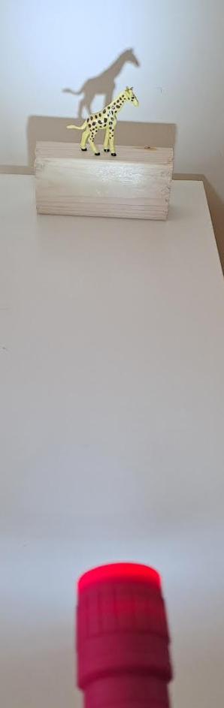
Hooska (Shadows)
Hoosku ma aha shay (object).
Hoosku waa qayb aan iftiin lahayn oo dusha ah, oo qaabkiisu yahay qaabka shayga iftiinka xannibay.
Hooska shay aan iftiin gelin (opaque) ma muujin karo qaababka ama midabka shayga.
Wuxuu kaliya muujinayaa qaabka, oo midab keliya ah (silhouette).

Slide 31
Fallaadhaha iftiinka (light rays) iyo hooska
Marka tooshka la shido, dusha u dhow aad ayuu u iftiimaan, laakiin meesha hoosku ku yaal ma helo iftiin dheeri ah.
Meesha hoosku ku yaal waxay u egtahay mid aad u madow, laakiin dhab ahaantii waxay ku sii jirtaa iftiinkii hore.
Waxay u egtahay mid madow marka la barbardhigo agagaarka, kaas oo hadda aad u iftiimay.

Slide 32
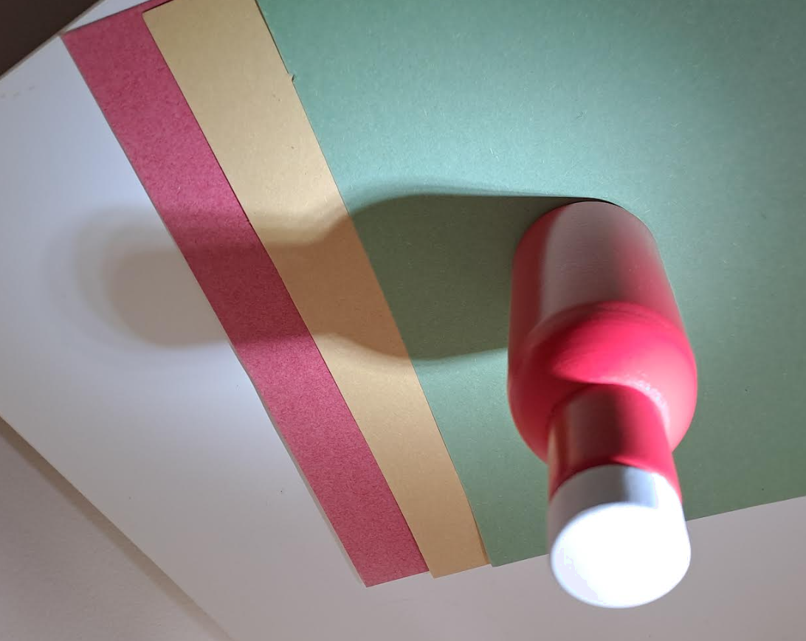

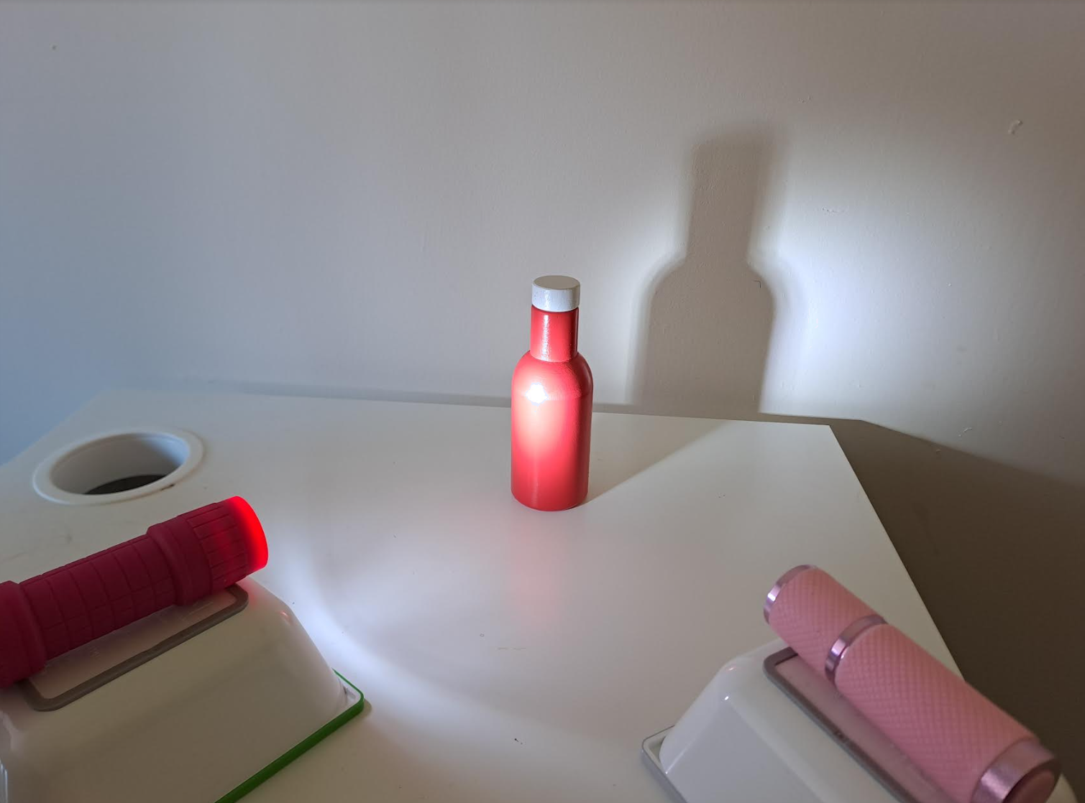
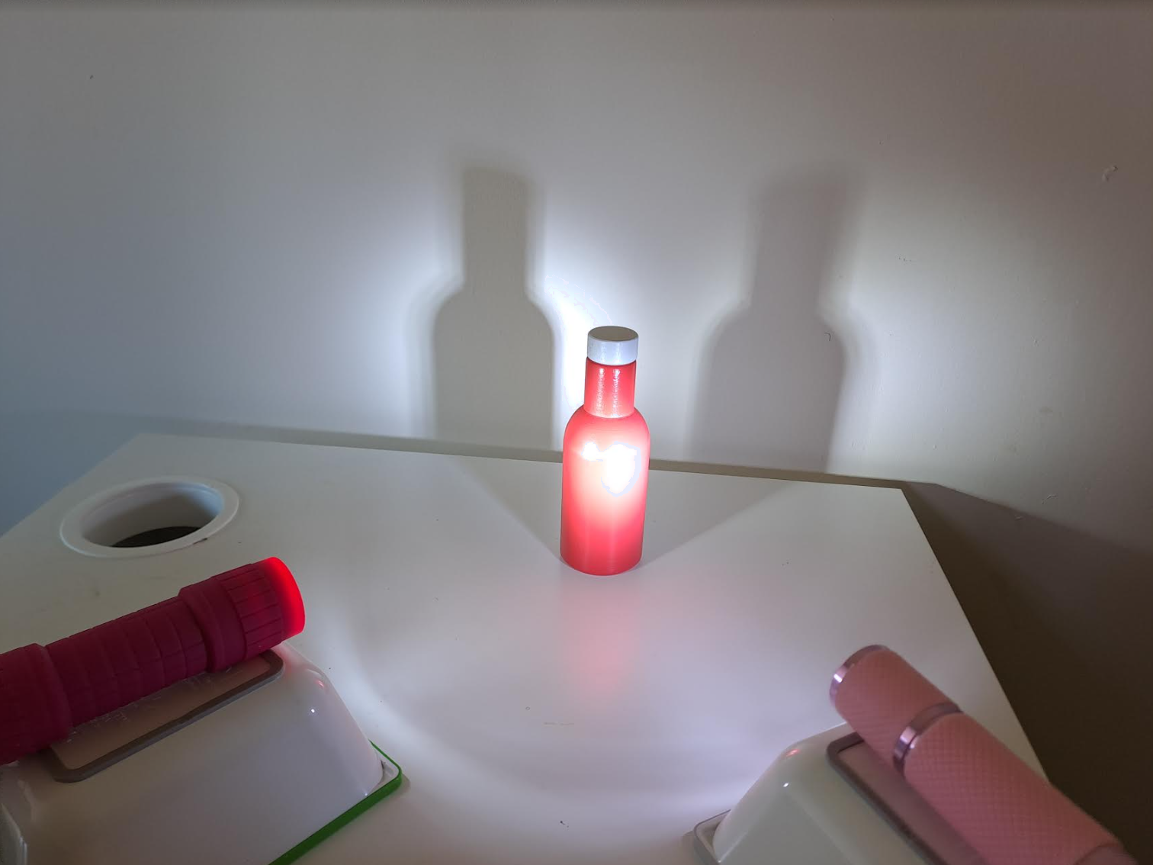
Hooska (Shadows)
Hoosku inta badan ma aha madow.
Waxay yihiin midabka dusha.
Halkan, shidista tooshka labaad waxay abuurtaa hoos labaad waxayna ka fududaysaa hooskii hore.
shidan (on)
off
on
on

Slide 33
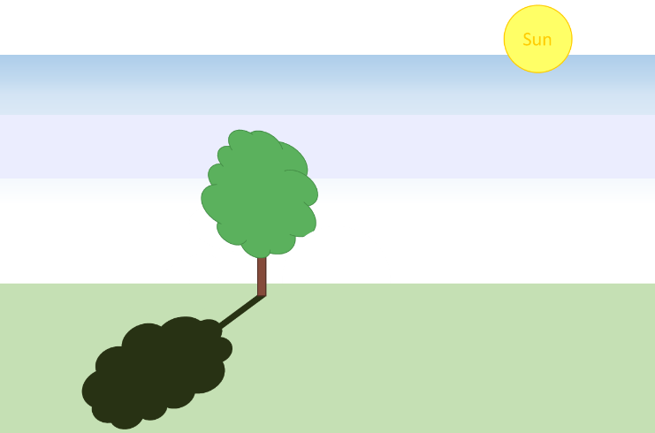
Hooska (Shadows)
Kuwee kuwa soo socda ayaa ah sharaxaadda saxda ah ee sida hooska geedka loo sameeyo?
Iftiinka (light) ma dhex mari karo geedka, marka cawska (grass) lama iftiimiyo.
a
b
Iftiinka (light) wuxuu ka yimaadaa Qorraxda (Sun) laakiin ma dhaafi karo geedka, marka waa madow.
c
Geedku wuxuu joojiyaa Qorraxda (Sun) inay sii iftiiso, marka geedku wuxuu sameeyaa hooska (shade).
Qorraxdu (Sun) waxay iftiimisaa geedka, hooskuna (shadow) waa milicsiga (reflection) geedka.
d

Slide 34
Hooska (Shadows)
Haddii isla shayga uu u dhow yahay laambad (lamp), wuxuu sameeyaa hoos (shadow) weyn.
hoos (shadow)
derbi (wall)
hoos (shadow)

Slide 35
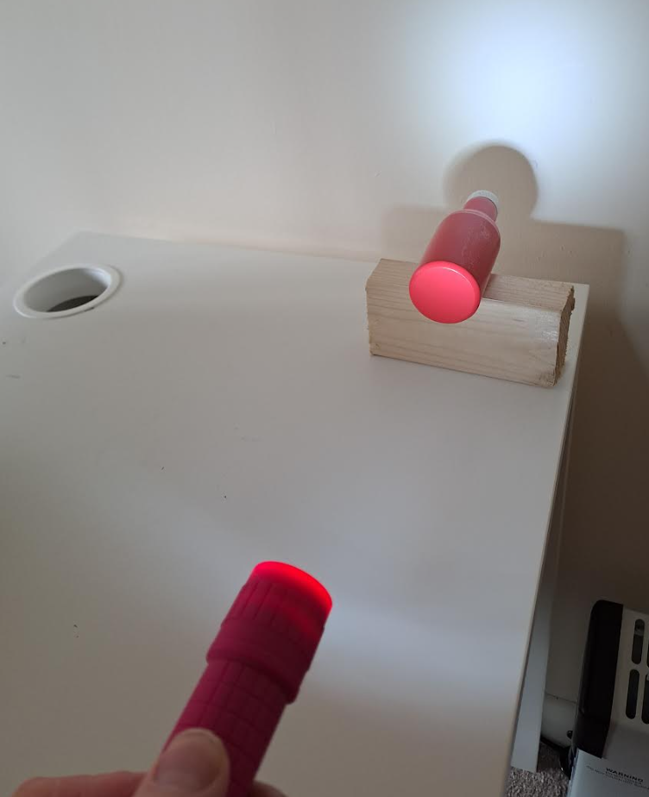
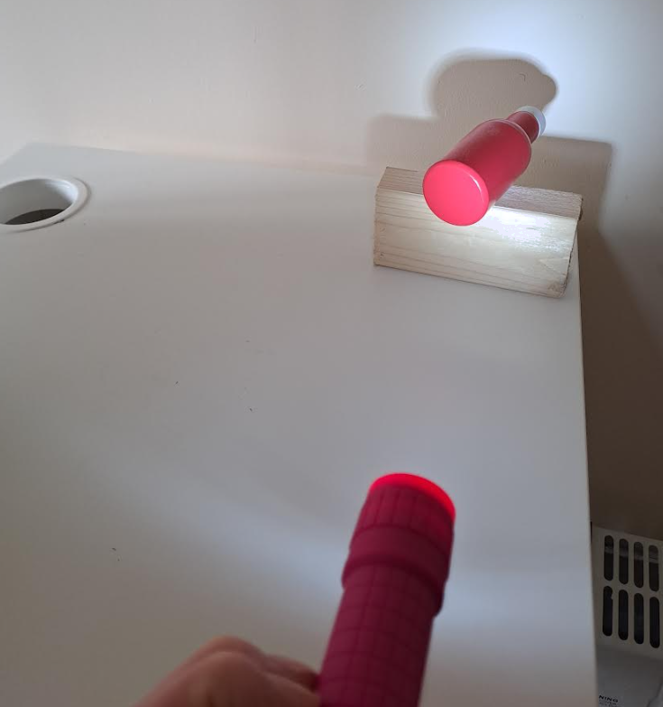
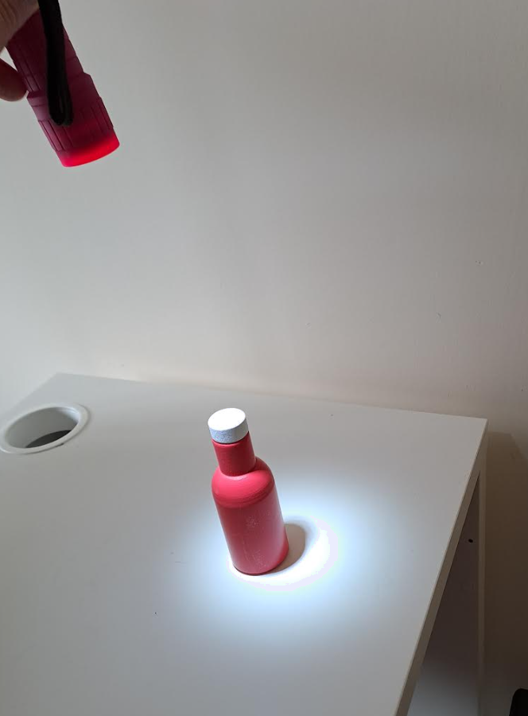
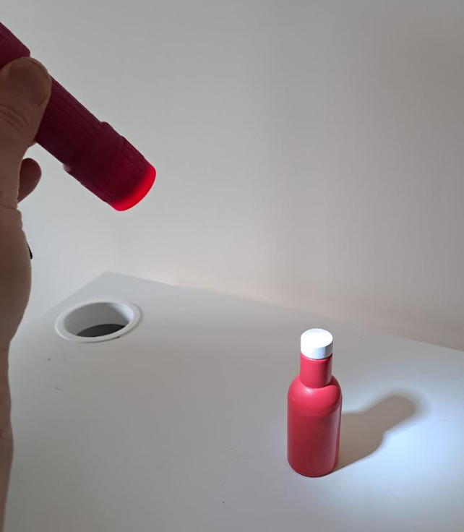
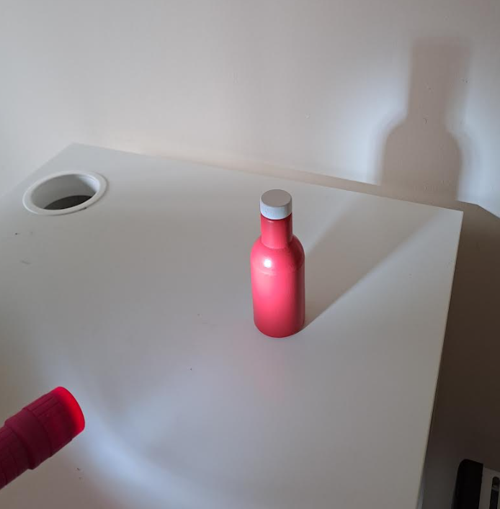
Hooska (Shadows)
Qaabka iyo cabbirka hoosku (shadow) wuxuu ku xiran yahay halka iftiinku (light) gaari karo.
Tan waxaa saameeya cabbirka (size) iyo booska (position) shayga, iyo xaglaha (angles) iyo masaafada (distances) ku lug leh.
Shucaacyo (Rays) laga soo sawiray cidhifka laambadda (lamp) oo dhaafaya cidhifka shayga ayaa kaa caawin kara inay muujiyaan halka hoosku (shadow) ka sameysmo iyo cabbirkiisa.

Slide 36

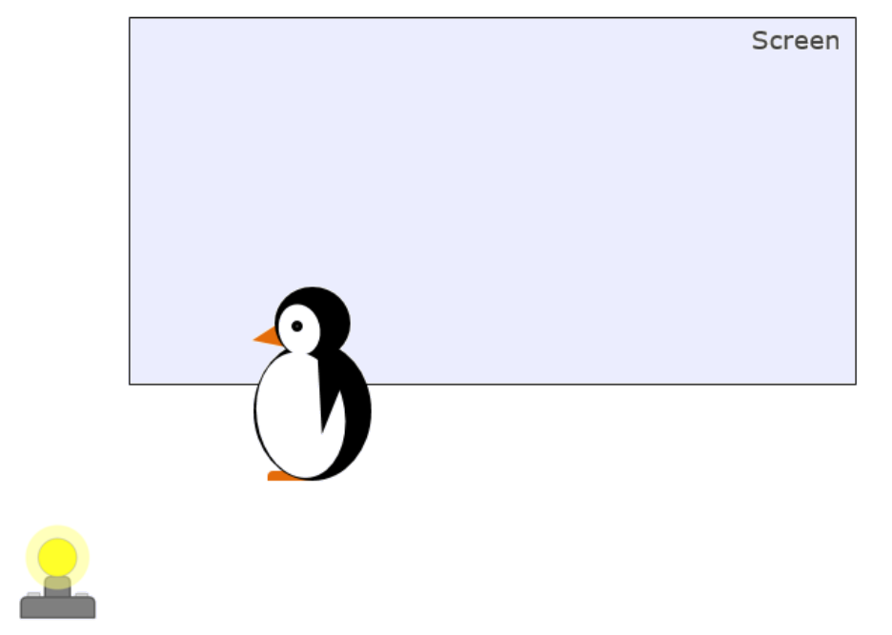
Hooska (Shadows)
Alaabtan ciyaarta ee penguin (penguin toy) waxay hoos (shadow) ku riddaa shaashad (screen) ka dambeysa.
Sawirkaa ayaa muujinaya sida hoosku (shadow) u ekaan doono?
a
b
c
d
Sawirkaa ayaa muujinaya cabbirka hooska (shadow) saxda ah? (tilmaan: ka fikir shucaacyada iftiinka (light rays))
a
b
c

Slide 37
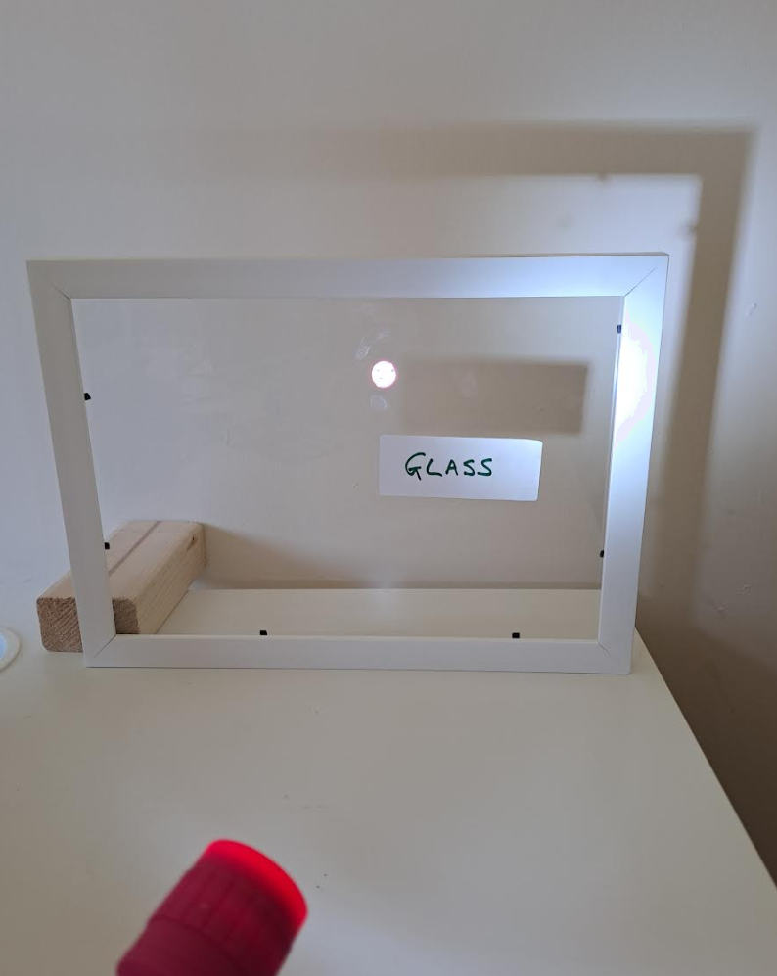
Hadhyo (Shadows)
Qaabka sawirka madhan wuxuu ka kooban yahay qaab alwaax ah iyo muraayad (loo yaqaan 'sticker'). Toosh ayaa iftiiminaya.
Sharax sababta qaabka iyo sticker-ku ay u saareen hadhyo gidaarka gadaashiisa.
Sharax sababta muraayaddu aan u saarin hadh.
Isticmaal ereyada muhiimka ah ee darasga jawaabahaaga.
toosh (torch)

Slide 38
Hadhyo (Shadows)
Tusaalooyin jawaab ah.
Sharax sababta qaabka iyo sticker-ku ay u saareen hadhyo gidaarka gadaashiisa.
Qaabka iyo sticker-ku waa kuwa aan iftiinka gudbin (opaque), marka ma gudbiyaan iftiin. Iftiinka ku dhaca waa la nuugi karaa ama waa laga celin karaa, sidaas darteed waa 'xanniban' inuu u socdo gidaarka gadaashiisa. Iftiinku wuxuu u socdaa sadar toosan oo keliya, marka ma uu rogi karo qaabka ama sticker-ka si uu u iftiimiyo gidaarka gadaashiisa. Tani waxay ka tagtaa meelo aan iftiin lahayn oo gidaarka ah oo qaabka qaabka iyo sticker-ka leh.
Sharax sababta muraayaddu aan u saarin hadh.
Muraayaddu waa mid iftiinka gudbisa (transparent). Iftiinka ku dhaca muraayadda wuu dhex mari karaa si uu u iftiimiyo gidaarka gadaashiisa. Sidaas darteed gidaarka gadaasha muraayadda waa iftiimay, ma aha hadh.

Slide 39
Hadhyo (Shadows)
Walxaha iftiinka gudbiya (transparent) waxay gudbiyaan iftiin.
Walxaha iftiinka qayb gudbiya (translucent) waxay gudbiyaan iftiin qaar, laakiin si aan caddayn.
Walxaha aan iftiinka gudbin (opaque) ma gudbiyaan iftiin, ma aragtid iyaga dhexdooda.
Iftiinku wuxuu u socdaa sadar toosan oo xawaarihiisu aad u dheereeyo.
Fallaaraha iftiinka (light rays) waa fallaaro toosan oo lagu daro jaantusyada si loo muujiyo jihada iftiinka qaarkiis.
Iftiinku wuu fidaa markuu socdo.
Iftiinku wuxuu sii soconayaa sadar toosan ilaa uu ku dhaco dusha shay. Qaar iftiinka waa la nuugaa, qaarna waa laga celiyaa (dib ayaa loo celiyaa).
Hadhku waa meel aan iftiin lahayn oo qaabka shayga xannibaya iftiinka leh.

