Slide 1
Isku ekaanshaha qaababka (Similarity in shapes)
Sifooyinka joomatari iyo aragtida Pythagoras (Geometrical properties and Pythagoras’ theorem)

Slide 2
sida loo isticmaalo darasyada Oak

Slide 3
Waxaan garan karaa in qaababka isku midka ah ay leeyihiin dhinacyo isku saami ah, laakiin cabbirka xagluhu waa ilaashan yahay.

Slide 4
Shayga (object) waa jaantuska bilowga ah ka hor inta aan la isticmaalin isbeddel (transformation).
Sawirka (image) waa jaantuska ka soo baxa ka dib marka isbeddel (transformation) la isticmaalo.
Laba qaab waa isku mid haddii kala duwanaanshaha kaliya ee u dhexeeya ay tahay cabbirkooda. Dhererka dhinacyadoodu waa isku saami.
Qiyaasta weyneynta (Scale factor) waa tirada lagu dhufto ee u dhaxaysa qaababka isku midka ah, oo qeexaysa sida uu u weyn yahay qaabka kale marka loo eego kan kale.
Sifo (property) ee qaabku waa mid aan isbeddelin (invariant) haddii sifooyinkaas aysan isbeddelin ka dib marka qaabka la beddelo.

Slide 5

Isku ekaanshaha qaababka (Similarity in shapes)
Aqoonsashada in qaababku yihiin kuwo isku mid ah
Helista qaababka isku midka ah ee jaantusyada adag

Slide 6
Aqoonsashada in qaababku yihiin kuwo isku mid ah
Marka qaabka uu yahay weyneynta (enlargement) qaab kale, waxay isku mid yihiin.
tusaale:
aan tusaale ahayn:
18 cm
18 cm
× 2
× 2
9 cm
9 cm
× 2
× 3
3 cm
6 cm
3 cm
9 cm
Saddexagallada waa isku mid (similar).
Saddexagallada ma aha isku mid (similar).

Slide 7
Aqoonsashada in qaababku yihiin kuwo isku mid (similar)
Marka laba qaab ay isku mid (similar) yihiin, dhererkoodu wuxuu ku jiraa isla saami (proportion).
tusaale (example):
aan tusaale ahayn (non-example):
12 cm
12 cm
9 cm
9 cm
× 3
× 2
× 3
× 3
3 cm
4 cm
3 cm
6 cm
Saddexagallada waa isku mid (similar).
Saddexagallada ma aha isku mid (similar).

Slide 8


Aqoonsashada in qaababku yihiin kuwo isku mid (similar)
Marka laba qaab ay isku mid (similar) yihiin, xagluhu (angles) waa isku mid qaab kasta, dhererkooduna wuxuu ku jiraa isla saami (proportion).
tusaale (example):
isku xaglo (same angles)
100°
3 cm
isku saami (proportions) dhexdooda dhererka
80°
4 cm
100°
Qaababku waa isku mid (similar).
6 cm
80°
8 cm

Slide 9

Aqoonsashada in qaababku yihiin kuwo isku mid (similar)
Marka laba qaab ay isku mid (similar) yihiin, xagluhu waa isku mid qaab kasta, dhererkooduna waa isku saami (proportion).
tusaale aan ahayn (non-example):
ma aha isku xaglo (same angles)
100°
3 cm
isku saami (proportions) dhexdooda dhererka
80°
4 cm
130°
Qaababku ma aha kuwo isku mid (similar).
6 cm
50°
8 cm

Slide 10

Aqoonsashada in qaababku yihiin kuwo isku mid (similar)
Marka laba qaab ay isku mid (similar) yihiin, xagluhu waa isku mid qaab kasta, dhererkooduna waa isku saami (proportion).
tusaale aan ahayn (non-example):
isku xaglo (same angles)
100°
3 cm
ma aha isku saami (proportion) u dhexeeya dhererrada
80°
4 cm
100°
Qaababku isku mid (similar) ma aha.
6 cm
80°
10 cm

Slide 11
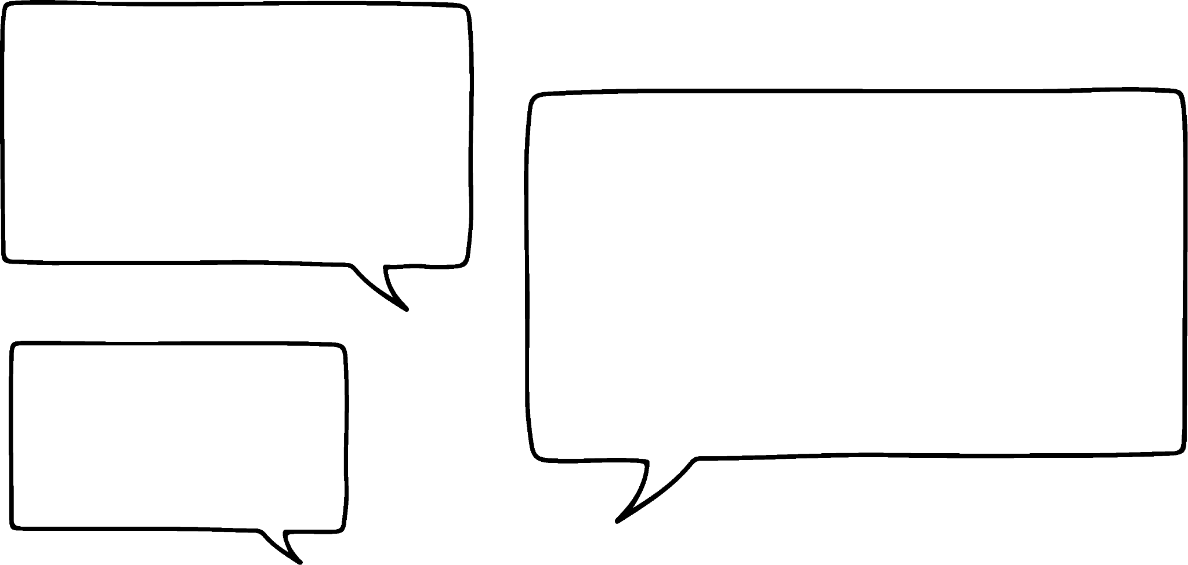
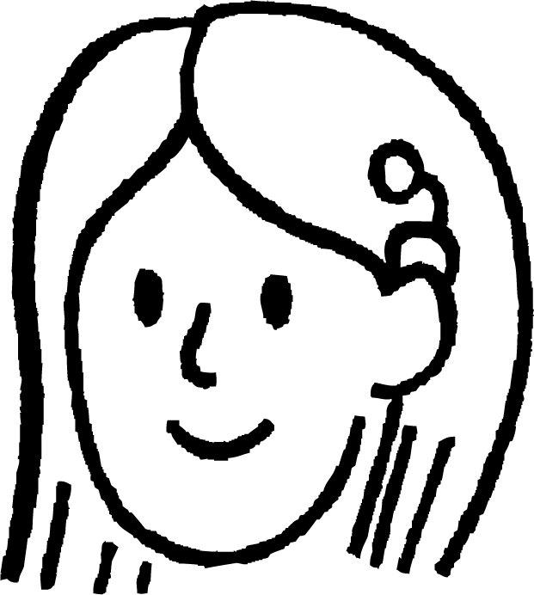
Garashada in qaababku yihiin kuwa isku mid (similar)
Suad waxay isku dayaysaa inay caddayso sababta labada qaab ee hoose aanay isku mid (similar) ahayn.
100°
80°
3 cm
Waan arki karaa inay isku mid (similar) ahayn, laakiin waxay leeyihiin isku xaglo (angles). Sidoo kale dhererrada la muujiyey waxay ku jiraan isku saami (proportion).
80°
100°
4 cm
100°
100°
6 cm
80°
80°
Maxay qaababku u isku mid (similar) ma aha?
8 cm

Slide 12
Garashada in qaababku yihiin kuwa isku mid (similar)
Suad waxay isku dayaysaa inay caddayso sababta labada qaab ee hoose aanay isku mid (similar) ahayn.
100°
80°
Inkasta oo labada qaab ay leeyihiin isku xaglo (angles), kuma jiraan isku nidaam (order).
3 cm
80°
100°
4 cm
100°
100°
Qaab A:
100°, 80°, 100°, 80°
6 cm
Qaab B:
100°, 100°, 80°, 80°
80°
80°
8 cm

Slide 13
Garashada in qaababku yihiin kuwa isku mid (similar)
Suad waxay isku dayaysaa inay caddayso sababta labada qaab ee hoose aanay isku mid ahayn (similar).
100°
80°
Qaab B wuxuu leeyahay laba xagal oo isku xiga oo ah 100°, laakiin Qaab A ma leh.
3 cm
80°
100°
4 cm
100°
100°
Qaab A:
100°, 80°, 100°, 80°
6 cm
Qaab B:
100°, 100°, 80°, 80°
80°
80°
8 cm

Slide 14
Aqoonsashada in qaababku yihiin kuwo isku mid ah (similar)
Suad waxay isku dayaysaa inay caddayso sababta labada qaab ee hoose aanay isku mid ahayn (similar).
100°
80°
Xataa haddii aan ku wareego si ka soo horjeeda (anti-clockwise) Qaab B, xagluhu weli waxay ahaan doonaan nidaam ka duwan Qaab A.
3 cm
80°
100°
4 cm
100°
100°
Qaab A:
100°, 80°, 100°, 80°
6 cm
Qaab B
100°, 100°, 80°, 80°
80°
80°
Marka qaababku yihiin kuwo isku mid ah (similar), xagluhu waa la ilaaliyaa oo waxay ku jiraan isku nidaam.
8 cm

Slide 15
Aqoonsashada in qaababku yihiin kuwo isku mid ah (similar)
Haddii laba qaab ay leeyihiin isku xaglo, markaas waa inay ahaadaan kuwo isku mid ah (similar).
Haddii xagluhu isku mid yihiin, waxay ka dhigan tahay in dhererka (lengths) ay sidoo kale ku jiraan isku saami (proportion).
Haddii qaabku leeyahay afar ama in ka badan oo geesood (vertices), xagluhu waxaa laga yaabaa inaanay ku jirin isku nidaam.

Slide 16
Aqoonsashada in qaababku (shapes) isku mid yihiin (similar)
Haddii laba qaab (shapes) aysan lahayn xaglo (angles) isku mid ah, markaas isku mid ma aha (similar).
Ma suurtogalna in dhammaan dhererka (lengths) ay isku saami (proportion) ahaadaan haddii xaglaha (angles) aan isku mid ahayn.
Qaar ka mid ah dhererka (lengths) wali waxay isku saami (proportion) ahaan karaan inkastoo xaglaha (angles) aan isku mid ahayn.

Slide 17
Aqoonsashada in qaababku (shapes) isku mid yihiin (similar)
Miiska saamiga (ratio table) wuxuu kaa caawin karaa helista saamiyada (proportions) ee dhererka (lengths) gudaha qaababka iyo helista qiyaasta (scale factors) ee u dhexeeya qaababka isku midka ah (similar shapes).
tusaale:
100°
Qaabka A | 4 | 3
Qaabka B | 8 | 6
A
3 cm
× 2
× 2
80°
4 cm
100°
B
6 cm
Tani waxaa laga yaabaa inaysan had iyo jeer lagama maarmaan ahayn, laakiin waxay caawin kartaa kiisaska adag.
80°
8 cm

Slide 18


Aqoonsashada in qaababku (shapes) isku mid yihiin (similar)
Layla waxay sawirtaa saddex leydi (rectangles) oo isku mid ah (similar). Waxay cabbirtaa qaar ka mid ah dhererka (lengths) iyo ballaca (widths) waxayna ku buuxisaa miiska saamiga (ratio table).
Waa maxay dhererka (length) ee leydiga B?
24 cm
leydi (rectangle) | dherer (length) (cm) | ballac (width) (cm)
A | 6 | 2
B |  | 8
C | 15
24

Slide 19
Aqoonsashada in qaababku ay yihiin kuwo isku mid ah (similar)
Layla waxay sawirtaa saddex leydi (rectangles) oo isku mid ah (similar). Waxay cabbirtaa qaar ka mid ah dhererka (lengths) iyo ballaca (widths) waxayna ku buuxisaa miiska saamiga (ratio table).
Waa maxay ballaca (width) leydiga C?
5 cm
leydi (rectangle) | dhererka (length) (cm) | ballaca (width) (cm)
A | 6 | 2
B | 24 | 8
C | 15
5

Slide 20
Aqoonsashada in qaababku ay yihiin kuwo isku mid ah (similar)
1) Ma labada qaab ee hoose waa isku mid (similar)? Ku caddey jawaabtaada sababaynta.
116°
6 m
135°
72°
135°
4 m
127°
116°
8 m
72°
127°
3 m

Slide 21


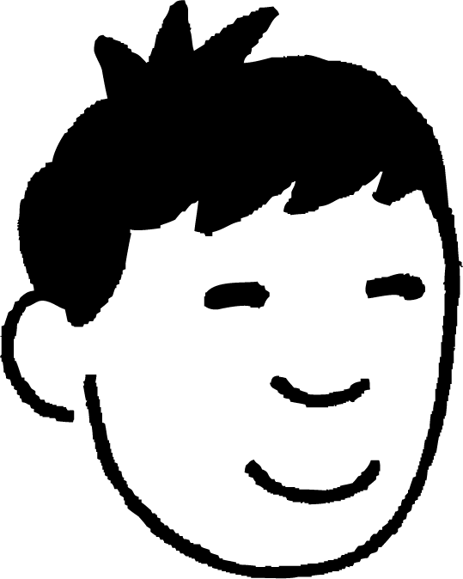
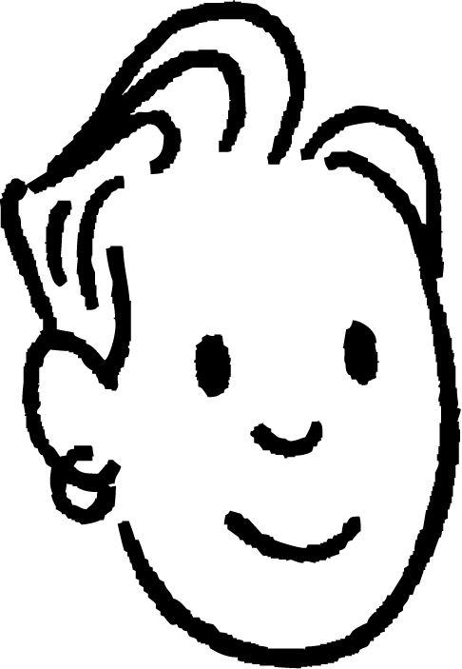
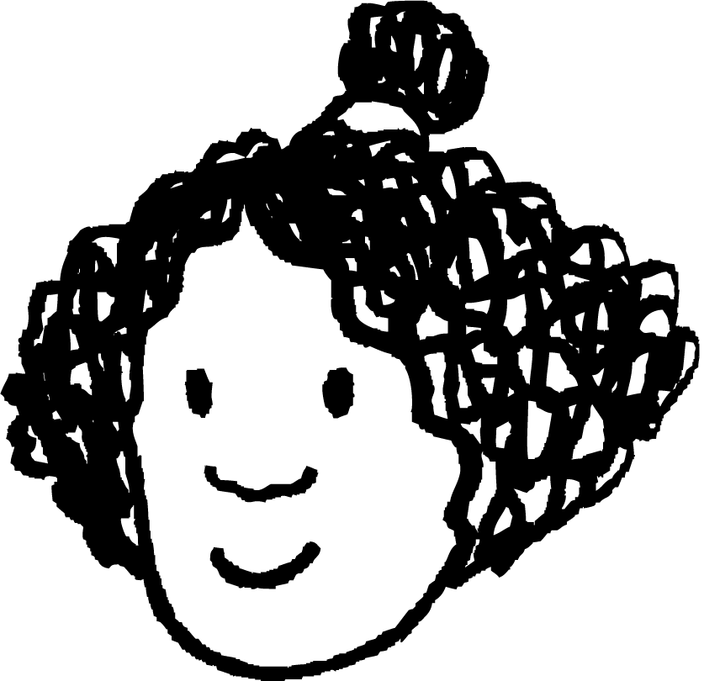
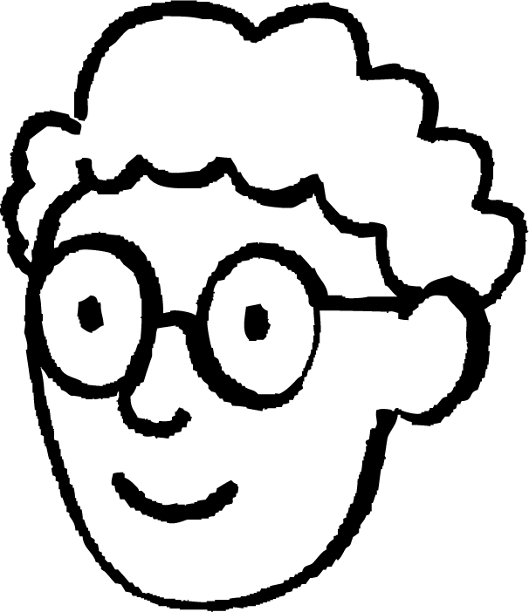




Aqoonsashada in qaababku ay yihiin kuwo isku mid ah (similar)
2) Axmed, Isra, Nuur iyo Saciid waxay sawireen qaar ka mid ah afar-geesoodyada (quadrilaterals).
Afar-geesoodkaygu (quadrilateral) wuxuu la mid yahay Axmed oo dhammaan cidhifyadu (edges) waa laba jeer dhererka.
Kani waa afar-geesoodkayga (quadrilateral).
60°
120°
4 cm
Axmed
120°
60°
Isra
6 cm
Afar-geesoodkaygu (quadrilateral) kuma eka Axmed, inkastoo dhammaan cidhifyadu (edges) ay yihiin laba jeer dhererka.
Afar-geesoodkaygu (quadrilateral) kuma eka Axmed, inkastoo dhammaan xagluhu (angles) ay isku mid yihiin.
Nuur
Saciid
Sawir afar-geesood (quadrilateral) suurtagal ah oo loogu talagalay Isra, Nuur iyo Saciid.

Slide 22
Aqoonsashada in qaababku ay yihiin kuwo isku mid ah (similar)
1) Labada qaab ee hoose ma isku mid (similar) baa? Ku caddey jawaabtaada sabab (reasoning).
116°
6 m
135°
72°
135°
4 m
127°
127°
8 m
116°
72°
3 m
Xaglaha (angles) Qaab A: 72°, 127°, 116°, 90°, 135°
Xaglaha (angles) isku nidaam (order) ma aha, marka qaababku isku mid (similar) ma aha.
Xaglaha (angles) Qaab B: 72°, 127°, 90°, 116°, 135°

Slide 23
Aqoonsashada in qaababku isku mid (similar) yihiin
2) Axmed, Isra, Nuur iyo Saciid waxay sawireen afar geesoodyo (quadrilaterals) qaar.
Afar geesoodkaygu (quadrilateral) wuxuu la mid (similar) yahay kan Axmed oo dhammaan cidhifyada (edges) waa laba jeer dhererka (length).
Kani waa afar geesoodkayga (quadrilateral).
60°
120°
4 cm
Axmed
120°
60°
Isra
6 cm
Afar geesoodkaygu (quadrilateral) kuma la mid (similar) kan Axmed, in kasta oo dhammaan cidhifyada (edges) yihiin laba jeer dhererka (length).
Afar geesoodkaygu (quadrilateral) kuma la mid (similar) kan Axmed, in kasta oo dhammaan xaglaha (angles) isku mid (same) yihiin.
Nuur
Saciid
Sawir qaab afar geesood (quadrilateral) suurtagal ah oo Isra, Nuur iyo Saciid leeyihiin.

Slide 24
Aqoonsashada in qaababku isku mid (similar) yihiin
Afar-geesoodkaygu wuxuu la mid yahay Axmed, dhammaan geesihiisuna waa laba jeer dhererkiisa.
Afar-geesoodkaygu kuma eka Axmed, in kastoo dhammaan geesihiisu yihiin laba jeer dhererkiisa.
Afar-geesoodkaygu kuma eka Axmed, in kastoo dhammaan xaglaha isku mid yihiin.
Nuur
8 cm
8 cm
Isra
Saciid
60°
120°
8 cm
120°
120°
12 cm
120°
60°
12 cm
60°
60°
12 cm

Slide 25
Isku ekaanshaha qaababka (similarity)
Aqoonsashada in qaababku isku mid yihiin (similar)
Helista qaabab isku mid ah (similar) oo ku jira jaantusyo adag

Slide 26
Helista qaabab isku mid ah (similar) oo ku jira jaantusyo adag
Qaababka isku midka ah (similar) waxay leeyihiin xaglo isku mid ah. Saddexagallo leh xaglo isku mid ah waa isku mid (similar).

Slide 27
Helista qaabab isku mid ah (similar) oo ku jira jaantusyo adag
∆ABE iyo ∆ACD waa isku mid (similar) waxayna ku jiraan jiho isku mid ah.
Sidee xaqiiqdan loo isticmaali karaa in la tuso in BE iyo CD ay yihiin kuwa barbarro (parallel)?
A
B
C
∠ABE = ∠ACD
E
∠CDE = ∠BEA
Xaglaha u dhigma (corresponding angles) waa isku mid markay ku yaalliin khadadka barbarro (parallel).
Sidaa darteed BE iyo CD waa barbarro (parallel).
D

Slide 28
Helista qaabab isku mid ah (similar) oo ku jira jaantusyo adag
Xaqiiqooyinka ku saabsan xaglaha khadadka barbarro (parallel) waxaa loo isticmaali karaa in la tuso in laba saddexagal ay yihiin kuwa isku mid ah (similar).
A
∆ABE iyo ∆ACD labaduba waxay ka kooban yihiin ∠EAB.
∠ABE = ∠BCD sababtoo ah xaglaha u dhigma (corresponding angles) ee khadadka barbar socda (parallel lines) waa siman yihiin.
∠CDE = ∠BEA sababtoo ah xaglaha u dhigma (corresponding angles) ee khadadka barbar socda (parallel lines) waa siman yihiin.
E
B
∆ABE iyo ∆ACD waxay leeyihiin xaglo isku mid ah, marka waa isku qaab (similar).
D
C

Slide 29
Helista qaababka isku midka ah (similar shapes) ee jaantusyada adag (complex diagrams)
Caddee in ∆ABE iyo ∆BCD ay yihiin isku qaab (similar).
A
∠EAB = ∠CDB sababtoo ah xaglaha beddelka ah (alternate angles) ee khadadka barbar socda (parallel lines) waa siman yihiin.
∠BCD = ∠BEA sababtoo ah xaglaha beddelka ah (alternate angles) ee khadadka barbar socda (parallel lines) waa siman yihiin.
C
B
∠ABE = ∠DBC sababtoo ah xaglaha si toos ah uga soo horjeeda (vertically opposite angles) waa siman yihiin.
E
∆ABE iyo ∆BCD waxay leeyihiin xaglo isku mid ah, marka waa isku qaab (similar).
D

Slide 30
Helista qaababka isku midka ah (similar shapes) ee jaantusyada adag (complex diagrams)
Xaggee (angle) ayaa la mid ah ∠CAB?
A
B
xaglaha beddelka ah (alternate angles) ee khadadka barbar socda (parallel lines)
∠CDE
∠DEC
C
∠ECD
E
D

Slide 31
Helista qaababka isku midka ah (similar shapes) ee jaantusyada adag (complex diagrams)
Xaggee (angle) ayaa la mid ah ∠BCD?
A
xaglaha u dhigma ee sadarrada barbar socda (corresponding angles on parallel lines)
∠ABE
5 cm
E
B
∠BEA
8 cm
∠EAB
D
C

Slide 32
Helista qaababka isku midka ah (similar shapes) ee jaantusyada adag
Ogaanshaha xaglaha isku midka ah wuxuu kaa caawin karaa inaad aqoonsato dhererka u dhigma ee saddexagallada isku midka ah (similar triangles).
Raadi dhererka AE. Dhererka oo dhan waxaa lagu siiyay cm.
A
AE waxay u dhaxaysaa xagal hal qaanso leh iyo xagal laba qaanso leh,
12
marka waa weyneyn (enlargement) CD.
EB waxay u dhaxaysaa xagal saddex qaanso leh iyo xagal laba qaanso leh,
B
4
C
marka waa weyneyn (enlargement) BC.
5
E
8
scale factor = 8 ÷ 4 = 2
D
AE = 5 × 2 = 10 cm

Slide 33
Helista qaababka isku midka ah (similar shapes) ee jaantusyada adag
Markaad xallinayso masalooyinka ku lug leh saddexagallada isku midka ah ee is-dul-saaran (nested similar triangles), waxaa caawin kara inaad sawirto labada saddexagal si gooni ah.
Raadi dhererka AD. Dhererka oo dhan waxaa lagu siiyay cm.
5
10
5
15
A
B
C
A
B
A
C
4
4
E
E
scale factor = 15 ÷ 5 = 3
D
AD = 4 × 3 = 12 cm
D

Slide 34
Helista qaababka isku midka ah (similar shapes) ee jaantusyada adag
Markaad xallinayso masalooyinka ku lug leh saddexagallada isku midka ah ee is-dul-saaran (nested similar triangles), waxaa caawin kara inaad sawirto labada saddexagal si gooni ah.
Raadi dhererka ED. Dhererka oo dhan waxaa lagu siiyay cm.
5
10
5
15
A
B
C
A
B
A
C
4
4
E
E
12
8
ED = AD − AE
= 12 − 4 = 8 cm
D
D

Slide 35
Helista qaababka isku midka ah ee jaantusyada adag (Finding similar shapes in complex diagrams)
Cidhifkee ee ∆CDE ayaa ah weyneyn (enlargement) AC?
A
B
CD
DE
C
EC
E
D

Slide 36
Helista qaababka isku midka ah ee jaantusyada adag (Finding similar shapes in complex diagrams)
Soo hel dhererka CD (Find the length of CD).
A
B
4 cm
6 cm
12 ÷ 6 = 2
4 × 2 = 8 cm
C
12 cm
E
D

Slide 37
Helista qaababka isku midka ah ee jaantusyada adag (Finding similar shapes in complex diagrams)
1) Soo hel qiimaha (value) mid kasta oo aan la garanayn.
12 cm
4 cm
24 cm
5 cm
a cm
b cm
18 cm
12 cm
c cm
60°
6 cm
12 cm
15 cm
10 cm
60°
d cm
5 cm
3 cm
30°

Slide 38
Helitaanka qaababka isku midka ah ee jaantusyada adag
2) Qaad warqad oo laab, sida hoos ku muujisan.
Warqadda aan isqabsan ayay samaysaa afar saddexagal.
Caddee in afar saddexagalkani ay dhammaan yihiin kuwo isku mid ah.

Slide 39
Helitaanka qaababka isku midka ah ee jaantusyada adag
1) Raadi qiimaha (value) mid kasta oo aan la garanayn.
12 cm
4 cm
24 cm
5 cm
a cm
b cm
a = 15 cm
18 cm
b = 16 cm
12 cm
c cm
60°
6 cm
12 cm
15 cm
10 cm
d = 4 cm
60°
d cm
5 cm
3 cm
30°
c = 20 cm

Slide 40
Helista qaababka isku midka ah (similar shapes) ee jaantusyada adag
2) Qaad warqad oo laab sida hoos ku qoran.
Warqadda aan is dulsaarin waxay samaysaa afar saddex-xagal (triangles).
Caddee in afar saddex-xagalkan oo dhami isku mid yihiin (similar).

Slide 41
Helista qaababka isku midka ah (similar shapes) ee jaantusyada adag
(90 - x)°
Saddex-xagal kasta wuxuu ka kooban yahay xagal quman (right angle) oo ka yimid afarta gees ee warqadda.
x°
x°
x°
Hal xagal ha ahaado x°.
Xaglaha saddex-xagalka wadartoodu waa 180°.
x°
180 − 90 − x ≡ 90 − x
Xaglaha iska soo horjeeda (vertically opposite angles) waa siman yihiin.
(90 - x)°
Xaglaha saddex-xagalka wadartoodu waa 180°.
(90 - x)°
180 − 90 − (90 − x) ≡ x
Afarta saddex-xagal oo dhami waxay ka kooban yihiin isku xagal, marka dhammaantood waa isku mid (similar).

Slide 42
Isku midnimo (Similarity) ee qaababka
Laba qaab oo keliya ayaa isku mid ah (similar) haddii xiriirka isku dhufashada (multiplicative relationship) ee u dhexeeya geesaha u dhigma (corresponding edges) uu la mid yahay lammaane kasta oo geesaha u dhigma ah.
Xagluhu waa invariant (invariant) inta u dhaxaysa qaababka isku midka ah (similar shapes).
Qaababka isku midka ah (similar shapes) mar walba ma fududa in la arko.
Jadwalka saamiga (ratio table) wuxuu kaa caawin karaa inaad hesho tirada scalar (scalar) iyo functional multipliers (functional multipliers) ee qaababka isku midka ah (similar shapes).

