Slide 1
Saamiyada sine iyo cosine (Sine and cosine ratios)
Trigonometry (Trigonometry)

Slide 2
Sida agabkeena waxbarista loogu talagalay fasalka

Slide 3
Waxaan ka soo saari karaa saamiyada sine iyo cosine (sine and cosine ratios) dhinacyada saddexagalka qumman (right-angled triangle).

Slide 4
Hypotenuse (hypotenuse) waa dhinaca saddexagalka qumman (right-angled triangle) ee ka soo horjeeda xagasha qumman (right angle).
Dhinaca ku xiga (adjacent side) ee saddexagalka qumman (right-angled triangle) waa dhinaca ku xiga labada xagal ee qumman iyo xagasha calaamadsan.
Dhinaca ka soo horjeeda (opposite side) ee saddexagalka qumman (right-angled triangle) waa dhinaca ka soo horjeeda xagasha calaamadsan.
Saamiyada trigonometric (trigonometric ratios) waa saamiyo u dhexeeya laba dhinac oo ka mid ah saddexagalka qumman (right-angled triangle).

Slide 5

Saamiyada sine iyo cosine (Sine and cosine ratios)
Shaxaha saamiyada (Ratio tables) iyo goobada halbeegga (unit circle)
Dhinaca ka soo horjeeda (opposite) iyo hypotenuse (hypotenuse)
Dhinaca ku xiga (adjacent) iyo hypotenuse (hypotenuse)
Isticmaalka xisaabiyaha (calculator) iyada oo aan la helin goobada halbeegga (unit circle)

Slide 6
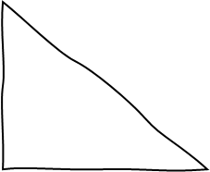
Shaxaha saamiyada (Ratio tables) iyo goobada halbeegga (unit circle)
Haddii aad u baahan tahay inaad hesho dhererka dhinaca saddexagalka oo hypotenuse (hypotenuse) aysan ahayn 1…
Markaas waxaad sawiri kartaa saddexagal la mid ah (similar triangle) oo hypotenuse (hypotenuse) uu yahay 1.
sawir saddexagal la mid ah (similar triangle)
4 cm
1 cm
sin(30°)
30°
30°
a cm
cos(30°)

Slide 7
Jaantusyada saamiga (ratio tables) ee goobta wareegta (unit circle)
xagal (angle) | sine (sine) | cosine (cosine) | tangent (tangent)
0 | 0 | 1 | 0
5 | 0.087 | 0.996 | 0.087
10 | 0.174 | 0.985 | 0.176
15 | 0.259 | 0.966 | 0.268
20 | 0.342 | 0.94 | 0.364
25 | 0.423 | 0.906 | 0.466
30 | 0.5 | 0.866 | 0.577
35 | 0.574 | 0.819 | 0.7
40 | 0.643 | 0.766 | 0.839
45 | 0.707 | 0.707 | 1
50 | 0.766 | 0.643 | 1.192
55 | 0.819 | 0.574 | 1.428
60 | 0.866 | 0.5 | 1.732
65 | 0.906 | 0.423 | 2.145
70 | 0.94 | 0.342 | 2.747
75 | 0.966 | 0.259 | 3.732
80 | 0.985 | 0.174 | 5.671
85 | 0.996 | 0.087 | 11.43
90 | 1 | 0 | ∞
cosine (cosine)
Isticmaal jaantuska qiimaha (trig values) si aad u hesho dhererka dhinaca u dhigma ee saddexagalka aad sawirtay.
Waxaan dooneynaa inaan helno dhererka dhinaca ku xiga xagasha 30° iyo xagasha qumman (right angle).
30
0.866
4 cm
1 cm
sin(30°)
30°
30°
cos(30°)
a cm
0.866

Slide 8
Jaantusyada saamiga (ratio tables) ee goobta wareegta (unit circle)
Hadda waxaan isticmaali karnaa sababaynta saamiga (proportional reasoning) si aan u helno dhererka dhinaca ku xiga ee saddexagalkeenii asalka ahaa.
hypotenuse (hypotenuse) | adjacent (adjacent)
1 | 0.866
4 | a
× 4
0.866 × 4
3.464
4 cm
1 cm
sin(30°)
30°
30°
3.464
0.866
a cm
× 4

Slide 9
Miisaska saamiga (Ratio tables) ee goobada halbeegga (unit circle)
xagal (angle) | sine (sine) | cosine (cosine) | tangent (tangent)
0 | 0 | 1 | 0
5 | 0.087 | 0.996 | 0.087
10 | 0.174 | 0.985 | 0.176
15 | 0.259 | 0.966 | 0.268
20 | 0.342 | 0.94 | 0.364
25 | 0.423 | 0.906 | 0.466
30 | 0.5 | 0.866 | 0.577
35 | 0.574 | 0.819 | 0.7
40 | 0.643 | 0.766 | 0.839
45 | 0.707 | 0.707 | 1
50 | 0.766 | 0.643 | 1.192
55 | 0.819 | 0.574 | 1.428
60 | 0.866 | 0.5 | 1.732
65 | 0.906 | 0.423 | 2.145
70 | 0.94 | 0.342 | 2.747
75 | 0.966 | 0.259 | 3.732
80 | 0.985 | 0.174 | 5.671
85 | 0.996 | 0.087 | 11.43
90 | 1 | 0 | ∞
sine (sine)
5.6 cm
Isticmaal jaantuskan qiimaha (trig values), hel dhererka dhinaca lagu calaamadeeyay x cm ee saddexagalka la sawiray.
20°
20
0.342
p cm
5.6 cm
20°
1 cm
20°
sin(20°)
p cm
0.342 cm
x cm

Slide 10
Miisaska saamiga (Ratio tables) ee goobada halbeegga (unit circle)
xagal (angle) | sine (sine) | cosine (cosine) | tangent (tangent)
0 | 0 | 1 | 0
5 | 0.087 | 0.996 | 0.087
10 | 0.174 | 0.985 | 0.176
15 | 0.259 | 0.966 | 0.268
20 | 0.342 | 0.94 | 0.364
25 | 0.423 | 0.906 | 0.466
30 | 0.5 | 0.866 | 0.577
35 | 0.574 | 0.819 | 0.7
40 | 0.643 | 0.766 | 0.839
45 | 0.707 | 0.707 | 1
50 | 0.766 | 0.643 | 1.192
55 | 0.819 | 0.574 | 1.428
60 | 0.866 | 0.5 | 1.732
65 | 0.906 | 0.423 | 2.145
70 | 0.94 | 0.342 | 2.747
75 | 0.966 | 0.259 | 3.732
80 | 0.985 | 0.174 | 5.671
85 | 0.996 | 0.087 | 11.43
90 | 1 | 0 | ∞
1) Buuxi meelaha bannaan iyo miiska saamiga (ratio table). Adigoo tixgelinaya dhinacyada u dhigma (corresponding sides), raadso dhererka dhinaca lagu calaamadeeyay a cm.
sawir saddexagal la mid ah (similar triangle)
12 cm
1 cm
sin(15°)
15°
15°
a cm
cos(15°)
hypotenuse (hypotenuse)
1
12

Slide 11
Jaantusyada saamiga (Ratio tables) ee goobta wareegta (unit circle)
2) Buuxi dhammaan meelaha bannaan iyo jaantusyada saamiga (ratio tables) si aad u hesho qiimaha (values) b iyo c adigoo tixgelinaya dhinacyada u dhigma (corresponding sides).
c cm
1 cm
70°
18 cm
7.5 cm
55°
b
cm
70°
55°
hypotenuse (hypotenuse)
1
7.5
hypotenuse (hypotenuse)
1
18

Slide 12
Jaantusyada saamiga (Ratio tables) ee goobta wareegta (unit circle)
angle (angle) | sine (sine) | cosine (cosine) | tangent (tangent)
0 | 0 | 1 | 0
5 | 0.087 | 0.996 | 0.087
10 | 0.174 | 0.985 | 0.176
15 | 0.259 | 0.966 | 0.268
20 | 0.342 | 0.94 | 0.364
25 | 0.423 | 0.906 | 0.466
30 | 0.5 | 0.866 | 0.577
35 | 0.574 | 0.819 | 0.7
40 | 0.643 | 0.766 | 0.839
45 | 0.707 | 0.707 | 1
50 | 0.766 | 0.643 | 1.192
55 | 0.819 | 0.574 | 1.428
60 | 0.866 | 0.5 | 1.732
65 | 0.906 | 0.423 | 2.145
70 | 0.94 | 0.342 | 2.747
75 | 0.966 | 0.259 | 3.732
80 | 0.985 | 0.174 | 5.671
85 | 0.996 | 0.087 | 11.43
90 | 1 | 0 | ∞
1) Buuxi meelaha bannaan iyo shaxda saamiga (ratio table). Adigoo tixgelinaya dhinacyada u dhigma (corresponding sides), hel dhererka dhinaca lagu calaamadeeyay a cm.
sawir saddexagal la mid ah (similar triangle)
12 cm
1 cm
sin(15°)
15°
15°
0.259
cm
a cm
cos(15°)
0.966 cm
hypotenuse (hypotenuse) | adjacent (adjacent)
1 | 0.966
12 | 11.592 cm
× 12

Slide 13
Shaxaha saamiga (ratio tables) ee goobada halbeegga (unit circle)
2) Buuxi dhammaan meelaha bannaan iyo shaxaha saamiga (ratio tables) si aad u hesho qiimaha (values) b iyo c.
c cm
sin(55°)
0.819 cm
1 cm
70°
cos(70°)
0.342 cm
18 cm
7.5 cm
55°
b
cm
cos(55°)
0.574 cm
70°
55°
1 cm
hypotenuse (hypotenuse) | opposite (opposite)
1 | 0.819
7.5 | 6.1425
hypotenuse (hypotenuse) | adjacent (adjacent)
1 | 0.342
18 | 6.156
× 7.5
× 18

Slide 14
Saamiyada sine iyo cosine (Sine and cosine ratios)
Shaxda saamiga (Ratio tables) ee goobada cutubka (unit circle)
Dhinaca ka soo horjeeda (opposite) iyo jibaabka (hypotenuse)
Dhinaca ku xiga (adjacent) iyo jibaabka (hypotenuse)
Isticmaalka xisaabiyaha (calculator) la'aanteed goobada cutubka (unit circle)

Slide 15
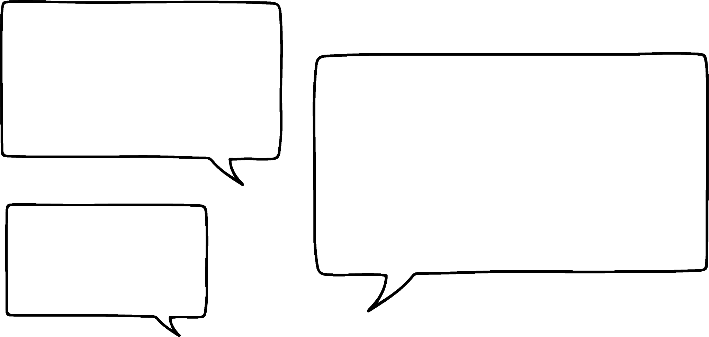


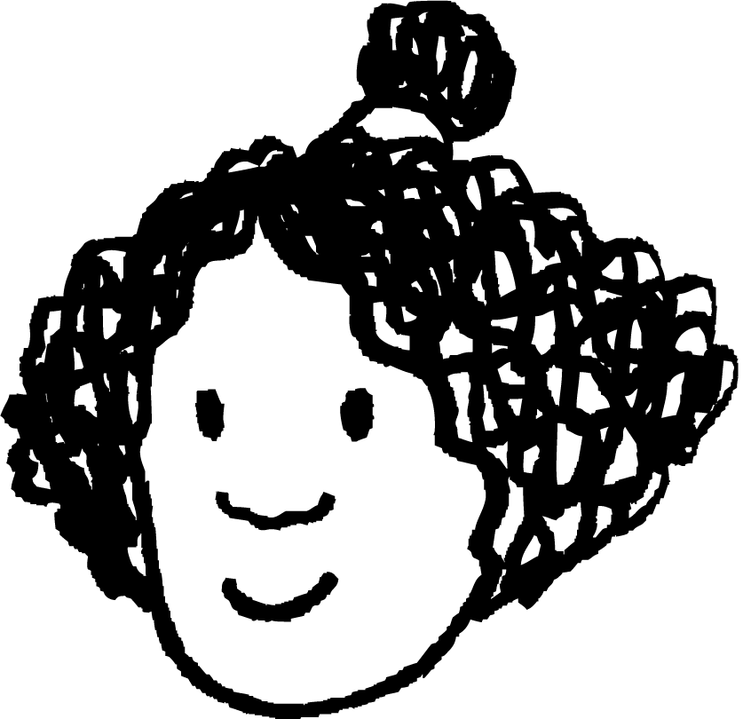
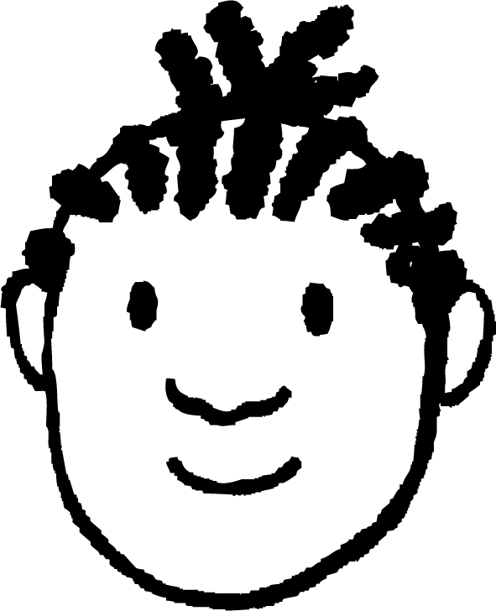


Dhinaca ka soo horjeeda (opposite) iyo jibaabka (hypotenuse)
Miyaanay macnaheedu in dhammaan dhinacyada kale ay sidoo kale lagu dhufto isla factor-ka (scale factor)?
Marka qodobka (scale factor) u dhexeeya waa had iyo jeer jibaabka (hypotenuse) saddex-xagalka kale!
Waxaan u malaynayaa inaan qaab (pattern) arkay!
Waxaan haystaa laba saddex-xagal oo isku mid ah (similar triangles).
Midkood waa ka goobada cutubka (unit circle) oo jibaabkiisu (hypotenuse) yahay 1.
Yacquub
× 7.3
Isra
1 cm
7.3 cm
4.1902 cm
7.3 × 0.574 cm
7.3 × sin(35°) cm
y cm
sin(35°)
35°
35°

Slide 16
Dhinaca ka soo horjeeda iyo hypotenuse-ka
Qaabka (pattern) Isra ay ogaatay wuxuu u shaqeeyaa dhammaan saddexagalka qumman (right-angled) ee la midka ah (similar) kan goobada halbeegga (unit circle).
Saddexagalkan wuxuu yeelan karaa hypotenuse dherer kasta (aan ku qoro h),
iyo xagal θ°,
markaas dhinaca ka soo horjeeda xagasha θ° wuxuu noqon doonaa h × sin(θ°).
× h
1 cm
h cm
h × sin(θ°) cm
y cm
sin(θ°)
θ°
θ°

Slide 17
Dhinaca ka soo horjeeda iyo hypotenuse-ka
Dhinaca ka soo horjeeda xagal (oo leh cabbir θ°) ee saddexagal qumman (right-angled) had iyo jeer waa sin(θ°) lagu dhuftay dhererka hypotenuse-ka.
Waxa kale oo aad ku heli kartaa natiijada isla markaas adiga oo tixgelinaya xiriirka isku dhufashada (multiplicative) ee u dhexeeya hypotenuse-ka iyo dhinacyada ka soo horjeeda.
dhinaca ka soo horjeeda = h × sin(θ°)
h cm
h × sin(θ°) cm
y cm
× sin(θ°)
Isra
θ°

Slide 18

Dhinaca ka soo horjeeda iyo hypotenuse-ka
Adigoo isticmaalaya xiriirkan, soo hel qiimaha (value) ay tahay in la geliyo meelahan bannaan.
dhinaca ka soo horjeeda = h × sin(θ°)
dhinaca ka soo horjeeda = × sin( )
46
75
a
b
46 cm
dhinaca ka soo horjeeda
Sidaas awgeed, soo hel dhererka dhinaca ka soo horjeeda xagasha 75°.
44.43 cm
75°

Slide 19

Dhinaca ka soo horjeeda iyo hypotenuse-ka
…laakiin, ma suurtogal tahay in la helo dhererka hypotenuse-ka haddii aan ognahay xagal iyo dhererka dhinaca ka soo horjeeda?
Marka, waxaan heli karnaa dhererka dhinac kasta oo "ka soo horjeeda" haddii aan ognahay xagasha uu ka soo horjeedo iyo dhererka hypotenuse-ka…
Yacquub
7.3 cm
h cm
y cm
10 cm
35°
35°

Slide 20
Dhinaca ka soo horjeeda iyo hypotenuse-ka
Waa suurtogal in la helo dhererka hypotenuse-ka haddii aan ognahay:
xagal kale oo ku yaal saddexagalka qumman (right-angled triangle)
dhererka dhinaca ka soo horjeeda xagashan
Waxaan tan ku samayn karnaa annagoo ku beddelaya qiimaha (value) la yaqaan ee saddex-xagalka, oo dib u habeyn ku sameynayna isla'egta aan ku dhammaanayno.
dhinaca ka soo horjeeda (opposite side) = h × sin(θ°)
10
= h × sin(35°)
h cm
17.42 cm
10
= h × 0.574
10 cm
0.574
0.574
10
= h
= 17.42
35°
0.574

Slide 21
Dhinaca ka soo horjeeda (opposite) iyo hypotenuse
Adigoo isticmaalaya xiriirkan, hel qiimaha (values) ee waa in ay galaan meelahan bannaan.
dhinaca ka soo horjeeda (opposite side) = h × sin(θ°)
= h × sin( )
46
75
a
b
Waa maxay qiimaha (value) ee gala meelahan bannaan?
46 = h × sin( 75 )
h cm
46 cm
0.966
0.966
c
d
Waxaan isticmaali karnaa shaxda qiimaha (table of values) si aan u aragno in sin( 75 ) uu leeyahay qiime (value) ah 0.966
75°

Slide 22
Dhinaca ka soo horjeeda (opposite) iyo hypotenuse
1) Hel dhererka dhinaca ka soo horjeeda (opposite side) xagasha calaamadsan adigoo isticmaalaya xiriirkan.
dhinaca ka soo horjeeda (opposite side) = h × sin(θ°)
a)
h × sin( θ° ) cm
b)
h × sin( θ° ) cm
77 cm
17.2 cm
h × sin( θ° ) cm
h × sin( θ° ) cm
35°
40°
c)
13.8 cm
d)
55°
0.122 cm
h × sin(θ°)
d cm
20°

Slide 23
Dhinaca ka soo horjeeda (opposite) iyo hypotenuse (hypotenuse)
2) Soo hel dhererka hypotenuse (hypotenuse) marka la bixiyo dhinaca ka soo horjeeda xagasha la calaamadeeyay.
dhinaca ka soo horjeeda (opposite side) = h × sin(θ°)
a)
b)
h = dhinaca ka soo horjeeda (opposite side)
h =
19 cm
0.174
9 cm
80°
10°
3.35 cm
c)
d) Saddex-xagal qumman (right-angled triangle) wuxuu leeyahay xagal 85°.
Dhererka dhinaca ka soo horjeeda xagashan waa 142 cm.
65°
h cm
43 cm
92 cm

Slide 24
Dhinaca ka soo horjeeda (opposite) iyo hypotenuse (hypotenuse)
1) Soo hel dhererka dhinaca ka soo horjeeda xagasha la calaamadeeyay adigoo isticmaalaya xiriirkan.
dhinaca ka soo horjeeda (opposite side) = h × sin(θ°)
a)
h × sin( θ° ) cm
b)
h × sin( θ° ) cm
77 cm
17.2 cm
77
40
h × sin( θ° ) cm
17.2
35
h × sin( θ° ) cm
77
0.643
= 9.8728 cm
35°
= 49.511 cm
40°
c)
13.8 cm
d)
55°
0.122 cm
h × sin(θ°)
d cm
= 11.3022 cm
= 0.041724 cm
20°

Slide 25
Dhinaca ka soo horjeeda iyo hypotenuse
2) Raadi dhererka hypotenuse marka la eego dhinaca ka soo horjeeda xagasha calaamadeysan.
dhinaca ka soo horjeeda = h × sin(θ°)
a)
b)
19
h =
9
h =
19 cm
0.985
0.174
9 cm
= 19.29 cm
= 51.72 cm
80°
10°
3.35 cm
c)
d) Saddex-xagal qumman wuxuu leeyahay xagal 85°.
Dhererka dhinaca ka soo horjeeda xagashan waa 142 cm.
65°
h cm
= 101.55 cm
43 cm
= 142.57 cm
92 cm

Slide 26
Saamiyada sine iyo cosine (Sine and cosine ratios)
Shaxda saamiga (Ratio tables) ee goobada halbeegga (unit circle)
Dhinaca ka soo horjeeda (opposite) iyo hypotenuse-ka
Dhinaca ku xiga (adjacent) iyo hypotenuse-ka
Isticmaalka xisaabiyaha (calculator) iyada oo aan la helin goobo halbeeg (unit circle)

Slide 27
Dhinaca ku xiga (adjacent) iyo hypotenuse-ka
Dhinaca ku xiga xagasha (angle θ°) ee saddex-xagalka qumman (right-angled triangle) waa had iyo jeer cos(θ°) oo lagu dhuftay dhererka hypotenuse-ka.
dhinaca ku xiga (adjacent side) = h × cos(θ°)
× h
h cm
1 cm
θ°
θ°
cos(θ°)
h × cos(θ°) cm
dhinaca ku xiga (adjacent side)

Slide 28
Dhinaca ku xiga (adjacent) iyo hypotenuse-ka
Haddii aan ognahay hypotenuse-ka iyo xagal (angle), waxaan heli karnaa dhererka dhinaca ku xiga xagashaas iyo xagasha qumman (right-angle).
Haddii aan ognahay xagal (angle) iyo dhererka dhinaca ku xiga (adjacent) xagashaas iyo xagasha qumman (right-angle), waxaan heli karnaa dhererka hypotenuse-ka.
22 cm
dhinaca ku xiga (adjacent side)
70°
adjacent = h × cos( θ° )
h × cos( θ° )
22 cm
70°
= h × cos( 70° )
22
× cos(70°)
22
22
× 0.342
22
= h × 0.342
Dhinaca ku xiga (adjacent) 70° iyo xagasha qumman (right-angle) waa 7.524 cm.
0.342
0.342
= 7.524
22
= h
= 64.33
0.342

Slide 29
Dhinaca ku xiga (adjacent) iyo hypotenuse-ka
Adigoo isticmaalaya xiriirkan, hel qiimaha (values) ee tahay inay galaan meelahan bannaan.
dhinaca ku xiga (adjacent side) = h × cos(θ°)
dhinaca ku xiga (adjacent side) = × cos( )
6
75
a
b
6 cm
75°
dhinaca ku xiga (adjacent side)
Sidaa awgeed, hel dhererka dhinaca ku xiga (adjacent) xagasha 75° iyo xagasha qumman (right-angle).
1.554 cm

Slide 30
Dhinaca ku xiga (adjacent) iyo hypotenuse-ka
1) Hel dhererka dhinaca ku xiga (adjacent) xagasha calaamadeysan adigoo isticmaalaya xiriirkan.
dhinaca ku xiga (adjacent side) = h × cos(θ°)
a)
b)
17.2 cm
h × cos(θ°) cm
40°
h × cos(θ°) cm
77 cm
35°
h × sin( θ° ) cm
h × cos(θ°) cm
c)
13.8cm
d)
0.122 cm
55°
h × cos(θ°)
20°
d cm

Slide 31
Dhinaca ku xiga (adjacent) iyo hypotenuse (hypotenuse)
2) Soo hel dhererka hypotenuse (hypotenuse) marka la siiyo dhinaca ku xiga xagasha la calaamadeeyay.
dhinaca ku xiga (adjacent side) = h × cos(θ°)
a)
= h × cos( )
b)
= h × cos( )
19 cm
= h ×
10°
80°
18 cm
3.35 cm
c)
d) Saddex-xagal qumman (right-angled triangle) wuxuu leeyahay xagal 35°.
Dhererka dhinaca ku xiga (adjacent) xagashan iyo xagasha qumman (right-angle) waa 142 cm.
65°
h cm
43 cm

Slide 32
Dhinaca ku xiga (adjacent) iyo hypotenuse (hypotenuse)
1) Soo hel dhererka dhinaca ku xiga (adjacent) xagasha la calaamadeeyay adigoo isticmaalaya xiriirkan.
dhinaca ku xiga (adjacent side) = h × cos(θ°)
a)
b)
17.2 cm
h × cos( θ° ) cm
40°
h × cos( θ° ) cm
77 cm
77
40
35°
h × sin( θ° ) cm
77
0.766
h × cos(θ°) cm
17.2
35°
= 58.982 cm
= 14.0868 cm
c)
13.8cm
d)
0.122 cm
55°
= 0.11468 cm
h × cos(θ°)
20°
= 7.9212 cm
d cm

Slide 33
Dhinaca ku xiga iyo hypotenuse
2) Raadi dhererka hypotenuse marka la eego dhinaca ku xiga xagasha la calaamadeeyay.
dhinaca ku xiga = h × cos(θ°)
b)
a)
= h × cos( )
= h × cos( )
18
10
3.35
80
19 cm
= h ×
0.985
18
h = 19.25 cm
10°
h = 18.27 cm
80°
18 cm
3.35 cm
c)
d) Saddex-xagal qumman wuxuu leeyahay xagal 35°.
Dhererka dhinaca ku xiga xagashan iyo xagasha qumman waa 142 cm.
65°
h cm
h = 173.38 cm
43 cm
h = 101.65 cm

Slide 34
Saamiyada sine iyo cosine (sine and cosine ratios)
Jaantusyada saamiga (ratio) ee goobada cutubka (unit circle)
Dhinaca ka soo horjeeda (opposite) iyo jibaabka (hypotenuse)
Dhinaca ku xiga (adjacent) iyo jibaabka (hypotenuse)
Isticmaalka xisaabiyaha (calculator) iyada oo aan lahayn goob cutub (unit circle)

Slide 35
Isticmaalka xisaabiyaha (calculator) iyada oo aan lahayn goob cutub (unit circle)
xagal (angle) | sine (sine) | cosine (cosine) | tangent (tangent)
0 | 0 | 1 | 0
5 | 0.087 | 0.996 | 0.087
10 | 0.174 | 0.985 | 0.176
15 | 0.259 | 0.966 | 0.268
20 | 0.342 | 0.94 | 0.364
25 | 0.423 | 0.906 | 0.466
30 | 0.5 | 0.866 | 0.577
35 | 0.574 | 0.819 | 0.7
40 | 0.643 | 0.766 | 0.839
45 | 0.707 | 0.707 | 1
50 | 0.766 | 0.643 | 1.192
55 | 0.819 | 0.574 | 1.428
60 | 0.866 | 0.5 | 1.732
65 | 0.906 | 0.423 | 2.145
70 | 0.94 | 0.342 | 2.747
75 | 0.966 | 0.259 | 3.732
80 | 0.985 | 0.174 | 5.671
85 | 0.996 | 0.087 | 11.43
90 | 1 | 0 | ∞
cosine (cosine)
Waxaan si fudud u heli karaa dhererka k.
k waa dhinaca ku xiga (adjacent),
iyo jibaabka (hypotenuse) waa 104 cm.
Marka, k = 104 × cos(55°).
Yacquub
55
0.574
55°
k cm
104 cm
104 × cos(55°)
104 × 0.574
= 59.70

Slide 36
Isticmaalka xisaabiyaha (calculator) iyada oo aan lahayn goobo (unit circle)
xagal (angle) | sine (sine) | cosine (cosine) | tangent (tangent)
0 | 0 | 1 | 0
5 | 0.087 | 0.996 | 0.087
10 | 0.174 | 0.985 | 0.176
15 | 0.259 | 0.966 | 0.268
20 | 0.342 | 0.94 | 0.364
25 | 0.423 | 0.906 | 0.466
30 | 0.5 | 0.866 | 0.577
35 | 0.574 | 0.819 | 0.7
40 | 0.643 | 0.766 | 0.839
45 | 0.707 | 0.707 | 1
50 | 0.766 | 0.643 | 1.192
55 | 0.819 | 0.574 | 1.428
60 | 0.866 | 0.5 | 1.732
65 | 0.906 | 0.423 | 2.145
70 | 0.94 | 0.342 | 2.747
75 | 0.966 | 0.259 | 3.732
80 | 0.985 | 0.174 | 5.671
85 | 0.996 | 0.087 | 11.43
90 | 1 | 0 | ∞
Laakin sidee aan u heli karaa dhererka dhinacan?
Waan ogahay inay noqon doonto 123 × cos(57°), laakiin cos(57°) kuma jiro jaantuskan?
Yacquub
57°
m cm
123 cm
123 × cos(57°)
123 × ???

Slide 37
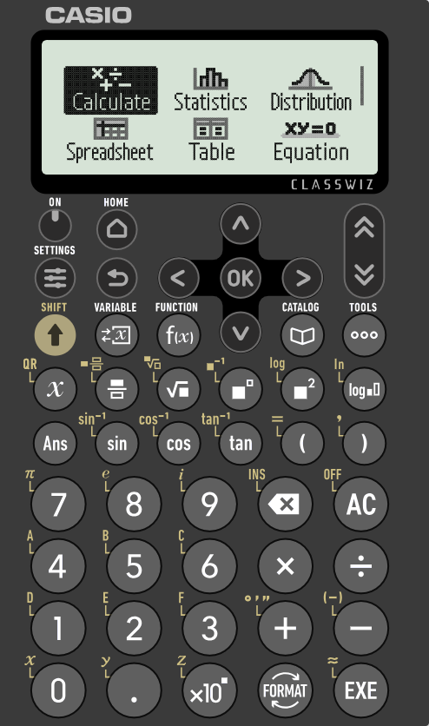
Isticmaalka xisaabiyaha (calculator) iyada oo aan lahayn goobo (unit circle)
Qiimaha (value) sin(θ°) ama cos(θ°) waxaa laga heli karaa xagal (angle) kasta adigoo isticmaalaya mid ka mid ah badhamadan xisaabiyahaaga (calculator).
57°
m cm
123 cm
123 × cos(57°)
123 × ???

Slide 38
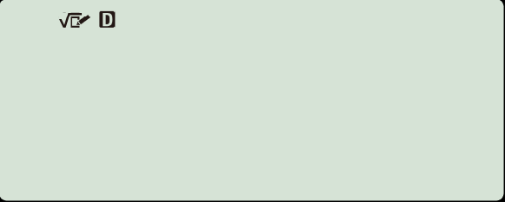
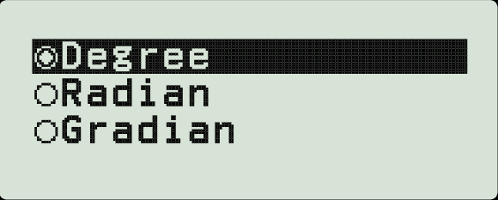
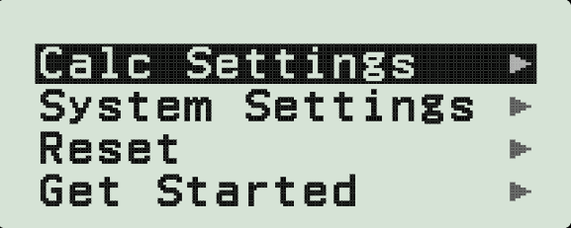
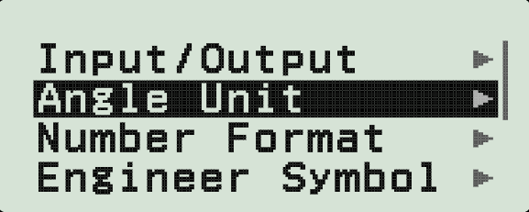

Isticmaalka xisaabiyaha (calculator) oo aan lahayn goobo halbeeg (unit circle)
Laakiin marka hore, waxaad u baahan tahay inaad hubiso in xisaabiyahaagu (calculator) ku jiro qaabka (mode) saxda ah si uu ula shaqeeyo xaglaha (angles) lagu qiyaasay darajooyin (degrees).
Riix badhanka dejinta (settings) oo dooro dejinta xisaabiyaha (calc settings).
Dooro halbeegga xagasha (angle unit) oo hubi in degree la doortay, ma aha radian ama gradian.
Riix OK si aad u xaqiijiso doorashadaada.

Slide 39
Isticmaalka xisaabiyaha (calculator) oo aan lahayn goobo halbeeg (unit circle)
Qiimaha (value) sin(θ°) ama cos(θ°) waxaa laga heli karaa xagal (angle) kasta adigoo isticmaalaya mid ka mid ah badhannadan ku yaal xisaabiyahaaga (calculator).
Hadda oo aad ogtahay in xisaabiyahaagu (calculator) uu shaqeyn doono xaglo (angles) lagu qiyaasay darajooyin (degrees), sidee u isticmaali kartaa xisaabiyaha (calculator) si aad u hesho dhererka (length) dhinaca (side) ku xiga xagasha toosan (right-angle) iyo xagasha 57°?
57°
m cm
123 cm
123 × cos(57°)
123 × ???

Slide 40
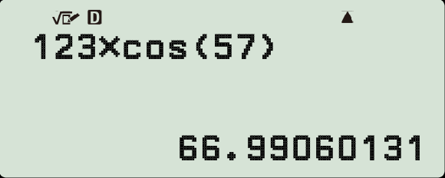
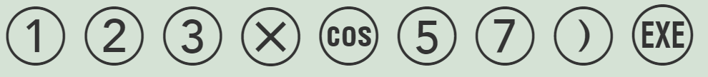
Isticmaalka xisaabiyaha (calculator) oo aan lahayn goobo halbeeg (unit circle)
Dhererka (length) hypotenuse-ka
Ku dhufo (multiplied by)
m cm
57°
66.99 cm
cosine (brack-ka furan (open bracket) waa la qoraa si toos ah)
123 cm
123 × cos(57°)
ee xagasha (angle) ku xiga (adjacent) (waa inaad qortaa brack-ka xidhan (close bracket) adiga).
123 × ???

Slide 41
Isticmaalka xisaabiyaha (calculator) oo aan lahayn goobo halbeeg (unit circle)
Adigoo isticmaalaya xisaabiye (calculator), soo hel dhererrada (lengths) labada dhinac (sides) ee saddex-xagalkan (triangle) oo loo qoro a iyo b (3 d.p.)
Isticmaal xisaabiyaha, raadi dhererka hypotenuse ee saddexagalka (1 d.p.)
64°
7.757
cm
16 cm
b
49 cm
29°
h cm
54.5 cm
16 × cos(29°)
13.994 cm
a
dhinaca ka soo horjeeda = h × sin(θ°)
dhinaca ku xiga = h × cos(θ°)

Slide 42
Isticmaal xisaabiyaha iyada oo aan lahayn goobo halbeeg (unit circle)
1) Raadi dhererka dhammaan dhinacyada saddexagalka kasta (3 d.p.)
a)
b)
c)
1 cm
1 cm
1 cm
sin(33°)
48°
33°
42°
cos(33°)
d)
e)
f)
17 cm
42 cm
42°
17°
17°
42 cm

Slide 43
Isticmaal xisaabiyaha iyada oo aan lahayn goobo halbeeg (unit circle)
1) Raadi dhererka dhammaan dhinacyada saddexagalka kasta (3 d.p.)
a)
b)
c)
1 cm
1 cm
1 cm
sin(33°)
48°
0.669 cm
0.669 cm
33°
0.545 cm
42°
cos(33°)
0.743 cm
0.743 cm
0.839 cm
d)
e)
12.280 cm
f)
12.841 cm
17 cm
43.919 cm
42 cm
11.375 cm
42°
17°
17°
12.633 cm
40.165 cm
42 cm

Slide 44
Saamiyada Sine iyo Cosine (Sine and cosine ratios)
Dhererka dhinac kasta oo ka soo horjeeda ama ku xiga xagal (θ°) oo ku jira saddex-xagal quman (right-angled triangle) oo ka yimid goobada cutubka (unit circle) waxaa laga heli karaa iyadoo la isticmaalayo shaxda qiimaha trig (trig values) oo ay ku jiraan sine (sine) iyo cosine (cosine).
Dhererka dhinac kasta oo ka soo horjeeda ama ku xiga xagal (θ°) oo ku jira saddex-xagal quman (right-angled triangle) kasta waxaa laga heli karaa iyadoo la tixgelinayo saddex-xagal la mid ah (similar triangle) oo ka yimid goobada cutubka (unit circle).
Dhererka dhinaca ka soo horjeeda xagal kasta (θ°) oo ku jira saddex-xagal quman (right-angled triangle) wuxuu la mid yahay h × sin(θ°).
Dhererka dhinaca ku xiga xagal kasta (θ°) iyo xagasha quman (right-angle) ee saddex-xagal (triangle) wuxuu la mid yahay h × cos(θ°).
Dhererka sin(θ°) iyo cos(θ°) (xagal kasta θ°) waxaa laga heli karaa iyadoo la isticmaalayo xisaabiyaha (calculator).

