Slide 1
Sigaar
Cudurrada iyo daroogada

Slide 2
Sida agabkeena waxbarista loogu talagalay fasalka

Slide 3






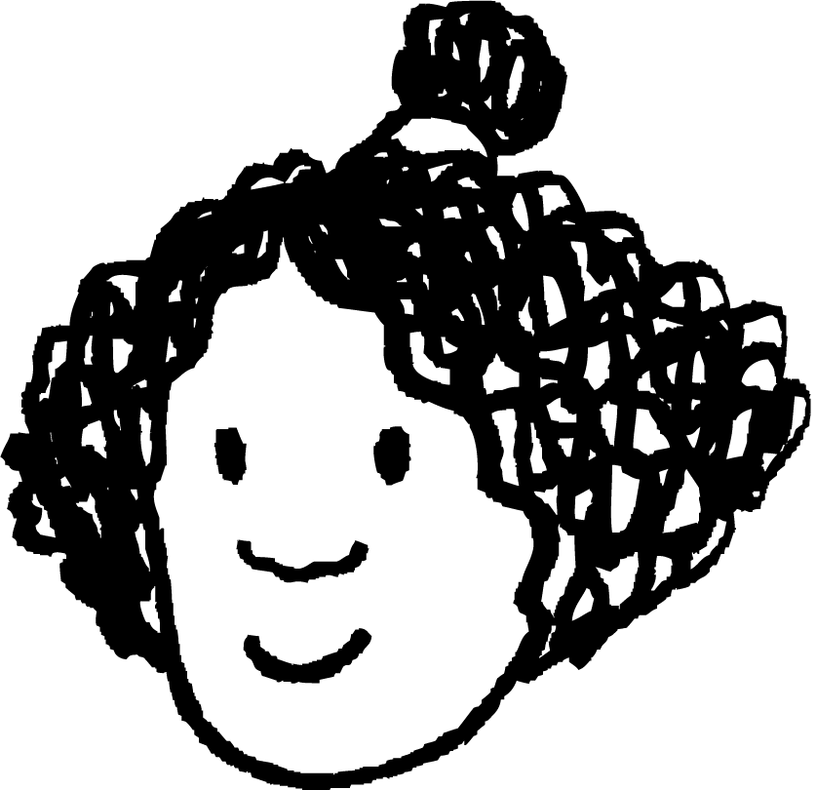
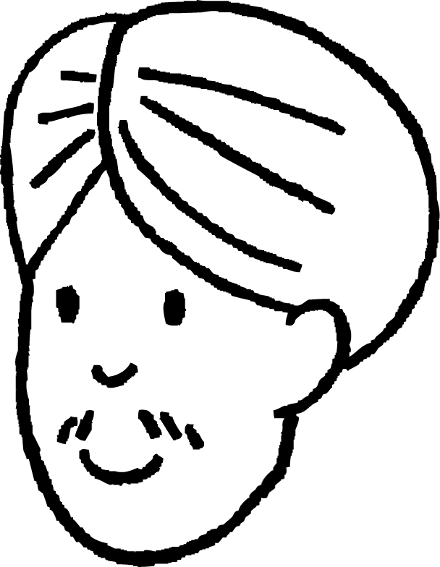




Dhegaysta dadka kale. Waa inaynu isku raalli noqon karnaa, laakiin waa inaynu si fiican u dhegaystano ka hor inta aynaan qaadan qiyaas ama go'aanka sida looga jawaabo. Marka aynu isku raalli nahay, ku celi hadalka, ee qofka ha ku eegin.
Ixtiraam qarsoodiga. Waanu ka wada hadli karnaa tusaalooyin, laakiin ha isticmaalin magacyo ama sharaxaad tilmaamaysa qof, oo aanu ku jirin nafteena.
Dooro heerka ka qaybgalka. Qof kastaa wuxuu xaq u leeyahay inuu doorto inuusan ka jawaabin su'aal ama uusan ku biirin dood. Weligayna qofna kuma qasbeyno inuu 'jawaabto'.
Xukun la'aan. Waanu sahamin karnaa caqiidooyinka iyo fahamka qaldan ee mawduuca iyada oo aan ka cabsanayn in la xukumo.
Layla
Cali
Yacquub
Isra

Slide 4
Waxaan qeexi karaa saamaynta sigaarka ee jidhka bini'aadamka.

Slide 5
sigaar
tobacco
nicotine
gas exchange

Slide 6
sigaar
Falka neefsashada iyo sii daynta qiiqa ka yimaada tobacco gubanaya.
tobacco
Caleemaha qallalan ee geedka tobacco.
nicotine
Daroogada si xoog leh u qabatimaaysa ee laga helo caleemaha tobacco.
beddelashada gaaska (gas exchange)
Habka oksijiinta (oxygen) uga faafeyso sambabada dhiigga, iyo kaarboon laba-ogsaydh (carbon dioxide) uga faafeyso dhiigga sambabada.

Slide 7

Sigaar qaadasho (Smoking)
Tobacco
Saamaynta nikotiinta (nicotine)
Saamaynta sigaarka qaadashada ee nidaamka beddelashada gaaska (gas exchange system)

Slide 8
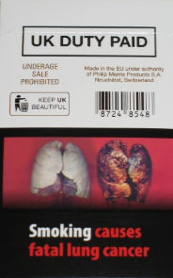
Tobacco
Bishii Maajo 2017, Dowladda Boqortooyada Ingiriiska waxay soo rogtay sharci ah in sigaarta hadda laga iibiyo baakado cagaaran oo heerar leh oo leh digniin sawir leh oo ku saabsan khatarta sigaarka. Kahor intaas, baakaduhu waxay ahaan jireen midabbo badan, qaarkoodna waxay lahaayeen jilayaal la aqoonsan karo.
Maxaad u malaynaysaa inay sidaa sameeyeen?
baakad sigaar oo leh digniin sawir leh
"New UK cigarette pack warnings #1" by andybullock77 waa shati CC BY 2.0.

Slide 9
Tobacco
Caalamkaba, sigaarku wuxuu dilaa in ka badan 8 milyan oo qof sanadkii. Sigaarku wuxuu keeni karaa dhibaatooyin badan:
dhaawaca maqaarka
cadaadis dhiig oo sarreeya (high blood pressure)
baakad sigaar oo leh digniin sawir leh
kansar (cancer)
asthma
dhaawaca uurjiifka (foetus)
emphysema, oo ah nooc ka mid ah cudurka sambabada oo daba-dheeraada (COPD)
"New UK cigarette pack warnings #1" by andybullock77 waa shati CC BY 2.0.

Slide 10
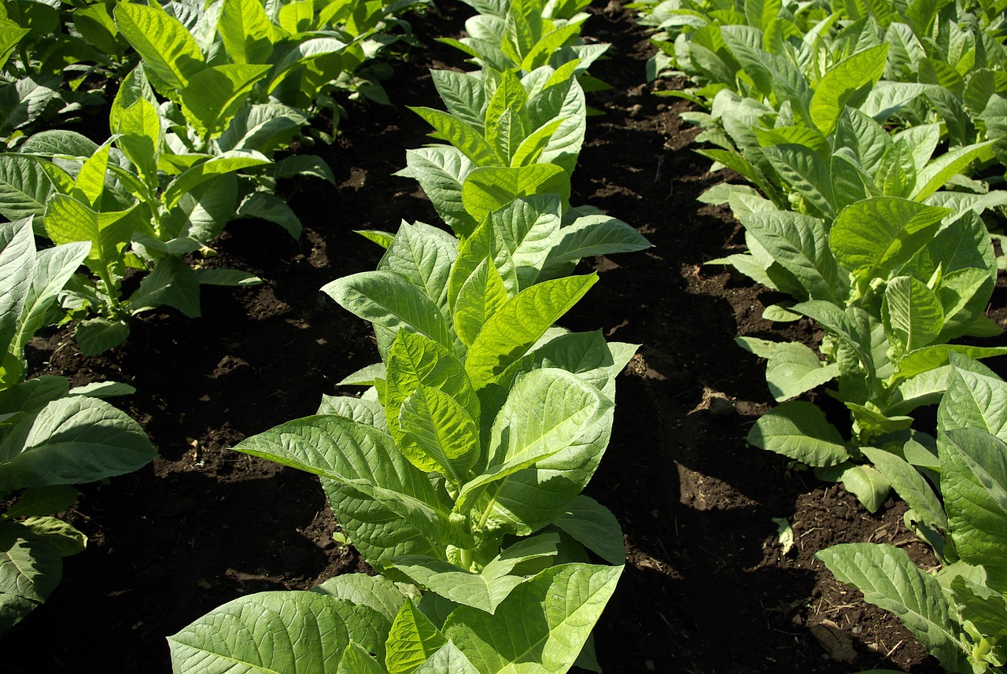
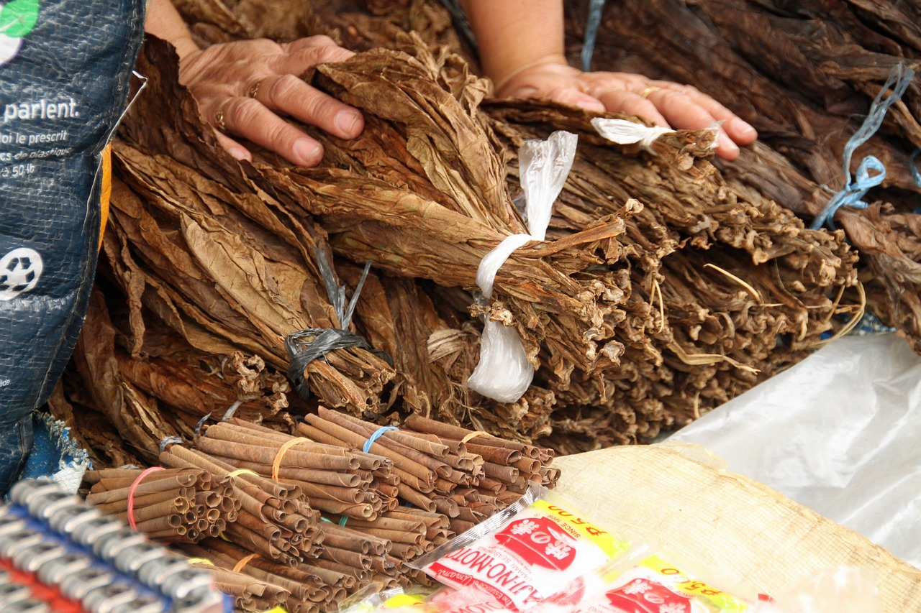
Tubaako
Tobacco wuxuu ka yimaadaa geedka tobacco.
beer tubaako
Caleemaha waa la qalajiyaa ka dibna waa la duubaa si ay u noqdaan sigaar ama sigaar.

Slide 11
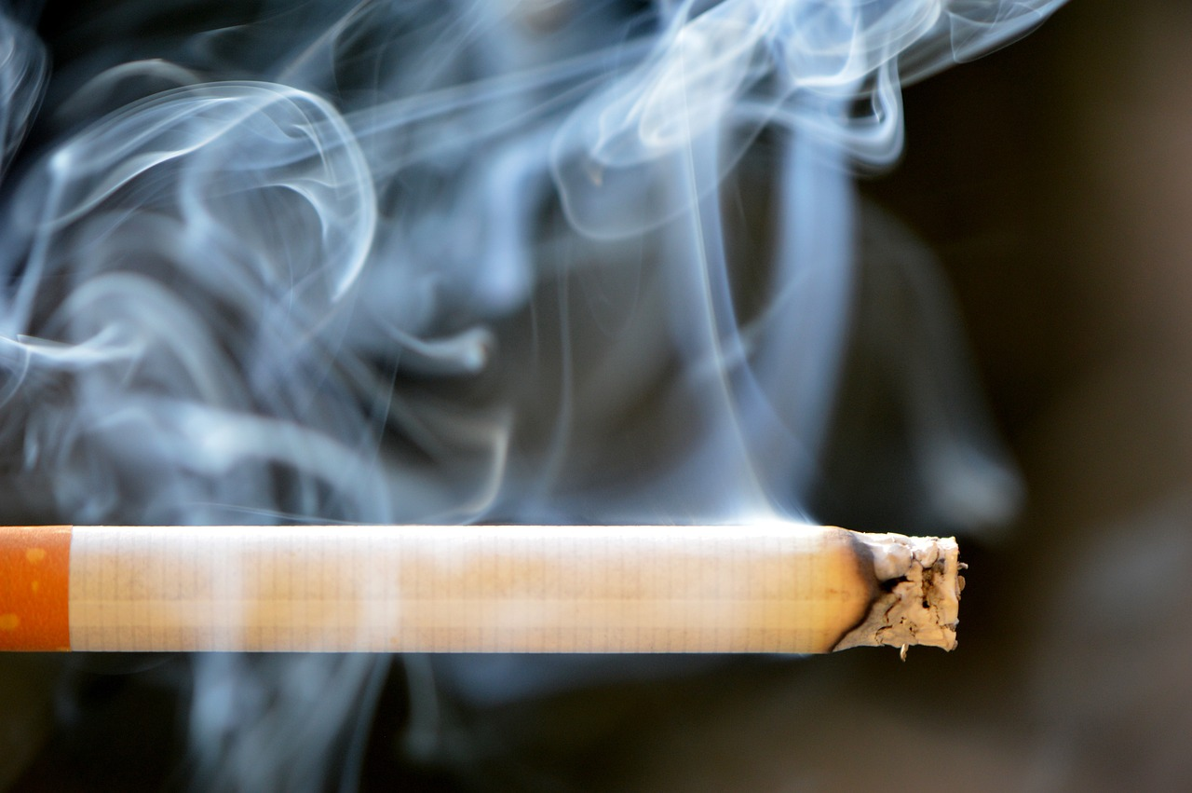
Tubaako
Marka tubaakada ku jirta sigaarku gubto, waxay sii daaysaa ilaa 5000 kiimiko oo kala duwan.
70 ka mid ah kiimikooyinkan ayaa keena kansar.
Ma jiro heer ammaan ah oo sigaar lagu cabo.
sigaar

Slide 12
Tubaako
Waa maxay kiimikooyinka kansarka keena ee ku jira sigaarka?
Kiimiko | Halkee kale laga heli karaa?
cadmium | batariga gaariga
arsenic | sun
formaldehyde | ilaaliye loo isticmaalo habka maydka
1, 3 - butadiene | loo isticmaalo samaynta caag
benzene | solvent warshadeed

Slide 13

Tobacco (Tobacco)
Inta aadan maalin walba sigaar cabbin, caafimaadkaagu waa fiicnaan doonaa.
Ma jiro heer ammaan ah oo sigaar cabista ah.
Waa inaad sigaar cabtaa wakhti kasta si aad u yeelato saameyn xun.

Slide 14
Tobacco (Tobacco)
Xaggee buu ka yimaadaa tobacco (Tobacco)?
xayawaanka
dhirta
dadku sameeyeen shaybaarka

Slide 15
Tobacco (Tobacco)
Ku sawir sawir sigaar ah boggaaga.
Ku sawir sawirro agagaarkeeda si aad u muujiso qaar ka mid ah saameynta sigaar cabista.
sigaar

Slide 16
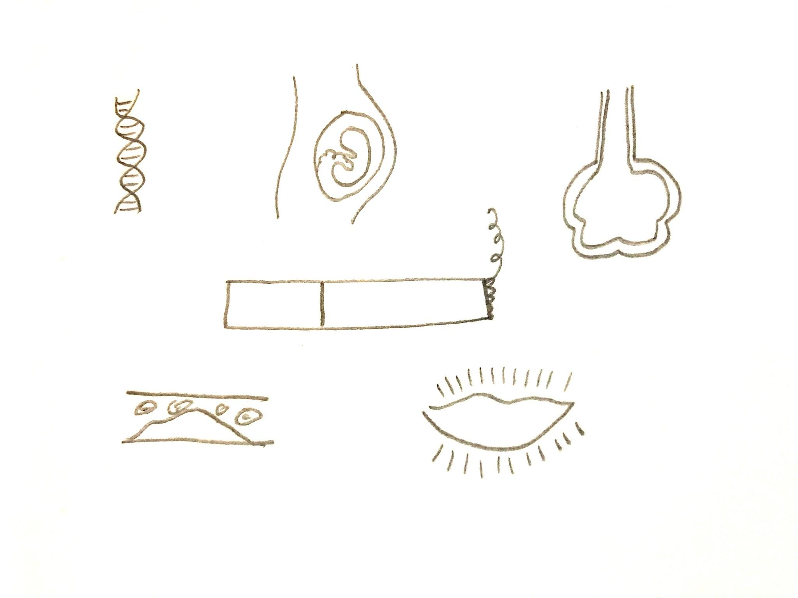
Tobacco (Tobacco)
Ku sawir sawir sigaar ah boggaaga.
Ku sawir sawirro agagaarkeeda si aad u muujiso qaar ka mid ah saameynta sigaar cabista.
dhaawaca ilmaha uurka ku jira
kansar (Cancer)
emphysema (Emphysema)
cadaadiska dhiigga oo sarreeya (High Blood Pressure)
laalaab (Wrinkles)

Slide 17
Sigaar cabista
Tobacco (Tobacco)
Saamaynta nikotiinka
Saamaynta sigaar cabista ee nidaamka is-weydaarsiga gaaska (gas exchange system)

Slide 18
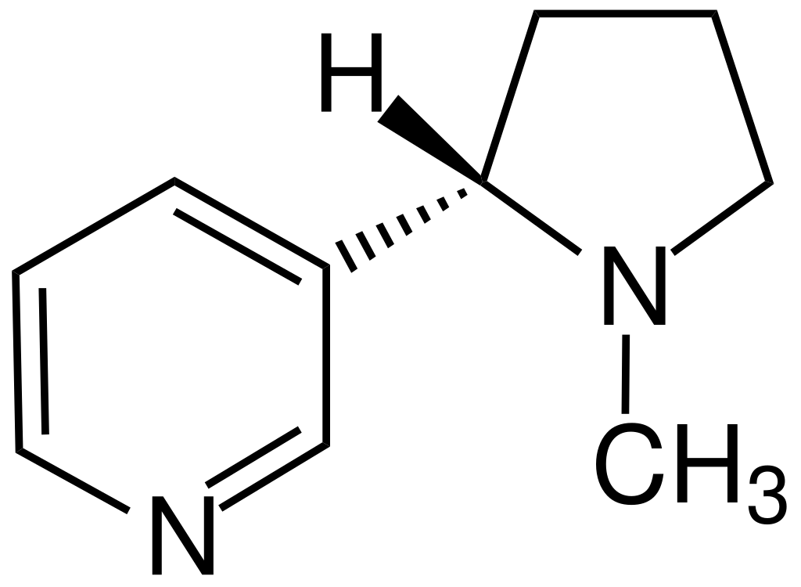

Saamaynta nikotiinka
Nikotiinku waa daroogo madadaalo (recreational drug) oo si dabiici ah uga dhaca geedaha tubaakada.
Nikotiinku waa mid aad u qabatimo leh (addictive).
Qabatimadu waxaa lagu gartaa rabitaan joogto ah oo ah isticmaalka daroogada.
Dadku waxay sii wadaan sigaar cabista inkastoo ay ogyihiin inaysan u fiicnayn.
qaab-dhismeedka nikotiinka
ubaxa tubaakada

Slide 19
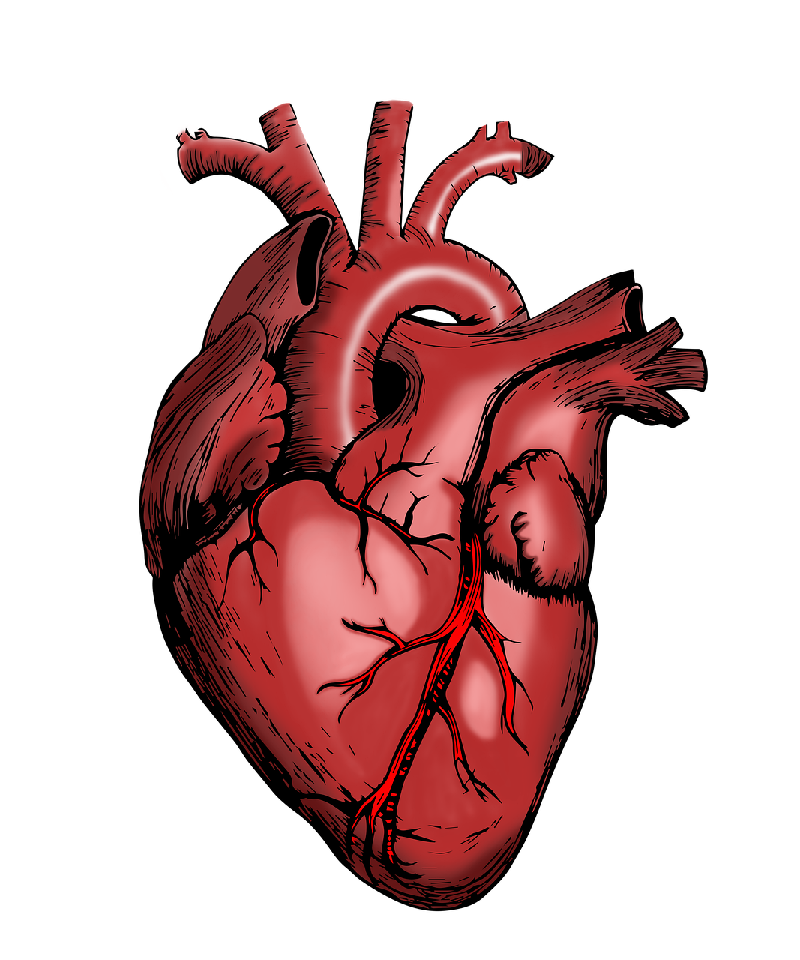
Saamaynta nikotiinka
Nikotiinku wuxuu cidhiidhin karaa xididdada dhiigga ee wadnaha dhiigga siiya.
Tani waxay yaraynaysaa socodka oksijiinta ee unugyada muruqa wadnaha si ay u helaan neefsashada unugyada (cellular respiration).
Tani waxay keeni kartaa in unugyada muruqu ay joojiyaan isku-jiidista oo ay dhintaan.
Haddii qayb weyn oo wadnaha ah ay dhaawacanto, tani waxay sababi kartaa wadne-qaad (heart attack) iyo dhimasho.
haldhigga wadnaha (coronary arteries)
wadnaha

Slide 20
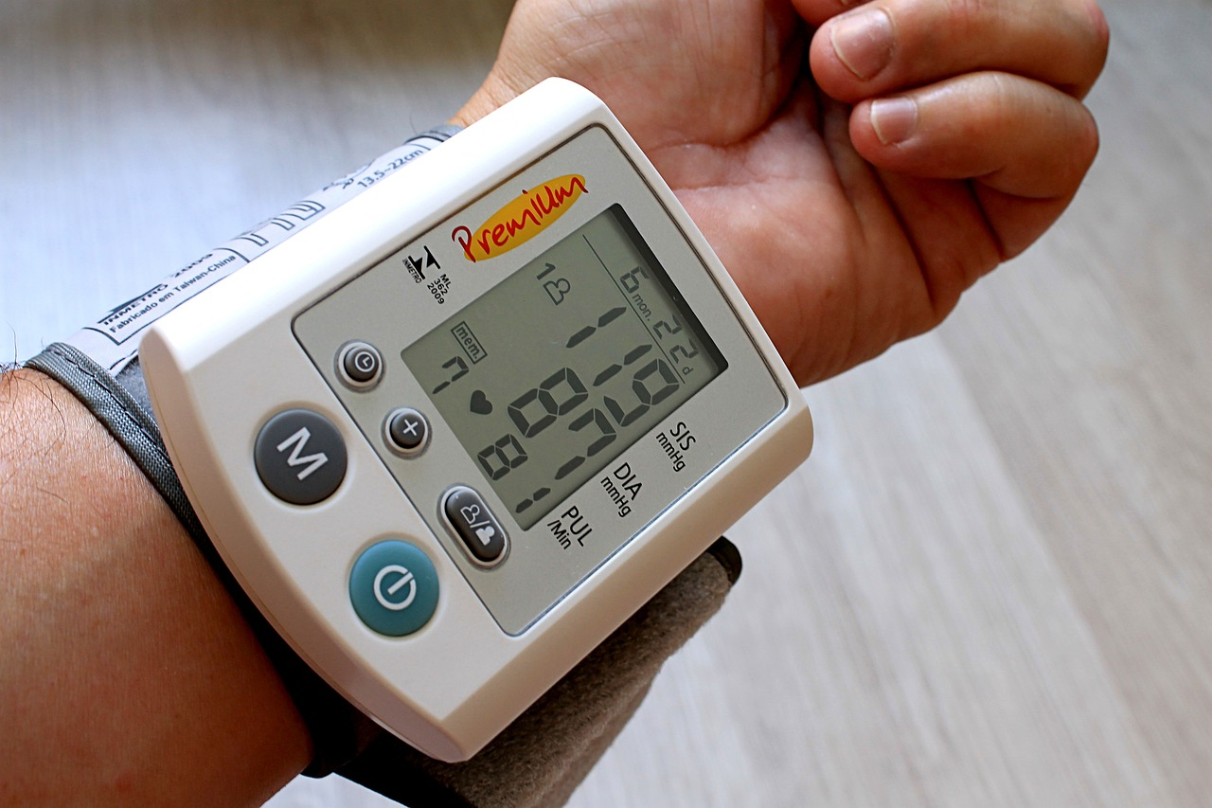
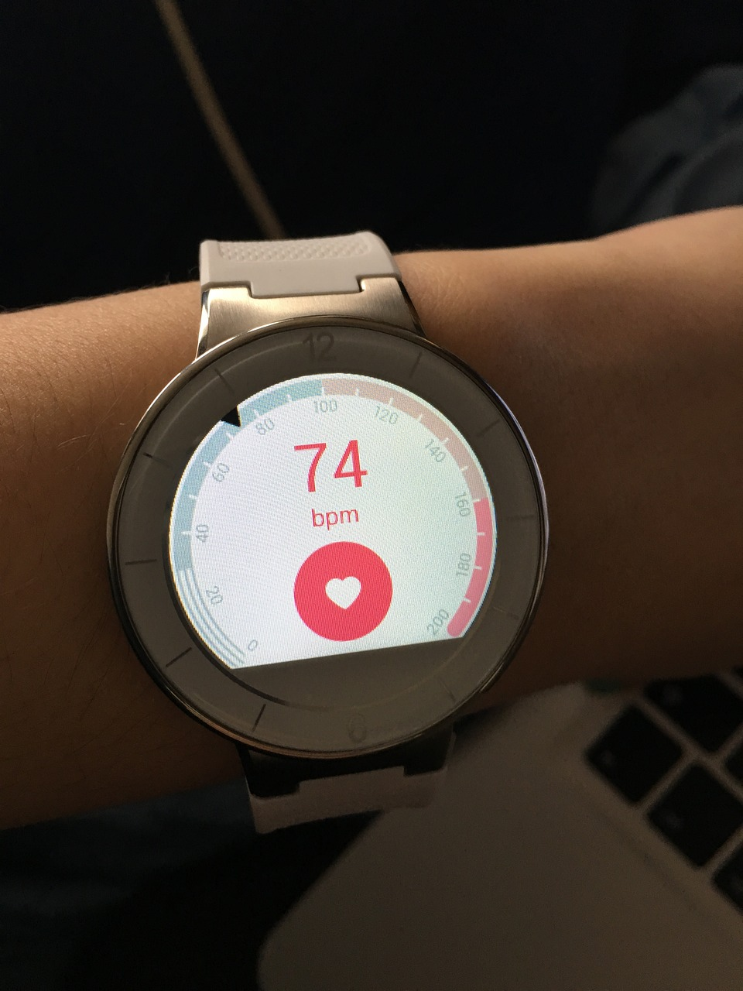
Saamaynta nikotiinka (Nicotine)
Nikotiinku wuxuu sidoo kale kordhin karaa cadaadiska dhiigga (blood pressure) iyo garaaca wadnaha (heart rate).
Cadaadiska dhiigga oo sarreeya wuxuu culays saaraa xididdada dhiigga wuxuuna dhaawici karaa. Tani waxay u horseedi kartaa cudur wadnaha iyo wadne-qaad suurtagal ah.
Haddii wadnuhu uu garaaco si joogto ah, muruqa wadnuhu wuxuu u baahan doonaa oksijiin iyo gulukoos (glucose) badan si uu u shideeyo neefsashada. Garaaca badan sidoo kale wuxuu cadaadis badan saaraa wadnaha, maadaama uu u shaqeeyo si adag.
qalabka cabbira cadaadiska dhiigga
qalabka cabbira garaaca wadnaha

Slide 21
Saamaynta nikotiinka (Nicotine)
Mid ka mid ah weedhahan soo socda ayaa been ah?
Nikotiinku (Nicotine) waa daroogo sharci darro ah oo aad u qabatimo badan.
Nikotiinku (Nicotine) wuxuu yareeyaa cadaadiska dhiigga.
Nikotiinku (Nicotine) wuxuu kordhiyaa garaaca wadnaha.
Nikotiinku (Nicotine) wuxuu keenaa cidhiidhiga halbowlayaasha wadnaha (coronary arteries).

Slide 22
Saamaynta nikotiinka (Nicotine)
1) Waa maxay kiimikada ugu weyn ee dadka ku kalifta inay sii cabbaan sigaarka, inkastoo ay ogyihiin inuusan fiicnayn?
2) Sharax sababta sigaarka u keeno cidhiidhiga halbowlayaasha wadnaha (coronary arteries) iyo sida ay tani u horseedi karto wadne-gabasho (cardiac arrest).

Slide 23
Saamaynta nikotiinka (Nicotine)
1) Waa maxay kiimikada ugu weyn ee dadka ku kalifta inay sii cabbaan sigaarka, inkastoo ay ogyihiin inuusan fiicnayn?
Sigaarada waxaa ku jira nikotiin (nicotine) oo ah daroogo madadaalo oo aad u qabatimo badan oo laga helo dhirta tubaakada (tobacco). Qabatimadu waxaa lagu gartaa rabitaan joogto ah oo ah isticmaalka daroogada. Tani waa sababta dadku u sii cabbaan sigaarka inkastoo ay ogyihiin inuusan fiicnayn.

Slide 24
Saamaynta nikotiinka (Nicotine)
2) Sharax sababta sigaarka u keeno cidhiidhiga halbowlayaasha wadnaha (coronary arteries) iyo sida ay tani u horseedi karto wadne-gabasho (cardiac arrest).
Sigaarada waxaa ku jira nikotiin (nicotine). Nikotiinku (Nicotine) wuxuu keenaa cidhiidhiga halbowlayaasha wadnaha (coronary arteries). Halbowlayaasha wadnaha ayaa wadnaha siiya dhiig. Dhiiggu wuxuu unugyada muruqa wadnaha u keenaa oksijiin (oxygen) si ay u sameeyaan neefsashada unugyada (cellular respiration). Haddii halbowlayaashu cidhiidhi yihiin, dhiig ku filan kama qulqulo. Tani waxay u horseedi kartaa wadne-qabad (heart attack).

Slide 25
Sigaar-cabbista (Smoking)
Tubaakada (Tobacco)
Saamaynta nikotiinka (Nicotine)
Saamaynta sigaarka ee nidaamka is-weydaarsiga gaaska (gas exchange system)

Slide 26
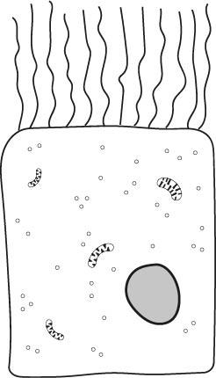
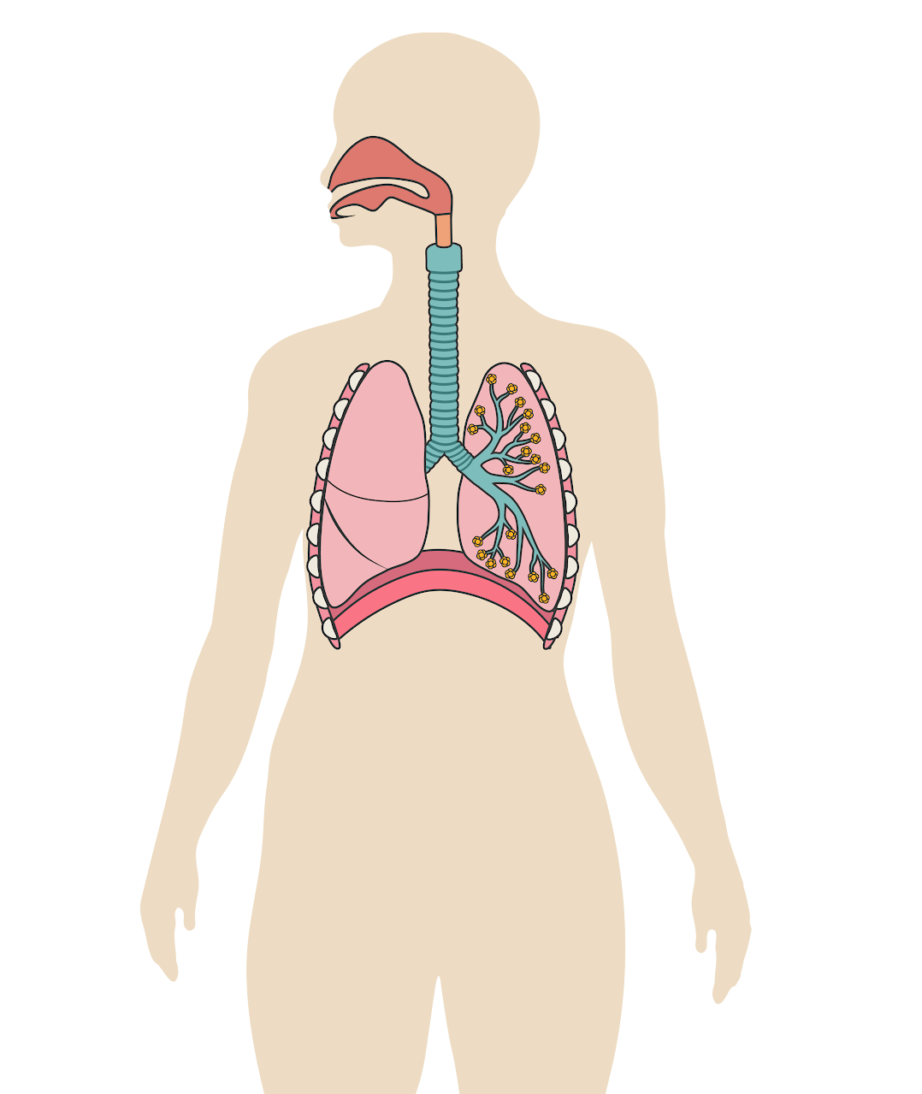
Saamaynta sigaarka ee nidaamka is-weydaarsiga gaaska (gas exchange system)
Qiiqa iyo kulaylku waxay dhaawacaan unugyada ciliated-ka ah (ciliated cells) ee safra marinnada hawada.
Cilia (timaha yaryar)
Unugyada ciliated ee ku xiga marinnada hawada
Nidaamka is-weydaarsiga gaasaska (gas exchange system)

Slide 27
Saamaynta sigaarka ee nidaamka is-weydaarsiga gaasaska
Unugyada ciliated ee caafimaadka qaba waxay qabtaan wasakhda iyo boodhka, taasoo naga ilaalisaa infekshannada.
Darteed, waxay noqon karaan kuwo aan si fiican uga saari karin xabka (mucus).
Qofka sigaarka cabba waa inuu qufacaa si uu u dhaqaajiyo xabka (qufaca sigaarka).
Waxay noqon doonaan kuwo u nugul infekshannada sambabada, sida bronchitis.
Cilia gaaban oo tiro yar
Unugyada ciliated ee dhaawacmay ee ku xiga marinnada hawada

Slide 28
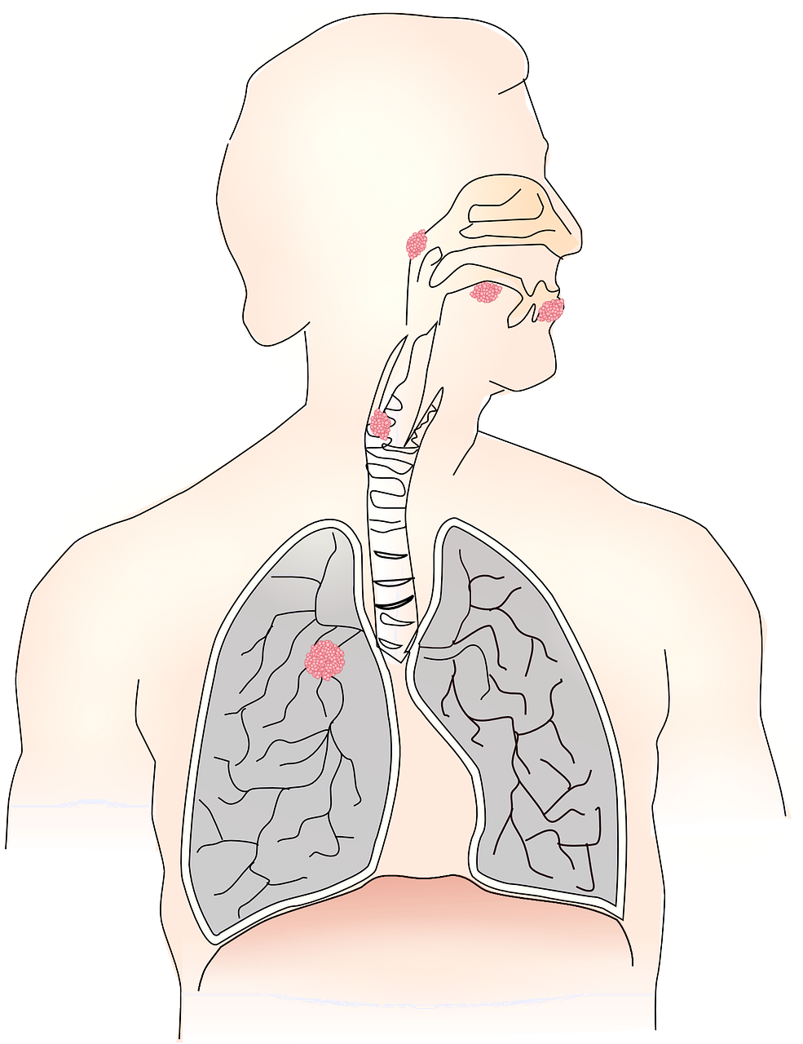
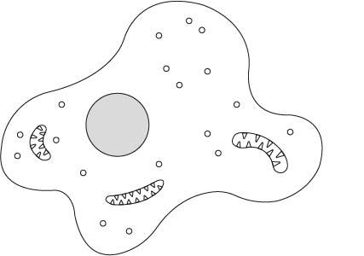
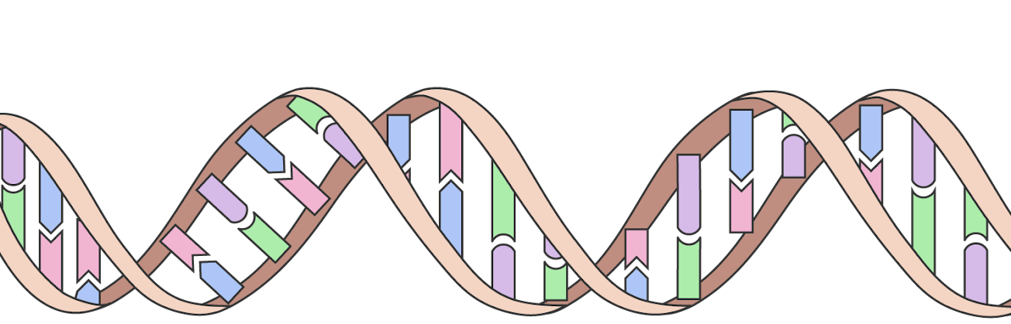
Saamaynta sigaarka ee nidaamka is-weydaarsiga gaasaska
Tar-ka ku jira qiiqa sigaarka wuxuu sababi karaa kansar.
Unug xayawaan (animal cell)
Kiimikooyinka ku jira tar-ku waxay dhaawacaan DNA-ga.
Tani waxay u horseedi kartaa qaybinta unugyada aan la xakameynin.
Tani waa kansar.
Kansar (cancer)
Tar-ku wuxuu sababi karaa noocyo kala duwan oo kansar ah, oo ay ku jiraan kansarka afka, cunaha iyo sambabada.
DNA

Slide 29
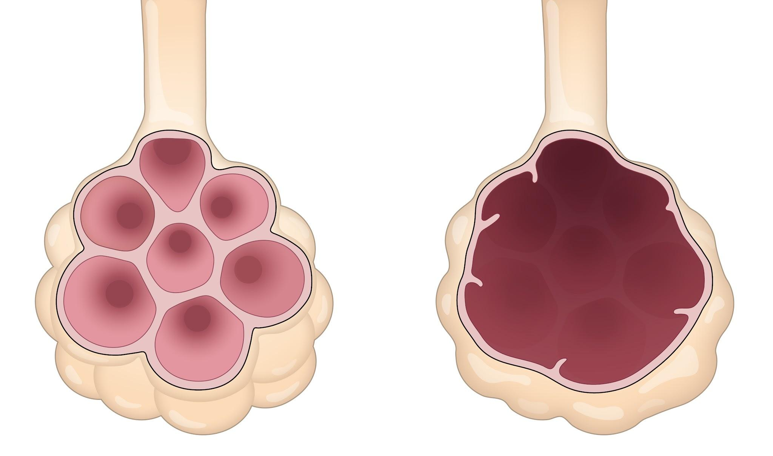
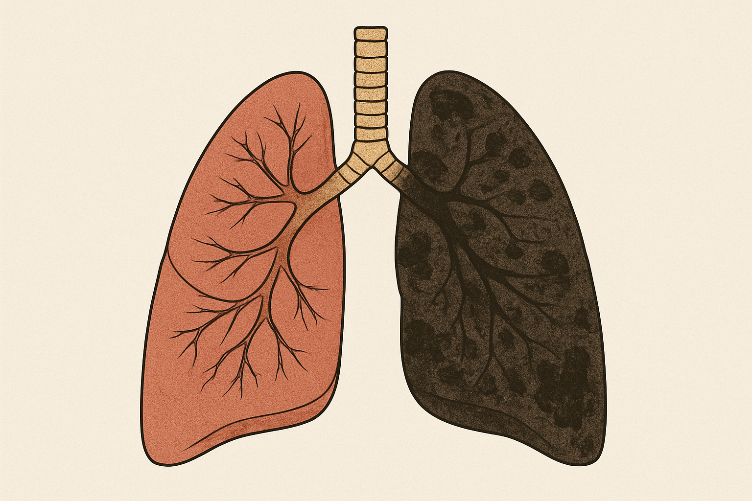
Saamaynta sigaarka ee nidaamka beddelka gaaska (gas exchange system)
Tar-ka laga helo qiiqa sigaarka wuxuu dhaawici karaa alveoli-ga sambabada wuxuuna u horseedi karaa cudurka COPD, sida emphysema.
alveoli caafimaad qaba
alveoli emphysema ah
Gidaarrada alveoli-ga ayaa jajabma, taasoo keenta in hoos u dhacdo bedka is-weydaarsiga gaasaska.
Sambabada madow ee qofka sigaarka cabba oo ay sababtay ururinta tar-ka

Slide 30
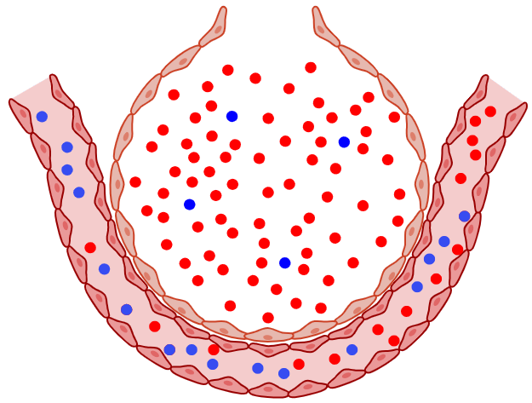
Saamaynta sigaarka ee nidaamka beddelka gaaska (gas exchange system)
Carbon monoxide (CO) waa gaas sun ah oo laga helo qiiqa sigaarka.
Carbon monoxide (CO) waa la neefsadaa wuxuuna ku faafi karaa (diffuse) dhiigga iyada oo loo marayo alveoli-ga.
carbon
Waxay bedeli kartaa booska oxygen-ka ee unugyada dhiigga cas (red blood cells).
Carbon monoxide (CO) iyo COPD labaduba waxay yareeyaan qadarka oxygen-ka ee dhiigga, marka nidaamka wareegga dhiigga (circulatory system) waa inuu ka shaqeeyaa si adag.
Tani waxay u horseedi kartaa cudurka wadnaha (heart disease).
oxygen
molecule-ga carbon monoxide (CO)
alveolus iyo xidid dhiig

Slide 31
Saamaynta sigaarka ee nidaamka beddelka gaaska (gas exchange system)
Kuwee cudurrada soo socda ayaa lala xiriiriyaa sigaarka?
bronchitis
jadeeco (measles)
emphysema
cudurka cagta ciyaartoyda (athlete’s foot)

Slide 32

Saamaynta sigaarka ee nidaamka beddelka gaaska (gas exchange system)
Cali wuxuu u sharxayaa Layla sababta uu u malaynayo in Dowladdu mamnuucday sigaarka meelaha dadweynaha sanadkii 2004.
Ma ku dari kartaa faahfaahin ku saabsan cudurro gaar ah oo saameeya nidaamka beddelka gaaska (gas exchange system)?
Qiiqa sigaarka ee dadka kale (second hand smoke) wuxuu weli saameyn karaa neefsashada qofka, sidaas darteed Dowladdu waxay mamnuucday sigaarka meelaha dadweynaha.
Layla
Cali

Slide 33
Saamaynta sigaarka ee nidaamka is-weydaarsiga gaaska (gas exchange system)
Ma ku dari kartaa faahfaahin ku saabsan cudurrada gaarka ah ee saameeya nidaamka is-weydaarsiga gaaska (gas exchange system)?
Kansar (Cancer): Daamurka (Tar) ee sigaarka wuxuu dhaawici karaa DNA-da unugga. Tani waxay u horseedi kartaa qaybinta unugyada aan la xakameynin. Kani waa kansar. Sigaarku wuxuu u horseedi karaa kansar cunaha, afka, ama sambabada.
Cudurka sambabada ee joogtada ah (COPD): Daamurka (Tar) ee laga helo sigaarka wuxuu dhaawici karaa alveoli-ga sambabada wuxuuna u horseedi karaa COPD. Gidaarada alveoli-ga ayaa burbura, taasoo keenta in hoos u dhacdo bedka (surface area) ee is-weydaarsiga gaaska. Tani waxay yaraysaa tirada oksijiinta ee dhiigga, sidaas darteed nidaamka wareegga dhiigga (circulatory system) waa inuu ka shaqeeyo si adag. Tani waxay u horseedi kartaa cudur wadnaha.
Layla
Cali

Slide 34
Sigaarka
Tobacco-ga waxaa laga helaa sigaarka, wuxuuna ka samaysan yahay caleemaha qalalan ee geedaha tobacco-ga.
Wuxuu ka kooban yahay kumanaan kiimiko oo kala duwan, oo ay ku jirto nikotiin (nicotine).
Nikotiinku waa daroogo aad u qabatisa (addictive) taasoo ka dhigaysa sigaarka inay sii wataan inay sigaaraan, inkastoo ay ogyihiin inaysan u fiicnayn.
Sigaarku wuxuu saameyn karaa nidaamka is-weydaarsiga gaaska (gas exchange system) wuxuuna u horseedi karaa asthma, caabuq sambabada, COPD, iyo kansar.

