Slide 1
Gariirka codka (Sound vibrations)
Codka, iftiinka iyo aragga (Sound, light and vision)

Slide 2
Sida agabkeena waxbarista loogu talagalay fasalka

Slide 3
Waxaan qeexi karaa sida codka u yimaado oo aan sharxi karaa waxa go'aamiya codka iyo heerka sare ama hoose ee codka (volume and pitch).

Slide 4
codka (volume)
qeexaysa qaylada codka
heerka sare ama hoose (pitch)
qeexaysa sida uu qoraalku u sarreeyo ama u hooseeyo
gariir (vibration)
dhaqdhaqaaq (movement) soo noqnoqda oo hor iyo dib ah
baaxadda gariirka (amplitude)
qiyaasta weynaha gariirka (vibration), tusaale, inta uu shay gariiro
soo noqnoqosho (frequency)
tirada gariirrada (vibrations) ee dhaca ilbiriqsi kasta

Slide 5

Gariirka codka (Sound vibrations)
Qeexida codka: codka (volume) iyo heerka sare ama hoose (pitch)
Codka waxaa keena gariir (vibration)
Qeexida gariirka (vibration): baaxadda (amplitude) iyo soo noqnoqosha (frequency)

Slide 6

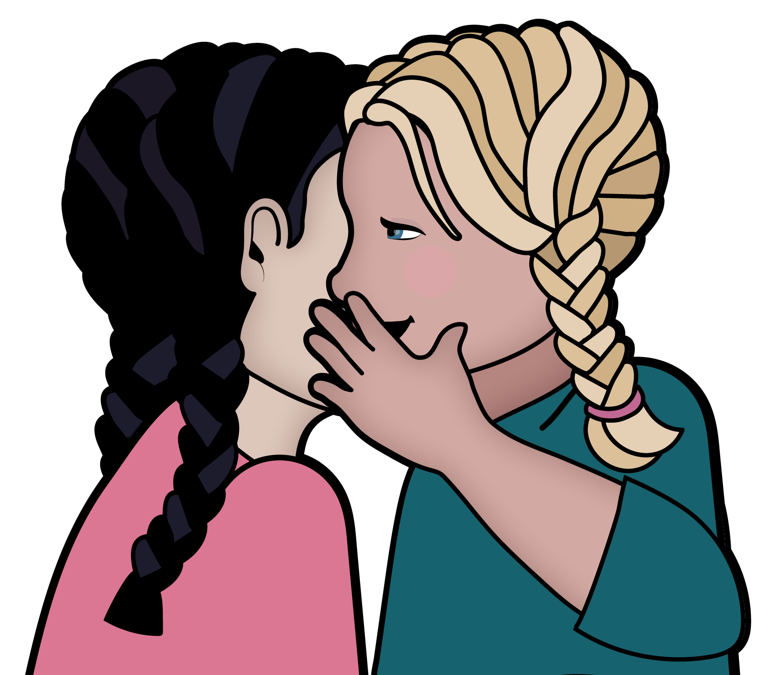
Qeexida codka: codka (volume) iyo heerka sare ama hoose (pitch)
Wax kasta oo aad maqasho waa cod, iyo cod aan loo baahnayn
waxaa loo yaqaan buuqa (noise).
Codka (volume) waa sida uu u qaylado.
Dhawaaq qaylo badan leh wuxuu leeyahay mug (volume) sare.
Dhawaaq qaylo yar leh wuxuu leeyahay mug (volume) hoose.

Slide 7

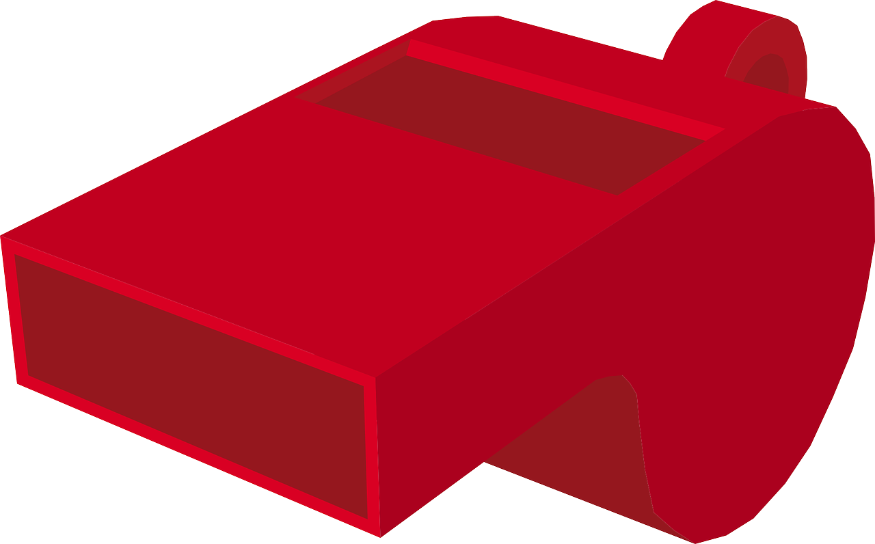
Sharaxaadda dhawaaqyada: mug (volume) iyo sar-joog (pitch)
Qaar ka mid ah dhawaaqyadu waa kuwa hooseeya oo gariira, qaarna waa
kuwa sareeya oo dhawaaq fiid ah.
Sar-joogga (pitch) dhawaaqu wuxuu macneynaa sida uu u sarreeyo ama uu u hooseeyo.
Dhawaaq fiidani wuxuu leeyahay sar-joog (pitch) sare.
Dhawaaq qoto dheeri wuxuu leeyahay sar-joog (pitch) hoose.
Jawaabaha:
fiid!
fiid!
gariirka onkodka

Slide 8
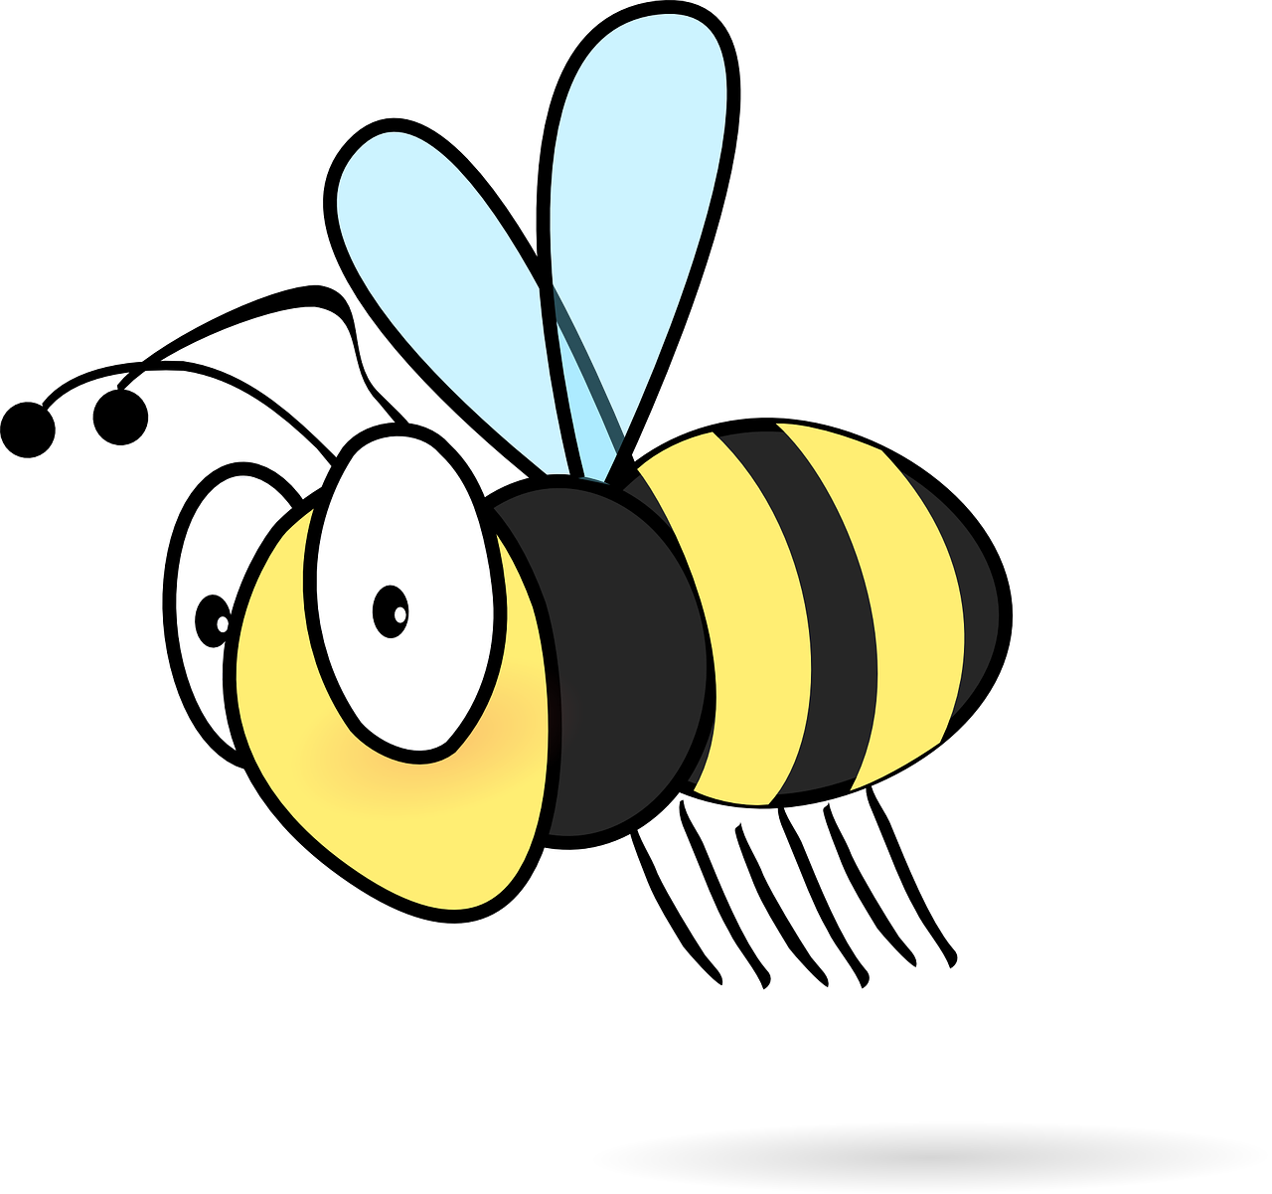
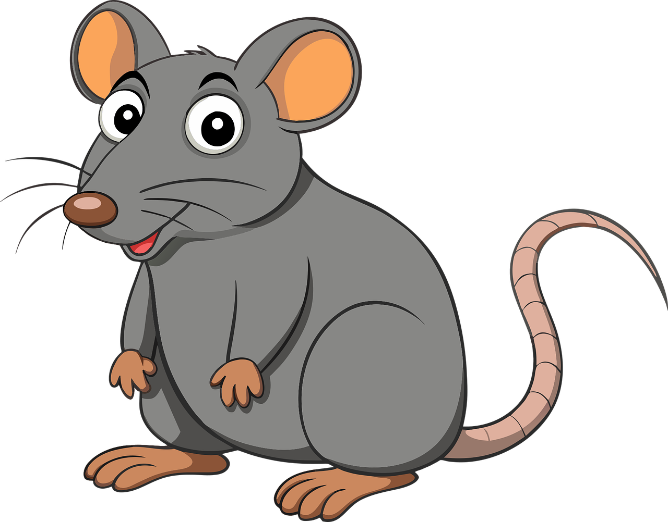
Sharaxaadda dhawaaqyada: mug (volume) iyo sar-joog (pitch)
Dhawaaqyadu waxay noqon karaan:
fiid
fiid
mug (volume) hoose iyo sar-joog (pitch) sare,
mug (volume) hoose iyo sar-joog (pitch) hoose,
Jawaabaha:
buzz
buzz
gariirka onkodka
fiid!
fiid!
mug (volume) sare iyo sar-joog (pitch) sare,
mug (volume) sare iyo sar-joog (pitch) hoose.

Slide 9

Qeexida codadka: mugga (volume) iyo heerka (pitch)
Kee ayaa ka mid ah weedhaha soo socda ee aad isticmaali lahayd si aad u qeexdo codka ciyeynta libaax?
heer sare (high pitch) iyo mug hoose (low volume)
heer sare (high pitch) iyo mug sare (high volume)
heer hoose (low pitch) iyo mug hoose (low volume)
heer hoose (low pitch) iyo mug sare (high volume)

Slide 10
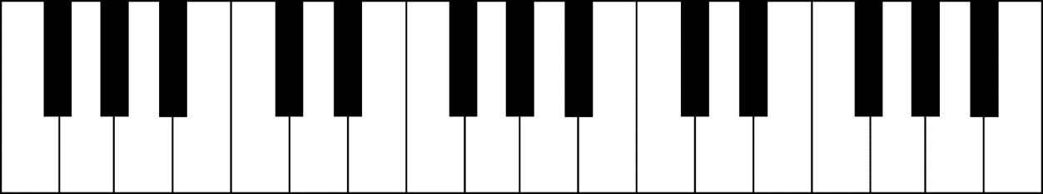

Qeexida codadka: mugga (volume) iyo heerka (pitch)
Buuxi meelaha bannaan, adigoo kaliya isticmaalaya ereyada 'mug (volume)' iyo 'heer (pitch)'.
Qaar ka mid ah qoobabka piano-ga waxay sameeyaan dhawaq hoose oo gariir leh
Qoobabkani waxay leeyihiin ________ hoose.
Riixista furayaasha si khafiif ah waxay sameysaa dhawaq leh ________ hoose.
Sireenka booliisku wuxuu leeyahay laba qoob.
Qoob kastaa wuxuu leeyahay ________ kala duwan.
Sireenku wuxuu leeyahay ________ aad u sareeya si loo maqlo.
wee
woo

Slide 11
Qeexida codadka: mugga (volume) iyo heerka (pitch)
Buuxi meelaha bannaan, adigoo kaliya isticmaalaya ereyada 'mug (volume)' iyo 'heer (pitch)'.
Qoraallo ku saabsan piano waxay sameeyaan dhawaq qoto dheer
sound. These notes have a low .
Riixista furayaasha si khafiif ah waxay sameysaa cod hoose .
pitch
volume
Sireenka booliisku wuxuu leeyahay laba qoob.
Qoob kastaa wuxuu leeyahay ________ kala duwan.
Sareynta (frequency) ayaa aad u saraysa si loo maqlo.
wee
woo
pitch
volume

Slide 12
Sound vibrations
Describing sounds: volume and pitch
Dhawaaqyada waxaa keena gariir (Vibrations)
Describing vibrations: amplitude and frequency

Slide 13
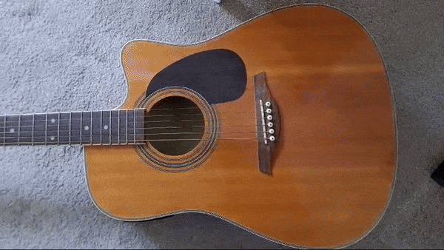
Dhawaaqyada waxaa keena gariir (vibrations)
Gariirinta xadhigga gitaarku waxay keentaa inuu gariiro oo uu dhawaq sameeyo.
Xadhigga gariiraya wuxuu u dhaqaaqaa dib iyo hor si aad u degdeg ah.
Joojinta gariirka ayaa joojisa codka.

Slide 14
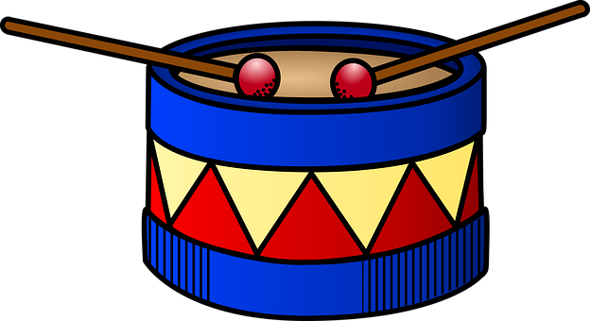
Dhawaaqyada waxaa keena gariir (vibrations)
Garaacidda durbaanka waxay ka dhigaysaa maqaarka durbaanka inuu gariiro oo sameeyo
cod. Laakiin gariirka (vibrations) way adag tahay in la arko.
Maqaarka durbaanka oo gariiraya waa la dareemi karaa isagoo si fudud loo taabto marka la garaaco.
Boodh lagu rusheyey maqaarka durbaanka ayaa ku boodi doona gariirka.

Slide 15

Dhawaqa (sound) waxaa sababa gariir (vibrations)
Waa maxay kuwa soo socda ee ay dhawaqa (sound) sababaan?
a
tamarta (energy)
b
buuqa (noise)
c
xadhkaha (strings)
d
gariirka (vibrations)

Slide 16
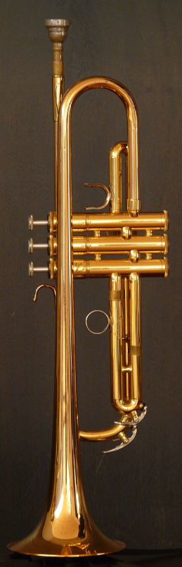
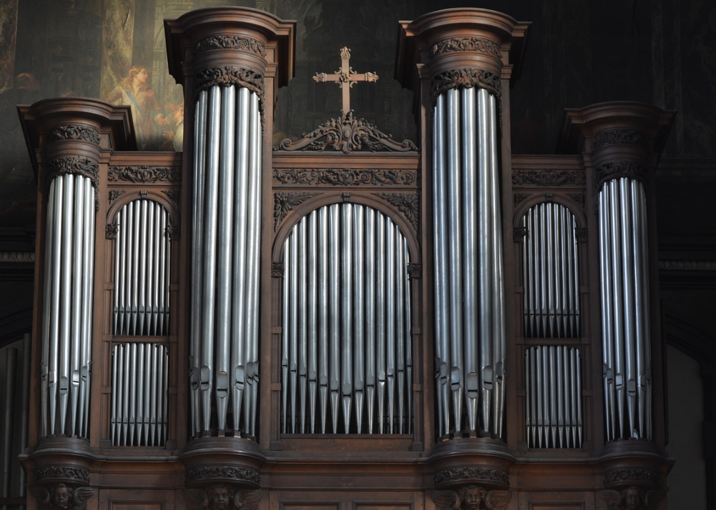
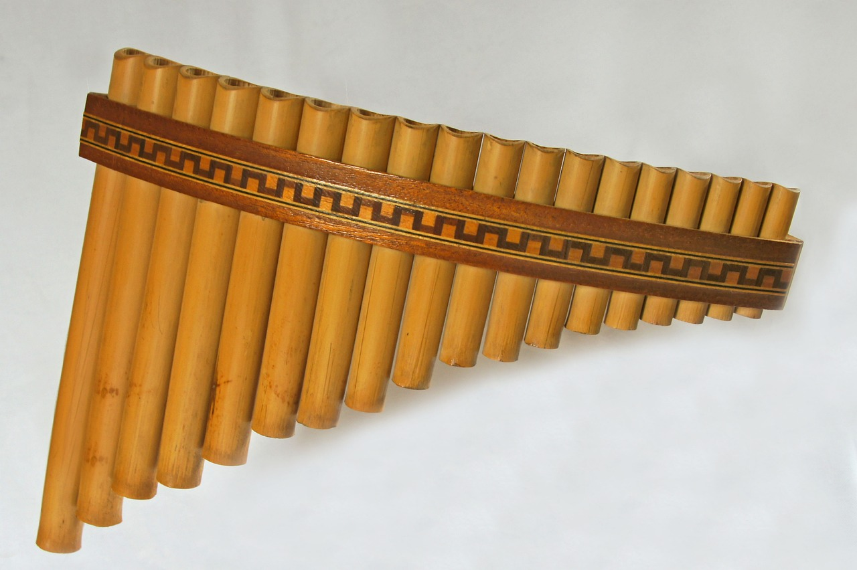
Dhawaqa (sound) waxaa sababa gariir (vibrations)
Qalabka dabaysha iyo birta (brass) waxay dhawaq (sound) sameeyaan iyagoo hawo ku jirta tuubbo gariirinaya.
Hawada ku jirta tuubbada waxaa loo gariirin karaa siyaabo kala duwan.

Slide 17
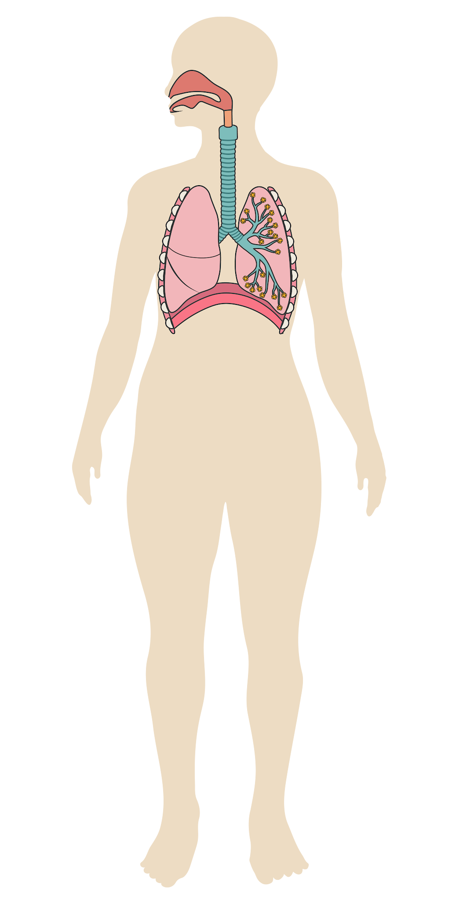
Dhawaqa (sound) waxaa sababa gariir (vibrations)
Codka bini'aadamku wuxuu u shaqeeyaa si la mid ah.
Hawada ku jirta cunaha, sanka iyo afka ayaa gariira si ay dhawaq (sound) u sameeyaan.
Sanduuqa codkaaga (larynx) wuxuu xakameeyaa sida hawadu u gariirto si ay u sameeyaan dhawaqyo (sounds) kala duwan.

Slide 18
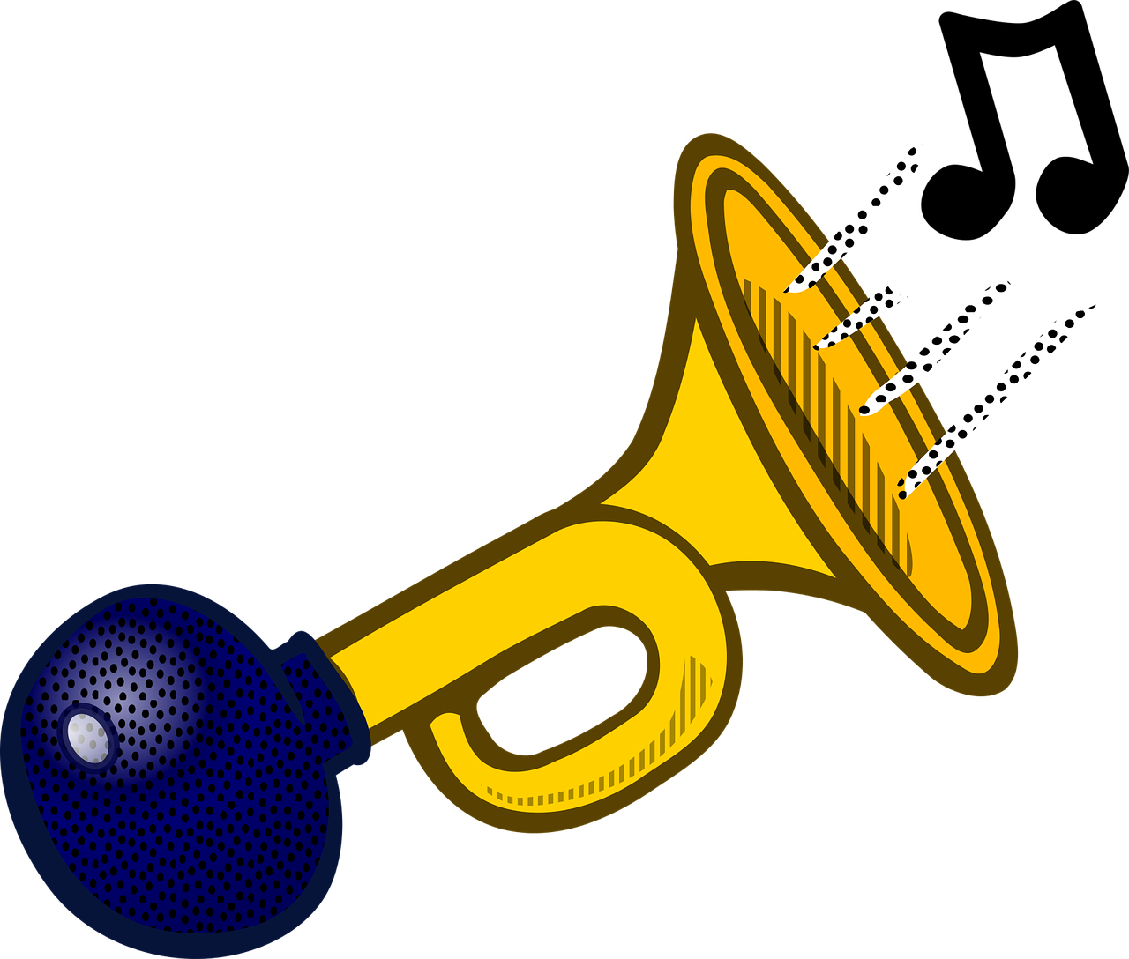
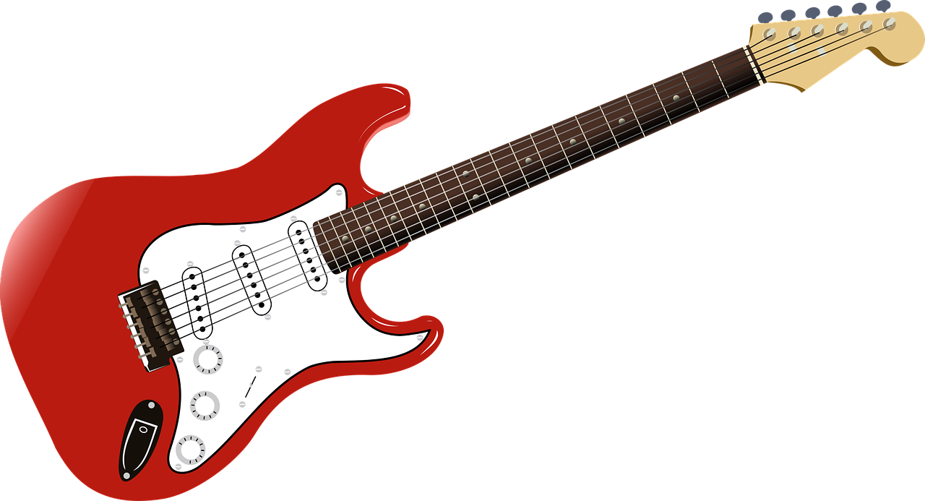
Dhawaqa (sound) waxaa sababa gariir (vibrations)
Kee ka mid ah kuwa soo socda ayaa gariira si uu dhawaq (sound) u sameeyo?
a
xadhkaha gitaarka (guitar strings)
b
maqaarka durbaanka (drum)
c
birta geeska (horn)
d
hawada ku jirta geeska (horn)

Slide 19
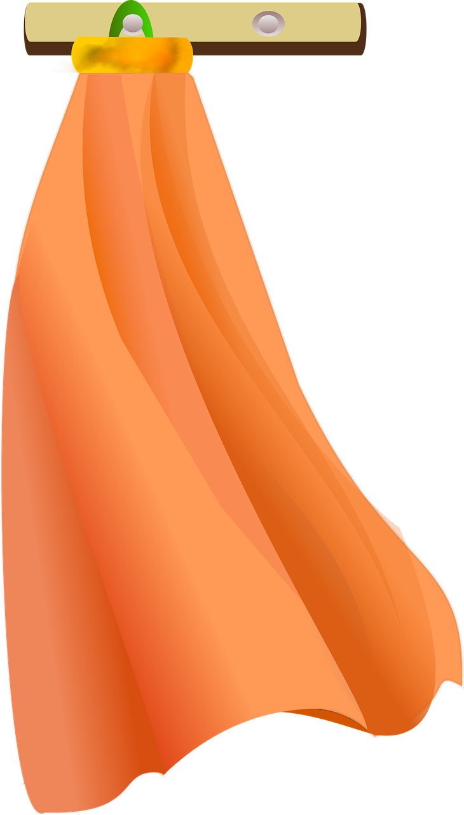
Dhawaqa (sound) waxaa sababa gariir (vibrations)
Ku garaacista maro (cloth) ul durbaan (drumstick) ma sameyso dhawaq (sound) badan.
Marada waa jilicsan tahay oo kuma gariirto (vibrate) wax badan.

Slide 20
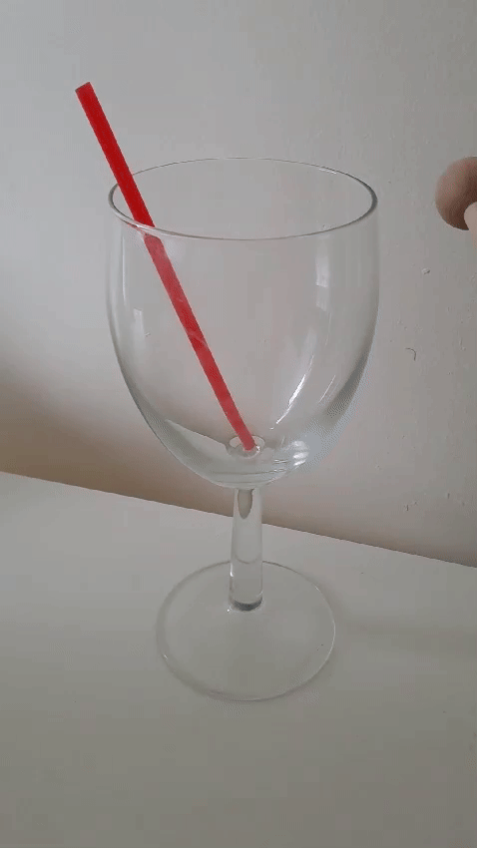
Dhawaqyada waxaa sababa gariir (vibrations)
Galaas (glass) si khafiif ah ugu garaacista usha durbaanka (drumstick) waxay sameysaa dhawaq, laakiin ma aragno gariir (vibration).
Waa inay gariiraysaa (vibrating) sababtoo ah waxay sameysaa dhawaq.
Gariirka (vibrations) aad buu u yar yahay oo u dhaqsi badan yahay in la arko.
Gelinta balo (straw) galaas (glass) dhexdiisa waxay muujinaysaa in galaasku (glass) uu gariiraayo (vibrating).

Slide 21
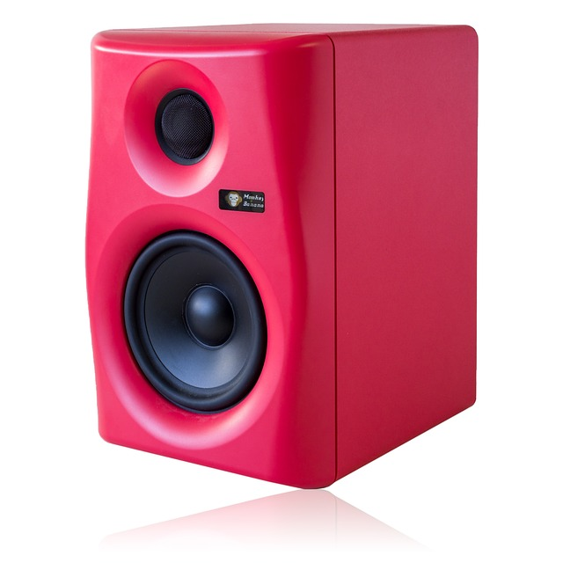
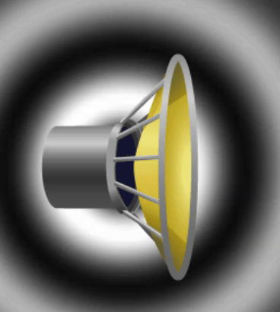
Dhawaqyada waxaa sababa gariir (vibrations)
Kuwa dhawaajiya (Speakers) waxay sameeyaan dhawaq iyagoo gariiraaya (vibrating).
Gariirka (vibrations) inta badan aad buu u yar yahay oo u dhaqsi badan yahay in la arko.
Gelinta xaashi yaryar ama kubbadaha teniska (table tennis balls) kor uga dhawaajiyaha (speaker) waxay muujin kartaa inuu gariiraayo (vibrating).
Sawirka midig: Jilitaan (Simulation) by PhET Interactive Simulations, University of Colorado Boulder, oo shatiyaysan CC-BY-4.0 (https://phet.colorado.edu)

Slide 22
Dhawaqyada waxaa sababa gariir (vibrations)
Laba dhagax oo yaryar ayaa la isku garaacay.
Mid ka mid ah kuwan soo socda ayaa si sax ah u sharxaya sababta dhawaq loo sameeyay?
a
Dhawaqu waa xoogga (force) dhagaxa midka kale.
b
Garaacista (knock) waxay sababtaa dhagaxyada inay gariiraan (vibrate).
c
Tamarta (energy) dhaqdhaqaaqa (movement) dhagaxyada ayaa sababta dhawaqa.
d
Dhagaxyadu aad bay u adag yihiin oo u adag yihiin (rigid).

Slide 23
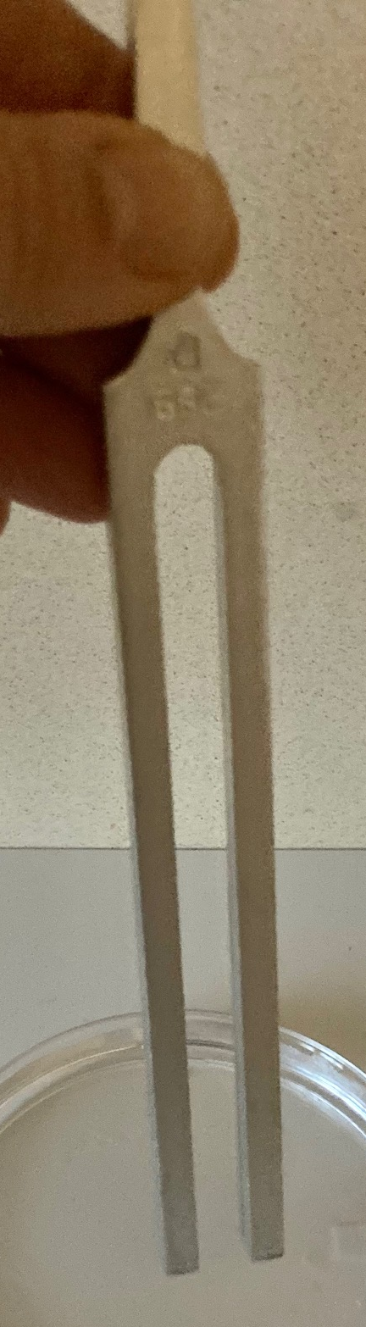
Dhawaqyada waxaa sababa gariir (vibrations)
Fargeeto laami (tuning fork) waxay sameysaa dhawaq marka la garaaco.
Saadaali waxa aad u malaynaysaa in la arki doono marka fargeeto laami (tuning fork), oo sameysa dhawaq, lagu taabto kubbad teniska (table tennis ball), oo ku xidhan dun (thread).
Sharax sababta aad u malaynayso inaad arki doonto tan.
Daawo jilitaan (simulation).
Ma sax ahayd saadaalintaada iyo sharaxaaddaada?
Qor sharaxaad wanaagsan oo ku saabsan waxa aad aragtay.

Slide 24
Dhawaqyada waxaa keena gariir (vibrations)
Jawaabo tusaale.
Saadaalin (Prediction):
Isla marka kubbadda tennis-ka taabato gariiriyaha (tuning fork), kubbadda waxaa si xoog leh dhinac ugu tuura gariiriyaha.
Sharaxaad (Sharraxaad):
Marka gariiriyuhu (tuning fork) dhawaq samaynayo, wuu gariirayaa, laakiin gariirku aad ayuu u yar yahay in la arko.
Marka gariiriyuhu (tuning fork) taabto kubbadda, waxa uu kubbadda dhinac u tuurayaa sababtoo ah wuxuu gariirayaa dhinac ilaa dhinac.

Slide 25
Gariirka dhawaqa (Sound vibrations)
Sharaxaadda dhawaqyada: codka iyo heerka (volume and pitch)
Dhawaqyada waxaa keena gariir (vibrations)
Sharaxaadda gariirka: baaxadda iyo inta jeer (amplitude and frequency)

Slide 26
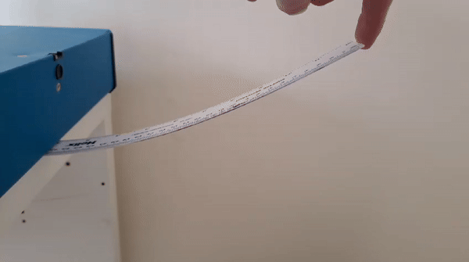
Sharaxaadda gariirka: baaxadda iyo inta jeer (amplitude and frequency)
Dhammaadka xaakimkan (ruler) wuxuu gariirayaa sababtoo ah:
wuxuu istaagaa marka uu kor u foorarsado, iyo xiisadda (tension) xaakimka ayaa dib u soo celisa.
wuxuu istaagaa marka uu hoos u foorarsado, iyo xiisadda (tension) xaakimka ayaa dib u soo celisa.

Slide 27
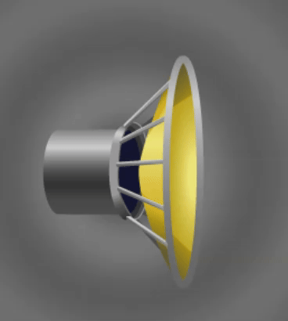
Sharaxaadda gariirka: baaxadda iyo inta jeer (amplitude and frequency)
Gariirrada waaweyn waxay leeyihiin baaxad (amplitude) ka weyn.
Qalabkan codka (speaker) ma gariirayo aad u fog. Gariirradu waa kuwo yar – waxay leeyihiin baaxad (amplitude) hoose.
Dhawaqa la sameeyay waa mid aamusan.
Hadal-bixiyahan (speaker) wuxuu gariiraa si dheeraad ah. Gariirku (vibrations) waa weyn yihiin – waxay leeyihiin baaxad (amplitude) weyn.
Dhawaaqa la sameeyo wuu ka sii qaylada badan yahay (louder).
Sawirka Bidix: Jilitaan (Simulation) oo ay sameeyeen PhET Interactive Simulations, Jaamacadda Colorado Boulder, oo shatiyeysan CC-BY-4.0 (https://phet.colorado.edu),
Sawirka Midig: Jilitaan (Simulation) oo ay sameeyeen PhET Interactive Simulations, Jaamacadda Colorado Boulder, oo shatiyeysan CC-BY-4.0 (https://phet.colorado.edu)

Slide 28
Sharaxaadda gariirka (vibrations): baaxad (amplitude) iyo inta jeer (frequency)
Gariirka (vibrations) sameeya dhawaaq qaylada badan (louder) wuxuu leeyahay baaxad (amplitude) weyn.
Nooca qalabka (instrument) | Maxaa la gariiriyaa (vibrate)? | Sidee loo soo saaraa gariir (vibrations) oo baaxad (amplitude) weyn leh (dhawaaq qaylada badan/louder)?
durbaan (percussion) | maqaar durbaan (drum skin) ama shay adag (solid object) | ku dhufta qalabka (instrument) si adag
xadhko (stringed) | xadhko (strings) | ku dhufta xadhkaha (strings) si adag jiida xadhkaha (strings) masaafo (distance) weyn ku cadaadi qaansada (bow) si adag
neef (wind) (tusaale: naxaas/brass, alwaax/woodwind) | hawada (air) ku jirta tuubbo (tube) | ku afuufa tuubbada (tube) si adag

Slide 29
Sharaxaadda gariirka (vibrations): baaxad (amplitude) iyo inta jeer (frequency)
Waa maxay kuwan soo socda ee dhaca marka durbaanka (drum) si adag loo dhufto?
a
Dhawaaqu waa isku mid.
b
Dhawaaqu wuu ka sii qaylada badan yahay.
c
Dhawaaqu wuxuu leeyahay cod sare (higher pitch).
Kee ayaa si sax ah u sharxaya jawaabtaada su'aasha Q1?
a
Waa isla durbaanka.
b
Xooggu (force) wuu ka weyn yahay.
c
Durbaanku wuxuu u gariirayaa si isku mid ah.
d
Durbaanku wuxuu u gariirayaa gariir weyn (larger vibrations).

Slide 30
Sharaxaadda gariirrada: amplitude iyo frequency
Frequency (frequency) ee shay macneheedu waa inta jeer ee uu dhaco.
Tusaale ahaan, frequency (frequency) ee adeegga baska waxay noqon kartaa 'mar kasta 10 daqiiqo'.
Frequency (frequency) ee gariirku wuxuu kuu sheegaa inta gariir ee dhacda ilbiriqsi kasta.
Marka gariirrada (vibrations) badnaadaan ilbiriqsi kasta, frequency (frequency) ayaa sare u kaca.

Slide 31
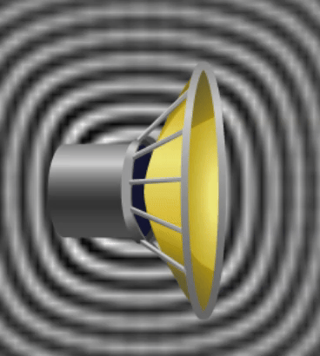
Sharaxaadda gariirrada: amplitude iyo frequency
Marka frequency (frequency) ee gariirradu sare u kaco, codka (pitch) ee la sameeyo wuu sare u kacaa.
Qalabkan wuu dhimaan gariirkiisa ilbiriqsi kasta. Gariirradu waa frequency hoose (low frequency).
Waxaa la sameeyaa cod hoose (low pitch).
Qalabkan wuxuu gariirayaa marar badan ilbiriqsi kasta. Gariirradu waa frequency sare (higher frequency).
Waxaa la sameeyaa cod sare (higher pitch).
Sawirka bidix: Simulation by PhET Interactive Simulations, University of Colorado Boulder, licensed under CC-BY-4.0 (https://phet.colorado.edu),
Sawirka midig: Simulation by PhET Interactive Simulations, University of Colorado Boulder, licensed under CC-BY-4.0 (https://phet.colorado.edu)

Slide 32
Sharaxaadda gariirka (vibrations): baaxadda (amplitude) iyo soo noqnoqodka (frequency)
Gariirka (vibrations) sameeya codadka dhawaaqa sare waxay leeyihiin soo noqnoqod (frequency) sare.
Nooca qalabka | Maxaa la gariiriyay (vibrated)? | Sidee loo soo saaraa gariir (vibrations) leh soo noqnoqod (frequency) sare (codadka dhawaaqa sare)?
durbaan (percussion) | maqaar durbaan ah ama shay adag (marka la garaaco) | garaacista durbaannada ka yar cabbirka waxay ka adkeysaa maqaarka durbaanka
neef (wind) (tusaale: naxaas (brass), alwaax (woodwind)) | hawada ku jirta tuubbo (tube) | ka dhig tuubbada dheer ama gaaban adigoo riixaya furayaasha (keys), ama slider isticmaal qalab leh dherer (lengths) kala duwan oo tuubbo ah

Slide 33
Sharaxaadda gariirka (vibrations): baaxadda (amplitude) iyo soo noqnoqodka (frequency)
Loudspeaker-ku wuxuu gariiraynayaa (vibrating) isagoo leh baaxad (amplitude) hoose iyo
soo noqnoqod (frequency) sare.
Noocee ah cod (sound) ayaa la maqlay?
a
dhawaaq (pitch) hoose iyo qaylo (loud)
b
dhawaaq (pitch) sare iyo qaylo (loud)
c
dhawaaq (pitch) hoose iyo aamusnaan (quiet)
d
dhawaaq (pitch) sare iyo aamusnaan (quiet)

Slide 34
Sharaxaadda gariirka (vibrations): baaxadda (amplitude) iyo soo noqnoqodka (frequency)
Loudspeaker-ku hadda wuxuu gariiraynayaa (vibrating) jeer badan ilbiriqsi kasta, laakiin cabbirka gariirka (vibration) waa isku mid.
Maxaa la beddelay?
a
soo noqnoqoshada gariirka (frequency of the vibration)
b
baaxadda gariirka (amplitude of the vibration)
c
codka muggiisa (volume of the sound)
d
heerka codka (pitch of the sound)

Slide 35
Sharaxaadda gariirka: baaxadda iyo soo noqnoqoshada (amplitude and frequency)
Kala saar weedhaha labada qaybood.
weedho ku saabsan soo noqnoqoshada gariirka (frequency of vibrations) | weedho ku saabsan baaxadda gariirka (amplitude of vibrations)
a
Qiyaasta sida degdegga ah uu shaygu u dhaqaaqo (movement) gadaal iyo horay.
b
Qiyaasta masaafada / cabbirka gariirka gadaal iyo horay.
c
Tirada gariirrada (vibrations) dhaca ilbiriqsi kasta.
d
Masaafada ugu fog ee la gaaro marka laga fogaado meesha nasashada (rest position).
e
Dejiyaa mugga codka (volume of the sound).
f
Dejiyaa heerka codka (pitch of the sound).

Slide 36
Sharaxaadda gariirka: baaxadda iyo soo noqnoqoshada (amplitude and frequency)
Kala saar weedhaha labada qaybood.
weedho ku saabsan soo noqnoqoshada gariirka (frequency of vibrations) | weedho ku saabsan baaxadda gariirka (amplitude of vibrations)
a
c
f
b
d
e
a
Qiyaasta sida degdegga ah uu shaygu u dhaqaaqo (movement) gadaal iyo horay.
b
Qiyaasta masaafada / cabbirka gariirka gadaal iyo horay.
c
Tirada gariirrada (vibrations) dhaca ilbiriqsi kasta.
d
Masaafada ugu fog ee la gaaro marka laga fogaado meesha nasashada (rest position).
e
Wuxuu dejiyaa mugga (volume) dhawaqa.
f
Wuxuu dejiyaa sar-joogga (pitch) dhawaqa.

Slide 37
Gariirka (vibrations) dhawaqa
Mugga (volume) dhawaqu waa sida uu u dheer yahay ama uu u hooseeyo. Sar-joogga (pitch) dhawaqu waa sida uu u sarreeyo (squeaky) ama uu u hooseeyo (deep).
Dhawaq kasta waxaa sababa gariir (vibrations). Qaar ka mid ah gariirku aad ayey u yar yihiin ama aad bay u dhaqsaa badan yihiin in la arko.
Baaxadda (amplitude) gariirku waxay cabbirtaa cabbirkiisa, tusaale ahaan inta uu shaygu gariiro. Gariirka waaweyn waxay leeyihiin baaxad (amplitude) weyn waxayna sameeyaan dhawaq dheer (louder).
Inta jeer ee gariirka (frequency) waa tirada gariirrada (vibrations) dhaca ilbiriqsi kasta. Marka gariirro badan dhacaan ilbiriqsi kasta, inta jeer ee gariirka (frequency) wuu kordhaa, sar-joogga (pitch) dhawaquna wuu sarreeyaa.

