Slide 1
Tababarka ciyaaraha (Sports coaching)
Xisaabta goobta shaqada (Xisaab in the workplace)

Slide 2
Sida agabkeena waxbarista loogu talagalay fasalka

Slide 3
Waxaan fahmi karaa sida xisaabta loogu isticmaalo tababarayaasha ciyaaraha.

Slide 4
Xogtu (Data) waa ururinta macluumaadka.
Celcelisku (Average) waa hal lambar oo muujinaya qiimaha (value) dhexe ama caadiga ah ee xogta (data); mod-ka (mode), dhexdhexaadka (median), iyo celceliska (mean).

Slide 5

Tababarka ciyaaraha (Sports coaching)
Diiwaangelinta iyo isticmaalka xogta (data)
Isticmaalka xogta (data) si loo qorsheeyo tababarka

Slide 6



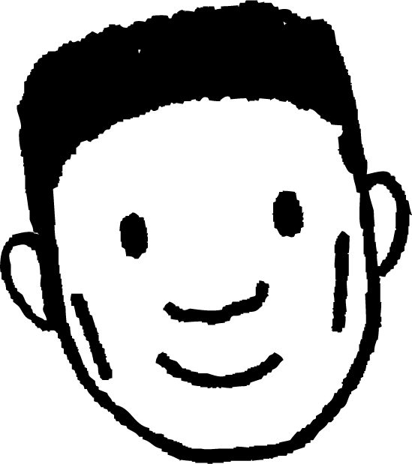
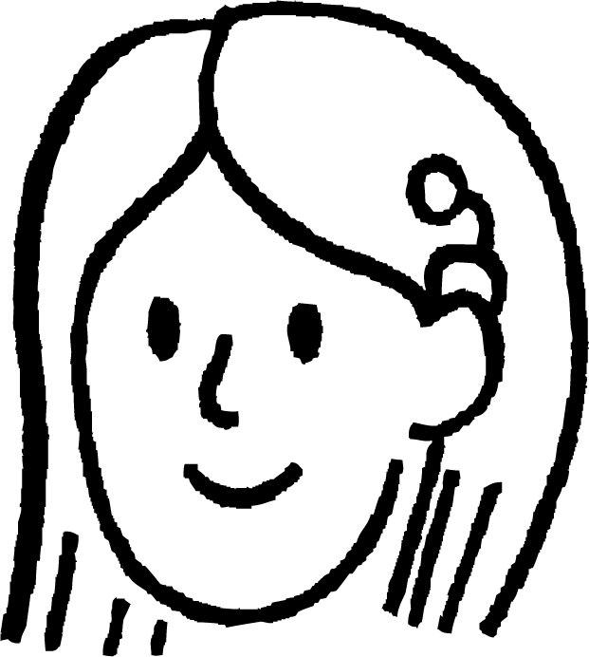


Diiwaangelinta iyo isticmaalka xogta (data)
Tababarayaasha ciyaaraha waxay isticmaalaan xisaab badan shaqadooda. Waxa ay aad u badan yihiin waa cabbiraadda (measuring)!
Sifiican Suad! Waxaad ku qabtay 800 daqiiqad 2:16
Ciyaaryahan Suad
Cabbirka masaafada (distance).
Cabbirka waqtiga (time).
Tababare Cabdi

Slide 7
Diiwaangelinta iyo isticmaalka xogta (data)
Dhab ahaantii, tababarayaasha ciyaaraha iyo ciyaartoydu waxay si fiican u yaqaaniin cabbiradooda, waxayna si toos ah u ogaadaan halbeegyada (units) la isticmaalayo.
Sifiican Suad! Waxaad ku qabtay 800 daqiiqad 2:16
800 mitir (metres)
2 daqiiqo (minutes)
Ciyaaryahan Suad
16 ilbiriqsi (seconds)
Tababare Cabdi
Maxay yihiin halbeegyada (units) aad u malaynaysaa in Tababare Cabdi uu isticmaalayo halkan?

Slide 8
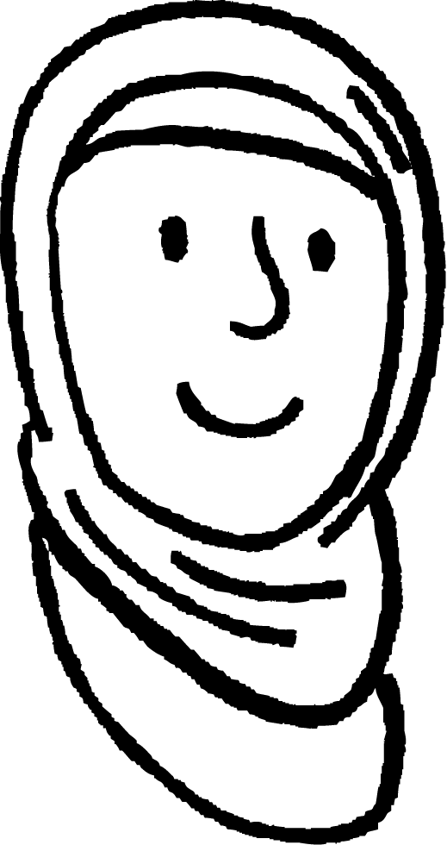
Diiwaangelinta iyo isticmaalka xogta (data)
Waa maxay halbeegyada uu Tababare Cabdi ka hadlayo halkan?
Waa hagaag Suad! Boodboodka dheer ee aad samaysay wuxuu ahaa 3.95
3.95 mitir (metres)
3 mitir (metres),
95 sentimitir (centimetres)
Suad oo Ciyaaraha ku Fiican
Waa hagaag Caasha! Waxaad ku orodday nus maratoon (half marathon) 1:57 taas oo ah xawaare dhexdhexaad ah (average speed) 7 mph
Caasha oo Ciyaaraha ku Fiican
1 saac, 57 daqiiqo (minutes)
7 mayl saacaddii (miles per hour)

Slide 9
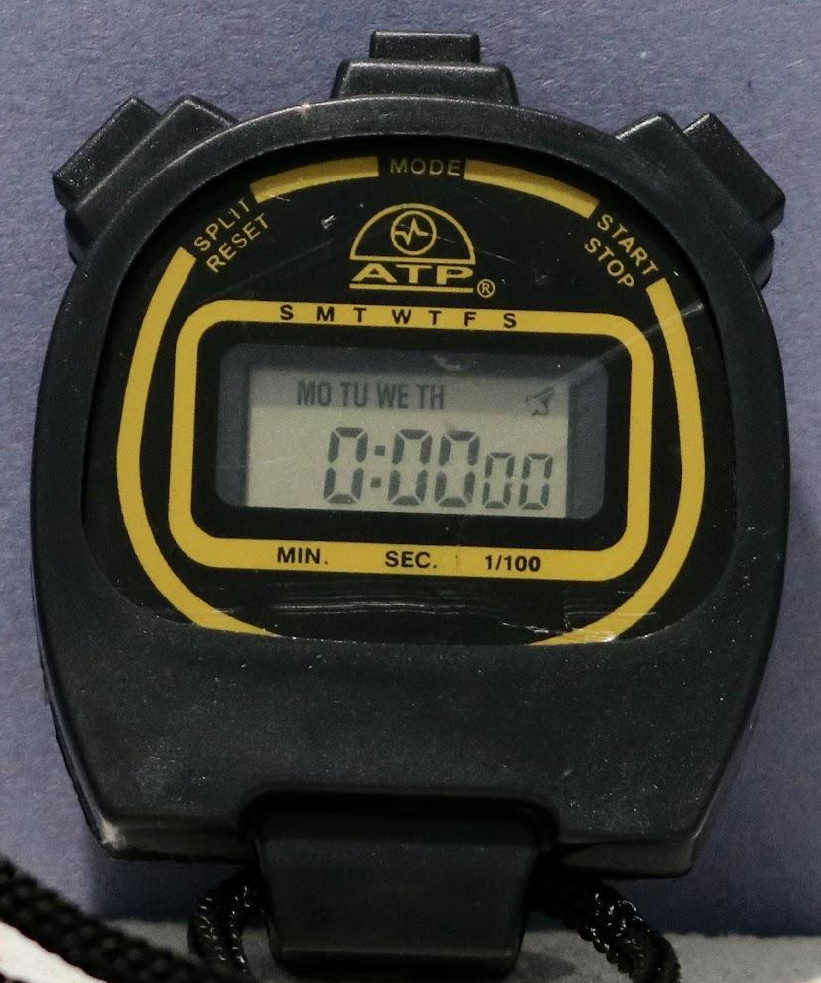
Diiwaangelinta iyo isticmaalka xogta (data)
Dhaqan ahaan, tababarayaashu waxay isticmaali jireen qalab sida saacad-joojiyaha (stopwatch) si ay u diiwaangeliyaan waxqabadka.
Qalabkani wuxuu ina siin jiray macluumaad xaddidan oo dhammaantiisna waa in la qoraa.

Slide 10
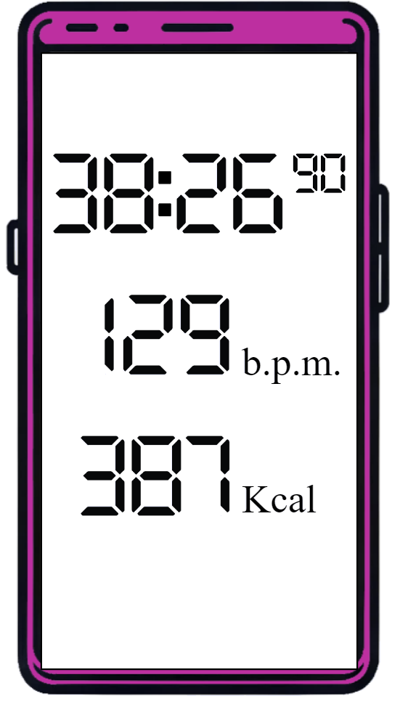
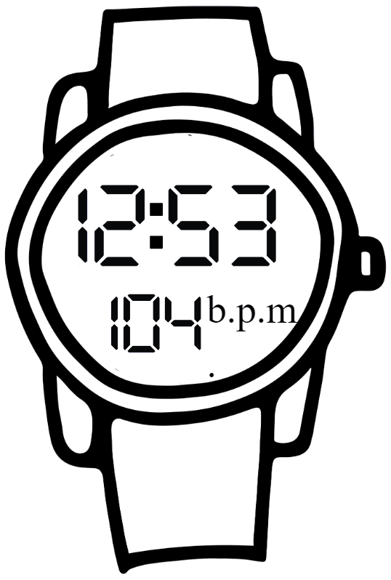
Diiwaangelinta iyo isticmaalka xogta (data)
Tignoolajiyada casriga ahi waxay hadda qabataa inta badan diiwaangelinta.
Tignoolajiyadu waxay diiwaangelisaa noocyo kala duwan oo xog (data) ah oo tababarayaasha iyo ciyaartoydu ay isticmaali karaan si ay ula socdaan waxqabadkooda.

Slide 11

Diiwaangelinta iyo isticmaalka xogta (data)
Mid ka mid ah waxyaabahan, maxay tahay waxa aad u malaynaysaa in tiknoolajiyada casriga ahi ay u diiwaangelin karto ciyaartoyda iyo tababarayaasha?
Waqtiga la qaatay
Masaafada la soo maray
Xawaaraha (Speed)
Xawaaraha celceliska (Average speed)
Heerka garaaca wadnaha (Heart rate)
Heerka garaaca wadnaha ee celceliska (Average heart rate)
Kaloriyada la gubay (Calories burnt)
Wadarta saacadaha tababarka
Saacadaha caqliga leh (Smart-watches) / Talefoonnada caqliga leh (Smart-phones) waa kuwo caqli badan! Waxay siiyaan ciyaartoyda iyo tababarayaasha xog (data) badan oo kala duwan si ay u falanqeeyaan oo u horumariyaan waxqabadka.

Slide 12
Diiwaangelinta iyo isticmaalka xogta (data)
Ciyaaraha waxaan la kulannaa halbeegyo (units) aan horay u arag.
Kcal waa soo gaabinta kilokalori (kilocalories).
Kalori (calorie) waa halbeeg (unit) tamar (energy) ah oo aan ka helno cuntada iyo cabitaanka. Dhalinyaradu waxay gubaan inta u dhaxaysa 1600 iyo 2400 maalin kasta.
Suad ciyaar jecel
Suad waxay ku tababartaa xoojin (intensity) sare saddex jeer ama ka badan usbuucii, waxayna ku xisaabtaa kaloriyadaas dheeraadka ah ee ay u baahan tahay cuntadeeda.

Slide 13
Diiwaangelinta iyo isticmaalka xogta (data)
Ciyaaraha waxaan la kulannaa halbeegyo (units) aan horay u arag.
b.p.m. waxay u taagan tahay 'Beats per minute' ( garaac daqiiqaddii)
Tani waa tirada jeer ee uu wadnahaagu ku garaaco hal daqiiqo.
Suad ciyaar jecel
Dhalinyarada iyo dadka waaweyn waxay leeyihiin b.p.m. nasasho ah oo u dhaxaysa 60 ilaa 100
Inta lagu jiro jimicsiga b.p.m. wuu kordhaa
sida wadnahaagu u shaqeeyo si adag si uu helo oksijiin (oxygen) muruqyadaada.

Slide 14
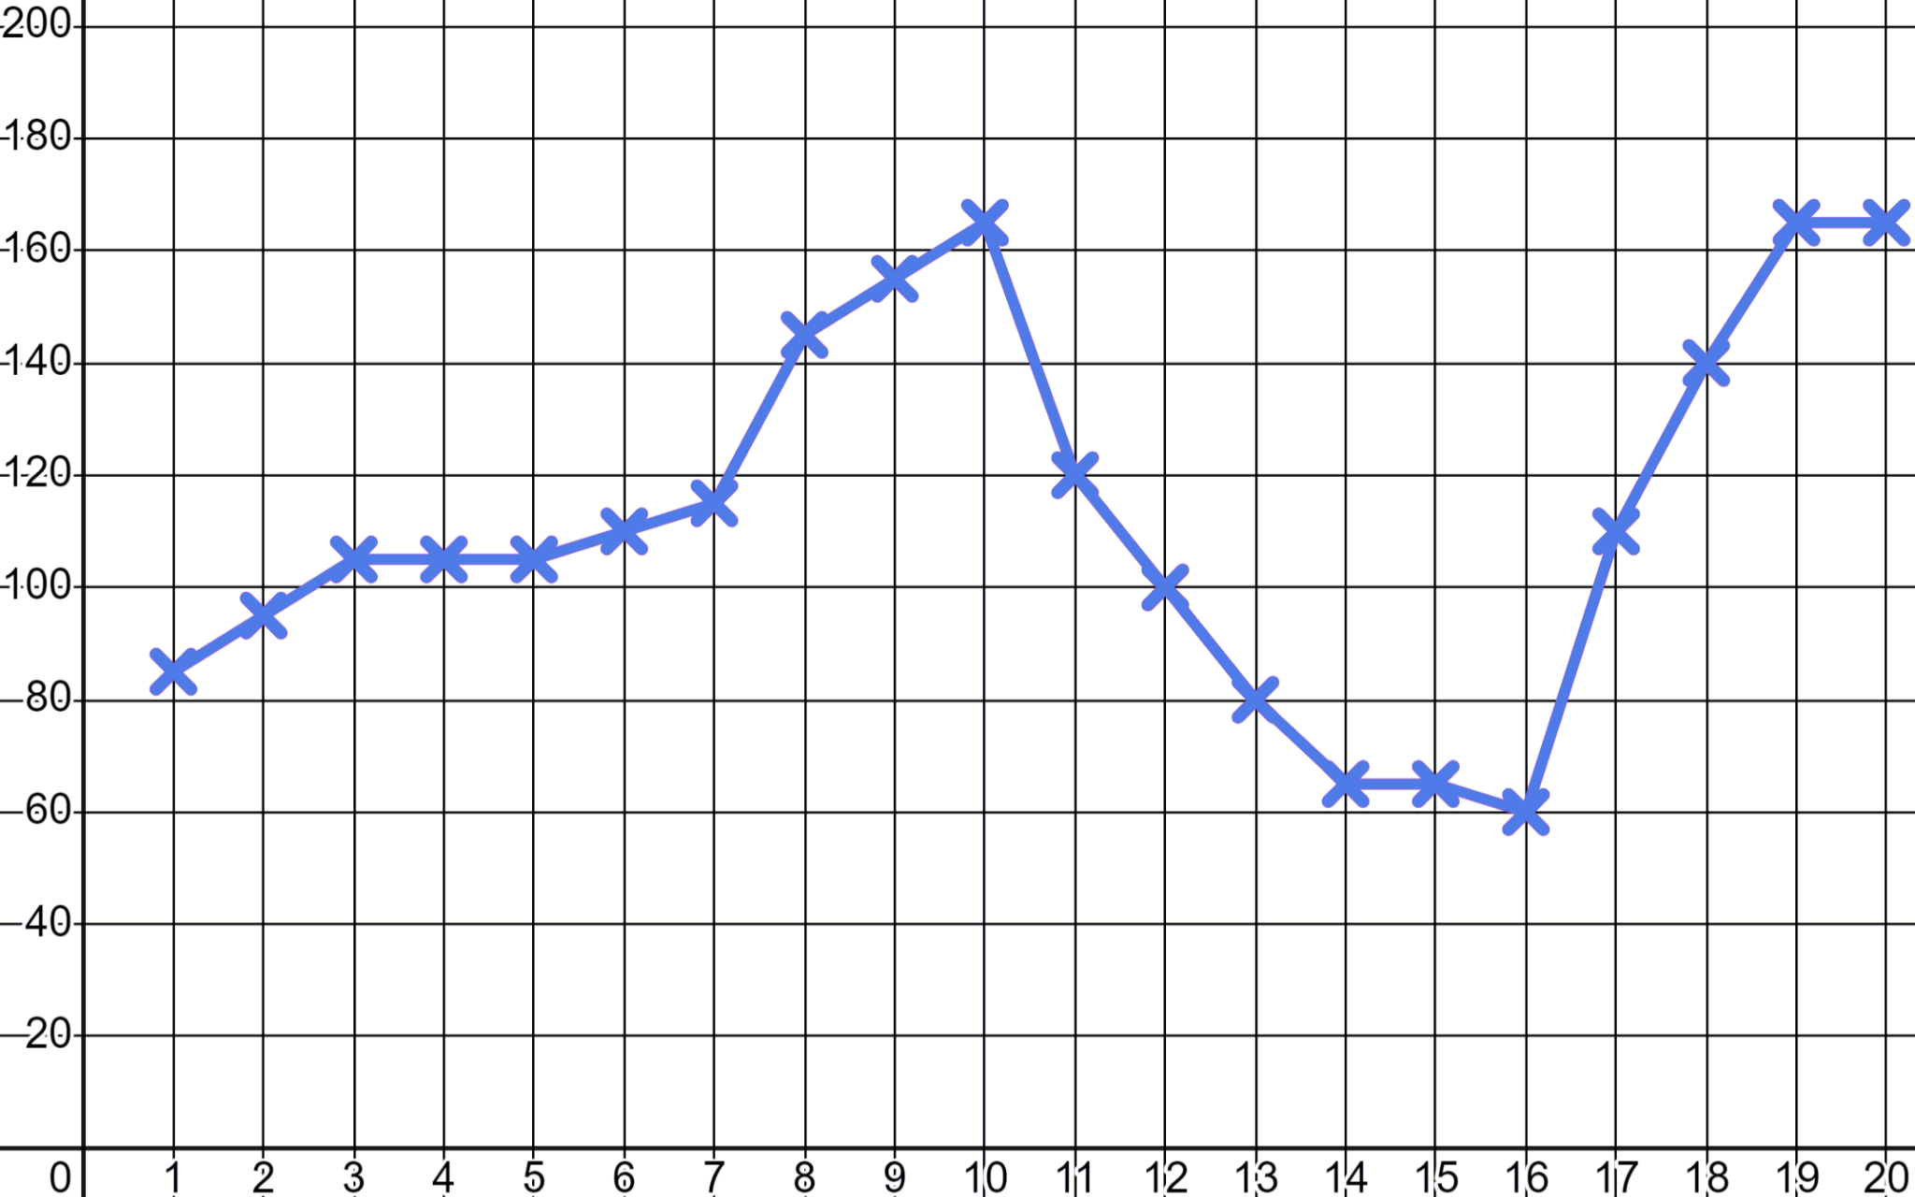
Recording and using data
Tababare Lucas wuxuu isticmaalayaa app diiwaangelisay oo garaaf u sameysay wadnaha Sofia inta lagu jiro tababarka.
Goormaad u maleyneysaa in Sofia ay shaqeysay xoog sare?
b.p.m.
High intensity
High intensity
Warming up
Goormaad u maleyneysaa in Sofia ay fidsanaysay?
Stretching
Time (minutes)

Slide 15
Recording and using data
Wadnaha Sofia wuxuu ahaa ugu yaraan 60 b.p.m. iyo ugu badnaan 165 b.p.m. inta lagu jiro tababarka.
Aan eegno haddii taasi caadi tahay.
b.p.m.
Dhallinyarada iyo dadka waaweyn waxay leeyihiin wadnaha nasashada inta u dhaxaysa 60 iyo 100 b.p.m. Ciyaartoydu waxay u janjeeraan dhanka hoose ee miisaankaas iyagoo wadnaha hooseeya.
Time (minutes)
Inta lagu jiro jimicsiga wadnahaagu wuu kici doonaa.
Laakiin, maxaan u hiigsanaynaa?

Slide 16
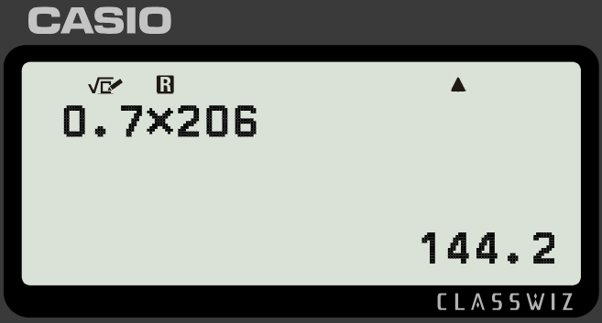
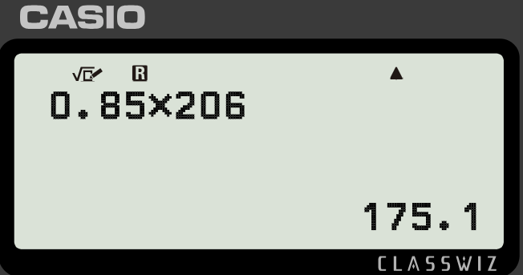
Recording and using data
Si loo ilaaliyo wadnaha caafimaadka qaba waxaa muhiim ah inaad kor u qaaddo wadnahaaga si joogta ah iyada oo loo marayo jimicsi. Waxaa jira xisaabinta wadnaha bartilmaameedka.
Wadnahaaga ugu sarreeya waa 220 b.p.m. laga jaray da'da
Wadnaha bartilmaameedka jimicsiga dhexdhexaadka ah waa 50 − 70% ee ugu sarreeya
Wadnaha bartilmaameedka jimicsiga xoogga sare waa 70 − 85% ee ugu sarreeya
Suad waa 14 jir waxayna ku shaqaynaysay xoog sare (high intensity).
Ma 165 b.p.m. ayaa ahayd wadnaha saxda ah (heart rate) iyada?
Wadnaha ugu sarreeya (Max heart rate): 220 − 14 = 206 b.p.m.
Qiimaha 70% (value): 0.7 × 206 = 144 b.p.m.
Marka 165 b.p.m., Suad waxay ku jirtay aagga saxda ah ee jimicsiga xoogga leh (intense exercise).
Qiimaha 85% (value): 0.85 × 206 = 175 b.p.m.

Slide 17

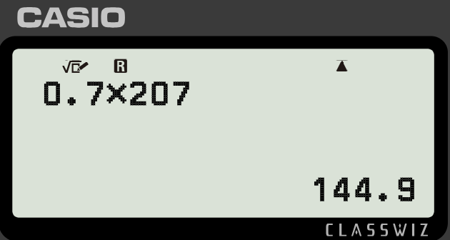
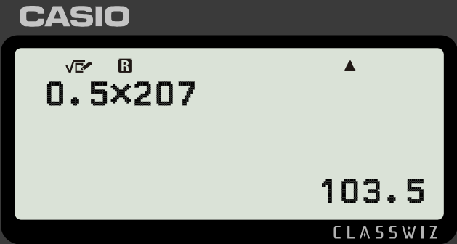
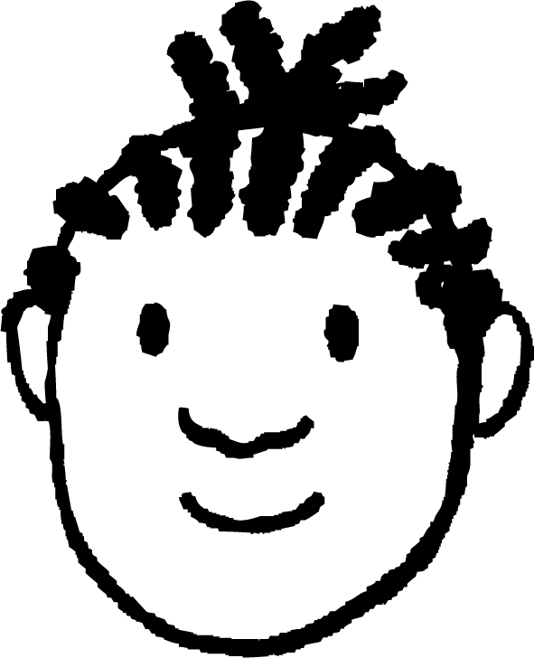
Duubista iyo isticmaalka xogta (data)
Yacquub wuxuu hadda bilaabayaa jimicsi joogto ah. Wuxuu rabaa inuu sameeyo jimicsi dhexdhexaad ah (moderate exercise) saddex jeer usbuucii wuxuuna tirin doonaa wadnaha (heart rate).
Wadnahaagu ugu sarreeya waa 220 b.p.m. minus da'da
Wadnaha bartilmaameedka ah ee jimicsiga dhexdhexaadka ah waa 50 − 70% ee kan ugu sarreeya
Wadnaha bartilmaameedka ah ee jimicsiga xoogga leh waa 70 − 85% ee kan ugu sarreeya
Yacquub waa 13. Waa imisa kala duwanaanshaha (range) ee wadnaha uu Yacquub bartilmaameedsanayo?
Wadnaha ugu sarreeya (Max heart rate): 220 − 13 = 207 b.p.m.
Yacquub waa inuu bartilmaameedsadaa wadnaha u dhexeeya 104 iyo 145 b.p.m. ee jimicsiga dhexdhexaadka ah.
Xadka hoose (Lower bound): 0.5 × 207 = 104 b.p.m.
Xadka sare (Higher bound): 0.7 × 207 = 145 b.p.m.

Slide 18
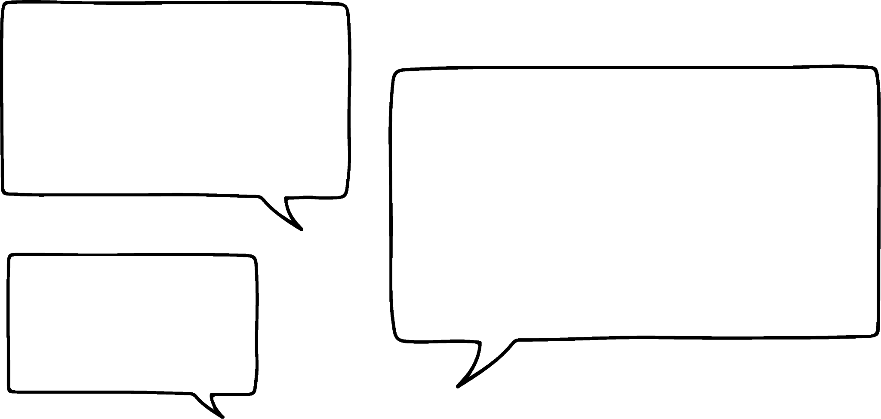
Duubista iyo isticmaalka xogta (data)
Waxaa jira siyaabo kale oo aan farsamo ahayn oo lagu qiyaaso dadaalka (effort) dadka hadda bilaabaya jimicsi joogto ah.
Jaantuska RPE (Heerka dadaalka la dareemo) (Rate of perceived exertion)
10 | Dadaal ugu sarreeya (Max effort) | Waa suurtagal ma aha in la sii wado Neefsasho ka baxay Awood la'aan hadal
9 | Aad u adag | Adag in la ilaaliyo Dhibaato neefsasho, si dhib yar u neefsada Ku hadlaya erayo keli ah
7-8 | Xoog badan (Vigorous) | Qarka u daran raaxo la'aan Neefsasho gaaban, jumlado keli ah
4-6 | Dhexdhexaad (Moderate) | Wuu sii socon karaa saacado Neefsasho culus, wada hadal gaaban
2-3 | Fudud (Light) | Fudud in la ilaaliyo saacado Si fudud wada hadal u sii wadi karaa
1 | Aad u fudud (Very light) | Wax kasta oo aan ahayn hurdo tusaale: Fadhiista oo daawanaya T.V.
Tababarayaasha sida aniga oo kale waxay isticmaali doonaan jaantuska RPE si ay u qorsheeyaan tababarkaaga Yacquub.
Tababare Cabdi

Slide 19
Duubista iyo isticmaalka xogta (data)
Jaantuska RPE (Heerka dadaalka la dareemo)
10 | Dadaal ugu badan | Ma suurtagelin in la sii wado Neefsasho ka baxday Awood la'aan inuu hadlo
9 | Aad u adag | Adag in la sii wado Dhibaato neefsasho Hadalka erey keliya
7-8 | Xoog leh | Qarka u ah raaxo-darro Neefsasho gaaban, jumlado keliya
4-6 | Dhexdhexaad | Waa la sii wadi karaa saacado Neefsasho culus, wada hadal gaaban
2-3 | Fudud | Fudud in la sii wado saacado Si fudud wada hadal loo sii wadi karaa
1 | Aad u fudud | Wax kasta oo aan ahayn hurdo tusaale. Fadhiista daawashada T.V.
Ma tahay jimicsi wanaagsan ku socodka sabuuradda? Waxaan jeclahay inaan bilaabo.
Taasi waa jimicsi aad u fiican! Waxay u dhexayn doontaa inay dareento sida 3, 4, ama 5
Tababare Cabdi (Coach Lucas)

Slide 20
Diiwaangelinta iyo isticmaalka xogta
Halkee kula tahay inay yihiin hawlahan jaantuska qofka hadda bilaabaya jimicsiga?
Jaantuska RPE (Heerka dadaalka la dareemo)
10 | Dadaal ugu badan | Waa aan suurtagal ahayn in la sii wado Neefsasho ka baxday Hadli kari maayo
9 | Aad u adag | Adag in la sii wado Waa ku dhow inaad neefsan weydo Ku hadlaya ereyo keli ah
7-8 | Xoog badan | Geestii raaxo-darrada Neefsasho gaaban, jumlado keli ah
4-6 | Dhexdhexaad | Waa la sii wadi karaa saacado Neefsasho culus, wada hadal gaaban
2-3 | Fudud | Fudud in la sii wado saacado Wada hadalka si fudud ayaa loo sii wadi karaa
1 | Aad u fudud | Wax kasta oo aan ahayn hurdo Tusaale: Fadhiista oo daawanaya TV-ga
Socodka mashiinka jimicsiga (treadmill)
Kor u socodka buurta dheer
10 daqiiqo baaskiil wadista guriga saaxiib
2 daqiiqo trampoline-ka xoogga leh
Ciyaaraha (Gaming)

Slide 21
Duubista iyo isticmaalka xogta (data)
Haddii aad bilaabayso, wali ma doonayo inaan arko 9 ama 10!
Jaantuska RPE (Heerka dadaalka la dareemo)
10 | Dadaal ugu badan | Aan suurtagal ahayn in la sii wado Neefsasho oo ka baxaysa Awoodi la'aan inuu hadlo
9 | Aad u adag | Adag in la sii wado Si dhib yar ayuu u neefsan karaa Hadalka ereyada keli ah
7-8 | Xoog badan (Vigorous) | Qarka u ah raaxo la'aan Neefsasho gaaban, jumlado keli ah
4-6 | Dhexdhexaad (Moderate) | Wuu sii socon karaa saacado Neefsasho culus, wada hadal gaaban
2-3 | Iftiin (Light) | Sahlan in la ilaaliyo saacado Wadahadal si fudud u socon karaa
1 | Aad u fudud (Very light) | Wax kasta oo aan ahayn hurdo tusaale: Fadhiista daawashada T.V.
Tababare Cabdi (Coach Lucas)
2 daqiiqo oo trampoline-ga xooggan
Kor u socodka buur dheer
Lugaynta mishiinka (treadmill)
10 daqiiqo oo baaskiil wadid ah
Ciyaaraha (Gaming)

Slide 22
Diiwaangelinta iyo isticmaalka xogta
Tababare Cabdi (Coach Lucas) wuxuu xisaabiyaa celcelis (averages) si uu ula socdo waxqabadka Caasha ee 800 m
Toddobaad (Week) | 1 | 2 | 3 | 4 | 5 | 6 | 7 | 8 | 9 | 10
Waqti (sec) | 136 | 132 | 138 | 132 | 136 | 128 | 138 | 130 | 126 | 132
Mood (Mode): 132 sec
Marka waxaa u badan in aan ordo 132, laakiin waxaa laga yaabaa in aan ordo 138 Taas kuma filna in aan ka adkaado tartamayaashayda!
Waxaan xisaabin karaa celcelisyada (averages) wakhtiyada Caasha.
Dhexe (Median): 132 sec
Celcelis (Mean): 132.8 sec
Naso. Waan ogahay inaad horumaraysid. Ma maqashay celcelis socod saddex-qodob (three-point moving averages)?
Tababare Cabdi (Coach Lucas)
Caasha Ciyaaraha (Sporty Sofia)

Slide 23
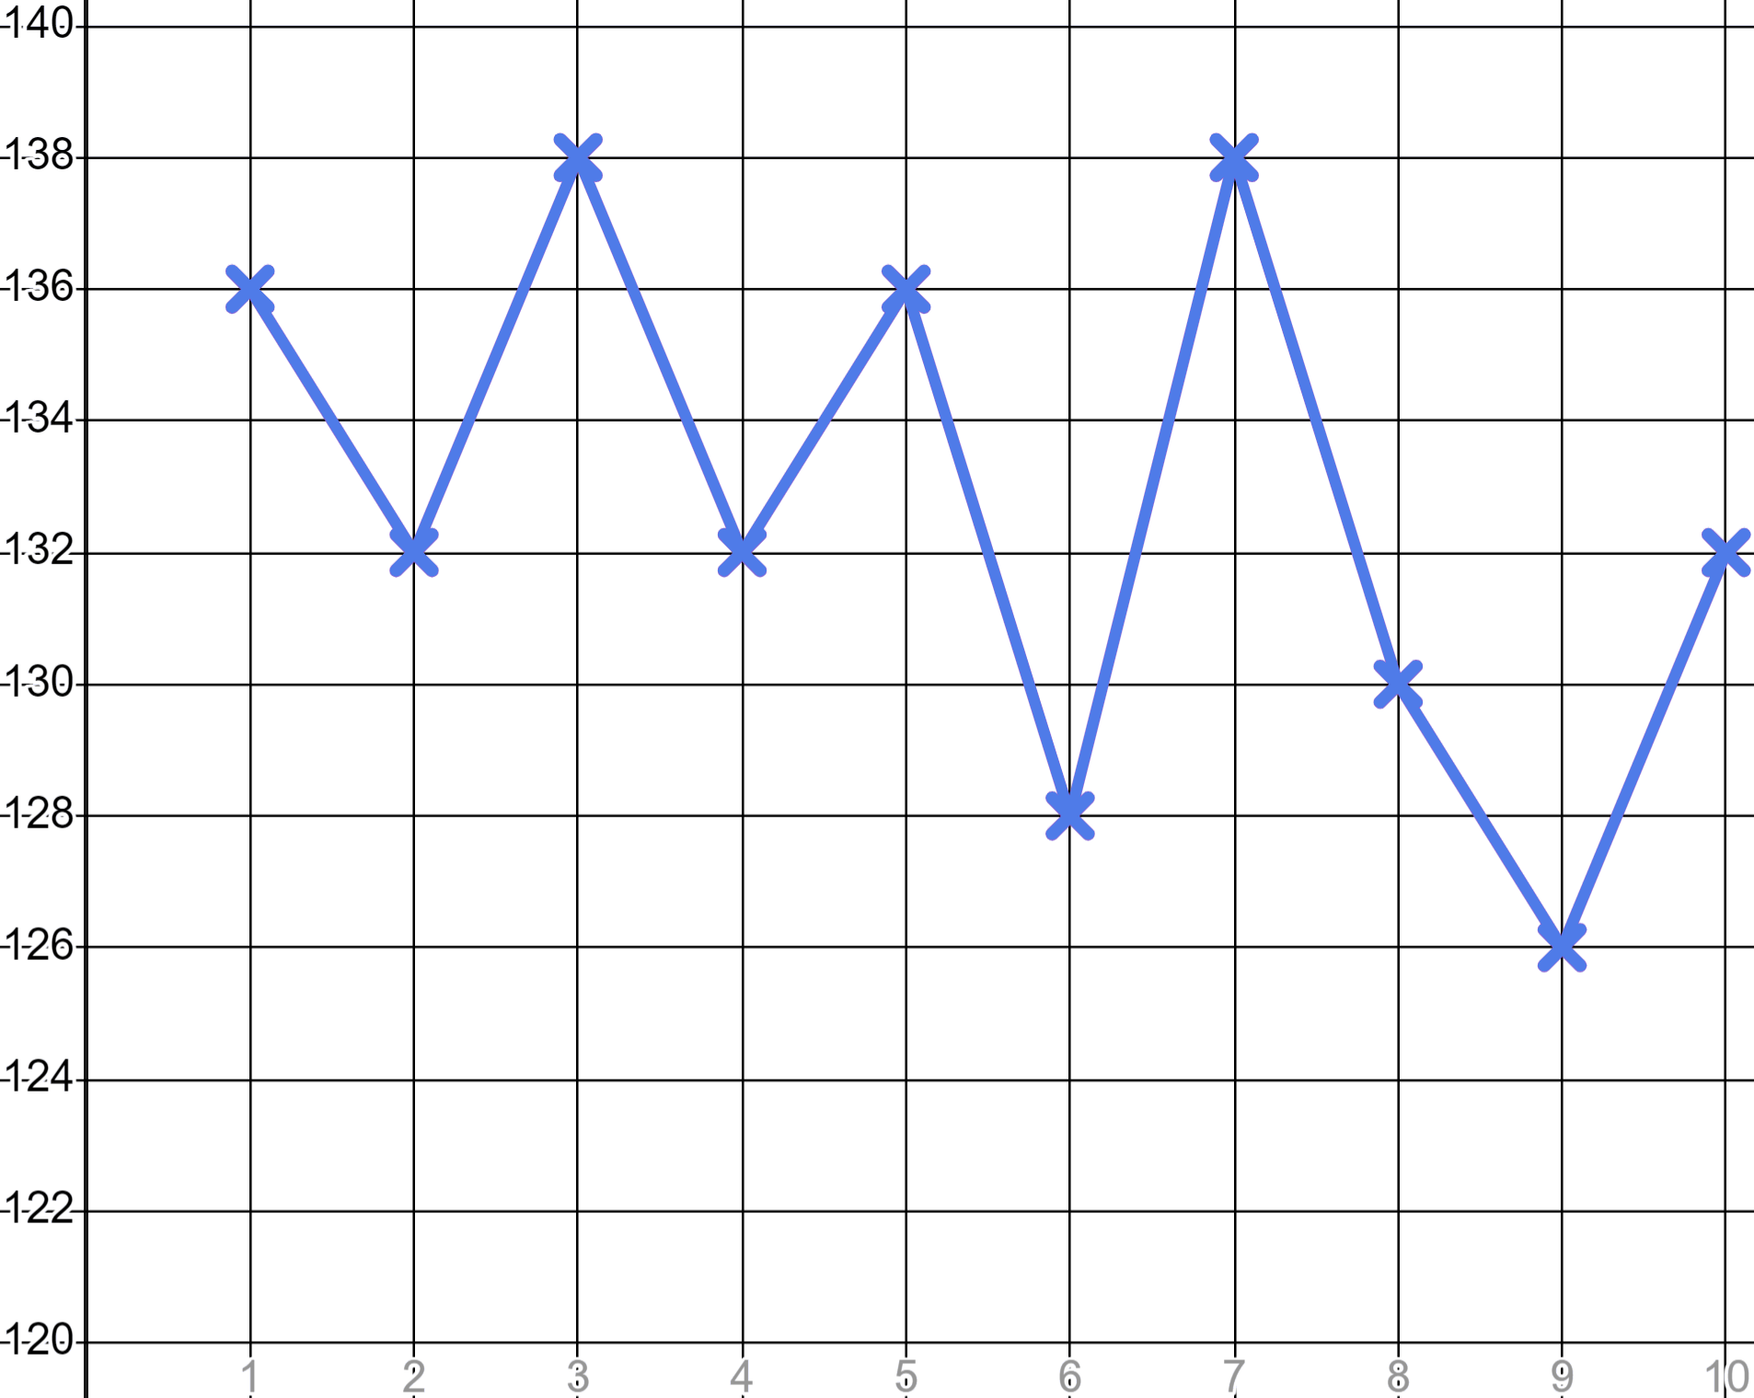
Diiwaangelinta iyo isticmaalka xogta
Waxaan garaafi karnaa waqtiyada Suad.
Toddobaad | 1 | 2 | 3 | 4 | 5 | 6 | 7 | 8 | 9 | 10
Waqti (sec) | 136 | 132 | 138 | 132 | 136 | 128 | 138 | 130 | 126 | 132
Khadku waa mid isbeddelaya (erratic).
Ma dib ayuu u kici doonaa?
Ma hoos ayuu u dhici doonaa marka xigta?
Ma horumaraysaa Suad?
Waqti (s)
Qaabka (pattern), isbeddelka (trend), waa sahlan tahay in la arko haddii aan sawirno celcelis socod saddex-qodob (three-point moving average).
Td

Slide 24
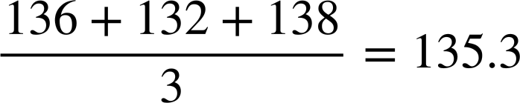
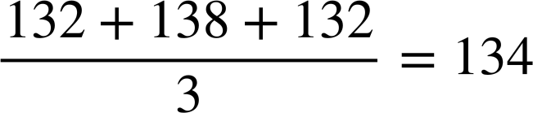
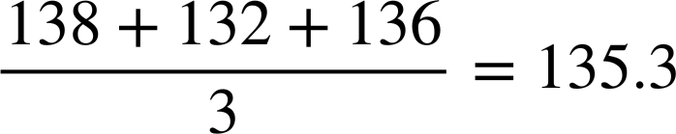
Diiwaangelinta iyo isticmaalka xogta
Toddobaad | 1 | 2 | 3 | 4 | 5 | 6 | 7 | 8 | 9 | 10
Waqti (sec) | 136 | 132 | 138 | 132 | 136 | 128 | 138 | 130 | 126 | 132
 |  | 135 | 134 | 135
 |  | 135
 |  | 135 | 134
Qaad celceliska saddexda qodob.
Waqti (s)
✖
✖
✖
Td

Slide 25
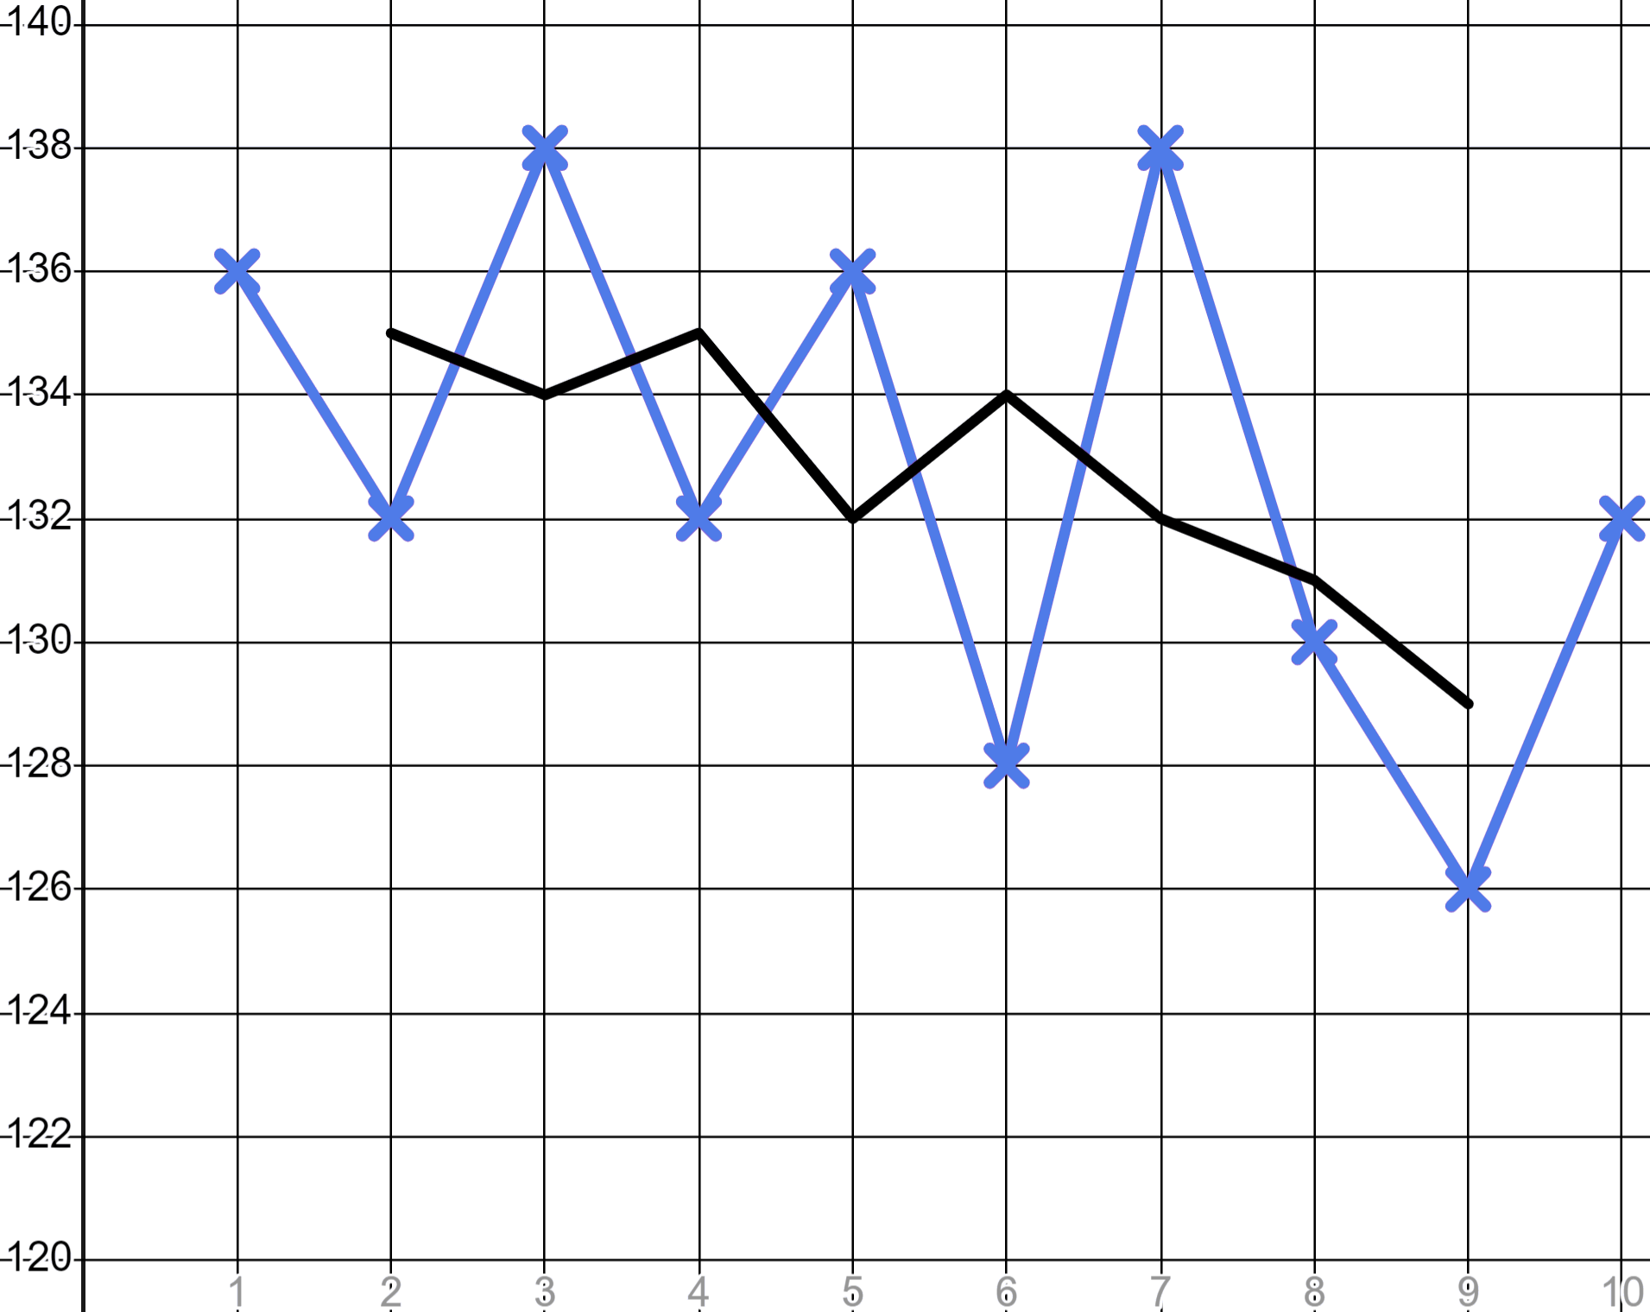
Diiwaangelinta iyo isticmaalka xogta
Toddobaad | 1 | 2 | 3 | 4 | 5 | 6 | 7 | 8 | 9 | 10
Waqtiga (Time) (sec) | 136 | 132 | 138 | 132 | 136 | 128 | 138 | 130 | 126 | 132
 |  | 135 | 134 | 135 | 132 | 134 | 132 | 131 | 129
Ka dib markii shaxda oo dhan la buuxiyay oo celceliska dhaqaaqa saddexda dhibcood la sawiray…
Waqtiga (Time) (s)
✖
✖
✖
✖
✖
✖
✖
Waxaan aragnaa khad aad u siman oo leh isbeddel cad oo hoos u socda.
✖
Suad waa horumaraysaa waqti ka dib.
Wk

Slide 26
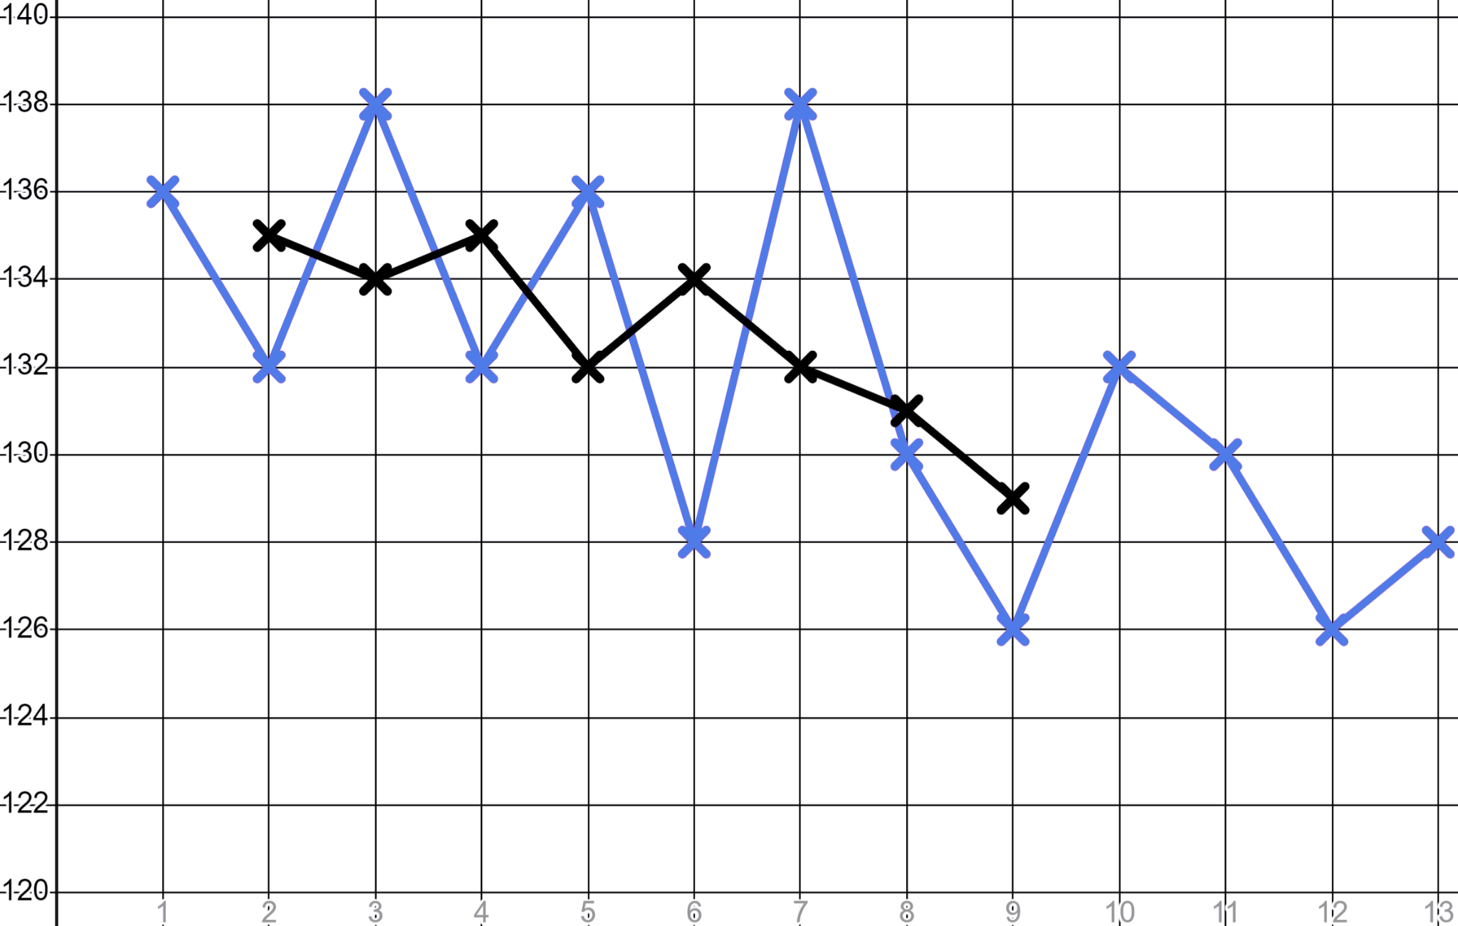
Duubista iyo isticmaalka xogta
Toddobaad (Week) | 1 | 2 | 3 | 4 | 5 | 6 | 7 | 8 | 9 | 10 | 11 | 12 | 13
Waqtiga (Time) (sec) | 136 | 132 | 138 | 132 | 136 | 128 | 138 | 130 | 126 | 132 | 130 | 126 | 128
 |  | 135 | 134 | 135 | 132 | 134 | 132 | 131 | 129
Soo hel celceliska dhaqaaqa saddexda dhibcood ee hadhay oo sii wad khadka isbeddelka ee Suad si aad u hubiso inay sii wadatay horumarka.
Waqtiga (Time) (s)
Wk

Slide 27
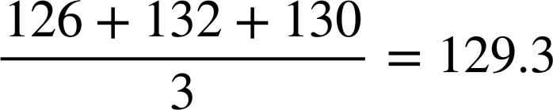
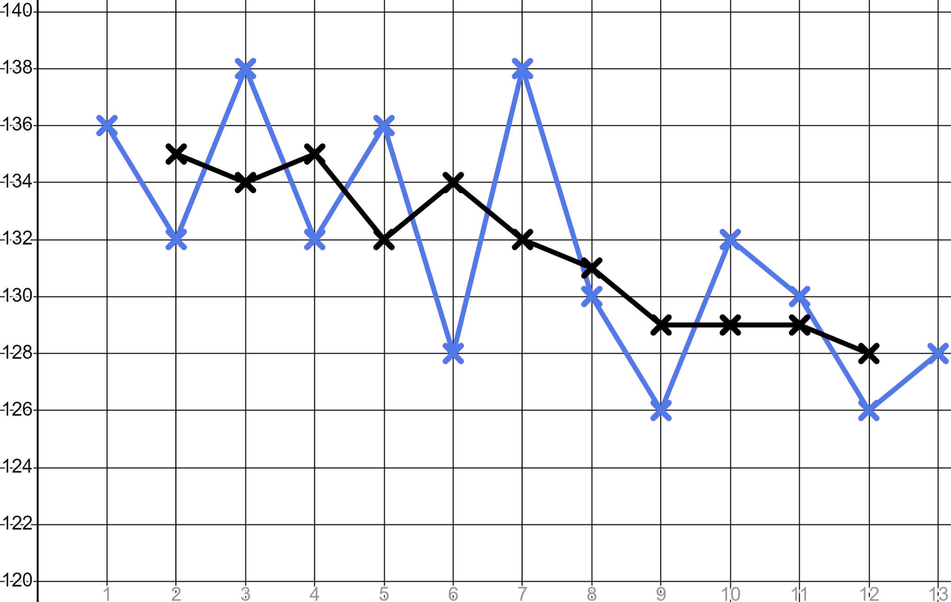
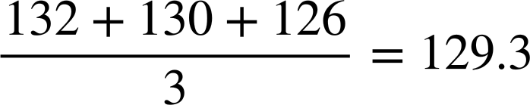
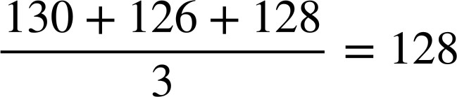
Duubista iyo isticmaalka xogta
Toddobaad (Week) | 1 | 2 | 3 | 4 | 5 | 6 | 7 | 8 | 9 | 10 | 11 | 12 | 13
Waqtiga (Time) (sec) | 136 | 132 | 138 | 132 | 136 | 128 | 138 | 130 | 126 | 132 | 130 | 126 | 128
 |  | 135 | 134 | 135 | 132 | 134 | 132 | 131 | 129 | 129
 |  | 135 | 134 | 135 | 132 | 134 | 132 | 131 | 129 | 129 | 129 | 128
 |  | 135 | 134 | 135 | 132 | 134 | 132 | 131 | 129 |  | 129
Waqtiga (Time) (s)
Suad waxay sii waday horumarka. Heerka horumarkeedu wuu yaraaday laakiin taasi
ma aha wax aan caadi ahayn kuwa wax qabta ee sare markay ku soo dhawaadaan awooddooda ugu badan.

Slide 28
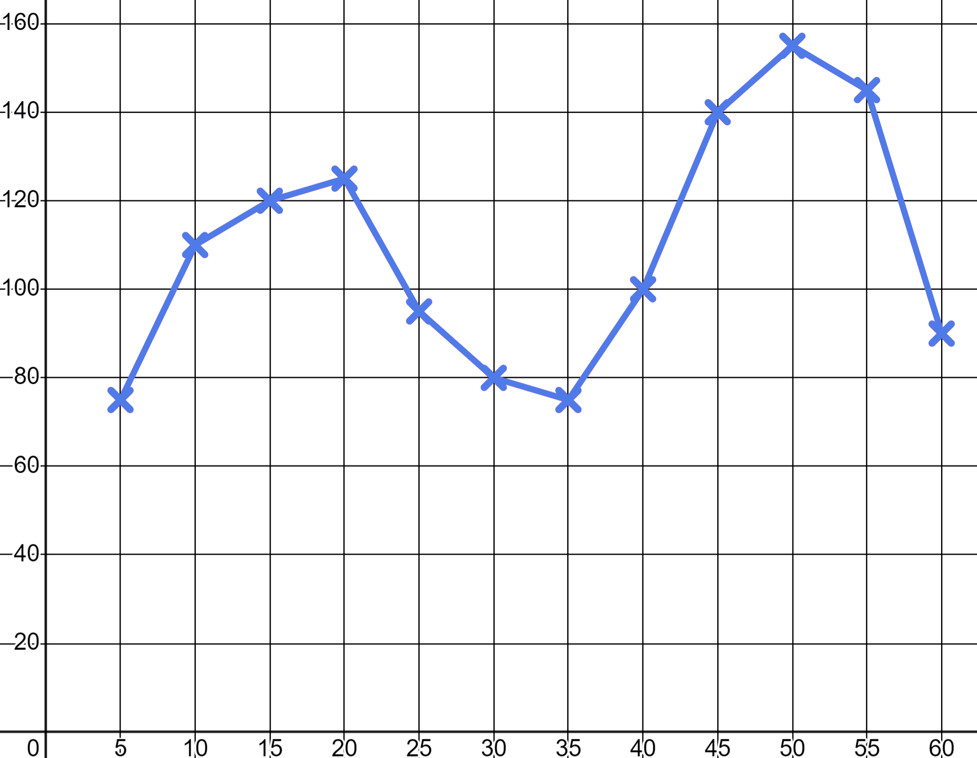
Duubista iyo isticmaalka xogta
1) a) Yacquub wuxuu raacayaa skateboarding oo saacaddiisu waxay duubaysaa b.p.m.-kiisa
Qor ugu yaraan saddex jumladood oo qeexaya fadhiga skateboarding ee Yacquub. Isticmaal ereyo sida 'xoojin dhexdhexaad ah (moderate intensity)' iyo 'xoojin sare (high intensity)'.
b.p.m.
T (min)

Slide 29
Diiwaan gelinta iyo isticmaalka xogta (data)
1) b) Qiimee (Rank) saddexdan daqiiqadood (moments) qiime (value) tiro oo ka yimid jaantuska RPE ee tababarayaasha.
Jaantuska RPE (Heerka shaqada ee la dareemo)
10 | Dadaal ugu badan | Ma joojin karo Neefsasho la'aan Hadli kari maayo
9 | Aad u adag | Adag in la sii wado Dhibaato neefsasho Hadalka erey keliya
7-8 | Xoog leh (Vigorous) | Qarka u raacsan raaxo la'aan Neefsasho gaaban, jumlado keliya
4-6 | Dhexdhexaad (Moderate) | Waa la sii wadi karaa saacado Neefsasho culus, wada hadal gaaban
2-3 | Fudud (Light) | Fudud in la sii wado saacado Wada hadal si fudud ayaa loo sii wadi karaa
1 | Aad u fudud | Wax kasta oo aan ahayn hurdo Tusaale: Fadhiista daawashada TV-ga
b.p.m.
T (min)

Slide 30
Diiwaangelinta iyo isticmaalka xogta (data)
2) Suad oo ciyaar jecel ayaa buuxinaysa jaantuska wadnaha ee loogu talagalay xubnaha qoyska ee da'da weyn si ay u isticmaalaan inta ay jimicsi samaynayaan.
Wadnahaagu wuxuu ugu sarreeyaa 220 b.p.m. laga jaray da'da
Wadnaha la beegsaday ee jimicsiga dhexdhexaadka ah waa 50 − 70% ee ugu sarreeya
Wadnaha la beegsaday ee jimicsiga xoogga leh waa 70 − 85% ee ugu sarreeya
Da' (Age) | Jimicsi dhexdhexaad ah min | Xoog sare wuxuu bilaabmaa | Xoog sare ugu sarreeya
20 | 100 | 140 | 170
30 | 95 |  | 161.5
50 |  | 119
 |  |  | 127.5
Buuxi meelaha bannaan ee jaantuska.

Slide 31
Diiwaangelinta iyo isticmaalka xogta (data)
3) Caasha waxay isku dayaysaa inay hagaajiso waqtigeeda 400 mitir. Halkan waxaa ah waqtiyadeeda ugu fiican 10 toddobaad oo tababar ah.
Caasha oo orod badan
Toddobaad (Week) | 1 | 2 | 3 | 4 | 5 | 6 | 7 | 8 | 9 | 10
Waqti (sec) | 73 | 70 | 66 | 73 | 69 | 65 | 70 | 64 | 67 | 63
a) Xisaabi celceliska (mean), qaabka (mode) iyo dhexdhexaadiyaha (median) waqtiyadeeda.
b) Qor jumlad sharraxaysa sababta saddexdan celcelis oo keliya aysan kuugu sheegin in Caasha soo hagaageyso iyo in kale.

Slide 32
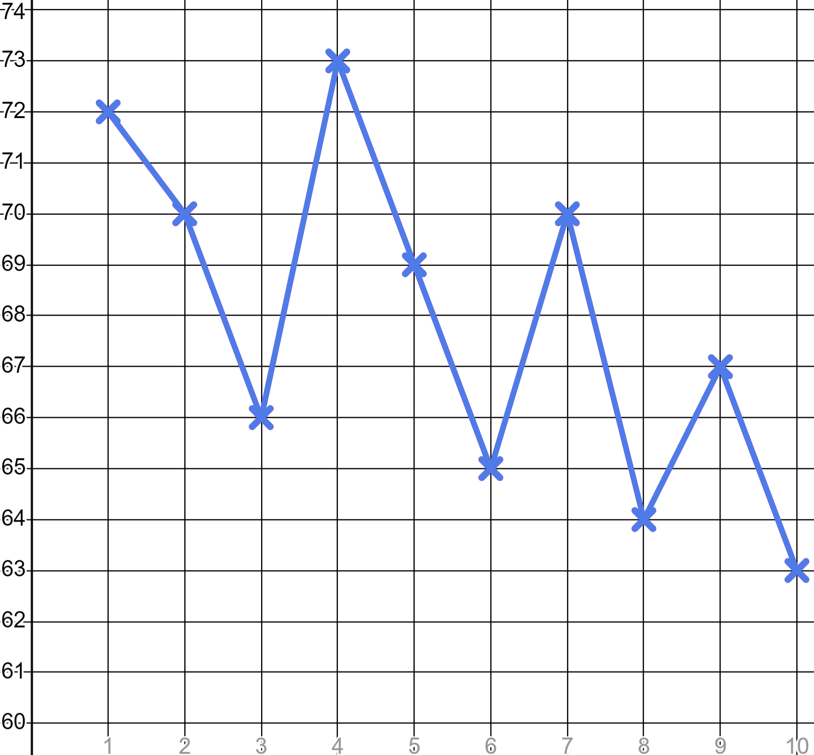
Diiwaangelinta iyo isticmaalka xogta (data)
3)
Toddobaad | 1 | 2 | 3 | 4 | 5 | 6 | 7 | 8 | 9 | 10
Waqti (sec) | 73 | 70 | 66 | 73 | 69 | 65 | 70 | 64 | 67 | 63
 | ✖ | 70
c) Buuxi jaantuska celcelisyada guurguura ee saddex-dhibcood (three-point moving averages) (tiro dhammays tiran). Midda koowaad ayaa laguu sameeyay.
d) Sawir garaafka (graph) celcelisyada guurguura ee saddex-dhibcood ee Caasha oo qor faallo ku saabsan haddii ay soo hagaageyso iyo in kale.
Waqti (s)
e) U isticmaal saddexda celcelis socda si aad u saadaaliso goorta Caasha laga yaabo inay jebiso xannibaadda 60 ilbiriqsi.
Toddobaad

Slide 33
Diiwaan gelinta iyo isticmaalka xogta
1) a) Yacquub wuxuu aadaa skateboarding-ga oo saacadiisu waxay diiwaan gelisaa b.p.m-kiisa.
Qor ugu yaraan saddex jumladood oo qeexaya fadhiyada skating-ga Yacquub. U isticmaal ereyo sida 'moderate intensity' iyo 'high intensity'.
b.p.m.
Waxaa laga yaabaa inaad qortay: "Yacquub wuxuu ku qaatay 20 daqiiqo oo ugu horreeyay isagoo ku shaqaynaya xoojin dhexdhexaad ah (moderate intensity). Ka dib wuxuu lahaa xilli nasasho ah. Wuxuu ku dhammeeyay xilli xoojin sare leh (high intensity) halkaas oo garaaca wadnihiisu uu ahaa kan ugu sarreeya".
T (min)

Slide 34
Diiwaan gelinta iyo isticmaalka xogta
1) b) Qiimee (rank) saddexdan xilli oo leh qiime (value) tiro oo ka yimid jaantuska RPE ee tababarayaasha.
Jaantuska RPE (Heerka xoojinta la dareemo)
10 | Xoojin ugu sarreysa | Ma suurtogal in la sii wado Neefsasho oo ka baxday Awoodi maayo inuu hadlo
9 | Aad u adag | Adag in la ilaaliyo Wuxuu si dhib leh u neefsanayaa Hadalka erey keliya
7-8 | Xooggan (Vigorous) | Xadka raaxo-darrada (Verge of uncomfortable) Neefsasho oogo, jumlado keliya (Short of breath, single sentences)
4-6 | Dhexdhexaad (Moderate) | Waa sii socon karaa saacado (Could continue for hours) Neefsasho culus, hadal gaaban (Breathing heavy, short conversation)
2-3 | Fudud (Light) | Fudud in la sii wado saacado (Easy to maintain for hours) Wada hadalka si fudud ayaa loo sii wadi karaa (Can maintain conversation easily)
1 | Aad u fudud (Very light) | Wax kasta oo aan ka ahayn hurdo (Anything other than sleeping) Tusaale: Fadhiisasho daawashada T.V. (e.g. Sitting watching T.V.)
7 ama 8
b.p.m.
4 ilaa 6
1
T (min)

Slide 35
Diiwaangelinta iyo isticmaalka xogta (Recording and using data)
2) Suad oo ciyaar jecel ayaa buuxinaysa jaantuska wadnaha ee bartilmaameedka loogu talagalay xubnaha qoyska ee da'da weyn si ay u isticmaalaan inta ay jimicsi samaynayaan.
Wadnahaagu wuxuu ugu badnaan karaa 220 b.p.m. laga jaray da'da (Your maximum heart rate is 220 b.p.m. minus age)
Wadnaha bartilmaameedka ah ee jimicsiga dhexdhexaadka ah waa 50 − 70% tirada ugu badan (Target heart rate for moderate exercise is 50 − 70% of maximum)
Wadnaha (heart rate) ee bartilmaameedka ah ee jimicsiga xoojinta sare waa 70 − 85% ee ugu badnaan (maximum)
Da' (Age) | Jimicsi dhexdhexaad daqiiqad (Moderate exercise min) | Xoog sare wuxuu bilaabmaa (High intensity starts) | Xoog sare ugu badnaan (High intensity max)
20 | 100 | 140 | 170
30 | 95 |  | 161.5
50 |  | 119
 |  |  | 127.5
Da'da | Jimicsi dhexdhexaad ah daqiiqo | Xoojinta sare waxay bilaabataa | Xoojinta sare ugu badnaan
20 | 100 | 140 | 170
30 | 95 | 133 | 161.5
50 | 85 | 119 | 144.5
70 | 75 | 105 | 127.5
Buuxi meelaha bannaan ee shaxda.

Slide 36
Diiwaangelinta iyo isticmaalka xogta (data)
3) Caasha waxay isku dayaysaa inay wanaajiso waqtigeeda 400 mitir. Waa kuwan waqtiyadeeda ugu fiican 10 toddobaad oo tababar ah.
Caasha oo ciyaar fudud
Toddobaad | 1 | 2 | 3 | 4 | 5 | 6 | 7 | 8 | 9 | 10
Waqti (ilbiriqsi) | 73 | 70 | 66 | 73 | 69 | 65 | 70 | 64 | 67 | 63
a) Xisaab celceliska (mean), qaabka (mode) iyo dhexdhexaadka (median) ee waqtiyadeeda.
Qaabka (mode): 70 ilbiriqsi
Dhexdhexaadka (median): 68 ilbiriqsi
Celceliska (mean): 67.9 ilbiriqsi
b) Qor jumlad sharraxaysa sababta saddexdan celcelis keligood aanay kuugu filnayn inay kuu sheegaan in Caasha ay horumarayso.
Waxaa laga yaabaa inaad tidhaahdo, "Celceliskan waxaa lagu xisaabiyay dhamaan 10 toddobaad. Waxay ina siinayaan macluumaad muhiim ah laakiin waxba kama sheegayaan horumarka waqtiga."

Slide 37
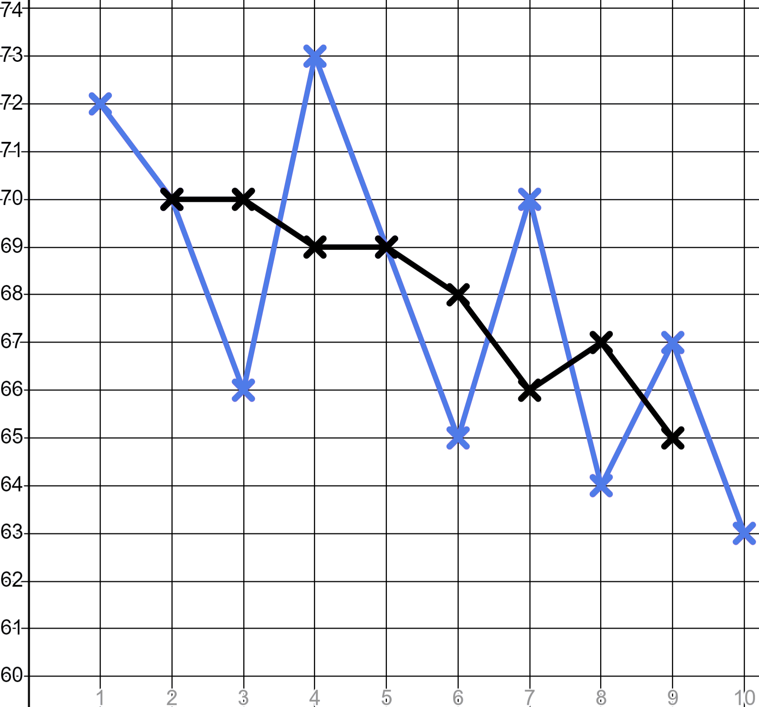
Diiwaangelinta iyo isticmaalka xogta (data)
3)
Toddobaad | 1 | 2 | 3 | 4 | 5 | 6 | 7 | 8 | 9 | 10
Waqti (ilbiriqsi) | 73 | 70 | 66 | 73 | 69 | 65 | 70 | 64 | 67 | 63
 | ✖ | 70
Toddobaad | 1 | 2 | 3 | 4 | 5 | 6 | 7 | 8 | 9 | 10
Waqti (ilbiriqsi) | 73 | 70 | 66 | 73 | 69 | 65 | 70 | 64 | 67 | 63
 | ✖ | 70 | 70 | 69 | 69 | 68 | 66 | 67 | 65 | ✖
c) Buuxi jaantuska celceliska socda ee saddexda dhibcood (ilaa nambarka ugu dhow). Kan koowaad waa laguu sameeyay.
d) Sawir celceliska socda ee Aisha oo qor faallo ah inay horumaraysid iyo in kale.
Time (s)
Waxaa laga yaabaa inaad tidhi, “Celceliska socda ee Aisha wuxuu u socdaa hoos; waxay horumaraysaa.”
Wk

Slide 38
Recording and using data
3)
Week | 1 | 2 | 3 | 4 | 5 | 6 | 7 | 8 | 9 | 10
Time (sec) | 73 | 70 | 66 | 73 | 69 | 65 | 70 | 64 | 67 | 63
 | ✖ | 70
Week | 1 | 2 | 3 | 4 | 5 | 6 | 7 | 8 | 9 | 10
Time (sec) | 73 | 70 | 66 | 73 | 69 | 65 | 70 | 64 | 67 | 63
 | ✖ | 70 | 70 | 69 | 69 | 68 | 66 | 67 | 65 | ✖
e) Isticmaal celceliska socda si aad u saadaaliso goorta Aisha laga yaabo inay jebiso xadka 60 ilbiriqsi.
You might have said, “Aisha’s three-point moving averages are improving by approximately half a second per week. If this trend continues she should break the 60 second barrier in another ten weeks.”
Time (s)
Wk

Slide 39
Sports coaching
Recording and using data
Using data to plan training sessions

Slide 40
Using data to plan training sessions
Tababarayaasha ciyaaraha waxay isticmaalaan xog si ay u qorsheeyaan tababaro ku habboon baahida tababarka ee ciyaaryahanka.
Cilmi-baaris ayaa noo sheegtay in noocyada kala duwan ee ciyaaryahannada ay leeyihiin baahiyo tababar oo kala duwan, sidaas darteed waa inay si kala duwan u tababaraan.
Qorshaha tababarku waa inuu buuxiyaa himilooyinka waxqabadka ee ciyaaryahanka.

Slide 41
Using data to plan training sessions
Hadafka Tababarka (Training Goal) | Qaybaha (Sets) | Ku celcelinta (Reps) | Waqtiga Nasashada (Rest Period) | Xoojinta (Intensity)
Adkaysiga (Endurance) | 3 - 4 | > 12 | Ilaa 30 ilbiriqsi (Up to 30 seconds) | < 67% ee 1RM
Jir-xumaan (Muscle leanness) | 3 - 6 | 6 - 12 | 30 ilaa 90 ilbiriqsi (30 to 90 seconds) | 67 - 85% ee 1RM
Xoogga Murqaha (Muscle strength) | 4 - 6 | < 6 | 2 ilaa 5 daqiiqo (2 to 5 minutes) | > 85% ee 1RM
Jadwalkani wuxuu kuu sheegayaa sida saddex nooc oo ciyaartoy ah ay tahay inay u tababaraan.

Slide 42
Isticmaalka xogta si loo qorsheeyo tababarka (Using data to plan training sessions)
Hadafka Tababarka (Training Goal) | Qaybaha (Sets) | Ku celcelinta (Reps) | Waqtiga Nasashada (Rest Period) | Xoojinta (Intensity)
Adkaysiga (Endurance) | 3 - 4 | > 12 | Ilaa 30 ilbiriqsi | < 67% of 1RM
Jir-cad (Muscle leanness) | 3 - 6 | 6 - 12 | 30 ilaa 90 ilbiriqsi | 67 - 85% of 1RM
Xoogga murqaha (Muscle strength) | 4 - 6 | < 6 | 2 ilaa 5 daqiiqo | > 85% of 1RM
'Rep' waa soo gaabinta 'Repetition'; taas macneheedu waa hal jeer ku celinta jimicsiga. Tusaale, hal riixid (press-up) wuxuu noqon karaa hal 'Rep'
'Set' waa ururinta 'Reps'. Tusaale, toban riixid (press-ups) wuxuu noqon karaa hal 'Set'
'Waqtiga Nasashada (Rest Period)' waa waqtiga lagu soo kabsanayo inta u dhaxaysa 'Sets'

Slide 43
Isticmaalka xogta si loo qorsheeyo jimicsiyada (training sessions)
Hadafka Jimicsiga (Training Goal) | Sets | Reps | Waqtiga Nasashada (Rest Period) | Xoogga (Intensity)
Adkaysiga (Endurance) | 3 - 4 | > 12 | Ilaa 30 ilbiriqsi | < 67% of 1RM
Jir-cad (Muscle leanness) | 3 - 6 | 6 - 12 | 30 ilaa 90 ilbiriqsi | 67 - 85% of 1RM
Xoogga murqaha (Muscle strength) | 4 - 6 | < 6 | 2 ilaa 5 daqiiqo | > 85% of 1RM
‘Xoojin (Intensity)’ waa sida uu jidhku u shaqeeyo inta lagu jiro jimicsi
‘1RM’ waa soo gaabinta ‘One Rep Max’, taas oo ah ugu badnaan la gaari karo hal ku celin (repetition) oo jimicsi ah oo uu sameeyo ciyaartoy

Slide 44
Isticmaalka xogta si loo qorsheeyo tababbarrada (training sessions)
Hadafka tababarka (Training Goal) | Qaybaha (Sets) | Ku celiska (Reps) | Waqtiga nasashada (Rest Period) | Xoojin (Intensity)
Adkaysi (Endurance) | 3 - 4 | > 12 | Ilaa 30 ilbiriqsi | < 67% of 1RM
Jilicsanaanta murqaha (Muscle leanness) | 3 - 6 | 6 - 12 | 30 ilaa 90 ilbiriqsi | 67 - 85% of 1RM
Xoogga murqaha (Muscle strength) | 4 - 6 | < 6 | 2 ilaa 5 daqiiqo | > 85% of 1RM
Ciyaartoyda orodka dheer waxaa laga yaabaa inay yeeshaan hadaf tababar oo ah ‘Adkaysi (Endurance)’
Ciyaartoyga 'decathlete' wuxuu u tababbaran karaa 'Murqo-xeefnimo (Muscle leanness)' sababtoo ah wuxuu u baahan yahay inuu qabto caqabado kala duwan oo ciyaaraha ah.
Ciyaartoyga miisaan qaadista wuxuu u tababbaran karaa 'Xoogga Murqaha (Muscle strength)'.

Slide 45
Isticmaalka xogta si loo qorsheeyo fasalada tababarka
Yoolka Tababarka (Training Goal) | Sets | Reps | Waqtiga Nasashada (Rest Period) | Xoojinta (Intensity)
Adkaysiga (Endurance) | 3 - 4 | > 12 | Ilaa 30 ilbiriqsi | < 67% ee 1RM
Murqo-xeefnimo (Muscle leanness) | 3 - 6 | 6 - 12 | 30 ilaa 90 ilbiriqsi | 67 - 85% ee 1RM
Xoogga Murqaha (Muscle strength) | 4 - 6 | < 6 | 2 ilaa 5 daqiiqo | > 85% ee 1RM
Qofka leh yoolka tababarka 'xoogga murqaha (muscle strength)' wuxuu caadi ahaan sameeyaa tiro yar oo 'reps' ah.
Qofka leh yoolka tababarka __________ wuxuu caadi ahaan sameeyaa tiro yar oo 'sets' ah.
Qofka ku tababbaran 70% ee 1RM wuxuu u tababbarayaa ___________.
Qofka leh hadafka tababarka xoogga murqaha (muscle strength) sida caadiga ah wuxuu sameeyaa reps yar.
Qofka leh hadafka tababarka adkaysiga (endurance) sida caadiga ah wuxuu sameeyaa sets yar.
Qof ku tababbaraya 70% ee 1RM wuxuu ku tababbarayaa ___________.
Qofka leh hadafka tababarka xoogga murqaha (muscle strength) sida caadiga ah wuxuu sameeyaa reps yar.
Qofka leh hadafka tababarka adkaysiga (endurance) sida caadiga ah wuxuu sameeyaa sets yar.
Qof ku tababbaraya 70% ee 1RM wuxuu ku tababbarayaa jilicsanaanta murqaha (muscle leanness).
Qofka leh yoolka tababarka ____________ wuxuu caadi ahaan sameeyaa tiro yar oo 'reps' ah.
Qofka leh yoolka tababarka __________ wuxuu caadi ahaan sameeyaa tiro yar oo 'sets' ah.
Qof ku tababbaraya 70% ee 1RM wuxuu ku tababbarayaa ___________.

Slide 46
Isticmaalka xogta si loo qorsheeyo tababarka
Hadafka Tababarka | Sets | Reps | Wakhtiga Nasashada | Xoojinta (Intensity)
Adkaysiga (Endurance) | 3 - 4 | > 12 | Ilaa 30 ilbiriqsi | < 67% ee 1RM
Jilicsanaanta murqaha (Muscle leanness) | 3 - 6 | 6 - 12 | 30 ilaa 90 ilbiriqsi | 67 - 85% ee 1RM
Xoogga murqaha (Muscle strength) | 4 - 6 | < 6 | 2 ilaa 5 daqiiqo | > 85% ee 1RM
Cabdi wuxuu diyaarinayaa qorshe tababar ah walaashiisii oo weyn, kaasoo isku dayaya inuu galo tartanka xoogga sare (powerlifting). Walaasha Cabdi waa ka weyn tahay 18 sano, sidaas darteed jidhkeedu waa mid buuxa oo koray, marka waxay ku tababaran kartaa sidii kor lagu sheegay xoogga murqaha (muscle strength).
Waxaan ku bilaabaynaa qorshe fudud bil ah, ka dibna waan kor u qaadaynaa. 1RM-keeda hadda waa 120 kg

Slide 47
Isticmaalka xogta (data) si loo qorsheeyo kalfadhiyada tababarka (training sessions)
Hadafka Tababarka (Training Goal) | Qaybaha (Sets) | Ku-celcelinta (Reps) | Waqtiga Nasashada (Rest Period) | Xoojinta (Intensity)
Adkaysiga (Endurance) | 3 - 4 | > 12 | Ilaa 30 ilbiriqsi (seconds) | < 67% ee 1RM
Jilicsanaanta Murqaha (Muscle leanness) | 3 - 6 | 6 - 12 | 30 ilaa 90 ilbiriqsi (seconds) | 67 - 85% ee 1RM
Xoogga Murqaha (Muscle strength) | 4 - 6 | < 6 | 2 ilaa 5 daqiiqo (minutes) | > 85% ee 1RM
Qorshaha bilowga:
Xoojinta (Intensity):
87.5% × 120 = 105 kg
Qaybaha/Ku-celcelinta (Sets/Reps):
4 qaybood (sets) oo 4 ku-celcelin (reps) ah
Wakhtiyada nasashada:
5 daqiiqo oo u dhexeeya sets
Waxaan ku bilaabaynaa qorshe fudud bil ah, ka dibna waan kor u qaadaynaa. 1RM-keeda hadda waa 120 kg

Slide 48
Isticmaalka xogta si loo qorsheeyo tababarka
Hadafka tababarka | Sets | Reps | Wakhtiga nasashada | Xoojinta (Intensity)
Adkaysiga (Endurance) | 3 - 4 | > 12 | Ilaa 30 ilbiriqsi | < 67% of 1RM
Jirka caafimaadka (Muscle leanness) | 3 - 6 | 6 - 12 | 30 ilaa 90 ilbiriqsi | 67 - 85% of 1RM
Xoogga murqaha (Muscle strength) | 4 - 6 | < 6 | 2 ilaa 5 daqiiqo | > 85% of 1RM
Qorshaha horumarinta (Improver plan):
Xoojinta (Intensity):
87.5% × 120 = 105 kg
Sets/Reps:
6 sets oo 4 reps ah
Wakhtiyada nasashada (Rest periods):
4 daqiiqo oo u dhexeeya sets-ka
Waxay soo martay bil iyada oo si fiican u tababaranaysa. Waxaan kor u qaadaynaa qorshaha tababarka.

Slide 49
Isticmaalka xogta si loo qorsheeyo kalfadhiyada tababarka
Hadafka Tababarka (Training Goal) | Sets | Reps | Wakhtiga Nasashada (Rest Period) | Xoogga (Intensity)
Adkaysiga (Endurance) | 3 - 4 | > 12 | Ilaa 30 ilbiriqsi | < 67% of 1RM
Jir-cad (Muscle leanness) | 3 - 6 | 6 - 12 | 30 ilaa 90 ilbiriqsi | 67 - 85% of 1RM
Xoogga murqaha (Muscle strength) | 4 - 6 | < 6 | 2 ilaa 5 daqiiqo | > 85% of 1RM
Qorshaha khabiirka:
Kani ma aha milan (solution) kaliya laakiin milankaagu waa inuu ku darayaa korodhka xoojinta (intensity)/sets/reps iyo dhimista wakhtiga nasashada.
Xoogga (Intensity):
90% × 120 = 108 kg
__________
Sets/Reps:
6 sets oo 5 reps ah
__________
Wakhtiyada nasashada (Rest periods):
2 daqiiqo oo u dhexeeya sets-ka
__________
Maxaad u malaynaysaa in qorshaha khabiirka uu u ekaado horumarinta xoogga murqaha (muscle strength) qofka 1RM-kiisu yahay 120 kg?

Slide 50
Isticmaalka xogta si loo qorsheeyo tababarka
Hadafka Tababarka | Sets | Reps | Wakhtiga Nasashada | Xoojinta (Intensity)
Adkaysiga (Endurance) | 3 - 4 | > 12 | Ilaa 30 ilbiriqsi | < 67% ee 1RM
Jilicsanaanta murqaha (Muscle leanness) | 3 - 6 | 6 - 12 | 30 ilaa 90 ilbiriqsi | 67 - 85% ee 1RM
Xoogga murqaha (Muscle strength) | 4 - 6 | < 6 | 2 ilaa 5 daqiiqo | > 85% ee 1RM
Qorshaha khabiirka (Expert plan):
Xoojinta (Intensity):
110% × 120 = 132 kg
Wuu ka badbadanyahay xadka (max.).
Qaybo/Jiidmo (Sets/Reps):
6 qaybood oo 6 jiidmo ah
Jiidmadu waa inay ka yaraadaan 6
90 ilbiriqsi inta u dhaxaysa qaybaha
Nasashada ugu yar waa 2 daqiiqo oo loogu talagalay xoogga murqaha (muscle strength).
Wakhtiga nasashada (Rest periods):
Maxay tahay waxa qaldan ee qorshahan ku jira ee horumarinta xoogga murqaha (muscle strength) qof leh 1RM 120 kg?

Slide 51
Isticmaalka xogta (data) si loo qorsheeyo kal-fadhiyada tababarka (training sessions)
Hadafka tababarka (Training Goal) | Qaybo (Sets) | Jiidmo (Reps) | Wakhtiga nasashada (Rest Period) | Xoogga (Intensity)
Adkaysiga (Endurance) | 3 - 4 | > 12 | Ilaa 30 ilbiriqsi | < 67% ee 1RM
Jilicsanaanta murqaha (Muscle leanness) | 3 - 6 | 6 - 12 | 30 ilaa 90 ilbiriqsi | 67 - 85% of 1RM
Xoogga murqaha (Muscle strength) | 4 - 6 | < 6 | 2 ilaa 5 daqiiqo | > 85% of 1RM
1) Walaalka Suad ee ka weyn ayaa u tababbaranaya heptathlon, sidaa darteed wuxuu u baahan yahay inuu horumariyo jilicsanaanta murqaha (muscle leanness). Wuxuu ka shaqeynayaa benc press-kiisa wuxuuna leeyahay 1RM 80 kg. U samee isaga:
a) Qorshaha bilowga (Starter plan)
b) Qorshaha horumarinta (Improver plan)
c) Qorshaha khabiirada (Expert plan)

Slide 52
Isticmaalka xogta si loo qorsheeyo casharrada tababarka
Hadafka tababarka (Training Goal) | Sets | Ku celis (Reps) | Wakhtiga nasashada (Rest Period) | Xoojinta (Intensity)
Adkaysiga (Endurance) | 3 - 4 | > 12 | Ilaa 30 ilbiriqsi | < 67% of 1RM
Jilicsanaanta murqaha (Muscle leanness) | 3 - 6 | 6 - 12 | 30 ilaa 90 ilbiriqsi | 67 - 85% of 1RM
Xoogga murqaha (Muscle strength) | 4 - 6 | < 6 | 2 ilaa 5 daqiiqo | > 85% ee 1RM
2) a) Qof 1RM-kiisu yahay 125 kg oo sameynaya ku celis (reps) 76 kg. Waa maxay hadafkiisa tababarka?
b) Qof kuu sheega inuu sameeyay 60 ku celis (repetitions) dhamaan set-yadiisa. Waa maxay hadafkiisa tababarka?
c) Qof ayaa kuu sheegaya inuu si xooggan u tababbaranayo muruq-caddayn (muscle leanness) oo uu kor u qaaday 136 kg. Waa maxay 1RM-kiisa?

Slide 53
Isticmaalka xogta si loo qorsheeyo fasalada tababarka
Hadafka Tababarka (Training Goal) | Gogol (Sets) | Ku-celin (Reps) | Waqtiga Nasashada (Rest Period) | Xoojinta (Intensity)
Adkaysiga (Endurance) | 3 - 4 | > 12 | Ilaa 30 ilbiriqsi | < 67% ee 1RM
Muruq-caddayn (Muscle leanness) | 3 - 6 | 6 - 12 | 30 ilaa 90 ilbiriqsi | 67 - 85% ee 1RM
Xoogga Muruqa (Muscle strength) | 4 - 6 | < 6 | 2 ilaa 5 daqiiqo | > 85% ee 1RM
1) Walaalka Suad ee ka weyn ayaa u tababbaranaya heptathlon, sidaa darteed wuxuu u baahan yahay inuu horumariyo muruq-caddayn (muscle leanness). Wuxuu ka shaqeynayaa benc press-kiisa wuxuuna leeyahay 1RM ah 80 kg. U samee isaga:
a) Qorshaha bilowga (Starter plan)
b) Qorshaha horumarinta (Improver plan)
c) Qorshaha khabiirka (Expert plan)

Slide 54
Isticmaal xogta si aad u qorsheysid tababaro (training sessions)
Hadafka Tababarka (Training Goal) | Sets | Reps | Wakhtiga Nasashada (Rest Period) | Xoojinta (Intensity)
Adkaysiga (Endurance) | 3 - 4 | > 12 | Ilaa 30 ilbiriqsi | < 67% of 1RM
Jir-caato (Muscle leanness) | 3 - 6 | 6 - 12 | 30 ilaa 90 ilbiriqsi | 67 - 85% of 1RM
Xoogga Muruqa (Muscle strength) | 4 - 6 | < 6 | 2 ilaa 5 daqiiqo | > 85% of 1RM
a) Qorshaha Bilowga (Starter plan)
b) Qorshaha Horumarinta (Improver plan)
c) Qorshaha Khabiirka (Expert plan)
Xoojinta (Intensity):
70% × 80 = 56 kg
75% × 80 = 60 kg
75% × 80 = 60 kg
Sets/Reps:
3 sets of 6 reps
3 qaybood oo 6 ku celcelin ah
6 qaybood oo 12 ku celcelin ah
Wakhtiyada nasashada:
90 ilbiriqsi
90 ilbiriqsi
30 ilbiriqsi
Kani ma aha milan (solution) keliya. Milan (solution)-kaagu waa inuu ka bilaabmaa darajooyinka fudud uguna gudbaa kuwa adag.

Slide 55

Isticmaalka xogta si loo qorsheeyo tababarka
Hadafka Tababarka | Qaybaha | Ku celcelinta | Wakhtiga Nasashada | Xoogga (Intensity)
Adkaysiga (Endurance) | 3 - 4 | > 12 | Ilaa 30 ilbiriqsi | < 67% ee 1RM
Jir-xadida (Muscle leanness) | 3 - 6 | 6 - 12 | 30 ilaa 90 ilbiriqsi | 67 - 85% ee 1RM
Xoogga murqaha (Muscle strength) | 4 - 6 | < 6 | 2 ilaa 5 daqiiqo | > 85% ee 1RM
2) a) Qof 1RM-kiisu yahay 125 kg oo sameynaya deadlift, wuxuu samaynayaa 76 kg reps. Waa maxay hadafkiisa tababarka?
Xoojin (Intensity) < 67% kg sidaas darteed tababar u ah adkaysiga (endurance).

Slide 56
Isticmaalka xogta si loo qorsheeyo tababarka
Hadafka Tababarka | Sets | Reps | Wakhtiga Nasashada | Xoojin (Intensity)
Adkaysi (Endurance) | 3 - 4 | > 12 | Ilaa 30 ilbiriqsi | < 67% ee 1RM
Jir-xumaan (Muscle leanness) | 3 - 6 | 6 - 12 | 30 ilaa 90 ilbiriqsi | 67 - 85% ee 1RM
Xoogga Murqaha (Muscle strength) | 4 - 6 | < 6 | 2 ilaa 5 daqiiqo | > 85% ee 1RM
b) Qof kuu sheegay inuu sameeyay 60 jeer (repetitions) dhamaan sets-kiisa. Waa maxay hadafkiisa tababarka?
6 × 5 = 30 waa tirada ugu badan (max reps) ee xoogga muruqyada (muscle strength) marka kani ma noqon karo taas.
4 sets oo 15 reps ah waa tababar u adkaysiga (endurance).
3 sets oo 20 reps ah waa tababar u adkaysiga (endurance).
6 qaybood oo 10 jeer ah waa tababarka muruqyada caatada (muscle leanness).
5 qaybood oo 12 jeer ah waa tababarka muruqyada caatada (muscle leanness).

Slide 57
Isticmaalka xogta (data) si loo qorsheeyo tababarka (training sessions)
Hadafka Tababarka (Training Goal) | Qaybaha (Sets) | Ku celcelinta (Reps) | Waqtiga Nasashada (Rest Period) | Xoogga (Intensity)
Adkaysiga (Endurance) | 3 - 4 | > 12 | Ilaa 30 ilbiriqsi (Up to 30 seconds) | < 67% of 1RM
Muruqyada caatada (Muscle leanness) | 3 - 6 | 6 - 12 | 30 ilaa 90 ilbiriqsi (30 to 90 seconds) | 67 - 85% of 1RM
Xoogga muruqyada (Muscle strength) | 4 - 6 | < 6 | 2 ilaa 5 daqiiqo (2 to 5 minutes) | > 85% of 1RM
c) Qof ayaa kuu sheegaya inuu si xooggan u tababbarayo muruqyada caatada (muscle leanness) isagoo kor u qaadaya 136 kg. Waa maxay 1RM-kiisa?
Heerka ugu xooggan (most intense level) ee muruqyada caatada (muscle leanness) waa 85% of 1RM-kiisa
1RM × 0.85 = 136 kg sidaas darteed…
136 kg ÷ 0.85 = 160 kg

Slide 58
Tababarka ciyaraha (Sports coaching)
Tababarayaasha ciyaaraha waxay isticmaalaan xog (data) si ay u la socdaan waxqabadka ciyaartoyga oo ay u muujiyaan horumarka.
Waxay sidoo kale isticmaalaan xog (data) si ay u qorsheeyaan baahida tababarka ee ciyaartoyga si ay u caawiyaan ciyaartoygooda inay horumaraan.

