Slide 1
Koronto taagan: dallac (charge)
Wareegyo taxane (Series circuits)

Slide 2
Sida agabkeena waxbarista loogu talagalay fasalka

Slide 3
Waxaan qeexi karaa waxa dallacyadu yihiin iyo sida loogu kala wareejiyo walxaha qaarkood, iyaga oo siinaya dallacyo iska soo horjeeda.

Slide 4
atom
dallac togan (positive charge)
dallac taban (negative charge)
electron

Slide 5
Atomyadu waa walxaha ka sameysan curiyeyaasha kiimikada, oo ka kooban tirooyin isleeg oo protons togan iyo electrons taban.
Dallac togan waa nooc ka mid ah dallaca korantada oo soo jiita dallac taban.
Dallac taban waa nooc ka mid ah dallaca korantada oo soo jiita dallac togan.
Electrons waa walxo taban oo ku jira gudbiyeyaasha (conductors) oo qulqula si ay u soo saaraan qulqul koronto (electric current).

Slide 6

Koronto taagan: dallac (charge)
Xaggee ayay ka timaadaa dallaca?
Sida dallacyadu u dhaqaaqaan
Isticmaalka iyo dhibaatooyinka korantada taagan (static electricity)

Slide 7
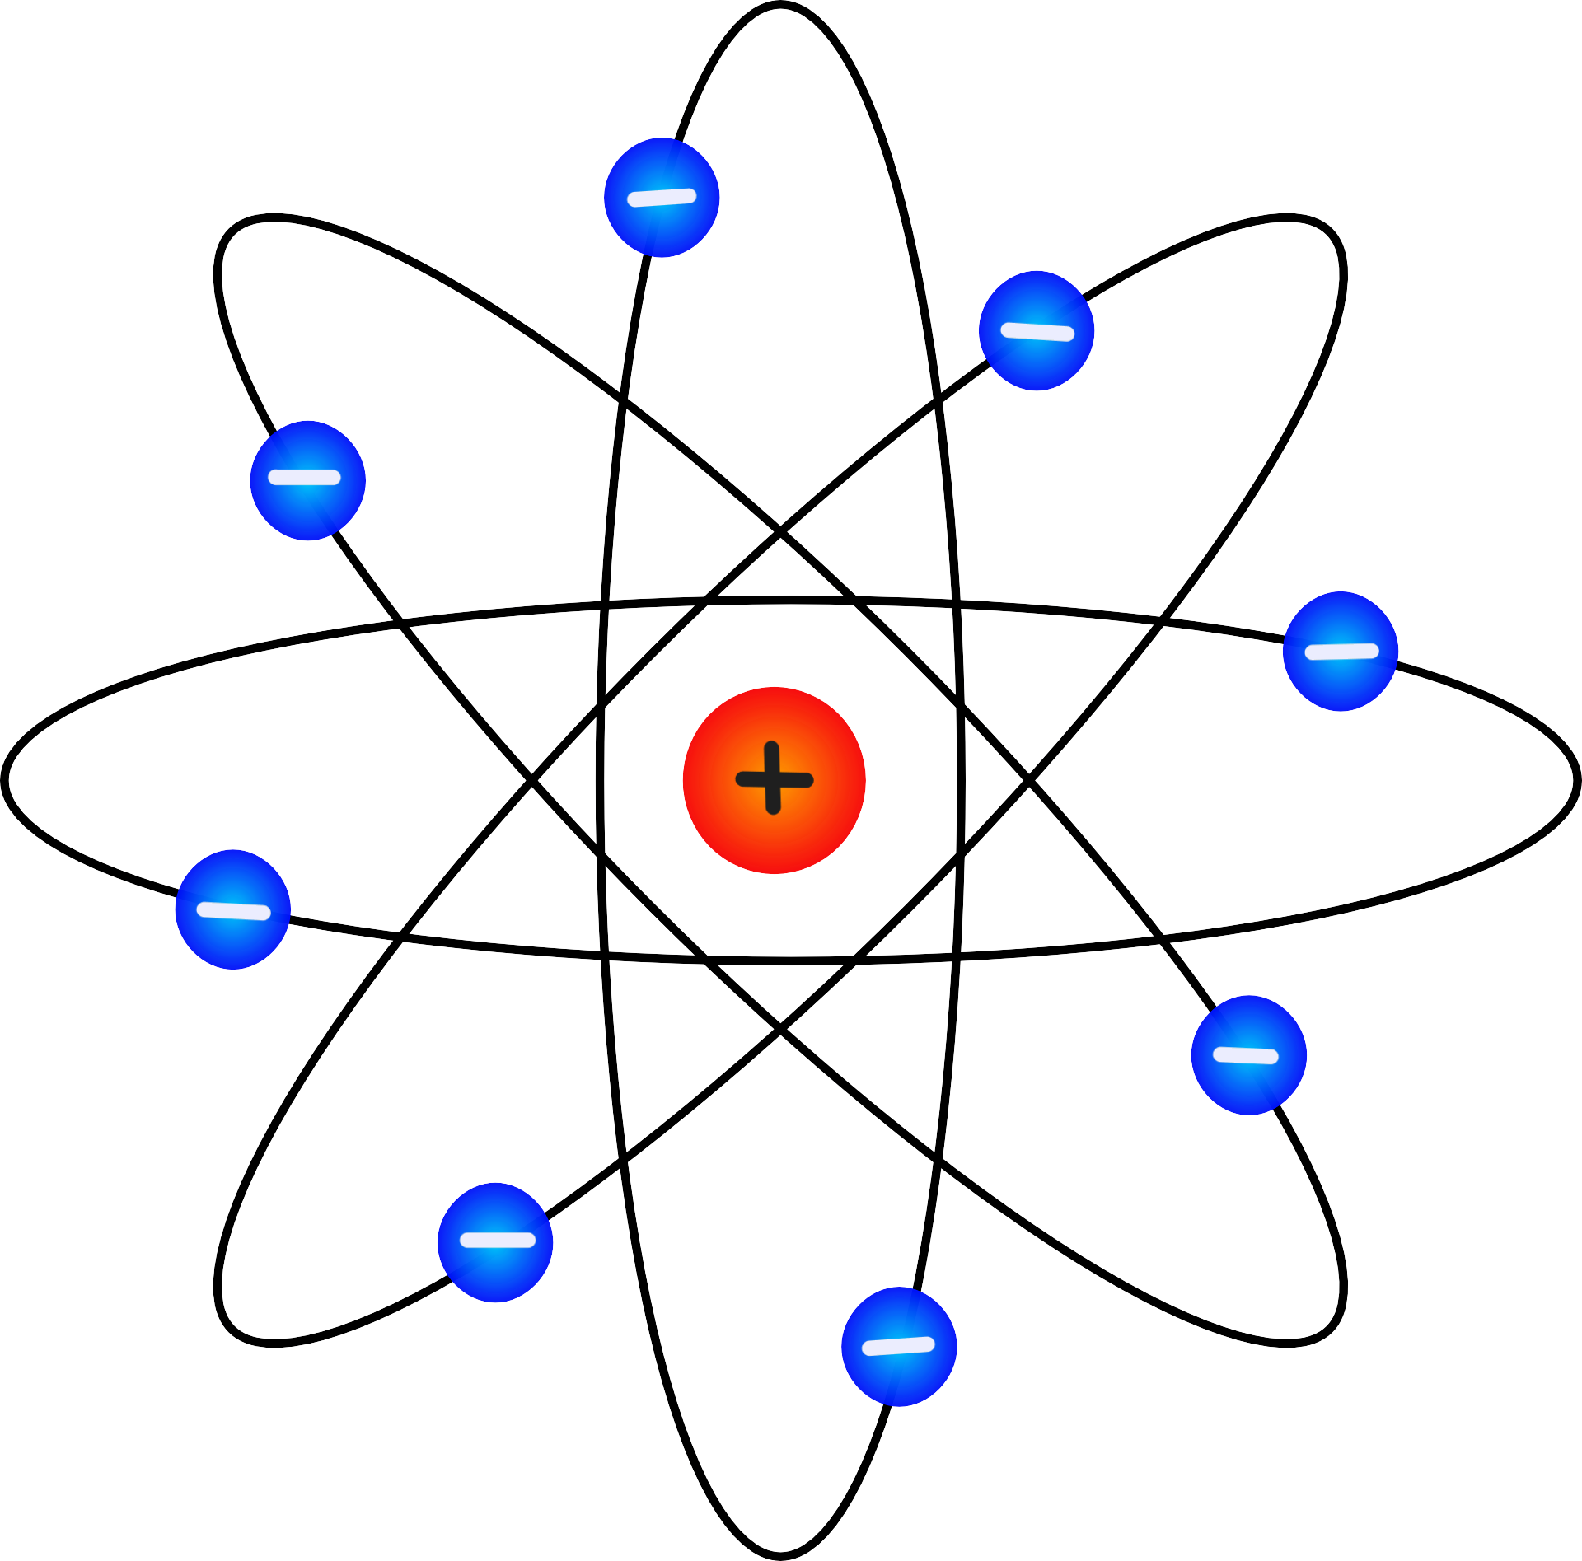
Xaggee ayay ka timaadaa dallaca?
Atom-ka mararka qaarkood waxaa lagu muujiyaa qaabkan:
electron
nucleus

Slide 8

Xaggee ayay ka timaadaa dallaca?
Waa maxay dallaca ku yaal nucleus-ka atom-ka?
dhexdhexaad (neutral)
taban (negative)
toon (positive)

Slide 9
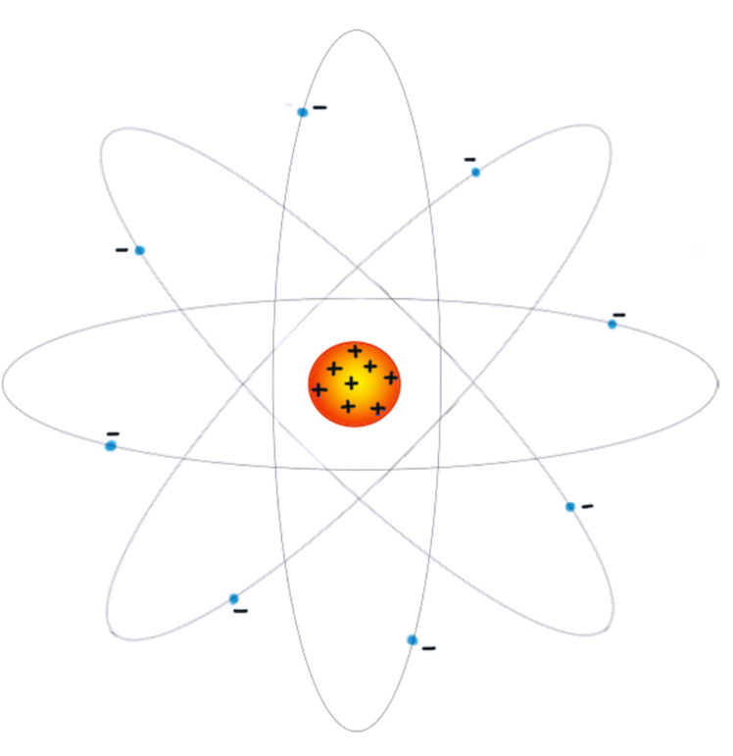
Xarig (charge) xaggee ka yimaadaa?
Qaabka waxaa loo sawiri karaa si ka sax ah.
elektaroonno (electrons) yaryar oo taban (negatively charged)
nukleus (nucleus) weyn oo toon (positively charged)

Slide 10
Xarig (charge) xaggee ka yimaadaa?
Atamkan (atom) waxaa ku yaal 8 elektaroon (electron) oo leh xarig taban (negative charges).

Slide 11
Xarig (charge) xaggee ka yimaadaa?
Atamkan (atom) waxaa ku yaal 8 elektaroon (electron) oo leh xarig taban (negative charges).
Waxaa sidoo kale jira 8 xarig toon (positive charges).

Slide 12
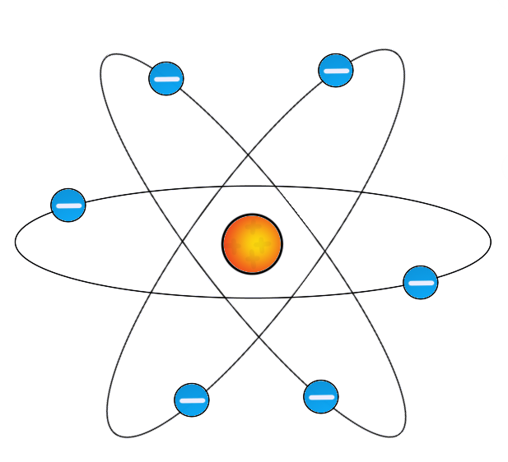
Xarig (charge) xaggee ka yimaadaa?
Imisa elektaroon (electron) ayaa ku jira atamka (atom) hoos ku sawiran?
2
4
6
8

Slide 13
Xarig (charge) xaggee ka yimaadaa?
8 xarig toon (+) ayaa tirtiraya 8 xarig taban (–).
+8 iyo –8 wadartoodu waa 0. Atamku (atom) waa dhexdhexaad (neutral), marka guud ahaan xarig (charge) ma laha.
Inta badan atamka (atoms) waxay leeyihiin tiro siman oo xarig toon (positive) iyo taban (negative) ah – waa dhexdhexaad (neutral).

Slide 14
Xarig (charge) xaggee ka yimaadaa?
Way fududahay in laga saaro elektaroon (electron) taban (negative) oo ka baxsan atamka (atom).
Way adag tahay in laga saaro xarig toon (positive charge) oo ka yimid gudaha atamka (atom).

Slide 15
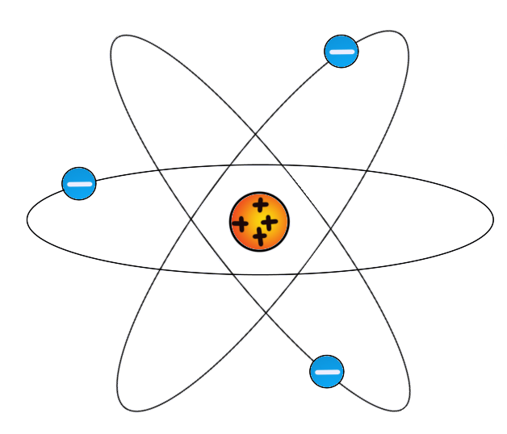
Xaggee ayay ka timaadaa kharashka (charge)?
Waa maxay xariga (charge) guud ee atamka (atom) hoos ku sawiran?
+1
–1
–3
+4

Slide 16
Xaggee ayay ka timaadaa kharashka (charge)?
Sharax sababta atamka badankoodu aan u lahayn kharash guud.
Sharax sababta ay u fudud tahay in laga saaro kharashyada taban (negative) atamka marka loo eego kuwa togan (positive).

Slide 17
Xaggee ayay ka timaadaa kharashka (charge)?
Sharax sababta atamka badankoodu aan u lahayn kharash guud.
Atamka badankoodu waxay leeyihiin tiro siman oo kharashyo togan iyo taban ah. Tani waxay ka dhigan tahay in kharashka guud uu yahay dhexdhexaad (neutral) maadaama kharashyada togan ay tirtiraan kuwa taban.
Sharax sababta ay u fudud tahay in laga saaro kharashyada taban (negative) atamka marka loo eego kuwa togan (positive).
Waxay u fudud tahay in laga saaro kharashyada taban (electrons) atamka marka loo eego kuwa togan sababtoo ah electrons-ka waxay ku yaalliin bannaanka atamka oo way fududahay in laga saaro. Kharashyada togan waxay si adag ugu xiran yihiin bartamaha atamka.

Slide 18
Korantada taagan (static electricity): kharash (charge)
Xaggee ayay ka timaadaa kharashka (charge)?
Sida kharashyadu u dhaqaaqaan
Isticmaalka iyo dhibaatooyinka korantada taagan (static electricity)

Slide 19
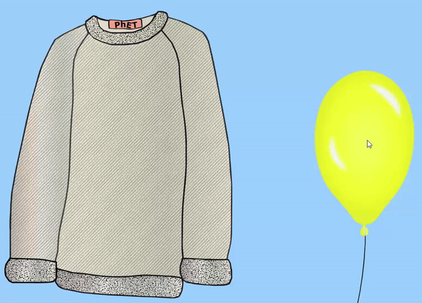
Sida kharashyadu u dhaqaaqaan
Marka insulator-ka lagu xoqo insulator kale, qaar ka mid ah electrons-ka waxaa laga saari karaa shayga kale.
Electrons-ka taban waxay ka tagaan tiro siman oo kharashyo togan ah.
GIF ka soo baxay jilitaanka PhET Interactive Simulations, Jaamacadda Colorado Boulder, oo shatiyeysan CC–BY–4.0

Slide 20
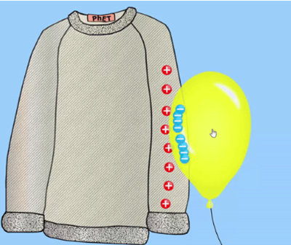
Sida kharashyadu u dhaqaaqaan
Maxay kharashka taban ugu sii hadhaa buufinka (balloon)?
caaggu waa dhegdheg
buufinku waa insulator
kharashka togan ayaa halkaas ku haya
GIF ka soo baxay jilitaan (simulation) PhET Interactive Simulations, Jaamacadda Colorado Boulder, oo shatiyeysan CC–BY–4.0

Slide 21
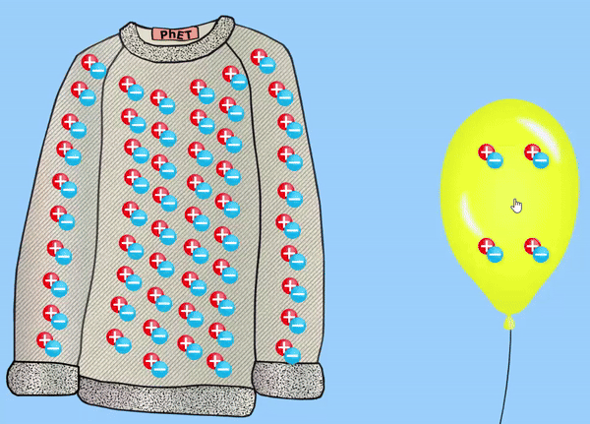
Sida korontadu (charges) u dhaqaaqdo
Inta badan kama muujinno dhammaan korontada (charges) shayga si aan sawirka uga dhigin mid adag:
Xaqiiqdii, waxaa jira koronto (charges) badan oo togan (positive) iyo taban (negative) oo dhammaan shayga ku jira.
Qaar ka mid ah korontada (charges) ayaa keliya awood u leh inay ka dhaqaaqaan shay ilaa shay kale.
GIF ka soo baxay jilitaan (simulation) PhET Interactive Simulations, Jaamacadda Colorado Boulder, oo shatiyeysan CC–BY–4.0

Slide 22
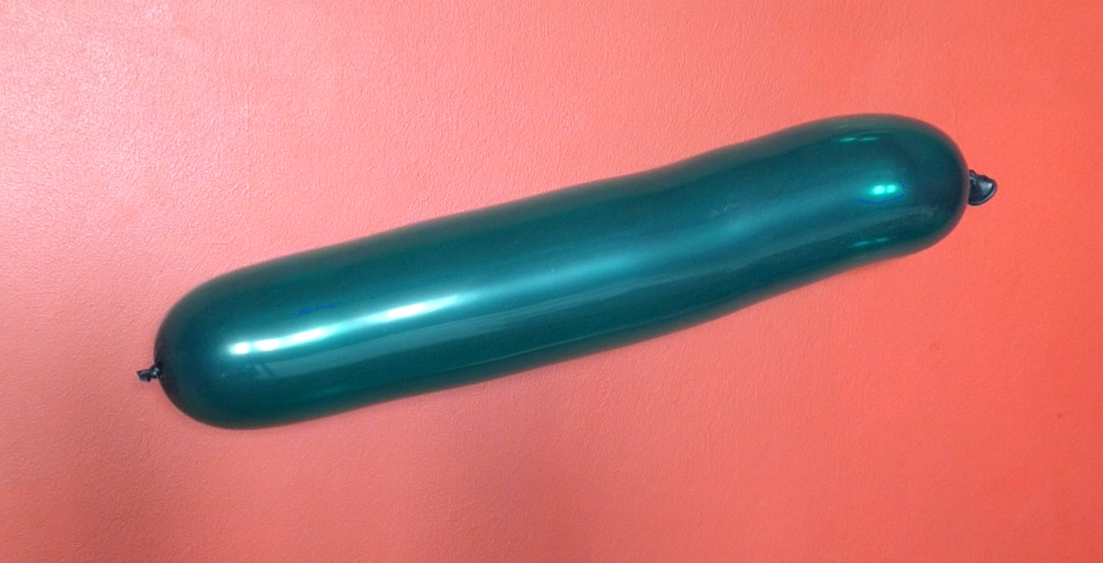
Sida korontadu (charges) u dhaqaaqdo
Shayga intooda badan, tirada korontada togan (positive charges) waxay u dheellitiran tahay tirada korontada taban (negative charges).
Tani waxay ka dhigan tahay in shayga intooda badan yihiin kuwa dhexdhexaad ah (neutral).

Slide 23
Sida korontadu (charges) u dhaqaaqdo
Marka shaygu yahay mid dhexdhexaad (neutral), inta badan kama muujinno korontada (charges).

Slide 24
Sida korontadu (charges) u dhaqaaqdo
Shaygu wuxuu noqdaa mid koronto leh (charged) oo keliya marka elektaroonnada (electrons) taban la dhaqaajiyo.
elektaroonnada (electrons) waxay ku dhaqaaqaan buufinka, iyagoo ka dhigaya mid koronto taban leh (negatively charged)
derbigu wuxuu noqdaa mid koronto togan leh (positively charged)

Slide 25
Sida korontadu (charges) u dhaqaaqdo
Waa maxay korontada (charge) marada haddii loo isticmaalo in lagu xoqo xisaabiyaha (ruler) kaas oo markaas noqda mid koronto togan leh (positively charged)?
togan (positive)
taban (negative)
dhexdhexaad (neutral)

Slide 26
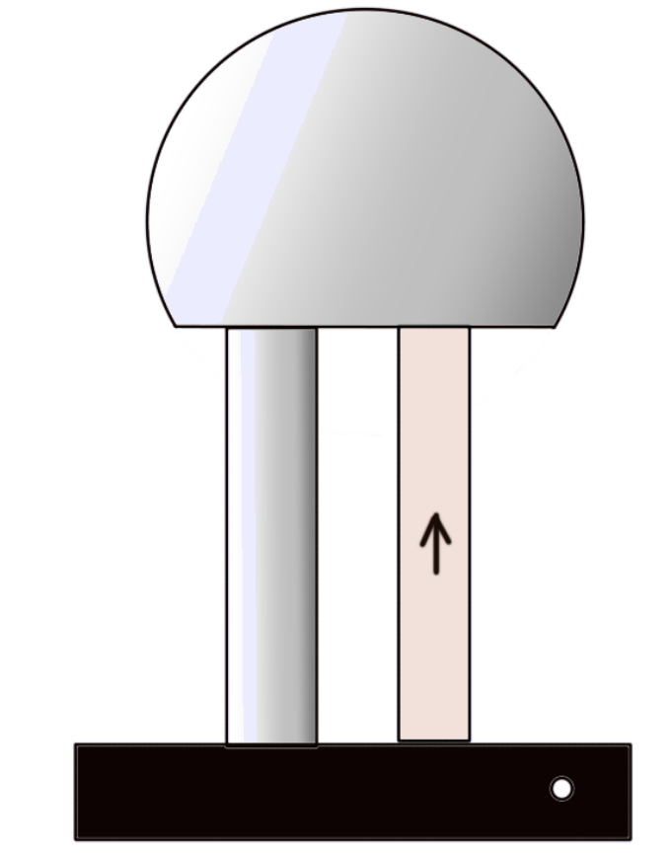
Sida korontadu (charges) u dhaqaaqdo
Matoorka Van der Graaff waxaa loo isticmaali karaa in lagu dhaliyo koronto taagan (static charge).
Qolofka birta ah ee godan wuxuu gudbiyaa oo ururiyaa (charge) kharashka.
Suunka caagga ah wuxuu ku xoqmaa roogagga gudaha wuxuuna keenaa in kharashku ururo.
Taageeradu waa caag mana gudbiso.

Slide 27
Sida kharashku u dhaqaaqo
Kharashku wuxuu ku ururaa dusha sare ee qolofka.
Kharashyadu is-celiyaan oo si siman u fidaan.
Qolofku waa mid go'doonsan oo hawadu ku wareegsan tahay, sidaas darteed kharashku ma qulquli karo.

Slide 28

Sida kharashku u dhaqaaqo
Marka kharash badan ururo, elektaroonnada (electrons) waxay ka boodi karaan qolofka iyagoo dhimbilo (spark) ah.
Taabashada qolofka waxay u oggolaanaysaa kharashka inuu ku qulqulo gacantaada oo ku soo gaadho jidhkaaga.

Slide 29
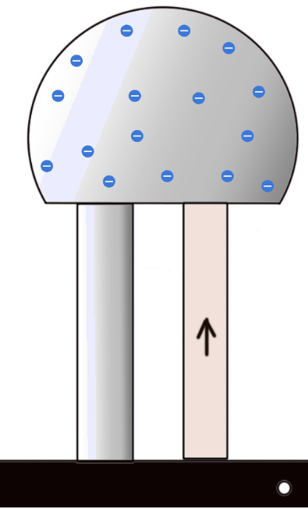
Sida kharashku u dhaqaaqo
Kee ka mid ah weedhahan soo socda ayaa sharxaya sababta kharashka ku yaal koronto-dhaliyaha Van der Graaff uu si siman ugu fido qolofka?
elektaroonnadu is-jiidaan
elektaroonnadu is-celiyaan
qolofku waa gudbiye (conductor)
elektaroonnadu waxay ku dheggan yihiin qolofka birta ah

Slide 30
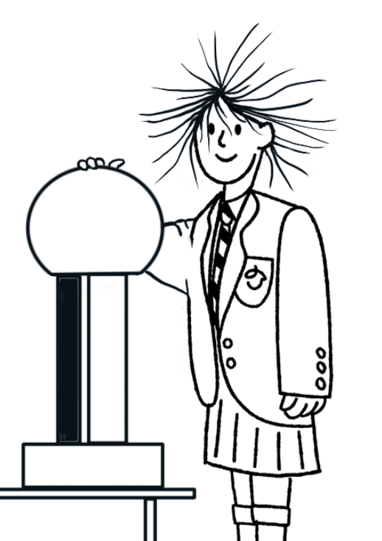
Sida kharashku u dhaqaaqo
Suad waxay taabataa koronto-dhaliyaha Van der Graaff ka dibna way shidaysaa.
Sharax sababta timaheeda u fidaan.

Slide 31
Sida kharashku u dhaqaaqo
Suad waxay taabataa koronto-dhaliyaha Van der Graaff ka dibna way shidaysaa.
Sharax sababta timaheeda u fidaan.
Marka Suad taabato koronto-dhaliyaha oo la shido, kharashku wuxuu ku soo dhaqaaqaa iyada oo ku faafaya jirkeeda.
Dhammaan timaheeda waxay yeelan doonaan nooc isku mid ah oo kharash ah. Tani waxay keentaa in timaha kala duwan ay is-celiyan oo dib u soo baxaan.

Slide 32
Korantada taagan: kharash
Xaggee ayay kharashku ka yimaadaa?
Sida kharashku u dhaqaaqo
Isticmaalka iyo dhibaatooyinka korantada taagan (static electricity)

Slide 33
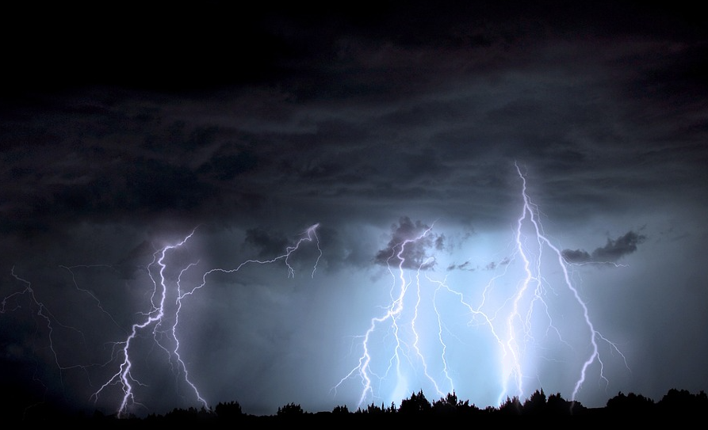
Isticmaalka iyo dhibaatooyinka korantada taagan
Hillaaca waxaa keena ururinta kharashka taagan.
Qas ku jira daruurtu waxay keentaa in kharashku ururo.
Marka kharashku gaaro heer sare oo ku filan, wuxuu ku boodaa hawada sida hillaac.

Slide 34
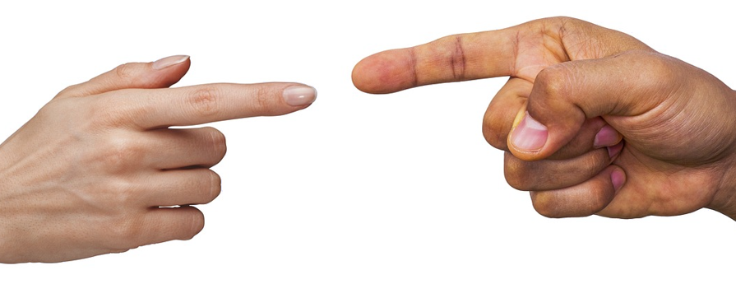
Isticmaalka iyo dhibaatooyinka korantada taagan
Mararka qaarkood waxaan dareemi karnaa sii-daynta korantada (ama dhimbilo) markaan taabano walxaha.
Is-jiidashada dharka ama roogagu waxay badanaa sabab u tahay ururinta kharashka taagan.

Slide 35
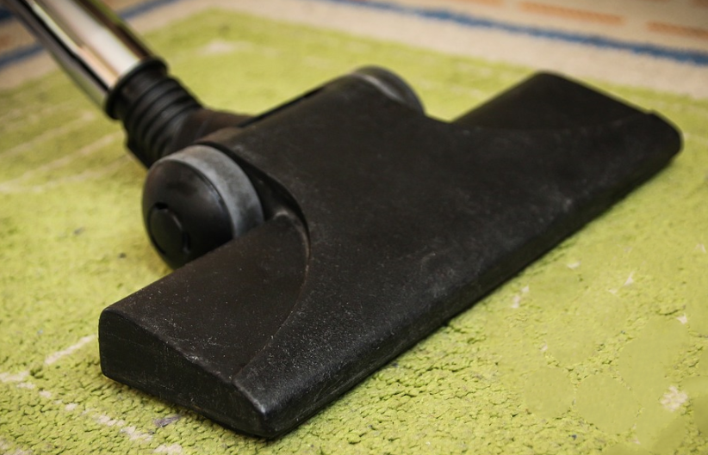
Isticmaalka iyo dhibaatooyinka korantada taagan
Qaybta vacuum cleaner waxay yeelataa kharash taagan sababtoo ah is-jiidashada hawada dhex marta.
Kharashka taagan wuxuu soo jiitaa boodhka.

Slide 36
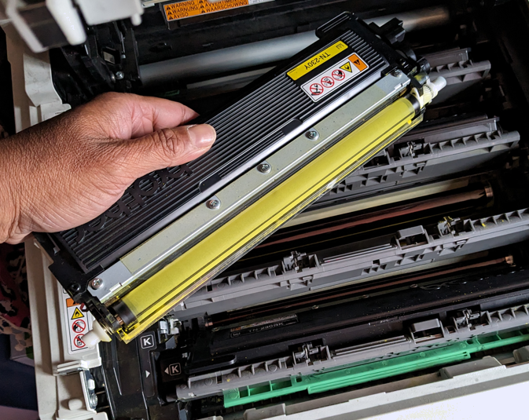
Isticmaalka iyo dhibaatooyinka korantada taagan
Daabacayaasha laser waxay isticmaalaan kharash taagan si ay u soo jiitaan toner-ka (khadka budada ah) meelaha saxda ah.
Roolerku wuxuu ururiyaa qaab kharash taagan oo soo jiita toner-ka.

Slide 37
Isticmaalka iyo dhibaatooyinka korantada taagan
Kee ka mid ah kuwan soo socda waa saameyn faa'iido leh oo korantada taagan?
boodhka ku dheggan qalabka
hillaac (lightning strikes)
daabacayaasha laser (laser printers)
helista shoogga taagan (static shocks)

Slide 38

Isticmaalka iyo dhibaatooyinka korantada taagan (static electricity)
Maamulaha hudheelku wuxuu rabaa inuu ku rakibo roog cusub oo adag oo ka samaysan nylon.
Sharax sababta ay tani u keeni karto dhibaato.

Slide 39
Isticmaalka iyo dhibaatooyinka korantada taagan (static electricity)
Maamulaha hudheelku wuxuu rabaa inuu ku rakibo roog cusub oo adag oo ka samaysan nylon.
Sharax sababta ay tani u keeni karto dhibaato.
Marka dadku ku socdaan roogga, waxaa jiri doona is-jiid (friction) oo u dhexeeya kabahooda iyo roogga.
Roogga nylon waa insulater (insulator) wuxuuna ku fiican yahay inuu keeno koronto taagan (static charge) oo urursan.
Martida hudheelka ayaa laga yaabaa inay helaan shoog taagan (static shocks) sababtoo ah ururinta korontadan.

Slide 40
Korantada taagan (static electricity): koronto (charge)
Atomyada (atoms) caadi ahaan waxay ka kooban yihiin tirooyin isleeg oo protons ah oo leh koronto togan iyo electrons ah oo leh koronto taban.
Korantada taban (electrons) waxaa laga wareejin karaa atomka iyadoo la xoqo.
Walxuhu waxay noqon karaan kuwa koronto taban leh iyagoo helaya electrons, ama koronto togan leh iyagoo luminaya electrons.
Generator-ka Van de Graaff wuxuu dhali karaa koronto taagan (static charge) iyadoo la adeegsanayo is-jiid (friction).
Korantada taagan (static electricity) badanaa waxay noqon kartaa dhibaato, laakiin waxay kaloo noqon kartaa mid faa'iido leh.

