Slide 1
Koronto taagan (Static electricity)
Wareegyo taxane ah (Series circuits)

Slide 2
Sida agabkeena waxbarista loogu talagalay fasalka

Slide 3
Waxaan qeexi karaa sida walxaha leh dallac (charge) togan ama taban ay u soo jiitaan ama u iska celiyaan walxaha kale ee dallacsan.

Slide 4
koronto taagan (static electricity)
dallac togan (positive charge)
dallac taban (negative charge)
xoog elektrostatic ah (electrostatic force)

Slide 5
Koronto taagan (static electricity) waxaa keena ururinta dallaca (charge) ee insulators-ka.
Dallac togan (positive charge) waa nooc ka mid ah dallaca korantada (electrical charge) oo soo jiita dallac taban (negative charge).
Dallac taban (negative charge) waa nooc ka mid ah dallaca korantada (electrical charge) oo soo jiita dallac togan (positive charge).
Xoogga elektrostatic (electrostatic force) waa xoog (force) u dhexeeya dallacyada (charges).

Slide 6

Koronto taagan (Static electricity)
Dallac taagan (Static charge)
Xoog elektrostatic (Electrostatic force)

Slide 7
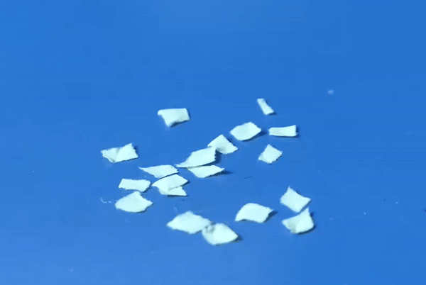
Dallac taagan (Static charge)
Marka bir caag ah lagu xoqo maro, qaybo yaryar oo warqad ah ayaa ku dhegi kara.
Birtu waxay awood u leedahay inay soo jiito qaybaha warqadda iyada oo aan taaban.

Slide 8
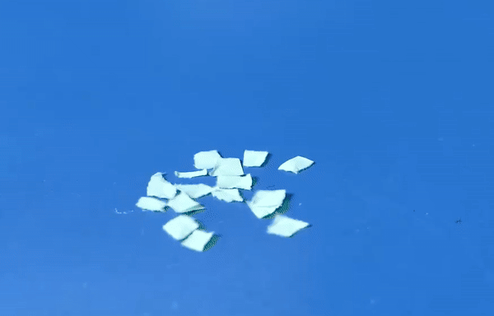
Dallac taagan (Static charge)
Buufin (balloon) ayaa sidoo kale warqad ku dhejin kara marka la xoqo.

Slide 9

Dallac taagan (Static charge)
Laba ka mid ah kuwan soo socda ayaa u oggolaanaya bir caag ah inay soo qaaddo qaybo yaryar oo warqad ah?
Xaakimka (ruler) waa inuu ku xirmaa baytari (battery).
Xaakimka (ruler) waa in lagu xoqaa maro (cloth).
Xaakimka (ruler) waa in loo soo dhoweeyaa jajabka waraaqaha (pieces of paper).
Xaakimka (ruler) waa inuu taabtaa jajabka waraaqaha (pieces of paper).

Slide 10

Koronto taagan (Static charge)
Buufin (balloon) xitaa waxay ku dhegi kartaa gidaar (wall) ka dib marka lagu xoqo.
Waraaqaha (paper) iyo buufinka (balloon) waa fudud yihiin, markaa way fududahay in la arko saamayntan.

Slide 11
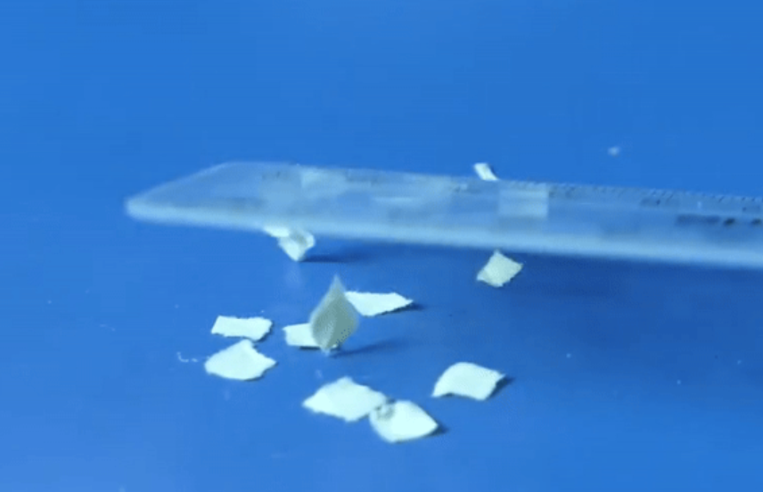
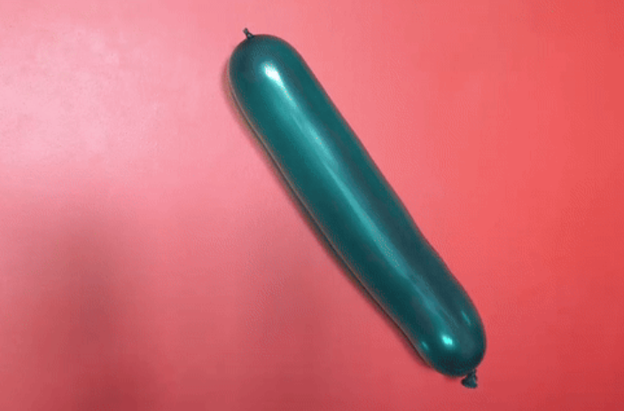
Koronto taagan (Static charge)
Xaakimka (ruler), buufinka (balloon) iyo gidaarka (wall) waxay noqdeen kuwo koronto leh (charged).
Tan waxaa loo yaqaan koronto taagan (static electricity), ama si cilmiyaysan, koronto taagan electrostatic (electrostatic charge).
Walxahan dhamaantood waa insulators (insulators), oo koronto taagan (static charge) badanaa wuxuu ku ururi karaa iyaga.

Slide 12
Koronto taagan (Static charge)
Kee ka mid ah kuwan soo socda ayaa ah sababta saxda ah ee koronto taagan (static charge) badanaa ugu ururi karo walxaha qaarkood?
waa insulators (insulators)
waa conductors (conductors)
waa magnetic (magnetic)

Slide 13
Koronto taagan (Static charge)
Ma arki karno koronto taagan (static charge) ee xaakimka (ruler), laakiin waxaan ogaan karnaa sababtoo ah waxay ku shaqeysaa xoog (force) waraaqaha aan koronta lahayn (uncharged paper).
Waxaa jira laba nooc oo koronto ah; koronto togan (positive charge) iyo koronto taban (negative charge).

Slide 14
Koronto taagan (Static charge)
Imisa nooc oo koronto (charge) ah ayaa jira?
mid (one)
laba
saddex

Slide 15

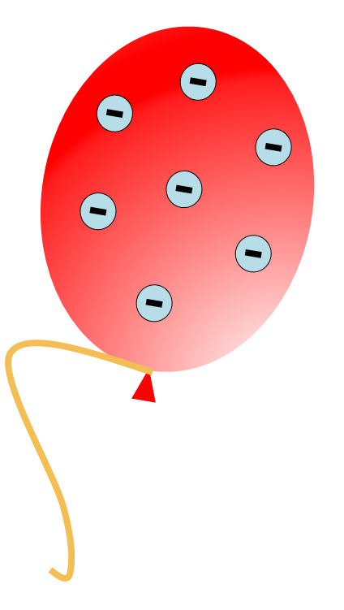
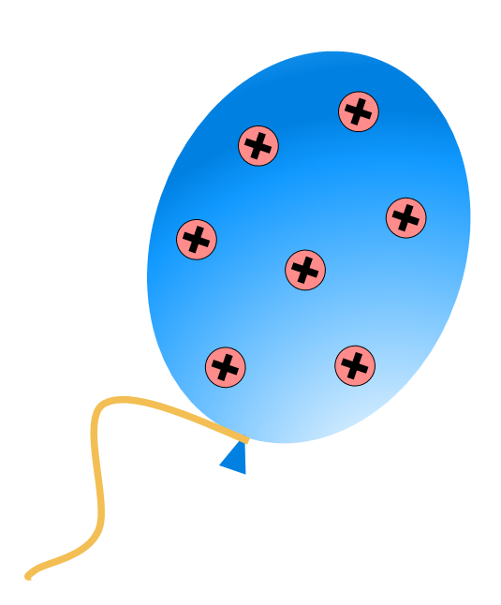
Koronto taagan (Static charge)
Baloonnadan waa:
dhexdhexaad (neutral) (koronto la'aan)
koronto taban (negatively charged)
koronto togan (positively charged)
Shayga badankiisu waa dhexdhexaad (neutral) laakiin mararka qaarkood wuxuu yeelan karaa koronto togan ama taban, sida ay muujinayaan calaamadaha '+' iyo '–'.

Slide 16
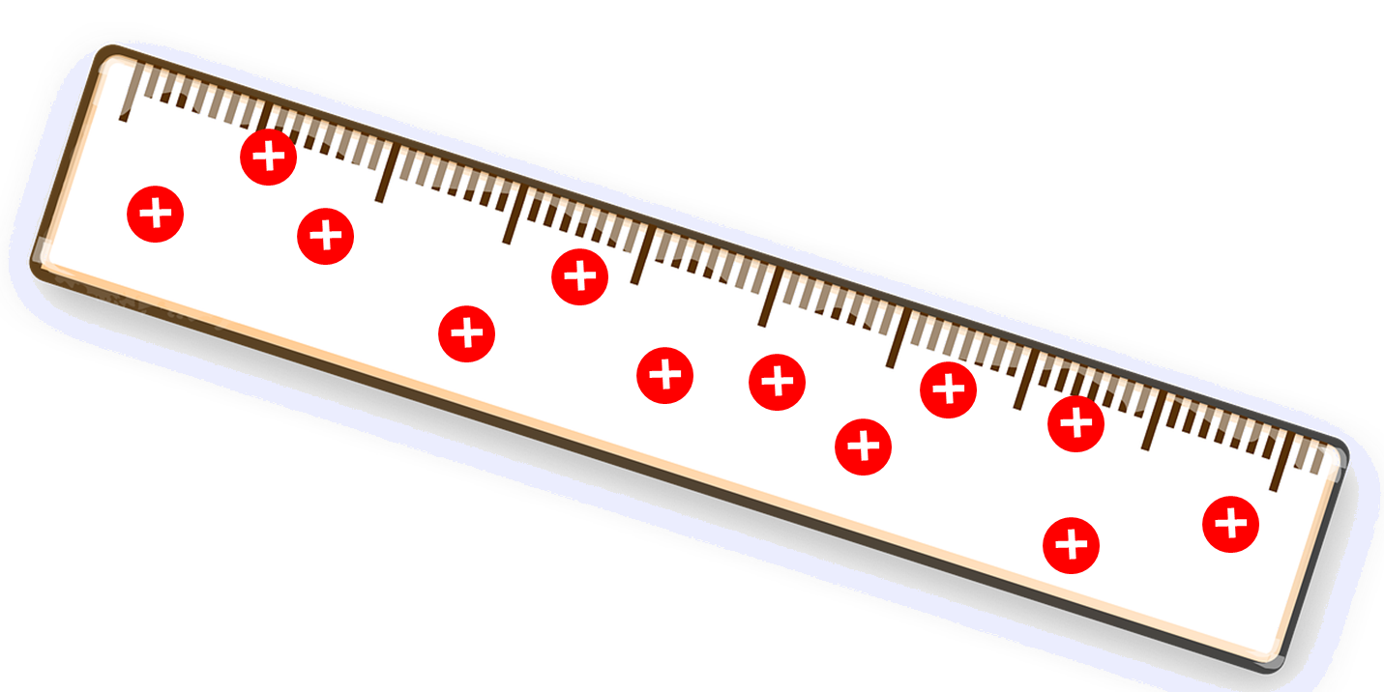
Koronto taagan (Static charge)
Waa maxay korontada ku taal birtaan (ruler)?
taban (negative)
togan (positive)
dhexdhexaad (neutral)

Slide 17
Koronto taagan (Static charge)
Shayga korontada leh wuxuu ku sameeyaa xoog (force) shay kale.
Xooggan waxaa loo yaqaan xoog koronto-taagan (electrostatic force).

Slide 18
Koronto taagan (Static charge)
Waa maxay magaca xoogga (force) ku haya baloonga derbiga?
magnetic (magnetic)
cufisjiidad (gravitational)
koronto-taagan (electrostatic)

Slide 19
Korontada taagan (Static charge)
Baloonnada kee ma keeni doono xoog koronto-taagan (electrostatic force)?

Slide 20
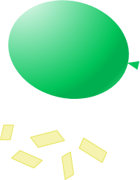
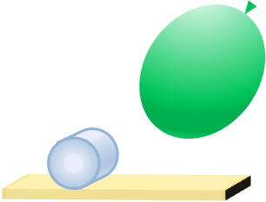
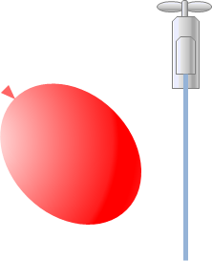

Korontada taagan (Static charge)
Samee afartan tijaabo oo qor waxaad ku aragtid (observations) jeer walba.
Ku dallac (Charge) buufinka adoo xoqaya oo meel dhow u dhig xaashi yaryar.
Ku dallac (Charge) buufinka adoo xoqaya oo u dhowee dhalo (can) macdan oo madhan.
Ku dallac (Charge) buufinka adoo xoqaya oo u dhowee durdur (stream) yar oo biyo (water) ah.
Qabo laba xariijin (stripes) polythene oo dhammaan kor ka wada qabta oo maro ku xoq hoos u sii socda.

Slide 21
Korontada taagan (Static charge)
Buufinku wuxuu soo qaaday xaashiyaha yaryar. Qaar baa dhaca laakiin mar kale waa la soo qaadayaa.
Dhalada (can) ayaa soo jiidatay buufinka iyada oo aan taaban. Sidii buufinku u soo dhawaado ayay u dhaqaaqaysaa.
Durdurka biyaha (water) ayaa loo soo jiiday buufinka. Buufinku waa inuu dhow yahay si biyaha u soo jiido.
Xariijimaha (strips) ayaa kala fogaaday oo kor u sii taagan sidii iyagoo midba midka kale riixaya.

Slide 22
Korantada taagan (Static electricity)
Korontada taagan (Static charge)
Xoogga elektroostatiga (Electrostatic force)

Slide 23
Xoogga elektroostatiga (Electrostatic force)
Dhaladu (can) waa mid aan la dallacin oo loo soo jiiday buufinka la dallacay iyada oo aan la taaban.
Xoogga elektroostatigu (Electrostatic force) waa xoog aan taabasho lahayn (non-contact force) oo masaafo gaaban ka shaqeeya.

Slide 24
Xoogga elektroostatiga (Electrostatic force)
Labadan buufin kuma laha isku dallac (charge).
Toosan (Positive) iyo taban (negative) waa dallacyo (charges) iska soo horjeeda.
Dallacyada (charges) iska soo horjeeda ayaa is soo jiita, sidaas darteed buufintu way is soo jiidayaan (way soo dhawaadaan).

Slide 25
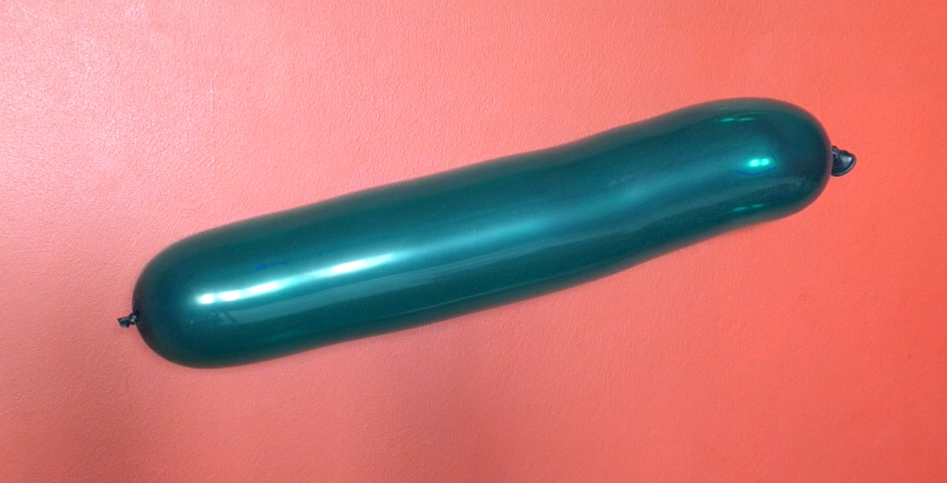
Xoog koronto-taag (Electrostatic force)
Marka buufinku lagu xoqo gidaarka…
…gidaarku wuxuu noqdaa mid koronto ku shuban (positively charged) buufinkuna wuxuu noqdaa mid koronto ku shuban (negatively charged).
Korontadu waxay ka dhigtaa buufinka iyo gidaarka inay is soo jiitaan.

Slide 26
Xoog koronto-taag (Electrostatic force)
Korontada ku taal gidaarka iyo buufinku waxay ku sii sugnaanayaan meel ay ku jiraan muddo gaaban sababtoo ah gidaarka iyo buufinku waa kuwo aan koronto qaadin (insulators).
Tani waa sababta loogu yeedho koronto taagan (static electricity).

Slide 27
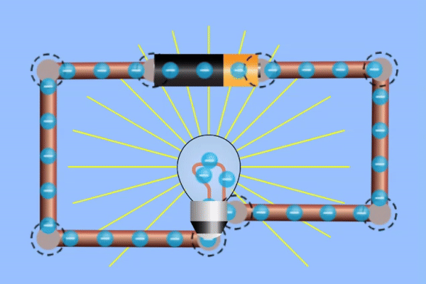
Xoog koronto-taag (Electrostatic force)
Korontada socota (current electricity), korontadu waxay lagu riixaa oo lagu jiidaa wareegga (circuit) waxayna dhex mari kartaa kuwa koronto qaada (conductors).
Korontada taagan (static electricity), korontadu waxay is riixi karaan oo is jiidi karaan, laakiin waxay ku dhegan yihiin kuwa aan koronto qaadin (insulators) mana dhaqaaqi karaan.
Kor: Gif Simulation by PhET Interactive Simulations, University of Colorado Boulder, licensed under CC-BY-4.0 (https://phet.colorado.edu)

Slide 28
Xoog koronto-taag (Electrostatic force)
Maxay korontada la arko marka kuwa aan koronto qaadin (insulators) la xoqo loogu yeedhaa koronto taagan (static electricity)?
korontadu waa mid taban (negative)
korontadu waxay ku sii sugnaataa meesha
walxaha waxaa haya xoog

Slide 29
Xoog koronto-taag (Electrostatic force)
Koronto isku mid ah (like charges) way is celin doonaan (isaga riixaya).
Koronto taban (negative charge) waxay is celisaa koronto taban (negative charge).
Koronto togan (positive charge) waxay is celisaa koronto togan (positive charge).

Slide 30
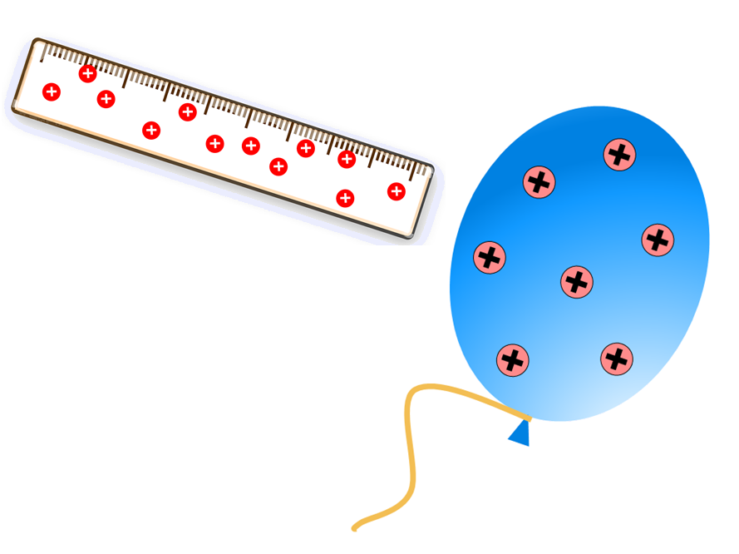
Xoog koronto-taag (Electrostatic force)
Maxaa ku dhici doonaan xaakin (ruler) iyo buufinkan?
way is celin doonaan (they will repel)
way is soo jiidan doonaan (they will attract)
Xoog (Force) ma jiri doono (there will be no force)

Slide 31
Xoogga Korantada (Electrostatic force)
Kordhinta masaafada u dhaxaysa buufinnada waxay yaraynaysaa cabbirka Xoogga Korantada (Electrostatic force).

Slide 32
Xoogga Korantada (Electrostatic force)
Kordhinta masaafada u dhaxaysa buufinnada waxay yaraynaysaa cabbirka Xoogga Korantada (Electrostatic force).

Slide 33
Xoogga Korantada (Electrostatic force)
Kordhinta masaafada u dhaxaysa buufinnada waxay yaraynaysaa cabbirka Xoogga Korantada (Electrostatic force).

Slide 34
Xoogga Korantada (Electrostatic force)
Saddexda mid ee qoraallada soo socda ee ku saabsan Xoogga Korantada (Electrostatic force) waa sax?
uma baahna taabasho (it does not require contact)
wuxuu kordhaa masaafada (it increases with distance)
wuxuu noqon karaa mid soo jiidasho leh (it can be attractive)
wuxuu noqon karaa mid celis (it can be repulsive)

Slide 35
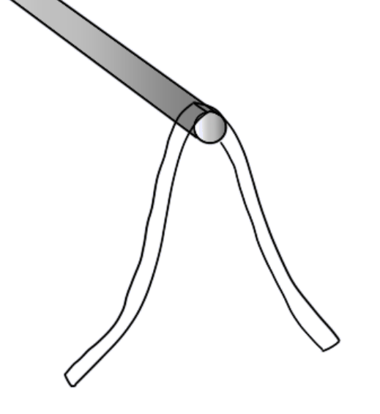
Xoogga Korantada (Electrostatic force)
Xariijintan caagga ah (plastic strip) ayaa lagu xoqay maro, labada qayboodna way is celinayaan (repelling each other).
Sharax sababta ay tani u dhacayso.
xariijin caag ah (plastic strip)

Slide 36
Xoogga Korantada (Electrostatic force)
Xariijintan caagga ah (plastic strip) ayaa lagu xoqay maro, labada qayboodna way is celinayaan (repelling each other).
Sharax sababta ay tani u dhacayso.
Xariijinta balaastiggu waxay noqotaa mid koronto ku shuban (charged) marka lagu xoqo marada.
Labada daraf ee xariijintu waxay leeyihiin koronto isku mid ah (same charge).
Korontooyinka isku midka ahi way iska celiyaan (repel), sidaas darteed labada daraf way iska fogaadaan iyada oo loo eegayo xoogga korantada (electrostatic force).
Natiijada, darafyadu waxay ahaanayaan kuwo kala fogaaday.

Slide 37
Koronto taagan (static electricity)
Koronto taagan (static electricity) ama koronto shuban (static charge) waxay ku ururtaa walxaha qaarkood marka la isku xoqo.
Waxaa jira laba nooc oo koronto shuban (electrostatic charge) ah: koronto togan (positive charge) iyo koronto taban (negative charge).
Walxaha korontada leh waxay ku dhici karaan xoog koronto (electrostatic force) oo aan taaban (non-contact) ah walxo kale.
Korontooyinka isku midka ahi way iska celiyaan (repel), korontooyinka kala duwanaanna way is soo jiitaan (attract).
Xoogga korantada (electrostatic force) wuu yaraadaa marka masaafada kordho.

