Slide 1
Qaab-dhismeedka polymers (Structure of polymers)
Qalabka (Materials)

Slide 2
Sida agabkeena waxbarista loogu talagalay fasalka

Slide 3
Waxaan siin karaa tusaalooyin polymers (polymers) ah oo aan sharxi karaa sida astaamaha polymers (polymers) ay ku xiran yihiin qaab-dhismeedkooda.

Slide 4
polymer (polymer)
Molekyuullo silsilad dheer leh oo la sameeyay iyadoo la isku xiro monomers (monomers).
forces of attraction (forces of attraction)
Xoog jiidasho oo walxaha isku dhoweya.
synthetic (synthetic)
Wax la soo saaray.
plasticiser (plasticiser)
Walax lagu daro polymer (polymer) si loo kordhiyo dabacsanaantiisa.
cross-link (cross-link)
Xidhiidh kiimikaad oo u dhexeeya atomooyinka silsiladaha kala duwan ee molecules polymer (polymer).

Slide 5

Qaab-dhismeedka polymer (polymer)
Polymers (Polymers)
Beddelidda astaamaha polymers (polymers)

Slide 6
Polymers (Polymers)
Polymers (Polymers) waxaa laga sameeyaa molekyuullo yaryar oo la yiraahdo monomers (monomers) kuwaas oo isku xirma si ay u sameeyaan silsilado aad u dheer oo atomo ah. Polymer (polymer) caadi ahaan wuxuu ka kooban yahay tobanaan kun oo atomo ah.
monomers (monomers)
polymer (polymer)
badan
qaybo
isku-xidhka kiimikaad ee xooggan (strong chemical bond)
qayb ka mid ah polymer (a section of a polymer)

Slide 7

Polymers (Polymers)
Imisa atom ayaa ku jira molecule polymer caadi ah?
<10
<100
<1000
>1000

Slide 8
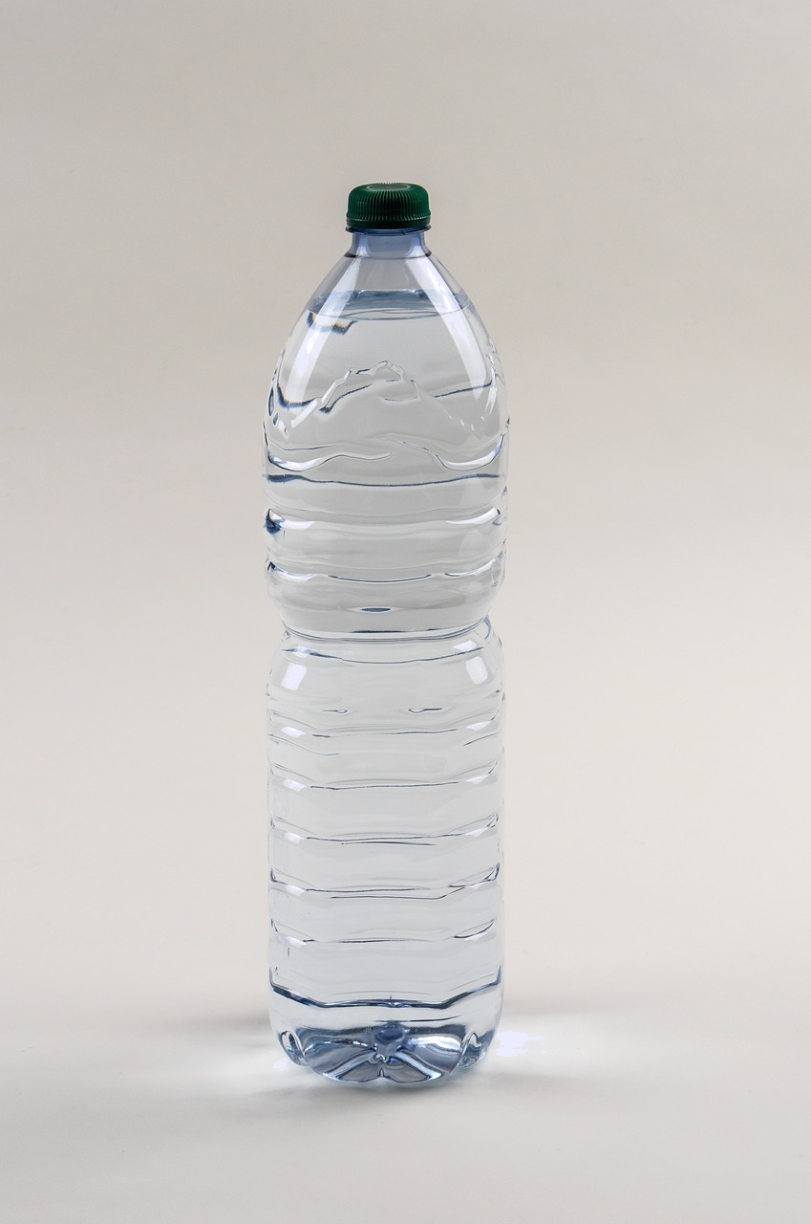
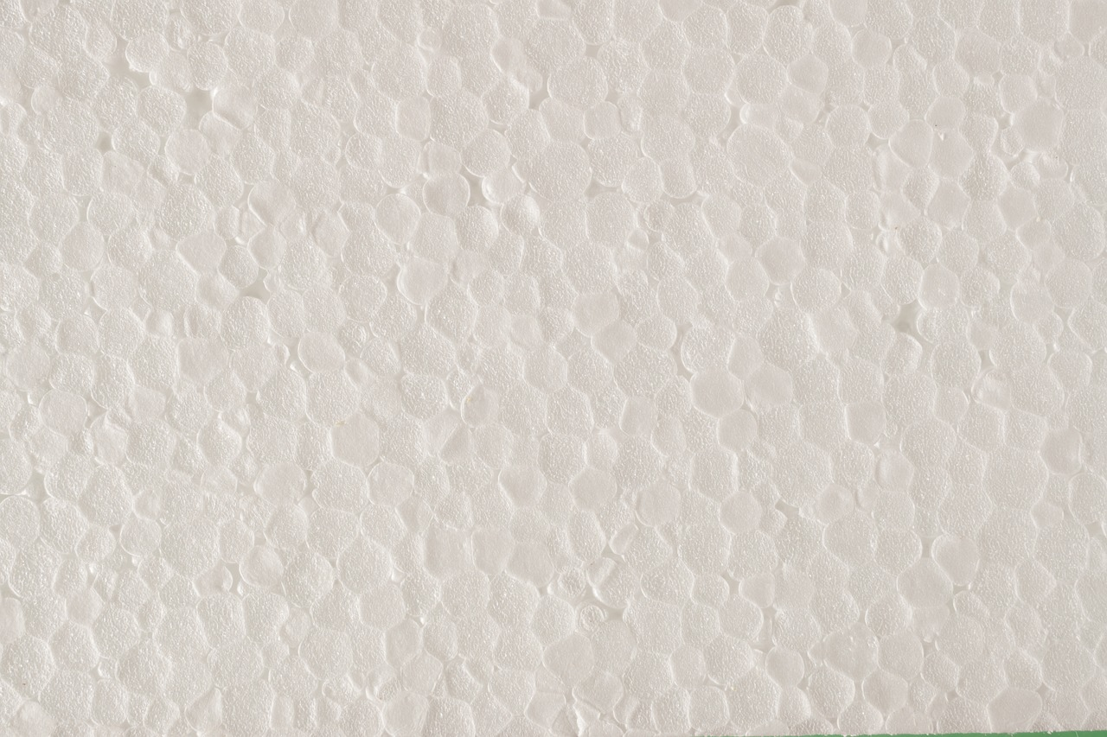
Polymers (Polymers)
Polymers waxaa la samayn karaa si synthetic ah laakiin qaarkood waxay sidoo kale ku yimaadaan si dabiici ah.
Poly(propene) iyo poly(styrene) waa tusaalooyin polymers synthetic ah.
Poly(propene) waxaa laga sameeyaa monomer propene.
dhalada poly(propene)
poly(styrene)
Poly(styrene) waxaa laga sameeyaa monomer styrene.

Slide 9
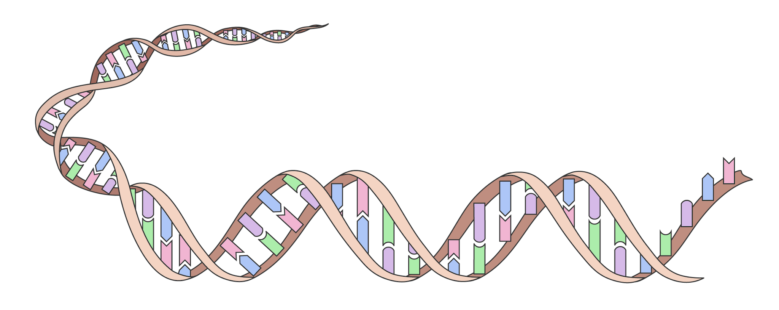
Polymers (Polymers)
Polymers (Polymers)
Deoxyribonucleic acid, DNA, waa tusaale polymer si dabiici ah u dhaca.
Polymers-ka dabiiciga ah waxay ka yimaadaan noolaha. Proteins, carbohydrates (tusaale ahaan starch iyo cellulose) dhamaantood waa polymers.

Slide 10
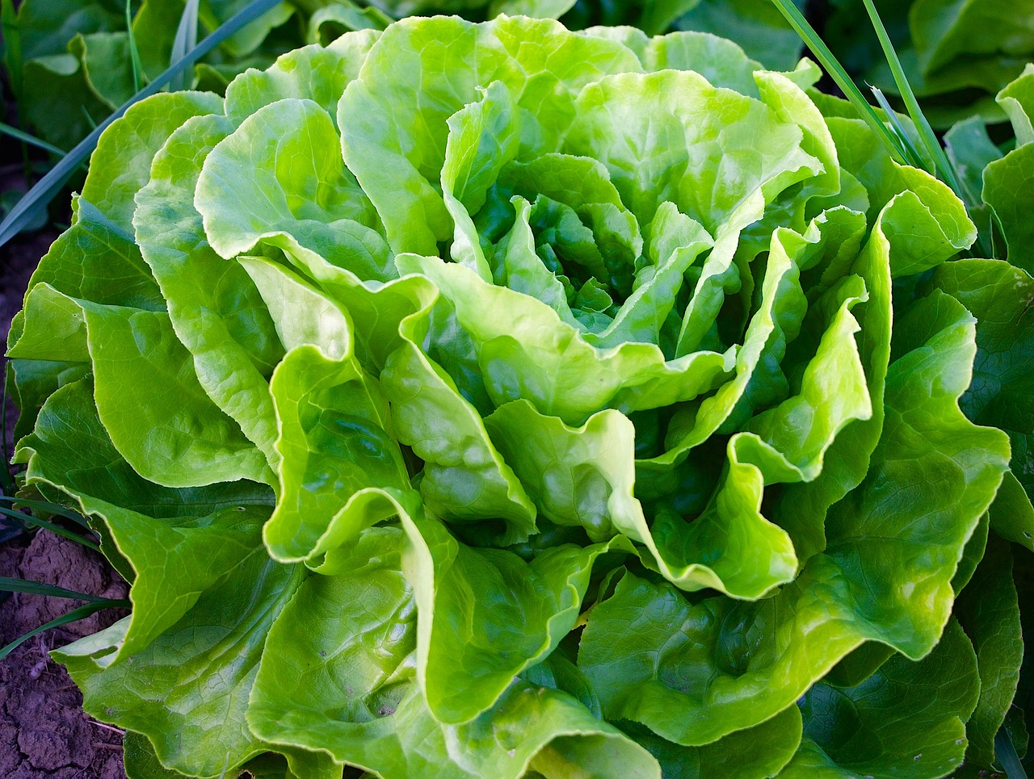
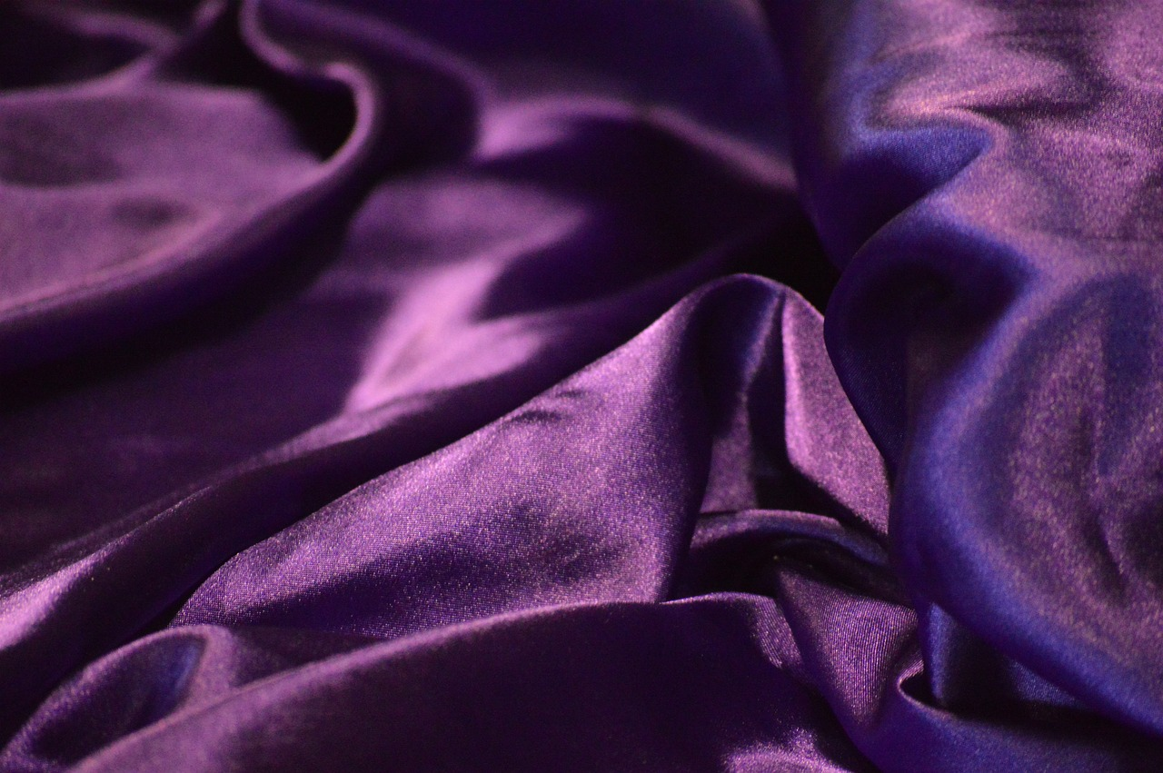
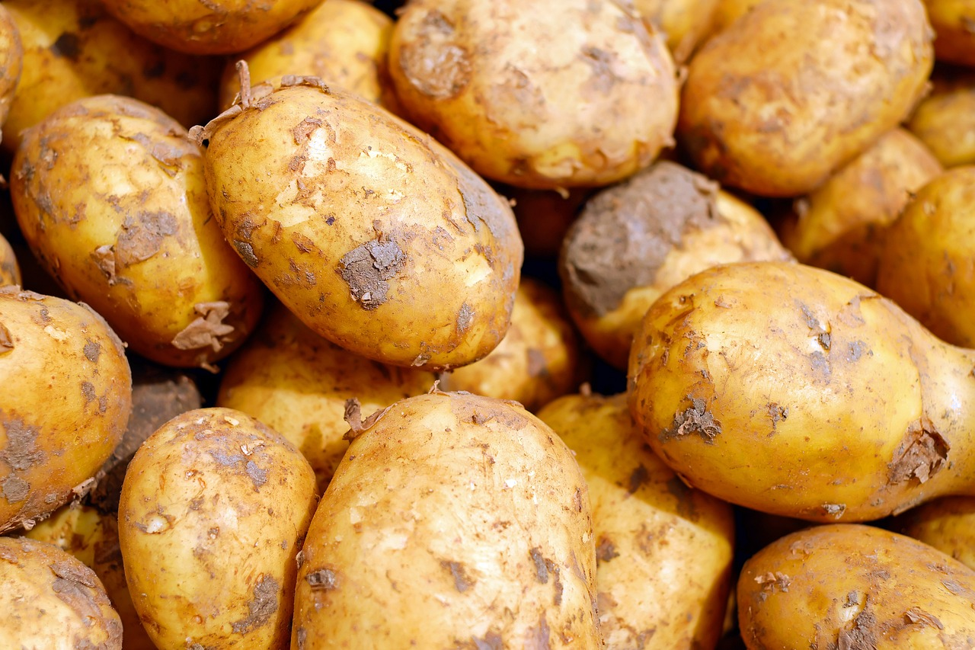
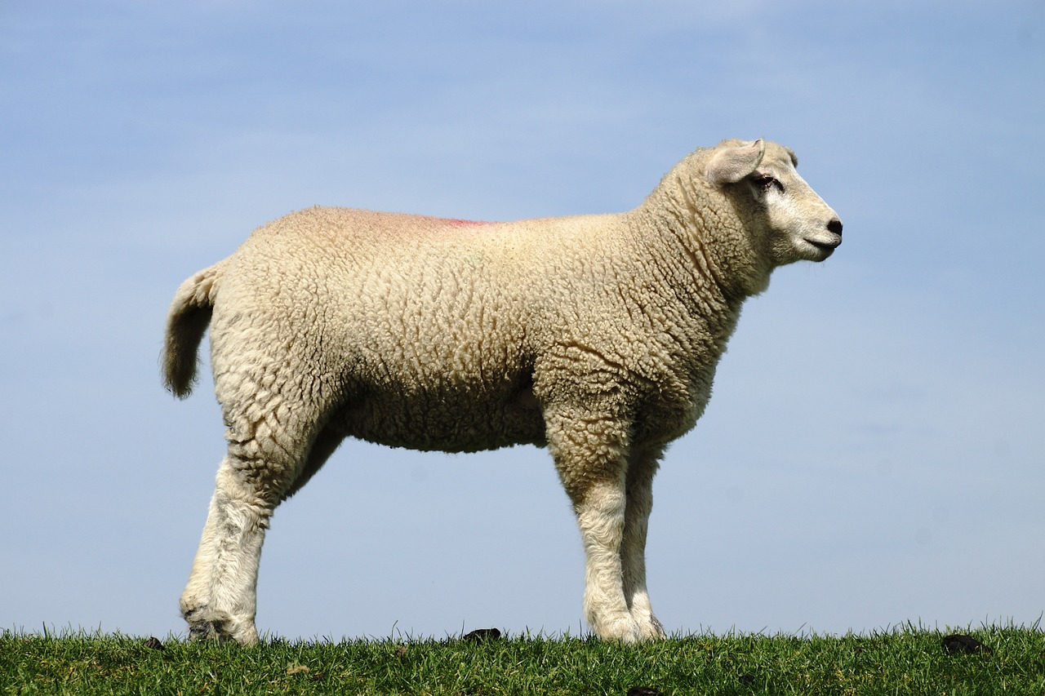
Polymers (Polymers)
Tusaalooyinka polymers-ka dabiiciga ah waxaa ka mid ah:
laga helo gidaarada unugyada dhirta
monomer glucose (monomer glucose)
faybar borotiin (protein fibre) oo uu sameeyo dixiriga (silkworm)
monomers: amino acids
cellulose
silk
laga helo cuntooyinka sida baradhada
monomer glucose (monomer glucose)
faybar borotiin (protein fibre) (keratin)
monomers: amino acids
starch
wool

Slide 11
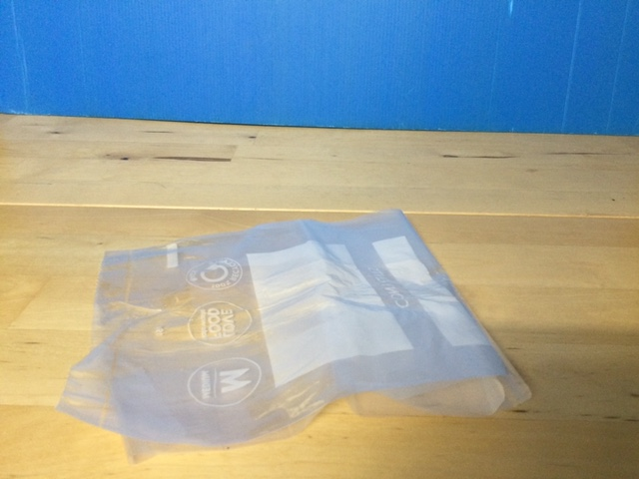
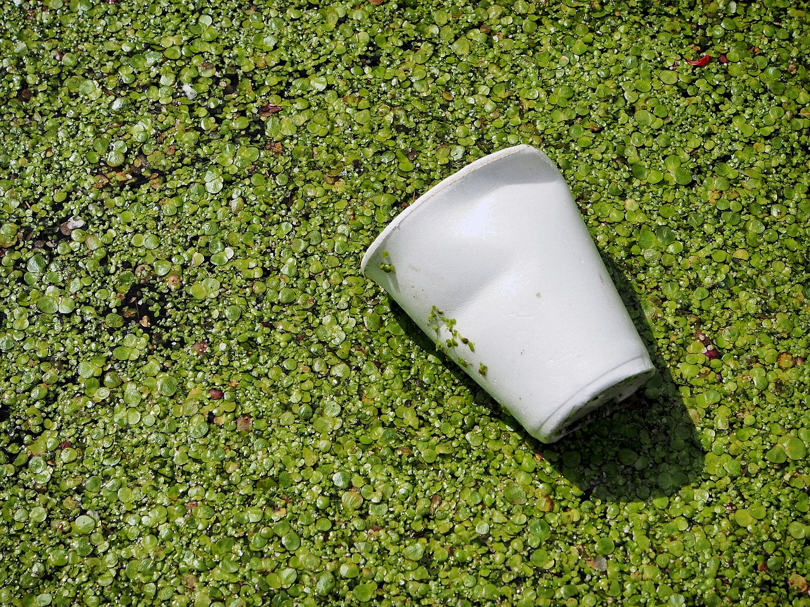
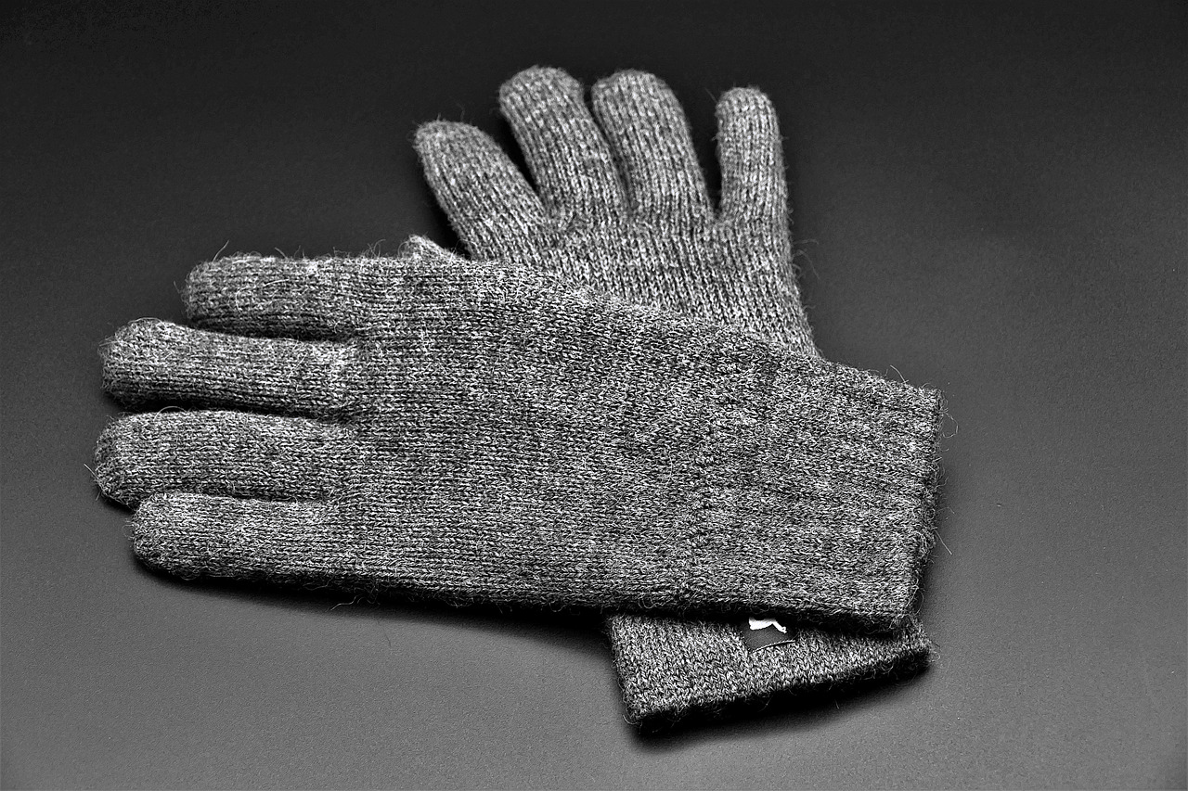
Polymers
Waa kuwee shayyada laga sameeyay polymers synthetic?
bac poly(ethene) (poly(ethene) bag)
koob poly(styrene) (poly(styrene) cup)
gacmo-gashi wool (wool gloves)

Slide 12
Polymers
Balaastigga waxaa laga sameeyaa polymers tusaale: poly(ethene).
Polymers waa molecules aad u dheer.
Waxaa jira xoogag soo jiidasho (forces of attraction) oo u dhexeeya molecules-ka polymer-ka.
molecules-ka polymer-ka
xoogag soo jiidasho (forces of attraction)
Heerkulka dhalaalka (melting point) ee polymers wuu ka sarreeyaa kan molecules-ka fudud.
qaab dhismeedka balaastigga (structure of a plastic)
Marka polymer-ku dhalaalo, molecules-ku way dhaqaaqaan. Sababtoo ah xoogagga soo jiidashada (forces of attraction) ee u dhexeeya molecules-ka ayaa jabay, ma aha bonds-ka u dhexeeya atoms-ka molecule-ka.

Slide 13
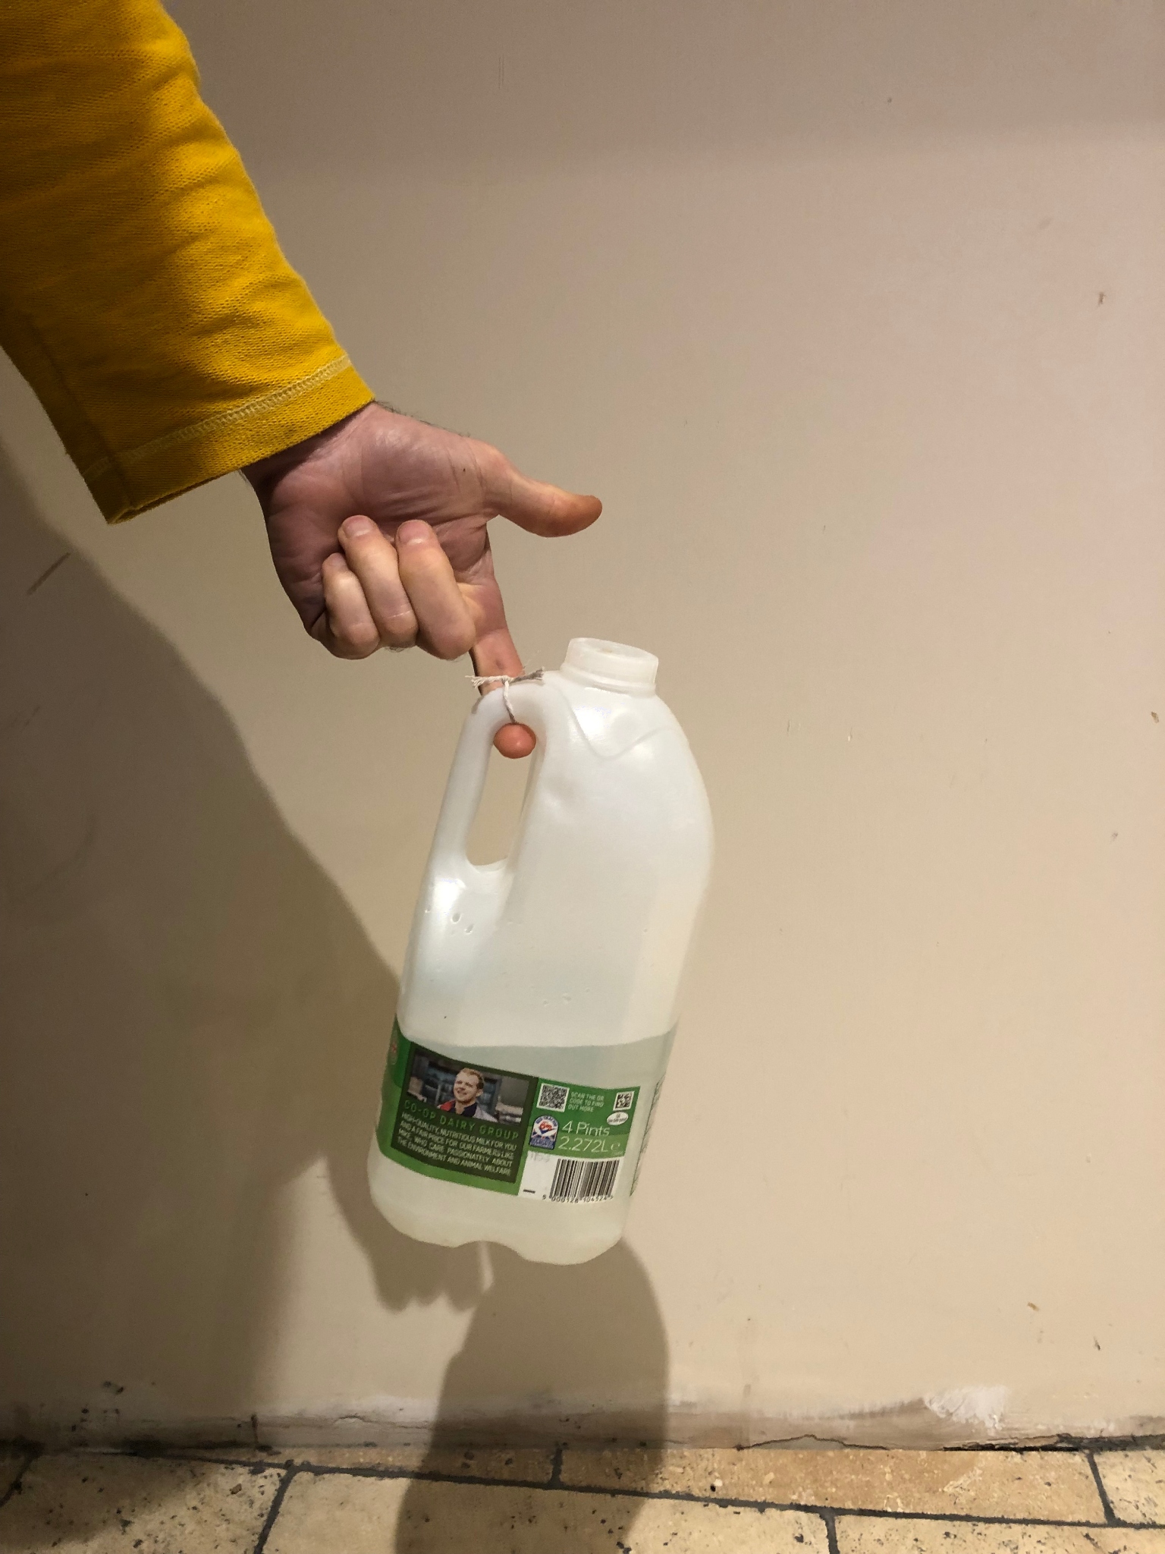
Polymers (Polymers)
Waxaa jira noocyo badan oo polymers ah. Isla monomer-ka ayaa xitaa samayn kara polymers kala duwan:
poly(ethene) cufnaan sare leh, HDPE
poly(ethene) cufnaan hoose leh, LDPE
Heerkulka dhalaalida ee HDPE wuu ka sarreeyaa LDPE sababtoo ah xoogagga soo jiidashada (forces of attraction) ee u dhexeeya molekyuulada ayaa ka xoog badan maadaama molekyuuladu isku dhow yihiin.
dhalo caano laga sameeyay HDPE
Heerkulka dhalaalida ee HDPE waa 120 - 180 oC.
molekyuulada polymer-ka (polymer molecules)
xoogagga soo jiidashada (forces of attraction)
qaab-dhismeedka polymer-ka cufnaanta sare leh (high density polymer)

Slide 14
Polymers (Polymers)
poly(ethene) cufnaan hoose leh, LDPE, wuxuu leeyahay heerkul dhalaalid ka hooseeya HDPE.
Tani waxay ugu wacan tahay silsiladaha polymer-ka oo leh laamo (branches) kuwaas oo keena xoogag soo jiidasho oo daciif ah.
balastiig laga sameeyay LDPE
molekyuulada polymer-ka (polymer molecules)
laamo (branches)
xoogagga soo jiidashada (forces of attraction)
Heerkulka dhalaalida ee LDPE waa qiyaastii 105 - 115oC.
qaab-dhismeedka LDPE

Slide 15
Polymers (Polymers)
Polymer-ka cufnaanta hooseeya wuxuu leeyahay heerkul dhalaalid ka sarreeya polymer-ka cufnaanta sare leh.
Polymer-ka cufnaanta sare leh wuxuu leeyahay xoogag soo jiidasho (forces of attraction) oo badan oo u dhexeeya molekyuulada.
Molekyuulka polymer-ka cufnaanta hooseeya wuxuu leeyahay bondiyo (bonds) ka xoog badan oo u dhexeeya atom-yada.

Slide 16

Polymers (Polymers)
Maxay polymers (Polymers) u leeyihiin heerkulka dhalaalida (Melting Point) oo ka sarreeya monomers-ka?
Qodob kasta, dooro hal tiir si aad u muujiso waxa aad qabtid
I
Waan hubaa inay sax tahay
I
Waxaan u malaynayaa inay sax tahay
I
Waxaan u malaynayaa inay khalad tahay
I
Waan hubaa inay khalad tahay
a
Atamka ku jira polymers (Polymers) ayaa si xoog leh isugu xidhan.
b
Waxaa jira xoogag (Forces) soo jiidasho oo ka weyn oo u dhexeeya molecules-ka.
c
Atam badan oo ku jira molecules-ka ayaa loo baahan yahay in la kala saaro.

Slide 17
Polymers (Polymers)
Maxay polymers (Polymers) u leeyihiin heerkulka dhalaalida (Melting Point) oo ka sarreeya monomers-ka?
Qodob kasta, dooro hal tiir si aad u muujiso waxa aad qabtid
I
Waan hubaa inay sax tahay
I
Waxaan u malaynayaa inay sax tahay
I
Waxaan u malaynayaa inay khalad tahay
I
Waan hubaa inay khalad tahay
a
Atamka ku jira polymers (Polymers) ayaa si xoog leh isugu xidhan.
b
Waxaa jira xoogag (Forces) soo jiidasho oo ka weyn oo u dhexeeya molecules-ka.
c
Atam badan oo ku jira molecules-ka ayaa loo baahan yahay in la kala saaro.

Slide 18
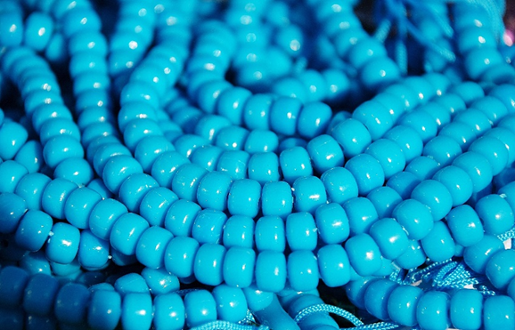
Polymer-yada (Polymers)
2) Arday qaar ayaa samaynaya qaab (Model) molecule polymer (Polymer) ah. Waxay go'aansadeen inay isticmaalaan silsilad dheer oo kuul ah.
Sheeg hal hab oo ay kuuluhu u yihiin matalaad wanaagsan oo ah unug polymer (polymer molecule).
Sheeg saddex hab oo ay kuuluhu u ahayn matalaad sax ah oo ah unug polymer (polymer molecule).
Starch waa polymer dabiici ah (natural polymer) iyo nylon waa polymer synthetic ah. Waa maxay farqiga?

Slide 19
Polymer-yada (Polymers)
2) Arday qaar ayaa samaynaya moodal unug polymer (polymer molecule). Waxay go'aansadeen inay isticmaalaan silsilad dheer oo kuulo ah.
Sheeg hal hab oo ay kuuluhu u yihiin matalaad wanaagsan oo ah unug polymer (polymer molecule).
Sheeg saddex hab oo ay kuuluhu u ahayn matalaad sax ah oo ah unug polymer (polymer molecule).
Waxay muujinaysaa kuulo badan (monomers) oo isku xiran silsilad dheer.
Kuuluhu waxay ku xiran yihiin xadhig kaliya.
Atamku ma aha buluug (blue).
Waxay mataleysaa qayb yar oo polymer ah sababtoo ah polymer-yada waxay ka samaysan yihiin kumannaan atam.
Ma aha cabbir sax ah (not to scale).

Slide 20
Polymer-yada (Polymers)
Starch waa polymer dabiici ah (natural polymer) iyo nylon waa polymer synthetic ah. Waa maxay farqiga?
Polymer-yada dabiiciga ah waxay ka yimaadaan noolaha, tusaale: starch waxaa sameeya dhirta sida baradhada.
Wax soo saarka synthetic waa la soo saaraa. Nylon waa polymer la soo saaray (man-made).

Slide 21
Qaab-dhismeedka polymer (Structure of a polymer)
Polymer-yada (Polymers)
Beddelidda sifooyinka polymer-yada (Changing the properties of polymers)

Slide 22
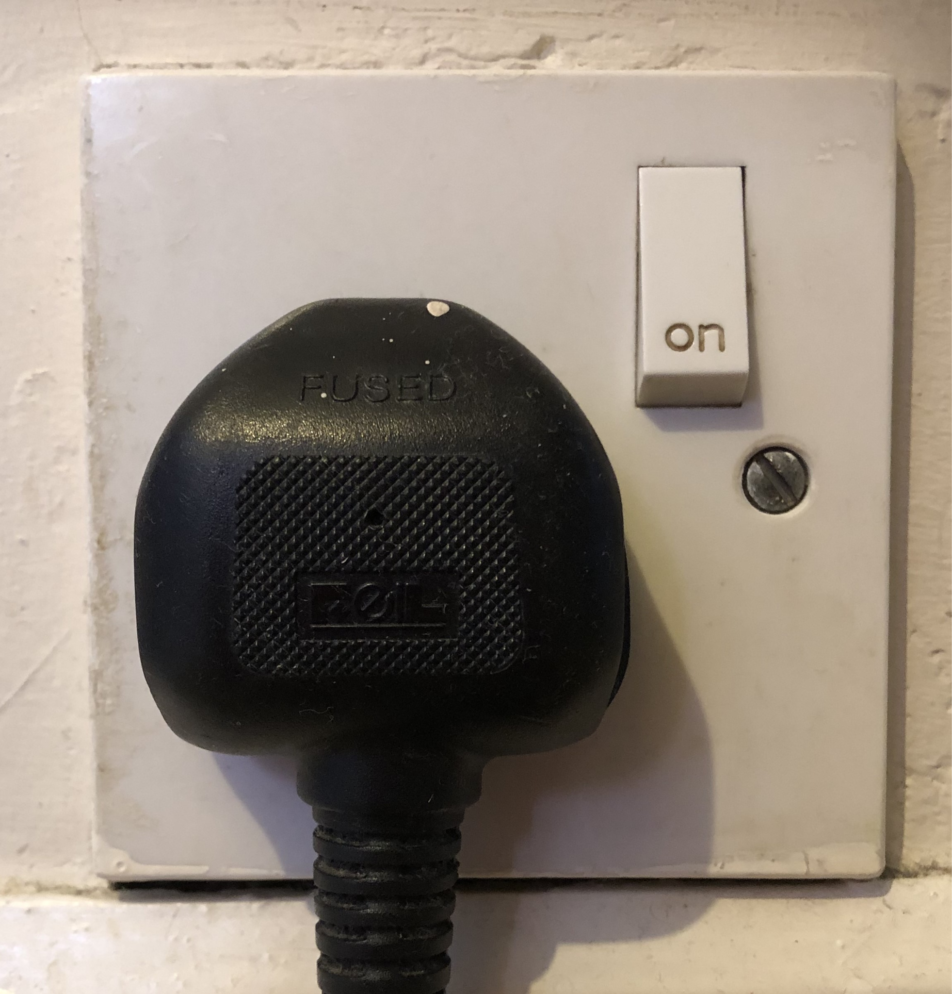
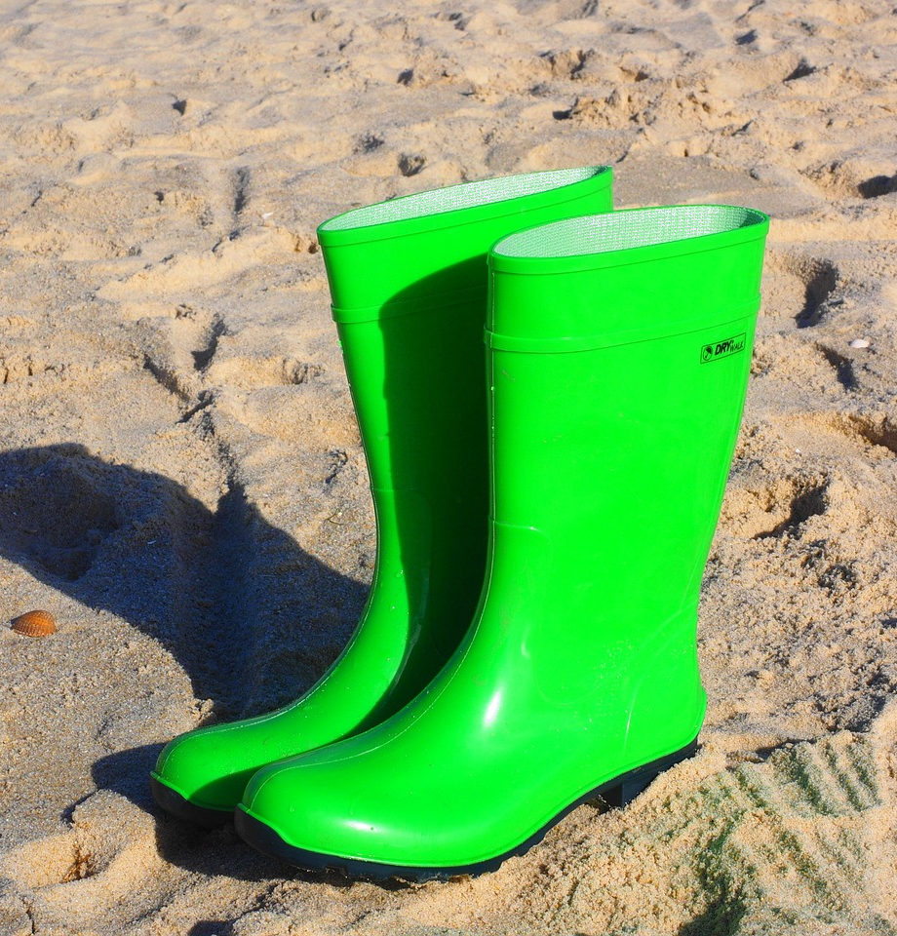
Beddelidda sifooyinka polymer-yada (Changing the properties of polymers)
Polymer-yadu waa agab aad u kala duwan oo leh codsiyo badan sababtoo ah waa sahlan tahay in la beddelo sifooyinka. Tusaale: polymer polyvinyl chloride (PVC) wuxuu noqon karaa mid jilicsan ama adag.
Furaha iftiinka (light switches) iyo godadka korontada (electrical sockets) waxaa laga sameeyaa PVC adag (rigid PVC).
Kabaha Wellington waxaa laga sameeyaa PVC jilicsan (flexible PVC).

Slide 23
Beddelka astaamaha polymer-yada (Changing the properties of polymers)
Si loo kordhiyo jilicsanaanta (flexibility) polymer-yada sida PVC, waxaa lagu dari karaa plasticiser.
plasticiser
molecule-yada polymer-ka (polymer molecules)
xoogagga soo jiidashada (forces of attraction)
qaabka polymer-ka (structure of polymer)
Plasticiser-ka lagu daro polymer-ka wuxuu dhexgalaa molecule-yada polymer-ka wuxuuna u oggolaadaa inay isku dhaqaaqaan si fudud. Wuxuu kala fidaa molecule-yada dhaadheer si xoogagga isku haya ay u yaraadaan.

Slide 24
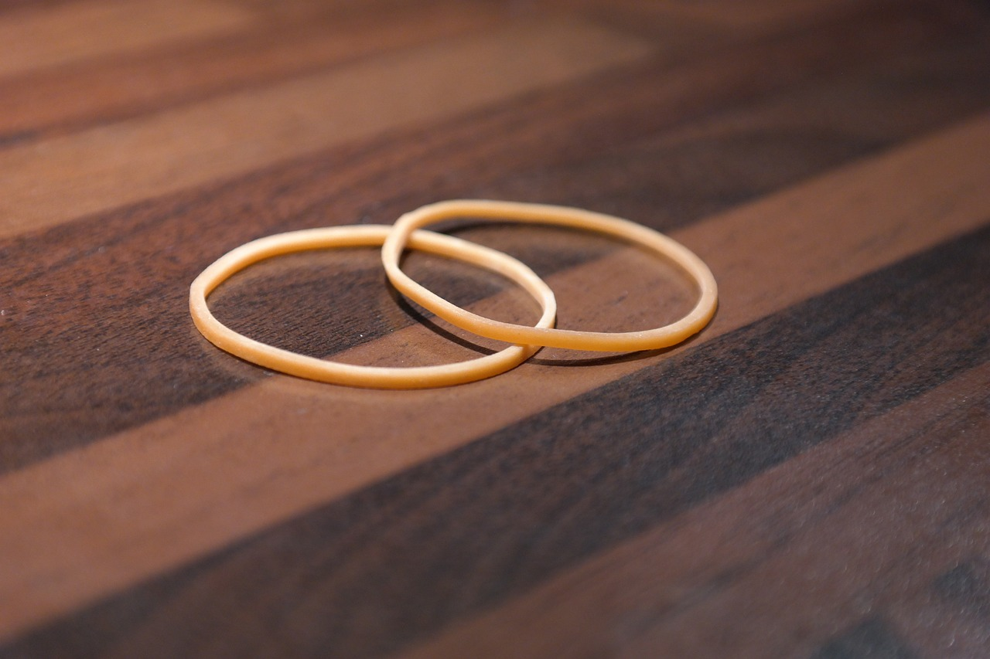
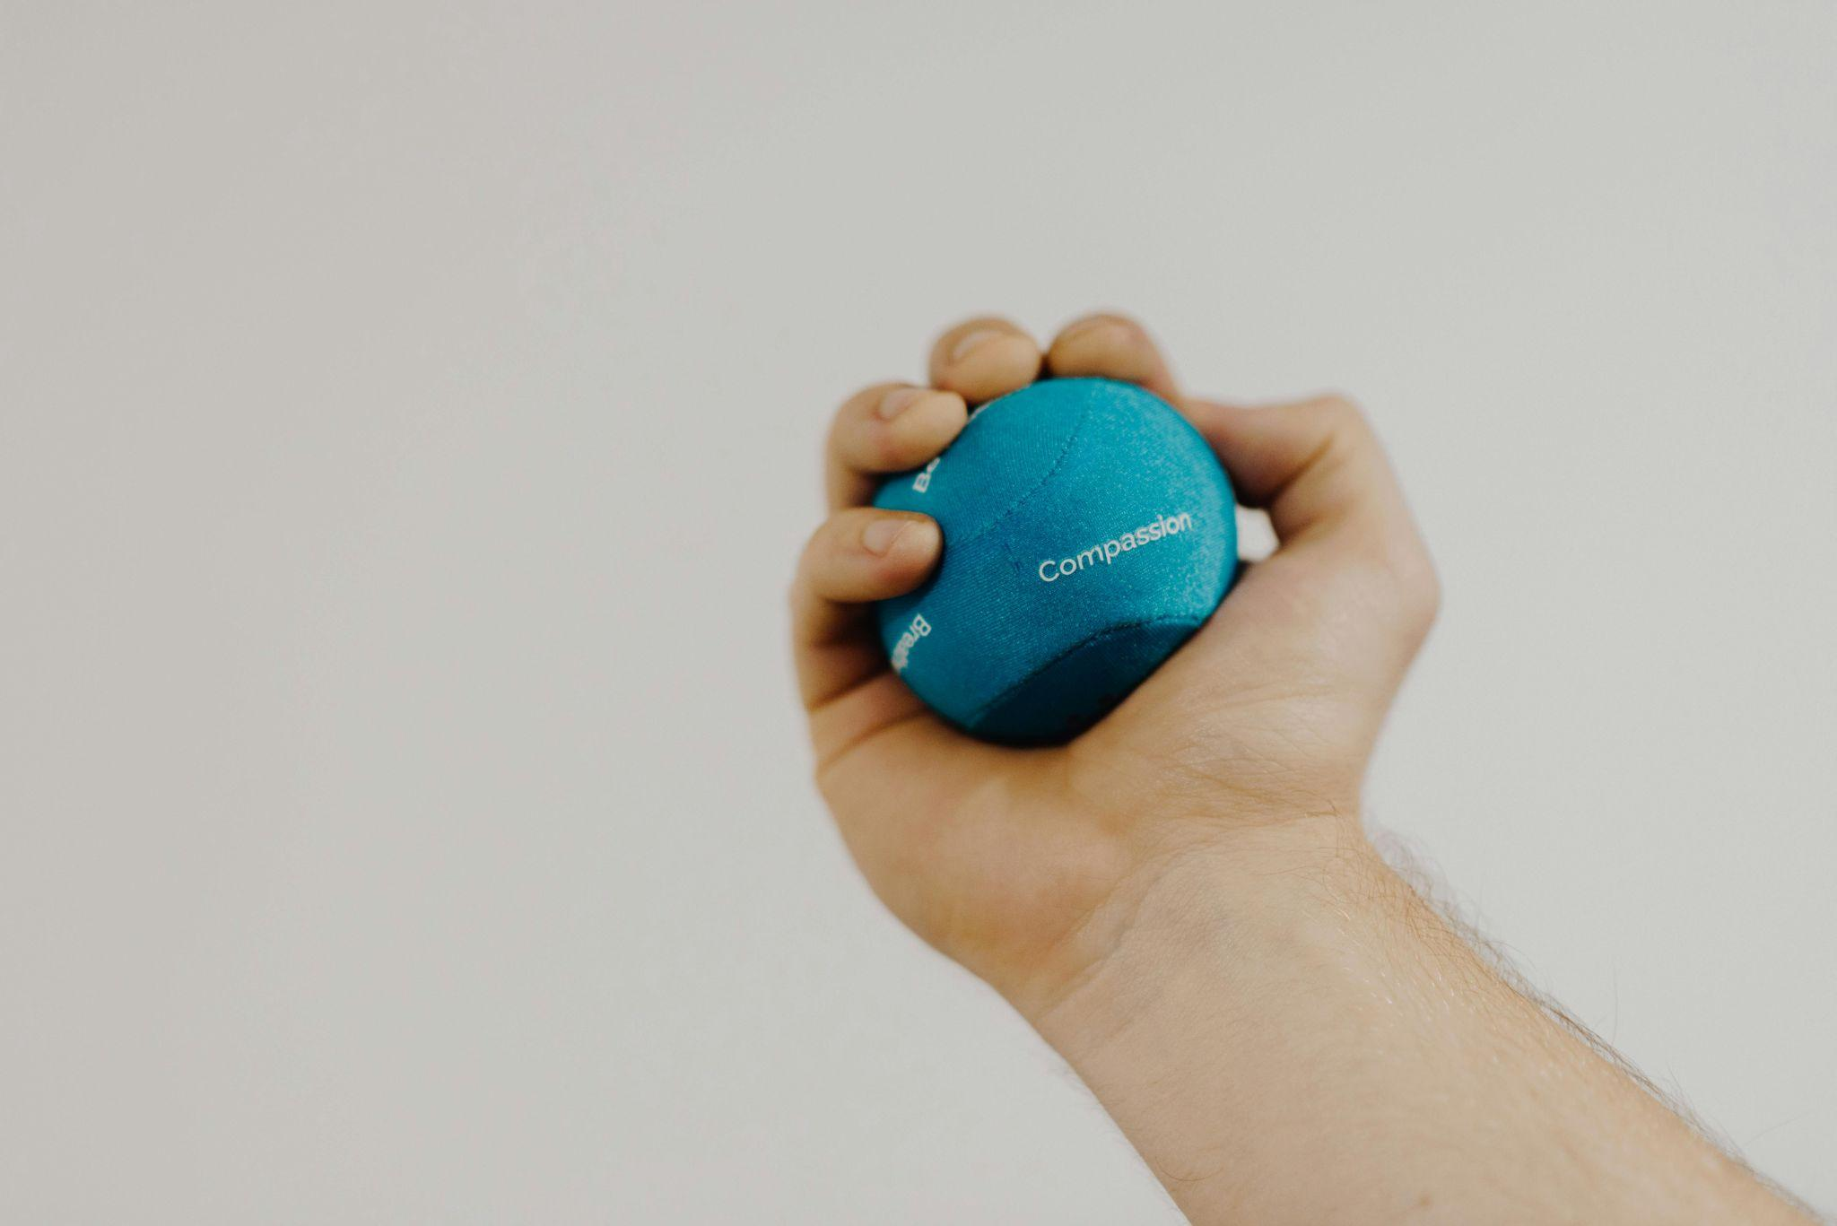
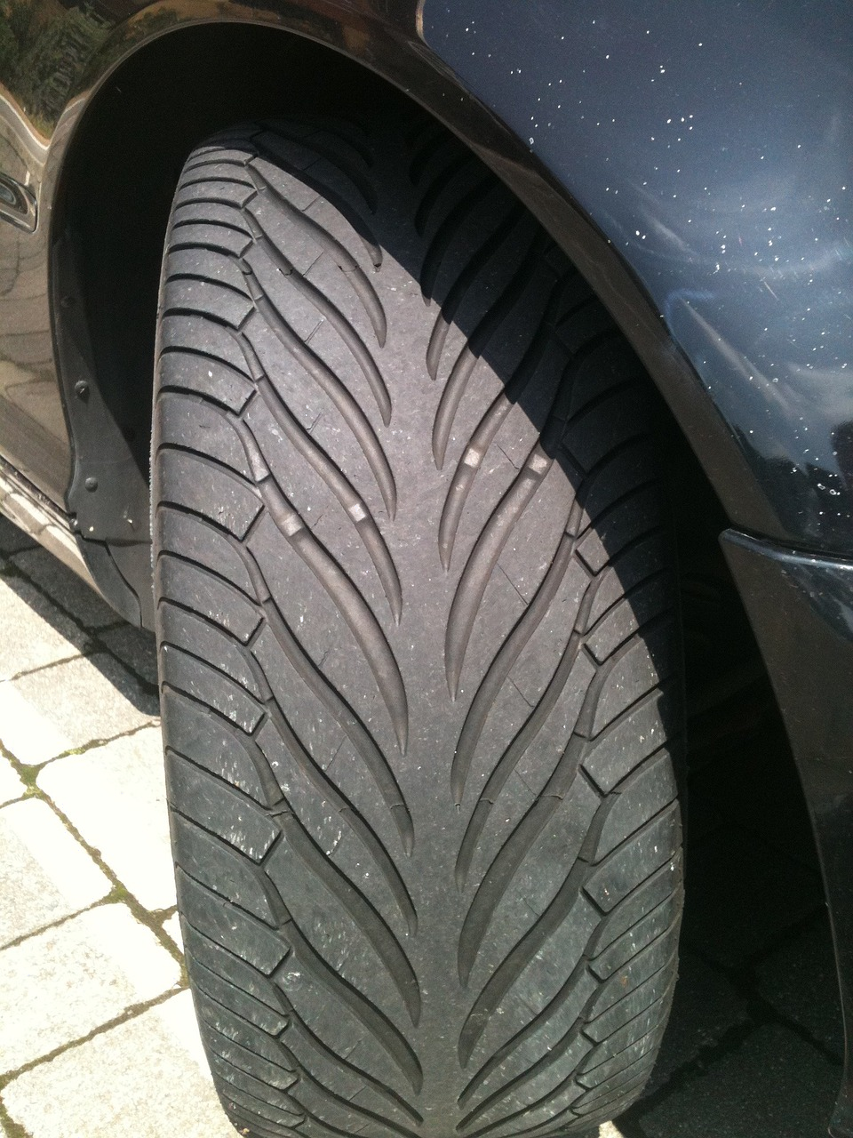
Beddelka astaamaha polymer-yada (Changing the properties of polymers)
Rubber-ku waa polymer dabiici ah (natural polymer) oo laga helo dheecaanka geedaha rubber-ka.
Rubber-ku wuxuu leeyahay adeegsi badan:
xariijinta rubber-ka (rubber band)
kubadda rubber-ka (rubber ball)
taayirada rubber-ka (rubber tyre)
Wuxuu leeyahay astaamo laastiko ah (elastic properties) waxaana la kala jiidi karaa ka dibna wuu soo laabtaa.

Slide 25
Beddelka astaamaha polymer-yada (Changing the properties of polymers)
Plasticiser-yada waxaa lagu daraa polymer-ka si ay u noqdaan…
adag (harder)
jilicsan (more flexible)
adag (more rigid)

Slide 26
Beddelidda astaamaha polymers (polymers)
Si loo kordhiyo adkaanta polymer-ka oo loo yareeyo dabacsanaantiisa, iskutallaab (cross-links) ayaa lagu daraa qaab-dhismeedka.
Cross-link waa xidhiidh kiimiko oo xooggan oo u dhexeeya silsilado kala duwan oo atomo ah oo ku jira polymer-ka kaas oo:
qaab-dhismeedka polymer-ka
polymer molecules
molecules-ka polymer-ka
iskutallaab (cross-link)
ka dhig polymer-ka mid adag oo aan dabacsanayn

Slide 27
Caagga loo isticmaalo samaynta taayirada wuxuu u baahan yahay inuu noqdo mid waara, adag oo aan dabacsanayn sida caagga dabiiciga ah.
ka dhig mid adag in molecules-ka polymer-ku isku siibaan
taayir caag ah
qaab-dhismeedka caagga loo isticmaalo samaynta taayirada
Hab loo yaqaan vulcanisation (vulcanisation) ayaa loo isticmaalaa in lagu daro iskutallaabyo (cross-links) inta u dhaxaysa silsiladaha polymer-ka.
Beddelidda astaamaha polymers (polymers)
molecules-ka caagga

Slide 28
Heerkulka dhalaalka caagga dabiiciga ah wuxuu qiyaas ahaan yahay 106OC.
Beddelidda astaamaha polymers (polymers)
qaab-dhismeedka caagga dabiiciga ah
isku-xirka (cross link)
Heerkulka dhalaalka caagga vulcanised (vulcanised) wuxuu qiyaas ahaan yahay 120 - 140OC.
xoogga soo jiidashada (force of attraction)
molecules-ka caagga
qaabka caagga la vulcanized (vulcanised rubber)
iskutallaab (cross-link)
Waxay u baahan tahay tamar badan in la kala saaro molecules-ka polymer-ka marka ay jiraan iskutallaabyo (cross-links), maxaa yeelay waxay ka xoog badan yihiin xoogagga soo jiidashada ee u dhexeeya molecules-ka caagga dabiiciga ah.

Slide 29
Beddelka sifooyinka polymer-yada
Isku-xirka (cross links) wuxuu kordhiyaa dabacsanaanta polymer-ka.
Waxay ku darsataa xidhiidhyo kiimiko oo xooggan oo u dhexeeya molecules-ka polymer-ka.
Waxay kala fogaaysaa silsiladaha polymer-ka, iyada oo ka dhigaysa mid fudud inay dhaqaaqaan.

Slide 30
Beddelka sifooyinka polymer-yada
1) Xabagta PVA waa mid dareere ah oo ay ku jirto polymer.
Isku darka milanka borax (borax solution) iyo xabagta PVA waxay ku darsataa isku-xirka (cross-links) polymer-ka.
Saadaali sida sifooyinka xabagta PVA ay u beddeli doonaan marka borax lagu daro?
Sheeg sababta aad u malaynayso inay tani dhacdo.
2) Sifooyinka polymer-ka waxaa lagu beddeli karaa iyadoo lagu daro isku-xirka (cross-links) ama plasticisers.
Sidee ku samayn kartaa polymer ka sii dabacsan?

Slide 31
Beddelka sifooyinka polymer-yada
1) Xabagta PVA waa mid dareere ah oo ay ku jirto polymer.
Isku darka milanka borax (borax solution) iyo xabagta PVA waxay ku darsataa isku-xirka (cross links) polymer-ka.
Saadaali sida sifooyinka xabagta PVA ay u beddeli doonaan marka borax lagu daro.
Sheeg sababta aad u malaynayso inay tani dhacdo.
PVA waa inay noqotaa mid aan dareere ahayn / aan dabacsanayn / sii kala bixi kara.
Isku-xirka (cross links) waa xidhiidhyo kiimiko oo xooggan oo u dhexeeya molecules-ka polymer-ka dhaadheer. Waxay ku adkaan doontaa molecules-ka polymer-ka inay iska siibtaan / is dhaafaan.
2) Sifooyinka polymer-ka waxaa lagu beddeli karaa iyadoo lagu daro isku-xirka (cross-links) ama plasticisers. Sidee ku samayn kartaa polymer ka sii dabacsan?
Ku dar plasticiser.

Slide 32
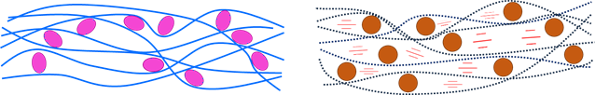



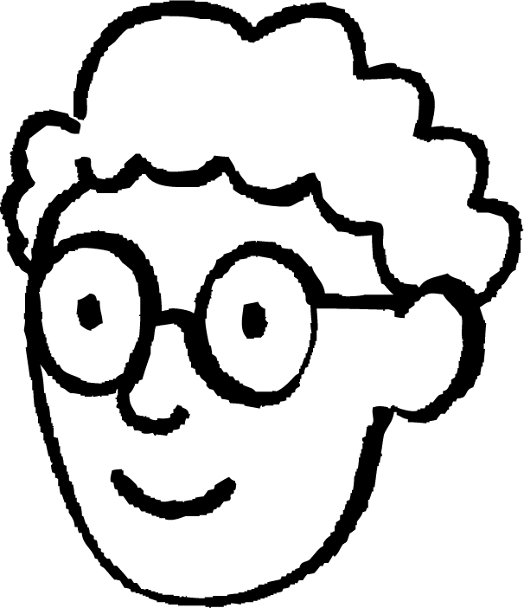


Bedelida astaamaha polymers
3) Laba arday ayaa sawiro sawiray si ay u sharaxaan sida plasticiser u shaqeeyo.
Saciid
Layla
Waa maxay xariijimaha buluuga ah (blue lines) ay matalaan?
Waa maxay oval-ka casaanka ah (pink ovals) ay matalaan?
Waa maxay xariijimaha dhibcaha leh (dotted lines) ay matalaan?
Waa maxay oval-ka oranji ah (orange ovals) ay matalaan?
Waa maxay xariijimaha casaanka ah (red lines) ay matalaan?

Slide 33
Bedelida astaamaha polymers
3) Laba arday ayaa sawiro sawiray si ay u sharaxaan sida plasticiser u shaqeeyo.
Saciid
Layla
Yaa sawirkiisu ka caawinaya in si fiican loo sharaxo sababta plasticiser uga dhigo PVC polymers kuwa dabacsan? Sabab u sheeg.

Slide 34
Bedelida astaamaha polymers
3) Laba arday ayaa sawiro sawiray si ay u sharaxaan sida balaastigaystaha (plasticiser) u shaqeeyo.
Saciid
Layla
molecules-ka polymer
Waa maxay xariijimaha buluuga ah (blue lines) ay matalaan?
Waa maxay oval-ka casaanka ah (pink ovals) ay matalaan?
Waa maxay xariijimaha dhibcaha leh (dotted lines) ay matalaan?
Waa maxay oval-ka oranji ah (orange ovals) ay matalaan?
Waa maxay xariijimaha casaanka ah (red lines) ay matalaan?
plasticiser-ka
molekyuulasha polymer-ka (polymer molecules)
balaastigaystaha (plasticiser)
Xoogagga soo jiidashada ee u dhexeeya molekyuulasha polymer-ka.

Slide 35
Beddelka astaamaha polymer-ka (polymers)
3) Laba arday ayaa sawiro sawiray si ay u sharaxaan sida balaastigaystaha (plasticiser) u shaqeeyo.
Saciid
Layla
Yaa sawirkiisu ka caawinayaa in si fiican loo sharaxo sababta balaastigaystaha (plasticiser) uga dhigo polymer-ka PVC mid jilicsan? Sabab u sheeg.
Sawirka Saciid. Labada sawirba waxay muujinayaan molekyuulasha polymer-ka iyo balaastigaystaha (plasticiser) laakiin sawirka Saciid wuxuu kaloo muujinayaa xoogagga soo jiidashada ee daciifka ah ee u dhexeeya molekyuulasha polymer-ka; sidaas darteed waa ka fiican yahay. Wuxuu bixiyaa faahfaahin dheeri ah oo ku saabsan waxa dhacaya.

Slide 36
Qaab-dhismeedka polymer-ka (polymers)
Polymer-ka (polymers) waxaa laga sameeyaa molekyuul yaryar oo loo yaqaan monomers kuwaas oo isku xirma si ay u sameeyaan molekyuul dheer oo silsilad ah.
Polymer-ka (polymers) waxaa lagu samayn karaa si macmal ah, laakiin qaarkood sidoo kale waxay u jiraan si dabiici ah.
Qaar ka mid ah polymer-ka (polymers) waxay leeyihiin heerkul dhalaal sare sababtoo ah molekyuulashooda way adag tahay in la kala saaro.
Balaastigaystaha (plasticiser) lagu daro polymer-ka (polymer) wuxuu dhexgalaa molekyuulasha polymer-ka wuxuuna u oggolaadaa inay isku dhaqaaqaan si fudud.
Isku-xirnaanta (cross-links) ee u dhexeysa molekyuulasha polymer-ka waxay ka dhigi kartaa polymer-ka mid adag oo aan jilicsanayn.

