Slide 1
Barashada isbeddelka cimilada deegaanka
Xisaabta iyo deegaanka

Slide 2
Sida agabkeena waxbarista loogu talagalay fasalka

Slide 3
Waxaan fahmi karaa sida cimilada UK u isbeddeshay muddo dheer.

Slide 4
Saadaal (forecast) waa saadaalin dhacdo mustaqbalka ah (oo ku salaysan xog).
Kordhin (extrapolation) waa hab lagu qiyaaso qiimayaal aan la garanayn oo ka baxsan xogta jirta.
Cimilo (climate) waa celceliska qaabka cimilada aagga muddo dheer.

Slide 5

Barashada isbeddelka cimilada deegaanka
Falanqaynta xogta cimilada deegaanka
Sameynta gabagabo ku saabsan isbeddelka cimilada deegaanka

Slide 6
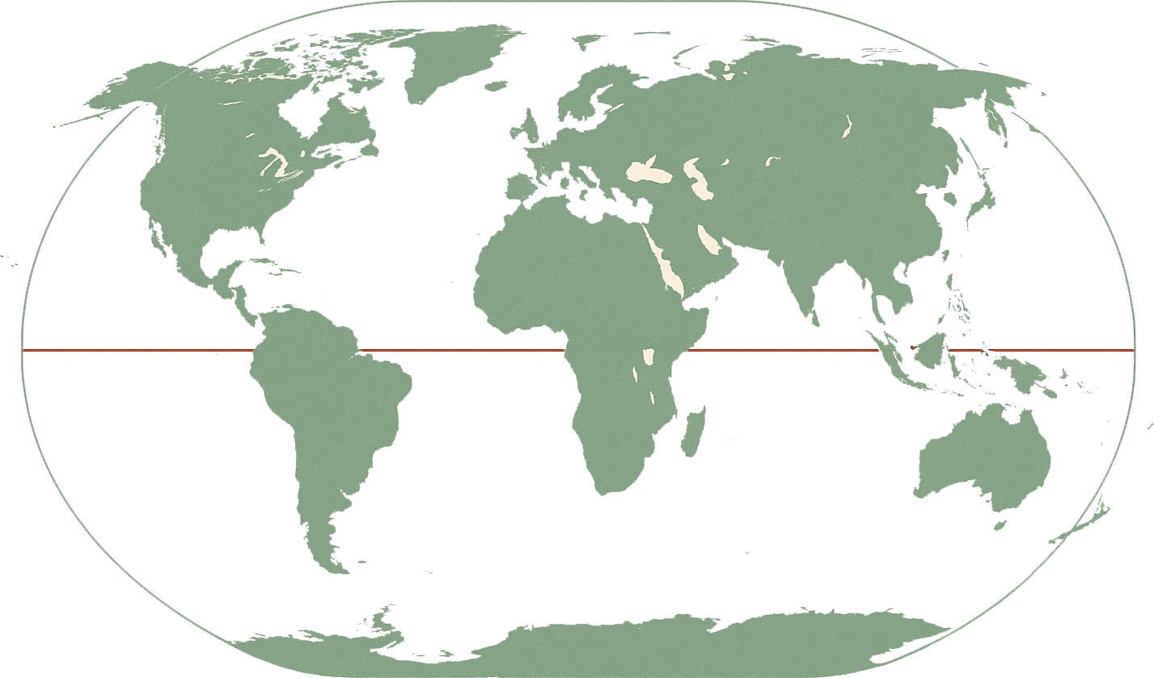
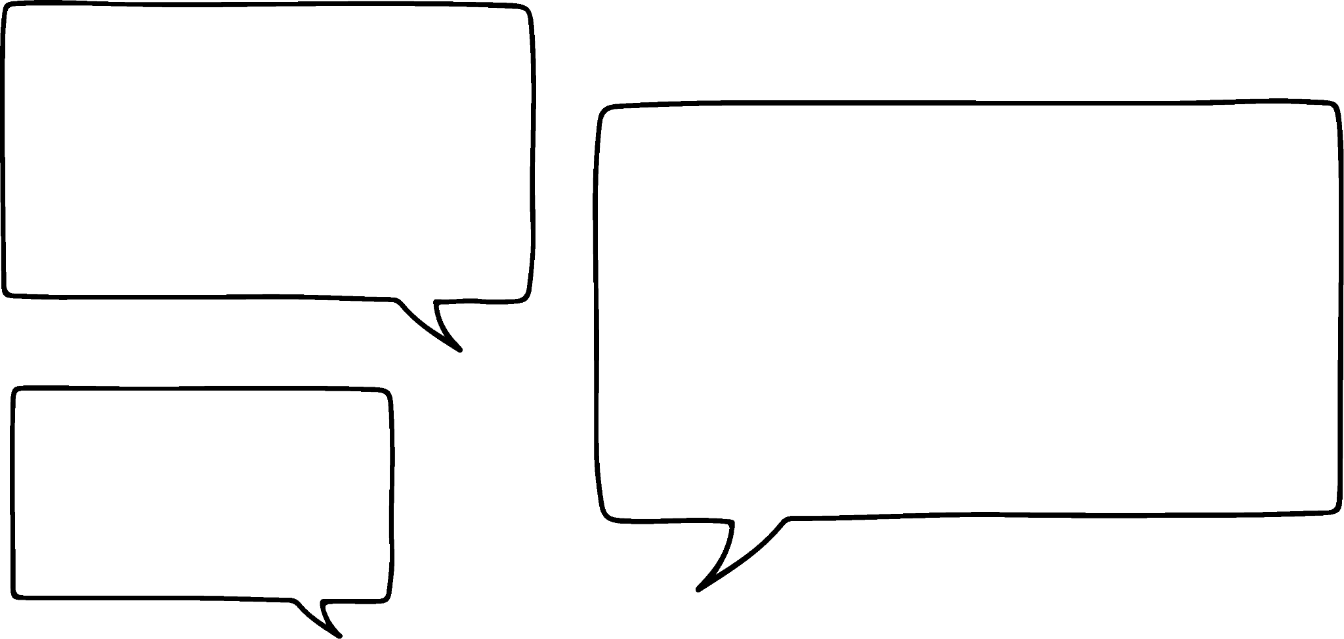



Falanqaynta xogta cimilada deegaanka
Sida cimilada waddanku u isbeddesho waqti ka dib waxay ku kala duwanaan kartaa iyadoo ku xiran goobta, sababo ay ka mid yihiin:
loolka (latitude)
kuu dhowaanshaha badda ama badweynta
bixinta kaarboon (carbon emissions)
Waxaan la yaabanahay sida cimilada UK u isbeddeshay waqti ka dib!
Waxaa aad u yar in laba gobol ay leeyihiin saameyn isku mid ah arrimahan, sidaas darteed cimiladoodu isku si uma kobci doonto waqti ka dib.
Cali
Qoraallo fiidiyowga: qeexid fudud oo loolka (latitude): masaafada woqooyi ama koonfur ee dhulbaraha.
Loolka koowaad wuxuu muujinayaa sida woqooyi ee Cairo, Masar uga fog yahay dhulbaraha.
Loolka labaad wuxuu muujinayaa sida woqooyi ee UK uga fog yahay dhulbaraha.

Slide 7
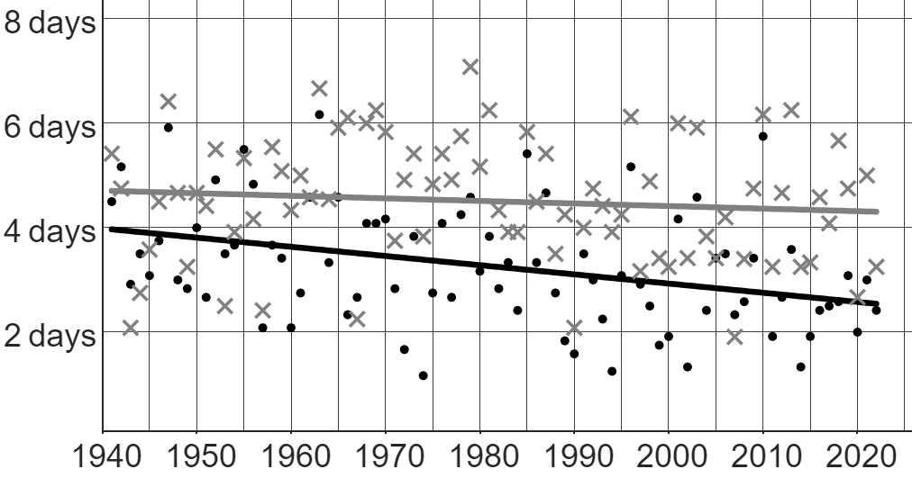
Falanqaynta xogta cimilada deegaanka (Analysing local climate data)
Waxaan isbarbardhigi karnaa sida qayb ka mid ah cimiladu u isbeddesho waqti ka dib laba goobood oo kala duwan oo isku waddan ah.
Jaantusku wuxuu muujinayaa xogta Met Office ee celceliska tirada maalmaha qabowga hawada (air frost) bishii intii u dhaxaysay sanadihii 1941 iyo 2022 ee Nairn iyo Oxford.
jaantus muujinaya qabowga hawada (air frost) muddo ka dib
Furaha (Key)
Nairn (Scotland)
Oxford (South England)

Slide 8
Falanqaynta xogta cimilada deegaanka (Analysing local climate data)
Waxaan isbarbardhigi karnaa sida qayb ka mid ah cimiladu u isbeddeleyso waqti ka dib laba goobood oo kala duwan oo isku waddan ah.
Labadan xog (data points) waxay muujinayaan celceliska tirada maalmaha qabowga hawada (air frost) bishii 1947 ee Nairn iyo Oxford labadaba.
Nairn, celcelisku wuxuu ahaa in ka yar 6 maalmood, halka Oxford uu ahaa in ka yar 6 maalmood.
jaantus muujinaya qabowga hawada (air frost) muddo ka dib
Furaha (Key)
Nairn (Scotland)
Oxford (South England)

Slide 9
Falanqaynta xogta cimilada deegaanka (Analysing local climate data)
Waxaan isbarbardhigi karnaa sida qayb ka mid ah cimiladu u isbeddeleyso waqti ka dib laba goobood oo kala duwan oo isku waddan ah.
Waxaan eegi karnaa khadadka isbeddelka (trendlines) ee labada goobood si ay nooga caawiyaan fahamka qaababka muddada-dheer iyo isbeddelada qaybtan cimilada.
jaantus muujinaya qabowga hawada (air frost) muddo ka dib
Furaha (Key)
Nairn (Scotland)
Oxford (South England)

Slide 10
Falanqaynta xogta cimilada deegaanka
Waxaan isbarbardhigi karnaa sida qayb ka mid ah cimiladu u isbeddesho waqti ka dib meelo kala duwan oo isku waddan ah.
Khadka isbeddelka (trendline) ee Nairn wuu ka sarreeyaa Oxford.
Sidaas darteed, qaabka guud waa waxaan filaynaa inaan aragno maalmo badan bishiiba oo dhaxan hawo ah (air frost) Nairn marka loo eego Oxford.
In kasta oo isbeddelkani (trend) inta badan run yahay, waxaa jiri kara sannado ka baxsan isbeddelka (break the trend).
jaantus muujinaya dhaxan hawo (air frost) waqti ka dib
Fure (Key)
Nairn (Scotland)
Oxford (South England)
Tusaale ahaan, 1955 markii Oxford lahaa celcelis ahaan wax yar ka sarreeya Nairn.

Slide 11
Falanqaynta xogta cimilada deegaanka
Waxaan isbarbardhigi karnaa sida qayb ka mid ah cimiladu u isbeddesho waqti ka dib meelo kala duwan oo isku waddan ah.
Jiirada (gradient) khadka isbeddelka (trendline) waxay muujinaysaa sida degdegga ah uu isbeddelku u dhacayo.
Khadka isbeddelka (trendline) ee Nairn wuxuu leeyahay jiiro (gradient) aad u yar oo taban.
Tani waxay ka dhigan tahay isbeddelka muddada dheer ee celceliska tirada maalmaha dhaxan hawo (air frost) bishiiba waa:
hoos u dhacaya... laakiin aan badnayn.
jaantus muujinaya dhaxan hawo (air frost) waqti ka dib
Fure (Key)
Nairn (Scotland)
Oxford (South England)

Slide 12
Falanqaynta xogta cimilada maxalliga ah
Waxaan isbarbardhigi karnaa sida qayb ka mid ah cimiladu u isbeddesho waqti ka dib meelo kala duwan oo isku waddan ah.
Khadka isbeddelka (trendline) ee Oxford sidoo kale wuxuu leeyahay jiiro (gradient) taban.
Hase yeeshe, jiiradan (gradient) waa mid ka sii dheer, taasoo la macno ah in celceliska tirada maalmaha dhaxan hawo (air frost) bishiiba ee Oxford uu hoos u dhacayo si ka degdeg badan Nairn.
jaantus muujinaya qabowga hawada (air frost) muddo ka dib
Furaha (Key)
Nairn (Scotland)
Oxford (Koonfurta England)

Slide 13
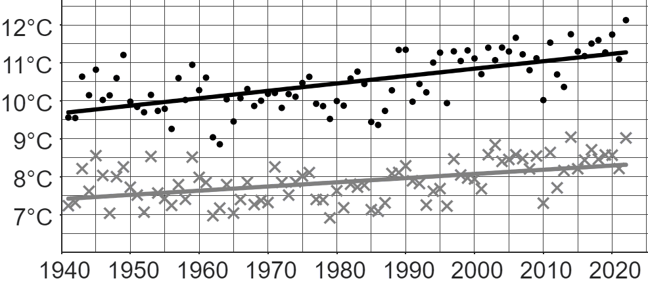


Falanqaynta xogta cimilada maxalliga ah
Jaantusku wuxuu muujinayaa xogta Met Office ee celceliska heerkulka sanadlaha ah laga bilaabo 1941 ilaa 2022 ee Wick iyo Oxford.
Furaha (Key)
Wick
Oxford
Mid ka mid ah hadalladan ayaa sax ah?
a
Celceliska heerkulka Wick ee 2022 wuxuu ka sarreeyay celceliska heerkulka sanad kasta oo kale.
b
Celceliska heerkulka Oxford ee 2022 wuxuu ka sarreeyay celceliska heerkulka sanad kasta oo kale.

Slide 14
Falanqaynta xogta cimilada maxalliga ah
Jaantusku wuxuu muujinayaa xogta Met Office ee celceliska heerkulka sanadlaha ah laga bilaabo 1941 ilaa 2022 ee Wick iyo Oxford.
Furaha (Key)
Wick
Oxford
Mid ka mid ah hadalladan ayaa sax ah?
a
Oxford, maalin kasta oo 2022 ah waxay ka kululayd maalin kasta oo 1990 ah.
Sababtoo ah celceliska heerkulka 2022 (Oxford) wuxuu ka sarreeyay celceliska heerkulka 1990, kuma xirna in maalin kasta oo 2022 ah ay leedahay heerkul ka sarreeya maalinta ugu kulul ee 1990.
Tusaale ahaan, maalin jiilaal 2022 ayaa weli ahayd mid aad uga qabow maalin xagaag 1990.
b
Oxford, isbeddelka guud (ama muddada-dheer) waa in heerkulku kordhayo.

Slide 15
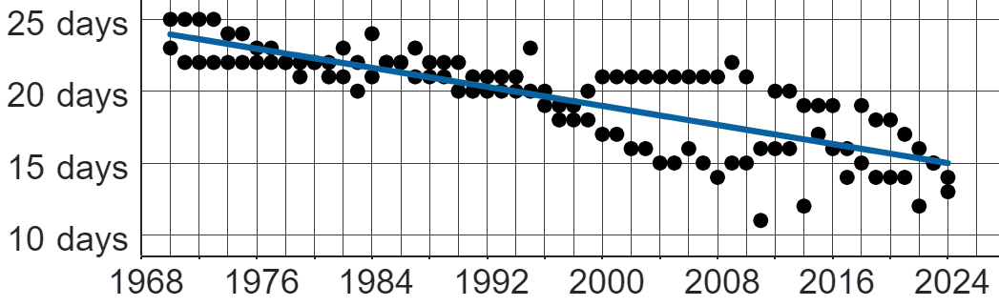
Falanqaynta xogta cimilada deegaanka
Jaantuskani wuxuu muujinayaa tirada maalmaha dhaxan hawada (air frost) ee Oakfield bisha Janaayo iyo Febraayo laga bilaabo 1970 ilaa 2024.
Kee ka mid ah weedhahan ayaa sax ah oo ku saabsan dhaxan hawada (air frost) ee Oakfield?
a
Sannad kasta, tirada maalmaha dhaxan hawada (air frost) bishiiba waa yaraanaysaa.
b
Isbeddel muddo dheer ah ayaa ah in tirada maalmaha dhaxan hawada (air frost) bishiiba ay sii yaraanayso.
c
Isbeddel muddo dheer ah ayaa ah in hadda jiro kala duwanaansho badan tirada maalmaha dhaxan hawada (air frost) bishiiba marka loo eego wakhtigii hore.

Slide 16




Falanqaynta xogta cimilada deegaanka
Jaantuskani wuxuu muujinayaa tirada maalmaha dhaxan hawada (air frost) ee Oakfield bisha Janaayo iyo Febraayo laga bilaabo 1970 ilaa 2024.
Waa yaab! Tirada maalmaha dhaxan hawada (air frost) bishiiba ee 2024 waxay u dhowdahay eber!
Sharax sababta gabagabada Caasha ay u khaldan tahay.
Dhidibka y (y-axis) ee jaantuskan wuxuu ka bilaabmaa 10 maalmood, ma aha 0 maalmood.
Inkasta oo isbeddelku yahay in tirada maalmaha dhaxan hawada (air frost) bishiiba ay sii yaraanayso, bilaha 2024 weli waxay leeyihiin 13 iyo 14 maalmood oo dhaxan hawada (air frost) ah.
Caasha

Slide 17
Falanqaynta xogta cimilada deegaanka
Jaantuskani wuxuu muujinayaa tirada maalmaha dhaxan hawada (air frost) ee Oakfield bisha Janaayo iyo Febraayo laga bilaabo 1970 ilaa 2024.
Kee ayaa laga yaabaa inay gabagabo macquul ah ka yimaadaan xogtan oo keliya?
a
Celceliska heerkulka Oakfield ee Janaayo iyo Febraayo ayaa laga yaabaa inuu sii kordhayo waqti ka dib.
b
Tirada maalmaha dhaxan hawada (air frost) ee Janaayo iyo Febraayo kasta ayaa laga yaabaa inay sii yaraanayso guud ahaan UK.
Midna gabagabo laguma gaari karo si kalsooni leh.
Waa adag tahay in la sameeyo gabagabo ballaadhan oo ka yimaada xog xaddidan.
Ma naqaanno wax ku saabsan arrimo kale, sidaas darteed ma u qaadan karno in kororka heerkulka uu yahay sababta hoos u dhaca dhaxan hawada (air frost).
Oo kaliya sababtoo ah isbeddel (trend) ayaa ka jira qayb ka mid ah UK ma micneheyno in isla isbeddelkaasi uu ka jiro guud ahaan UK.

Slide 18
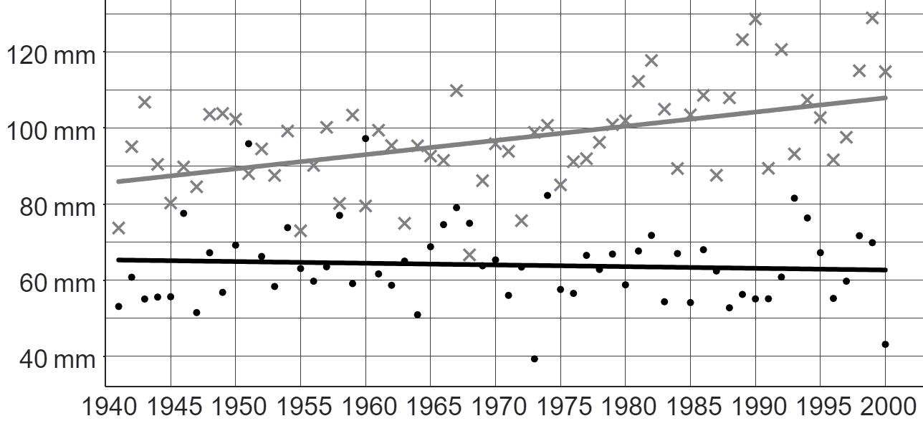
Falanqaynta xogta cimilada maxalliga ah (local climate data)
Jaantuskan (graph) ee Met Office wuxuu muujinayaa celceliska roobabka bishii (mm) sannad kasta laga bilaabo 1941 ilaa 2000 ee Stornoway iyo Southampton.
Furaha (Key)
Stornoway
Southampton
Cali wuxuu yidhi: "Waxaan caadi ahaan u filaynaa in roobab badan ku da'o bil kasta ee Stornoway marka loo eego Southampton."
1a) Sharax sida Cali uu u yimaaddo gabagabadan (conclusion).
b) Sannadkii 1968, roob badan ayaa ku da'ay Southampton marka loo eego Stornoway. Sharax haddii tani ka dhigayso sheegashada Cali mid khaldan (incorrect) iyo in kale.

Slide 19
Falanqaynta xogta cimilada maxalliga ah (local climate data)
Jaantuskan (graph) ee Met Office wuxuu muujinayaa celceliska roobabka bishii (mm) sannad kasta laga bilaabo 1941 ilaa 2000 ee Stornoway iyo Southampton.
Furaha (Key)
Stornoway
Southampton
Suad waxay tiri: "Waqti ka dib, isbeddelka guud (general trend) ee Stornoway waa in celceliska qadarka roobabku uu kordhayo."
c) Suad waa sax. Sharax sida Suad ugu iman karto gabagabadan (conclusion).
d) Qor jumlad (sentence) sharraxaysa isbeddelka muddada-dheer (long-term trend) ee roobabka Southampton.

Slide 20
Falanqaynta xogta cimilada maxalliga ah (local climate data)
Jaantuskan (graph) ee Met Office wuxuu muujinayaa celceliska roobabka bishii (mm) sannad kasta laga bilaabo 1941 ilaa 2000 ee Stornoway iyo Southampton.
Furaha (Key)
Stornoway
Southampton
Isra waxay tiri: "Stornoway waxay ku taallaa Scotland. Taas macneheedu waa in qadarka roobabka ee qaybaha kale ee Scotland uu sidoo kale kordhayo waqtiga."
e) Sharax haddii hadalka Isra uu sax yahay (correct) iyo in kale.

Slide 21
Falanqaynta xogta cimilada deegaanka
Jaantuskan oo ka socda Met Office wuxuu muujinayaa celceliska roobabka bishii (mm) sannad kasta laga bilaabo 1941 ilaa 2000 ee Stornoway iyo Southampton.
Fure
Stornoway
Southampton
Cali wuxuu yidhi: "Sida caadiga ah waxaan filaynaa in roobab badan bishii ku da'o Stornoway marka loo eego Southampton."
1a) Sharax sida Cali uu u yimaado gabagabadan.
Khadka isbeddelka (trendline) ee Stornoway wuxuu ka sarreeyaa khadka isbeddelka ee Southampton.
Tani waxay ka dhigan tahay in jiro isbeddel (trend) ah in Stornoway ay leedahay qadar roobab ka badan Southampton.

Slide 22
Falanqaynta xogta cimilada deegaanka
Jaantuskan oo ka socda Met Office wuxuu muujinayaa celceliska roobabka bishii (mm) sannad kasta laga bilaabo 1941 ilaa 2000 ee Stornoway iyo Southampton.
Fure
Stornoway
Southampton
b) Sannadkii 1968, roobab badan ayaa ku da'ay Southampton marka loo eego Stornoway. Sharax in tani ay ka dhigayso sheegashada Cali mid khaldan iyo in kale.
Cali waa sax. Isbeddelka (trend) waa hubaal in Stornoway ay ka badan tahay roobabka Southampton. Dhowr sano oo aan ku habboonayn isbeddelkan macnaheedu ma aha in isbeddelku aan run ahayn muddo dheer.

Slide 23
Falanqaynta xogta cimilada deegaanka
Jaantuskan oo ka socda Met Office wuxuu muujinayaa celceliska roobabka bishii (mm) sannad kasta laga bilaabo 1941 ilaa 2000 ee Stornoway iyo Southampton.
Key
Stornoway
Southampton
Suad waxay tidhi: "Waqti ka dib, isbeddelka guud ee Stornoway waa in celceliska qadarka roobabku uu kordhayo."
c) Suad waa sax. Sharax sida Suad ay u timaado gabagabadan.
Stornoway’s trendline has a positive gradient (the line is going up from left to right).

Slide 24
Analysing local climate data
This graph from the Met Office shows the average monthly rainfall (in mm) each year from 1941 to 2000 in Stornoway and Southampton.
Key
Stornoway
Southampton
d) Qor jumlad sharxaysa isbeddelka muddada dheer ee roobka Southampton.
Over time, the general trend in Southampton is that the average amount of rainfall is very slightly decreasing.
ama Celceliska roobka waa uu joogto yahay waqti ka dib.

Slide 25
Analysing local climate data
This graph from the Met Office shows the average monthly rainfall (in mm) each year from 1941 to 2000 in Stornoway and Southampton.
Key
Stornoway
Southampton
Izzy says: “Stornoway is in Scotland. That means the amount of rainfall in other parts of Scotland is also increasing over time.”
e) Sharax haddii hadalka Izzy uu sax yahay iyo in kale.
Ma fiicna in la guudmariyo gabagabada meel kale, xataa gudaha waddan isku mid ah.
Waxaa jira sababo badan oo tan keena, sida u dhowaanshaha badda ee Stornoway, marka loo barbardhigo qaybaha kale ee Scotland.

Slide 26
Barashada isbeddelka cimilada deegaanka
Falanqaynta xogta cimilada deegaanka
Forming conclusions about local climate change

Slide 27
Sameynta gabagabo ku saabsan isbeddelka cimilada deegaanka
Waa suurtagal in la isku daro xog cimilo oo kala duwan oo ku saabsan goob si loo aqoonsado xiriirka (correlation) ee ku lug leh waqtiga.

Slide 28
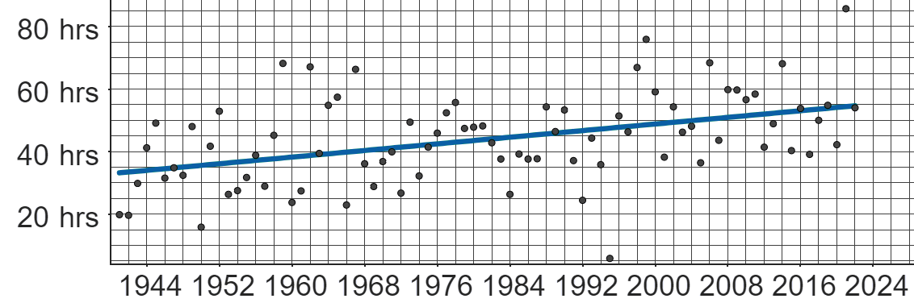
Sameynta gabagabo ku saabsan isbeddelka cimilada deegaanka
Jaantuskani wuxuu muujinayaa xogta Met Office ee wadarta saacadaha qorraxda ee bisha Janaayo sannad kasta laga bilaabo 1941 ilaa 2022 ee Sheffield.
Isbeddelka muddada-dheer ee xogtan wuxuu soo jeedinayaa in wadarta saacadaha qorraxda ee Janaayo ee Sheffield ay kordheen waqti ka dib.

Slide 29
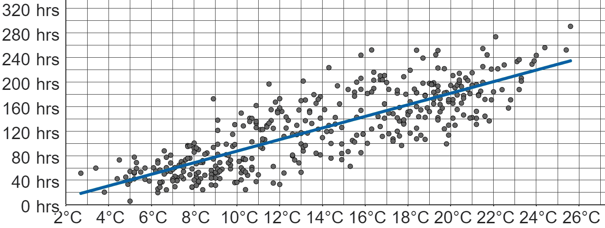
Sameynta gabagabo ku saabsan isbeddelka cimilada deegaanka
Jaantuskani wuxuu muujinayaa xogta Met Office ee wadarta saacadaha qorraxda ee bisha Janaayo sannad kasta laga bilaabo 1941 ilaa 2022 ee Sheffield.
Jaantuska labaad wuxuu muujinayaa xogta Met Office ee heerkulka ugu sarreeya maalin kasta iyo wadarta saacadaha qorraxda ee bisha kasta laga bilaabo 1990 ilaa 2022 ee Sheffield.

Slide 30
Sameynta gabagabo ku saabsan isbeddelka cimilada deegaanka
Waxaa jira xiriir togan (positive correlation) oo u dhexeeya heerkulka ugu sarreeya maalin kasta iyo wadarta saacadaha qorraxda ee bisha.
Isbeddelka xogtan wuxuu soo jeedinayaa in marka heerkulka ugu sarreeya uu kordho, wadarta saacadaha qorraxda ee bishuna ay kordhaan.
Jaantuska labaad wuxuu muujinayaa xogta Met Office ee heerkulka ugu sarreeya maalin kasta iyo wadarta saacadaha qorraxda ee bisha kasta laga bilaabo 1990 ilaa 2022 ee Sheffield.

Slide 31
Sameynta gabagabo ku saabsan isbeddelka cimilada deegaanka
Labada jaantus waxay muujinayaan xiriir togan (positive correlation).
Intaa waxaa dheer, labada jaantus waxay wadaagaan doorsoome (variable) guud oo ah 'wadarta saacadaha qorraxda ee bisha'.
Waxaa laga yaabaa in la aqoonsado xiriir (correlation) u dhexeeya doorsoomaha aan guud ee jaantus kasta.

Slide 32
Sameynta gabagabo ku saabsan isbeddelka cimilada deegaanka
Jaantuska 1 wuxuu muujinayaa in wadarta saacadaha qorraxda ee bishu ay kordhaan waqti ka dib.
Jaantuska 2 wuxuu muujinayaa in wadarta saacadaha qorraxda ee bishu ay kordhaan marka heerkulka ugu sarreeya uu kordho.
Sidaa darteed, heerkulka ugu sarreeya ayaa laga yaabaa inuu sidoo kale kordho waqti ka dib.

Slide 33
Samaynta gunaanad ku saabsan isbeddelka cimilada deegaanka (local climate change)
Laba jaantus oo kala duwan ayaa muujinaya xiriir togan (positive correlation) oo suurtagal ah inta u dhaxaysa wakhtiga iyo heerkulka celceliska maalinlaha ah ee ugu sarreeya (mean daily maximum temperature) ee Sheffield.
Gunaanadka laga soo saaro isbarbardhigga xog badan (multiple sets of data) ayaa laga yaabaa inuu ka sax yahay kan laga soo saaro hal xog oo keliya.

Slide 34
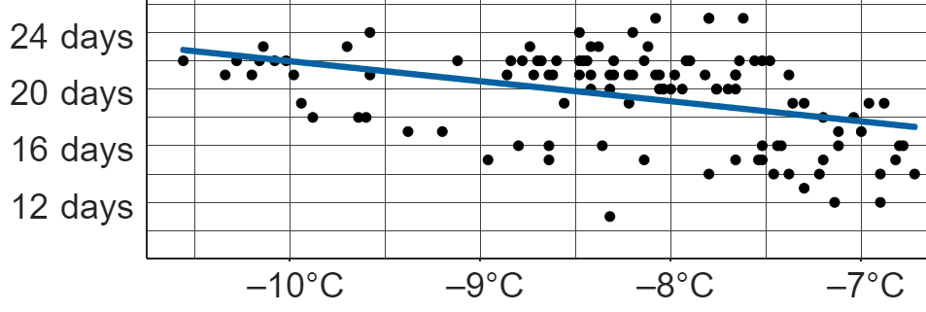
Samaynta gunaanad ku saabsan isbeddelka cimilada deegaanka (local climate change)
tirada maalmaha qabowga hawada (air frost) bishii
Jaantusyada labaduba waxay muujinayaan xogta Oakfield bilihii Janaayo iyo Febraayo laga soo bilaabo 1970 ilaa 2024.
Waa maxay doorsoomaha guud (common variable) ee labada jaantus?
tirada maalmaha qabowga hawada (air frost)
heerkulka ugu hooseeya ee celceliska maalinlaha ah (mean daily minimum temperature) vs. tirada maalmaha qabowga hawada (air frost)

Slide 35
Samaynta gunaanad ku saabsan isbeddelka cimilada deegaanka (local climate change)
tirada maalmaha qabowga hawada (air frost) bishii
Jaantusyada labaduba waxay muujinayaan xogta Oakfield bilihii Janaayo iyo Febraayo laga soo bilaabo 1970 ilaa 2024.
Sharax xiriirka (correlation) u dhexeeya heerkulka ugu hooseeya ee celceliska maalinlaha ah (mean daily minimum temperature) iyo tirada maalmaha qabowga hawada (air frost).
Marka heerkulku kordho, tirada maalmaha qabowga hawada (air frost) way yaraataa.
xiriir taban (negative correlation)
heerkulka ugu hooseeya ee celceliska maalinlaha ah (mean daily minimum temperature) vs. tirada maalmaha qabowga hawada (air frost)

Slide 36
Samaynta gunaanad ku saabsan isbeddelka cimilada deegaanka (local climate change)
tirada maalmaha qabowga hawada (air frost) bishii
Dhammeysti gunaanaddan suurtagalka ah adigoo isticmaalaya labada jaantus:
Sababtoo ah isbeddelka muddada-dheer (long-term trend) waa in tirada maalmaha qabowga hawada (air frost) bishii ay sii yaraanayso wakhti ka dib, heerkulka ugu hooseeya ee celceliska maalinlaha ah (mean daily minimum temperature) wuu _____________ wakhti ka dib.
kordhaya (increasing)
heerkulka ugu hooseeya ee celceliska maalinlaha ah (mean daily minimum temperature) vs. tirada maalmaha qabowga hawada (air frost)

Slide 37
Sameynta gunaanad ku saabsan isbeddelka cimilada deegaanka
Garaafkani wuxuu muujinayaa xogta Met Office ee ku saabsan wadarta saacadaha qorraxda ee bille ah ee Janaayo, sannad kasta laga bilaabo 1941 ilaa 2022 ee Sheffield.
Garaafka labaad wuxuu muujinayaa xogta Met Office ee ku saabsan celceliska heerkulka ugu sarreeya ee maalinlaha ah iyo wadarta saacadaha qorraxda ee bille ah, bil kasta laga bilaabo 1990 ilaa 2022 ee Sheffield.
Si kastaba ha ahaatee, heerka ay sax noqon karto gunaanadku wuxuu ku xirnaan karaa saxnaanta isbarbardhigyada la sameeyay ee u dhexeeya labada garaaf.

Slide 38
Sameynta gunaanad ku saabsan isbeddelka cimilada deegaanka
Garaafkani wuxuu muujinayaa xogta Met Office ee ku saabsan wadarta saacadaha qorraxda ee bille ah ee Janaayo, sannad kasta laga bilaabo 1941 ilaa 2022 ee Sheffield.
Garaafka labaad wuxuu muujinayaa xogta Met Office ee ku saabsan celceliska heerkulka ugu sarreeya ee maalinlaha ah iyo wadarta saacadaha qorraxda ee bille ah, bil kasta laga bilaabo 1990 ilaa 2022 ee Sheffield.
Garaafku wuxuu muujinayaa xogta kaliya ee Janaayo ee sannad kasta, halka kan kalena uu muujinayo xogta bil kasta ee sannad kasta.
Muddadaha labada garaaf sidoo kale way kala duwan yihiin, iyadoo isbeddellada muddada-dheer ee garaafka koowaad ay ka kooban yihiin sannado badan oo xog ah marka loo eego kan labaad.

Slide 39
Sameynta gunaanad ku saabsan isbeddelka cimilada deegaanka
Garaafkani wuxuu muujinayaa xogta Met Office ee ku saabsan wadarta saacadaha qorraxda ee bille ah ee Janaayo, sannad kasta laga bilaabo 1941 ilaa 2022 ee Sheffield.
Garaafka labaad wuxuu muujinayaa xogta Met Office ee ku saabsan celceliska heerkulka ugu sarreeya ee maalinlaha ah iyo wadarta saacadaha qorraxda ee bille ah, bil kasta laga bilaabo 1990 ilaa 2022 ee Sheffield.
Gunaanadka ah “heerkulka ugu sarreeya ayaa laga yaabaa inuu sidoo kale kordho waqti ka dib” ma noqon karo mid sax ah, sababtoo ah qayb yar oo ka mid ah xogta koox kasta ayaa laga soo qaaday isku waqti.

Slide 40
Sameynta gunaanad ku saabsan isbeddelka cimilada deegaanka
tirada maalmaha qabowga hawada (air frost) ee bil kasta
Labada garaaf waxay muujinayaan xogta Oakfield ee bilaha Janaayo iyo Febraayo laga bilaabo 1970 ilaa 2024.
Sheeg hal sabab oo gunaanadka laga soo qaaday isbarbardhigga labadan garaaf ay u noqon karaan kuwo sax ah.
Labada garaaf waxay muujinayaan xog isku meel ah iyo isku waqti (Janaayo & Febraayo 1970 ilaa 2024).
celceliska heerkulka ugu hooseeya ee maalinlaha ah vs. tirada maalmaha qabowga hawada (air frost)

Slide 41
Samaynta gunaanad ku saabsan isbeddelka cimilada deegaanka (local climate change)
 | fogaanta (d), ee km
 | d < 2 | 2 ≤ d < 5 | 5 ≤ d < 10 | 10 ≤ d < 20 | 20 ≤ d < 30 | 30 ≤ d < 40 | 40 ≤ d < 60 | d ≥ 60
Waqooyi Bari | 202 172 | 235 849 | 220 617 | 192 451 | 55 976 | 20 205 | 15 795 | 33 880
Koonfur Bari | 706 167 | 688 146 | 604 950 | 582 465 | 301 705 | 156 951 | 168 384 | 169 351
1) Jadwalkan ONS wuxuu muujinayaa masaafada dadka Waqooyi-Bari iyo Koonfur-Bari ee England u safrayeen shaqada maalin kasta sanadkii 2011.
a) Immisa qof oo Waqooyi-Bari ah ayaa macluumaadkooda loo soo ururiyay sahankan?
b) Waa maxay jajabka (fraction) dadka Koonfur-Bari ee u safraa in ka yar 10 km maalin kasta si ay u taga shaqada?
Mid ka mid ah saamaynta suurtagalka ah ee cimilada deegaanka waa xaddiga bixinta (emission) kaarboonka (oo la xidhiidha safarrada dhaadheer).
c) Goorta (Waqooyi-Bari ama Koonfur-Bari) ayaa boqolkiiba (percentage) dadka u safra 20 km ama ka badan maalin kasta shaqada ka sarreeya?

Slide 42
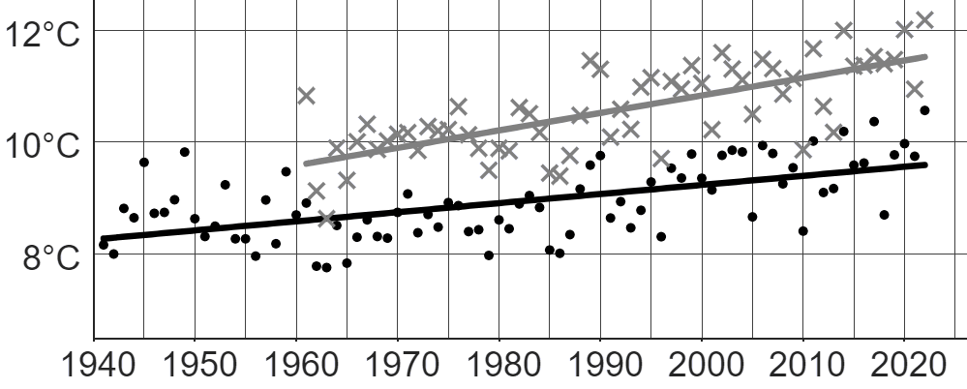
Samaynta gunaanad ku saabsan isbeddelka cimilada deegaanka (local climate change)
Jadwalkan wuxuu muujinayaa xogta Met Office ee heerkulka celceliska sanadlaha ah laba goobood oo UK ah: Manston (1961 – 2022) iyo Durham (1941 – 2022).
Furaha (Key)
Manston (Koonfur-Bari England)
Durham (Waqooyi-Bari England)
2) Isbeddellada muddada-dheer ee Manston iyo Durham waa isku mid. Labada gooboodba waxay muujinayaan kororka heerkulka celceliska sanadlaha ah (mean yearly temperature) waqti ka dib.
Goorta heerkulka celceliska sanadlaha ah uu ku kordhayo xawaare dheereeya? Sharax sida aad u ogaatay.

Slide 43
Samaynta gunaanad ku saabsan isbeddelka cimilada deegaanka (local climate change)
Jadwalkan wuxuu muujinayaa xogta Met Office ee heerkulka celceliska sanadlaha ah laba goobood oo UK ah: Manston (1961 – 2022) iyo Durham (1941 – 2022).
Furaha (Key)
Manston (Koonfur-Bari England)
Durham (Waqooyi-Bari England)
3a) Adigoo isticmaalaya jawaabahaaga su'aalaha 1c iyo 2, qor xiriir suurtagal ah oo u dhexeeya masaafada loo safro shaqada iyo heerkulka celceliska sanadlaha ah.
b) Sharax inta uu xiriirkan sax yahay ama qaldan yahay adigoo qiimeynaya ansaxnimada (validity) isbarbardhigga labada xogood.

Slide 44
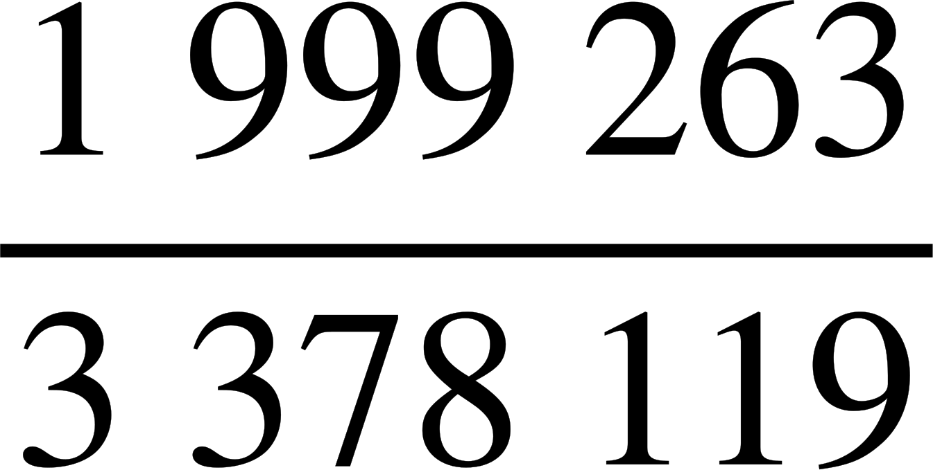
Sameynta gabagabo (conclusions) ku saabsan isbeddelka cimilada deegaanka
 | masaafada (d), km gudahood
 | d < 2 | 2 ≤ d < 5 | 5 ≤ d < 10 | 10 ≤ d < 20 | 20 ≤ d < 30 | 30 ≤ d < 40 | 40 ≤ d < 60 | d ≥ 60
Waqooyi (North) Bari (East) | 202 172 | 235 849 | 220 617 | 192 451 | 55 976 | 20 205 | 15 795 | 33 880
Koonfur Bari (South East) | 706 167 | 688 146 | 604 950 | 582 465 | 301 705 | 156 951 | 168 384 | 169 351
1) Jadwalkan oo ka yimid ONS wuxuu muujinayaa masaafada dadka Waqooyi-Bari iyo Koonfur-Bari ee England ay u safraan shaqada maalin kasta 2011.
a) Immisa qof oo macluumaadkooda laga soo ururiyay Waqooyi-Bari ee sahankan?
b) Waa imisa jajab (fraction) dadka Koonfur-Bari ee u safraa in ka yar 10 km maalin kasta si ay u shaqeeyaan?
976 945 qof

Slide 45
Sameynta gabagabo (conclusions) ku saabsan isbeddelka cimilada deegaanka
 | masaafada (d), km
 | d < 2 | 2 ≤ d < 5 | 5 ≤ d < 10 | 10 ≤ d < 20 | 20 ≤ d < 30 | 30 ≤ d < 40 | 40 ≤ d < 60 | d ≥ 60
Waqooyi (North) Bari (East) | 202 172 | 235 849 | 220 617 | 192 451 | 55 976 | 20 205 | 15 795 | 33 880
Koonfur Bari (South East) | 706 167 | 688 146 | 604 950 | 582 465 | 301 705 | 156 951 | 168 384 | 169 351
1) Jadwalkan oo ka yimid ONS wuxuu muujinayaa masaafada dadka Waqooyi-Bari iyo Koonfur-Bari ee England ay u safraan shaqada maalin kasta 2011.
Hal saameyn oo suurtagal ah ee cimilada aagga waa xadiga bixinta (emission) kaarboon (oo la xiriirta safarka masaafo dheer).
c) Goorma (Waqooyi-Bari ama Koonfur-Bari) ayay boqolkiiba dadka u safra 20 km ama ka badan maalin kasta si ay u shaqeeyaan?
Waqooyi-Bari: 12.9% (1 d.p.)
Koonfur-Bari: 23.6% (1 d.p.)
Boqolkiiba dadka Koonfur-Bari ee u safra 20 km ama ka badan ayaa ka badan.

Slide 46
Sameynta gabagabo (conclusions) ku saabsan isbeddelka cimilada deegaanka
Jaantuskani wuxuu muujinayaa xogta Met Office ee celceliska heerkulka sanadlaha ah ee laba goobood oo UK ah: Manston (1961 – 2022) iyo Durham (1941 – 2022).
Furaha (Key)
Manston (Koonfur-Bari England)
Durham (Waqooyi-Bari England)
2) Isbeddellada muddada-dheer ee Manston iyo Durham waa isku mid. Labada goobood waxay muujinayaan kororka heerkulka celceliska sannadlaha ah ee waqtiga.
Goorma ayuu heerkulka celceliska sannadlaha ah u kordhaya si dhakhso leh? Sharax sida aad u ogaatay.
Celceliska heerkulka sanadlaha ah ee Manston wuxuu kordhayaa heer ka dhaqso badan kan Durham, sababtoo ah khadka isbeddelka muddada-dheer ee Manston wuxuu leeyahay jiiro (gradient) ka dheer.

Slide 47
Samaynta gunaanad ku saabsan isbeddelka cimilada maxalliga ah (local climate change)
Jaantuskani wuxuu muujinayaa xogta Met Office ee celceliska heerkulka sanadlaha ah ee laba goobood oo UK ah: Manston (1961 – 2022) iyo Durham (1941 – 2022).
Furaha (Key)
Manston (Koonfur-Bari England)
Durham (Waqooyi-Bari England)
2) Isbeddellada muddada-dheer ee Manston iyo Durham labaduba waa isku mid. Labada goobood waxay muujinayaan kororka celceliska heerkulka sanadlaha ah waqti ka dib.
Goobta heerkulkeeda celcelis ahi uu kordho heerka ugu dhaqsaha badan? Sharax sida aad u ogaatay.
Fiiro gaar ah: Heerkulka kordhaya heer dhaqso wuxuu ugu wacan yahay jiirada (steepness) khadka isbeddelka ee Manston, ma aha sababtoo ah khadka laftiisu wuu ka sarreeyaa kan Durham.

Slide 48
Samaynta gunaanad ku saabsan isbeddelka cimilada maxalliga ah (local climate change)
Jaantuskani wuxuu muujinayaa xogta Met Office ee celceliska heerkulka sanadlaha ah ee laba goobood oo UK ah: Manston (1961 – 2022) iyo Durham (1941 – 2022).
Furaha (Key)
Manston (Koonfur-Bari England)
Durham (Waqooyi-Bari England)
3a) Isticmaal labada jawaab ee su'aalaha 1c iyo 2, qor xidhiidh suurtagal ah oo u dhexeeya masaafada la safray shaqada iyo celceliska heerkulka sanadlaha ah.
Xidhiidhku wuxuu noqon karaa in goobaha dadku u safraan masaafo dheer si ay uga shaqeeyaan (iyo bixinta (emission) kaarboon ee sareysa) ay heerkulku u kordho heer ka dhaqso badan goobaha dadka yar ee u safra masaafo dheer si ay u shaqeeyaan.

Slide 49
Samaynta gunaanad ku saabsan isbeddelka cimilada maxalliga ah (local climate change)
Jaantuskani wuxuu muujinayaa xogta Met Office ee heerkulka celceliska sanadlaha ah ee laba goobood oo UK ah: Manston (1961 – 2022) iyo Durham (1941 – 2022).
Fure
Manston (Koonfur-Bari England)
Durham (Waqooyi-Bari England)
b) Sharax inta ay xidhiidhkani sax yahay ama qaldan yahay, adoo qiimeynaya ansaxnimada (validity) isbarbardhigga labada xogood.
In kastoo jaantuska (su'aasha 2) iyo shaxda (su'aasha 1) ay muujinayaan xogta Koonfur-Bari iyo Waqooyi-Bari England, jaantusku wuxuu muujinayaa oo kaliya hal qayb oo kasta oo gobolka ah.
Sidaa darteed, waxaa laga yaabaa inaysan ansax ahayn in la guudgeliyo gabagabada aan ka qaadano heerka kororka heerkulka ee Manston iyo Durham inta ka hartay gobolka.

Slide 50
Samaynta gabagabo ku saabsan isbeddelka cimilada deegaanka
Jaantuskani wuxuu muujinayaa xogta Met Office ee heerkulka celceliska sanadlaha ah ee laba goobood oo UK ah: Manston (1961 – 2022) iyo Durham (1941 – 2022).
Fure
Manston (Koonfur-Bari England)
Durham (Waqooyi-Bari England)
b) Sharax inta ay tahay saxnaanta ama qaladka xiriirkan adoo qiimeynaya ansaxnimada isbarbardhigyada labada xogood.
Waxyaabaha ansaxinta isbarbardhigyada waxaa ka mid ah waqtiyada. Labada gobol ee jaantuska waxay muujinayaan xogta 1961 ilaa 2022 (iyadoo Durham ay leedahay xog laga soo bilaabo 1941), taas oo u oggolaanaysa isbarbardhigyo la mid ah oo u dhexeeya gobollada. Intaa waxaa dheer, shaxda su'aasha 1 waxay muujinaysaa xogta la ururiyay 2011, taas oo ku jirta waqtiga 1961 ilaa 2022.

Slide 51
Barashada isbeddelka cimilada deegaanka
Waxaa jira curiye (element) badan oo cimilo ah, sida heerkulka, qadarka roobka, qadarka qabowga hawada, iwm.
Curiye (element) la qiyaasi karo oo cimilada ah oo ku yaal goobo badan ayaa lagu barbardhigi karaa jaantus. Waxaa suurtagal ah in la aasaaso oo la barbardhigo isbeddellada muddada dheer ee u dhexeeya goobahan.
Hase yeeshee, isbeddelladan laguma guudgelin karo goobo kale ama curiye (element) kale oo cimilada ah iyada oo aan la helin macluumaad dheeri ah.
Waxaa suurtagal ah in la bilaabo samaynta gabagabo ku saabsan cimilada goobta adoo tixgelinaya xogta ka imanaysa curiye (element) kala duwan oo cimiladeeda ah iyo falanqaynta xiriirka ka dhexeeya xog kasta.
Hase yeeshee, inta ay faa'iidada leedahay gabagabadani waxay ku xiran tahay in xog kastaa ay muujinayso isbeddellada isla goobta isla muddadaas.

