Slide 1
Saamiga taanjanta (Tangent ratio)
Trigonometry (Trigonometry)

Slide 2
Sida agabkeena waxbarista loogu talagalay fasalka

Slide 3
Waxaan ka soo saari karaa saamiga taanjanta (tangent ratio) dhinacyada saddexagalka qumman (right-angled triangle).

Slide 4
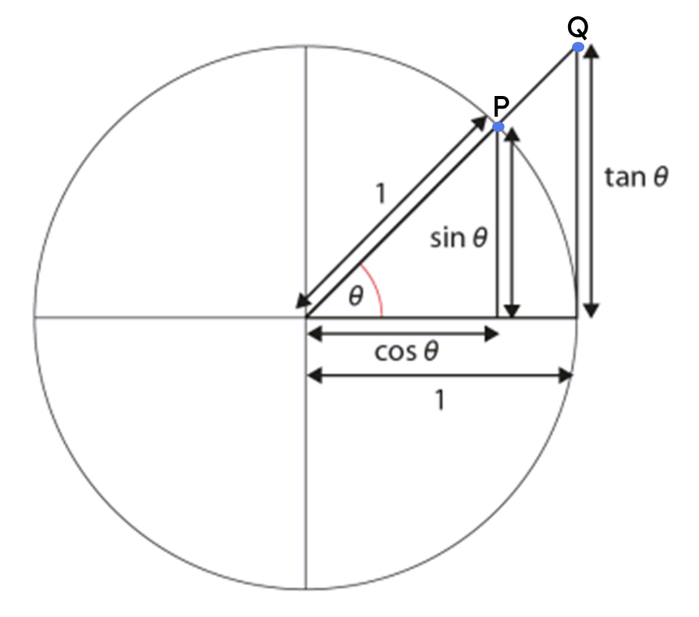
Dhinaca ku xiga (adjacent side) ee saddexagalka qumman waa dhinaca ku xiga xagasha qumman iyo xagasha calaamadeysan labadaba.
Dhinaca ka soo horjeeda (opposite side) ee saddexagalka qumman waa dhinaca ka soo horjeeda xagasha calaamadeysan.
Saamiyada trigonometric (trigonometric ratios) waa saamiyo u dhexeeya laba dhinac oo ka mid ah dhererka saddexagalka qumman.
Taanjanta xagal (tan(θ°)) waa isku-dubbaridka y (y-coordinate) ee barta Q ee saddexagalka ka soo baxa goobada halbeegga (unit circle).

Slide 5

Saamiga taanjanta (Tangent ratio)
Shaxaha saamiyada (ratio tables), goobada halbeegga (unit circle), iyo taanjanta (tangents)
Dhinaca ka soo horjeeda (opposite) iyo dhinaca ku xiga (adjacent)
Si wax ku ool ah u isticmaalka xisaabiyaha (calculator) saamiga taanjanta (tan ratio)

Slide 6
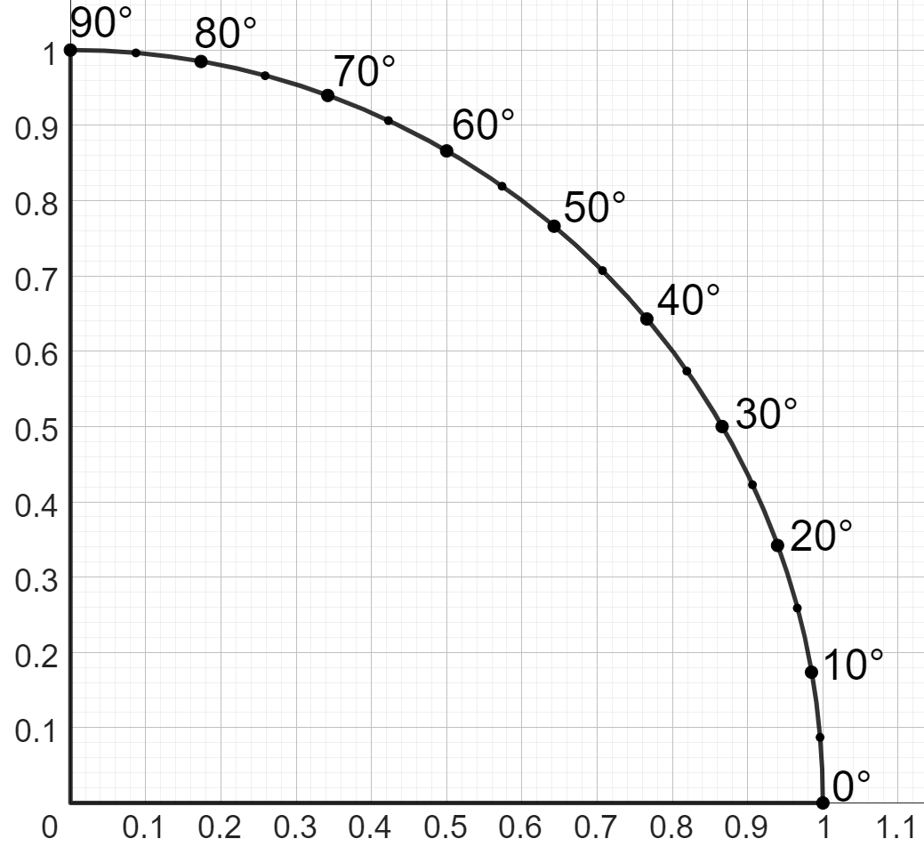
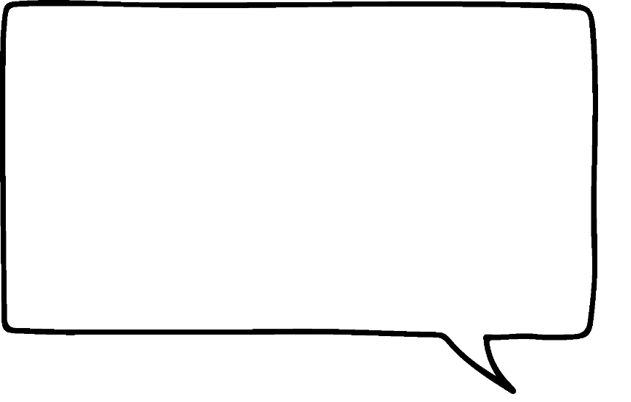

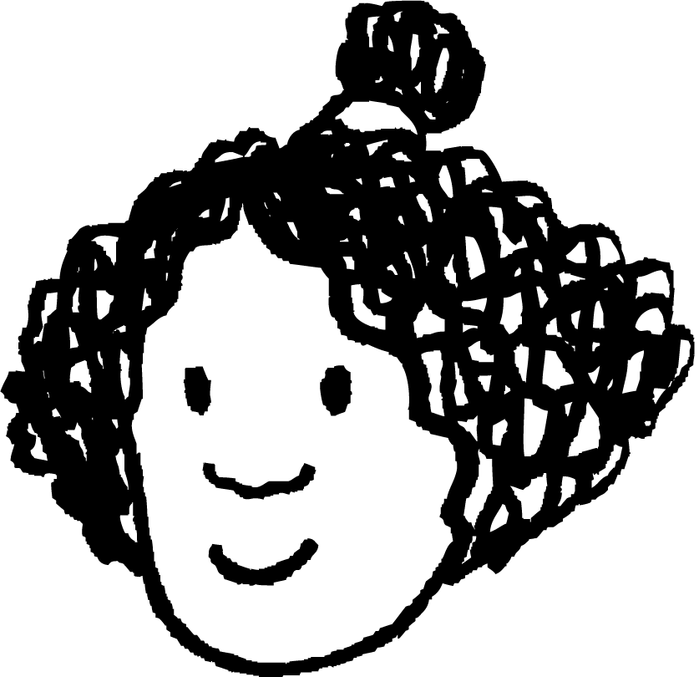

Shaxaha saamiyada (ratio tables), goobada halbeegga (unit circle), iyo taanjanta (tangents)
taanjanta goobada (tangent to circle)
Qiyamyada kala duwan ee θ°, waxaan diiwaangelin karaa dhererka kala duwan ee dhinaca ka soo horjeeda θ°.
Si kasta ha ahaatee, dhinaca ku xiga θ° wali waa 1 halbeeg (1 unit).
Isra
xagal (angle) (θ°) | dhererka taanjanta (length of tangent)
40° | 0.84
30° | 0.57
25° | 0.46
dhererka taanjanta (length of tangent)
dhinaca ku xiga (adjacent)
1 halbeeg (1 unit)
θ°

Slide 7
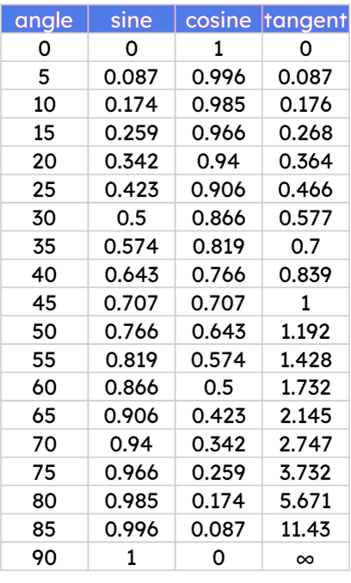
Shaxda saamiga (ratio tables), goobada halbeegga (unit circle), iyo taangent-yada (tangents)
tan
Oh, tirooyinkan waxay u muuqdaan kuwo la yaqaan. Hadda waxaan dib u abuuray shaxda qiimaha trig ee saamiga tan.
Haddii dhererka dhinaca ku xiga xagal uu yahay 1 halbeeg (unit), markaas dhinaca ka soo horjeeda xagasha wuxuu ku yaalaa taangent (tangent) goobada halbeegga (unit circle).
35
0.7
Isra
Sidaa darteed, waxaan isticmaali karnaa saamiga tan (tan ratio) ee shaxda qiimaha trig si aan u helno dhererka dhinaca ka soo horjeeda xagasha.
0.7 halbeeg (units)
tan(35°)
35°
1 halbeeg (unit)

Slide 8
Shaxda saamiga (ratio tables), goobada halbeegga (unit circle), iyo taangent-yada (tangents)
tan
Oh, laakiin sidoo kale waa suurtagal in la helo dhererka dhinaca ka soo horjeeda xagal xitaa haddii dhinaca ku xiga xagasha uusan ahayn 1 halbeeg (unit)!
Waxaan u baahanahay inaan sawiro saddexagal la mid ah oo leh dhinac ku xiga oo dhererkiisu yahay 1 halbeeg (unit), oo aan isticmaalo saamiga tan (tan ratio) ee xagashaas.
Isra
sawir saddexagal la mid ah (similar triangle)
50
1.192
12.16
cm
1.192
×
10.2
1.192 cm
tan(50°)
50°
50°
10.2 cm
× 10.2
1 cm

Slide 9

Shaxda saamiga (ratio tables), goobada halbeegga (unit circle), iyo taangent-yada (tangents)
tan
Saddexagal la mid ah kani waa la sawiri doonaa, kaas oo dhinaciisa ku xiga xagasha 55° uu dhererkiisu yahay 1 cm.
Adigoo isticmaalaya shaxda qiimaha trig (trig values), raadi dhererka dhinaca calaamadeysan a.
sawir saddexagal la mid ah (similar triangle)
55
1.428
a
1.428 cm
55°
55°
20 cm
1 cm

Slide 10
Shaxaha saamiga (ratio tables), goobada halbeegga (unit circle), iyo tangents
Saddexagal la mid ah kani waa la sawiri doonaa, kaas oo dhinaciisa ku xiga xagasha 55° uu dhererkiisu yahay 1 cm.
Adigoo isticmaalaya saddexagallo isku mid ah (similar triangles), raadi dhererka dhinaca calaamadeysan b.
sawir saddexagal la mid ah (similar triangle)
b
28.56
cm
1.428 cm
55°
55°
× 20
20 cm
1 cm

Slide 11
Shaxaha saamiga (ratio tables), goobada halbeegga (unit circle), iyo tangents
tan
Waxa sidoo kale suurtogal ah in la isticmaalo saamiga tan (tan ratio) si loo helo dhererka dhinaca ku xiga xagasha marka la eego dhererka dhinaca ka soo horjeeda.
opp (opp) | adj (adj)
0.7
1
×
16
0.7
16
16
x
22.86
0.7
35
0.7
sawir saddexagal la mid ah (similar triangle)
16
cm
0.7 cm
tan(35°)
35°
35°
x cm
1 cm
22.86 cm
×
16
0.7

Slide 12
Shaxda saamiga (Ratio tables), goobta cutubka (unit circle), iyo taangiyada (tangents)
tan (tan)
Soo hel dhererka dhinaca lagu calaamadeeyay a. (Find the length of the side labelled a.)
opp (opp) | adj (adj)
0.466
1
a
25
0.466
sawir saddex-xagal la mid ah (sketch a similar triangle)
40
cm
0.466
cm
a
25°
25°
x cm
1 cm

Slide 13
Shaxda saamiga (Ratio tables), goobta cutubka (unit circle), iyo taangiyada (tangents)
tan (tan)
Waa maxay isku-dhufashada (scale factor), oo loo qoro jajab (fraction), laga bilaabo saddexagalka (triangle) leh dhinac ku xiga (adjacent side) oo ah 1 cm ilaa kan kale?
opp (opp) | adj (adj)
40
0.466
1
×
0.466
40
25
0.466
sawir saddex-xagal la mid ah (sketch a similar triangle)
40
cm
0.466
cm
25°
25°
x cm
1 cm
×
40
b
0.466

Slide 14
Shaxanka saamiyada (ratio tables), goobada halbeegga (unit circle), iyo taangentada (tangents)
tan
Sidaa awgeed, soo hel dhererka dhinaca lagu calaamadeeyay x (2 d.p.)
opp | adj
40
0.466
1
×
0.466
40
85.84
25
0.466
sawir saddexagal la mid ah (similar triangle)
40
cm
0.466
cm
25°
25°
85.84 cm
1 cm
x cm
×
40
0.466

Slide 15
Shaxanka saamiyada (ratio tables), goobada halbeegga (unit circle), iyo taangentada (tangents)
1) Buuxi meelaha bannaan iyo shaxanka saamiyada (ratio table). Adigoo tixgelinaya dhinacyada u dhigma (corresponding sides), soo hel dhererka dhinaca lagu calaamadeeyay a cm.
sawir saddexagal la mid ah (similar triangle)
a cm
tan(15°)
15°
15°
18.5 cm
1 cm
ku xiga (adjacent) | ka soo horjeeda (opposite)
1

Slide 16
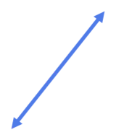
Shaxda saamiga (ratio tables), goobada cutubka (unit circle), iyo taangentiyada (tangents)
2) Adigoo sawiraya saddexagallo isku mid ah (similar triangles), hel dhererka dhinaca maqan ee saddexagal kasta.
sawir saddexagal isku mid ah (similar triangle)
60
cm
65°
b cm
×
d cm
18.5
cm
50°
c cm
40°
0.88
cm

Slide 17
Shaxda saamiga (ratio tables), goobada cutubka (unit circle), iyo taangentiyada (tangents)
1) Buuxi meelaha bannaan iyo shaxda saamiga (ratio table). Adigoo tixgelinaya dhinacyada u dhigma (corresponding sides), hel dhererka dhinaca lagu calaamadeeyay a cm.
sawir saddexagal isku mid ah (similar triangle)
a cm
tan(15°)
15°
4.958 cm
15°
0.268
18.5 cm
1 cm
ku xiga (adjacent) | ka soo horjeeda (opposite)
1 | 0.268
18.5 | 4.958
× 18.5

Slide 18
Shaxda saamiga (ratio tables), goobada cutubka (unit circle), iyo taangentiyada (tangents)
2) Adigoo sawiraya saddexagallo isku mid ah (similar triangles), hel dhererka dhinaca maqan ee saddexagal kasta.
sawir saddexagal isku mid ah (similar triangle)
60
cm
65°
b = 128.7
b cm
×
60
d cm
18.5
cm
50°
c = 1.04896
d = 22.05
c cm
40°
0.88
cm

Slide 19
Saamiga taangentada (Tangent ratio)
Shaxaha saamiyada (Ratio tables), goobada cutubka (unit circle), iyo taangentada (tangents)
Dhinaca ka soo horjeeda (opposite) iyo dhinaca ku xiga (adjacent)
Si wax ku ool ah u isticmaalka kalkuleetarka (calculator) saamiga tan (tan ratio)

Slide 20
Dhinaca ka soo horjeeda (opposite) iyo dhinaca ku xiga (adjacent)
Dhinaca ka soo horjeeda xagasha (angle) (oo le'eg θ°) ee saddexagalka qumman (right-angled triangle) had iyo jeer waa tan(θ°) lagu dhuftey dhererka dhinaca ku xiga (adjacent) isla xagashaas.
Waxaan la yaabanahay inay jirto xiriir la mid ah oo u dhexeeya dhinacyada ka soo horjeeda (opposite) iyo kuwa ku xiga (adjacent) ee saddexagalka iyo saamiga taangentada (tangent ratio).
Isra
adj
× tan(θ°)
= opp
opp
adj × tan(θ°) cm
θ°
adj

Slide 21
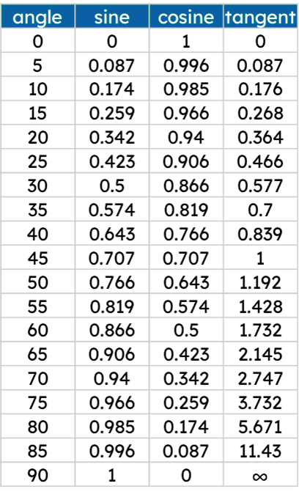
Dhinaca ka soo horjeeda (opposite) iyo dhinaca ku xiga (adjacent)
dhinaca ka soo horjeeda = adj × tan(θ°)
Adigoo isticmaalaya xiriirkan, soo hel qiimaha (values) waa inuu galo meelahan bannaan.
dhinaca ka soo horjeeda (opposite side) = × tan( )
68
80
a
b
dhinaca ka soo horjeeda
Sidaas awgeed, soo hel dhererka dhinaca ka soo horjeeda xagasha 80°.
80°
385.628 cm
68 cm

Slide 22
Dhinaca ka soo horjeeda iyo dhinaca ku xiga (adjacent)
Waxaa sidoo kale suurtogal ah in la helo dhererka dhinaca ku xiga (adjacent) haddii aan ognahay:
cabirka xagasha uu dhinacu ku xiga yahay (adjacent)
dhererka dhinaca ka soo horjeeda xagashan
Waxaan tan ku samayn karnaa annagoo ku beddelaya qiimaha (values) la yaqaan ee saddexagalka, oo dib u habeynaya isla'egta (equation) aan ku dhameyno.
dhinaca ka soo horjeeda = adj × tan(θ°)
78
= adj × tan(30°)
78 cm
78
= adj × 0.577
0.577
0.577
30°
78
= adj
= 135.18
h cm
135.18 cm
0.577

Slide 23
Dhinaca ka soo horjeeda iyo dhinaca ku xiga (adjacent)
Adigoo isticmaalaya xiriirkan, soo hel qiimaha (values) waa inuu galo meelahan bannaan.
dhinaca ka soo horjeeda (opposite side) = adj × tan(θ°)
= adj × tan( )
105
75
a
b
Adiga oo og in tan(75) uu leeyahay qiime (value) 3.732, waa maxay qiimaha (value) gelaya meelahan bannaan?
105 cm
105 = adj × tan(75)
3.732
3.732
c
d
75°
Sidaa awgeed, waa imisa dhererka dhinaca ku xiga xagasha 75°?
adj
28.135 cm

Slide 24
Dhinaca ka soo horjeeda (opposite) iyo dhinaca ku xiga (adjacent)
1) Raadi dhererka dhinaca ka soo horjeeda (opposite) xagasha calaamadeysan adiga oo isticmaalaya xiriirkan.
dhinaca ka soo horjeeda (opposite side) = adj × tan(θ°)
a)
adj × tan(θ°) cm
h × tan(θ°) cm
h × sin(θ°) cm
40°
91 cm

Slide 25
Dhinaca ka soo horjeeda (opposite) iyo dhinaca ku xiga (adjacent)
1) Raadi dhererka dhinaca ka soo horjeeda (opposite) xagasha calaamadeysan adiga oo isticmaalaya xiriirkan.
dhinaca ka soo horjeeda (opposite side) = adj × tan(θ°)
b)
h × tan(θ°) cm
35°
16.9 cm
c)
d)
55°
d cm
adj × tan(θ°)
20°
143
cm
0.44 cm

Slide 26
Dhinaca ka soo horjeeda (opposite) iyo dhinaca ku xiga (adjacent)
2) Raadi dhererka dhinaca ku xiga (adjacent) marka la siiyo dhinaca ka soo horjeeda (opposite) xagasha la calaamadeeyay.
dhinaca ka soo horjeeda (opposite) = adj × tan(θ°)
b)
66 cm
65 cm
a)
88 cm
80°
10°
adj
adj = dhinaca ka soo horjeeda (opposite)
adj =
0.176

Slide 27
Dhinaca ka soo horjeeda (opposite) iyo dhinaca ku xiga (adjacent)
2) Raadi dhererka dhinaca ku xiga (adjacent) marka la siiyo dhinaca ka soo horjeeda (opposite) xagasha la calaamadeeyay.
dhinaca ka soo horjeeda (opposite) = adj × tan(θ°)
d) Saddex-xagal qumman (right-angled triangle) wuxuu leeyahay xagal 85°.
Dhererka dhinaca ka soo horjeeda (opposite) xagashan waa 142 cm.
c)
65°
202 cm
adj
183 cm

Slide 28
Dhinaca ka soo horjeeda (opposite) iyo dhinaca ku xiga (adjacent)
1) Raadi dhererka dhinaca ka soo horjeeda (opposite) xagasha la calaamadeeyay adigoo isticmaalaya xiriirkan.
dhinaca ka soo horjeeda = adj × tan(θ°)
a)
adj × tan(θ°) cm
b)
h × tan( θ° ) cm
h × tan( θ° ) cm
16.9
35
91
40
h × sin( θ° ) cm
91
0.839
40°
35°
= 11.83 cm
= 76.349 cm
16.9 cm
91 cm
c)
d)
d = 0.16016 cm
55°
d cm
adj × tan(θ°)
20°
143 cm
= 204.204 cm
0.44 cm

Slide 29
Dhinaca ka soo horjeeda iyo dhinaca ku xiga (adjacent)
2) Raadi dhererka dhinaca ku xiga (adjacent) marka la eego dhinaca ka soo horjeeda xagasha la calaamadeeyay.
dhinaca ka soo horjeeda = adj × tan(θ°)
a)
b)
88 cm
66 cm
65 cm
10°
adj = dhinaca ku xiga (adjacent side)
65
= 500 cm
adj =
80°
0.176
5.671
adj
= 11.46 cm
c)
d) Saddexagal qumman (right-angled triangle) wuxuu leeyahay xagal 85°.
Dhererka dhinaca ka soo horjeeda xagashan waa 142 cm.
65°
202 cm
adj
= 85.31 cm
= 12.42 cm
183 cm

Slide 30
Saamiga taangent (Tangent ratio)
Shaxda saamiga (Ratio tables), goobta cutubka (unit circle), iyo taangent (tangents)
Dhinaca ka soo horjeeda (opposite) iyo dhinaca ku xiga (adjacent)
Isticmaalka xisaabiyaha (calculator) si wax ku ool ah ugu saamiga taangent (tan ratio)

Slide 31
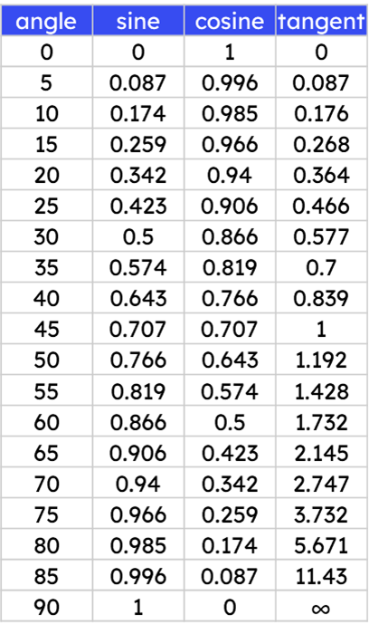

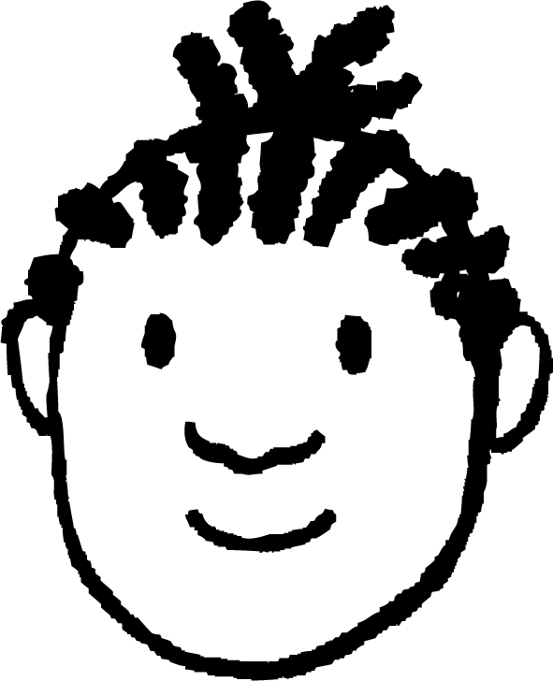


Isticmaalka xisaabiyaha (calculator) si wax ku ool ah ugu saamiga taangent (tan ratio)
Ma isticmaali karo shaxda saddexagalkaan, sababtoo ah tan(61°) kuma jiro shaxda.
Waxaan u malaynayaa inaan isticmaalo xisaabiye (calculator).
Yacquub
61°
100 cm
k cm
Qorista tan(61°) xisaabiyaha (calculator) waxay bixisaa…
100
× tan(61°)
100
× 1.804047755
= 180.4047755

Slide 32
Si fiican u isticmaalka xisaabiyaha (calculator) ee saamiga tan (tan ratio)
Qorista 1.804047755 mar kale waa mid culus.
Ma jirtaa hab ka dhakhso badan oo loo isticmaalo xisaabiyaha (calculator)?
Yacquub
61°
100 cm
k cm
Qorista tan(61°) ee xisaabiyaha (calculator) waxay bixisaa…
100
× tan(61°)
100
× 1.804047755
= 180.4047755

Slide 33
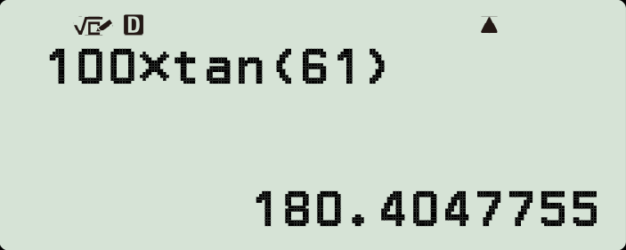

Si fiican u isticmaalka xisaabiyaha (calculator) ee saamiga tan (tan ratio)
Ka hor isticmaalka xisaabiyaha (calculator), hubi inuu ku jiro qaabka darajooyinka (degrees mode) (D).
Dhererka dhinaca ku xiga (adjacent)
Laguna dhufo
61°
saamiga tan (tan ratio) (xarigga furitaanka waa si toos ah loo qoray)
100 cm
ee xagasha ku xiga (adjacent) (waa inaad qortaa xarigga xidhitaanka adiga)
100
× tan(61°)

Slide 34
Si fiican u isticmaalka xisaabiyaha (calculator) ee saamiga tan (tan ratio)
Marka waa sahlan tahay inaad isticmaasho xisaabiyaha (calculator) si aad u hesho dhererka dhinaca ka soo horjeeda (opposite) haddii aad taqaanid dhinaca ku xiga (adjacent)…
Laakiin helista dhererka dhinaca ku xiga (adjacent) waxay noqon doontaa mid adag, maadaama ay ku jirto qaybin (division), sax?
Yacquub
64°
= 45
k cm
k
× tan(64°)
= 45
× tan(64°)
× tan(64°)
× tan(64°)
45 cm
= 45
k
=
× tan(64°)

Slide 35
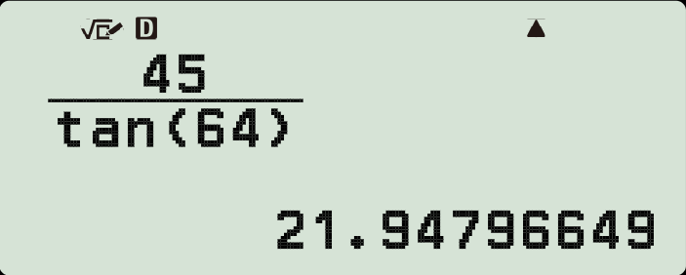

Isticmaalka xisaabiyaha (calculator) si hufan uga faa'iidaysta saamiga tan (tan ratio)
Ka bilow badhanka jajabka (fraction button) si ay u caddaato waxaad u baahan tahay inaad saarto tireeye (numerator) iyo hooseeye (denominator).
64°
= 45
× tan(64°)
Dhinaca ka soo horjeeda (opposite side),
u qaybi (divide by)
45 cm
saamiga tan (tan ratio) ee xagasha ka soo horjeeda (opposite angle).

Slide 36
Isticmaalka xisaabiyaha (calculator) si hufan uga faa'iidaysta saamiga tan (tan ratio)
Isku dhig saddax-xagalka (triangle) xisaabta (calculation) helaysa dhererka dhinaciisa maqan.
a
42°
b
42°
x cm
200 cm
x cm
200 cm
200
tan(42°)
x =
x =
x = 200 × tan(42°)
tan(42°)
200
e
c
d

Slide 37

Isticmaalka xisaabiyaha (calculator) si hufan uga faa'iidaysta saamiga tan (tan ratio)
Isku dhig saddax-xagalka (triangle) xisaabta (calculation) helaysa dhererka dhinaciisa maqan.
a
42°
b
42°
180.08 cm
x cm
200 cm
222.12 cm
x cm
200 cm
x = 200 × tan(42°)
200
x =
e
tan(42°)
c
Sidaa awgeed, isticmaal xisaabiyaha (calculator) si aad u hesho dhererka dhinac kasta oo maqan oo lagu calaamadeeyay x (2 d.p.)
tan(42°)
x =
200
d

Slide 38
Si wax ku ool ah u isticmaalka xisaabiyaha (calculator) ee saamiga tan (tan ratio)
1) Laga bilaabo kan ugu yar, dhiga dhererka dhinacyada saddexagalka qumman (right-angled) ee kala duwan si ay u kala horreeyaan.
0.4
50
50 × tan(70°)
tan(10°)
tan(70°)
0.4 × tan(10°)
0.4 × tan(70°)
0.4
50 × tan(45°)
tan(70°)

Slide 39
Si wax ku ool ah u isticmaalka xisaabiyaha (calculator) ee saamiga tan (tan ratio)
2) Raadi dhererka dhammaan dhinacyada maqan ee ku calaamaysan xaraf (3 d.p.)
a)
b)
c)
a cm tan(33°)
b cm
48°
c cm
33°
42°
1 cm
1 cm
1 cm
d)
e)
f)
d cm
e cm
42 cm
42°
19°
19°
19 cm
42 cm
f cm

Slide 40
Si wax ku ool ah u isticmaalka xisaabiyaha (calculator) ee saamiga tan (tan ratio)
1) Laga bilaabo kan ugu yar, dhiga dhererka dhinacyada saddexagalka qumman ee kala duwan si ay u kala horreeyaan.
0.4 × tan(10°)
0.4 × tan(70°)
0.4
0.4
0.071
tan(70°)
1.099
tan(10°)
0.146
2.269
50 × tan(70°)
50 × tan(45°)
50
137.374
50
tan(70°)
18.199

Slide 41
Si wax ku ool ah u isticmaalka xisaabiyaha (calculator) ee saamiga tan (tan ratio)
2) Raadi dhererka dhammaan dhinacyada maqan ee lagu calaamadeeyay xaraf (3 d.p.)
a)
b)
c)
a cm tan(33°)
b cm
48°
c cm
33°
42°
1 cm
1 cm
1 cm
a = 0.649
b = 0.900
c = 0.900
d)
e)
e = 14.462
f)
f = 121.977
d cm
e cm
42 cm
42°
19°
19°
19 cm
42 cm
f cm
d = 17.108

Slide 42
Saamiga tan (Tangent ratio)
Dhererka dhinac kasta oo ka soo horjeeda ama ku xiga xagal (θ°) saddexagal qumman (right-angled triangle) oo ka yimid goobada halbeegga (unit circle) waxaa laga heli karaa iyadoo la isticmaalo shaxda qiimaha trig (trig values) oo ay ku jirto saamiga tan (tan ratio). Saddexagalkan waa la weyneyn karaa (enlarged) taasina wali run ayay tahay.
Dhererka dhinaca ka soo horjeeda xagal kasta (θ°) saddexagal qumman (right-angled triangle) wuxuu la eg yahay dhinaca ku xiga (adjacent) × tan(θ°).
Xisaabiyaha (calculator) waxaa loo isticmaali karaa in lagu helo dhererka dhinaca ka soo horjeeda ama dhinaca ku xiga (adjacent) ee saddexagal qumman (right-angled triangle) haddii midka kale la yaqaan.

