Slide 1
Helitaanka qaab-dhismeedka DNA
Dhaxalka iyo DNA

Slide 2
sida loo isticmaalo darasyada Oak

Slide 3
Waxaan qeexi karaa sida saynisyahanadu u ururiyeen caddayn oo ay u wadaageen natiijooyin si ay u horumariyaan moodel lagu qeexayo qaab-dhismeedka DNA.

Slide 4
DNA
X-ray
double helix
genome

Slide 5
DNA waa walaxda kiimikaad ee laga sameeyo maadada hidde-side; waxay kaydisaa koodhka hidde-side.
X-ray waa nooc ka mid ah shucaaca loo isticmaali karo samaynta sawiro.
DNA waxay leedahay qaab-dhismeedka double helix oo ka kooban laba silsiladood oo qalloocan.
Genome waa dhammaan maadada hidde-side ee unugga.

Slide 6

Helitaanka qaab-dhismeedka DNA
Aqoonta hore ee DNA
Helitaanka qaab-dhismeedka DNA
Muhiimadda fahamka DNA

Slide 7
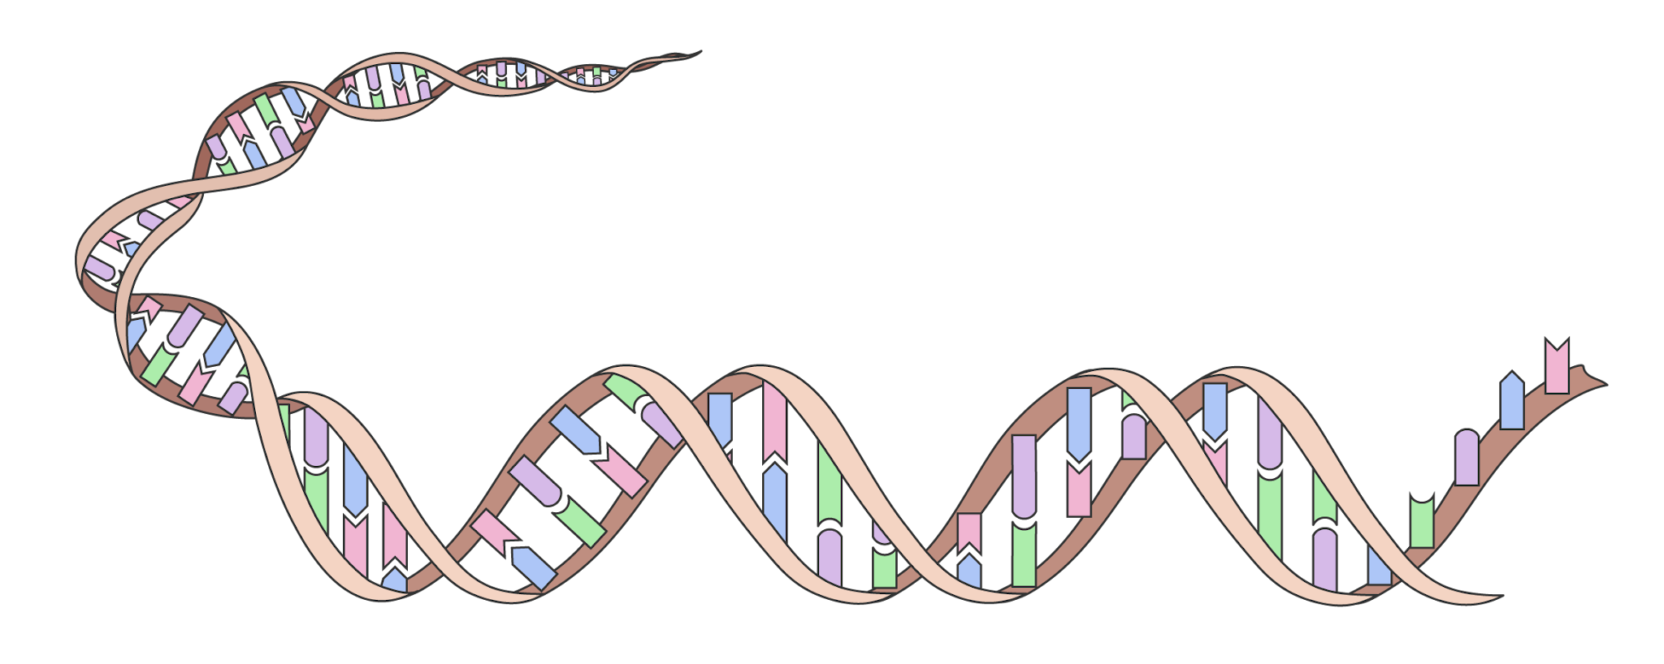
Aqoonta hore ee DNA
DNA waxaa laga soo saari karaa unugyo nool, sida midho.
DNA waxaa la helay 1869, markii laga soo saaray nucleus-ka unugyada bini'aadamka.
Kadib waxaa la ogaaday inay tahay isku-dhaf gaar ah oo curiye ah.
nucleus
unug xayawaan (animal cell)
DNA

Slide 8
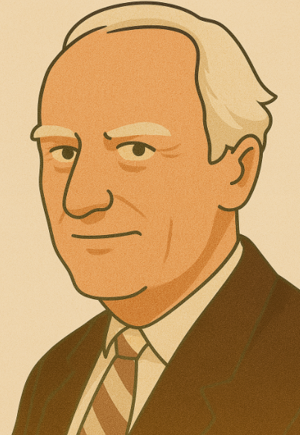
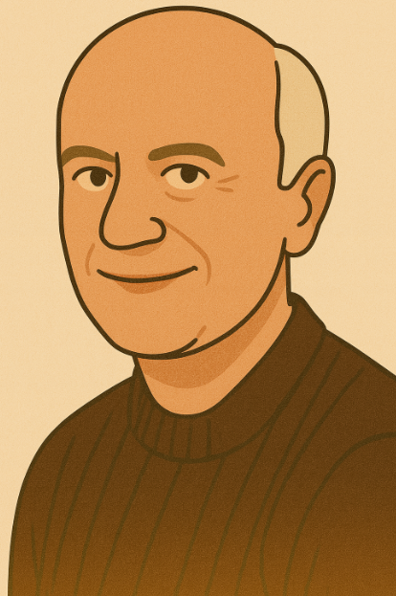
Aqoonta hore ee DNA
Sanadkii 1944, saynisyahannadu waxay garteen in DNA uu yahay walaxda hidde-sidaha (genetic material) ee unugyada (cells) taasoo u oggolaanaysa sifooyinka in la dhaxlo (inherited).
Bilowgii 1950-meeyadii, Francis Crick iyo James Watson waxay ahaayeen cilmi-baarayaal ka shaqaynayay Jaamacadda Cambridge.
Waxay isku dayayeen inay ogaadaan qaab-dhismeedka (structure) DNA oo ay dhisaan moodel (model) molecule DNA ah.
Francis Crick
James Watson

Slide 9
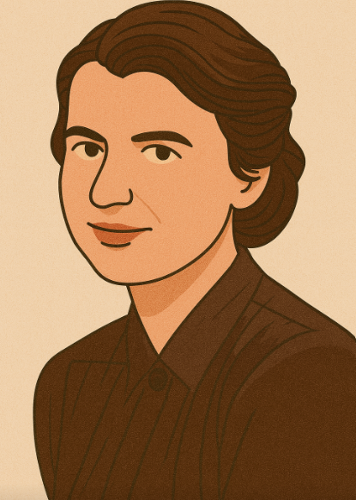
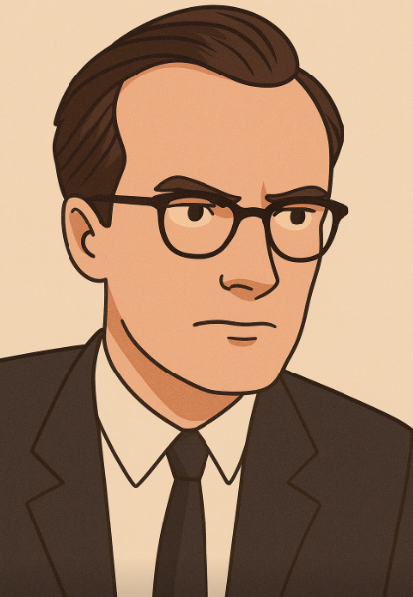
Aqoonta hore ee DNA
Koox kale oo cilmi-baarayaal ah oo ka tirsan King's College, London, ayaa sidoo kale isku dayayay inay ogaadaan qaab-dhismeedka DNA iyagoo adeegsanaya farsamo cusub oo la yiraahdo X-ray crystallography.
Farsamadani waxay adeegsatay shucaaca (radiation) X-ray si ay u sawirto qaab-dhismeedka walxaha aad u yaryar sida molecules-ka.
Kooxdan waxaa ka mid ahaa Rosalind Franklin iyo Maurice Wilkins.
Rosalind Franklin
Maurice Wilkins

Slide 10

Aqoonta hore ee DNA
DNA waxaa markii ugu horreysay helay Watson iyo Crick.
DNA waxaa loo aqoonsaday inuu yahay isku-dhaf kiimikooyin gaar ah (specific combination of chemicals) sanadkii 1869.
Watson iyo Crick waxay ogaayeen in DNA uu yahay walaxda hidde-sidaha (genetic material) ee la dhaxlo (inherited).

Slide 11




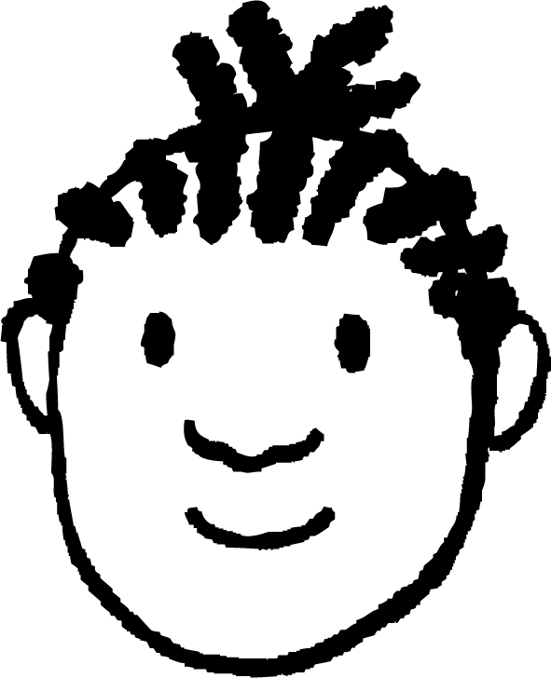
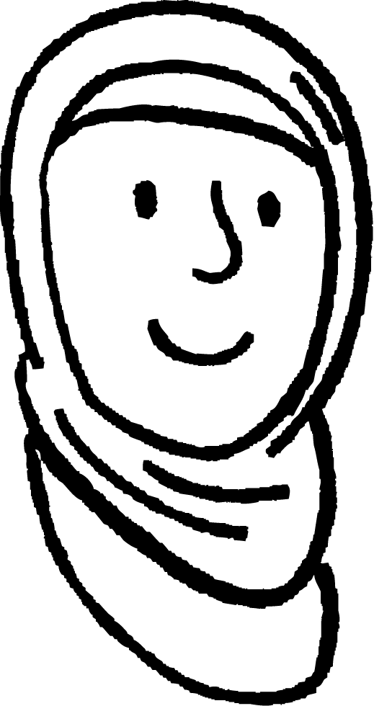
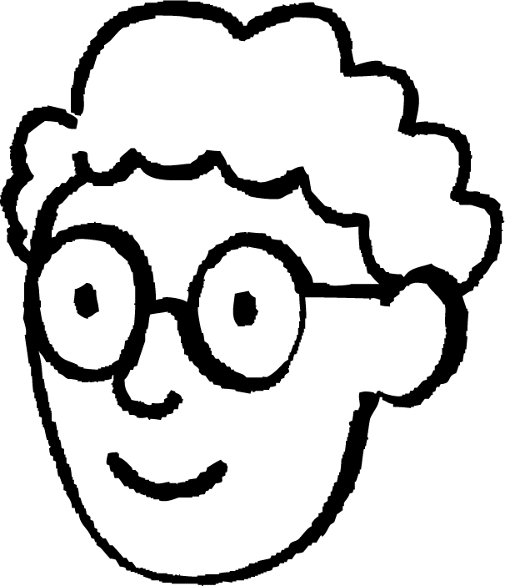




Aqoonta hore ee DNA
Ardayda qaar ayaa ka wada hadlaya aqoonta DNA ee sanadkii 1950.
Sanadkii 1950 qofna ma ogeyn waxa DNA yahay.
Sanadkii 1950 qofna ma ogeyn waxa DNA ka samaysan yahay.
Caasha
Yacquub
Sanadkii 1950 qofna ma ogeyn doorka (role) DNA.
Sanadkii 1950 qofna ma ogeyn qaab-dhismeedka (structure) DNA.
Saciid
Axmed
Dooro ardayga saxan.
Sharax sababta ay u saxan yihiin, iyo sababta ardayda kale ay u qaldan yihiin.

Slide 12
Aqoonta hore ee DNA
Ardayda ayaa ka hadlaya aqoonta DNA ee 1950.
Dooro ardayga saxan.
Sharax sababta ay u saxan yihiin, iyo sababta ardayda kale ay u qaldan yihiin.
Caasha waa qaldan. DNA waxaa laga helay nucleus-ka 1869.
Yacquub waa qaldan. Markii DNA la helay waxaa la ogaaday in uu ka kooban yahay isku-dhaf kiimikooyin gaar ah.
Saciid waa qaldan. DNA waxaa la ogaaday in uu qayb ka yahay maadada hidde-sidaha (genetic material) ee la dhaxlo 1944.
Axmed waa sax. Saynisyahannadu ma ay ogeyn qaab-dhismeedka (structure) DNA 1950.
Caasha: 1950 qofna ma ogeyn waxa DNA yahay.
Yacquub: 1950 qofna ma ogeyn waxa DNA ka samaysan yahay.
Saciid: 1950 qofna ma ogeyn doorka DNA.
Axmed: 1950 qofna ma ogeyn qaab-dhismeedka (structure) DNA.

Slide 13
Helitaanka qaab-dhismeedka DNA
Aqoonta hore ee DNA
Helista qaab-dhismeedka (structure) DNA
Muhiimadda fahamka DNA

Slide 14
Helitaanka qaab-dhismeedka DNA
Sanadkii 1952 Rosalind Franklin, oo ahayd farmashiist (chemist), waxay samaysay sawir DNA iyadoo isticmaalaysa raajo (X-rays).
Farsamadani waxay ahayd mid cusub waxayna muujisay in DNA uu leeyahay qaab wareegsan (helix shape).
Sawirka waxaa loo tusay James Watson oo ku sugnaa Cambridge, waxaana tusay Maurice Wilkins, oo ahaa madaxa Rosalind Franklin, iyada oo aan la ogayn.
Sanadkii 1953 Watson iyo Crick waxay isticmaaleen sawirka si ay uga caawiyaan soo saarista qaabka (model) qaab-dhismeedka DNA.
Rosalind Franklin

Slide 15
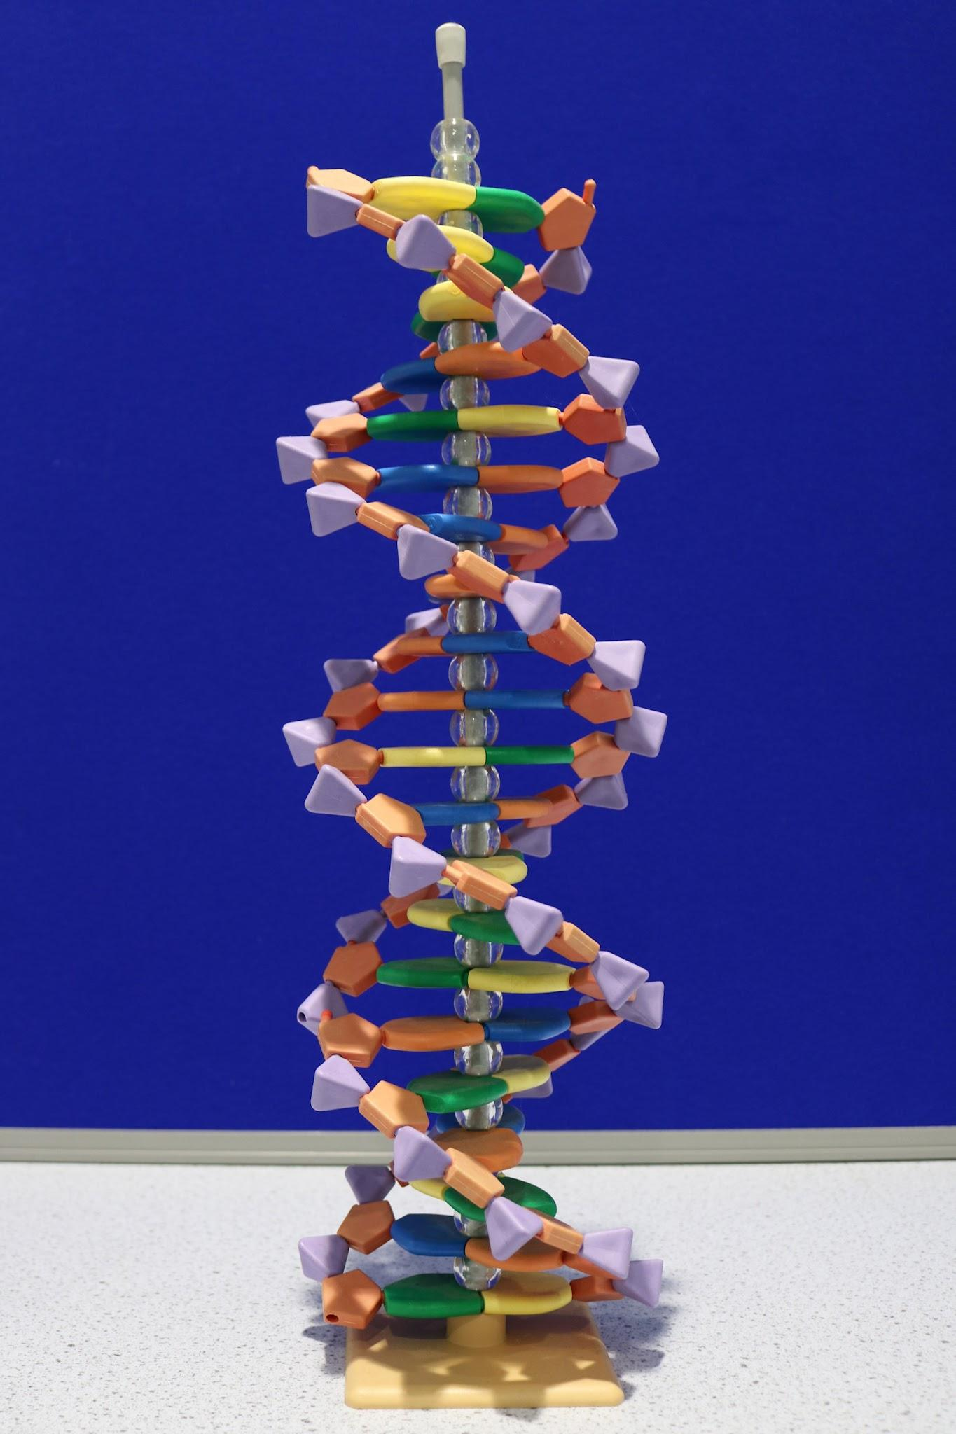
Helitaanka qaab-dhismeedka DNA
Watson iyo Crick waxay qaabeeyeen laba xarig (strands) oo isku wareega si ay u sameeyaan laba-jeex wareegsan (double helix).
Laba xarig waxaa isku haya xidhiidhyo (bonds) dhexda, sida jaranjarooyinka jaranjaro qalloocan.
Sanadkii 1953 waxay dhisteen qaabkii ugu horreeyay ee 3D ee DNA.
qaab casri ah oo DNA ah

Slide 16
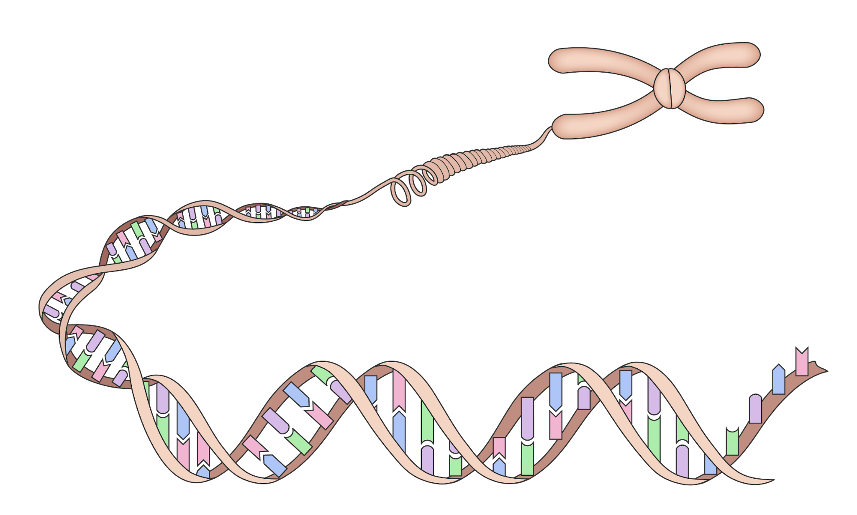
Helitaanka qaab-dhismeedka DNA
Watson, Crick iyo Wilkins waxay heleen abaalmarinta Nobel sanadkii 1962 sababtoo ah waxay ogaadeen qaab-dhismeedka DNA.
Rosalind Franklin laguma darin ama looma tixgalin cilmi-baadhiseedii muhiimka ahayd.

Slide 17
Helitaanka qaab-dhismeedka DNA
Dhig weedhahan si habboon si aad u soo koobto helitaanka DNA:
Qaab-dhismeedka DNA waa la ogaaday.
DNA waxaa laga soo saaray xudunta (nucleus) unugga (cell).
Qaybaha kiimikada (chemical parts) ee DNA waa la aqoonsaday.
DNA waxaa laga sawiray iyadoo la isticmaalayo raajo (X-rays).
Jawaabaha:
4
1
2
3

Slide 18
Helitaanka qaab-dhismeedka DNA
Maxay saynisyahannadu sameeyeen si ay u ogaadaan qaab-dhismeedka DNA?
Waxyaabihii la ururiyay (Collected evidence)
Wadaagista natiijooyinka (Shared findings)
Dhisidda moodello (Built models)
Sameeyay sharaxaad ku habboon caddaynta (Developed an explanation that fit the evidence)

Slide 19
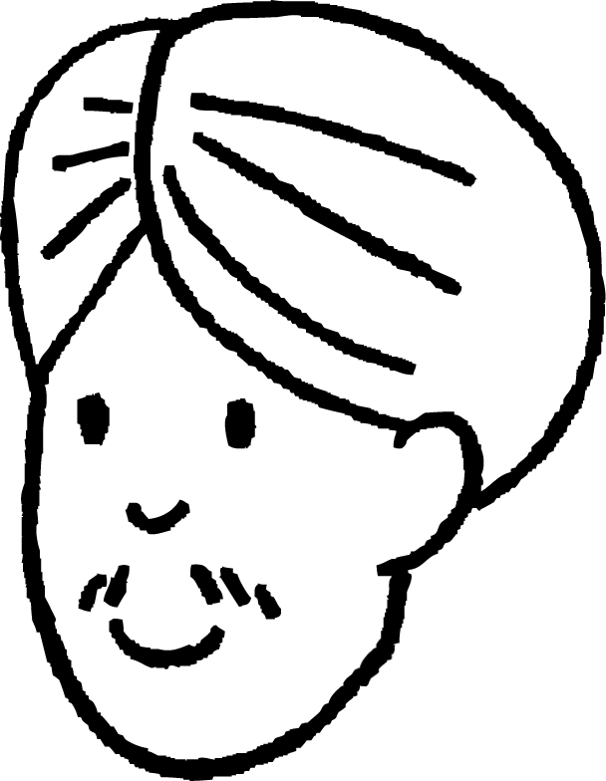

Helitaanka qaab-dhismeedka DNA
Ardaydu waxay ka wada hadlayeen cinwaanka maqaal online ah oo loo isticmaali lahaa si ay u soo jiitaan dareenka dadweynaha, haddii helitaanka qaab-dhismeedka DNA la sameeyo maanta.
Saddex waa shirkad, afarna waa dad badan oo ku tartamaya inay noqdaan saynisyahano sare oo helitaanka DNA.
Laba maskaxood ayaa furaysa koodhka nolosha.
Layla
Cali
Ka hadla cinwaanka Layla iyo Cali: ma soo jiitaan dareenkaaga? Ma yihiin soo koobid wanaagsan?
Qor cinwaan war ah oo soo jiiti doona dareenka dadweynaha.
U sharax qof kale sababta cinwaankaagu u yahay soo koobid wanaagsan oo ku saabsan helitaanka qaab-dhismeedka DNA.

Slide 20
Helitaanka qaab-dhismeedka DNA
Ka hadla cinwaanka Layla iyo Cali; ma soo jiitaan dareenkaaga? Ma yihiin soo koobid wanaagsan?
Cali wuxuu soo koobayaa saynisyahannadii ku guuleystay abaalmarinta Nobel; Watson, Crick iyo Wilkins. Franklin laguma darin liiska sababtoo ah waxay ku biirisay sawirka DNA iyadoo la adeegsanayo raajo (X-rays).
Layla waxay soo koobaysaa Watson iyo Crick oo helay qaab-dhismeedka DNA. Tani ma aqoonsanayso waxqabadka Franklin iyo Wilkins.
Qor cinwaan war ah oo soo jiiti doona dareenka dadweynaha.
U sharax qof kale sababta cinwaankaagu u yahay soo koobid wanaagsan oo ku saabsan helitaanka qaab-dhismeedka DNA.

Slide 21
Helista qaab-dhismeedka DNA
Aqoonta hore ee DNA
Helitaanka qaab-dhismeedka DNA
Muhiimadda fahamka DNA

Slide 22
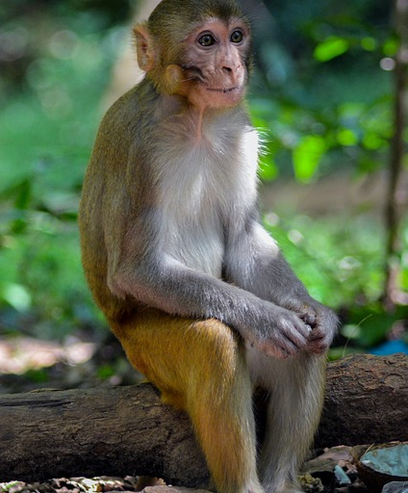
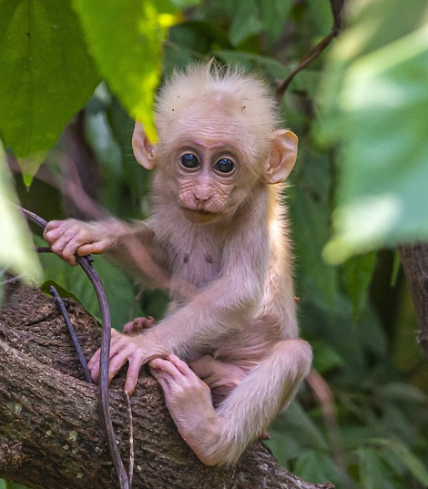
Muhiimadda fahamka DNA
Helista DNA ayaa xaqiijisay sida astaamaha loogu gudbiyo jiil ilaa jiil.
DNA waxay isticmaashaa koodh hidde-side (genetic code) si ay u kaydiso tilmaamaha dhammaan astaamaha la dhaxlo iyo hababka noolaha (living organisms). Waxaa loo gudbiyaa tarmidda (reproduction), faraca (offspring).
Tarmidda (Reproduction)
DNA
daayeer weyn (adult monkey)
daayeer yar (infant monkey)

Slide 23
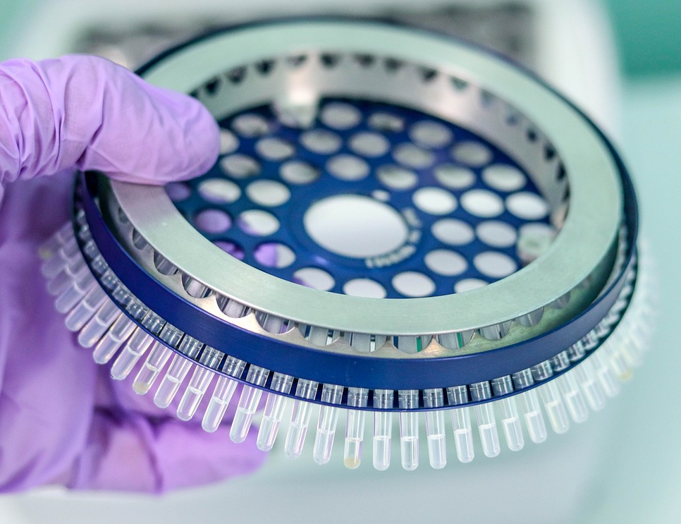
Muhiimadda fahamka DNA
Dhammaan DNA-ga ku jira noole (organism) waxaa loo yaqaan genome-ka.
Genome-ku wuxuu siday dhammaan tilmaamaha astaamaha la dhaxlo ee noole (organism).
Sanadkii 2003, genome-ka bini'aadamka oo dhan ayaa markii ugu horreysay la taxay (sequenced).
Tan iyo markaas, saynisyahannadu waxay baarayaan qaybaha genome-ka ee bixiya tilmaamaha astaamaha.
muunado DNA ah oo loo isticmaalo taxista genome-ka (genome sequencing)

Slide 24
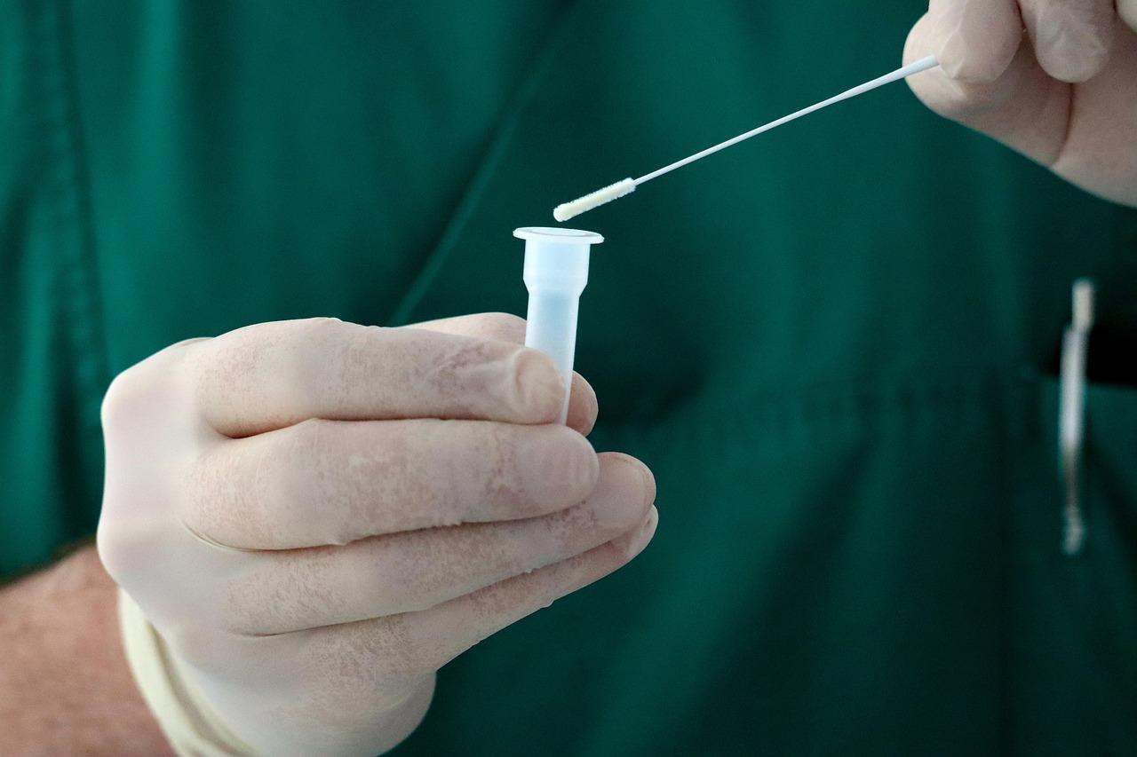
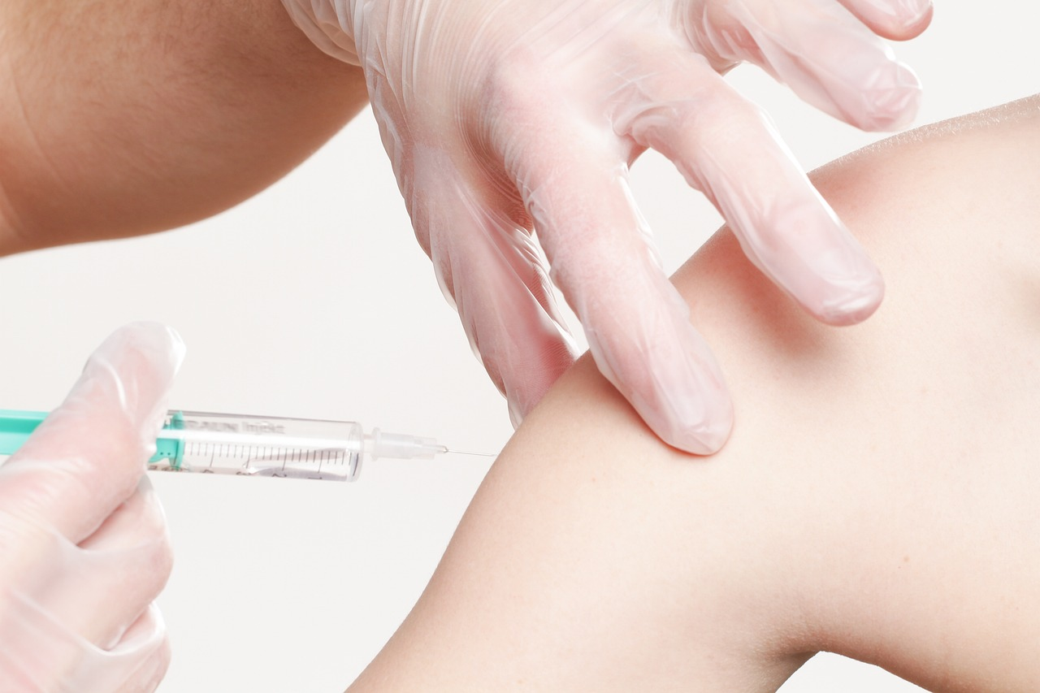
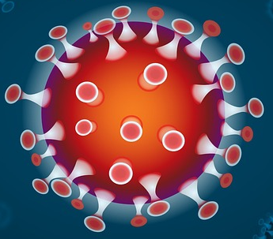
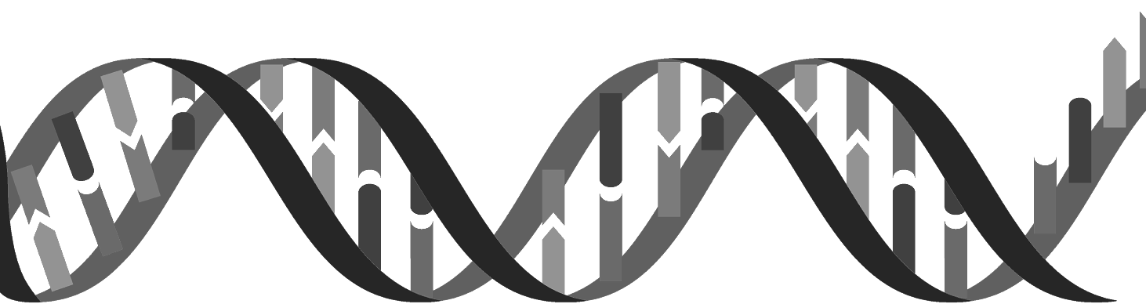
Muhiimadda fahamka DNA
Taxista (Sequencing) genome-yada bini'aadamka iyo noolaha kale waxay keentay horumarro weyn oo ku saabsan meelaha sida daawada (medicine) iyo xakamaynta cudurrada.
tijaabinta DNA-ga fayraska (virus DNA)
tallaalidda DNA-ga fayraska (vaccinating with virus DNA)
tifatirka genome-yada (editing genomes) si loo daweeyo cudurrada

Slide 25
Muhiimadda fahamka DNA
Fahamka DNA wuxuu naga caawiyaa horumarinta caafimaadka dadka.
Fahanka DNA kaliya wuxuu sharaxaa sida astaamaha (features) loogu gudbiyo jiil ilaa jiil.
.
Fahanka DNA waxay keentay horumarinta daawada (medicine) iyo xakamaynta cudurrada (disease control).

Slide 26
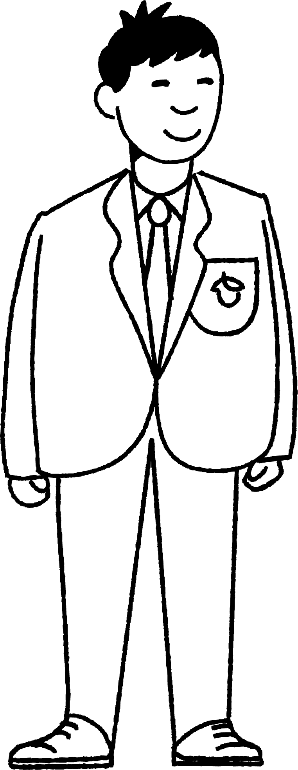
Muhiimadda fahanka DNA
Nuur wuxuu samaynayaa jadwalka waqtiga (timeline) ee helista DNA.
1869
DNA laga soo saaray nucleus-ka (nucleus) waxaana la helay kooxaha kiimikaad (chemical groups).
Dhamaystir jadwalka waqtiga (timeline) si aad u muujiso dhacdooyinka waaweyn.

Slide 27
Muhiimadda fahanka DNA
Nuur wuxuu samaynayaa jadwalka waqtiga (timeline) ee helista DNA.
Dhamaystir jadwalka waqtiga (timeline) si aad u muujiso dhacdooyinka waaweyn.
1869
DNA laga soo saaray nucleus-ka (nucleus) waxaana la helay kooxaha kiimikaad (chemical groups).
1944
DNA waxaa la ogaaday inuu yahay maadada hidaha (genetic material) ee dhaxalka (heredity).
1952
Franklin waxay soo saartay sawir DNA iyadoo isticmaalaysa raajo (X-rays).
1953
Watson iyo Crick waxay soo saareen moodel 3D ah oo DNA ah.
1962
Watson, Crick iyo Wilkins waxay ku guuleysteen abaalmarinta Nobel ee helista DNA.
2003
Human genome (Human genome) waa la xusay (sequenced).

Slide 28
Helista qaabka (structure) DNA
DNA waxaa la helay 1869, laakiin saynisyahannadu ma ay ogaanin qaabkiisa (structure) ilaa 1953.
DNA waxaa la ogaaday inuu yahay molecule-ka (molecule) dhaxalka (heredity) 1944.
Kooxda Rosalind Franklin ee London waxay isticmaaleen raajo (X-rays) si ay u soo saaraan sawir molecule-ka (molecule) DNA 1952.
Maurice Wilkins oo ka tirsan kooxda Franklin ayaa sawirka tusay James Watson oo ka socday Cambridge.
James Watson iyo Francis Crick waxay isticmaaleen caddaynta sawirka ee Rosalind Franklin si ay u horumariyaan moodel qeexaya qaabka laba-laabka (double helix) ee DNA.
Fahanka DNA ee sii kordhaya wuxuu keentay horumarinta daawada (medicine) iyo xakamaynta cudurrada (disease control).

