Slide 1
Nidaamka is-weydaarsiga gaaska ee bini'aadamka iyo neefsashada
Neefsashada iyo neefsiga

Slide 2
sida loo isticmaalo darasyada Oak

Slide 3
Waxaan qeexi karaa sida bini'aadamku u neefsado, oo ay ku jiraan doorka qaybaha kala duwan ee nidaamka is-weydaarsiga gaaska.

Slide 4
nidaamka is-weydaarsiga gaaska
cadaadis (pressure)
mug (volume)
neefsasho (inhalation)
neefsasho (exhalation)

Slide 5
Nidaamka is-weydaarsiga gaaska ee bini'aadamku waa koox xubno ah oo wada shaqeeya si ay noo suurtogeliyaan inaan neefsano.
Molekyuulada gaaska ee ku jira weel ayaa isku dhaca derbiyada weelka taasna waxay abuurtaa cadaadis.
Mugga gaasku waa qadarka booska 3D ee uu buuxiyo.
Neefsashada gudaha waxaa loo yaqaan inhalation.
Neefsashada dibadda waxaa loo yaqaan exhalation.

Slide 6

Nidaamka is-weydaarsiga gaaska ee bini'aadamka iyo neefsashada
Nidaamka is-weydaarsiga gaaska
Cadaadis, mug iyo neefsasho

Slide 7

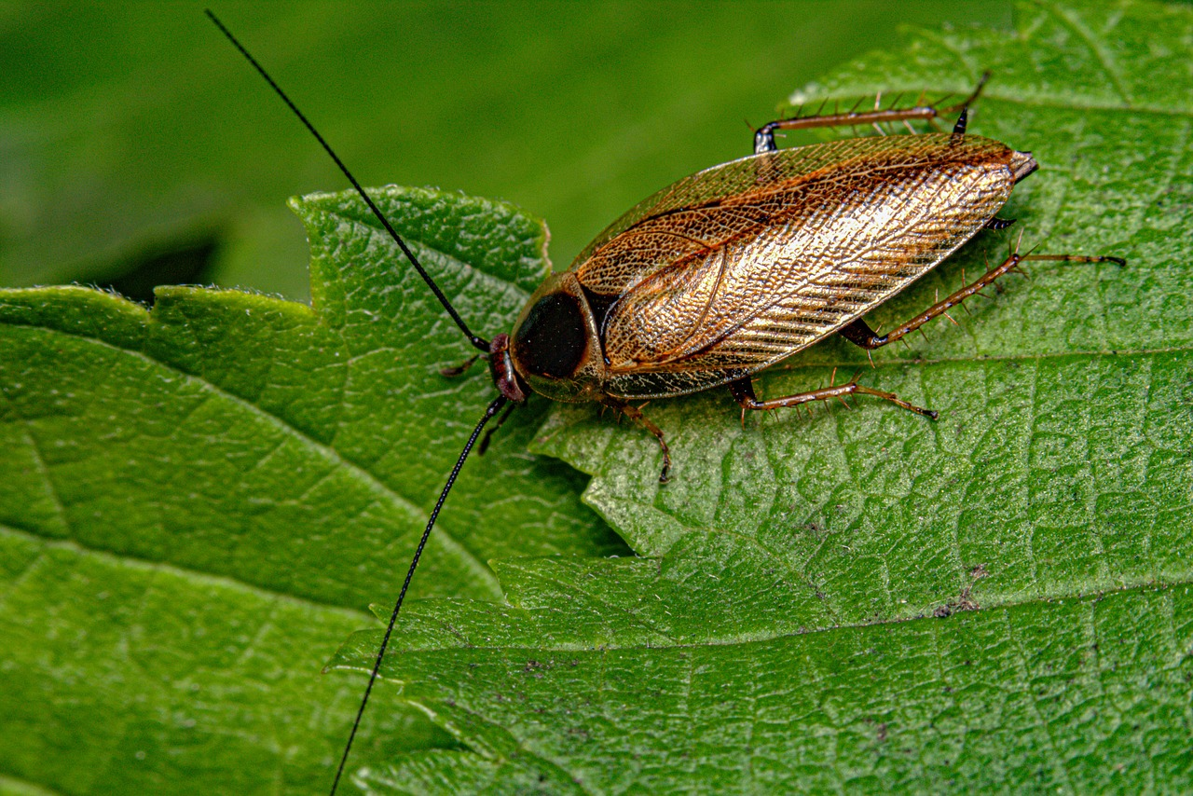
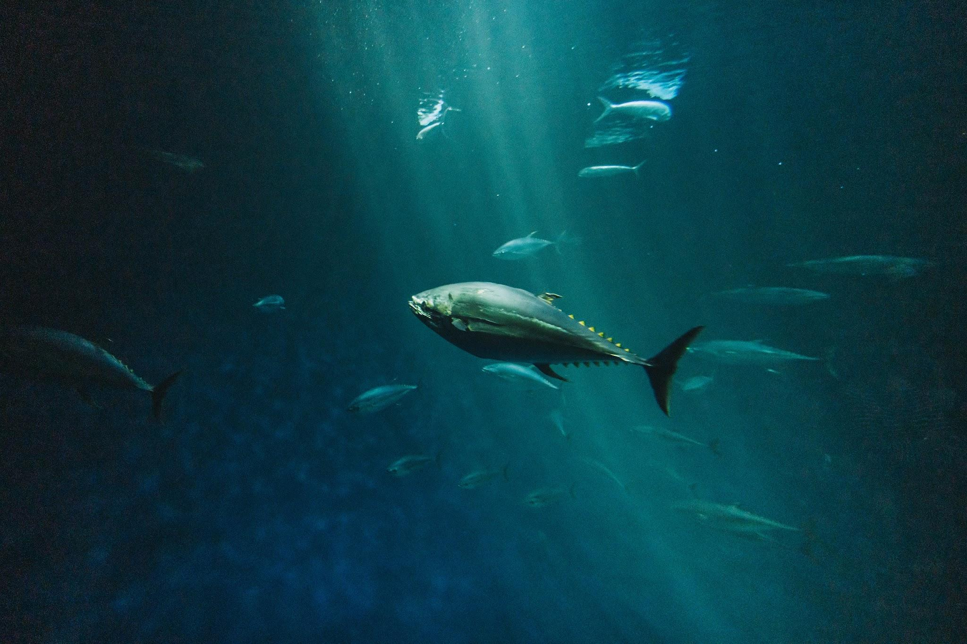
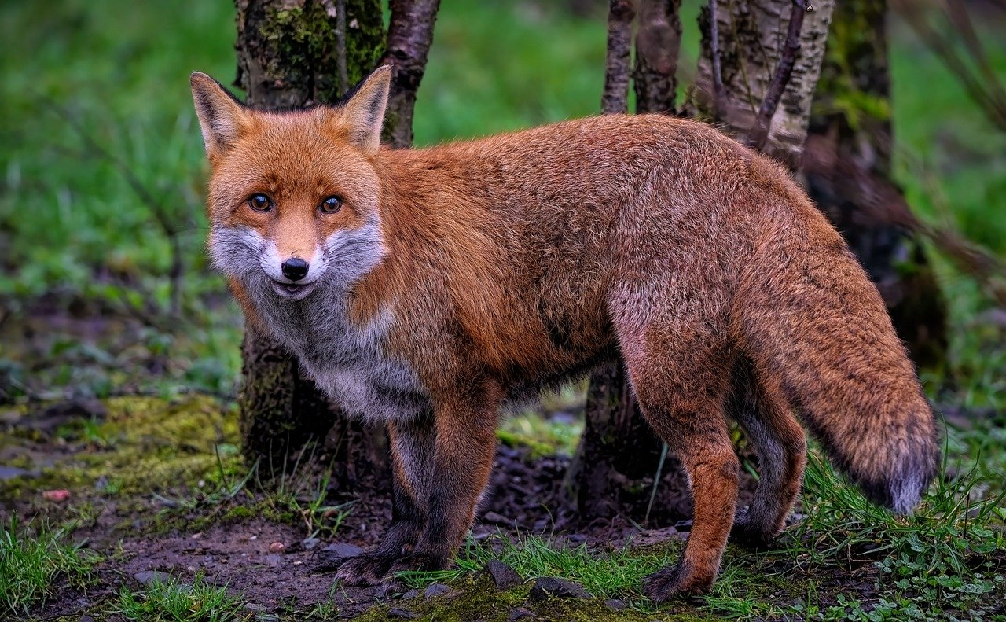
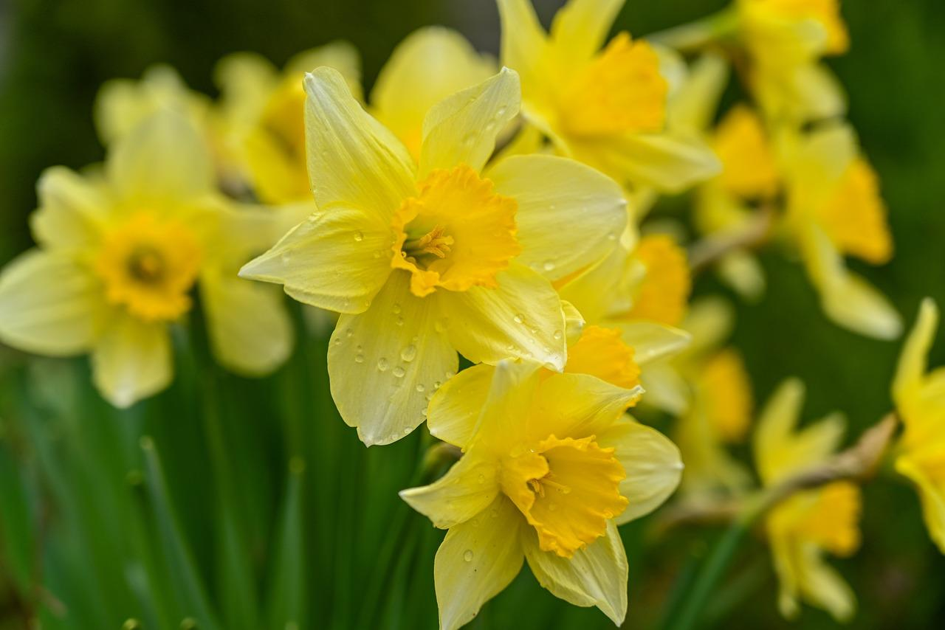

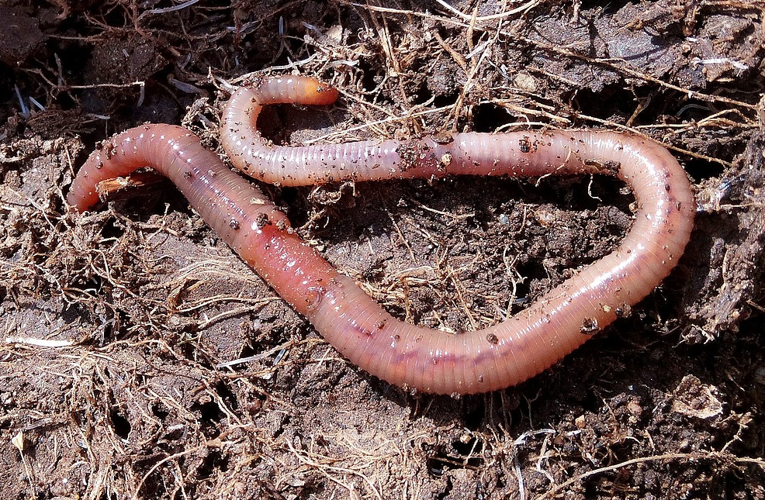
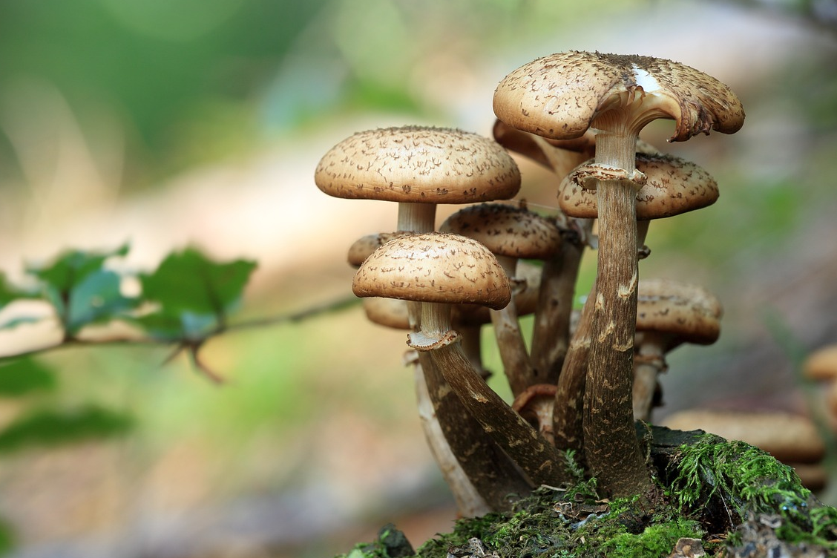
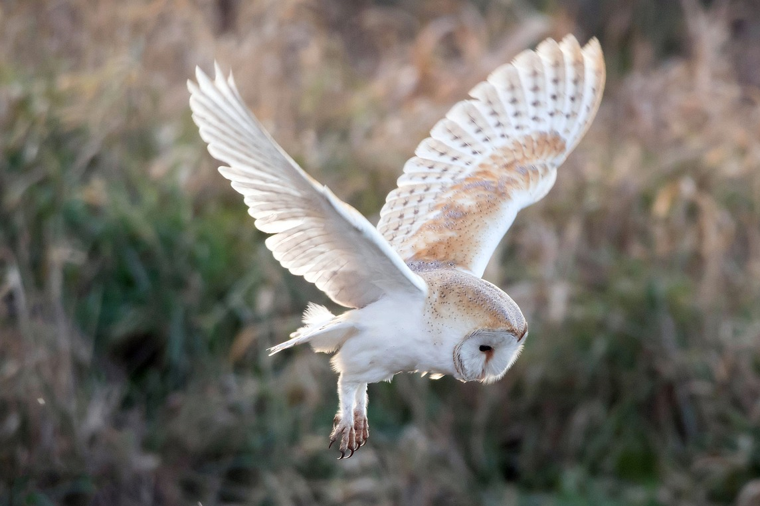

Nidaamka is-weydaarsiga gaaska
Bini'aadamka, xayawaanka kale, dhirta iyo fangaska waxay u baahan yihiin oksijiin (oxygen) hawada si ay u noolaadaan.
Waxay u baahan yihiin oksijiin (oxygen) neefsiga unugyada (cellular respiration) ee mitochondria, unugyadooda.
Laakiin dhammaan nooluhu ma neefsadaan.
Bini'aadamka iyo xayawaanka qaarkood waxay neefsadaan si ay hawada uga qaataan oksijiin.

Slide 8
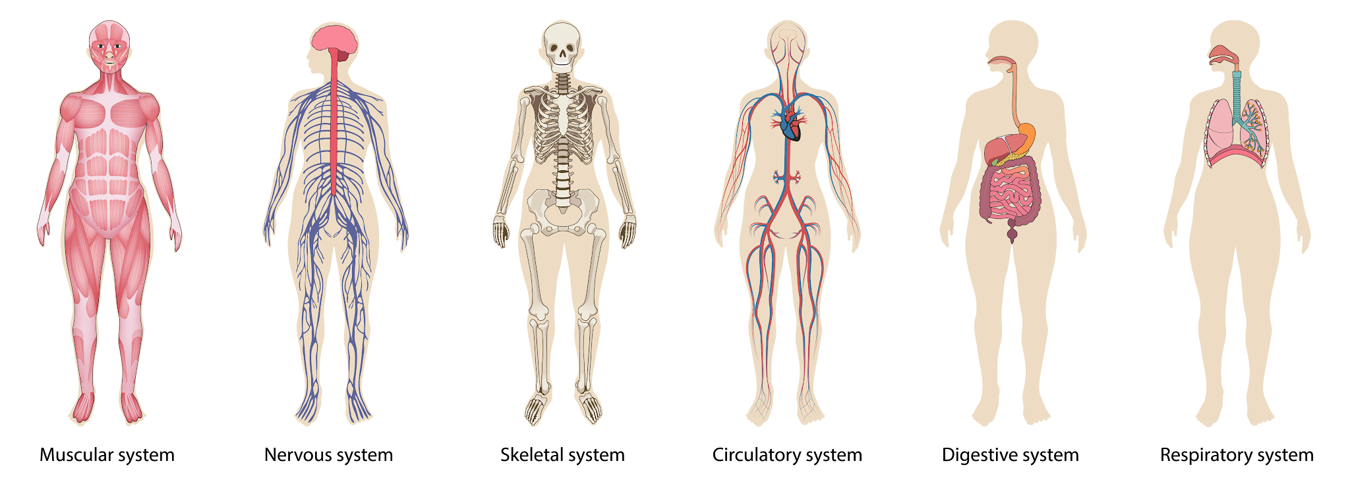
Nidaamka is-weydaarsiga hawada (Gas exchange system)
Neefsashadu waxay ku lug leedahay sambabada (lungs).
Marka aan neefsanayno, hawadu waxay u dhaqaaqdaa gudaha iyo dibadda sambabada.
hawada (air)
sambabada (lungs)
Si kastaba ha ahaatee, ma aha oo kaliya sambabada ku lug leh neefsashada!

Slide 9
Nidaamka is-weydaarsiga hawada (Gas exchange system)
Qaybo badan oo ka mid ah nidaamka is-weydaarsiga hawada ayaa wada shaqeeya si ay noo suurtogeliyaan neefsashada.
sanka iyo afka (nose and mouth)
sameeyaan waddo ay hawadu ku dhaqaaqdo gudaha iyo dibadda sambabada
qanjirka hunguriga (trachea)
sambabada (lungs)
laba xubnood oo ku yaal bini'aadamka iyo xayawaanka qaarkood
xididka neefsashada (diaphragm)
xidid muruq ah oo hoos yimaada sambabada kaas oo isku qabsada oo nasada si uu uga caawiyo dhaqdhaqaaqa hawada gudaha iyo dibadda sambabada

Slide 10

Nidaamka is-weydaarsiga hawada (Gas exchange system)
Qaab-dhismeedkee ayaan ka mid ahayn nidaamka is-weydaarsiga hawada ee bini'aadamka?
xididka neefsashada (diaphragm)
wadnaha (heart)
sambabada (lungs)
qanjirka hunguriga (trachea)

Slide 11
Nidaamka is-weydaarsiga hawada (Gas exchange system)
Markaan neefsano, hawadu waxay martaa qaababkan soo socda:
sanka iyo afka
trachea (qanjirka hawada)
bronchi (laamaha hawada)
bronchioles (laamo yaryar)
alveoli (kiishash yaryar oo sambabaha ku yaal)

Slide 12
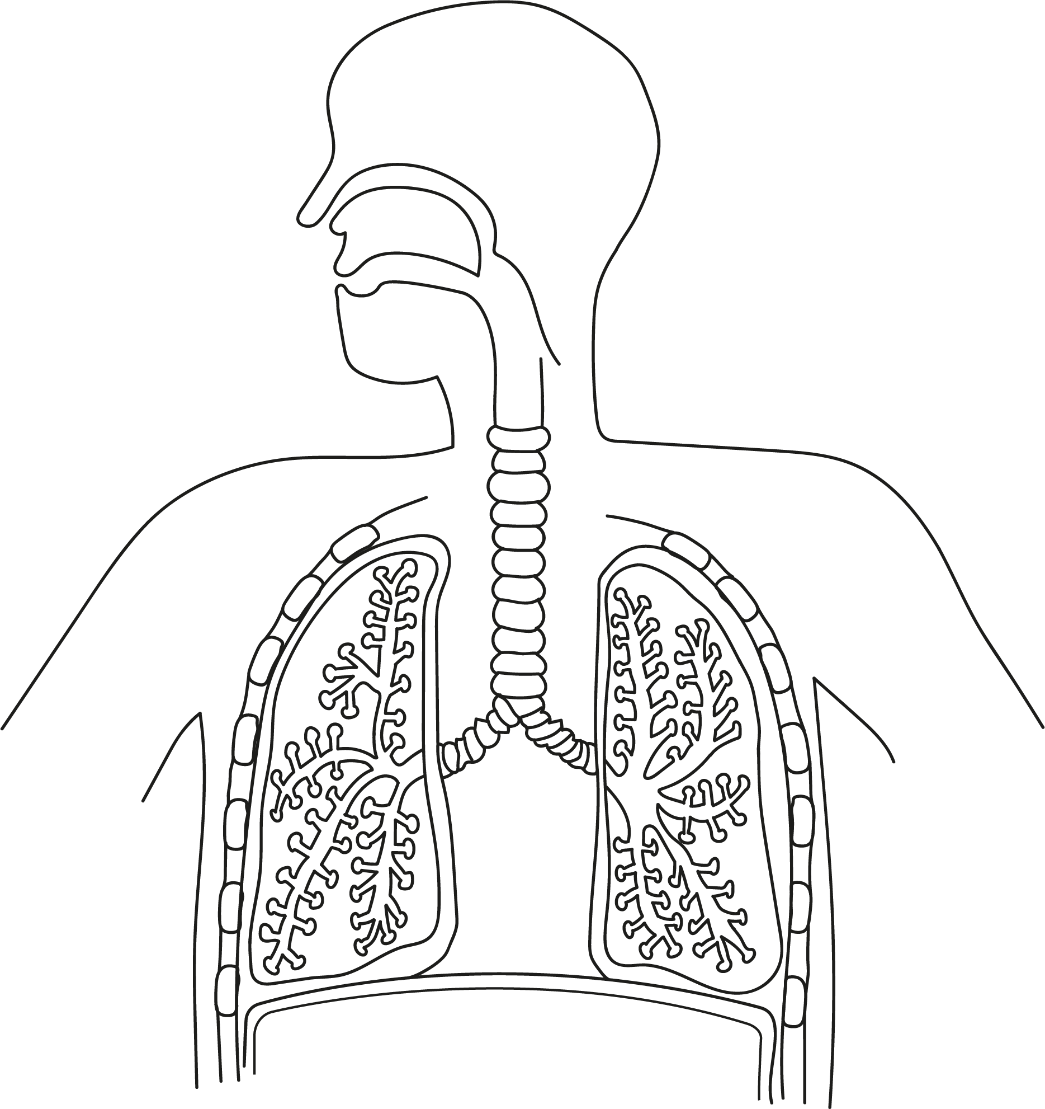
Nidaamka is-weydaarsiga gaasaska (gas exchange system)
Ku calaamadee jaantuska.
trachea (qanjirka hawada)
__________
bronchioles (laamo yaryar)
B. __________
alveoli (kiishash yaryar)
C. __________
E. diaphragm (xijaab)
bronchi (laamaha hawada)
E. __________
D. __________

Slide 13
Nidaamka is-weydaarsiga gaasaska (gas exchange system)
Laga bilaabo afka, kala saar qaababkan sida ay hawadu u marto markaan neefsano.
alveoli (kiishash yaryar)
bronchioles (laamo yaryar)
trachea (qanjirka hawada)
bronchi (laamaha hawada)
afka
afka
trachea (qanjirka hawada)
Bronchi (Neef-mareenka weyn)
Bronchioles (Neef-mareenka yar)
Alveoli (Kiishadaha hawada)

Slide 14
Nidaamka is-weydaarsiga gaaska (gas exchange system)
Sharax socdaalka unugga oksijiinta (oxygen molecule) ee afka ilaa alveolus (kiishad yar oo hawada) ee sambabada.

Slide 15
Nidaamka is-weydaarsiga gaaska
Sharax socdaalka unugga oksijiinta ee afka ilaa alveolus (kiishad yar oo hawada) ee sambabada.
Unugga oksijiinta wuxuu ka soo guuraa afka galinta tuubbo la yiraahdo trachea (neef-mareenka weyn).
Kadib wuxuu u guuraa mid ka mid ah labada tuubbo oo cidhiidhi ah oo la yiraahdo bronchi.
Intaas ka dib, wuxuu u guuraa tuubbo ka sii cidhiidhi ah oo la yiraahdo bronchiole.
Kadib unugga oksijiinta wuxuu u guuraa alveolus, oo ah kiishad yar oo hawada ah ee sambabada.

Slide 16
Nidaamka is-weydaarsiga gaaska ee bini'aadamka iyo neefsashada
Nidaamka is-weydaarsiga gaaska
Cadaadiska (Pressure), mugga (volume) iyo neefsashada

Slide 17
Cadaadiska, mugga iyo neefsashada
Si loo fahmo sida neefsashadu u dhacdo, waa inaan ka fikirnaa cadaadiska iyo mugga.
Qiyaas sanduuq ay ka buuxaan gaaska oksijiinta (oxygen gas).
Unugyada oksijiinta ee sanduuqa dhexdiisa waxay u dhaqaaqaan si aan kala go' lahayn.
Waxay isku dhacaan derbiyada sanduuqa, taas oo abuurta cadaadis (pressure).
Unugga oksijiinta (oxygen molecule)

Slide 18
Cadaadiska, mugga iyo neefsashada
Sanduuqa B wuxuu leeyahay mug (volume) ka weyn sanduuqa A, laakiin wuxuu ka kooban yahay isla qadar gaas oksijiin ah.
Sanduuqa B, molecule-yadu waxay leeyihiin meel badan oo ay ku dhaqaaqaan, marka waxay la kulmaan gidaarada si yar. Marka cadaadiska gudaha sanduuqa wuu hooseeyaa.
A
B
molecule oksijiin

Slide 19
Cadaadis (Pressure), mug (volume) iyo neefsasho
Sanduuqee ayaa leh mugga (volume) ugu weyn?
molecule-yada oksijiin

Slide 20
Cadaadis (Pressure), mug (volume) iyo neefsasho
Sanduuqee ayaa leh cadaadiska (pressure) ugu sarreeya?
Molecule-yada oksijiin

Slide 21
Cadaadis (Pressure), mug (volume) iyo neefsasho
Haddii hawadu ay geli karto oo ka bixi karto weel, waxay:
geli marka cadaadiska gudaha uu hooseeyo
bixi marka cadaadiska gudaha uu sarreeyo.
kor u jiid
hoos u riix
mugga (volume) wuu kordhaa
cadaadiska (pressure) wuu yaraadaa
mugga (volume) wuu yaraadaa
cadaadiska (pressure) wuu kordhaa
sirinqa (syringe)
hawadu way gashaa
hawadu way baxdaa

Slide 22
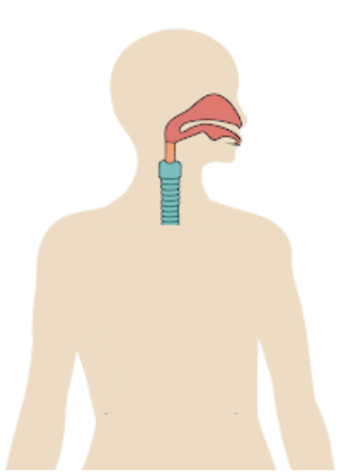
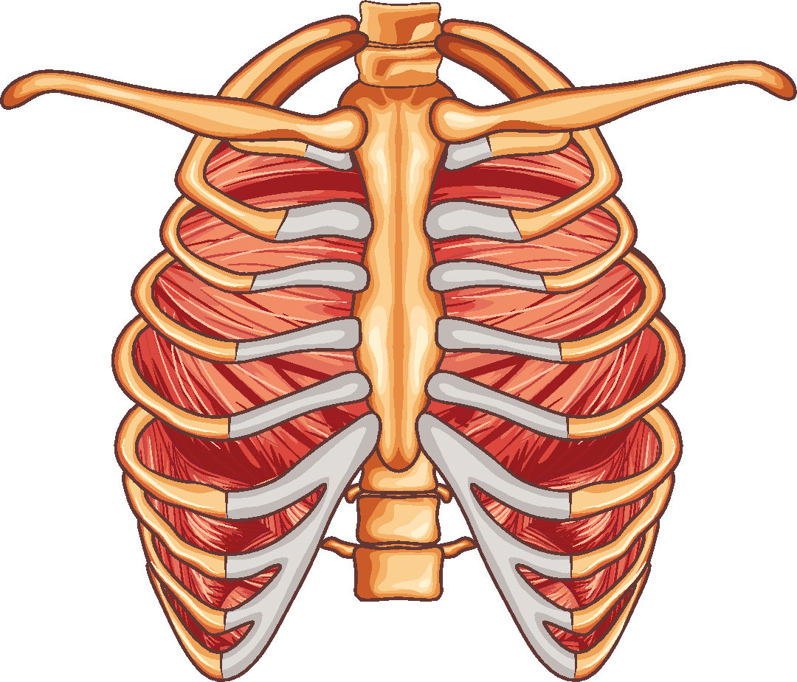
Cadaadis (Pressure), mug (volume) iyo neefsasho
Markaan neefsanayno, muruqyada iyo lafuhu way dhaqaaqaan si ay u beddelaan mugga (volume) iyo cadaadiska (pressure) ku jira laabta.
feeraha
Lafaha feeraha waxay sameeyaan qaab loo yaqaan sanduuqa feeraha (ribcage) oo ku wareegsan sambabada
muruqyada intercostal (intercostal muscles)
muruqyada u dhexeeya feeraha, kuwaas oo isku qabsan kara (contract) oo nasan kara (relax)

Slide 23
Cadaadiska (Pressure), mugga (volume) iyo neefsashada
Neefsashada gudaha waxaa loo yaqaan inhalation.
Muruqyada intercostal (intercostal muscles) way isku qabsadaan (contract), taas oo soo jiidaysa sanduuqa feeraha (ribcage) kor iyo dibadda.
hawadu waxay u dhaqaaqdaa gudaha
muggu (volume) wuu kordhaa
cadaadiska (pressure) wuu yaraadaa
Diaphragm-ku (diaphragm) wuu isku qabsadaa (contracts) oo wuu fidsanaadaa (flattens).

Slide 24
Cadaadiska (Pressure), mugga (volume) iyo neefsashada
Neefsashada dibadda waxaa loo yaqaan exhalation.
Muruqyada intercostal (intercostal muscles) way nastaanna (relax), sanduuqa feeraha (ribcage) wuxuu u dhaqaaqaa hoos iyo gudaha.
hawadu waxay u dhaqaaqdaa dibadda
muggu (volume) wuu yaraadaa
cadaadiska (pressure) wuu kordhaa
Diaphragm-ku (diaphragm) wuu nastaanaa (relaxes) oo wuu qaloocamaa (curves up).

Slide 25
Cadaadis (Pressure), mug (volume) iyo neefsasho
Kala sooc weedhahan ku saabsan inhalation (inhalation) si ay ugu habboonaato nidaamka.
Kii ugu horreeyay ayaa laguu sameeyay:
Muruqyada intercostal (intercostal muscles) way isku qabsadaan (contract).
Diaphragm-ku sidoo kale wuu isku qabsadaa oo wuu fidsanaadaa.
Tani waxay yaraysaa cadaadiska (pressure) sambabada.
Tani waxay soo jiidataa lafta feeraha (rib cage) kor iyo dibedda.
Hawadu waxay soo gashaa sambabada.
Mugga (volume) sambabada wuu kordhaa.

Slide 26
Cadaadis, mug iyo neefsasho
Kala saar weedhahan ku saabsan neefsashada (inhalation) si ay ugu qulqulaan sida saxda ah.
Kii ugu horreeyay ayaa laguu sameeyay:
Murqaha intercostal (intercostal muscles) way isku qabsadaan.
Tani waxay soo jiidataa lafta feeraha kor iyo dibedda.
Diaphragm-ku sidoo kale wuu isku qabsadaa oo wuu fidsanaadaa.
Mugga sambabada wuu kordhaa.
Tani waxay yaraysaa cadaadiska sambabada.
Hawadu waxay soo gashaa sambabada.

Slide 27
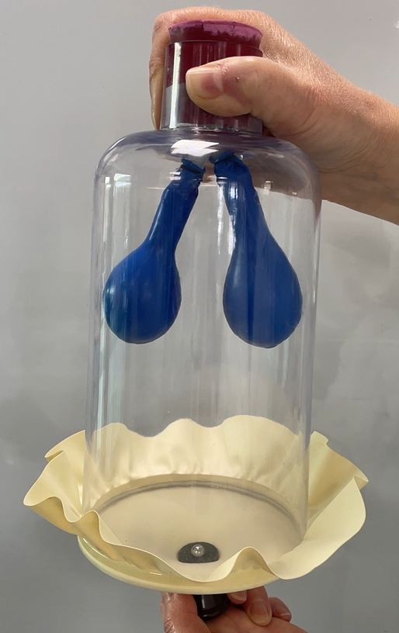
Cadaadis, mug iyo neefsasho
Qalabkani waa moodel (model) isbeddellada ku dhaca laabta inta lagu jiro neefsashada (inhalation) iyo neefsashada (exhalation).
weel dhalo ah (bell jar)
wuxuu u taagan yahay lafta feeraha (ribcage)
buufinno (balloons)
waxay u taagan yihiin sambabada
xaashi caag ah (rubber sheet)
wuxuu matalaa xuubka hawo-mareenka (diaphragm)

Slide 28
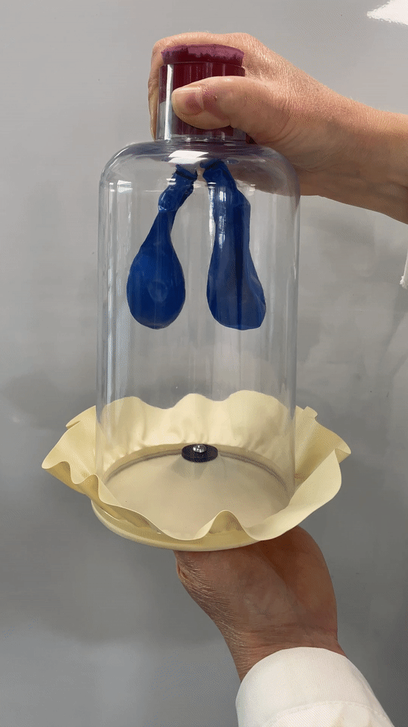
Cadaadis (Pressure), mug (volume) iyo neefsasho
Neefsasho (Inhalation)
Neefsasho (Exhalation)
Xaashida caagga ah ayaa hoos loo jiidaa
Tani waxay mataleysaa xuubka hawo-mareenka (diaphragm) oo is-jiidaya (contracting)
Tani waxay kordhisaa mugga (volume), waxayna yaraysaa cadaadiska (pressure)
Buufinnada ayaa barara (inflate)
Tani waxay mataleysaa hawadu oo u dhaqaaqeysa sambabada
Xaashida caagga ah ayaa kor loo riixaa
Tani waxay mataleysaa xuubka hawo-mareenka (diaphragm) oo nasanaya (relaxing)
Tani waxay yaraysaa mugga (volume), waxayna kordhisaa cadaadiska (pressure)
Buufinnada ayaa ciriirima (deflate)
Tani waxay mataleysaa hawadu oo ka baxaysa sambabada

Slide 29
Cadaadis (Pressure), mug (volume) iyo neefsasho
Maxay xaashida caagga ah u taagan tahay (represent) qaabka dharabka (bell jar) ee neefsashada?
Xuubka hawo-mareenka (Diaphragm)
Sambabada (Lungs)
Feeraha (Ribs)

Slide 30
Cadaadis (Pressure), mug (volume) iyo neefsasho
Sharax isku ekaanshaha iyo kala duwanaanshaha u dhexeeya neefsashada bini'aadamka iyo qaabka dharabka (bell jar) ee neefsashada.

Slide 31
Cadaadis (Pressure), mug (volume) iyo neefsasho
Sharax isku ekaanshaha iyo kala duwanaanshaha neefsashada bini'aadamka iyo qaabka bell jar ee neefsashada.
Isku ekaansho
Xaashida caagga ah waa la kor riixaa, taas oo la mid ah sida diaphragm-ku u qallooco marka neefsashada (exhalation).
Buufinadu way buuraan oo way dheeraan, taas oo la mid ah sida hawadu u gasho oo uga soo baxdo sambabada marka mugga iyo cadaadiska laabtu isbeddelaan.
Kala duwanaansho
Ma jiraan wax matalaya murqaha intercostal ee qaabka bell jar.
Bell jar-ku ma dhaqaaqo, laakiin feeraha (ribcage) waa la kor u jiidaa oo dibadda loo sii daa marka neefsashada (inhalation), ka dibna hoos iyo gudaha ayuu u dhaqaaqaa marka neefsashada (exhalation).

Slide 32
Nidaamka isweydaarsiga gaaska (gas exchange) ee bini'aadamka iyo neefsashada
Qaybo badan oo ka mid ah nidaamka isweydaarsiga gaaska ayaa si wada jir ah u shaqeeya si aan u neefsano.
Murqaha ku jira nidaamka isweydaarsiga gaaska ayaa isku qandacsada oo nasasha, taas oo beddesha mugga iyo cadaadiska laabta gudaheeda.
Tani waxay keentaa in hawadu u gasho sambabada (inhalation) oo ka soo baxdo (exhalation).

