Slide 1
Goobta magnetic-ga ee magnet-ka birta ah (bar magnet)
Magnets iyo electromagnets

Slide 2
Sida agabkeena waxbarista loogu talagalay fasalka

Slide 3
Waxaan awoodi karaa inaan sawiro goobta magnetic-ga ee magnet-ka birta ah.

Slide 4
goobta magnetic-ga (magnetic field)
Meel uu walax magnetic-ku ku dareemo xoog (force).
compass-ka sawirka (plotting compass)
Compass yar oo muujin kara goobta magnet-ka.
cirifka magnetic-ga ee raadinaya waqooyi (north-seeking pole)
Cirifka needle-ka compass-ka ee tilmaamaya waqooyiga Dhulka.
cirifka magnetic-ga ee raadinaya koonfur (south-seeking pole)
Cirifka needle-ka compass-ka ee tilmaamaya koonfurta Dhulka.
khadka goobta (field line)
Khad khiyaali ah oo muujinaya jihada iyo qaabka goobta magnetic-ga.

Slide 5

Goobta magnetic-ga ee magnet-ka birta ah
Sawirista goobta magnetic-ga
Khadadka goobta magnetic-ga

Slide 6
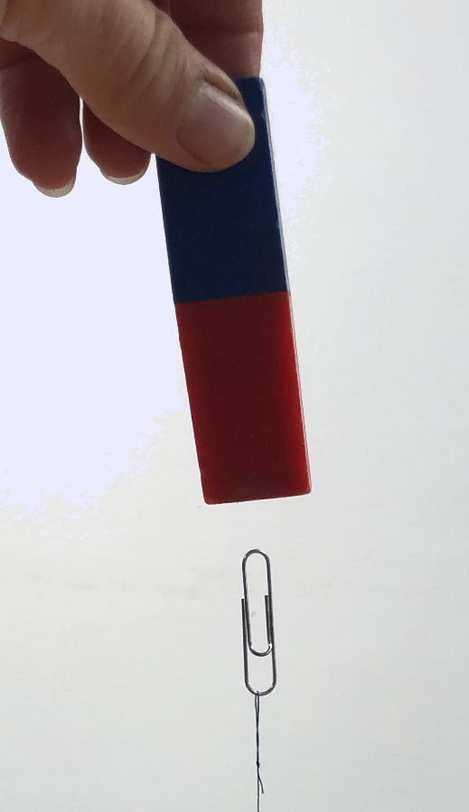
Sawirista goobta magnetic-ga
Magnet-kan birta ah wuxuu ku shaqaynayaa xoog (force) iyada oo loo marayo meesha u dhexeysa isaga iyo paperclip-ka.
Waxaan nidhaahnaa waxaa jira goob magnetic ah meesha ku xeeran magnet-ka.

Slide 7
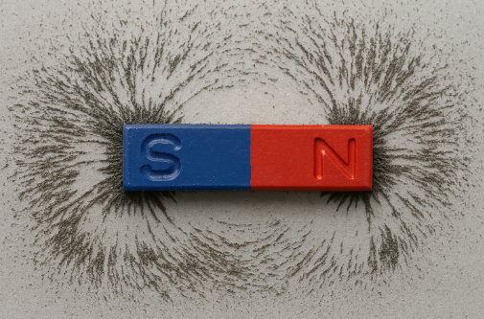
Sawirista goobta magnetic-ga
Iron filings-ka waxaa loo isticmaali karaa in lagu muujiyo halka goobtan aan la arki karin ay ku taal.
Xubnaha birta ah waxaa magnetiyeeyay (magnetised) magnet-ka waxayna isku toosiyaan (align) goobta magnetic-ga (magnetic field).

Slide 8

Qorsheynta goobta magnetic-ga (Plotting a magnetic field)
Maxaad u malaynaysaa in goobta magnetic-ga (magnetic field) ee ku wareegsan magnet-ku sameeyo?
Wuxuu soo jiitaa walxaha magnetic-ka ah ka hor inta uusan magnet-ku taaban.
Wuxuu soo jiitaa jajabyo yaryar oo tissue ah, sida buufin koronto (electric charge) ku leh oo samayn karto.
Wuxuu riixi karaa magnet-yada kale ka hor inta uusan magnet-ku taaban.

Slide 9

Qorsheynta goobta magnetic-ga (Plotting a magnetic field)
Qaybta woqooyi-raadisa (north–seeking pole) ee compass-ka qorsheynta (plotting compass) waxay u jeeddaa dhanka woqooyi juqraafiyeed (geographic north pole) ee Dhulka.
Dhulku wuxuu leeyahay goob magnetic ah (magnetic field) oo keenta in cirbadda compass-ku (compass needle) isku toosiso (align) iyada.

Slide 10
Qorsheynta goobta magnetic-ga (Plotting a magnetic field)
Qaybta koonfur-raadisa (south–seeking pole) ee compass-ka qorsheynta (plotting compass) waxay u jeeddaa dhanka koonfur juqraafiyeed (geographic south pole) ee Dhulka.

Slide 11
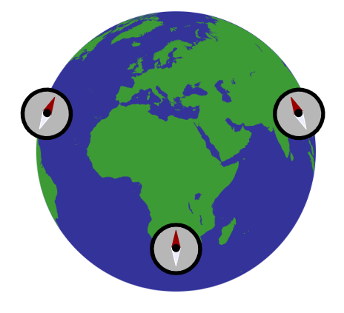
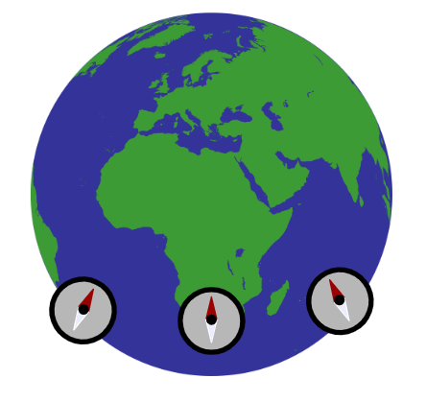
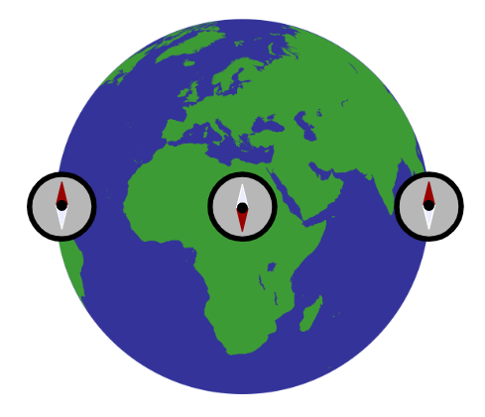
Qorsheynta goobta magnetic-ga (Plotting a magnetic field)
Mid ka mid ah sawirada soo socda ayaa muujinaya isku toosinta (alignment) saxda ah ee cirbadda compass-ka (compass needles)?

Slide 12

Qorsheynta goobta magnetic-ga (Plotting a magnetic field)
Magnet-ka iyo compass-ka qorsheynta (plotting compass) labaduba waxay leeyihiin qaybo woqooyi-raadisa (north–seeking poles).
qaybaha woqooyi-raadisa (north–seeking poles)
Qaybtan (guduudan) ee woqooyi-raadisa (north–seeking pole) ee compass-ku caadi ahaan waxay u jeeddaa woqooyi.
Dhamaadka cad waa qayb koonfur-raadisa (south–seeking pole).

Slide 13
Qorsheynta goobta magnetic-ga (Plotting a magnetic field)
Haddii compass-ka qorsheynta (plotting compass) loo soo dhoweeyo magnet-ka, qaybaha isku midka ah (like poles) ayaa is riixi doona (repel).
Compass-ku wuxuu u jeedaa ka fog qaybta N (N–pole) ee magnet-ka.

Slide 14
Qorista goobta magnetic-ga
Compass-yo badan oo dheeri ah ayaa sidoo kale u jeedi doona ka fog qaybta N (N–pole) ee magnet-ka.

Slide 15
Qorista goobta magnetic-ga
Compass-ka qorista wuxuu u jeexi doonaa dhanka S-pole ee magnet-ka.

Slide 16
Qorista goobta magnetic-ga
Qaybtee ka mid ah magnet-ka bar-ka ayuu ciribta compass-ka qorista u jeexaa?
bartamaha magnet-ka bar-ka
N-pole ee magnet-ka bar-ka
S-pole ee magnet-ka bar-ka

Slide 17
Qorista goobta magnetic-ga
Compass-ka qorista waxaa loo isticmaali karaa in lagu raad-raaco goobta agagaarka magnet-ka bar-ka.
S
N

Slide 18
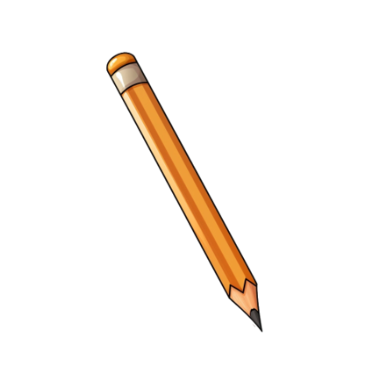
Qorista goobta magnetic-ga
S
N
Ku sawir dhibic geeska.
Dhig magnet-ka dhexda warqad A4 ah oo ku wareeji qalin fiiqan.

Slide 19
Qorista goobta magnetic-ga
Dhig compass-ka qorista si uu hal darafkiisu ugu dhowaado dhibicda.
S
N
Ku sawir dhibic kale dhanka north-seeking ee ciribta compass-ka qorista oo ka fog magnet-ka.

Slide 20
Qorista goobta magnetic-ga
Ku sawir dhibic kale dhanka north-seeking ee ciribta compass-ka qorista.
S
N
Dhaqaaq compass-ka qorista si ciribtu u saarto dhibicda cusub.

Slide 21
Qorista goobta magnetic-ga
Dhaqaaq compass-ka qorista mar kale si ciribtu u saarto dhibicda cusub.
S
N
Ku sawir dhibic kale dhanka north-seeking ee ciribta compass-ka qorista.

Slide 22
Qorsheynta goobta magnetic (magnetic field)
S
N
Marka dhibcuhu gaadhaan cidhifka warqadda…
ku sawir xariiq siman oo dhex mara.

Slide 23
Qorsheynta goobta magnetic (magnetic field)
Xariiqyo badan oo goobta (field lines) ayaa laga sawiri karaa meelo kala duwan si loo muujiyo goobta magnetic (magnetic field) oo dhan.
S
N
Ku dar fallaaro (arrow) si loo muujiyo jihada uu tilmaamayo compass-ka (plotting compass).

Slide 24

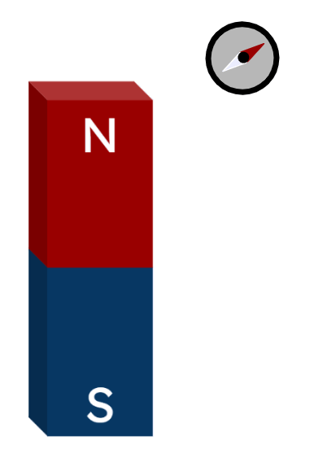
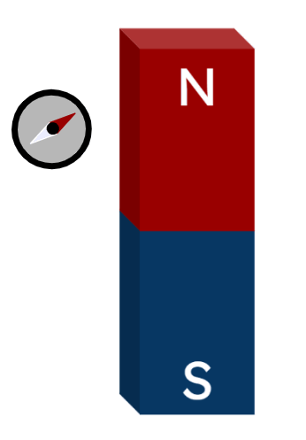
Qorsheynta goobta magnetic (magnetic field)
Sawirradan midkee ayaa muujinaya compass-ka (plotting compass) oo u jeeda jihada saxda ah?

Slide 25
Qorsheynta goobta magnetic (magnetic field)
Ku qorshee goobta (field) agagaarka magnet-ka ul (bar magnet) adigoo isticmaalaya compass-ka (plotting compass).
Ka bilow compass-ka (plotting compass) dhibcaha la muujiyay mar kasta.
S
N
Iska jir inaad dhaqaajiso magnet-ka ul (bar magnet).

Slide 26
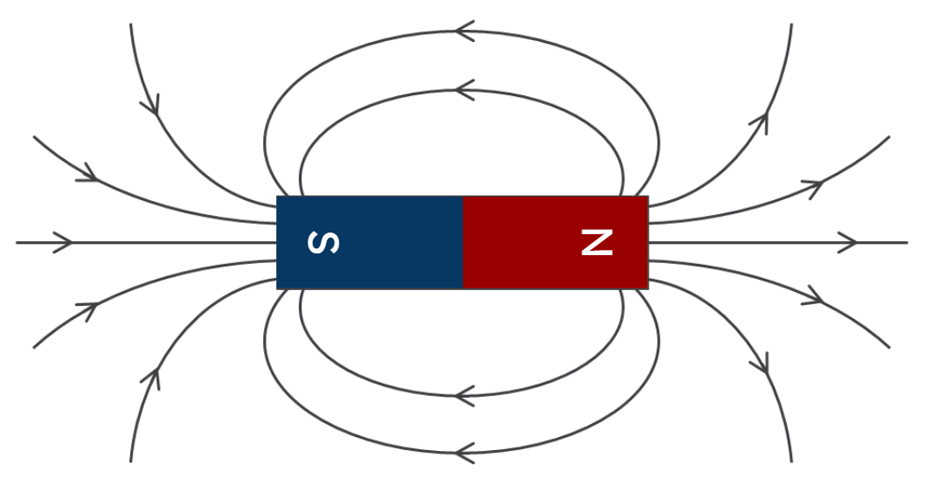
Qorsheynta goobta magnetic (magnetic field)
Ku qorshee goobta (field) agagaarka magnet-ka ul (bar magnet) adigoo isticmaalaya compass-ka (plotting compass).
Tusaale goobta magnetic (magnetic field) ee magnet-ka ul (bar magnet) (dhibco la'aan).

Slide 27
Goobta magnetic (magnetic field) ee magnet-ka ul (bar magnet)
Qorsheynta goobta magnetic (magnetic field)
Xariiqyada goobta magnetic (magnetic field lines)

Slide 28
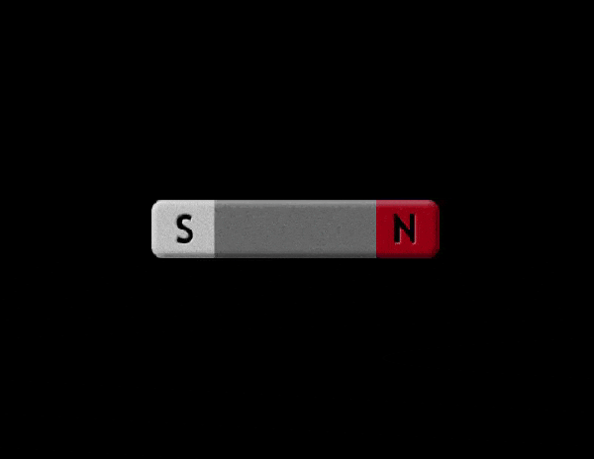
Xariiqyada goobta magnetic (magnetic field lines)
Animation-kani wuxuu muujinayaa sida compass-ka (plotting compass) ugu toosmo goobta (field) ee magnet-ka ul (bar magnet).
Jilitaanka (Simulation) waxaa sameeyay PhET Interactive Simulations, University of Colorado Boulder, oo shatiyaysan CC–BY–4.0 (https://phet.colorado.edu).

Slide 29
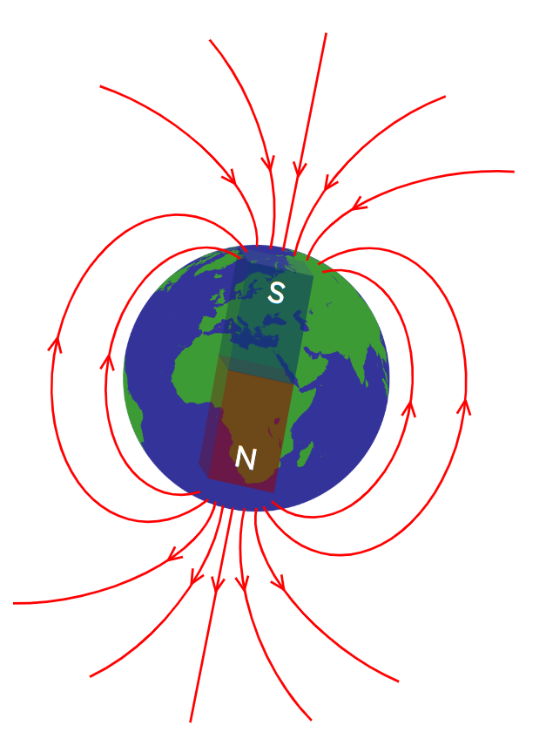
Khadadka goobta magnetic (Magnetic field lines)
Dhulku wuxuu leeyahay goob magnetic (magnetic field) oo u eg tii magnet-ka ul (bar magnet).
Dhamaadka compass-ka ee raadiya woqooyiga wuxuu tilmaamaa jihada khadadka goobta.

Slide 30
Khadadka goobta magnetic (Magnetic field lines)
Marka birta (iron filings) lagu rusheeyo agagaarka magnet-ka, waxay isku toosiyaan khadadka goobta.

Slide 31
Khadadka goobta magnetic (Magnetic field lines)
Khadadka goobta magnetic waxay ka baxaan N–pole.
Khadadka goobta ayaa markaas gala S–pole.

Slide 32
Khadadka goobta magnetic (Magnetic field lines)
Dhamaadka compass-ka ee raadiya woqooyiga waa la riixaa oo la jiidaa khadadka goobta; laga bilaabo N–pole ilaa S–pole.

Slide 33
Khadadka goobta magnetic (Magnetic field lines)
Khadadka goobta ee magnet-ka go'doonsan waa kuwo joogto ah (continuous).
Haddii khadadka goobta ee ku dhamaada cidhifka warqadda lagu sawiro warqad dheeri ah, waxay raacaan si ay u sameeyaan wareegyo joogto ah.

Slide 34
Khadadka goobta magnetic (Magnetic field lines)
Khadadka goobta iskuma gudbaan, mana jiraan meelo bannaan oo khadadka dhexdooda ah.
Qaabka khadadka goobta waa isku mid (symmetrical).

Slide 35
Khadadka goobta magnetic (Magnetic field lines)
Khadadka goobta way isku ururaan oo isku dhowaadaan meelaha poles-ka.
Magnet-ka bar-ka ah (bar magnet) wuxuu ugu xoog badan yahay meelaha poles-ka.

Slide 36
Khadadka goobta magnetic (Magnetic field lines)
Maxay khadadka goobta iyo fallaadhahoodu muujinayaan oo ku saabsan cabbirka xoogga magnet-ka ee saameeya walxaha magnetic ama magnet-ka kale?
Waxay ka weyn tahay halka khadadku leeyihiin dhamaad xor ah.
Waxay ka weyn tahay halka khadadku u dhow yihiin magnet-ka.
Waa ka weyn yahay halka xariijimuhu isugu dhow yihiin.
Waa ugu weyn yahay halka ay xariijimo jiraan (xariijimo la'aan = xoog (force) la'aan).

Slide 37
Xariijimaha goobta magnetic-ga (Magnetic field lines)
Xeerarka ku saabsan xariijimaha goobta magnetic-ga (magnetic field lines):
Waxay ka bilaabmaan cidhifka N (N–pole) waxayna u socdaan cidhifka S (S–pole).
Isma gudbaan.
Firqo (gaps) ma laha.
Xariijimo badan ayaa ku urursan cidhifyada (poles), taas oo muujinaysa goob (field) xoog badan.

Slide 38
Xariijimaha goobta magnetic-ga (Magnetic field lines)
Maxay xariijimaha iyo fallaadhuhu ka muujinayaan jihada xoogga (force) magnet-ka ee saameeya walxaha magnetic-ga ama magnet-yada kale?
Jihada walax magnetic ah loo riixo ama loo jiido.
Jihada cidhifka raadinaya woqooyiga (north–seeking pole) ee magnet kale loo riixo ama loo jiido.
Jihada labada cidhif ee magnet loo riixo ama loo jiido.
Jihada shay koronto ku jira (charged object), sida buufin caag ah, loo riixo ama loo jiido.

Slide 39
Xariijimaha goobta magnetic-ga (Magnetic field lines)
Qor sharaxaad ku saabsan waxa ay yihiin xariijimaha goobta magnetic-ga iyo sida ay u sharxi karaan shaqada compass-ka (compasses).

Slide 40
Xariijimaha goobta magnetic-ga (Magnetic field lines)
Qor sharaxaad ku saabsan waxa ay yihiin xariijimaha goobta magnetic-ga iyo sida ay u sharxi karaan shaqada compass-ka (compasses).
Xariijimaha goobta magnetic-ga waxay ka socdaan cidhifka N (N–pole) ilaa cidhifka S (S–pole) iyagoon is gudbin oo aan firqo (gaps) lahayn.
Waa kuwa siman (symmetrical) agagaarka magnet-ka ul (bar magnet), oo marka xariijimaha isku urursan yihiin, xoogga (strength) goobta (field) wuu weynaadaa.
Cirbadda (needles) compass-ka magnetic-ga ah waa la riixaa oo waa la jiidaa si cidhifka raadinaya N (N–seeking end) ugu tooso jihada fallaadhaha ee xariijimaha goobta, una tilmaamo cidhifka S (S–pole) ee magnet-ka (kee sameeyay goobta (field)).

Slide 41
Goobta magnetic-ka ee magnet-ka birta ah
Meelaha ku wareegsan magnet-ka waxaa ku jira goob magnetic ah oo aan la arki karin.
Cirbaddu (needle) waa magnetic waxayna u jeeddaa xagga cidhifka S (S–pole) ee magnet-ka. Compass-ka sawiridda (plotting compass) waxaa loo isticmaali karaa in lagu sawiro goobta magnetic-ga (magnetic field).
Khadadka goobta (Field lines) waa kuwo joogto ah oo ka socda N–pole ilaa S–pole iyagoon isku gudbin. Waxay sameeyaan qaab isku mid ah (symmetrical).

