Slide 1
Miisaanka itimaalka (probability scale)
Itimaal (probability): itimaalada aragtida (theoretical probabilities)

Slide 2
Sida agabkeena waxbarista loogu talagalay fasalka

Slide 3
Waxaan u qoondeyn karaa qiime (value) natiijo si aan u bixiyo itimaalka (probability) in natiijadu dhacdo.

Slide 4
Natiijadu waa mid aan macquul ahayn (impossible) haddii aysan jirin suurtogalnimo inay dhacdo.
Natiijadu waa mid hubaal ah (certain) haddii la dammaanad qaaday inay dhacdo.
Natiijadu waxay leedahay fursad siman (even chance) haddii ay tahay inay dhacdo iyo inayna dhacayn isku mid tahay.
Tijaabo (experiment) waa ku celcelinta tijaabin (trial) marar badan si loo eego inta jeer oo natiijo kasta dhacdo.

Slide 5
Itimaalka (probability) in dhacdo dhacdo waa saamiga (proportion) jeer ee dhacdada la filayo inay dhacdo tijaabo (experiment) ku habboon oo weyn.

Slide 6

Miisaanka itimaalka (probability scale)
Muujinta itimaalka (probability): boqolleyda iyo jajab tobanle (decimals)
Muujinta itimaalka (probability) jajab ahaan (fractions)

Slide 7
Muujinta itimaalka (probability): boqolleyda iyo jajab tobanle (decimals)
Itimaalku (probability) waa cabbirka suurtogalnimada in natiijo dhacdo.
Erayada sida 'laga yaabee' iyo 'sugnaan la'aan' waxay qeexayaan suurtogalnimada in dhacdo dhacdo, laakiin waa kuwo aan caddayn.
Itimaallada (probabilities) waxay si qeexan u qeexaan suurtogalnimada dhacdo iyagoo adeegsanaya qiime (value) tiro si ay u muujiyaan suurtogalnimadeeda.
Itimaalka (probability) in dhacdo dhacdo waa saamiga (proportion) jeer ee dhacdada la filayo inay dhacdo tijaabo (experiment) ku habboon oo weyn.

Slide 8
Muujinta itimaalka (probability): boqolleyda iyo jajab tobanle (decimals)
Dhacdo hubaal ah (certain) waxay leedahay itimaal (probability) 100% inay dhacdo.
Tusaale: 100% tijaabooyinka (trials) lagu sameeyay wareeggan (spinner) waxay noqon doonaan 'guul'.
guul (win)
100%
aan suurtagal ahayn (impossible)
fursad siman (even chance)
hubaal (certain)
suurtagal darro (unlikely)
suurtagal (likely)

Slide 9
Muujinta itimaallada (probabilities): boqolleyda (percentages) iyo jajab tobanle (decimals)
Dhacdo aan suurtagal ahayn (impossible) waxay leedahay 0% itimaal (probability) inay dhacdo.
Tusaale ahaan, 0 ka mid ah tijaabooyinka (trials) lagu sameeyay wareeggan (spinner) waxay noqon lahaayeen 'guul (win)'.
guuldarro (lose)
guul (win)
0%
100%
aan suurtagal ahayn (impossible)
fursad siman (even chance)
hubanti (certain)
suurtagal darro (unlikely)
suurtagal (likely)

Slide 10
Muujinta itimaallada (probabilities): boqolleyda (percentages) iyo jajab tobanle (decimals)
Dhacdo leh fursad siman (even chance) waxay leedahay 50% itimaal (probability) inay dhacdo.
Tusaale ahaan, haddii aan sameynno tiro badan oo tijaabooyin (trials) ah oo wareeggan (spinner) ah, waxaan filaynaa in qiyaastii 50% natiijooyinka (outcomes) ay noqdaan 'guul (win)'.
guul (win)
guuldarro (lose)
guuldarro (lose)
guul (win)
0%
50%
100%
suurtagal ma aha (impossible)
fursad siman (even chance)
hubanti (certain)
sugan (unlikely)
sugan (likely)

Slide 11
Muujinta itimaalka (probabilities): boqolleyda (percentages) iyo jajab tobanle (decimals)
Itimaalka (Probabilities) ka weyn 50% waxay leeyihiin fursad ka siman (even chance) inay dhacaan.
Tusaale: Haddii aan sameyn lahayn tiro badan oo tijaabooyin (trials) ah oo leh wareeggan (spinner), markaas waxaan filan lahayn inuu ku dhaco 'guul' (win) marar ka badan 'khasaare' (lose).
guul (win)
guul (win)
khasaare (lose)
khasaare (lose)
khasaare (lose)
guul (win)
0%
50%
60%
70%
80%
90%
100%
suurtagal ma aha (impossible)
fursad siman (even chance)
sugan (certain)
sugan (likely)

Slide 12
Muujinta itimaalka (probabilities): boqolleyda (percentages) iyo jajab tobanle (decimals)
Itimaalka (Probabilities) ka yar 50% waxay leeyihiin fursad ka yar fursad siman (even chance) inay dhacaan.
Tusaale: Haddii aan sameyn lahayn tiro badan oo tijaabooyin (trials) ah oo leh wareeggan (spinner), markaas waxaan filan lahayn inuu ku dhaco 'guul' (win) marar ka yar 'khasaare' (lose).
guuldarro (lose)
guul (win)
guul (win)
guuldarro (lose)
guuldarro (lose)
guul (win)
guuldarro (lose)
guul (win)
0%
10%
20%
30%
40%
50%
60%
70%
80%
90%
100%
suurtagal ma aha (impossible)
fursad siman (even chance)
sugan (certain)
aan laga badnayn (unlikely)
laga yaabo (likely)

Slide 13
Muujinta itimaalka (probability): boqolleyda (percentages) iyo jajab tobanle (decimals)
Itimaalka (probability) waxaa sidoo kale lagu muujin karaa iyadoo la isticmaalayo jajab tobanle (decimals) u dhigma.
Itimaal (probability) 0 wuxuu ka dhigan yahay in dhacdadu (event) tahay mid aan suurtagal ahayn (impossible).
Itimaalka (probability) 1 wuxuu macnaheedu yahay dhacdo (event) waa hubaal (certain).
Tirada weynaanta waxay muujinaysaa inta ay u badan tahay in dhacdo (event) dhacdo.
lumi
guul
guul (win)
lumi
guuldarro (lose)
guul
lumi
guul (win)
0
0.1
0.2
0.3
0.4
0.5
0.6
0.7
0.8
0.9
1
aan suurtagal ahayn (impossible)
fursad siman (even chance)
hubaal (certain)
aan laga badnayn (unlikely)
laga yaabo (likely)

Slide 14

Muujinta itimaalka (probabilities): boqolleyda (percentages) iyo jajab tobanle (decimals)
Kee (spinner) ayaa leh itimaal (probability) 48% inuu ku soo degto 'guul'?
lumi
guul
lumi
guul
lumi
guul

Slide 15




Muujinta itimaalka (probabilities): boqolleyda (percentages) iyo jajab tobanle (decimals)
Spinner wuxuu leeyahay afar natiijo (outcomes): ξ = {A, B, C, D }
Natiijooyinka (outcomes) uma badna inay dhacaan si isku mid ah.
Itimaalka (probability) spinner uu ku soo degto A waa 25%
Itimaalka (probability) spinner uu ku soo degto B waa 18%
Itimaalka (probability) spinner uu ku soo degto C waa 34%
Itimaalka (probability) spinner uu ku soo degto D waa 23%
Saciid
Tani waxay u egtahay qaab dheer oo lagu sheegayo suurtogalnimadan (probabilities). Waxaan la yaabanahay haddii ay jirto calaamad (notation) loo isticmaali karo in lagu gaabiyo macluumaadkan?

Slide 16
Muujinta suurtogalnimada (probabilities): boqolleyda (percentages) iyo jajab tobanle (decimals)
Oraahda ku saabsan suurtogalnimada (probability) waxaa loo qeexi karaa si hufan iyadoo la isticmaalayo calaamadda (notation) 'P(natiijada) ='.
Tusaale: Suurtogalnimada (probability) in wareeggu (spinner) ku soo baxo A waa 25%.
P(A) = 25%
'P' waa 'suurtogalnimo (probability)'
natiijada (outcome) gudaha qawska (brackets)
qiimaha tirooyinka (numerical value) ee suurtogalnimada (probability)

Slide 17
Muujinta suurtogalnimada (probabilities): boqolleyda (percentages) iyo jajab tobanle (decimals)
Wareeggu (spinner) wuxuu leeyahay afar natiijood (outcomes): ξ = {A, B, C, D }
Suurtogalnimada (probabilities) natiijo kasta (outcome) ayaa hoos ku qoran.
D
A
P(A) = 25%
P(B) = 18%
C
B
P(C) = 34%
P(D) = 23%
Natiijo (outcome) intee le'eg ayaad filanaysaa inay inta badan dhacdo?
C
B
Natiijo (outcome) intee le'eg ayaad filanaysaa inay ugu yar dhacdo?
Haddii ay jiraan 2000 tijaabo (trials), qiyaas ahaan imisa jeer ayaa wareegga (spinner) laga filan karaa inuu ku soo baxo A?
25% ee 2000 = 500

Slide 18

Muujinta suurtogalnimada (probabilities): boqolleyda (percentages) iyo jajab tobanle (decimals)
Ciyaar fiidiyoow (video game) oo ku salaysan bakhtiyaa-nasiib (chance) waxay leedahay 25% suurtogalnimo (probability) 'guul'.
Lambarka hoose ee ugu macquulsan (most reasonable estimate) waa kan qiyaasaha ugu fiican ee guulaha laga filan karo 1000 ciyaar?
a
b
c
Jawaabaha:
50
250
500
1000
d

Slide 19
Muujinta suurtogalnimada (probabilities): boqolleyda (percentages) iyo jajab tobanle (decimals)
1) Qor suurtogalnimada (probabilities) hoose si habboon oo ku qoran miisaanka suurtogalnimada (probability scale).
0%, 100%, 20%, 75%, 50%, 45%, 55%
aan macquul ahayn (impossible)
aan la filayn (unlikely)
fursad siman (even chance)
lagu filan karo (likely)
hubaal (certain)
2) Ku qor itimaalka (probabilities) hoos ku qoran sida saxda ah ee miisaanka itimaalka (probability scale).
1, 0, 0.5, 0.1, 0.35, 0.95, 0.6
aan suurtagal ahayn (impossible)
aan la filayn (unlikely)
fursad siman (even chance)
lagu filan karo (likely)
hubaal (certain)

Slide 20
Muujinta itimaalka (probabilities): boqolleyda iyo jajab tobanle (percentages and decimals)
3) Su'aal kasta waxaa lagu siinayaa wareeg (spinner) iyo doorasho afar itimaal (probabilities) ah. Su'aal kasta, calaamadee itimaalka (probability) uu wareeggu (spinner) ku soo degi doono 'guul' (win).
a)
0.5%
b)
0
c)
0.1
1%
0.5
khasaare (lose)
0.45
guul (win)
khasaare (lose)
2%
guul (win)
1
0.5
guul (win)
50%
100
0.9
d)
40%
e)
50%
f)
0.1
guul (win)
khasaare (lose)
50%
guul (win)
52%
guul (win)
khasaare (lose)
0.45
52%
khasaare (lose)
75%
0.5
95%
98%
0.6

Slide 21
Muujinta itimaalka (probabilities): boqolleyda (percentages) iyo jajab tobanle (decimals)
1) Ku qor itimaalka (probabilities) hoose nidaamka saxda ah ee miisaanka itimaalka (probability scale).
0%, 100%, 20%, 75%, 50%, 45%, 55%
0%
20%
45%
50%
55%
75%
100%
aan macquul ahayn (impossible)
suuragal yar (unlikely)
fursad siman (even chance)
suuragal (likely)
hubanti (certain)
2) Ku qor itimaalka (probabilities) hoose nidaamka saxda ah ee miisaanka itimaalka (probability scale).
1, 0, 0.5, 0.1, 0.35, 0.95, 0.6
0
0.1
0.35
0.5
0.6
0.95
1
aan macquul ahayn (impossible)
suuragal yar (unlikely)
fursad siman (even chance)
suuragal (likely)
hubanti (certain)

Slide 22
Muujinta itimaalka (probabilities): boqolleyda (percentages) iyo jajab tobanle (decimals)
3) Su'aal kasta, waxaa lagu siinayaa wareejiye (spinner) iyo doorasho afar itimaal (probability) ah. Su'aal kasta, calaamadee itimaalka (probability) uu wareejiyuhu (spinner) ku soo degi lahaa 'guul (win)'.
a)
0.5%
b)
0
c)
0.1
1%
0.5
khasaare (lose)
0.45
guul (win)
khasaare (lose)
2%
guul
1
0.5
guul (win)
50%
100
0.9
d)
40%
e)
50%
f)
0.1
guul
lumi
50%
guul (win)
52%
guul (win)
khasaare (lose)
0.45
52%
lumi
75%
0.5
95%
98%
0.6

Slide 23
Miisaanka ixtimaalka (probability scale)
Muujinta ixtimaalka (probability): boqolleyda iyo jajab tobanle (decimals)
Muujinta ixtimaalka (probability) sida jajab (fractions)

Slide 24
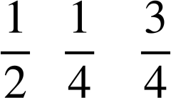
Muujinta ixtimaalka (probability) sida jajab (fractions)
Ixtimaalka (probability) waxaa sidoo kale lagu muujin karaa iyadoo la isticmaalo jajab (fractions) u dhigma.
Ixtimaalka (probability) 0 wuxuu ka dhigan yahay in dhacdadu tahay mid aan suurtagal ahayn (impossible).
Ixtimaalka (probability) 1 dhan wuxuu ka dhigan yahay in dhacdadu tahay mid sugan (certain).
Ixtimaalka (probability) nus wuxuu ka dhigan yahay in dhacdadu leedahay fursad siman (even chance).
Ixtimaalaadka (Probabilities) ka yar nus waxay muujinayaan dhacdo aan dhici doonin.
Ixtimaalaadka (Probabilities) ka weyn nus waxay muujinayaan dhacdo dhici doonta.
lose
guul
lumi
win
lumi
guul
lose
guul
0
1
aan suurtagal ahayn (impossible)
aan loo badnayn (unlikely)
fursad siman (even chance)
loo badan yahay (likely)
sugan (certain)

Slide 25
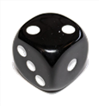
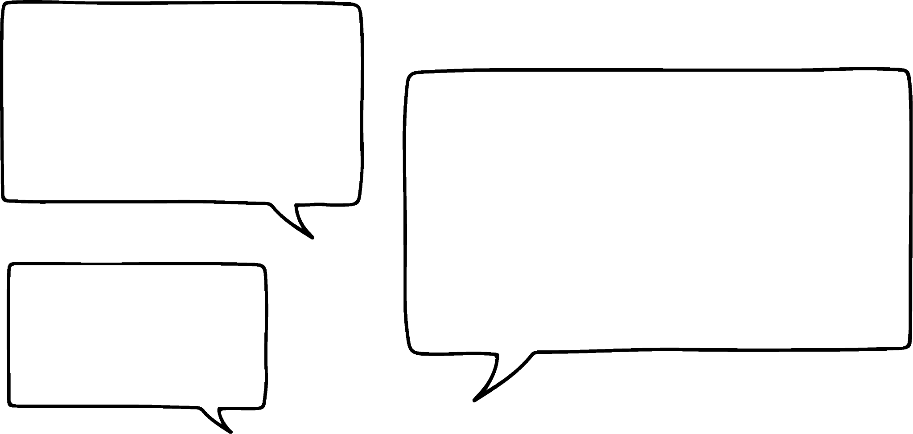
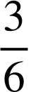
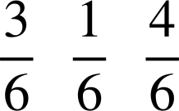




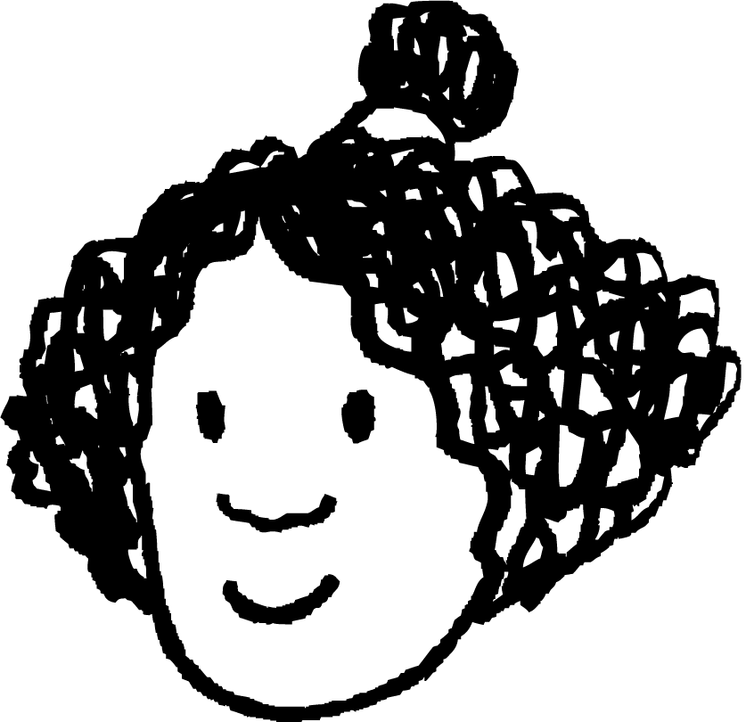
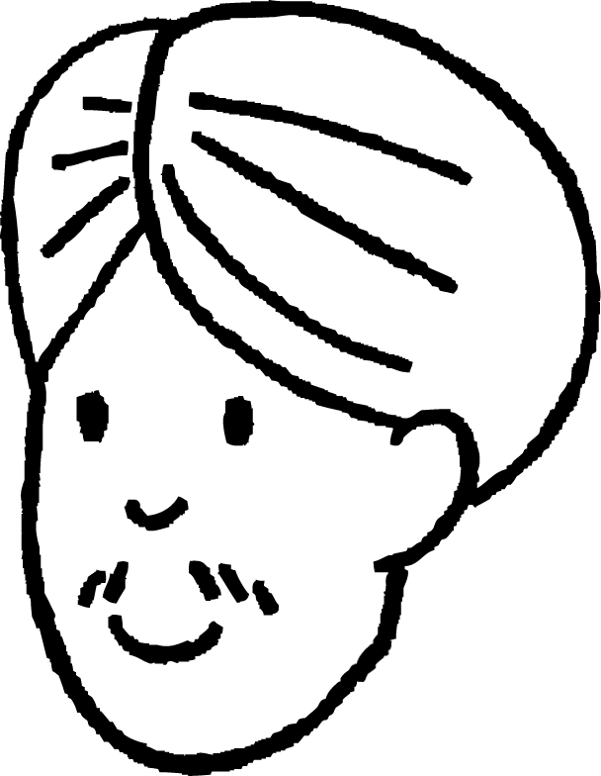



Muujinta ixtimaalaadka (probabilities) jajab ahaan (fractions)
Cali, Isra iyo Layla waxay ciyaarayaan ciid sabuurad (board game) oo ku lug leh duubista (rolling) lix-geesood (six-sided dice) caadi ah. Mid kasta wuxuu xusay tirooyinka ka caawin kara duubista (dice roll) xigta.
Ixtimaalka (probability) in aan duubo (roll) tiro aan doonayo markay tahay .
Ixtimaalka (probability) in aan duubo (roll) tiro aan doonayo markay tahay .
Ixtimaalka (probability) in aan duubo (roll) tiro aan doonayo markay tahay .
Cali
Isra
Layla
Yaa ugu badan inuu duubo (roll) tiro uu doonayo marka xigta?
Layla

Slide 26
Muujinta ixtimaalaadka (probabilities) jajab ahaan (fractions)
Cali, Isra iyo Layla waxay ciyaarayaan ciid sabuurad (board game) oo ku lug leh duubista (rolling) lix-geesood (six-sided dice) caadi ah. Mid kasta wuxuu xusay tirooyinka ka caawin kara duubista (dice roll) xigta.
Ixtimaalka (probability) in aan duubo (roll) tiro aan doonayo markay tahay .
Ixtimaalka (probability) in aan duubo (roll) tiro aan doonayo markay tahay .
Itimaalka (probability) in aan ku duubo nambarka aan doonayo markay tahay .
Cali
Isra
Layla
Yaa leh fursad siman (even chance) inuu ku duubo nambarka uu doonayo?
Cali

Slide 27
Muujinta itimaalka (probabilities) sida jajab (fractions)
Cali, Isra iyo Layla waxay ciyaarayaan ciyaar sabuurad (board game) oo ku lug leh duubista dice (six-sided dice) caadi ah. Mid kastaa wuxuu xusay nambarada ka caawin doona duubista xigta.
Itimaalka (probability) in aan ku duubo nambarka aan doonayo markay tahay .
Itimaalka (probability) in aan ku duubo nambarka aan doonayo markay tahay .
Itimaalka (probability) in aan ku duubo nambarka aan doonayo markay tahay .
Cali
Isra
Layla
Cali
Isra
wuxuu leeyahay itimaal (probability) saddex jeer ka badan si uu u helo nambarka uu doonayo.

Slide 28
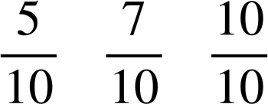
Muujinta itimaalka (probabilities) sida jajab (fractions)
Itimaalka (probabilities) saddex dhacdo (events) oo aan xiriir lahayn ayaa hoos ku qoran.
P(A) =
P(B) =
P(C) =
Dhacdo (event) kee ayaa ugu yar inuu dhaco?
A

Slide 29
Muujinta itimaalka (probabilities) sida jajab (fractions)
Itimaalka (probabilities) saddex dhacdo (events) oo aan xiriir lahayn ayaa hoos ku qoran.
P(A) =
P(B) =
P(C) =
Dhacdo (event) kee ayaa hubaal inuu dhaco?
C

Slide 30



Muujinta itimaalka (probabilities) sida jajab (fractions)
Axmed wuxuu u socdaa inuu ku wareejiyo spinner (spinner) 40 jeer oo uu qoro natiijooyinkiisa.
Immisa jeer ayuu filayaa in wareeggu ku soo dego 'win'?
Waxaan filayaa in wareeggu ku soo dego 'win' qiyaastii jeer.
10
win
lose
lose
lose
Taas waa sababta aan filayo inuu ku soo dego qayb kasta si siman.
Laakiin taasi ma aha inay dhacdo.

Slide 31

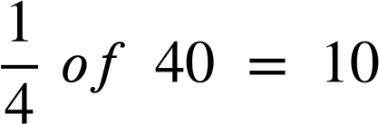
Expressing probabilities as fractions
An outcome with a probability of could be expected to happen in
qiyaastii wadarta tijaabooyinka la sameeyay.
E.g. In an experiment with 40 trials, we might expect the outcome to happen approximately 10 times.
of
Tijaabooyin badan oo tijaabo ku jira, waxay u badan tahay in saamiga natiijooyinka uu la mid noqdo waxa la filayo.

Slide 32
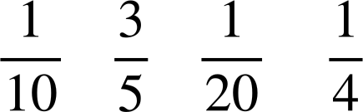
Expressing probabilities as fractions
Wareeggu wuxuu leeyahay afar lambar. Itimaalka wareeggu ku soo dego lambar kasta waa hoose.
P(1) =
P(2) =
P(3) =
P(4) =
Inta lagu jiro ciyaar, wareegga waa la wareejiyaa wadarta 100 jeer.
Lambar kee ayaa la filan karaa inuu ku soo dego inta badan?
2

Slide 33
Expressing probabilities as fractions
Wareeggu wuxuu leeyahay afar lambar. Itimaalka wareeggu ku soo dego lambar kasta waa hoose.
P(1) =
P(2) =
P(3) =
P(4) =
Inta lagu jiro ciyaar, wareegga waa la wareejiyaa wadarta 100 jeer.
Qiyaastii, immisa jeer ayaa wareegga laga filan karaa inuu ku soo dego lambarka 4?
25

Slide 34
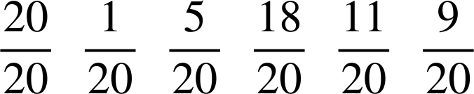
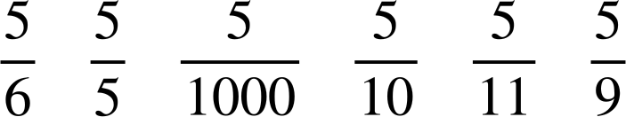
Muujinta ixtimaalka (probabilities) sida jajab (fractions)
1) Qor ixtimaalka (probabilities) hoos ku qoran sida saxda ah ee miisaanka ixtimaalka (probability scale).
aan suurtagal ahayn (impossible)
sugan (unlikely)
fursad siman (even chance)
sugan (likely)
huban (certain)
2) Qor ixtimaalka (probabilities) hoos ku qoran sida saxda ah ee miisaanka ixtimaalka (probability scale).
aan suurtagal ahayn (impossible)
sugan (unlikely)
fursad siman (even chance)
sugan (likely)
huban (certain)

Slide 35


Muujinta ixtimaalka (probabilities) sida jajab (fractions)
3) Buuxi meelaha bannaan ee shaxda (table).
dhacdo (event) | ixtimaal (probability) sida jajab (fraction) | ixtimaal (probability) sida tobanle (decimal) | ixtimaal (probability) sida boqolkiiba (percentage) | sharraxaadda suurtagalnimada (likelihood) | soo noqoshada la filayo (expected frequency) ee 600 tijaabo (trials)
tusaale (example) |  | 0.5 | 50% | fursad siman (even chance) | 300
A |  | 0.25 |  | suurtogal darro (unlikely)
B |  |  | 75%
C
D |  |  |  |  | 0

Slide 36

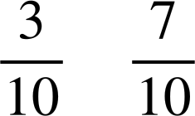

Muujinta itimaalka (probabilities) jajab ahaan (fractions)
4) Koontad (cone) la tuuro waxay ku dhici kartaa laba siyaabood: 'saldhig hoos' ama 'qalooc hoos'.
Tijaabo (experiment) weyn ayaa soo gabagabeysay itimaalka (probabilities) soo socda:
P(saldhig hoos) = P(qalooc hoos) =
a) Koontada (cone) ayaa hadda ku dhow in dib loo tuuro. Kee ayaa u badan inuu dhaco?
b) Tijaabo (experiment) 100 jeer ah, imisa jeer ayaad qiyaasi kartaa in koontadu (cone) ku dhici doonto qalooc hoos?
c) Isticmaal linkiga si aad u hesho jilitaanka (simulation) tijaabadan (experiment): Jilitaanka koontada (Cone simulation)🖇 Sanduuqa 'count' wuxuu muujinayaa tirada tijaabooyinka (trials) la sameeyay. Riix badhanka 'run' si aad u bilowdo jilitaanka (simulation) oo u ogolow inuu socdo 100 tijaabo (trials).
Natiijooyinku ma la mid yihiin waxaad ku saadaalisay qaybta (b)?

Slide 37
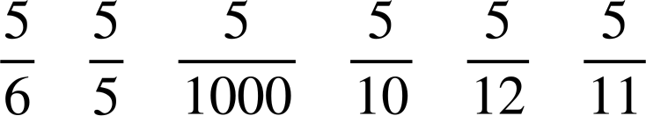
Muujinta itimaalka (probabilities) jajab ahaan (fractions)
1) Ku qor itimaalka (probabilities) hoos ku qoran sida saxda ah ee miisaanka itimaalka (probability scale).
suurtogal darro (impossible)
suurtogal darro (unlikely)
fursad siman (even chance)
badan (likely)
huban (certain)
2) Ku qor itimaalka (probabilities) hoos ku qoran sida saxda ah ee miisaanka itimaalka (probability scale).
suurtogal darro (impossible)
suurtogal darro (unlikely)
fursad siman (even chance)
sugan (likely)
huban (certain)

Slide 38
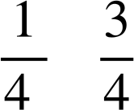
Muujinta ixtimaalka (probability) jajab ahaan
3) Buuxi meelaha bannaan ee shaxda.
dhacdo (event) | ixtimaalka (probability) jajab ahaan | ixtimaalka (probability) tobanle ahaan | ixtimaalka (probability) boqolkiiba ahaan | sharraxaadda suurtogalnimada (likelihood) | soo noqnoqoshada la filayo ee 600 tijaabo (trials)
tusaale (example) |  | 0.5 | 50% | fursad siman (even chance) | 300
A |  | 0.25 |  | sugan (likely)
B |  |  | 75%
C
D |  |  |  |  | 0
25%
150
0.75
sugan (likely)
450
0.4
40%
aan laga sugi karin (unlikely)
240
0
0
0%
aan suurtogal ahayn (impossible)

Slide 39

Muujinta ixtimaalka (probability) jajab ahaan
4) Koofiyad (cone) la tuuray waxay ku dhici kartaa laba siyaabood: 'salka hoose' ama 'qalooca hoose'.
Tijaabo (experiment) weyn ayaa soo gabagabeysay ixtimaalka (probability) soo socda:
P(salka hoose) = P(qalooca hoose) =
a) Koofiyadda (cone) ayaa hadda la tuurayaa. Kee ayaa ugu badan inuu dhaco?
qalooca hoose
b) Tijaabo (experiment) 100 jeer ah, imisa jeer ayaad filan kartaa in koofiyaddu ku dhacdo qalooca hoose?
of 100 = 70

Slide 40
Expressing probabilities as fractions
c) Isticmaal linkiga si aad u hesho jilitaanka tijaabadan: Jilitaanka koorta🖇_x000B_ Sanduuqa 'count' wuxuu muujinayaa tirada tijaabooyinka la sameeyay._x000B_ Riix badhanka 'run' si aad u bilowdo jilitaanka oo u ogolow inuu socdo 100 tijaabo.
Are the results the same as what you predicted in part (b)?
Example answers:
'Natiijooyinku waxay la mid ahaayeen saadaashayda laakiin kuma ayna ahayn isku mid.'
'Waxaa jiray 89 natiijo oo qalooc hoos u ah, taasoo ka badan intii aan filayay.'
'Tirada jeer ee ay ku soo degtay qalooc hoos ayaa aad uga badnayd tirada jeer ee ay ku soo degtay sal hoos, taasoo ahayd waxa aan filayay. Laakiin tirada saxda ah ee jeer ee ay ku soo degtay dhinac kasta way ka duwanayd waxa aan filayay.'
Jawaabuhu way kala duwanaan karaan iyadoo ku xiran natiijooyinka jilitaanka.

Slide 41
The probability scale
Itimaalka (Probability) waa cabbirka suurtogalnimada dhacdo.
Probabilities take numerical values between 0 and 1.
Itimaalka 0 wuxuu ka dhigan yahay in dhacdadu tahay mid aan macquul ahayn.
Itimaalka 1 wuxuu ka dhigan yahay in dhacdadu tahay mid hubaal ah.
The probability that an event will occur is the proportion of times the event is expected to happen in a suitably large experiment.

