Slide 1
Goobo halbeeg (unit circle)
Trigonometry (Trigonometry)

Slide 2
Sida agabkeena waxbarista loogu talagalay fasalka

Slide 3
Waxaan qiimeyn (value) karaa in shaqooyinka trigonometric (trigonometric functions) laga soo qaatay cabbiro ku dhex jira goobo halbeeg (unit circle).

Slide 4
Radius (radius) waa qayb kasta oo xariiq ah oo isku xirta bartamaha goobada iyo meel kasta oo ku taal wareegga (circumference).
Hypotenuse (hypotenuse) waa dhinaca saddexagalka qumman ee ka soo horjeeda xagasha qumman.

Slide 5
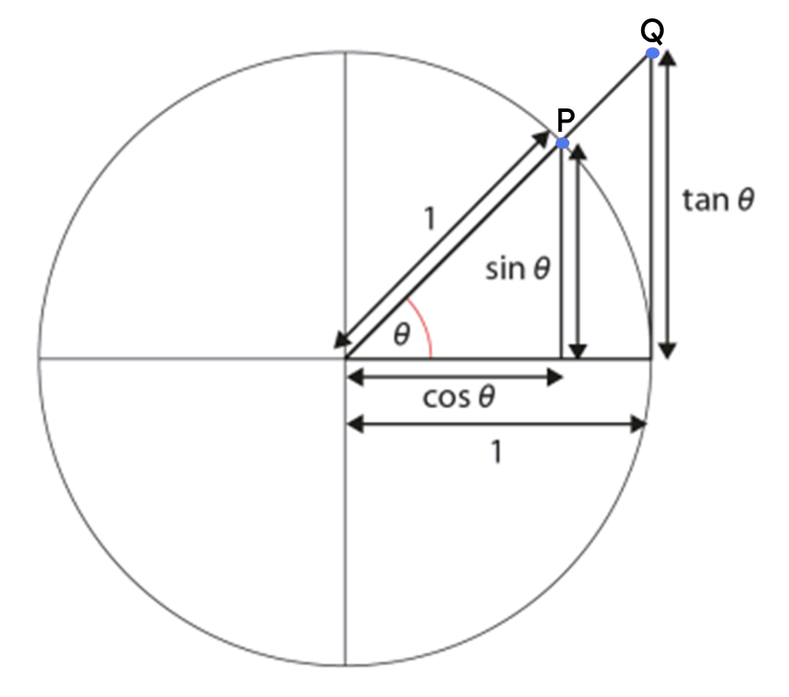
Shaqooyinka trigonometric (trigonometric functions) waxaa badanaa lagu qeexaa saamiyada labada dhinac ee saddexagal xagal qumman leh xagal la bixiyay.
Sine (sine) ee xagal (sin(θ°)) waa isku-dubbaridka y (y-coordinate) ee dhibicda P ee saddexagalka ka samaysan gudaha goobo halbeeg (unit circle).
Cosine (cosine) ee xagal (cos(θ°)) waa isku-dubbaridka x (x-coordinate) ee dhibicda P ee saddexagalka ka samaysan gudaha goobo halbeeg (unit circle).
Tangent (tangent) ee goobo waa xariiq isgooya goobada hal mar oo kaliya.
Tangent (tangent) ee xagal (tan(θ°)) waa isku-dubbaridka y (y-coordinate) ee dhibicda Q ee saddexagalka ka soo baxa goobo halbeeg (unit circle).

Slide 6

Goobo halbeeg (unit circle)
Hordhac ku saabsan sine (sine) iyo cosine (cosine)
Hordhac ku saabsan tangent (tangent)

Slide 7
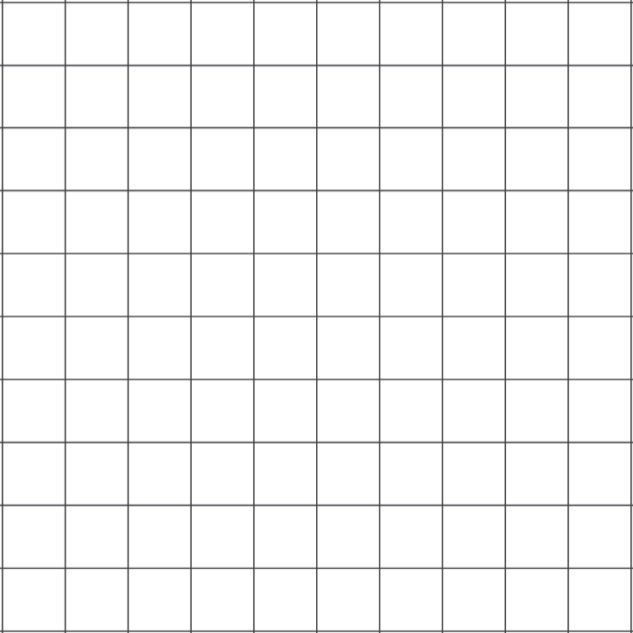
Hordhac ku saabsan sine (sine) iyo cosine (cosine)
Intee ayay u jirtaa dhibicda isku-dubbaridkeedu yahay (4, 3) asalka?
y
x² =
4²
+ 3²
5
4
(4,3)
x² =
25
3
2
x
x =
5 halbeeg (units)
1
O
x
-5
-4
-3
-2
-1
1
2
3
4
5
-1
-2
-3
-4
-5

Slide 8


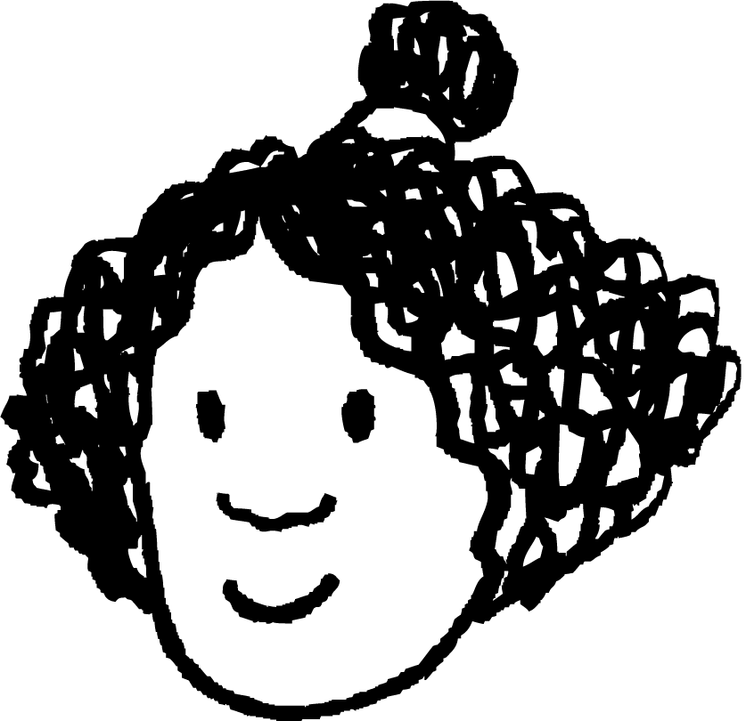
Hordhac ku saabsan sine (sine) iyo cosine (cosine)
Dhererka hypotenuse (hypotenuse) waa 5 halbeeg (units) wuxuuna leeyahay gees asalka ah.
Izzy waxay abuurtay saddexagal la mid ah shabakad isku-duwayn ah oo leh hypotenuse dhererkiisu yahay 1 halbeeg. Waa maxay isku-duwayaasha barta P?
y
y
caleemaha (scale factor) =
(4, 3)
P
5
1
ee 4 = 0.8
3
0.6
O
O
x
x
4
0.8
ee 3 = 0.6
(0.8, 0.6)

Slide 9
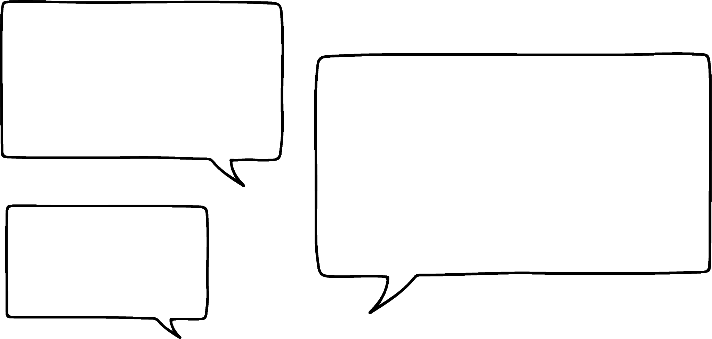


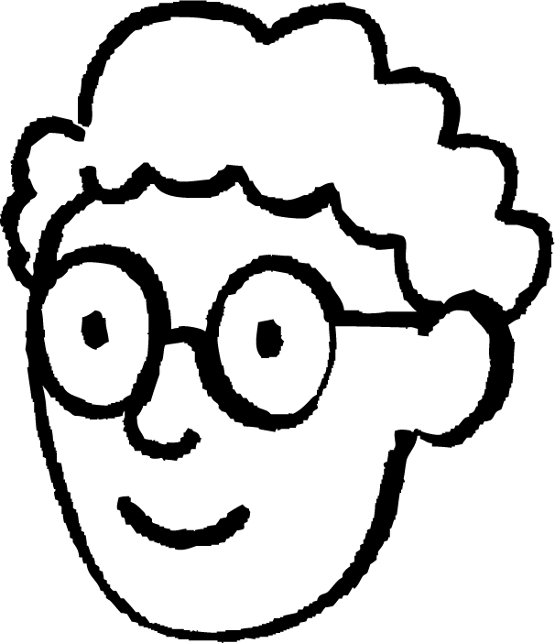


Hordhaca sine iyo cosine
Saddexagalka hoose wuxuu leeyahay hypotenuse dhererkiisu yahay 1 halbeeg, oo mid ka mid ah geesihiisu yahay asalka.
y
Point P would move in a circle around the origin.
Maxaa dhacaya haddii aan ku hayno hypotenuse dherer go'an oo ah 1 halbeeg oo aan beddelno booska barta P?
P
1
Radius-ka goobada wuxuu noqonayaa 1 halbeeg.
O
x
Alex
Izzy
Isticmaal linkiga nooca is-dhexgalka ah: saddexagal leh hypotenuse 1 halbeeg🖇

Slide 10
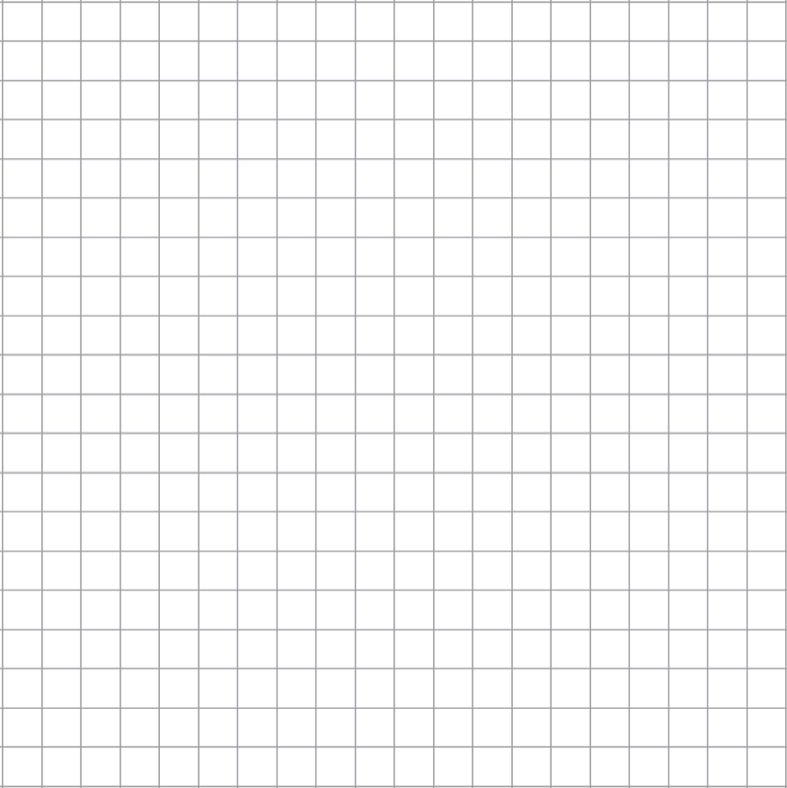
Hordhaca sine iyo cosine
Goobada halbeegga ah waa goobo ku taal shabakad isku-duwayn
oo xarunteedu tahay
origin
oo radius-kiisu yahay 1 halbeeg.
y
1
1
1
1
1
1
x
-1
O
1
1
1
1
-1

Slide 11

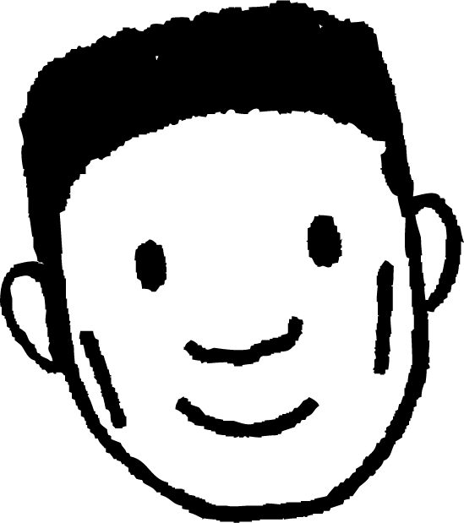

Hordhaca sine iyo cosine
Saddexagal qumman ayaa laga samayn karaa inta u dhaxaysa radius-ka iyo dhidibka x.
y
1
Jifaarka saddexagalka waa gacan-ka goobada (radius).
Sidaa darteed, jifaarku wuxuu leeyahay dherer 1 halbeeg.
1
-1
O
1
x
Lucas
-1

Slide 12
Hordhaca sine iyo cosine
Labada dherer ee kale ee saddexagalka waxaa laga heli karaa isku-duwayaasha (coordinates) barta uu radius-ku ku gooyo goobada.
y
1
(0.8, 0.6)
Dhererka cidhifka jiifka ah ee saddexagalka waxaa laga heli karaa isku-duwayaasha x (x-coordinate).
1
-1
O
0.8
1
x
0.8
Lucas
-1

Slide 13
Hordhaca sine (sine) iyo cosine (cosine)
Labada dherer ee kale ee saddexagalka waxaa laga heli karaa isku-duwayaasha barta halka radius (radius) uu ku gooyo goobada.
y
1
(0.8, 0.6)
Dhererka cidhifka toosan ee saddexagalka waxaa laga heli karaa isku-duwayaasha y (y-coordinate).
0.6
1
0.6
-1
O
0.8
1
x
0.8
Cabdi
-1

Slide 14
Hordhaca sine (sine) iyo cosine (cosine)
Marka radius (radius) uu ku wareego goobada, waxaan tixgelin karnaa sida xagasha wareeggu u saameeyo dhererka saddexagalka.
y
1
(1, 0)
-1
O
1
x
-1

Slide 15
Hordhaca sine (sine) iyo cosine (cosine)
Marka radius (radius) uu ku wareego goobada, waxaan tixgelin karnaa sida xagasha wareeggu u saameeyo dhererka saddexagalka.
y
1
(0.94, 0.34)
1
20°
-1
O
1
x
-1

Slide 16
Hordhaca sine (sine) iyo cosine (cosine)
Marka radius (radius) uu ku wareego goobada, waxaan tixgelin karnaa sida xagasha wareeggu u saameeyo dhererka saddexagalka.
y
1
(0.8, 0.6)
1
37°
-1
O
1
x
-1

Slide 17
Hordhaca sine (sine) iyo cosine (cosine)
Marka radius (radius) uu ku wareego goobada, waxaan tixgelin karnaa sida xagasha wareeggu u saameeyo dhererka saddexagalka.
y
1
(0.4, 0.92)
Maxaa isbeddelaya?
Dhererka cidhifyada jiifka iyo tooska way kala duwan yihiin.
1
67°
-1
O
1
x
Maxaa isku mid ah?
Dhererka hypotenuse (hypotenuse) had iyo jeer waa 1 halbeeg (unit).
-1

Slide 18
Hordhaca sine (sine) iyo cosine (cosine)
Marka radius (radius) uu ku wareego goobada, xagasha wareeggu waxay saameysaa isku-duwayaasha y (y-coordinate) ee barta goobada.
y
1
Sine (sine) ee xagal waa isku-duwayaasha y (y-coordinate) ee barta halka radius (radius) loo wareejiyay xagashaas.
0.6
(0.8, 0.6)
37°
-1
O
1
x
Tusaale: Sine (sine) ee 37° waa 0.6.
Ku xidh nooca isdhexgalka: goobo halbeeg (unit circle) (sine iyo cosine)🖇
-1

Slide 19
Hordhac ku saabsan sine iyo cosine
Marka gacan-radius uu ku wareego goobta, xagasha wareejinta waxay saameyn ku yeelataa isku-duwayaasha x (x-coordinate) ee dhibcaha goobta.
y
1
Cosine-ka xagal la siiyay waa isku-duwayaasha x (x-coordinate) ee dhibcaha halka gacan-radius loo wareejiyay si uu u sameeyo xagashaas.
(0.94, 0.34)
20°
-1
O
1
x
0.94
Tusaale: Cosine-ka 20° waa 0.94.
Ku xidh nooca is-dhexgalka ah: goobta halbeegga (unit circle) (sine iyo cosine)🖇
-1

Slide 20
Hordhac ku saabsan sine iyo cosine
y
1
sine
xagal waa isku-duwayaasha y (y-coordinate) ee dhibcaha halka gacan-radius loo wareejiyay xagashaas.
52°
-1
O
1
x
-1

Slide 21
Hordhac ku saabsan sine iyo cosine
y
1
Cosine-ka xagal waa ee dhibcaha halka gacan-radius loo wareejiyay xagashaas.
x-coordinate
52°
-1
O
1
x
-1

Slide 22
Hordhac ku saabsan sine iyo cosine
Xagasha waxaa lagu matali karaa xarafka Giriigga ah θ (“theta”).
y
sin(θ)
Gudaha goobta halbeegga (unit circle), θ waa xagasha gacan-radius uu ku wareejiyo si ka soo horjeeda saacadda (anticlockwise) laga bilaabo barta bilowga ah ee (0, 1).
1
Qaab gaaban oo loo qoro “sine-ka xagasha” waa sin(θ), halkaas oo sin macneheedu yahay sine iyo θ waa xagasha.
θ°
-1
1
x
O
cos(θ)
Qaab gaaban oo loo qoro “cosine-ka xagasha” waa cos(θ), halkaas oo cos macneheedu yahay cosine iyo θ waa xagasha.
-1

Slide 23


Hordhac ku saabsan sine iyo cosine
Saddexagallada (triangles) ma laha dherer taban. Sidaa darteed, saddexagallada gudaha goobta halbeegga (unit circle), sin(θ) waxay la mid tahay dhererka toosan (vertical length) kaliya marka qiimihiisu yahay mid togan.
sin(θ)
1
Sidoo kale, cos(θ) waxay la mid tahay dhererka jiifka (horizontal) kaliya marka qiimihiisu (value) yahay mid togan.
II
I
Rubacyada (quadrants) ee sin(θ) iyo cos(θ) labaduba qiime (value) togan ku yeeshaan?
θ°
-1
O
1
cos(θ)
III
IV
Rubaca (quadrant) keliya ee koowaad.
-1

Slide 24
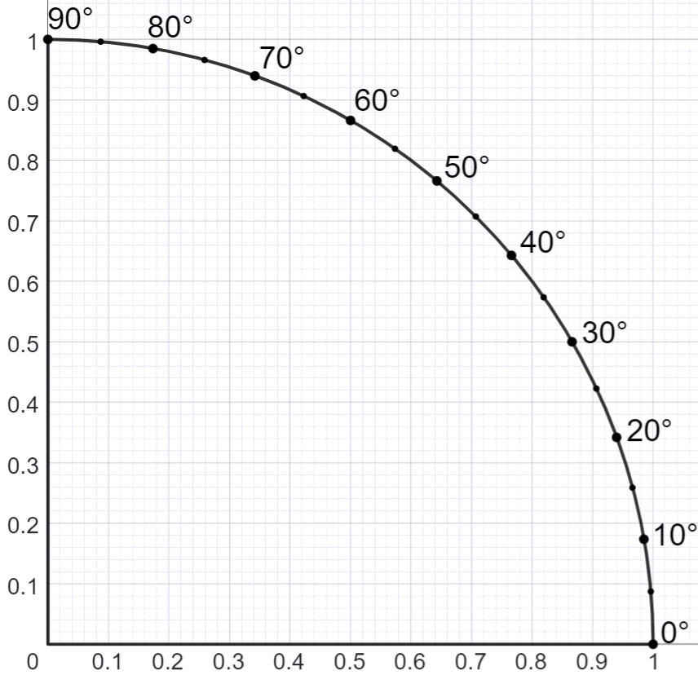
Hordhaca sine iyo cosine
Jaantusku (diagram) wuxuu muujinayaa qaybta goobada cutubka (unit circle) ee ku taal rubaca (quadrant) koowaad.
sin(θ)
Dhibcaha ku wareegsan wareegga (circumference) waxay muujinayaan xagasha (angle) wareegga (θ) ee ka imanaysa dhidibka jiifka (horizontal axis) ilaa gacan-dhererka (radius) ee dhibic kasta.
E.g. θ = 20°
20°
cos(θ)
Ku xidh nooc isdhexgal ah: goobo cutub (unit circle) oo ku taal rubaca (quadrant) koowaad🖇

Slide 25
Hordhaca sine iyo cosine
sin(θ)
Waa maxay sine ee 40°?
0.64
sin(40°) = 0.64
40°
cos(θ)
0.77

Slide 26
Hordhaca sine iyo cosine
sin(θ)
0.91
Waa maxay cosine ee 65°?
cos(65°) = 0.42
65°
cos(θ)
0.42

Slide 27
Hordhaca sine iyo cosine (Introduction to sine and cosine)
1) Jaantusku wuxuu muujinayaa qaybta goobada halbeegga (unit circle) ee ku taal rubuca koowaad.
sin(θ)
a) Isticmaal jaantuska si aad u buuxiso shaxda.
θ° | 0 | 10 | 20 | 30 | 40 | 50 | 60 | 70 | 80 | 90
sin(θ)
b) Maxaa ku dhaca qiimaha (value) sin(θ) marka xagasha (angle) ay kordho rubucan?
c) Isticmaal shaxdaada si aad u hesho xagasha (angle) halka sin(θ) = 0.5.
d) Isticmaal jaantuska si aad u hesho xagasha (angle) halka sin(θ) = 0.8.
cos(θ)

Slide 28
Hordhaca sine iyo cosine (Introduction to sine and cosine)
2) Jaantusku wuxuu muujinayaa qaybta goobada halbeegga (unit circle) ee ku taal rubuca koowaad.
sin(θ)
a) Isticmaal jaantuska si aad u buuxiso shaxda.
θ° | 0 | 10 | 20 | 30 | 40 | 50 | 60 | 70 | 80 | 90
cos(θ)
b) Maxaa ku dhaca qiimaha (value) cos(θ) marka xagasha (angle) ay kordho rubucan?
c) Raadi xagasha (angle) halka cos(θ) = 0.5.
d) Raadi qiimaha (value) θ halka cos(θ) = sin(40°).
cos(θ)
e) Raadi xagasha (angle) halka cos(θ) = sin(θ).

Slide 29
Hordhaca sine iyo cosine (Introduction to sine and cosine)
1) Jaantusku wuxuu muujinayaa qaybta goobada halbeegga (unit circle) ee ku taal rubuca koowaad.
a) Isticmaal jaantuska si aad u buuxiso shaxda.
θ° | 0 | 10 | 20 | 30 | 40 | 50 | 60 | 70 | 80 | 90
sin(θ)
0
0.17
0.34
0.5
0.64
0.77
0.87
0.94
0.98
1
Jawaabuhu waxay kala duwanaan karaan wax yar iyadoo ku xiran sida saxda ah ee loo akhriyay garaafka.
Isticmaal linkiga nooca is-dhexgalka ah: goobta (unit circle) rubuc-koowaad 🖇
b) Maxaa ku dhaca qiimaha (value) sin(θ) marka xagasha (angle) ay kordho rubucan?
Waa kordhaa. Qiimihiisa (value) ugu hooseeya waa 0, kan ugu sareeya waa 1.
30°
c) Isticmaal shaxdaada si aad u hesho xagasha (angle) halka sin(θ) = 0.5.
d) Isticmaal jaantuska si aad u hesho xagasha (angle) halka sin(θ) = 0.8.
53°

Slide 30
Hordhaca sine iyo cosine
2) Jaantusku wuxuu muujinayaa qaybta goobta (unit circle) ee ku taal rubuc-koowaad.
a) Isticmaal jaantuska si aad u buuxiso shaxda.
θ° | 0 | 10 | 20 | 30 | 40 | 50 | 60 | 70 | 80 | 90
cos(θ)
1
0.98
0.94
0.87
0.77
0.64
0.5
0.34
0.17
0
Jawaabuhu waxay kala duwanaan karaan wax yar iyadoo ku xiran sida saxda ah ee loo akhriyay garaafka.
Isticmaal linkiga nooca is-dhexgalka ah: goobta (unit circle) rubuc-koowaad 🖇
b) Maxaa ku dhaca qiimaha (value) cos(θ) marka xagasha (angle) ay kordho rubucan?
Waa yaraadaa. Qiimihiisa (value) ugu hooseeya waa 0, kan ugu sareeya waa 1.
60°
c) Raadi xagasha (angle) halka cos(θ) = 0.5.
d) Raadi qiimaha θ halka cos(θ) = sin(40°).
50°
e) Raadi xagasha (angle) halka cos(θ) = sin(θ).
45°

Slide 31
Goobta (unit circle)
Hordhaca sine iyo cosine
Hordhaca tangent

Slide 32
Hordhaca taanjanta (tangent)
Tangent-ka goobta (circle) waa xariiq ku gooya goobta hal mar oo kaliya.
taanjanto (tangents):
taanjanta (tangent)
ma aha taanjanto (tangents):

Slide 33
Hordhaca taanjanta (tangent)
y
Taanjanta (tangent) xagal waa isku-dubbarid-y (y-coordinate) meesha xariiqda (jibaabka saddex-xagalka) ay ku goyso xariiqda taanjanta (tangent line).
1
1
45°
-1
O
1
x
Tusaale: Taanjanta (tangent) 45° waa 1.
Xiriirka nooca is-dhexgalka ah: goobada cutubka (taanjanta (tangent))🖇
-1

Slide 34
Hordhaca taanjanta (tangent)
y
1
Qaab gaaban oo loo qoro "taanjanta (tangent) xagalka" waa
tan(θ)
1
45°
Soo-gaabinta taanjanta (tangent)
-1
1
Xagasha wareegga (Angle of rotation)
O
x
Tusaale: tan(45°) = 1
Xiriirka nooca is-dhexgalka ah: goobada cutubka (taanjanta (tangent))🖇
-1

Slide 35
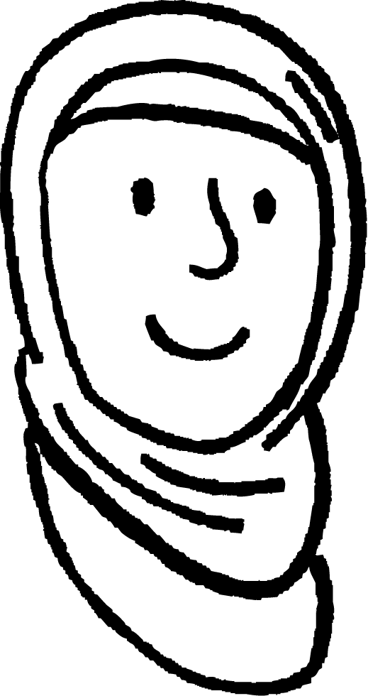
Hordhaca taanjanta (tangent)
Isticmaal nooca is-dhexgalka si aad u sahamiso waxa dhaca marka θ isbeddelo
y
1
tan(θ)
Waan la yaabanahay waxa ku dhaca qiimaha (value) tan(θ) marka xagashu isbeddesho.
θ
-1
O
1
x
Caasha
Xiriirka nooca is-dhexgalka ah: goobada cutubka (taanjanta (tangent))🖇
-1

Slide 36
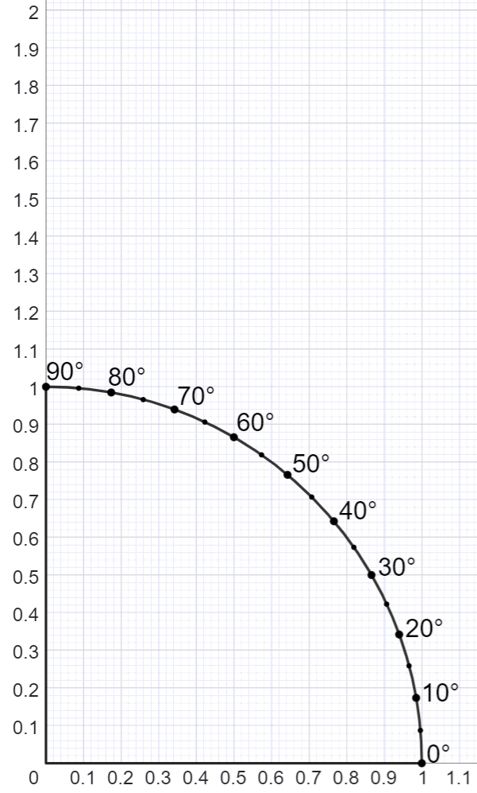
Hordhaca taangent (tangent)
Jaantusku wuxuu muujinayaa qaybta (sector) goobada cutubka ee ku jirta rubuca koowaad (first quadrant).
Adoo sawiraya taangent (tangent) x = 1, waxaan heli karnaa taangent (tangent) xaglo ka mid ah goobada halbeegga (unit circle).
0.84
Tusaale: tan(40°) =
0.84
Ku xidh nooc isdhexgal ah: goobada halbeegga (unit circle) rubucda koowaad🖇
40°

Slide 37
Hordhaca taangent (tangent)
Waa maxay qiimaha (value) tan(50°)?
1.19
1.19
0.77
0.77
0.64
50°
0.64

Slide 38
Hordhaca taangent (tangent)
Waa maxay qiimaha (value) sin(50°)?
1.19
1.19
0.77
0.77
0.64
50°
0.64

Slide 39
Hordhaca taangent (tangent)
Waa maxay qiimaha (value) cos(50°)?
1.19
1.19
0.77
0.77
0.64
50°
0.64

Slide 40
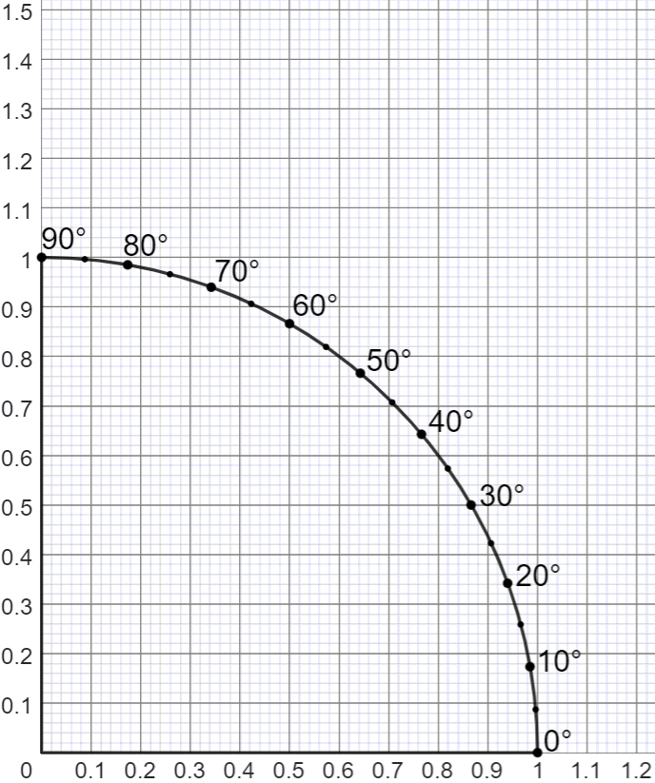
Hordhaca taangent (tangent)
1) Jaantusku wuxuu muujinayaa rubucda koowaad ee goobada halbeegga (unit circle).
a) Sawir taangent (tangent) x = 1.
b) Raadi qiimaha (value) tan(35°)
c) Raadi qiimaha (value) tan(55°)
d) Isticmaal jaantuska si aad u hesho xagasha halka tan(θ) = 1.
e) Isticmaal jaantuska si aad u hesho xagasha halka tan(θ) = 0.5.
Nooc isdhexgal ah oo jaantuska ah, guji linkiga: goobada halbeegga (unit circle) rubucda koowaad🖇

Slide 41
Hordhaca taangent (tangent)
2) a) Buuxi shaxda.
θ° | 30 | 40 | 50
sin(θ)
cos(θ)
tan(θ)
b) Xagal kasta, u qaybi qiimaha sin(θ) qiimaha cos(θ). Maxaad dareemeysaa?
For an interactive version of the diagram, click the link: unit circle in first quadrant🖇

Slide 42
Introduction to tangent
1) Jaantusku wuxuu muujinayaa rubuca koowaad ee goobada halbeegga (unit circle).
a) Draw a tangent at x = 1.
b) Raadi qiimaha tan(35°)
0.7
c) Raadi qiimaha tan(55°)
1.4
d) Isticmaal jaantuska si aad u hesho xagasha tan(θ) = 1.
45°
e) Isticmaal jaantuska si aad u hesho xagasha tan(θ) = 0.5.
27°
Jawaabuhu waxay kala duwanaan karaan wax yar iyadoo ku xiran sida saxda ah ee loo akhriyo jaantuska.

Slide 43
Introduction to tangent
2) a) Complete the table.
θ° | 30 | 40 | 50
sin(θ)
cos(θ)
tan(θ)
0.5
0.64
0.77
0.87
0.77
0.64
0.58
0.84
1.19
Answers may vary depending on accuracy.
b) Xagal kasta, u qaybi qiimaha sin(θ) qiimaha cos(θ). Maxaad dareemeysaa?
Natiijada qayb kasta waxay u dhowdahay qiimaha tan(θ).

Slide 44
Goobada halbeegga (unit circle)
Goobta halbeegga (unit circle) waa goobo leh radius 1 halbeeg.
Goobta halbeegga waxay ku taallaa asalka (origin).
Sine-ka xagasha waa isku-duwayaasha y ee barta halka radius-ka loo wareejiyay xagashaas.
Cosine (cos) ee xagal waa isku-duwayaasha x (x-coordinate) ee barta halka radius (radius) loo wareejiyay xagashaas.
Tangent (tan) ee xagal waa isku-duwayaasha y (y-coordinate) ee barta halka radius (radius) la dheereeyay uu ku gooyo tangent (line) ee goobada halbeegga (unit circle) (x = 1).

