Slide 1
Jeegaan (spectrum) muuqda
Samaynta sawirada

Slide 2
Sida agabkeena waxbarista loogu talagalay fasalka
Darsigani wuxuu ku darayaa qalab dheeri ah oo laga soo dejin karo bogga darsiga.

Slide 3
Waxaan qeexi karaa waxa iftiin cad yahay, iyo sharaxaad sababta jeegaan (spectrum) muuqda looga soo saari karo iftiin cad.

Slide 4
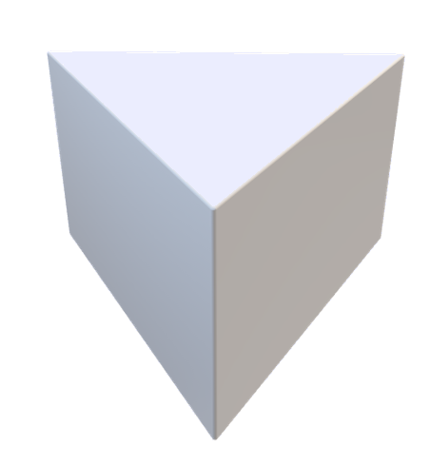

Iftiin cad
Iftiin ka kooban iftiin cas, cagaar iyo buluug oo isle'eg, sidaas darteed wuxuu u muuqdaa cad.
Murays saddexagal (triangular prism)
Qaab 3D isku mid ah oo leh darafyo saddexagal.
Jeegaan (spectrum) iftiin muuqda
Qaab qaanso roobaad oo iftiin midab leh oo had iyo jeer ku yimaada isku nidaam midabbo.
Unugyada koorta (cone cells)
Unugyada gadaasha isha ee ogaada midabka.

Slide 5

Jeegaan (spectrum) muuqda
Iftiin cad
Arkida jeegaan (spectrum) muuqda
Murays labaad

Slide 6
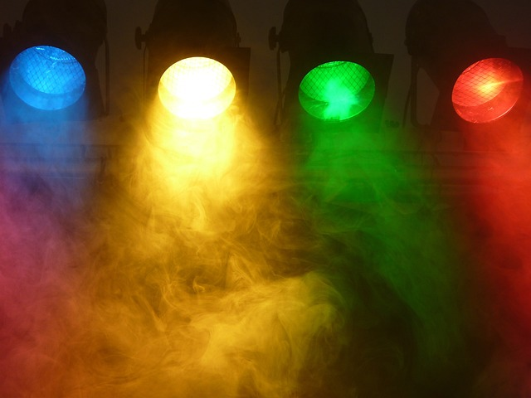
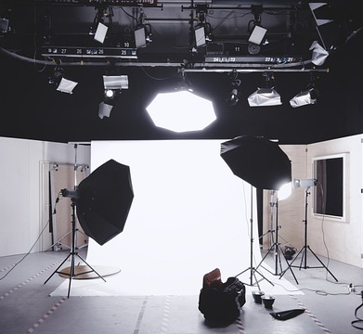
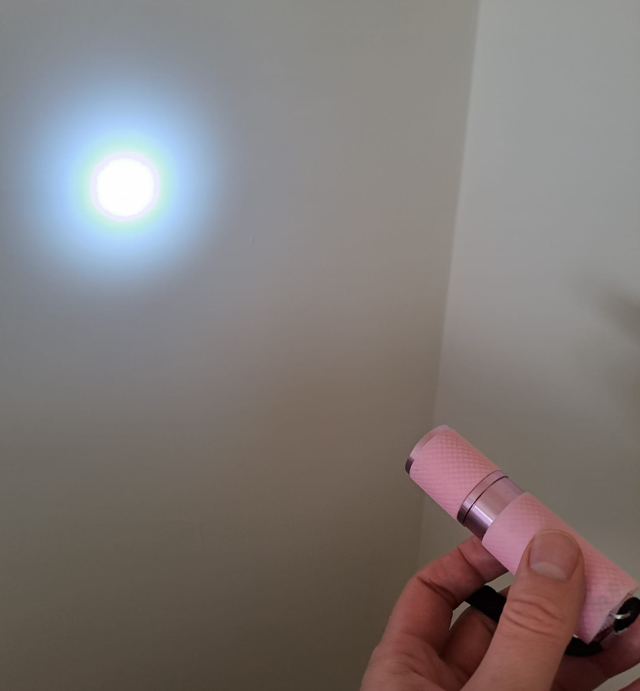
Iftiin cad
Iftiin qaar waa midab leh.
Iftiin kale waa cad.
Inta badan iftiinka guryaha waxaa loogu talagalay inuu soo saaro iftiin cad (ama mid aad ugu dhow iftiin cad).

Slide 7
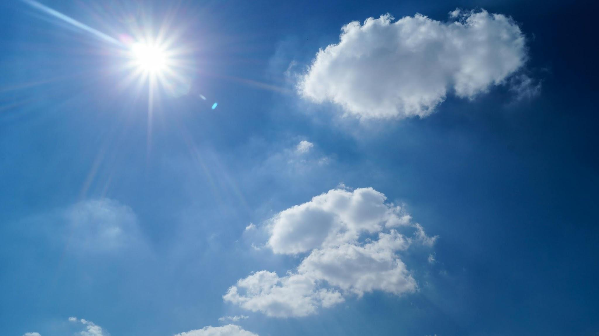
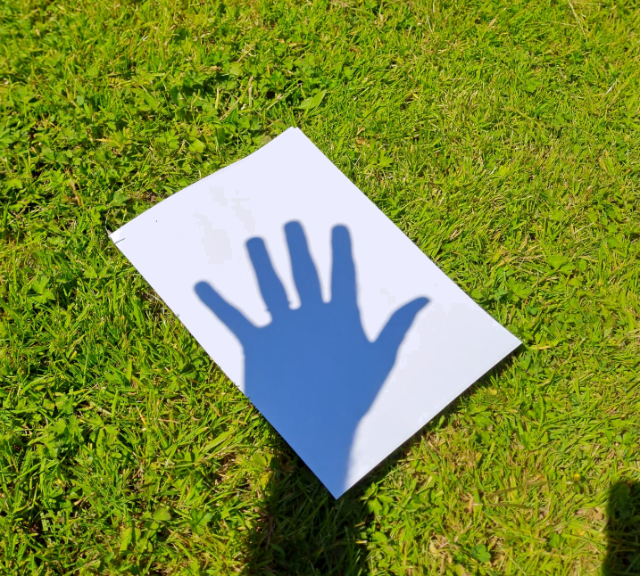
Iftiin cad
Iftiinka Qorraxdu waa caddaan (white).
Fikradda ah in Qorraxdu tahay jaalle, oranji ama casaan waa qalad.
Haddii Qorraxda ama iftiinka qorraxdu yihiin jaalle, markaas shayyada ay iftiimiso qorraxdu waxay u ekaan lahaayeen jaalle. Laakiin ma eka.

Slide 8
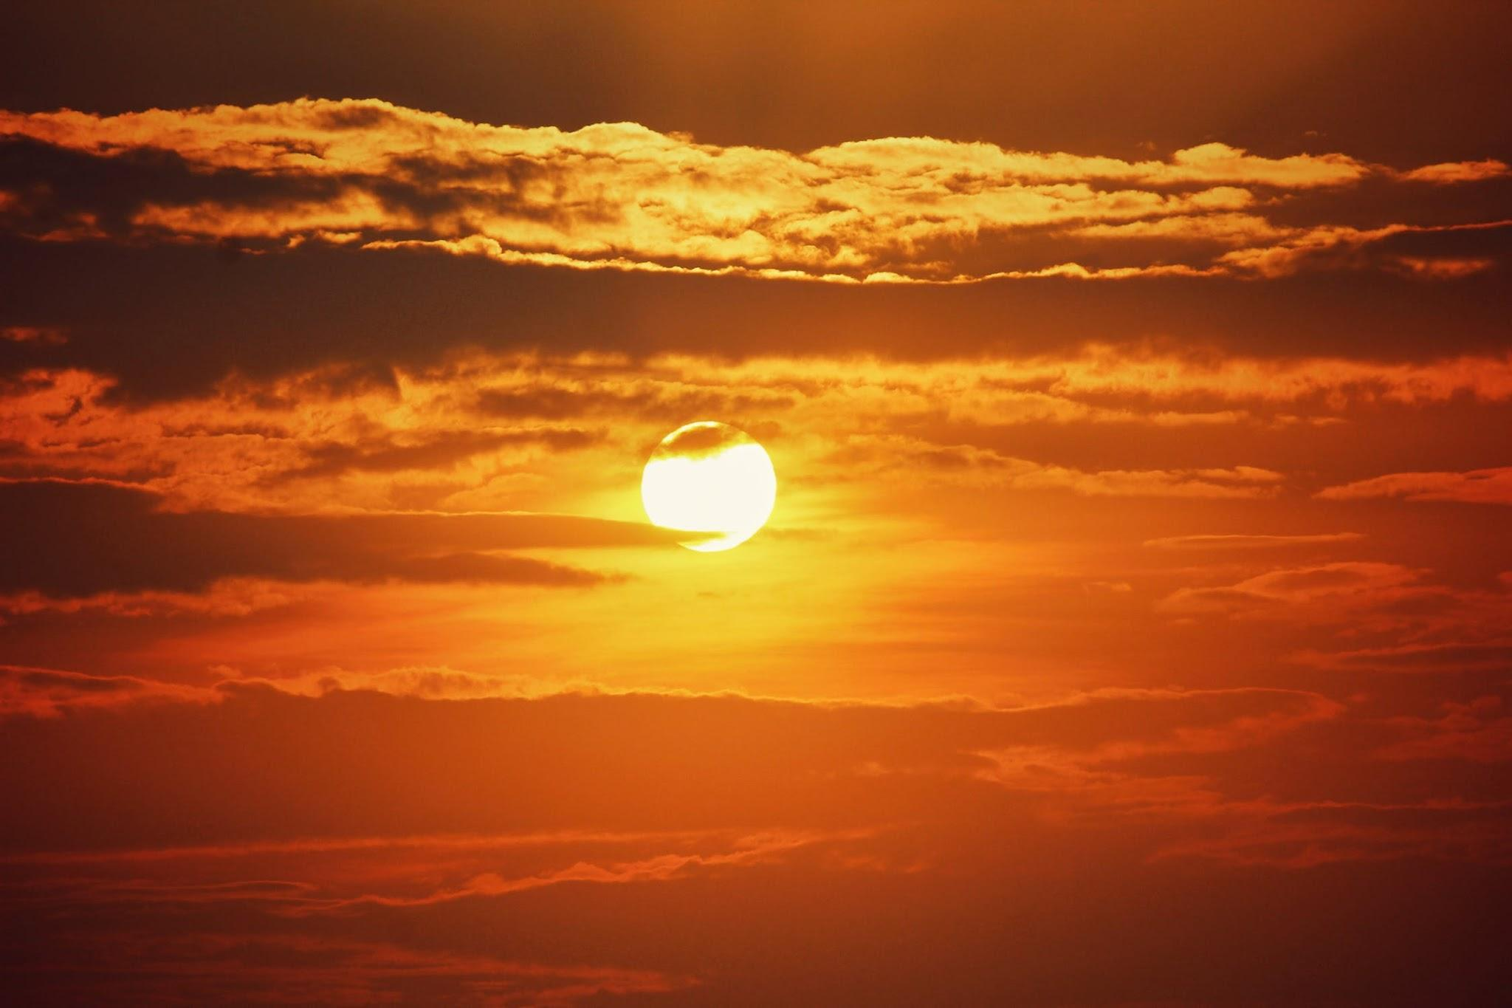
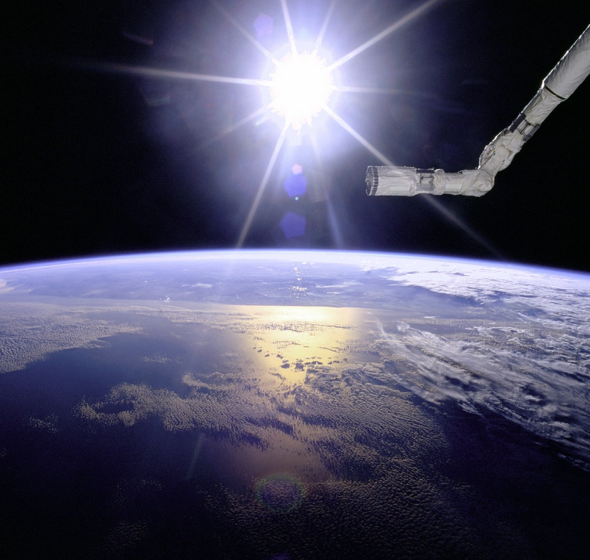
Iftiin cad (White light)
Qorraxdu waxay mararka qaar u ekaan kartaa jaalle ama oranji markay qorrax soo baxdo ama dhacdo. Laakiin tani waxay ugu wacan tahay jawiga dhulka iyo xagasha hoose ee Qorraxda cirka waqtigan.
Meel bannaan, ka sarreysa jawiga dhulka, waxaa la arki karaa in Qorraxdu tahay caddaan (white) wakhti kasta.

Slide 9



Iftiin cad (White light)
1) Waa maxay midabka iftiinka qorraxda?
a
Qorrax (Sun)
cir (sky)
2) Waa maxay midabka iftiinka maalinta?
a
a
b
jaalle-cad (yellowish)
c
isku dhafka jaalle, oranji iyo casaan (mixture of yellow, orange and red)
d
buluug (blue)
caddaan (white)

Slide 10
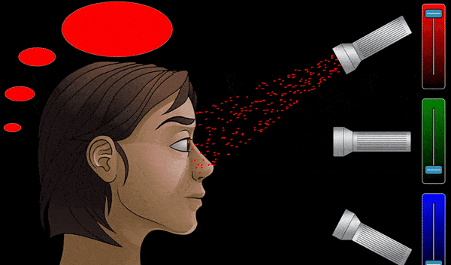

Iftiin cad (White light)
Midabada qaar waxaa la samayn karaa iyadoo la isku daro midabada kale ee iftiinka.
R
+
G
jaalle (yellow)
G
+
B
cyan (cyan)
B
+
R
magenta (magenta)
R
+
G
+
B
caddaan (white)
Jilitaan (Simulation) by PhET Interactive Simulations, University of Colorado Boulder, licensed under CC–BY–4.0 (https://phet.colorado.edu).

Slide 11
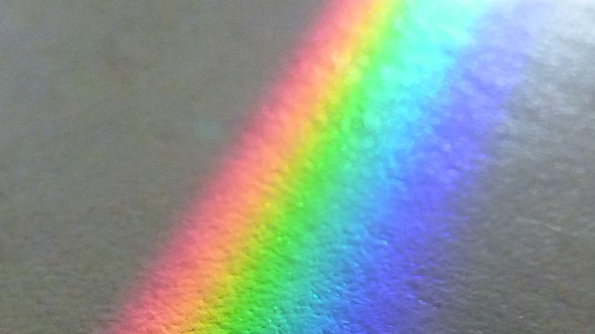
Iftiin cad
Muraayad saddex geesood oo hufan waxay muujin kartaa in iftiinka cad ee qorraxda ama nalka uu dhab ahaantii ka kooban yahay dhammaan midabada iftiinka ee qaanso roobaadka.
Qaabka qaanso roobaadka aad hesho waxaa loo yaqaan jeegaan (spectrum) midab ama jeegaan (spectrum) iftiin muuqda.
iftiin cad
galaas

Slide 12
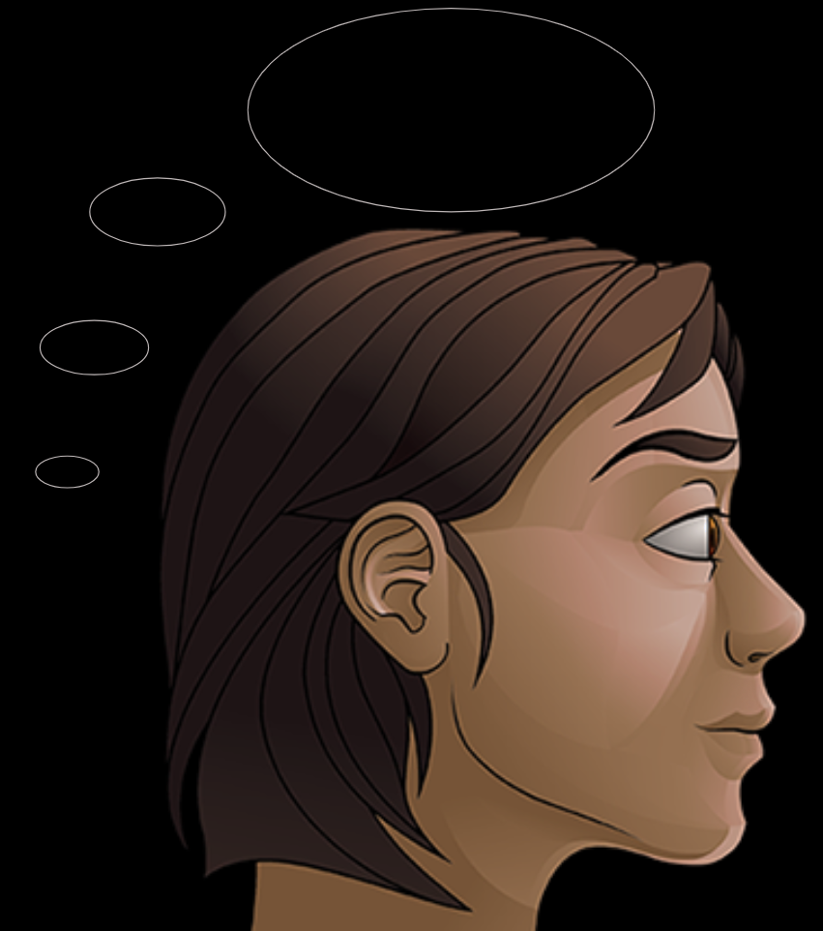
Iftiin cad
Marka dhammaan midabada iftiinka ee jeegaan (spectrum) muuqda ay isku mar galaan ishaada, waxaad arkaysaa cad.
iftiin qorraxda (iftiin dhammaan midabada jeegaan (spectrum))
Tani waa isla saamaynta marka iftiinka casaan, cagaar iyo buluug ay isku mar galaan ishaada.
iftiin casaan, cagaar iyo buluug
Labada xaaladba, midabada kala duwan ee iftiinka ayaa isku dhala oo soo saara iftiin cad.
Jilitaan (Simulation) by PhET Interactive Simulations, University of Colorado Boulder, licensed under CC–BY–4.0 (https://phet.colorado.edu).

Slide 13
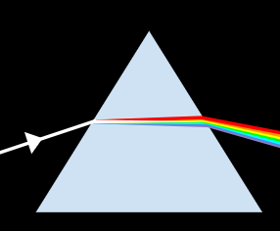
Iftiin cad
Marka iftiinka cad uu dhex maro muraayad saddex geesood, waxaa soo baxa jeegaan (spectrum) iftiin. Ii sheeg bayaan kee sababta?
a
Iftiinku wuxuu ka qaataa midab galaaska.
b
Iftiinku wuxuu la falgalaa galaaska oo wuxuu beddelaa midabkiisa.
Muraayadda saddex geesood waxay kala qaybisaa iftiinka cad ee ay ka kooban tahay midabada kala duwan.
c

Slide 14
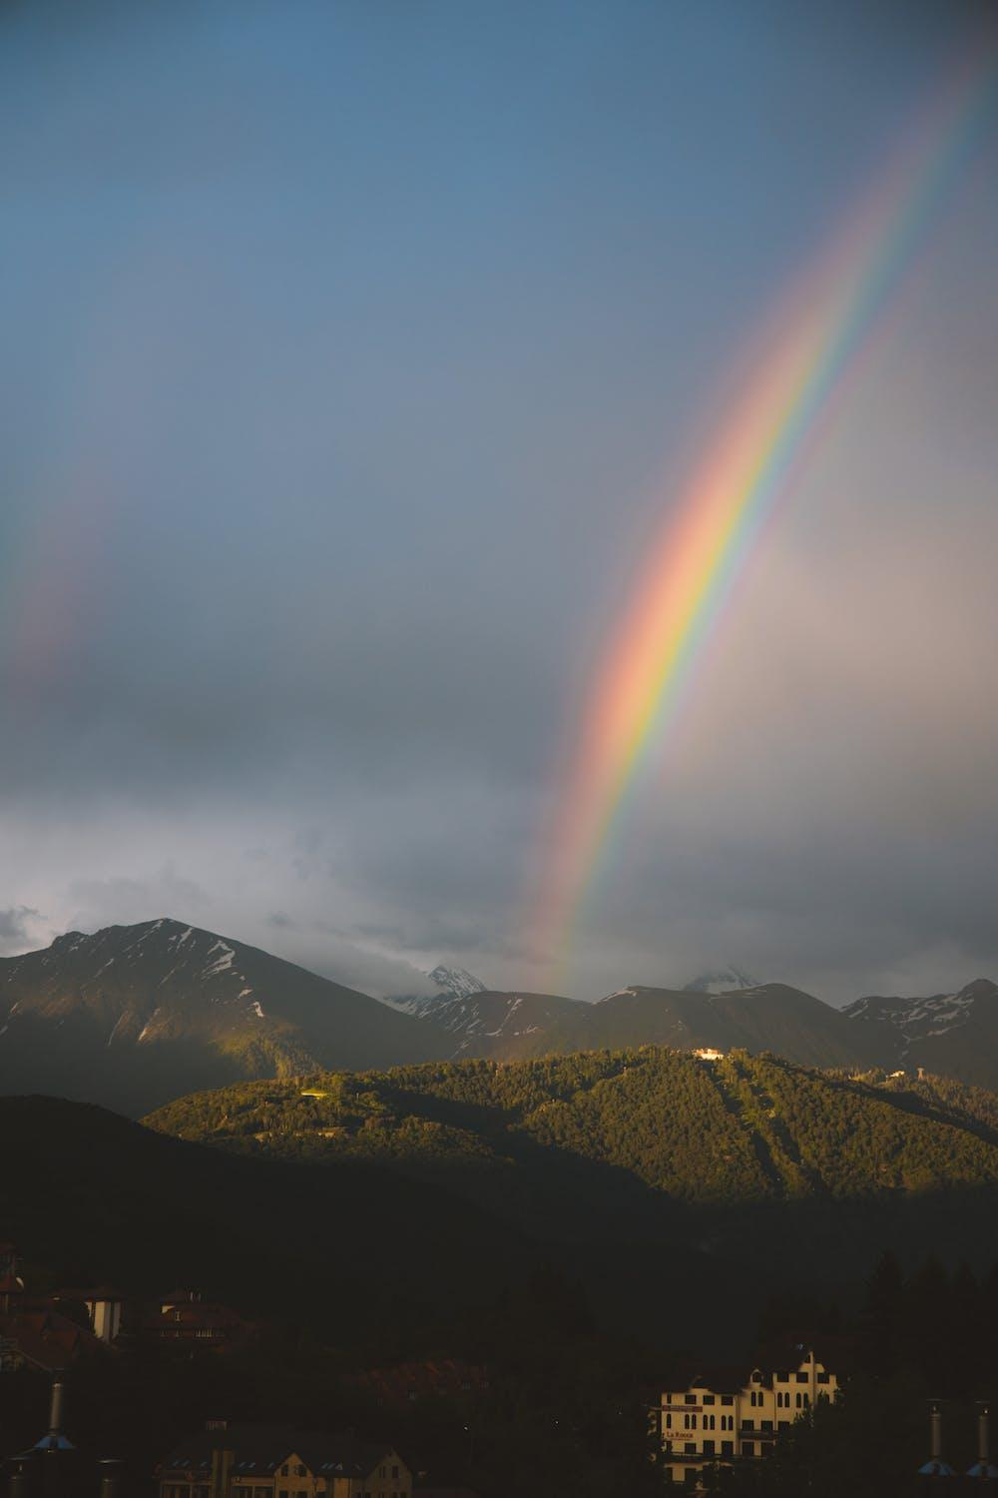
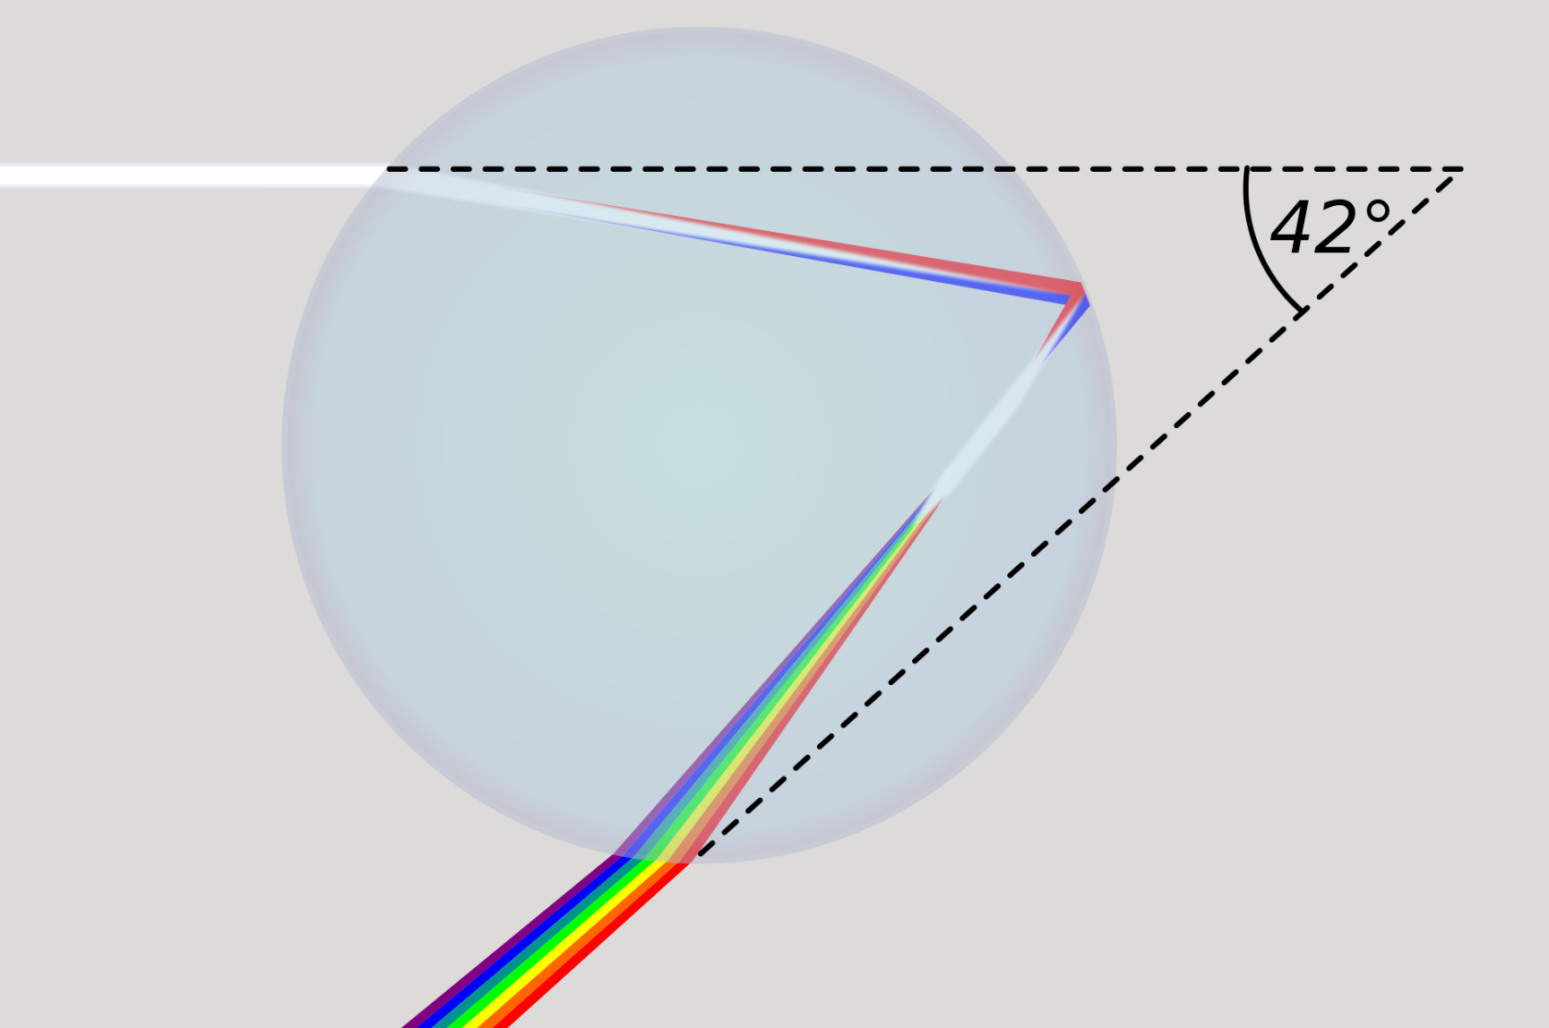
Iftiin cad
Qaanso roobaadka cirka waxaa keena hab la mid ah.
Iftiin cad oo ka yimaada qorraxda waxaa kala qaybin kara dhammaan midabada jeegaan (spectrum) muuqda dhibco roob oo fog.
iftiin cad oo ka yimaada qorraxda (gadaashaada)
hal dhibic roob oo fog
Iftiinkan wuxuu u safraa ishaada isagoo keenaya qayb ka mid ah qaanso-roobaadka in la arko.

Slide 15
Iftiin cad (White light)
Dhaqan ahaan, jeeganka iftiinka la arki karo (visible light spectrum) waxaa la sheegaa inuu ka kooban yahay toddoba midab.
guduud orange jaalle cagaar buluug indigo violet
Xaqiiqda, jeeganka iftiinka la arki karo (visible light spectrum) waa kala-duwanaansho joogto ah oo midabyo ah.
Kala soocida buluug, indigo iyo violet ma cadda.
Midabada ku jira jeeganka iftiinka la arki karo (visible light spectrum) had iyo jeer waxay u muuqdaan isku nidaam.
Tani waa sababtoo ah midab kasta oo iftiin ah wuxuu leeyahay astaamo wax yar ka duwan oo wuxuu u safraa jihada wax yar ka duwan iyada oo loo marayo muraayad (prism) (ama dhibic roob).

Slide 16
Iftiin cad (White light)
Laga bilaabo guduud, sheeg magacyada toddobada midab ee dhaqameed ee jeeganka iftiinka la arki karo (visible light spectrum) sida ay u kala horreeyaan ee ay uga muuqdaan jeeganka.
guduud, orange, jaalle, cagaar, buluug, indigo, violet

Slide 17
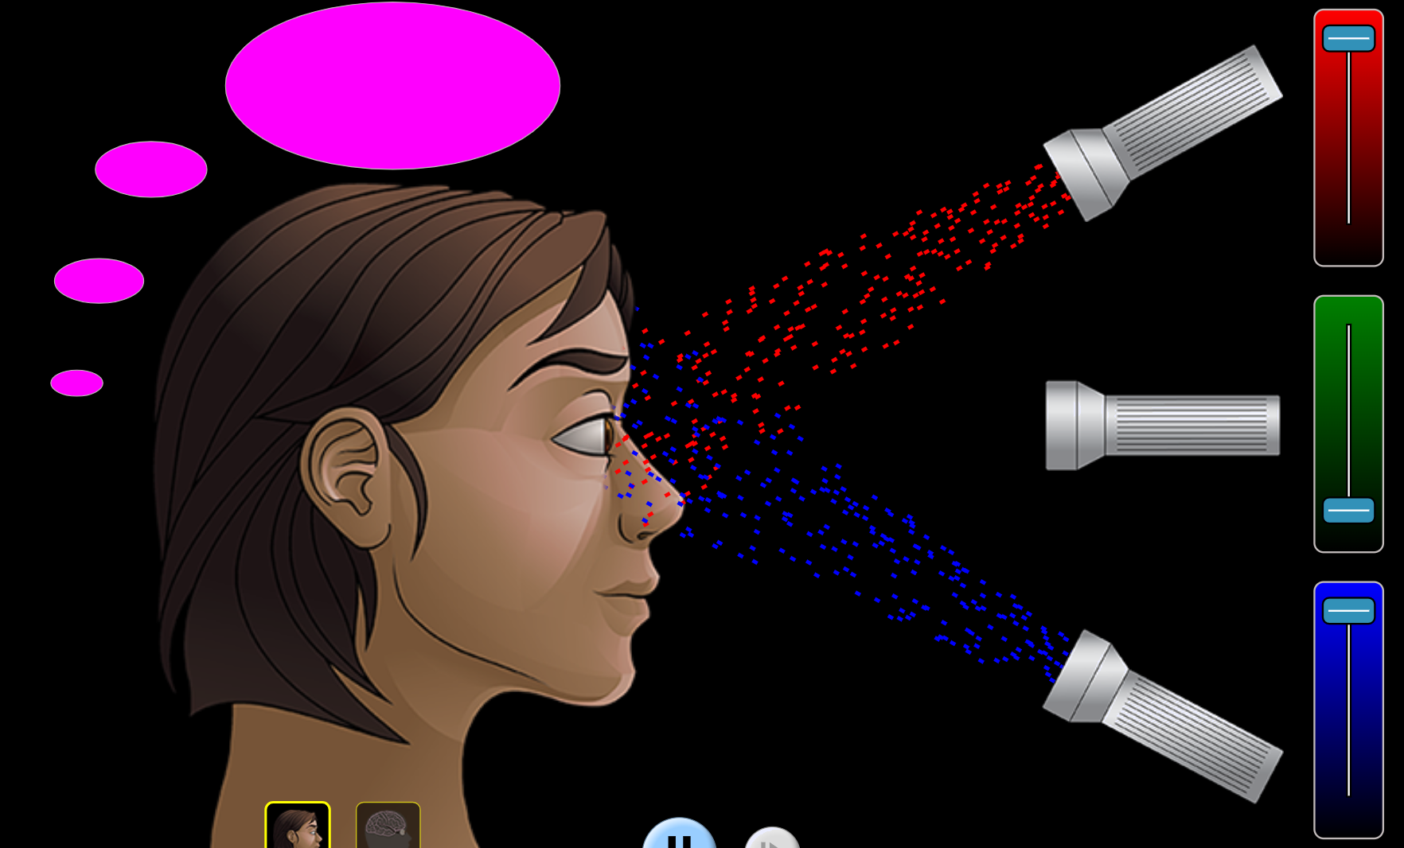
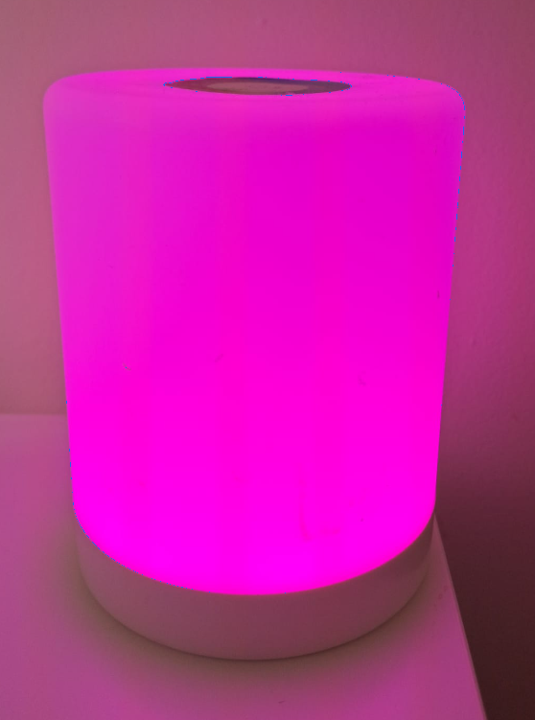
Iftiin cad (White light)
Jeeganka iftiinka la arki karo (visible light spectrum) wuxuu muujinayaa kala-duwanaanshaha midabyada ee iftiinku yeelan karo.
Midab kasta oo aan ka mid ahayn jeeganka, sida cad ama magenta ( ), waxaa lagu abuuri karaa oo kaliya isku darka midabyada iftiinka ee jeeganka.
B
+
R
magenta
Iftiinku run ahaantii ma noqon karo magenta.
Waxaan uun aragnaa magenta marka iftiinka guduud iyo buluug ay isku waqti galaan indhaha.
Jilitaanka PhET Interactive Simulations, University of Colorado Boulder, oo shatiyeysan CC–BY–4.0 (https://phet.colorado.edu).

Slide 18
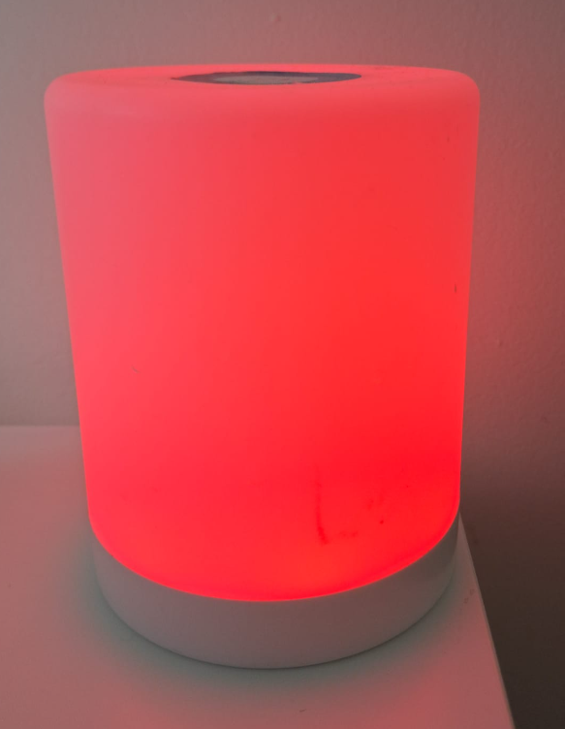
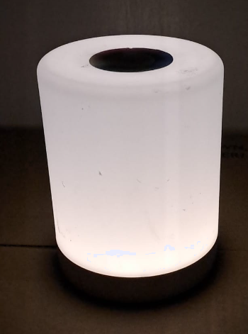
Iftiin cad (White light)
Ku xid nalkasta tirada midabbada iftiinka uu soo saaro.
1)
nalka magenta
2)
nalka cas
3)
nalka cad
b
a
c
a
soo saarista hal midab oo iftiin ah
b
soo saarista laba midab oo iftiin ah
c
soo saarista dhammaan midabyada iftiinka ee jeeganka

Slide 19
Iftiin cad
Waa kee qeexida ugu saxsan ee iftiinka cad?
a
Iftiin saafi ah.
b
Iftiin aan lahayn midab.
c
Maqnaanshaha iftiinka.
d
Isku darka midabbo kala duwan oo iftiin ah.

Slide 20
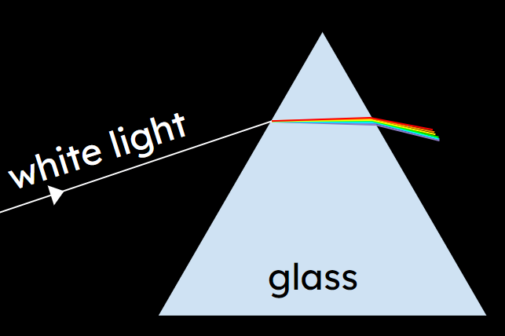
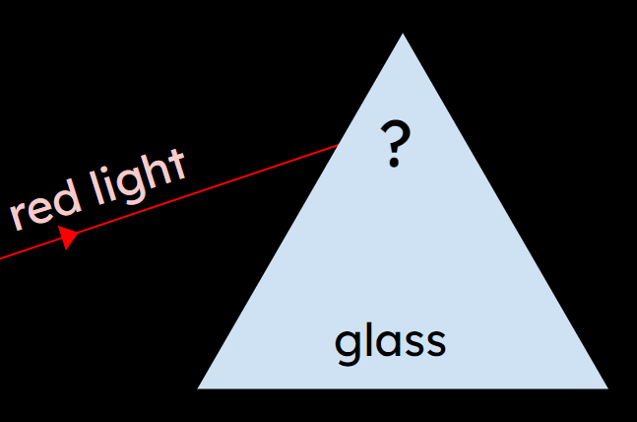
Iftiin cad
Isticmaal sanduuqa laydhka, dalool iyo muraayad saddexagal oo hufan si aad uga abuurto iftiin cad jeegaan (spectrum) iftiin muuqda.
Saadaali waxa aad u malaynayso inaad arki doonto marka iftiinka cad ee soo dhaca lagu beddelo iftiin cas. Miyuu soo bixi doonaa jeegaan (spectrum)?
Sharax sababta aad u malaynayso inaad arki doonto tan.
Daawo muujin.
Ma sax ahayd saadaashaada iyo sharaxaaddaada?
Qor sharaxaad ka fiican oo ku saabsan waxa aad aragtay.

Slide 21
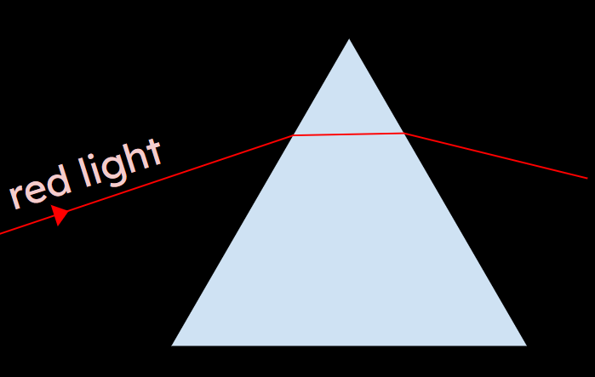
Iftiin cad
Jawaabo tusaale.
Iftiinka cas kuma soo bixin doono jeegaan (spectrum) midab ah, mana beddeli doono midabkiisa. Iftiinka cas wuxuu raaci doonaa waddo isku mid ah dhexda muraayadda sida iftiinka cas ee ka yimid iftiinka cad.
Saadaal:
Muraayadaha saddexagalka ah ma beddelaan midabka iftiinka. Waxay kala qaybin karaan iftiinka midabbo kala duwan oo ka kooban iftiinka. Laakiin iftiinka cas waa midab kaliya oo iftiin ah, ma aha isku darka midabbo, marka kala qaybin ma dhacdo. (Muraayaduhu waxay u beddelaan jihada midab kasta oo iftiin ah xagal yar oo kala duwan.)
Sharaxaad:

Slide 22
Jeegaan (spectrum) muuqda
Iftiin cad (White light)
Arinta jeegaan (spectrum) muuqda
Muraayad labaad (A second prism)

Slide 23
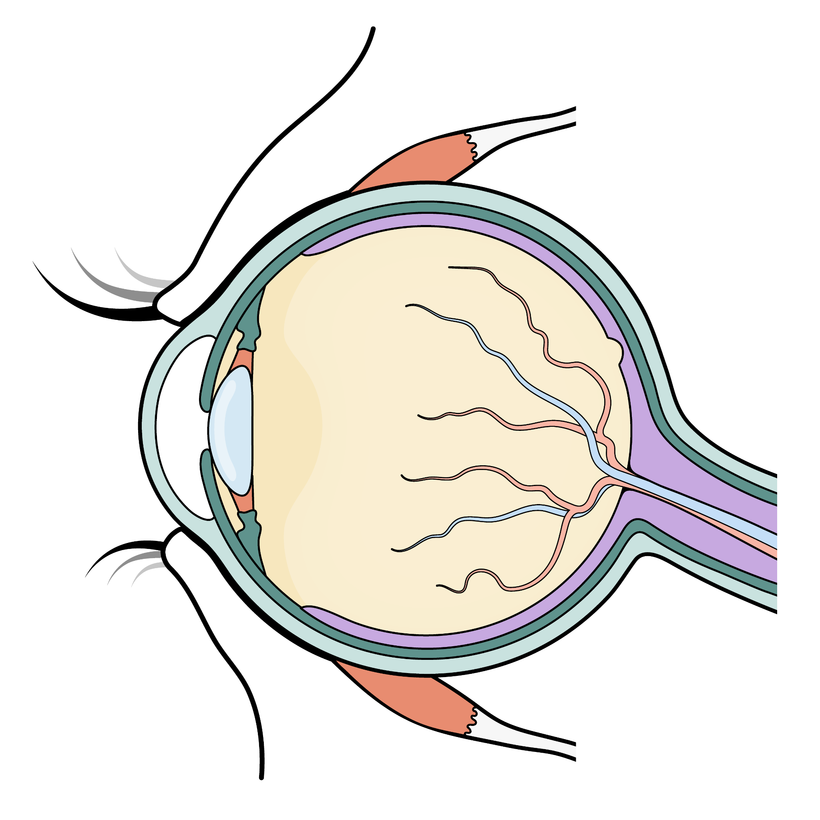
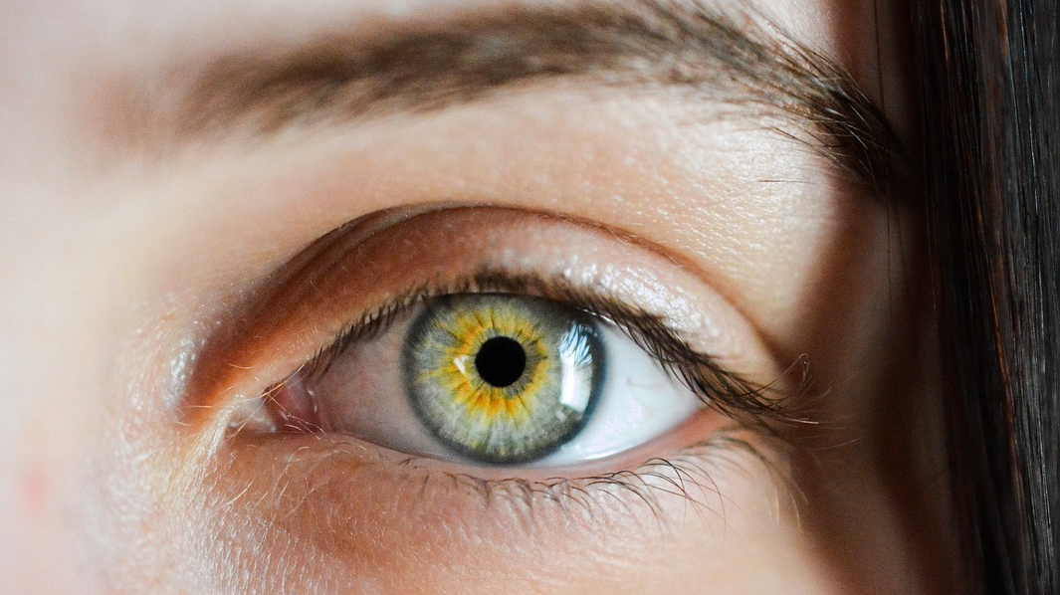
Arinta jeegaan (spectrum) muuqda
Waxaan aragnaa marka iftiinku galo isha oo uu nuugo unugyada ku yaal retina.
jaantus isha (aragti-dhinac)
Unugyada Rod ee retina waxay dareemaan iftiin (brightness), unugyada cone-na waxay dareemaan midab (colour).
retina
Waxaa jira saddex nooc oo unug cone ah: mid ogaada iftiin guduudan (R), mid ogaada iftiin cagaaran (G), iyo mid ogaada iftiin buluug (B).
pupil

Slide 24
Arinta jeegaan (spectrum) muuqda
Miyaa hadal kastaa khuseeyaa unugyada rod, unugyada cone, ama labadaba?
ogaada midabka (detect colour)
ogaada iftiinka (detect brightness)
waxaa jira saddex nooc
laga helaa retina (dusha dambe ee isha)
unugyada cone (cone cells)
unugyada rod (rod cells)
unugyada cone (cone cells)
labadaba (both)

Slide 25
Aragtida jeegaan (spectrum) muuqda
Marka midabka saxda ah ee iftiinku ku dhaco unugga koofiyadda (cone cell), wuxuu u diraa calaamad neerf oo koronto ah maskaxda si aad u aragto midab.
Nooc kasta oo unug koofiyad (cone cell) ah ayaa dhab ahaan u nugul kala duwanaanshaha midabada iftiinka.
Midabadaan iftiinka ayaa kiciya unugyada koofiyadda 'R' (cone cells).
Midabadaan iftiinka ayaa kiciya unugyada koofiyadda 'B' (cone cells).
Midabadaan iftiinka ayaa kiciya unugyada koofiyadda 'G' (cone cells).
Dadka indhuhu midabada u kala saari waayaan (colour blind) waxaa laga yaabaa inay kaliya 2 nooc oo unug koofiyad (cone cell) ah ku yaalaan xuubka dambe ee isha (retina). Ama, mid ka mid ah noocyada unugyada koofiyadda ayaa laga yaabaa inuu u soo diro calaamado kala duwan maskaxda oo maskaxdu aysan fasiri karin.

Slide 26
Aragtida jeegaan (spectrum) muuqda
Iftiinka cas (red light) wuxuu kiciyaa oo kaliya unugyada koofiyadda 'R' (cone cells).
Iftiinka cagaaran (green light) wuxuu kiciyaa oo kaliya unugyada koofiyadda 'G' (cone cells).
Iftiinka buluuga ah (blue light) wuxuu kiciyaa oo kaliya
unugyada koofiyadda 'B' (cone cells).
Haddii in ka badan hal nooc oo unug koofiyad (cone cell) ah ay 'xirmaan' isku mar, maskaxdu waxay isku daraa calaamadaha si ay u samayso midabyo kale. Midabka aan aragno wuxuu ku xiran yahay heerarka calaamadaha R, G iyo B ee maskaxdu hesho.
Jilitaanka PhET Interactive Simulations, University of Colorado Boulder, oo shatiyeysan CC–BY–4.0 (https://phet.colorado.edu).

Slide 27
Aragtida jeegaan (spectrum) muuqda
Iftiinka jaalaha ah ee saafiga ah (hal midab oo iftiin ah oo ka yimid jeegaan (spectrum)) wuxuu isku mar kiciyaa unugyada koofiyadda R iyo G (cone cells). Tani waxay nagu sababaysaa inaan aragno jaale.
Y
Unugyada koofiyadda R+G ayaa xirma (fire)
Y
Iftiin R+G
Saamayntu waxay la mid tahay haddii qadar isku mid ah oo iftiin cas iyo cagaar ah ay galaan indhaha si ay isku mar u kiciyaan unugyada koofiyadda R iyo G (cone cells); waxaan arki lahayn jaale.
Unugyada koofiyadda R+G ayaa xirma (fire)
Jilitaanka PhET Interactive Simulations, University of Colorado Boulder, oo shatiyeysan CC–BY–4.0 (https://phet.colorado.edu).

Slide 28
Aragtida jeegaan (spectrum) muuqda
1) Ka dooro R, G iyo B si aad u buuxiso meelahan bannaan.
Iftiinka cyan saafiga ah (midab kaliya oo iftiinka ah oo ka yimid jeegaan (spectrum)) wuxuu kiciyaa unugyada (cone cells) __ iyo __ isku mar. Tani waxay naga dhigaysaa inaan aragno cyan.
G
B
C
Unugyada (cone cells) G+B way kaceen
2) Ka dooro casaan (red), cagaar (green) iyo buluug (blue) si aad u buuxiso meelahan bannaan.
C
Iftiinka G+B
cagaar (green)
Saamayntu waxay la mid tahay haddii qadar siman oo ______ iyo ______ iftiin ah ay soo galaan indhahayaga
Unugyada (cone cells) G+B way kaceen
buluug (blue)
Jilitaanka PhET Interactive Simulations, University of Colorado Boulder, oo shatiyeysan hoos CC–BY–4.0 (https://phet.colorado.edu).

Slide 29
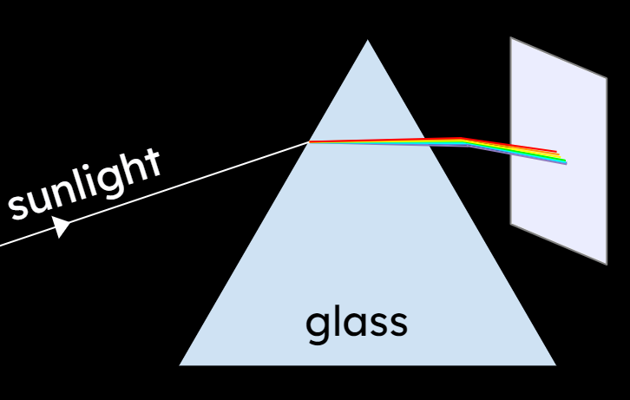
Arka jeegaan (visible spectrum)
Iftiinka qorraxda ayaa loo isticmaalaa in lagu soo saaro jeegaan (visible spectrum) oo shaashad ah.
a
b
c
d
e
barta shaashadda | midabka iftiinka ku dhaca shaashadda oo ka muuqda indhahaaga | unugyada (cone cells) la kiciyay (R/G/B) | midabka barta u muuqda
a
b
c
d
e
1) Buuxi shaxda.
2) Sharax sababta aan qayb ka mid ah shaashadda uga muuqan magenta ( ).

Slide 30
Arka jeegaan (visible spectrum)
1)
a
b
c
d
e
barta shaashadda | midabka iftiinka ku dhaca shaashadda oo ka muuqda indhahaaga | unugyada (cone cells) la kiciyay (R/G/B) | midabka uu dhibcuhu ka soo muuqdo
a | guduud (red) | R | guduud (red)
b | jaalle (yellow) (aqbal orange) | R+G | jaalle (yellow) (aqbal orange)
c | cagaar (green) | G | cagaar (green)
d | cyan (cyan) | G+B | cyan (cyan)
e | buluug (blue) (aqbal indigo/violet) | B | buluug (blue) (aqbal indigo/violet)
2) Sharax sababta aan qayb ka mid ah shaashadda uga muuqan magenta ( ).
Tusaale jawaab: Qayb ka mid ah shaashadda ma milicsanayso iftiin guduud iyo buluug labadaba indhahaaga, si ay u kiciyaan unugyada R+B cone (kaas oo sida magenta loo arko).

Slide 31
Jeegaan (spectrum) muuqda
Iftiin cad (White light)
Arka jeegaan (spectrum) muuqda
Muraayad labaad (second prism)

Slide 32
Muraayad labaad (second prism)
If guduud (red) oo ku dhaca muraayad saddexagal oo hufan ayaa beddelaya jihada.
Ku darista muraayad saddexagal oo labaad oo rogan ayaa dib u celin karta isbeddelada jihada.
Ifka ka soo baxa muraayadda labaad wuxuu ku socdaa jihada la midka ah ifkii asalka ahaa.
Sidaas oo kale ayaa ku dhaci doonta iftiin midab kasta oo kali ah, oo kaliya xaglo isbeddel ah oo yar yar.

Slide 33
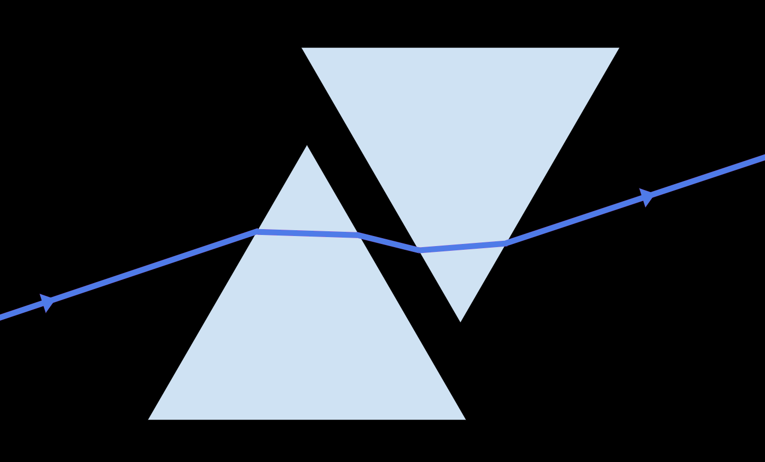
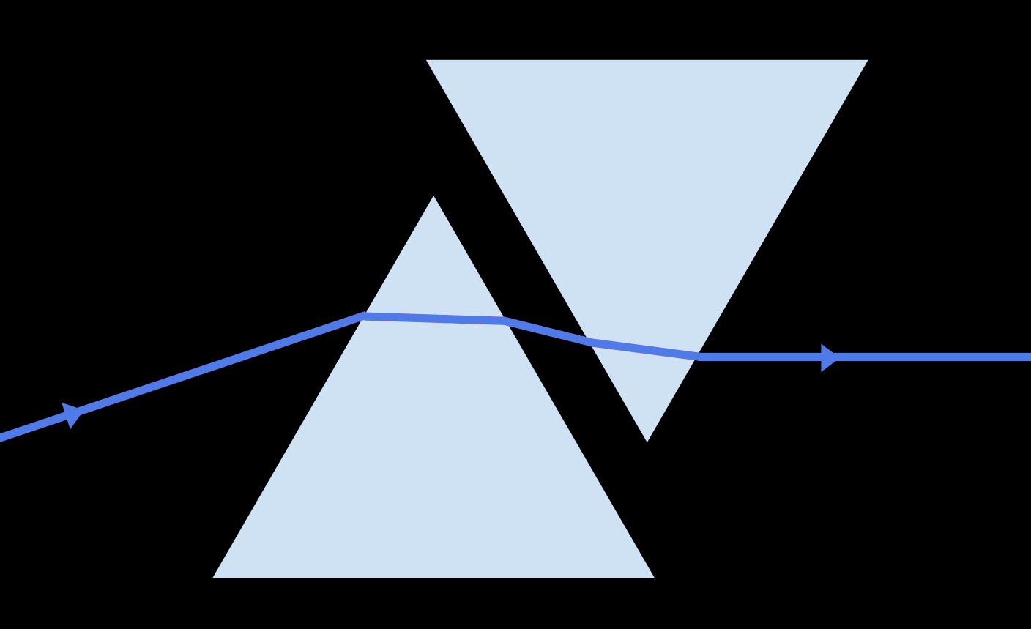
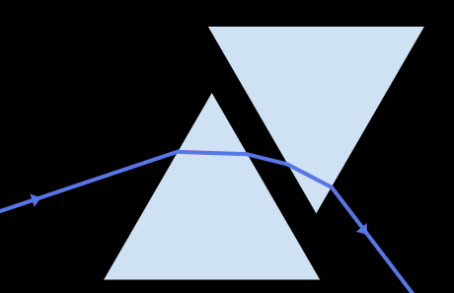
Muraayad labaad (prism)
Jaantuskee ayaa muujinaya sida laba muraayadood (prisms) u rogi doonaan iftiin guduudan (violet light)?
a
b
c

Slide 34
Muraayad labaad (prism)
Saadaali waxa aad u malaynayso inaad arki doonto marka muraayadda labaad (prism) lagu daro sida la tusay. Maxay muraayadda labaad (prism) ku samayn doontaa jeeganka (spectrum)?
Iftiin cad (white light)
?
Sharax sababta aad u malaynayso inaad arki doonto tan.
Daawo muujin (demonstration).
Saadaashaada iyo sharaxaadaadu miyay sax ahaayeen?
Qor sharaxaad horumaraysa oo ku saabsan waxa aad arkay.

Slide 35
Muraayad labaad (prism)
Jawaabo tusaale ah (Example answers).
Muraayadda labaad (prism) waxay ka dhigi doontaa jeeganka iftiinka muuqda (visible light spectrum) mid la waayo oo u rogmi doonta iftiin cad (white light) oo ku socda jihadii asalka ahayd mar kale.
Saadaal (Prediction):
Muraayadda labaad (prism) waxay rogisaa isbeddelada jihada ee ku dhacay midab kasta oo iftiin ah. Sidaas darteed, dhammaan midabada iftiinka mar dambe kuma kala baxaan. Dhammaantood waxay ku dhammaadaan inay wada socdaan jihada isku midka ah.
Isku darka dhammaan midabada iftiinka wuxuu u eg yahay iftiin cad, waana sababta uu ugu soo laabtay iftiin cad (white beam).
Sharaxaad (Sharraxaad):

Slide 36
Jeeganka muuqda (visible spectrum)
Iftiinka cad (white light) ee qorraxda iyo nalalka badan wuxuu ka kooban yahay iftiin dhammaan midabada jeeganka iftiinka muuqda (visible light spectrum) (qaansoroobaad).
Muraayad saddex-geesood ah oo hufan (transparent triangular prism) ayaa kala qaybin kara iftiinka qorraxda oo noqda jeeganka iftiinka muuqda (visible light spectrum).
Jeeganka iftiinka muuqda (visible light spectrum) wuxuu muujinayaa kala duwanaanshaha midabada ee iftiinka yeelan karo.
Waxaa jira saddex nooc oo unugyo koorta (cone cells) ah oo ishii ku yaal oo ogaada midabka (R, G iyo B) mid kastana wuxuu u nugul yahay midabyo iftiin oo kala duwan.
Midabada aan aragno waxay ku xiran tahay unugyada koorta (cone cells) ee kiciya inay calaamad u diraan maskaxda.

