Slide 1
Dhumucda siligga (Thickness of a wire)
Iska caabbinta (Resistance) iyo wareegyada barbar socda (parallel circuits)

Slide 2
Sida agabkeena waxbarista loogu talagalay fasalka

Slide 3
Waxaan qeexi karaa sida batterigu u riixo (push) current-ka siligyo dhumuc kala duwan.

Slide 4
atom (atom)
elektaroon (electron)
bir-ion (metal ion)
iska caabbinta (resistance)
saami ah (proportional)

Slide 5
Atom (atom) waa qaybta ugu yar ee curiye (element) kiimiko oo jira.
Elektaroonnada (Electrons) waa charges-ka ku jira conductors-ka kuwaas oo qulqula si ay u bixiyaan current koronto.
Bir-ion (metal ion) waxaa la sameeyaa marka atom bir ah uu lumiyo hal ama in ka badan oo elektaroon (electron) ah oo uu leeyahay charge togan.
Iska caabbinta (Resistance) waa cabbirka sida ay u adag tahay in current uu qulqulo.
Labo doorsoome (variables) waa saami ah (proportional) haddii midku isbeddelo sida tiro badan oo kan kale.

Slide 6

Dhumucda siligga (Thickness of a wire)
Current-ka siligyo dhumuc kala duwan
Qaab (model) loogu talagalay current koronto

Slide 7
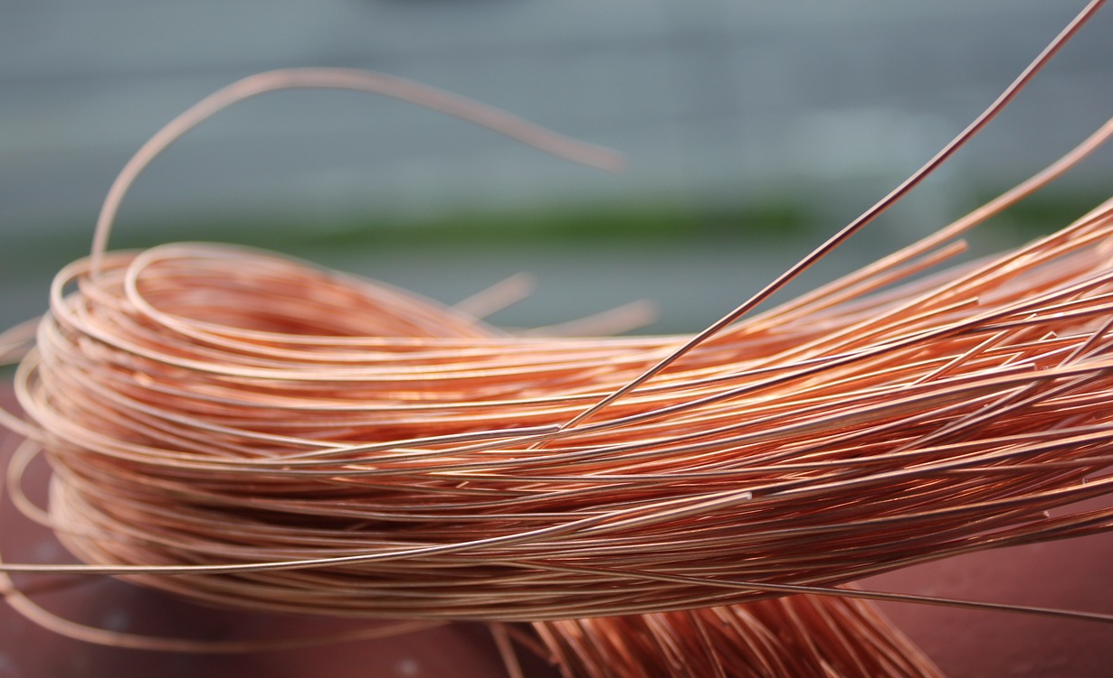
Current-ka siligyo dhumuc kala duwan
Silig naxaas ah (Copper wire) waxaa loo isticmaalaa qalab badan oo koronto ah sababtoo ah waa conductor aad u wanaagsan oo koronto.

Slide 8
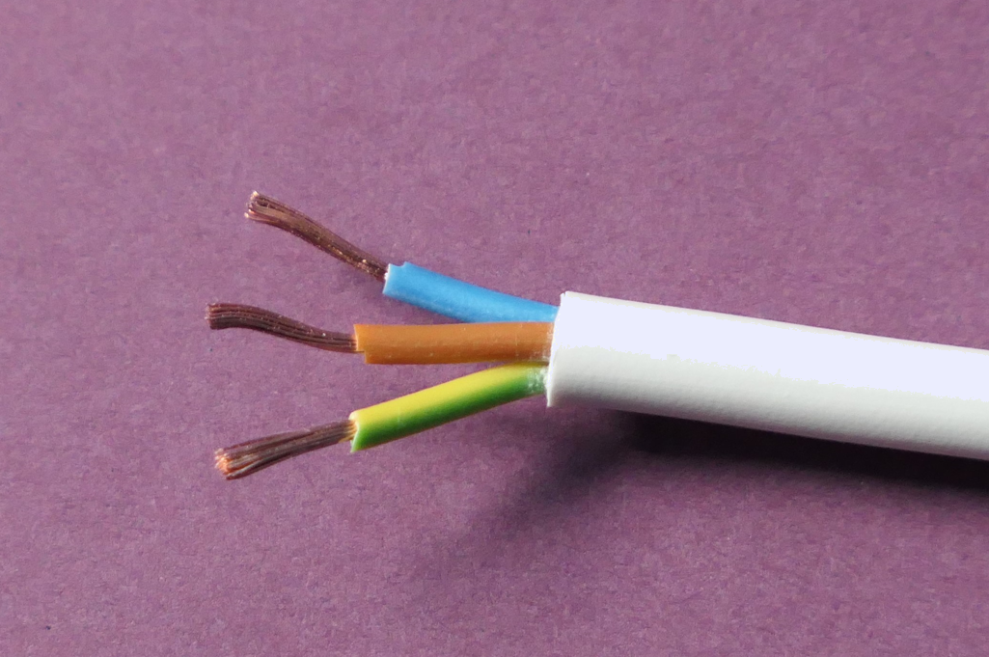
Current-ka siligyo dhumuc kala duwan
Inta badan ma aragno naxaasta (copper) sababtoo ah waa
sida caadiga ah waxaa lagu daboolaa insulation si looga hortago shoogga koronto (electric shocks).
dahaar (insulation)
naxaas (copper)

Slide 9

Koronto (Current) maraya siligyo dhumucdoodu kala duwan tahay
Maxay siligyada naxaasta ah ee qaada korontada guriga loogu daboolay caag midab leh?
si korontadu u socoto si degdeg ah
si looga hortago luminta kulaylka
si looga hortago shoogga korontada (electric shocks)
si ay u caawiyaan shaqaalaha korontada inay aqoonsadaan siligyada

Slide 10
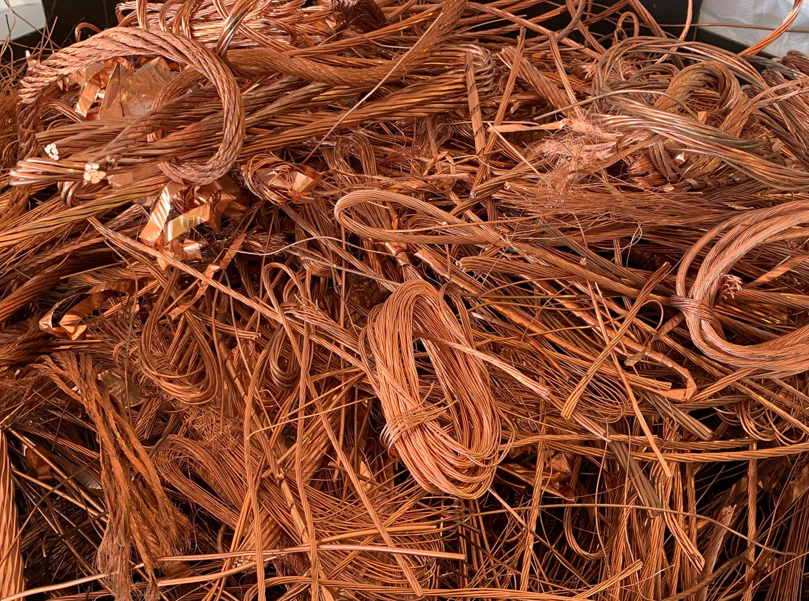
Koronto (Current) maraya siligyo dhumucdoodu kala duwan tahay
Siligyada naxaasta (copper) ah waxaa loo isticmaali karaa qalab badan waxaana laga heli karaa dhumuc kala duwan.
aad u dhuuban
dhumuc weyn
dhexdhexaad

Slide 11

Koronto (Current) maraya siligyo dhumucdoodu kala duwan tahay
Marka elegtaroon (electron) uu ka tago atamka naxaasta (copper) ee gooni ah, wuxuu ka taga ion bir ah (naxaas) oo koronto ku leh (positively charged).
elegtaron (electron)
ion naxaas (copper ion)
Birta dhexdeeda, elegtaroonadu (electrons) si buuxda ugama tagaan atamka laakiin waxay ku sii jiraan meel u dhow.

Slide 12
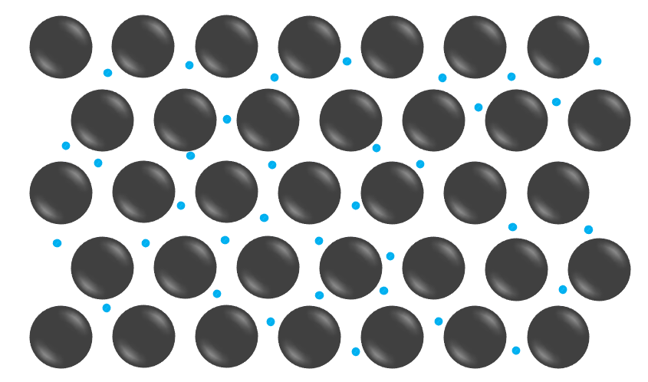
Koronto (Current) maraya siligyo dhumucdoodu kala duwan tahay
Siliga naxaasta (copper) dhexdiisa, waxaa jira ion naxaas (copper ions) oo leh elegtaroono (electrons) oo si dabacsan u haya. Elegtaroonadu (electrons) waxay u dhaqaaqi karaan ion ilaa ion iyo inta u dhaxaysa.
elegtaron (electron)
Qaabkani ma muujinayo kharashyo (charges)
ion naxaas (copper ion)
Ion-ka naxaasta (copper) ayaa ku xidhan meeshooda.

Slide 13
Qulqulka (Current) iyada oo loo marayo silacyo dhumucdoodu kala duwan tahay
Waa maxay kharashka (charge) uu yeelan doono atom-ka naxaasta (copper) haddii uu lumiyo elektaroon (electron)?
toogan (positive)
taban (negative)
kharash la'aan – dhexdhexaad (neutral)

Slide 14
Qulqulka (Current) iyada oo loo marayo silacyo dhumucdoodu kala duwan tahay
Haddii batteri (battery) lagu xiro silaca, cidhifyada
silaca ayaa noqonaya kuwo kharash leh (charged) oo elektaroonnada (electrons) 'dhaqaaqaan' (drift) iyagoo silaca dhex mara, oo ka tallaabsanaya ion ilaa ion.
dhamaadka toogan (positive) ee silaca
dhamaadka taban (negative) ee silaca
socodka kharashka (charge flow)
Badan 'badweynta elektaroonnada' (sea of electrons) ayaa 'dhaqaaqi karta' (drift) silaca dhexdiisa iyada oo ka socota dhamaadka taban (negative) ilaa dhamaadka toogan (positive) ee batteriga (battery), taasoo keenta qulqul (current).

Slide 15
Qulqulka (Current) iyada oo loo marayo silacyo dhumucdoodu kala duwan tahay
Kee ayaa sababa qulqulka (current) birta dhexdeeda?
badweynta elektaroonnada (sea of electrons) ee dhaqaaqaysa
ion-yada dhaqaaqaya
atamka (atoms) sida elektaroonnada (electrons) wata

Slide 16
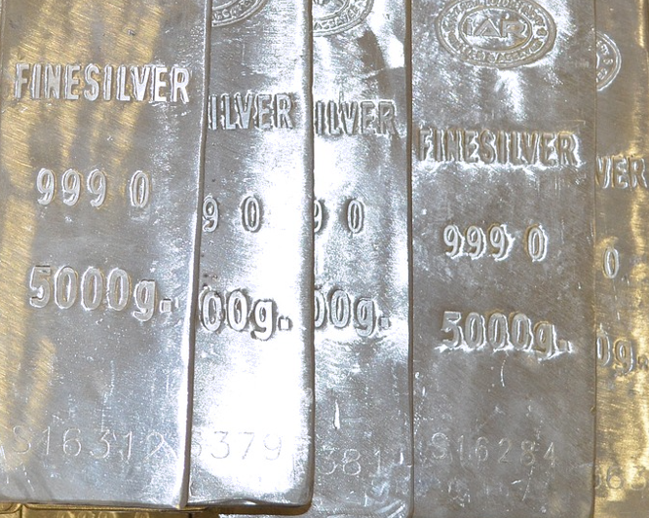
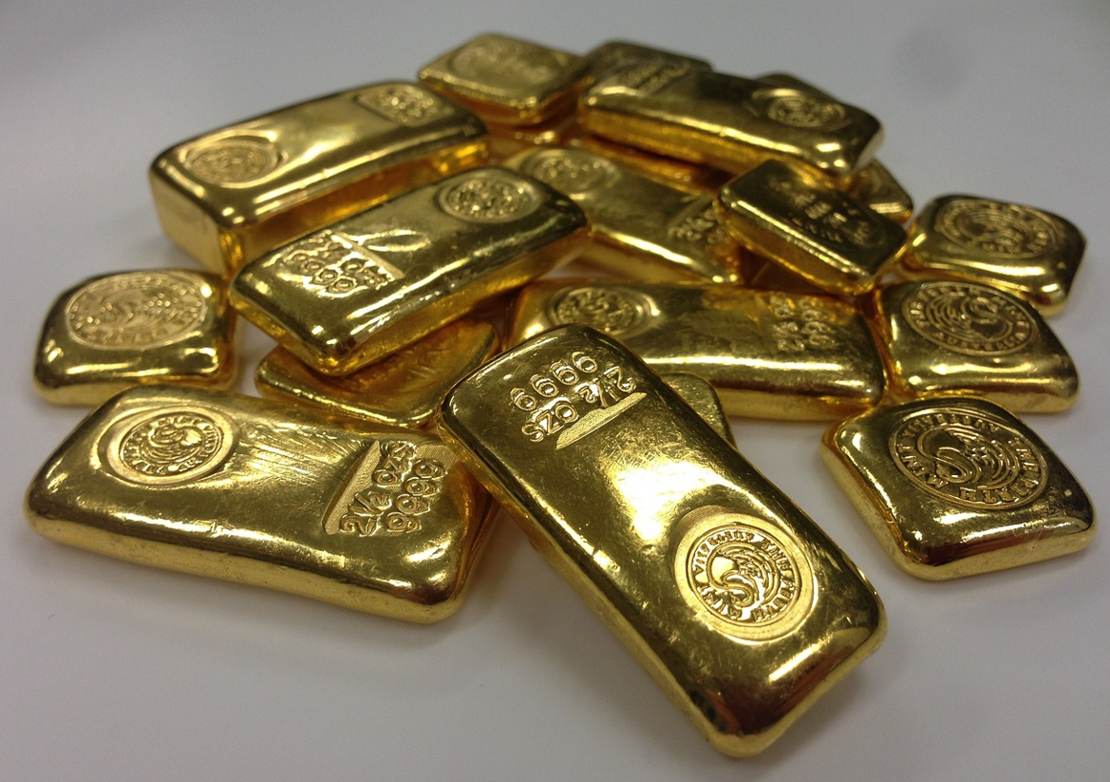
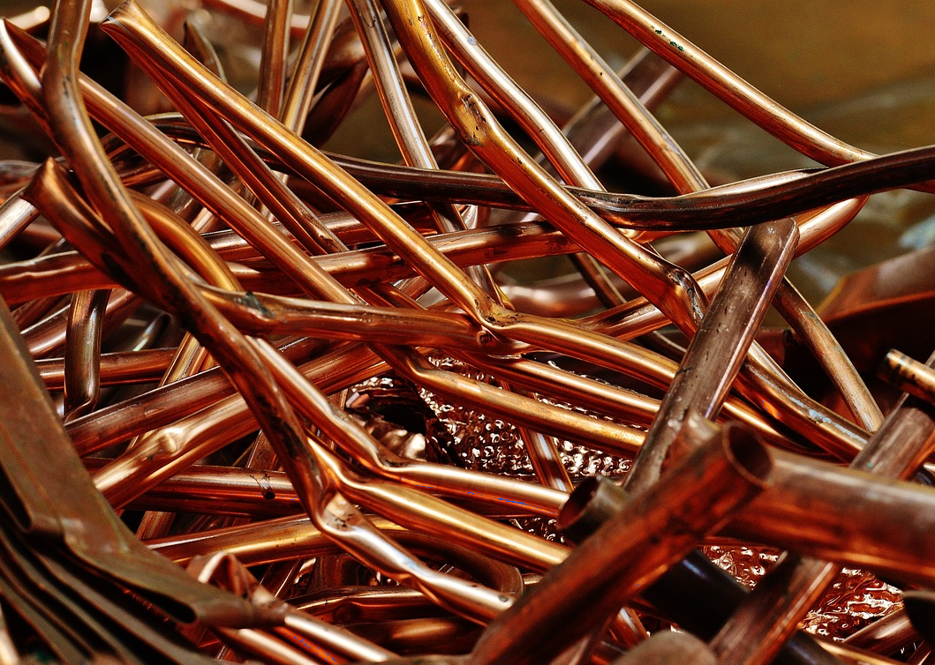
Qulqulka (Current) iyada oo loo marayo silacyo dhumucdoodu kala duwan tahay
Biraha (metals) sida qalinka (silver), naxaasta (copper) iyo dahabka (gold) ayaa ah kuwa ugu fiican ee qaadiya (conductors) oo u oggolaada 'badweynta elektaroonnada' (sea of electrons) inay si sahal ah u dhaqaaqdo.
Tani waxay ugu wacan tahay sida atamka (atoms) birta loo habeeyay, sida elektaroonnada (electrons) loo xidho, iyo sida birta u saafiga (pure) tahay.

Slide 17
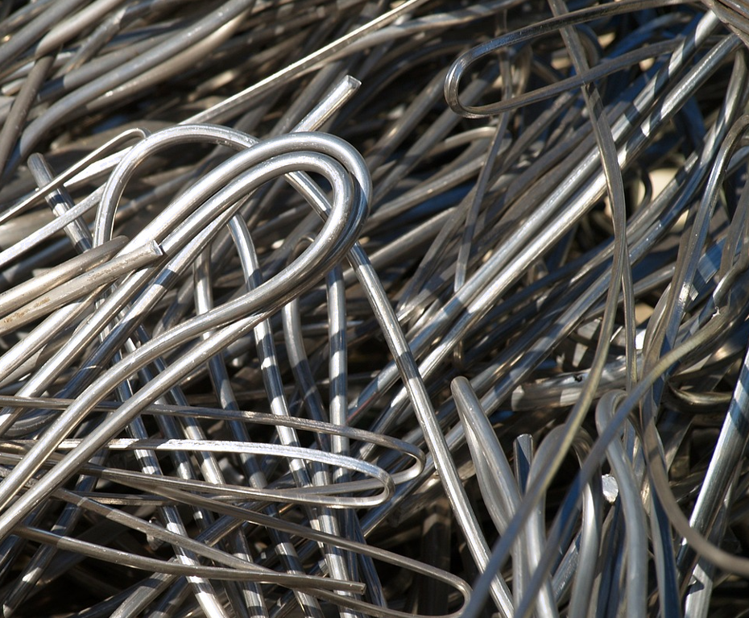
Qulqulka (Current) siligyo dhumucdoodu kala duwan tahay
Biraha qaarkood sida constantan (constantan), nichrome (nichrome) ama bir (steel) sidoo kale waa wadeyaal wanaagsan oo koronto (electricity) ah, laakiin kama wanaagsana lacagta (silver), dahabka (gold) ama naxaasta (copper).
Marka la baarayo iska caabinta (resistance), waxaan inta badan isticmaalnaa siligyo constantan (constantan) ama nichrome (nichrome) sababtoo ah iska caabintoodu (resistance) waa sarreeyaa oo si fudud ayaa loo qiyaasi karaa.

Slide 18
Qulqulka (Current) siligyo dhumucdoodu kala duwan tahay
Siligyadan (dhumuc, qaab iyo dherer isku mid ah) kee baa leh iska caabinta (resistance) ugu sarreysa?
silig dahab (gold wire)
silig constantan (constantan wire)
silig lacag (silver wire)
silig naxaas (copper wire)

Slide 19
Qulqulka (Current) siligyo dhumucdoodu kala duwan tahay
Labadan silig ee naxaasta (copper) ah waa isku dherer.
Siligga dhumucdiisu weyn tahay wuxuu u furan yahay:
atomyo naxaas (copper atoms) oo badan, sidaas darteedna wuxuu leeyahay
elektronno (electrons) badan oo qaadi kara
qulqul (current) weyn.
Marka, siligga dhumucdiisu weyn tahay wuxuu yeelan doonaa iska caabin (resistance) hoose.

Slide 20
Qulqulka (Current) siligyo dhumucdoodu kala duwan tahay
Labadan silig, siligga dhuuban wuxuu leeyahay iska caabin (resistance) yar.
Waxaa jira bir (metal) yar oo uu dhaqaalaha (charge) dhex mari karo.
Waxaa jira ionno bir (metal ions) oo ka yar jidka dhaqaalaha (charge).

Slide 21
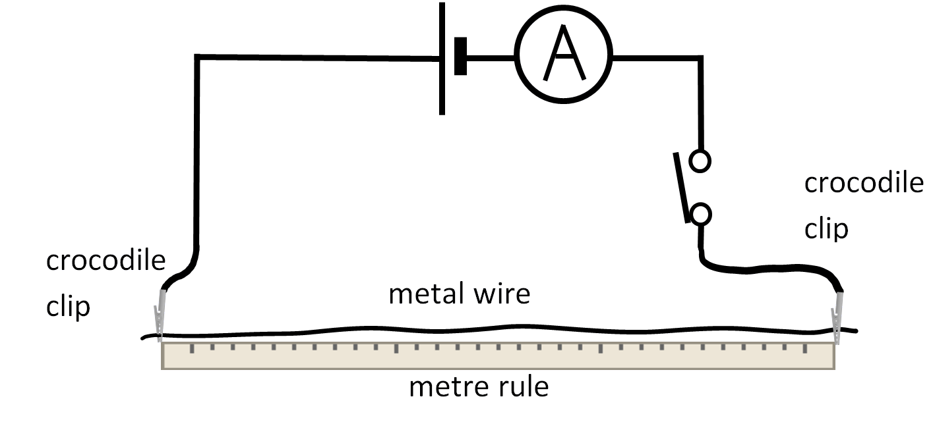
Current (current) ee maraya siligyo dhumucdoodu kala duwan tahay
Tijaabi inta qulqul (current) ee qaadi kara dhumuc kala duwan oo silig ah.
Isticmaal saddex dhumuc oo silig nichrome (nichrome wire) ah.
Isticmaal ammeter (ammeter) si aad u cabbirto current (current) iyada oo loo marayo 1.0 m oo mid kasta ah.
Cabbir current (current) ee maraya silig kasta saddex jeer oo xisaabi celceliska current (current) ee mid kasta.
dhumucda siligga | current (A)
 | 1 | 2 | 3 | celcelis
dhumuc weyn
dhexdhexaad
dhuuban
Sharax waxa aad heshay.
Sharax sida aad u hubisay in natiijooyinkaagu ay yihiin kuwa sax ah oo lagu kalsoonaan karo.

Slide 22
Current (current) ee maraya siligyo dhumucdoodu kala duwan tahay
Natiijooyin tusaale ah:
dhumucda siligga | current (A)
 | 1 | 2 | 3 | celcelis
dhumuc weyn (SWG 30) | 0.477 | 0.472 | 0.481 | 0.477
dhexdhexaad (SWG 36) | 0.179 | 0.180 | 0.175 | 0.178
dhuuban (SWG 38) | 0.111 | 0.055 | 0.113 | 0.112
Qiyaastii labaad ee siliga dhuuban wuxuu ahaa mid aan caadi ahayn (anomalous) marka looma adeegsan xisaabinta celceliska (mean).
1) Sharax waxa aad heshay.
Natiijooyinku waxay muujiyeen in siligga ka dhuuban uu yeesho current (current) hooseeya.
Siligyo dhuuban waxay leeyihiin iska caabin (resistance) sare oo ku saabsan socodka current (current).

Slide 23
Korantada (Current) maraysa siligyo dhumucdoodu kala duwan tahay
2) Sharax sida aad u hubisay in natiijooyinkaagu yihiin kuwa sax ah (accurate) iyo
kuwo la isku halleyn karo (reliable).
Waxaan hubiyay in natiijooyinkaygu yihiin kuwa sax ah (accurate) oo la isku halleyn karo (reliable) anigoo qaaday akhrinno soo noqnoqda (repeat readings) oo ku qiyaasay korantada (current) ilaa saddex meelood oo jajab tobanle ah.
Waxaan raadiyay qiyaaso aan caadi ahayn (anomalous measurements) oo aanan u adeegsan xisaabinta celceliska (mean).
Markii aan qiyaasayay dhererka siliga ilaa 1 mitir, waxaan hubiyay in siligu toosan yahay oo kala goysyada yaxaasta (crocodile clips) ay si sax ah ugu yaalliin dhibcaha 0.0 cm iyo 100.0 cm.
Si looga fogaado in siligu kululaado (overheating), waxaan shiday wareegga (circuit), qaaday akhrinta (reading), oo isla markiiba damiyay.

Slide 24
Dhumucda siliga (Thickness of a wire)
Korantada (Current) maraysa siligyo dhumucdoodu kala duwan tahay
Qaab (Model) loogu talagalay korantada (electric current)

Slide 25
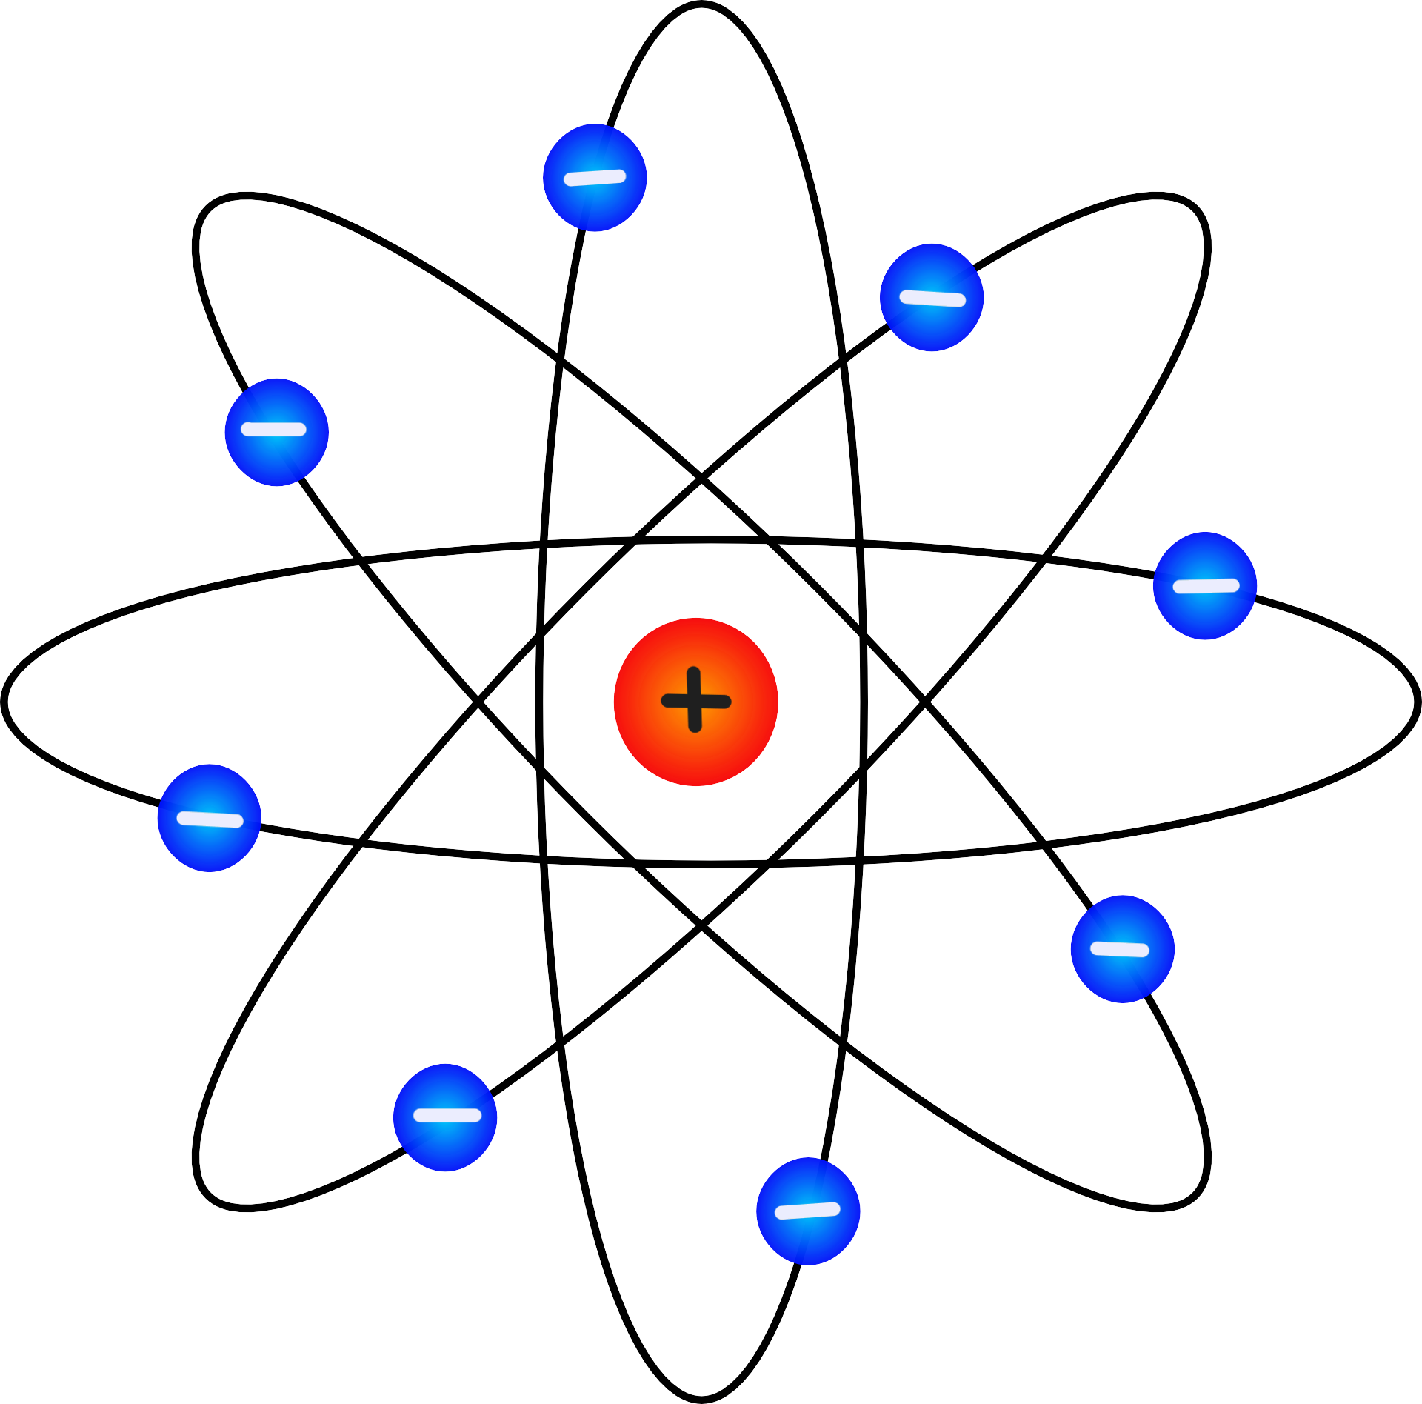
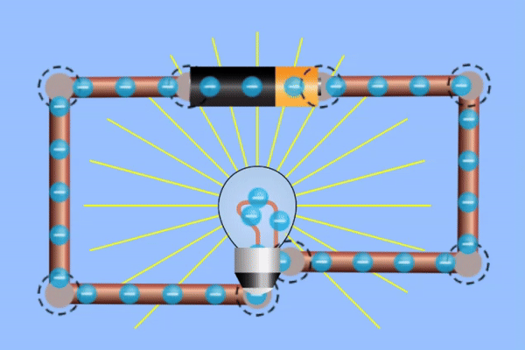
Qaab (Model) loogu talagalay korantada (electric current)
Ma arki karno elektaroonnada (electrons) oo ku qulqulaya siligyo, marka waxaan u adeegsanaa qaabab (models) kala duwan si aan u fahanno korontada (electricity).
Qaabkan (model), elektaroonnada (electrons) waa goobo waaweyn oo ku wareegaya xudunta (nucleus).
Halkan, elektaroonnada (electrons) waxay ku kala firdhiyeen ion-ka birta (metal ions) waxayna xor u yihiin inay socdaan (drift).
Elektaroonnada (electrons) ku jira siligu waxay ku socdaan wareegga (circuit) qaabkan (model).
Midig: Gif Simulation by PhET Interactive Simulations, University of Colorado Boulder, licensed under CC-BY-4.0 (https://phet.colorado.edu)

Slide 26
Qaab (Model) loogu talagalay korantada (electric current)
Tilmaamahaa (statements) ayaa sax ah oo ku saabsan qaabkan (model)?
goobaha buluugga ah waa elektaroonnada (electrons)
goobaha buluugga ah waa borotoonnada (protons)
goobta casaanka ah waa elektaroon (electron)
kubbadda cas waxay leedahay dallac togan (positive charge)

Slide 27
Moodal loogu talagalay koronto socota (electric current)
Yaa run ah oo ku saabsan moodalkan silig naxaasta ah?
waxaa jira elektaroonno xor ah oo ka badan ion-yada
waxaa jira tiro siman oo elektaroonno xor ah iyo ion-yo
waxaa jira ion-yo ka badan elektaroonnada xorta ah

Slide 28
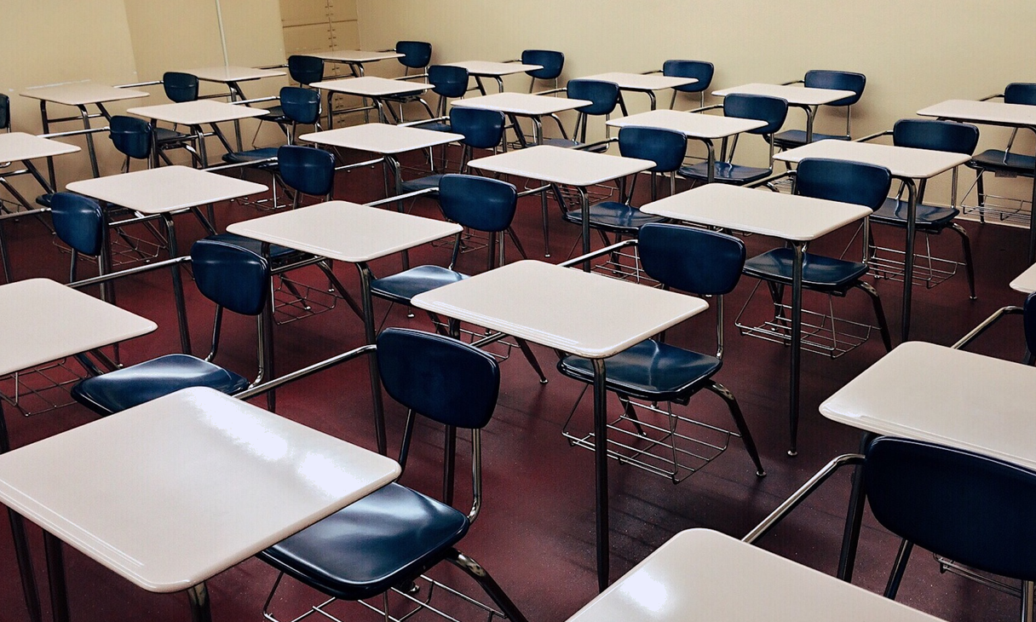
Moodal loogu talagalay koronto socota (electric current)
Moodal kale oo loogu talagalay korontada waa dad lugaynaya oo dhex maraya kuraasta.

Slide 29
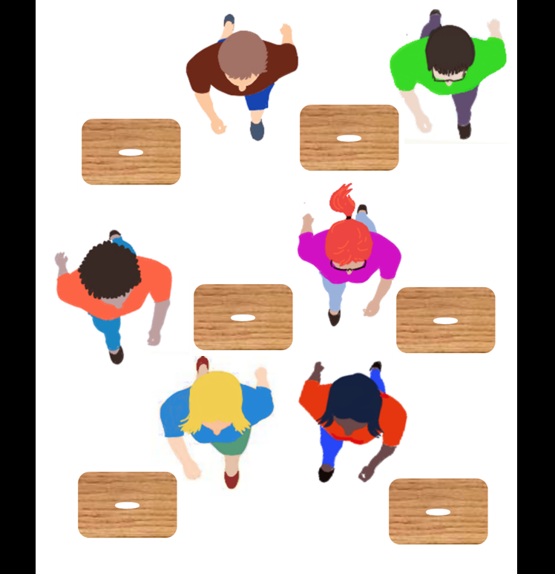
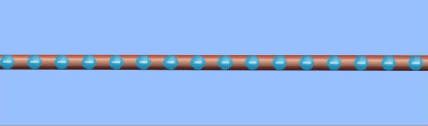
Moodal loogu talagalay koronto socota (electric current)
Dadka dhaqaaqaya waxay la mid yihiin qulqulka dallaca (charge) ee socda.
kursi alwaax ah oo la mid ah ion
elektaroonnada ku jira silig
qulqulka dallaca (charge flow)
qof la mid ah elektaroon (electron)
Midig: Gif Simulation by PhET Interactive Simulations, University of Colorado Boulder, licensed under CC-BY-4.0 (https://phet.colorado.edu)

Slide 30
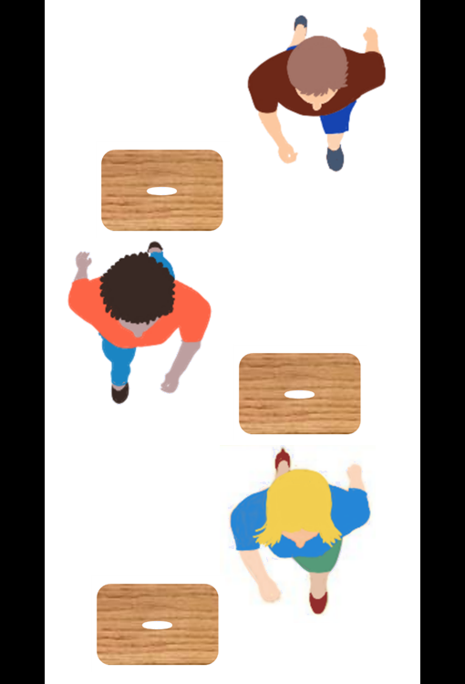
Moodal loogu talagalay koronto socota (electric current)
Meel cidhiidhi ah, dad yar ayaa mara waqti kasta.
godadku waa yar yihiin
kuraastu way hor istaagaan
Tani waxay la mid tahay iska caabin sare (high resistance) iyo koronto hoose (low current) oo ku jira silig khafiif ah.

Slide 31
Moodal loogu talagalay koronto socota (electric current)
Meel ballaadhan, dad badan ayaa mari kara.
Tani waxay la mid tahay iska caabin (resistance) hoose iyo haddana (current) sare oo ku jira silig ballaadhan.

Slide 32
Moodeel (model) loogu talagalay haddana (electric current)
Waa kuwee odhaahyada saxda ah ee ku saabsan moodeelka dadka iyo kuraasta?
kuraastu waxay matalaan socodka (flow) ee dallacaadda (charge)
kuraastu waxay matalaan ion-yada (ions)
dadku waxay matalaan elektaroonnada (electrons)
dadka ayaa ka badan kuraasta

Slide 33
Moodeel (model) loogu talagalay haddana (electric current)
Moodeellada (models) korontadu waxay noqon karaan kuwo waxtar leh laakiin sidoo kale waxay noqon karaan kuwo marin habaabinaya.
faa'iidooyinka | khasaarooyinka
waxay ka caawiyaan in la sawiro (visualise) wax aanan arki karin, tusaale ahaan elektaroonnada (electrons)
waxaan inta badan u isticmaalnaa goobooyin (spheres) elektaroonnada (electrons), laakiin elektaroonnadu ma aha sidaas
waxay isticmaalaan waxyaabo aan fahamno si ay u sharaxaan fikrado aan la taaban karin (abstract)
waxay si khaldan u matali karaan fikradda saxda ah
waxay fududeeyaan fikrado adag
waxay si aad u fudud u matali karaan fikrado
Moodeello (models) kala duwan ayaa loo isticmaali karaa in lagu sharaxo fikradda isku midka ah.

Slide 34
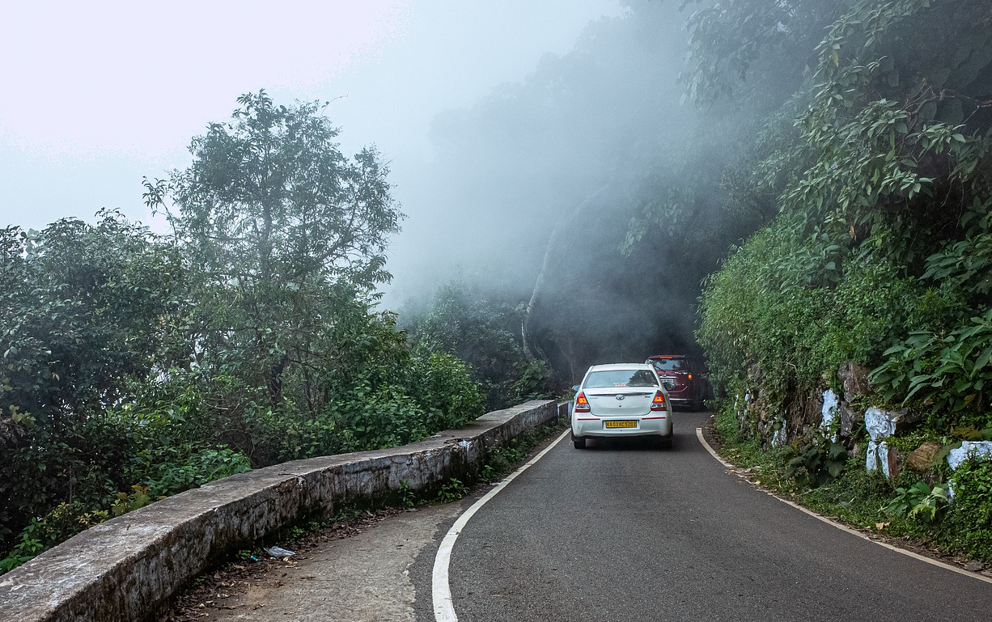
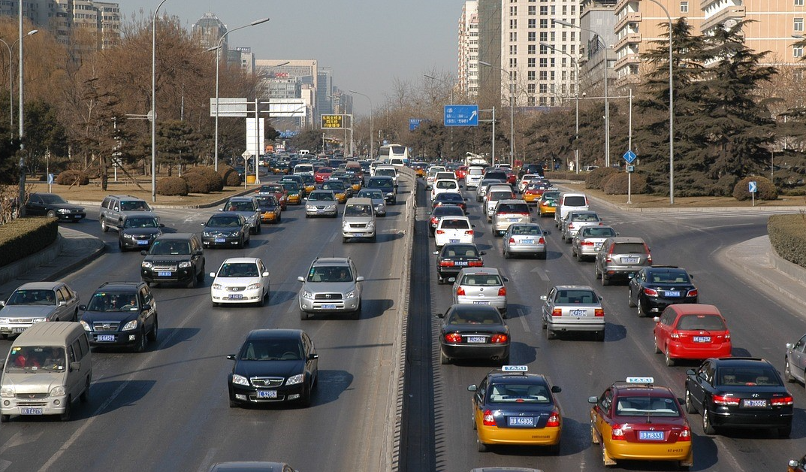
Moodeel (model) loogu talagalay haddana (electric current)
Moodeel (model) kale ayaa isticmaala waddo iyo baabuur si ay u matalaan haddana (electric current).
Waddo cidhiidhi ah waxay la mid tahay silig dhuuban oo u oggolaanaya dhawr baabuur oo keliya inay dhex maraan.
Waddo ballaadhan waxay la mid tahay silig qaro weyn oo u oggolaanaya baabuur badan inay dhex maraan.

Slide 35
Moodeelka socodka korantada (electric current)
Qiimaynta moodeelka wadooyinka iyo baabuurta.
Faa'iidooyinka:
Waxaan isticmaalnaa wadooyinka mar walba waana kuwo aan yaqaan.
Ballaca wadooyinka wuxuu la mid yahay dhumucda fiilada.
Baabuurta waxay la mid yihiin elektaroonnada (electrons).
Darawalada baabuurta waxay iska fogaadaan baabuurta kale, elektaroonnadu way is celiyaan.
Qasaarooyinka:
Ion-ka naxaasta ee fiilada laguma muujin.
Baabuurta si fudud ayay uga baxaan wadada, elektaroonnadu waxay ku sii jiraan fiilada.
Baabuurta aad bay uga yar yihiin elektaroonnada ku jira fiilada.
Darawalada baabuurta waxay doortaan meesha ay tagaan, elektaroonnada waxaa riixa hal jiho batteriga (battery).

Slide 36
Moodeelka socodka korantada (electric current)
Yaa sheegaya faa'iidada moodeelka wadooyinka iyo baabuurta?
darawalada baabuurta waxay dooran karaan meelaha ay tagaan
baabuurta waxay ka bixi karaan wadada
baabuurta way ka yar yihiin elektaroonnada
wadooyinka waa kuwo aan yaqaan

Slide 37
Moodeelka socodka korantada (electric current)
Bedka isgoysyada fiiladan waa 'A'.
bedka A
Haddii bedka la labanlaabo, waxay qaadi kartaa laba jeer socodka (current).
2A
Iskaabixu (resistance) wuxuu noqon doonaa nus (halved).

Slide 38
Qaab (model) loogu talagalay socodka korantada (electric current)
Waa maxay iskaabixu (resistance) ee siliga dhumucdiisu weyn tahay?
silig dhuuban: iskaabixu (resistance) 8 Ω
silig dhumucdiisu weyn tahay
8 Ω
4 Ω
2 Ω

Slide 39
Qaab (model) loogu talagalay socodka korantada (electric current)
Haddii isku danab (voltage) la isticmaalo, socodka korantadu (current) wuxuu ku xiran yahay bedka (area).
Haddii bedku (area) kordho ⨉2, socodka korantadu (current) wuxuu kordhaa ⨉2.
1 Amp
2 Amps
Haddii bedku (area) kordho ⨉3, socodka korantadu (current) wuxuu kordhaa ⨉3.
1 Amp
3 Amps
Socodka korantadu (current) wuxuu u dhigmaa (proportional) bedka (area), wuxuu kordhaa isla qaddarka.

Slide 40
Qaab (model) loogu talagalay socodka korantada (electric current)
Waa maxay socodka korantada (current) ee siliga dhuuban (haddii isku danab (voltage) lagu dabaqo)?
silig dhumucdiisu weyn tahay: socodka korantada (current) 16 A
silig dhuuban
8 A
4 A
2 A

Slide 41
Qaab (model) loogu talagalay socodka korantada (electric current)
1) Bixi saddex faa'iido oo ah qaabka (model) dadka iyo kuraasta.
2) Waa maxay saddex shay oo aan si fiican ugu habboonayn?

Slide 42
Qaab (model) loogu talagalay socodka korantada (electric current)
1) Bixi saddex faa'iido oo ah moodeelka dadka iyo kuraasta.
Dadku waxay yaqaaniin kuraasta qolka, waxayna si fudud u isticmaali karaan.
Kuraastu waxay hor istaagaan dadka, sida atomiga (atoms) hor istaaga elektaroonada (electrons).
Inta lagu jiro ciyaarta doorka (role play), waxay tijaabin karaan xaalado kala duwan si ay u arkaan saameynta.
2) Waa maxay saddex shay oo aan si fiican u qummanayn?
Waxaa jira arday aad uga yar elektaroonada (electrons).
Ardaydu waxay leeyihiin doorasho halkay tagaan, elektaroonadu (electrons) waxay ka tagaan taban (negative) ilaa togan (positive).
Waxaa jira meelo bannaan oo weyn oo u dhexeeya kuraasta; fiilooyinka meelaha bannaan iyo elektaroonadu (electrons) aad bay u yar yihiin.
Qolku wuxuu yeelan doonaa gidaarro ku haysta ardayda, fiiladu uma baahna gidaarro.

Slide 43
Dhumucda fiilada (thickness of a wire)
'Bad elektaroonada (sea of electrons)' waxay 'dhex socon kartaa' fiilo, u dhexaysa iyoonada birta (metal ions), laga bilaabo taban (negative) ilaa dhamaadka togan (positive) taasoo keenta koronto (current).
Kordhinta dhumucda fiilada, waxay kordhisaa bedka isgoysyada (cross-sectional area) taasoo kordhisa tirada elektaroonada (electrons) ee qaadi kara koronto (current).
Korontada (current) la qaadi karo waxay u dhigantaa bedka isgoysyada (cross-sectional area) ee fiilada. Sidaa darteed, labanlaabista bedka waxay labanlaabin doontaa korontada (current).
Moodello kala duwan ayaa faa'iido u leh sharaxaadda sida korontadu (current) u dhaqanto.

