Slide 1
Tababbarid iyo tijaabin moodel (model)
Barashada mashiinka (machine learning) iyadoo la isticmaalayo micro:bit

Slide 2
Sida agabkeena waxbarista loogu talagalay fasalka

Slide 3
Waxaan tababbari karaa moodel (model) barashada mashiinka (machine learning) waxaana tijaabin karaa saadaasha (predictions) moodelka.

Slide 4
xogta tababarka (training data)
tusaalayaal loo isticmaalo in lagu baro moodelka (model) barashada mashiinka (machine learning) sida loo aqoonsado qaababka (patterns)
saadaal (prediction)
wax soo saarka uu moodelku (model) sameeyo isagoo ku salaynaya qaababka (patterns) laga helay xogta tababarka (training data)
kalsooni (confidence)
cabirka sida ay u badan tahay in wax soo saarka moodelku (model) sax yahay
eex (bias)
si aan caadi ahayn u doorbidid hal dhinac, koox, ama natiijo marka loo eego kuwa kale
ka-baxsan (outlier)
dhibic xogeed (data point) oo si weyn uga duwan inta kale ee xogta ku jirta xogta (data set)

Slide 5

Tababbarid iyo tijaabin moodel (model)
Aqoonso in moodellada (models) ay isticmaalaan qaabab (patterns) si ay u sameeyaan saadaal (predictions)
Tijaabi in wax soo saarka moodelka (model) la filayo
Aqoonso astaamaha xogta tayada hoose

Slide 6
Aqoonso in moodellada (models) ay isticmaalaan qaabab (patterns) si ay u sameeyaan saadaal (predictions)
Waxaa jira noocyo badan oo kala duwan oo moodello (models) barashada mashiinka (machine learning) ah.
Kala-saaraha AI (AI classifier) waa algorithm (algorithm) barashada mashiinka (machine learning) kaas oo xogta u kala saara kooxo. Kadibna wuxuu koox kasta u magacaabaa fasalka (class).

Slide 7
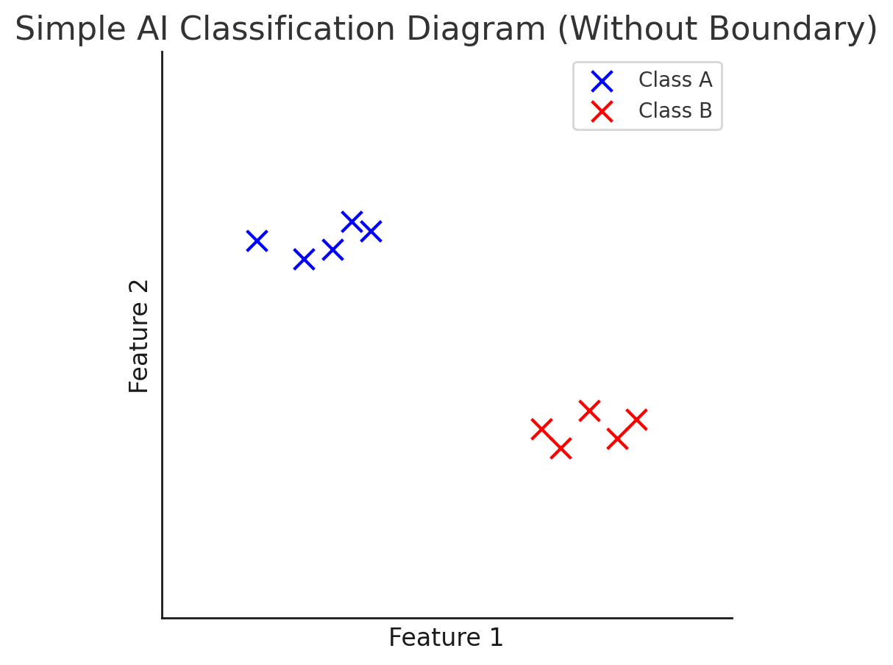
Recognise models use patterns to make predictions
Kala-saaruhu (classifier) wuxuu 'bartaa' isagoo helaya qaabab (patterns) ku jira xogta tababarkiisa (training data).
Software-ku wuxuu falanqeeyaa qaababka (patterns) u dhexeeya muunadaha (samples) wuxuuna u kala saaraa fasallo (classes).

Slide 8
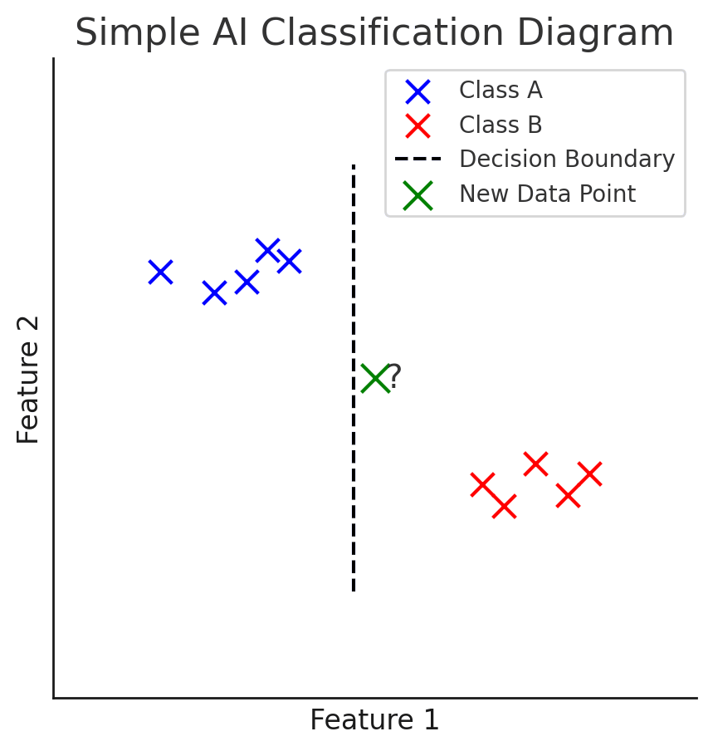
Recognise models use patterns to make predictions
Marka uu aqoonsado qaababka gudaha fasalka iyo inta u dhexeysa, classifier-ku wuxuu dhisi karaa model wuxuuna saadaalin karaa fasalka ay xogta cusubi ka tirsan tahay isagoo adeegsanaya xuduudaha (boundaries) ama sharciyada kala saaraya.

Slide 9

Recognise models use patterns to make predictions
A classifier analyses patterns between samples.
Why?
Muunadaha leh qaabab isku mid ah waxaa lagu koobi karaa fasalka.

Slide 10
Recognise models use patterns to make predictions
A classifier analyses patterns between classes.
Why?
The classifier is created by analysing the patterns of data in each class. Once the classifier has been created, new items of data are analysed by the classifier for the classifier to make a prediction of which class the new data belongs to.

Slide 11
Recognise models use patterns to make predictions
Sharax sida xogta cusubi loo kala saaro.
You could use these keywords:
boundaries
predict
class

Slide 12
Recognise models use patterns to make predictions
Sharax sida xogta cusubi loo kala saaro.
You could use these keywords:
boundaries
saadaali (predict)
fasal (class)
Kala-saare (classifier) wuxuu isticmaalaa xuduudaha (boundaries) ee model-ka si uu u saadaaliyo (predict) fasalka (class) xogta cusubi ay tahay inay iska leedahay.

Slide 13
Tababarka (training) iyo tijaabinta (testing) model-ka
Gartay in models-ku ay isticmaalaan qaabab (patterns) si ay u sameeyaan saadaalin (predictions)
Tijaabi in wax soo saarka (outputs) model-ka ay yihiin kuwa la filayo
Aqoonsi sifooyinka xogta tayadoodu liidato (poor quality data)

Slide 14
Tijaabi in wax soo saarka (outputs) model-ka ay yihiin kuwa la filayo
Tag: oak.link/createai
Ka sii wad halkaad ka tagtay.
Ama:
  fur kalfadhigaagii (session) ugu dambeeyay, ama
  si wad kalfadhiga (session) aad badbaadisay daraskii hore
Fiiro: haddii aadan haysan kalfadhi (session) jira, waxaad isticmaali kartaa faylka muunada xogta (data sample file) ee la bixiyay sida il dheeri ah.

Slide 15
Tijaabi in wax soo saarka (outputs) model-ka ay yihiin kuwa la filayo
Tababar (train) model-kaaga.
Guji badhanka buluuga ah ee 'Train model'.

Slide 16
Tijaabi in soosaarka moodelku yahay mid la filayo
Tijaabi in model-kaagu u shaqeeyo sidii la filayo.
Fiiro: hubi in micro:bit-ku ku xiran yahay.
Samee mid ka mid ah dhaqdhaqaaqyadaada (movements) si fiican oo eeg fasalka (class) uu model-ku saadaaliyo (predict) in ficilku u dhigmaayo.
Samee mid ka mid ah dhaqdhaqaaqyadaada (movements) si xun oo eeg fasalka (class) uu model-ku saadaaliyo (predict) in ficilku u dhigmaayo.
Waxaad arki doontaa buundooyinka kalsoonida (confidence) ee ficilkaaga.

Slide 17
Tijaabi in soosaarka moodelku yahay mid la filayo
Weydii qof kale inuu tijaabiyo moodelkaaga.
Ma helayaan buundooyin kalsooni (confidence scores) isku mid ah ama kala duwan?

Slide 18

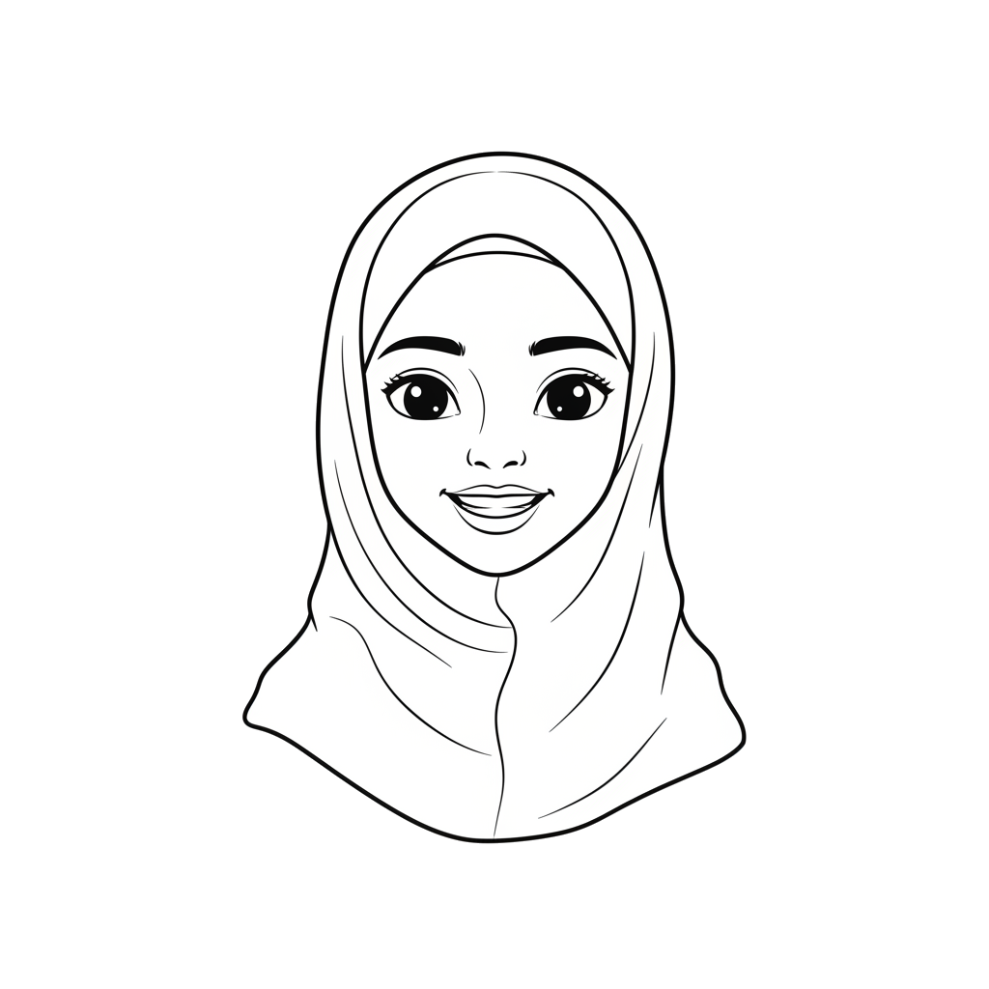
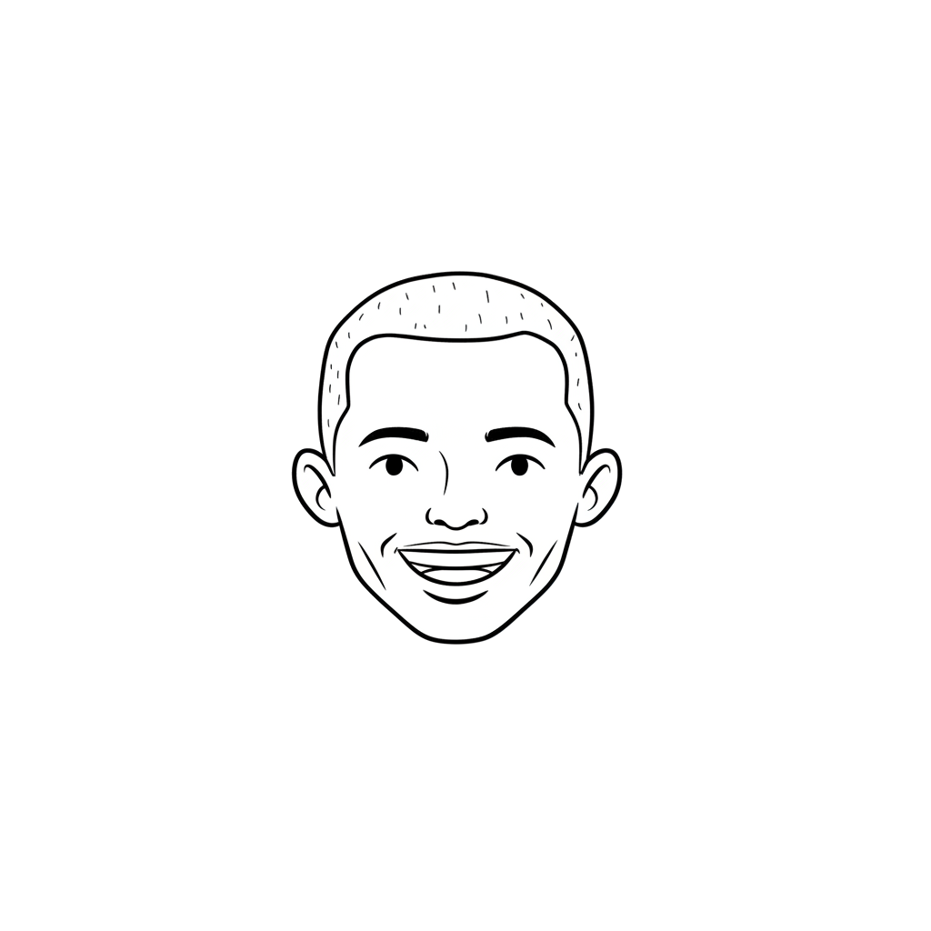



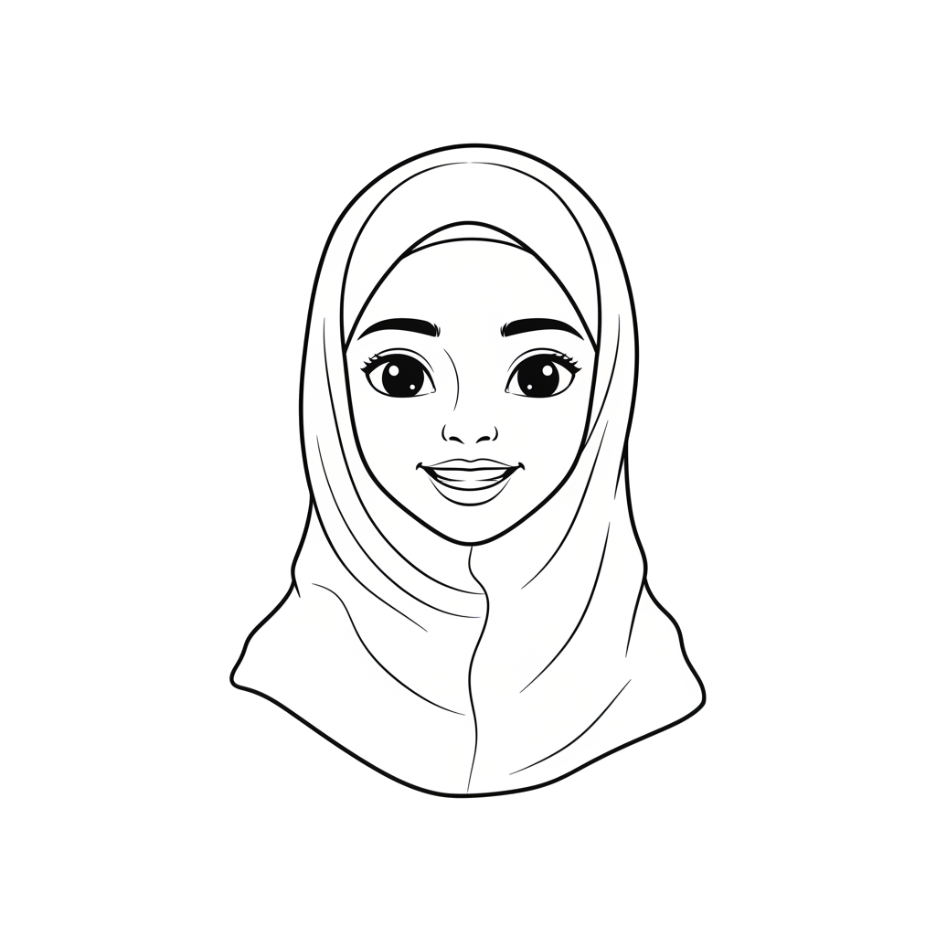
Tijaabi in soosaarka moodelku yahay mid la filayo
Waa maxay muhiimadda ay leedahay inaad moodelkaaga ku tijaabiso dad kale?
Qof kastoo dhaqdhaqaaq (movement) isku mid ah kuma socdo.
Dhaqdhaqaaq (movement) wanaagsan oo qof loogu talagalay ayaa laga yaabaa inuu noqdo dhaqdhaqaaq (movement) xun oo qof kale.
Helista tusaalooyin xogeed oo kala duwan (diverse data samples) waxay yaraynaysaa khatarta ah in la soo geliyo eex xogeed (data bias) gudaha moodelka.
Isra
Cabdi

Slide 19
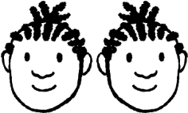
Tijaabi in soosaarka moodelku yahay mid la filayo
Xog tababbar oo eex leh (Bias training data)
Waa maxay muhiimadda ay leedahay in la yareeyo eexda xogeed (data bias)?
Eexda xogeed (Data bias) waxay u horseedi kartaa gabagabo qaldan ama go'aanno cadaalad darro ah.
Cabdi
Yacquub

Slide 20
Tijaabi in soosaarka moodelku yahay mid la filayo
Maxay nidaamku u isticmaalay xog tababbar (training data)?
tusaalooyin dhaqdhaqaaq (movement) oo la calaamadeeyay (labelled samples)
magacyada fasalka (class names)
wadarta wakhtiga loo baahan yahay si tusaalooyinka oo dhan loo dib u ciyaaro (play back)

Slide 21
Tijaabi in wax soo saarka moodeelka (model) uu yahay mid la filayo
Sidee baad ku tijaabisay in moodeelku (model) uu u shaqeeyo sidii la filayay?
wuxuu hubiyay in dhammaan qiimayaashu ay la mid yihiin xogta tababarka (training data)
wuxuu arkay dhaqdhaqaaq (movement) la filayay garaafka
wuxuu hubiyay kalsoonida saadaasha (prediction)

Slide 22
Tijaabi in wax soo saarka moodeelka (model) uu yahay mid la filayo
Sharax sababta saadaasha (prediction) moodeelka (model) ay u noqon karto mid qalad ah.

Slide 23
Tijaabi in wax soo saarka moodeelka (model) uu yahay mid la filayo
Sharax sababta saadaasha (prediction) moodeelka (model) ay u noqon karto mid qalad ah.
Waxa la geliyo (input) ayaa laga yaabaa inaysan la mid ahayn qaababka (patterns) laga helay xogta tababarka (training data).

Slide 24
Tababarka iyo tijaabinta moodeelka (model)
Garow in moodeelada (models) ay isticmaalaan qaabab (patterns) si ay u sameeyaan saadaal (predictions)
Tijaabi in wax soo saarka moodeelka (model) uu yahay mid la filayo
Aqoonso astaamaha xogta tayadoodu hooseyso (poor-quality data)

Slide 25
Aqoonso astaamaha xogta tayadoodu hooseyso (poor-quality data)
Waxaad haysataa 10 muunadood (samples).
Ku darista xog tababar (training data) oo dheeri ah waxay ka caawin kartaa nidaamka inuu dhiso moodeel (model) sax ah, maxaa yeelay waxaa jira xog badan oo la isbarbardhigi karo si loo helo qaabab (patterns).

Slide 26
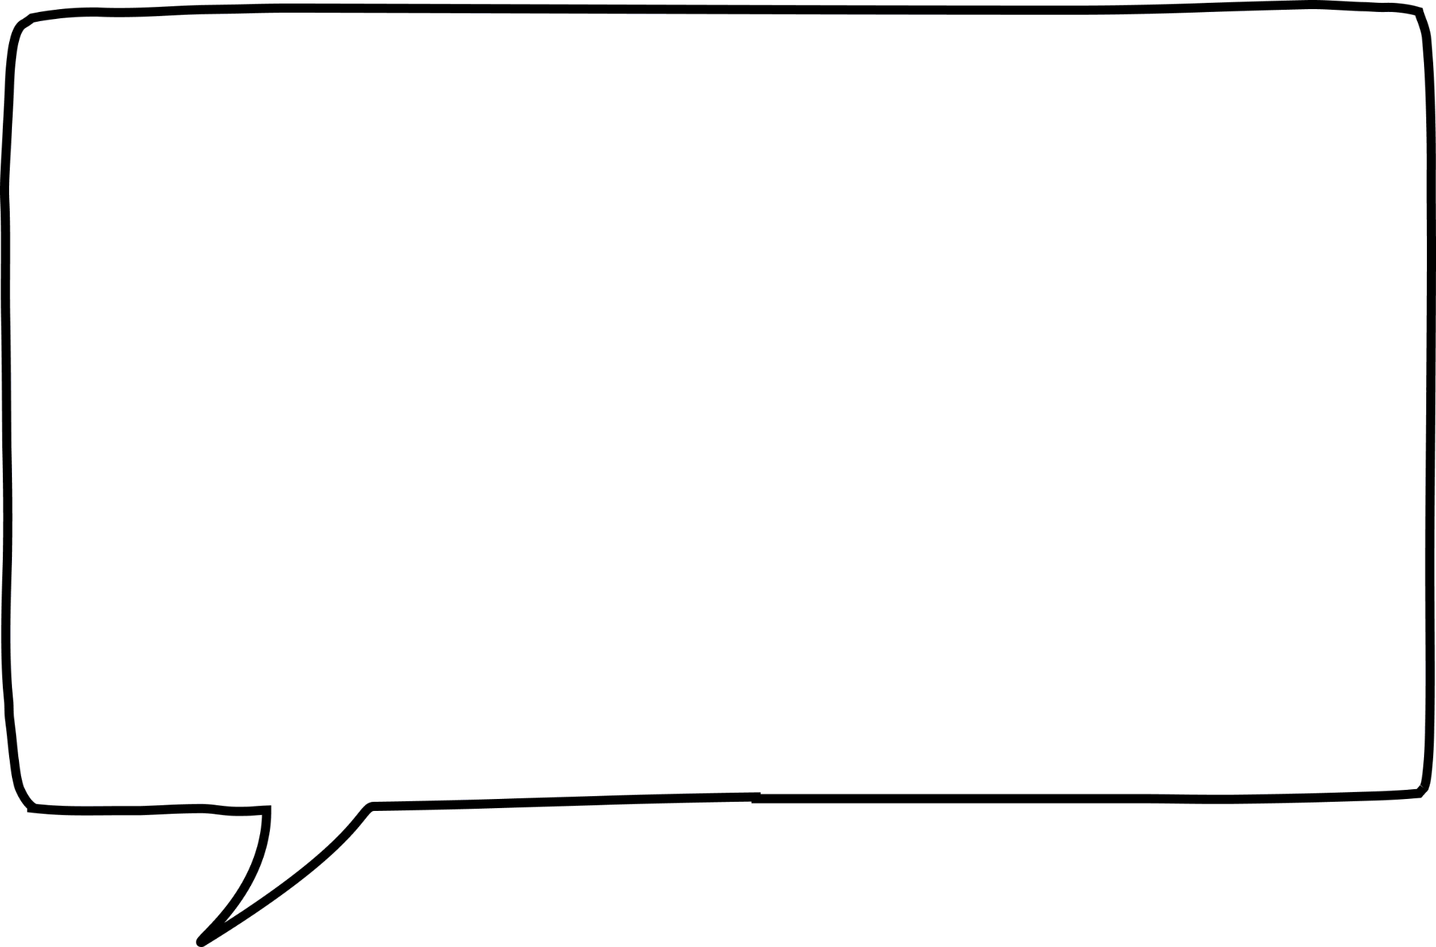
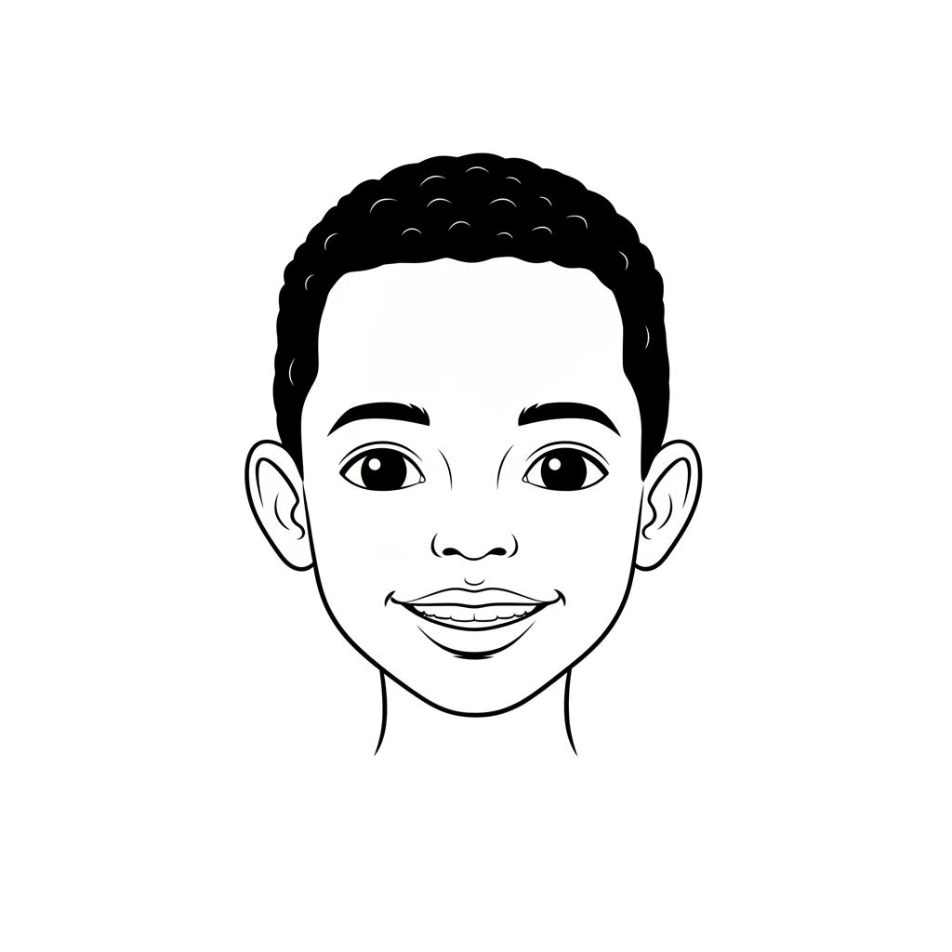
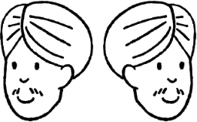
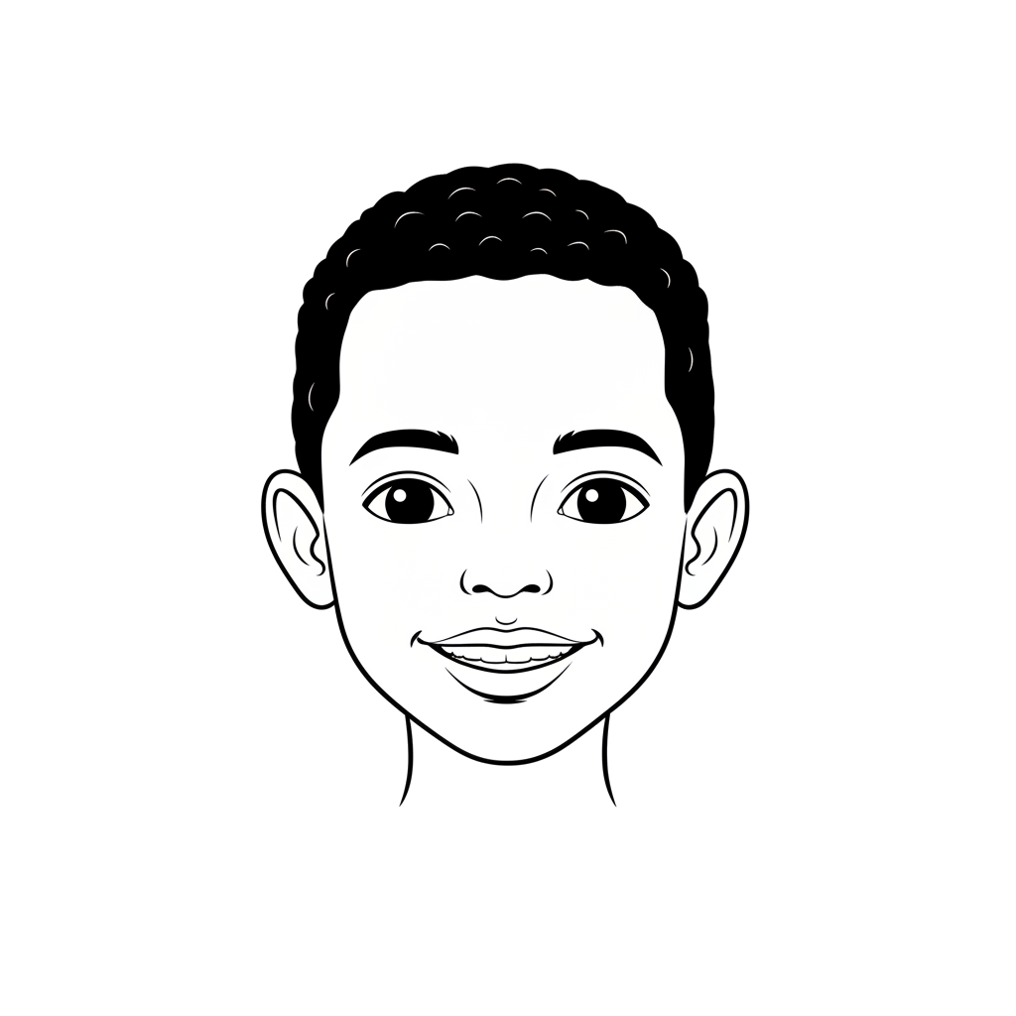
Aqoonso astaamaha xogta tayadoodu hooseyso (poor-quality data)
Raadi kuwa ka baxsan (outliers) xogtaada tababarka (training data).
Qaar ka mid ah muunadahayga (samples) ayaa u eg kuwa kale.
Qaabka ka baxsan (outlier) waa muunad si weyn uga duwan muunadaha kale.
Ma dib uga bilowday ficil (action)?
Ma mid ka mid ah ficillada (actions) ayaan u sax ahayn sida kuwa kale?
Cabdi
Cali

Slide 27
Aqoonso astaamaha xogta tayadeedu liidato (poor-quality data)
Maxaa dhacaya marka uusan jirin dhaqdhaqaaq (movement)?
Qaabkaygu (model) wali wuu saadaaliyaa, laakiin saadaashu waa qiyaas (uncertain).
Yacquub
Qaabkaygu (model) wali wuxuu hubaa in dhaqdhaqaaqaygu (movement) ku habboon yahay fasalka (class).
Qaabku (model) wuxuu u kala saaraa (classifies) gelin kasta (input) mid ka mid ah fasallada (classes) jira, xitaa haddii xogta (data) aysan si fiican ugu habboonayn fasalka.
Qaabab badan (models) waxay soo saaraan itimaal (probabilities) oo waa inay isku geeyaan 100%. Fasalka itimaalkiisu ugu sarreeyo (highest probability class) ayaa la doortaa, xitaa haddii uu wax yar kaga fiican yahay kan kale.
Isra

Slide 28
Aqoonso astaamaha xogta tayadeedu liidato (poor-quality data)
Kee ka mid ah kuwani wuxuu u horseedi karaa saadaal tayo liidata (poor quality predictions)?
muunado dhammaantood isku dherer ah (samples all the same length)
muunado badan (lots of samples)
tiro xaddidan oo fasallo ah (limited number of classes)

Slide 29
Aqoonso astaamaha xogta tayadeedu liidato (poor-quality data)
Kee ka mid ah kuwani waa astaanta xogta tayadeedu liidato (poor quality data)?
Saadaashu (predictions) way isbeddeshaa marka xog cusub (new data) soo gasho.
Qaar ka mid ah muunadaha (samples) waa kuwa ka baxsan (outliers).
Heerarka kalsoonida (confidence scores) waa sarreeyaan.

Slide 30
Aqoonsi sifooyinka xogta tayadoodu hooseyso
Sharax sababta qaabku (model) u saadaalin karo marka aan dhaqdhaqaaq (movement) la ogaan (detected).

Slide 31
Aqoonsi sifooyinka xogta tayadoodu hooseyso
Sharax sababta modelku uu u saadaalin karo marka aan la ogaanin dhaqdhaqaaq (movement).
Modelku wuxuu uun ka dooran karaa fasallada (classes) jira, sidaas darteed nidaamku wuxuu saadaaliyaa ugu dhowaanshaha, xataa haddii uu yahay mid aan ku habboonayn.

Slide 32
Tababarka iyo tijaabinta model
Saadaasha classifier-ku waxay uun tahay inta xogta tababarku u oggolaato.
Classifiers-ku waxay weli saadaalin karaan iyagoo leh heerka kalsooni sare, xataa haddii xogta tababarku ay tahay mid liidata.
Sababaha keena xogta tababarka oo liidata waxaa ka mid ah: qiimayaal ka baxsan (outliers), xog tababar oo xaddidan, iyo xog si liidata loo calaamadeeyay.
Waxaa muhiim ah in la tijaabiyo classifier si loo hubiyo in natiijooyinku yihiin kuwa la filayo.

