Slide 1
Dhaqdhaqaaq (movement) codka
Codka, iftiinka iyo aragga

Slide 2
Sida agabyadeena waxbarista loogu talagalay fasalka
Darsigan wuxuu ku darayaa agabyo dheeri ah oo laga soo dejin karo bogga darsiga.

Slide 3
Waxaan sharxi karaa sababta codka uu aad uga aamusnaaday masaafo dheer, iyo sababta mowjadaha codka (sound waves) uga sii dhakhsaha badan adkaha (solids) iyo dareeraha (liquids) marka loo eego gaasaska (gases), laakiin aan si haba yaraatee u dhex mari karin meel banaan (vacuum).

Slide 4
walxo (particles)
Waa waxa ay adkaha (solids), dareeraha (liquids) iyo gaasaska (gases) ka samaysan yihiin.
gariir (vibrate)
In si joogto ah oo soo noqnoqota loo dhaqaajiyo gadaal iyo horay.
mowjadda codka (sound wave)
Waa 'garaac' (pulse) ku dhex safra shay, oo ay keento gariirka (vibrations) walxaha (particles).
dhexdhexaad (medium)
Waa shayga uu codka dhex marayo, kaas oo la gariiriya.
meel banaan (vacuum)
Waa meel bannaan oo aan wax walxo ah ku jirin (oo aan walxo (particles) ku jirin).

Slide 5

Dhaqdhaqaaq (movement) codka
Codka ayaa ka aamusnaaday masaafo dheer
Mowjadaha codka (sound waves) ee adkaha (solids), dareeraha (liquids) iyo gaasaska (gases)
Meel banaan (vacuum)

Slide 6
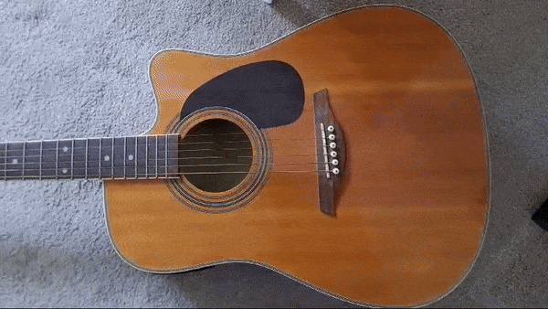

Codka ayaa ka aamusnaaday masaafo dheer
Shay gariiraya wuxuu keenaa in walxaha (particles) hawada ku dhow ay gariiraan sidoo kale.
Walxaha (particles) hawada ayaa la riixaa horay, laakiin markii shaygu dib u noqdo, way ku fidaan gadaal.
Walxaha hawada ee gariiraya waxay garaacaan deriskooda waxayna iyaguna gariiriyaan.
Qaabka walxaha gariiraya wuxuu abuuraa mawjad dhawaaq (sound wave).

Slide 7


Dhawaaqyada ayaa ka aamusan yihiin meel fog
Mid ka mid ah kuwan soo socda ayaa ka soo baxa isha dhawaaqa (source of sound)?
a
walxaha hawada (air particles)
b
walxaha dhawaaqa (sound particles)
c
mawjadaha dhawaaqa (sound waves)

Slide 8
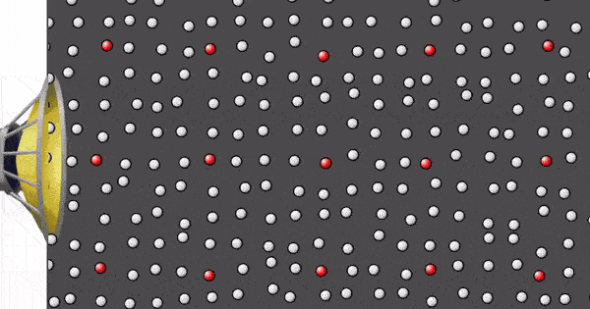
Dhawaaqyada ayaa ka aamusan yihiin meel fog
Meel ka fog shayga gariiraya, baaxadda gariirka (amplitude of vibrations) waa ka yar tahay. Codka (volume) ayaa hooseeya.
Jawaabaha:
baaxad yar (smaller amplitude)
baaxad weyn (larger amplitude)
Jilitaanka (Simulation) waxaa sameeyay PhET Interactive Simulations, Jaamacadda Colorado Boulder, oo shatiyaysan CC-BY-4.0 (https://phet.colorado.edu).

Slide 9
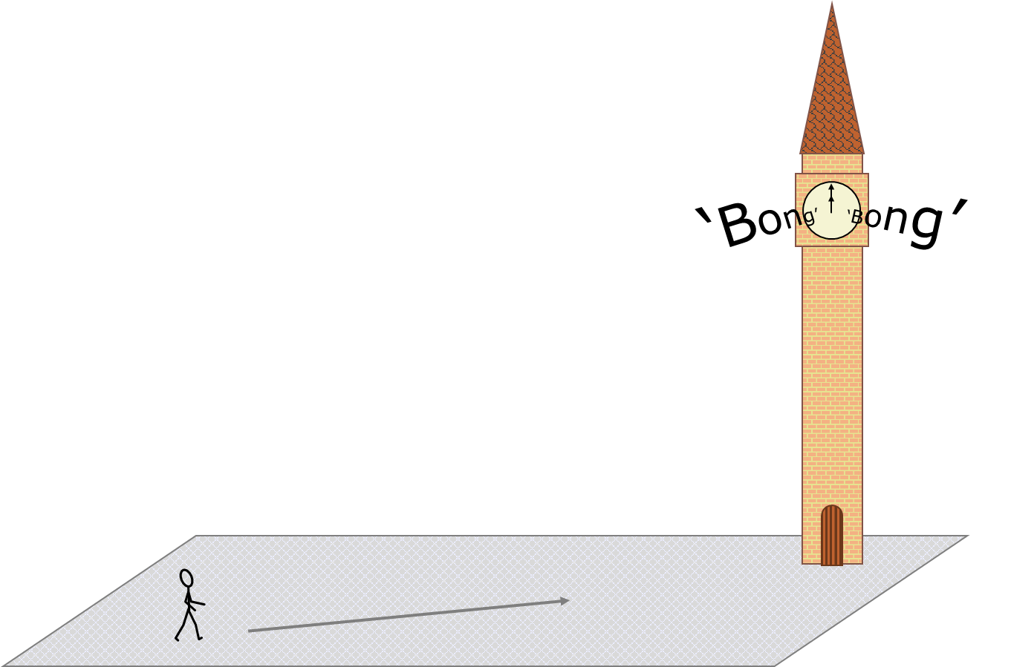
Dhawaaqyada ayaa ka aamusan yihiin meel fog
Maxay saacadda (clock) uga dhawaaq badan tahay markaad u dhowdahay?
Dhawaaqa (sound) wuxuu leeyahay baaxad (amplitude) sare.
Dhawaaqa (sound) wuxuu leeyahay inta jeer (frequency) sare.
Dhawaaqa (sound) wuxuu leeyahay sarayn (pitch) sare.

Slide 10
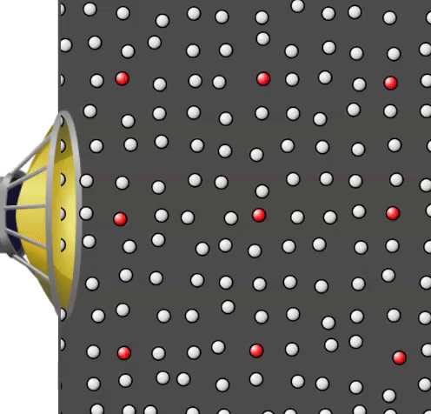
Dhawaaqyada ayaa ka aamusan yihiin meel fog
Tamarta (Energy) waxaa loo wareejiyaa walxaha hawada (air particle) marka la riixo hore.
Walxaha hawadaas (air particle) waxay qayb ka mid ah tamarteeda u wareejisaa walxaha xiga ee ay ku garaacdo, laakiin waxaa jiri kara shilal (collisions) badan ka hor inta aan walxuhu wareejin dhammaan tamarta ay heleen.
Meel ka fog shayga gariiraya, tamarta (energy) waxaa loo qaybiyaa walxo (particles) badan.
Jilitaanka (Simulation) waxaa sameeyay PhET Interactive Simulations, Jaamacadda Colorado Boulder, oo shatiyaysan CC-BY-4.0 (https://phet.colorado.edu).

Slide 11
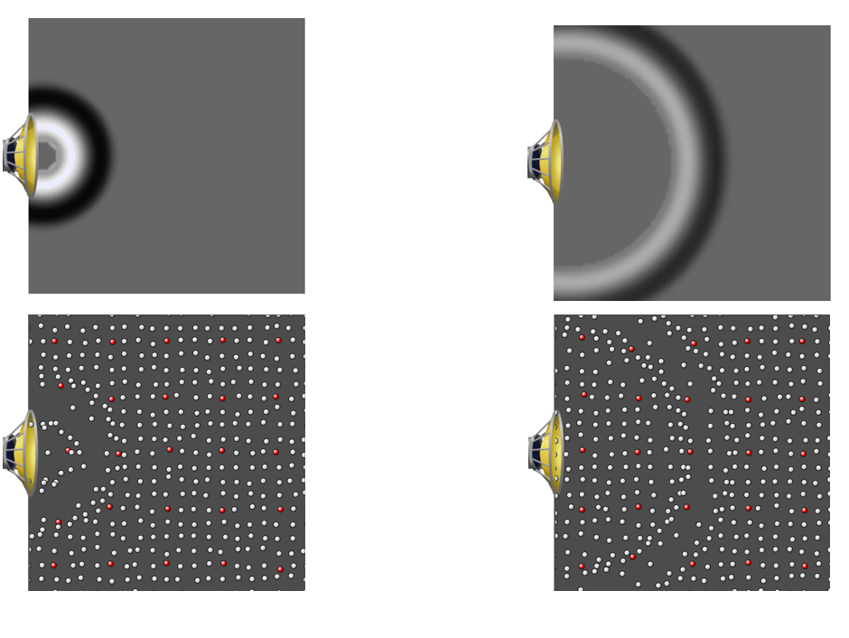

Dhawaaqyadu way ka aamusan yihiin markaad ka fog tahay
Marka mowjadda dhawaaqa (sound wave) socoto, tamartu way kala fidaa.
Kaliya qaybahan ayaa gariiraya (vibrating).
Hadda dhammaan qaybahaan way gariirayaan (vibrating).
Jilitaan (Simulation) by PhET Interactive Simulations, University of Colorado Boulder, licensed under CC-BY-4.0 (https://phet.colorado.edu).

Slide 12
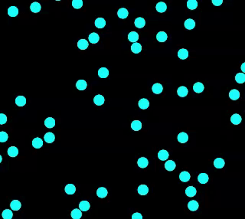
Dhawaaqyadu way ka aamusan yihiin markaad ka fog tahay
Ka hor inta aan mowjadda dhawaaqa (sound wave) dhex marin, qaybaha hawadu waxay u dhaqaaqaan si random sababtoo ah waa gaas.
Mowjadda dhawaaqa (sound wave) waxay ku dartaa dhaqdhaqaaq (movement) dheeri ah (gariir) oo ku kordha dhaqdhaqaaqa random.
Marka mowjadda dhawaaqa (sound wave) ay dhex marto hawada, waxay keentaa in dhaqdhaqaaqa (movement) random ee qaybaha hawadu wax yar kordho. Tani waxay keentaa saameyn kulayl oo yar.
Muuqaalka dhaqdhaqaaqa (movement) random ee qaybaha hawada (iyada oo aan lahayn mowjad dhawaaq).
Jilitaan (Simulation) by PhET Interactive Simulations, University of Colorado Boulder, licensed under CC-BY-4.0 (https://phet.colorado.edu).

Slide 13
Dhawaaqyadu way ka aamusan yihiin markaad ka fog tahay
Waxaad u socotaa dhanka saacad markay ku dhufanayso 12 duhurnimo.
Kee ayaa si sax ah u sharxaya sababta 'bongs' ugu sii qaylinayaan?
a
Dhawaaqu wuu ka yar yahay fidsanaantiisa markaad ku dhow dahay.
b
Dhawaaqu wuxuu leeyahay waqti yar oo uu ku baaba'o ka hor inta uusan ku gaadhin.
c
Dhagahaagu waxay la qabsadaan dhawaaqa.

Slide 14
Dhawaaqyadu way ka aamusan yihiin markaad ka fog tahay
Ka wada hadla in hadal kastaa sax yahay iyo in khalad yahay, ka dibna calaamadee hal column mid kasta.
Waxaan hubaa inay tani sax tahay
Waxaan u malaynayaa inay tani sax tahay
Waxaan u malaynayaa inay tani khalad tahay
Waan hubaa in kani khalad yahay
Tamarta dhawaqa (sound) waa la isticmaalaa markay safarto.
a
b
Dhawaqu (sound) wuu fidaa markuu safro.
Qaybaha hawadu (air particles) had iyo jeer waxay u gudbiyaan tamartooda oo dhan qaybta xigta.
c
Mowjadaha dhawaaqa (sound waves) waxay soo saari karaan saameyn kulayl oo yar.
d

Slide 15
Dhawaqyadu (sounds) way ka aamusan yihiin markaad ka fog tahay
Ka wada hadla in hadal kastaa sax yahay iyo in khalad yahay, ka dibna calaamadee hal column mid kasta.
Waan hubaa in kani sax yahay
Waxaan u malaynayaa in kani sax yahay
Waxaan u malaynayaa in kani khalad yahay
Waan hubaa in kani khalad yahay
Tamarta dhawaqa (sound) waa la isticmaalaa markay safarto.
a
b
Dhawaqu (sound) wuu fidaa markuu safro.
Qaybaha hawadu (air particles) had iyo jeer waxay u gudbiyaan tamartooda oo dhan qaybta xigta.
c
Mowjadaha dhawaqa (sound waves) waxay soo saari karaan saameyn kulayl oo yar.
d

Slide 16
Dhawaq safaraya (travelling sound)
Dhawaqyadu (sounds) way ka aamusan yihiin markaad ka fog tahay
Mowjadaha dhawaqa (sound waves) ee adkaha, dareeraha iyo gaasaska
Meel faaruq ah (vacuum)

Slide 17

Mowjadaha dhawaqa (sound waves) ee adkaha, dareeraha iyo gaasaska
Mowjadaha dhawaqa (sound waves) waxay mari karaan adkaha iyo dareeraha.
Walaxda uu dhawaqgu dhex marayo waxaa loo yaqaan medium (medium).
Waxaa laga yaabaa inaad maqasho qofka qolka ku xiga iyada oo loo marayo gidaar adag.
Waxaad maqli kartaa dhawaqyo ka yimaada dibadda xataa marka albaabada (solid) iyo daaqadaha (solid) oo dhami xiran yihiin.
beep
honk

Slide 18




Mowjadaha dhawaqa (sound waves) ee adkaha (solids), dareeraha (liquids) iyo gaasaska (gases)
Yacquub wuxuu ku jiraa gudaha iyadoo albaabada iyo daaqadaha oo dhami xiran yihiin, laakiin wali wuu maqli karaa hooyadiis oo jaraysa cawska dibadda.
Sidee mowjadda dhawaqa (sound wave) u gaadhaa Yacquub?
a
Kaliya iyada oo loo maro daloollada ku wareegsan daaqadaha iyo albaabada.
b
Iyada oo loo maro muraayadda daaqadaha.
c
Iyada oo loo maro albaabka dambe ee qoryaha ah.
d
Iyada oo loo maro derbiga.

Slide 19
Mowjadaha dhawaqa (sound waves) ee adkaha (solids), dareeraha (liquids) iyo gaasaska (gases)
Qaybaha (particles) ee adkaha (solid) aad bay isu dhow yihiin.
Waxaa jira xoogo (forces) xoog leh oo qaybaha (particles) adkaha (solid) ku haya deriskooda.
Qaybuhu (particles) isku wareegi karaan ama kala tagi karaan. Waxay kaliya gariiri karaan (vibrate) meelaha ay ku xidhan yihiin.
Waxay gariiraan (vibrate) sababtoo ah heerkulkooda (temperature).

Slide 20

Mowjadaha dhawaqa (sound waves) ee adkaha (solids), dareeraha (liquids) iyo gaasaska (gases)
Gariirinta (vibrating) cidhifka adkaha (solid) waxay ka dhigaysaa qaybaha (particles) ee
cidhifka adkaha (solid) inay gariiraan (vibrate). Qaybahaas (particles) waxay isku dhacaan qaybaha deriska ah, iyagoo gariirka (vibrations) ku gudbinaya adkaha (solid).
jihada gariirka (vibration)
jihada ay mowjadaha dhawaqa (sound waves) ku safraan
Qaybuhu (particles) kuma safraan adkaha (solid), laakiin mowjadda dhawaqa (sound wave) way safartaa.
Gariirka (vibrations) uu sababo mawjadda dhawaaqa (sound wave) ayaa ku kordha gariirka yar ee walxaha (particles) ay sababto heerkulkooda (temperature).

Slide 21
Mawjadaha dhawaaqa (sound waves) ee adkaha (solids), dareeraha (liquids) iyo neefaha (gases)
Hooyada Yacquub waxay isticmaashaa mishiinka cawska (lawnmower) ee qaylada badan beerta gudaheeda. Yacquub wuxuu ku jiraa guriga dhexdiisa oo albaabbada iyo daaqadaha oo dhami xiran yihiin, laakiin wali wuu maqli karaa mishiinka cawska.
Maxaa sababa inuu gariiro (vibrate)?
a
hawada (air)
b
muraayadda daaqadaha (glass in the windows)
c
albaabka dambe ee alwaaxda ah (the wooden back door)
d
derbiga (the wall)

Slide 22
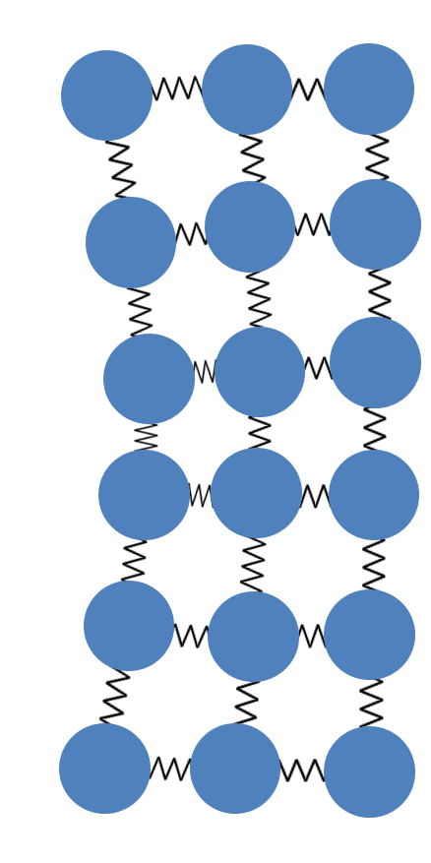
Mawjadaha dhawaaqa (sound waves) ee adkaha (solids), dareeraha (liquids) iyo neefaha (gases)
Mawjadaha dhawaaqa (sound waves) waxay u safraan si ka dhakhso badan adkaha (solids) marka loo eego dareeraha (liquids) iyo neefaha (gases).
Tani waxay u tahay sababta oo ah gariirka (vibrations) waxaa si fudud loogu kala gudbin karaa hal walx (particle) una gudbin karaa kan ku xiga adkaha (solid) dhexdiisa, maxaa yeelay:
walxaha (particles) aad bay ugu dhow yihiin
xoogagga soo jiidashada (forces of attraction) ee u dhexeeya walxaha (particles) aad bay u xooggan yihiin, marka hal walx (particle) ka baxo booskiisa, tani waxay soo jiidataa walxaha deriska ah (neighbouring particles) inay yara ka baxaan booskooda

Slide 23
Mawjadaha dhawaaqa (sound waves) ee adkaha (solids), dareeraha (liquids) iyo neefaha (gases)
Dhawaaqyada (sounds) ka imanaya dibedda ayaa ka cad (clearer) oo ka qaylo badan (louder) marka la maqlo daaqad furan marka loo eego daaqad xiran.
Marka daaqaddu xiran tahay, qaar ka mid ah mawjadaha dhawaaqa (sound waves) ayaa ka soo booda (reflect) muraayadda (glass).
Si kastaba ha ahaatee, mawjadaha dhawaaqa (sound waves) ee dhex mara muraayadda (glass) waxay u safraan si ka dhakhso badan siday hawada (air) ugu safraan.

Slide 24

Mawjadaha dhawaaqa (sound waves) ee adkaha (solids), dareeraha (liquids) iyo neefaha (gases)
Run ama been (True or false)?
Mawjadaha dhawaaqa (sound waves) waxay u safraan si ka wanaagsan adkaha (solids) marka loo eego neefaha (gases).
T
Run (True)
F
Been (False)
Caddee jawaabtaada.
Walxaha (particles) neef (gas) aad bay u kala fog yihiin, sidaas darteed waxaa jira boosasho (gaps) badan oo dhawaaqu (sound) ka dhex mari karo.
b
Adkaha (solid) dhexdiisa, waxaa jira walxo (particles) badan (isla meel isku mid ah) oo riixa (push) dhawaaqa (sound) sii wada.
a
c
Walxaha (Particles) adag aad bay isu jiitaan, marka qaar badan baa gariira marka mid gariiro.
Walxaha (Particles) adag aad bay isu dhow yihiin, marka si fudud ayay isku dhacaan markay gariiraan (vibrate).
d

Slide 25
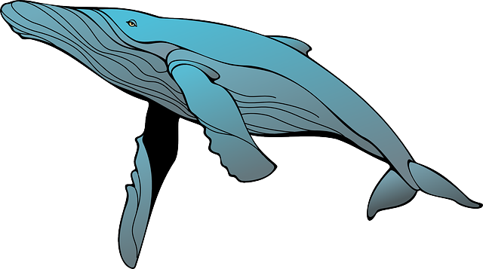
Mowjadaha codka (Sound waves) ee adag, dareere, iyo gaas
Mowjadaha codka (Sound waves) sidoo kale si fiican ayay u dhex maraan dareeraha (liquids).
Markaad dabaalanayso biyaha (water) hoostooda, dhawaqyadu way aamusan yihiin oo way cufan yihiin. Laakiin sababtu waxay tahay in dhagaha bini'aadamku si fiican ugama shaqeeyaan biyaha (water).
Gariirku (Vibrations) dhab ahaan wuxuu si ka dhakhso badan oo ka fog u dhex maraa dareeraha (liquids) marka loo eego gaasaska (gases) sida hawada.
Nibirrada (Blue whales) waxay sameeyaan dhawaqyo biyaha (water) hoostooda kuwaas oo masaafo aad u dheer ku safra. Xubnahooda maqalku si fiican ugama shaqeeyaan biyaha (water).

Slide 26
Mowjadaha codka (Sound waves) ee adag, dareere, iyo gaas
Walxaha (Particles) dareeraha (liquid) waxay leeyihiin tamar ku filan si ay qayb ahaan uga baxsadaan xoogagga (forces) soo jiidashada ee xooggan. Waxay isku wareegi karaan midba midka kale laakiin ma kala tagaan.
Sababtoo ah walxaha (Particles) dareeraha (liquid) aad bay isu dhow yihiin, si fudud ayay isku dhici karaan oo u gudbin karaan gariirka (vibrations).
Tani waa sababta mowjadaha codka (Sound waves) uga dhakhso badan yihiin dareeraha (liquids) marka loo eego gaasaska (gases).

Slide 27
Mowjadaha codka (Sound waves) ee adag, dareere, iyo gaas
Hase yeeshee, mowjadaha codka (Sound waves) waxay ka dhakhso badan yihiin adkaha (solids) marka loo eego dareeraha (liquids).
Walxaha (Particles) dareeraha (liquid) kuma xidhna walxo kale, sida ay ku xidhan yihiin adkaha (solid).
Dareeraha (liquid), dhaqdhaqaaqa (movement) walxaha (particles) ee isku wareegaya wuxuu adkeeyaa gudbinta mowjadaha codka (sound waves).

Slide 28
Mowjadaha codka (Sound waves) ee adag, dareere, iyo gaas
Buuxi meelaha bannaan adigoo isticmaalaya ereyada: adkaha (solids), dareerayaasha (liquids), neefaha (gases).
Mowjadaha codka (Sound waves) waxay ugu gaabis badan yihiin dhex marista __________ . Mowjadaha codka (Sound waves) waxay ka dhakhso badan yihiin __________ iyo __________ sababtoo ah walxaha (particles) aad bay isu dhow yihiin, marka si fudud ayay isku dhici karaan si ay u gudbiyaan gariirka (vibrations).
Mowjadaha codka (Sound waves) waxay ugu dhakhso badan yihiin dhex marista __________ sababtoo ah walxaha (particles) waa kuwo isku xidhan.
__________ iyo __________ walxaha (particles) kuma xidhna, taas oo adkeyneysa sida gariirka (vibrations) loo gudbin karo.
Jawaabaha:
neefaha (gases)
adkaha (solids) dareerayaasha (liquids)
adkaha (solids)
dareerayaasha (liquids) neefaha (gases)

Slide 29
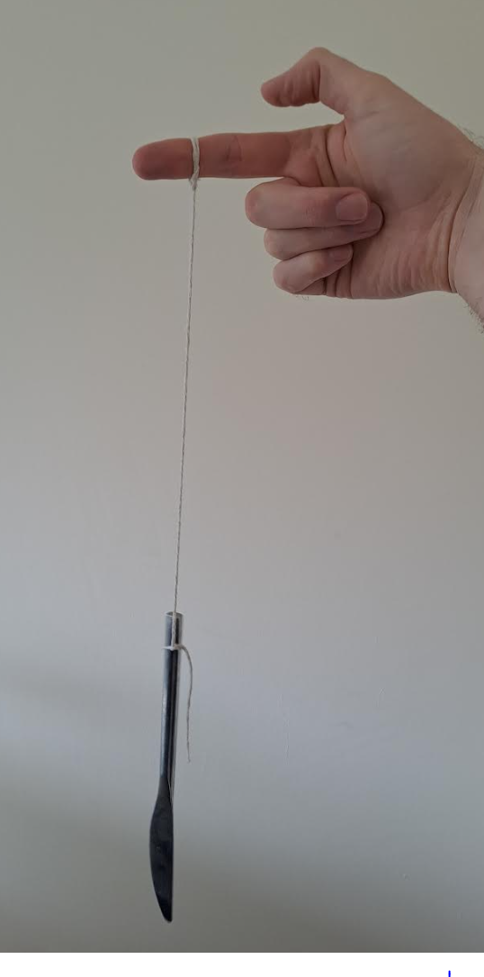
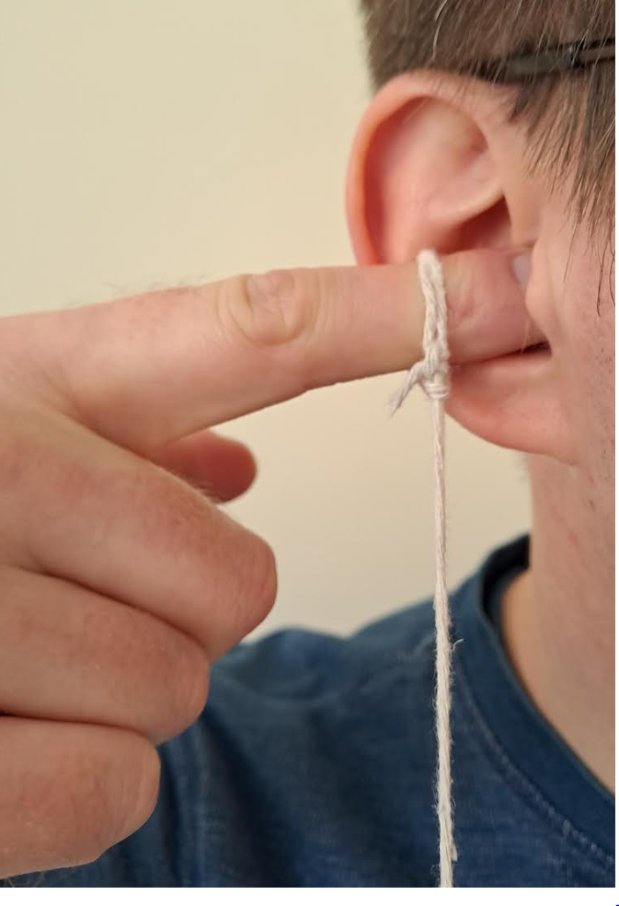
Mowjadaha dhawaqa (Sound waves) ee adkaha (solids), dareerayaasha (liquids) iyo neefaha (gases)
Shay bir ah ayaa ku xidhan xadhig. Wuxuu sameeyaa dhawaq (sound) marka si khafiif ah loo taabto.
1) Saadaali waxa aad u malaynaysid inay dhawaqa (sound) ku dhici doonaan haddii aad fartaa dhigto dhegtaada.
2) Sharax sababta aad u malaynaysid inay tani dhacayso.
3) Daawo muujin (demonstration).
4) Ma sax baa saadaashaada iyo sharaxaadaadu?
Qor sharaxaad (explanation) horumaraysa oo ku saabsan waxa dhacay.

Slide 30
Mowjadaha dhawaqa (Sound waves) ee adkaha (solids), dareerayaasha (liquids) iyo neefaha (gases)
Jawaabaha tusaale ahaan:
Saadaal (Prediction):
Marka aan fartayda dhigto dhegta, waxaan maqli doonaa dhawaqa (sound) si cad oo laga yaabo inuu ka sii dheereeyo.
Sharaxaad (Sharraxaad):
Fartayda la'aan dhegta waxaan maqlay dhawaqa (sound) hawada (neef - gas) dhexdeeda. Fartayda dhegta ku jirta waxaan maqlay dhawaqa (sound) xadhigga (adke - solid) iyo fartayda dhexdeeda. Mowjadaha dhawaqa (Sound waves) waxay si fiican u socdaan adkaha (solids) marka loo eego neefaha (gases), sidaa darteed dhawaqu wuu caddaystay oo dheeraaday.
Adke (solid) dhexdiisa, walxaha (particles) waa isku dhow yihiin oo waa isku xidhan yihiin; gariirrada (vibrations) waxaa si fudud loo gudbiyaa walxaha (particles) dhexdooda. Neef (gas) dhexdiisa, walxaha (particles) waa kala fog yihiin oo iskuma xidhna, taasoo ka dhigaysa mid adag in gariirradu (vibrations) socdaan.

Slide 31
Dhawaqa (Sound) socda
Dhawaqyadu (Sounds) way ka sii xun yihiin marka laga sii fogaado
Mowjadaha codka (Sound waves) ee adkaha, dareeraha iyo gaasaska
Meel faaruq ah (vacuum)

Slide 32
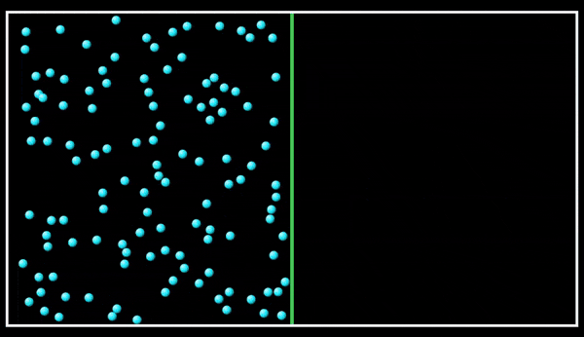
Meel faaruq ah (vacuum)
Meel faaruq (vacuum) waxay ka dhigan tahay meel gabi ahaanba madhan. Ma jiraan wax gabi ah oo ku jira meel faaruq ah (ma jiraan adke, dareere ama gaas).
Ma jiraan walxo (particles) ku jira meel faaruq ah (vacuum).
Animation-ku wuxuu muujinayaa gaas ku fidsanaya meel faaruq ah (vacuum). Dhamaadka, meesha faaruqa ah (vacuum) ma jirto.
Jilitaanka PhET Interactive Simulations, Jaamacadda Colorado Boulder, oo shatiyeysan CC-BY-4.0 (https://phet.colorado.edu).

Slide 33
Meel faaruq ah (vacuum)
Mowjadaha codka (Sound waves) waxay ka kooban yihiin walxo (particles) oo gariiraya.
Mowjadaha codka (Sound waves) ma mari karaan meel faaruq ah (vacuum), sababtoo ah meel faaruq ah ma jiraan walxo (particles) la gariirin karo.
Mowjadaha codka (Sound waves) waxay u baahan yihiin dhexdhexaad (medium) ay ku maraan.
Ka sarreeya jawiga dhulka, meesha bannaan (space) waa meel faaruq ah (vacuum).

Slide 34
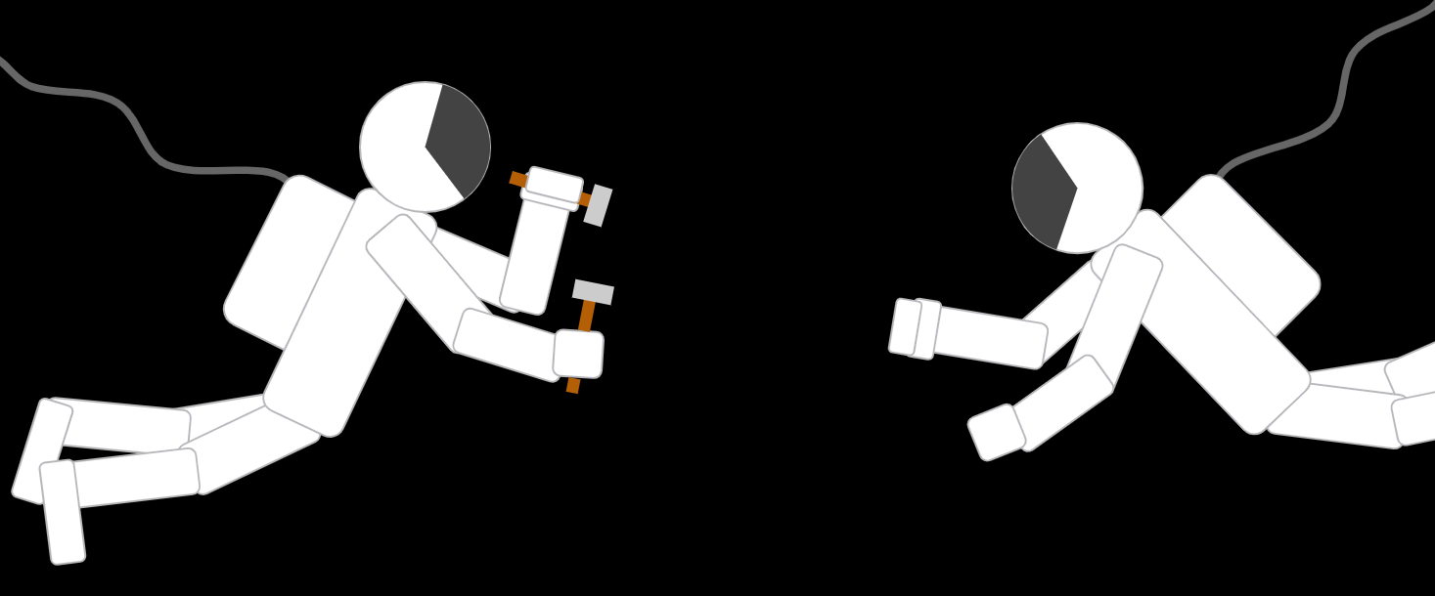
Meel faaruq ah (vacuum)
Labo cirbixiyeen ayaa ku socda socod bannaan (spacewalk).
Mid ka mid ah cirbixiyeenka ayaa isku garaacaya laba qalab.
Kee ayaa sharxaya sababta cirbixiyeenka kale uusan u maqlin cod?
a
Ma jiraan daloollo ku jira suudhkooda bannaan (space suit), marka codku ma soo geli karo.
b
Ma jiraan walxo (particles) u dhexeeya labada cirbixiyeen ee la gariirin karo.
c
Ma jiraan walxo (particles) u dhexeeya labada cirbixiyeen si ay codka u riixaan.

Slide 35
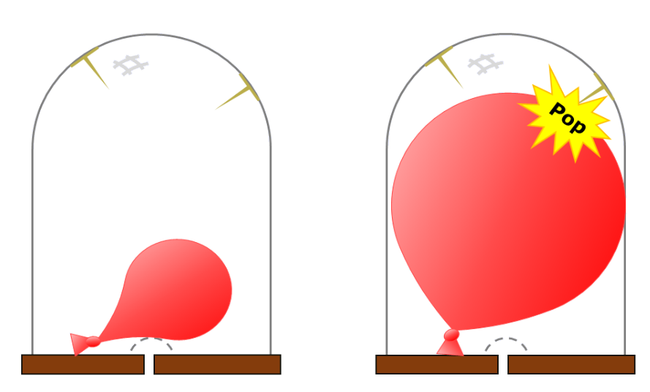
Meel faaruq ah (vacuum)
Buufin (balloon) yar oo buuxinaysa ayaa la geliyay weel (jar) xiran, sida jaantuska (diagram) ku cad. Hawada (air) ayaa laga soo saaray weelka (jar) oo buufintu (balloon) way weynaataa.
Biinanka (pins) ayaa buufinta (balloon) qarxin doona.
biino (pins)
1) Saadaali waxa aad u malaynayso inaad maqli doonto marka buufinku qarxo.
2) Sharax sababta aad u malaynayso inaad maqli doonto tan.
3) Daawo muujin (demonstration).
hawada la soo saaray
4) Ma sax ahayd saadaasha (prediction) iyo sharaxaaddaada (explanation)?
Qor sharaxaad (explanation) hagaagsan oo ku saabsan waxa dhacay.

Slide 36
Meel bannaan (vacuum)
Jawaabo tusaale (Example answers).
Saadaal (Prediction):
Marka buufintu (balloon) qarxdo, waxay sameyn doontaa dhawaq (noise) aad uga xasilloon kan ay samayn lahayd haddii ay hawada (air) ku qarxdo, ama laga yaabee inaysan dhawaq (noise) sameynin gabi ahaanba.
Sharaxaad (Sharraxaad):
Soo saarista hawada (air) weelka (jar) waxay ka dhigan tahay inay jiraan walxo hawo (air particles) aad u yar oo ku jira weelka (jar). Gudaha weelka (jar) waxaa laga yaabaa inay u dhowdahay meel bannaan (vacuum).
Marka buufintu (balloon) qarxdo, waxaa jiri doona walxo (particles) aad u yar ama midna oo ku jira weelka (jar) si ay u gudbiyaan gariirrada (vibrations) dhanka derbiyada weelka (jar). Sidaa darteed, mowjadaha dhawaqa (sound waves) aad u yar ama midna kama baxayaan weelka (jar).

Slide 37
Socodka dhawaqa (Travelling sound)
Dhawaqu (Sound) wuxuu ku faafaa (spreads out) markuu socdo. Meel ka fog xigta isha dhawaqa (source of sound), waxaa jira gariirro (vibrations) leh baaxad (amplitude) yar, codkuna (volume) wuu hooseeyaa.
Mowjadaha dhawaqa (Sound waves) waxay mari karaan adkaha (solids), dareeraha (liquids) iyo gaasaska (gases). Walxaha (material) dhex mara waxaa loo yaqaan dhexdhexaadiyaha (medium).
Mowjadaha dhawaqa (Sound waves) waxay ka dhaqso badan yihiin dareeraha (liquid) marka loo eego gaaska (gas), sababtoo ah walxaha (particles) ayaa isugu dhow dareeraha (liquid).
Mowjadaha dhawaqa (Sound waves) waxay xitaa ka dhaqso badan yihiin adkaha (solids), sababtoo ah walxaha (particles) adkaha (solids) waa isku xidhan yihiin.
Mowjadaha dhawaqa (Sound waves) ma mari karaan meel bannaan (vacuum) sababtoo ah meel bannaan (vacuum) ma jiraan walxo (particles) si ay u gariiraan (vibrate).

