Slide 1
Gariirka safarka (Travelling vibrations)
Dhawaaqa, iftiinka iyo aragga (Sound, light and vision)

Slide 2
Sida agabkeena waxbarista loogu talagalay fasalka

Slide 3
Waxaan sharxi karaa sida gariirka loogu gudbiyo hawada iyo hawada dhexdeeda, si dhawaaqa loo maqlo.

Slide 4
qaybaha yaryar (particles)
Waxa ay ka samaysan yihiin adkaha, dareeraha iyo gaasaska.
gariir (vibrate)
In si joogto ah oo soo noqnoqota dib iyo gadaal loo dhaqaaqo.
qaab cilmiyeed (scientific model)
Hab kasta oo si sax ah u matala, sawira ama qiyaasa fikrad cilmiyeed.
mowjad (wave)
Khalkhal safar ah, sida hirarka biyaha (water) oo kale.

Slide 5

Gariirka safarka (Travelling vibrations)
Gariirinta hawada
Sida gariirku u safro
Moodooyinka dhawaaqa

Slide 6
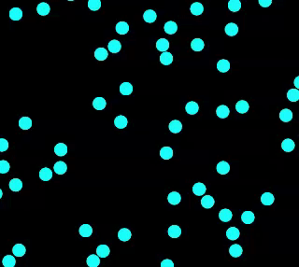
Gariirinta hawada
Hawadu waa isku dhaf gaasas.
Hawadu waxay ka samaysan tahay qaybo aad u badan, oo ku dhaqaaqaya xawli iyo jihooyin kala duwan.
matalaadda qaybaha hawada
Jilitaanka PhET Interactive Simulations, Jaamacadda Colorado Boulder, oo shatiyeysan CC-BY-4.0 (https://phet.colorado.edu).

Slide 7
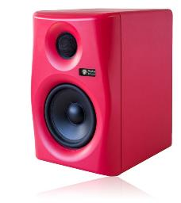
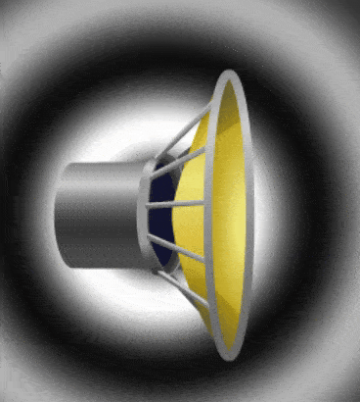
Gariirinta hawada
Hadal-hayayaashu (Speakers) waxay sameeyaan dhawaaq (sound) iyagoo gariiraya (vibrating).
Gariirka (vibrations) badanaa waa yar yahay oo dhakhso badan in la arko.
Qaybta ugu weyn ee gariirta (vibrating) ee hadal-hayaha (speaker) waxaa loo yaqaan koontada (cone).
Sawirka Midig: Jilitaan (Simulation) by PhET Interactive Simulations, Jaamacadda Colorado Boulder, shatiyaysan CC-BY-4.0 (https://phet.colorado.edu).

Slide 8
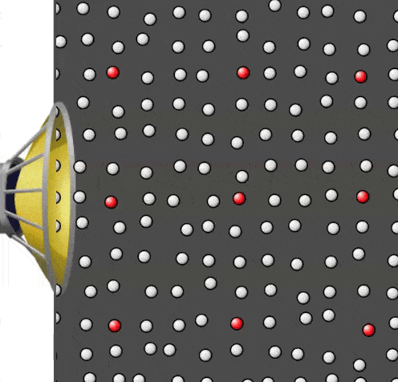
Gariirinta (Vibrating) hawada (air)
Jilitaanku (animation) wuxuu muujinayaa koontada (cone) hadal-hayaha (speaker) oo gariiraysa (vibrating) oo ka dhigaysa walxaha hawada (air particles) ku xeeran inay gariiraan (vibrate) sidoo kale.
Marka gariirku (vibration) bilaabmo, daawo dhaqdhaqaaqa (motion) mid ka mid ah walxaha hawada (air particles) la muujiyey.
Jilitaankan (animation) ma muujinayo dhaqdhaqaaqa (movement) buuxa ee walxaha hawada (air particles).
Jilitaan (Simulation) by PhET Interactive Simulations, Jaamacadda Colorado Boulder, shatiyaysan CC-BY-4.0 (https://phet.colorado.edu).

Slide 9


Gariirinta (Vibrating) hawada (air)
Dhammeysti jumlada (sentence).
Shay gariira (vibrating object) wuxuu sababaa walxaha hawada (air particles) ku dhow inay…
a
safaraan (travel) meel fog oo ka fog hadal-hayaha (speaker).
b
gariiraan (vibrate) sidoo kale.
c
dhaqaaqaan (move) si aan kala sooc lahayn (randomly).
d
kala fogaadaan (move apart) (si dhawaaqa (sound) uu u maro).

Slide 10

Gariirinta (Vibrating) hawada (air)
Marka koontada (cone) hadal-hayaha (speaker) oo gariiraysa (vibrating) ay horay u dhaqaaqdo (moves forwards), waxay riixdaa (pushes) walxaha hawada (air particles) ku dhow, iyadoo isku buufinaysa (squashing them together).
Marka koontada (cone) ay dib u dhaqaaqdo (moves backwards), waxay ka tagtaa boos (space) horteeda.
Qaar ka mid ah walxaha hawada (air particles) ayaa si dhakhso leh dib ugu soo noqda booska (space). Walxuhu (Particles) waxay u dhaqaaqaan (move) jihooyin kala duwan sidaas darteedna way kala firdhiyaan (spread out) si ay u buuxiyaan booska (space) la heli karo.
Jilitaan (Simulation) by PhET Interactive Simulations, Jaamacadda Colorado Boulder, shatiyaysan CC-BY-4.0 (https://phet.colorado.edu).

Slide 11
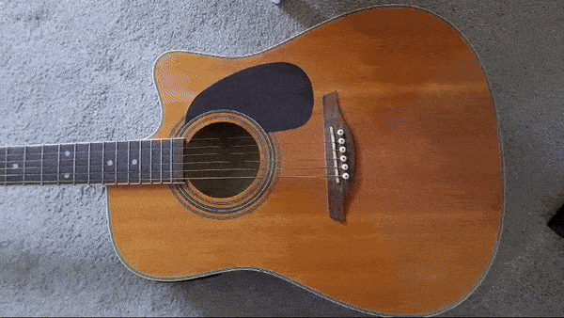
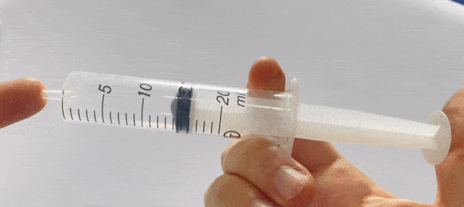
Gariirinta (Vibrating) hawada (air)
Dhammaan walxaha gariiraya waxay keenaan hawada ku xeeran inay u gariirto si la mid ah sida qolofka (speaker cone).
Waxay isku beddelaan inta ay isku buunshaan qaybaha hawada ku dhow, ka dibna u oggolaadaan inay kala fidaan.
Waxay la mid tahay waxa ku dhaca hawada ku jirta tuubadan.

Slide 12
Gariirinta hawada
Marka shay gariiraya uu horay u dhaqaaqo, wuxuu riixaa qaybaha hawada ku dhow horay. Maxaa markaa keena in qaybuhu dib ugu noqdaan?
a
Waxay dib u dhaqaaqaan sababtoo ah hadda way gariirayaan.
Shayga gariiraya ayaa dib u soo jiidaya marka uu dib u dhaqaaqo.
b
c
Qaybaha hawadu waxay u dhaqaaqaan dhinacyo kala duwan, sidaas darteed qaar baa dib u dhaqaaqa.

Slide 13
Gariirinta hawada
Sharax waxa ku dhaca qaybaha hawada ku dhow marka qolofka (speaker cone) uu gariiro.
Sharax sababta ay tani u dhacdo.

Slide 14
Gariirinta hawada
Sharax waxa ku dhaca qaybaha hawada ku dhow marka qolofka (speaker cone) uu gariiro.
Sharax sababta ay tani u dhacdo.
Jawaab tusaale:
Qolofka (speaker cone) gariiraya wuxuu keenaa in qaybaha hawada ku dhow ay sidoo kale gariiraan.
Marka qolofka (speaker cone) uu horay u dhaqaaqo, wuxuu riixaa qaybaha hawada ku dhow, isagoo horay u riixaya. Waxay isku buunshaan ama 'isku ururaan'.
Marka qolofka (speaker cone) uu dib u dhaqaaqo, wuxuu abuuraa meel bannaan. Qaybaha hawada ku dhow waxay si degdeg ah ugu fidaan meesha bannaan (sababtoo ah dhaqdhaqaaqooda xorta ah ee dhinacyo kala duwan). Ka dib qolofka (speaker cone) wuxuu mar kale horay u dhaqaaqaa.

Slide 15
Gariirrada safraya
Gariirinta hawada
Sida gariirku u safro
Moodooyinka codka (Models of sound)

Slide 16
Sida gariirradu u safraan
Marka koontarada (speaker cone) uu horay u dhaqaaqo, waxay ku dhacdaa walxaha (particles) hawada ee u dhow, iyada oo horay u riixaysa.
Walxaha (particles) la riixay waxay ku dhacaan walxaha (particles) hawada ee hortooda ah.

Slide 17
Sida gariirradu u safraan
Walxahan (particles) markaas waxay ku dhacaan walxaha (particles) hawada ee hortooda ah, iyo wixii la mid ah.
Tani waa sida gariir (dhawaaq) uu horay ugu safro hawada (air).

Slide 18
Sida gariirradu u safraan
Mid ka mid ah kuwan soo socda waa inuu dhacaa si dhawaaqu u safro?
a
Walxuhu (particles) waa inay isku dhacaan (markay gariiraan).
b
Walxuhu (particles) waa inay u safraan meesha dhawaaqa laga maqlo.
Farqiga u dhexeeya walxaha (particles) waa inuu ku filan yahay si dhawaaqu u dhex maro.
c

Slide 19
Sida gariirradu u safraan
Walxaha (particles) hawadu waxay u dhaqaaqayaan dhinacyo kala duwan. Marka koontarada (speaker cone) dib u dhaqaaqdo, waxay abuurtaa farqi (gap).
Qaar ka mid ah walxaha (particles) hawada ee u dhow ayaa si degdeg ah dib ugu soo noqda booskan.
Tani waxay abuurtaa boos (space) dheeraad ah. Walxaha (particles) hore loo riixay ayaa dib ugu soo noqda booskan.

Slide 20
Sida gariirradu u safraan
Koontarada (speaker) markaas waxay horay u riixdaa walxaha (particles) kowaad si ay u soo saarto gariirka xiga.
Marka, dhaqdhaqaaqa (movement) horay iyo dib ee walxaha (particles) wuu ku soo noqnoqdaa mar kasta oo koontarada (speaker cone) gariirto.
Shay kasta oo gariira wuxuu sameeyaa in walxaha (particles) hawada ee ku xeeran ay sidoo kale gariiraan, si la mid ah koontarada (speaker cone).

Slide 21
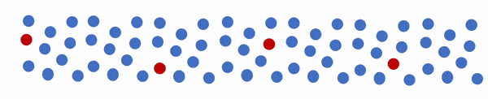
Sida gariirradu u safraan
Animation-ka hoose wuxuu muujinayaa saamaynta guud:
Dhawaaqu wuxuu u socdaa jihadan.
Qayb kasta oo hawo (air particle) ah waxay kaliya gariirayaan.
Ma jiraan walxo (particles) hawada oo ka safraya isha dhawaaqa (sound source).

Slide 22
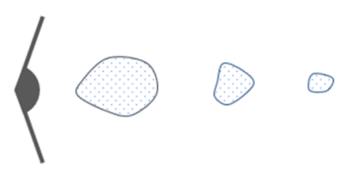
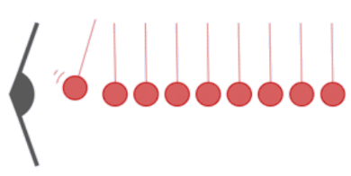

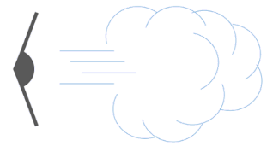
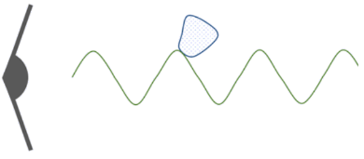
Sida gariirku u safro
Kee ka mid ah sawirada hoose ayaa si sax ah u muujiya dhawaaqa safraya hawada (air)?
a
b
c
d

Slide 23

Sida gariirku u safro
Qaybaha hawadu (air particles) waxay ku gariiraan qaab. Qaabku wuxuu soo saaraa 'garaacyo' (pulses) socda oo hawo ah (loogu yeero cufis (compressions)).
Waa 'garaacyada' (pulses) kuwa safra, ma aha qaybaha hawada (air particles).

Slide 24
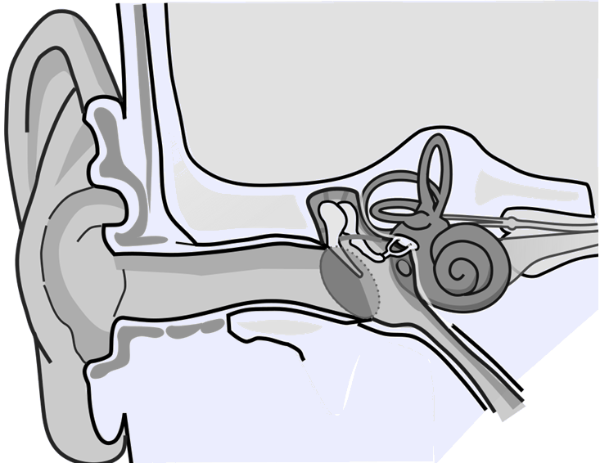
Sida gariirku u safro
Dhawaaqa waxaa la maqlaa kaliya marka gariirku (garaacyada) yimaadaan dhegta qofka. Waxay qaataan waqti si ay halkaas u gaadhaan.
Si aad u maqasho dhawaaq, qaybaha hawada (air particles) ee dhegtaada ku jira waa inay keenaan qaybo ka mid ah dhegta inay gariiraan (iyadoo la isku dhaco (collisions)).
Qaab-dhismeedka Dhegta Bini'aadamka, Lars Chittka; Axel Brockmann, 2009, Laysinka CC-BY 2.5. Waa la gooyay oo la madoobaadiyay.

Slide 25
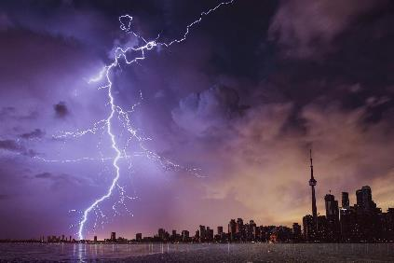

Sida gariirku u safro
Hillaacu (Lightning) wuxuu sameeyaa dhawaaq aad u qaylo badan (onkod).
Run ama been?
Haddii hillaacu (Lightning) ku dhaco 3 km, waxaad maqli doontaa isla markiiba.
T
Run
F
Been
Sharax jawaabtaada.
a
Hillaacu (Lightning) waa qaylo badan, sidaas darteed gariirku wuxuu leeyahay baaxad (amplitude) aad u weyn.
b
Gariirku wuxuu qaataa waqti si uu kuugu gaadho hawada (air) dhexdeeda.

Slide 26
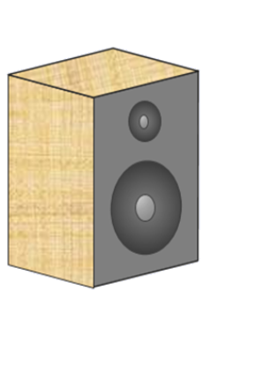
Sida gariirku u safro
Shumac shidan ayaa la hor dhigaa qalabka codka (speaker).
Saadaali waxa aad u malaynayso in la arki doono marka cod-baahiyaha (speaker) la shido.
Sharax sababta aad u malaynayso inaad tan arki doonto.
Daawo muujin (demonstration).
Ma sax baa saadaashii iyo sharaxaaddii?
Qor sharaxaad la hagaajiyay oo ku saabsan waxa aad aragtay inay dhacaan.

Slide 27
Sida gariirrada (vibrations) u safraan
Jawaabaha tusaale ahaan:
Saadaal: Marka cod-baahiyaha (speaker) la shido, ololka shumaca ayaa gariiri doona. Shumacdu wuu sii gubi doonaa.
Sharaxaad: Marka cod-baahiyaha (speaker) uu sameeyo dhawaaq, wuu gariiraa (vibrates).
Tani waxay sababtaa in qaybaha hawada (air particles) ee u dhow cod-baahiyaha (speaker) ay sidoo kale gariiraan. Qaybaha hawada ee gariiraya ayaa ku dhaca qaybaha ku xiga, iyagoo sidoo kale gariirinaya.
Qaybaha hawada (air particles) ee ku wareegsan ololka shumaca ayaa ugu dambeyntii gariiri doona. Qaybahan hawada ee gariiraya ayaa sababa gariirka ololka. Shumacdu wuu sii gubaa sababtoo ah had iyo jeer waxaa jira oksijiin (oxygen) hawada ku dhow (dhawaaqu kama saaro tan ama wax kama firdhiyo).

Slide 28
Gariirrada (vibrations) safraya
Gariirinta hawada (air)
Sida gariirrada (vibrations) u safraan
Qaababka (models) dhawaaqa

Slide 29
Qaababka (models) dhawaaqa
Qaybaha hawada (air particles) waxaa lagu matali karaa goobo yaryar oo leh xawli iyo jihooyin kala duwan, oo beddela jihada markay isku dhacaan.
Kani waa qaab cilmiyeed (scientific model). Qaabaynta hawada (iyo gaasaska kale) sidan ayaa naga caawin karta sharaxaadda iyo saadaalinta sifooyinkooda.
qaab (model) (representation) ee qaybaha hawada (air particles)
Jilitaan (Simulation) by PhET Interactive Simulations, University of Colorado Boulder, licensed under CC-BY-4.0 (https://phet.colorado.edu).

Slide 30
Qaababka (models) dhawaaqa
Qaababka cilmiyeed (Scientific models) waxay si sax ah u muujin doonaan oo keliya qaybo ka mid ah waxa ay matalayaan.
Tusaale ahaan, moodelka kore ma muujinayo in hawadu tahay isku dhaf (mixture) oo gaasas (gases) ah.
Moodelkan hawada/gaasaska ma sharxi karo sifo kasta oo hawada ama gaasasku leeyihiin.
moodel (matabax) ee qaybaha hawada (air particles)
Jilitaan (Simulation) by PhET Interactive Simulations, University of Colorado Boulder, licensed under CC-BY-4.0 (https://phet.colorado.edu).

Slide 31
Moodello (Models) ee dhawaqa (sound)
Kee ka mid ah weedhahan ku saabsan moodellada sayniska (scientific models) waa sax?
Moodellada sayniska waa inay si sax ah u matalaan dhammaan qaybaha habka ama fikradda ay moodeelayaan.
a
b
Moodellada sayniska had iyo jeer waa kuwo jireed (3D) ah.
Moodellada sayniska waxay noqon karaan sawiro warqad ah, shaashadda, ama maskaxdeena.
c
Moodellada sayniska waxay soo saari karaan saadaalin (predictions), xog (data), sawiro (images), iyo muuqaallo (visualisations).
d

Slide 32
Moodello (Models) ee dhawaqa (sound)
Si loo moodeelo dhawaqa, waxaa fiican in la iska indhatiro dhaqdhaqaaqa (movement) caadiga ah ee qaybaha hawada, maxaa yeelay loogama baahna in lagu sharaxo dhawaqa.
Waxaan muujinaynaa oo kaliya dhaqdhaqaaqa (movement) gadaal iyo horay ee qaybaha marka dhawaqu dhex maro. Tani waxay ka dhigaysaa moodelkayaga mid cad.
(Xaqiiqda, qaybaha hawadu waxay sidoo kale u dhaqaaqaan jihooyin kala duwan.)
Qaybaha aan ku jirin moodelka sayniska waxaa badanaa lagu dari karaa markii dambe, haddii loo baahdo.

Slide 33

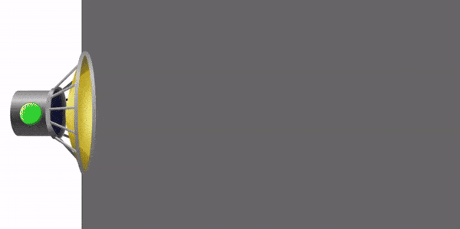
Moodello (Models) ee dhawaqa (sound)
Dhaqdhaqaaqa (movement) horay iyo gadaal ee qaybaha hawada marka dhawaqu dhex maro waxay u eg tahay dhaqdhaqaaqa (movement) kor iyo hoos ee biyaha (water) marka mowjadda biyuhu dhex maraan.
mowjadaha biyaha (water waves) / hirarka (ripples):
dhawaq (sound):
Bidix iyo midig Sawir: Jilitaan (Simulation) by PhET Interactive Simulations, University of Colorado Boulder, licensed under CC–BY–4.0 (https://phet.colorado.edu).

Slide 34
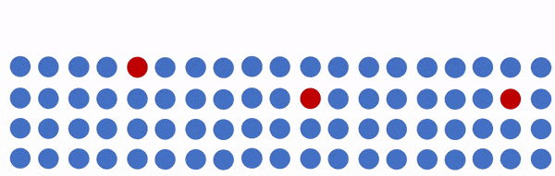
Moodello (Models) ee dhawaqa (sound)
Gariirka ama 'garaacyada' codka ee dhex mara hawada (ama walax kale) waxaa loo yaqaan mowjadaha codka (sound waves).
representation of a sound wave:
vibration:
direction of travel:
representation of a water wave:
vibration:
Sida mowjadaha (waves) oo dhan, mowjadaha dhawaqa (sound waves) waxay gudbiyaan tamar (energy).

Slide 35
Models of sound
Kee ka mid ah weedhahan ayaa sax ah?
a
Codka waxaa keena gariir.
b
Ilo codka waxay abuuraan qaybo cod ah oo safra.
c
Ilo codka waxay abuuraan mowjad cod ah oo safra.
d
Sound is a substance.
e
Sound is energy.
f
Sound waves transfer energy.

Slide 36
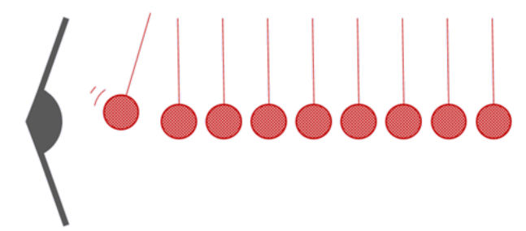
Models of sound
Koox arday ah waxay sameeyaan moodel si ay u muujiyaan sida aan u maqalno qalabka codka (loudspeaker).
1) Maxay kubbadaha teniska miiska u taagan yihiin?
2) Maxaa dhacaya kubbadaha teniska miiska marka qalabku gariiro?
loudspeaker
table tennis balls hanging on thread
3) Sidee moodelkan ugu eg yahay waxa dhaca marka codku dhex maro hawada?
4) Sidee moodelkan uga duwan yahay waxa dhaca marka codku dhex maro hawada?

Slide 37
Moodellada dhawaqa (Models of sound)
Jawaabaha tusaale ahaan:
1) Maxay kubbadaha teniska miisku u taagan yihiin? qaybaha hawada (air particles)
2) Maxaa dhacaya kubbadaha teniska miisku marka qalabka codka (loudspeaker) uu gariiro?
Qalabka codka (loudspeaker) wuxuu ku dhacaa kubbadda koowaad, isaga oo horay u riixaya. Kubbaddan waxay ku dhacdaa tan xigta, iyo wixii la mid ah, ilaa tan ugu dambeysa la dhaco. Dhawaqa (gariirka) waxaa laga dareemi karaa kubbadda ugu dambeysa.
Kubbad kasta waxay dib u lulmaysaa ka dib markii horay loo riixo, halkaas oo ay mar kale horay ugu riixdo gariirka xiga.
Sidaas darteed, kubbad kasta waxay ku dambaysaa iyada oo gadaal iyo horay u socota (gariirta).

Slide 38
Moodellada dhawaqa (Models of sound)
3) Sidee moodellkan ugu eg yahay waxa dhaca marka dhawaqu (sound) uu dhex maro hawada?
Qalabka codka (loudspeaker) wuxuu gariiriyaa qaybaha hawada (air particles) si la mid ah – isaga oo ku dhaca. Qaybaha hawada (air particles) sidoo kale waxay isku dhacaan waxayna u dhaqaaqaan gadaal iyo horay sida kubbadaha oo kale.
4) Sidee moodellkan ugu kala duwan yahay waxa dhaca marka dhawaqu (sound) uu dhex maro hawada?
Qaybaha hawada (air particles) laguma hayo meel go'an – waxay u dhaqaaqaan xawliyo iyo jihooyin kala duwan, sidoo kale waxaa gariiriya qalabka codka (speaker). Qaybaha hawada (air particles) kuma ‘lulmaan’ si ay dib ugu noqdaan, waxay dib u dhaqaaqaan ama waxaa dib u riixa qaybaha kale ee hawada. Qaybaha hawada (air particles) kuma wada jiraan sadar, aad bay u yar yihiin waxaana aad uga badan yihiin isla meesha.

Slide 39
Gariirrada safarka (Travelling vibrations)
Shay gariira wuxuu sababaa in qaybaha hawada (air particles) ku dhow ay sidoo kale gariiraan. Qaybaha hawada (air particles) horay ayaa loo riixaa laakiin dib ayaa loo fidiyaa marka shaygu dib u soo noqdo.
Qaybaha hawada (air particles) ee gariira ayaa ku dhaca kuwa deriska ah waxayna iyaguna gariiriyaan, si la mid ah.
Qaabka qaybaha gariira wuxuu abuuraa mowjad dhawaq (sound wave).
Moodellada sayniska (scientific models) badanaa waxay si sax ah u muujiyaan qaar ka mid ah dhinacyada waxa ay u taagan yihiin. Dhaqdhaqaaqyada caadiga ah ee qaybaha gaaska (gas particles) badanaa waa la iska indhatiraa moodellada mowjadaha dhawaqa (sound waves).

