Slide 1
Fahanka xogta cimilada
Xisaab iyo deegaanka

Slide 2
Sida agabkeena waxbarista loogu talagalay fasalka

Slide 3
Waxaan fahmi karaa warbixinta cimilada.

Slide 4
Saadaasha waa saadaalin dhacdo mustaqbalka (oo ku salaysan xogta).

Slide 5

Fahanka xogta cimilada
Fahanka saadaasha cimilada ee aasaasiga ah
Falanqaynta macluumaadka saadaasha dheeraadka ah

Slide 6








Fahanka saadaasha cimilada ee aasaasiga ah
Inta badan saadaasha cimiladu waxay isticmaalaan astaamo kala duwan si ay u matalaan noocyada cimilada kala duwan.
Maxaad u malaynaysaa inay astaamahan cimiladu macne yihiin?
a)
b)
c)
d)
hillaac
dabayl
daruur
baraf
e)
f)
g)
h)
qorrax
qorrax dhexda
roob dabayl
roob culus

Slide 7


Fahanka saadaasha cimilada ee aasaasiga ah
Goorma ayaad arki kartaa labadan astaamood ee cimilada, iyo astaamo kale oo ay beddeli karaan?
Calaamadahan cimilada ayaa bedeli doona calaamad kasta oo ku lug leh Qorraxda haddii saadaashu muujiso cimilada habeenkii.
cir cad habeenkii
cir cad oo habeenkii
qorrax leh
qorrax dhexda
roob shubid
roob culus

Slide 8
Fahamka saadaasha cimilada aasaasiga ah
Saadaashu waa saadaalinta dhacdo mustaqbalka ah (oo ku salaysan xogta).
saa daa sh
ka hor
qorshee
Saadaasha cimiladu waa saadaalinta xaaladaha cimilada mustaqbalka ee ku salaysan xogta laga soo ururiyay xaaladaha jawiga, iyo sidoo kale macluumaadka cimilada taariikhiga ah.

Slide 9
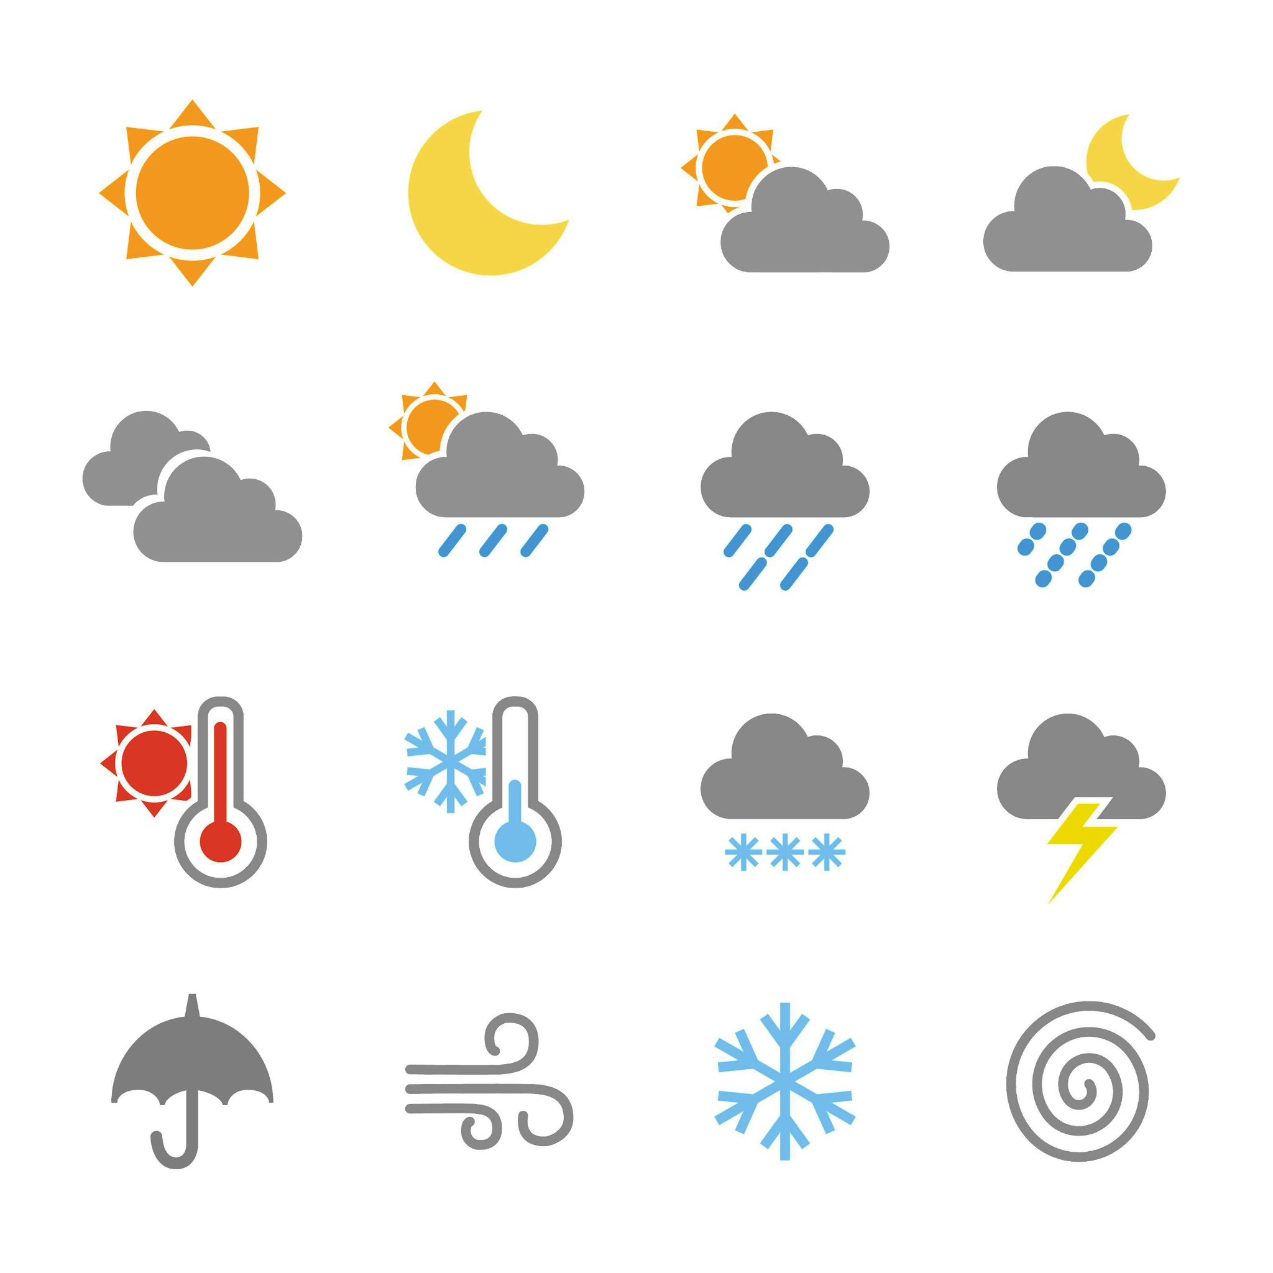
Fahamka saadaasha cimilada aasaasiga ah
Waxaa jira laba qaab oo caadi ah oo loo arko saadaasha cimilada.
Warbixin cimilo
06:00 | 09:00 | 12:00 | 15:00 | 18:00 | 21:00
9°C | 10°C | 13°C | 12°C | 11°C | 10°C
18°C
16°C
19°C
17°C
17°C
Khariidad cimilo

Slide 10
Fahamka saadaasha cimilada aasaasiga ah
Warbixinnada cimiladu waa hab fiican oo lagu qiimeeyo xaaladaha cimilada meel keliya muddo ka mid ah (sida hal maalin ama maalmo badan).
Warbixinnada cimilada ee kala duwan waxay bixin doonaan heerar kala duwan oo macluumaad ah, laakiin waxaad inta badan arki doontaa…
waqti
00:00 | 03:00 | 06:00 | 09:00 | 12:00 | 15:00 | 18:00 | 21:00
7°C | 5°C | 9°C | 10°C | 11°C | 12°C | 12°C | 10°C
xaaladaha cimilada
heerkulka
cimilada “Oakfield Old Town”

Slide 11
Fahamka saadaasha cimilada ee aasaasiga ah
Saadaasha cimiladu waxay muujin doontaa cimilada la filayo waqti go'an.
Xaaladaha cimilada ee waqti kasta oo kale (aan ku jirin saadaasha) waxay noqon karaan wax kasta. Si kastaba ha ahaatee, badanaa waa mid ka mid ah xaaladaha cimilada ee waqtiga warbixinta ama wax yar ka hor ama wax yar ka dib waqtigaas.
00:00 | 03:00 | 06:00 | 09:00 | 12:00 | 15:00 | 18:00 | 21:00
7°C | 5°C | 9°C | 10°C | 11°C | 12°C | 12°C | 10°C
10 subaxnimo, cimiladu waxay u badan tahay inay noqoto iftiin qorraxeed oo kala go'a ama roob dabayl ah, heerkulna u dhexeeya 10°C iyo 11°C.
cimilada 'Oakfield Old Town'
Tusaale ahaan, cimilada 9 subaxnimo waa iftiin qorraxeed oo kala go'a, cimilada 12 duhurnimo waa roob dabayl ah.
Roobka dabaylaha ahi wuxuu bilaabmi doonaa waqti u dhexeeya 9 subaxnimo iyo 12 duhurnimo.

Slide 12
Fahamka saadaasha cimilada ee aasaasiga ah
Dhammeystir labadan jumladood.
Heerkulka 3 subaxnimo wuxuu noqon doonaa 5°C .
Heerkulka 3 subaxnimo wuxuu noqon doonaa ___________ .
Heerkulka 4:30 subaxnimo waxaa u badan inuu u dhexeeyo 5°C iyo 9°C .
Heerkulka 4:30 subaxnimo waxaa u badan inuu u dhexeeyo ___________________ .
00:00 | 03:00 | 06:00 | 09:00 | 12:00 | 15:00 | 18:00 | 21:00
7°C | 5°C | 9°C | 10°C | 11°C | 12°C | 12°C | 10°C
cimilada 'Oakfield Old Town'

Slide 13
Fahamka saadaasha cimilada ee aasaasiga ah
Waa maxay xaaladaha cimilada ee laga yaabo inay ahaadaan 7 fiidnimo?
Ama qorrax ama roob dabayl ah.
00:00 | 03:00 | 06:00 | 09:00 | 12:00 | 15:00 | 18:00 | 21:00
7°C | 5°C | 9°C | 10°C | 11°C | 12°C | 12°C | 10°C
cimilada 'Oakfield Old Town'

Slide 14
Fahamka saadaasha cimilada ee aasaasiga ah
Waa goorma u dhaxaysa labada wakhti ee qorraxdu soo baxdo?
Sharax sida aad u ogaatay.
00:00 | 03:00 | 06:00 | 09:00 | 12:00 | 15:00 | 18:00 | 21:00
7°C | 5°C | 9°C | 10°C | 11°C | 12°C | 12°C | 10°C
cimilo ee “Oakfield Old Town”
U dhexeeya 6 subaxnimo iyo 9 subaxnimo.
Tani waa sababta oo ah 6 subaxnimo cimiladu waxay muujinaysaa cir cad oo aan qorrax lahayn, halka 9 subaxnimo ay muujinayso cir cad oo qorrax leh.

Slide 15
Fahamka saadaasha cimilada aasaasiga ah
Khariidadaha cimiladu waa hab fiican oo lagu qiimeeyo xaaladaha cimilada ee goobo badan hal waqti.
Oakfield
18°C
Khariidadaha cimilada ee kala duwan waxay bixin doonaan heerar kala duwan oo macluumaad ah, laakiin sida caadiga ah waxaad arki doontaa…
16°C
19°C
Oakfield
Academy
xaaladaha cimilada
16°C
Oakfield
Harbour
heerkulka
15°C
17°C
Oakfield
Old Town
N
Oakmoor
15:00

Slide 16
Fahanka saadaasha cimilada ee aasaasiga ah
Khariidadda cimilada waxaa loo isticmaali karaa in lagu barbar dhigo xaaladaha cimilada meel ballaaran, oo lagu qiimeeyo noocyada isbeddellada ee jira.
Oakfield
18°C
19°C
Tusaale ahaan
3 pm, cimilada Oakfield waxay ka diiran tahay bari, oo ka qabow tahay galbeed.
16°C
Oakfield
Academy
16°C
Oakfield
Harbour
Dhanka waqooyi bari ee Oakfield, cimiladu waa qorrax. Si kastaba ha ahaatee, dhanka galbeed ee Oakfield, cimiladu waa daruuro leh roob da'aya.
15°C
17°C
Oakfield
Old Town
N
Oakmoor
15:00

Slide 17

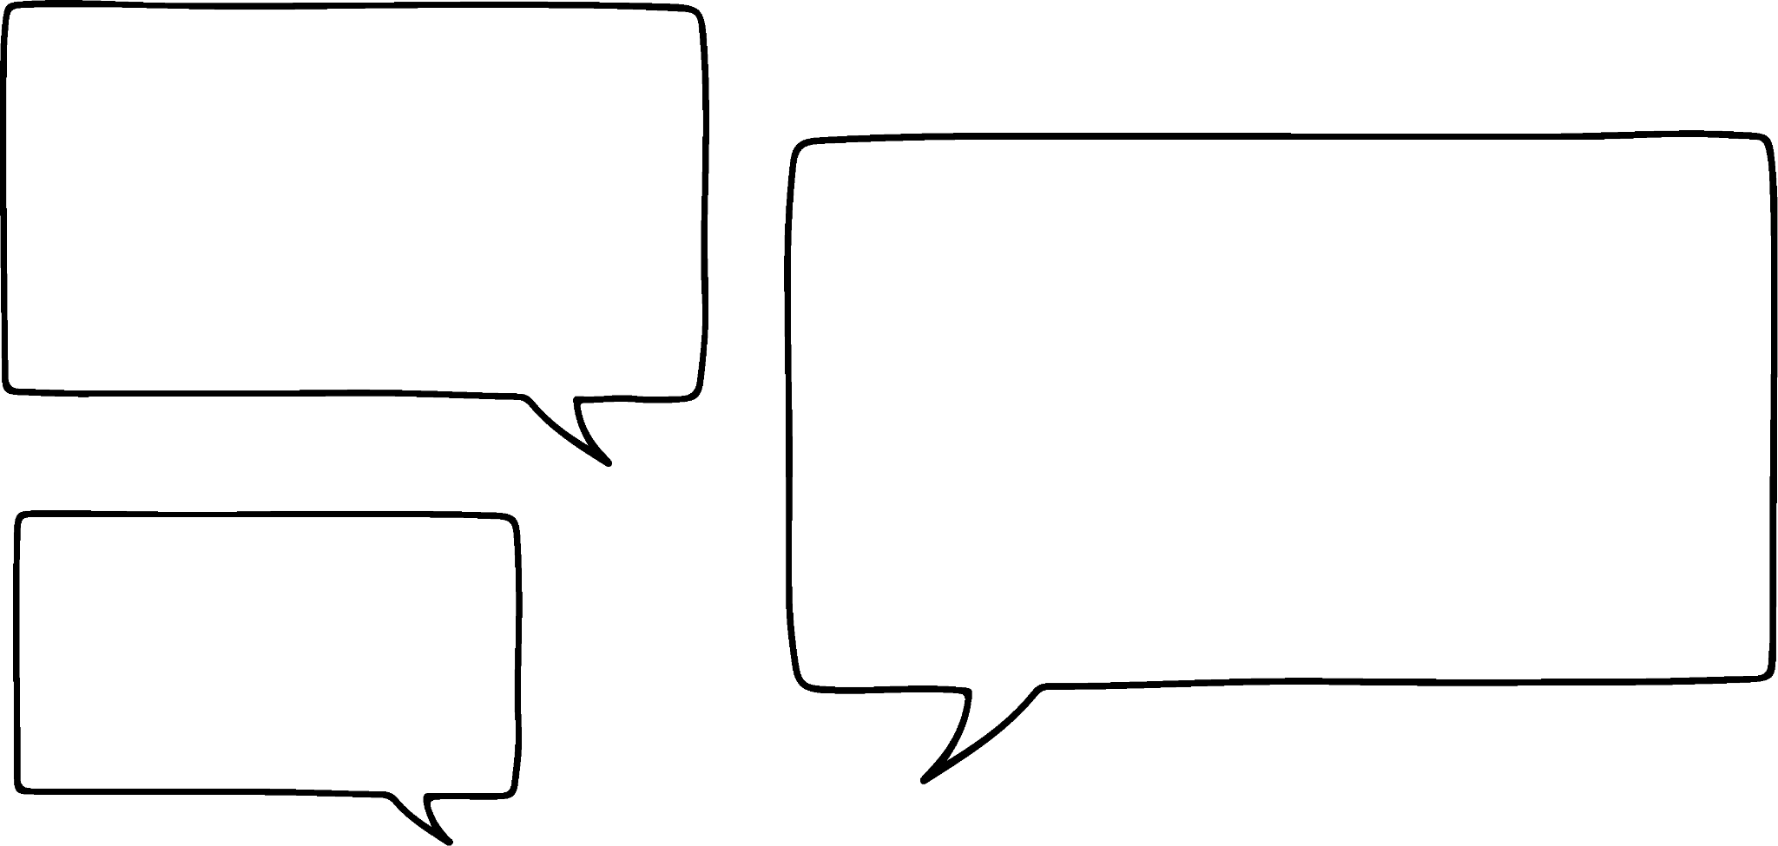









Fahanka saadaasha cimilada ee aasaasiga ah
Yaa hadalkiisu ku saabsan cimilada uu sax yahay?
Caasha
Waxaa jira roob waqooyi-bari Oakfield.
Oakfield
12°C
13°C
10°C
Oakfield
Academy
Layla
14°C
Waxaa jira roob Oakmoor.
Oakfield
Harbour
14°C
15°C
Cabdi
Heerkulka koonfurta Oakfield wuu ka diiran yahay waqooyiga Oakfield.
Oakfield
Old Town
N
Oakmoor
17:00

Slide 18
Fahamka saadaasha hawada ee aasaasiga ah
Goormee goobta ugu weyn isbeddelka heerkulka laga bilaabo 3 pm ilaa 5 pm?
Oakfield
12°C
Oakfield Academy | 16°C
Oakmoor | 15°C
Oakfield Old Town | 17°C
Oakfield Harbour | 19°C
13°C
10°C
Oakfield
Academy
14°C
Oakfield
Harbour
Heerkulka Oakfield marka 15:00
14°C
15°C
Oakfield Harbour
Oakfield
Old Town
N
Oakmoor
17:00

Slide 19
Fahamka saadaasha hawada ee aasaasiga ah
Oakfield Old Town waxay lahayd hoos u dhaca ugu weyn ee heerkulka laga bilaabo 3 galabnimo ilaa 11 habeenimo. Soo jeedi heerkul suurtagal ah oo ku yaal Oakfield Old Town saacadda 11 habeenimo.
Oakfield
11°C
Oakfield Academy | 16°C
Oakmoor | 15°C
Oakfield Old Town | 17°C
Oakfield Harbour | 19°C
9°C
8°C
Oakfield
Academy
10°C
Oakfield
Harbour
Heerkulka Oakfield ee 15:00
7°C
???
Oakfield
Old Town
Heerkul kasta oo ka hooseeya 6°C, sida: 5.5°C ama 2°C.
N
Oakmoor
23:00

Slide 20
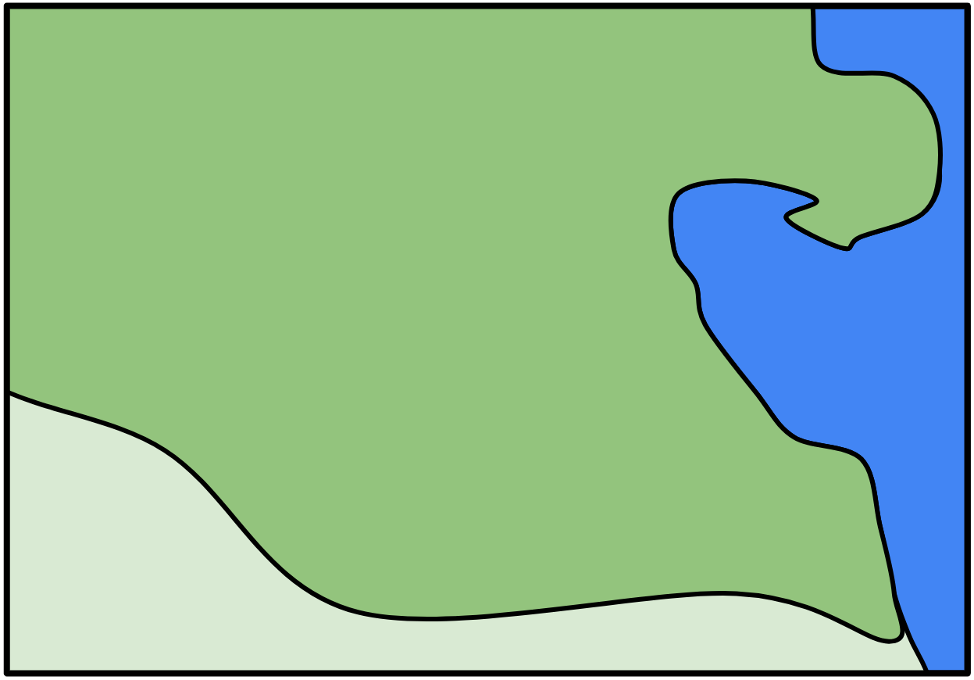
Fahamka saadaasha hawada ee aasaasiga ah
1) Saacadda 8 subaxnimo, Suad waxay ku socotaa Oakfield Academy gurigeeda oo u dhow Old Town. Xariiqda dhibcuhu waxay tusaysaa waddada Suad.
Oakfield
11°C
Suad waxay haysaa alaabtan soo socota. Kee ayay tahay inay u qaaddo safarkeeda Oakfield Academy? Sharax jawaabtaada mid kasta.
12°C
7°C
Oakfield
Academy
9°C
Oakfield
Harbour
muraayadaha qorraxda (cimilo qorrax oo joogto ah)
jaakad roobka (roob kasta oo yar)
shaal (haddii heerkulku ka hooseeyo 10°C)
8°C
10°C
Oakfield
Old Town
N
Oakmoor
08:00

Slide 21
Fahamka saadaasha cimilada ee aasaasiga ah
2) Warbixinta cimiladani waxay muujinaysaa xogta cimilada ee 1da Juun 2024.
00:00 | 02:00 | 04:00 | 06:00 | 08:00 | 10:00 | 12:00 | 14:00
9°C | 10°C | 8°C | 10°C | 13°C | 12°C | 11°C | 12°C
cimilo ku taal “Oakfield Harbour”
a) Waa goorma u dhaxaysa labada wakhti ee qorraxdu soo baxdo?
b) Sharax isbeddelka xaaladaha cimilada ee u dhexeeya 8 subaxnimo iyo 12 duhurnimo.
c) Waa maxay celceliska heerkulka (mean temperature) saacadaha habeenkii?
d) Xaaladaha cimilada ee soo socda midkee ayaa laga yaabaa inuu jiro 1 duhurnimo? Ku caddey doorashadaada.
Jawaabaha:
qorrax
qorrax dhexdhexaad ah
roob shub ah
roob culus
hillaac

Slide 22
Fahamka saadaasha hawada ee aasaasiga ah
00:00 | 03:00 | 06:00 | 09:00 | 12:00 | 15:00 | 18:00 | 21:00
6°C | 5°C | 9°C | 12°C | 13°C | 12°C | 10°C | 10°C
Warbixin cimilo oo ku saabsan goobta Oakfield.
Oakfield
12°C
3a) Goorta ee Oakfield ayay u badan tahay in warbixinta cimiladani ka hadlayso?
b) Waa maxay kala duwanaanshaha heerkulka (range of temperatures) goobtan?
c) Kala duwanaanshaha heerkulka goobta A wuxuu la mid yahay kii goobta warbixinta. Waa maxay heerkulka ugu sarreeya iyo ugu hooseeya goobta A?
13°C
10°C
A
Oakfield
Academy
8°C
Oakfield
Dekedda
10°C
9°C
B
N
Oakmoor
Oakfield
Magaalada Hore
18:00

Slide 23
Fahamka saadaasha hawada ee aasaasiga ah
1) Saacadda 8 subaxnimo, Sofia waxay ku socotaa Oakfield Academy gurigeeda oo u dhow Magaalada Hore. Xariiqda dhibcaysan waxay muujinaysaa wadada Sofia.
Oakfield
11°C
Sofia waxay haysaa alaabtan. Kee ayay tahay inay keento safarkeeda Oakfield Academy? Sharax jawaabtaada mid kasta.
12°C
7°C
Oakfield
Akadeemiye
9°C
Oakfield
Dekedda
muraayadaha qorraxda (cimilo qorrax oo joogto ah)
jaakad roob (roob kasta)
shaal (haddii heerkulku hoos u dhaco 10°C)
8°C
10°C
Oakfield
Magaalada Hore
N
Oakmoor
08:00

Slide 24
Fahamka saadaasha cimilada aasaasiga ah
Suad waa inay soo qaataa jaakad roobkeeda, sababtoo ah waxay dhex martaa laba meelood oo roobabka muujiya.
Suad waa inay sidoo kale soo qaataa shaashadeeda, sababtoo ah meelaha roobabka leh, heerkulku wuxuu ka hooseeyaa 10°C (8°C iyo 9°C).
Suad uma baahna inay soo qaato muraayadaha qorraxda, sababtoo ah waxaa jira wakhtiyo qorrax leh oo keliya Oakfield Academy, ma aha qorrax joogto ah.
Oakfield
11°C
12°C
7°C
Oakfield
Akadeemi (Academy)
9°C
Oakfield
Deked (Harbour)
8°C
10°C
Oakfield
Magaalada Hore (Old Town)
N
Oakmoor
08:00

Slide 25
Fahamka saadaasha cimilada aasaasiga ah
2) Warbixintan cimiladu waxay muujinaysaa xogta cimilada ee 1da Juun 2024.
00:00 | 02:00 | 04:00 | 06:00 | 08:00 | 10:00 | 12:00 | 14:00
9°C | 10°C | 8°C | 10°C | 13°C | 12°C | 11°C | 12°C
cimilo “Oakfield Harbour”
a) Waa goorma u dhexeeya labada wakhti ee qorraxdu soo baxdo?
b) Sharax isbeddelka xaaladaha cimilada inta u dhaxaysa 8 subaxnimo iyo 12 duhurnimo.
Inta u dhaxaysa 4 subaxnimo iyo 6 subaxnimo.
Roobabku wuxuu kordhaa roobab qaybsan ilaa roobab culus. Heerkulku sidoo kale wuxuu hoos u dhacaa 2°C, 13°C ilaa 11°C.

Slide 26
Fahamka saadaasha cimilada aasaasiga ah
2) Warbixintan cimiladu waxay muujinaysaa xogta cimilada ee 1da Juun 2024.
00:00 | 02:00 | 04:00 | 06:00 | 08:00 | 10:00 | 12:00 | 14:00
9°C | 10°C | 8°C | 10°C | 13°C | 12°C | 11°C | 12°C
cimilo “Oakfield Harbour”
c) Waa maxay celceliska heerkulka (mean temperature) inta lagu jiro saacadaha habeenkii?
(9°C + 10°C + 8°C) ÷ 3 = 9°C

Slide 27
Fahamka saadaasha cimilada aasaasiga ah
2) Warbixintani cimiladu waxay muujinaysaa xogta cimilada 1da Juun 2024.
00:00 | 02:00 | 04:00 | 06:00 | 08:00 | 10:00 | 12:00 | 14:00
9°C | 10°C | 8°C | 10°C | 13°C | 12°C | 11°C | 12°C
cimilo ee “Oakfield Harbour”
d) Xaaladaha cimilada ee noocee ah ayaa laga yaabaa inay jiraan 1 pm? Sharax doorashadaada.
Inkastoo cimiladu wax kasta noqon karto 1 pm, waxay u badan tahay inay tahay cimilada 12 pm (roob culus) ama cimilada 2 pm (qorrax dhexdhexaad ah), ama isku darka labadaba (roobab).
qorrax leh
qorrax dhexdhexaad ah
roobab
roob culus
hillaac

Slide 28
Fahamka saadaasha cimilada ee aasaasiga ah
00:00 | 03:00 | 06:00 | 09:00 | 12:00 | 15:00 | 18:00 | 21:00
6°C | 5°C | 9°C | 12°C | 13°C | 12°C | 10°C | 10°C
Warbixinta cimilada ee goob ku taal Oakfield.
Oakfield
12°C
3a) Goorta ee Oakfield ayay u badan tahay in warbixintani cimiladu ka hadlayso?
13°C
10°C
A
Oakfield
Academy
Oakmoor.
Sababtoo ah warbixinta iyo khariidadda labaduba waxay muujinayaan roob culus iyo heerkul 10°C 6 pm.
8°C
Oakfield
Harbour
10°C
9°C
B
N
Oakmoor
Oakfield
Old Town
18:00

Slide 29
Fahamka saadaasha cimilada (weather forecast) aasaasiga ah
00:00 | 03:00 | 06:00 | 09:00 | 12:00 | 15:00 | 18:00 | 21:00
6°C | 5°C | 9°C | 12°C | 13°C | 12°C | 10°C | 10°C
Warbixin cimilo (weather report) oo ku saabsan goob ku taal Oakfield.
Oakfield
12°C
b) Waa maxay kala duwanaanshaha (range) heerkulka (temperatures) goobtan?
13°C
10°C
A
Kala duwanaanshaha (range) heerkulka (temperatures) ee Oakmoor (warbixinta cimilada) waa 13°C – 5°C = 8°C.
Oakfield
Akadeemi (Academy)
8°C
Oakfield
Dekedda (Harbour)
10°C
9°C
B
N
Oakmoor
Oakfield
Magaalada Hore (Old Town)
18:00

Slide 30
Fahamka saadaasha cimilada (weather forecast) aasaasiga ah
00:00 | 03:00 | 06:00 | 09:00 | 12:00 | 15:00 | 18:00 | 21:00
6°C | 5°C | 9°C | 12°C | 13°C | 12°C | 10°C | 10°C
Warbixin cimilo (weather report) oo ku saabsan goob ku taal Oakfield.
Oakfield
12°C
c) Kala duwanaanshaha (range) heerkulka (temperatures) ee goobta A waa la mid kii goobta warbixinta. Waa maxay heerkulka ugu sarreeya (maximum) iyo ugu hooseeya (minimum) ee goobta A?
13°C
10°C
A
Oakfield
Akadeemi (Academy)
8°C
Oakfield
Dekedda (Harbour)
12°C + 8°C = 20°C
ama
12°C – 8°C = 4°C
10°C
9°C
B
N
Oakmoor
Oakfield
Magaalada Hore
18:00

Slide 31
Fahamka xogta hawada
Fahamka saadaasha hawada ee aasaasiga ah
Falanqaynta macluumaadka saadaasha dheeraadka ah

Slide 32



Falanqaynta macluumaadka saadaasha dheeraadka ah
Ma runbaa 16°C halkan Oakfield Academy?
Waxay dareentaa qabow badan intaas!
Oakfield
18°C
16°C
19°C
Oakfield
Akadeemi
16°C
Oakfield
Dekedda
15°C
Cali
17°C
Oakfield
Magaalada Hore
N
Oakmoor
15:00

Slide 33
Falanqaynta macluumaadka saadaasha dheeraadka ah
Heerkulka ugu badan ee lagu muujiyo saadaasha cimilada waa heerkulka hawada.
Oakfield
18°C
16°C
19°C
16°C
Marka, 16°C ee Oakfield Academy waxay muujinaysaa oo kaliya heerkulka hawada banaanka saacadda 3 pm.
Oakfield
Akadeemi
16°C
Oakfield
Dekedda
15°C
17°C
Waa maxay arrimo kale oo cimilo oo ka dhigi kara heerkulka inuu dareemo qabow ka badan 16°C Cali?
Oakfield
Old Town
N
Oakmoor
15:00

Slide 34
Falanqaynta macluumaadka saadaasha dheeraadka ah
Farqiga u dhexeeya heerkulka hawada iyo waxa heerkulka dhab ahaan dareemo waxaa sababi kara:
Oakfield
18°C
16°C
19°C
16°C
roobabka (rainfall)
xawaaraha dabaysha (wind-speed)
jihooyinka dabaysha (wind direction)
cadaadiska hawada (air pressure)
qoyaanka (humidity)
Oakfield
Academy
16°C
Oakfield
Harbour
15°C
17°C
Oakfield
Old Town
N
Oakmoor
15:00

Slide 35
Falanqaynta macluumaadka saadaasha dheeraadka ah
Heerkulka 'feels like' ee Oakfield Academy wuxuu noqon karaa mid hooseeya sababtoo ah roobka qabow iyo dabaylaha.
Oakfield
Oakfield
18°C
18°C
19°C
16°C
16°C
12°C
Oakfield
Akadeemi (Academy)
Oakfield
Akadeemi (Academy)
16°C
14°C
Oakfield
Harbour
Cali
Oakfield
Harbour
15°C
10°C
17°C
13°C
In kastoo heerkulka hawada ee Oakfield Academy uu yahay 16°C, waxay u muuqataa inay ku dhowdahay 12°C sababtoo ah roobka qabow iyo dabaylaha badan.
Oakfield
Old Town
Oakfield
Old Town
N
N
Oakmoor
Oakmoor
Heerkulka 'feels like'
15:00
15:00
Sawirada cimilada: Raura7/ Shutterstock.com

Slide 36
Falanqaynta macluumaadka saadaasha dheeriga ah
Khariidadda cimilada iyo warbixinta cimilada labaduba waxay muujin karaan macluumaad dheeri ah oo siiya faahfaahin dheeri ah oo ku saabsan xaaladaha cimilada.
Macluumaadkan dheeriga ah wuxuu kaa caawin karaa inuu sharaxo farqiga u dhexeeya heerkulka hawada iyo heerkulka "feels like" (dareenka) wakhti kasta.
00:00 | 03:00 | 06:00 | 09:00 | 12:00 | 15:00 | 18:00 | 21:00
10°C | 9°C | 11°C | 14°C | 11°C | 11°C | 16°C | 10°C
xawaaraha dabaysha (km/h)
jihooyinka dabaysha
4 | 4 | 7 | 8 | 10 | 16 | 7 | 5
↗ | ↓ | ↓ | ↓ | ↙ | ↙ | ↗ | ↙
"feels like" (dareenka)
10°C | 7.5°C | 9°C | 11.5°C | 7°C | 5°C | 16°C | 8°C

Slide 37
Falanqaynta macluumaadka saadaasha dheeriga ah
Mararka qaarkood, kororka xawaaraha dabaysha wuxuu ka dhigi karaa heerkulka mid qabow.
Warbixintan cimilada, kororka xawaaraha dabaysha laga bilaabo 10 km/h ilaa 16 km/h wuxuu hoos u dhigayaa heerkulka "feels like" (dareenka) 2°C, xitaa haddii heerkulka hawadu isku mid yahay.
00:00 | 03:00 | 06:00 | 09:00 | 12:00 | 15:00 | 18:00 | 21:00
10°C | 9°C | 11°C | 14°C | 11°C | 11°C | 16°C | 10°C
xawaaraha dabaysha (km/h)
jihooyinka dabaysha
4 | 4 | 7 | 8 | 10 | 16 | 7 | 5
↗ | ↓ | ↓ | ↓ | ↙ | ↙ | ↗ | ↙
"feels like" (dareenka)
10°C | 7.5°C | 9°C | 11.5°C | 7°C | 5°C | 16°C | 8°C

Slide 38
Falanqaynta macluumaadka saadaasha dheeriga ah
Mararka qaarkood, kororka xawaaraha dabaysha wuxuu ka dhigi karaa heerkulka mid qabow.
Intaa waxaa dheer, dabaysha ka timaadda jiho koonfur-galbeed uma muuqato inay saameyn ku leedahay heerkulka, halka dabaysha ka timaadda jiho kasta oo woqooyi ah ay u muuqato inay hoos u dhigto heerkulka "feels like" (dareenka).
00:00 | 03:00 | 06:00 | 09:00 | 12:00 | 15:00 | 18:00 | 21:00
10°C | 9°C | 11°C | 14°C | 11°C | 11°C | 16°C | 10°C
xawaaraha dabaysha (km/h)
jihooyinka dabaysha
4 | 4 | 7 | 8 | 10 | 16 | 7 | 5
↗ | ↓ | ↓ | ↓ | ↙ | ↙ | ↗ | ↙
"feels like" (dareenka)
10°C | 7.5°C | 9°C | 11.5°C | 7°C | 5°C | 16°C | 8°C

Slide 39
Falanqaynta macluumaadka saadaasha dheeriga ah
Waqtigee maalinta dabayshu waxay keentaa farqiga ugu weyn ee u dhexeeya heerkulka hawada iyo heerkulka "feels like" (dareenka)?
3 pm
00:00 | 03:00 | 06:00 | 09:00 | 12:00 | 15:00 | 18:00 | 21:00
6°C | 8°C | 10°C | 13°C | 17°C | 16°C | 15°C | 11°C
xawaaraha dabaysha (km/h)
jihada dabaysha
7 | 7 | 10 | 12 | 14 | 16 | 15 | 10
↗ | ← | ← | ↗ | ← | ← | ↗ | ←
“dareenka”
6°C | 6°C | 7°C | 12°C | 12°C | 10°C | 14°C | 8°C

Slide 40
Falanqaynta macluumaadka saadaasha dheeraadka ah
Laba jihada dabaysha ee warbixinta cimiladaan, kee baa u muuqda mid saameyn ku leh heerkulka “dareenka”?
Dabaylaha bari (dabaylaha ka imanaya bari)
00:00 | 03:00 | 06:00 | 09:00 | 12:00 | 15:00 | 18:00 | 21:00
6°C | 8°C | 10°C | 13°C | 17°C | 16°C | 15°C | 11°C
xawaaraha dabaysha (km/h)
jihada dabaysha
7 | 7 | 10 | 12 | 14 | 16 | 15 | 10
↗ | ← | ← | ↗ | ← | ← | ↗ | ←
“dareenka”
6°C | 6°C | 7°C | 12°C | 12°C | 10°C | 14°C | 8°C

Slide 41
Falanqaynta macluumaadka saadaasha dheeraadka ah
Cadaadiska hawada ee cufnaan kala duwan ayaa sidoo kale saameyn ku yeelan kara xaaladaha cimilada.
Oakfield
13°C
Jawiga qabow waxaa lagu muujiyaa xariiq buluug ah iyo saddexagallo.
Jihada ay u jeedaan saddexagalladu waxay muujinaysaa jihada hawada qabow ee ugu badan taasoo keenta heerkul hoose iyo roob.
17°C
9°C
Oakfield
Akadeemiye
16°C
Oakfield
Harbour
18°C
12°C
Oakfield
Old Town
N
Oakmoor
10:00

Slide 42
Falanqaynta macluumaadka saadaasha dheeraadka ah (Analysing extra forecast information)
Cadaadiska hawada ee cufnaanta kala duwan (Air pressures of different densities) ayaa sidoo kale saameyn ku yeelan kara xaaladaha cimilada.
Oakfield
Goobaha ay saameeyaan qabowga hore (cold fronts) ayaa u badan roobab.
“Boqolleyda fursadda roobka (percentage chance of rainfall)” waxaa sidoo kale lagu muujin karaa khariidadda cimilada ama warbixinta cimilada.
60%
15%
100%
Oakfield
Akadeemi (Academy)
10%
Oakfield
Harbour
< 5%
55%
Oakfield
Old Town
N
Oakmoor
10:00

Slide 43
Falanqaynta macluumaadka saadaasha dheeraadka ah (Analysing extra forecast information)
Cadaadiska hawada ee cufnaanta kala duwan (Air pressures of different densities) ayaa sidoo kale saameyn ku yeelan kara xaaladaha cimilada.
Oakfield
20°C
Qabowga hore (warm front) waxaa lagu muujiyaa xariiq cas iyo goobo nus ah (semicircles).
Jihada ay u jeedaan goobo nuska (semicircles) ayaa muujinaysa jihada hawada diiran ee u badan (dominant warm air) taasoo keenta heerkul kulul iyo cirro cad.
21°C
19°C
Oakfield
Akadeemi (Academy)
16°C
Oakfield
Harbour
17°C
14°C
Oakfield
Old Town
N
Oakmoor
16:00

Slide 44
Falanqaynta macluumaadka saadaasha dheeraadka ah
Oakfield
Khariidadan cimiladu waxay muujinaysaa 'boqolkiiba fursada roobka' saddex meelood oo kala duwan.
Qor qiyam ku habboon a iyo b.
b
Oakfield
Akadeemi (Academy)
65%
Oakfield
Harbour (Deked)
a
a waa inay ku dhowaadaan 65%, halka b ay tahay inay aad uga hooseeyaan 65%.
Oakfield
Old Town (Magaalada Hore)
N
Oakmoor
16:00

Slide 45
Falanqaynta macluumaadka saadaasha dheeraadka ah
Oakfield
Kee ka mid ah meelahan ayaa u badan inuu leeyahay heerkul 25°C?
a) Oakfield Academy
b) Oakmoor
c) Oakfield Harbour
d) Oakfield Old Town
Oakfield
Akadeemi (Academy)
Oakfield
Harbour (Deked)
23°C
Oakfield
Old Town (Magaalada Hore)
N
Oakmoor
16:00

Slide 46
Falanqaynta macluumaadka saadaasha dheeraadka ah
1) Warbixintan cimiladu waxay muujinaysaa saadaasha cimilada ee Oakfield Harbour.
a) Jihada dabayshee keenta farqiga ugu badan iyo ugu yar ee u dhexeeya heerkulka hawada iyo heerkulka "feels like"?
b) Dabayl qabow (cold front) ayaa ku soo duuli doonta Oakfield Harbour. Adigoo isticmaalaya warbixinta cimilada, qor waqtiga ugu macquulsan ee tani dhacdo, oo caddey jawaabtaada.
00:00 | 03:00 | 06:00 | 09:00 | 12:00 | 15:00 | 18:00 | 21:00
13°C | 15°C | 15°C | 22°C | 24°C | 18°C | 14°C | 12°C
heerkulka hawada (air temperature)
xawaaraha dabaysha (km/h)
jihada dabaysha (wind direction)
2 | 5 | 7 | 3 | 8 | 14 | 11 | 2
↗ | ↑ | ↑ | ← | ← | ← | ← | ←
"feels like"
13°C | 14°C | 14°C | 21°C | 22°C | 14°C | 10°C | 9°C

Slide 47
Falanqaynta macluumaadka saadaasha dheeraadka ah
Warbixinta cimilada ee 1da Luulyo ee Oakfield Old Town.
08:00 | 11:00 | 14:00 | 17:00
6°C | 10°C | 17°C | 18°C
2) Qoyaanku (Humidity) wuxuu cabbiraa qadarka qoyaanka hawada. Sidoo kale wuxuu saameeyaa heerkulka "feels like".
a) Maalintee, iyo waqtigee, ayaa jirtay farqiga ugu weyn ee u dhexeeya heerkulka hawada iyo heerkulka "feels like"?
heerkulka hawada (air temperature)
qoyaanka (humidity)
30% | 45% | 70% | 65%
"feels like"
5°C | 12°C | 20°C | 20°C
Warbixin cimilo 10dii Luulyo ee Oakfield Old Town.
08:00 | 11:00 | 14:00 | 17:00
6°C | 10°C | 17°C | 18°C
heerkulka hawada (air temperature)
qoyaanka (humidity)
20% | 20% | 15% | 15%
"feels like"
5°C | 9°C | 16°C | 17°C

Slide 48
Falanqaynta macluumaadka saadaasha dheeraadka ah
Warbixin cimilo 1dii Luulyo ee Oakfield Old Town.
08:00 | 11:00 | 14:00 | 17:00
6°C | 10°C | 17°C | 18°C
2) Qoyaan (Humidity) waxay cabbirtaa xaddiga qoyaanka hawada ku jira. Waxay sidoo kale saamaysaa heerkulka "dareenka" (feels like).
b) Dhammaystir jumladan:
"Qoyaan sare (Humidity) waxay u badan tahay inay keento ___________ heerkulka 'dareenka' (feels like) marka la barbar dhigo heerkulka hawada."
c) Waa maxay xaaladaha cimilada ee keeni kara qoyaan sare (Humidity)?
heerkulka hawada
qoyaanka (Humidity)
30% | 45% | 70% | 65%
"dareenka" (feels like)
5°C | 12°C | 20°C | 20°C
Warbixin cimilo 10dii Luulyo ee Oakfield Old Town.
08:00 | 11:00 | 14:00 | 17:00
6°C | 10°C | 17°C | 18°C
heerkulka hawada
qoyaanka (Humidity)
20% | 20% | 15% | 15%
"dareenka" (feels like)
5°C | 9°C | 16°C | 17°C

Slide 49
Falanqaynta macluumaadka saadaasha dheeraadka ah
3) Adigoo isticmaalaya macluumaadka khariiddada cimilada iyo warbixinta cimilada, samee saadaal macquul ah oo ku saabsan faahfaahinta cimilada ee maqan saacadda 4 galabnimo ee Oakmoor.
Qor jumlado caddaynaysa saadaashaada.
Oakfield
12:00 | 16:00
11°C
8 | 12
↙ | ↙
20%
10°C
A
heerkulka hawada
xawaaraha dabaysha (km/h)
jihooyinka dabaysha
% fursadda roobka
“dareenka”
Oakfield
Academy
Oakfield
Harbour
B
N
cimilada “Oakmoor”
Oakmoor
Oakfield
Old Town
12:00

Slide 50
Falanqaynta macluumaadka saadaasha dheeraadka ah
1) Warbixintan cimiladu waxay muujinaysaa saadaasha cimilada ee Oakfield Harbour.
a) Jihooyinka dabaysha ee keenaya farqiga ugu badan iyo ugu yar ee u dhexeeya heerkulka hawada iyo heerkulka “dareenka”?
Dabaysha koonfureed waxay keentaa farqiga ugu yar (ugu badnaan 1°C farqi).
Dabaysha bari waxay keentaa farqiga ugu badan (ugu badnaan 4° farqi).
00:00 | 03:00 | 06:00 | 09:00 | 12:00 | 15:00 | 18:00 | 21:00
13°C | 15°C | 15°C | 22°C | 24°C | 18°C | 14°C | 12°C
heerkulka hawada
xawaaraha dabaysha (km/h)
jihooyinka dabaysha
2 | 5 | 7 | 3 | 8 | 14 | 11 | 2
↗ | ↑ | ↑ | ← | ← | ← | ← | ←
“dareenka”
13°C | 14°C | 14°C | 21°C | 22°C | 14°C | 10°C | 9°C

Slide 51
Falanqaynta macluumaadka saadaasha dheeraadka ah
b) Dabayl qabow (cold front) ayaa ku dhufan doonta Oakfield Harbour. Adigoo isticmaalaya warbixinta cimilada, qor waqtiga ugu macquulsan ee tani dhacdo, oo caddey jawaabtaada.
Waxay u badan tahay in dabaysha qabowgu ay ku dhufatay Oakfield Harbour intii u dhaxaysay 12 pm iyo 3 pm. Sababta waxaa weeye in xaaladaha cimilada ay ka rogmadeen qorrax cad oo kala goys ah oo roob culus, heerkulkuna wuxuu bilaabay inuu si weyn hoos ugu dhaco, laga bilaabo wakhtigan.
00:00 | 03:00 | 06:00 | 09:00 | 12:00 | 15:00 | 18:00 | 21:00
13°C | 15°C | 15°C | 22°C | 24°C | 18°C | 14°C | 12°C
heerkulka hawada
xawaaraha dabaysha (km/h)
jiho dabaysha
2 | 5 | 7 | 3 | 8 | 14 | 11 | 2
↗ | ↑ | ↑ | ← | ← | ← | ← | ←
“dareenka”
13°C | 14°C | 14°C | 21°C | 22°C | 14°C | 10°C | 9°C

Slide 52
Falanqaynta macluumaadka saadaasha dheeraadka ah
Warbixinta cimilada 1da Luulyo ee Oakfield Old Town.
08:00 | 11:00 | 14:00 | 17:00
6°C | 10°C | 17°C | 18°C
2) Qoyaanku (Humidity) wuxuu cabbiraa qadarka qoyanka hawada. Wuxuu sidoo kale saameeyaa heerkulka “dareenka”.
a) Maalintee, iyo waqtigee, ayaa jirtay farqiga ugu weyn ee u dhexeeya heerkulka hawada iyo heerkulka “dareenka”?
heerkulka hawada
qoyaanka (Humidity)
30% | 45% | 70% | 65%
“dareenka”
5°C | 12°C | 20°C | 20°C
Warbixinta cimilada 10ka Luulyo ee Oakfield Old Town.
08:00 | 11:00 | 14:00 | 17:00
6°C | 10°C | 17°C | 18°C
Farqiga ugu weyn wuxuu ahaa 1da Luulyo saacadda 2 pm. Heerkulka “dareenka” wuxuu ahaa 3°C ka sarreeya heerkulka hawada.
heerkulka hawada
qoyaanka (Humidity)
20% | 20% | 15% | 15%
“dareenka”
5°C | 9°C | 16°C | 17°C

Slide 53
Falanqaynta macluumaadka saadaasha dheeraadka ah
Warbixin cimilo 1dii Luulyo ee Oakfield Old Town.
08:00 | 11:00 | 14:00 | 17:00
6°C | 10°C | 17°C | 18°C
b) Dhammaystir weedhan:
“Qoyaanka (humidity) sare wuxuu u badan yahay inuu kordhiyo heerkulka “feels like” marka la barbardhigo heerkulka hawada (air temperature).”
c) Waa maxay xaaladaha cimilada ee keeni kara qoyaanka (humidity) sare?
heerkulka hawada
qoyaanka (Humidity)
30% | 45% | 70% | 65%
“dareenka”
5°C | 12°C | 20°C | 20°C
Warbixin cimilo 10dii Luulyo ee Oakfield Old Town.
08:00 | 11:00 | 14:00 | 17:00
6°C | 10°C | 17°C | 18°C
Uumiga (evaporation) roobka sababtoo ah heerkulka sare wuxuu keeni karaa qoyaanka (humidity) sare.
heerkulka hawada
qoyaanka (Humidity)
20% | 20% | 15% | 15%
“dareenka”
5°C | 9°C | 16°C | 17°C

Slide 54
Falanqaynta macluumaadka saadaasha dheeraadka ah
3) Adigoo isticmaalaya macluumaadka khariidda cimilo iyo warbixinta cimilo, samee saadaal macquul ah oo ku saabsan faahfaahinta maqan ee xaaladda cimilo ee 4 galabnimo ee Oakmoor.
Qor jumlad oo caddaynaysa saadaashaada.
Oakfield
12:00 | 16:00
11°C
8 | 12
↙ | ↙
20%
10°C
A
heerkulka hawada (air temperature)
xawaaraha dabaysha (km/h)
jiho dabaysha (wind direction)
% fursad roob (chance of rain)
“feels like”
Oakfield
Academy
Oakfield
Harbour
B
N
Oakfield
Old Town
cimilo ee “Oakmoor”
Oakmoor
12:00

Slide 55
Falanqaynta macluumaadka saadaasha dheeraadka ah
Jihooyinka dabaysha waxay u badan tahay inay ku qaaddo qabowga (cold front) ee Oakmoor. Qabowgu wuxuu hoos u dhigi doonaa heerka kulka hawada wuxuuna kordhin doonaa fursadda roobka. Dabaylaha xooggan iyo fursadda roobka sare awgood, “dareenka” heerkulka ayaa sidoo kale hoos u dhici kara.
Oakfield
12:00 | 16:00
11°C | 6°C
8 | 12
↙ | ↙
20% | 80%
10°C | 3°C
A
heerka kulka hawada (air temperature)
xawaaraha dabaysha (km/h)
jihooyinka dabaysha (wind direction)
% fursadda roobka
“dareenka” (feels like)
Oakfield
Akadeemiye (Academy)
Oakfield
Dekedda (Harbour)
B
N
Tusaale saadaal habboon.
Oakmoor
Oakfield
Magaalada Hore (Old Town)
12:00

Slide 56
Fahamka xogta cimilada (weather data)
Saadaasha cimilada waxaa lagu muujin karaa khariidad cimilo ama warbixin cimilo. Waxaa jira faa'iidooyin labada noocba.
Xaaladaha cimilada kala duwan waxaa lagu matali karaa astaamo (icons) kala duwan.
Saadaasha cimilada aasaasiga ah waxay badanaa muujisaa xaaladaha cimilada iyo heerka kulka hawada.
Hase yeeshee, saadaasha cimilada kakan waxay sidoo kale muujin kartaa: xawaaraha dabaysha, jihooyinka dabaysha, qabowga iyo kulaylka (cold and warm fronts), fursadda roobka, ama heerka qoyaanka.
Xogaha cimilada ee kale waxay saameyn karaan sida heerkulka loo dareemo marka la barbar dhigo heerka kulka hawada.

