Slide 1
Isticmaalka jaantuska Venn si loo muujiyo natiijooyinka in ka badan laba dhacdo
Itimaalka (Probability): natiijooyinka suurtagalka ah

Slide 2
Sida agabkeena waxbarista loogu talagalay fasalka

Slide 3
Waxaan si nidaamsan u heli karaa dhammaan natiijooyinka suurtagalka ah ee in ka badan laba dhacdo adigoo isticmaalaya jaantuska Venn.

Slide 4
Jaantusyada Venn waa matalaad loo isticmaalo in lagu qaabeeyo su'aalaha tirakoobka/itimaalka. Caadi ahaan goobo ayaa loo isticmaalaa in lagu matalo dhacdooyinka.

Slide 5

Isticmaalka jaantuska Venn si loo muujiyo natiijooyinka in ka badan laba dhacdo
Jaantusyada Venn
Natiijooyinka ka yimaada jaantuska Venn

Slide 6
Jaantusyada Venn
Marka wareejintan la wareejiyo natiijooyinka waa {1, 2, 3, 4, 5, 6, 7, 8, 9, 10}, waxaan ugu yeernaa booska muunadda (sample space).
3
4
Natiijooyinka waxaa lagu kala saari karaa jaantuska Venn ee laba dhacdo.
2
5
1
6
Tusaale: Dhacdo A = {nambar togan (even number)}
Dhacdo B = {qaybiyaha 20 (factor of 20)}
10
7
ξ
9
8
A
B
1
6
2
Haddii dhacdo saddexaad {nambar labajibbaaran (square number)} lagu daro, ma jirtaa hab lagu muujiyo jaantuska Venn?
4
8
5
10
7
9
3

Slide 7
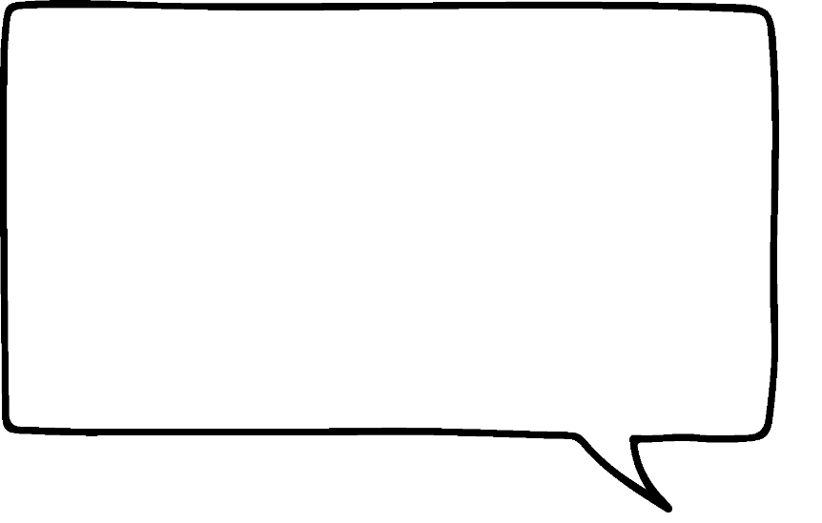

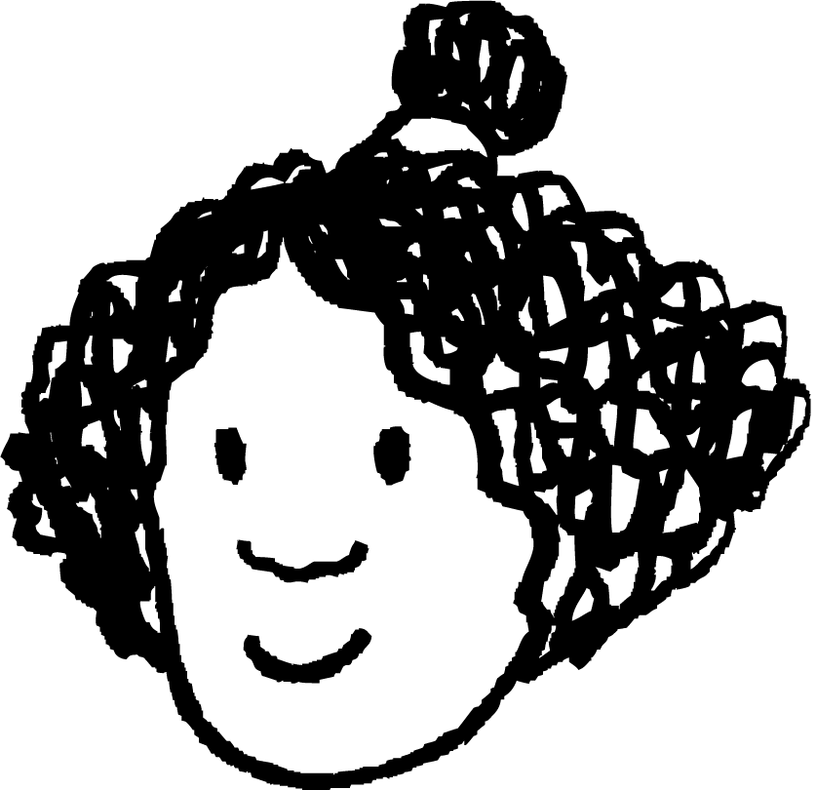

Jaantusyada Venn
Haddii dhacdo A = {nambar togan}, dhacdo B = {qaybiyaha 20} iyo dhacdo C = {nambar labajibbaaran}.
3
4
ξ
B
2
5
A
C
1
6
6
2
1
Waxaa laga yaabaa in qaabka jaantuska Venn uu noqdo sidan, kaliya goobo dheeri ah.
10
7
4
9
8
8
10
5
7
9
3
Ma dhacdo kastaa waxay leedahay natiijooyinka saxda ah?
Maya, {4} waa nambar labajibbaaran sidoo kale waa togan iyo qaybiyaha 20.
Isra

Slide 8
Jaantusyada Venn
Haddii dhacdo A = {nambar togan}, dhacdo B = {qaybiyaha 20} iyo dhacdo C = {nambar labajibbaaran}.
3
4
ξ
B
2
5
A
C
1
6
6
2
1
Marka, dhacdada (event) C waa inay isgoysaa (intersect) labada dhacdo A iyo B. Ma jirtaa qaab loo sameeyo?
10
7
4
9
8
8
10
5
7
9
3
Dhacdo kasta ma leedahay natiijooyinka (outcomes) saxda ah?
Maya, {4} waa tiro labajibbaaran (square number) sidoo kalena waa xitaa (even) iyo qaybiye (factor) 20.
Isra

Slide 9
Jaantusyada Venn (Venn diagrams)
Haddii dhacdada A = {tiro xitaa}, dhacdada B = {qaybiye 20} iyo dhacdada C = {tiro labajibbaaran}.
Natiijada {4} hadda waxay ku jirtaa isgoyska (intersection) dhammaan saddexda dhacdo.
3
4
ξ
2
5
A
B
6
2
5
1
6
10
10
7
8
4
Qaabdhismeedkani wuxuu u muuqdaa mid shaqeeya. Dhacdo kasta waxay isgoysaa dhacdo kasta oo kale.
9
8
1
7
C
9
3
Isra

Slide 10
Jaantusyada Venn
Haddii dhacdada A = {tiro xitaa}, dhacdada B = {qaybiye 20} iyo dhacdada C = {tiro labajibbaaran}.
Isgoyskani wuxuu u yaal natiijooyinka dhacdada B iyo dhacdada C. Qaybiyeyaasha 20 ee sidoo kale ah tirooyin labajibbaaran.
3
4
ξ
2
5
A
B
6
2
5
1
6
10
10
7
8
4
9
8
1
7
C
9
3

Slide 11
Jaantusyada Venn
Haddii dhacdada A = {tiro xitaa}, dhacdada B = {qaybiye 20} iyo dhacdada C = {tiro labajibbaaran}.
Isgoyskani wuxuu u yaal natiijooyinka dhacdada B iyo dhacdada C laakiin kuma jiraan dhacdada A. Qaybiyeyaasha 20 ee sidoo kale ah tirooyin labajibbaaran laakiin aan xitaa ahayn.
3
4
ξ
2
5
A
B
6
2
5
1
6
10
10
7
8
4
9
8
1
7
C
9
3

Slide 12
Jaantusyada Venn
Maxay ka dhigan tahay qaybta hooska leh (shaded section) ee jaantuska Venn?
ξ
Natiijooyinka ku jira dhacdada A iyo dhacdada C laakiin kuma jiraan dhacdada B.
A
B
C

Slide 13
Jaantusyada Venn
Maxay ka dhigan tahay qaybta hooska leh ee jaantuska Venn?
ξ
Natiijooyinka kaliya ku jira dhacdada A.
A
B
C

Slide 14
Jaantusyada Venn
Jaantuskan Venn wuxuu matalaa arday qaar.
A = {booqday Spain}
ξ
B = {booqday France}
C = {booqday America}
A
B
Yacquub
Waxaan ka arki karnaa jaantuska Venn
in 8 arday la matalay
in 1 arday uusan booqan Spain, France iyo America midna
in 4 arday booqdeen America
in 2 arday booqdeen France iyo America labadaba
Cabdi
Saciid
Caasha
Nuur
Isra
Axmed
C
Cali

Slide 15
Jaantusyada Venn
Jaantuskan Venn wuxuu matalaa arday qaar.
A = {booqday Spain}
ξ
B = {booqday France}
C = {booqday America}
A
B
Yacquub
Yaa booqday Spain?
Cabdi
Saciid
Caasha
Cabdi, Saciid iyo Nuur
Nuur
Isra
Axmed
C
Cali

Slide 16
Jaantusyada Venn (Venn diagrams)
Jaantuskan Venn wuxuu muujinayaa arday qaar.
A = {booqday Spain}
ξ
B = {booqday France}
C = {booqday America}
A
B
Yacquub
Yaa booqday Spain, France iyo America?
Cabdi
Saciid
Caasha
Saciid
Nuur
Isra
Axmed
C
Cali

Slide 17
Jaantusyada Venn (Venn diagrams)
Jaantuskan Venn wuxuu muujinayaa arday qaar.
A = {booqday Isbayn (Spain)}
ξ
B = {booqday Faransiiska (France)}
C = {booqday Ameerika (America)}
A
B
Yacquub
Yaa kaliya booqday Faransiiska?
Cabdi
Saciid
Caasha
Yacquub iyo Caasha
Nuur
Isra
Axmed
C
Cali

Slide 18
Jaantusyada Venn (Venn diagrams)
Jaantuska Venn wuxuu muujinayaa xulashooyinka menu ee 8 arday.
Bilow (Starter)
ξ
G
F
Boqoshaada toonta (Garlic mushrooms) (G)
Yacquub
Cali
Axmed
Halloumi bites (H)
Caasha
Nuur
Cuntada weyn (Main)
Bacon cheeseburger (C)
Isra
Saciid
Kalluun iyo baradho (F)
Cabdi
Khudrad curry (V)
I
Macmacaan (Dessert)
Jalaato (I)
Waan ognahay saddexda cunto (courses) oo loo doortay qaar ka mid ah ardayda.
Salad khudradeed (S)

Slide 19
Jaantusyada Venn (Venn diagrams)
Jaantuska Venn wuxuu muujinayaa xulashooyinka cuntada ee 8 arday.
Bilowga cuntada
ξ
G
F
Garlic mushrooms (G)
Yacquub
Cali
Axmed
Halloumi bites (H)
Caasha
Nuur
Cuntada weyn (Main)
Bacon cheeseburger (C)
Isra
Saciid
Kalluun iyo chips (F)
Cabdi
Curry khudrad (V)
I
Macmacaan
Jalaato (I)
Waan ognahay saddexda cunto ee loo doortay qaar ka mid ah ardayda.
Salad khudrad (S)

Slide 20
Jaantusyada Venn (Venn diagrams)
Jaantuska Venn wuxuu muujinayaa doorashada cuntada ee 8 arday.
Bilow (Starter)
ξ
G
F
Garlic mushrooms (G)
Yacquub
Cali
Axmed
Halloumi bites (H)
Caasha
Nuur
Cuntada weyn
Bacon cheeseburger (C)
Isra
Saciid
Kalluun iyo chips (F)
Cabdi
Vegetable curry (V)
I
Macmacaan (Dessert)
Ice Cream (I)
Waan ognahay saddexda cunto (courses) oo loo doortay qaar ka mid ah ardayda.
Fruit Salad (S)

Slide 21
Jaantusyada Venn (Venn diagrams)
Jaantuska Venn (Venn diagram) wuxuu muujinayaa xulashooyinka cuntada (menu) ee 8 arday.
Bilow
ξ
G
F
Garlic mushrooms (G)
Yacquub
Cali
Axmed
Halloumi bites (H)
Caasha
Nuur
Cuntada weyn (Main)
Bacon cheeseburger (C)
Isra
Saciid
Fish and chips (F)
Cabdi
Curry khudrad (V)
I
Macmacaan
Jalaato (I)
Halka kuwa kalena aynaan u garanayn saddexda cunto.
Salad khudrad (S)

Slide 22
Jaantusyada Venn
Jaantuska Venn wuxuu muujinayaa xulashooyinka liiska cuntada ee 8 arday.
Bilow (Starter)
ξ
G
F
Mushroom toon (G)
Layla hadda way u soo socotaa cuntada. Waxay dalbanaysaa halloumi, curry khudrad iyo salad khudrad. Ku dar jaantuska Venn.
Yacquub
Cali
Axmed
Qaniinyada Halloumi (H)
Caasha
Nuur
Cuntada weyn
Bacon cheeseburger (C)
Isra
Saciid
Kalluun iyo chips (F)
Cabdi
Curry khudrad (V)
I
Layla
Macmacaan (Dessert)
Jalaato (Ice Cream) (I)
Salad Khudrad (Fruit Salad) (S)

Slide 23
Jaantusyada Venn (Venn diagrams)
1) Wareeg (spinner) ayaa leh natiijooyinka suurtagalka ah {3, 5, 6, 8, 10, 12, 15, 18, 20, 25}.
Dhacdada A = {tirooyin kisi (odd numbers)}, dhacdada B = {tiro qaybiyeyaasha 30 (factors of 30)} iyo dhacdada C = {tirooyin dhufsane 3 (multiples of 3)}.
Sawir jaantus Venn oo muujinaya macluumaadkan.
2) Waxaa jira 20 kaad oo ciyaar ah. Kaad kasta waa midab cas (R) ama madow (B) iyo lambar 1 ilaa 10. Tusaale, R3 waa kaad cas lambar 3.
Dhacdada A = {kaad madow (black cards)}, dhacdada B = {lambar siman (even number)} iyo dhacdada C = {tiro qaybiye 10 (factor of 10)}.
Sawir jaantus Venn oo muujinaya macluumaadkan.

Slide 24
Jaantusyada Venn (Venn diagrams)
3) Ku xidh weedhaha meelaha hadhka leh.
ξ
A
B
ξ
A
B
ξ
A
B
C
C
C
natiijooyinka dhacdada A
natiijooyinka dhacdada B kaliya
natiijooyinka dhacdada A iyo dhacdada B laakiin ma aha dhacdada C

Slide 25
Jaantusyada Venn (Venn diagrams)
1) Wareeggu wuxuu leeyahay natiijooyin suurtagal ah {3, 5, 6, 8, 10, 12, 15, 18, 20, 25}.
Dhacdada A = {tirooyin khariijin ah}, dhacdada B = {tirooyinka 30 qaybiya} iyo dhacdada C = {tirooyinka 3 ku dhufan}.
Sawir jaantus Venn (Venn diagram) si aad u muujiso macluumaadkan.
ξ
A
B
5
25
10
3
15
6
18
12
8
C
20

Slide 26
Jaantusyada Venn (Venn diagrams)
2) Waxaa jira 20 kaad oo ciyaar ah. Kaad kastaa waa mid cas (R) ama madow (B) iyo tiro 1 ilaa 10. Tusaale, R3 waa kaad cas oo tiro 3 ah.
Dhacdada A = {kaadaha madow}, dhacdada B = {tirooyin siman} iyo dhacdada C = {tirooyinka 10 qaybiya}.
Sawir jaantus Venn (Venn diagram) si aad u muujiso macluumaadkan.
ξ
A
B
B7
B4
R6
B9
R8
B8
B6
B3
R4
B10
B1
B2
R2
B5
R10
R5
R1
R7
R9
C
R3

Slide 27
Jaantusyada Venn (Venn diagrams)
3) Ku xidh weedhaha meelaha hadhka leh.
ξ
A
B
ξ
A
B
ξ
A
B
C
C
C
natiijooyinka dhacdada A
natiijooyinka dhacdada B kaliya
natiijooyinka dhacdada A iyo dhacdada B laakiin ma aha dhacdada C

Slide 28
Isticmaalka jaantus Venn (Venn diagram) si loo muujiyo natiijooyinka in ka badan laba dhacdo
Jaantusyada Venn (Venn diagrams)
Natiijooyinka ka soo baxa jaantus Venn (Venn diagram)

Slide 29
Natiijooyinka ka soo baxa jaantusyada Venn (Venn diagrams)
Halkan waa jaantus Venn (Venn diagram) oo loogu talagalay saddexda dhacdo A, B iyo C, halkaasoo:
ξ = {1, 2, 3, 4, 5, 6, 7, 8, 9, 10, 11, 12}
A = {tiro koowaad (prime number)} = {2, 3, 5, 7, 11}
B = {tiro kisi (odd number)} = {1, 3, 5, 7, 9, 11}
A
B
C = {qaybiyaha (factor) 12} = {1, 2, 3, 4, 6, 12}
7
9
11
5
{9} waa kisi (odd) kaliya
3
2
1
{3} waa koowaad (prime), kisi (odd), iyo qaybiyaha (factor) 12
6
12
8
4
C
10
{8, 10} ma aha koowaad (prime), kisi (odd), ama qaybiyaha (factor) 12

Slide 30
Natiijooyinka (outcomes) ka yimid jaantusyada Venn
Dhacdo A = {qaybiyaha (factors) 10}
Dhacdo B = {tiro siman (even numbers)}
Dhacdo C = {tiro dhufsan (multiples) 5}
Natiijo (outcome) kee ayaa ku jira dhacdooyinka saddexda?
ξ = {1, 2, 3, 4, 5, 6, 7, 8, 9, 10}
A
B
1
2
8
6
10
4
{10}
9
5
7
3
C

Slide 31
Natiijooyinka (outcomes) ka yimid jaantusyada Venn
Dhacdo A = {qaybiyaha (factors) 10}
Dhacdo B = {tiro siman (even numbers)}
Dhacdo C = {tiro dhufsan (multiples) 5}
Natiijo (outcome) kee ayaa qaybiyaha (factor) 10 kaliya?
ξ = {1, 2, 3, 4, 5, 6, 7, 8, 9, 10}
A
B
1
2
8
6
10
4
{1}
9
5
7
3
C

Slide 32
Natiijooyinka (outcomes) ka yimid jaantusyada Venn
Dhacdo A = {qaybiyaha (factors) 10}
Dhacdo B = {tiro siman (even numbers)}
Dhacdo C = {tiro dhufsan (multiples) 5}
Natiijooyinka (outcomes) kee ayaa ah qaybiyaha (factors) 10 iyo tiro dhufsan (multiples) 5 labadaba?
ξ = {1, 2, 3, 4, 5, 6, 7, 8, 9, 10}
A
B
1
2
8
6
10
4
{5, 10}
9
5
7
3
C

Slide 33
Natiijooyinka jaantusyada Venn
Jaantuska Venn waa la dhammeeyey saddex dhacdo, A, B iyo C.
ξ
A
B
16
Waxaan ka arki karnaa jaantuska Venn
in ay jiraan 7 natiijo oo ku jira dhacdada A
in ay jiraan 4 natiijo oo ku jira dhacdada B
in ay jiraan 5 natiijo oo ku jira dhacdada C
in aysan jirin natiijooyin aan ku jirin dhacdada A, B ama C
10
14
20
2
4
8
7
5
C

Slide 34
Natiijooyinka jaantusyada Venn
Buuxi meelaha bannaan.
ξ
A
B
Jaantuska Venn wuxuu muujinayaa in ay jiraan:
natiijooyin ku jira dhacdada A
natiijooyin ku jira dhacdada A iyo B
natiijooyin ku jira dhacdada C kaliya
1
11
9
12
6
7
3
2
6
2
5
8
2
10
4
C

Slide 35

Natiijooyinka jaantusyada Venn
Aan sawirno natiijooyinka.
Geedkan natiijadu wuxuu leeyahay saddex dhacdo: A, B iyo C.

Slide 36
Natiijooyinka jaantusyada Venn
Adoo tixgelinaya halka dhacdo kasta ku taal jaantuska Venn (Venn diagram), waxaan sidoo kale dhigi karnaa natiijooyinkan jaantuska Venn.
C
A,B,C
B
A
aan C ahayn
A, B, ma C
aan B ahayn
C
A, ma B, C
ma C
A, ma B, ma C
aan A ahayn
C
ma A, B, C
B
aan C ahayn
ma A, B, ma C
aan B ahayn
C
ma A, ma B, C
aan C ahayn
ma A, ma B, ma C
Jawaabaha:
1
2
ξ
B
A
3
2
6
4
4
1
5
3
5
7
6
8
C
7
8

Slide 37
Natiijooyinka jaantusyada Venn (Venn diagrams)
Sidoo kale, waxaan ka soo saari karnaa geed natiijo (outcome tree) jaantuska Venn.
ξ
A
B
A
1
11
1, 3, 5, 7, 9, 11
9
12
7
3
6
5
ma A
8
2
10
4
2, 4, 6, 8, 10, 12
C

Slide 38
Natiijooyinka jaantusyada Venn (Venn diagrams)
B
ξ
A
B
3, 9
A
1
11
1, 3, 5, 7, 9, 11
9
12
ma B
7
1, 5, 7, 11
3
6
5
B
ma A
10
6, 12
8
2
4
2, 4, 6, 8, 10, 12
C
ma B
2, 4, 8, 10

Slide 39
Natiijooyinka jaantusyada Venn (Venn diagrams)
C
Muuqaal kee ayaad door bidaysaa?
3
B
ma C
3, 9
9
A
C
1, 3, 5, 7, 9, 11
ma B
5
ξ
A
B
1, 5, 7, 11
ma C
1
11
1, 7, 11
9
12
C
7
B
3
ma A
6
6, 12
ma aha C
6
2, 4, 6, 8, 10, 12
5
12
ma B
C
8
2
10
4
2, 4, 8, 10
2, 10
C
ma aha C
4, 8

Slide 40
Natiijooyinka ka soo baxa Venn diagrams
Buuxi natiijooyinka maqan.
C
3
B
ma aha C
3, 9
9
A
ξ
A
B
C
1, 3, 5, 7, 9, 11
ma aha B
5
1
11
9
12
1, 5, 7, 11
ma aha C
1, 7, 11
7
3
C
6
B
5
ma aha A
6
6, 12
ma aha C
2, 4, 6, 8, 10, 12
10
12
8
2
4
ma aha B
C
C
2, 4, 8, 10
2, 10
ma aha C
4, 8

Slide 41
Natiijooyinka ka soo baxa Venn diagrams
Venn diagram-kani wuxuu matalayaa arday qaar.
A = {booqday Spain}
Waa qayb ka mid ah geedka natiijada (outcome tree) si aad u dhamaystirto.
B = {booqday France}
C = {booqday America}
C
ξ
B
Isra
A
B
Isra, Caasha, Yacquub
ma C
Yacquub
Cabdi
Axmed
ma A
Caasha, Yacquub
Saciid
Caasha
Nuur
Isra
C
ma B
Layla
Layla, Cali
Layla
C
ma C
Cali
Cali

Slide 42
Natiijooyinka ka imanaya jaantusyada Venn (Venn diagrams)
1) Isticmaal jaantuskan Venn si aad uga jawaabto su'aalahan soo socda:
a) Liis garo natiijooyinka ku jira dhacdada A (event A)
ξ
A
B
10
5
7
b) Liis garo natiijooyinka ku jira dhacdada C (event C)
8
11
c) Liis garo natiijooyinka ku jira labada dhacdo B iyo C (event B and event C)
6
2
12
3
4
1
d) Liis garo natiijooyinka kaliya ku jira dhacdada B (event B)
C
9
e) Liis garo natiijada aan ku jirin mid ka mid ah dhacdooyinka (events)

Slide 43
Natiijooyinka jaantuska Venn
2) Jaantuska Venn, wuxuu muujinayaa ardayda doortay taariikhda (H), xisaabta (M) ama cilmi-nafsiga (P) doorashadooda GCSE.
ξ
H
M
a) Ardaydee baa doortay inay bartaan taariikhda?
Cabdi
Axmed
Nuur
b) Ardaydee baa doortay inay bartaan taariikhda iyo cilmi-nafsiga?
Layla
Caasha
Saciid
Suad
Isra
c) Buuxi qaybtan geedka natiijada
Yacquub
P
P
Cali
M
{ }
{ }
ma aha P
ma aha M
{Nuur}
{Axmed, Caasha, Suad}

Slide 44
Natiijooyinka jaantuska Venn
1) Isticmaal jaantuskan Venn si aad uga jawaabto su'aalahan soo socda:
a) Liis garay natiijooyinka dhacdada A
ξ
A
B
{2, 4, 6, 8 ,10, 12}
10
5
7
b) Taxo natiijooyinka dhacdada C
{1, 2, 3, 4, 6, 12}
8
11
c) Taxo natiijooyinka dhacdada B iyo dhacdada C labadaba
6
2
12
3
4
{2, 3}
1
d) Taxo natiijooyinka kaliya ee dhacdada B ku jira
C
9
{5, 7, 11}
e) Taxo natiijada aan ku jirin dhacdo kasta
{9}

Slide 45
Natiijooyinka jaantusyada Venn (Venn diagrams)
2) Jaantuska Venn (Venn diagram) wuxuu muujinayaa ardayda doortay taariikhda (H), xisaabta (M) ama cilmi-nafsiga (P) doorashadooda GCSE.
ξ
H
M
a) Ardaydee ayaa doortay inay bartaan taariikhda?
Cabdi
{Axmed, Caasha, Nuur, Saciid, Suad}
Axmed
Nuur
b) Ardaydee ayaa doortay inay bartaan taariikhda iyo cilmi-nafsiga?
Layla
Caasha
Saciid
{Suad, Saciid}
Isra
Suad
c) Buuxi qaybtan geedka natiijada (outcome tree)
Yacquub
P
P
Cali
Saciid
M
{ }
{ }
Nuur, Saciid
ma aha P
ma aha M
{Nuur}
{Axmed, Caasha, Suad}

Slide 46
Isticmaalka jaantuska Venn si loo muujiyo natiijooyinka in ka badan laba dhacdo
Natiijooyinka suurtagalka ah ee in ka badan laba dhacdo waxaa lagu muujin karaa jaantuska Venn.
Natiijooyinka suurtagalka ah ee liis ama geed natiijo ayaa dhali kara jaantuska Venn.
Jaantuska Venn wuxuu dhali karaa liis natiijooyin suurtagal ah ama geed natiijo.

