Slide 1
Isticmaalka saamiga cosine (cosine ratio)
Trigonometry (Trigonometry)

Slide 2
Sida agabkeena waxbarista loogu talagalay fasalka

Slide 3
Waxaan u isticmaali karaa saamiga cosine (cosine ratio) si aan u helo dhinaca ama xagasha maqan ee saddexagalka qumman (right-angled triangle).

Slide 4
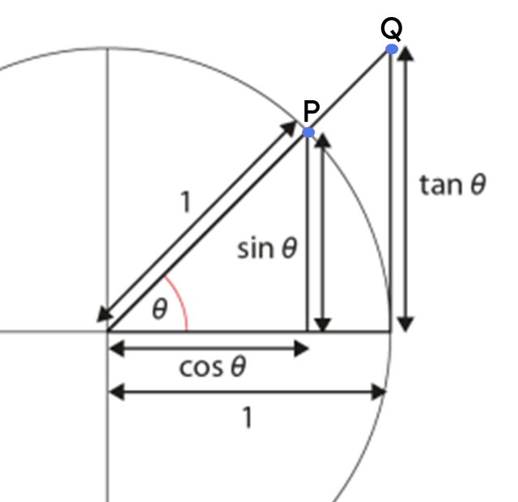
Hypotenuse (hypotenuse) waa dhinaca saddexagalka qumman (right-angled triangle) ee ka soo horjeeda xagasha qumman.
Dhinaca ku xiga (adjacent side) ee saddexagalka qumman (right-angled triangle) waa dhinaca ku xiga xagasha qumman iyo xagasha calaamadsan labadaba.
Hawlaha trigonometric (trigonometric functions) waxaa sida caadiga ah lagu qeexaa saamiyada labada dhinac ee saddexagalka qumman (right-angled triangle) ee ka kooban xagasha.
Cosine-ka xagasha (cos(θ°)) waa isku-duwayaasha x (x-coordinate) ee barta P ee saddexagalka ka samaysan gudaha goobada halbeegga (unit circle).

Slide 5

Isticmaalka saamiga cosine (cosine ratio)
Qaabaynta qaacidada cosine (cosine formula)
Xisaabinta xagasha iyadoo la isticmaalayo qaacidada cosine (cosine formula)

Slide 6
Qaabaynta qaacidada cosine (cosine formula)
Waxaan ognahay in labadan saddexagal ay isku mid yihiin (similar), sababtoo ah labada xagal ee mid ka mid ah waxay la mid yihiin labada xagal ee kan kale.
Waxaan ku heli karnaa dhererka dhinaca lagu calaamadeeyay x adigoo isticmaalaya jaantuska saamiga (ratio table).
× 0.68
1
0.68
× 15
× 15
15
0.68 × 15
× 15
10.2
× 0.68
15 cm
1 cm
47°
47°
10.2 cm
0.68 cm
x cm

Slide 7
Qaabaynta qaacidada cosine (cosine formula)
Waxaan kaloo guudeyn karnaa habkan saddex-xagal kasta oo qumman (right-angled triangle) oo leh xagal θ°, halkaasoo dhinaca ku xiga θ° iyo xagasha qumman uu le'eg yahay cos(θ°).
× cos(θ°)
1
cos(θ°)
× h
× h
h
h × cos(θ°)
× h
adj
× cos(θ°)
h cm
1 cm
θ°
θ°
h × cos(θ°)
cos(θ°)
adj

Slide 8
Qaabaynta qaacidada cosine (cosine formula)
Waxaan kaloo guudeyn karnaa habkan saddex-xagal kasta oo qumman (right-angled triangle) oo leh xagal θ°, halkaasoo dhinaca ku xiga θ° iyo xagasha qumman uu le'eg yahay cos(θ°).
h cm
1
cos(θ°)
h
h × cos(θ°)
θ°
× cos(θ°)
adj
h × cos(θ°)
Dhererka hypotenuse-ka (hypotenuse)
oo lagu dhuftay cosine-ka xagal θ°
wuxuu la mid yahay dhererka dhinaca ku xiga xagashaas iyo xagasha qumman.

Slide 9
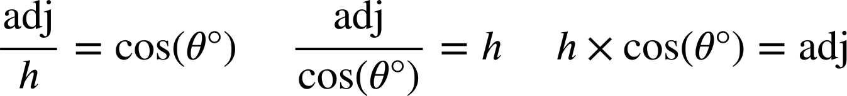
Qaabaynta qaacidada cosine (cosine formula)
Waxaan u isticmaali karnaa jaantuska saamiga si aan u soo saarno qaacidada muujinaysa xiriirka ka dhexeeya dhinaca ku xiga (adjacent) xagasha θ° iyo hypotenuse, waxaana u matali karnaa qaacidada saddex siyaabood.
Qaacidada cosine (cosine formula)
× cos(θ°)
1
cos(θ°)
cos(θ°)
h cm
× h
× h
÷ h
h
adj
h
adj
θ°
ku xiga (adjacent)
× cos(θ°)
÷ cos(θ°)
× cos(θ°)
h × cos(θ°)

Slide 10
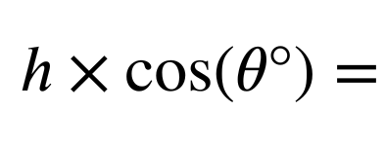
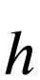
Qaabaynta qaacidada cosine (cosine formula)
Waxaan sidoo kale ka soo saari karnaa laba nooc oo qaacidada ah marka la eego mid ka mid ah kuwa kale adoo sameynaya qaybin (division).

Slide 11
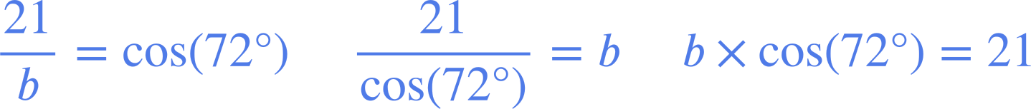
Qaabaynta qaacidada cosine (cosine formula)
Waxaan ku beddeli karnaa qiimayaasha (values) saddexagal qumman (right-angled triangle) nooc kasta oo ka mid ah qaacidada cosine si aan u matalo xiriirka ka dhexeeya dhinaca ku xiga (adjacent) xagal iyo hypotenuse siyaabo kala duwan.
b cm
72°
21 cm

Slide 12



Qaabaynta qaacidada cosine (cosine formula)
Isla'egta saxda ah ee muujinaysa xiriirka ka dhexeeya hypotenuse iyo dhinaca ku xiga (adjacent) xagasha 38° waa:
1
cos(θ°)
× 20
× 20
20
adj
× cos(38°)
Mid ka mid ah kuwaan ayaa sidoo kale si sax ah u muujinaya xiriirka ka dhexeeya hypotenuse iyo dhinaca ku xiga (adjacent) ee saddexagalkaan?
a
20 cm
38°
b
adj

Slide 13
Qaabaynta qaacidada cosine (cosine formula)
Mid ka mid ah kuwaan ayaa si sax ah u muujinaya xiriirka ka dhexeeya hypotenuse iyo dhinaca ku xiga (adjacent) xagasha 82° ee saddexagalkaan (qiimayaasha waxaa lagu soo koobay tirada ugu dhow)?
a
d
100 cm
b
e
82°
c
14 cm

Slide 14
Qaabaynta qaacidada cosine (cosine formula)
Mid ka mid ah kuwaan ayaa si sax ah u muujinaya xiriirka ka dhexeeya hypotenuse iyo dhinaca ku xiga (adjacent) xagasha θ° ee saddexagalkaan?
a
d
39 cm
b
θ°
e
116 cm
c

Slide 15
Qaabaynta qaacidada cosine (cosine formula)
Nooc kasta oo ka mid ah qaacidada, qayb ka duwan oo saddexagalka ah ayaa loo qoray mawduuc (subject).
Waxaa faa'iido leh inaad isticmaasho nooca qaacidada uu mawduuciisu (subject) u dhigma qaybta saddexagalka ee aad rabto inaad qiimeheeda (value) hesho.
hyp
103 cm
57°
103 × cos(57°) = p
p cm
p = 56.098 cm (3 d.p.)
adj
Waxaan rabnaa inaan helno qiimaha (value) p, oo ah dhererka dhinaca ku xiga (adjacent) xagasha 57°.

Slide 16
Qaabaynta qaacidada cosine-ka (cosine formula)
Kee ayaa si sax ah u muujinaya xiriirka ka dhexeeya hypotenuse-ka iyo dhinaca ku xiga xagasha 16° saddexagalkaan (qiimaha waxaa lagu soo koobay tiro dhammaystiran)?
85 m
a
16°
d
b
q cm
e
c

Slide 17
Qaabaynta qaacidada cosine-ka (cosine formula)
Kee waa isla'egta saxda ah si loo helo qiimaha (value) q si ugu habboon?
Sidaas awgeed, hel qiimaha (value) dhinaca lagu calaamadeeyay q (2 d.p.)
85 m
a
16°
b
q = 88.43
q cm
88.43 cm
d
88.43 cm waxay u muuqataa jawaab macquul ah, maadaama kani yahay hypotenuse-ka, sidaas darteed waa inuu ka weyn yahay dhererka dhinaca 85 cm.

Slide 18
Qaabaynta qaacidada cosine-ka (cosine formula)
1) Ku beddel dhinacyada iyo xagasha la calaamadeeyay saddexagal kasta qaacidada cosine-ka (cosine formula) ee la bixiyay, oo hel dhererka dhinaca maqan.
b cm
× cos( ) =
51°
289
a =
3.5 cm
289 cm
=
cos( )
85°
b =
a cm

Slide 19
Qaabaynta qaacidada cosine-ka (cosine formula)
2) Isku dhig saddexagalka isla'egta muujinaysa xiriirka ka dhexeeya hypotenuse-kiisa iyo dhinaca ku xiga.
Isticmaal isla'egta si aad u hesho dhererka dhinaca maqan ee lagu calaamadeeyay x saddexagal kasta (2 d.p.)
c)
a)
b)
53 cm
31 cm
x cm
53°
31°
x cm
53 cm
31°
x cm
53 × cos(31°) = x
d
x × cos(31°) = 53
e
31 × cos(53°) = x
f

Slide 20
Qaabaynta qaacidada cosine (Formalising the cosine formula)
3) Adigoo isticmaalaya qaacidada cosine (cosine formula), hel dhererka dhinaca maqan ee lagu calaamadeeyay xaraf saddexagalka kasta (2 d.p.)
a)
b)
c)
1 cm
22 cm
22 cm
32°
32°
42°
a cm
b cm
c cm
d)
e)
f)
e cm
f cm
d cm
48°
22 cm
42°
22°
42°
42 cm
22 cm

Slide 21
Qaabaynta qaacidada cosine (Formalising the cosine formula)
4) Raadi dhererka masaafada a, b, c, iyo d
(ku dhawaad tirada guud ee ugu dhow).
d cm
18 cm
b cm
37 cm
24°
a cm
11 cm
c cm
5 cm

Slide 22

Qaabaynta qaacidada cosine
1) Ku beddel dhinacyada iyo xagasha calaamadeysan ee saddexagal kasta qaacidada la siiyay ee cosine, oo raadi dhererka dhinaca maqan.
b cm
× cos( ) =
51°
289
85°
a
a =
3.5 cm
25.19
289 cm
3.5
b
=
cos( )
51°
85°
b =
5.56
a cm

Slide 23
Qaabaynta qaacidada cosine
2) Isku dhig saddexagalka iyo isla'egta tusaysa xiriirka ka dhexeeya hypotenuse-kiisa iyo dhinaca ku xiga.
Isticmaal isla'egta si aad u raadiso dhererka dhinaca maqan ee lagu calaamadeeyay x ee saddexagal kasta (2 d.p.)
c)
a)
b)
53 cm
31 cm
x cm
53°
31°
x cm
53 cm
31°
x cm
31 × cos(53°) = x
f
53 × cos(31°) = x
d
x × cos(31°) = 53
e
x = 18.66
x = 45.43
x = 61.83
Dhinaca ku xiga 53° wuxuu leeyahay dherer 18.66 cm
Dhinaca ku xiga 31° wuxuu leeyahay dherer 45.43 cm
Hypotenuse-ga wuxuu leeyahay dherer 61.83 cm

Slide 24
Qaabaynta qaacidada cosine (cosine formula)
3) Adigoo isticmaalaya qaacidada cosine (cosine formula), raadi dhererka dhinaca maqan ee lagu calaamadeeyay xaraf mid kasta oo ka mid ah saddexagalladan (2 d.p.)
a)
b)
c)
1 cm
22 cm
22 cm
32°
32°
42°
a cm
a = 0.85
b cm
b = 18.66
c cm
c = 16.35
d)
e)
f)
e cm
f cm
d cm
48°
22 cm
42°
22°
42°
42 cm
22 cm
d = 29.60
e = 32.88
f = 45.30

Slide 25
Qaabaynta qaacidada cosine (cosine formula)
4) Raadi dhererka masaafada a, b, c, iyo d
(ku wareeji tirada ugu dhow).
5 cm
d cm
18 cm
12 cm
b cm
37 cm
24°
a cm
11 cm
c cm
5 cm
34 cm
16 cm

Slide 26
Isticmaalka saamiga cosine (cosine ratio)
Qaabaynta qaacidada cosine (cosine formula)
Xisaabinta xaglaha iyadoo la adeegsanayo qaacidada cosine (cosine formula)

Slide 27
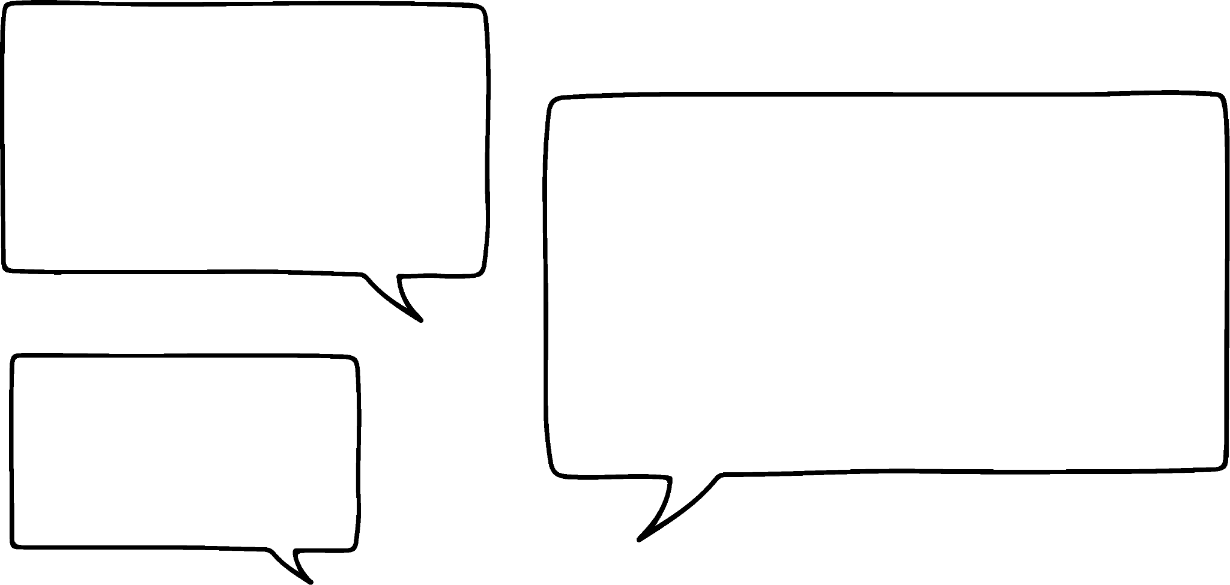


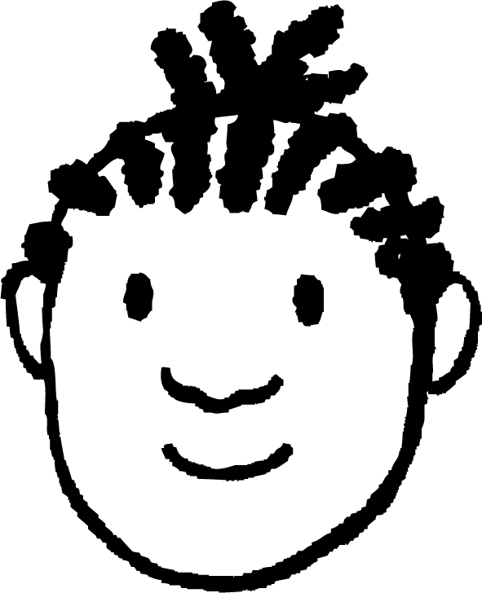
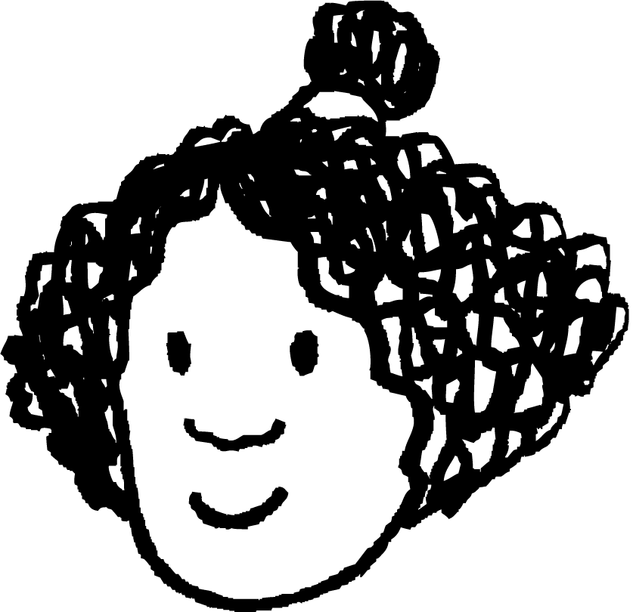


Xisaabinta xaglaha iyadoo la isticmaalayo qaacidada cosine (cosine formula)
Waxaan xisaabin karaa dhererka dhinaca ku xiga (adjacent) 40° sababtoo ah waxaan sidoo kale ogahay dhererka hypotenuse-ka!
Waxaan xisaabin karaa dhererka hypotenuse-ka sababtoo ah waxaan sidoo kale ogahay dhererka dhinaca ku xiga (adjacent) 59°.
Isra
Yacquub
6 cm
hyp
59°
3 cm
40°
adj
6 × cos(40°) = adj
3
hyp =
= 5.82
cos(59°)
adj = 4.60

Slide 28
Xisaabinta xaglaha iyadoo la isticmaalayo qaacidada cosine (cosine formula)
Laakiin sidee u isticmaali karnaa noocan kale ee qaacidada cosine (cosine formula) si aan u helno xagasha haddii aan ognahay dhererka hypotenuse-ka iyo dhinaca ku xiga (adjacent) xagashaas?
23 cm
θ°
13 cm
Yacquub
cos(θ°) =
13
≈ 0.565
23
Sidee ku heli kartaa cabbirka xagasha θ°?

Slide 29
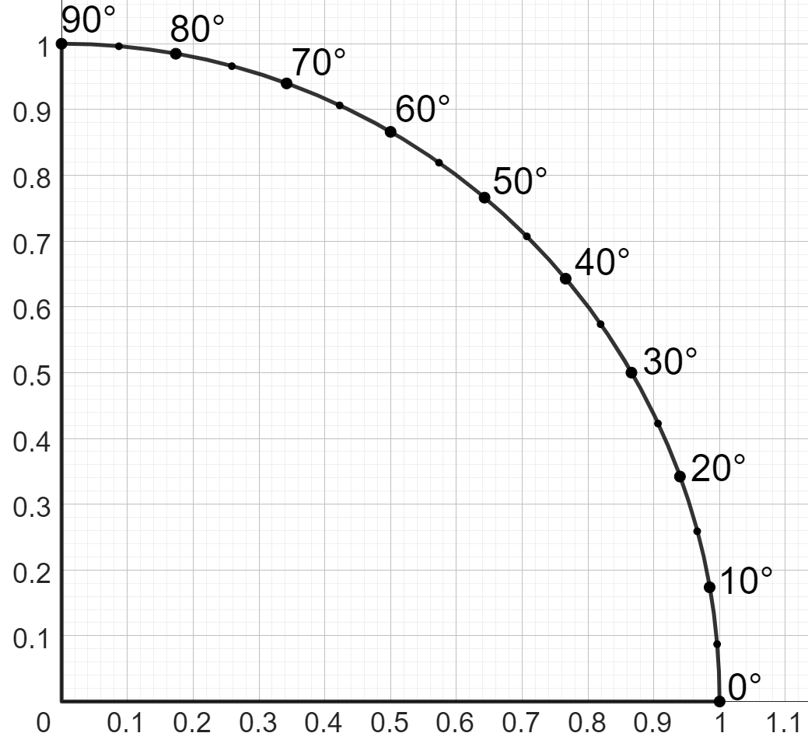
Xisaabinta xaglaha iyadoo la adeegsanayo qaacidada cosine (cosine formula)
Goobo cutub ah (unit circle), waxaan ku heli karnaa dhererka dhinaca ku xiga xagasha 30° adigoo ku dabaqaya shaqada cosine (cosine function) xagashaas:
cos( 30° ) =
30°
0.866
xagal (angle)
dhererka dhinaca ku xiga ee goobta cutubka (unit circle)
1 cutub (unit)
Shaqada cosine waxay leedahay shaqo rogaal ah oo loo yaqaan arccosine (arccos function).
Waxaad ku arki kartaa cos-1 kalkuule (calculator).
30°
0.866 cutub (units)

Slide 30
Xisaabinta xaglaha iyadoo la adeegsanayo qaacidada cosine (cosine formula)
Goobo cutub ah (unit circle), waxaan ku heli karnaa dhererka dhinaca ku xiga xagasha 30° adigoo ku dabaqaya shaqada cosine (cosine function) xagashaas:
0.866
arccos
arccos
=
cos-1(0.866)
1 cutub (unit)
0.866
Jawaabaha:
dhererka dhinaca ku xiga ee goobta cutubka (unit circle)
xagal (angle)
0.866 cutub (units)
cos( 30° ) =
30°
30°
cos-1( 30° ) =
30°
30°

Slide 31
Xisaabinta xaglaha iyadoo la adeegsanayo qaacidada cosine (cosine formula)
Helista cosine (cosine) ee xagal waxay soo saartaa saami (ratio) dhinaca ku xiga (adjacent) iyo hypotenuse.
Hawlaha rogaal celiska ah ee cosine, hawlaha arccos, wuxuu qaataa saamiga (ratio) dhinaca ku xiga (Adjacent) xagasha iyo hypotenuse (oo loo qoro jajab ama tobanle), wuxuuna ku siinayaa cabbirka xagashaas.
In kastoo saamigan (ratio) inta badan loo qoro tobanle (decimal) (marka loo eego hypotenuse 1), waxaan u fasiri karnaa tobanlehan (decimal) sida jaantusyo (fractions) u dhigma:
13
cos-1( 30) =
cos-1( 0.565 ) =
55.6°
23
0.866
1.732
86.6
Dhinaca ku xiga (adjacent) waa 13, hypotenuse-na waa 23.
Ama loo qoro tobanle (decimal).
cos(30°) =
=
=
1
2
100
23 cm
Dhinaca ku xiga (adjacent) waa 86.6, saddexagal leh hypotenuse 100.
Dhinaca ku xiga (Adjacent) ee 0.866 oo ku yaal saddexagal leh hypotenuse 1.
Dhinaca ku xiga (Adjacent) ee 1.732 oo ku yaal saddexagal leh hypotenuse 2.
55.6°
θ°
13 cm

Slide 32
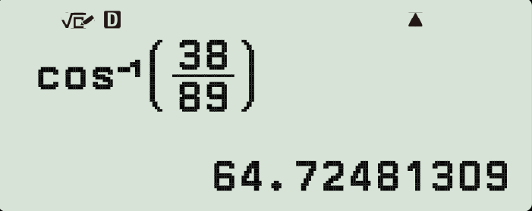
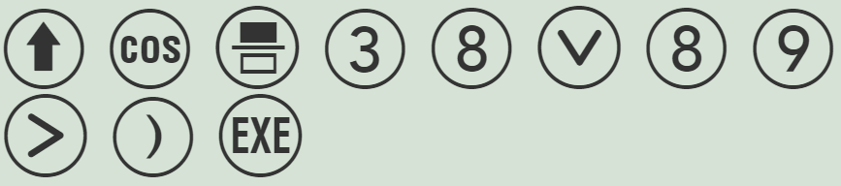
Xisaabinta xagasha iyadoo la adeegsanayo qaacidada cosine
Waxaan isticmaali karnaa hawlaha arccos ee xisaabiyaha (calculator) si aan u helno xagal.
38
cos-1( )
= 64.7°
89
89 cm
θ°
38 cm
cos(θ°) =
38
89
38
cos-1( )
= θ°
89

Slide 33
Xisaabinta xagasha iyadoo la adeegsanayo qaacidada cosine
Kee ka mid ah isla'egyadan (equations) ayaa sax ah marka la raadinayo cabbirka xagasha n° ee isla'egta:
cos(n°) = 0.86?
a
c
b
d

Slide 34
Xisaabinta xagasha iyadoo la adeegsanayo qaacidada cosine
Kee ka mid ah kuwan ayaa u dhigma isla'egtan?
cos(n°) = ?
4
9
a
c
b
d

Slide 35
Xisaabinta xaglaha (angles) iyadoo la isticmaalayo qaacidada cosine (cosine formula)
Mid ka mid ah isla'egyada (equations) soo socda ayaa sax ah marka la raadinayo cabbirka xagasha u° (angle u°) saddex-xagalkan (triangle)?
a
c
69 cm
b
d
u°
16 cm

Slide 36
Xisaabinta xaglaha (angles) iyadoo la isticmaalayo qaacidada cosine (cosine formula)
1) U dhigma (Match) saddex-xagal (triangle) kasta: isla'eg (equation) qeexaysa xiriirka ka dhexeeya hypotenuse-kiisa iyo dhinaca ku xiga (adjacent side), iyo cabbirka xagashiisa (angle) (2 d.p.).
a
b
d
4 cm
e
5 cm
4
cm
θ°
3 cm
θ°
f
3 cm
c
5 cm
θ° = 53.13°
g
θ° = 36.87°
h
3 cm
θ°
θ° = 41.41°
i
4 cm

Slide 37
Xisaabinta xaglaha (angles) iyadoo la isticmaalayo qaacidada cosine (cosine formula)
2) Raadi cabbirka xagal kasta oo calaamad u leh xaraf (1 d.p.)
a)
33 cm
b)
71 cm
c)
b°
28 cm
1 cm
a°
28 cm
c°
28
0.87 cm
cos(a°) =
cos(b°) =
33
a° = cos-1(
28
)
b° = cos-1(
)
=
=
33
d)
e)
f)
0.5 cm
2 cm
0.9 cm
f°
e°
d°
0.435 cm
0.87 cm
0.87 cm

Slide 38
Xisaabinta xaglaha iyadoo la adeegsanayo qaacidada cosine (cosine formula)
1) Isku dhig saddexagal kasta: isla'eg (equation) qeexaysa xiriirka ka dhexeeya hypotenuse iyo dhinac ku xiga, iyo cabbirka xagalkiisa (2 d.p.).
a
b
c
5 cm
4 cm
3 cm
5 cm
4
cm
θ°
θ°
4 cm
3 cm
θ°
e
d
3 cm
f
θ° = 36.87°
θ° = 41.41°
h
i
θ° = 53.13°
g

Slide 39
Xisaabinta xaglaha iyadoo la adeegsanayo qaacidada cosine (cosine formula)
2) Soo hel cabbirka xagal kasta oo calaamad u leh xaraf (1 d.p.)
a)
33 cm
b)
71 cm
c)
b°
28 cm
1 cm
a°
28 cm
c°
28
0.87 cm
28
cos(b°) =
cos(a°) =
71
33
28
32.0°
28
66.8°
c = 29.5°
a° = cos-1(
)
=
b° = cos-1(
)
=
33
71
d)
e)
e = 14.8°
f)
0.5 cm
2 cm
0.9 cm
d = 64.2°
f°
d°
e°
0.435 cm
0.87 cm
0.87 cm
f = 29.5°

Slide 40
Isticmaalka saamiga cosine (cosine ratio)
Xiriirka ka dhexeeya hypotenuse (hypotenuse) ee saddex-xagal quman (right-angled triangle) iyo dhinaca ku xiga xagal θ° iyo xagasha quman (right-angle) waxaa loo qori karaa qaaciddo (formula) siyaabo kala duwan:
Qaaciddadan cosine (cosine formula) waxaa loo isticmaali karaa in lagu helo dhererka hypotenuse (hypotenuse), dhererka dhinaca ku xiga xagal θ°, ama cabbirka xagasha θ° lafteeda.
Si loo helo cabbirka xagal, waa in la isticmaalaa shaqada ka soo horjeeda cosine (cosine function): shaqada arccos (arccos function).
Kalkuleytar (calculator) gudahiisa, shaqada arccosine (arccosine function) waxaa badanaa loo qoraa cos-1.
Saddex-xagal (triangle) waxaa laga dhisi karaa qaaciddadiisa cosine (cosine formula) iyo dhererka hypotenuse (hypotenuse) ama dhinaca ku xiga mid ka mid ah xagalladiisa.

