Slide 1
Isticmaalka fx-991CW ee tirooyinka iyo aljabra (algebra)
Shaqada xisaabiyaha (calculator)

Slide 2
Sida agabkeena waxbarista loogu talagalay fasalka

Slide 3
Waxaan awoodi karaa inaan isticmaalo fx-991CW si aan u sameeyo xisabinta tirooyinka iyo xallinta isla'egyada (equations) tiro ahaan.

Slide 4
Cunsuriyaha (factors) asaasiga ah waa cunsuriyaha tiro ee qudhoodu yihiin tiro asaasi ah (prime).
Isla'eg (equation) waxaa loo isticmaalaa in lagu muujiyo 2 tibaax oo isla eg.
Isla'egyada (equations) oo matalaya xiriirro kala duwan oo u dhexeeya doorsoomayaasha (variables) isku mid ah waxaa loo yaqaan isla'egyada isku mar (simultaneous equations).
Sinnaan la'aan (inequality) waxaa loo isticmaalaa in lagu muujiyo in hal tibaax (expression) laga yaabo inuusan la mid ahayn mid kale.

Slide 5

Isticmaalka fx-991CW ee tirooyinka iyo aljabra (algebra)
Beddelka (Conversions)
Xallinta isla'egyada toosan (linear equations)
Xallinta polynomials

Slide 6
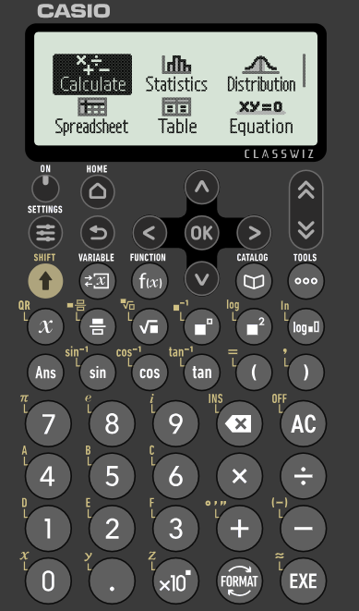
Beddelka (Conversions)
Darsigan, waxaan isticmaali doonaa nooca Casio fx-991CW.
Waxaan dabooli doonaa sida loo isticmaalo xisaabiyahan si loo sameeyo xisabinta kala duwan.
Ka dib markaad shido xisaabiyaha, waxaad arki doontaa shaashaddan.

Slide 7
Beddelka (Conversions)
Waxaad isticmaali kartaa furayaasha fallaadha (arrow keys) si aad u dhaqaaqdid inta u dhaxaysa ikhtiyaarrada. Hadda, waxaan diiradda saaraynaa 'Calculate'.
Riix badhanka 'EXE'.

Slide 8
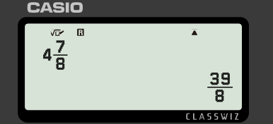

Beddelka (Conversions)
Gelinta tiro isku dhafan (mixed number) ee xisaabiyaha iyo riixida 'EXE' waxay soo celisaa isla qiime (value) laakiin sida jajab aan habboonayn (improper fraction).

Slide 9

Beddelka (Conversions)
Maxay tahay waxa gelinta jajab aan habboonayn (improper fraction) ee xisaabiyaha iyo riixida 'EXE' ay soo celiso?
Isla jajabka aan habboonayn (improper fraction)
Isla qiimaha (value) laakiin sida tiro isku dhafan (mixed number)
Isla qiimaha (value) laakiin sida jajab tobanle (decimal)

Slide 10
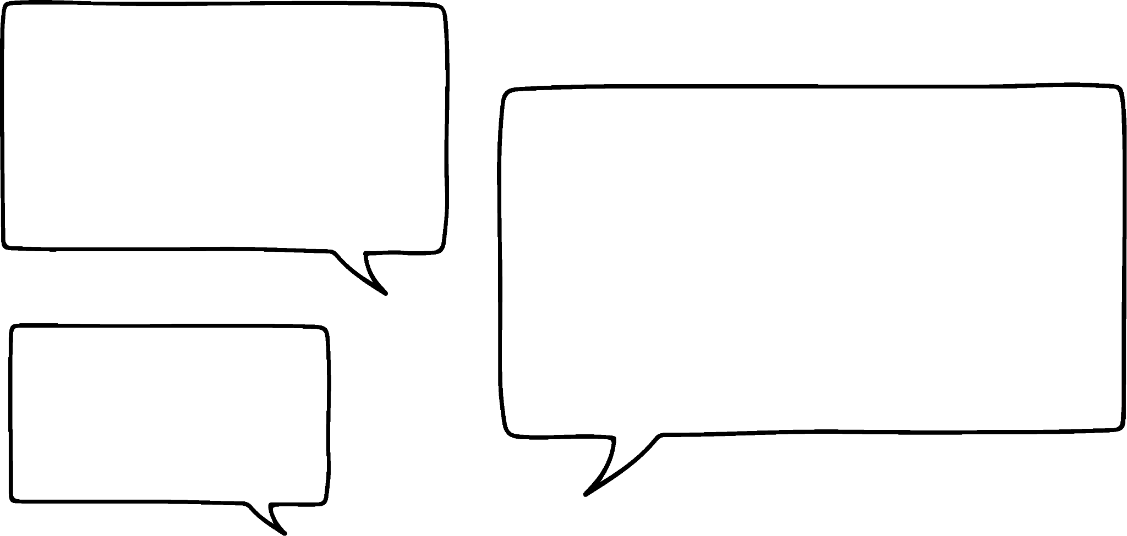







Beddelka (Conversions)
Sidee baan u beddelaa jajabka aan habboonayn (improper fraction) iyo tirooyinka isku dhafan (mixed numbers)?
Waxaad u baahan tahay inaad isticmaasho badhanka .
Caasha
Saciid

Slide 11
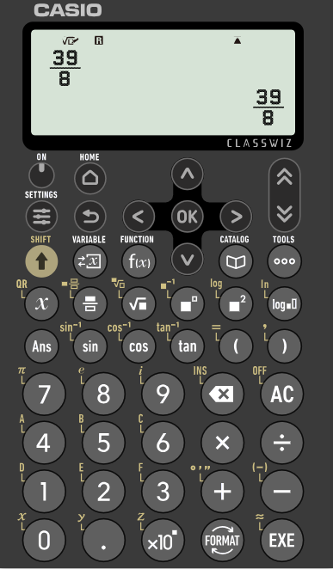
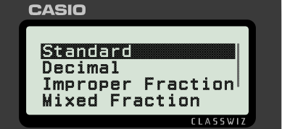
Beddelka (Conversions)
Marka jajab aan habboonayn (improper fraction) la muujiyo, waxaad bedeli kartaa qaabka qiimaha (value) adigoo riixaya badhanka 'FORMAT'.
Qiimaha (value) waxaa loo muujin karaa jajab tobanle (decimal), jajab aan habboonayn (improper fraction), ama jajab isku dhafan (mixed fraction).

Slide 12

Beddelka (Conversions)
Adigoo isticmaalaya xisaabiyahaaga, dooro qaabka jajabka tobanle (decimal) ee u dhigma
25.94237096
25.94236269
25.94230769

Slide 13
Beddelka (Conversions)
Ma wax badan oo kale ayaa xisaabiyahaygu beddeli karaa?
Haa! Waxaad sidoo kale ku beddeli kartaa waqti.
Caasha
Saciid

Slide 14
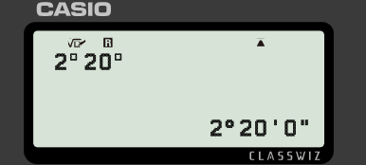


Beddelka (Conversions)
U beddel 2 saacadood iyo 20 daqiiqo saacado.
Riixida badhanka 'SHIFT', ka dibna '+' waxay noo ogolaaneysaa inaan ku qorno qaabka 'saacad, daqiiqad, ilbiriqsi'.

Slide 15
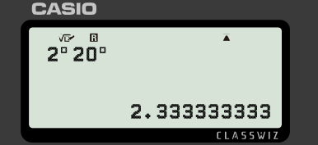

Beddelid (Conversions)
U beddel 2 saacadood iyo 20 daqiiqo saacado.
Riixida furaha 'FORMAT' waxay kuu ogolaaneysaa inaad wakhtiga ku muujiso siyaabo kala duwan.

Slide 16
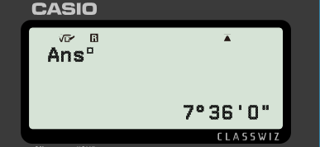
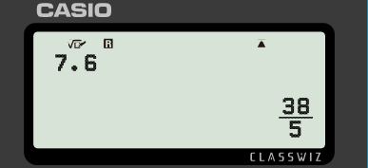

Beddelid (Conversions)
Qiime (value) saacaduhu waxaa loo beddeli karaa saacado, daqiiqooyin iyo ilbiriqsi.
Riixida badhanka 'SHIFT', oo ay ku xigto '+', waxay u beddeshaa qaabka 'saacad, daqiiqad, ilbiriqsi'.
7.6 saacadood = 7 saacadood iyo 36 daqiiqo (0 ilbiriqsi)

Slide 17
Beddelid (Conversions)
3.875 saacadood waxay u dhigmaan wakhti intee le'eg?
3 saacadood, 8 daqiiqo iyo 8 ilbiriqsi
3 saacadood, 45 daqiiqo iyo 8 ilbiriqsi
3 saacadood, 52 daqiiqo iyo 30 ilbiriqsi

Slide 18
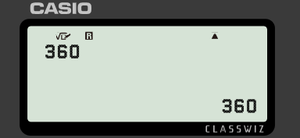

Beddelid (Conversions)
Tirooyinka waxaa loo qori karaa qaabka cunsuriyaha (prime factor) tusaale: 49 = 72 iyo 124 = 22 × 31
Muuji 360 qaabka cunsuriyaha (prime factor).

Slide 19
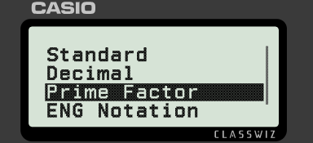
Beddelid (Conversions)
Riix 'FORMAT' oo dooro 'Cunsuriyaha (Prime Factor)'.
Muuji 360 qaabka cunsuriyaha (prime factor).

Slide 20
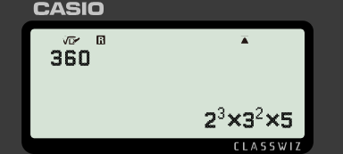
Beddelid (Conversions)
Riixida 'EXE' waxay ku siinaysaa tirada qaabka cunsuriyaha (prime factor).
Muuji 360 qaabka cunsuriyaha (prime factor).

Slide 21
Beddelid (Conversions)
Dooro tirada maqan: 10 375 750 = 2 × 53 × 7 × 112
2
3
4

Slide 22
Beddelid (Conversions)
1) U beddel waqtiyadan soo socda saacadood.
a) 1 saac iyo 15 daqiiqo
b) 2 saacadood, 20 daqiiqo iyo 20 ilbiriqsi
c) 4 saacadood, 15 daqiiqo iyo 16 ilbiriqsi

Slide 23
Beddelid (Conversions)
2) U beddel tirada saacadaha soo socda saacad, daqiiqo iyo ilbiriqsi.
a) 7.25
b) 3.7
c) 7.42
d) 3.63

Slide 24
Beddelid (Conversions)
3) Buuxi meelaha bannaan.
a) 121 = 11²
b) 5500 = 2 × ³ × 11
c) 384 = 2⁷ × 3
d) 351 = 3 × × 13

Slide 25
Beddelid (Conversions)
1) U beddel waqtiyadan soo socda saacadood.
a) 1 saac iyo 15 daqiiqo = 1.25
b) 2 saacadood, 20 daqiiqo iyo 20 ilbiriqsi = 2.338
c) 4 saacadood, 15 daqiiqo iyo 16 ilbiriqsi = 4.254
.
.

Slide 26
Beddelid (Conversions)
2) U beddel tirada saacadaha soo socda saacad, daqiiqo iyo ilbiriqsi.
a) 7.25 = 7 saacadood iyo 15 daqiiqo
b) 3.7 = 3 saacadood iyo 42 daqiiqo
c) 7.42 = 7 saacadood, 25 daqiiqo iyo 12 ilbiriqsi
d) 3.63 = 3 saacadood, 37 daqiiqo iyo 48 ilbiriqsi

Slide 27
Beddelid (Conversions)
3) Buuxi meelaha bannaan.
a) 121 = 11²
b) 5500 = 2 × ³ × 11
c) 384 = 2 × 3
d) 351 = 3 × ? × 13
Qiimaha (value) ay ka kooban yihiin su'aalaha waa inay la mid noqdaan 1.
Tan waxaa lagu samayn karaa iyadoo la helo sal (base) 1 ah iyo jibbaar (exponent) kasta, ama iyadoo la helo sal (base) kasta iyo jibbaar (exponent) 0 ah.
2
5
7
1
3
?

Slide 28
Isticmaalka fx-991CW ee tirooyinka iyo aljabra (algebra)
Beddelka (Conversions)
Xallinta isla'egyada toosan (linear equations)
Xallinta polynomials

Slide 29
Xallinta isla'egyada toosan (linear equations)
Marka maxaa kale oo xisaabiyaha (calculator) igu samayn karaa?
Wuxuu xallin karaa noocyada qaarkood ee isla'egyada (equations).
Caasha
Saciid

Slide 30
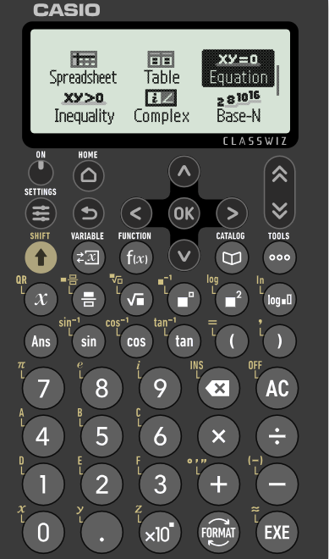
Xallinta isla'egyada toosan (linear equations)
Laga bilaabo shaashadda 'HOME', waxaad hoos u dhaadhacdaa si aad u aragto ikhtiyaarro dheeri ah.
Waxaan eegi doonnaa 'Equation' iyo 'Inequality' labadaba.
Waxaan ku bilaabi doonnaa 'Equation'.

Slide 31

Xallinta isla'egyada toosan (linear equations)
Xalli isla'egta 9x − 7 = 25
Hore ayaan uga ogahay sida loo sameeyo! Jawaabtu waa
Caasha ma sax baa?
Waxaan hubin karnaa iyadoo:
Dib-u-habaynta iyo xallinta
Isticmaalka xisaabiyaha (calculator)
Caasha

Slide 32
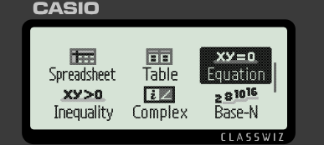
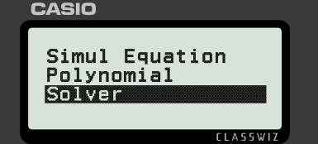
Xallinta isla'egyada toosan (linear equations)
Xalli isla'egta 9x − 7 = 25
Laga soo bilaabo menu-ga guriga, dooro 'Equation' ka dibna u gudub 'Solver'.

Slide 33
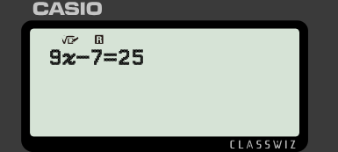


Xallinta isla'egyada toosan (linear equations)
Xalli isla'egta 9x − 7 = 25
Si aad u geliso isla'egta, waxaanu isticmaalnaa badhanka si aan u matalno doorsoome (variable) iyo calaamadda '=' oo ku taal koritaanka xarafka bidix.

Slide 34
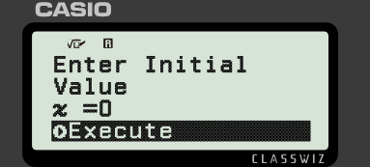
Xallinta isla'egyada toosan (linear equations)
Xalli isla'egta 9x − 7 = 25
Riix 'EXE'. U gudub ikhtiyaarka 'Execute' oo riix 'EXE'.

Slide 35
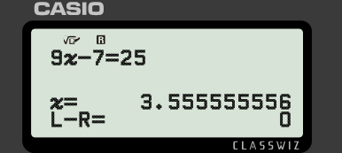
Xallinta isla'egyada toosan (linear equations)
Xalli isla'egta 9x − 7 = 25
Qiimaha (value) doorsoomaha ayaa hadda la muujiyay.
Qaabkan waxaa loo isticmaali karaa in lagu xalliyo isla'egyada toosan (linear equations) oo leh hal doorsoome.

Slide 36

Xallinta isla'egyada toosan (linear equations)
Qaabka 'Solver' wuxuu xallin karaa isla'egtan, iyada oo aan loo baahnayn dib-u-habayn.
Isku day adiga. Waa inaad ogaataa in x = 8

Slide 37
Xallinta isla'egyada toosan (linear equations)
Qaabka 'Solver' wuxuu xallin karaa isla'egtan, iyada oo aan loo baahnayn dib-u-habayn: 4 = 5y + 19
Isku day adiga. Waxaad u baahan doontaa inaad ku qorto x halkii y ee xisaabiyahaaga. Waa inaad ogaataa in y = −3

Slide 38
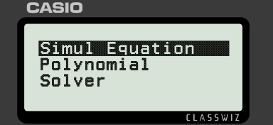
Xallinta isla'egyada toosan (linear equations)
Xisaabiyaha ayaa sidoo kale xallin kara laba isla'eg oo toosan oo isku mar ah (simultaneous equations).
Ka bixi menu-ga guriga, dooro 'Equation' ka dibna u gudub 'Simul Equation'. Kadib dooro '2 Unknowns'.

Slide 39
Xallinta isla'egyada toosan (linear equations)
Xisaabiyahaagu wuxuu aqbali doonaa oo kaliya isla'egyada qaabka ax + by = c, sidaa darteed waxaa laga yaabaa inay lagama maarmaan tahay in dib loo habeeyo ka hor gelinta.
w + h + 8 = 0
x + y = −8
h = 4w − 17
4x − y = 17
Xisaabiyuhu wuxuu isticmaalaa x iyo y, marka waxaa muhiim ah inaad ogaato variable-ka x uu matalayo iyo variable-ka y uu matalayo.

Slide 40
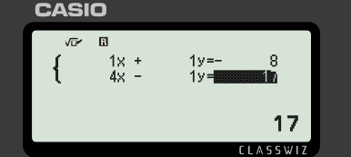
Xallinta isla'egyada toosan (linear equations)
Xisaabiyahaagu wuxuu aqbali doonaa oo kaliya isla'egyada qaabka ax + by = c, sidaa darteed waxaa laga yaabaa inay lagama maarmaan tahay in dib loo habeeyo ka hor gelinta.
w + h + 8 = 0
x + y = −8
h = 4w − 17
4x − y = 17
Ka digtoonow qiimaha (values) taban.

Slide 41
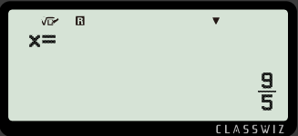
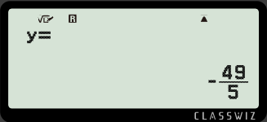
Xallinta isla'egyada toosan (linear equations)
Xisaabiyahaagu wuxuu aqbali doonaa oo kaliya isla'egyada qaabka ax + by = c, sidaa darteed waxaa laga yaabaa inay lagama maarmaan tahay in dib loo habeeyo ka hor gelinta.
w + h + 8 = 0
x + y = −8
h = 4w − 17
4x − y = 17
Riixida 'EXE' waxay siinaysaa hal qiime (value), riixida 'EXE' mar kale waxay muujinaysaa qiimaha (value) labaad.
Waxaan u fasiri karnaa tan sida w = 1.8 iyo h = −9.8

Slide 42
Xallinta isla'egyada toosan (linear equations)
Waxaad gelin kartaa laba isla'eg oo isku mar ah (simultaneous equations) oo kasta xisaabiyahaaga iyada oo aan loo baahnayn in dib loo habeeyo.
Isla'egyadu waa inay ahaadaan qaabka ax + by = c
Mararka qaarkood waxaa lagama maarmaan ah in dib loo habeeyo marka hore.

Slide 43
Xallinta isla'egyada toosan (linear equations)
1) Xalli kuwan soo socda iyada oo aan la isticmaalin xisaabiye, ka dibna hubi jawaabahaaga adigoo isticmaalaya xisaabiyaha.
Habkee ayaa ka dhakhso badan?
a) b) c)

Slide 44
Xallinta isla'egyada toosan (linear equations)
2) Xalli labada isla'eg ee isku mar ah (simultaneous equations) ee soo socda adigoo isticmaalaya xisaabiyahaaga.
a) b)
2a + 3b = 1
2b + a = 8
−a + 4b = 8
2b + 3 = 7a

Slide 45

Xallinta isla'egyada toosan (linear equations)
1) Xalli kuwan soo socda iyada oo aan la isticmaalin xisaabiye, ka dibna hubi jawaabahaaga adigoo isticmaalaya xisaabiyaha.
Waa kee habka xallinta (solving) ee ka dhakhsaha badan?
a) b) c)
x = 36
x = 2
y = −3.47058…

Slide 46
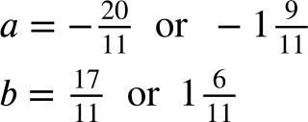
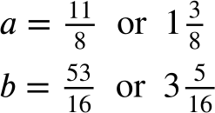
Xallinta isla'egyada toosan (linear equations)
2) Xalli labada isla'eg oo isku mar ah (simultaneous equations) adigoo isticmaalaya xisaabiyahaaga.
a) b)
2a + 3b = 1
2b + a = 8
−a + 4b = 8
2b + 3 = 7a

Slide 47
Isticmaalka fx-991CW ee tirooyinka iyo aljabrada (algebra)
Beddelka (Conversions)
Xallinta isla'egyada toosan (linear equations)
Xallinta polynomials

Slide 48
Xallinta polynomials
Marka xisaabiyuhu wuu xallin karaa isla'egyada toosan (linear equations), oo ay ku jiraan kuwa isku mar ah (simultaneous). Wax kale ma jiraan?
Wuxuu xallin karaa isla'egyada polynomial. Sidoo kale wuxuu xallin karaa sinnaan-la'aanta quadratic (quadratic inequalities).
Caasha
Saciid

Slide 49
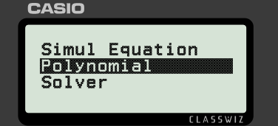
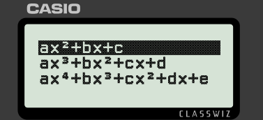
Xallinta polynomials
Laga soo bilaabo menu-ga guriga, dooro 'Equation' ka dibna u gudub oo dooro 'Polynomial'. Dooro qaabka guud ee polynomial-ka aad rabto inaad xalliso.

Slide 50
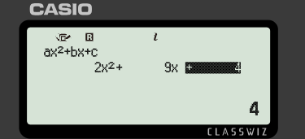
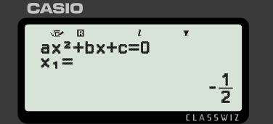
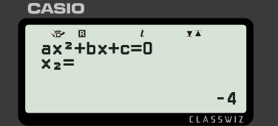
Xallinta polynomials
Xalli 2x2 + 9x + 4 = 0
Xisaabiyahaagu wuxuu aqbali doonaa oo kaliya isla'egyada qaabka ax2 + bx + c = 0, marka waxaa laga yaabaa inay lagama maarmaan tahay inaad hore u habaysid.
Riix 'EXE' si aad u xalliso. Riix 'EXE' mar kale si aad u aragto xalka labaad.

Slide 51
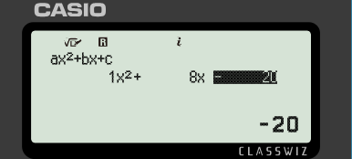
Xallinta polynomials
Isticmaal xisaabiyahaaga si aad u hesho xalka/xalka (solution) ee x2 + 8x − 20 = 0
x = 2
x = −10

Slide 52
Xallinta polynomials
Xalli x2 + 8x − 20 < 0
Waxaan isticmaali doonaa xisaabiyaha (calculator) si aan u helo xididdada (roots) ka dibna aan ogaado habka calaamadaha sinnaan-la'aanta (inequality) ay u socdaan.
Waxaad samayn kartaa taas ama...
Caasha
Saciid

Slide 53
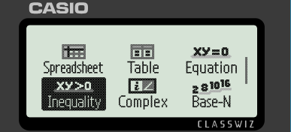
Xallinta polynomials
Laga bilaabo menu-ga guriga, dooro 'Inequality'. Dooro qaabka guud ee polynomial-ka aad rabto inaad xalliso.

Slide 54
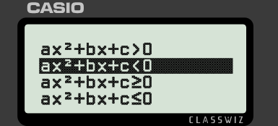
Xallinta polynomials
Xalli x2 + 8x − 20 < 0
Hubi inaad dooratay sinnaan-la'aanta (inequality) saxda ah.

Slide 55
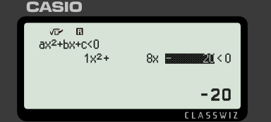
Xallinta polynomials
Isticmaal xisaabiyaha (calculator) si aad u hesho xalalka (solutions) ee x2 + 8x − 20 < 0
−10 < x < 2

Slide 56
Xallinta polynomials
1) Xalli sinnaan-la'aantan quadratic (ilaa 2 d.p. haddii ay habboon tahay).
a) −x² − 8x + 20 ≥ 0
b) x² + 8x − 19 < 0
c) x² + 6x + 8 < 3
d) 5x² − x + 5 > 3x² − 10x − 2

Slide 57

Xallinta polynomials
1) Xalli sinnaan-la'aantan quadratic (ilaa 2 d.p. haddii ay habboon tahay).
a) −x² − 8x + 20 ≥ 0 −10 ≤ x ≤ 2
b) x² + 8x − 19 < 0 −9.92 < x < 1.92
c) x² + 6x + 8 < 3 −5 < x < −1
d) 5x² − x + 5 > 3x² − 10x − 2

Slide 58
Isticmaalka fx-991CW ee tiro iyo algebra
Qaar ka mid ah xisaabiyayaasha (calculators) waxay qaban karaan wax ka badan xisaabinta aasaasiga ah.
fx-991CW waxay u beddeli kartaa qaabab kala duwan oo qiimaha (values) ah.
fx-991CW waxay si tiro (numerically) u xallin kartaa isla'egyada (equations).

