Slide 1
Isticmaalka fx-991CW ee tirakoobka (statistics)
Shaqada xisaabiyaha (calculator)

Slide 2
Sida agabkeena waxbarista loogu talagalay fasalka

Slide 3
Waxaan isticmaali karaa fx-991CW si aan u sameeyo xisaabinta xogta.

Slide 4
Soo noqnoqoshada (frequency) waa tirada jeer ee dhacdo dhacdo; ama tirada shakhsiyaadka (dadka, xayawaanka iwm.) ee leh sifo gaar ah.
Celceliska (arithmetic mean) ee xogta tirooyinka waa wadarta qiimaha (values) loo qaybiyo tirada qiimaha. Waa cabbirka u dhaxaysa (central tendency) oo matalaya celceliska qiimaha.
Dhexda (median) waa xogta dhexe (bartamaha) marka xogta loo habeeyo tiro ahaan. Waa cabbirka u dhaxaysa (central tendency) oo matalaya celceliska qiimaha.

Slide 5
Qaabka (mode) waa qiimaha (value) ugu soo noqnoqda. Waa cabbirka u dhaxaysa (central tendency) oo matalaya celceliska qiimaha.
Soo koobista tirakoobka (statistical summary) waxay soo koobtaa astaamaha xogta. Waxaa laga yaabaa inay ku jiraan celceliska (mean), dhexda (median) iyo/ama qaabka (mode) kuwaas oo cabbira u dhaxaysa (central tendency). Sidoo kale waxaa laga yaabaa inay ku jirto kala fogaan (range) taas oo cabbira fidsanaanta.

Slide 6

Isticmaalka fx-991CW ee tirakoobka (statistics)
Helista celceliska (mean) ee miiska soo noqnoqoshada (frequency table)
Falanqaynta (Analysis)

Slide 7
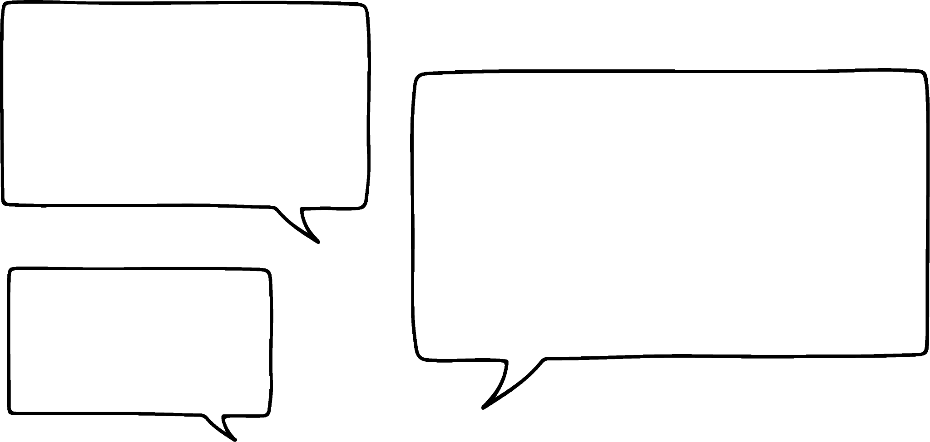



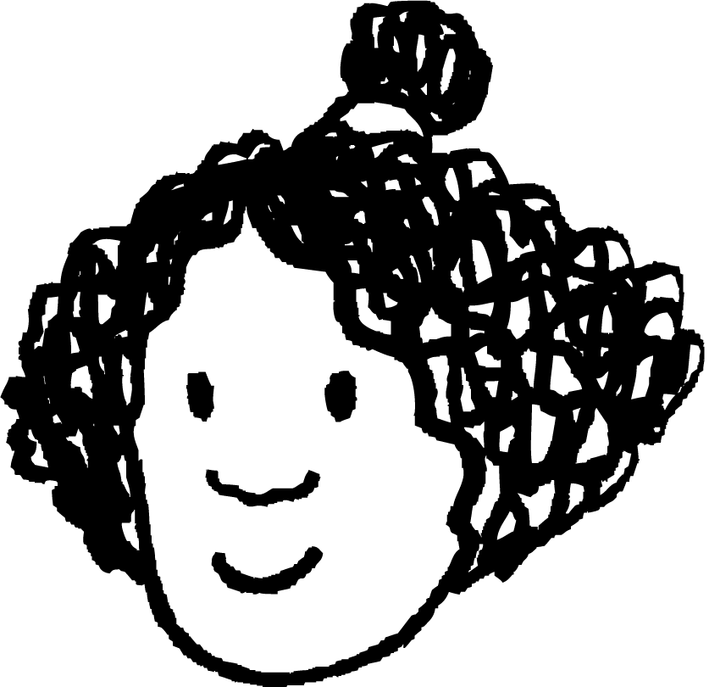


Helista celceliska (mean) ee miiska soo noqnoqoshada (frequency table)
Celceliska (arithmetic mean) ee xogta tirooyinka waa wadarta qiimaha (values) loo qaybiyo tirada qiimaha.
Ma macnaheedu waa inaan isticmaalo qaabka xisaabinta (calculate mode) si aan ugu daro dhammaan tirooyinka ka hor qaybinta?
Waxaa jira hab fudud oo lagu xisaabiyo celceliska (mean).
Isra
Nuur

Slide 8
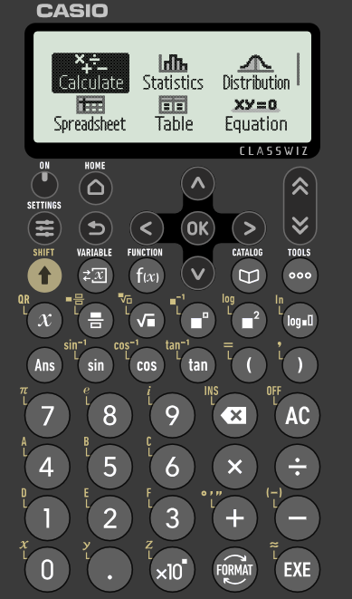
Helista celceliska (mean) ee miiska soo noqnoqoshada (frequency table)
Darsigan, waxaan isticmaali doonaa nooca Casio fx-991CW.
Waxaan dabooli doonaa sida loo isticmaalo xisaabiyahan si loo sameeyo xisaabinta kala duwan.
Ka dib markaad shido xisaabiyaha, waxaad arki doontaa shaashaddan.

Slide 9
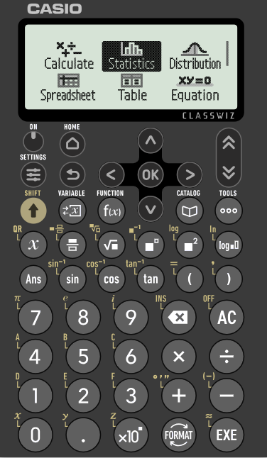
Helitaanka celceliska (mean) miiska soo noqnoqoshada (frequency table)
Waxaad isticmaali kartaa furayaasha fallaadhaha si aad u dhex socoto ikhtiyaarrada. Waxaan ku bilaabaynaa inaan diiradda saarno sida loo xisaabiyo celceliska (mean) miiska soo noqnoqoshada (frequency table).
U gudub 'Statistics' oo riix badhanka 'EXE'.

Slide 10
Helitaanka celceliska (mean) miiska soo noqnoqoshada (frequency table)
Cabbirka kooxda (Group size) | Soo noqnoqoshada (Frequency)
0 | 1
1 | 1
2 | 2
3 | 2
4 | 3
5 | 2
Waa kan miis muujinaya tirada dadka cuntada ku cunaya miisaska kala duwan ee maqaayadda.
Tani waxay ka dhigan tahay 3 miisas, mid kastaa wuxuu leeyahay 4 dad cunaya.
Tani waxay ka dhigan tahay 2 miisas, mid kastaa wuxuu leeyahay 5 dad cunaya.

Slide 11
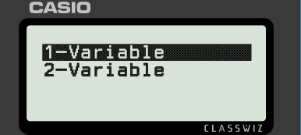
Helitaanka celceliska (mean) miiska soo noqnoqoshada (frequency table)
Cabbirka kooxda (Group size) | Soo noqnoqoshada (Frequency)
0 | 1
1 | 1
2 | 2
3 | 2
4 | 3
5 | 2
Waxaan la tacaalaynaa hal xog oo keliya, marka waxaan dooranaynaa '1-Variable' ee liiska Statistics.

Slide 12
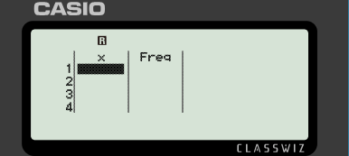
Helitaanka celceliska (mean) miiska soo noqnoqoshada (frequency table)
Cabbirka kooxda (Group size) | Soo noqnoqoshada (Frequency)
0 | 1
1 | 1
2 | 2
3 | 2
4 | 3
5 | 2
Hadda waxaan u baahanahay inaan gelinno qiimaha (values) miiska ee xisaabiyaha (calculator).
Haddii tiirka Freq uu maqan yahay, riix 'Tools', dooro 'Frequency' ka dibna dooro 'On'.

Slide 13
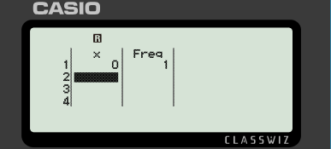
Helitaanka celceliska (mean) miiska soo noqnoqoshada (frequency table)
Cabbirka kooxda (Group size) | Soo noqnoqoshada (Frequency)
0 | 1
1 | 1
2 | 2
3 | 2
4 | 3
5 | 2
Geli 0 ka dibna riix 'EXE'. Waa maxay qiimaha (value) ka soo baxa tiirka 'Freq'?

Slide 14
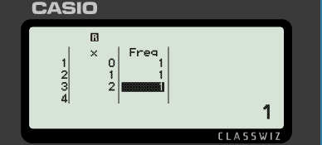
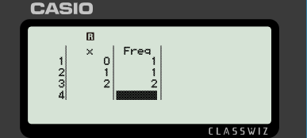
Helista celceliska (mean) ee shaxda soo noqnoqda (frequency table)
Cabbirka kooxda (Group size) | Soo noqnoqoshada (Frequency)
0 | 1
1 | 1
2 | 2
3 | 2
4 | 3
5 | 2
1 waa qiimaha (value) caadiga ah ee soo noqnoqda (frequency).
Waxaad bedeli kartaa qiimaha (value) adigoo u gudbaya qiimaha aad rabto inaad beddesho, ku qor qiimaha saxda ah kadibna riix 'EXE'.

Slide 15
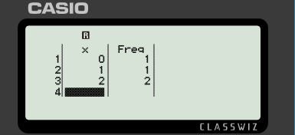

Helista celceliska (mean) ee shaxda soo noqnoqda (frequency table)
Cabbirka kooxda (Group size) | Soo noqnoqoshada (Frequency)
0 | 1
1 | 1
2 | 2
3 | 2
4 | 3
5 | 2
Geli qiimayaasha (values) haray ee xisaabiyaha (calculator).

Slide 16
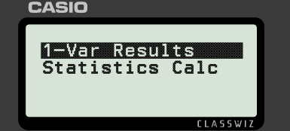
Helista celceliska (mean) ee shaxda soo noqnoqda (frequency table)
Cabbirka kooxda (Group size) | Soo noqnoqoshada (Frequency)
0 | 1
1 | 1
2 | 2
3 | 2
4 | 3
5 | 2
Marka dhammaan qiimayaasha (values) si sax ah loo geliyo, riix 'EXE'.
Riix 'EXE' mar kale si aad u soo saarto celceliska (mean) ee xogta aad gelisay.

Slide 17
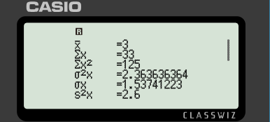
Helista celceliska (mean) ee shaxda soo noqnoqda (frequency table)
Cabbirka kooxda (Group size) | Soo noqnoqoshada (Frequency)
0 | 1
1 | 1
2 | 2
3 | 2
4 | 3
5 | 2
Marka dhammaan qiimayaasha (values) si sax ah loo geliyo, riix 'EXE'.
Celceliska (mean) waxaa loo qoraa sida

Slide 18
Helista celceliska (mean) ee shaxda soo noqnoqda (frequency table)
Cabbirka kooxda (Group size) | Joogto (Frequency)
0 | 1
1 | 1
2 | 2
3 | 2
4 | 3
5 | 2
Marka dhammaan qiimayaasha (values) si sax ah loo geliyo, riix 'EXE'.
Celceliska waxaa loo qoraa
Waa maxay qiimaha celceliska?
3

Slide 19
Helista celceliska ee shaxda joogtada (frequency table)
Celceliska (arithmetic) ee xogta tirooyinka waa wadarta qiimayaasha loo qaybiyay tirada qiimayaasha.
Laakiin maxaan sameeyaa haddii aan haysto shax joogto oo kooxaysan?
Xisaabiyahaagu wuxuu weli heli karaa qiyaasta celceliska.
Isra
Nuur

Slide 20
Helista celceliska ee shaxda joogtada (frequency table)
Si dhakhso ah u nadiifiso xogta jirta ee shaxda, riix 'Tools' ka dib dooro 'Edit' markaas 'Delete All'.
Hadda waxaad haysataa shax madhan oo aad ku gelin karto qiimayaasha cusub.
Haddii kale, waxaad si fudud u bedeli kartaa qiimayaasha jira.

Slide 21
Helista celceliska ee shaxda joogtada (frequency table)
57 qof ayaa la weydiiyay inta lacag ee ay ku kharash gareeyeen cuntada markay booqdeen suuqa weyn ee Oakfield.
lacagta la kharash gareeyay (in £) | joogto (frequency) (f )
£0 < £ ≤ £20 | 20
£20 < £ ≤ £50 | 14
£50 < £ ≤ £100 | 10
£100 < £ ≤ £200 | 8
£200 < £ ≤ £300 | 5
Si loo xisaabiyo qiyaasta celceliska, waxaan u baahanahay inaan isticmaalno barta dhexe ee fasalkasta.

Slide 22
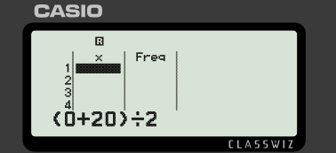
Helista celceliska ee shaxda joogtada (frequency table)
57 qof ayaa la weydiiyay inta lacag ee ay ku kharash gareeyeen cuntada markay booqdeen suuqa weyn ee Oakfield.
lacagta la kharash gareeyay (£) | soo noqnoqosho (frequency) (f )
£0 < £ ≤ £20 | 20
£20 < £ ≤ £50 | 14
£50 < £ ≤ £100 | 10
£100 < £ ≤ £200 | 8
£200 < £ ≤ £300 | 5
Xisaabiyaha ayaa tan kuu qaban kara:
Geli xisaabta oo riix 'EXE'.

Slide 23
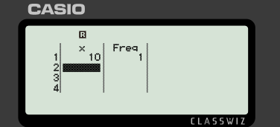
Helista celceliska (mean) ee shaxda soo noqnoqosha (frequency table)
57 qof ayaa la waraystay oo la weydiiyay inta lacag ee ay ku kharash gareeyeen cuntada intii ay ku sugnaayeen suuqa Oakfield.
lacagta la kharash gareeyay (£) | soo noqnoqosho (frequency) (f )
£0 < £ ≤ £20 | 20
£20 < £ ≤ £50 | 14
£50 < £ ≤ £100 | 10
£100 < £ ≤ £200 | 8
£200 < £ ≤ £300 | 5
Xisaabiyaha ayaa tan kuu qaban kara:
Bartamaha (midpoint) waxaa lagu muujiyay safka koowaad.

Slide 24
Helista celceliska (mean) ee shaxda soo noqnoqosha (frequency table)
57 qof ayaa la waraystay oo la weydiiyay inta lacag ee ay ku kharash gareeyeen cuntada intii ay ku sugnaayeen suuqa Oakfield.
lacagta la kharash gareeyay (£) | soo noqnoqosho (frequency) (f )
£0 < £ ≤ £20 | 20
£20 < £ ≤ £50 | 14
£50 < £ ≤ £100 | 10
£100 < £ ≤ £200 | 8
£200 < £ ≤ £300 | 5
Xisaabi qiyaasta celceliska (mean) lacagta la kharash gareeyay ee booqde kasta.
£68.25 waa qiyaasta celceliska (mean) lacagta la kharash gareeyay ee booqde kasta.

Slide 25
Helista celceliska (mean) ee shaxda soo noqnoqosha (frequency table)
1) Shaxdan soo noqnoqosha (frequency table) waxay tusinaysaa tirada goolalka la dhaliyay ciyaar kasta oo ay sameeyeen kooxaha kubbadda cagta ee naadiga hal xilli ciyaareed.
Goolalka la dhaliyay | Soo noqnoqosho (Frequency)
0 | 19
1 | 34
2 | 21
3 | 15
4 | 11
Waa maxay celceliska (mean) tirada goolalka la dhaliyay?

Slide 26
Helista celceliska (mean) ee miiska soo noqnoqoshada (frequency table)
2) Miiskan soo noqnoqoshada (frequency table) wuxuu muujinayaa qiimaynta xiddigta (star rating) uu helay makhaayad intii lagu guda jiray usbuuca furitaanka.
Qiimaynta xiddigta (Star rating) | Soo noqnoqoshada (Frequency)
1 | 12
2 | 18
3 | 21
4 | 38
5 | 45
Waa maxay celceliska (mean) qiimaynta xiddigta (star rating)?

Slide 27
Helista celceliska (mean) ee miiska soo noqnoqoshada (frequency table)
3) Miiska soo noqnoqoshada (frequency table) wuxuu muujinayaa tirada qolalka jiifka ee guryaha kala duwan ee degmada magaalada.
Qolalka jiifka | Soo noqnoqoshada (Frequency)
1 | 20
2 | 93
3 | 54
4 | 33
Waa maxay celceliska (mean) tirada qolalka jiifka?

Slide 28
Helista celceliska (mean) ee miiska soo noqnoqoshada (frequency table)
4) Waqtiga ay ku qaadanayso muunad arday ah inay tagaale iskuulka ayaa lagu soo ururiyay miisan kooxaysan oo soo noqnoqoshada (grouped frequency table).
Waqtiga lagu qaatay safarka iskuulka (daqiiqado) | Soo noqnoqoshada (Frequency) (f )
0 < t ≤ 4 | 28
4 < t ≤ 10 | 23
10 < t ≤ 16 | 70
16 < t ≤ 26 | 52
26 < t ≤ 40 | 30
40 < t ≤ 60 | 13
Waa maxay qiyaasta celceliska (mean) waqtiga safarka (ilaa daqiiqada ugu dhow)?

Slide 29
Helista celceliska (mean) ee miiska soo noqnoqoshada (frequency table)
1) Miiskan soo noqnoqoshada (frequency table) wuxuu muujinayaa tirada goolalka la dhaliyay ee ciyaar kasta oo ay ciyaareen kooxaha kala duwan ee naadiga intii lagu guda jiray xilli kubbadda cagta.
Goolalka la dhaliyay | Soo noqnoqoshada (Frequency)
0 | 19
1 | 34
2 | 21
3 | 15
4 | 11
Waa maxay celceliska (mean) tirada goolalka la dhaliyay?
1.65 gool (oo ku soo wareegaya 2)

Slide 30
Helista celceliska (mean) ee miiska joogteynta (frequency table)
2) Miiskan joogteynta (frequency table) wuxuu muujinayaa qiimeynta xiddig ee maqaayad heshay usbuucii furitaanka.
Qiimeynta xiddig (Star rating) | Joogteynta (Frequency)
1 | 12
2 | 18
3 | 21
4 | 38
5 | 45
Waa maxay celceliska qiimeynta xiddig?
3.64… xiddigood (oo ku wareegaya 4)

Slide 31
Helista celceliska (mean) ee miiska joogteynta (frequency table)
3) Miiska joogteynta (frequency table) wuxuu muujinayaa tirada qolalka jiifka ee guryaha kala duwan ee aagga magaalada.
Qolalka jiifka (Bedrooms) | Joogteynta (Frequency)
1 | 20
2 | 93
3 | 54
4 | 33
Waa maxay celceliska tirada qolalka jiifka?
2.5 qolal jiif (oo ku wareegaya 3)

Slide 32
Helista celceliska (mean) ee miiska joogteynta (frequency table)
4) Waqtiga ay qaadanayso muunad arday si ay iskuulka ugu tagaan ayaa lagu soo ururiyay miiskan joogteynta (frequency table) ee kooxaysan.
Waqtiga lagu qaatay safarka iskuulka (daqiiqado) | Joogteynta (Frequency) (f )
0 < t ≤ 4 | 28
4 < t ≤ 10 | 23
10 < t ≤ 16 | 70
16 < t ≤ 26 | 52
26 < t ≤ 40 | 30
40 < t ≤ 60 | 13
Waa maxay qiyaasta celceliska waqtiga safarka (ilaa daqiiqadda ugu dhow)?
18 daqiiqo

Slide 33
Isticmaalka fx-991CW ee tirakoobka (statistics)
Helista celceliska (mean) ee miiska joogteynta (frequency table)
Falanqaynta (Analysis)

Slide 34
Falanqaynta (Analysis)
Xisaabiyahaagu wuxuu sameyn karaa wax ka badan celceliska (mean) kaliya.
Markii aan helay celceliska (mean), wax badan ayaa shaashadda lagu muujiyay.
Xisaabinta kale ayaa isla waqtigaas la sameeyaa.
Isra
Nuur

Slide 35
Falanqaynta (Analysis)
Cabbirka kooxda (Group size) | Soo noqnoqoshada (Frequency)
0 | 1
1 | 1
2 | 2
3 | 2
4 | 3
5 | 2
Waa shax muujinaysa tirada dadka cuntada ku cunaya miisaska kala duwan oo maqaayad ah.
Markii aan xisaabinay celceliska (mean), macluumaadkan ayaa la soo bandhigay:

Slide 36
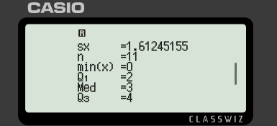
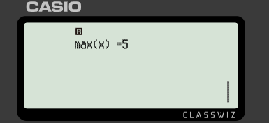
Falanqaynta (Analysis)
Riixida furaha fallaadho hoos u tilmaamaya ayaa muujinaysa macluumaad dheeri ah.

Slide 37
Falanqaynta (Analysis)
Waxaan u fiirsanaynaa macluumaadka loo baahan yahay xisaabta GCSE.
Celceliska (Mean)
Wadarta qiimayaasha (The sum of the values)
(waxaa laga yaabaa in loo qoro ∑fx)

Slide 38
Falanqaynta (Analysis)
Waxaan u fiirsanaynaa macluumaadka loo baahan yahay xisaabta GCSE.
Tirada qiimayaasha (The number of values)
Qiimaha ugu yar ee x (Minimum x value)
Rubucda hoose (Lower quartile)
Dhex-dhexaad (Median)
Rubuc sare (Upper quartile)

Slide 39
Falanqayn (Analysis)
Waxaan u fiirsanaynaa macluumaadka loo baahan yahay GCSE xisaab.
Qiimaha ugu sarreeya ee x (Maximum x value)

Slide 40
Falanqayn (Analysis)
Xogtan, xisaabi kuwan soo socda:
Cabbirka kooxda (Group size) | Soo noqnoqosho (Frequency)
0 | 1
1 | 1
2 | 2
3 | 2
4 | 3
5 | 2
a) Celcelis (Mean)
b) Dhex-dhexaad (Median)
c) Kala-fogaan rubuc-dhexe (Interquartile range)

Slide 41
Falanqayn (Analysis)
Xogtan, xisaabi kuwan soo socda:
Cabbirka kooxda (Group size) | Soo noqnoqosho (Frequency)
0 | 1
1 | 1
2 | 2
3 | 2
4 | 3
5 | 2
a) Celcelis (Mean) = 3
b) Dhex-dhexaad (Median) = 3
c) Kala-fogaan rubuc-dhexe (Interquartile range) = 4 − 2 = 2

Slide 42
Falanqayn (Analysis)
1) Jadwalka soo noqnoqoshada wuxuu muujinayaa tirada goolalka la galay ciyaar kasta oo ay sameeyeen kooxaha oo dhan ee naadiga hal xilli kubbadda cagta.
Goolal la galay | Soo noqnoqoshada (Frequency)
0 | 19
1 | 34
2 | 21
3 | 15
4 | 11
a) Xisaab dhexdhexaadka (median).
b) Xisaab kala-fogaan dhexe (interquartile range).
c) Ma jeclaan lahaa naadigu inuu soo sheego celceliska (mean) ama dhexdhexaadka (median) sida celceliska tirada goolalka? Sabab?

Slide 43
Falanqaynta (Analysis)
2) Jadwalkan soo noqnoqoshada (frequency) wuxuu muujinayaa qiimaynta xiddigaha (star rating) uu helay makhaayad intii lagu jiray usbuuca furitaankeeda.
Qiimaynta xiddigaha (Star rating) | Soo noqnoqoshada (Frequency)
1 | 12
2 | 18
3 | 21
4 | 38
5 | 45
a) Xisaab dhexdhexaadka (median).
b) Xisaab kala-fogaan dhexe (interquartile range).
c) Ma jeclaan lahaa makhaayaddu inay soo sheegto celceliska (mean) ama dhexdhexaadka (median) sida celceliska qiimaynta? Sabab?

Slide 44
Falanqaynta (Analysis)
3) Jadwalka soo noqnoqoshada (frequency) wuxuu muujinayaa tirada qolalka jiifka ee guryaha kala duwan ee ku yaala aagga magaalada.
Qolalka jiifka (Bedrooms) | Soo noqnoqoshada (Frequency)
1 | 20
2 | 93
3 | 54
4 | 33
Horumariye (developer) wuxuu rabaa inuu dhiso guryo qaali ah (3+ qolal) laakiin golaha deegaanka waxay rabaan guryo jaban. Goluhu waxay ku doodayaan in horey u jiraan guryo ku filan oo leh 3 ama in ka badan qolal jiif.
Ma sax baa goluhu? Isticmaal xogta si aad u taageerto go'aankaaga.

Slide 45
Falanqaynta (Analysis)
4) Waqtiga ay qaadanayso muunad arday ah si ay ugu safraan dugsiga ayaa lagu ururiyay jadwalkan soo noqnoqoshada ee kooxaysan (grouped frequency table).
Waqtiga loo qaaday safarka iskuulka (daqiiqado) | Soo noqnoqosho (Frequency) (f )
0 < t ≤ 4 | 28
4 < t ≤ 10 | 23
10 < t ≤ 16 | 70
16 < t ≤ 26 | 52
26 < t ≤ 40 | 30
40 < t ≤ 60 | 13
Waxay qaadataa 17 daqiiqo in Yacquub uu safro isagoo bas ku raacaya.
Yacquub wuxuu sheeganayaa in tani ay ka qaadato waqti dheer celceliska ardayda, sidaas darteed waa in maalin kasta gaari loogu qaado dugsiga.
Ma ku raacsan tahay Yacquub mise waad diidaysaa? Isticmaal caddayn si aad u taageerto jawaabtaada.

Slide 46
Falanqayn (Analysis)
1) Jadwalkan soo noqnoqoshada (frequency) wuxuu muujinayaa tirada goolalka la dhaliyay ciyaar kasta oo ay sameeyeen kooxaha kooxda ciyaarta kubbadda cagta hal xilli.
Goolal la dhaliyay | Soo noqnoqosho (Frequency)
0 | 19
1 | 34
2 | 21
3 | 15
4 | 11
a) Xisaabi dhexdhexaadka (median).
1 gool
b) Xisaabi kala duwanaanshaha rubuc-dhexe (interquartile range).
3 − 1 = 2 gool

Slide 47
Falanqayn (Analysis)
1) Jadwalkan soo noqnoqoshada (frequency) wuxuu muujinayaa tirada goolalka la dhaliyay ciyaar kasta oo ay sameeyeen kooxaha kooxda ciyaarta kubbadda cagta hal xilli.
Goolal la dhaliyay | Soo noqnoqosho (Frequency)
0 | 19
1 | 34
2 | 21
3 | 15
4 | 11
c) Kooxdu ma doorbidi lahayd inay soo sheegto celceliska (mean) ama dhexdhexaadka (median) sida celceliska tirada goolalka? Sabab?
Celcelis (Mean) = 1.65 gool. Dhexdhexaad (Median) = 1 gool.
Kooxdu waxay doorbidi lahayd inay soo sheegto celceliska (mean) sababtoo ah waxay ku wareegaysaa 2 gool taasoo ka dhigaysa waxqabadka kooxda mid u muuqda mid fiican.

Slide 48
Falanqayn (Analysis)
2) Jadwalkan soo noqnoqoshada (frequency) wuxuu muujinayaa qiimaynta xiddigaha (star rating) ee uu helay makhaayad usbuuca furitaankeeda.
Qiimaynta xiddigaha (Star rating) | Soo noqnoqosho (Frequency)
1 | 12
2 | 18
3 | 21
4 | 38
5 | 45
a) Xisaabi dhexdhexaadka (median).
4 xiddigood
b) Xisaabi kala-fogaan dhaxe (interquartile range).
5 − 3 = 2 xiddigood

Slide 49
Falanqayn (Analysis)
2) Jadwalkan soo noqnoqoshada (frequency table) wuxuu muujinayaa qiimaynta xiddigaha ee maqaayad heshay usbuuca furitaankeeda.
Qiimaynta xiddigaha (Star rating) | Soo noqnoqosho (Frequency)
1 | 12
2 | 18
3 | 21
4 | 38
5 | 45
c) Maqaayaddu ma doorbidi lahayd inay soo sheegto celceliska (mean) ama dhexe (median) sida celceliska qiimaynta? Sabab?
Celcelis (Mean) = 3.64… xiddigood. Dhexe (Median) = 4 xiddigood.
Maqaayaddu waxay soo sheegi kartaa midkood, laakiin dhexe (median) uma baahna in la soo koobo.

Slide 50
Falanqayn (Analysis)
3) Jadwalka soo noqnoqoshada (frequency table) wuxuu muujinayaa tirada qolalka jiifka ee guryaha kala duwan ee aagga magaalada.
Qolalka jiifka (Bedrooms) | Soo noqnoqosho (Frequency)
1 | 20
2 | 93
3 | 54
4 | 33
Horumariye (developer) wuxuu rabaa inuu dhiso guryo qaali ah (3+ qolal jiif) laakiin golaha deegaanku waxay rabaan guryo jaban. Goluhu waxay ku doodayaan in horey u jiraan guryo ku filan oo leh 3 ama in ka badan oo qolal jiif ah.
Goluhu ma sax baa? U isticmaal xogta si aad u taageerto go'aankaaga.

Slide 51
Falanqayn (Analysis)
3) Jadwalka soo noqnoqoshada (frequency table) wuxuu muujinayaa tirada qolalka jiifka ee guryaha kala duwan ee aagga magaalada.
Qolalka jiifka (Bedrooms) | Joogto (Frequency)
1 | 20
2 | 93
3 | 54
4 | 33
Celcelis (Mean) = 2.5 qolal jiif. Dhexe (Median) = 2 qolal jiif.
Kala-fogaan dhaxe (Interquartile range) = 3 − 2 = 1
E.g.
Haddii goluhu isticmaalo celceliska (mean), waxay soo koobi karaan oo sheegi karaan in celceliska tirada qolalka jiifka ee guryaha aaggan yahay 3. Sidaas darteed waxaa jira guryo badan oo leh 3 (ama in ka badan) qolal jiif.

Slide 52
Falanqayn (Analysis)
4) Waqtiga ay qaadanayso muunad arday si ay u tagaalo iskuulka waxaa lagu soo ururiyay jaantuska joogtada ee kooxaysan.
Waqtiga lagu qaatay inuu tago iskuulka (daqiiqado) | joogto (frequency) (f )
0 < t ≤ 4 | 28
4 < t ≤ 10 | 23
10 < t ≤ 16 | 70
16 < t ≤ 26 | 52
26 < t ≤ 40 | 30
40 < t ≤ 60 | 13
Waxay qaadataa 17 daqiiqo in Yacquub uu tago iskuulka baska.
Yacquub wuxuu sheeganayaa in tani ay ka qaadato waqti dheer marka loo eego ardayda caadiga ah, sidaas darteed waa in maalin kasta lagu qaado iskuulka gaari.
Ma ku raacsan tahay ama ma diidaysaa Yacquub? U adeegso caddayn si aad u taageerto jawaabtaada.

Slide 53
Falanqayn (Analysis)
4) Waqtiga ay qaadanayso muunad arday si ay u tagaalo iskuulka waxaa lagu soo ururiyay jaantuska joogtada ee kooxaysan.
Waqtiga lagu qaatay inuu tago iskuulka (daqiiqado) | joogto (frequency) (f )
0 < t ≤ 4 | 28
4 < t ≤ 10 | 23
10 < t ≤ 16 | 70
16 < t ≤ 26 | 52
26 < t ≤ 40 | 30
40 < t ≤ 60 | 13
Celcelis ≈ 18 daqiiqo. Dhexdhexaad = 13 daqiiqo.
Haddii Yacquub uu isticmaalo waqtiga dhexdhexaadka ah, markaas waa sax.
Si kastaba ha ahaatee, qoyska Yacquub waxay ku doodi karaan inuu qaldan yahay adoo isticmaalaya celceliska waqtiga.

Slide 54
Isticmaalka fx-991CW ee tirakoobka (statistics)
Xisaabiyayaasha qaarkood waxay qaban karaan wax ka badan xisaabinta aasaasiga ah.
fx-991CW waxay soo saari kartaa soo koobid tirakoob (statistical summary) oo ah xog.
Soo koobidu waxay ku daraysaa celceliska (mean), dhexdhexaadka (median), rubucda sare iyo hoose (upper and lower quartiles).

