Slide 1
Isticmaalka fx-CG50 ee tirooyinka iyo aljabrada (algebra)
Hawlaha xisaabiyaha (calculator)

Slide 2
Sida agabkeena waxbarista loogu talagalay fasalka

Slide 3
Waxaan isticmaali karaa fx-CG50 si aan u sameeyo xisaabinta tirooyinka iyo xallinta isla'egyada (equations) tiro ahaan.

Slide 4
Isla'eg (equation) waxaa loo isticmaalaa in lagu muujiyo 2 tibaaxood (expressions) oo isku qiimo (value) ah.
Isla'egyada (equations) ka dhiganaya xiriirro kala duwan oo u dhexeeya doorsoomayaasha (variables) isku mid ah waxaa loo yaqaan isla'egyada isku mar (simultaneous equations).

Slide 5

Isticmaalka fx-CG50 ee tirooyinka iyo aljabrada (algebra)
Xallinta isla'egyada (equations) garaaf ahaan
Xallinta isla'egyada (equations) tiro ahaan

Slide 6
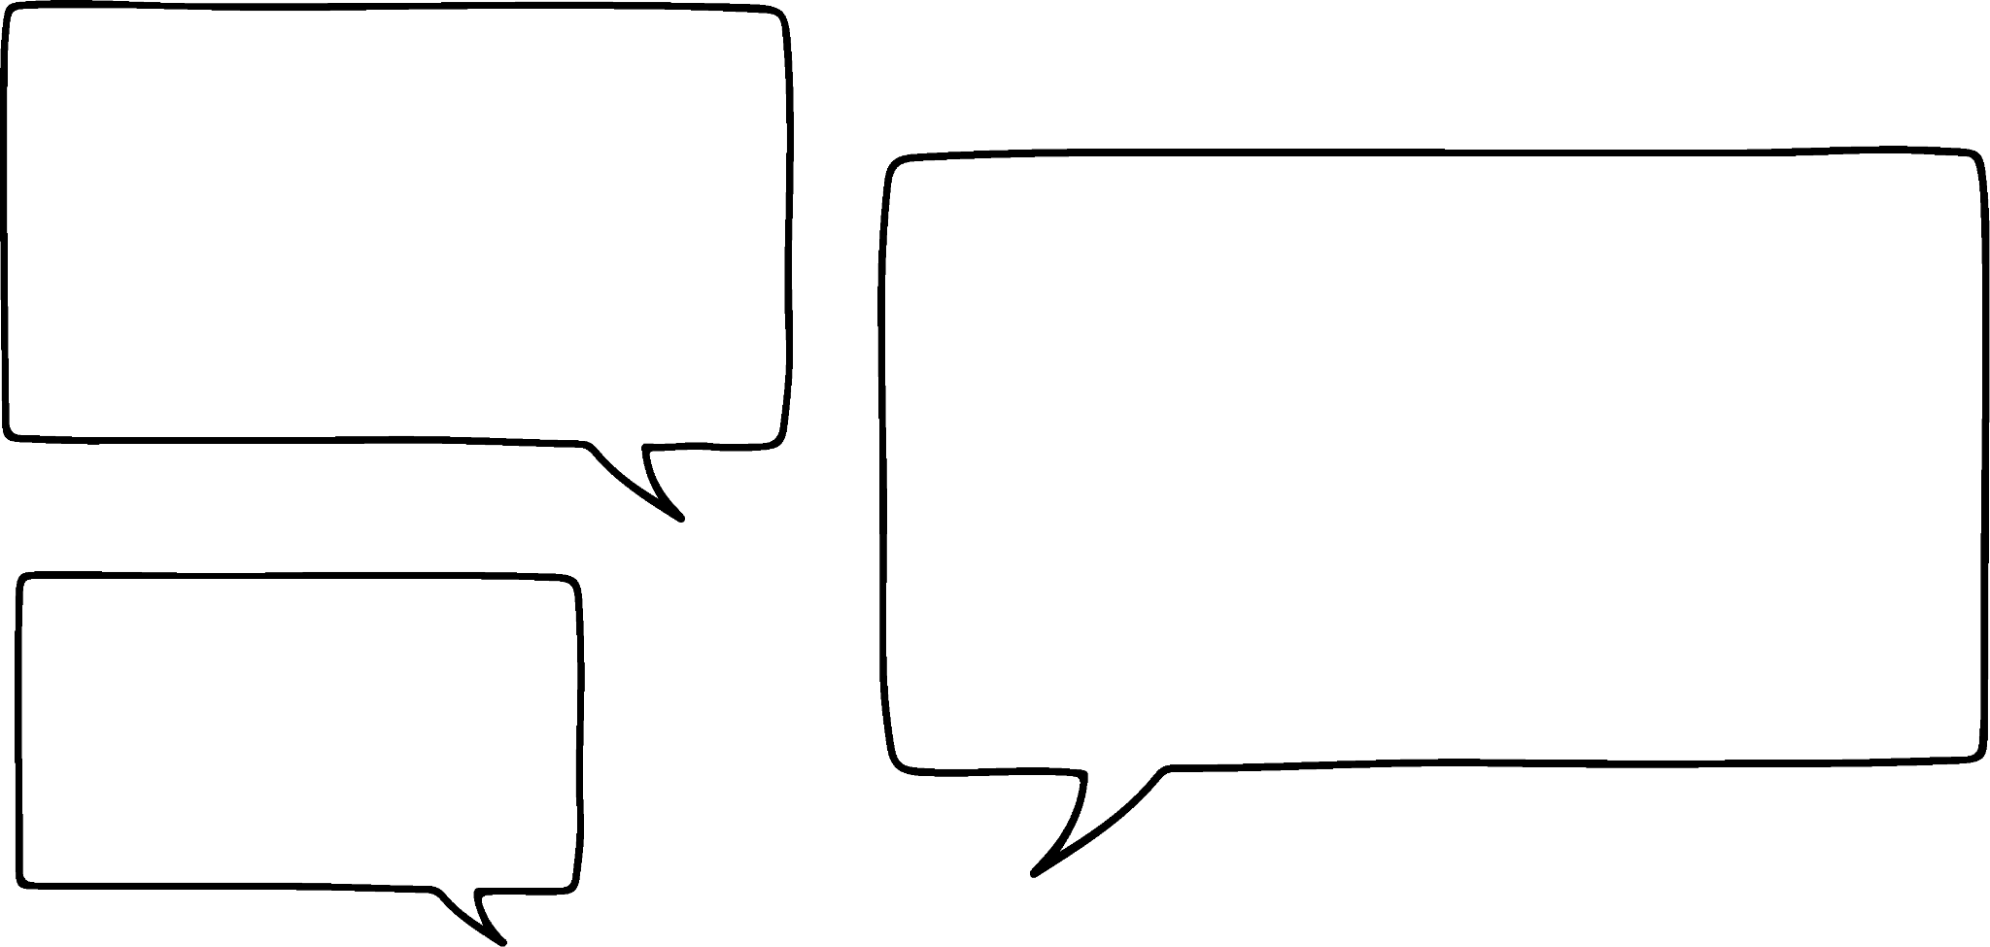






Xallinta isla'egyada (equations) garaaf ahaan
Xisaabiyayaashu (calculators) wax badan bay qaban karaan tiro ahaan.
fx-CG50 sidoo kale waxay xallin kartaa garaaf ahaan.
Caasha
Saciid

Slide 7
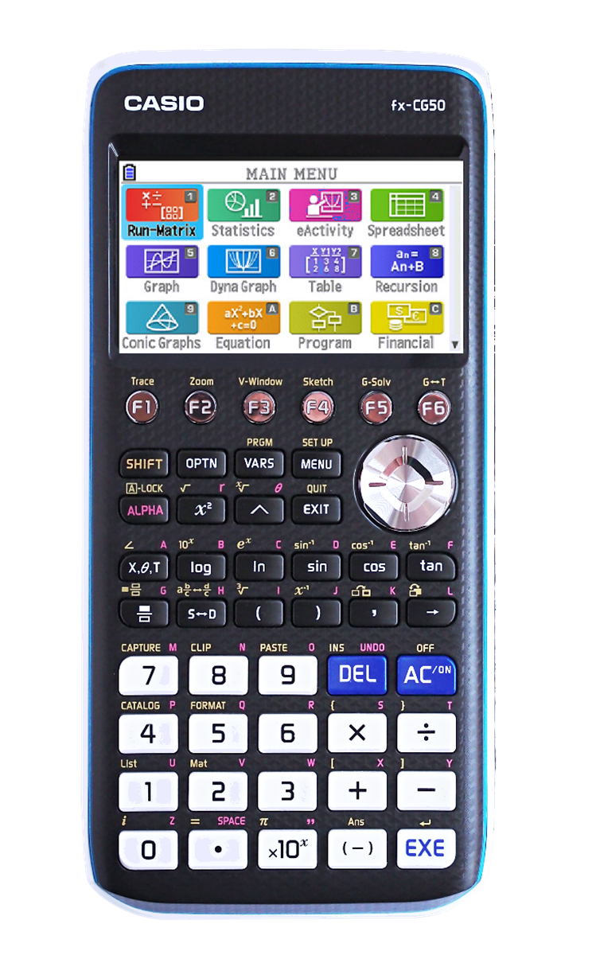
Xallinta isla'egyada (equations) garaaf ahaan
fx-CG50 waxay kuu ogolaaneysaa inaad sawirto garaafyada (graphs) ka dibna aad falanqeyso.
Laga bilaabo menu-ga (menu) guud, u gudub ikhtiyaarka 'Graph' oo riix 'EXE'.

Slide 8

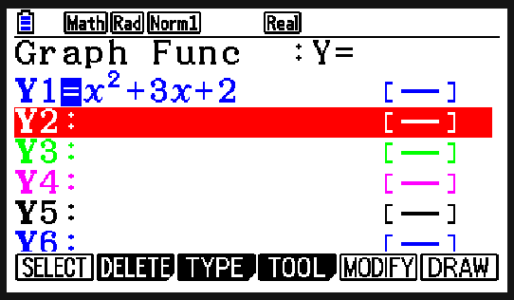
Xallinta isla'egyada (equations) garaaf ahaan
Waxaad ku geli kartaa isla'egta (equation) garaafka shaashaddan, adigoo isticmaalaya badhanka si aad u gasho doorsoomaha x.

Slide 9
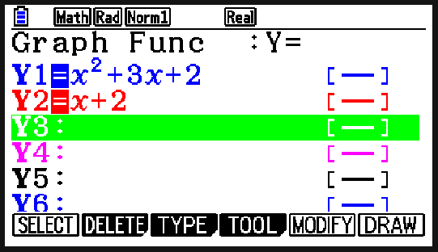
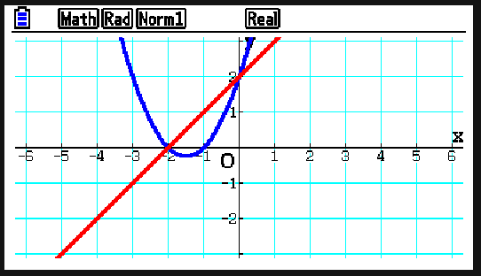
Xallinta isla'egyada (equations) garaaf ahaan
Markaad diyaar tahay, riix F6 si aad u sawirto garaafka. Haddii aad gashay isla'egyada (equations) garaafyo badan, xisaabiyuhu (calculator) wuxuu sawiri doonaa dhammaantood.

Slide 10

Xallinta isla'egyada (equations) garaaf ahaan
Xisaabiyaha (calculator) wuxuu sawiri karaa hal garaaf (graph) kaliya markiiba.
Waxaa jira meelo bannaan oo ilaa 20 isla'eg (equation) oo garaafyo ah oo la gelin karo.

Slide 11
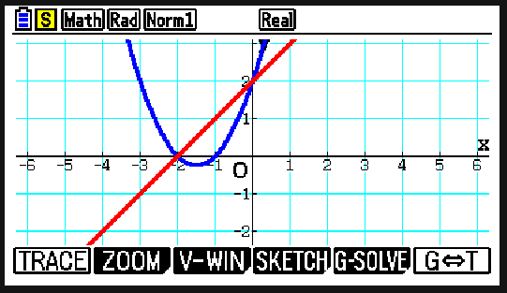
Xallinta isla'egyada (equations) garaaf ahaan
Markaad sawirto garaafyadaada (graphs), waxaad isticmaali kartaa menu-ga 'G-Solve' si aad u falanqeyso garaafyada.
Riixida 'SHIFT' oo ay raacdo F5 waxay kuu ogolaaneysaa inaad gasho 'G-Solve'.

Slide 12
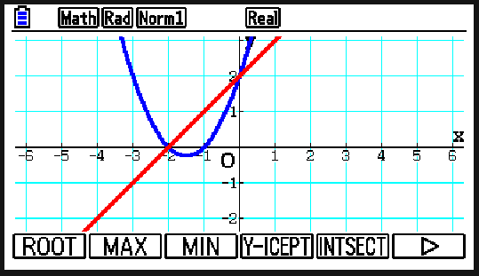
Xallinta isla'egyada (equations) garaaf ahaan
Waxaad ka heli kartaa xididdada (roots), dhibcaha ugu sarreeya/ugu hooseeya (maximum/minimum), y-intercept-ka, iyo dhibcaha isgoysyada (intersection) haddii aad haysato garaafyo badan.

Slide 13

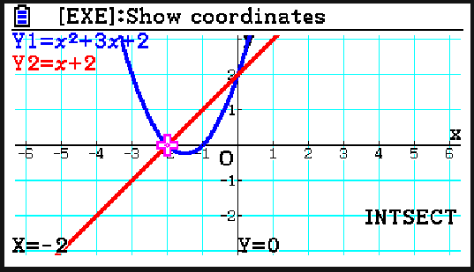
Xallinta isla'egyada (equations) garaaf ahaan
Dhibcaha koowaad ee isgoyska waa marka x = −2, y = 0
Fallaaraha (arrows) waxaa loo isticmaali karaa in lagu xusho dhibcaha xiga.

Slide 14
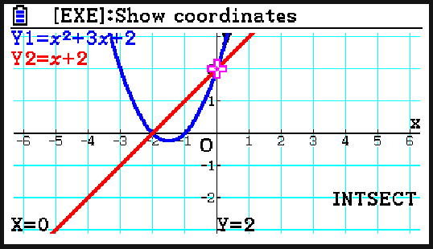
Xallinta isla'egyada (equations) garaaf ahaan
Waa maxay isku-duwayaasha (coordinates) dhibcaha labaad ee isgoyska?
(0, 2)

Slide 15
Xallinta isla'egyada (equations) garaaf ahaan
1) Isticmaal xisaabiyahaaga (calculator) si aad u xalliso labadan isla'eg oo isku mar ah (simultaneous equations).
a)
y = x − 3
y = 3x + 6
b)
6y − x = 14
x + 3y = 13

Slide 16
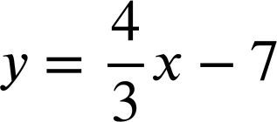
Xallinta isla'egyada (equations) garaaf ahaan
2) Labada isla'eg oo isku mar ah (simultaneous equations) kasta, qor waxa xisaabiyahaagu (calculator) yiraahdo markaad isku daydo inaad xalliso garaaf ahaan. Maxaad u maleyneysaa in xisaabiyuhu (calculator) bixiyo natiijadan?
a)
35x − 7y = 63
y = 5x + 1
b)
3x + 4y = 7
c)
25x − 5y + 5 = 0
y = 5x + 1

Slide 17
Xallinta isla'egyada (equations) garaaf ahaan
3) Isticmaal xisaabiyahaaga (calculator) si aad u qiyaasto xallinta labadan isla'eg oo isku mar ah (simultaneous equations) ilaa 3 d.p.
y = 3x − x²
y = 1.7 − 0.8x

Slide 18
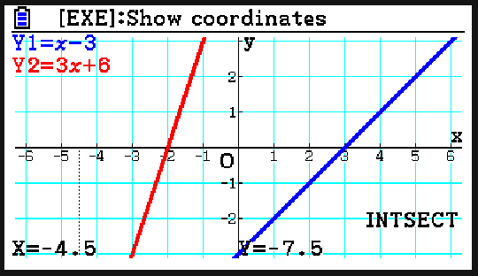
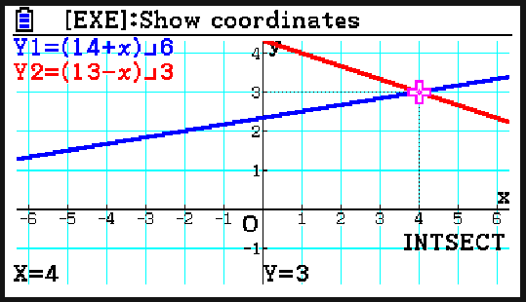
Xallinta isla'egyada (equations) garaaf ahaan
1) Isticmaal xisaabiyahaaga (calculator) si aad u xalliso labadan isla'eg oo isku mar ah (simultaneous equations).
a)
y = x − 3
y = 3x + 6
b)
6y − x = 14
x + 3y = 13
x = − 4.5, y = − 7.5
x = 4, y = 3

Slide 19
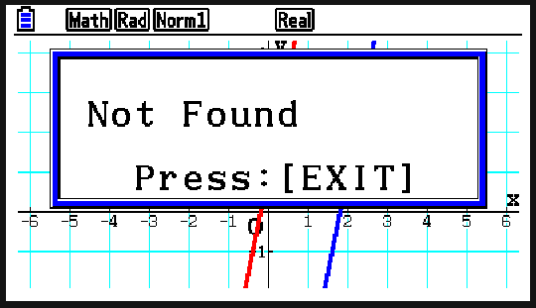
Xallinta isla'egyada (equations) garaaf ahaan
E.g.
Xisaabiyaha (calculator) ma helin milan (solution) maadaama aysan jirin meel isgoys (point of intersection).
Khadadka (lines) waa isbarbar yaac (parallel) maadaama ay leeyihiin jiiro (gradient) isku mid ah.
2) Labada isla'eg oo isku mar ah (simultaneous equations) kasta, qor waxa xisaabiyahaagu (calculator) yiraahdo markaad isku daydo inaad xalliso garaaf ahaan. Maxaad u maleyneysaa in xisaabiyuhu (calculator) bixiyo natiijadan?
a)
35x − 7y = 63
y = 5x + 1

Slide 20
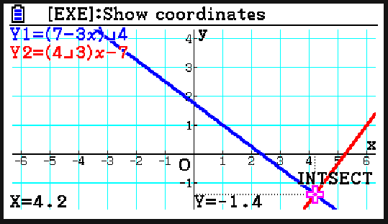
Xallinta isla'egyada (equations) garaaf ahaan (graphically)
E.g.
Khadadka (lines) waxay leeyihiin hal isgoys (intersection) oo xisaabiyaha (calculator) awooday inuu helo. Wuxuu muujiyaa isku-duwayaasha (coordinates) ee barta isgoyska (point of intersection).
2) Isla'egyada (equations) isku xiran (simultaneous) ee kasta, qor waxa xisaabiyaha (calculator) kuu sheego markaad isku daydo inaad garaaf ahaan (graphically) ku xalliso. Maxaad u malaynaysaa in xisaabiyuhu (calculator) soo saaro natiijadan?
b)
3x + 4y = 7

Slide 21
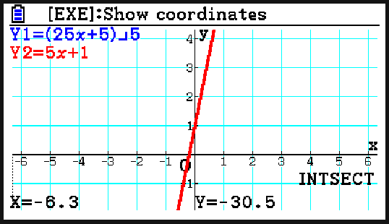
Xallinta isla'egyada (equations) garaaf ahaan (graphically)
E.g.
Xisaabiyaha (calculator) wuxuu bixiyaa barta isgoyska (point of intersection). Markaad rogrogto waxaa soo baxaya inay jiraan dhowr isgoys (points of intersection). Sababta oo ah labada khad (lines) waa isku mid, sidaas darteed waxay leeyihiin milan (solutions) aan xad lahayn (infinitely many).
2) Isla'egyada (equations) isku xiran (simultaneous) ee kasta, qor waxa xisaabiyaha (calculator) kuu sheego markaad isku daydo inaad garaaf ahaan (graphically) ku xalliso. Maxaad u malaynaysaa in xisaabiyuhu (calculator) soo saaro natiijadan?
c)
25x − 5y + 5 = 0
y = 5x + 1

Slide 22
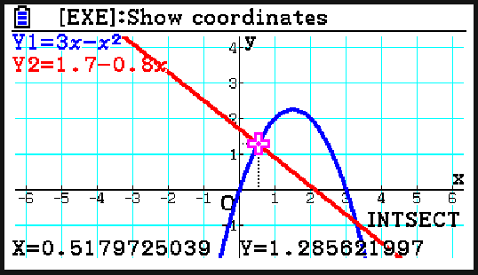
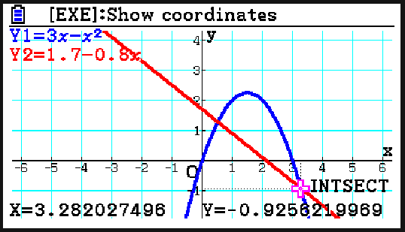
Xallinta isla'egyada (equations) garaaf ahaan (graphically)
3) U isticmaal xisaabiyahaaga (calculator) si aad u qiyaasto milan (solutions) ee isla'egyadan (equations) isku xiran (simultaneous) ilaa 3 d.p.
y = 3x − x²
y = 1.7 − 0.8x
x = 0.518, y = 1.286
x = 3.282, y = − 0.926

Slide 23
Isticmaalka fx-CG50 ee tiro iyo algebra
Xallinta isla'egyada (equations) garaaf ahaan (graphically)
Xallinta isla'egyada (equations) tiro ahaan (numerically)

Slide 24
Xallinta isla'egyada (equations) tiro ahaan (numerically)
Marka xisaabiyahan (calculator) kaliya ma xalliyaa isla'egyada (equations) garaaf ahaan (graphically)?
Maya! Waxa uu xitaa la tacaali karaa qaaciidooyinka (formulas).
Caasha
Saciid

Slide 25
Xallinta isla'egyada (equations) tiro ahaan (numerically)
fx-CG50 waxa uu kuu ogolaanayaa inaad xalliso isla'egyada (equations) tiro ahaan (numerically) oo aad qiimeyso (evaluate) qaaciidooyinka (formulas).
Laga bilaabo menu-ga (main menu) guji ikhtiyaarka 'Equation' kadibna riix 'EXE'.

Slide 26
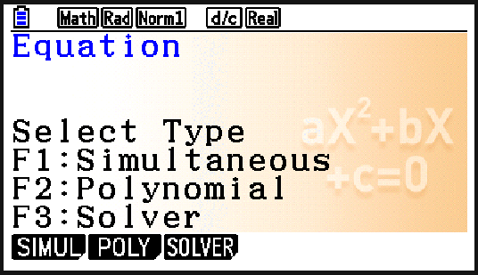
Xallinta isla'egyada (equations) tiro ahaan (numerically)
Markii 'Equation' la doorto, dooro 'Solver' adigoo riixaya F3.

Slide 27

Xallinta isla'egyada (equations) tiro ahaan
Geli isla'egta (equation) ama qaacidada (formula), adigoo isticmaalaya badhanka 'ALPHA' si aad u doorato doorsoomayaasha (variables) kala duwan sida loo baahan yahay.
Waa maxay qiimaha (value) a marka s = 210, u = 2 iyo t = 5?

Slide 28
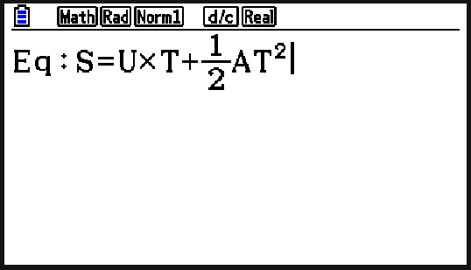
Xallinta isla'egyada (equations) tiro ahaan
Waa maxay qiimaha (value) a marka s = 210, u = 2 iyo t = 5?
Xusuusnow inaad isticmaasho badhanka 'ALPHA' si aad u gasho doorsoomayaasha (variables).
Ma khalad inay u muuqdaan xarfo waaweyn.

Slide 29
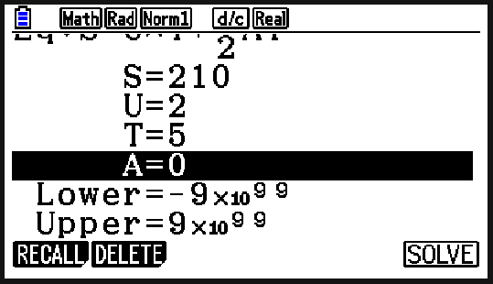
Xallinta isla'egyada (equations) tiro ahaan
Waa maxay qiimaha (value) a marka s = 210, u = 2 iyo t = 5?
Riixida 'EXE' waxay kuu ogolaaneysaa inaad dejiso qiimaha (values) doorsoomayaasha (variables).
Geli qiimaha (values) la yaqaan oo ka tag kan aad rabto inaad hesho 0.

Slide 30
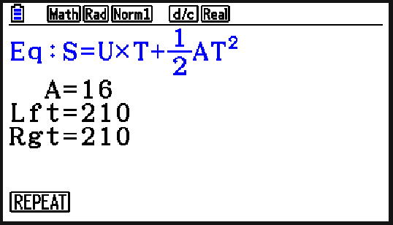
Xallinta isla'egyada (equations) tiro ahaan
Waa maxay qiimaha (value) a marka s = 210, u = 2 iyo t = 5?
Riixida 'SOLVE' (F6) waxay soo saartaa qiimaha (value) doorsoomaha (variable) haray.

Slide 31
Xallinta isla'egyada (equations) tiro ahaan
Qaabka 'Solver' wuxuu kaliya xallin karaa isla'egyada (equations) toosan (linear).
Qaabka 'Solver' wuxuu kuu ogolaanayaa inaad go'aamiso qiimaha (value) doorsoome (variable) kasta oo ku jira qaacidada (formula).

Slide 32
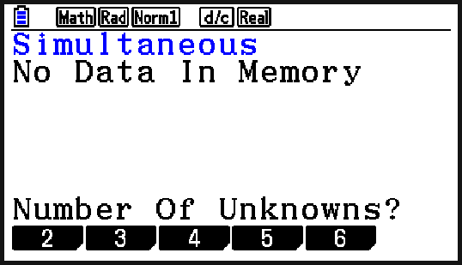
Xallinta isla'egyada (equations) tiro ahaan
Xisaabiyaha (calculator) ayaa sidoo kale xallin kara laba isla'eg (simultaneous equations) oo toosan (linear).
Markii 'Equation' la doorto, dooro 'Simultaneous' adigoo riixaya F1.
Waxaan la tacaaleynaa isla'egyada (simultaneous equations) leh laba doorsoome (unknowns) marka waxaan dooranaynaa 2.

Slide 33
Xallinta isla'egyada (equations) tiro ahaan
Xisaabiyahaagu wuxuu aqbali doonaa oo kaliya isla'egyada (equations) qaabka ax + by = c, marka waxaa laga yaabaa inay lagama maarmaan tahay in dib loo habeeyo ka hor gelinta.
w + h + 8 = 0
x + y = −8
h = 4w − 17
4x − y = 17
Xisaabiyuhu wuxuu isticmaalaa x iyo y, marka waxaa muhiim ah inaad ogaato variable-ka x uu matalayo iyo variable-ka y uu matalayo.

Slide 34
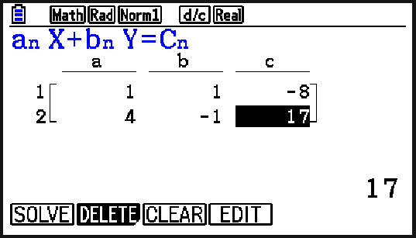
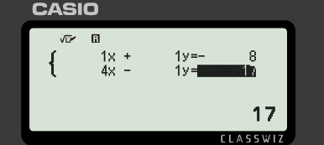
Xallinta isla'egyada (equations) tiro ahaan
Xisaabiyahaagu wuxuu aqbali doonaa oo kaliya isla'egyada (equations) qaabka ax + by = c, marka waxaa laga yaabaa inay lagama maarmaan tahay in dib loo habeeyo ka hor gelinta.
w + h + 8 = 0
x + y = −8
h = 4w − 17
4x − y = 17
Ka digtoonow qiimaha (values) taban.

Slide 35
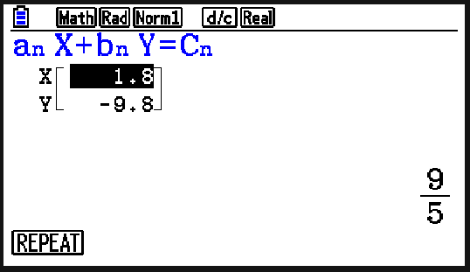
Xallinta isla'egyada (equations) tiro ahaan
Xisaabiyahaagu wuxuu aqbali doonaa oo kaliya isla'egyada (equations) qaabka ax + by = c, marka waxaa laga yaabaa inay lagama maarmaan tahay in dib loo habeeyo ka hor gelinta.
w + h + 8 = 0
x + y = −8
h = 4w − 17
4x − y = 17
Riixida 'SOLVE' (F1) waxay soo bandhigaysaa labada qiime (values).
Waxaan u fasiri karnaa tan sida w = 1.8 iyo h = −9.8

Slide 36
Xallinta isla'egyada (equations) tiro ahaan
Waxaad gelin kartaa laba isla'eg (equations) oo isku mar ah (simultaneous) oo kasta oo xisaabiyahaaga ah iyada oo aan loo baahnayn in dib loo habeeyo.
Isla'egyada (equations) waa inay ahaadaan qaabka ax + by = c
Mararka qaarkood waxaa lagama maarmaan ah in marka hore dib loo habeeyo.

Slide 37
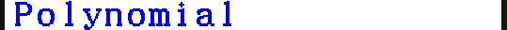
Xallinta isla'egyada (equations) tiro ahaan
Waxaad xallin kartaa isla'egyada (equations) laba jibaaran (quadratic) adoo dooranaya 'Equation' ka dibna 'Polynomial'. Dooro qaabka guud ee polynomial-ka aad rabto inaad xalliso.

Slide 38
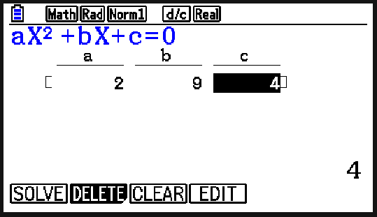
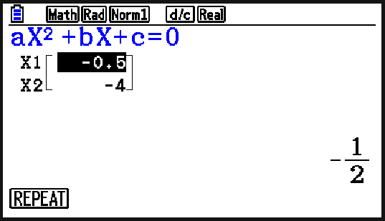
Xallinta isla'egyada (equations) tiro ahaan
Xalli 2x2 + 9x + 4 = 0
Xisaabiyahaagu wuxuu aqbali doonaa oo kaliya isla'egyada (equations) qaabka ax2 + bx + c = 0, marka waxaa laga yaabaa inay lagama maarmaan tahay in marka hore dib loo habeeyo.
Riix 'SOLVE' (F1) si aad u xalliso.

Slide 39
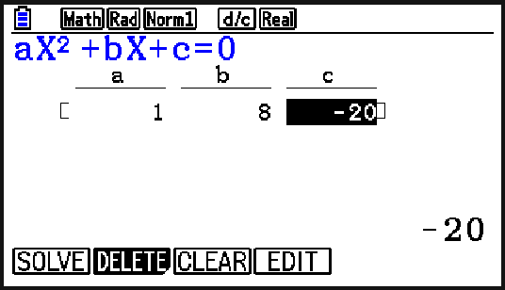
Xallinta isla'egyada (equations) tiro ahaan
Isticmaal xisaabiyahaaga si aad u hesho xallinta (solution(s)) ee x2 + 8x − 20 = 0
x = 2
x = −10

Slide 40
Xallinta isla'egyada (equations) tiro ahaan (numerically)
1) Xalliyaan (Solve) lamaanaha isla'egyada (simultaneous equations) ee soo socda adigoo isticmaalaya xisaabiyahaaga (calculator).
a) b)
2a + 3b = 1
2b + a = 8
−a + 4b = 8
2b + 3 = 7a

Slide 41
Xallinta isla'egyada (equations) tiro ahaan (numerically)
2) Xisaabi xalalka (solutions) isla'egyadan (quadratic equations).
a) −x² − 8x + 20 = 0
b) x² + 8x − 19 = 0
c) x² + 6x + 8 = 3
d) 5x² − x + 5 = 3x² − 10x − 2

Slide 42
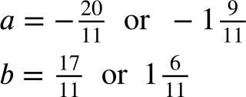
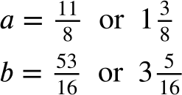
Xallinta isla'egyada (equations) tiro ahaan (numerically)
1) Xalliyaan (Solve) lamaanaha isla'egyada (simultaneous equations) ee soo socda adigoo isticmaalaya xisaabiyahaaga (calculator).
a) b)
2a + 3b = 1
2b + a = 8
−a + 4b = 8
2b + 3 = 7a

Slide 43
Xallinta isla'egyada (equations) tiro ahaan (numerically)
2) Xisaabi xalalka (solutions) isla'egyadan (quadratic equations).
a) −x2 − 8x + 20 = 0 x = −10 ama x = 2
b) x² + 8x − 19 = 0
c) x2 + 6x + 8 = 3 x = −5 ama x = −1
d) 5x2 − x + 5 = 3x2 − 10x − 2 x = −1 ama x = −3.5

Slide 44
Isticmaalka fx-CG50 ee tirooyinka (number) iyo aljabrada (algebra)
Qaar ka mid ah xisaabiyayaasha (calculators) waxay qaban karaan wax ka badan xisaabinta aasaasiga ah.
fx-CG50 wuxuu xallin karaa isla'egyada (equations) garaaf ahaan (graphically) iyo tiro ahaan (numerically).

