Slide 1
Isticmaalka fx-CG50 ee tirakoobka (statistics)
Shaqeynta xisaabiyaha (calculator)

Slide 2
Sida agabkeena waxbarista loogu talagalay fasalka

Slide 3
Waxaan awoodi karaa inaan isticmaalo fx-CG50 si aan u sameeyo xisaabinta xogta.

Slide 4
Soo noqnoqoshada (frequency) waa tirada jeer ee dhacdo dhacdo; ama tirada shakhsiyaadka (dadka, xayawaanka iwm.) ee leh sifo gaar ah.
Celceliska (arithmetic mean) ee xogta tirooyinka waa wadarta qiimaha (values) loo qaybiyo tirada qiimaha. Waa cabbirka u dhaxaysa (central tendency) oo matalaya celceliska qiimaha.
Dhexda (median) waa xogta dhexe (bartamaha) marka xogta loo habeeyo si tiro ahaan. Waa cabbirka u dhaxaysa (central tendency) oo matalaya celceliska qiimaha.

Slide 5
Moodka (mode) waa qiimaha (value) ugu soo noqnoqda. Waa cabbirka u dhaxaysa (central tendency) oo matalaya celceliska qiimaha.
Soo koobista tirakoobka (statistical summary) waxay soo koobtaa astaamaha xogta. Waxaa laga yaabaa inay ku jiraan celceliska (mean), dhexda (median) iyo/ama moodka (mode) kuwaas oo cabbira u dhaxaysa (central tendency). Sidoo kale waxaa laga yaabaa inay ku jirto kala duwanaanshaha (range) kaas oo cabbira faafitaanka.

Slide 6

Isticmaalka fx-CG50 ee tirakoobka (statistics)
Soo koobista tirooyinka xogta
Matalaadda garaafyada xogta

Slide 7
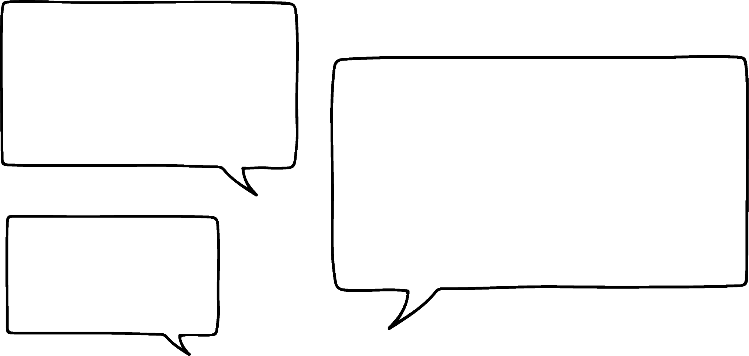






Soo koobista tirooyinka xogta
Celceliska (arithmetic mean) ee xogta tirooyinka waa wadarta qiimaha (values) loo qaybiyo tirada qiimaha.
Ma waxay la macno tahay inaan isticmaalo qaabka xisaabinta si aan ugu daro dhammaan tirooyinka ka hor intaanan u qaybin?
Waxaa jira hab fudud oo lagu xisaabiyo celceliska (mean).
Isra
Nuur

Slide 8
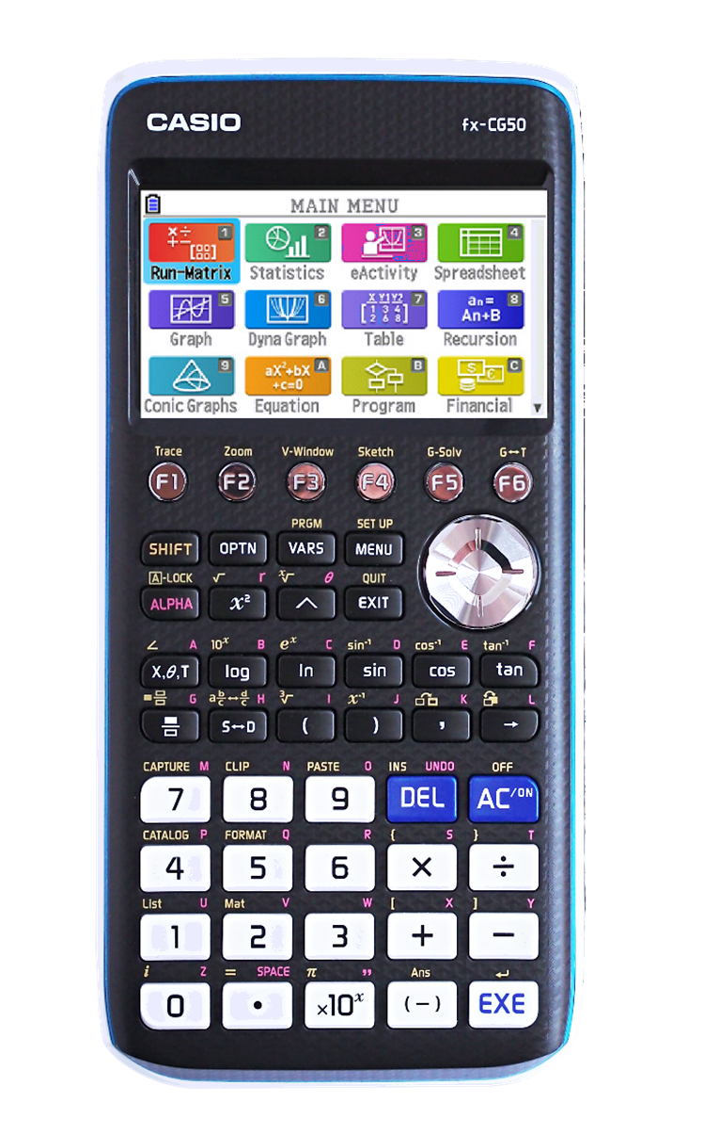
Soo koobista tirooyinka xogta
fx-CG50 waxay kuu ogolaaneysaa inaad si dhakhso leh u soo saarto soo koobista tirakoobka (statistical summary).
Laga soo bilaabo menu-ga guud, u gudub ikhtiyaarka 'Statistics' oo riix 'EXE'.

Slide 9
Soo koobid tirooyin oo xog ah (Numerical summaries of data)
Cabbirka kooxda (Group size) | Inta jeer ee dhacdo (Frequency)
0 | 1
1 | 1
2 | 2
3 | 2
4 | 3
5 | 2
Waa kan shax muujinaya tirada dadka cuntada ku cunaya miisas kala duwan oo makhaayad ah.
Tani waxay ka dhigan tahay 3 miis, mid kastaa wuxuu leeyahay 4 cunto qaata.
Tani waxay ka dhigan tahay 2 miis, mid kastaa wuxuu leeyahay 5 cunto qaata.

Slide 10
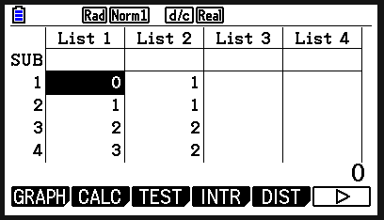
Soo koobid tirooyin oo xog ah (Numerical summaries of data)
Cabbirka kooxda (Group size) | Inta jeer ee dhacdo (Frequency)
0 | 1
1 | 1
2 | 2
3 | 2
4 | 3
5 | 2
Geli xogta isku hab isku mid ah miiska shaashadda.

Slide 11
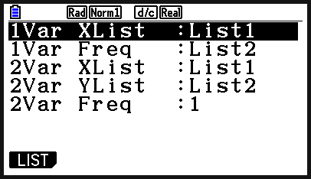
Soo koobid tirooyin oo xog ah (Numerical summaries of data)
Cabbirka kooxda (Group size) | Inta jeer ee dhacdo (Frequency)
0 | 1
1 | 1
2 | 2
3 | 2
4 | 3
5 | 2
Riix 'CALC' (F2). Hadda waxaad u baahan tahay inaad qeexdo waxa liis kastaa ka dhigan yahay. Riix 'SET' (F6).

Slide 12
Soo koobid tirooyin oo xog ah (Numerical summaries of data)
Cabbirka kooxda (Group size) | Inta jeer ee dhacdo (Frequency)
0 | 1
1 | 1
2 | 2
3 | 2
4 | 3
5 | 2
1Var XList: waa inay dhahdaa List 1.
1Var Freq: waa inay dhahdaa List 2. (Tani waa waxa liis kastaa ka dhigan yahay miiskeenna.)
Waxaad isticmaali kartaa 'LIST' (F1) si aad tan u beddesho haddii loo baahdo.

Slide 13
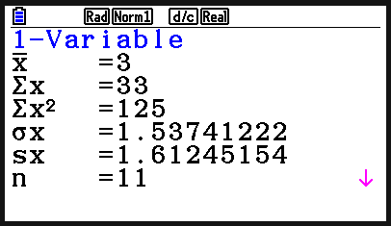
Soo koobid tirooyin oo xog ah (Numerical summaries of data)
Cabbirka kooxda (Group size) | Joogteynta (Frequency)
0 | 1
1 | 1
2 | 2
3 | 2
4 | 3
5 | 2
Riix 'EXIT' ka dibna dooro '1-VAR' (F1), si aad u soo saarto soo koobida tirakoobka. Waxaad hoos u dhaadhacaysaa si aad wax badan u aragto.
Celceliska waxaa loo qoraa sida

Slide 14
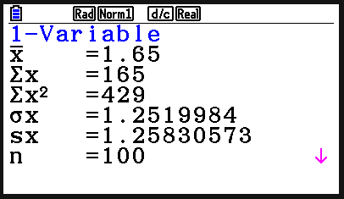
Soo koobida tirooyinka xogta (Numerical summaries of data)
Jaantuskan joogteynta (frequency) wuxuu muujinayaa tirada goolalka la dhaliyay ciyaar kasta oo ay sameeyeen kooxaha kulligood xilli ciyaareed kubbadda cagta.
Goolal la dhaliyay | Joogteynta (Frequency)
0 | 19
1 | 34
2 | 21
3 | 15
4 | 11
Waa imisa celceliska tirada goolalka la dhaliyay?
1.65 gool (oo ku wareegaya 2)

Slide 15
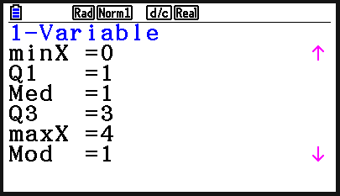
Soo koobida tirooyinka xogta (Numerical summaries of data)
Jaantuskan joogteynta (frequency) wuxuu muujinayaa tirada goolalka la dhaliyay ciyaar kasta oo ay sameeyeen kooxaha kulligood xilli ciyaareed kubbadda cagta.
Goolal la dhaliyay | Joogteynta (Frequency)
0 | 19
1 | 34
2 | 21
3 | 15
4 | 11
Waa imisa dhexdhexaadka (median) tirada goolalka la dhaliyay?
1 gool

Slide 16
Soo koobida tirooyinka xogta (Numerical summaries of data)
Celceliska (arithmetic mean) ee xogta tirooyinka waa wadarta qiimaha (values) loo qaybiyay tirada qiimaha.
Laakiin maxaan sameeyaa haddii aan haysto jaantus joogteyn kooxaysan (grouped frequency table)?
Xisaabiyahaagu wuxuu weli heli karaa qiyaasta celceliska.
Isra
Nuur

Slide 17
Soo koobida tirooyinka xogta (Numerical summaries of data)
57 qof ayaa la waraystay waxaana la weydiiyay inta lacag ah ee ay ku kharash gareeyeen cuntada intii ay ku sugnaayeen booqashadooda suuqa Oakfield.
qadarka la kharash gareeyay (amount spent) (in £) | soo noqnoqoshada (frequency) (f )
£0 < £ ≤ £20 | 20
£20 < £ ≤ £50 | 14
£50 < £ ≤ £100 | 10
£100 < £ ≤ £200 | 8
£200 < £ ≤ £300 | 5
Si loo xisaabiyo qiyaasta celceliska, waxaan u baahanahay inaan isticmaalno barta dhexe ee fasalka kasta.

Slide 18
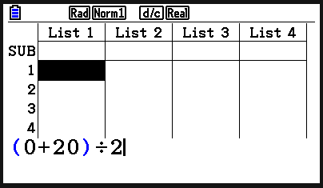
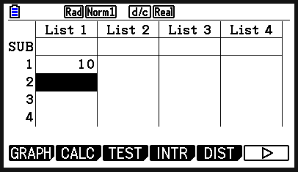
Soo koobista tirooyinka xogta (Numerical summaries of data)
57 qof ayaa la waraystay waxaana la weydiiyay inta lacag ee ay ku kharash gareeyeen cuntada intii ay ku sugnaayeen suuqa Oakfield.
qadarka la kharash gareeyay (amount spent) (in £) | soo noqnoqoshada (frequency) (f )
£0 < £ ≤ £20 | 20
£20 < £ ≤ £50 | 14
£50 < £ ≤ £100 | 10
£100 < £ ≤ £200 | 8
£200 < £ ≤ £300 | 5
Xisaabiyaha ayaa tan kuu samayn kara:
Geli xisaabta oo riix 'EXE'.

Slide 19
Soo koobista tirooyinka xogta (Numerical summaries of data)
57 qof ayaa la waraystay waxaana la weydiiyay inta lacag ee ay ku kharash gareeyeen cuntada intii ay ku sugnaayeen suuqa Oakfield.
qadarka la kharash gareeyay (amount spent) (in £) | soo noqnoqoshada (frequency) (f )
£0 < £ ≤ £20 | 20
£20 < £ ≤ £50 | 14
£50 < £ ≤ £100 | 10
£100 < £ ≤ £200 | 8
£200 < £ ≤ £300 | 5
Xisaabiyaha ayaa tan kuu samayn kara:
Barta dhexe waxaa lagu muujiyay tiirka koowaad.

Slide 20
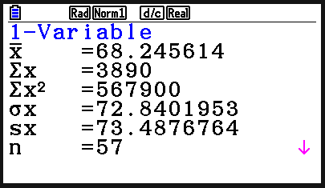
Soo koobista tirooyinka xogta (Numerical summaries of data)
57 qof ayaa la waraystay waxaana la weydiiyay inta lacag ee ay ku kharash gareeyeen cuntada intii ay ku sugnaayeen suuqa Oakfield.
qadarka la kharash gareeyay (amount spent) (in £) | joogteynta (frequency) (f )
£0 < £ ≤ £20 | 20
£20 < £ ≤ £50 | 14
£50 < £ ≤ £100 | 10
£100 < £ ≤ £200 | 8
£200 < £ ≤ £300 | 5
Xisaabi qiyaasta celceliska qadarka lacagta ee booqde kasta ku bixiyay.
£68.25 waa qiyaasta celceliska qadarka lacagta ee booqde kasta ku bixiyay.

Slide 21
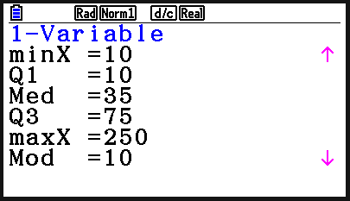
Soo koobista tirooyinka xogta (Numerical summaries of data)
57 qof ayaa la waraystay waxaana la weydiiyay inta lacag ee ay ku bixiyeen cuntada intii ay ku sugnaayeen suuqa Oakfield.
qadarka lacagta la bixiyay (amount spent) (in £) | joogteynta (frequency) (f )
£0 < £ ≤ £20 | 20
£20 < £ ≤ £50 | 14
£50 < £ ≤ £100 | 10
£100 < £ ≤ £200 | 8
£200 < £ ≤ £300 | 5
Xisaabi qiyaasta dhexda (median) qadarka lacagta ee booqde kasta ku bixiyay.
£35 waa qiyaasta dhexda (median) qadarka lacagta ee booqde kasta ku bixiyay.

Slide 22
Soo koobista tirooyinka xogta (Numerical summaries of data)
1) Jadwalkan joogteynta (frequency) wuxuu muujinayaa qiimaynta xiddigaha ee maqaayad heshay usbuuca furitaankeeda.
Qiimaynta xiddigaha (Star rating) | Joogteynta (Frequency)
1 | 12
2 | 18
3 | 21
4 | 38
5 | 45
a) Waa maxay celceliska qiimaynta xiddigaha?
b) Waa maxay dhexda (median) qiimaynta xiddigaha?

Slide 23
Soo koobista tirooyinka xogta (Numerical summaries of data)
2) Jadwalka joogteynta (frequency) wuxuu muujinayaa tirada qolalka jiifka ee guryaha kala duwan ee degmada magaalada.
Qolalka jiifka (Bedrooms) | Joogteynta (Frequency)
1 | 20
2 | 93
3 | 54
4 | 33
a) Waa maxay celceliska tirada qolalka jiifka?
b) Waa maxay dhexda (median) tirada qolalka jiifka?

Slide 24
Soo koobid tirooyin (Numerical summaries of data)
3) Waqtiga ay qaadanayso muunad arday si ay u tagaan iskuulka ayaa lagu soo ururiyay jaantuska soo noqnoqda ee kooxaysan.
Waqtiga lagu qaatay safarka iskuulka (daqiiqado) | Soo noqnoqod (Frequency) (f )
0 < t ≤ 4 | 28
4 < t ≤ 10 | 23
10 < t ≤ 16 | 70
16 < t ≤ 26 | 52
26 < t ≤ 40 | 30
40 < t ≤ 60 | 13
a) Waa maxay celceliska waqtiga safarka (ilaa daqiiqada ugu dhow)?
b) Waa maxay dhexdhexaadka waqtiga safarka (ilaa daqiiqada ugu dhow)?

Slide 25
Soo koobid tirooyin (Numerical summaries of data)
1) Jaantuskan soo noqnoqda wuxuu muujinayaa qiimaynta xiddigta ee maqaayad ka heshay usbuuca furitaankeeda.
Qiimaynta xiddigta (Star rating) | Soo noqnoqod (Frequency)
1 | 12
2 | 18
3 | 21
4 | 38
5 | 45
a) Waa maxay celceliska qiimaynta xiddigta?
3.64… xiddigood (oo ku wareegaya 4)
b) Waa maxay dhexdhexaadka qiimaynta xiddigta?
4 xiddigood

Slide 26
Soo koobid tirooyin (Numerical summaries of data)
2) Jaantuska soo noqnoqda wuxuu muujinayaa tirada qolalka jiifka ee guryaha kala duwan ee aagga magaalada.
Qolalka jiifka (Bedrooms) | Soo noqnoqod (Frequency)
1 | 20
2 | 93
3 | 54
4 | 33
a) Waa maxay celceliska tirada qolalka jiifka?
2.5 qolal jiif (oo ku wareegaya 3)
b) Waa maxay dhexdhexaadka tirada qolalka jiifka?
2 qolal jiif

Slide 27
Soo koobid tirooyin (Numerical summaries) oo xog ah
3) Waqtiga ay qaadanayso muunad arday si ay u tagaan iskuulka ayaa lagu soo ururiyay jaantuska soo noqnoqda (grouped frequency table).
Waqtiga lagu qaatay safarka iskuulka (daqiiqado) | Soo noqnoqosho (Frequency) (f )
0 < t ≤ 4 | 28
4 < t ≤ 10 | 23
10 < t ≤ 16 | 70
16 < t ≤ 26 | 52
26 < t ≤ 40 | 30
40 < t ≤ 60 | 13
a) Waa maxay qiyaasta celceliska waqtiga safarka (ilaa daqiiqada ugu dhow)?
18 daqiiqo
b) Waa maxay qiyaasta dhexdhexaadka waqtiga safarka (ilaa daqiiqada ugu dhow)?
13 daqiiqo

Slide 28
Isticmaalka fx-CG50 ee tirakoobka (statistics)
Soo koobid tirooyin (Numerical summaries) oo xog ah
Muuqaallo garaafeed oo xog ah (Graphical representations)

Slide 29
Muuqaallo garaafeed oo xog ah (Graphical representations)
fx-CG50 waxay sawiri kartaa garaafyo firdhiyeen (scatter graphs) oo ay soo saari kartaa khadka ugu habboon (line of best fit).
Wow! Taasi waa cajiib!
Waxay samayn kartaa xisaabinta loo baahan yahay xisaabta heerka A (A Level maths).
Isra
Nuur

Slide 30
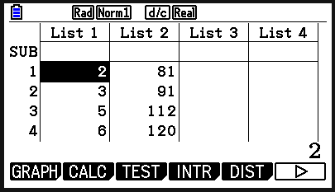
Muuqaallo garaafeed oo xog ah (Graphical representations)
Xogta hoose waxay muujinaysaa da'da iyo dhererka muunad lix carruur ah. Maxaad ka dareensan tahay xogtan?
da'da (sano) | dhererka (cm)
2 | 81
3 | 91
5 | 112
6 | 120
7 | 124
11 | 138
Waxaad ku sawiri kartaa garaafkan firdhiyeen (scatter graph) xisaabiyahaaga adoo isticmaalaya qaabka 'Statistics'.
Geli xogta (data) miiska.

Slide 31
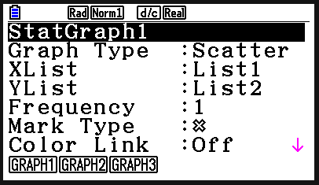
Muuqaallo garaafeed (Graphical representations) oo xogta (data)
Xogta (data) hoose waxay tusinaysaa da'da iyo dhererka shan carruur ah. Maxaad ka dareensan tahay xogtan?
da'da (sano) | dhererka (cm)
2 | 81
3 | 91
5 | 112
6 | 120
7 | 124
11 | 138
Riix 'GRAPH' (F1). Riixida 'SET' (F6) waxay kuu ogolaaneysaa inaad go'aamiso doorsoome (variable) ku yaal dhidibada (axis) iyo sida dhibcuhu u ekaan doonaan. (Nooca calaamadda (Mark type).)

Slide 32
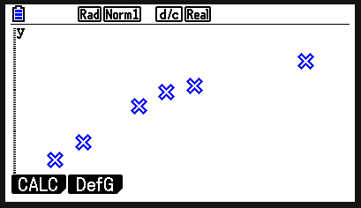
Muuqaallo garaafeed (Graphical representations) oo xogta (data)
Xogta (data) hoose waxay tusinaysaa da'da iyo dhererka shan carruur ah. Maxaad ka dareensan tahay xogtan?
da'da (sano) | dhererka (cm)
2 | 81
3 | 91
5 | 112
6 | 120
7 | 124
11 | 138
Riix 'EXIT' ka dibna dooro 'GRAPH1' (F1).

Slide 33
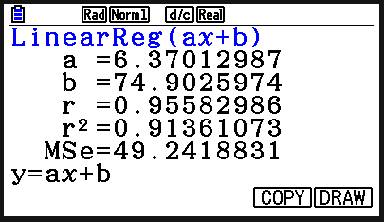
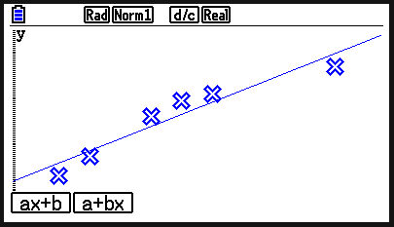
Muuqaallo garaafeed (Graphical representations) oo xogta (data)
Xogta (data) hoose waxay tusinaysaa da'da iyo dhererka shan carruur ah. Maxaad ka dareensan tahay xogtan?
da'da (sano) | dhererka (cm)
2 | 81
3 | 91
5 | 112
6 | 120
7 | 124
11 | 138
Riix 'CALC' (F1), ka dibna X (F2) iyo ka dibna 'ax+b' (F1).
Shaashadda xigta, riix 'DRAW' (F6) si aad u aragto khadka ugu habboon (line of best fit).

Slide 34
Muuqaallo garaafeed (Graphical representations) oo xogta (data)
Xogta (data) hoose waxay tusinaysaa da'da iyo dhererka shan carruur ah. Maxaad ka dareensan tahay xogtan?
da'da (sano) | dhererka (cm)
2 | 81
3 | 91
5 | 112
6 | 120
7 | 124
11 | 138
Waxay u muuqataa inay jirto xiriir togan (positive correlation). Marka uu ilmuhu weynaado, wuu dheer yahay.

Slide 35
Muuqaallo garaafeed oo xog ah (Graphical representations of data)
Xogta hoose waxay muujinaysaa mugga biyaha (water) ee weel ku jira muddo ka dib.
a) Kii doorsoome (variable) ayaa loo qorsheeyay inuu ku yaallo dhidibka x?
Biyo (Water) (l) | 0.25 | 0.63 | 0.78 | 1.11 | 1.29 | 1.57
Waqti (Time) (s) | 30 | 60 | 90 | 120 | 150 | 180
Doorsoome madax-bannaan (independent variable) - waqtiga.

Slide 36
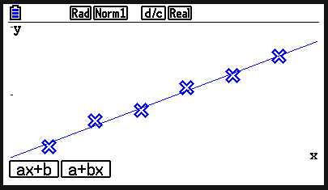
Muuqaallo garaafeed oo xog ah (Graphical representations of data)
Xogta hoose waxay muujinaysaa mugga biyaha (water) ee weel ku jira muddo ka dib.
b) Sawir garaafka firdhisani (scatter graph) iyo xariiqda ugu habboon (line of best fit). Maxaad ka ogaataa xogta?
Biyo (Water) (l) | 0.25 | 0.63 | 0.78 | 1.11 | 1.29 | 1.57
Waqti (Time) (s) | 30 | 60 | 90 | 120 | 150 | 180
Waxaa jira xiriir togan (positive correlation). Marka waqtigu kordho, mugga biyuhu (water) sidoo kale wuu kordhaa.

Slide 37
Muuqaallo garaafeed oo xog ah (Graphical representations of data)
1) Jadwalku wuxuu muujinayaa xogta cimilada ee Bradford, shan bilood ee 2021.
Maxay xogtan ka soo jeedinaysaa cimilada? Ku caddey jawaabtaada.
Bil | Wadarta roobka (mm) | Wadarta qorraxda (saacadood)
Feb | 100 | 66
Apr | 16 | 216
Jun | 22 | 173
Aug | 61 | 126
Oktoobar (Oct) | 93 | 86

Slide 38
Muuqaallo garaafeed oo xog ah (Graphical representations of data)
2) Yacquub wuxuu ordaa taxane tartamo masaafo dheer. Tartan kasta, wuxuu diiwaan geliyaa waqtigiisa iyo sareynta koorsada. Maxay xogtan ka soo jeedinaysaa sareynta iyo waqtiga la qaatay? Caddee jawaabtaada.
sareyn (m) (elevation (m)) | waqti (s) (time (s))
51 | 1756
4 | 1644
35 | 1735
115 | 1911
96 | 1870

Slide 39
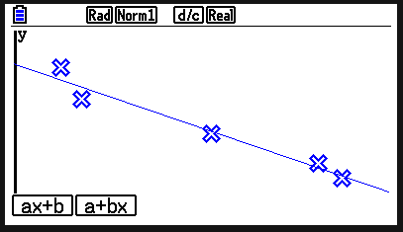
Muuqaallo garaafeed oo xog ah (Graphical representations of data)
1) Jadwalku wuxuu muujinayaa xog cimilo oo ka timid Bradford, shan bilood oo 2021 ah.
Maxay xogtan ka soo jeedinaysaa cimilada? Caddee jawaabtaada.
Bisha (Month) | Wadarta roobka (mm) (Total rainfall (mm)) | Wadarta qorraxda (saacadood) (Total sunshine (hours))
Feb | 100 | 66
Apr | 16 | 216
Jun | 22 | 173
Aug | 61 | 126
Oct | 93 | 86
Waxaa jira xiriir taban (negative correlation). Roob badan waxay ka dhigan tahay qorrax yar.

Slide 40
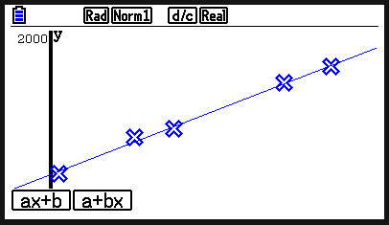
Muuqaallo garaafeed oo xog ah (Graphical representations of data)
2) Yacquub wuxuu ordaa taxane tartamo masaafo dheer. Tartan kasta, wuxuu diiwaan geliyaa waqtigiisa iyo sareynta koorsada. Maxay xogtan ka soo jeedinaysaa sareynta iyo waqtiga la qaatay? Caddee jawaabtaada.
sareyn (m) (elevation (m)) | waqti (s) (time (s))
51 | 1756
4 | 1644
35 | 1735
115 | 1911
96 | 1870
Waxaa jira xiriir togan (positive correlation). Sareynta weyn, waqtiga uu ku qaato inuu ordo ayaa badan.

Slide 41
Isticmaalka fx-CG50 ee tirakoobka (statistics)
Qaar ka mid ah xisaabiyeyaasha (calculators) waxay qaban karaan wax ka badan xisaabinta aasaasiga ah.
fx-CG50 waxay soo saari kartaa soo koobid tirakoob (statistical summary) oo ku saabsan xog (data) go'an.
Soo koobidu waxay ku daraysaa celceliska (mean), dhexdhexaadka (median), rubucda sare iyo tan hoose (upper and lower quartiles).
fx-CG50 waxay soo saari kartaa matalaadyo garaaf (graphical representations) oo xog (data) ah.

